Slide 1
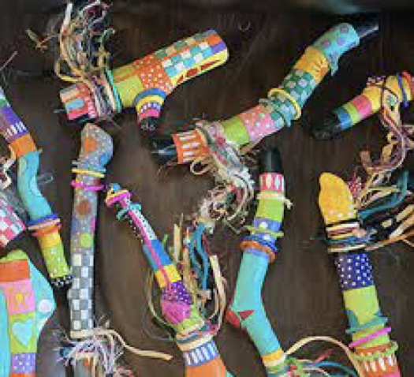
Math Journey sticks

Slide 2
Objectives

Slide 3
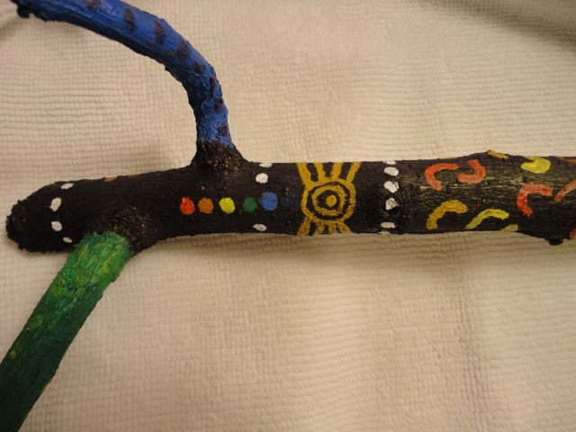
objectives
Students will create a “math journey stick” modeled on their own set of criteria concerning fractions.
Students will learn about indigenous cultures and how they used the “talking stick” to communicate in a time before modern technology.
Students will experience natural materials such as sticks from trees, fibers, clay…

Slide 4
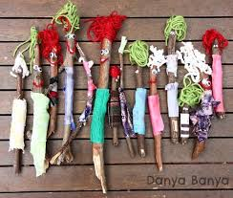
Materials
For the Math journey stick

Slide 5
materials
Stick for wrapping
scissors
Yarn
Handmade clay objects
Key to read the journey stick based on fractions
Beads
Ribbon
String
Anything else to add texture and interest

Slide 6
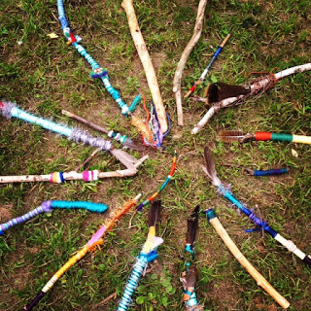
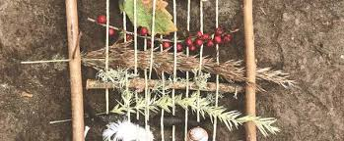
Pass or play!
What do you know about talking or journey sticks?

Slide 7

What is a journey sick?
https://www.youtube.com/watch?v=sfdp1XE6HHY

Slide 8
Vocabulary
Math and Art

Slide 9
vocabulary
Math:
Fraction
Increase
Take away
Art:
Texture
Wrap
color

Slide 10
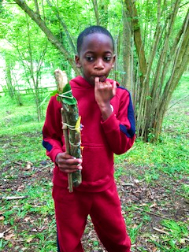
Instructions

Slide 11
instructions
Students will create a key they will use to communicate the fractions they have decided to express in their journey stick
Students will choose colored yarn, string, ribbon, and begin to wrap their sticks in an aesthetically pleasing way transforming the stick into a work of art
Students will embellish their sticks with clay objects, beads, feathers etc. to and texture and interest to the piece.

Slide 12
references
https://wildthingsblog.wordpress.com/2016/05/03/journey-sticks/
https://www.pinterest.com/holloway0386/journey-sticks/
https://www.google.com/imgres?imgurl=https%3A%2F%2Fjustbrightideas.com%2Fwp-content%2Fuploads%2FA-Community-of-Stick-People.jpg.webp&imgrefurl=https%3A%2F%2Fjustbrightideas.com%2Ftwig-crafts-for-kids%2F&tbnid=hWQqY8cIkvn79M&vet=10CCkQMyh7ahcKEwiIzYfl2a7zAhUAAAAAHQAAAAAQDQ..i&docid=X2aHx4olXsgNTM&w=600&h=509&q=journey%20stick&client=safari&ved=0CCkQMyh7ahcKEwiIzYfl2a7zAhUAAAAAHQAAAAAQDQ

