Slide 1
Ekphrastic POeTry
Lesson 4 5th grade Mrs. Smutny

Slide 2
materials
For this lesson

Slide 3

materials

Slide 4
objectives
of this lesson

Slide 5
objectives
To learn about and discuss ekphrastic poetry and theme. To write an ekphrastic poem.

Slide 6
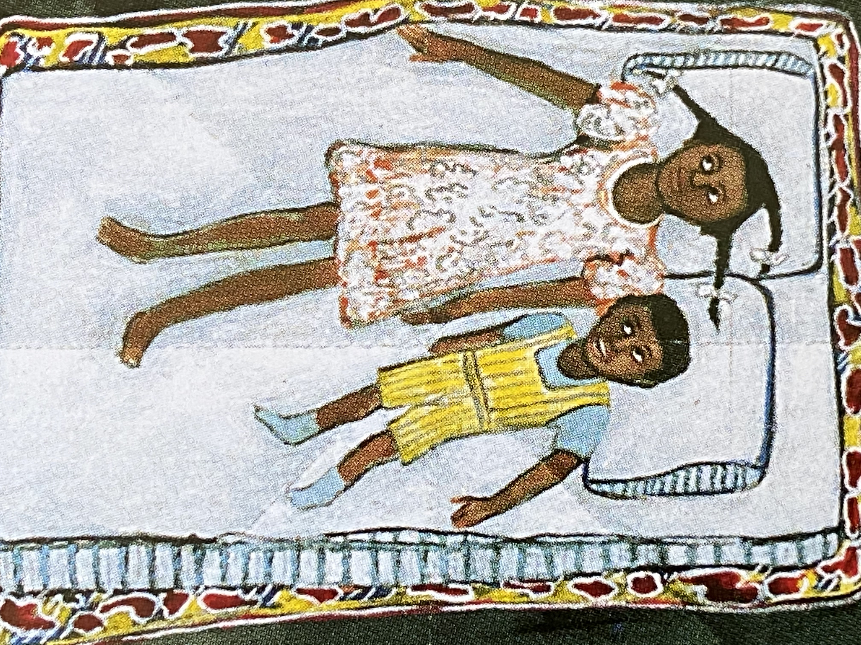
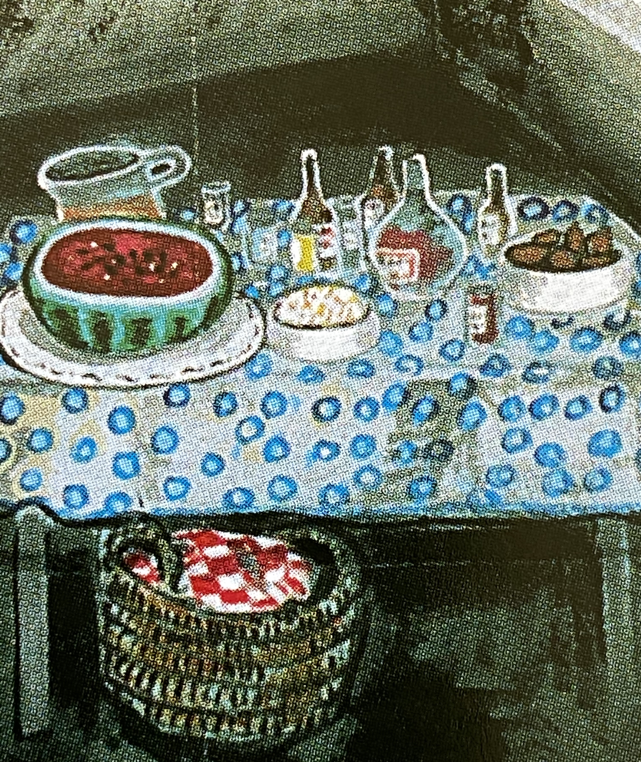
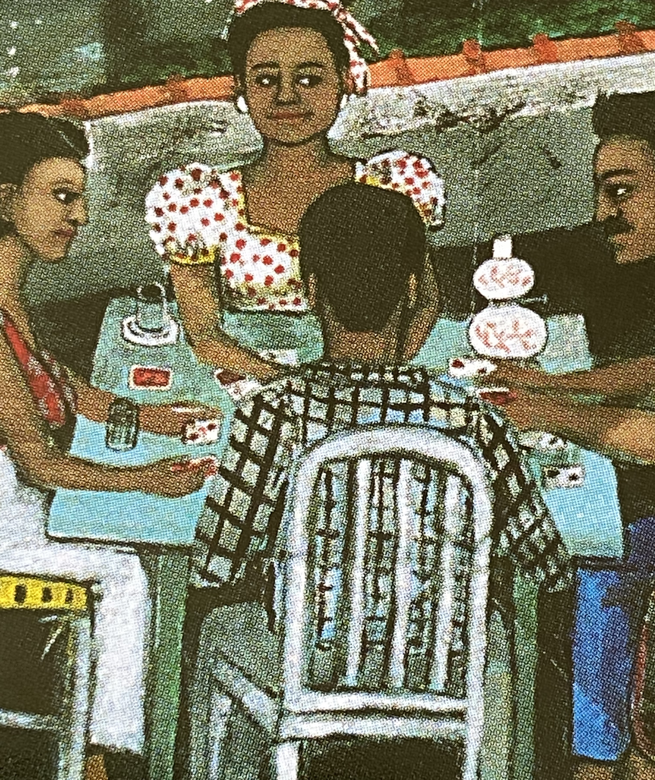
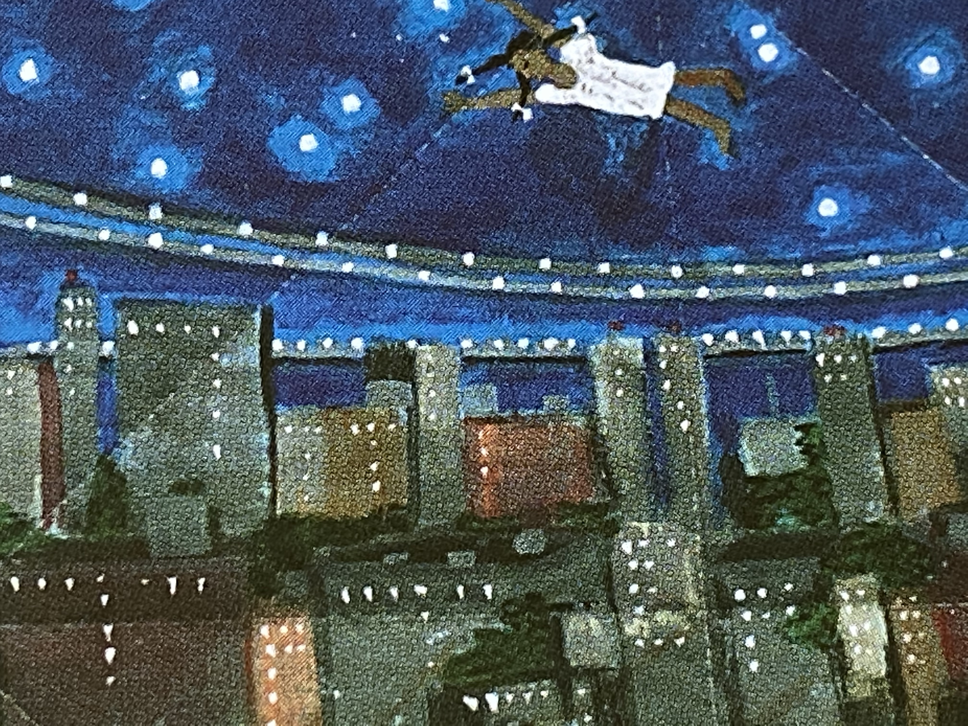
What do you notice?
What’s going on?

Slide 7
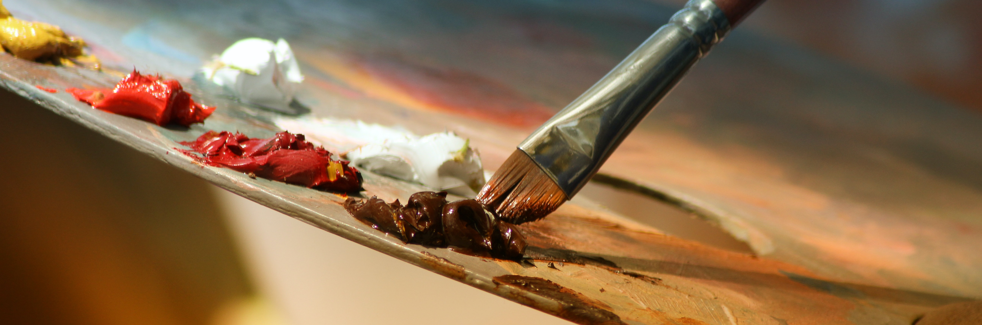
What is ekphrastic poetry?
Poems inspired by/written about art.
Paintings, photographs, sculptures, pottery

Slide 8
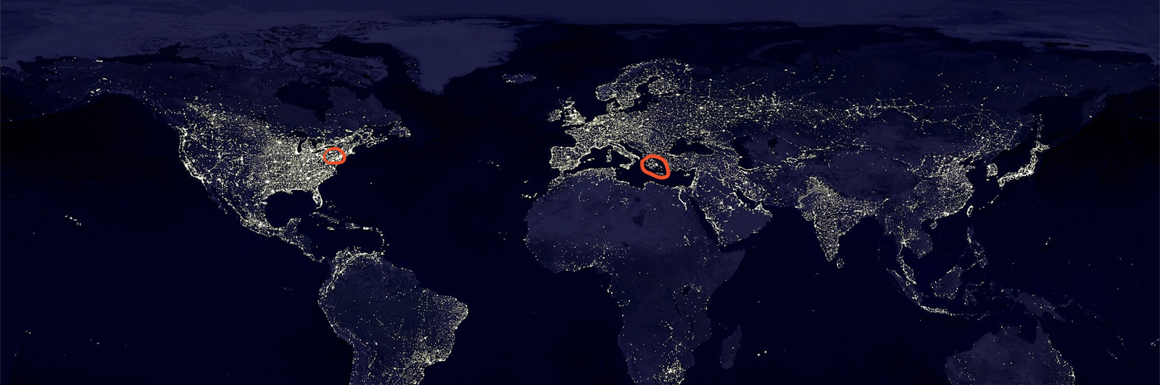
Origin of Ekphrastic Poetry
Ekphrasis = Description
Origin: Greek
A vivid description of a work of art.

Slide 9
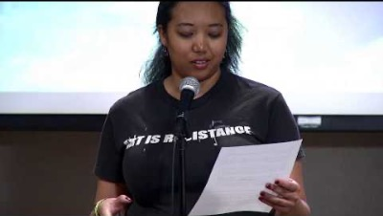
Arkansas Arts Center Ekphrastic Poetry Slam 2012
Lady Krysis, Poet; Art: “Mixed Company” by Deborah Brown, 1993

Slide 10
instructions

Slide 11
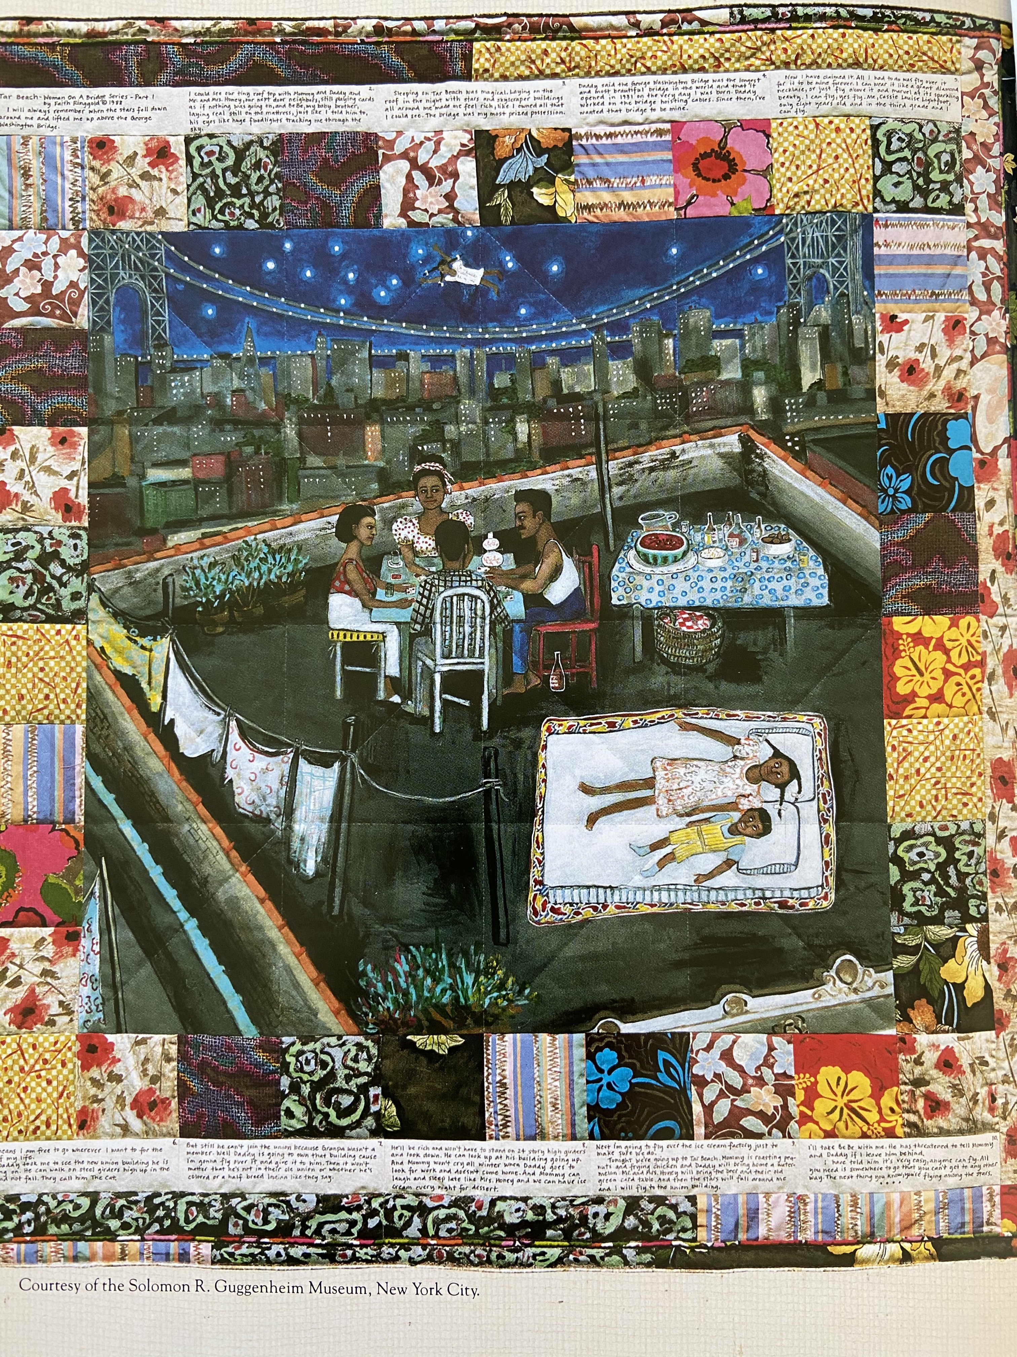
“Tar Beach” by Faith Ringgold
Philadelphia Museum of Art 10X2 Exercise
List 10 things you see, hear, smell, taste.
List another10 things.
What is going on?
What do you wonder about?

Slide 12

What’s one thing you learned today?

Slide 13

Lesson 4 – Ekphrastic POetry
Day 2

Slide 14
Review
What did we do last week in class?

Slide 15
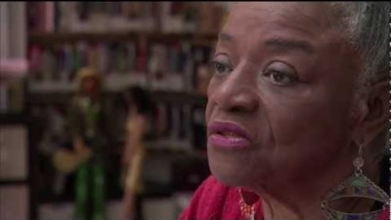
Faith Ringgold

Slide 16

What do you know about theme?
Theme is the message the writer wants
to give to the reader.
What are some themes?
Love
Loss
Nature
Dreams
Forgiveness
Good
Evil
Growing Up

Slide 17
vocabulary

Slide 18

vocabulary
Ekphrastic Poetry
Theme
Line Breaks
Metaphor

Slide 19
instructions

Slide 20
Individual
Writing Time!
Use your 10X2 list…
Write a poem inspired by
Faith Ringgold’s “Tar Beach”

Slide 22
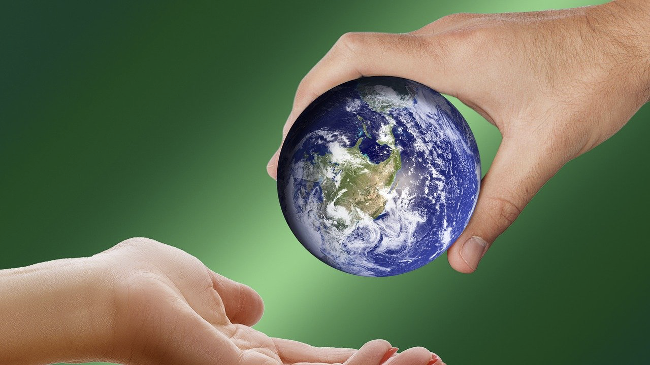
Do you want to share your poem?
Your thoughts on the writing process?

Slide 23
Lesson 4 – Ekphrastic Poetry
Day 3

Slide 24
Review
What did we do last week in class?

Slide 25
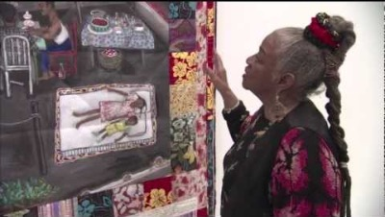
Faith Ringgold speaks about creating “Tar Beach”

Slide 26
AFTERNOON CLASS
Let’s Write!
I see a party
and night sky.
I imagine the watermelon tastes
like cotton candy.
and the clothes on the line smell
like fresh rain.
Silver stars Children whispering
Tall buildings Grown-up laughing
Dark windows Cards shuffling
A clothes line Cars honking
A night sky Wind whooshing
Red Water flowing
A party TV blaring
A wicker basket First day of April
Words Last day of school
Yellow Fish swimming in
Big flowers ocean
Blue Squirrels gathering
Honey nuts
Cotton candy Birthday party
Sweet tea Balloon floating
Summer toward sky
Winter air Fly
Spring Dream
Flowers Be still
Fresh rain Sing
Tell stories
Imagine the impossible
Summer Dream
After “Tar Beach”
by Faith Ringgold
I hear cards shuffling
and wind whooshing.
I wonder if the children feel
happy as fish swimming in the ocean
and if the adults know
they can fly.

Slide 27
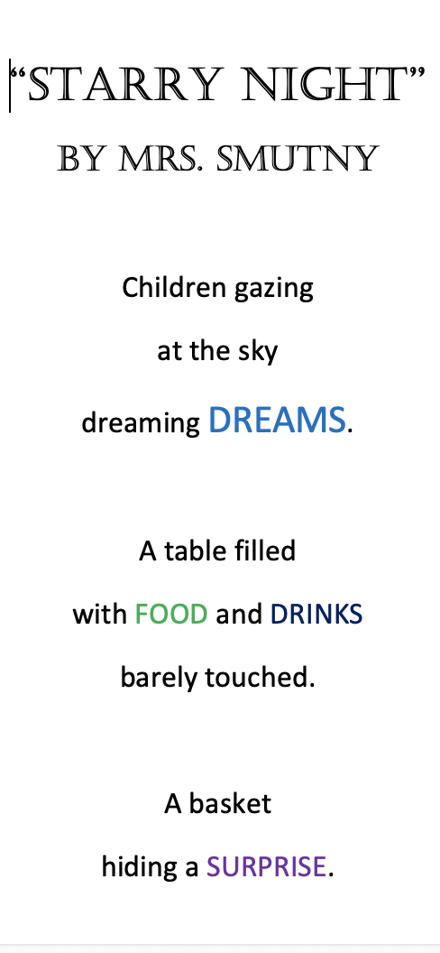
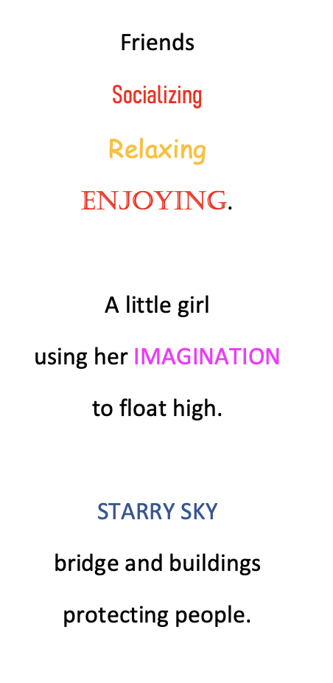
After ”Tar Beach” by Faith Ringgold

Slide 28
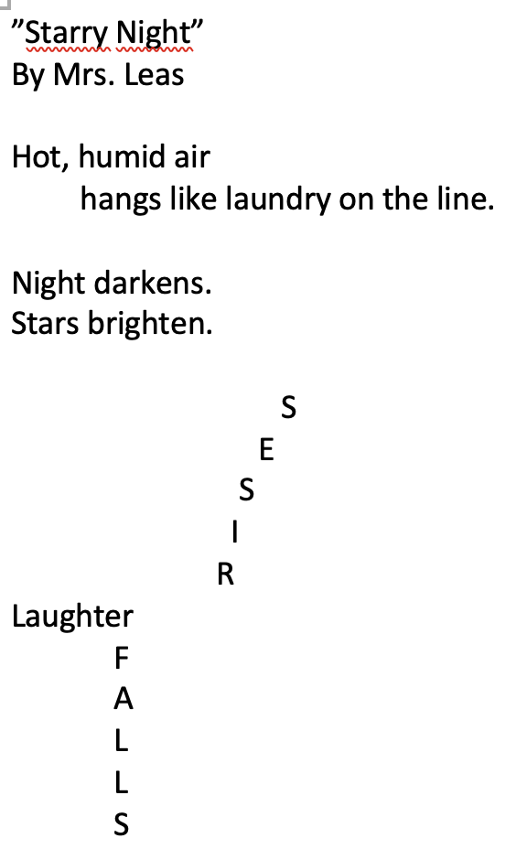
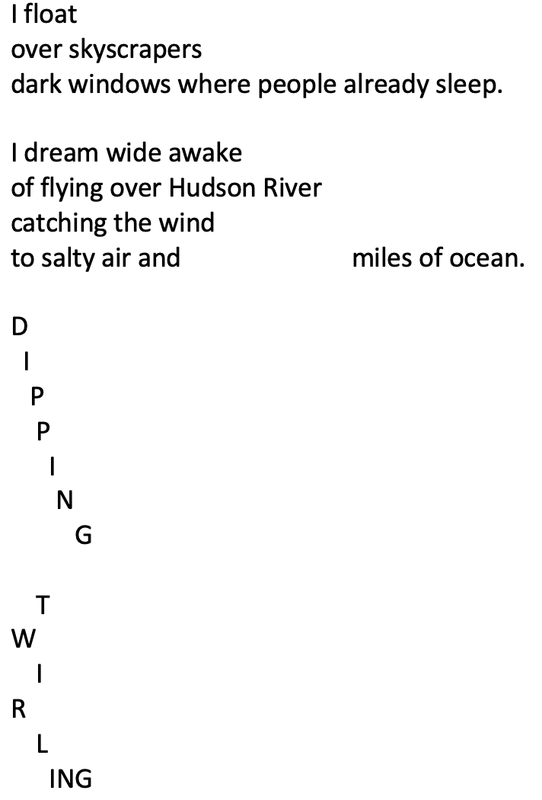
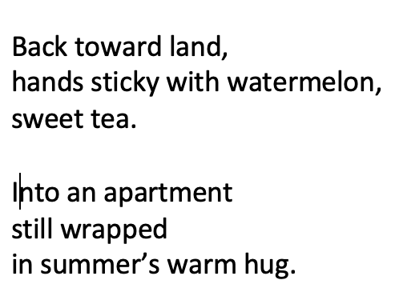
After ”Tar Beach” by Faith Ringgold

Slide 29
What are line breaks?
MORNING CLASS
How to Write a Poem by Mrs. Leas
Open all the windows and doors
of your imagination. Scatter the ideas
that fall from the sky on your paper.
Don’t be afraid. Let your pencil run
free across the page. Then puzzle
your words together.
Use a simile, adjectives, onomatopoeia.
Maybe some personification? Line by line,
stanza by stanza, watch your poem come alive!
Breaks = Ending points
Sometimes include
punctuation
but not always
Add to rhythm of poem
End on nouns, verbs,
adjectives;
not articles
or prepositions
We changed stanza and line breaks as a group.
This is the final result.

Slide 30
Individual Writing!
MORNING CLASS
Finish revising the ekphrastic poem
you wrote last week.
Add line breaks or change line breaks
Try adding a metaphor
Use ARMS

Slide 31
Lesson 4 – Ekphrastic Poetry
Day 4

Slide 32
Review
What did we do last week in class?

Slide 33
AFTERNOON CLASS
Let’s Revise +Edit!
Summer Dream After “Tar Beach” by Faith Ringgold
I see a party, red roses,
and night sky.
I imagine the watermelon tastes
like cotton candy
and the clothes on the line smell
like fresh rain.
Silver stars Children whispering
Tall buildings Grown-up laughing
Dark windows Cards shuffling
A clothes line Cars honking
A night sky Wind whooshing
Red Water flowing
A party TV blaring
A wicker basket First day of April
Words Last day of school
Yellow Fish swimming in
Big flowers ocean
Blue Squirrels gathering
Honey nuts
Cotton candy Birthday party
Sweet tea Balloon floating
Summer toward sky
Winter air Fly
Spring Dream
Flowers Be still
Fresh rain Sing
Tell stories
Imagine the impossible
Let’s add something to
stanza 1.
Let’s move something to
Stanza 3.
Let’s fix punctuation mistake
in stanza 2.
Let’s fix spelling mistake
In stanza 4.
I hear card shuffling
and wind whooshing.
I wonder if the children feel
happy as fish swimming in the ocean
and if the adults know
they can fly.
Partner with someone to
Finish revising/editing this poem.

Slide 34
What are line breaks?
AFTERNOON CLASS
How to Write a Poem by Mrs. Leas
Open all the windows and doors
of your imagination. Scatter the ideas
that fall from the sky on your paper.
Don’t be afraid. Let your pencil run
free across the page.
Then piece your words
together like a puzzle.
Use a simile, adjectives, onomatopoeia.
Maybe some personification?
Line by line,
stanza by stanza,
watch your poem come alive!
Breaks = Ending points
Sometimes include
punctuation
but not always
Add to rhythm of poem
End on nouns, verbs,
adjectives;
not articles
or prepositions

Slide 35
After ”Tar Beach” by Faith Ringgold

Slide 36
After ”Tar Beach” by Faith Ringgold

Slide 37
AFTERNOON CLASS
Let’s Practice Line Breaks!
A softball tumbling down stair after stair after stair to race across the room. Flash of fluffy, tabby fur. Teeny-tiny meow. My heart opened wide. His body and personality grew – softball, soccer ball, beach ball. Apricot/white striped mane like a lion. Always ready to chase crumbled paper across tiled floor. Always ready to hide in a pile of clean, unfolded clothes. Always ready for a surprise attack on unknowing humans. Curled on couch, tip of tail touching nose, he purred. A persistent nudge of his nose on my hand. Huggable, loveable, unforgettable. Buckley the cat.
(If time)

Slide 38
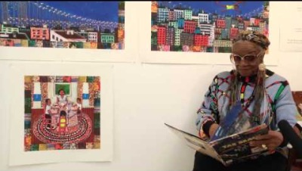
Faith Ringgold reading “Tar Beach”

Slide 39
What is one thing you learned or what to learn more about?

Slide 40

Extension Exercises
Visit https://www.philamuseum.org. Pick a painting and
write a poem about it.
Find a picture in your house.
Write an ekphrastic poem about it..
Read your ekphrastic poem to your family or a friend.
Visit the children’s page on poetryfoundation.org
to read more poems.

Slide 41
references

Slide 42
references
Videos courtesy youtube.
Music by bensound.com
Images from pexels and pixabay
Images of “Tar Beach” – photos from TAR BEACH by Faith Ringgold (Dragonfly Books)
https://www.philamuseum.org/booklets/12_71_143_0.html
https://www.shmoop.com
https://poemanalysis.com/

Slide 43
Do you want to share your poem – draft + revised/edited version?
What are your thoughts on the writing process?

Slide 44
Individual Editing!
MORNING CLASS
Read your ekphrastic poem to yourself.
Is there anything else you want to change?
Edit your poem using CUPS:
Capitalization
Usage
Punctuation
Spelling

Slide 45
MORNING CLASS
Let’s Practice Line Breaks!
A softball tumbling down stair after stair to race across the room. Flash of fluffy, tabby fur. Teeny-tiny meow. My heart opened wide. His body and personality grew – softball, soccer ball, beach ball. Apricot/white striped mane like a lion. Always ready to chase crumbled paper across tiled floor. Always ready to hide in a pile of clean, unfolded clothes. Always ready for a surprise attack on unknowing humans. Curled on couch, tip of tail touching nose, he purred. A persistent nudge of his nose on my hand. Huggable, loveable, unforgettable. Buckley the cat.

