Slide 1
Paper Sculptures
Part 1

Slide 2
objectives
of this lesson

Slide 3
objectives
Learn about Alexander Calder
Begin sketches to inspire our paper sculptures for next class

Slide 4
materials

Slide 5
materials
Pencil
Paper

Slide 6
Pass or play!

Slide 7
What is a sculpture?

Slide 8
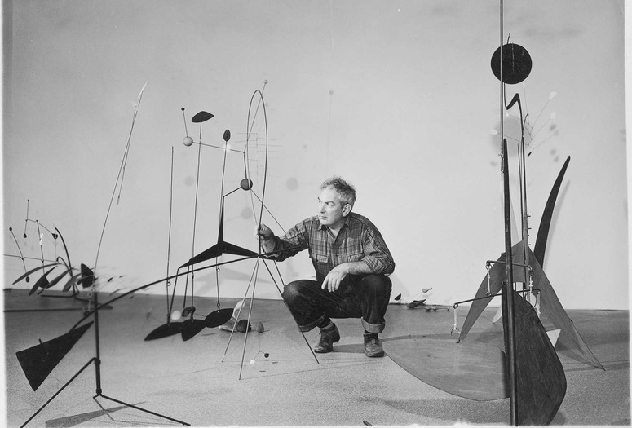
About Calder
Born 1898 in Lawnton, Pennsylvania to artist parents
Received a degree in engineering and worked as an engineer
Eventually became an illustrator and later worked on sculptures

Slide 9
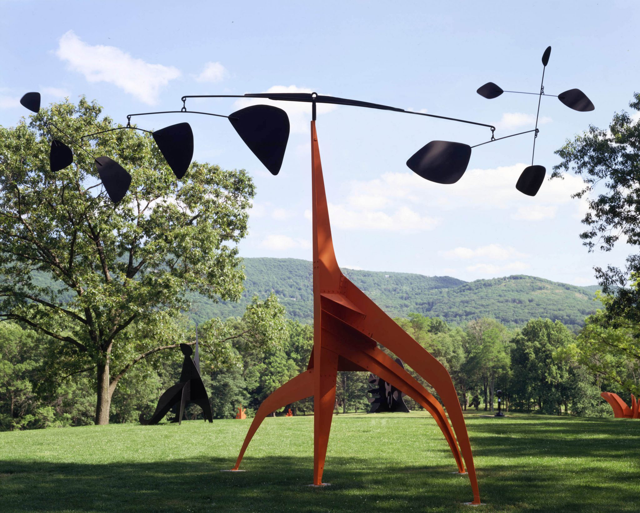

Slide 10
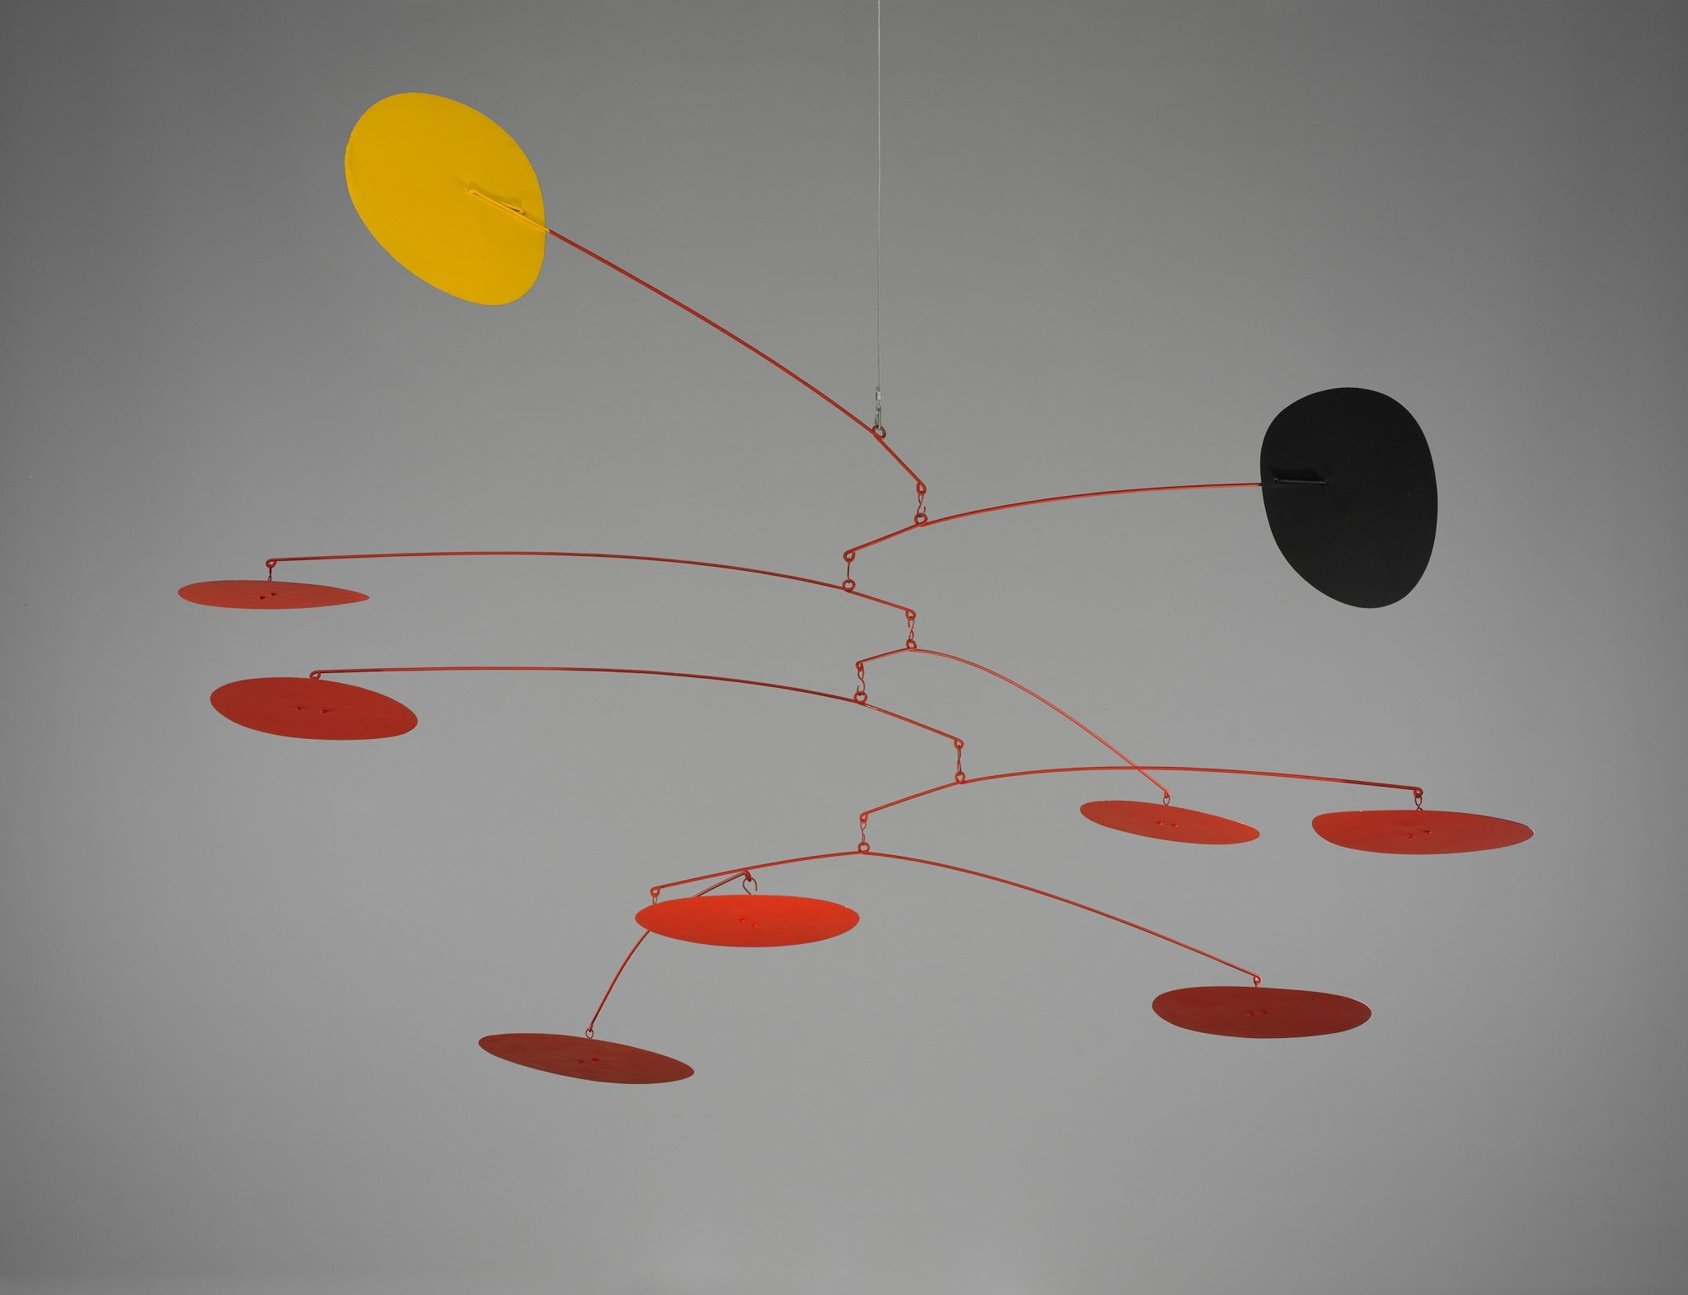

Slide 11
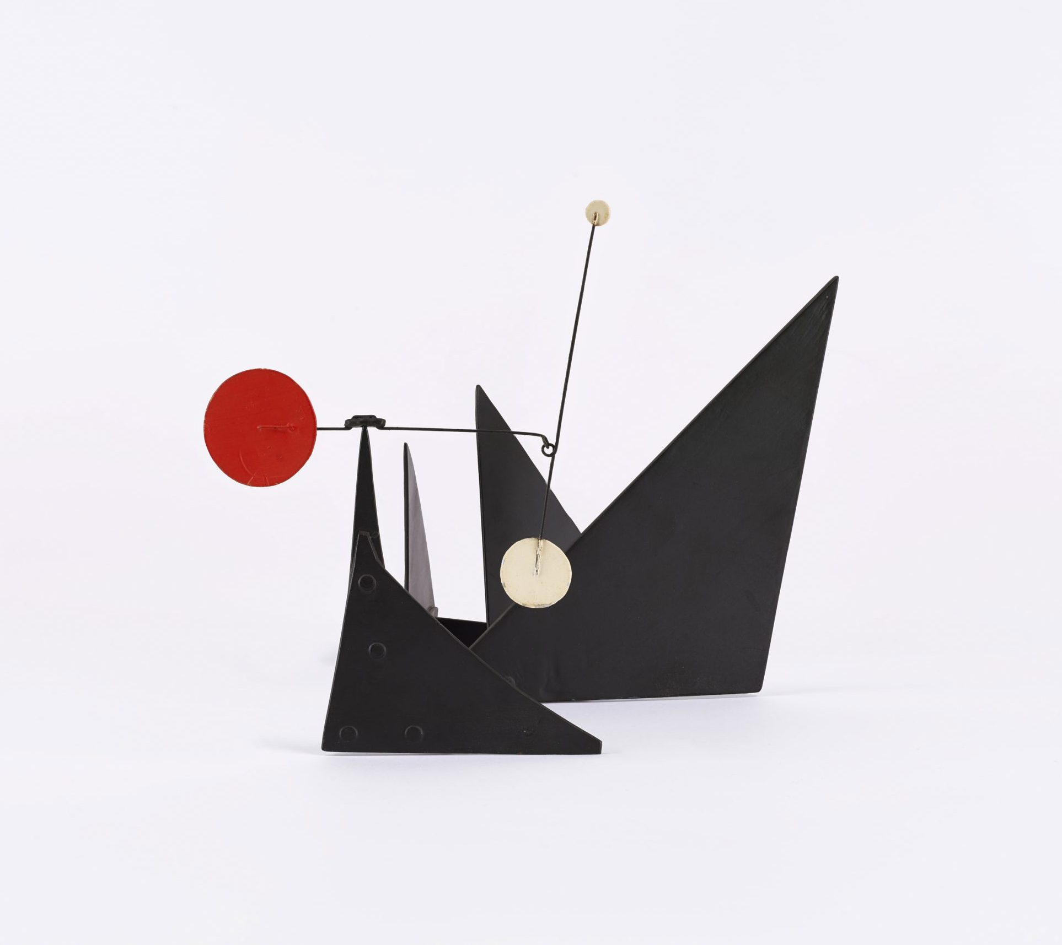

Slide 12
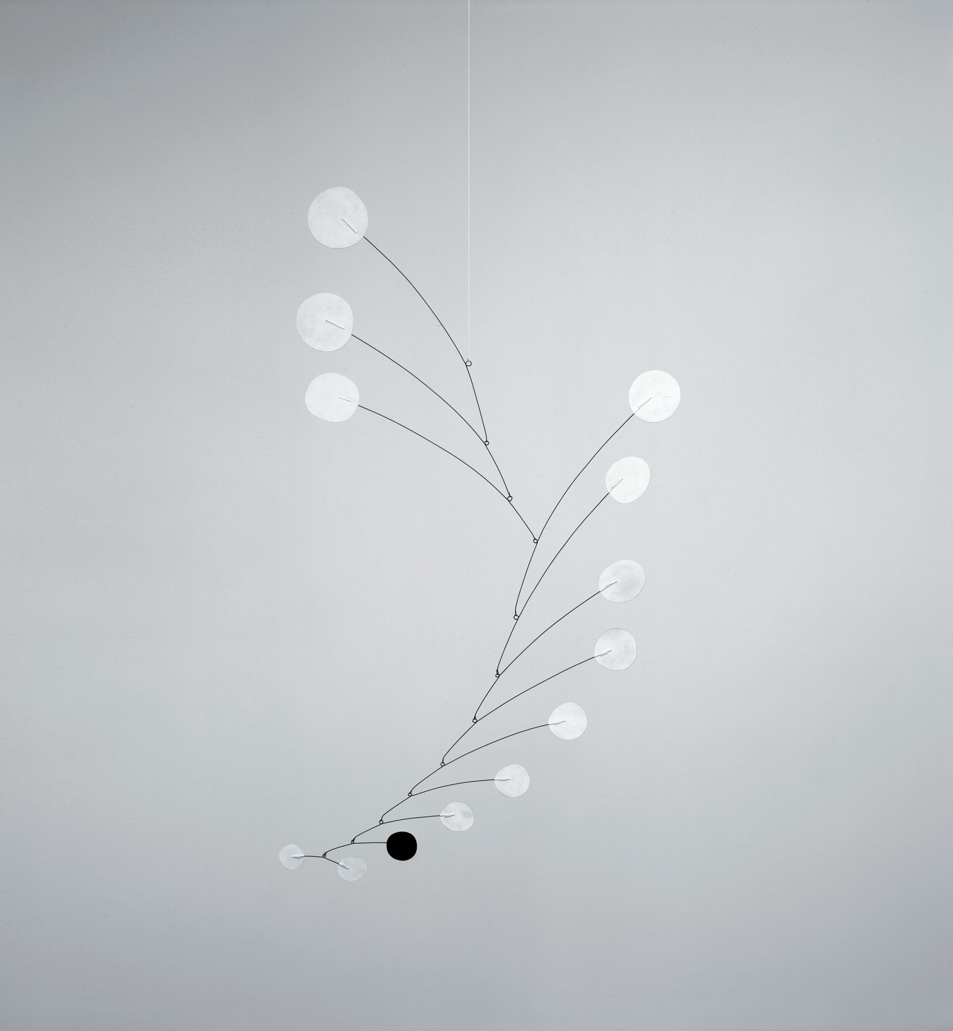

Slide 13
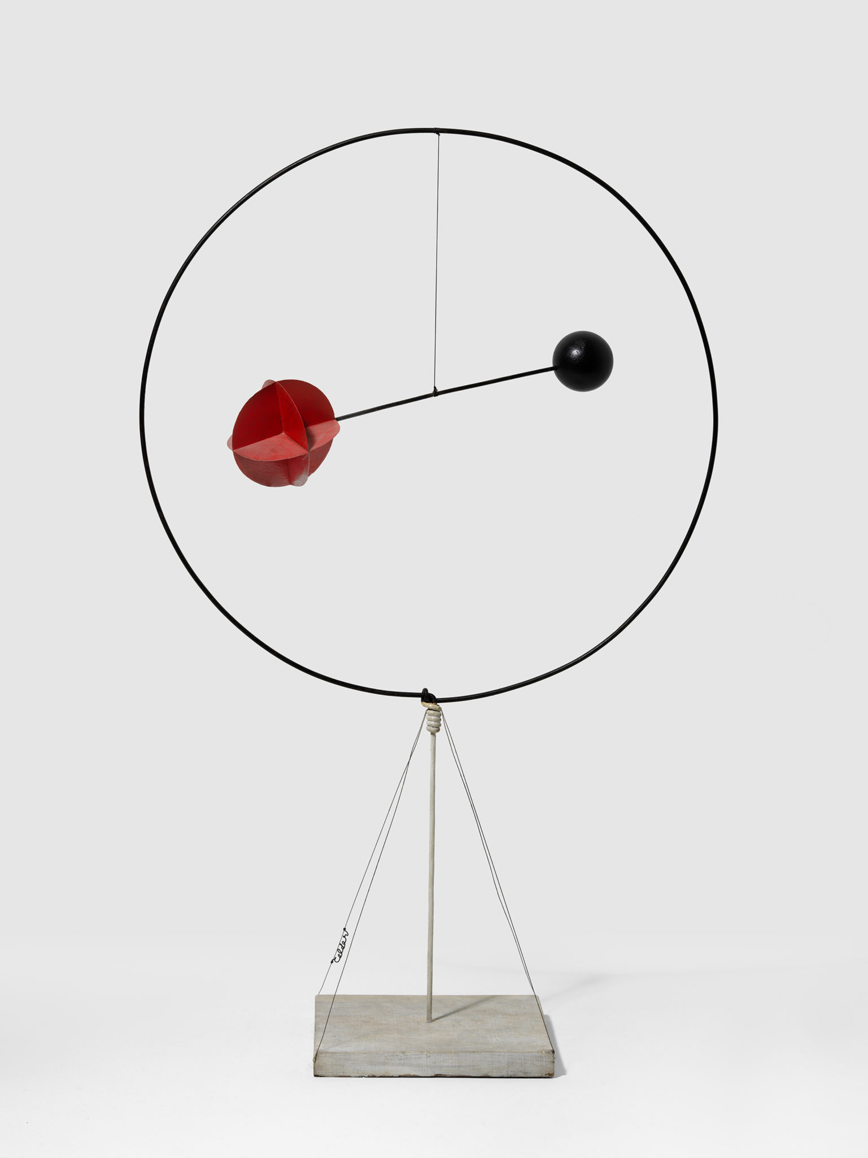

Slide 14
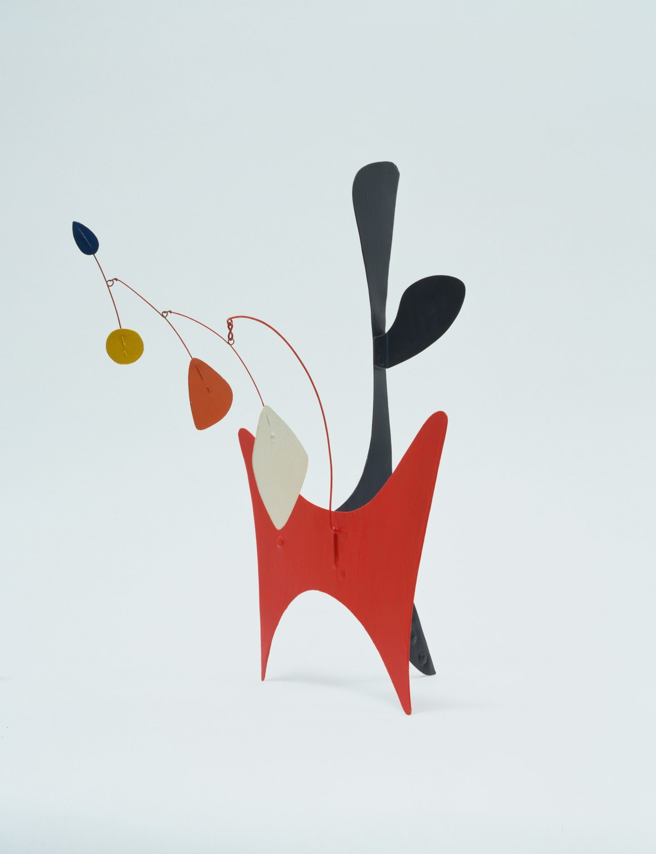

Slide 15
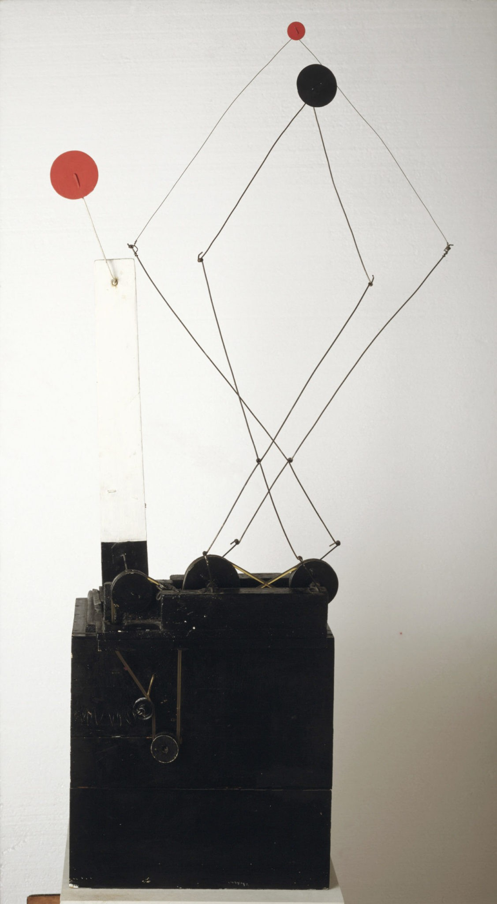

Slide 17
Video on Calder’s Work
https://www.youtube.com/watch?v=j3OqfduWdhc&t=6s

Slide 18
vocabulary

Slide 19
vocabulary
Shape
Geometric Shape
Organic Shape

Slide 22
Let’s GATHER SOME SHAPES!

Slide 23
instructions

Slide 24
instructions
Together, we will make a list of all the shapes you learned from math class
Then we will review drawing the shapes
Once we have gathered all of our shapes, we can make a 2D shape sketch that will inspire our sculptures that we will start next class
A lot of artists start with sketches and plans before moving on to their final project. Think of it as a sloppy copy to work all of your ideas out first.
Your sketch must include at least 4 DIFFERENT geometric shapes and at least 2 DIFFERENT organic shapes
You can include more than the numbers above! They are just a guideline

Slide 25
references
https://www.moma.org/calendar/events/6988
https://calder.org/
https://www.youtube.com/watch?v=j3OqfduWdhc&t=6s

