Slide 1
Paper Sculptures
Part 5

Slide 2
objectives
of this lesson

Slide 3
objectives
Finish our paper sculptures by completing main shapes and adding decorative elements
Share our work and identify the shapes we used to create our sculptures

Slide 4
materials

Slide 5
materials
Pencil
Paper
Glue
Scissors

Slide 6
Pass or play!

Slide 7
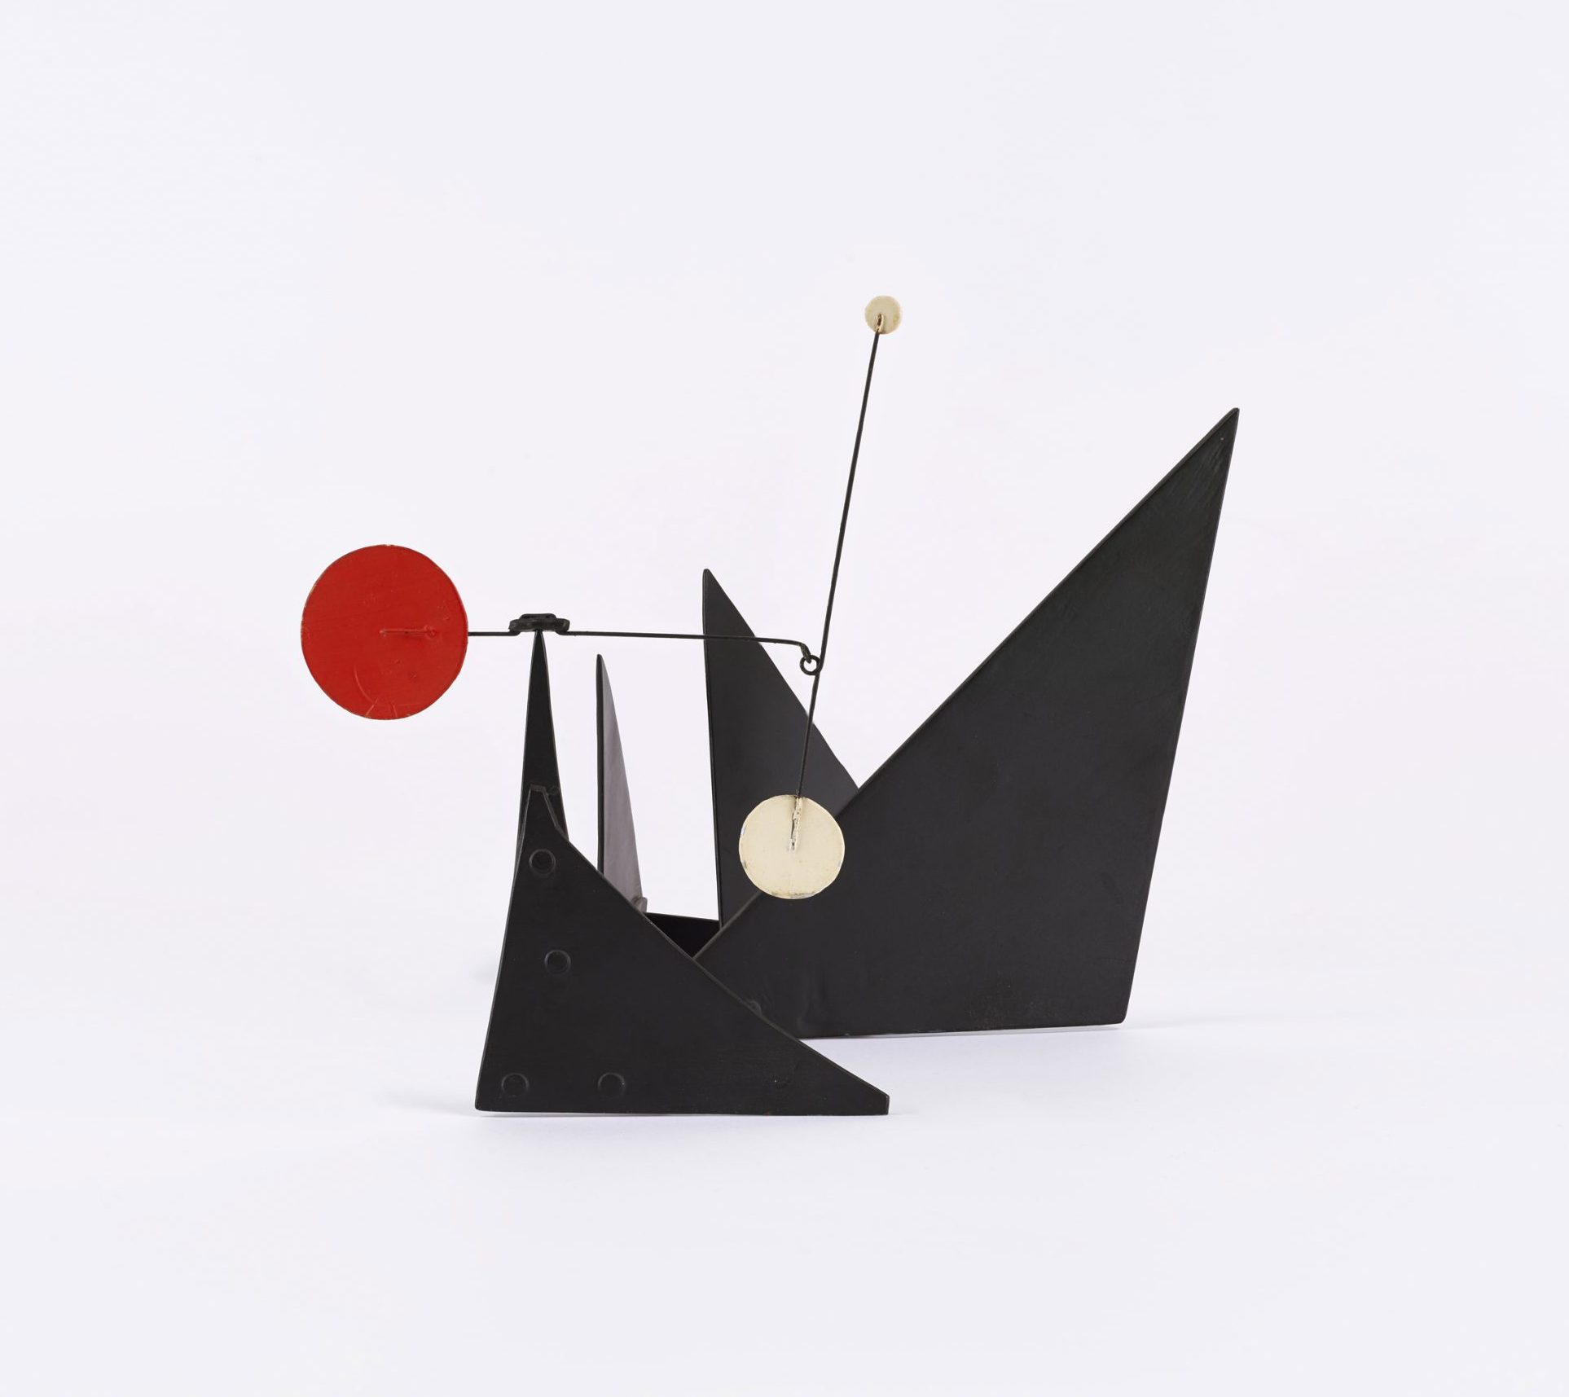

Slide 8
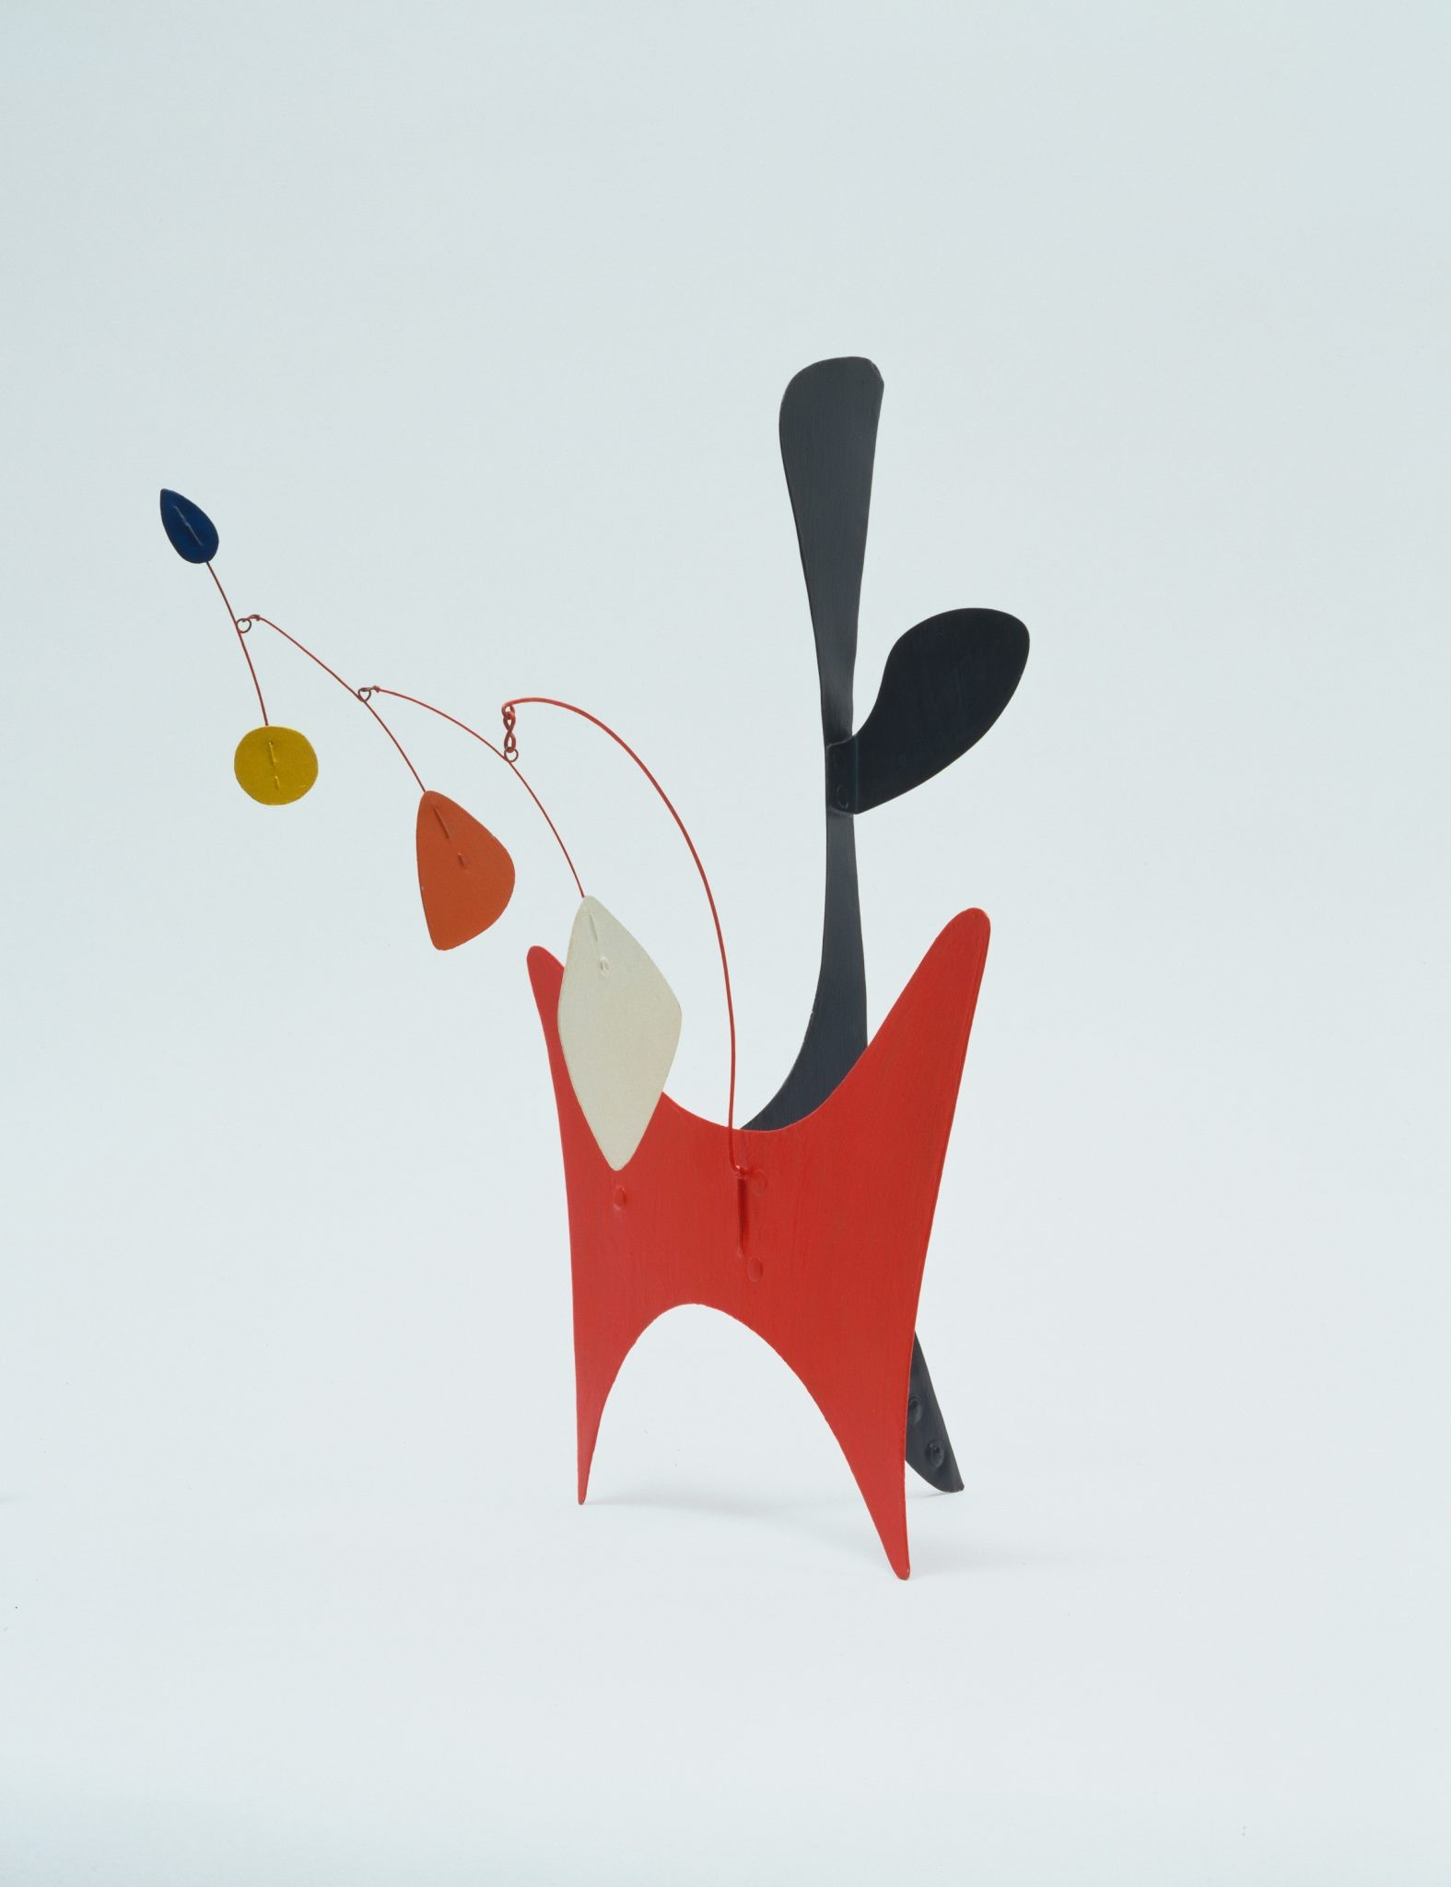

Slide 9
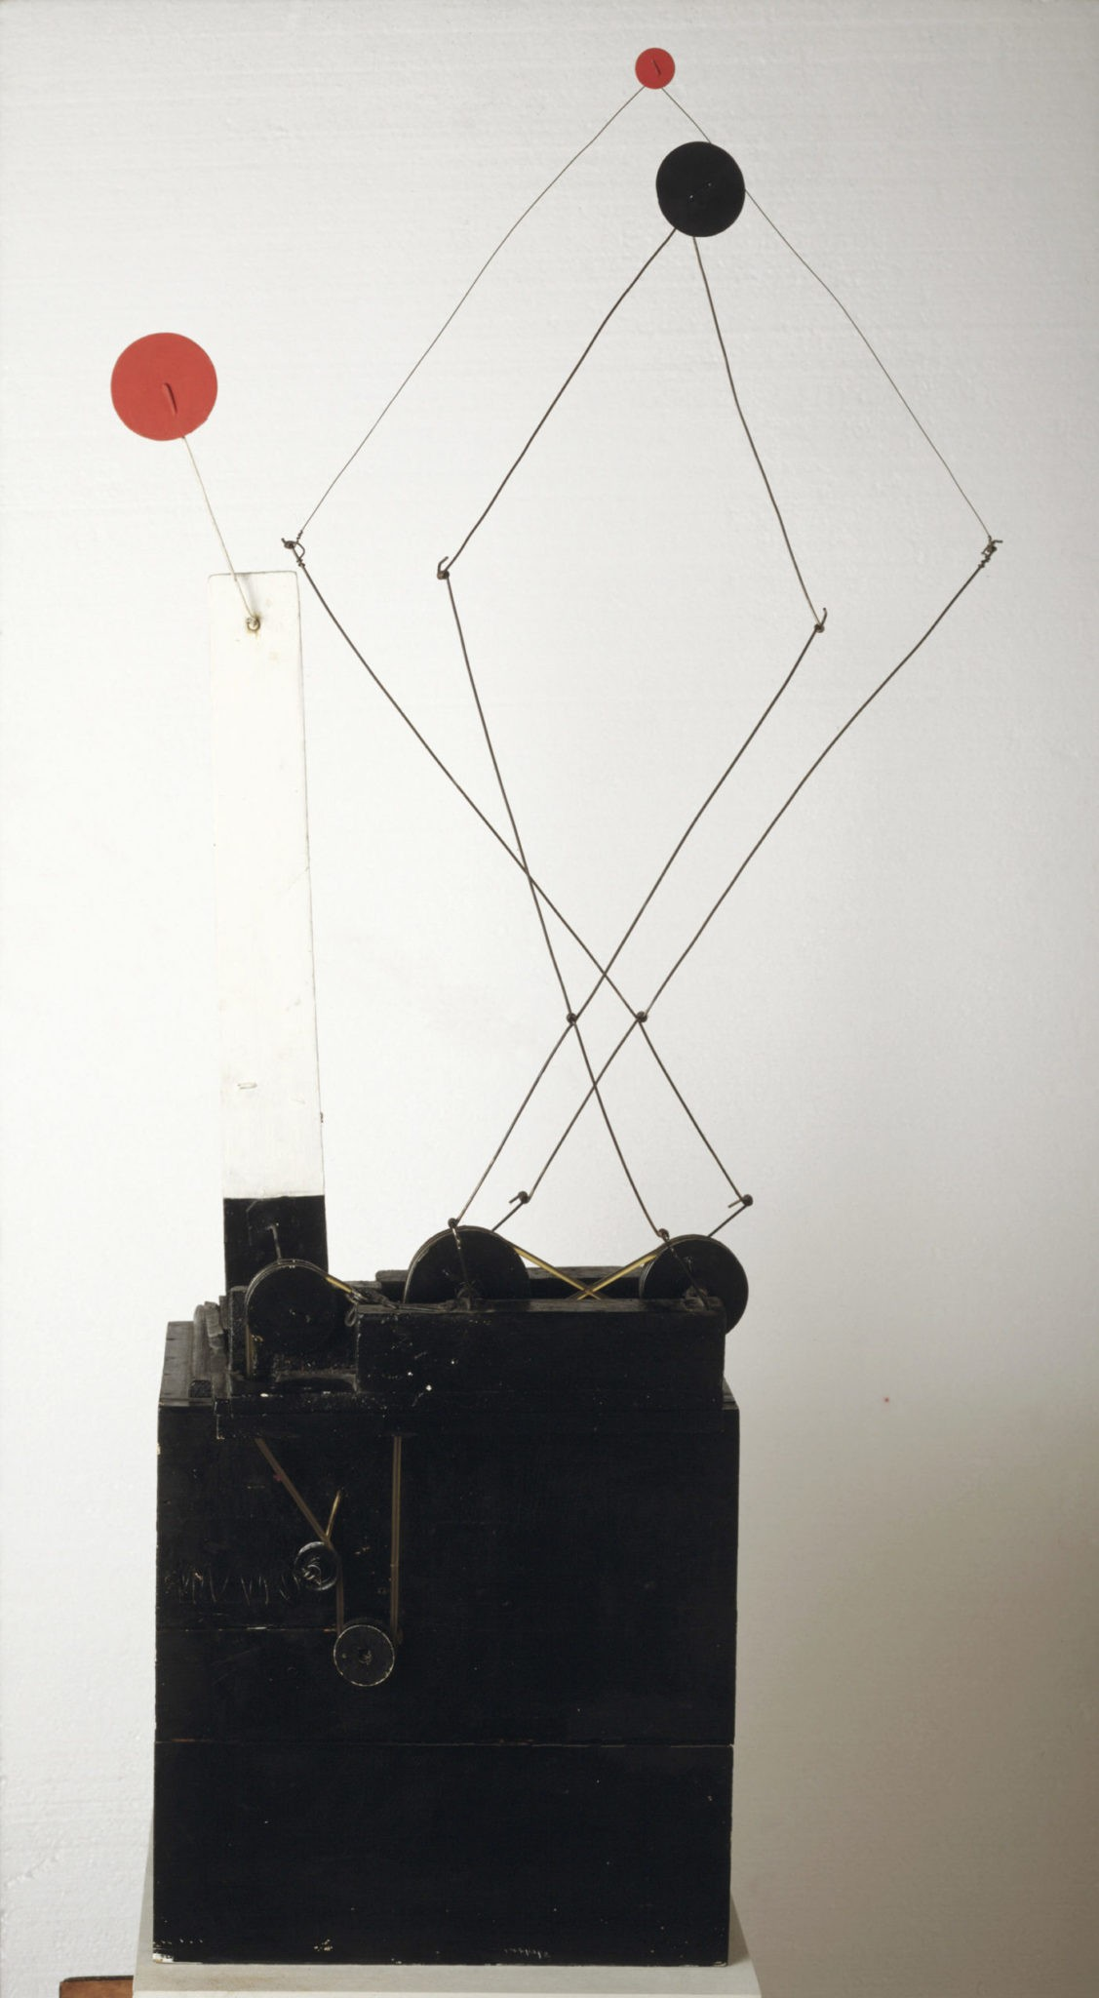

Slide 10
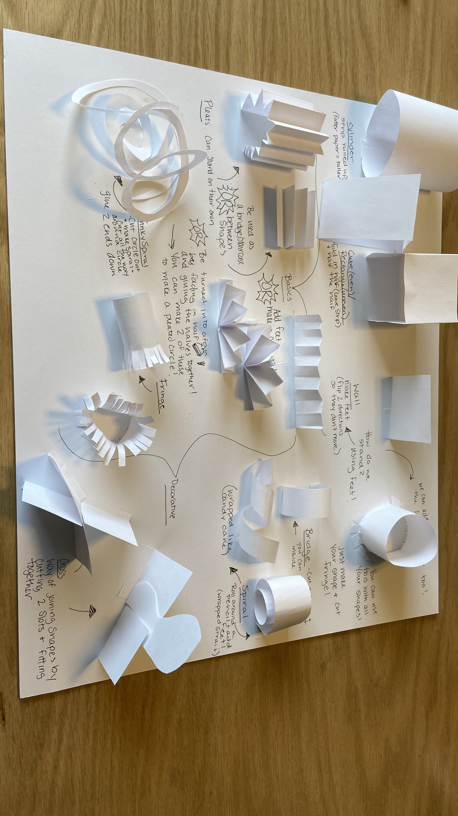

Slide 11
vocabulary

Slide 12
vocabulary
Shape
Geometric Shape
Organic Shape
2D Shape
3D Shape

Slide 13
instructions

Slide 14
instructions
We are continuing our sculptures with at least 4 DIFFERENT geometric shapes and at least 2 DIFFERENT organic shapes
You should have a base complete. Now, start building up your sculpture. REMEMBER TO ROTATE YOUR SCULPTURE AS YOU CREATE IT.
Connect different shapes with cross joints, bridges, or feet
Add some decorative elements like fringe, spirals, or pleats
At the end, we will share our projects. Please be ready to discuss all of the different shapes you used to create it.

Slide 15
references
https://www.moma.org/calendar/events/6988
https://calder.org/
https://www.youtube.com/watch?v=j3OqfduWdhc&t=6s

