Slide 1
Pop Art
Part 1

Slide 2
objectives
of this lesson

Slide 3
objectives
Learn about Andy Warhol and Pop Art
Begin a Pop Art inspired piece by creating stencils to use for next time

Slide 4
materials

Slide 5
materials
Pencil
Paper
Ruler

Slide 6
Pass or play!

Slide 7
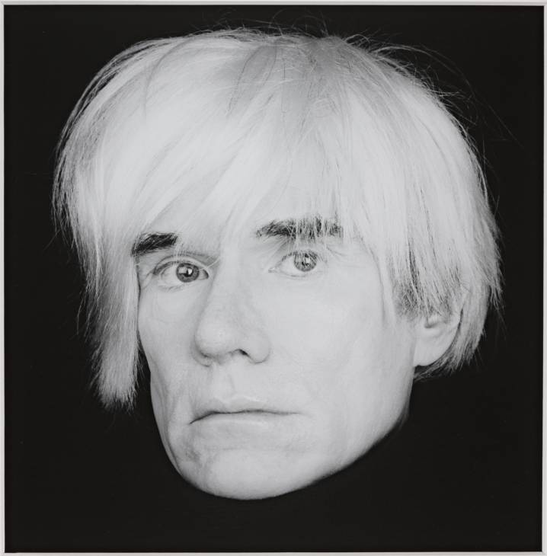
About Warhol
Born in Pittsburgh, PA 1928
Illustrator during the 40s and 50s
Part of the Pop Art Movement
Famous for his silk screen prints
Process where an image on a screen is used as a stencil to push ink through and create the image

Slide 8
What is Pop Art?
Challenged art traditions by using images of popular culture like celebrities, comic book pages, advertisements, or soup cans
Artists had been experimenting before using “found objects” but the Pop Art Movement took it further

Slide 9
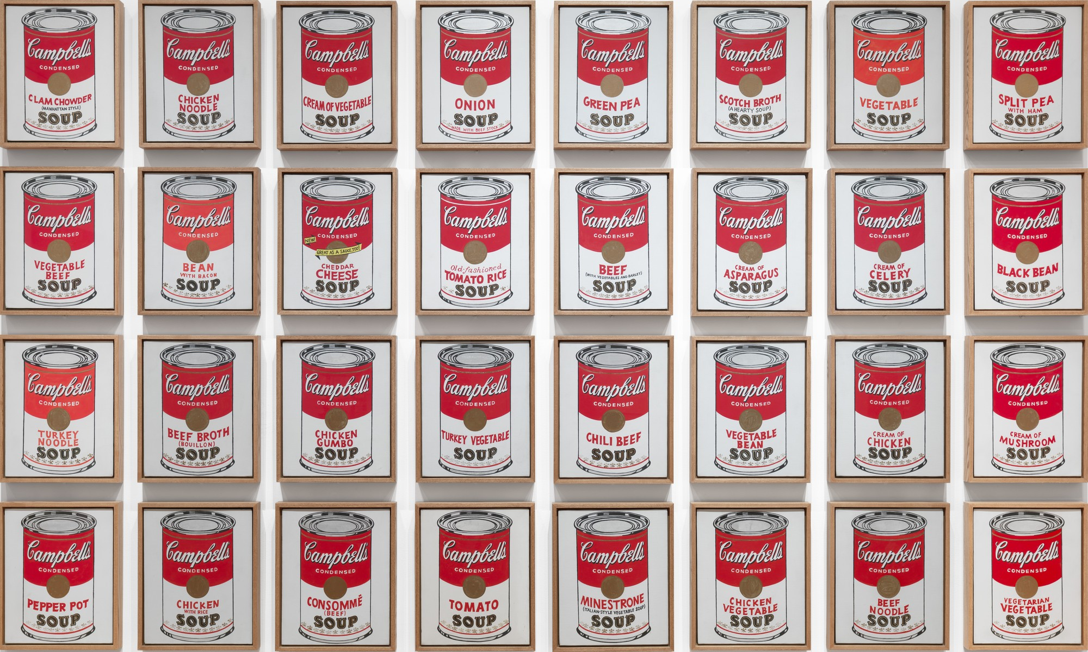

Slide 10
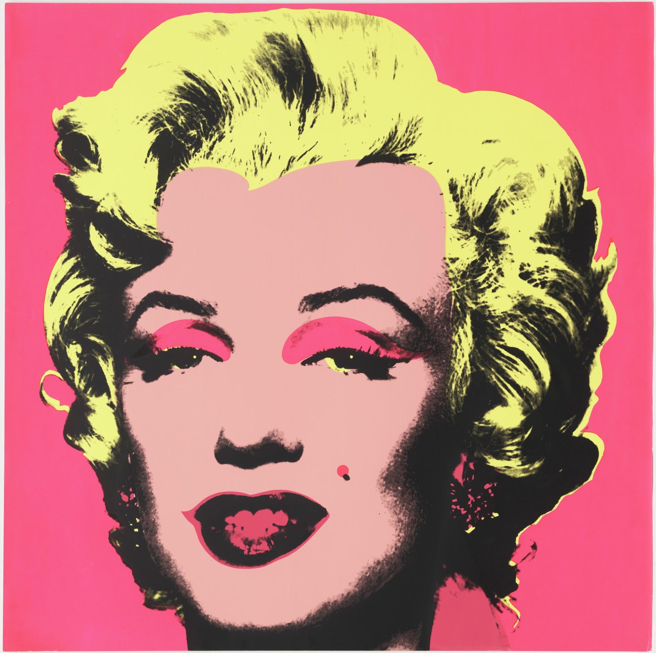

Slide 11
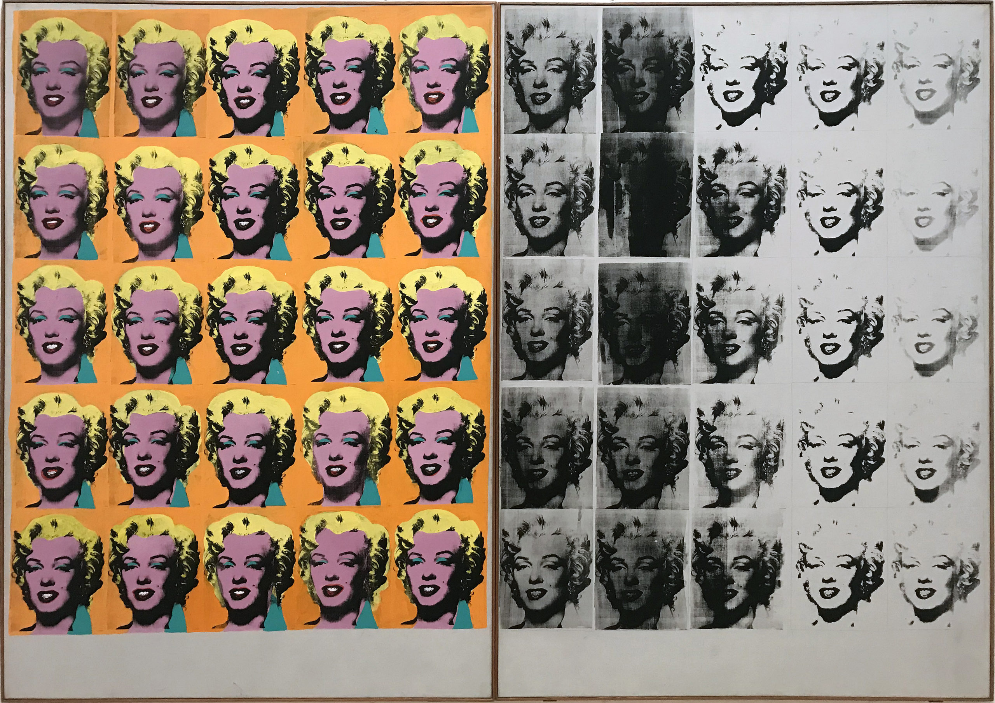

Slide 12
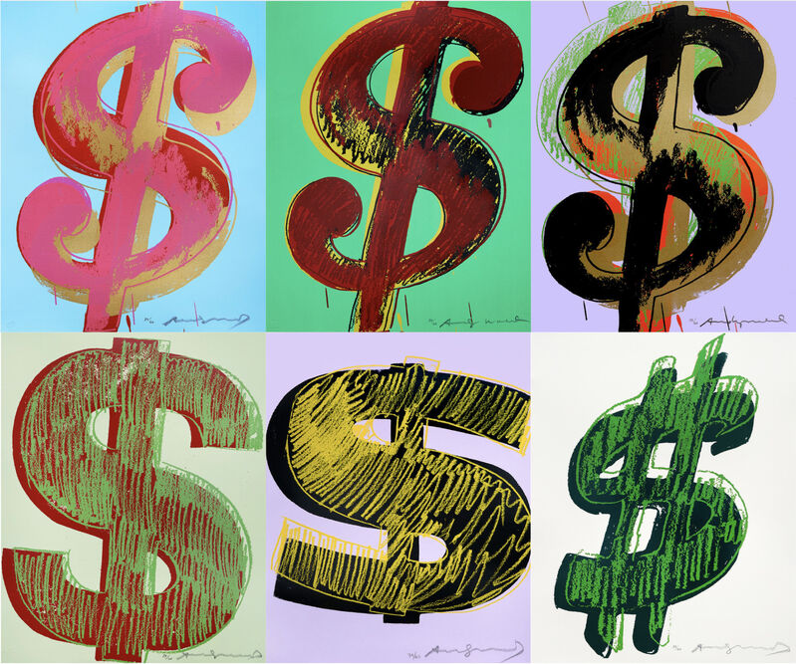

Slide 13
Video on Screen Printing
https://www.youtube.com/watch?v=O8HB2cQm_Ag

Slide 14
vocabulary

Slide 15
vocabulary
Line
path traced by the point of a tool or medium as it moves across an area
Contrast
arrangement of opposite elements (light and dark, rough and smooth, large and small)
Value
how light or dark a color can be

Slide 16
instructions

Slide 17
instructions
Place a dot on your paper that will serve as the center of our circle
Measure out 2.5” on both sides horizontally and vertically
Measure out 2.5” on each side diagonally
Connect the dots to create a circle
Cut your circle out
Create a 6” square on your paper
Trace the circle inside
Make part of the circle thicker by adding another line on one side that tapers off as it goes around the circle (This will show the thickness of the coin)

Slide 18
references
https://www.artsy.net/artwork/andy-warhol-complete-set-of-6-dollar-signs-1981
moma.org/collection/works/61240
https://www.moma.org/collection/works/79809
https://www.tate.org.uk/art/artists/andy-warhol-2121/what-was-andy-warhol-thinking
https://smarthistory.org/warhol-marilyn-diptych/

