Slide 1
Pop Art
Part 2

Slide 2
objectives
of this lesson

Slide 3
objectives
Finish cutting out our stencils
Begin cutting out background colors for our project

Slide 4
materials

Slide 5
materials
Pencil
Colored Paper
Ruler
Stencils from last class

Slide 6
Let’s review Pop Art!
https://www.youtube.com/watch?v=DhEyoDCTSDQ&t=84s

Slide 7
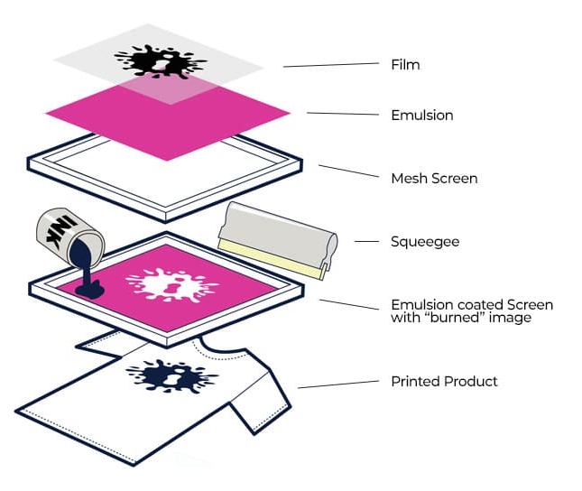

Slide 8
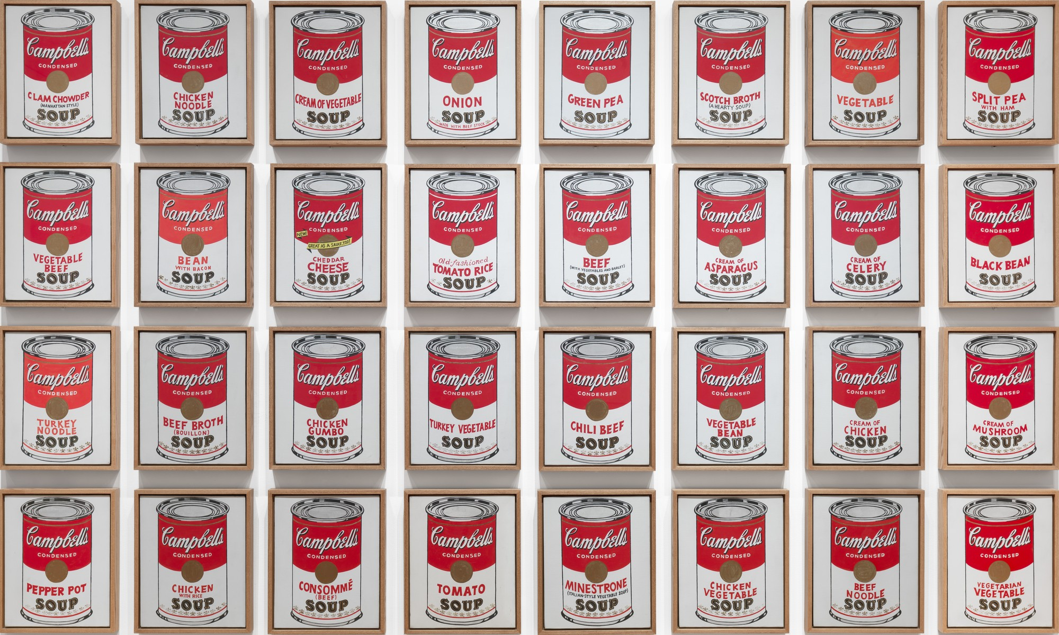

Slide 9
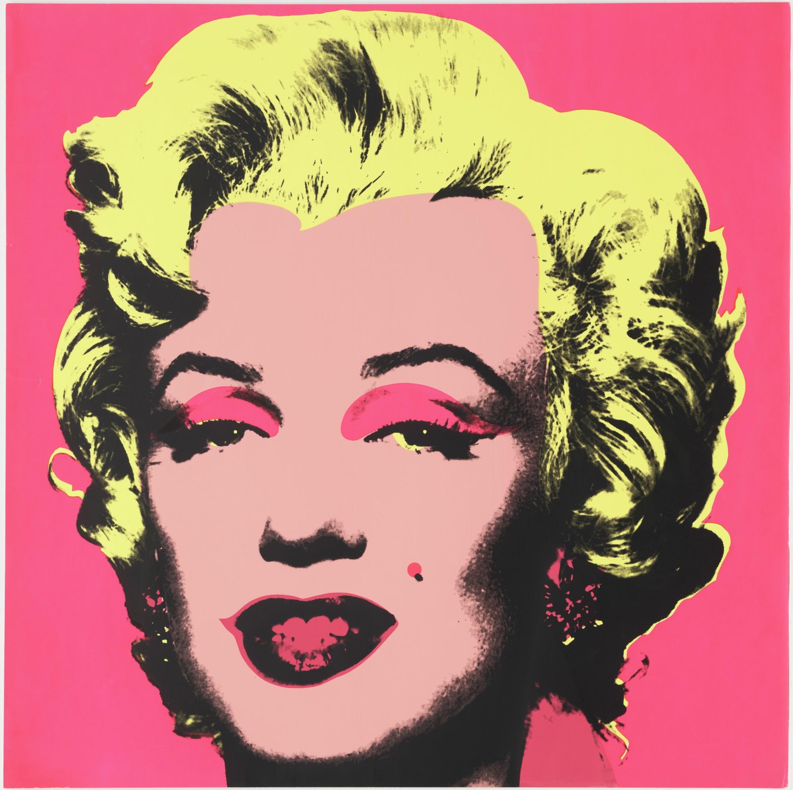

Slide 10
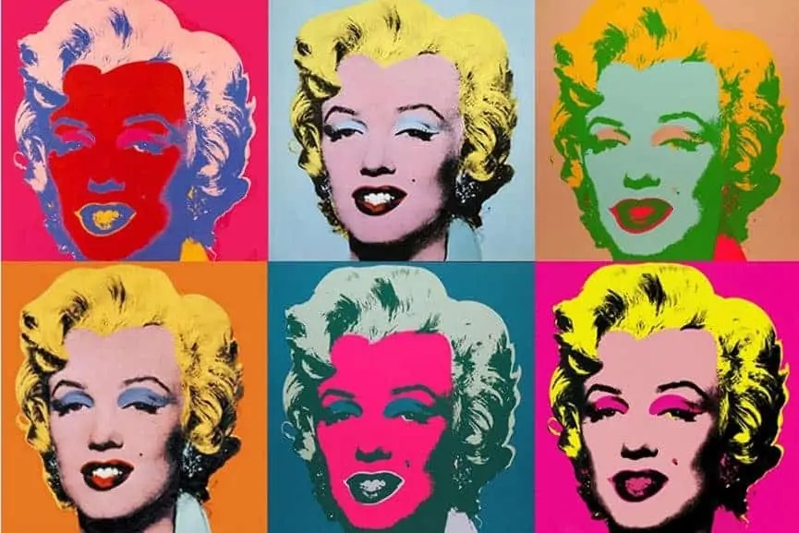

Slide 11
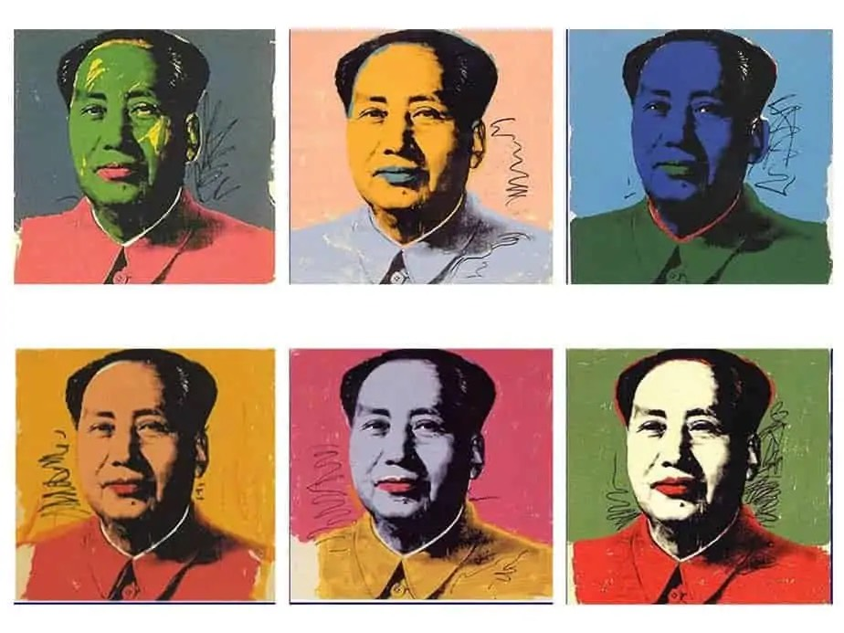

Slide 12


Slide 13
vocabulary

Slide 14
vocabulary
Line
path traced by the point of a tool or medium as it moves across an area
Contrast
arrangement of opposite elements (light and dark, rough and smooth, large and small)
Value
how light or dark a color can be

Slide 15
instructions

Slide 16
instructions
Finish drawing and cutting out stencils
Choose at least 4 different colors for your background
Start using your stencils on top of the colored paper
Begin with one outline of the main stencil (in any color),
Offset and fill in the same stencil (in another color different from the last one)
Fill in the shadow stencil (in the same color as last step or a different color)
Create ridges (depending on the coin) by drawing lines over the shadow stencil (to help keep the lines within the boarders of the shadow shape).
Repeat to fill all four squares! Switch the colors and use a variety like Warhol! Make sure you have bold contrasting colors!

Slide 17
references
Images:
https://www.artsy.net/artwork/andy-warhol-complete-set-of-6-dollar-signs-1981
moma.org/collection/works/61240
https://www.moma.org/collection/works/79809
https://www.tate.org.uk/art/artists/andy-warhol-2121/what-was-andy-warhol-thinking
https://smarthistory.org/warhol-marilyn-diptych/
https://www.theartist.me/art-inspiration/famous-andy-warhol-paintings/
https://impact-nw.com/the-basics-of-screen-printing/
https://www.artsy.net/artwork/andy-warhol-flowers-fs-ii-dot-69-5

