Slide 1
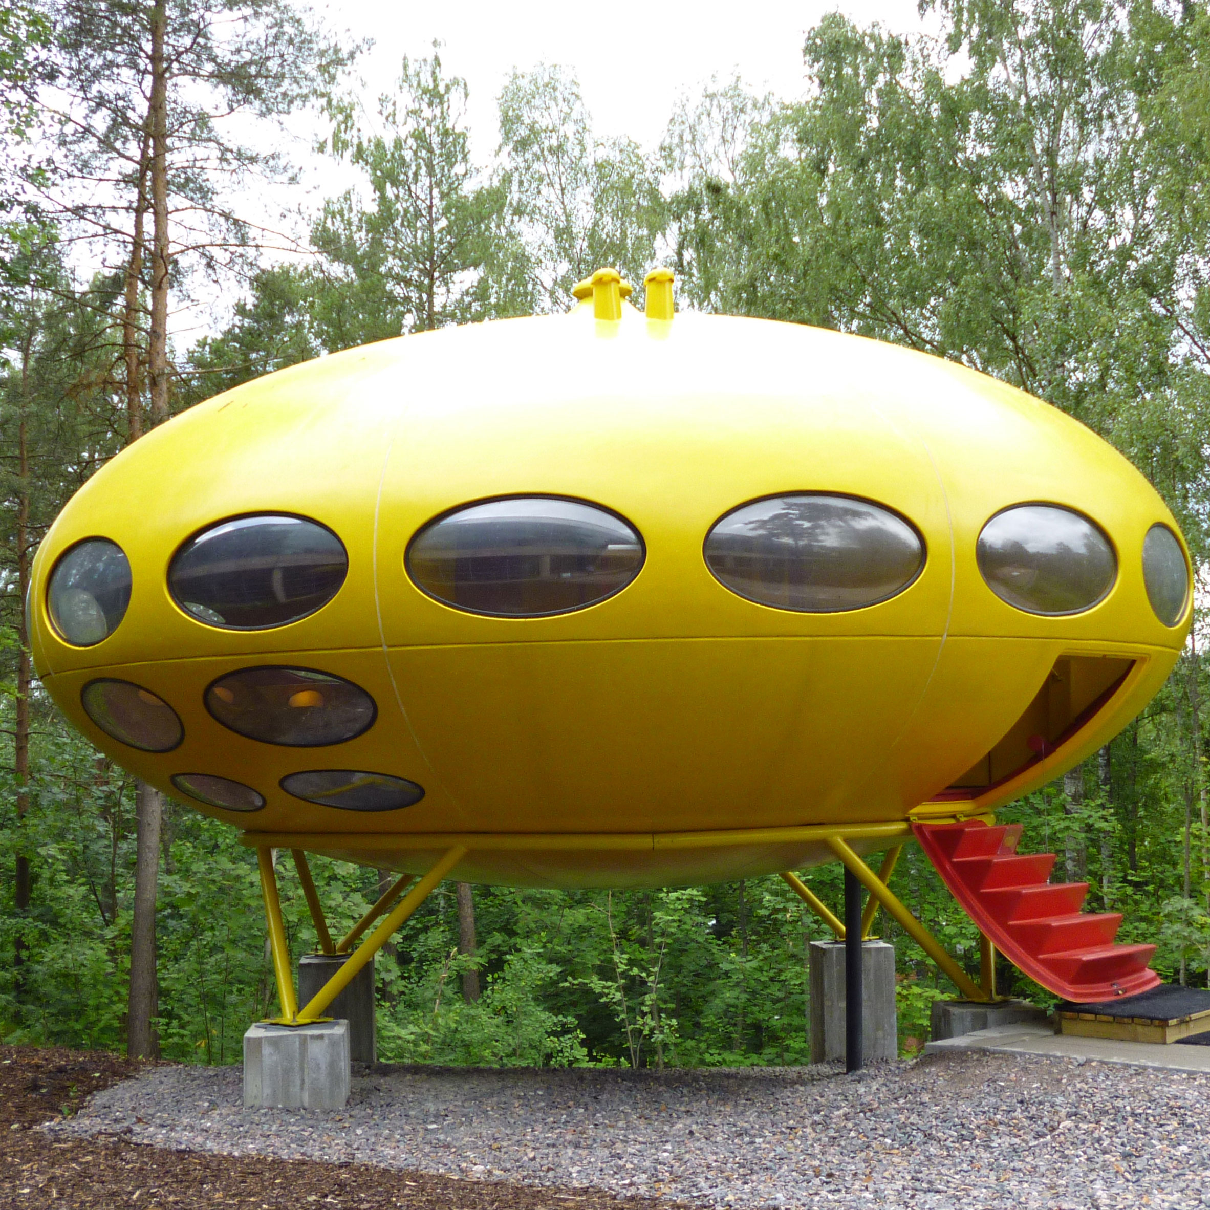
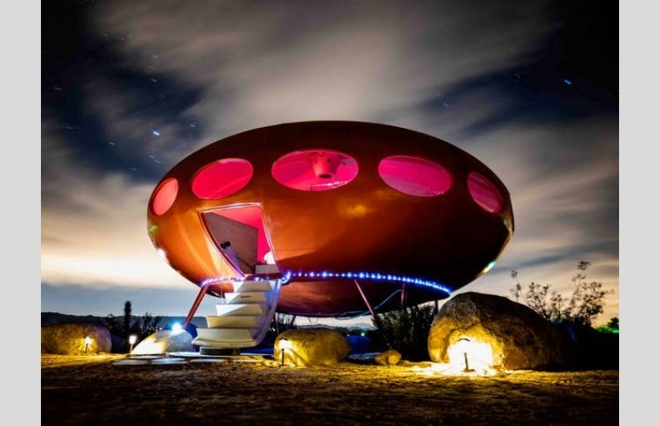
Do Now: Would you live in a Futuro House? Why or why not?

Slide 2

Welcome To:
Arts Link

Slide 3
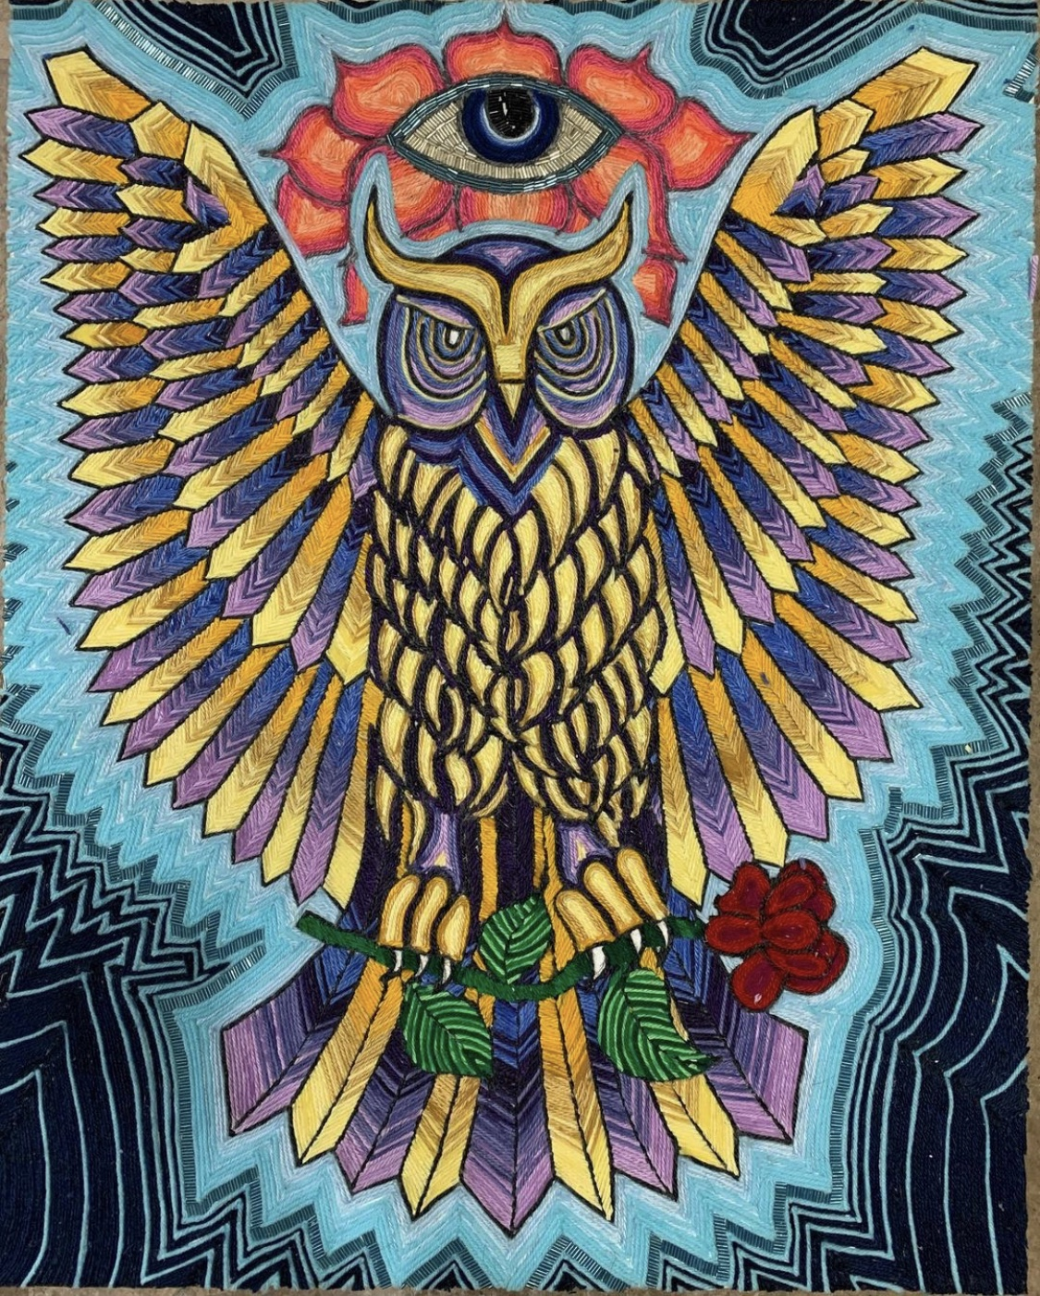
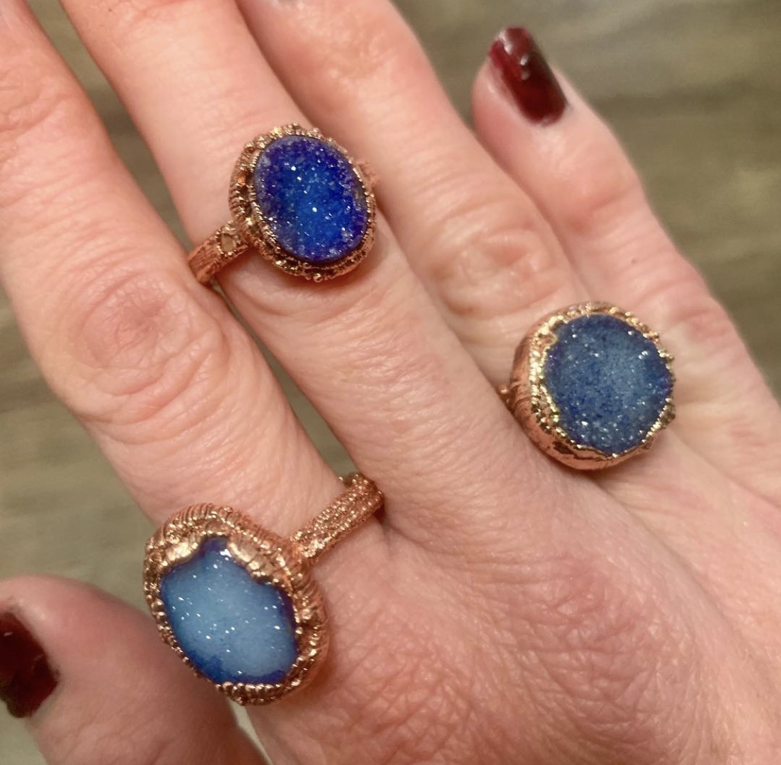
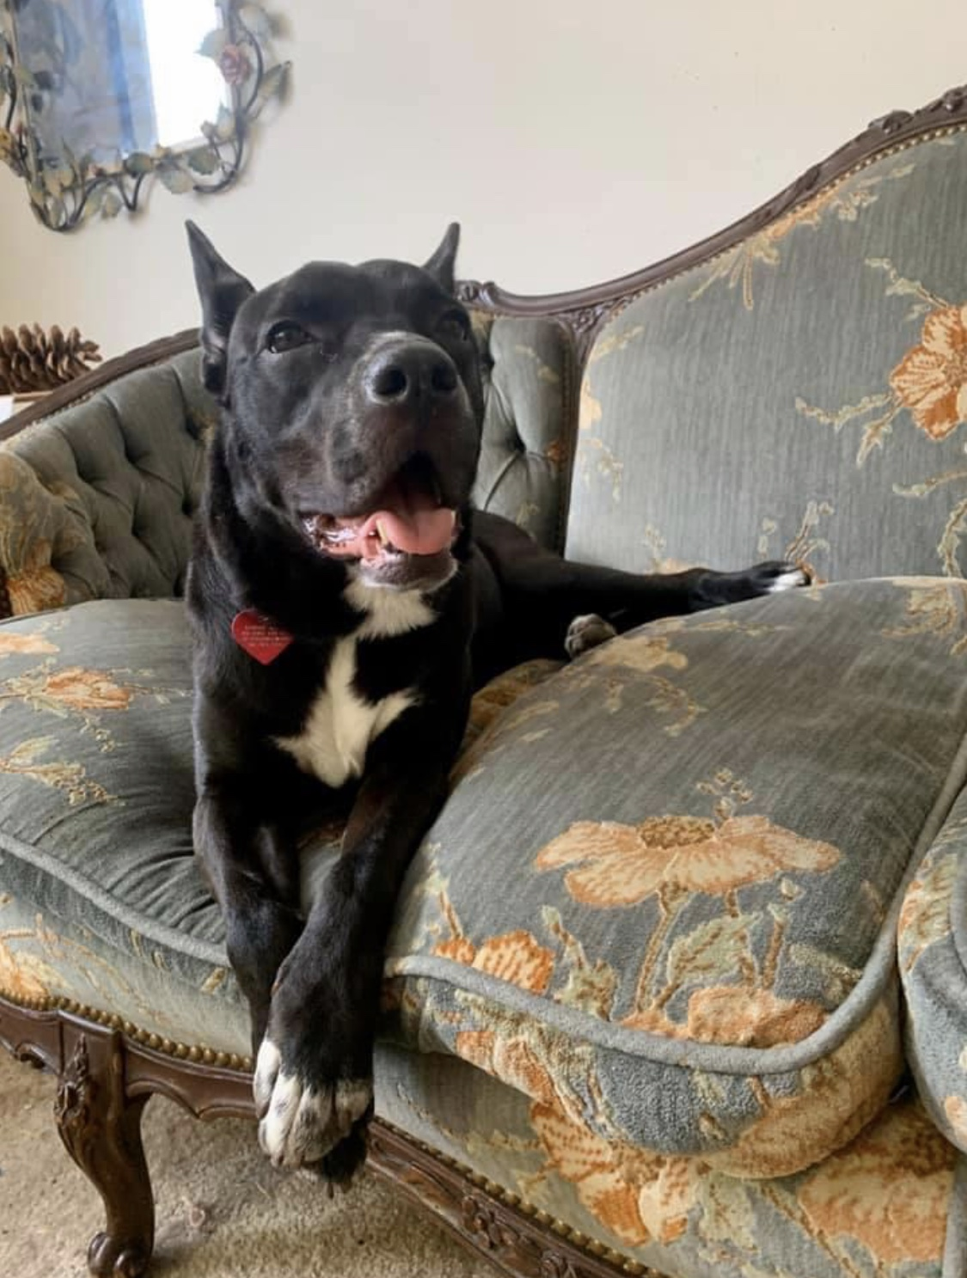
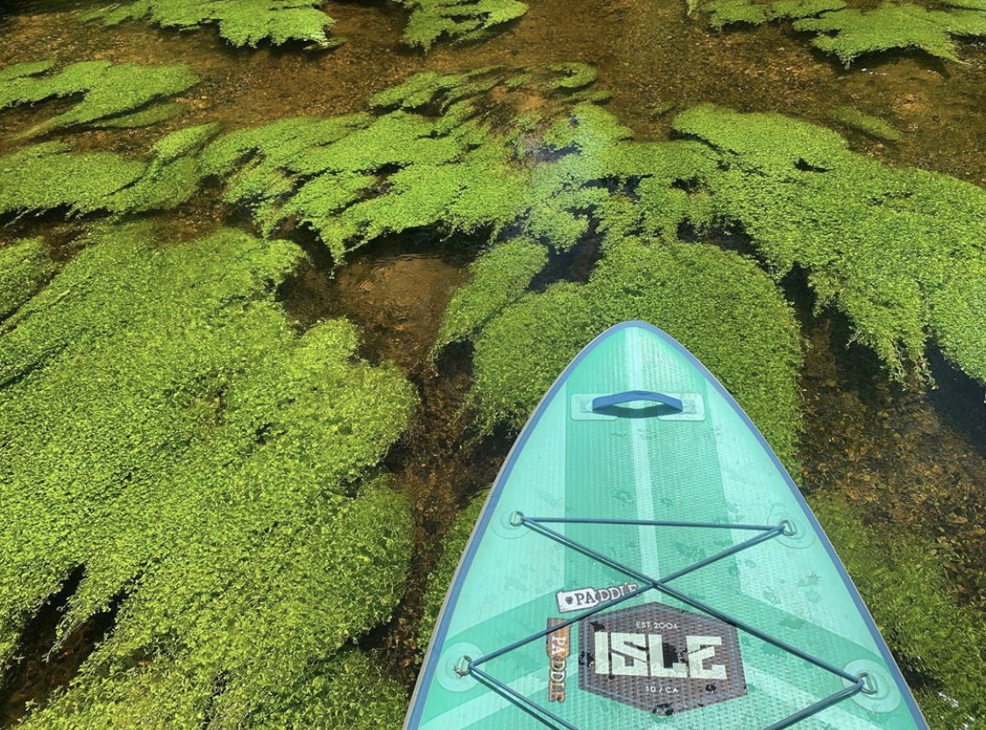
Meet Ms. Lipin !

Slide 4


Materials for the Day:
-Pencil
-Paper
-Eraser

Slide 5
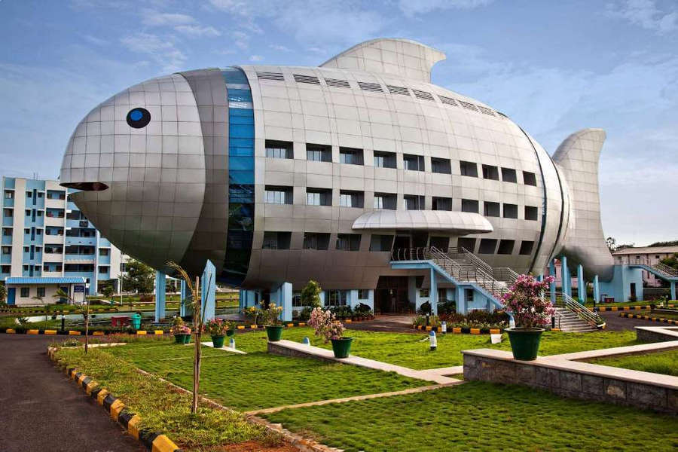
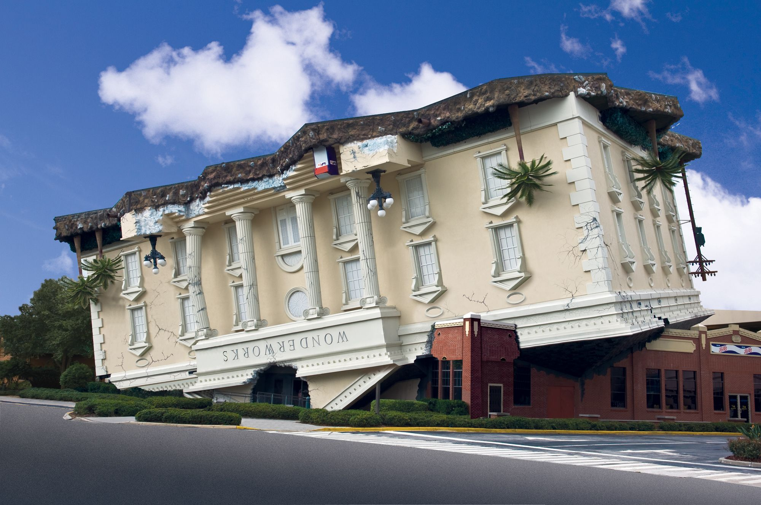
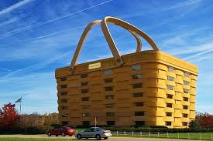
Cityscapes and Fun Architecture
https://www.youtube.com/watch?v=LrgbDXtt4UQ

Slide 6
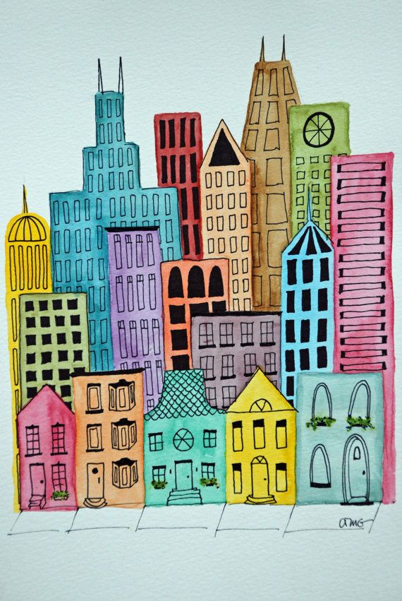
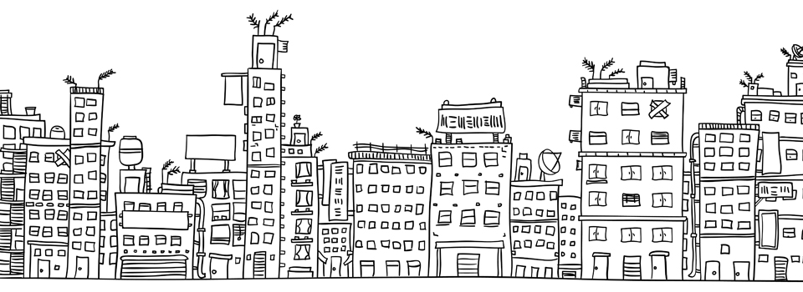
Build your Dream City and Cityscape
Where is your city ? Is it by the water? Is it on land? Is it floating in the sky?
Put your favorite shops and restaurants in your city or create new ones!
What is in the sky in your city? Birds? Airplanes? Helicopters? Flying superheroes?

Slide 7
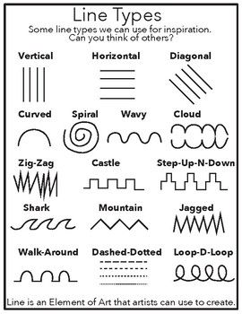
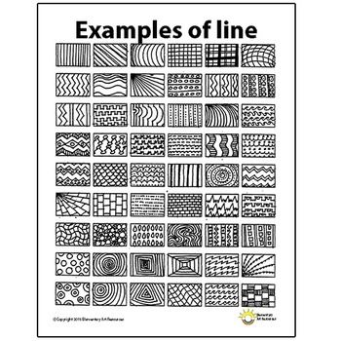
Art Vocabulary- Line
Horizontal
Vertical
Diagonal
Straight
Curved
Dotted
Broken
Thick
Thin

Slide 8
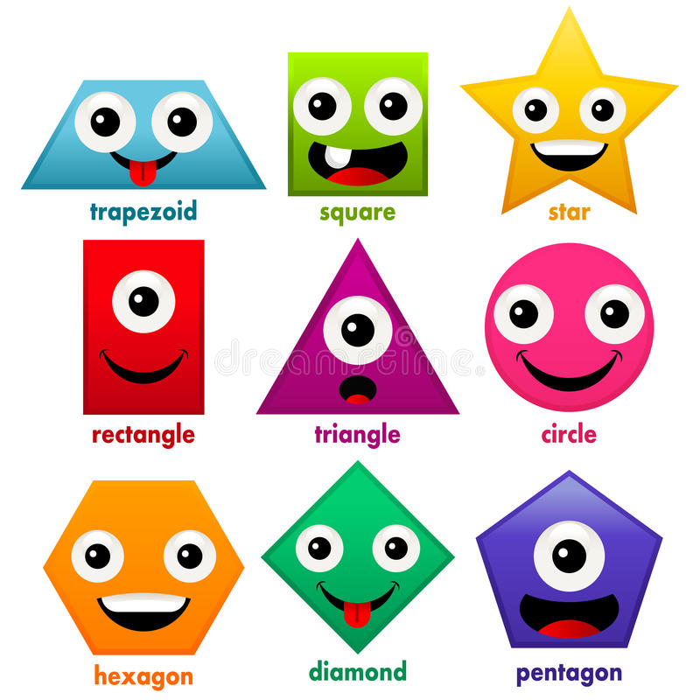

Art Vocabulary– Shape
2D (two dimentional) / flat
Geometric – square, circle, oval, triangle
Organic (all other shapes) Example: Maple Leaf

Slide 9
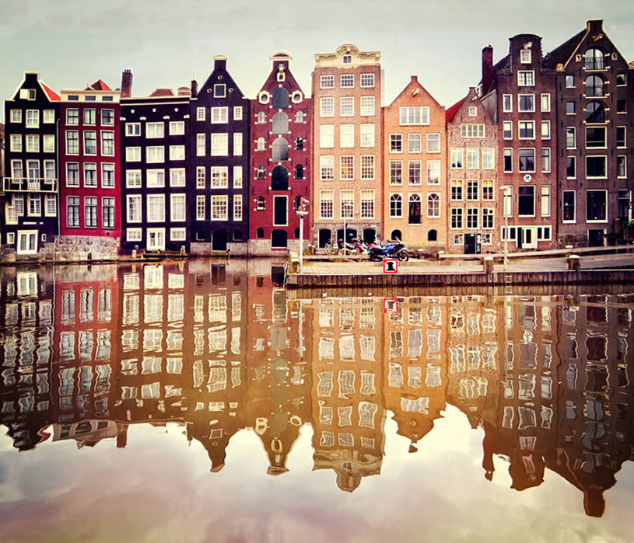
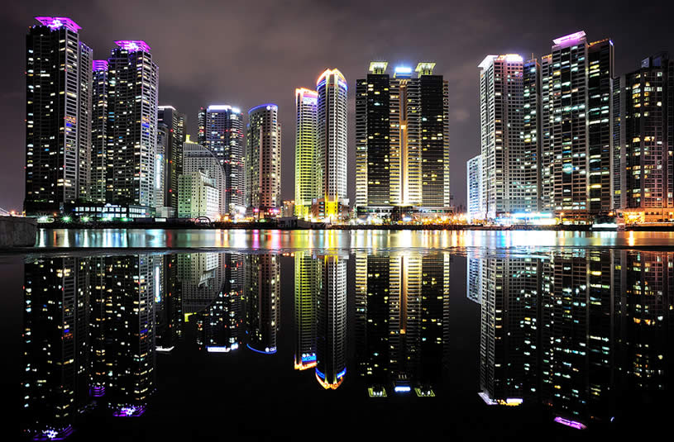
Art Vocabulary – Cityscape
An artistic representation of a city or urban area.

Slide 10
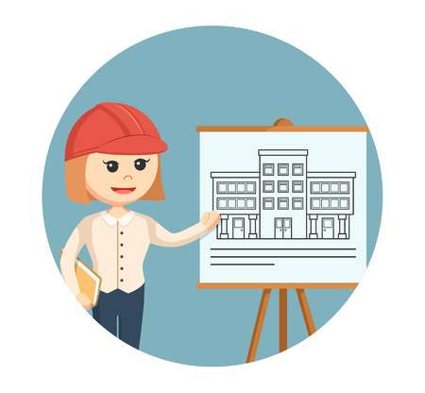

Art Vocabulary – Architect
A person who designs buildings with art and design in mind and also may help in the construction.

Slide 11
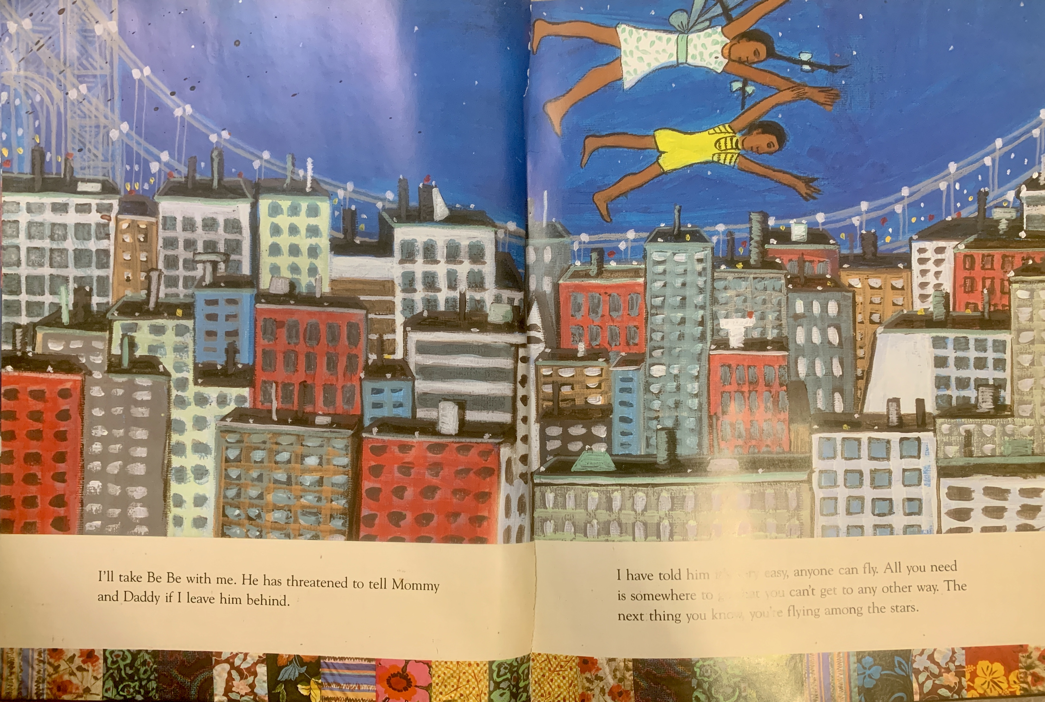
Please get ready to draw !
Please use your pencil lightly so you can erase
Please follow along.
Each row of windows should have the same number in them so that they can be skip counted.

Slide 12
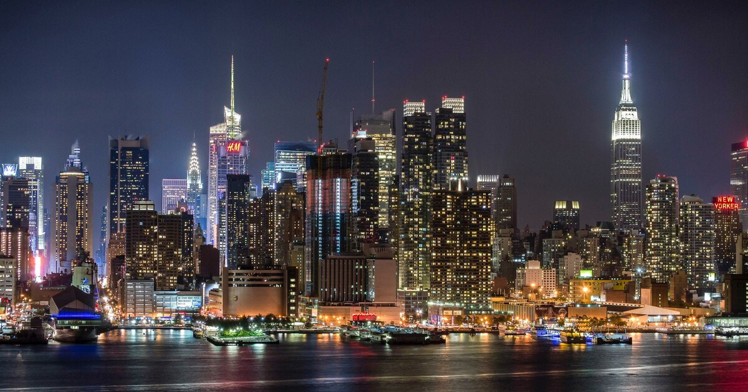
Before we go for the day ………..
What was one thing that you learned today in ArtsLink?
What is something that you were interested in today?

Slide 13
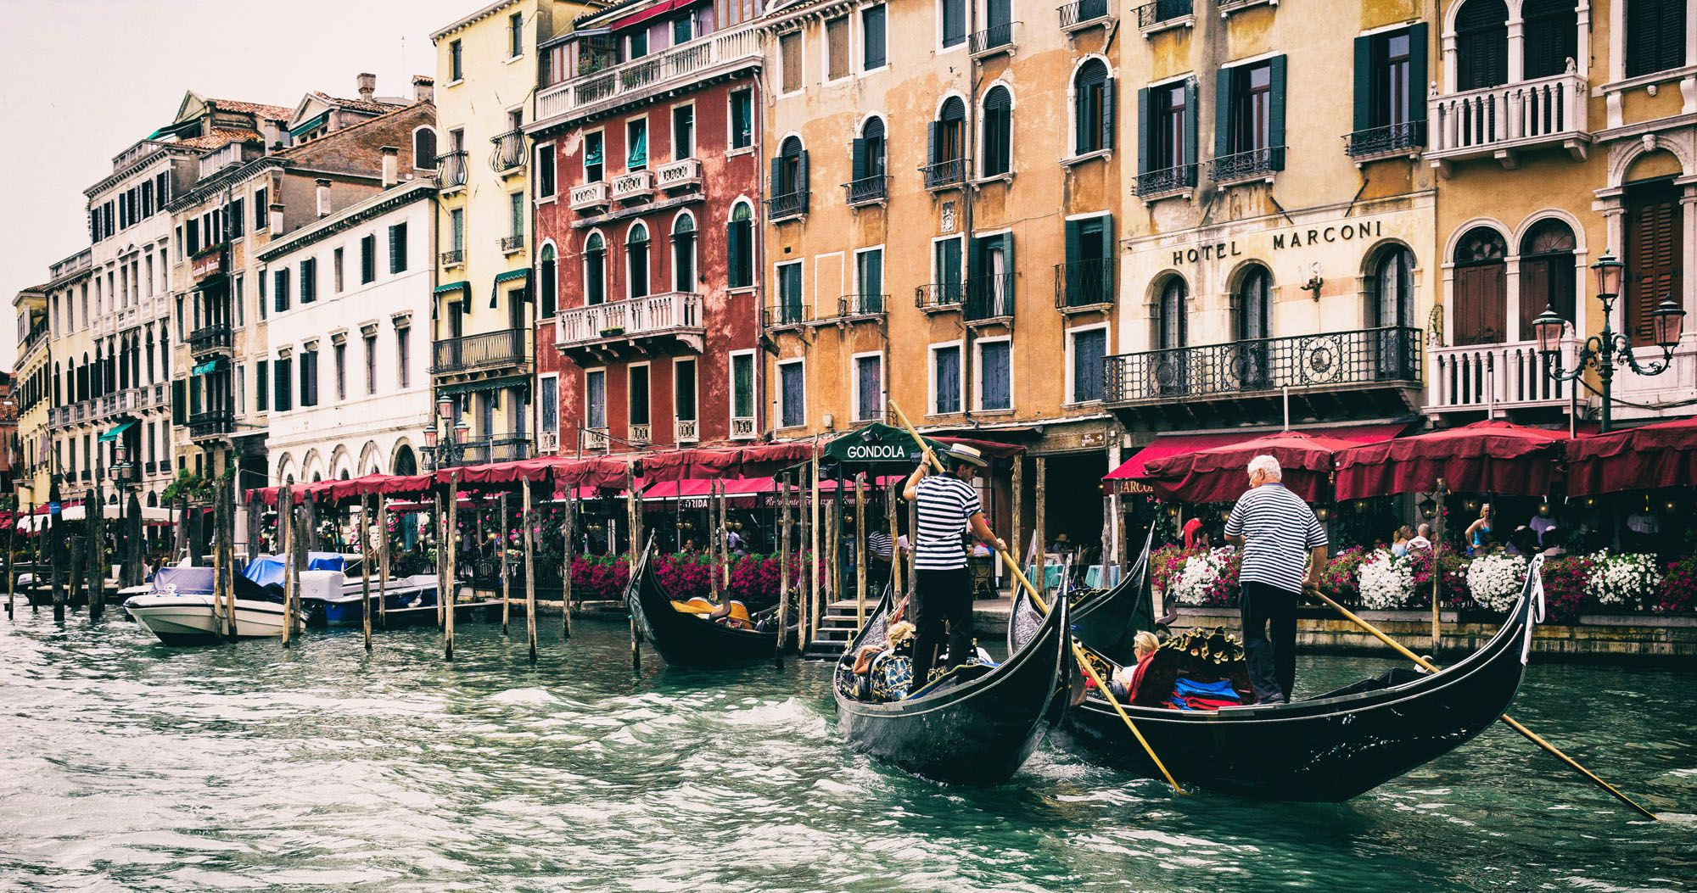
Learn More About Architecture!
https://franklloydwright.org/VirtualClassroom/ - learn about famous architect Francis Lyoyd Wright with activities and virtual tours
https://www.timeout.com/travel/virtual-landmark-tours - virtual tours of some of the world’s oldest and most famous architecture
https://travel.earth/13-brilliant-virtual-city-tours-you-can-take-from-home / take virtual city tours of the worlds most famous cities while enjoying the cityscapes and architecture

Slide 14
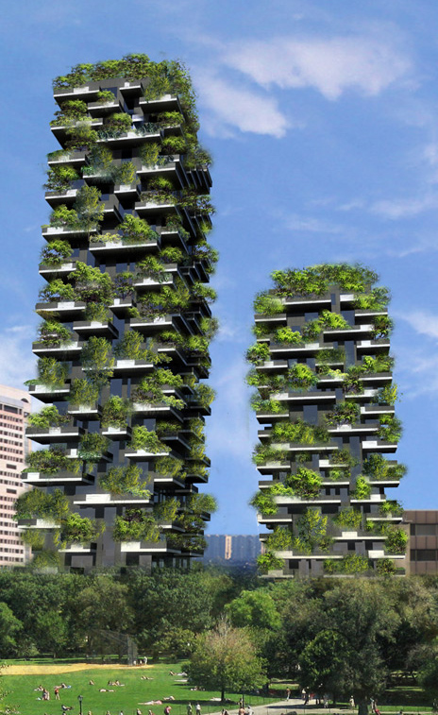
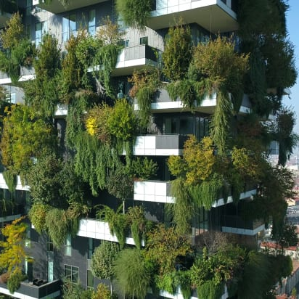
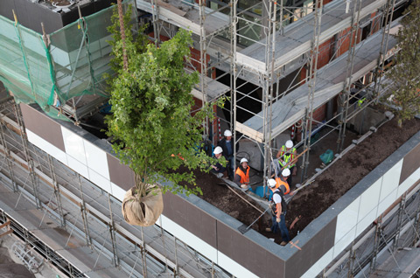
Why do you think an architect would design a “Vertical Forest” building? Do you like this building? Why or why not?

Slide 15
Welcome To:
Arts Link

Slide 16
Meet Ms. Lipin !

Slide 17

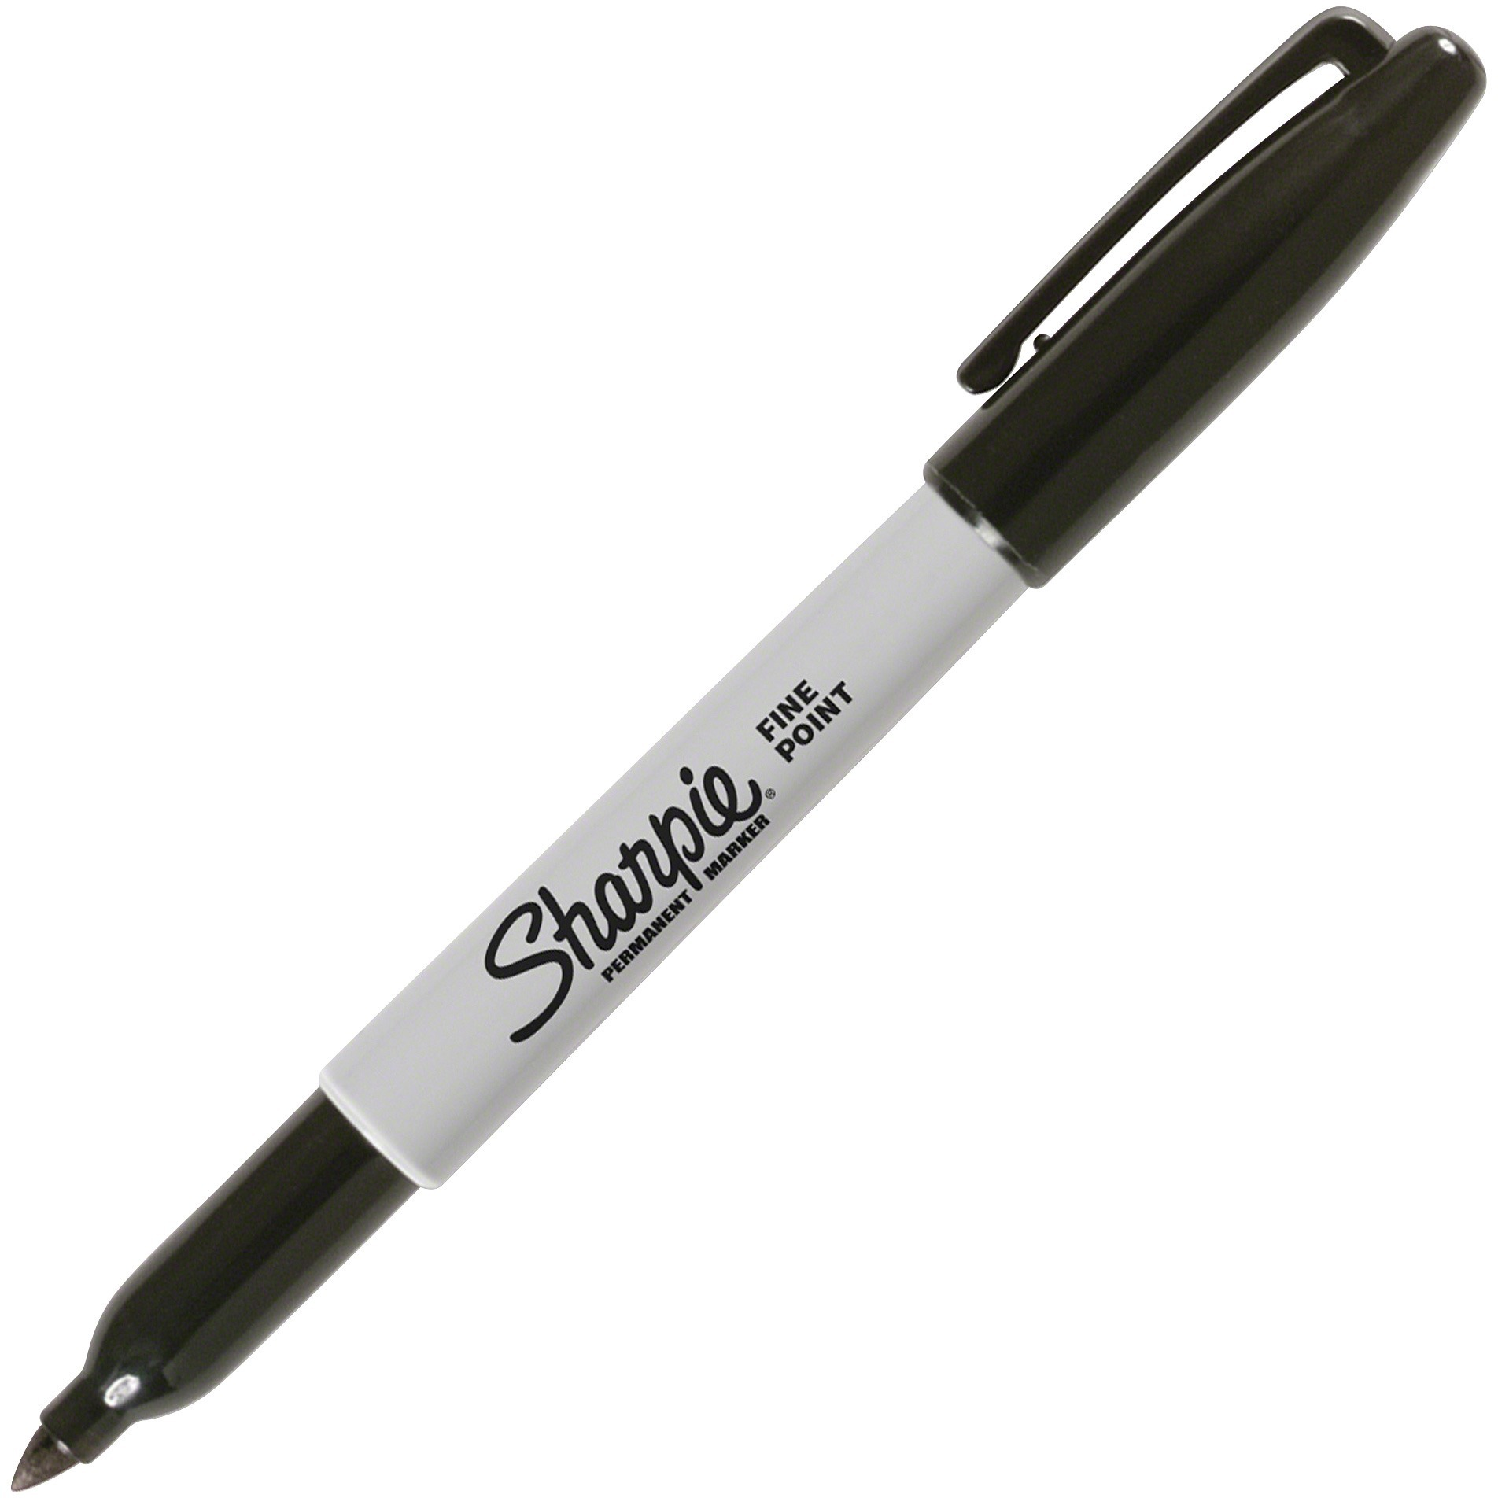
Materials for the Day:
-Pencil / Eraser
-Work from last week
-Marker
-Crayons

Slide 18
Build your Dream City and Cityscape
Where is your city ? Is it by the water? Is it on land? Is it floating in the sky?
Put your favorite shops and restaurants in your city or create new ones!
What is in the sky in your city? Birds? Airplanes? Helicopters? Flying superheroes?

Slide 19
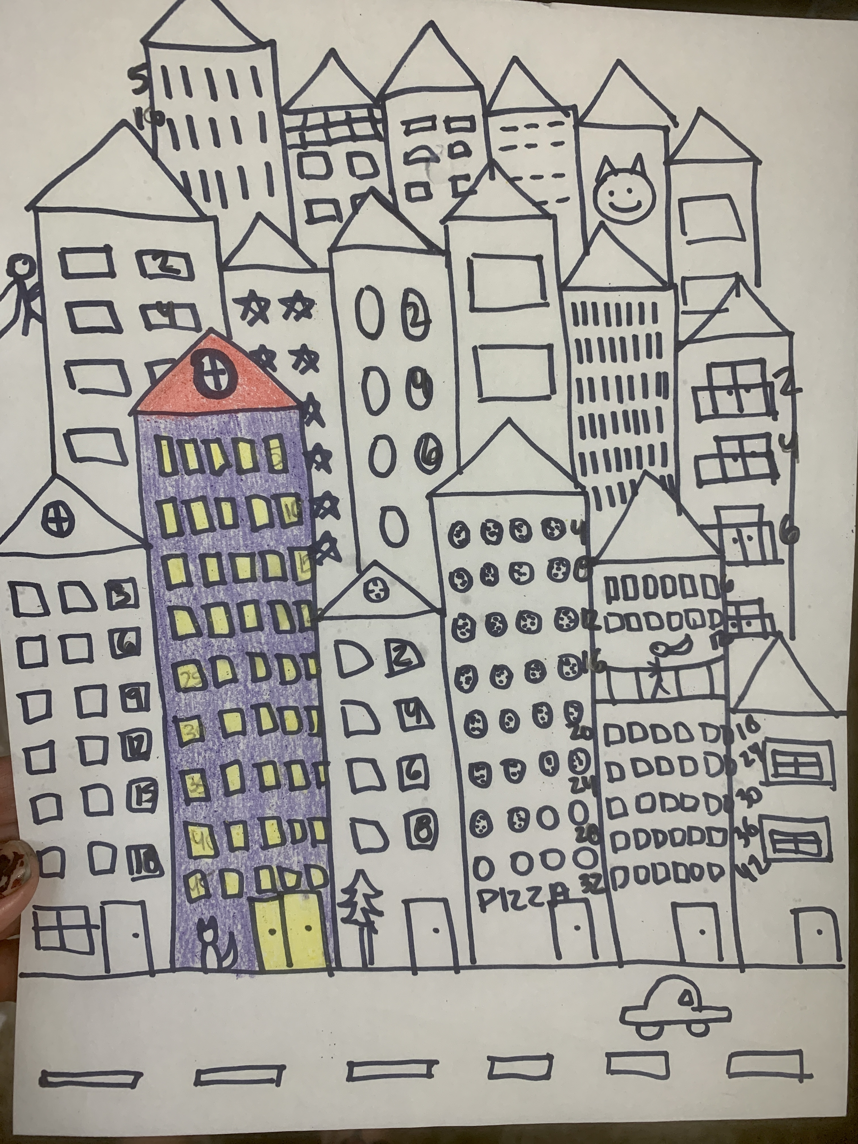
To Do Today:
-Complete your city in pencil
-Skip count your city windows
-Go over your pencil line in marker
-Fill in your drawing with crayon

Slide 20
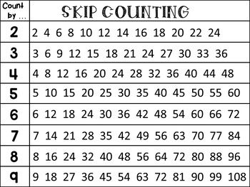
Skip Counting

Slide 21
Before we go for the day ………..
What was one thing that you learned today in ArtsLink?
What is something that you were interested in today?

Slide 22
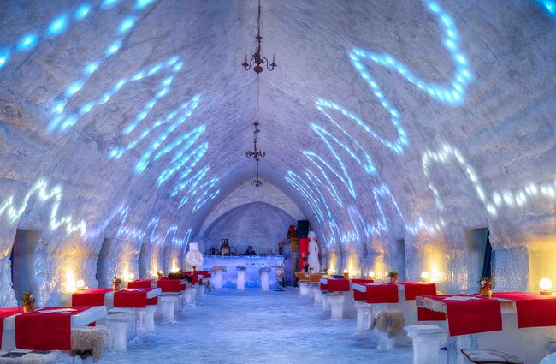
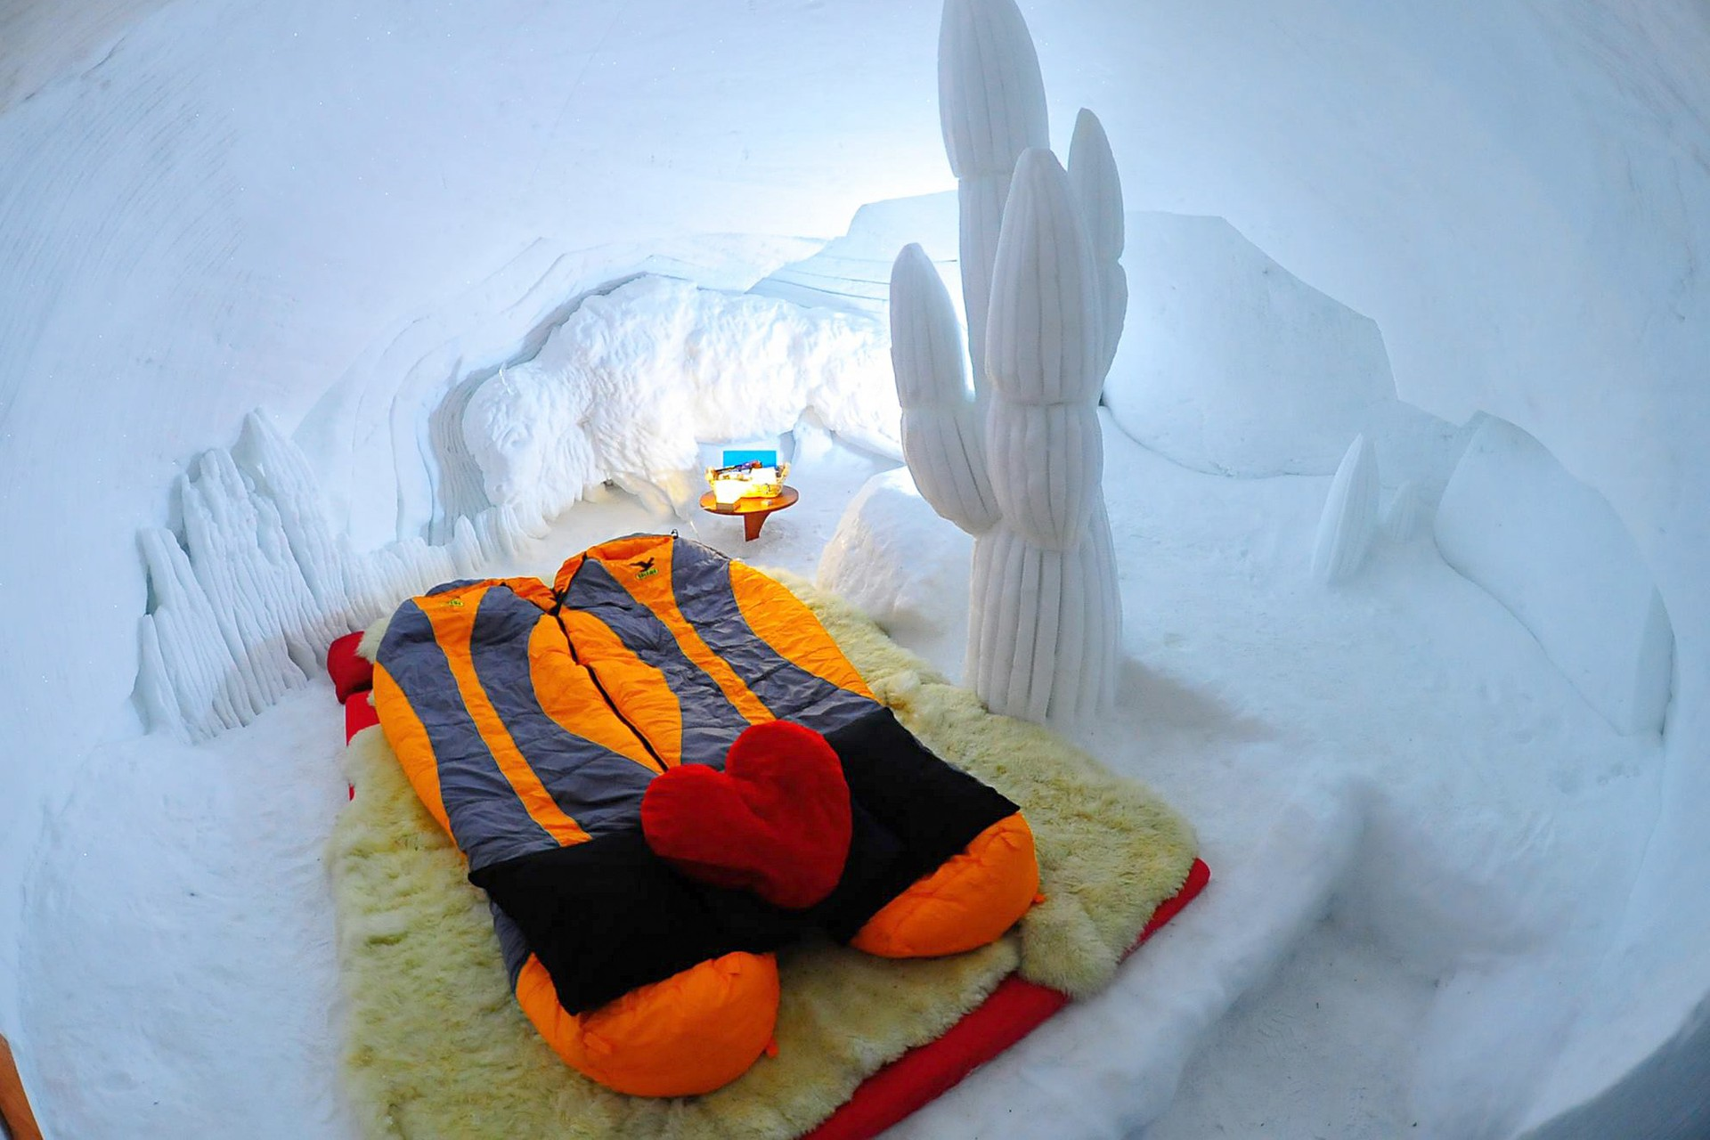
Do Now: Would you ever stay in a hotel made of ice? Why or why not ?

Slide 23
Welcome To:
Arts Link

Slide 24
Meet Ms. Lipin !

Slide 25
Materials for the Day:
-Pencil / Eraser
-Work from last week
-Marker
-Crayons
-Lined Notebook paper

Slide 26
To Do Today:
-Complete your city in pencil
-Skip count your city windows
-Go over your pencil line in marker
-Fill in your drawing with crayon
-Go over how you could use your
Skip counting city for multiplication

Slide 27
Before we go for the day ………..
What was one thing that you learned today in ArtsLink?
What is something that you were interested in today?

