Slide 1
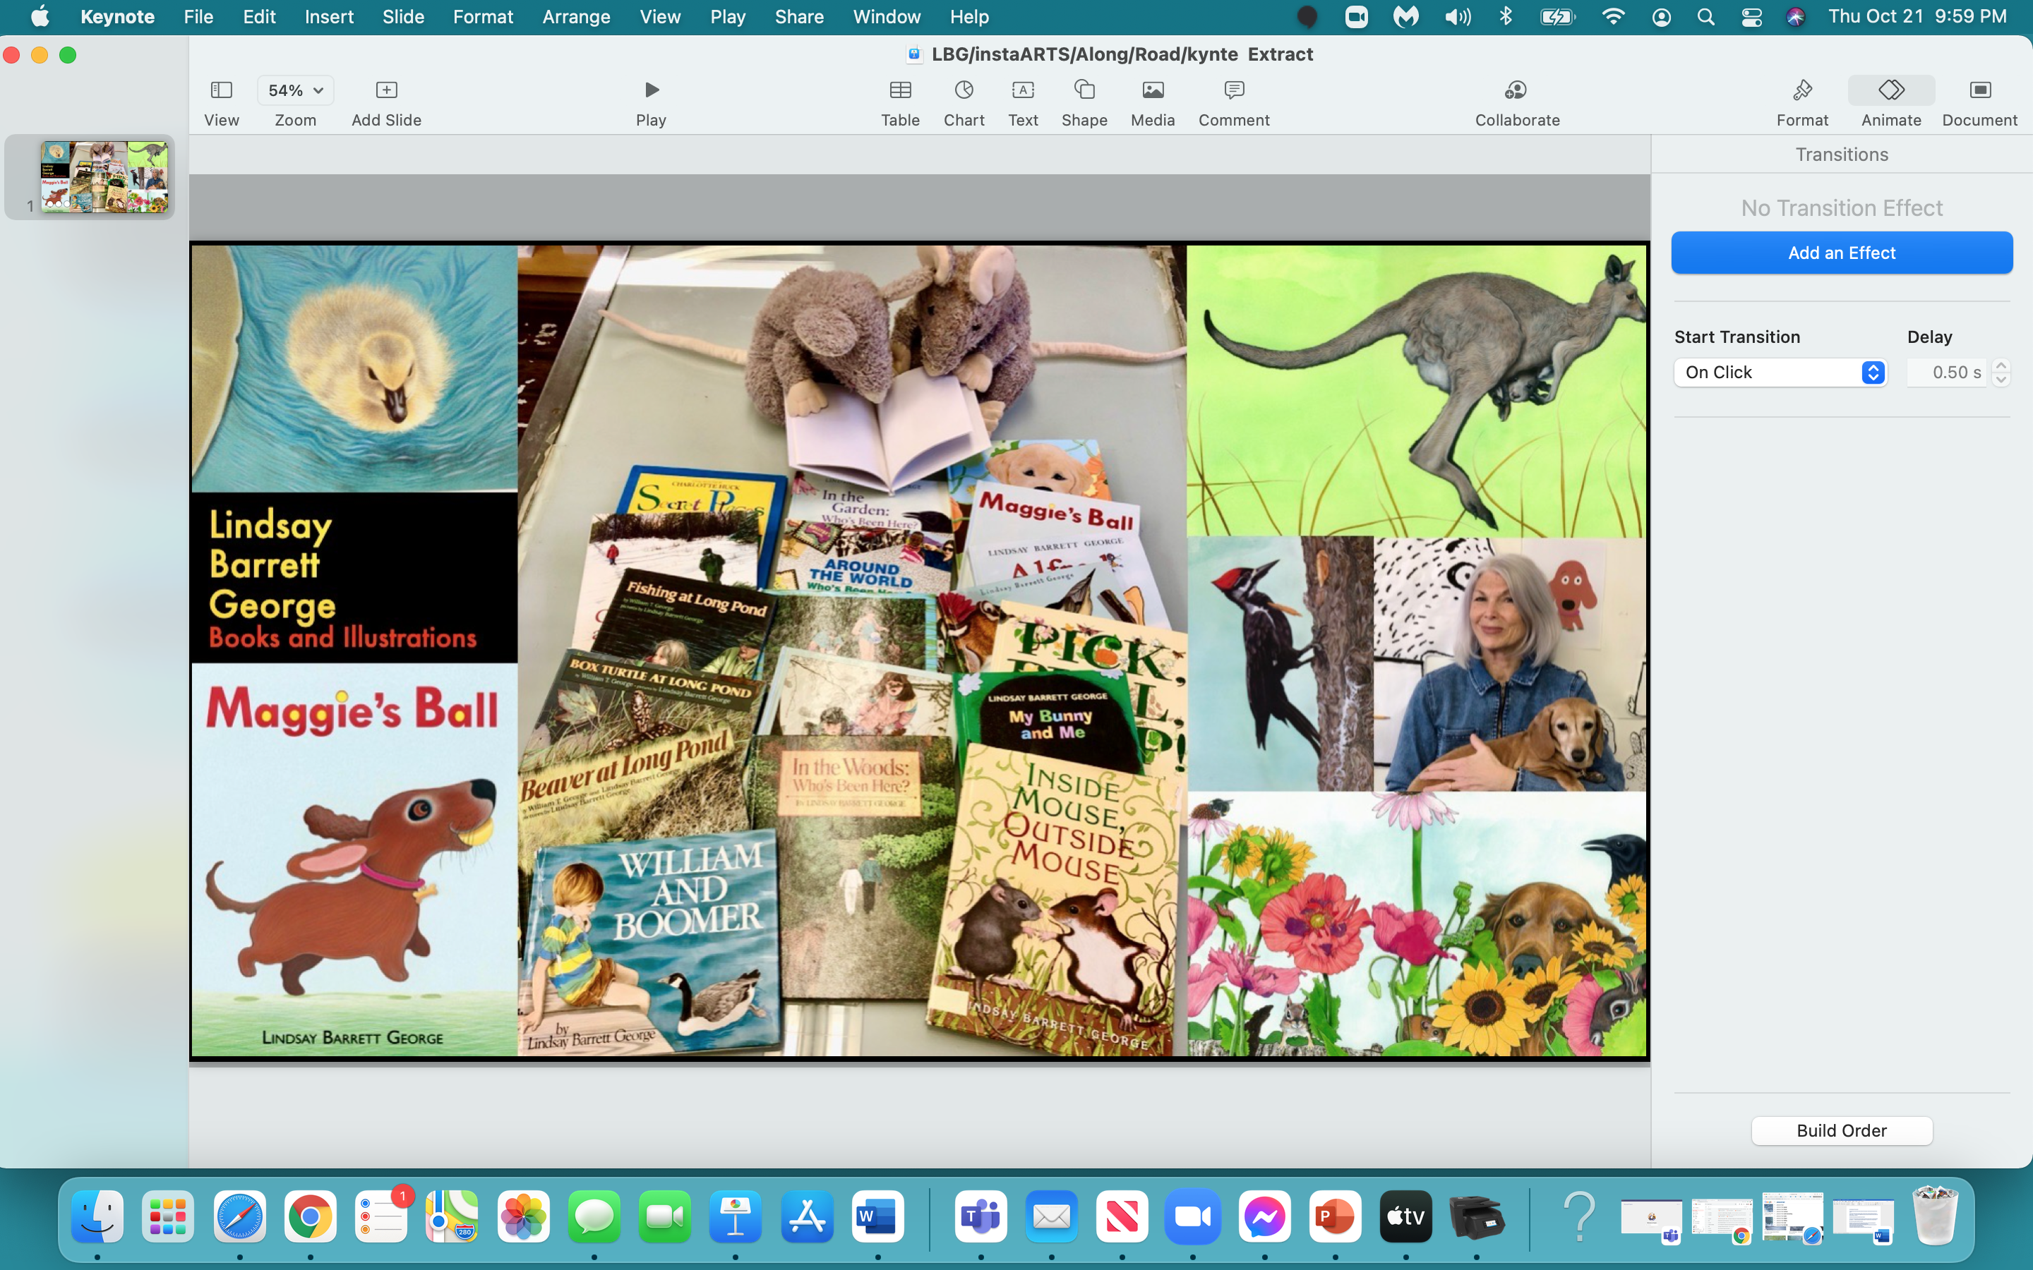

Slide 2
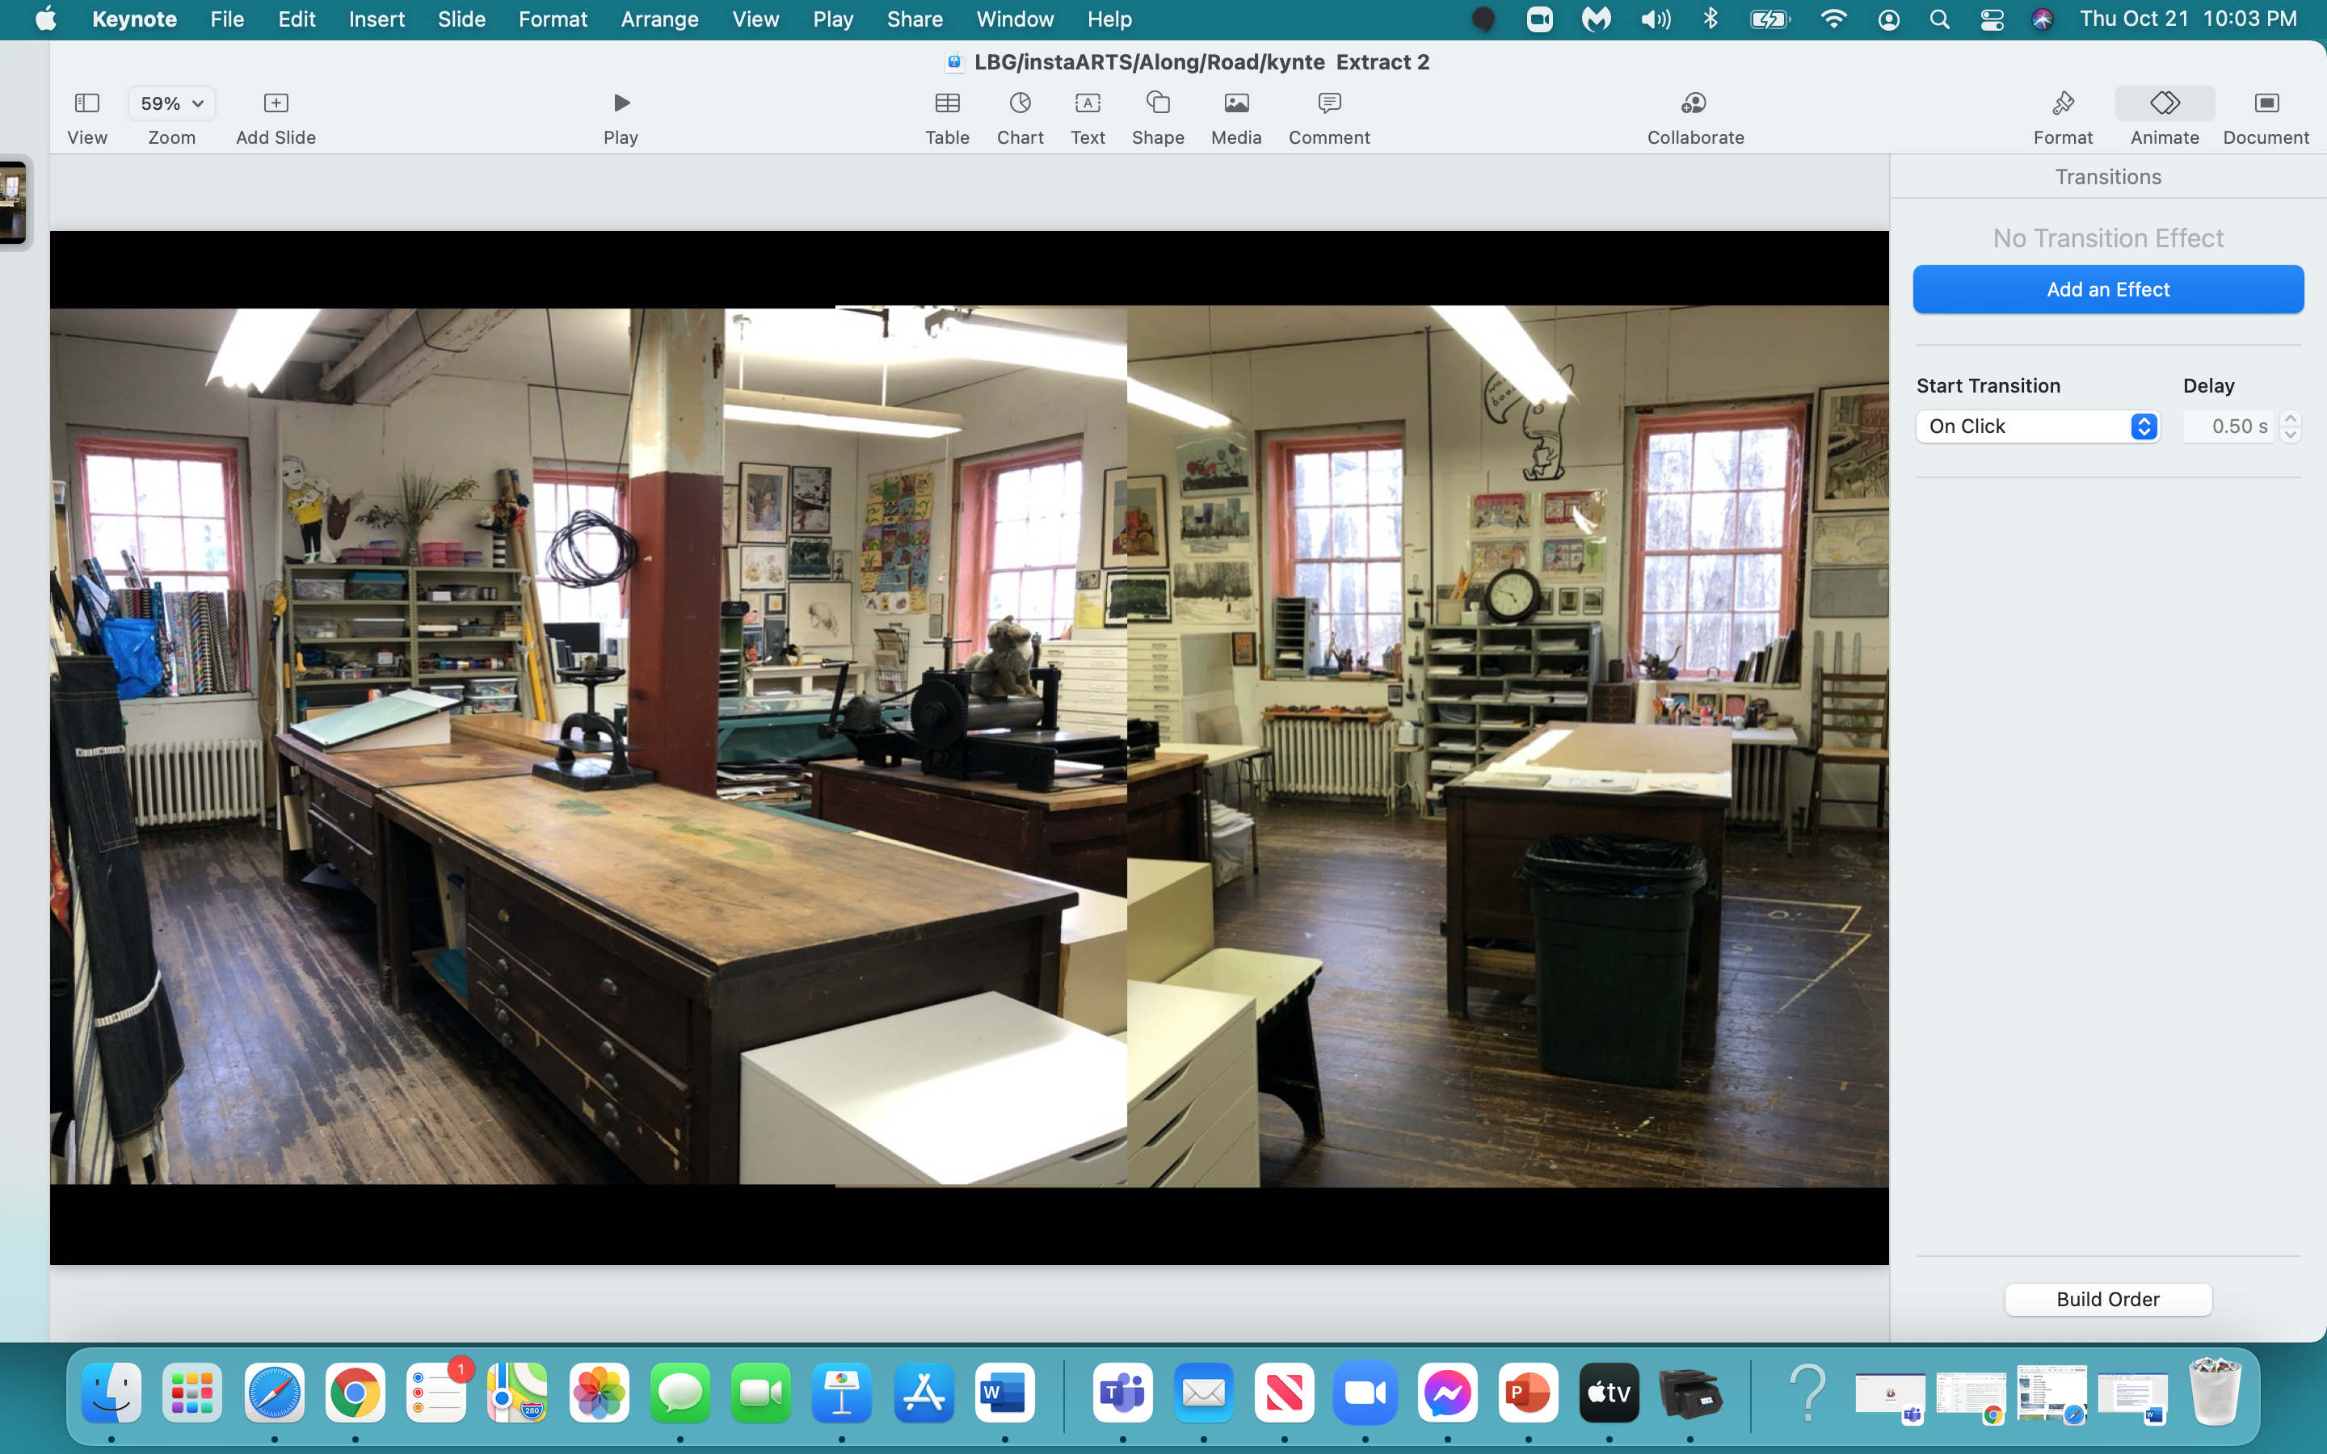

Slide 3


Slide 4
Where Is Every…
Body?

Slide 5


Slide 6
In the next hour, your BRAIN will:
understand the basic story ‘elements’ of ALL stories
develop a story with 4 sequential events
develop speaking and performing skills
recognize an ‘inciting incident’ in a story

Slide 7


Slide 8
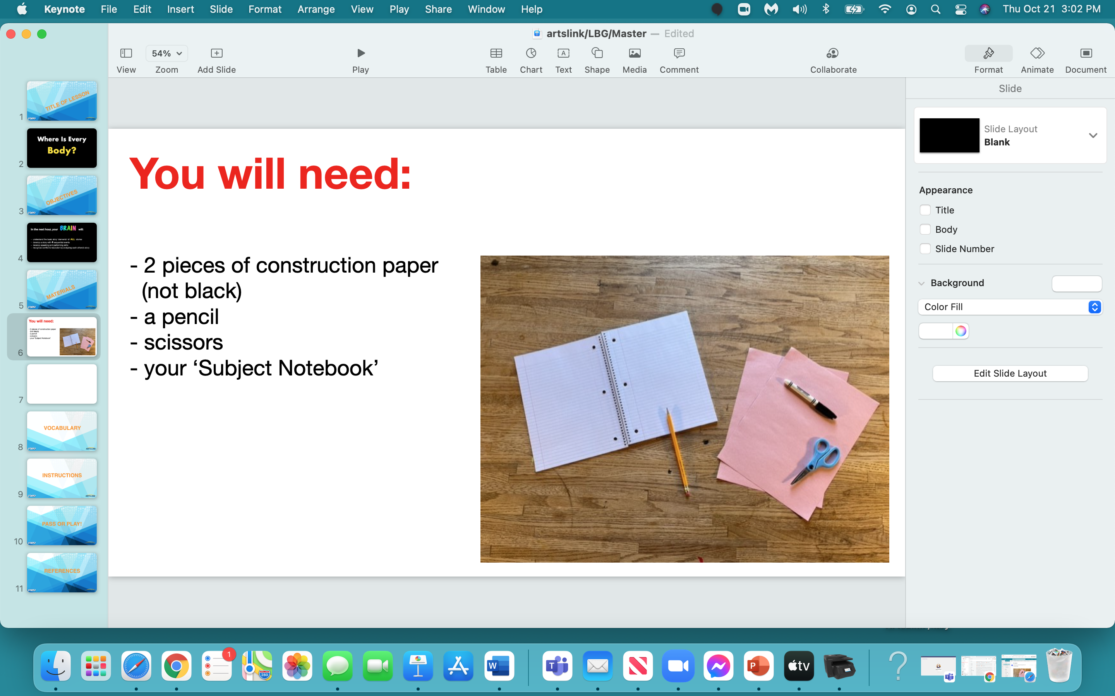

Slide 9
The Cut:
Please take one of your pieces of paper… and cut it in half.
Put one of the 1/2 sheets aside.
Cut the half of the sheet you’re keeping - in half…
cut those 2 pieces in half…
cut those 4 pieces in half…
cut those 8 pieces in half…
until you have 16 little pieces of paper.
Set these aside.

Slide 10
Before we do ANYTHING else,
we’re going to draw…
a story.

Slide 11
The ‘Story’

Slide 12
A review of what we just did:
-established the setting of our story
-established the characters in our story
-introduced the ‘inciting incident’ that changed the ‘status quo’
-moved characters in response to the ‘inciting incident’

Slide 13


Slide 14
story structure - beginning, middle & end
setting & characters
narrator
sequential
‘status quo’
‘inciting incident’…

Slide 15
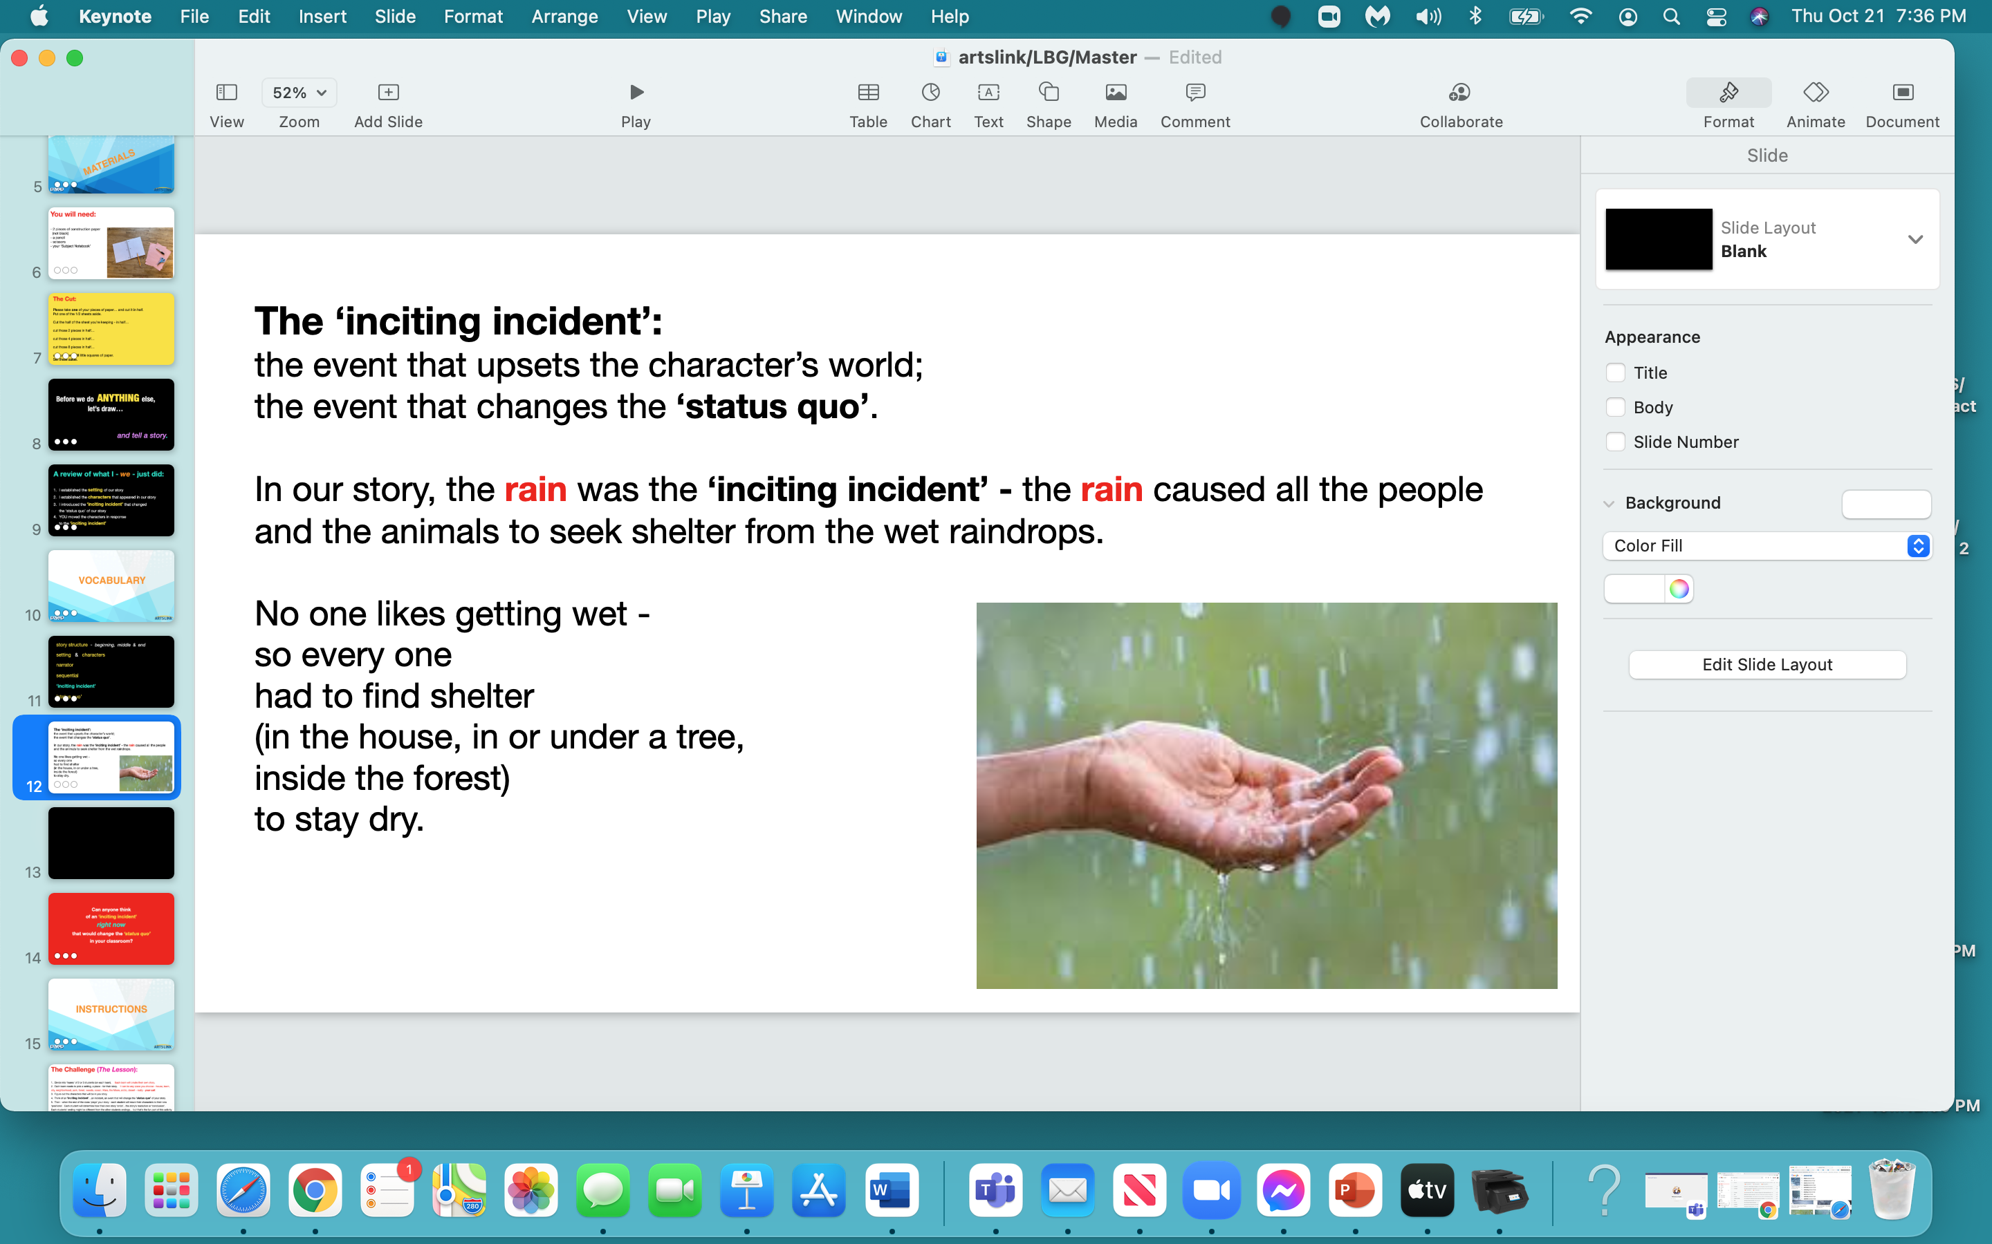

Slide 16
Can anyone think
of an ‘inciting incident’
right now
that would change the ‘status quo’
in your classroom?

Slide 17


Slide 18
The Challenge (or The Lesson):
1. Divide the class into ‘teams’. Each ‘team’ will create their own ‘story’.
2. Each ‘team’ needs to pick:
a setting, a place - for their ‘story’. It can be any place you choose - a house, a tree,
a town, a city, a neighborhood, a park, a forest, the woods, the ocean, Mars,
the arctic, the desert - your call.
3. Each team needs to pick:
the characters that will be in your ‘story’.
4. Each team needs to the think of:
an ‘inciting incident’ that will change the ‘status quo’ of your ‘story’ -
an event that will make the other team move the characters around the paper -
in response to the ‘inciting incident’.

Slide 19
The ‘Presenting Team’:
establishes setting
establishes the characters
introduces ‘inciting incident’
picks ‘narrator’
Other Teams:
- need 2 pieces of paper - cut up 16 little pieces, plus one ‘full’ sheet
- each member of the other team will play the game
- each person’s ending will be different…but that’s the FUN part!!!

Slide 20
After you ‘played the game’ -
after you drew your ‘story’ -
could you recognize the ‘inciting incident’
of the other team?
What did you think of it?
Did it work?
Was it effective?

Slide 21


Slide 22
OK - who wants to volunteer
ONE THING
that they learned today in this lesson,
in this project…
you can either PASS
or PLAY (SHARE)!

Slide 23


Slide 24
www.readwritethink.org 2006 NCTE/IRA
Charlip, Remy, “Where is Everybody?”, Scholastic Book Services, 1957, 1st Printing, USA
https://literacyideas.com
George, Lindsay Barrett Once Upon a Doodle - ‘storydraw’, 2016

