Slide 1
Visual Storytelling

Slide 2
OBJECTIVES
OF THIS LESSON

Slide 3
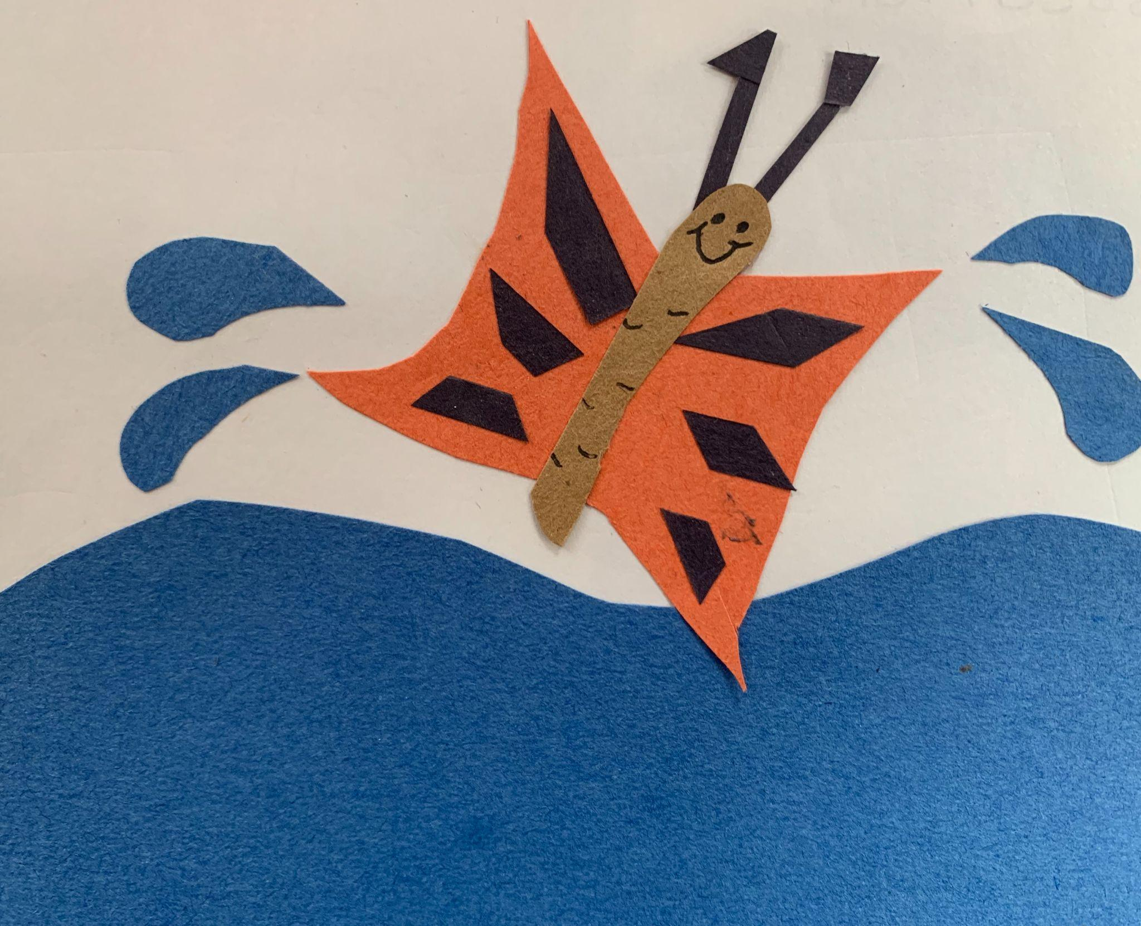
OBJECTIVES
Use the five senses
in our writing.
Finish our story panels.

Slide 4
MATERIALS
FOR THIS LESSON

Slide 5
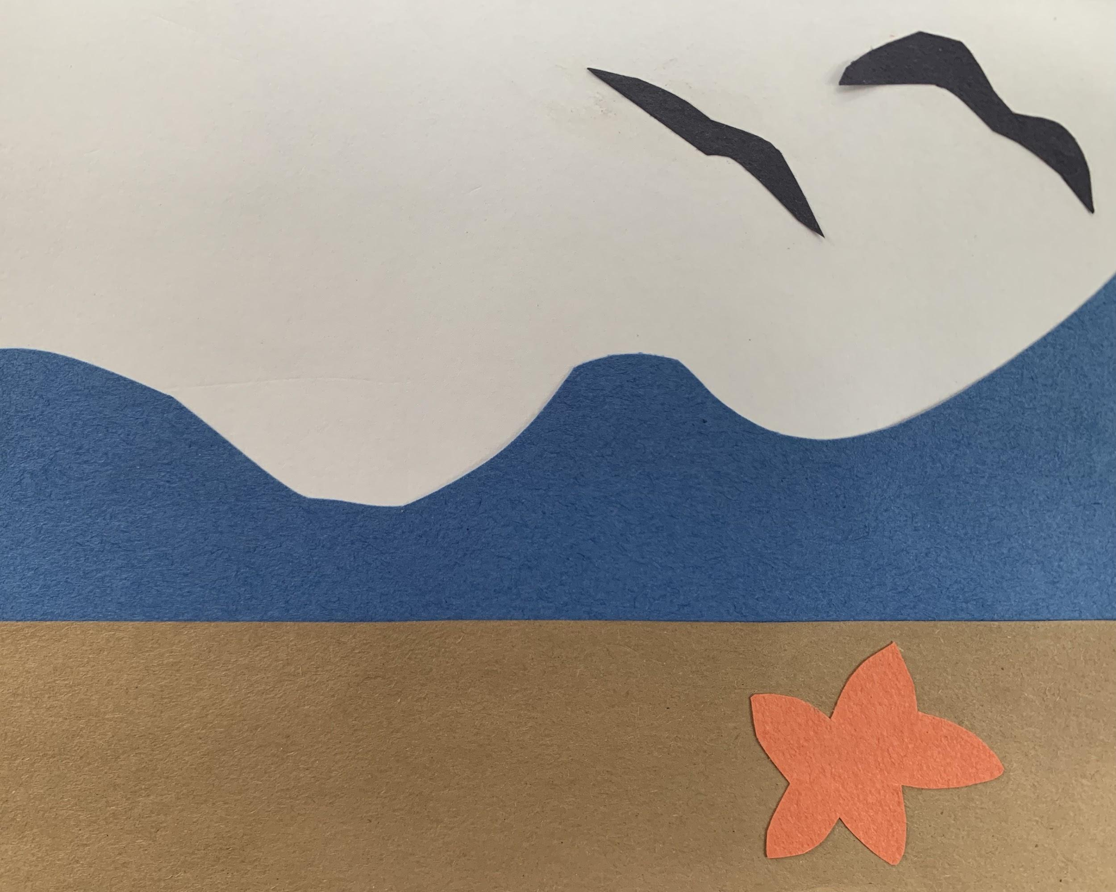
Your visual story panels
Scissors, construction paper, & glue stick
The rough draft of your story
Your imagination and attention

Slide 6
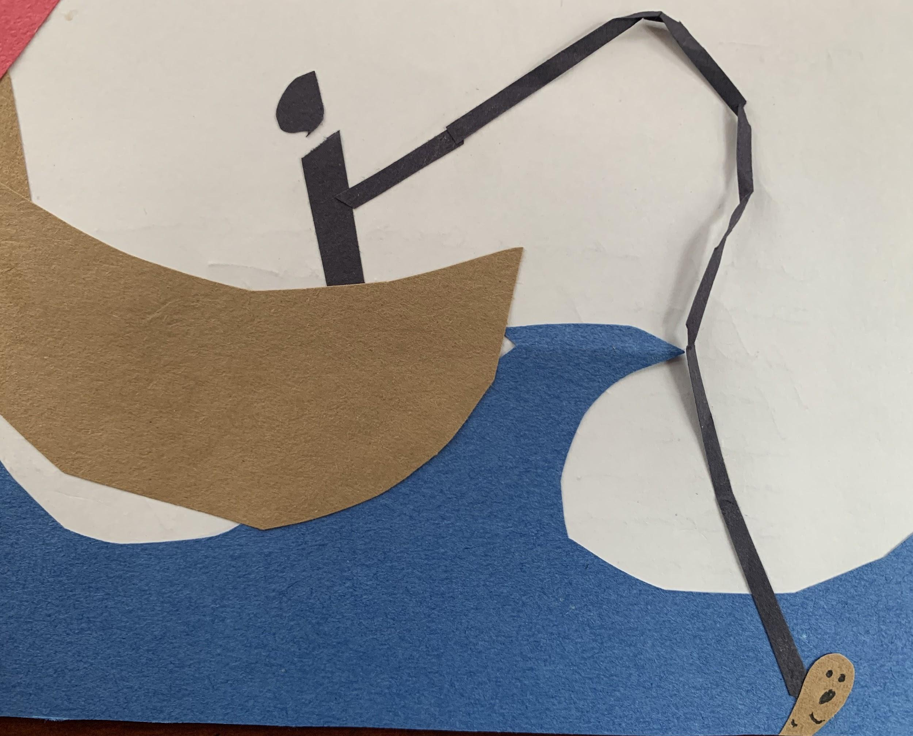
WARM UP
Notes:
Moving picture of one panel using body

Slide 7
VOCABULARY
REVIEW

Slide 8
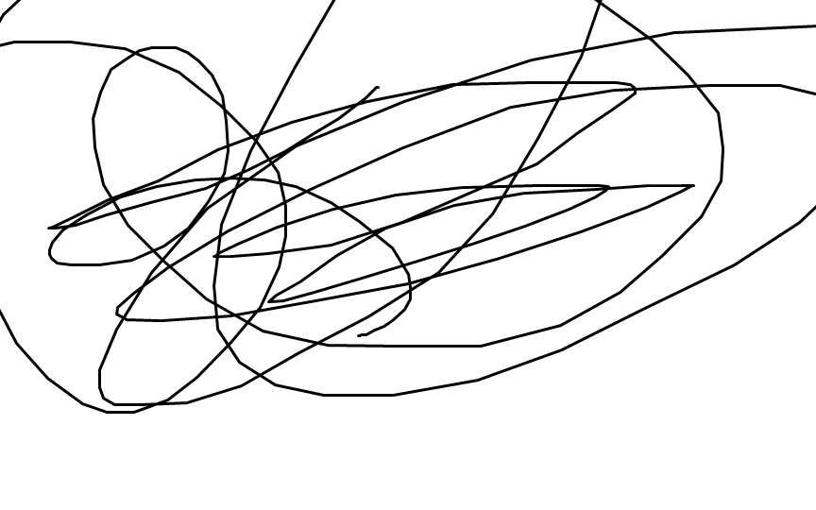
Rough Draft
a first version of something (such as a story) that needs a lot of editing and rewriting.
very rough draft
Notes:
Collaborate

Slide 9

Writing the Introduction to Your Story
Setting
Be descriptive. Use the five senses.
You can start with a sound, or describe how the setting looks.
The ocean waves sloshed and wooshed as the seagulls called overhead. It was a peaceful day at the ocean.
Notes:
Collaborate

Slide 10
Writing the Introduction to Your Story
Character
Be descriptive. Use the five senses.
Describe how the character looks, or what they are doing, or begin with a bit of dialogue.
“Bloop,” said Gus, the happiest fish in the ocean. It was Gus’ birthday, and he knew from the glittering ahead of him that a present was in store.
Notes:
Collaborate

Slide 11
Writing the Plot to Your Story
Be descriptive. Use the five senses.
What’s going on in the next part of your story? The plot shows us action. Describe what is happening.
Way above Gus on the surface of the water, a fisherman dangled a line from his boat. The line went deep into the water, and on the end of the line squirmed a very uncomfortable worm.
Notes:
Collaborate

Slide 12
Writing the Conflict to Your Story
Be descriptive. Use the five senses.
The conflict introduces a problem in the story. Show us what is happening with the problem by describing.
Wilma the worm knew she had more of a purpose than to dangle on a line. She had dreams of becoming something beautiful. But this wasn’t her best day. She was underwater, on a hook, and what was that up ahead … a fish mouth?
Notes:
Collaborate

Slide 13
Writing the Resolution to Your Story
Be descriptive. Use the five senses.
This is where the story ends, or resolves. Show us how the problem is solved.
Wilma had to think fast. The fish mouth loomed ahead, looking hungrier and hungrier. Wilma felt a tickle at her back, and then another. She wiggled off the hook. Colorful wings sprouted from her back and carried her up out of the water and into the clear, blue sky. She was a butterfly!
Notes:
Collaborate

Slide 14
Let’s Write!
Complete your rough draft.
Then, on the back of each of your visual story panels, write your story:
setting
character
plot
conflict
resolution
Notes:
Collaborate

Slide 15
Story Sharing/Reflection
Share your story with a partner.
Ask your partner:
What was their favorite part?
What description stood out for them?
Did your work show all the parts of the story?

Slide 16
REFERENCES

Slide 17
REFERENCES
Animation: giphy.com

