Slide 1
Story Sharing

Slide 2
OBJECTIVES
OF THIS LESSON

Slide 3
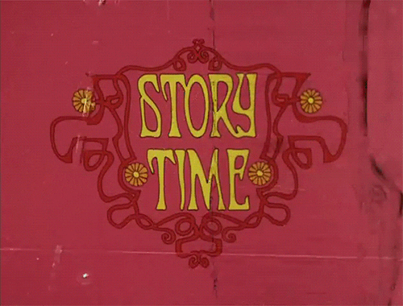
OBJECTIVES
Share our stories with a partner
Create a game with our stories

Slide 4
MATERIALS
FOR THIS LESSON

Slide 5
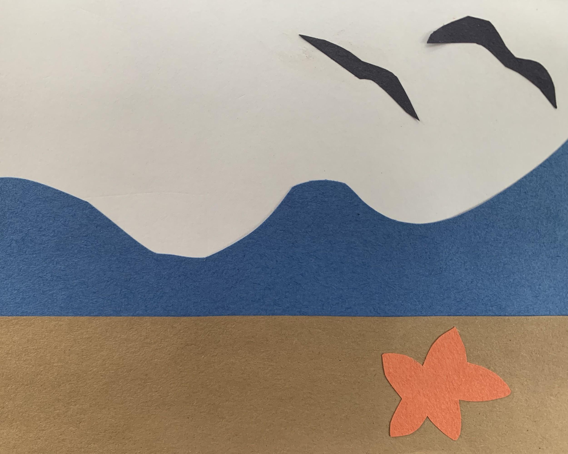
Your visual story panels
Your imagination and attention
Your active listening skills

Slide 6
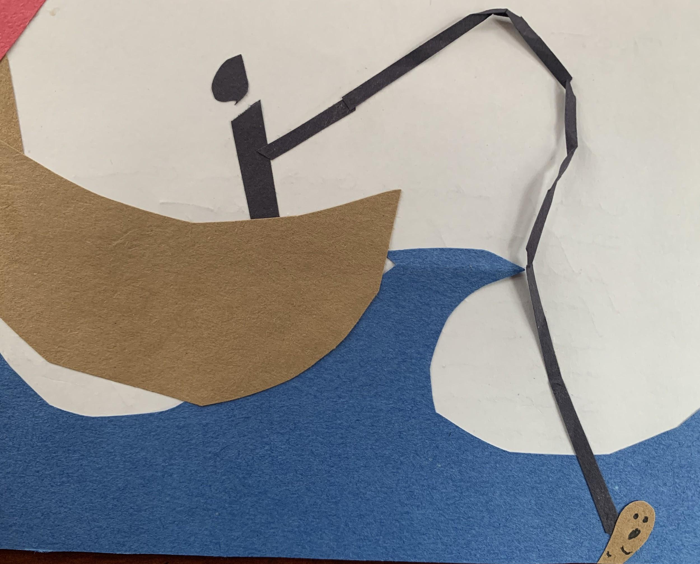
WARM UP
Notes:
Swap a panel with a partner. What happens to your story when you do this?

Slide 7
VOCABULARY REVIEW

Slide 8

VOCABULARY
Active Listening
Fully concentrating on what is being said. You listen with all of your senses and give your full attention to the person speaking.
Notes:
Collaborate

Slide 9
Story Sharing/Reflection
Share your story with a partner.
Ask your partner:
What was their favorite part?
What description stood out for them? Did your work show all the parts of the story?

Slide 10
Let’s Play!
Swap a panel from your story panel with your partner. Decide together which part of the story you are going to swap:
setting
character
plot
conflict
resolution
What new story is created?
Notes:
Collaborate

Slide 11
REFERENCES

Slide 12
REFERENCES
Animation: giphy.com, Story Time, Terry Gilliam

