Slide 1
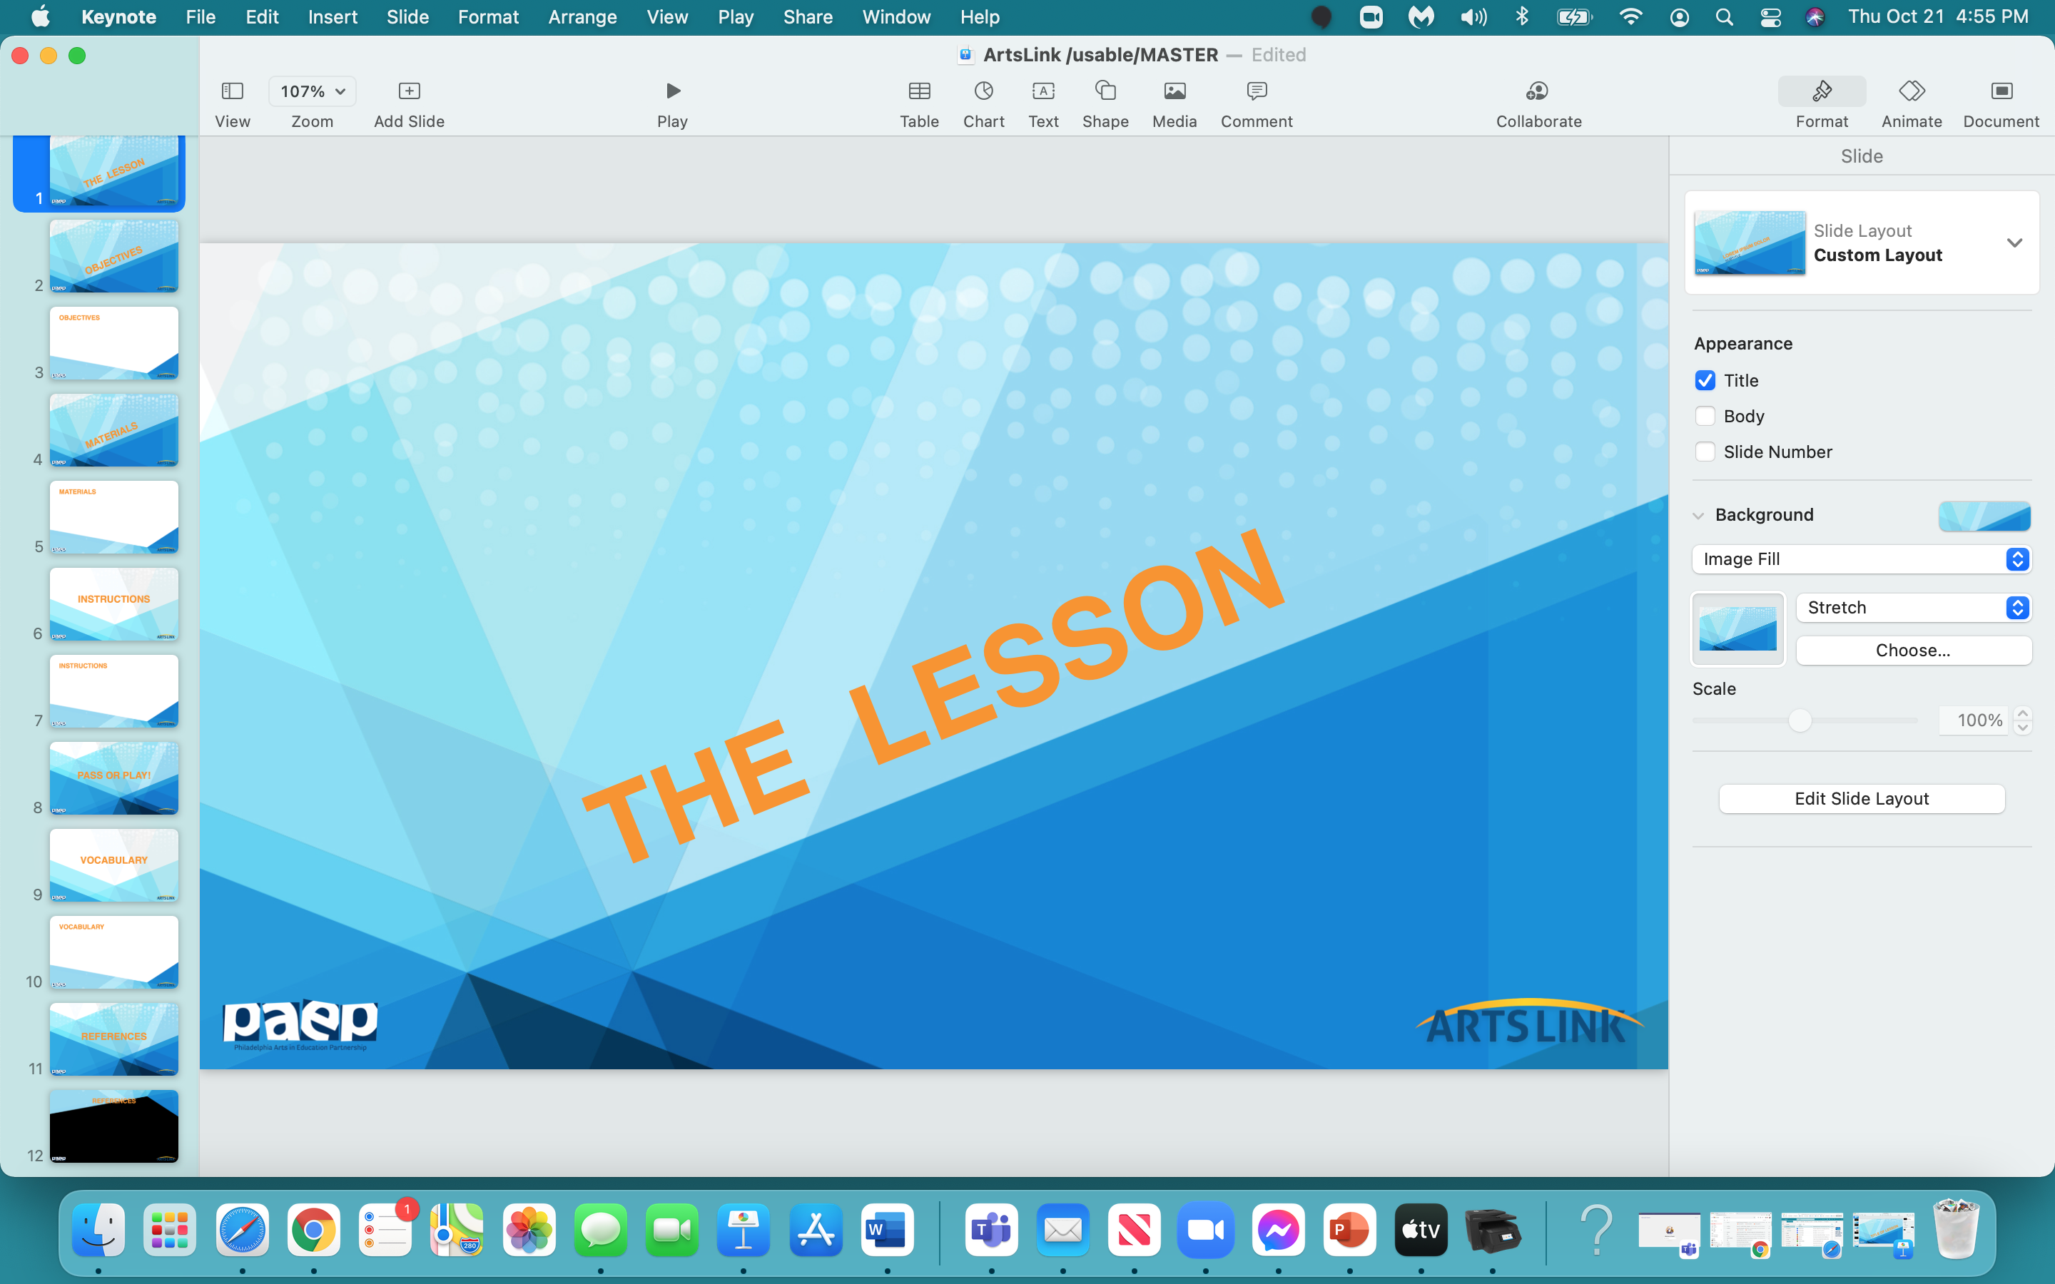

Slide 2
ALONG OUR LONG ROAD

Slide 3
Let’s read the book -

Slide 4


Slide 5
In the next hour, you will:
start to collaboratively design and illustrate a group book
draw a ‘continuous line’ across all the pages in the collaborative book
understand that your experiences will influence what & how you illustrate your page
understand the role of visual storytelling in a book format

Slide 6


Slide 7
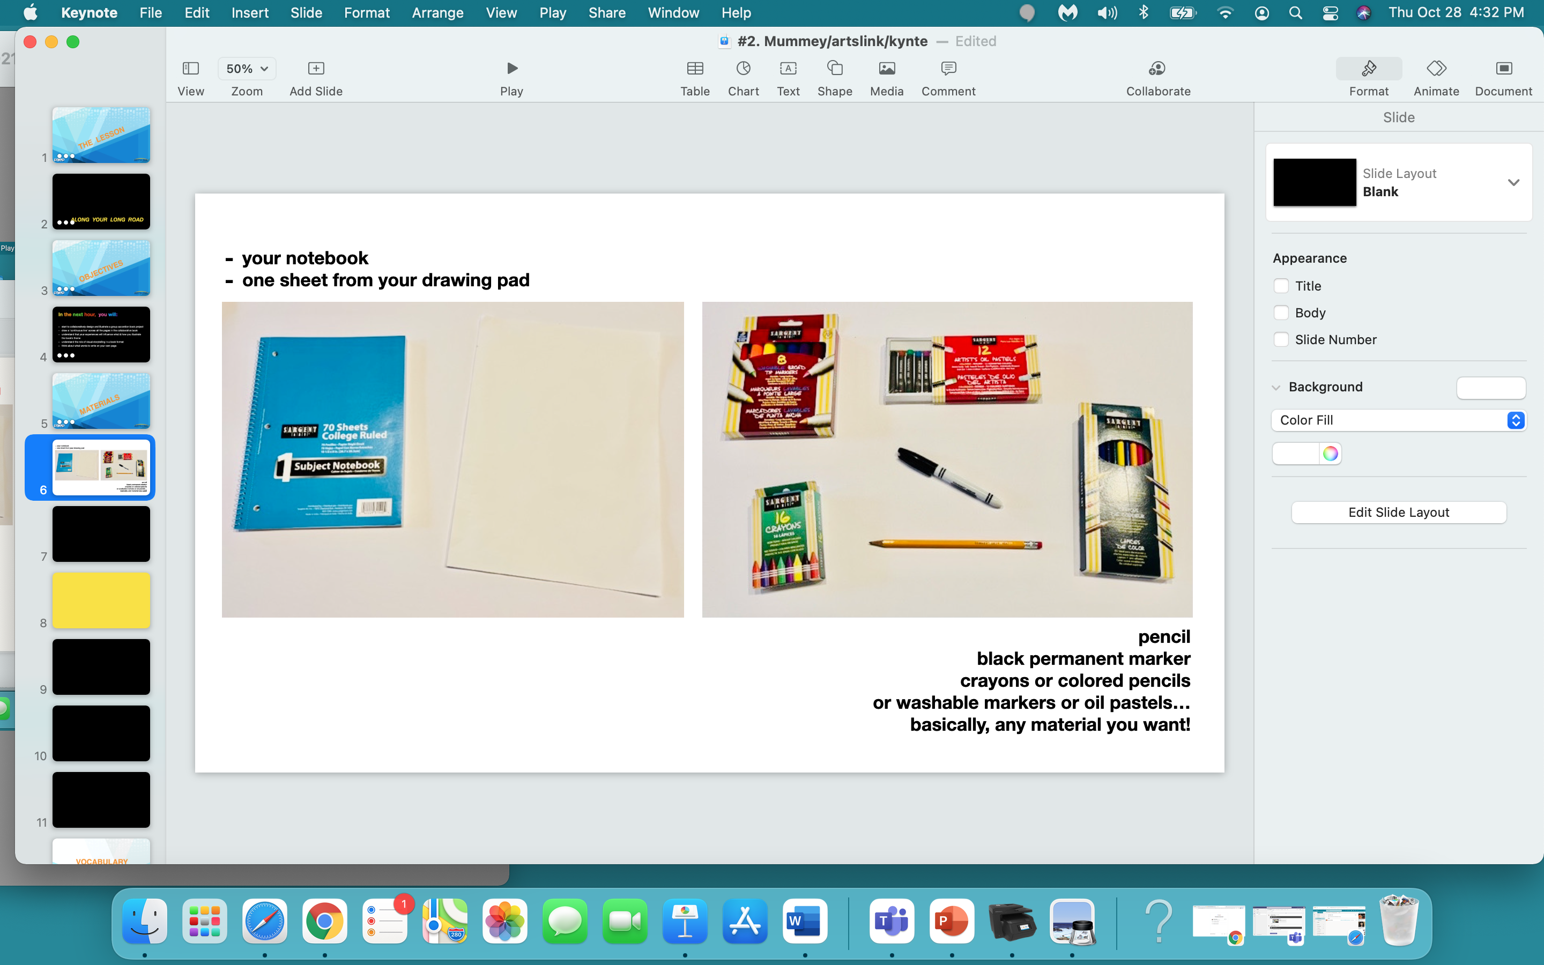

Slide 8
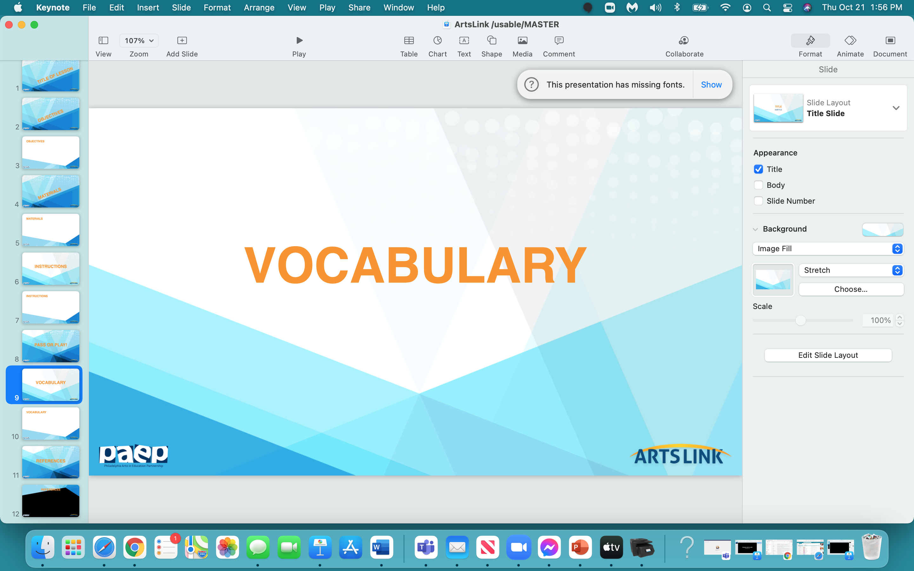

Slide 9
book
collaboration
‘continuous line’
illustrate
text

Slide 10
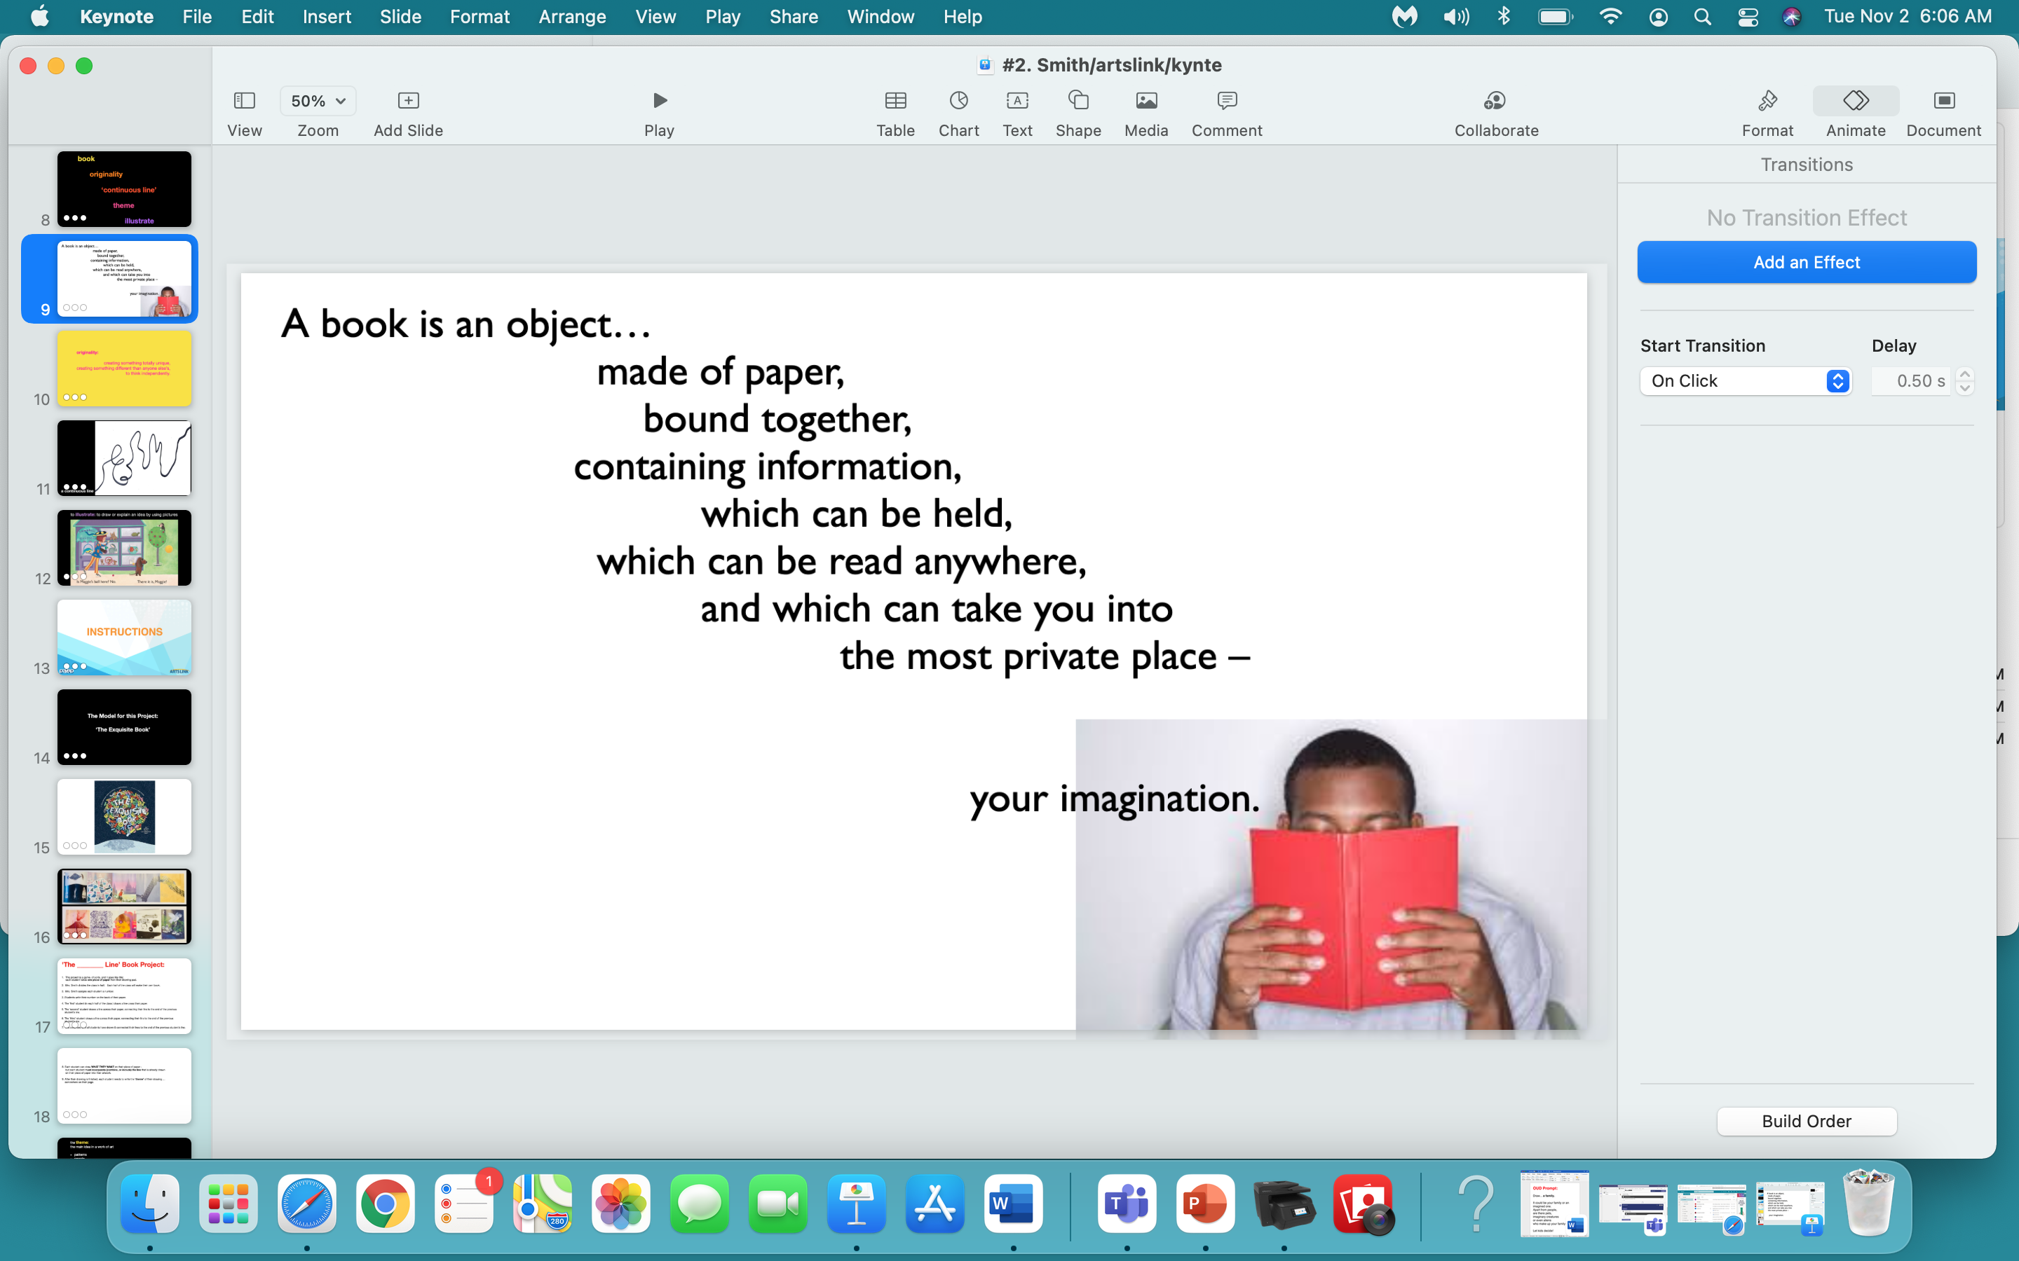

Slide 11
collaboration:
working with someone else
to produce or create something…
as in - working together
as a class
to create a class book.

Slide 12
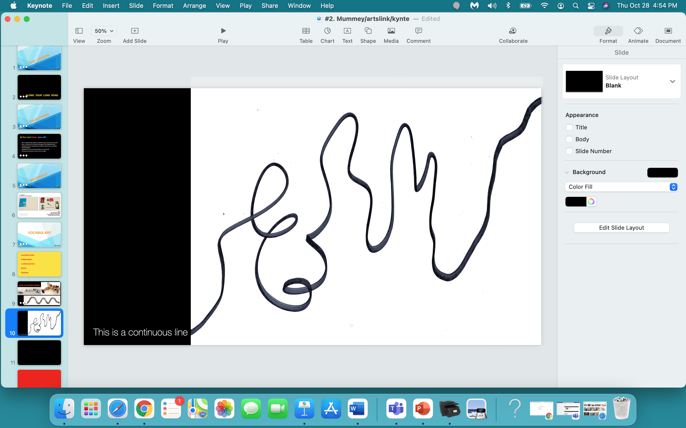

Slide 13
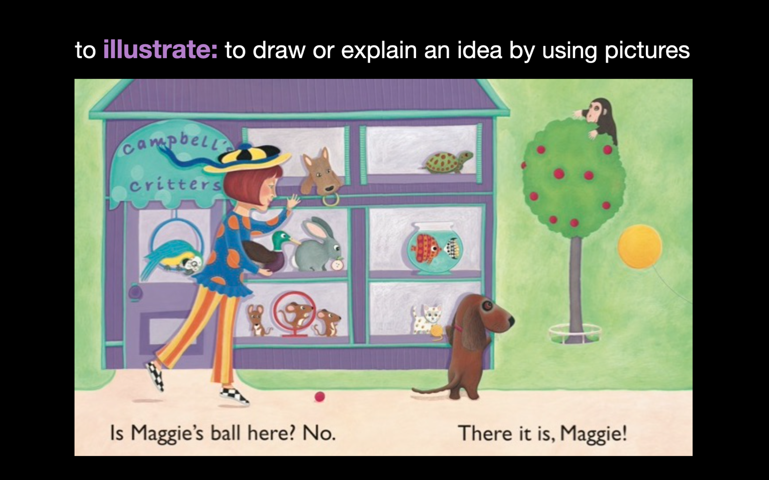

Slide 14
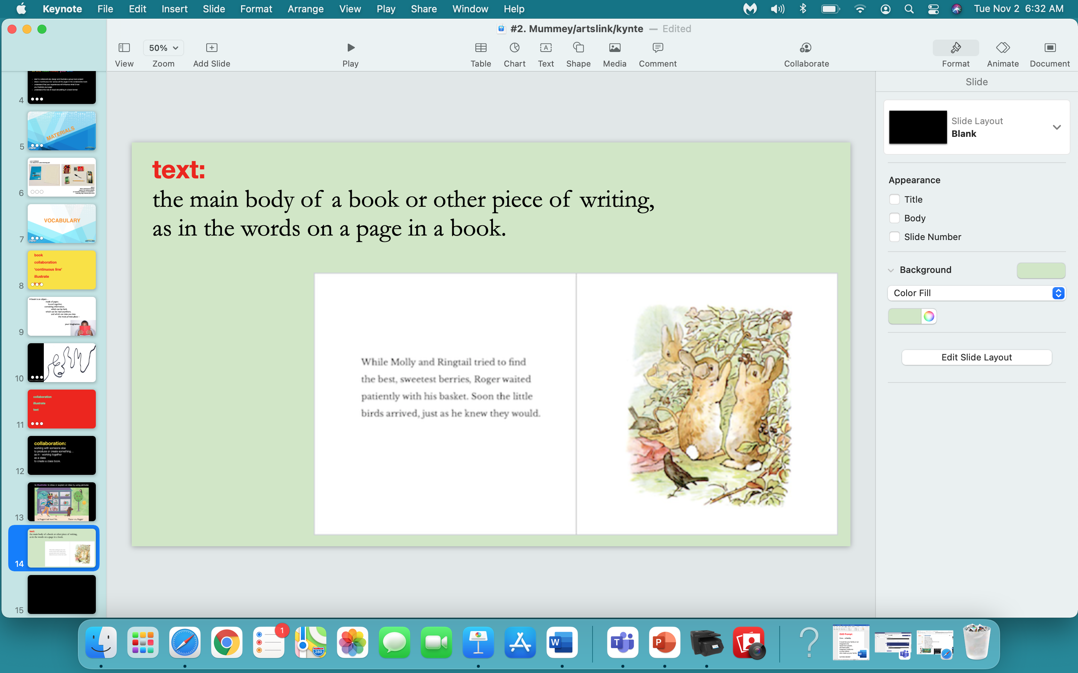

Slide 15
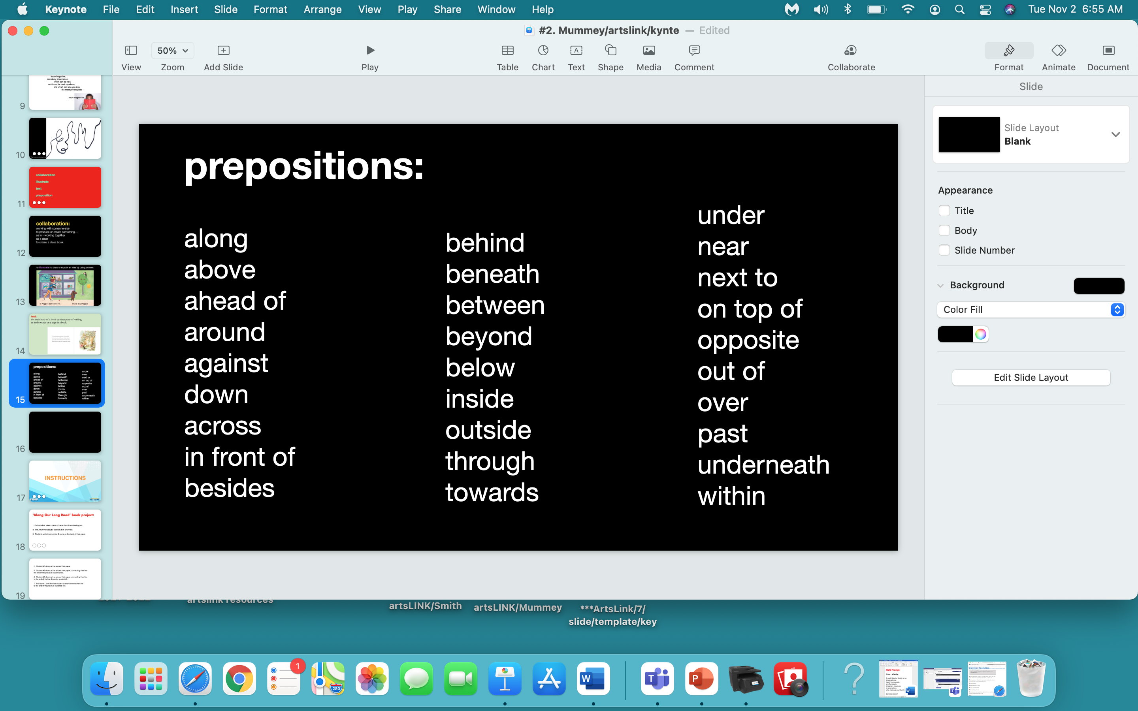

Slide 16
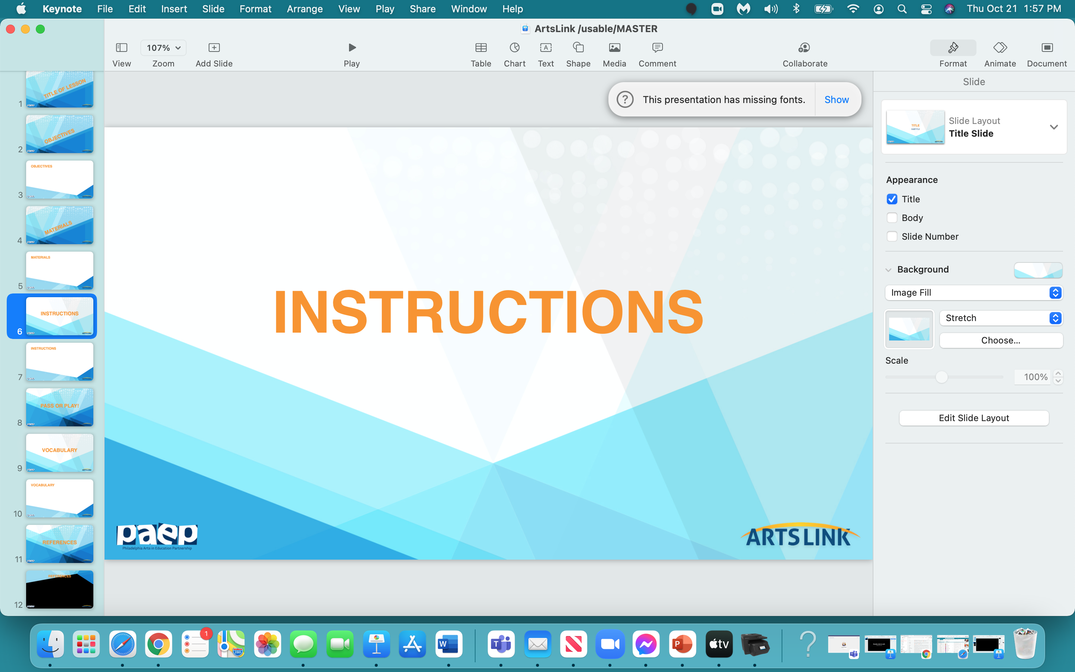

Slide 17
‘Along Our Long Road’ book project:
Each student takes a piece of paper from their drawing pad.
2. Mrs. Mummey assigns each student a number.
3. Students write their number & name on the back of their paper.

Slide 18
4. Student #1 draws a line across their paper.
5. Student #2 draws a line across their paper, connecting their line to
the end of the previous student’s line.
6. Student #3 draws a line across their paper, connecting their line
to the end of the line drawn by student #2.
7. And so on…until the last student draws/connects their line
to the end of the previous student’s line.

Slide 19
8. The class discusses and chooses a theme for the book -
for example…
a journey through the city, around the neighborhood,
around the school, through an imaginary place, through outer space, etc…
9. The line you all drew across your page - becomes a road though your book.
10. You all need to decide who is riding, walking, driving, through your book -
and this person - this walker, the driver, this rider - will appear
on every page in the book.

Slide 20
11. Each student draws a picture of something ‘seen’ along the road.
Students need to discuss what they’re going to draw,
so that there aren’t duplicates of the same building, park,
river, stream, etc.
10. Again - students can use any art material…except watercolors.
We’ll save the watercolors for another project.
11. Each student will be writing a phrase, some ‘text’, on their drawing,
so leave a space where you think the text, the ‘words’ will ‘go’.
You can write this phrase on a separate piece of paper
and glue it onto your artwork later.

Slide 21
So - ‘teams’ need to:
establish the setting of their book
establish the character who will be travelling along the road through the book
how will the traveller get through the book?
  - walking
  - riding
  - driving

Slide 22
Ok - questions?

Slide 23
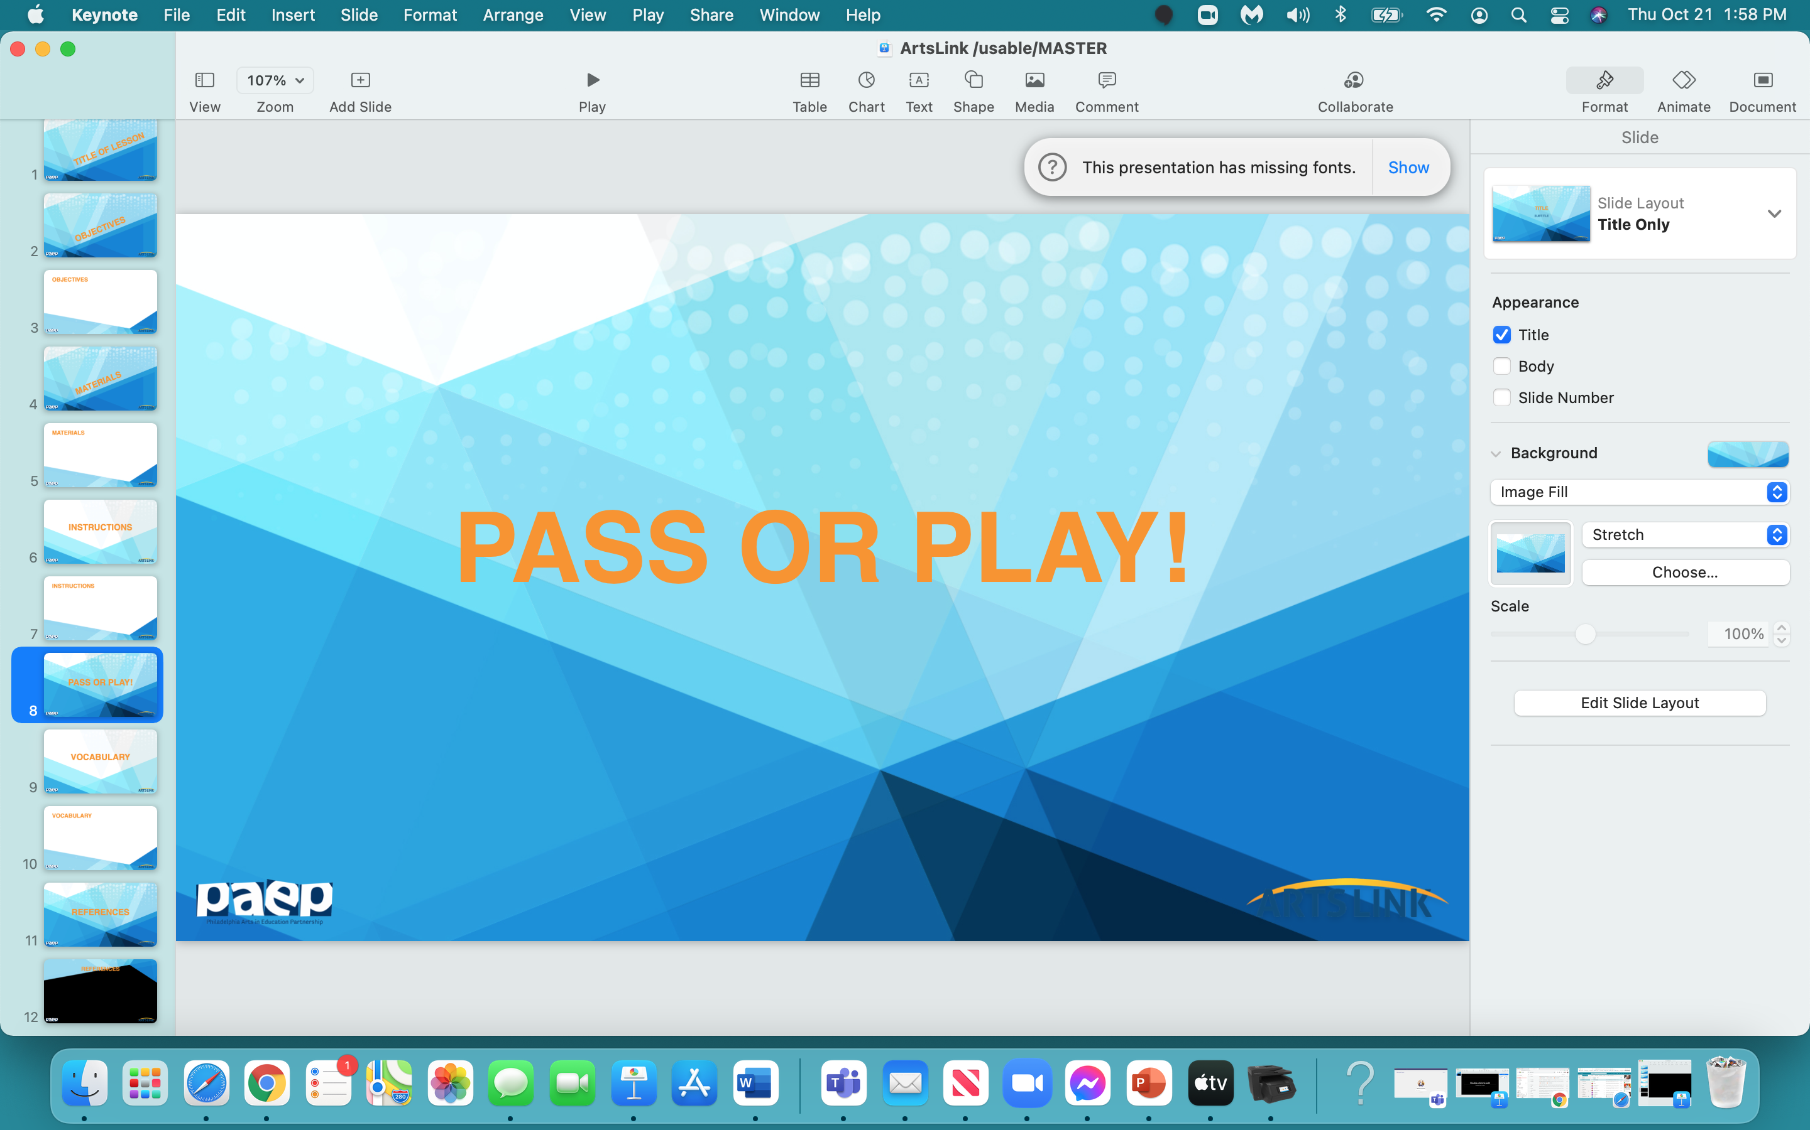

Slide 24
OK - who wants to volunteer
ONE THING
that they learned today in this lesson,
in this project…
you can either PASS
or PLAY (SHARE)!

Slide 25
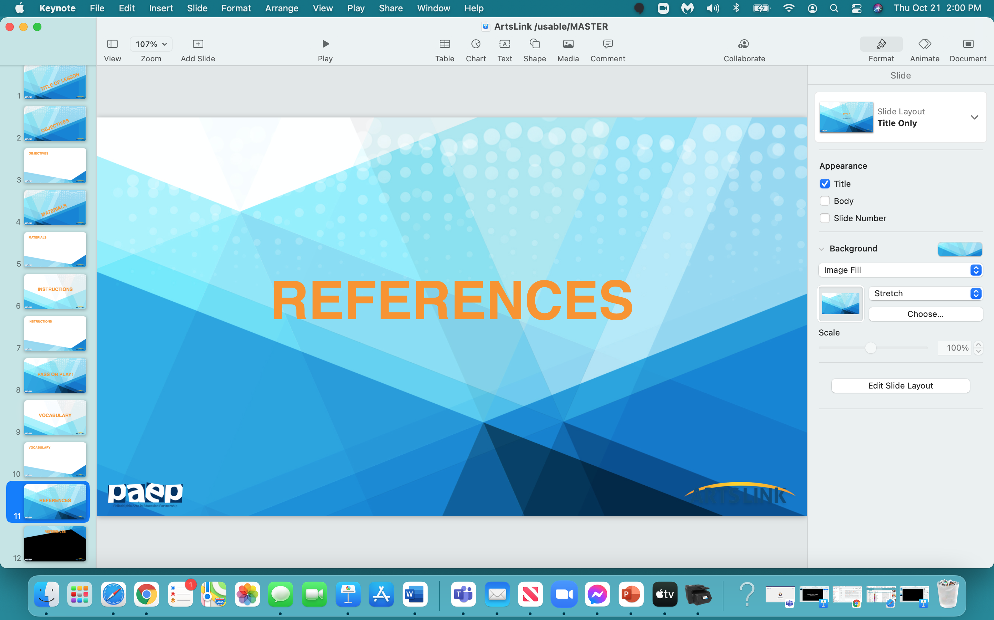

Slide 26
‘Along A Long Road’, Viva, Frank, 2011, Little, Brown and Company, New York, NY
www.theimaginaryshop.com
www.riverpublishers.com
lib.utah.edu/collections/book-arts/community/accordion
www.scholastic.com
www.materialsforthearts.org collaboratively pick a ‘theme’ for your book project

