Slide 1
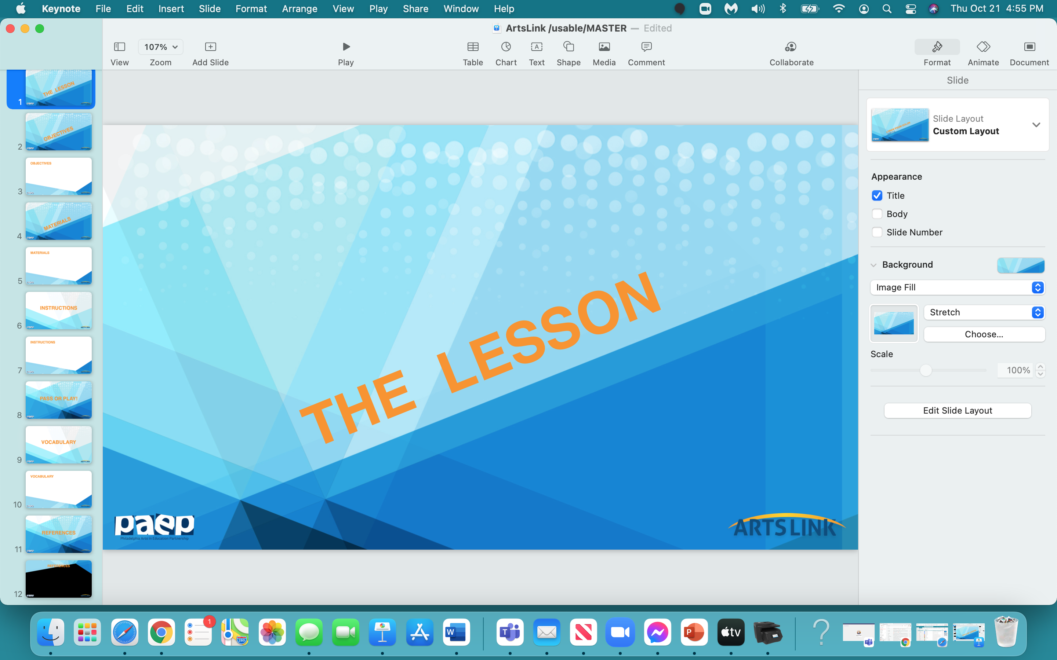

Slide 2
THE ____________ LINE

Slide 3


Slide 4
In the next hour, you will be able to:
understand & collaboratively start the class book project
collaboratively ‘paginate’ the book
understand that your experiences will influence what & how you illustrate your page
understand the concept of ‘illustration’

Slide 5


Slide 6
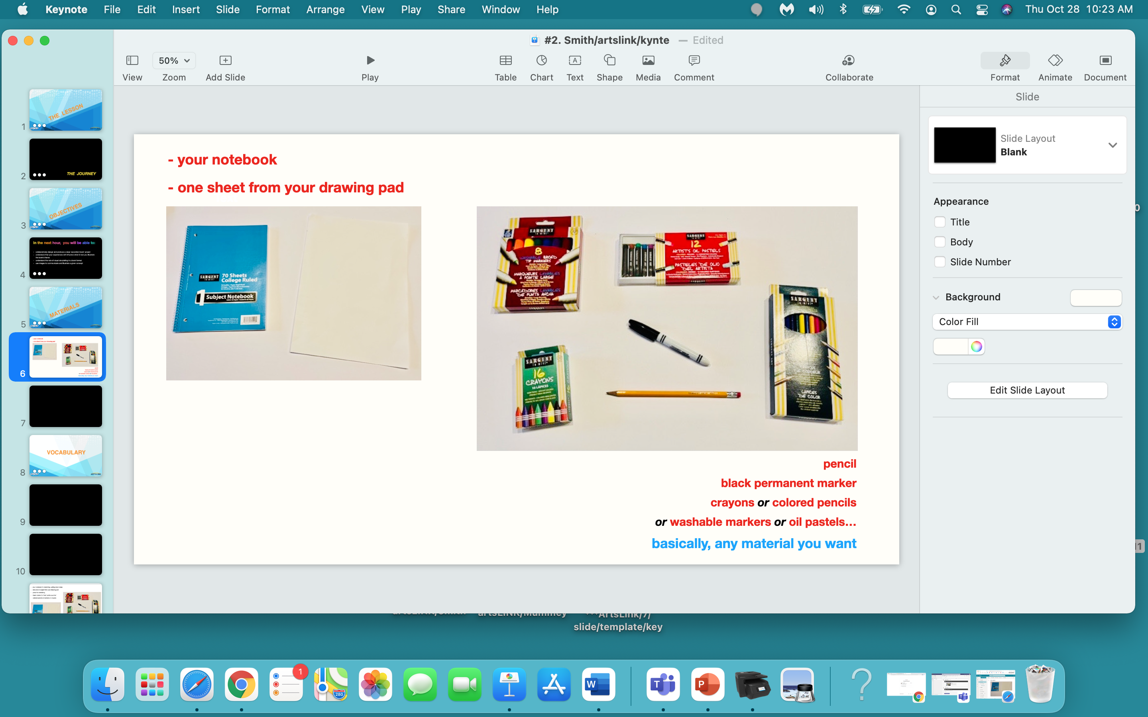

Slide 7
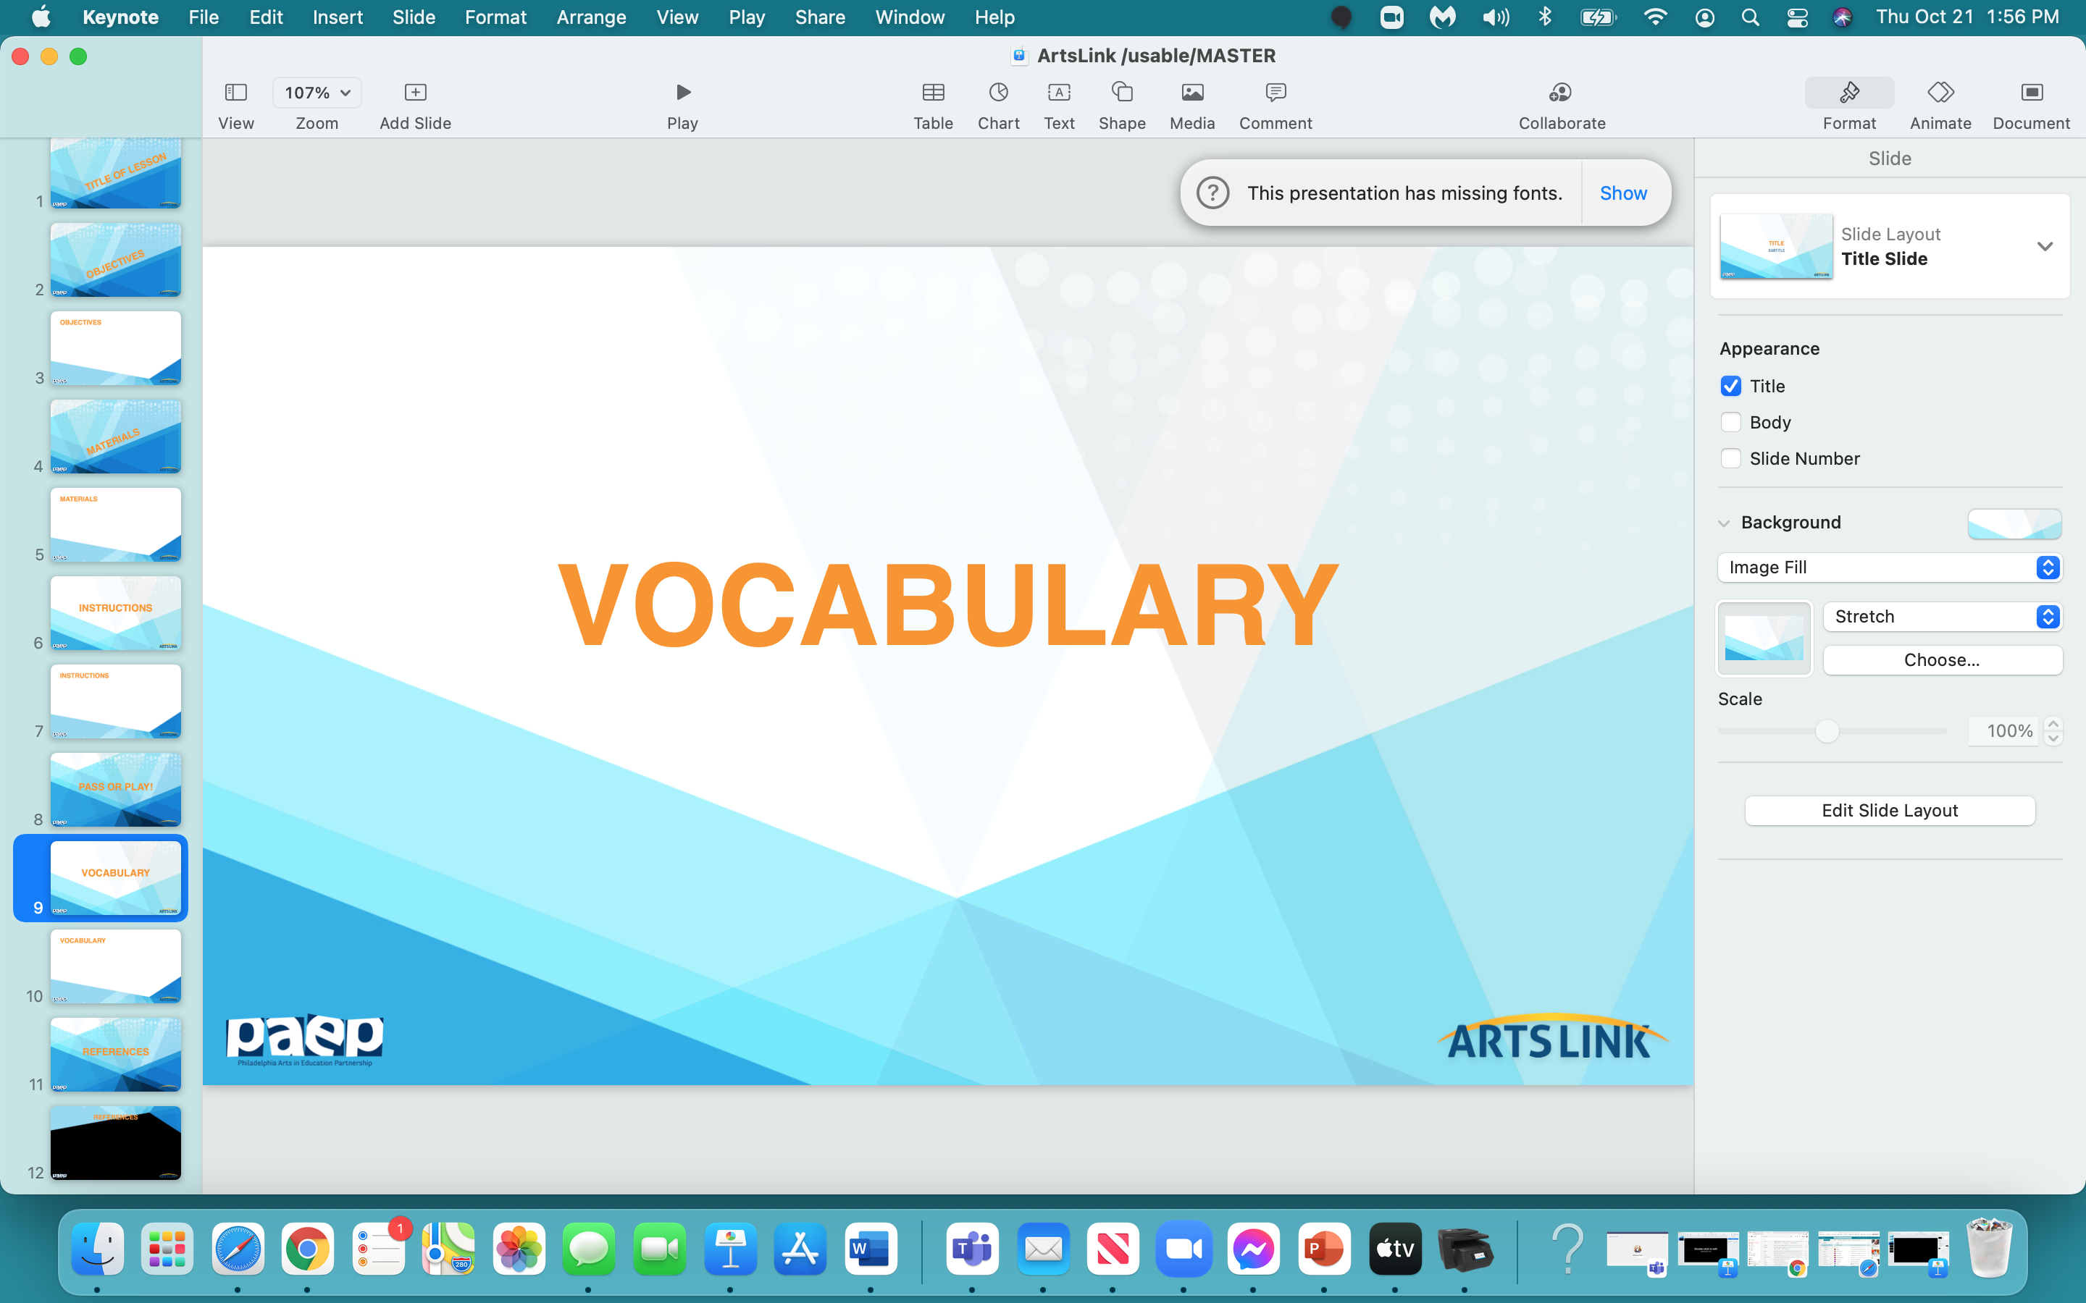

Slide 8
book
originality
‘continuous line’
theme
illustrate

Slide 9
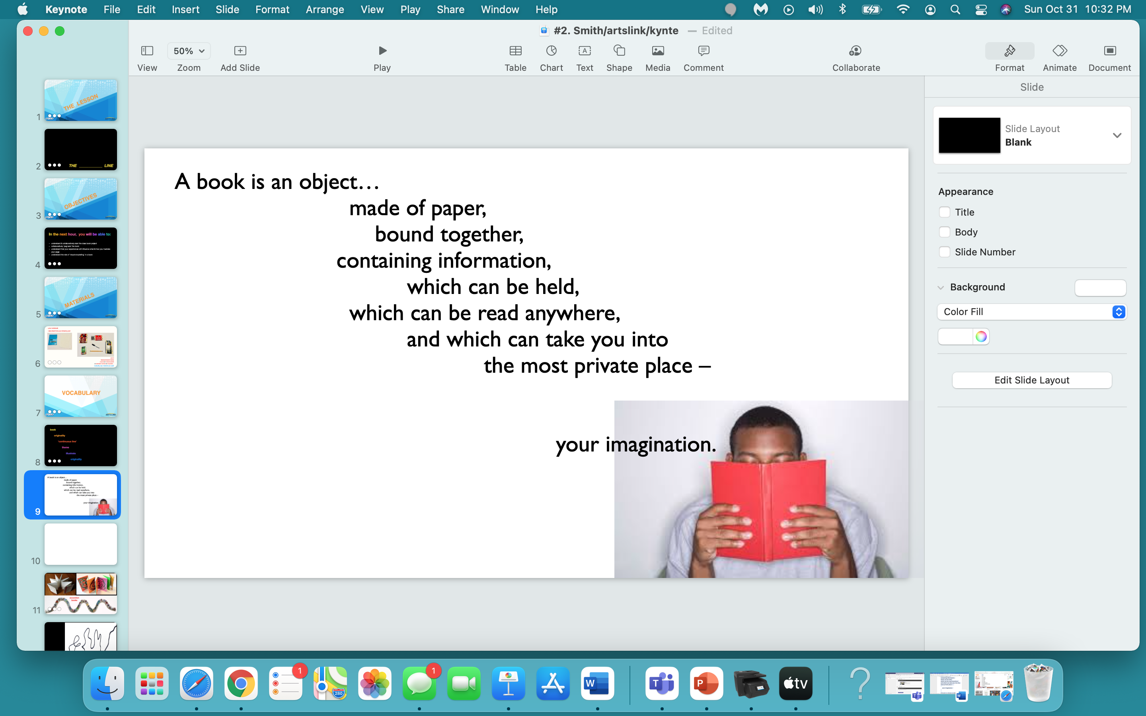

Slide 10
originality:
creating something totally unique,
creating something different than anyone else’s,
to think independently.

Slide 11
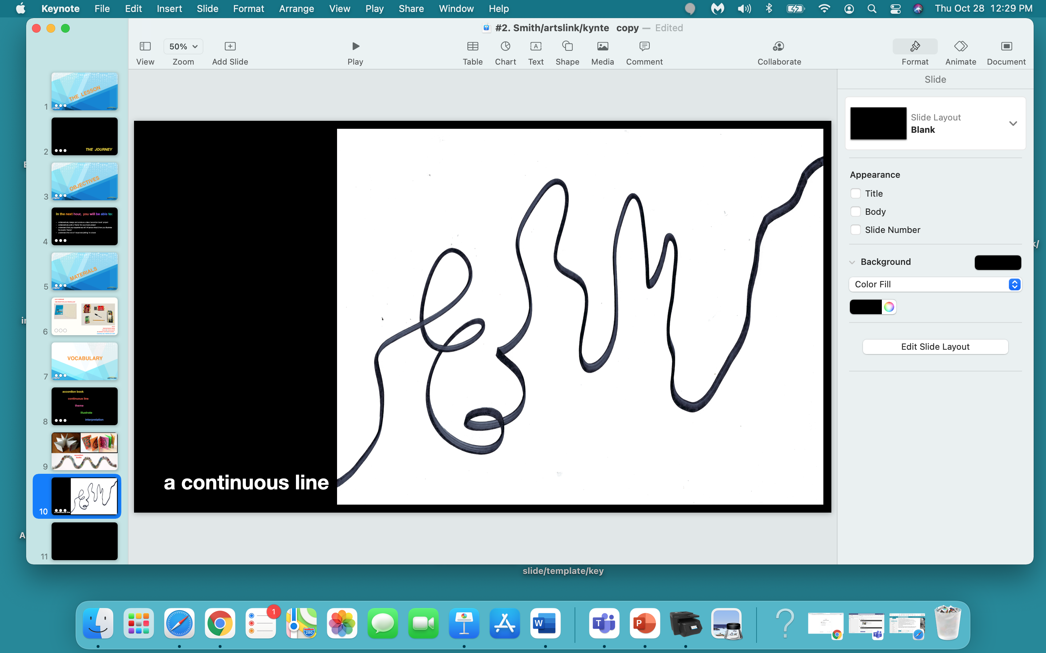

Slide 12
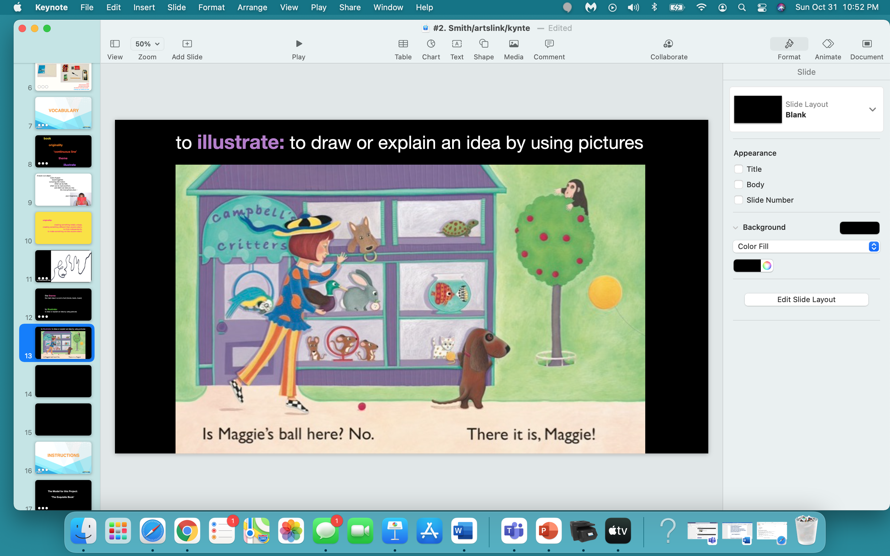

Slide 13
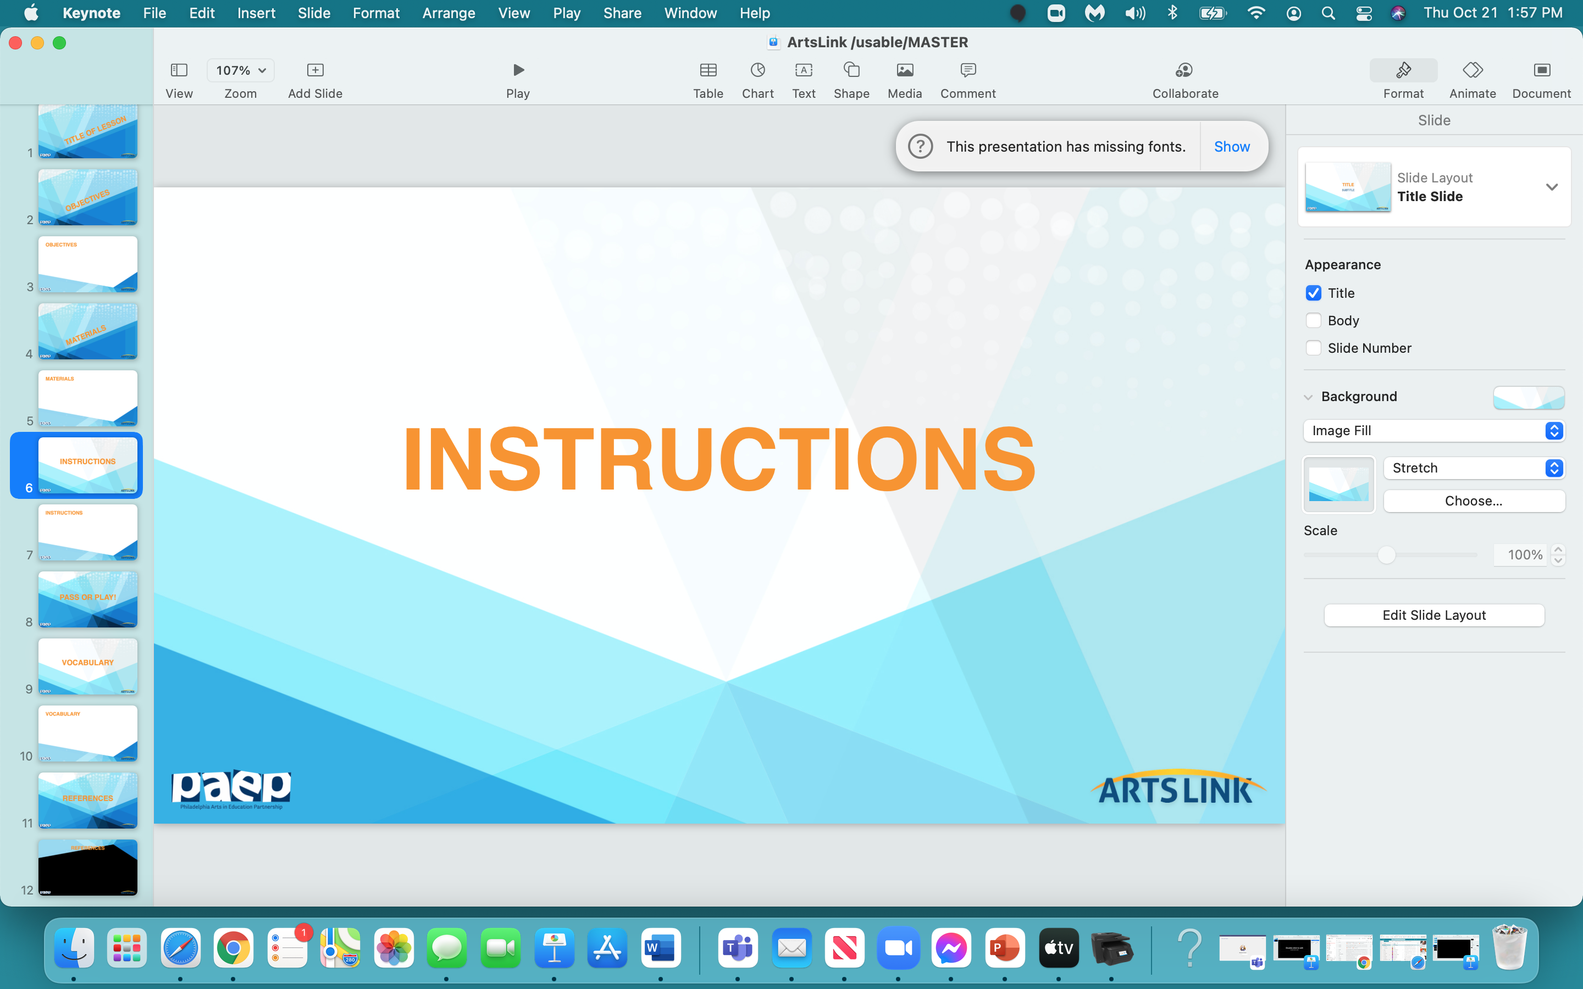

Slide 14
The Model for this Project:
‘The Exquisite Book’

Slide 15
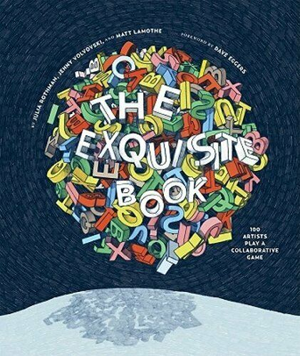

Slide 16
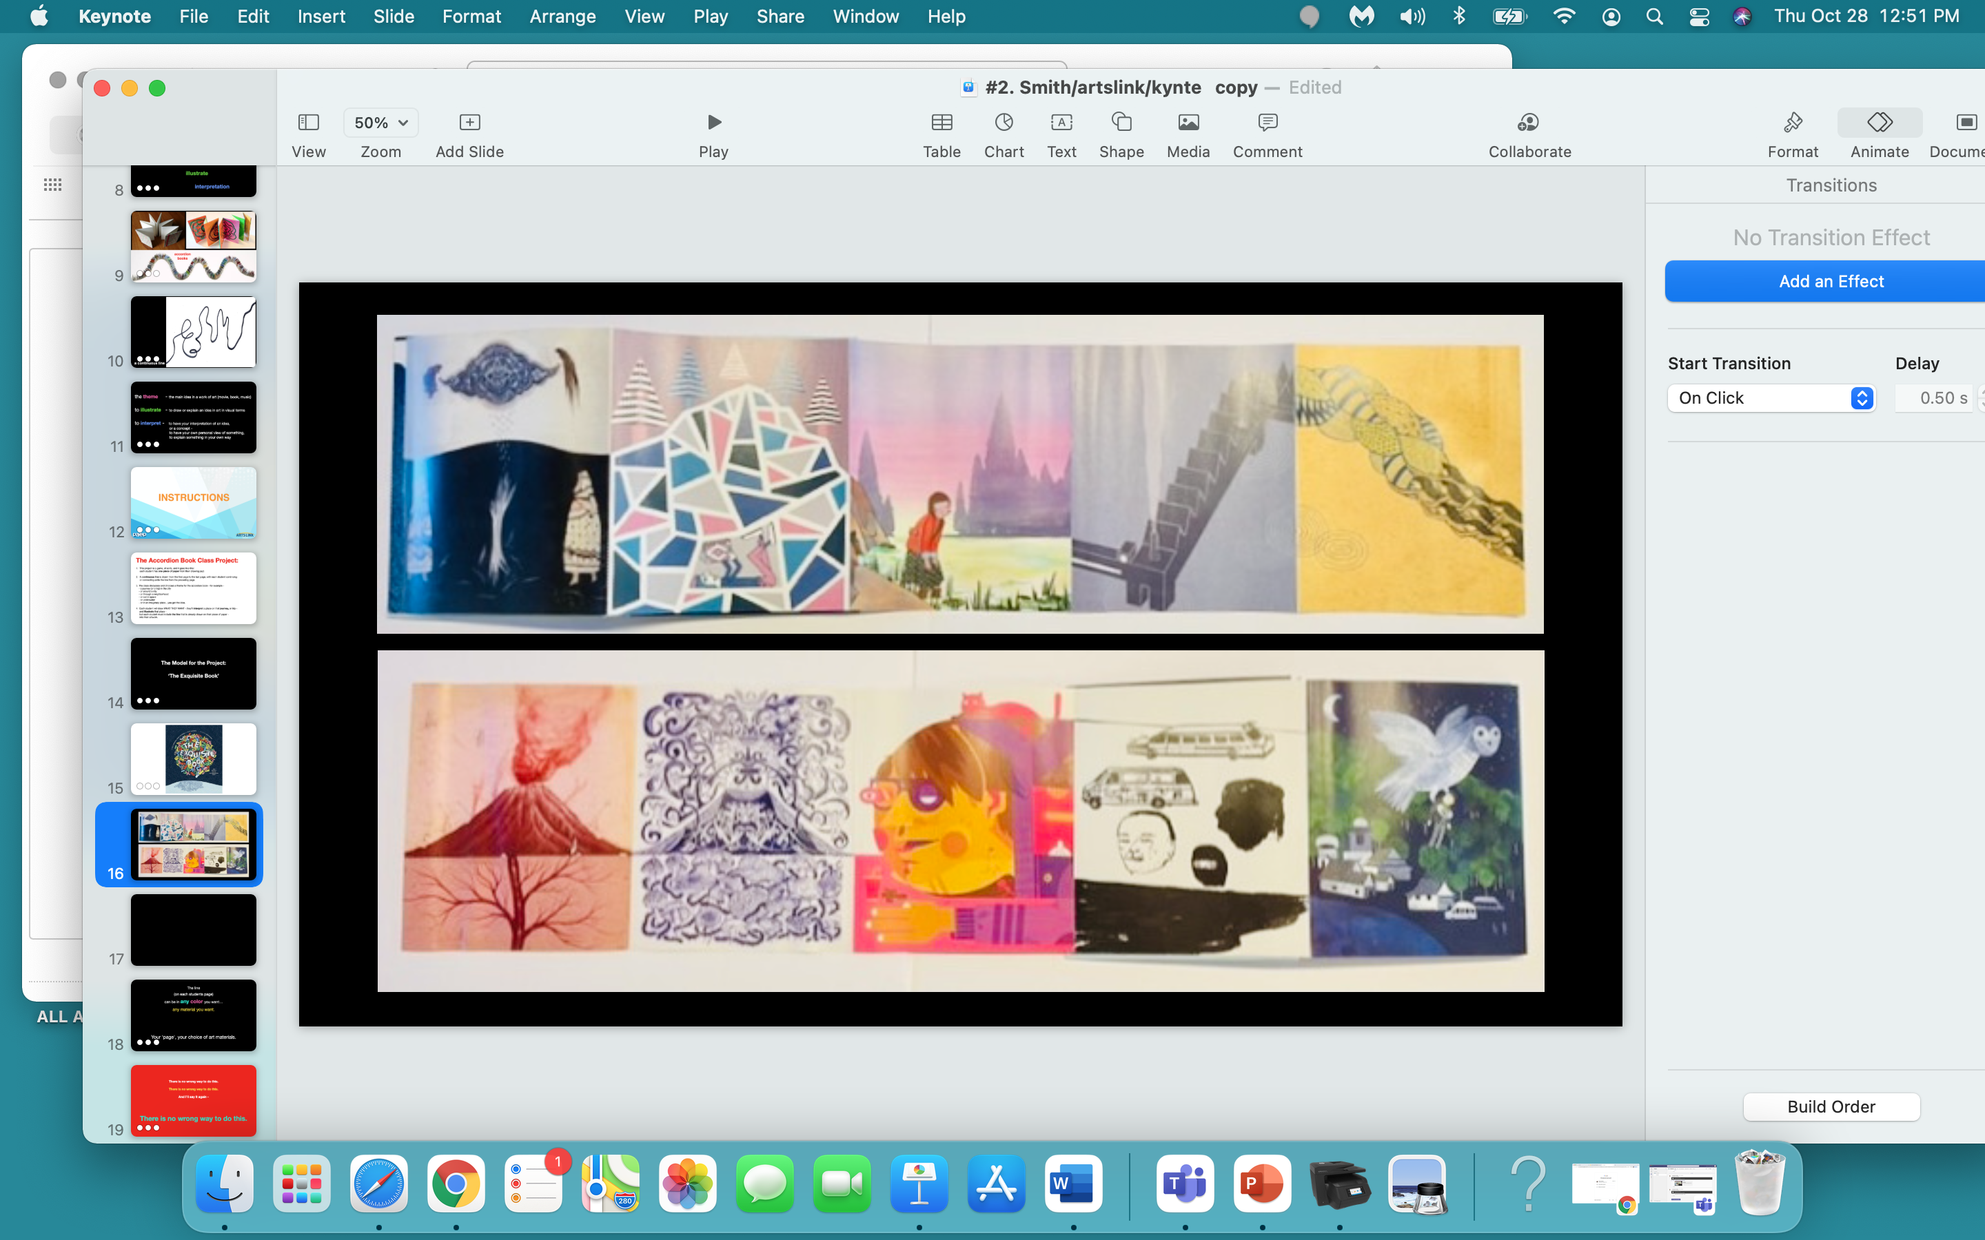

Slide 17
'The ________ Line’ Book Project:
This project is a game, of sorts, and it goes like this: each student takes one piece of paper from their drawing pad.
2. Mrs. Smith divides the class in half. Each half of the class will make their own book.
3. Mrs. Smith assigns each student a number.
3. Students write their number on the back of their paper.
4. The ‘first’ student (in each half of the class ) draws a line cross their paper.
5. The ‘second’ student draws a line across their paper, connecting their line to the end of the previous
student’s line.
6. The ‘third’ student draws a line across their paper, connecting their line to the end of the previous
student’s line.
7. This continues until all students have drawn & connected their lines to the end of the previous student’s line.

Slide 18
8. Each student can draw WHAT THEY WANT on their piece of paper -
but each student must incorporate (combine, or include) the line that is already drawn
on their piece of paper into their artwork.
9. After their drawing is finished, each student needs to write the ‘theme’ of their drawing …
somewhere on their page.

Slide 19
the theme:
the main idea in a work of art
patterns
people
animal
phantasy creatures
line
shape
color
texture
abstract
repetition
dots
an illustration of someone, something, an event
what’s your image about?

Slide 20
The line
(on each students page)
can be in any color you want…
any material you want.
It’s your ‘page’… your choice of art materials.

Slide 21
There is no wrong way to do this.
There is no wrong way to do this.
And I’ll say it again -
There is no wrong way to do this.

Slide 22
Are there any questions?
I know there are questions…so let’s ‘draw’ some examples…

Slide 23
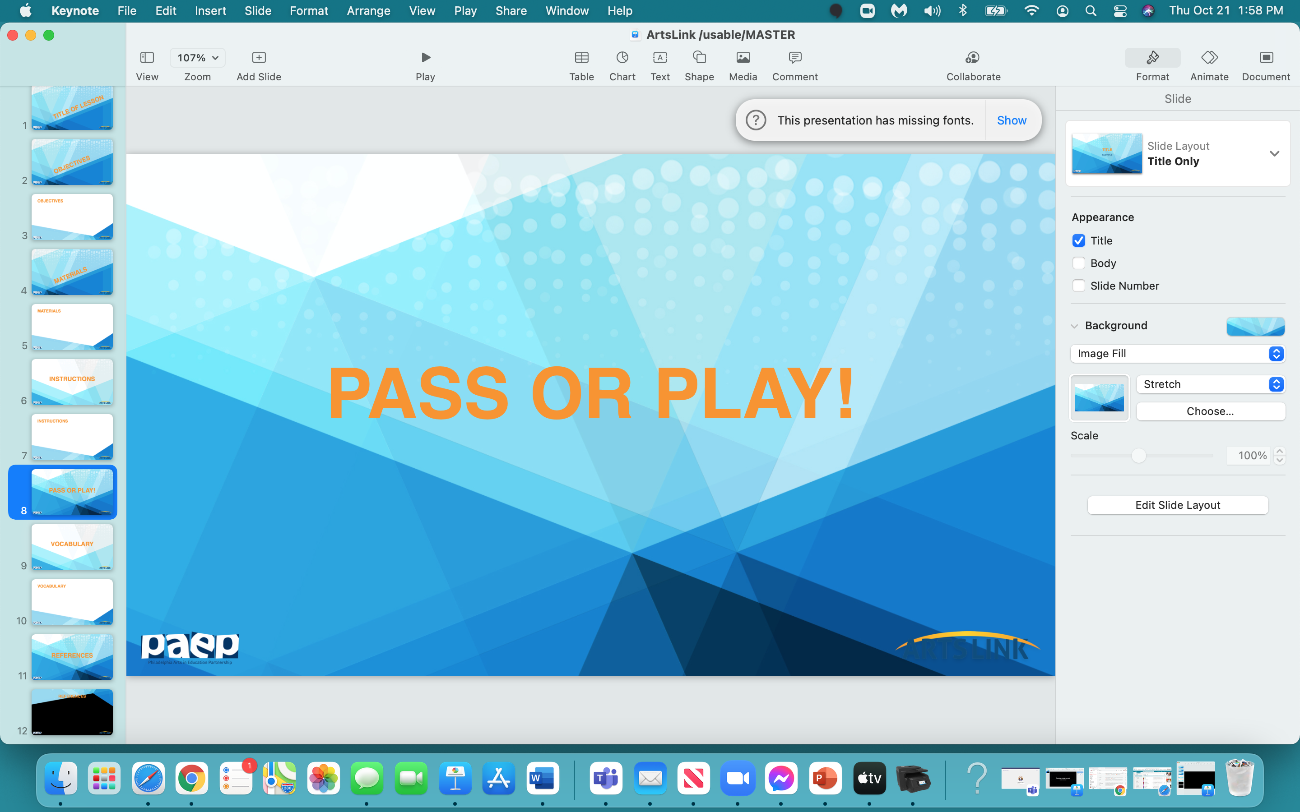

Slide 24
OK - who wants to volunteer
ONE THING
that they learned today in this lesson,
in this project…
you can either PASS
or PLAY (SHARE)!

Slide 25
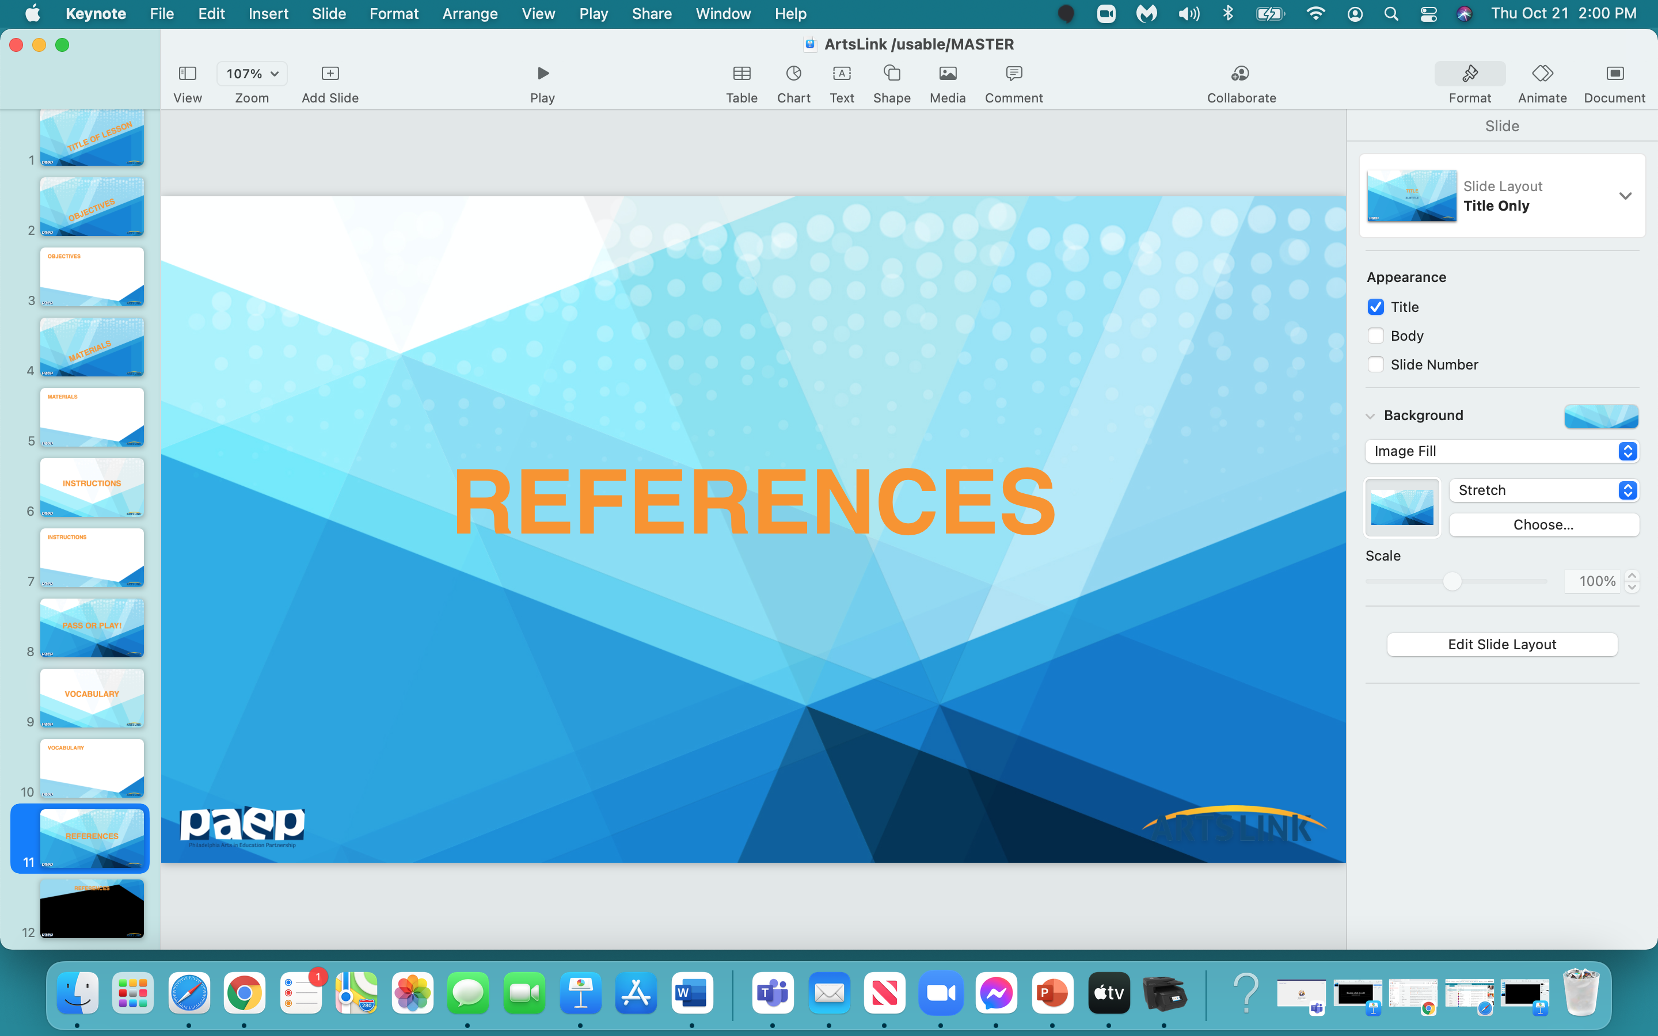

Slide 26
‘The Exquisite Book’, Rothman, Julia & Volvovski, Jenny & Lamothe, Matt, 2010, Chronicle Books LCC, San Francisco, California
www.theimaginaryshop.com
www.riverpublishers.com
lib.utah.edu/collections/book-arts/community/accordion
www.scholastic.com
www.materialsforthearts.org collaboratively pick a ‘theme’ for your book project

