Slide 1
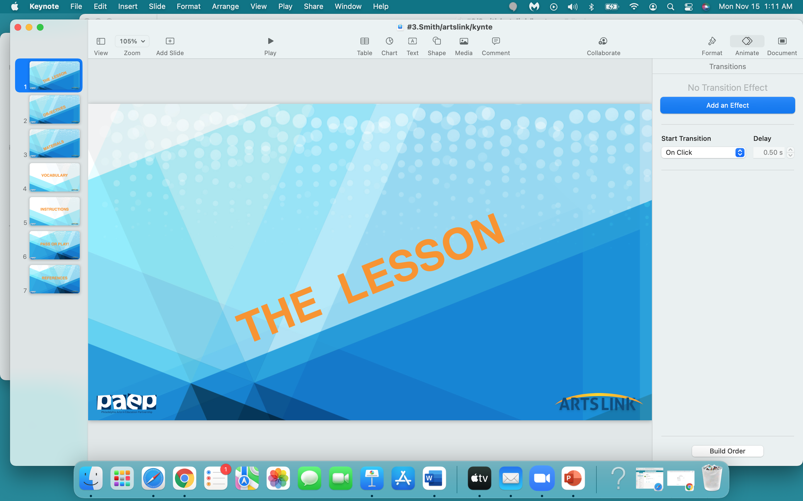

Slide 2
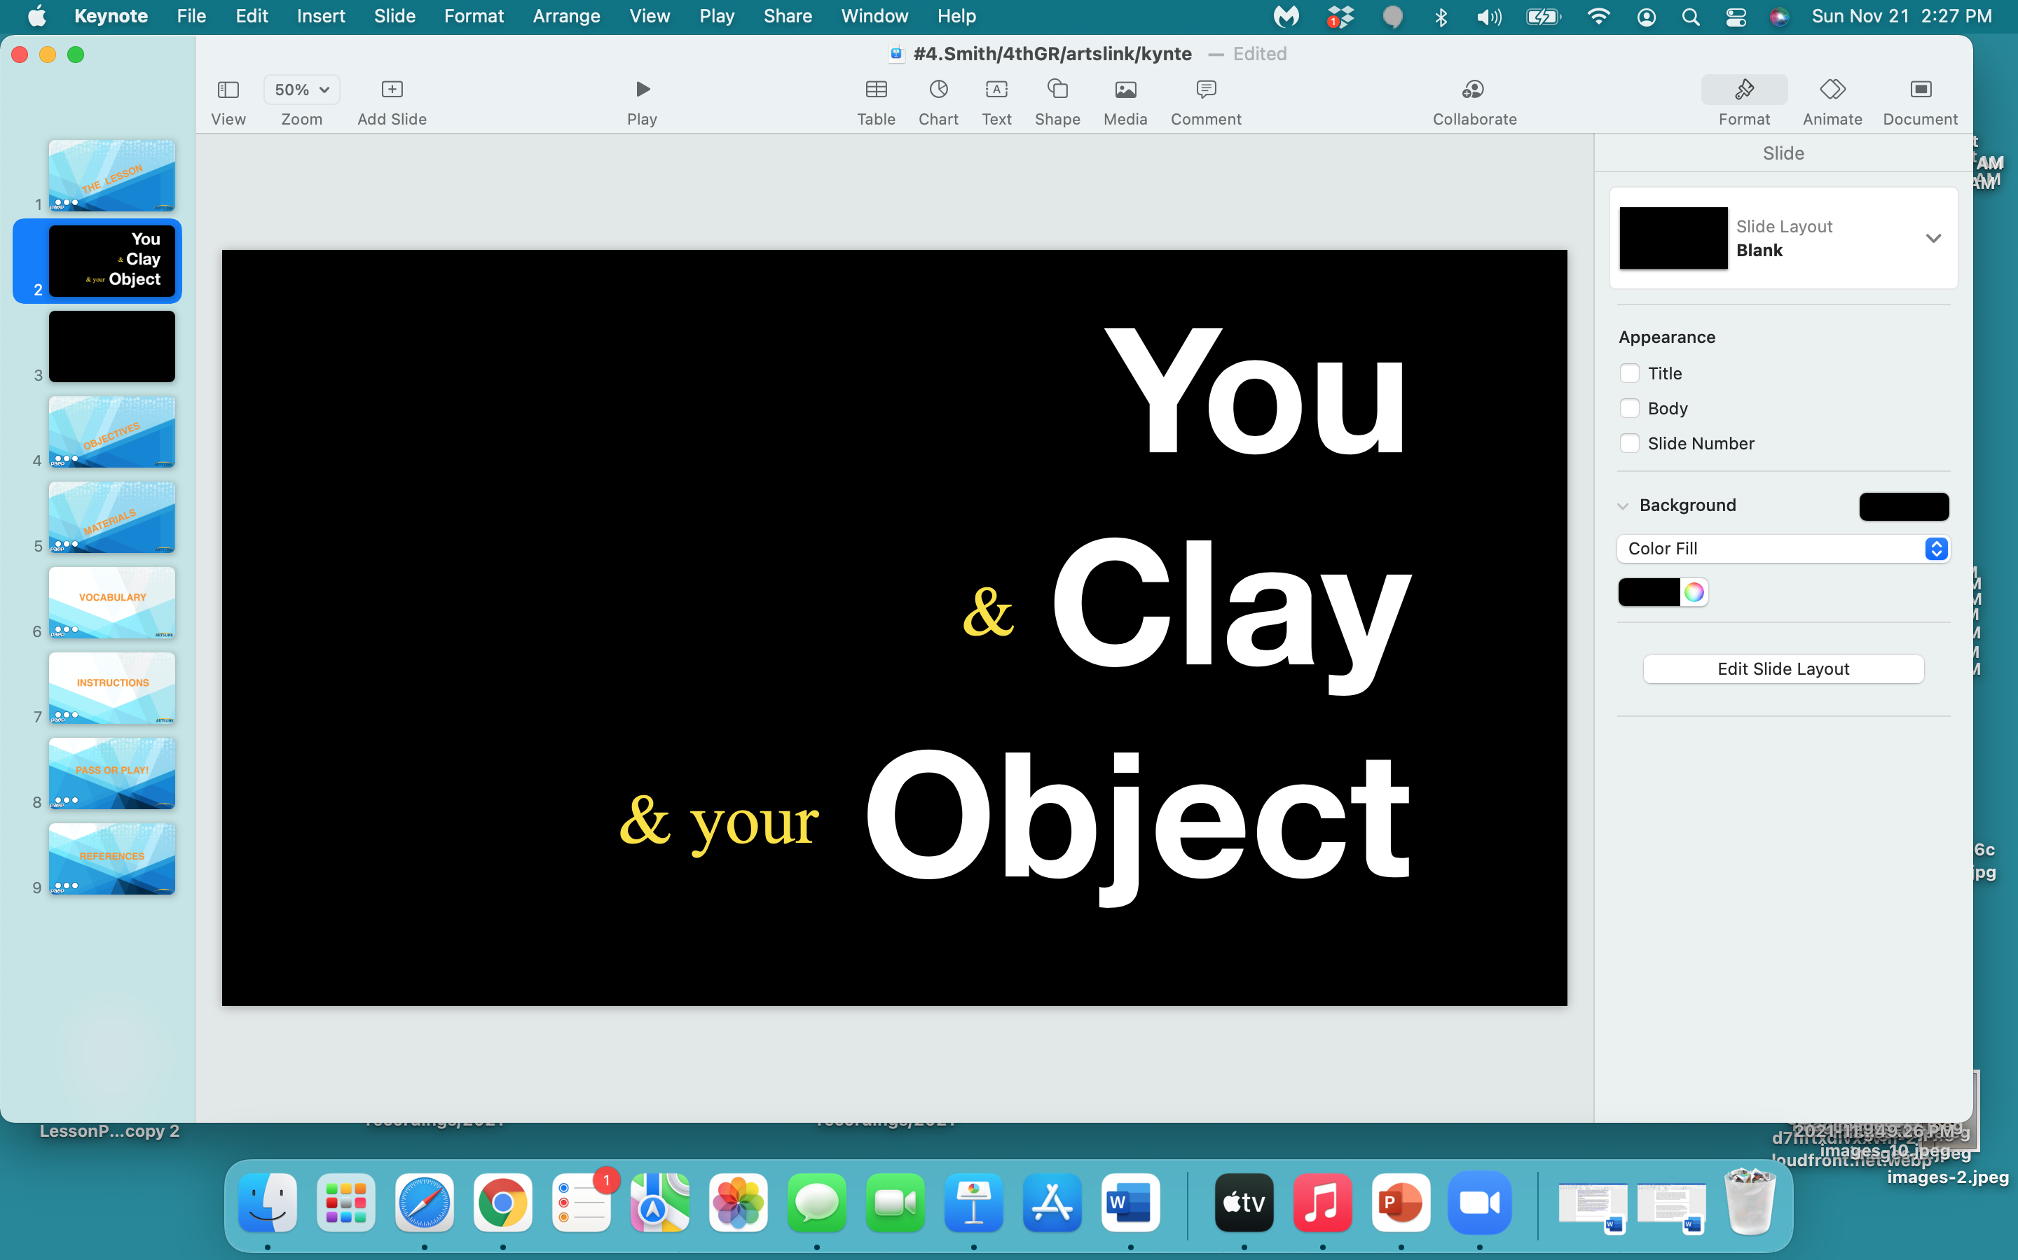

Slide 3
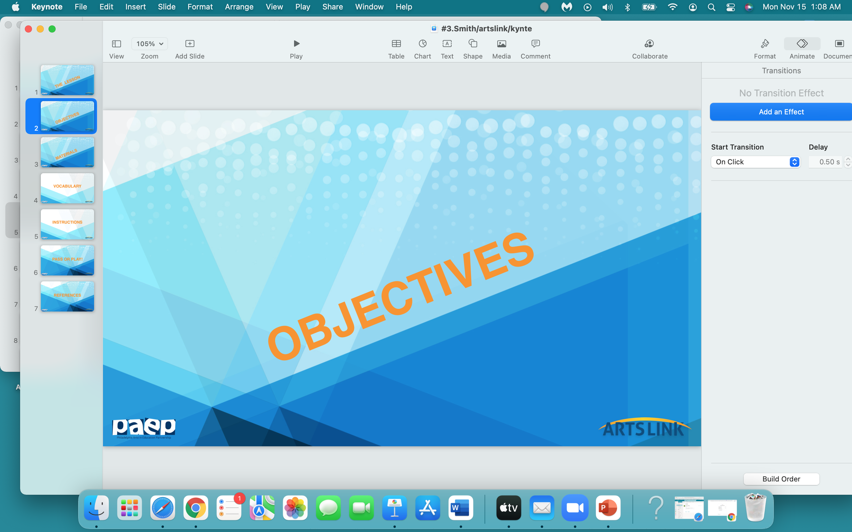

Slide 4
YOU WILL:
- learn a little bit about clay - what it is - what it was originally used for
- learn about some basic clay building techniques
- learn about Claes Oldenburg and his art objects
- think about an object that you like, or love
use your drawing skills to sketch out your object
have your literacy enforced by writing one paragraph (3 sentences) about why you chose the object you did…what your object means to you!

Slide 5
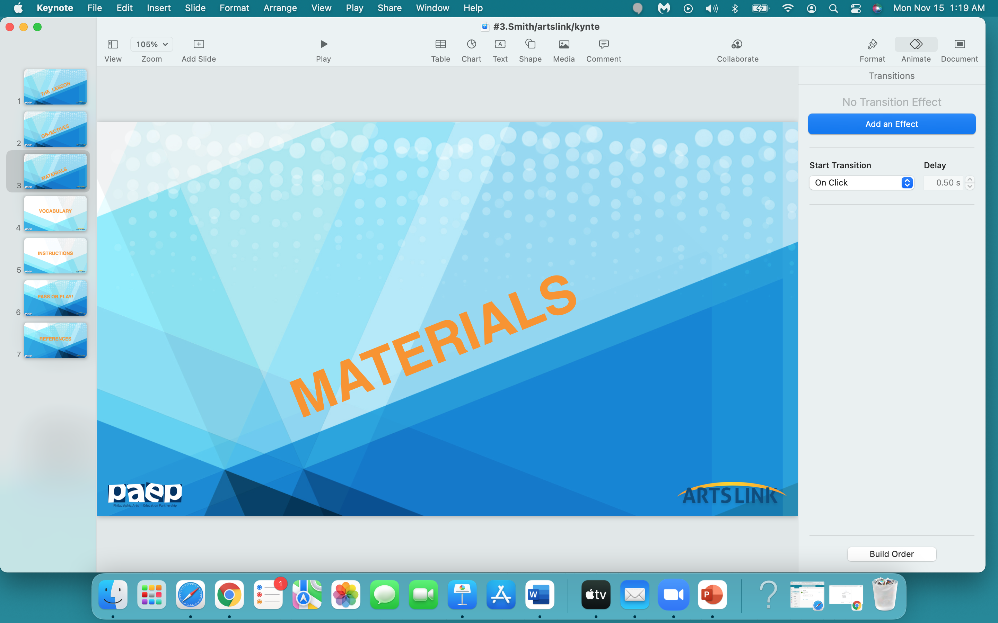

Slide 6
your clay
paper - any kind
notebook
watercolor set - (the lid for use as a water container)
brush
ruler
plastic baggie
pencil
paper towel
water

Slide 7
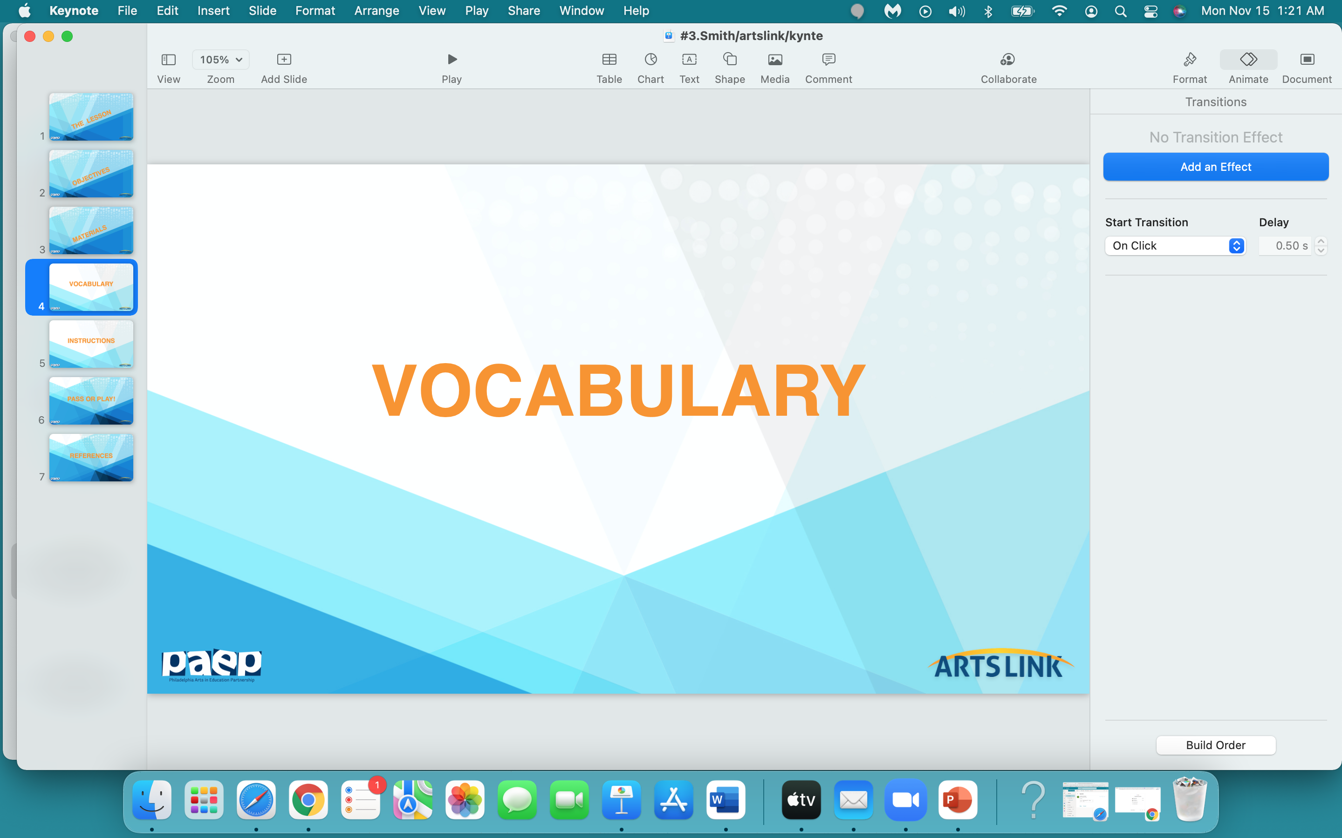

Slide 8
clay
hand-building
sculpture
Oldenburg - pop artist

Slide 9
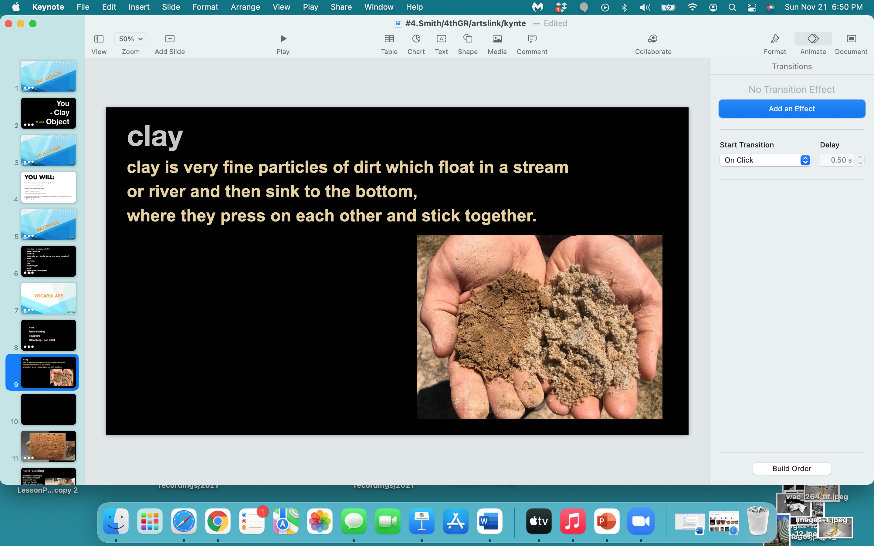

Slide 10
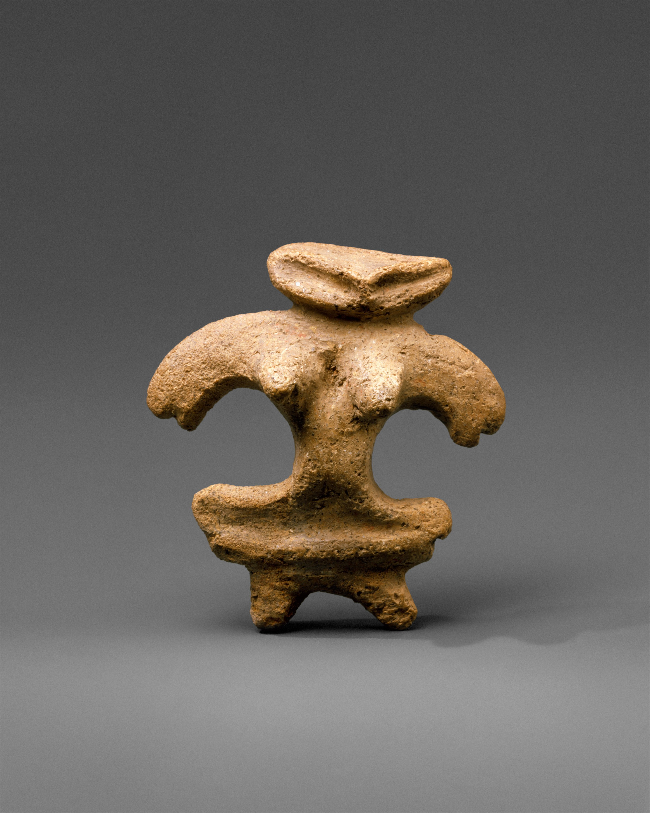
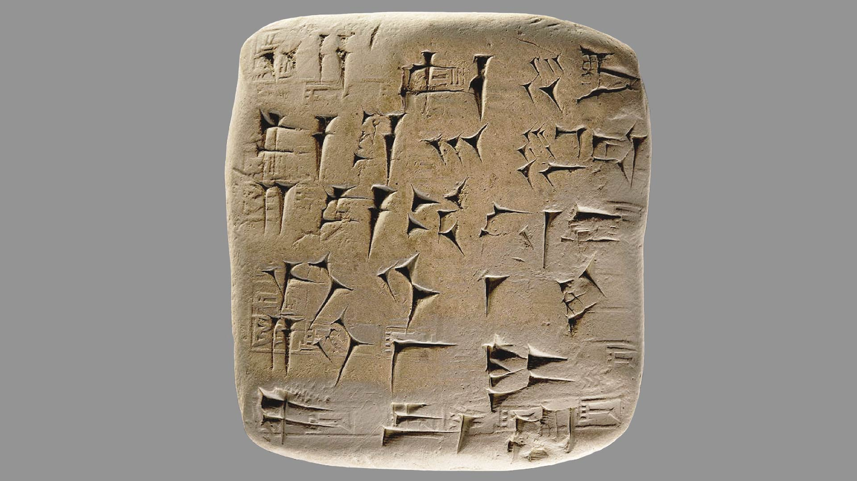
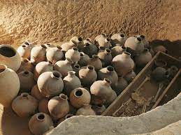

Slide 11
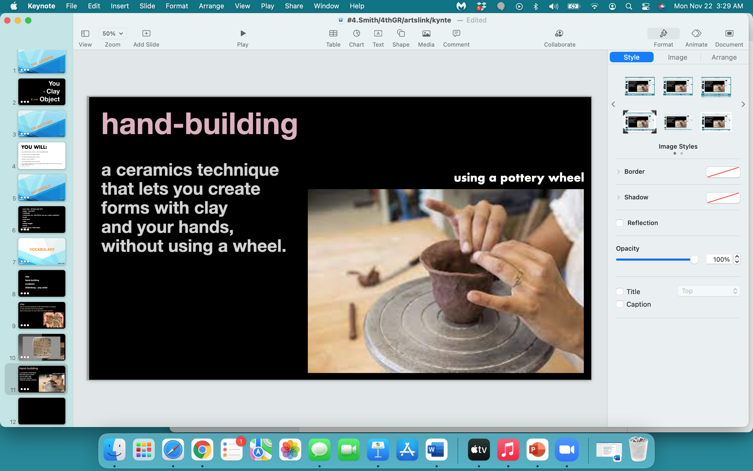

Slide 12
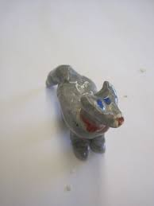
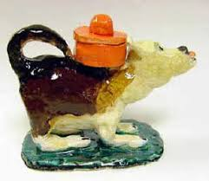
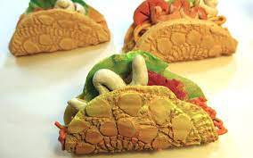
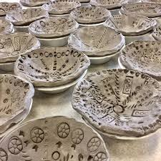
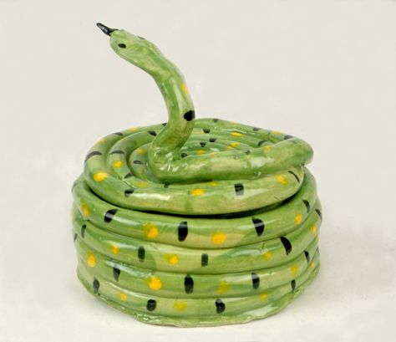
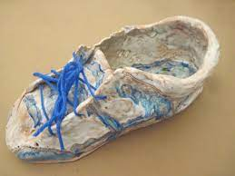
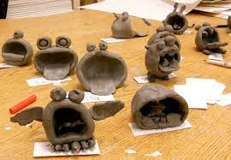
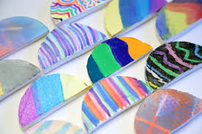
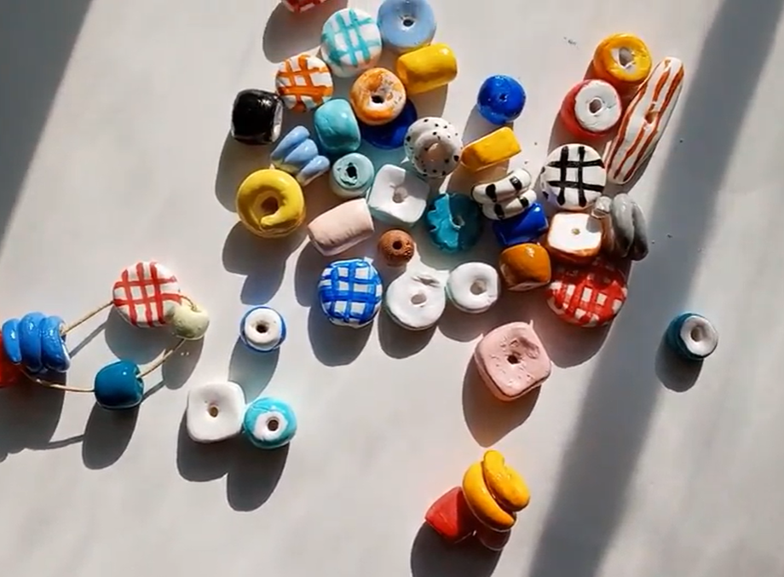
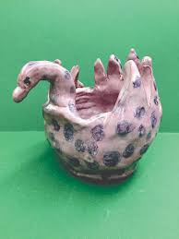
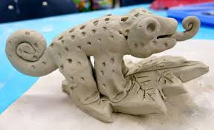

Slide 13
sculpture
a 3 - dimensional art object
a piece of art that you can walk under, behind, over, around…you get the point

Slide 14
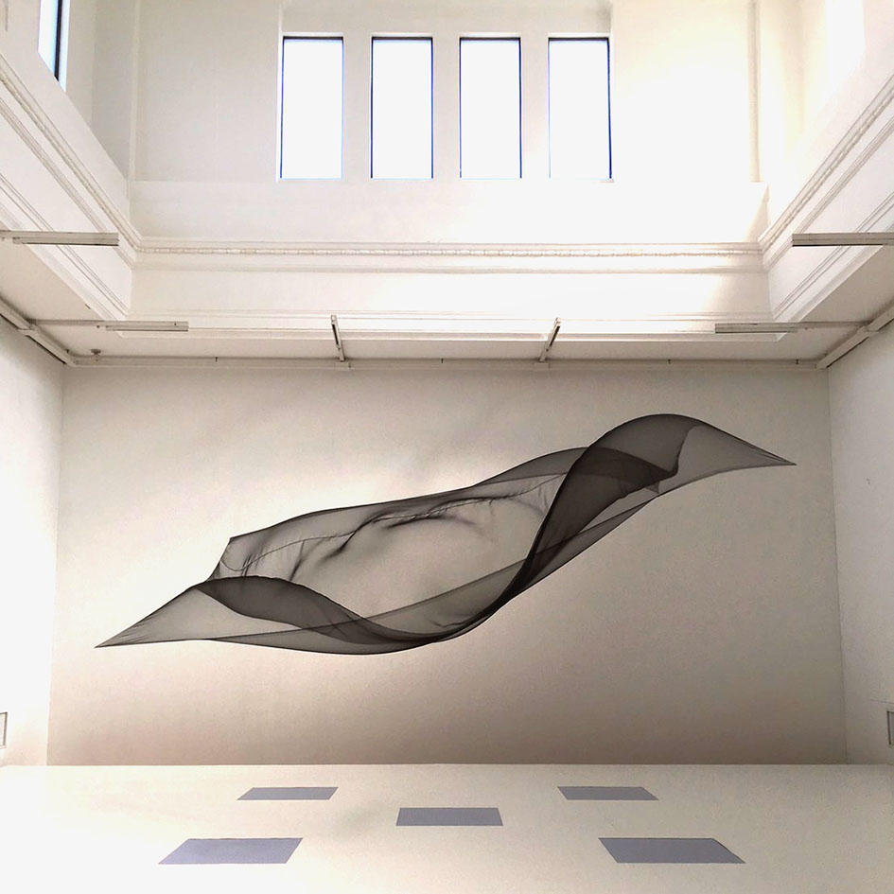
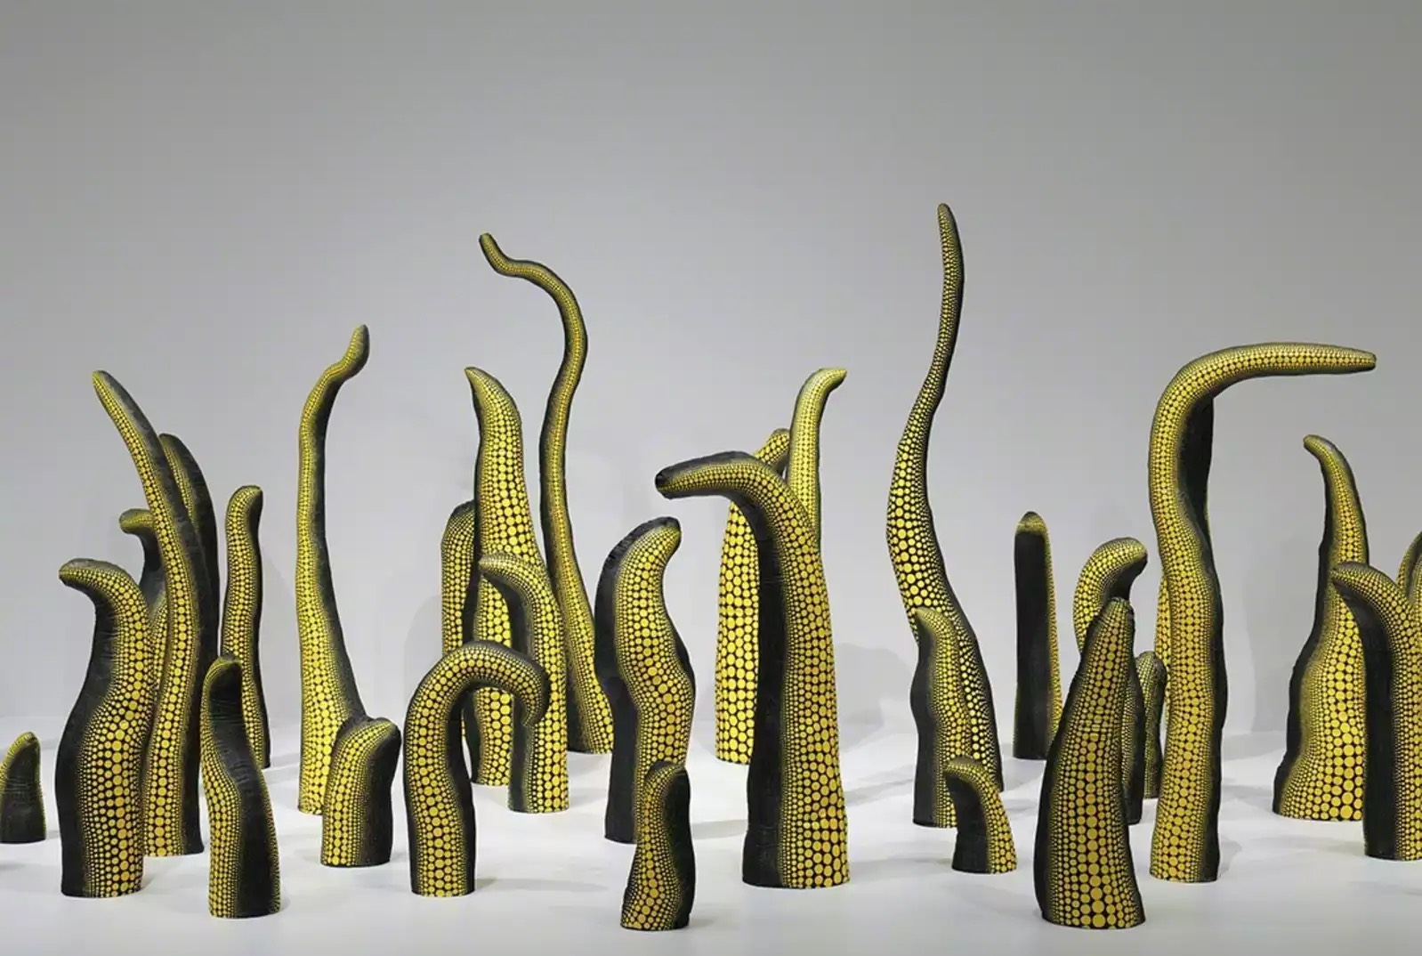
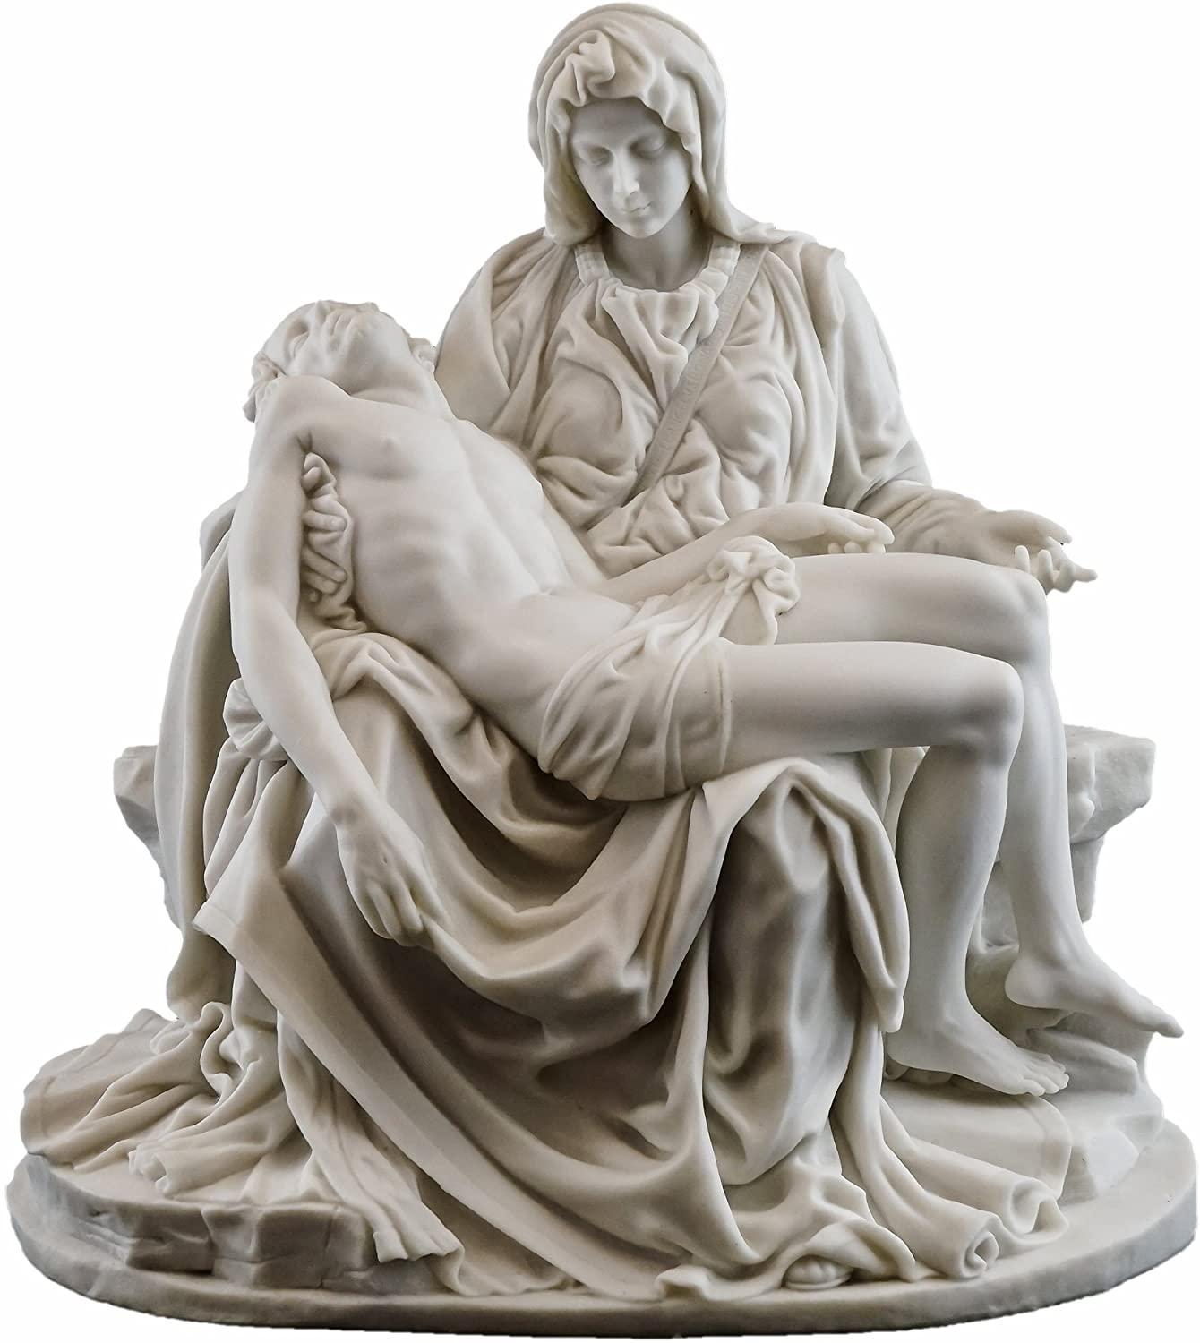
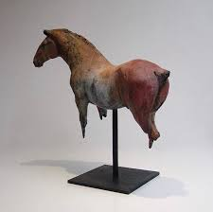
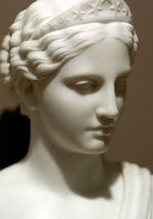
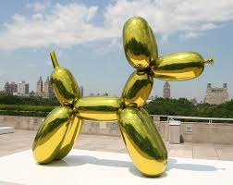

Slide 15
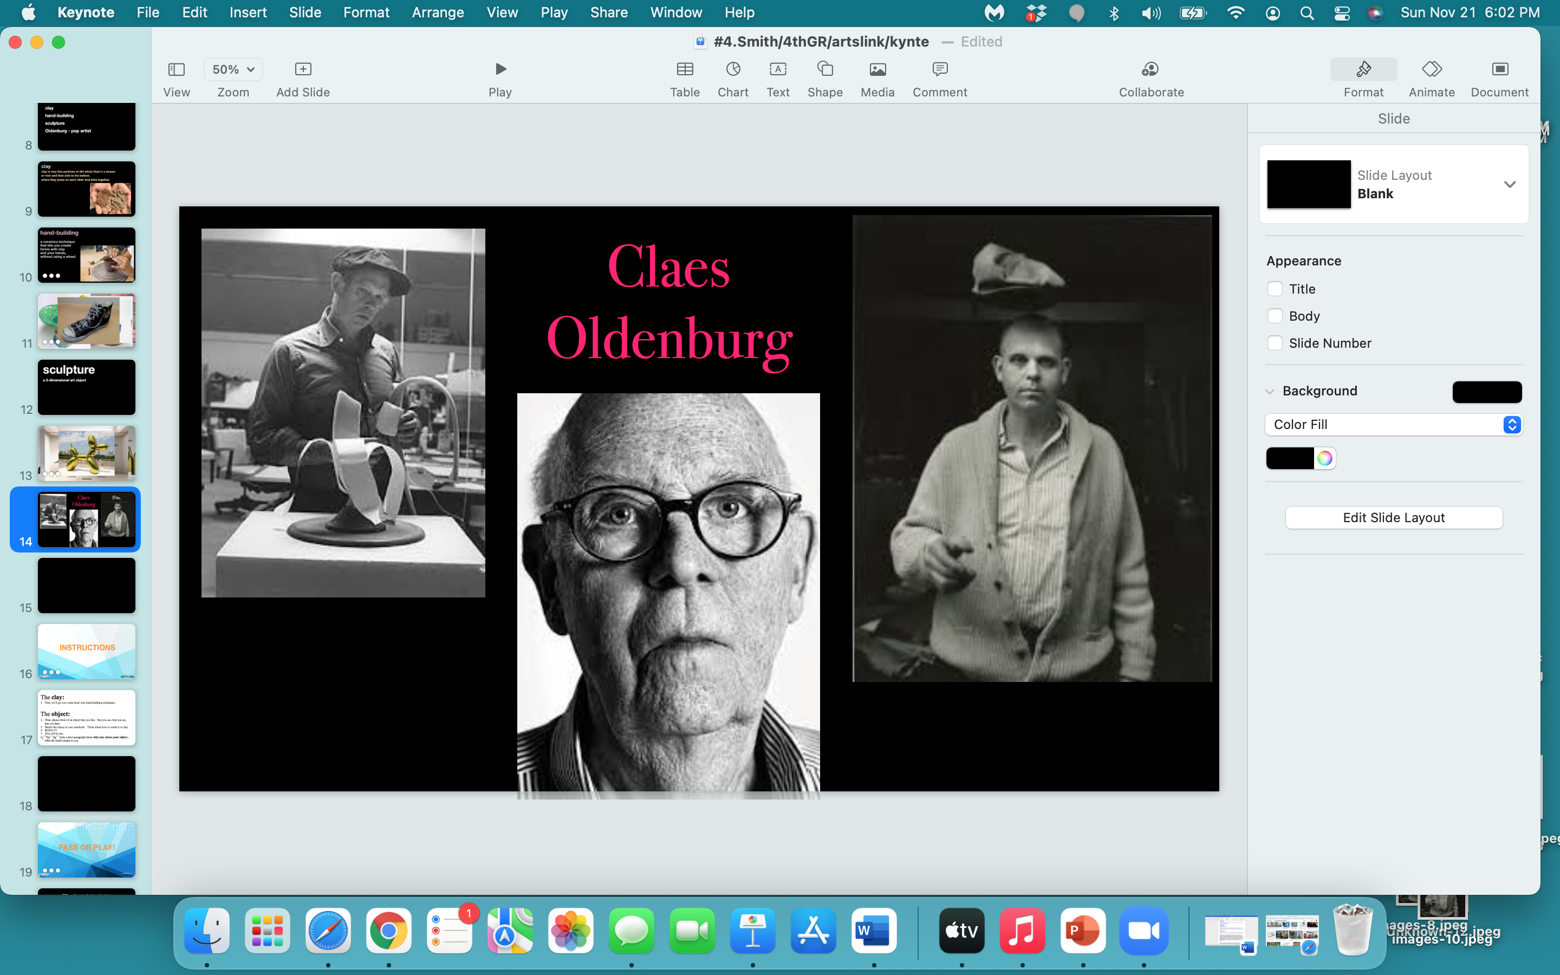

Slide 16
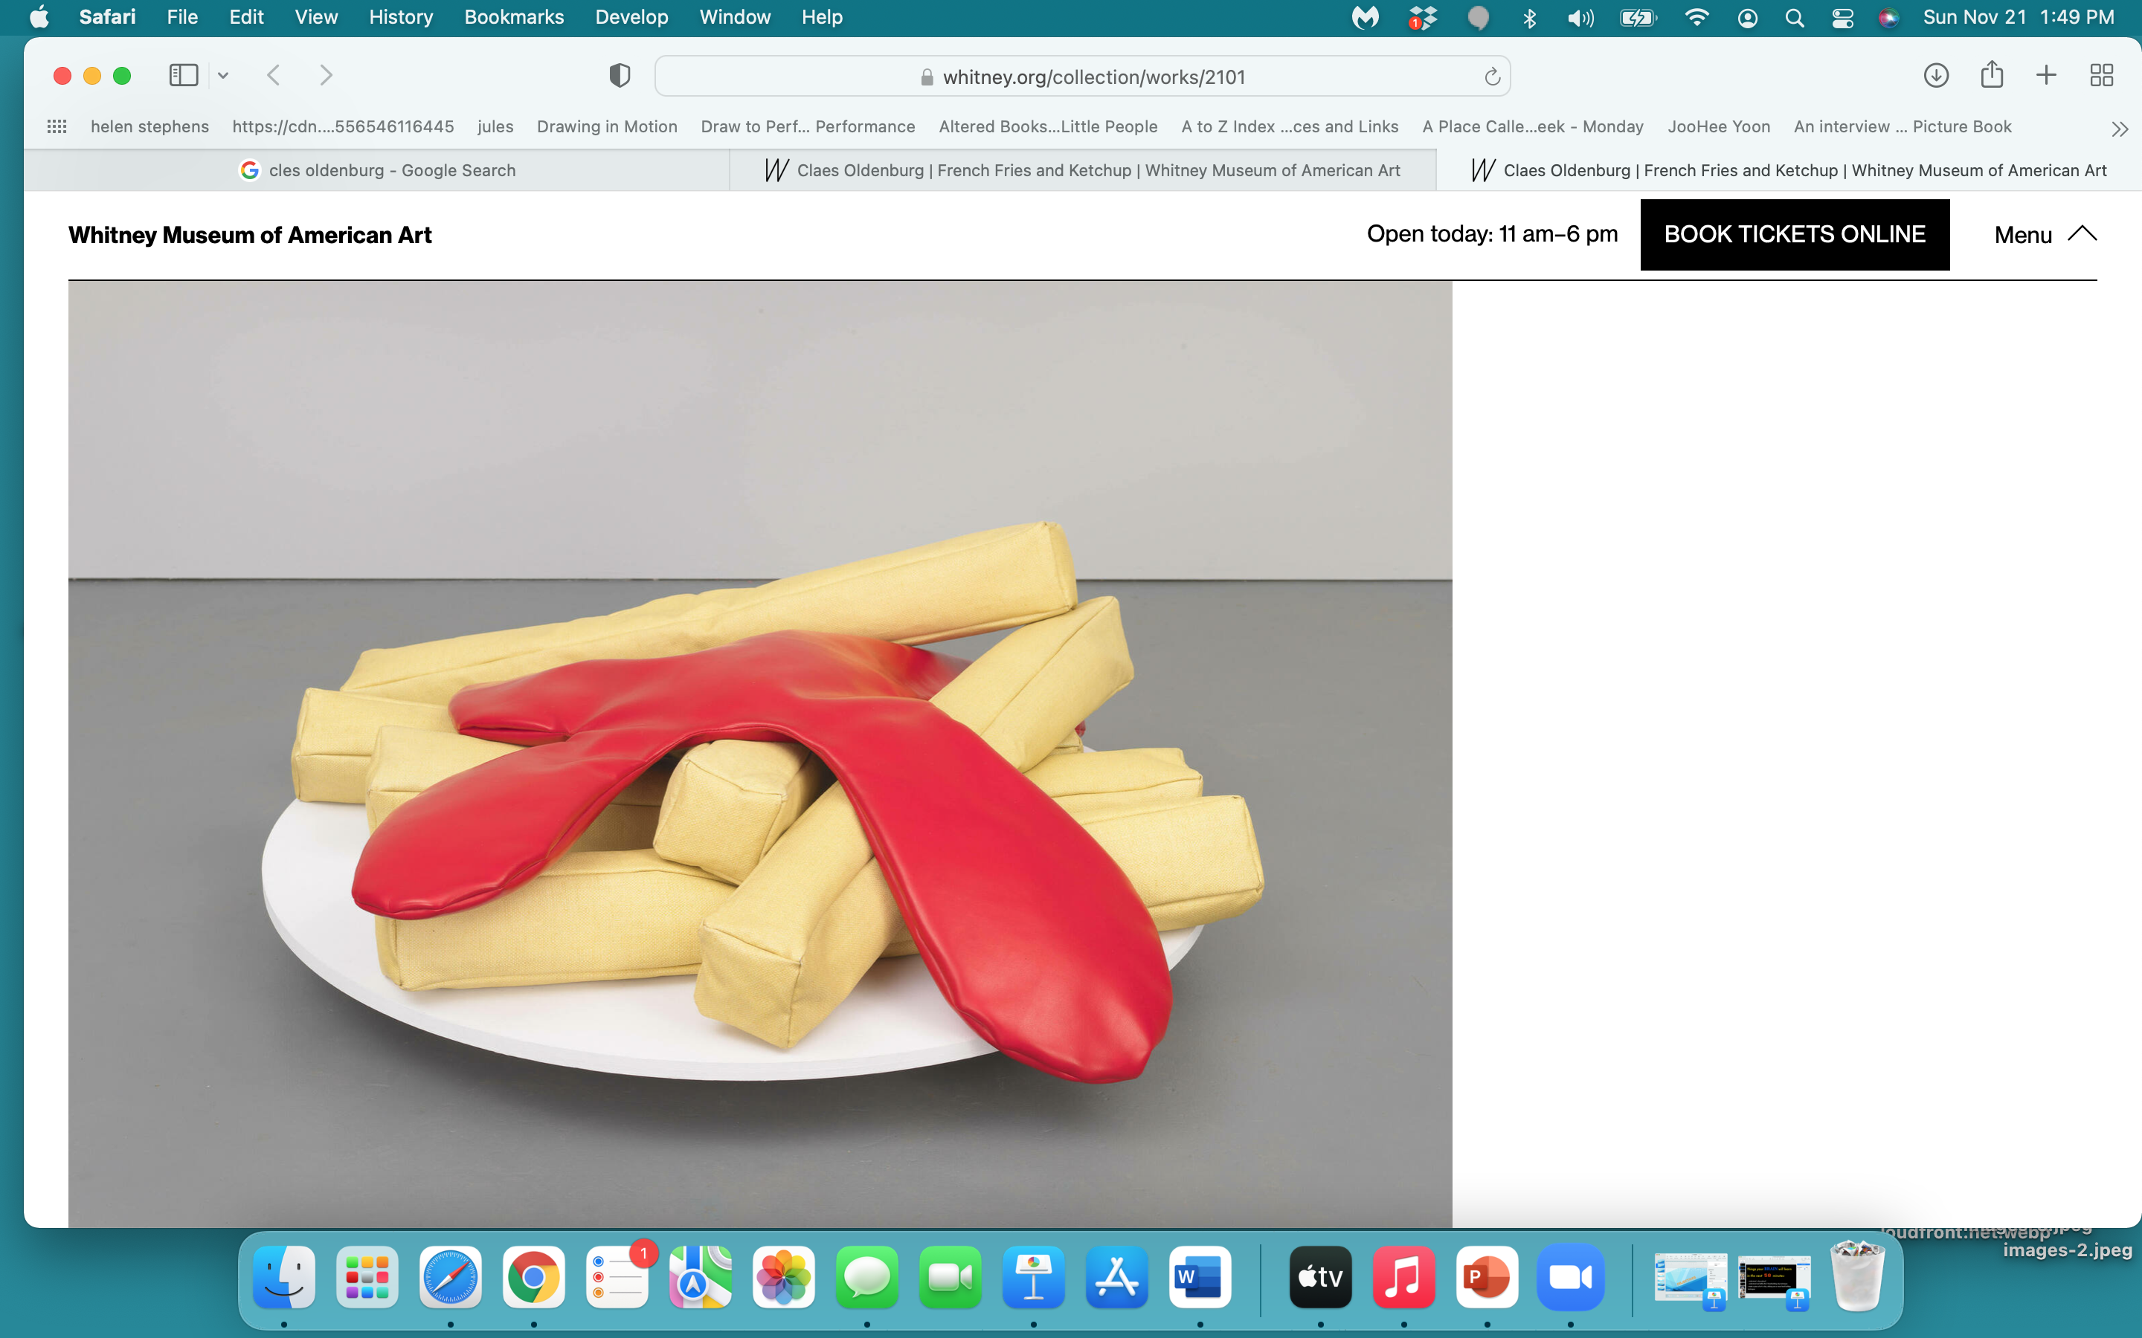
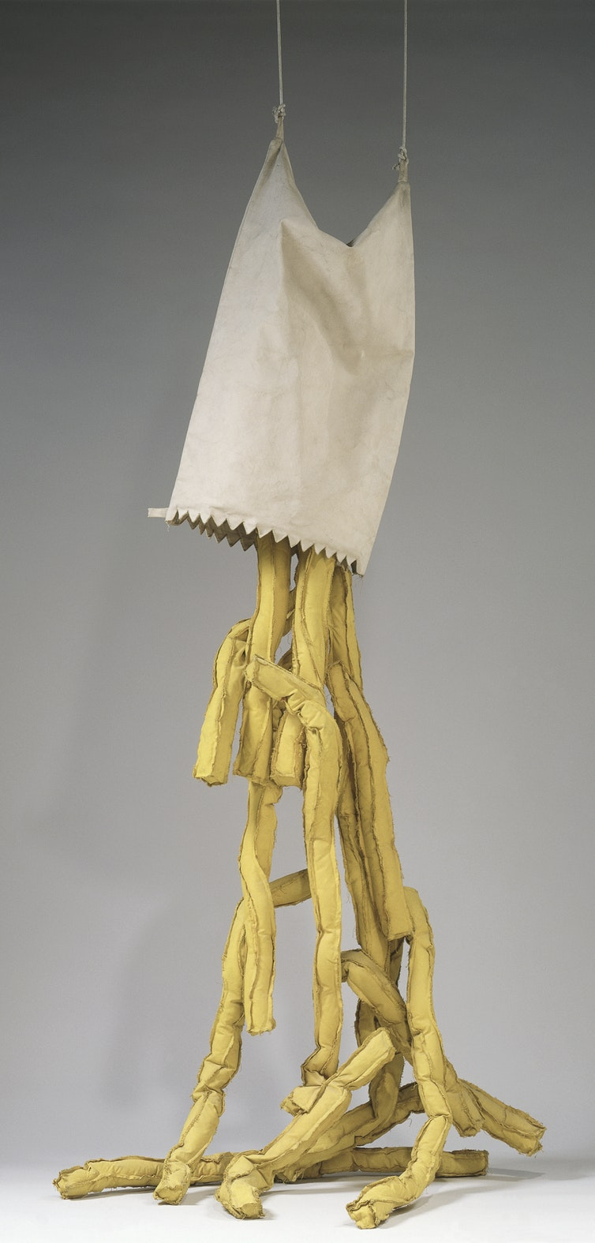
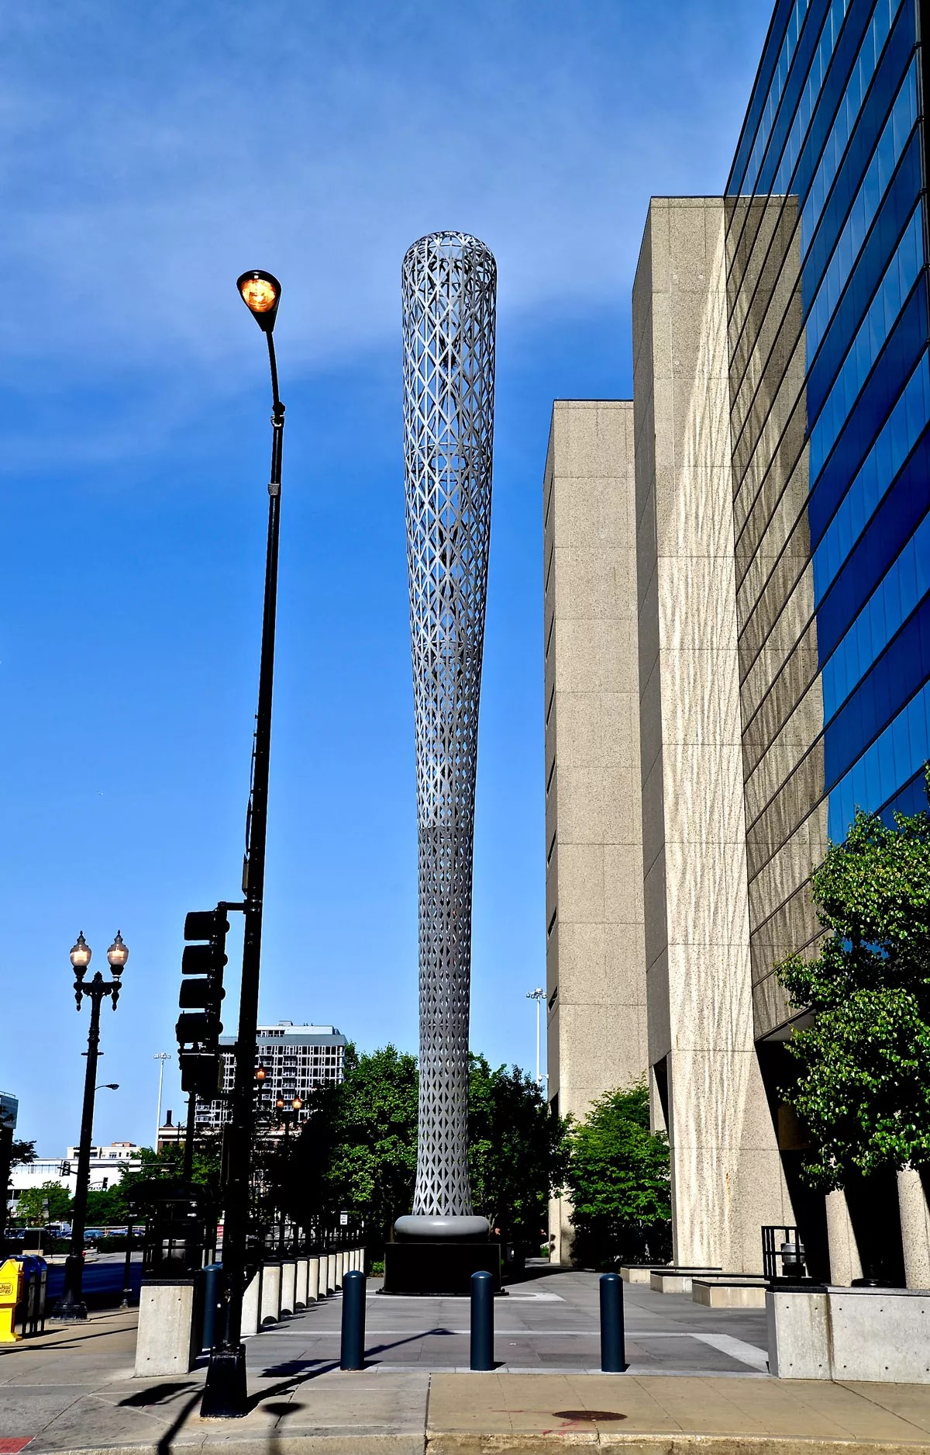
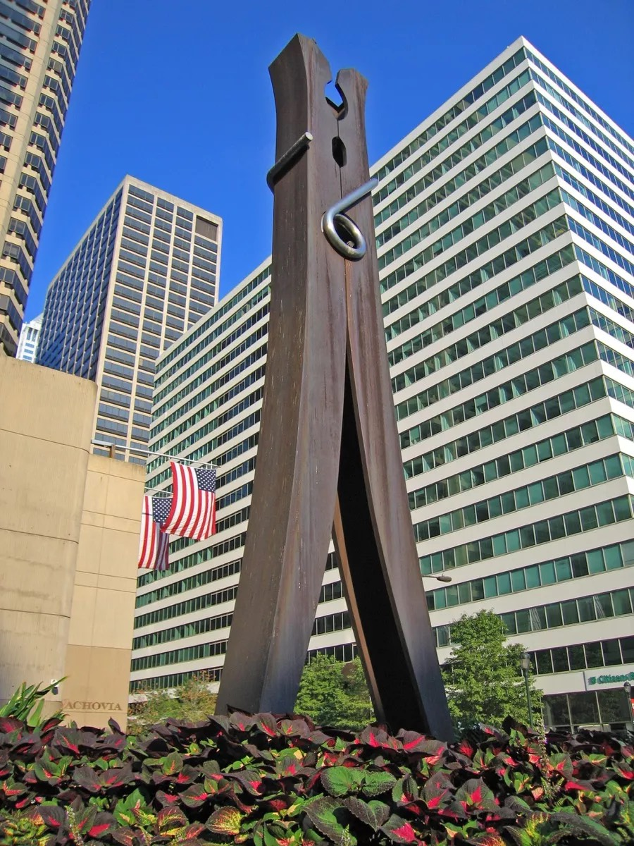
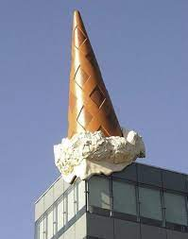
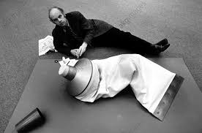
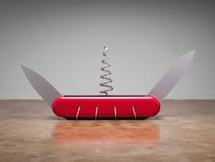
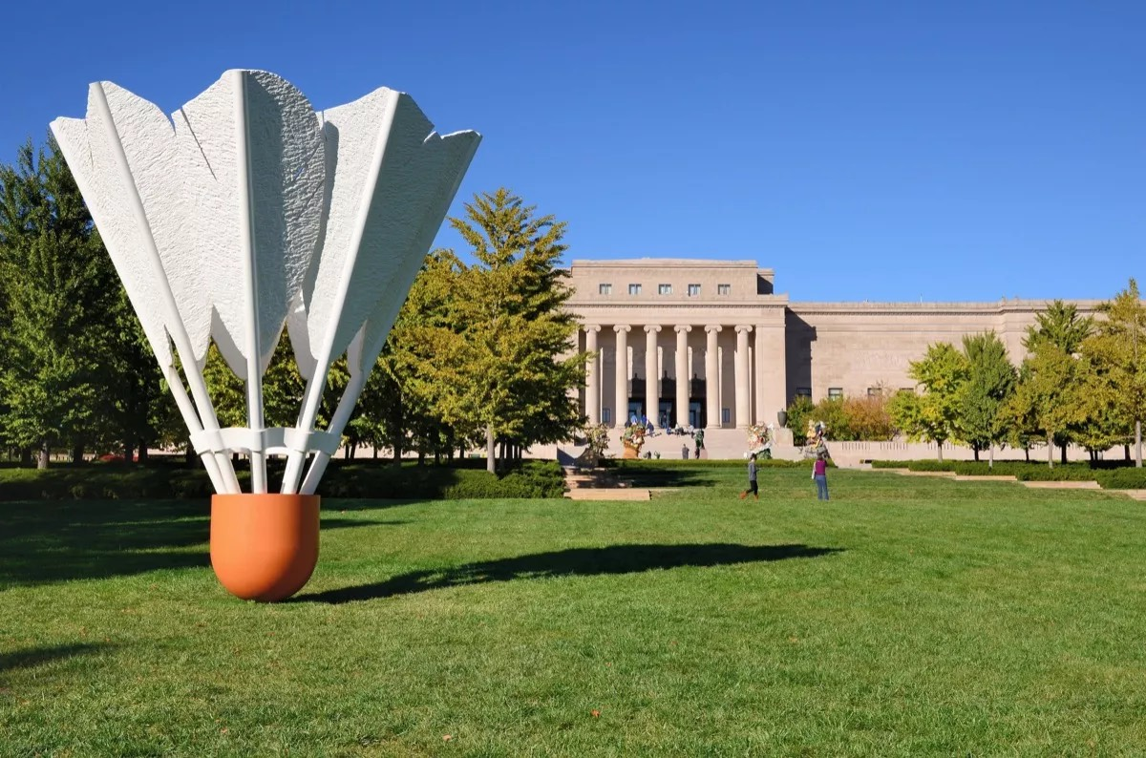

Slide 17
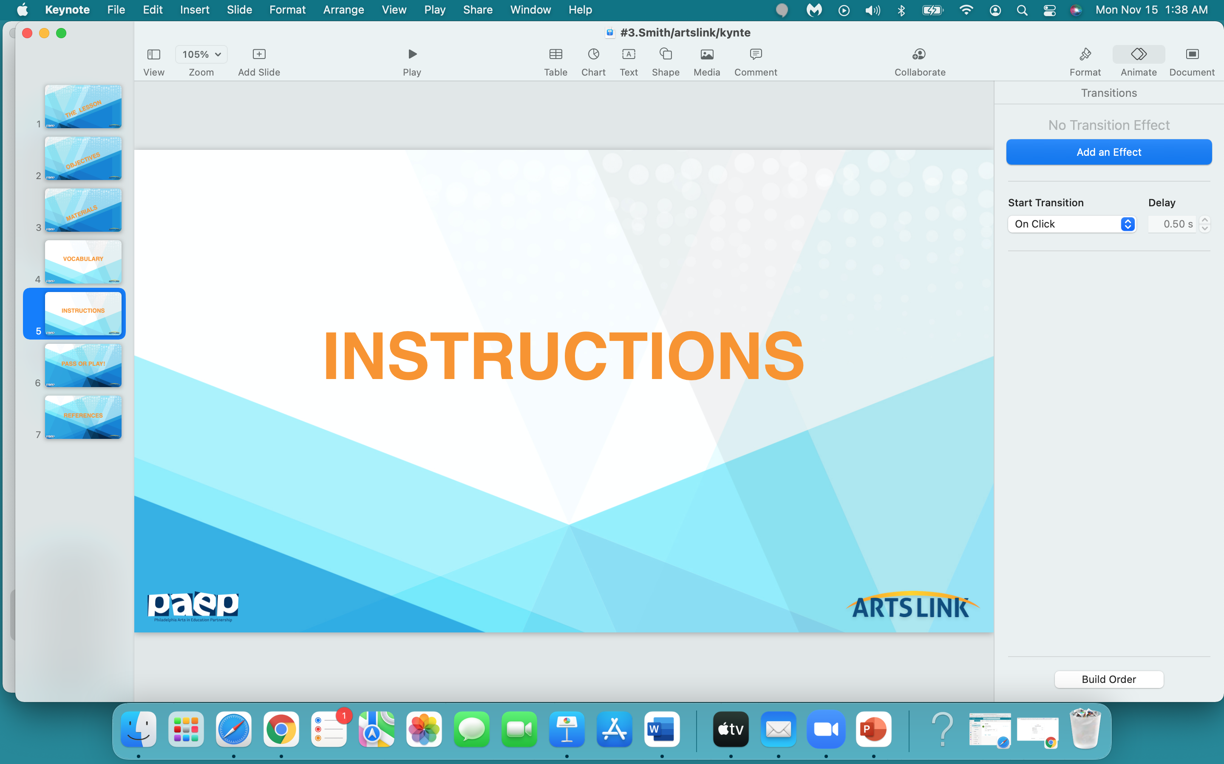

Slide 18
The clay:
First, we’ll go over some basic clay hand-building techniques.
The object:
Then, please think of an object that you like - that you use, that you eat, that you love.
Sketch the object in your notebook. Think about how to create it in clay.
BUILD IT.
This will be fun.
Then please write a short paragraph about why you chose your object… what the object means to you.

Slide 19
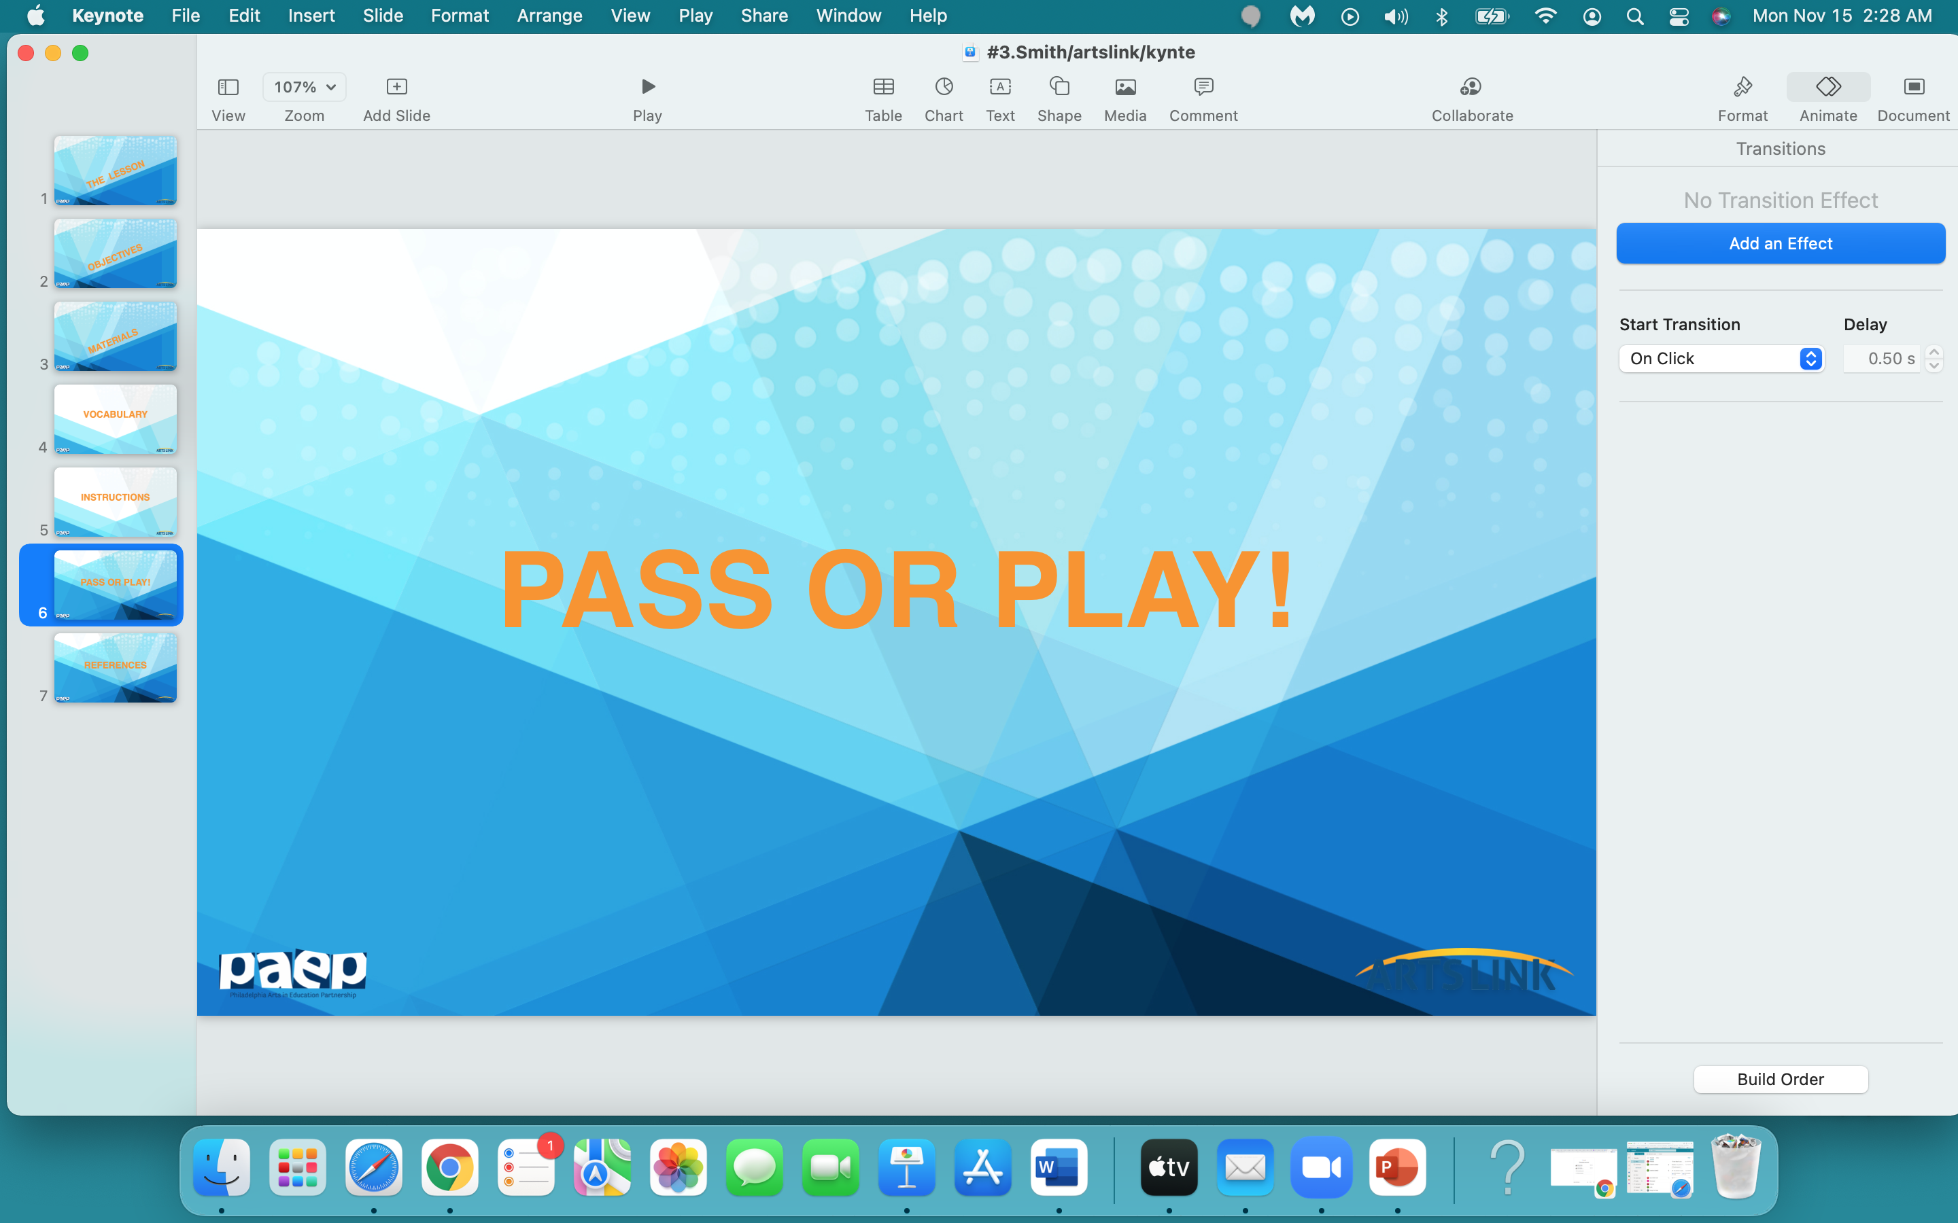

Slide 20
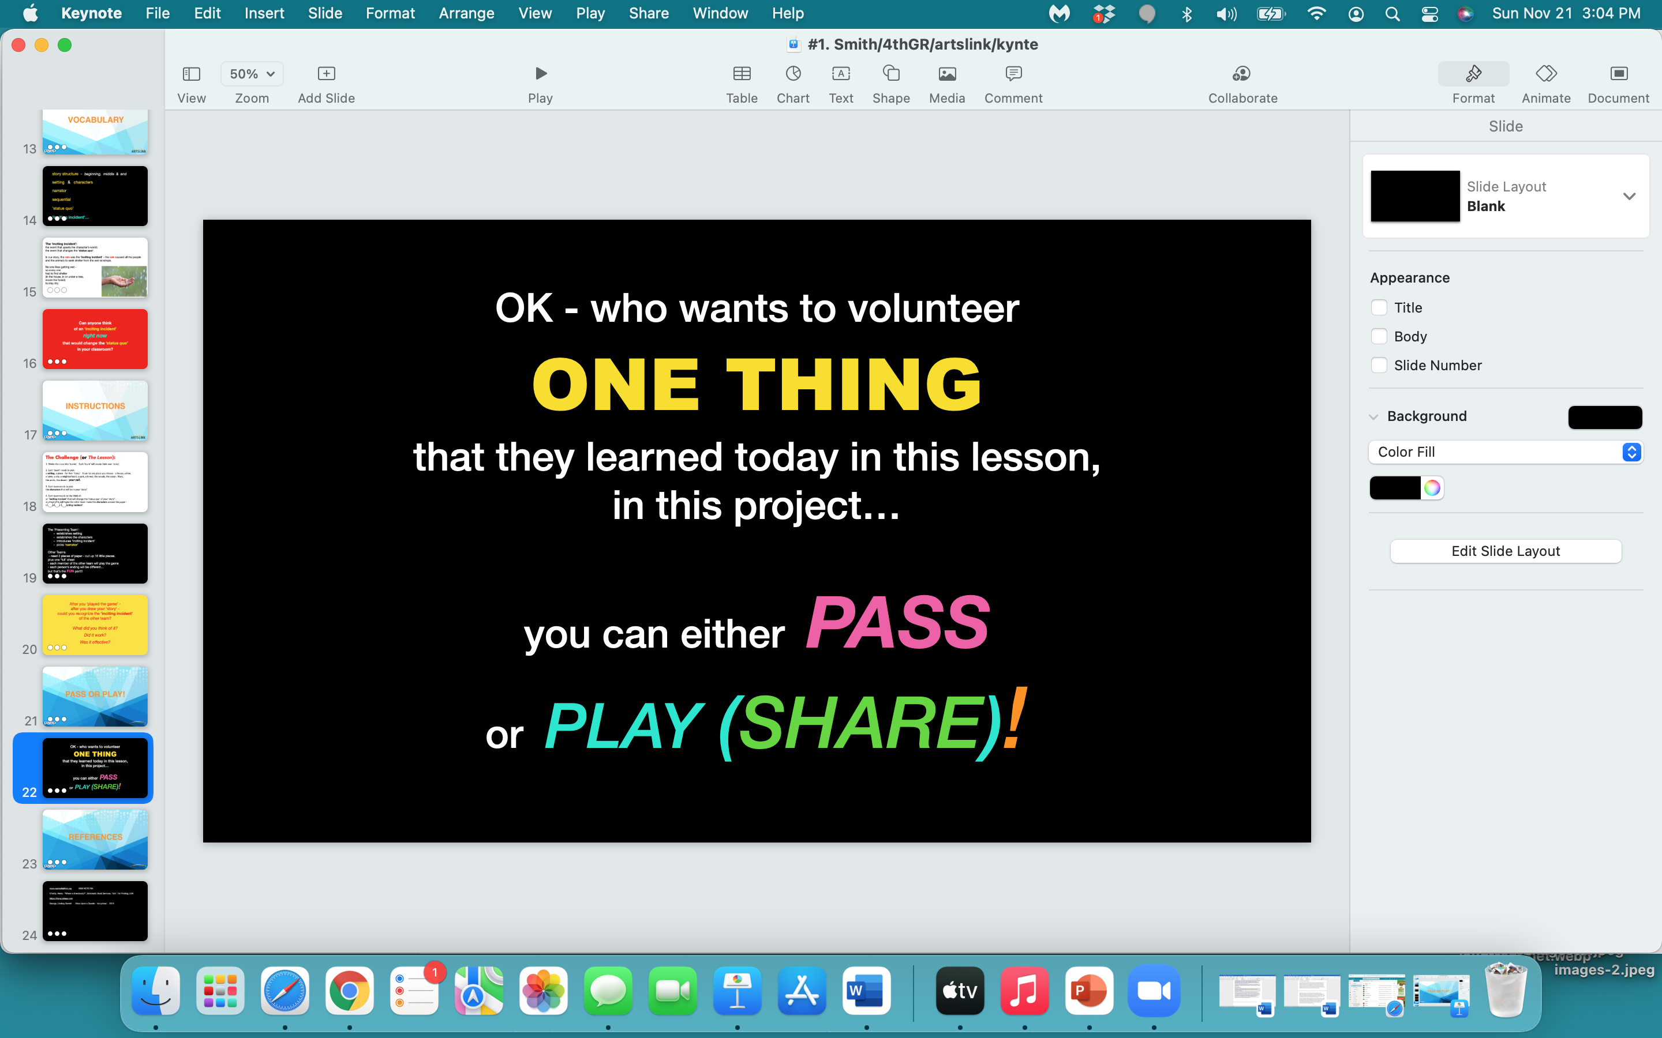

Slide 21
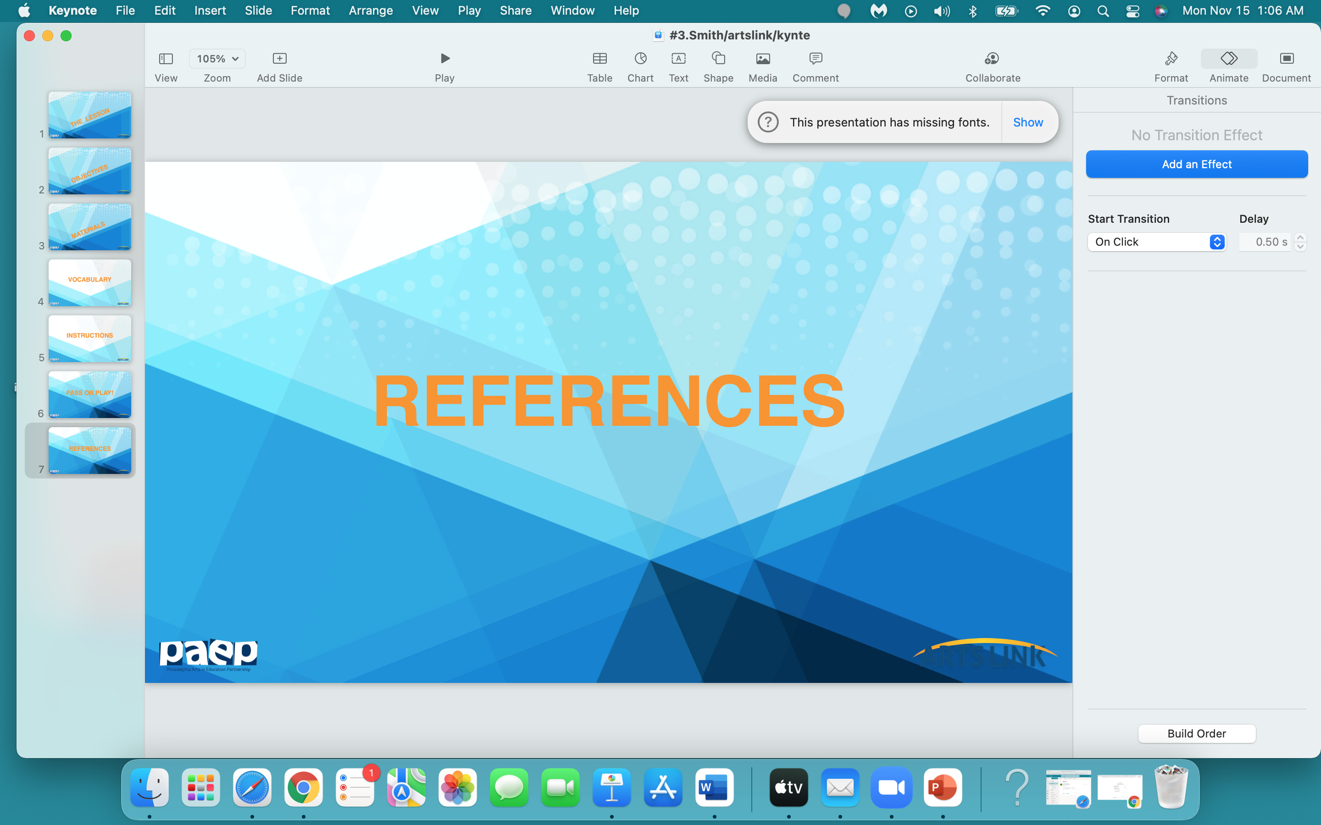

Slide 22
www.timeout.com/newyork/art/top-famous-sculpture-of-all-time
www.artsy.com
en.wikipedia
quatr.us/art/art/alay-history-art
classbento.com.au/art-classes-sydney
www.visual-arts-cork.com/sculpture/terracotta.html
www.designboom.com

