Slide 1
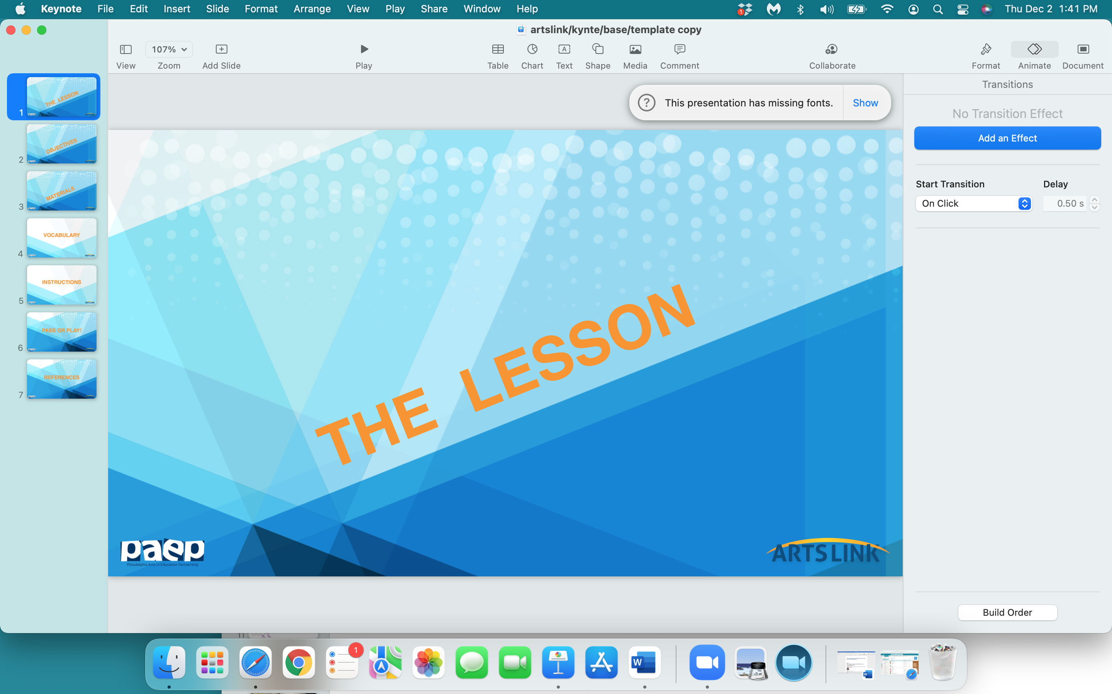

Slide 2
What’s
Your
Story?

Slide 3
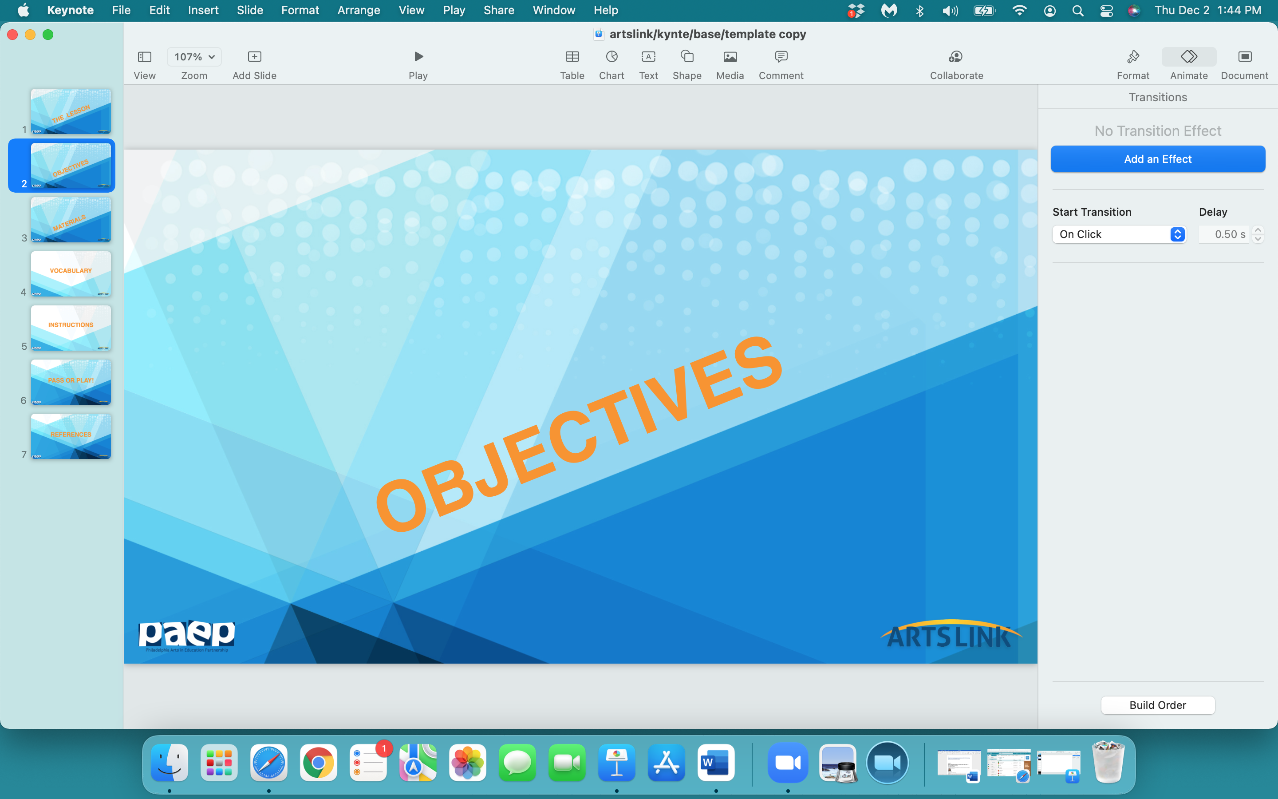

Slide 4
In the next 60 minutes,
your brain will:
- learn why we love, need & create stories
- understand what stories ‘do’ to our brain
- establish a relationship between 10 unrelated things
and create a visual ‘story’

Slide 5
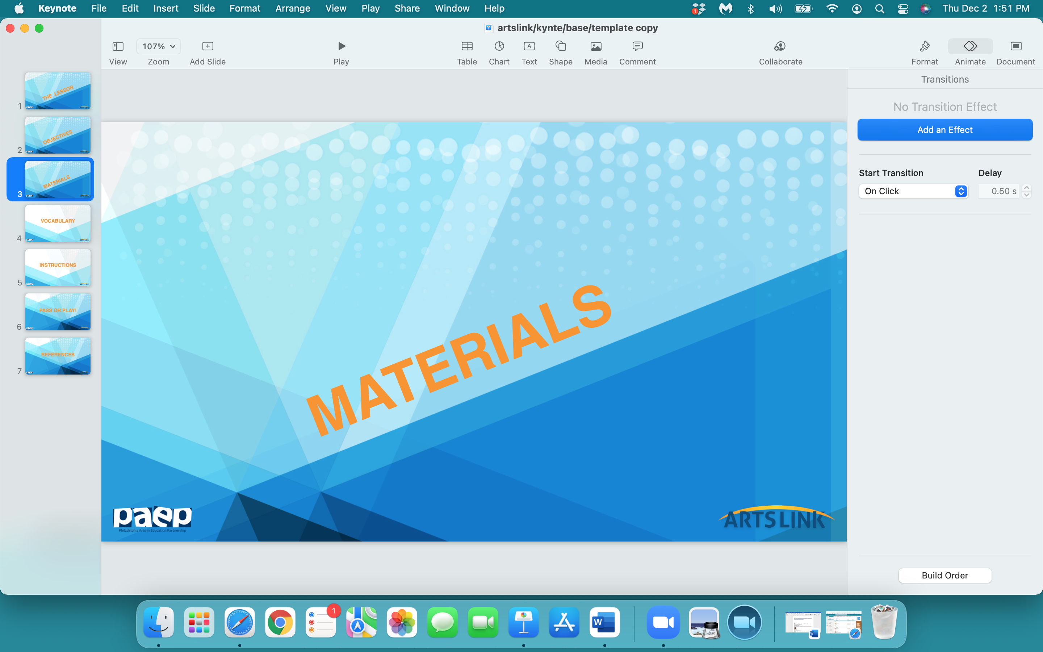

Slide 6
Materials for this lesson:
notebook
sheet from drawing pad
pencil
drawing utensils - markers, colored pencils
eraser

Slide 7
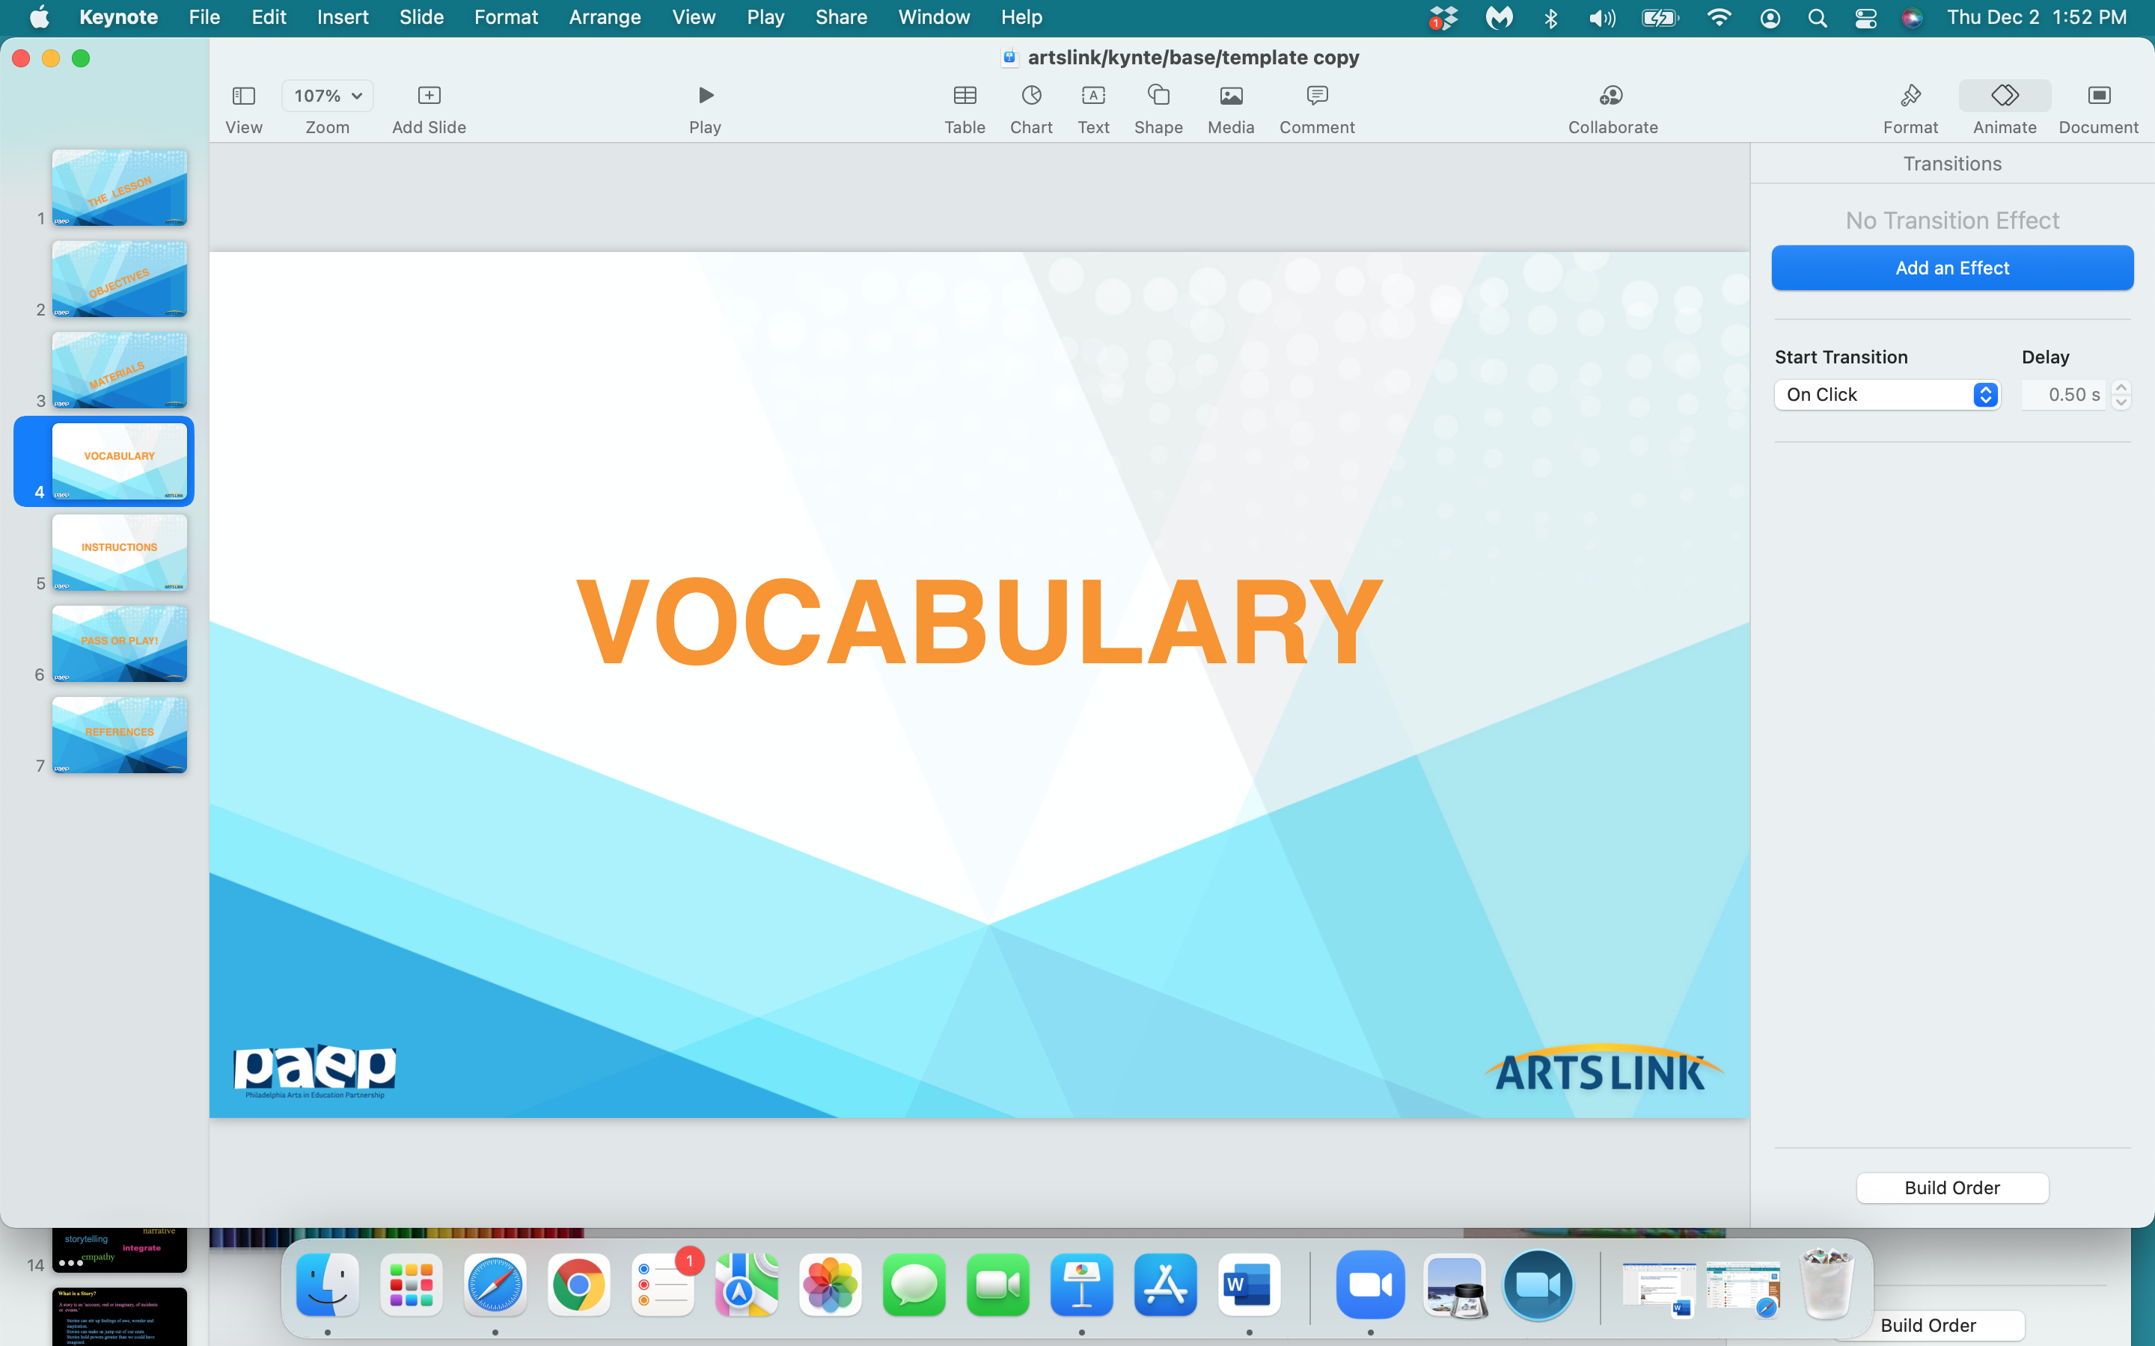

Slide 8
vocabulary words:
  story
  narrative
  storytelling
  integrate
  illustration empathy

Slide 9
Story
      A story is an ‘account, real or imaginary, of events.
      Stories can stir up feelings of awe, wonder and inspiration.
Stories can make us jump out of our seats.
Stories hold powers greater than we could have imagined.
Stories can effect how your brain functions.

Slide 10
  narrative:
  a written or spoken account of
  connected events;
  a story

Slide 11
  storytelling:
  the act of telling a story,
  sometimes with improvisation, theatrics or adding details to make the story more interesting.
  Every culture creates its own stories.

Slide 12
  integrate:
  to unite or combine,
  complete to produce a whole
  or a larger unit

Slide 13
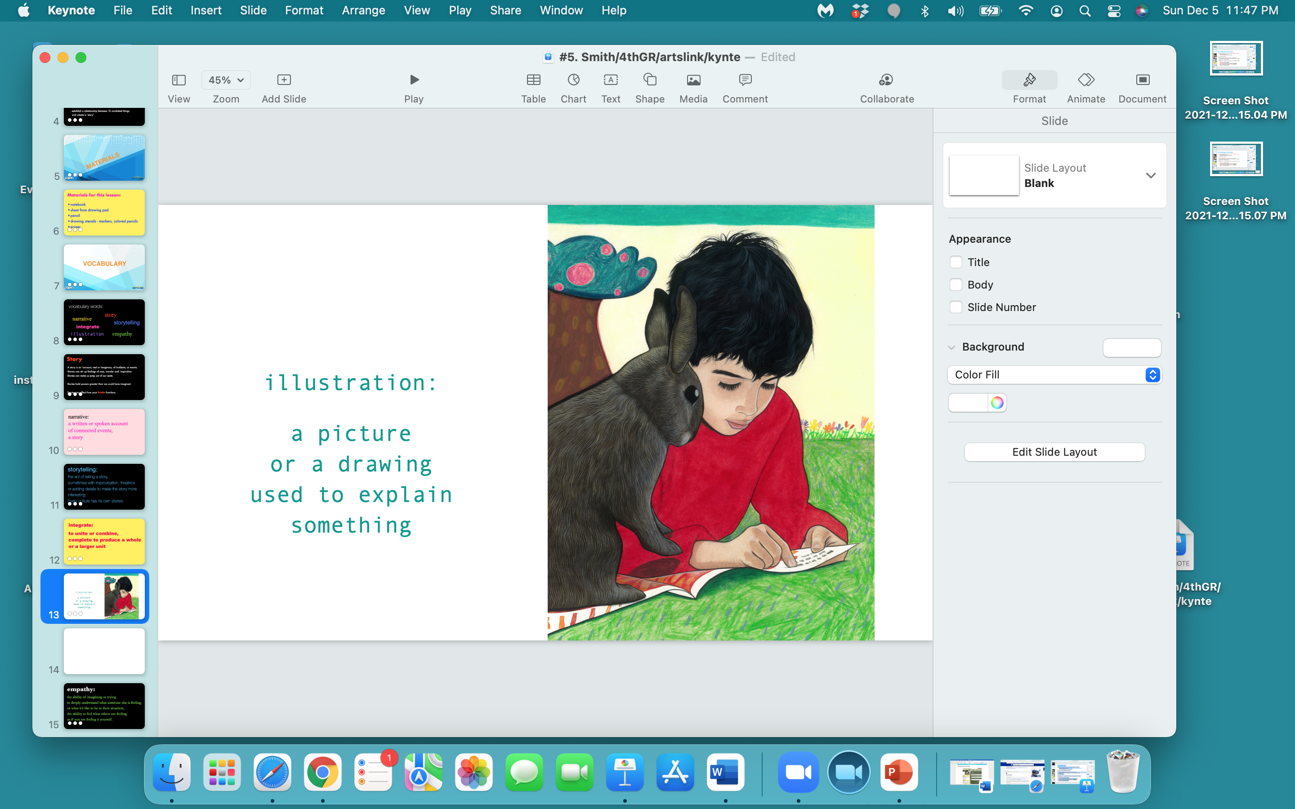

Slide 14
  empathy:
  the ability of imagining or trying
  to deeply understand what someone else is feeling, or what it’s like to be in their situation;
  the ability to feel what others are feeling, as if you are feeling it yourself.

Slide 15
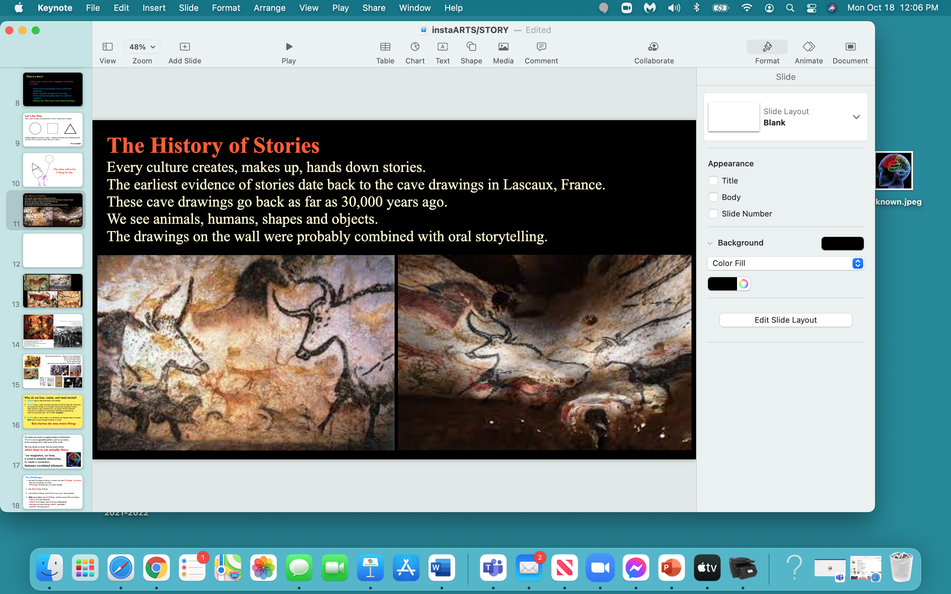

Slide 16
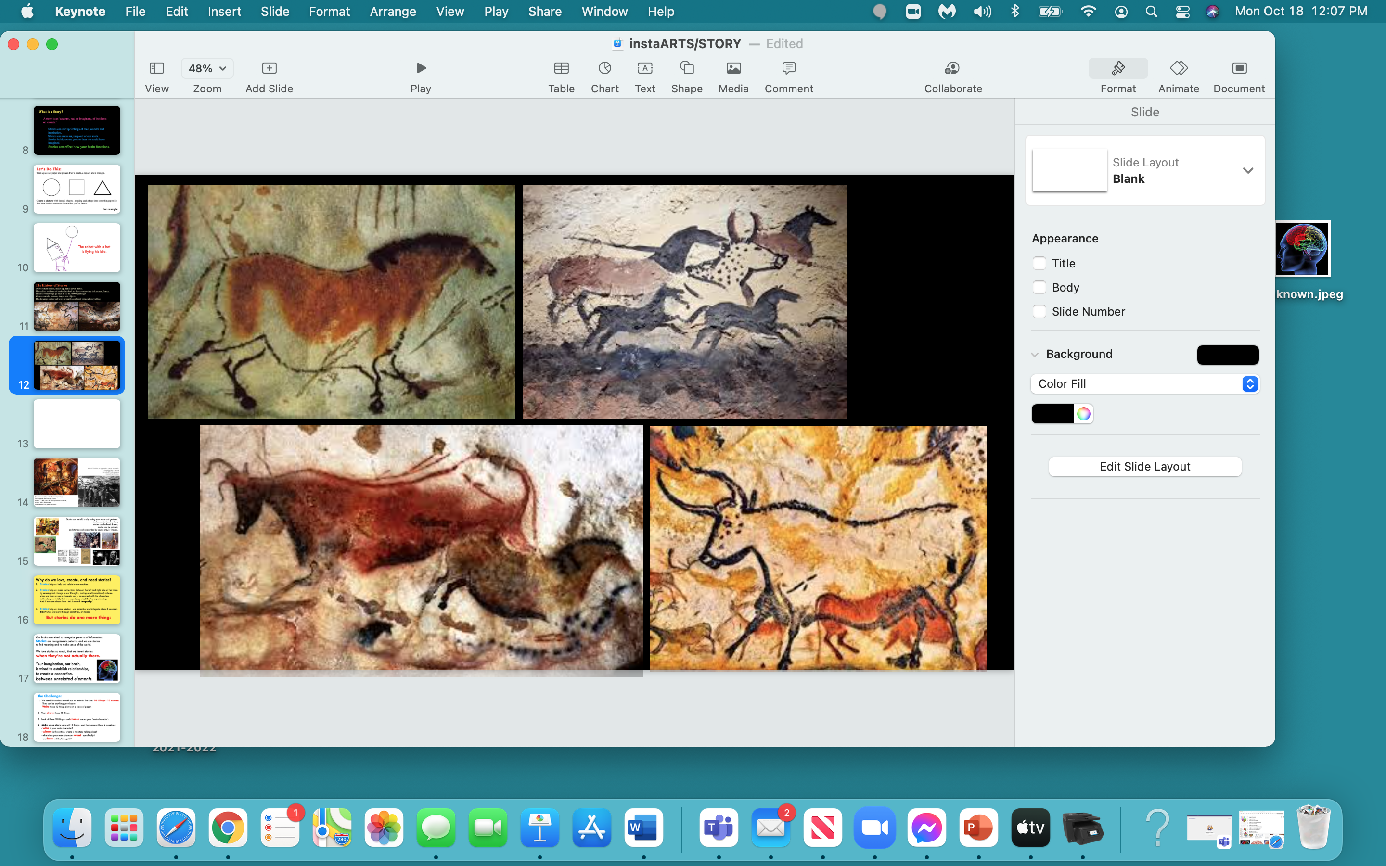

Slide 17
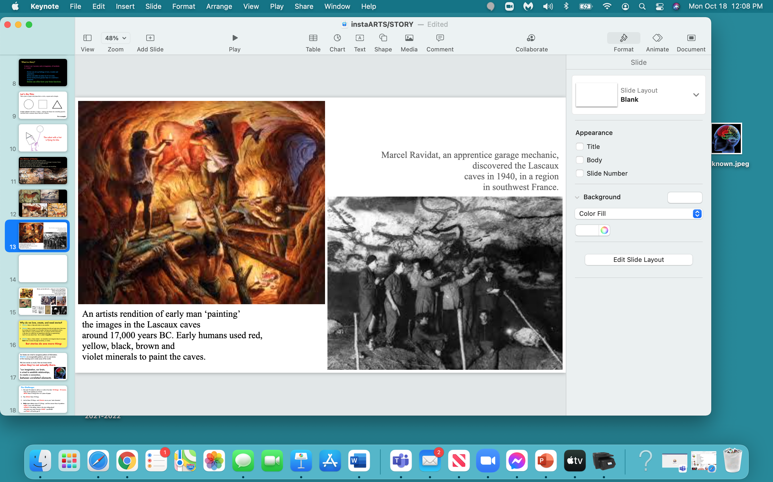

Slide 18
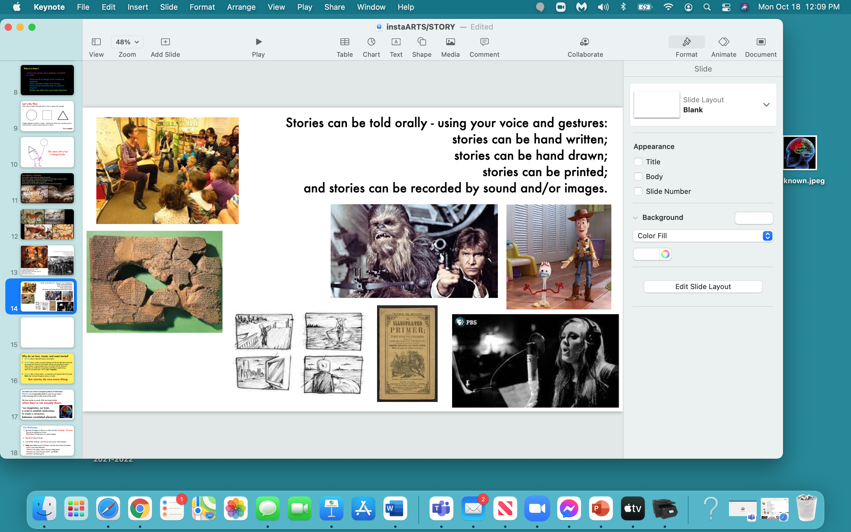

Slide 19
Why do we love, create, and need stories?
Stories help us: relate to one another.
Stories help us: make connections between the left and right side of the brain by causing real change to our thoughts, feelings and (sometimes) actions - when we hear or see a dramatic story, we connect with the characters in the story so vividly that we experience what they’re experiencing. And if we care about them - this is called ‘empathy’.
Stories help us: share wisdom - we remember and integrate ideas & concepts best when we learn through narratives, or stories.
But stories do one more thing:

Slide 20
Here’s the
POINT
of this
whole lesson…

Slide 21
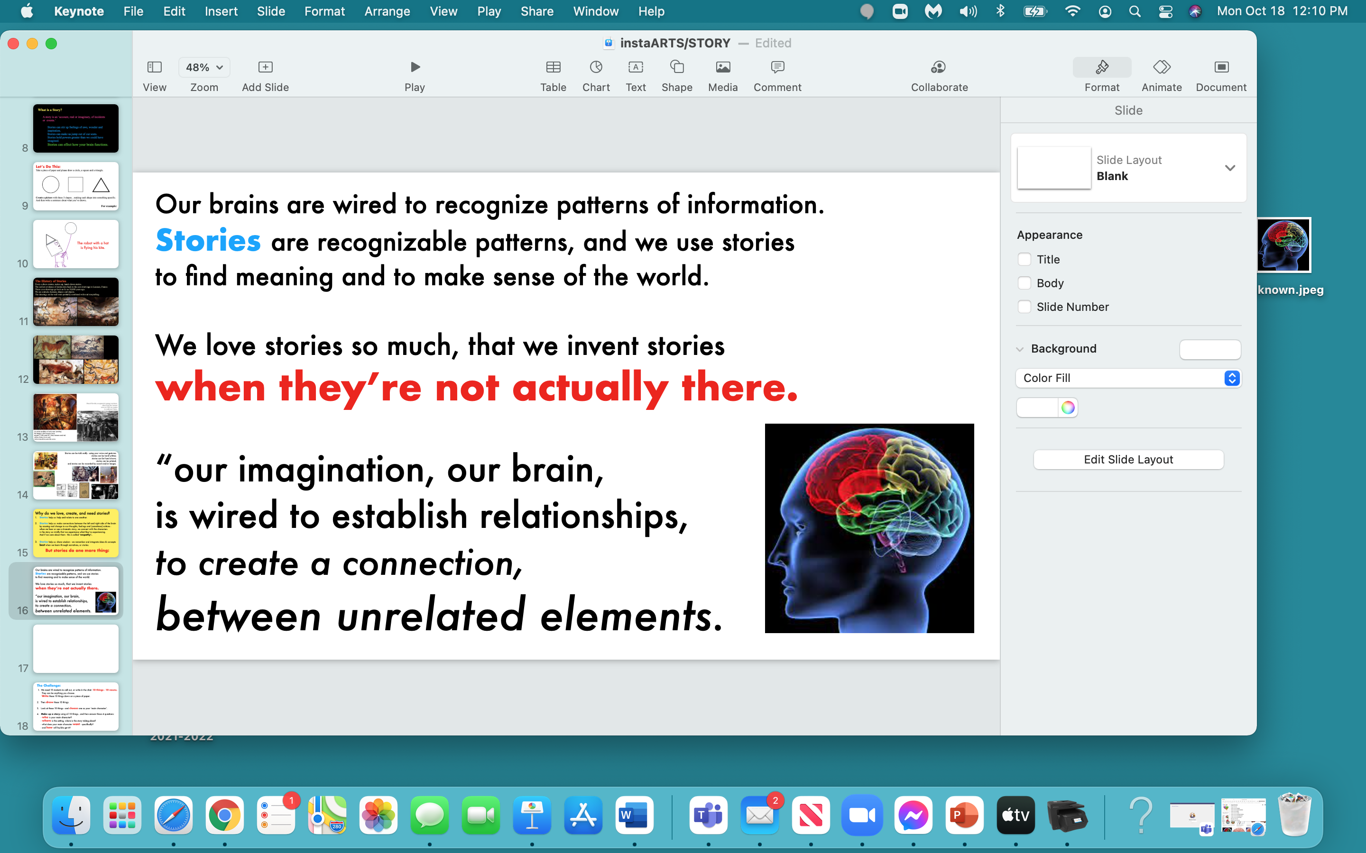

Slide 22
  our imagination, our brain,
  is wired to establish relationships,
  to create a connection…
  between unrelated elements.

Slide 23
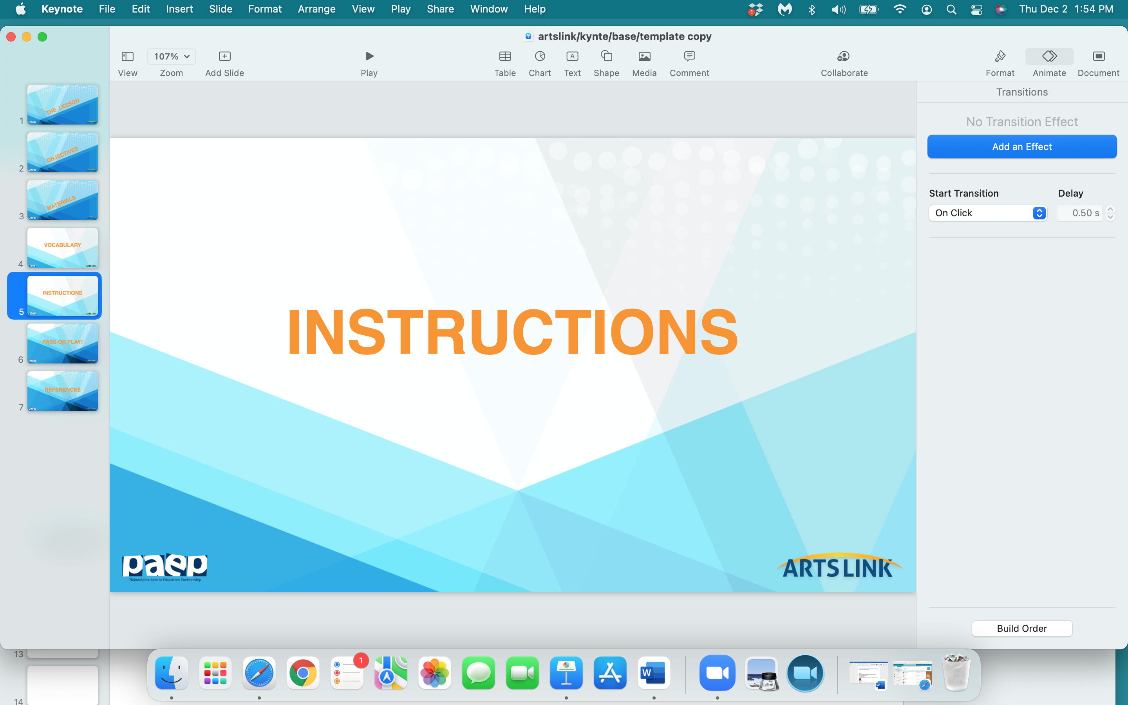

Slide 24
You‘re all going to make an illustration…
tell a story using pictures…
from unrelated elements.

Slide 25
1. We need 10 students to call out:
10 things - 10 nouns.
They can be anything you choose.
Write these 10 things down in your notebook.

Slide 26
2. Look at these 10 things.
You’re going to create an illustration,
using the 10 things, or the 10 objects.

Slide 27
3. Look at the list of 10 things…
pick one as the main character
of your illustration…
and start… storytelling!

Slide 28
Now - tell the rest of the class about your illustration.
What’s happening in your illustration.
Who is the illustration about?
What’s the story behind the illustration…
what’s going on?

Slide 29
This is what I did:

Slide 30
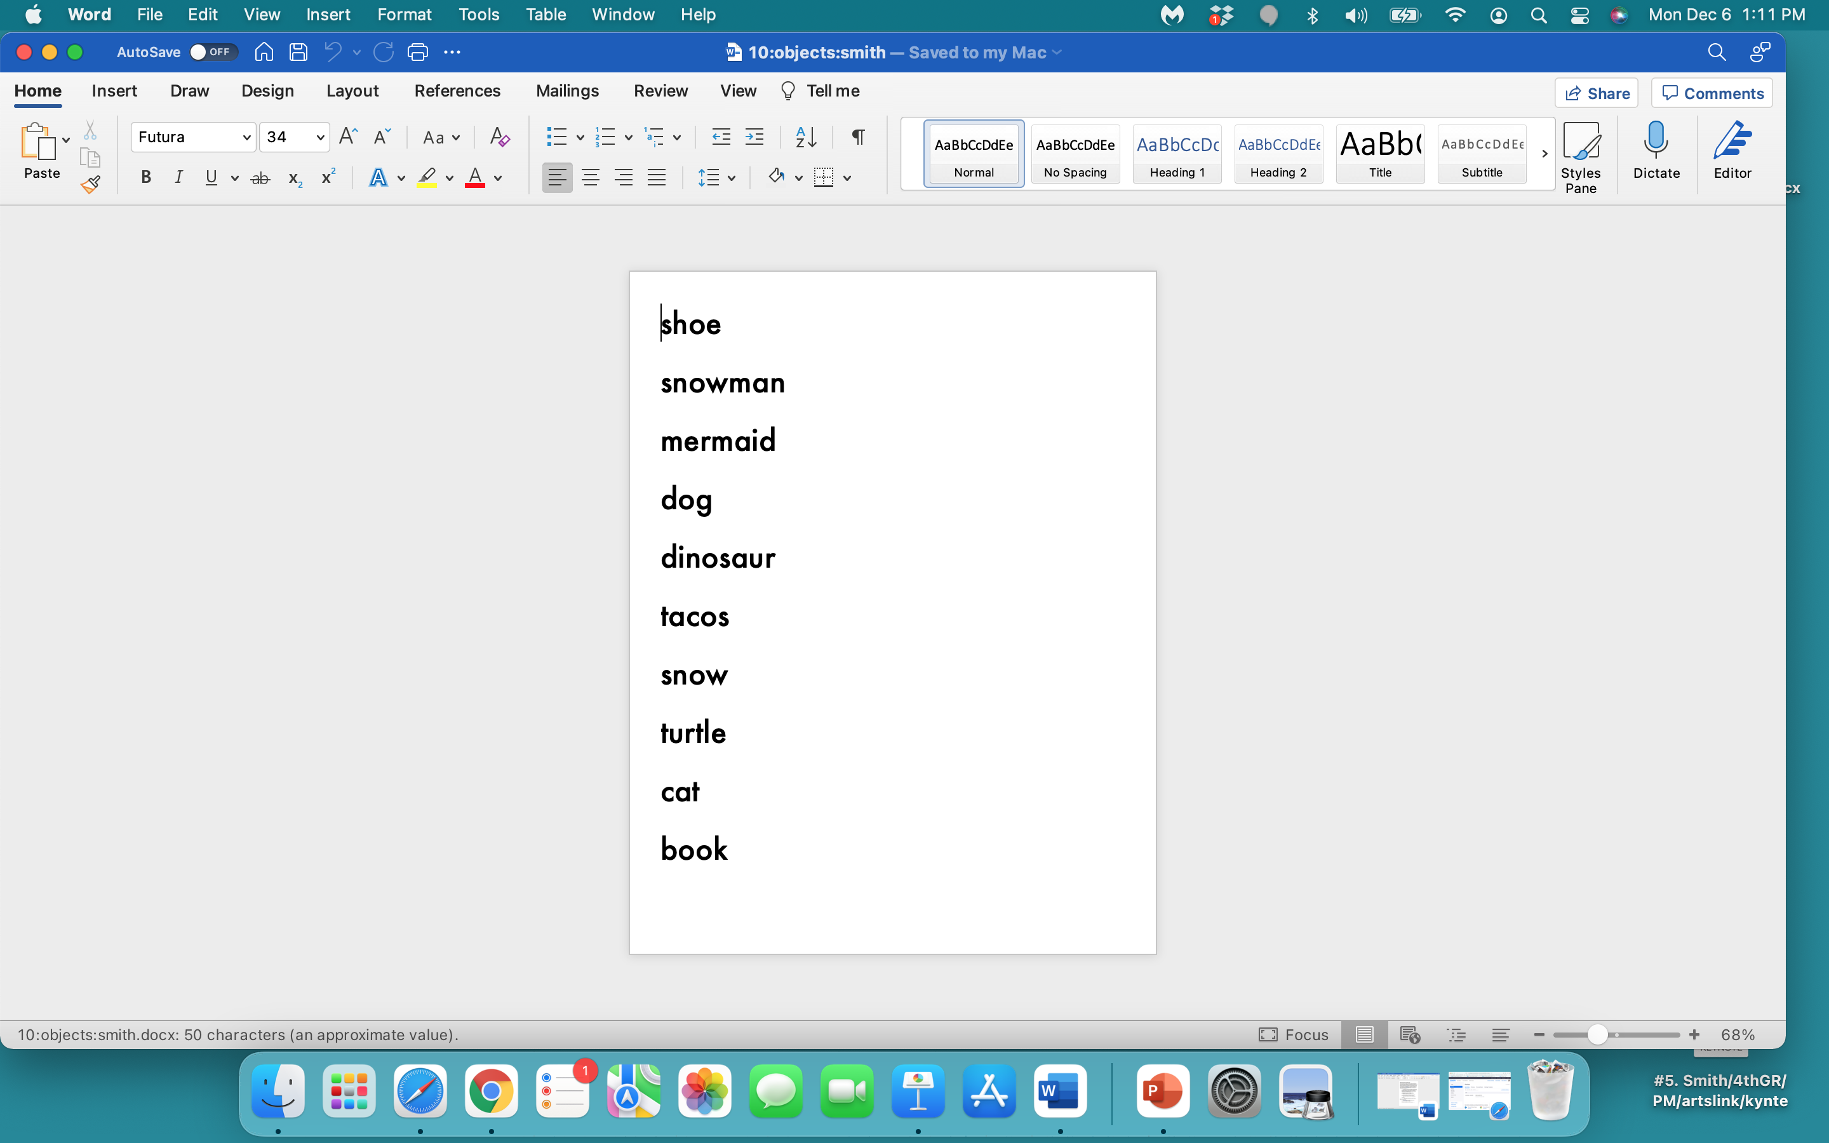

Slide 31
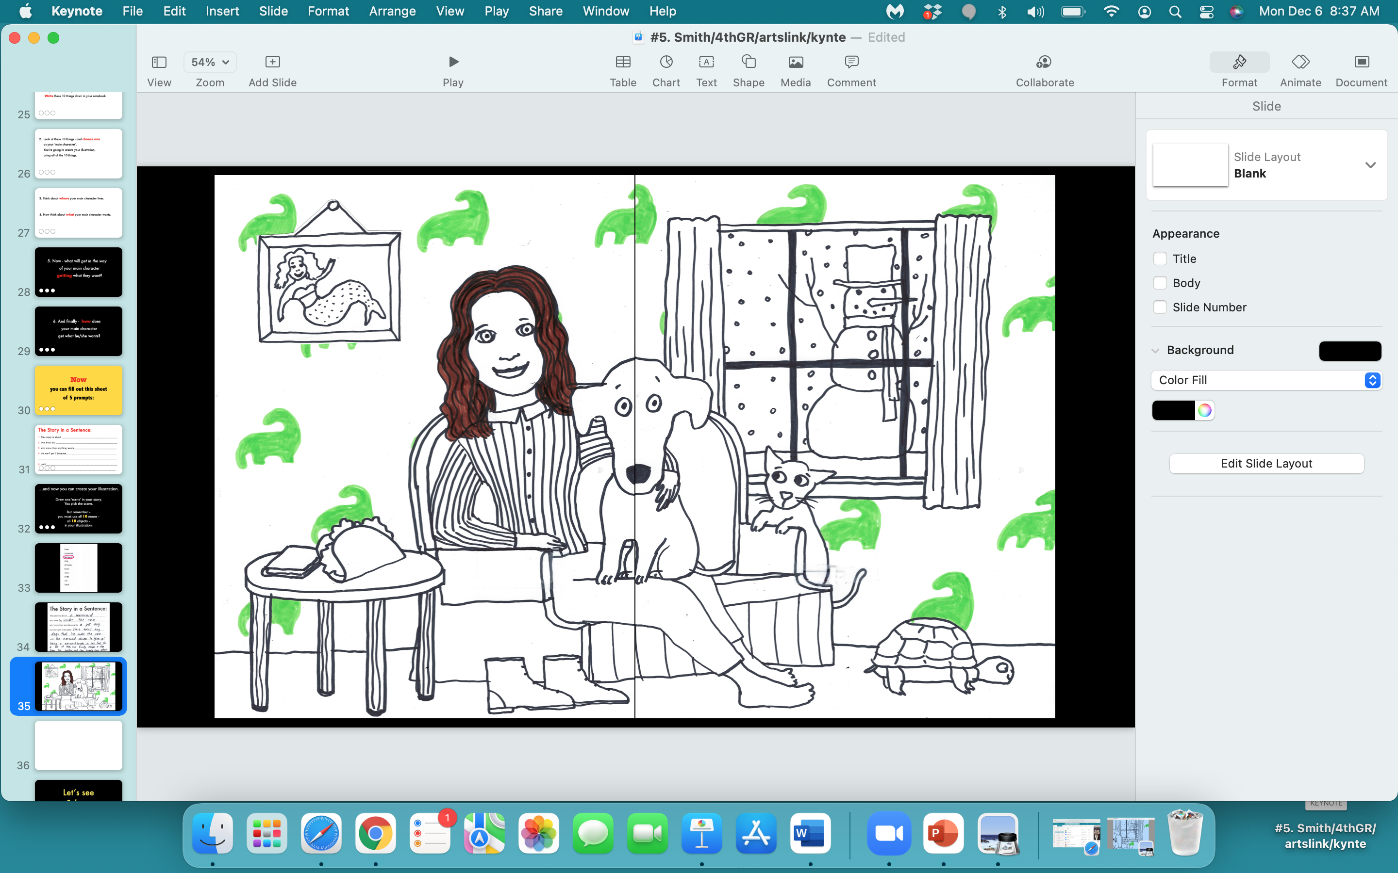

Slide 32
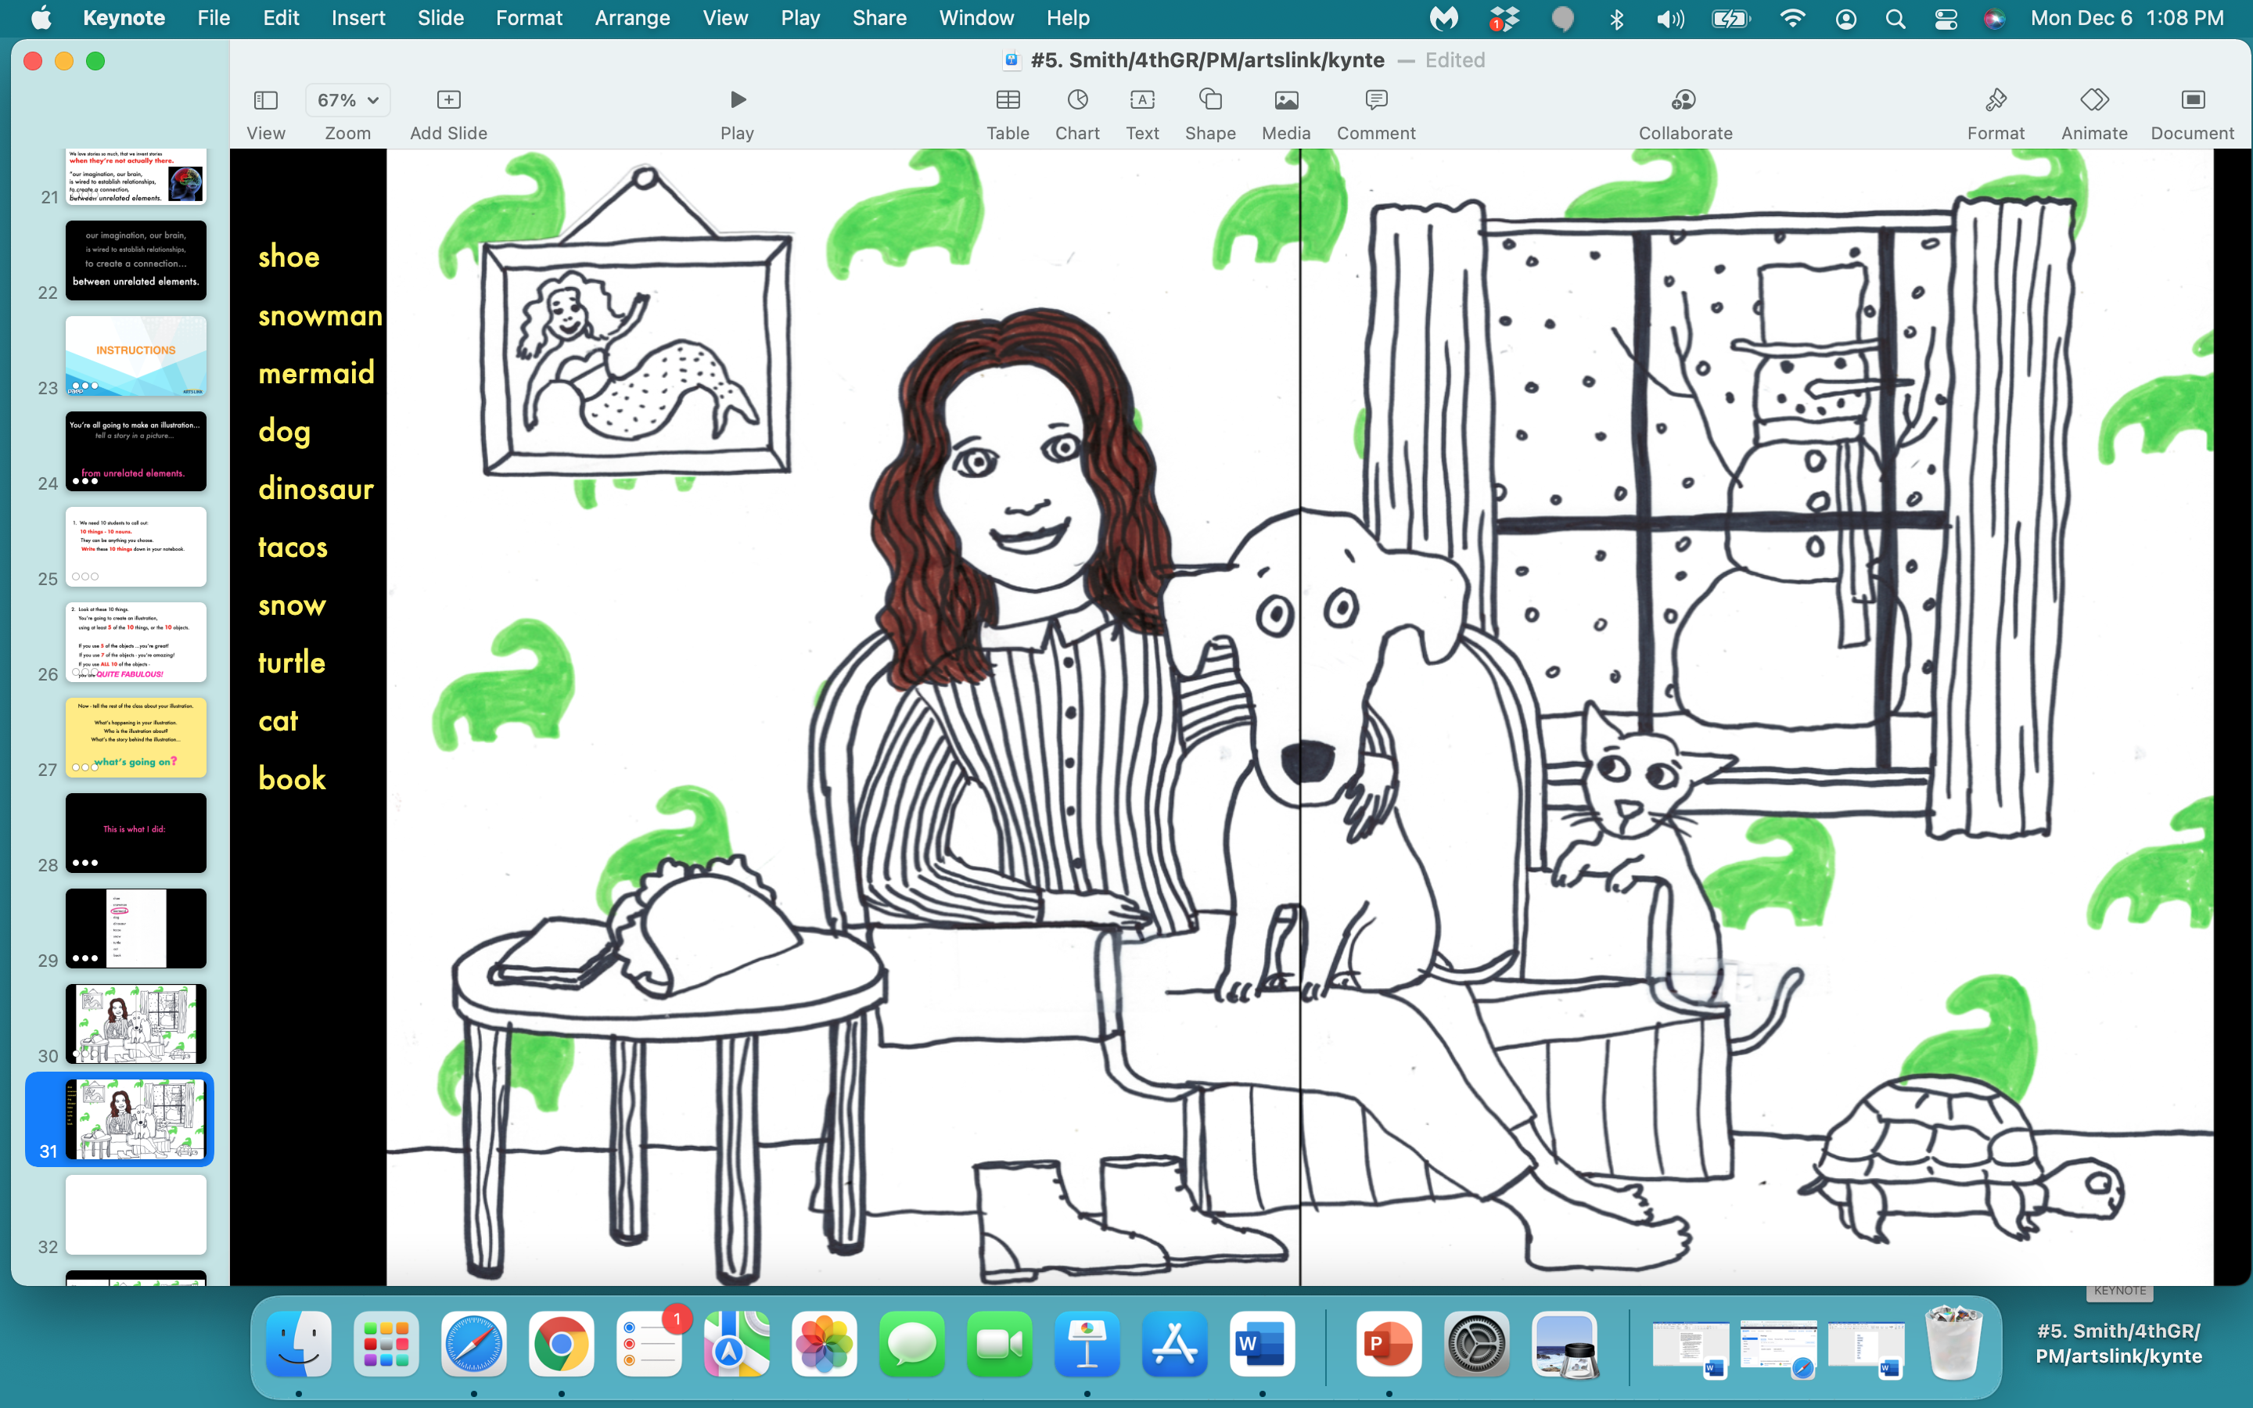

Slide 33
Let’s see
& hear
your stories!

Slide 34
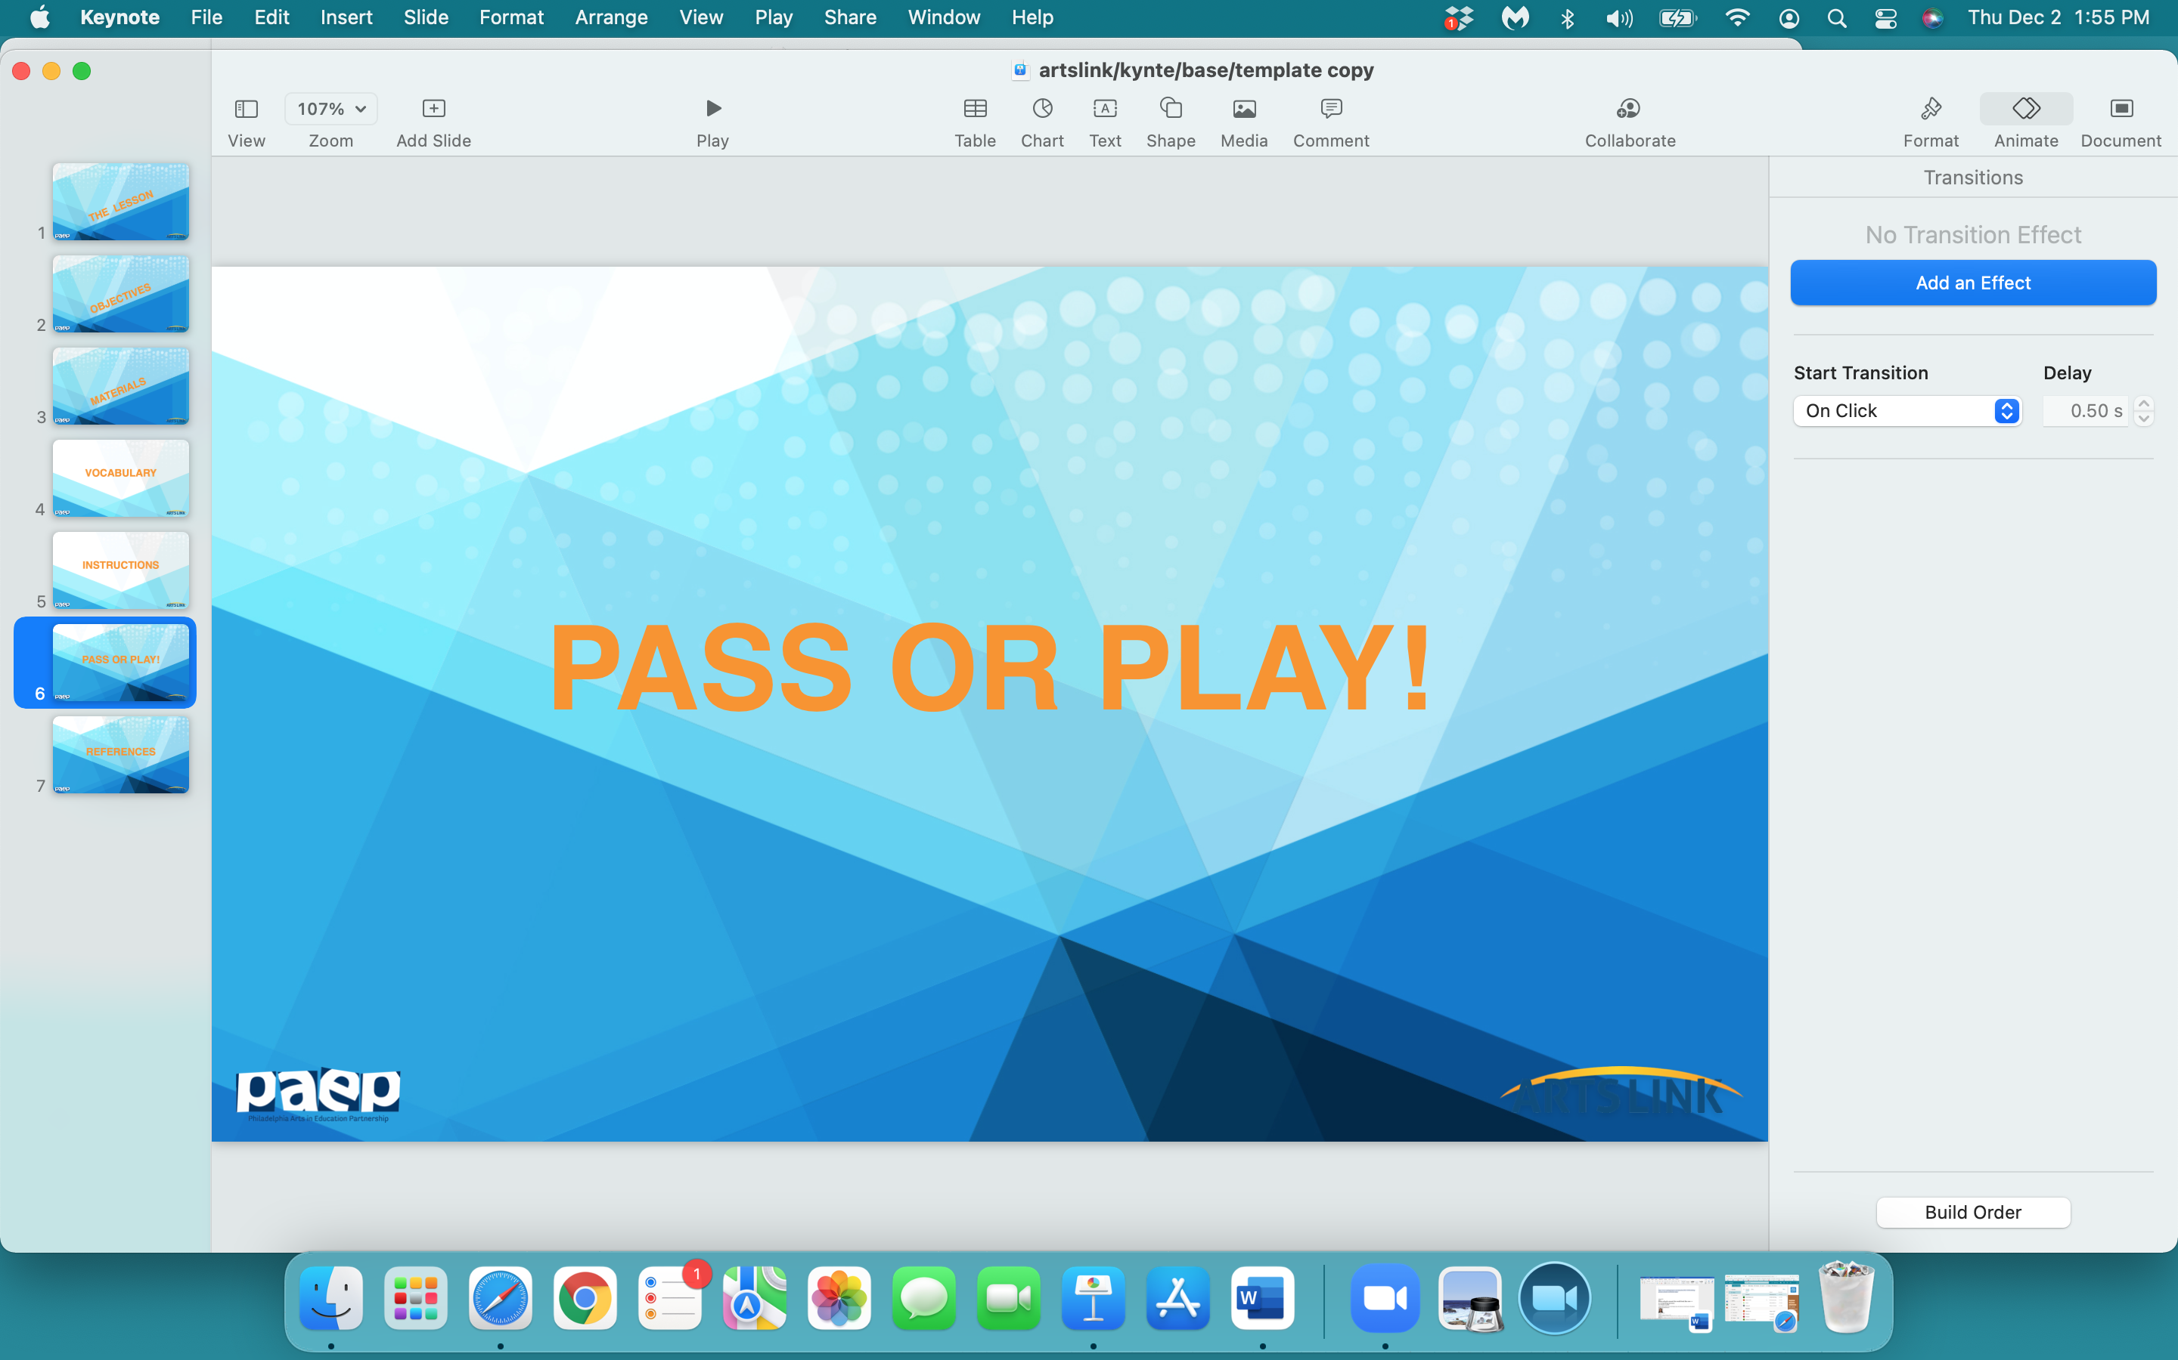

Slide 35
what one thing
did
you
learn
today…pass or play?

Slide 36
