Slide 1


Slide 2
What
Colors
Do You Hear?
What
Colors
Do You Feel?

Slide 3


Slide 4
In the next 60 minutes, your brain will:
explore the concept of abstract art and the work of Wassily Kandinsky
identify shape, form and color used in Kandinsky’s work
create an abstract artwork, experimenting with shape, form and color,
inspired by music
appreciate the work of other students inspired by Kandinsky

Slide 5


Slide 6
notebook (journal)
sheet(s) from your sketch pad
pencil
black permanent marker
watercolors
brushes
ruler
compass
tub of water
paper towels

Slide 7


Slide 8
abstract art
synesthesia
emotional response
organic shapes
geometric shapes
nonobjective

Slide 9


Slide 10
synesthesia: a condition where a person’s
senses are joined.
People with synesthesia hear a musical note
and see a color, or smell a perfume
and hear a sound, or see a word
and taste a flavor.

Slide 11
emotional response: an emotional reaction
or response, such as happiness, fear, anger, sadness -
to an event, situation, a person, people, things
or situations; how one reacts to something, an event, a person

Slide 12
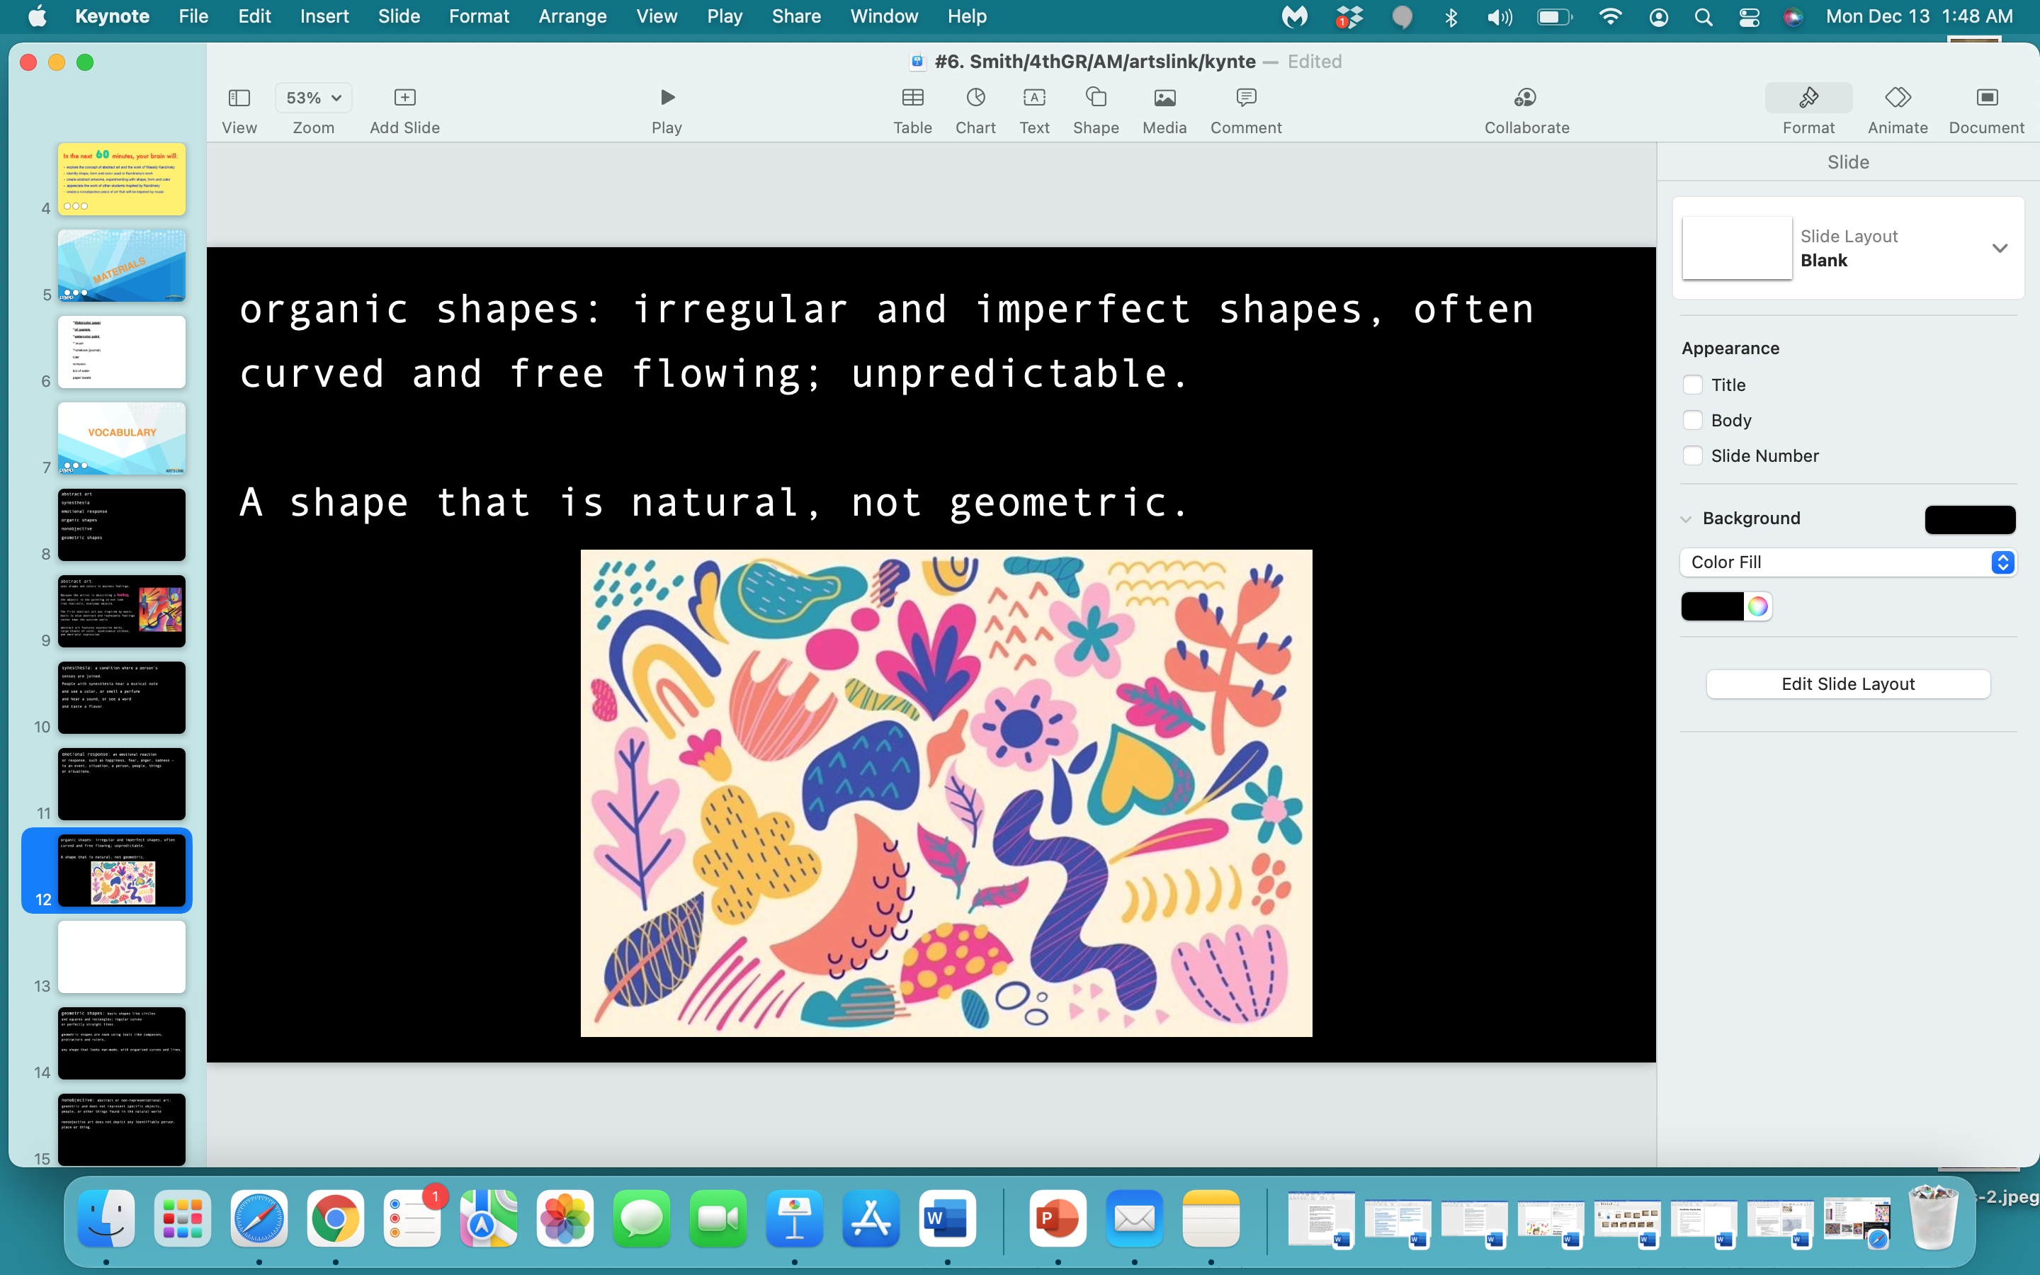

Slide 13
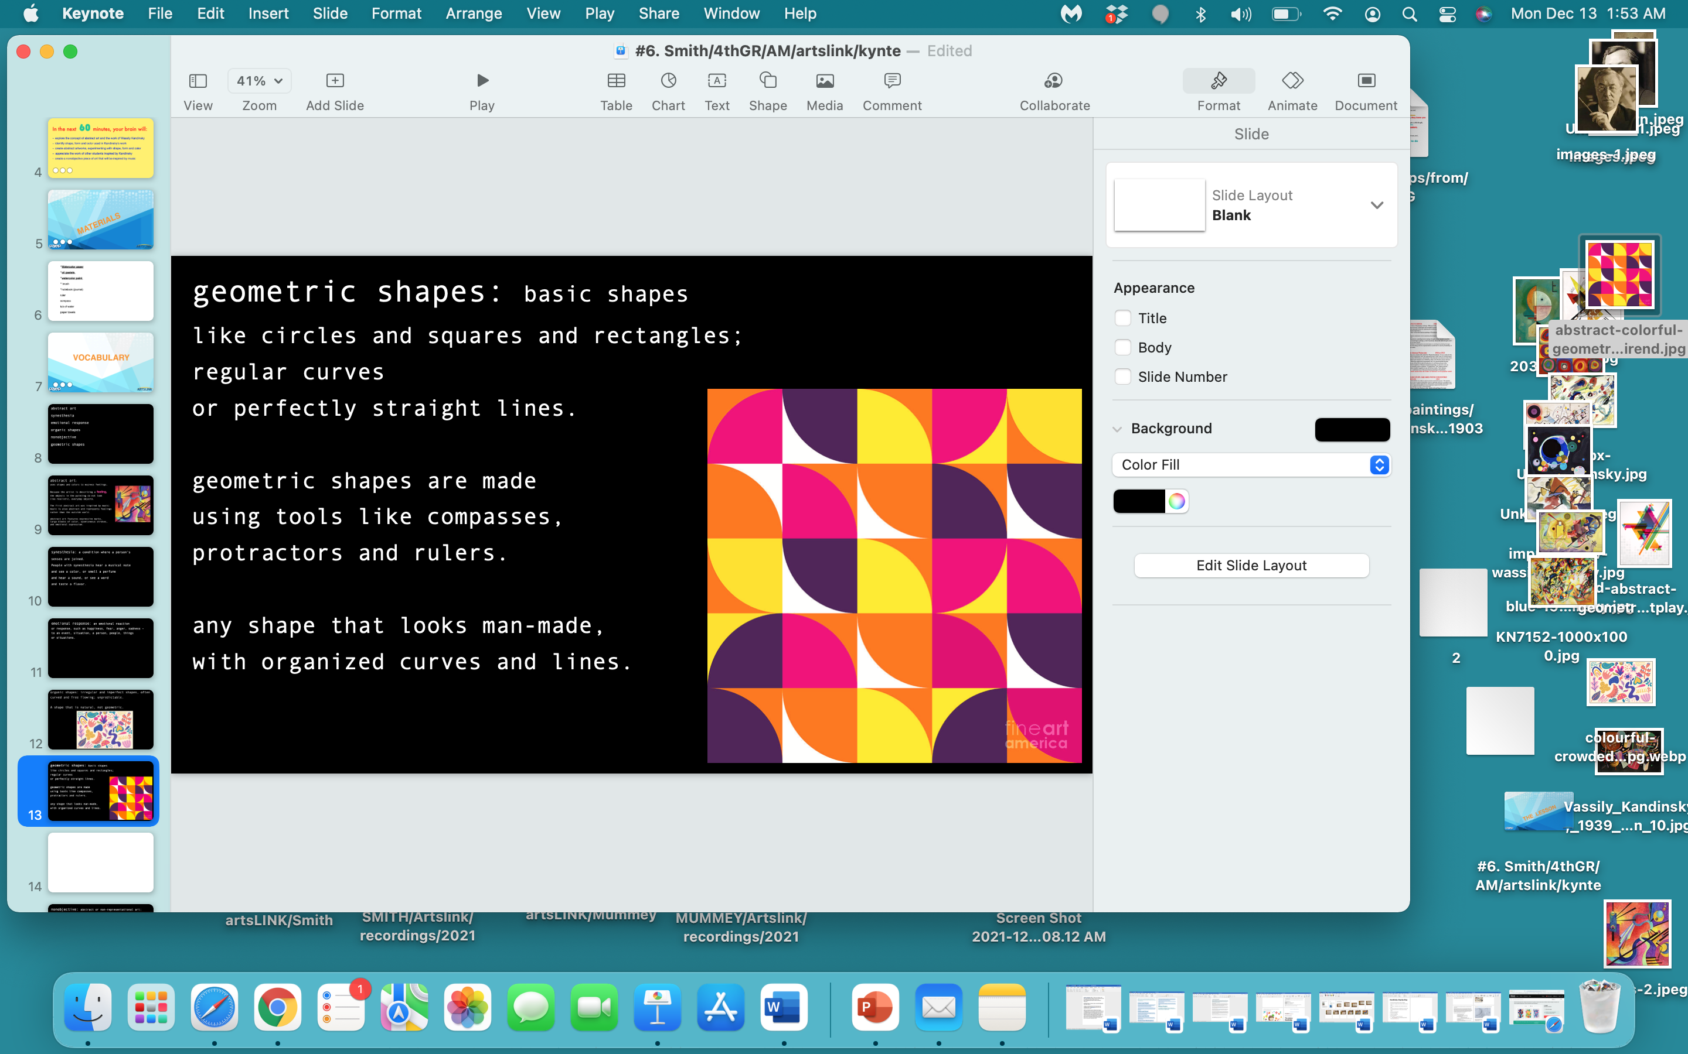

Slide 14
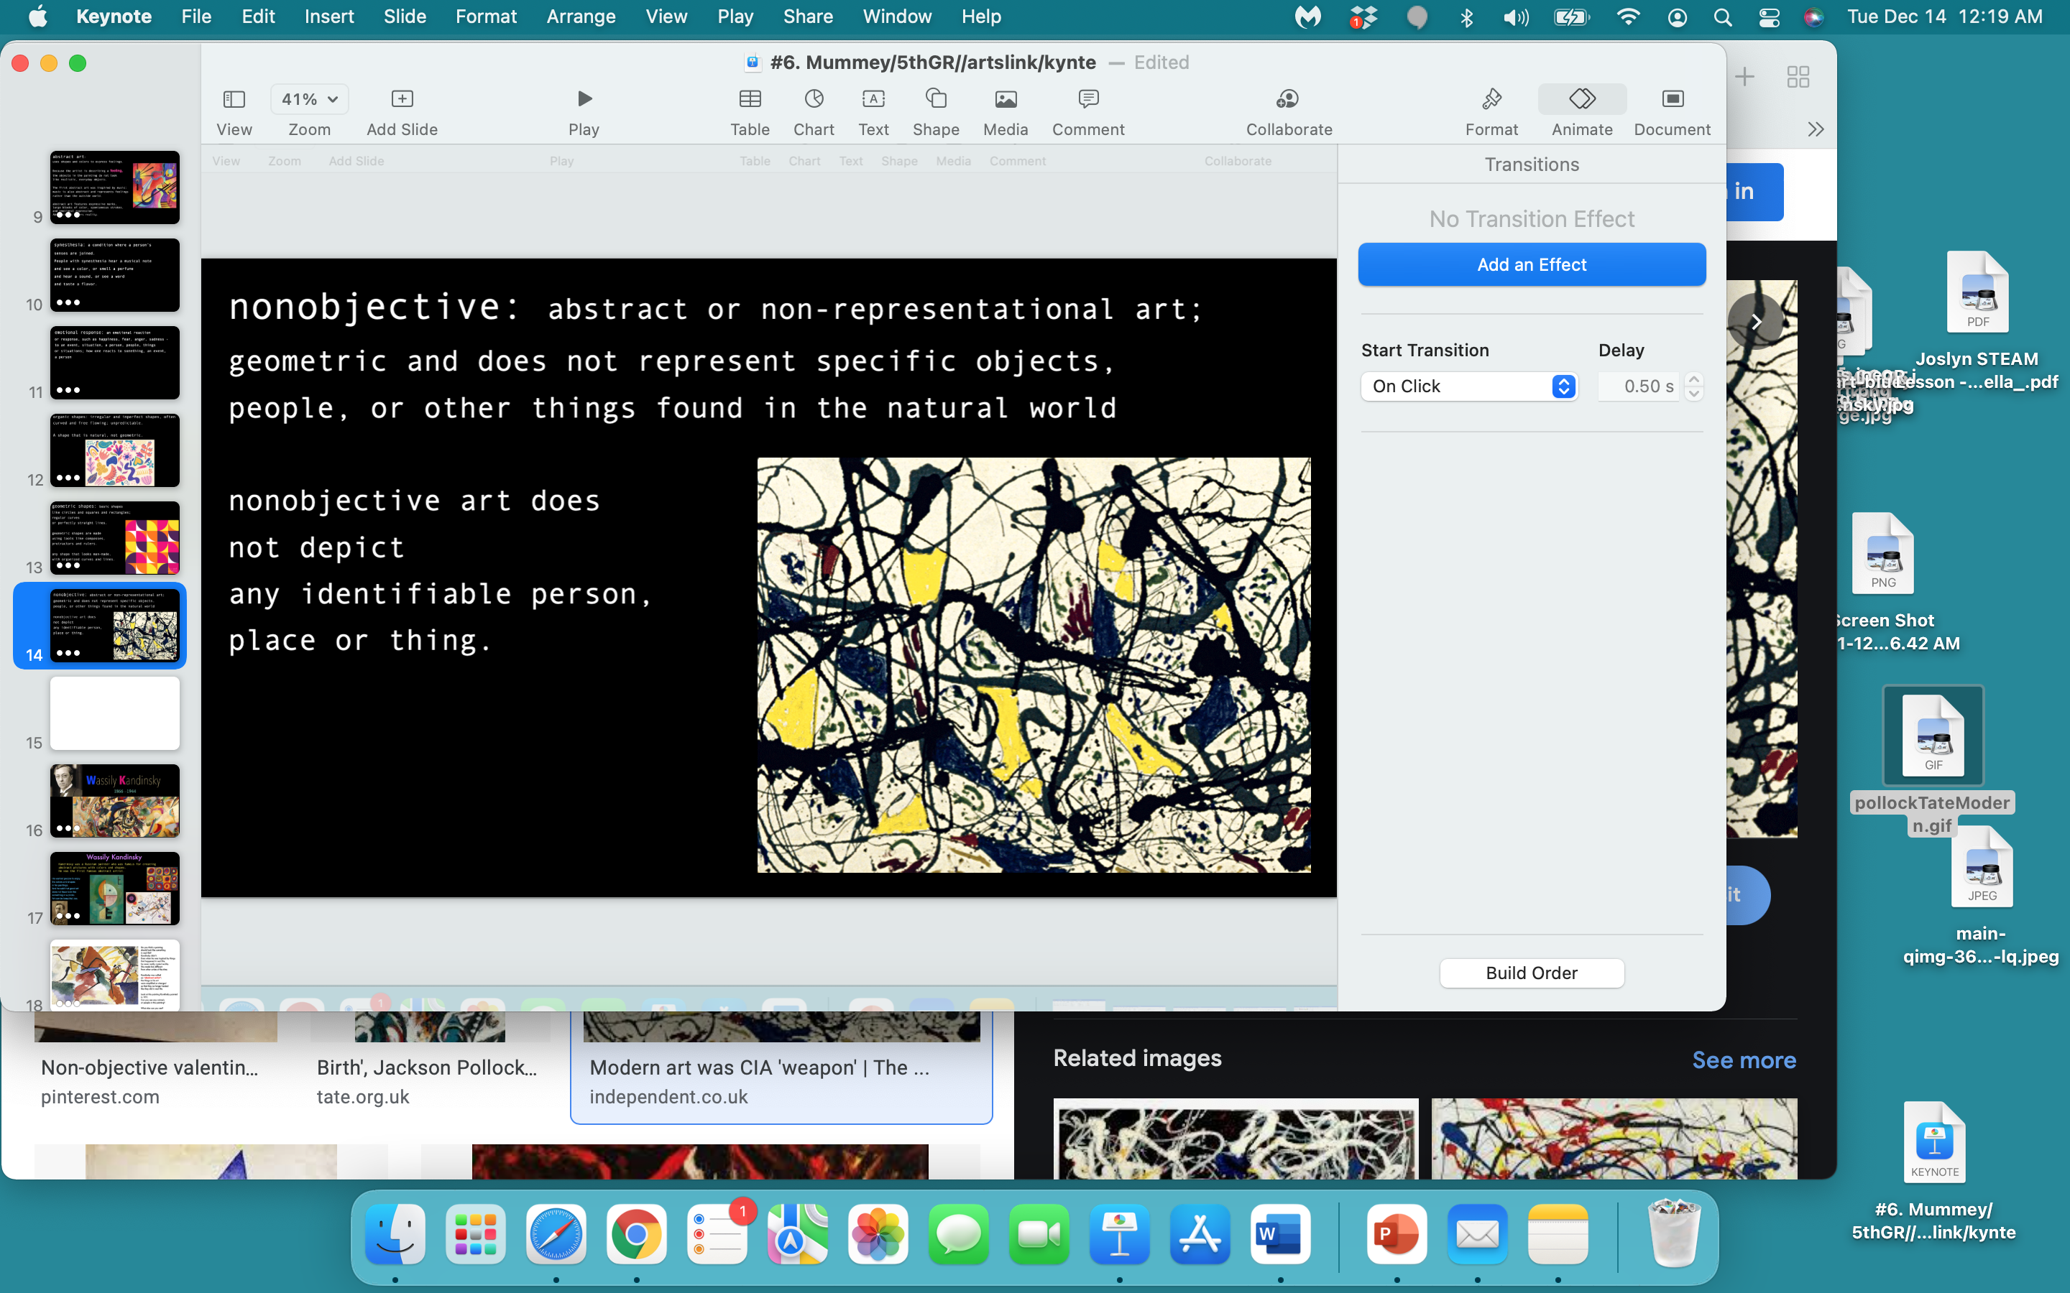

Slide 15
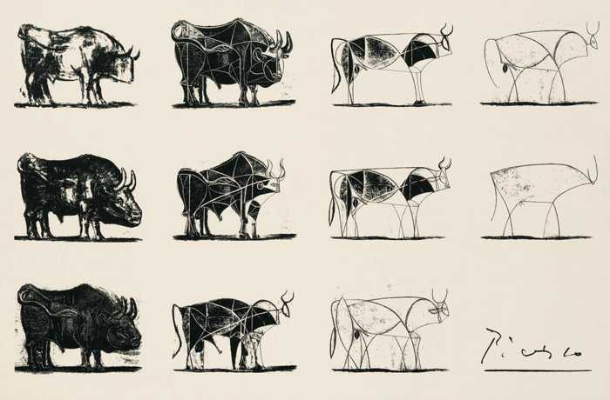

Slide 16
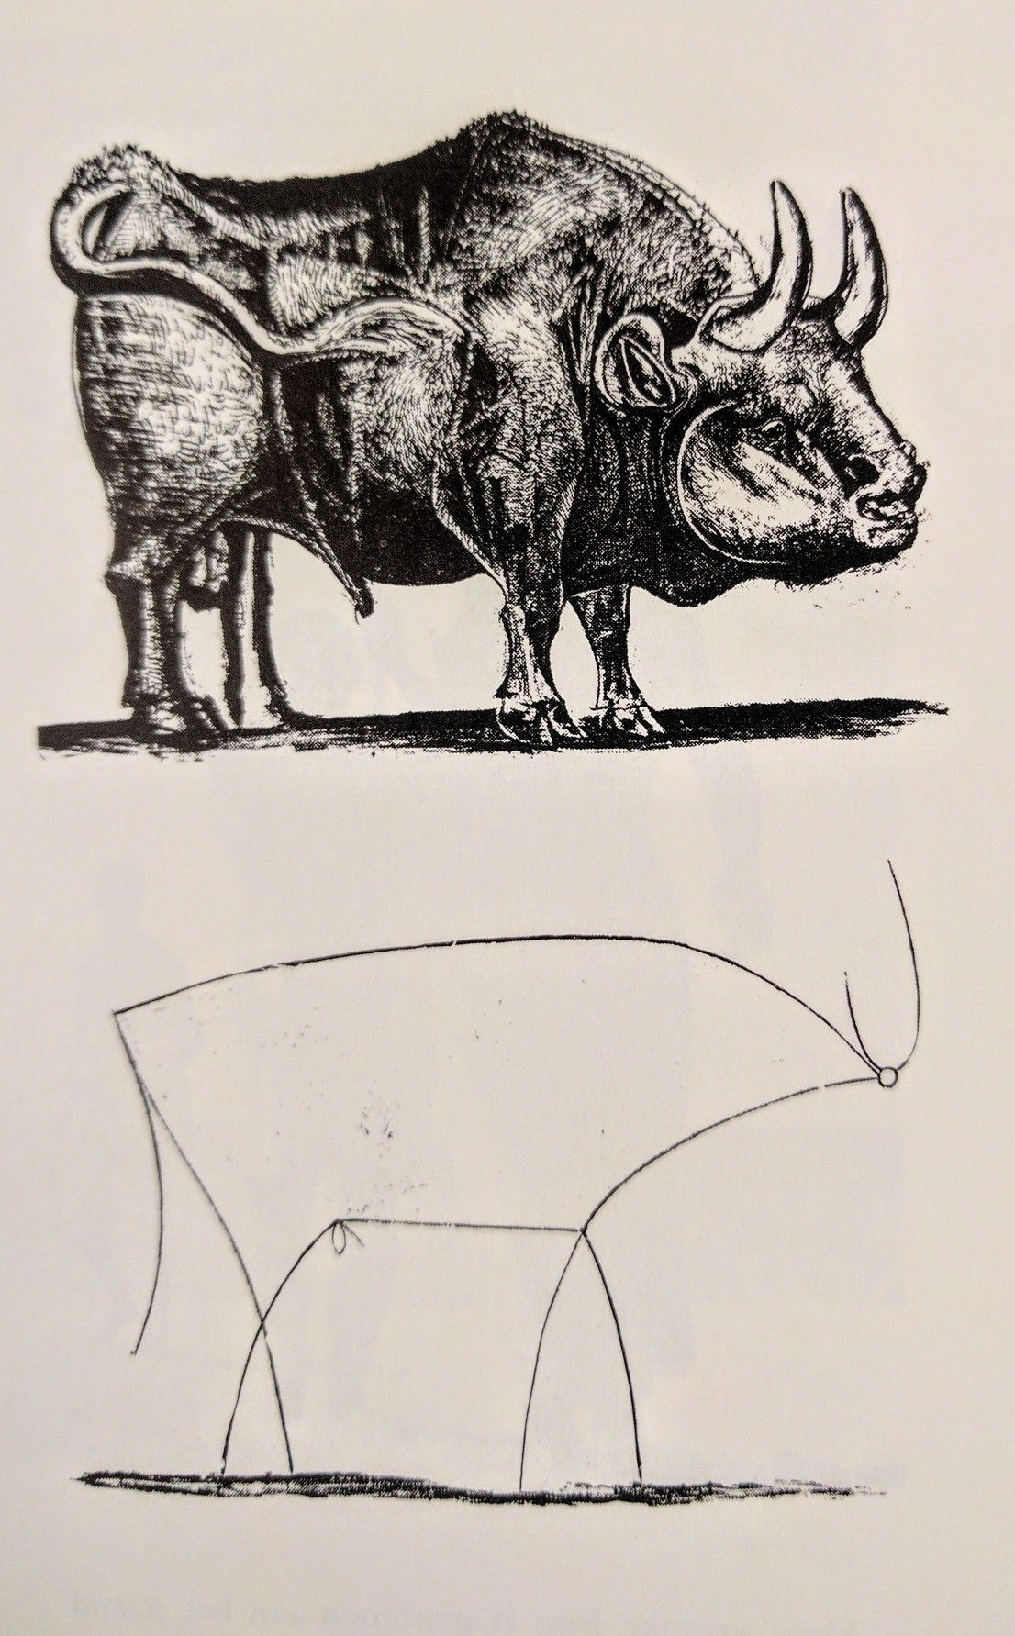

Slide 17
A quick exercise:
I’m going to show you 3 objects.
Pick one of the 3 objects
and draw or interpret it, using as few lines as possible,
reducing the object to its most basic elements -
an abstracted image.

Slide 18


Slide 19


Slide 20
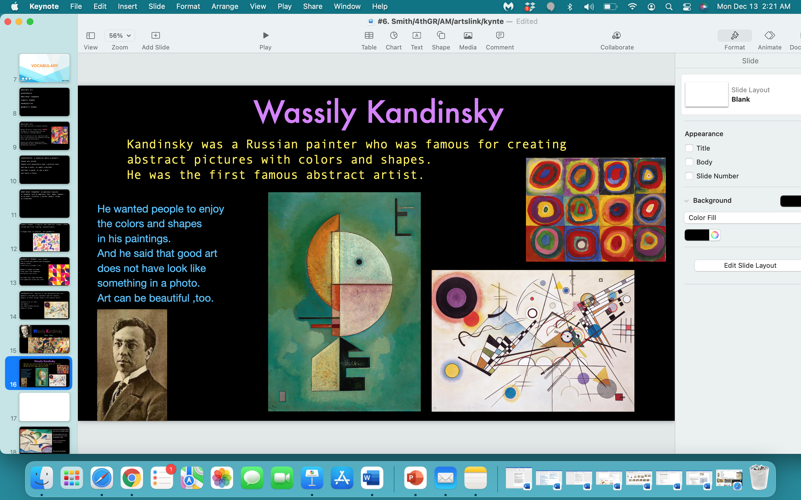

Slide 21
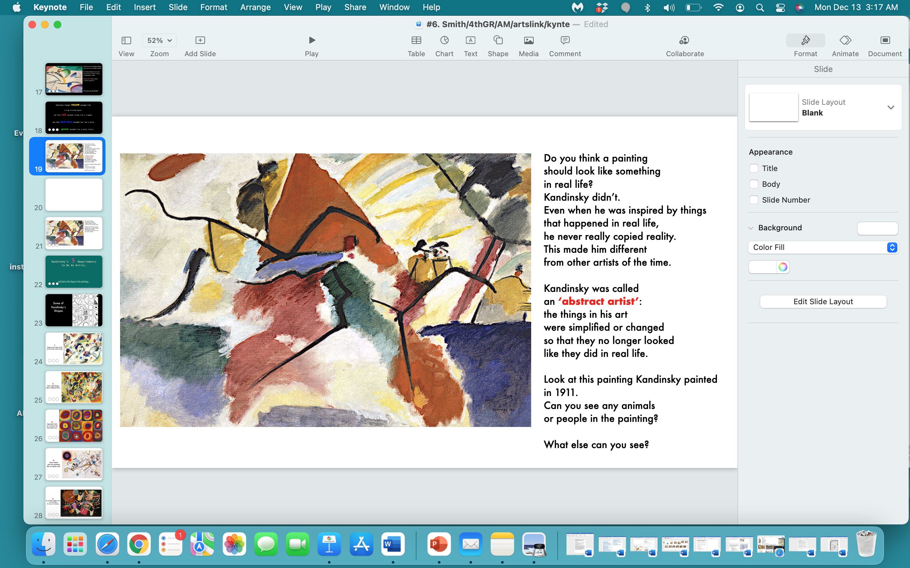

Slide 22
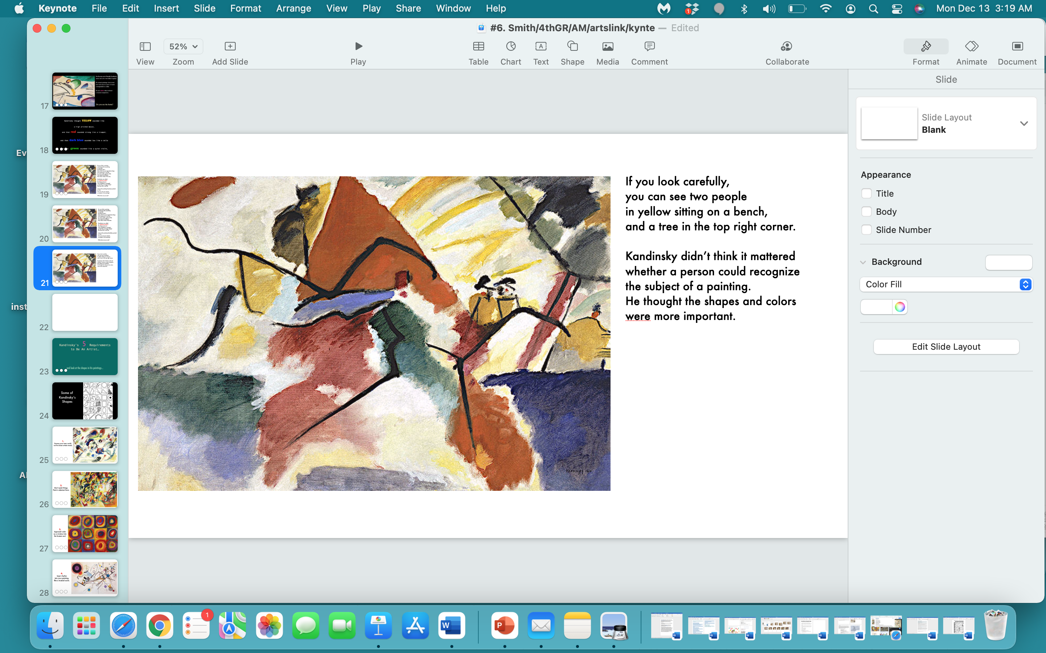

Slide 23
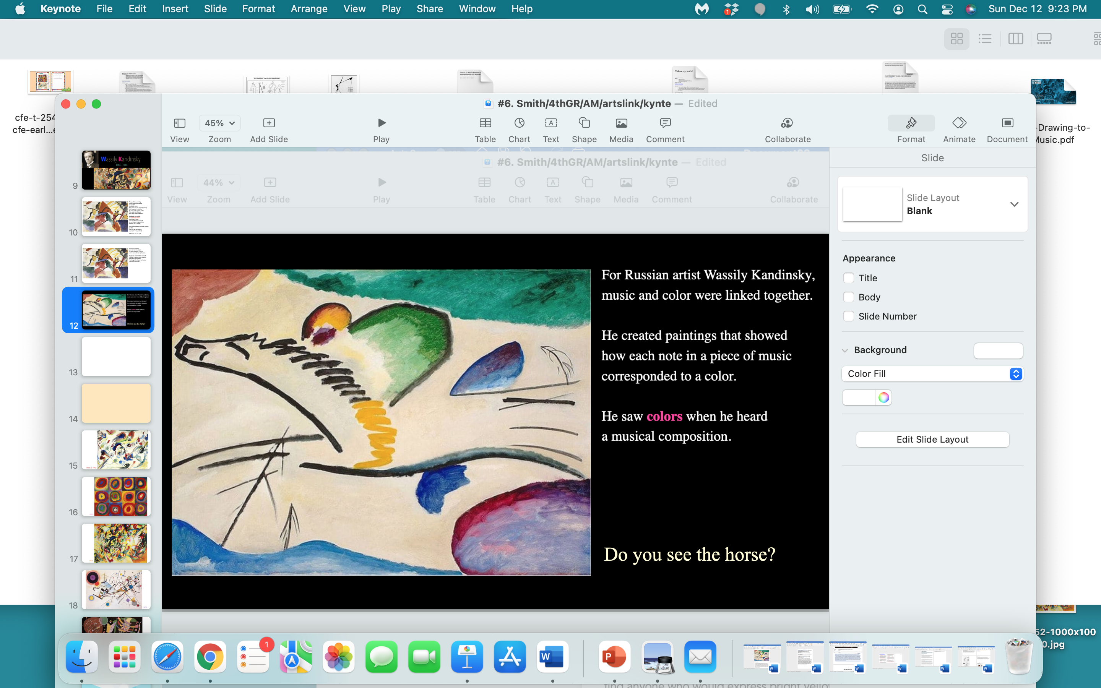

Slide 24
Kandinsky thought yellow sounded like
a high pitched mouse…
and that red sounded strong like a trumpet,
and that dark blue sounded low like a cello
and that green sounded like a quiet violin…

Slide 25
Kandinsky’s 5 Requirements
to Be An Artist…
and look at the shapes in his paintings…

Slide 26
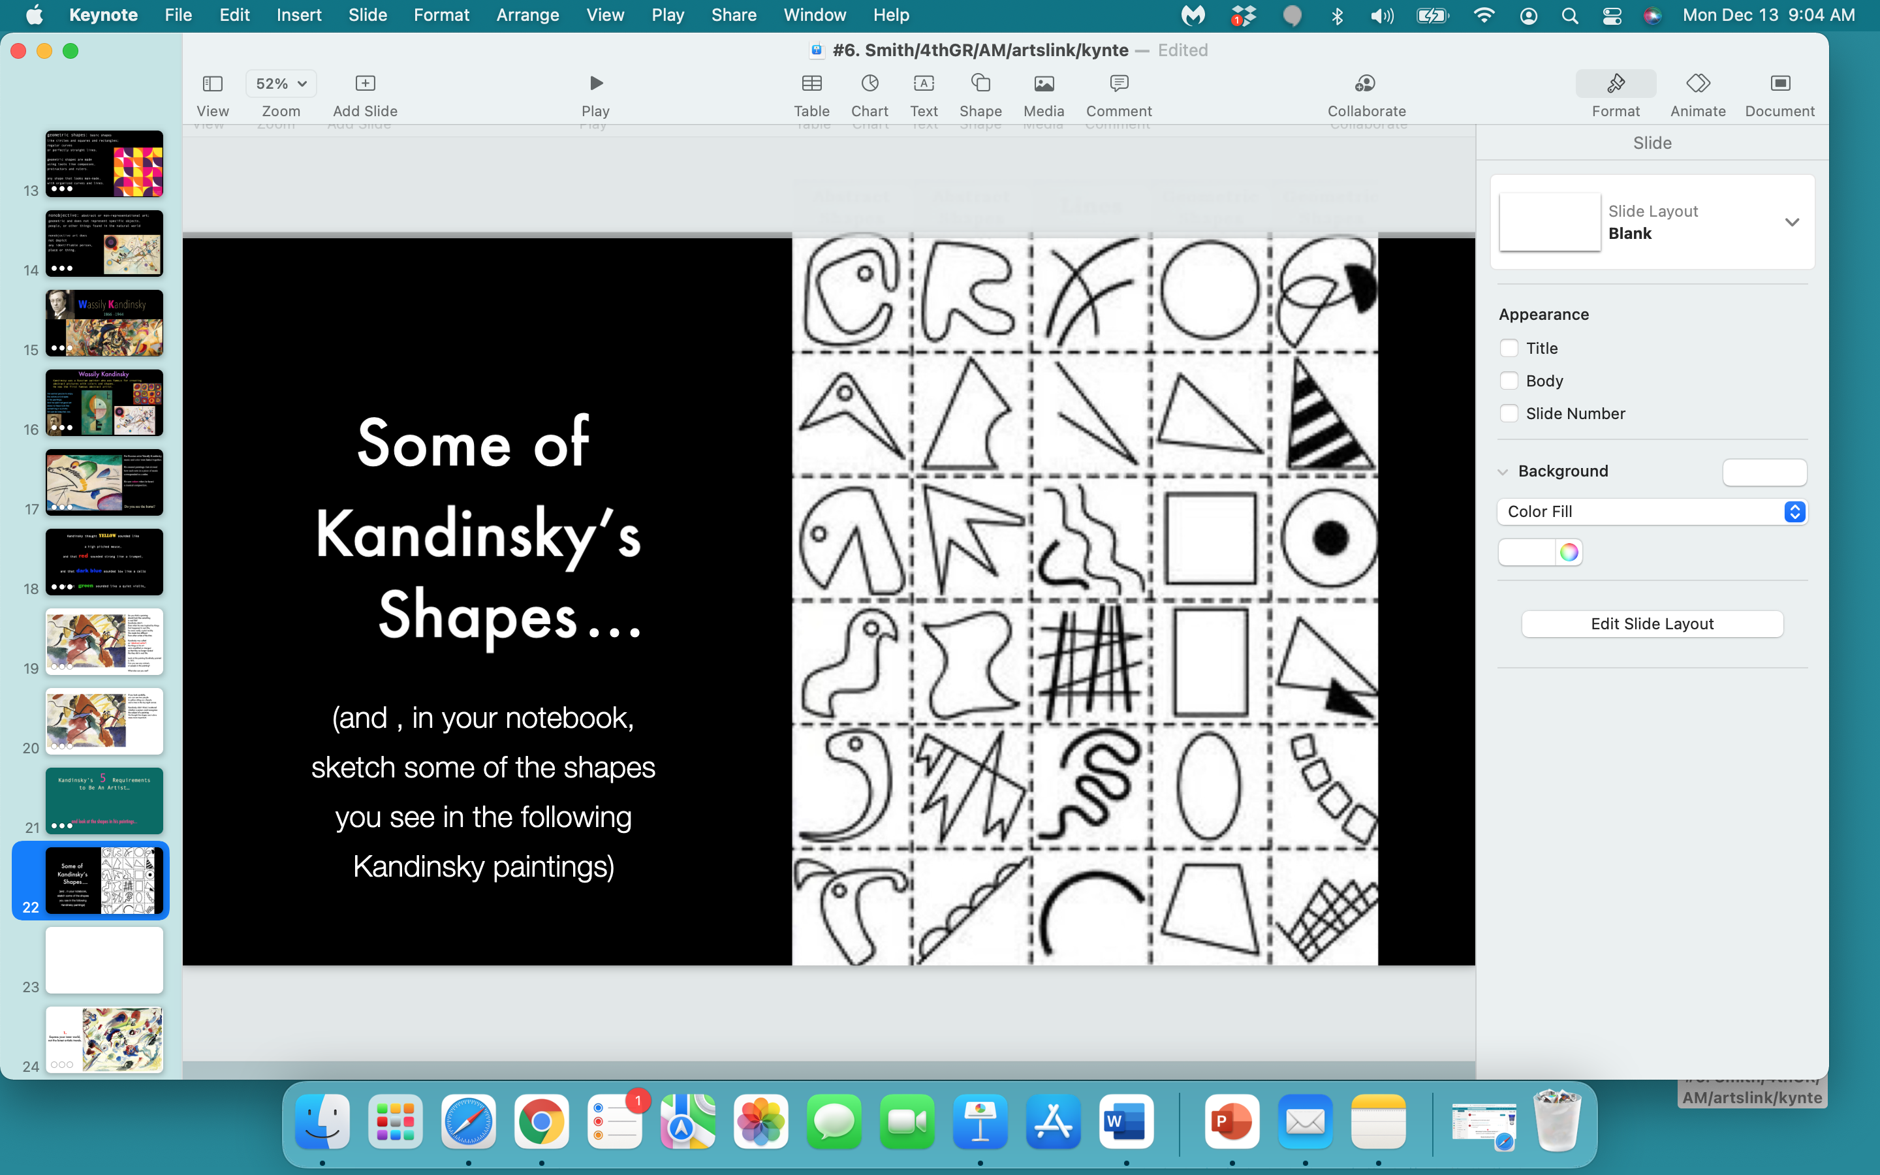

Slide 27


Slide 28


Slide 29
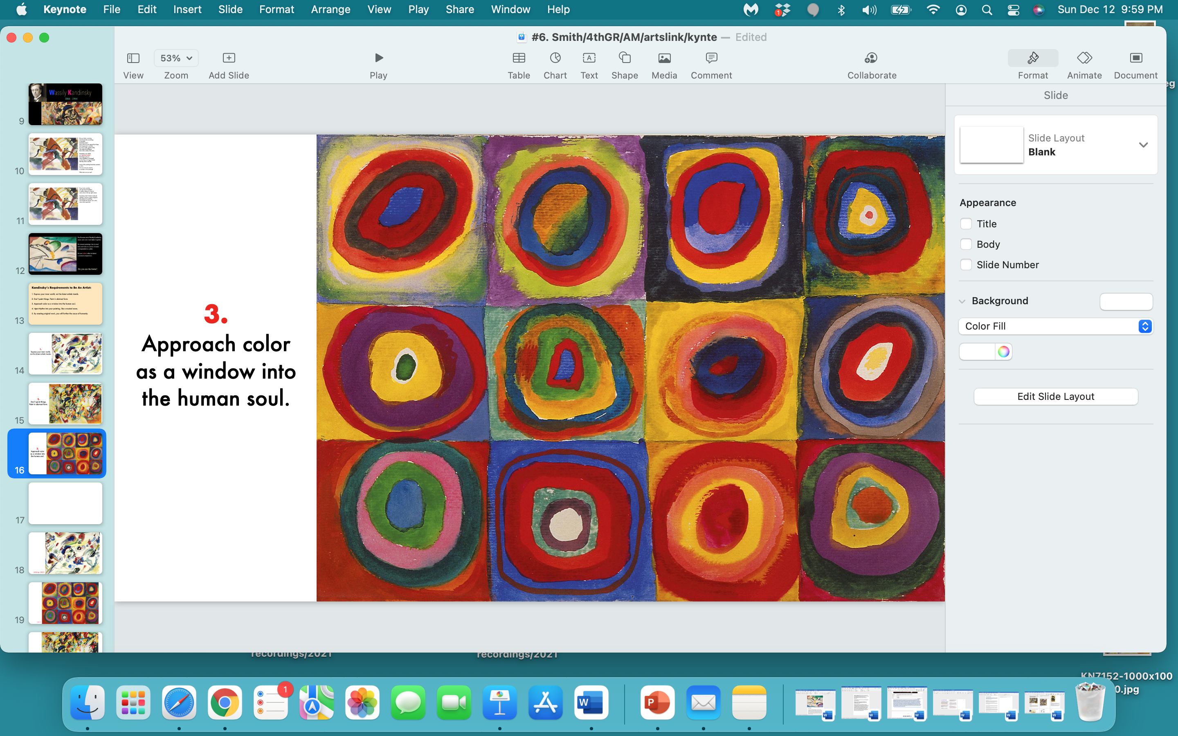

Slide 30


Slide 31
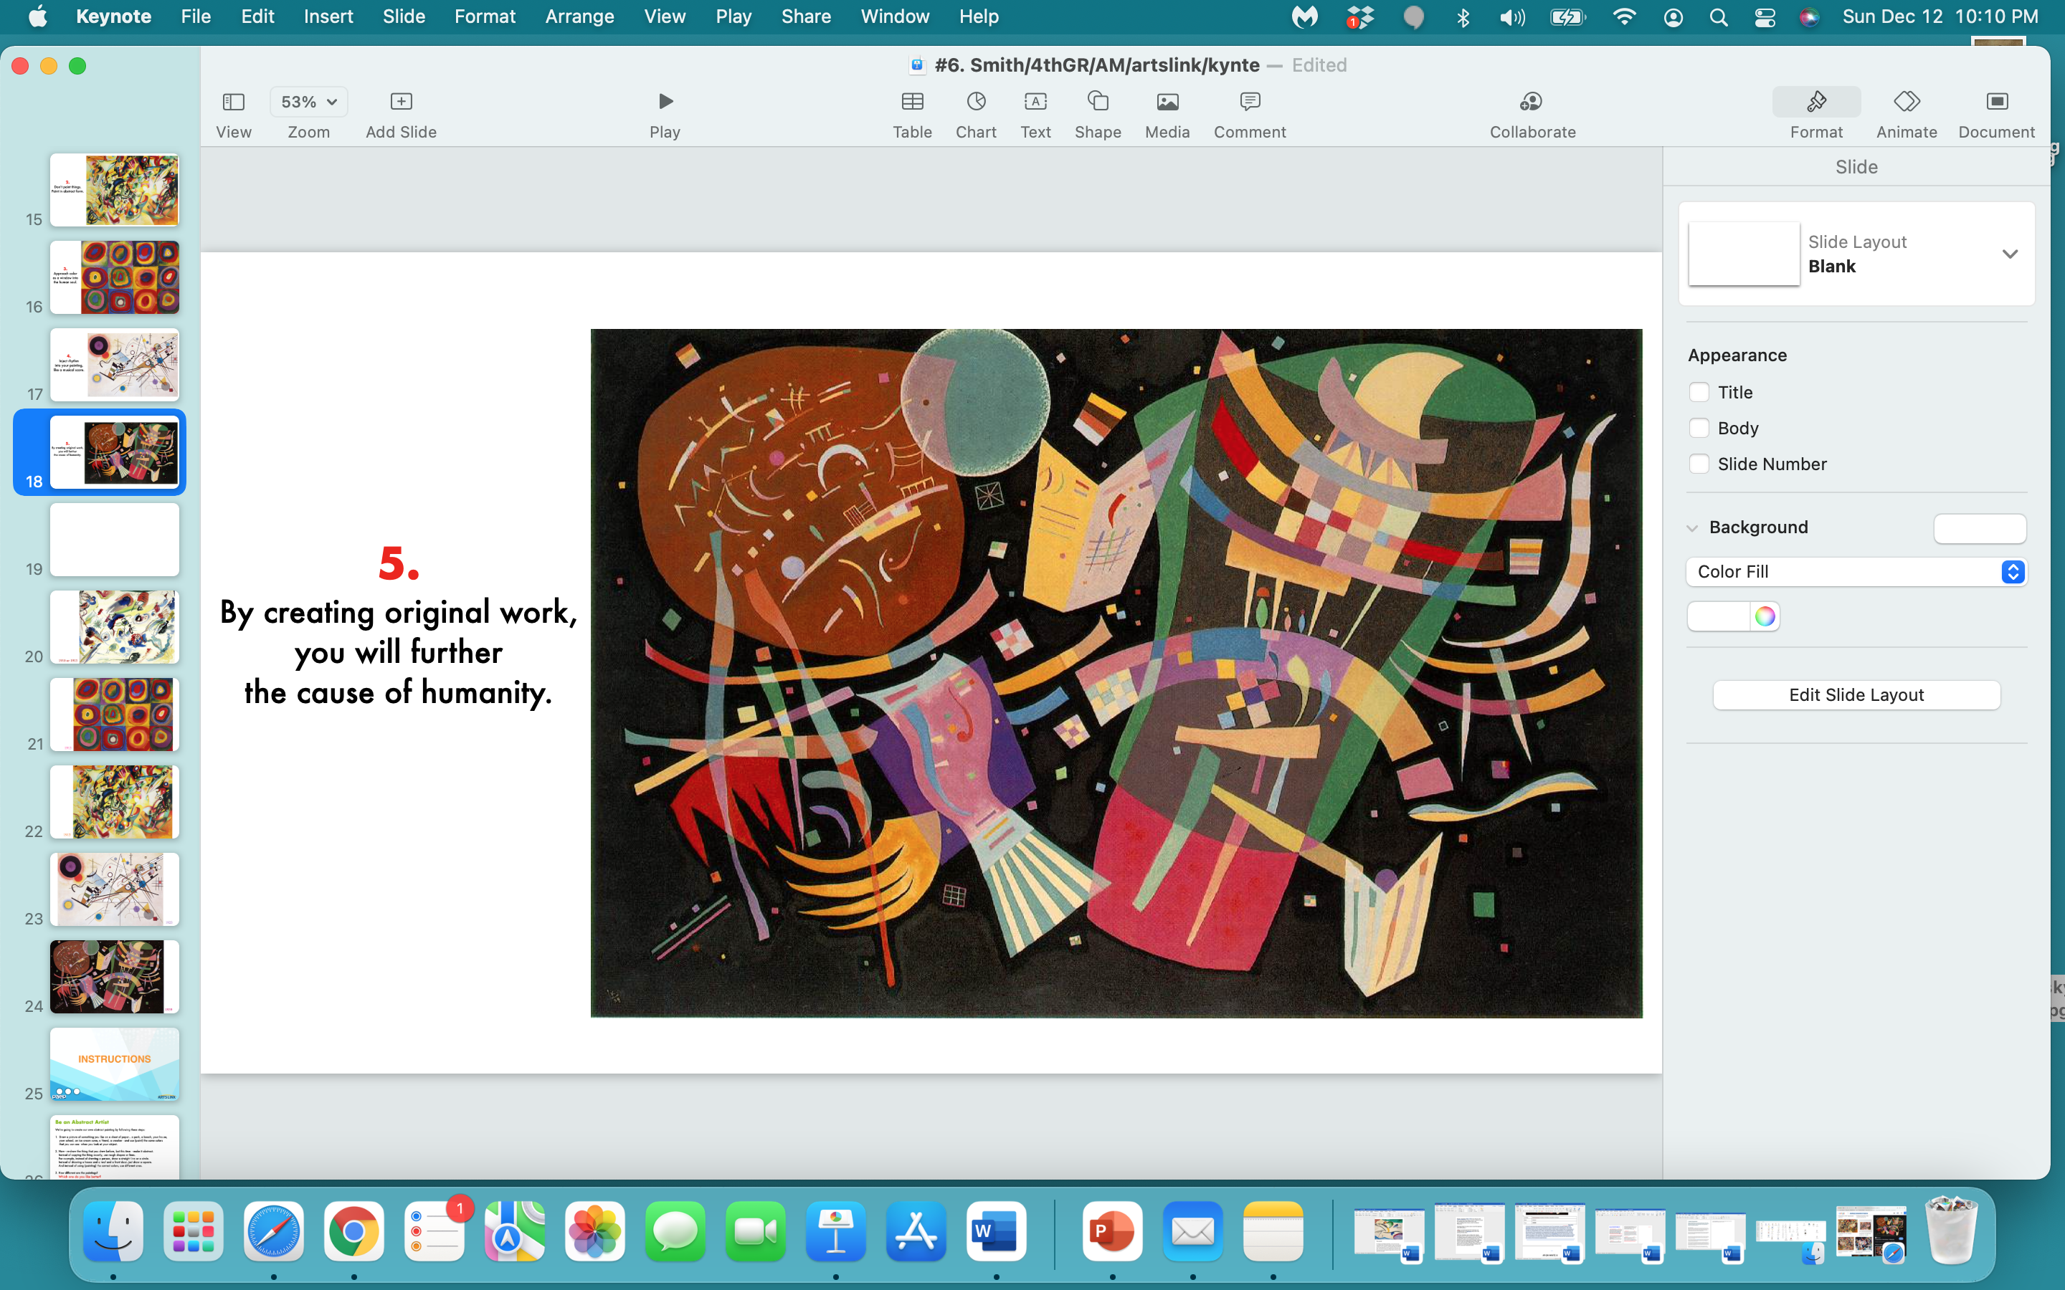

Slide 32


Slide 33
1. Listen and Think
Listen to the music.
While you are listening, write down five words in your journal that the music
brings to your mind.
Don't think too hard; just write down any connections you make:
What colors come to your mind?
Do different colors seem to belong with different parts of the music?
2. Listen and Draw
As you listen to the music, draw lines and shapes with your black permanent marker.
Think of shapes that mean something to you personally…think abstractly, not realistically.
Let the music guide you as you decide what to draw and where to place it on the paper.
Then, paint colors (with your watercolors) what you ‘feel’ around the shapes,
within the shapes, in the shapes.

Slide 34


Slide 35
what one thing
did
you
learn
today…pass or play?

Slide 36


Slide 37
https://3o9d0y1wloj7e90sc37nviar-wpengine.netdna-ssl.com/wp-content/uploads/DLP-Drawing-to-Music.pdf
https://theartofeducation.edu/packs/abstract-artmaking-every-level/
https://www.artsy.net/article/artsy-editorial-artist-kandinsky
https://nurturestore.co.uk/kandinsky-circles-art-lesson-for-children
https://www.ssf.net/home/showpublisheddocument/20564/637275520672370000
https://v2.toolboxpro.org/classrooms/mobile.cfm?ID=5014&P=112010
https://www.youtube.com/watch?v=R6nZjVNaJLg
https://sargentart.com/lesson-plan/kandinsky-%C2%ADinspired-by-music/
https://www.youtube.com/watch?v=4nZ_qkeffY4
https://www.youtube.com/watch?v=2xDnxkzQtdI
https://mymodernmet.com/wassily-kandinsky/
https://www.artsintegration.net/visualizing-music.html
https://3o9d0y1wloj7e90sc37nviar-wpengine.netdna-ssl.com/wp-content/uploads/DLP-Drawing-to-Music.pdf

