Slide 1

WELCOME CLASS!
PROJECT #1 FINISHED – MINI PROJECT
MEETING #4
11/17/2021

Slide 2

What are we doing today?
Showing off your finished projects.
Warm-up exercise.
Scribble division or multiplication drawing!

Slide 3
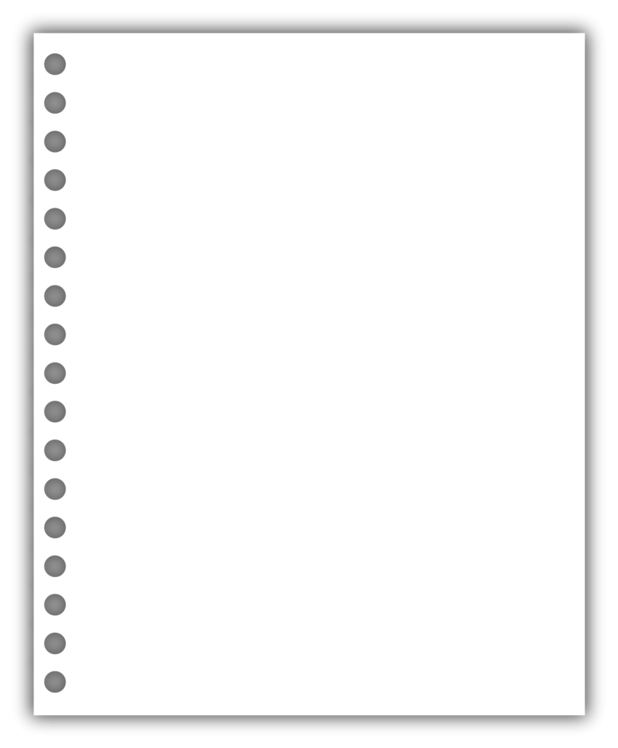
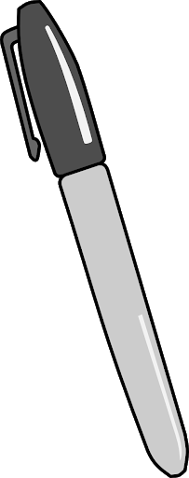
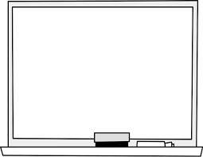

Materials: gather these items for today!
- Your project, drawing pad, coloring utensils, and marker board supplies ☺

Slide 4
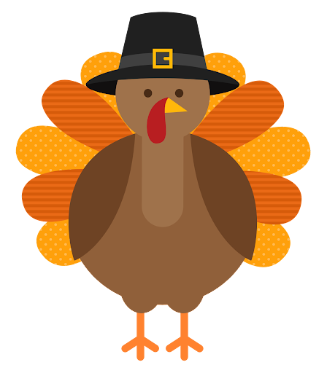
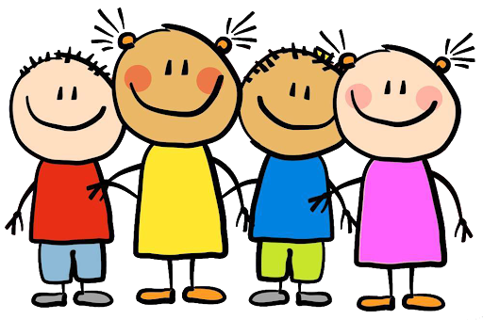

Warm-up exercise: Draw a quick doodle of what You are thankful for! ☺

Slide 5
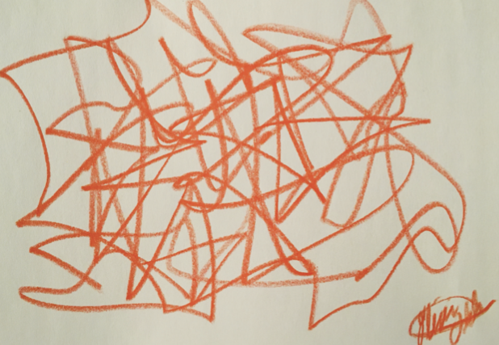
Create a scribble on each side of your divided paper

Slide 6
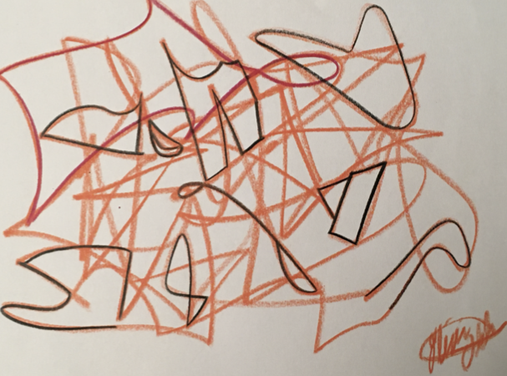
Find objects within both scribbles & multiply both amounts together

Slide 7

See you all after thanksgiving break! Until next time... ☺

