Slide 1
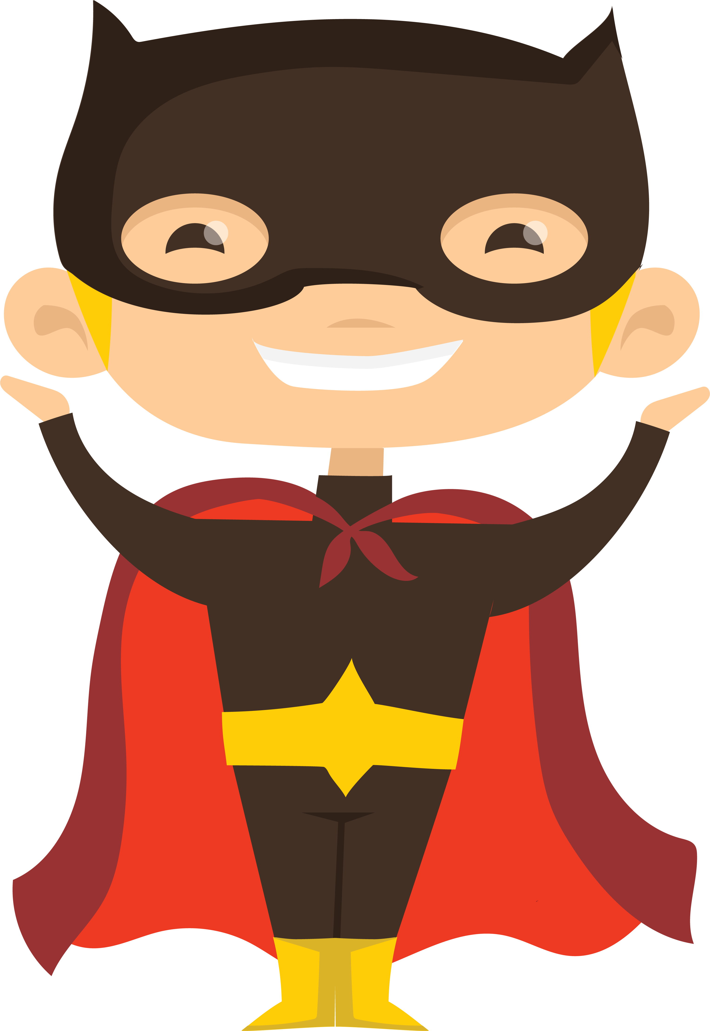
Sidekicks & villains
Adding to your cast of characters

Slide 2
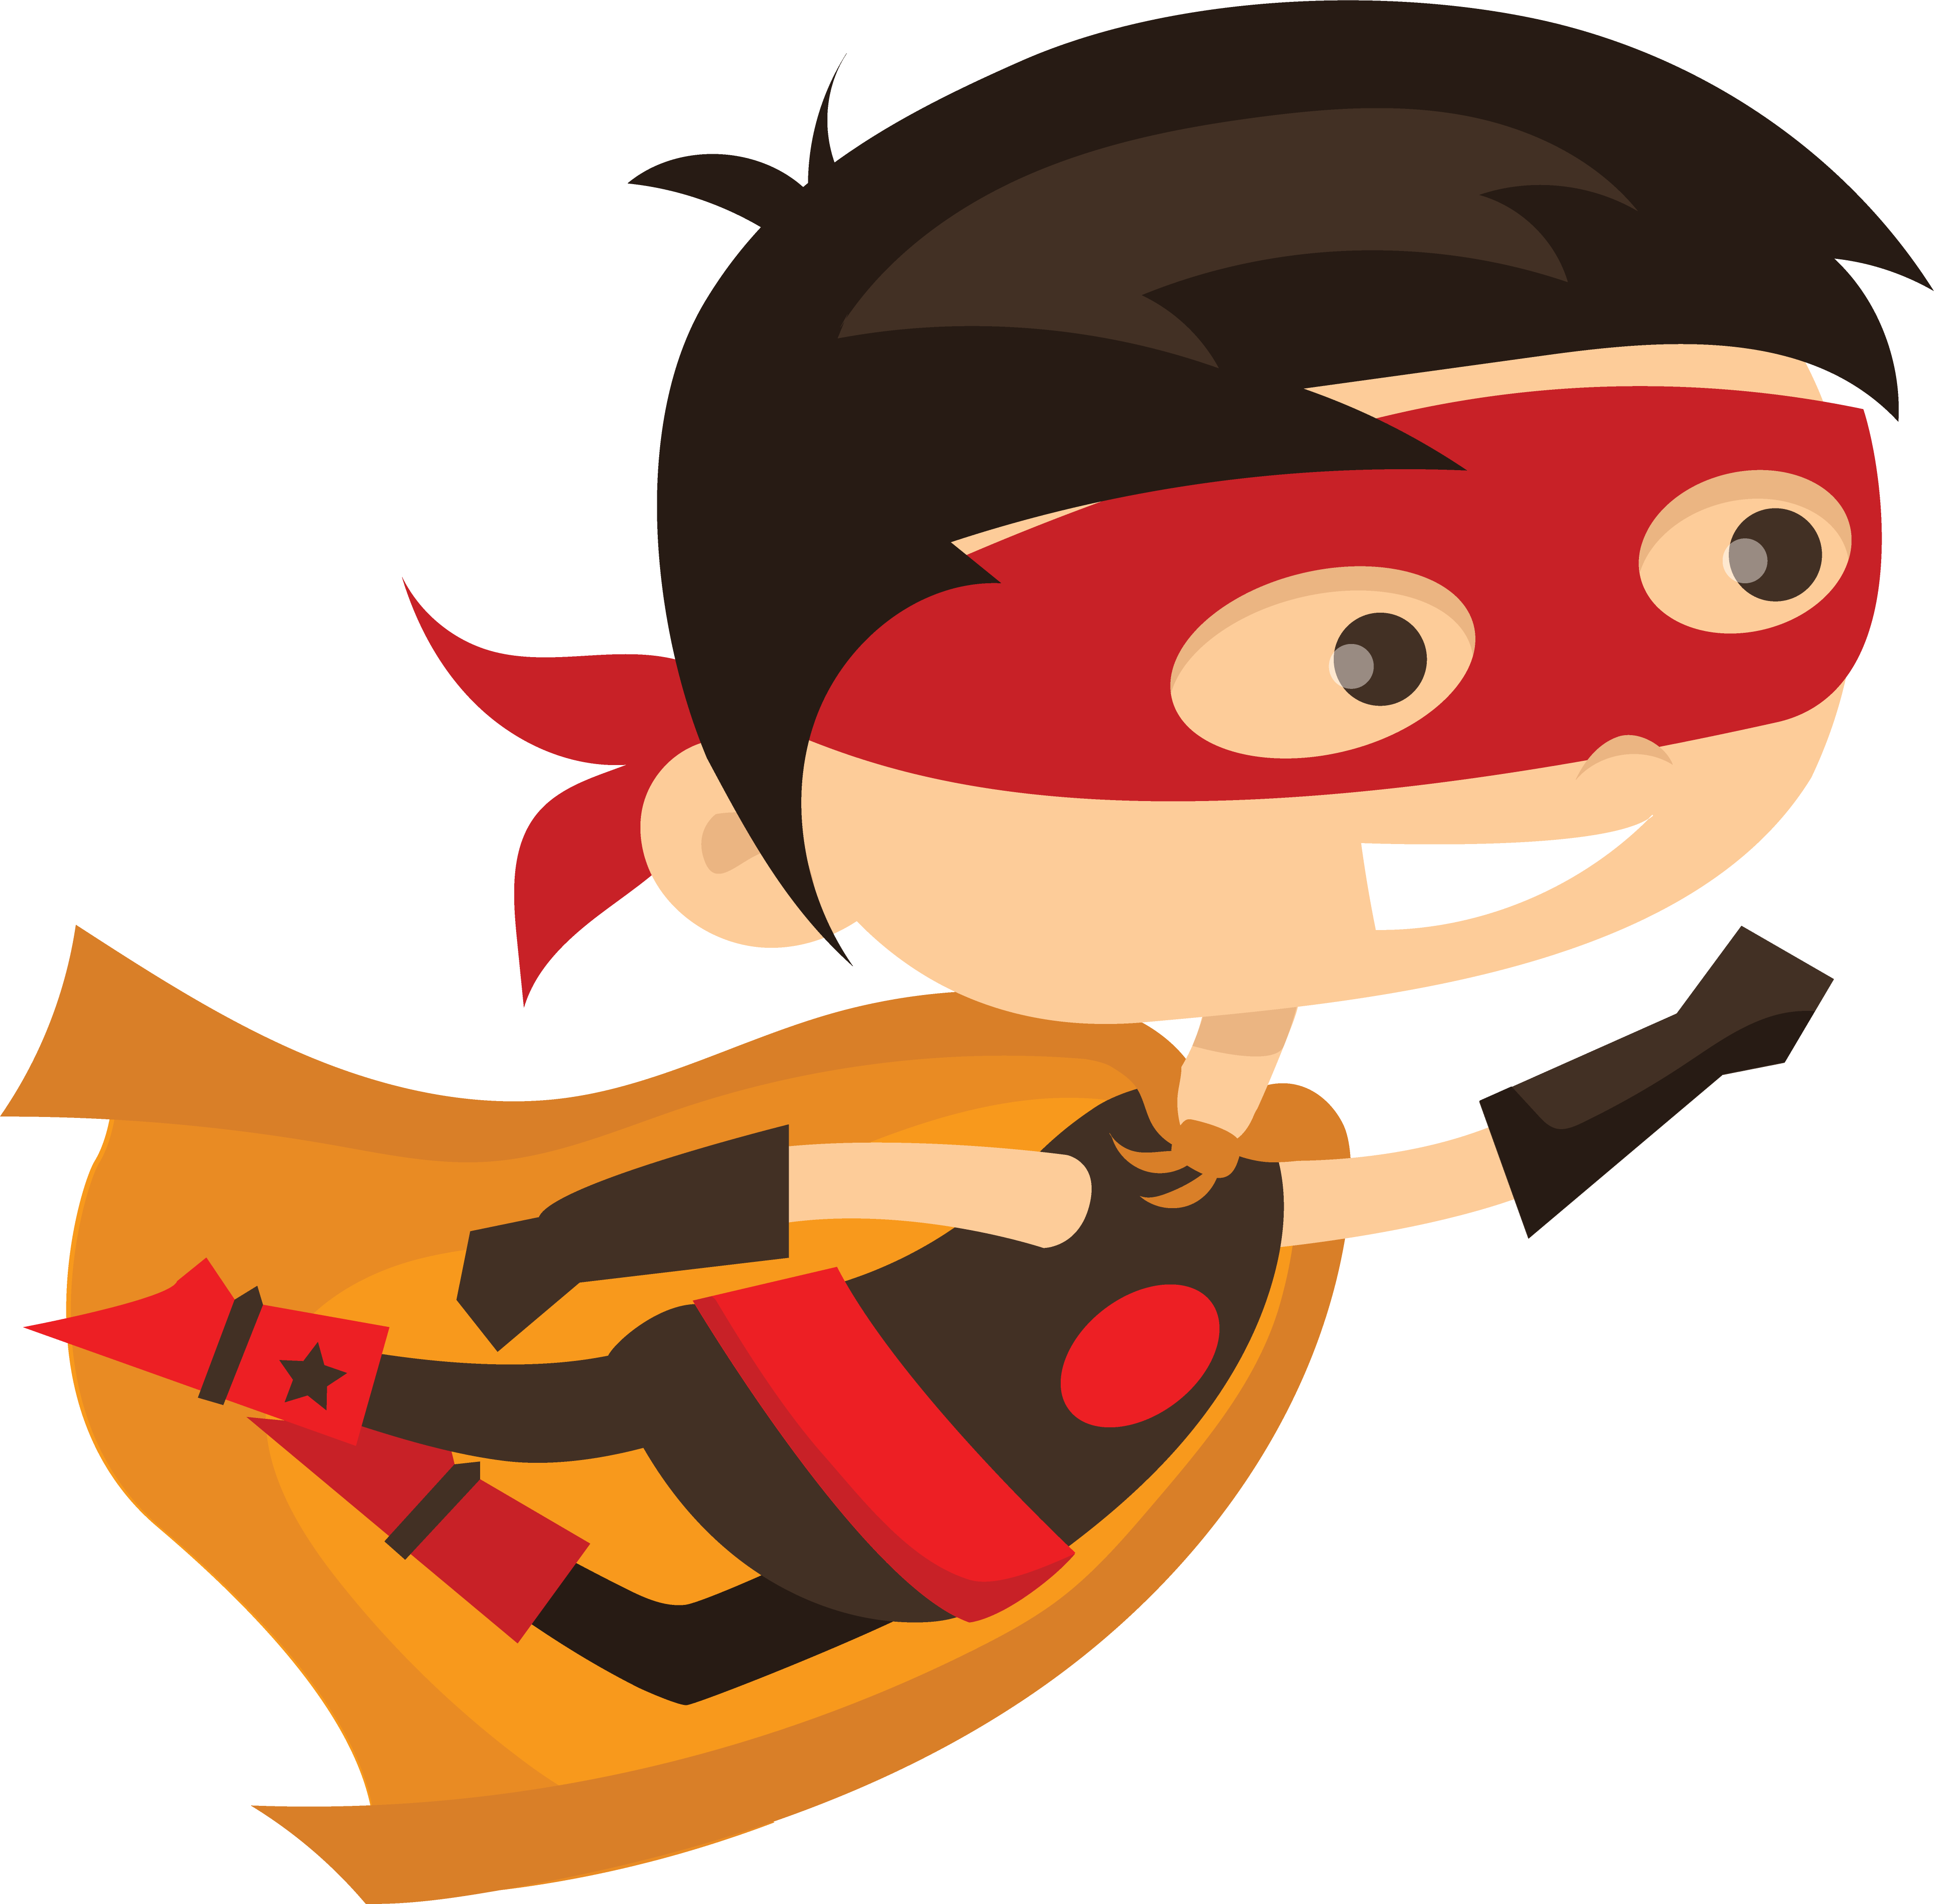
objectives
Share what you created since the last time we met
Discuss examples of supporting characters from the comic world – sidekicks, villains, mentors, etc.
Imagine one or more characters who will play an important role in your Superhero’s story.

Slide 3

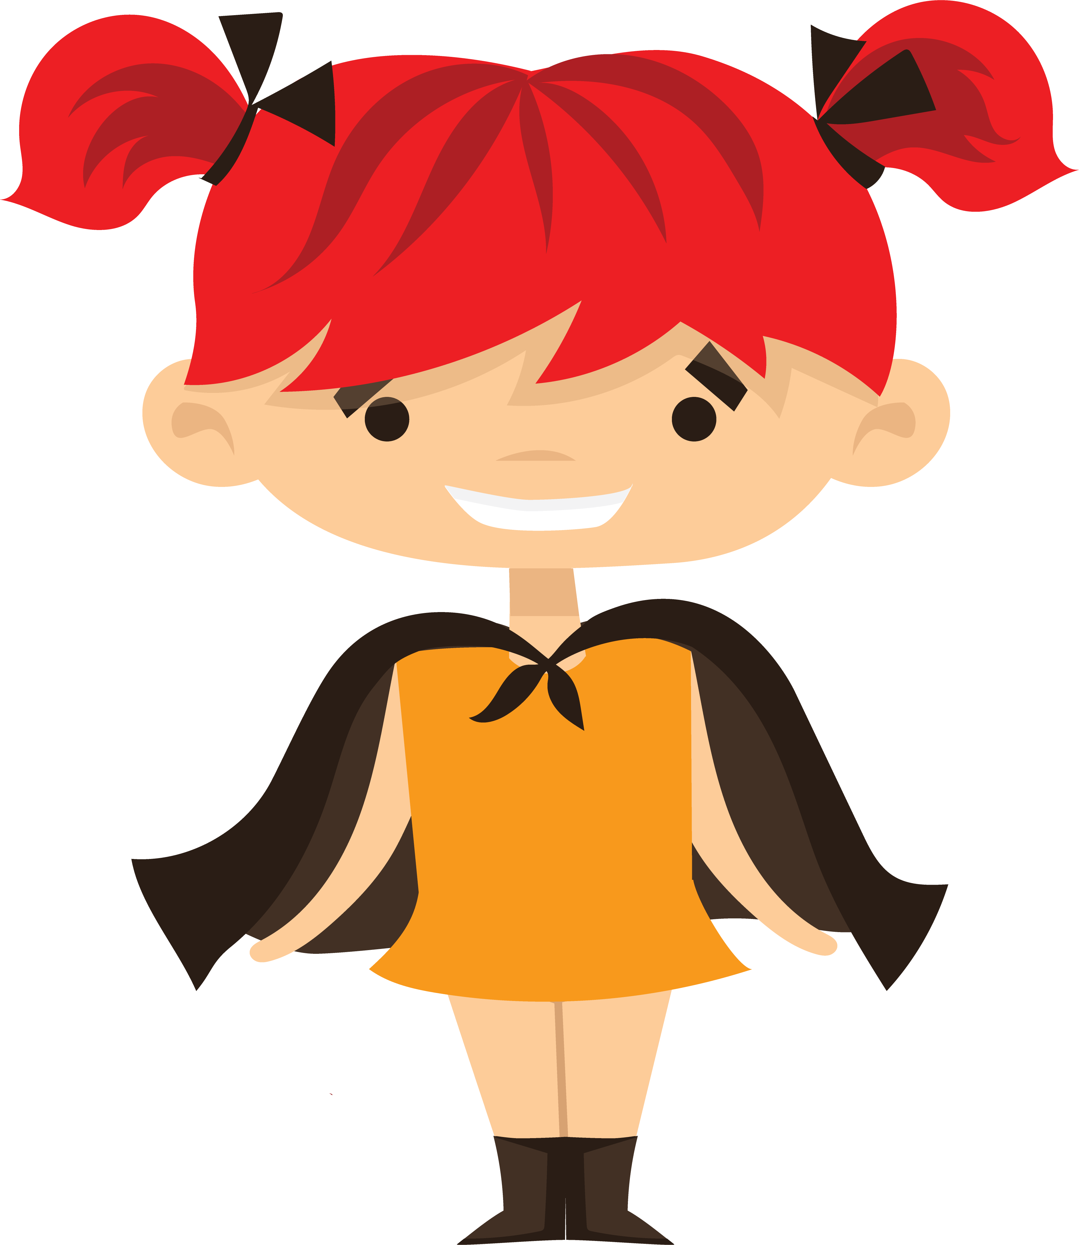
Pass or play!
Share your super hero hideouts!

Slide 4
Vocabulary - Story lines & Arcs
What happens when your superhero’s weapons get in the wrong hands – e.g. IronMan
Nature vs. Technology
Villain motivation – Loki’s jealousy, Wanda’s grief
Sidekicks become main characters
  Teen Titans, Wanda Maximoff, Falcon,
Mirror image conflict
  When your villain and superhero want the same thing

Slide 5
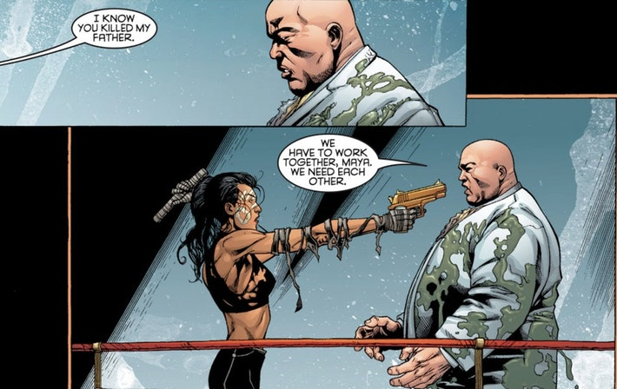
Echo (Maya Lopez)
https://www.inverse.com/entertainment/echo-hawkeye-villain-netflix-marvel-crossover-theory
Deaf superhero - has the powers of telepathy, superhuman strength, and flight.
Went to school for gifted after copying song on piano.
Half Cheyenne, half Latinx superhero who possesses photographic reflexes. She can copy any move she sees, matching her opponent’s strengths.
Raised by Kingpin (who killed her father). Handprint on her face from father’s touch while dying.

Slide 6
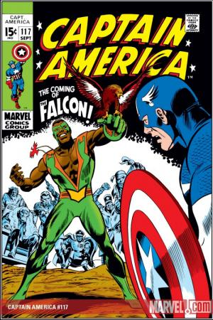
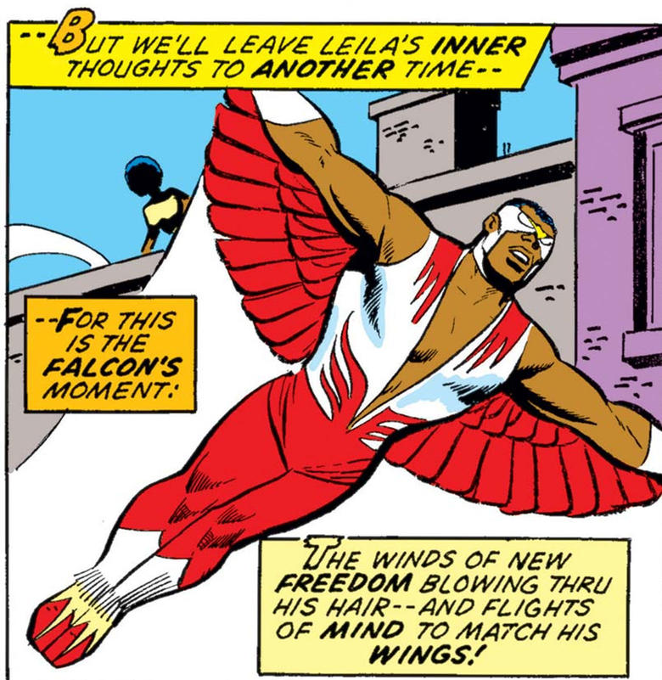

Slide 7
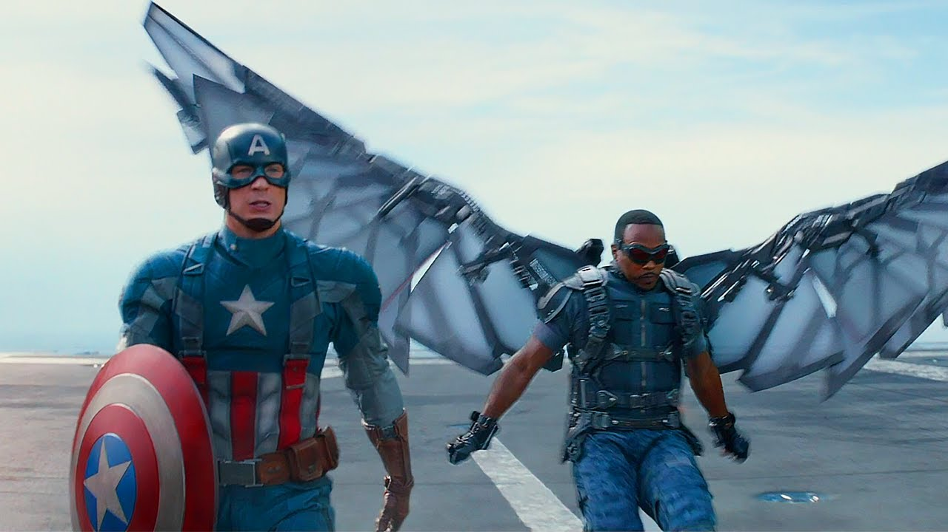
Captain America and The Winter Soldier

Slide 8
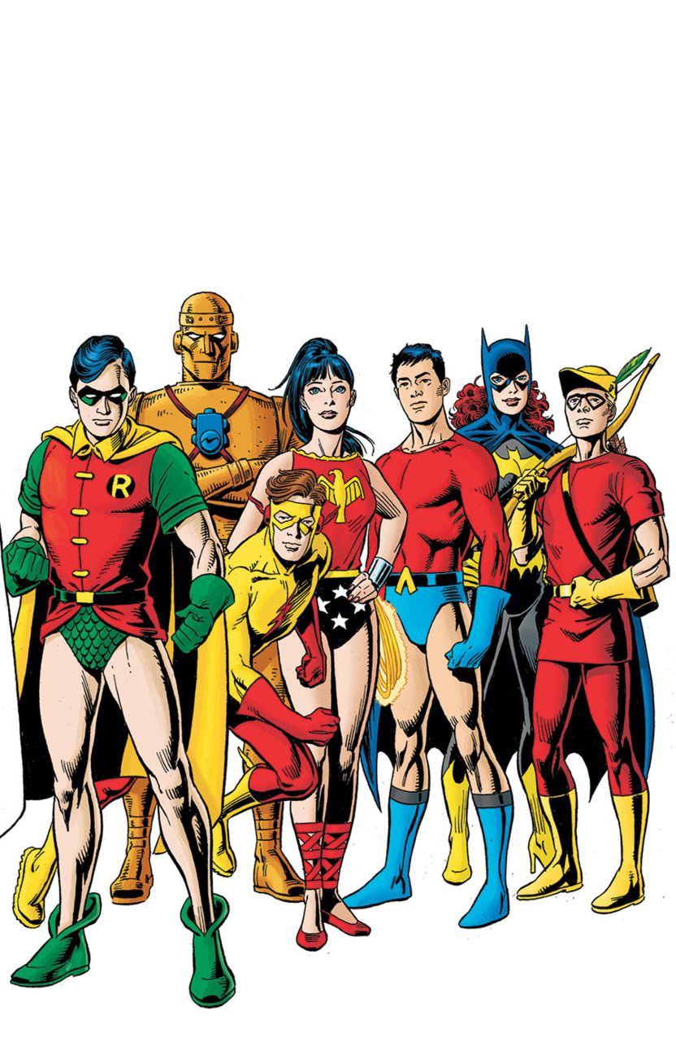
Teen titans
Kid Flash (Wally West)
Aqualad
Robin
WonderGirl (Donna Troy)
Starfire
BeastBoy
Raven
Cyborg
Nightwing

Slide 9
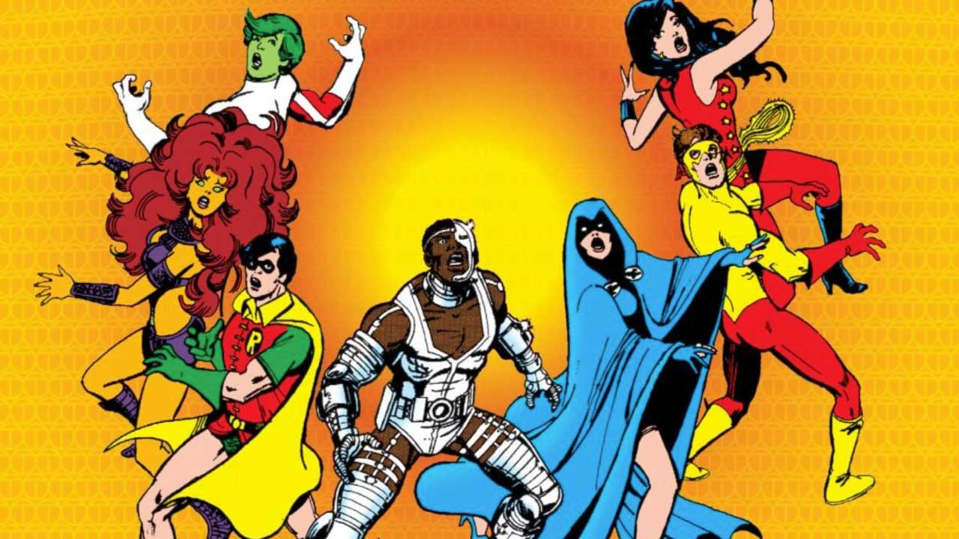

Slide 10
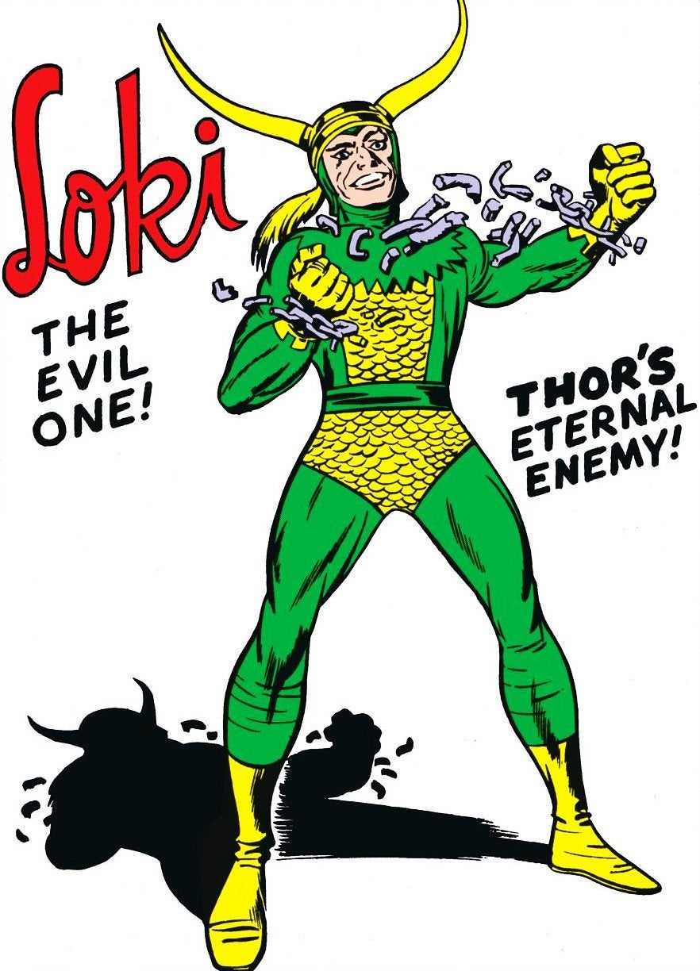
Capacity for change: not all bad or all good
“…if Loki was a god of chaos, and that he could never actually change, that would drive him to distraction. Loki trying to escape his fate struck me as a real godly sort of reason to do something. This is just one of my big themes, across all my work: can people change? Can bad people get better? Why are people bad? And if so, how much? And if not, why not? -Kieron Gillen, INVERSE

Slide 11
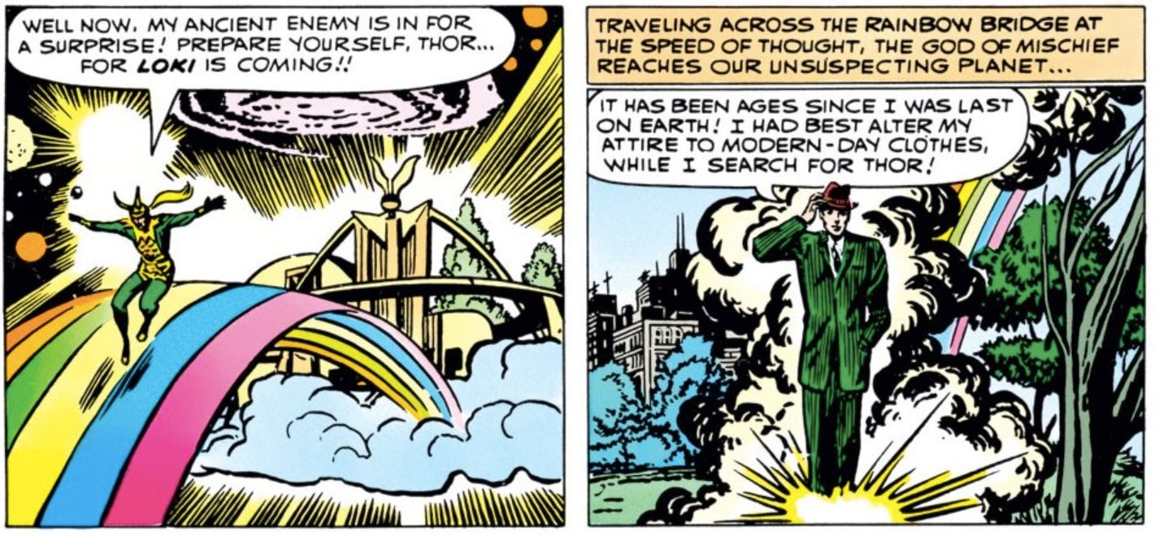
Loki makes his Marvel debut in Journey Into Mystery #85 (1962).Marvel

Slide 12
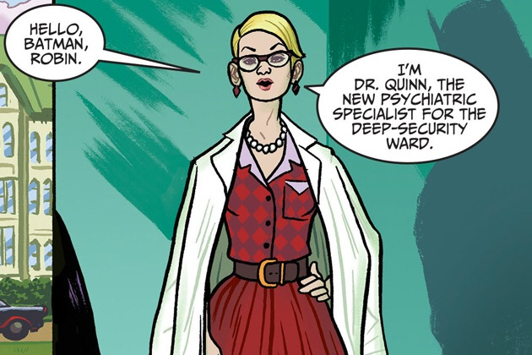
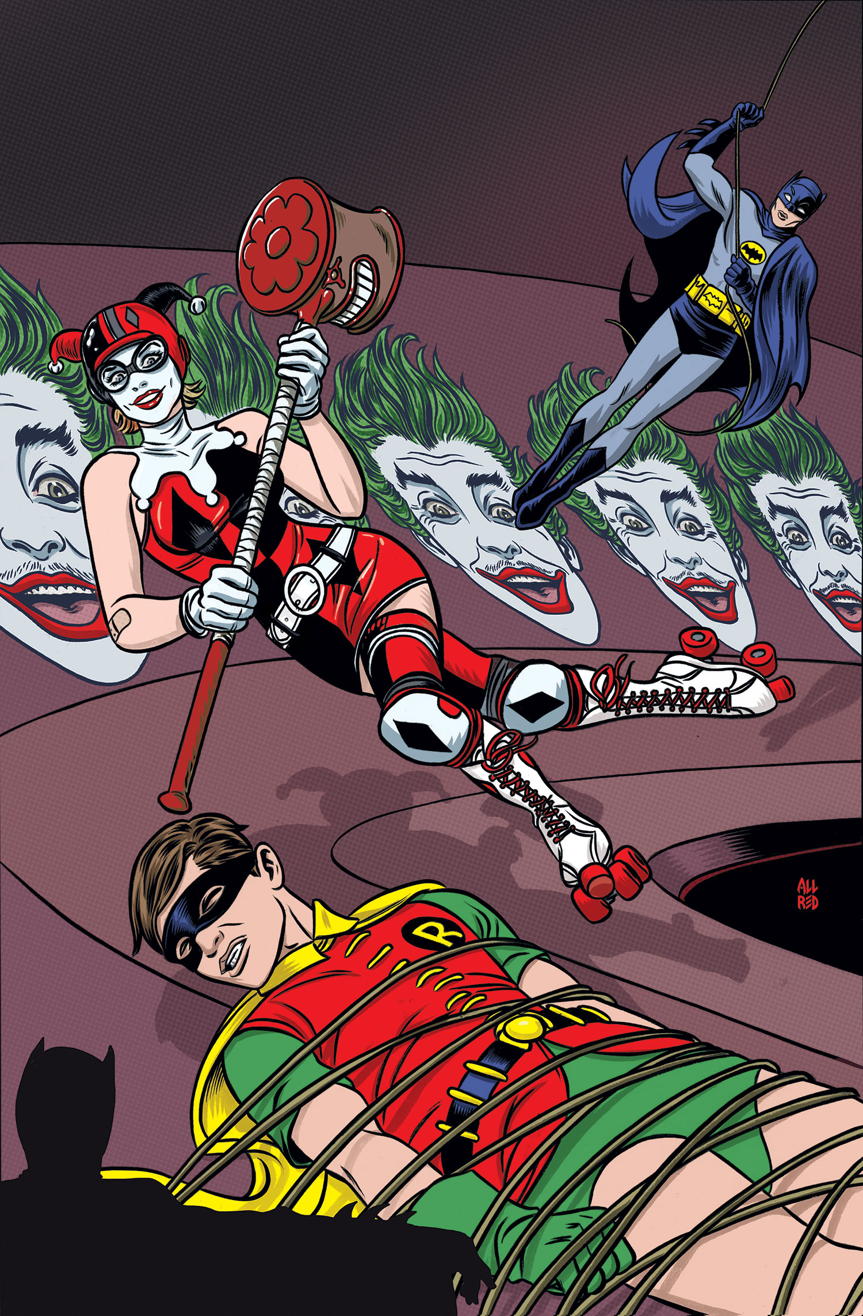
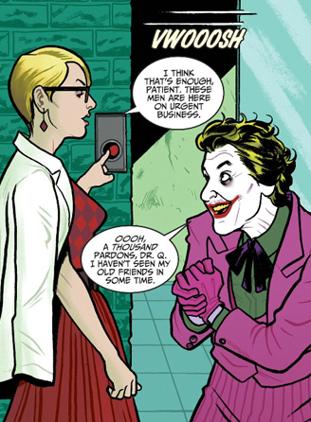
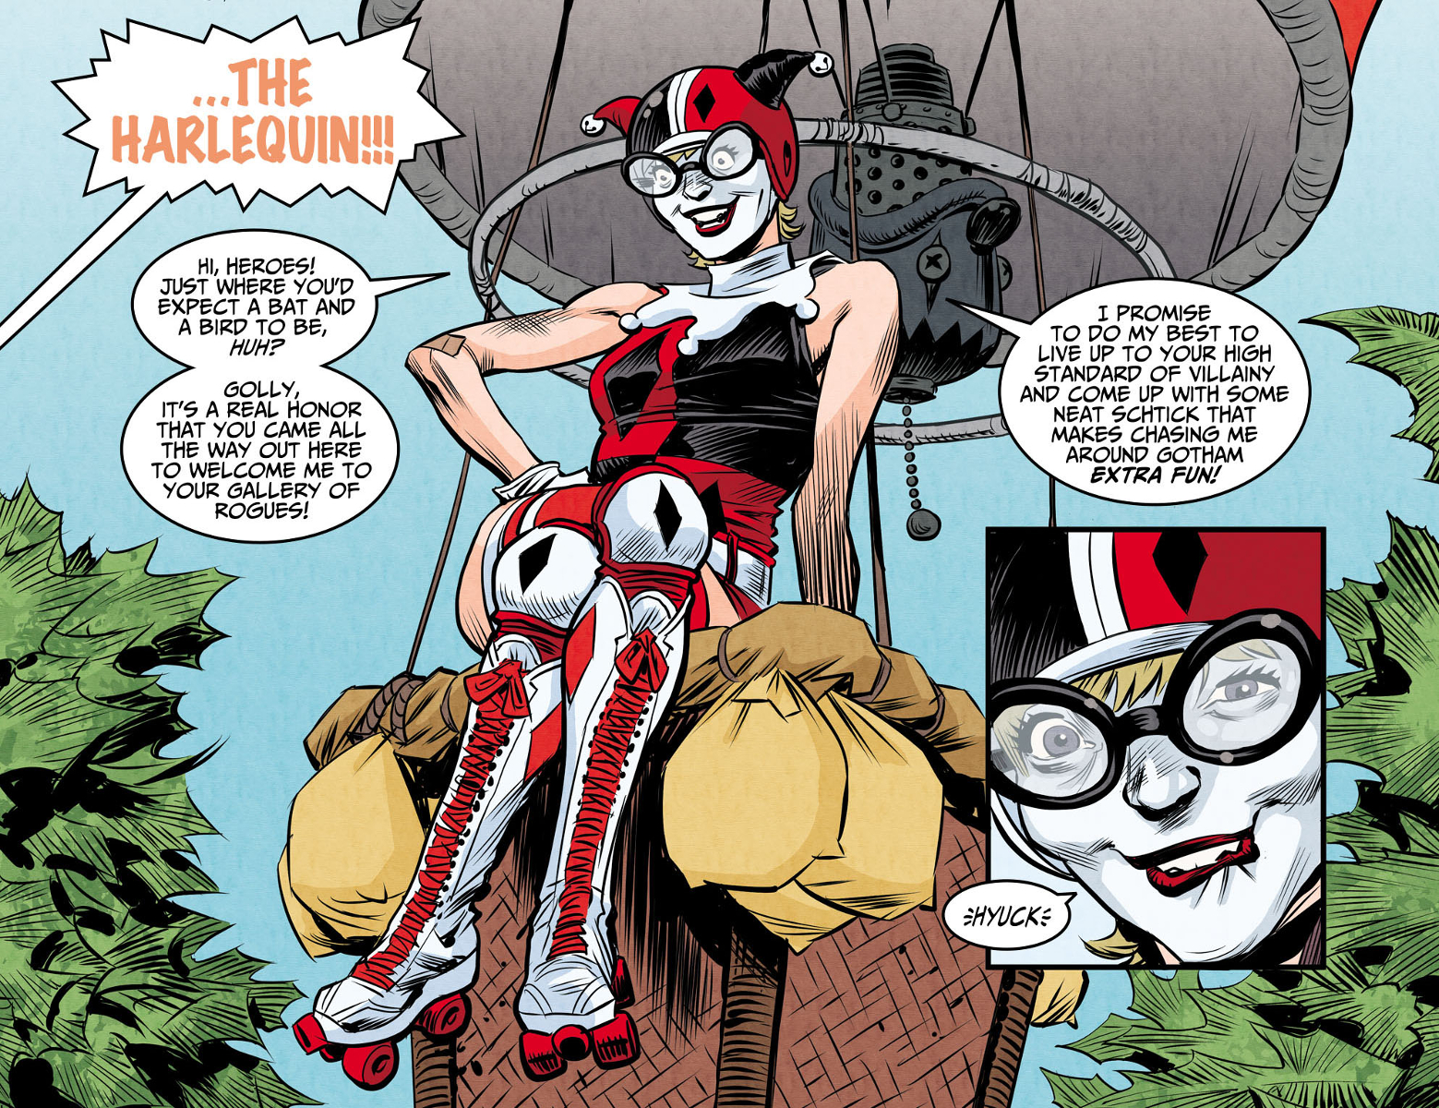
Harley Quinn
Sidekick and Villain

Slide 13
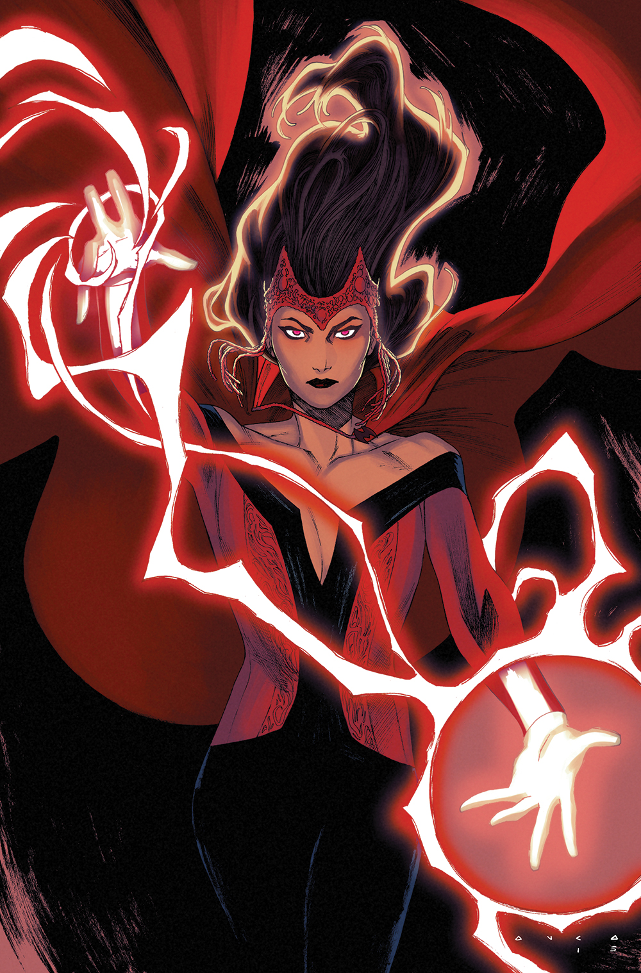
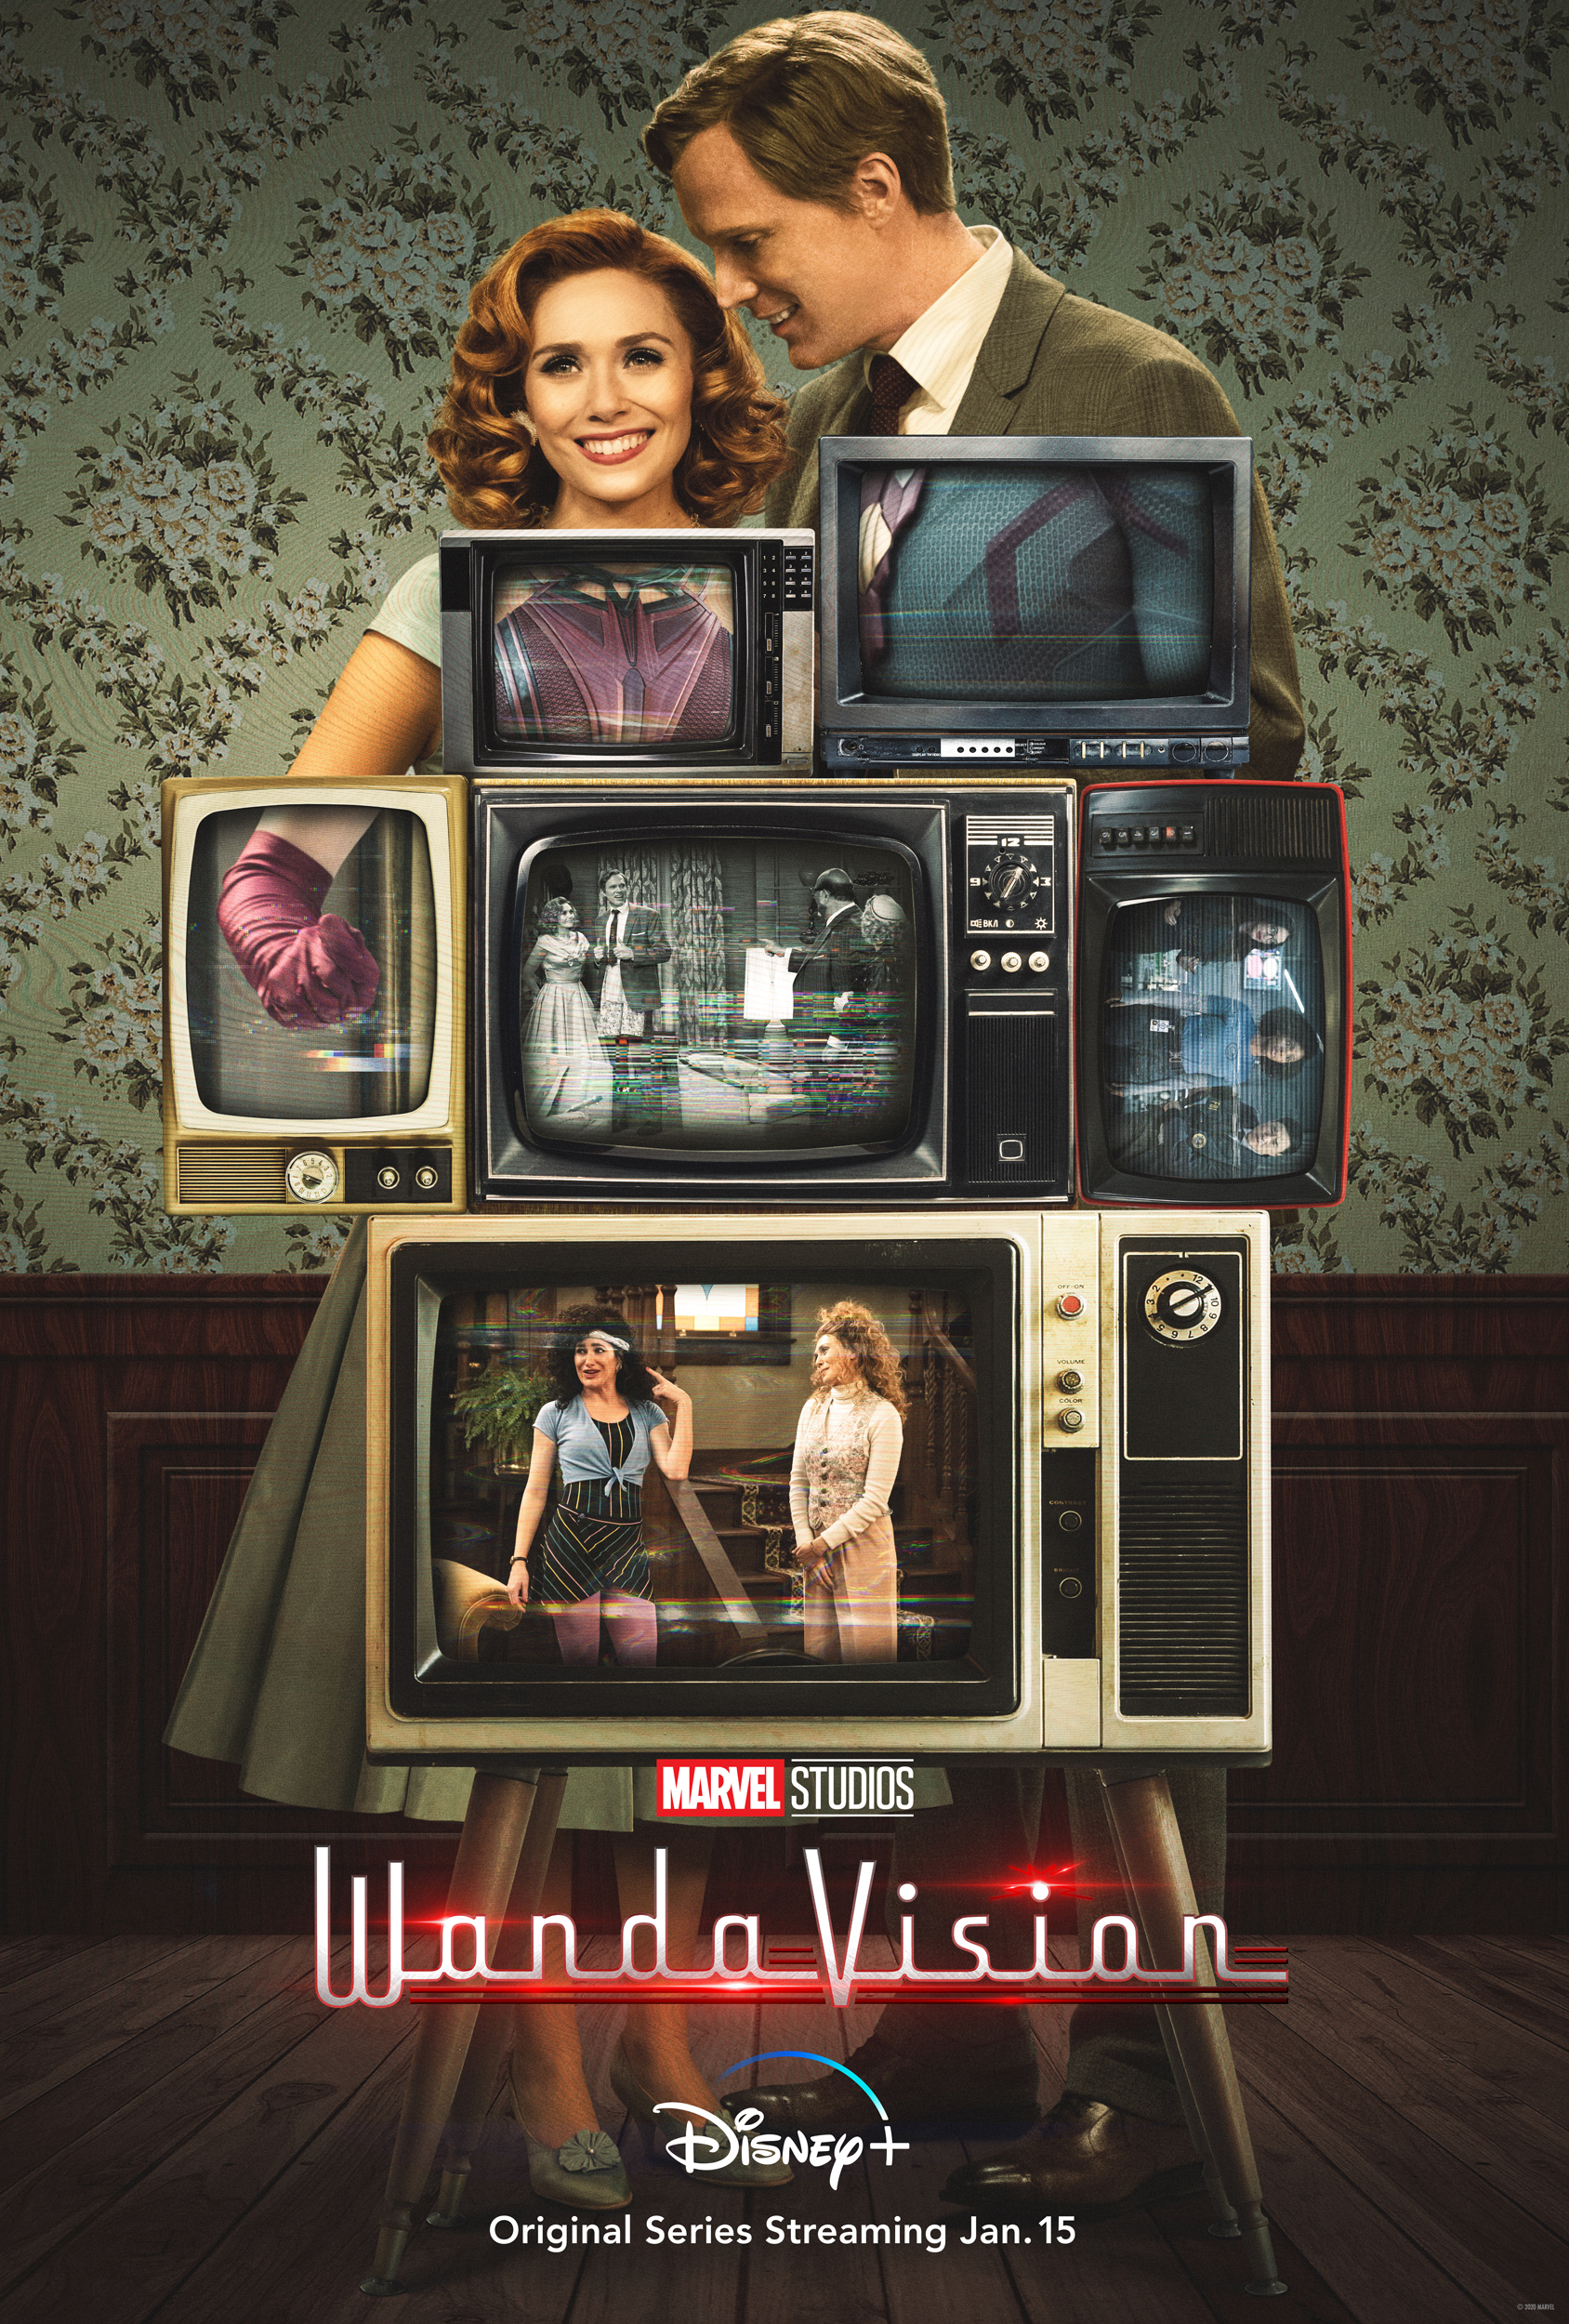
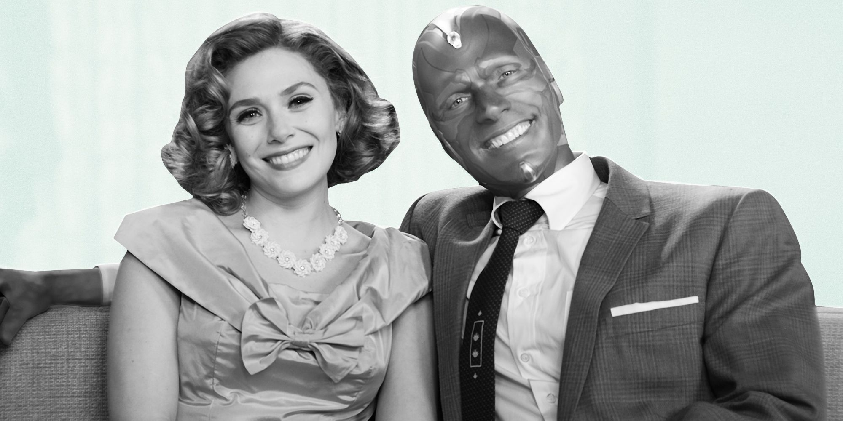
Wanda Maximoff aka Scarlet Witch, learns magic, uses power for evil – loses brother and joins forces with the Avengers, loses her partner Vision and gets her own show in which she resurrects him in a hijacked town she recreates after the TV family sitcoms she watched as a child.

Slide 14
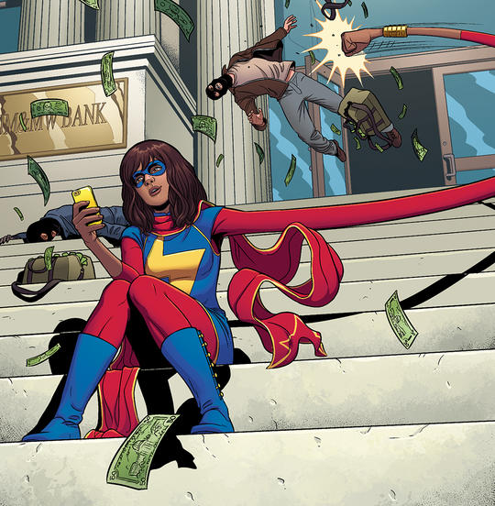
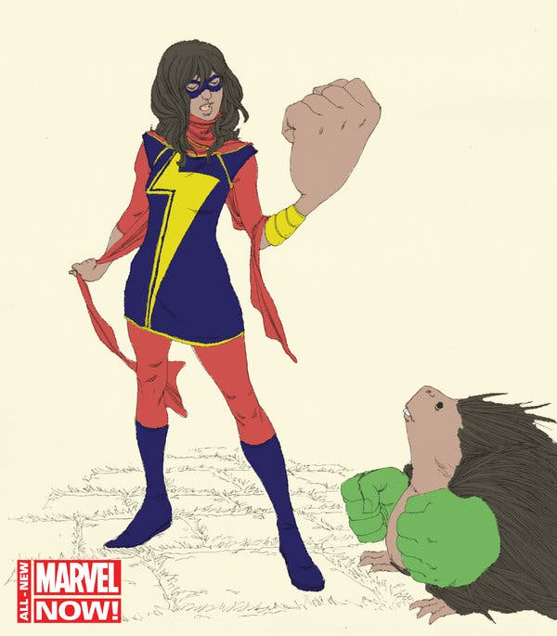
Who Is Kamala Khan, aka Ms. Marvel?
A smart Pakistani-American geek who loves playing video games, hanging out with friends, and writing Avengers fan fiction, Kamala is the first Muslim character to star in her own Marvel Comics series.
As Ms. Marvel, Kamala is an Inhuman with the ability to polymorph all or parts of her body.

Slide 15
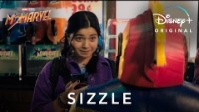
Coming in 2022 – Ms. Marvel on screen

Slide 16
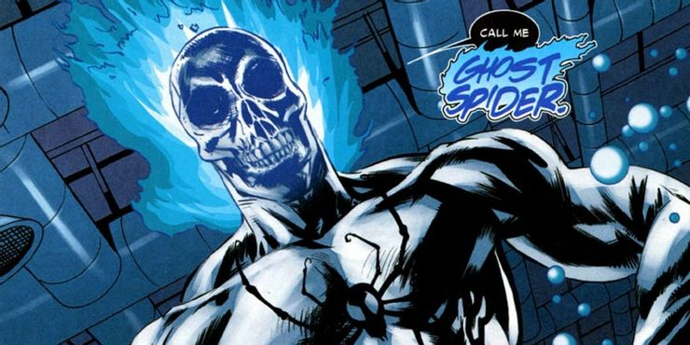
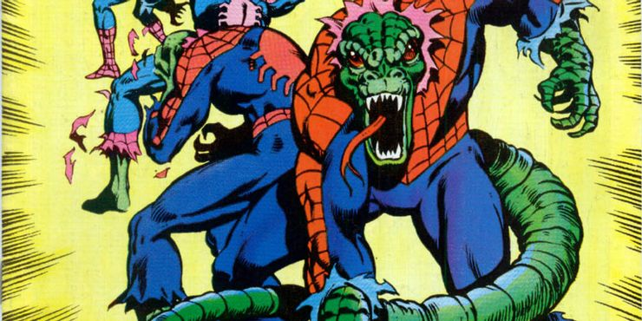
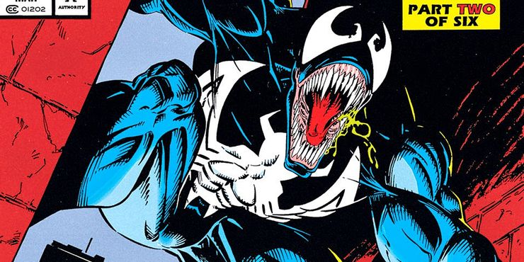
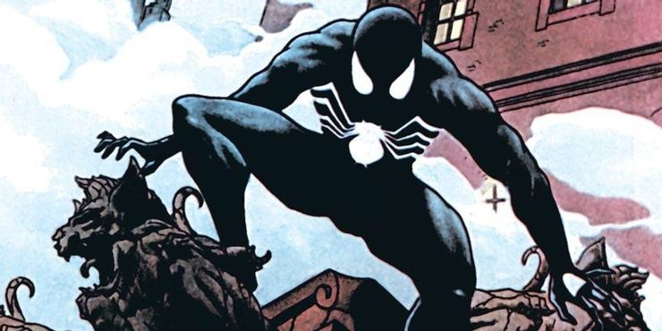

Slide 17
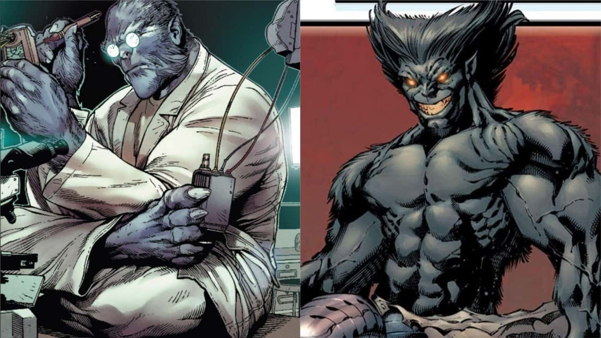
Henry McCoy, or Dark Beast, is an alternate reality version of Beast. Unlike Hank, Henry is an evil, treacherous scientist who enjoys conducting nefarious and evil experiments on his patients.

Slide 18
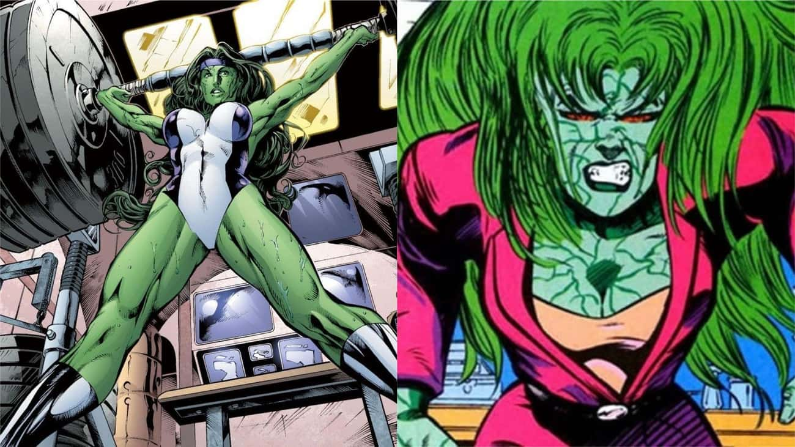
As the archenemy of She-Hulk, Adrenazon possesses the same super strength and super speed. She acquired her superhuman powers by undergoing a series of experimental surgeries after she was crippled in a car accident.

Slide 19
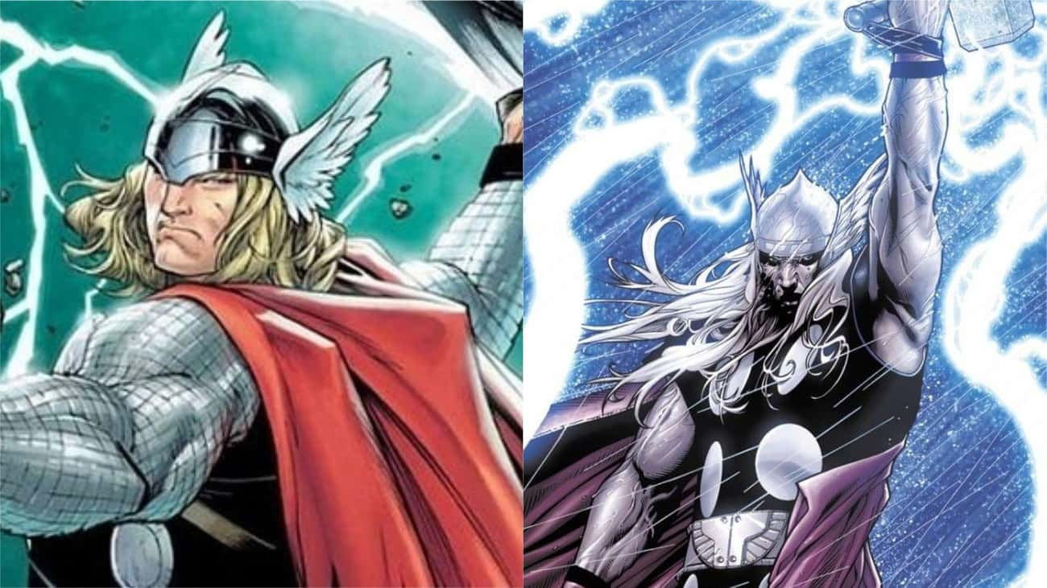
As a cyborg clone of Thor, Ragnarok first appeared in the Civil War comic #3 in 2006. His look is nearly identical to Thor's and he possesses the same superpowers - only, you know, he's evil.

Slide 20
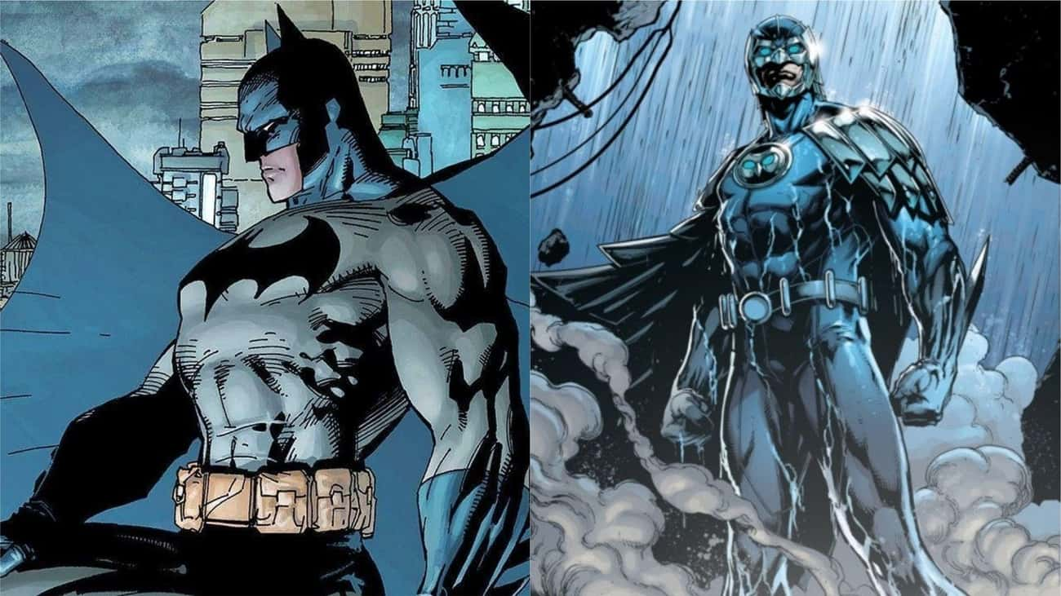
Debuting in 1964, Owlman is a super-smart supervillian who was created to be Batman's evil counterpart. As part of the Crime Syndicate of America, Owlman also has his own sidekick, Talon, who's basically a mirror image of Robin.

Slide 21
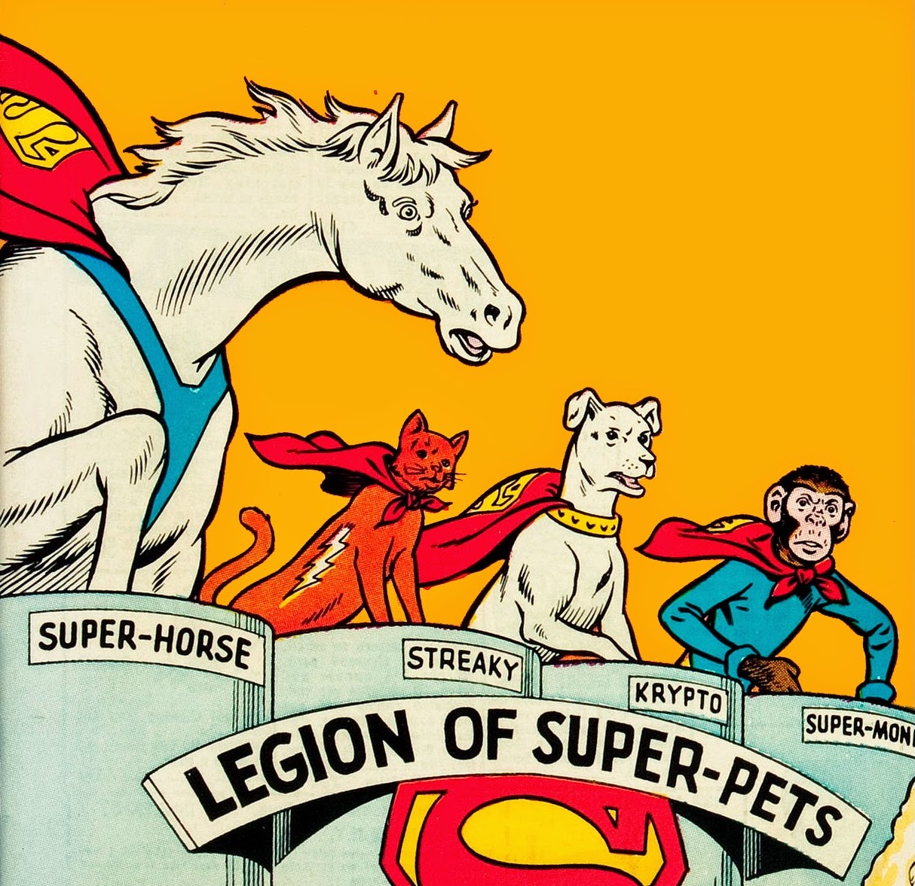
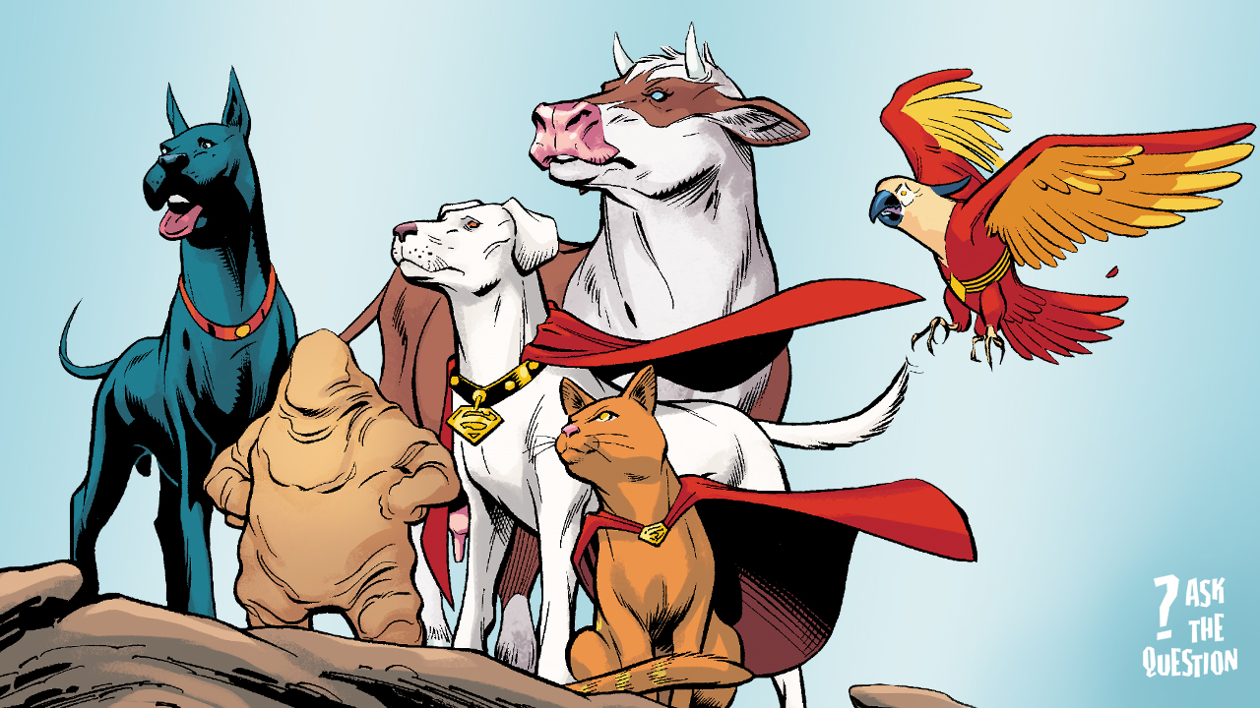
SuperPets!!!

Slide 22
instructions
Create at least one additional character who will appear in your story. Draw a picture and then write a caption.
What character traits do they have that your superhero needs or that match their weakness?
Identify which of your classmates’ characters would be good allies.
Which characters have weapons that could be used against them?
Which characters draw on the creative powers of nature to fight against manmade technological destruction?

Slide 23
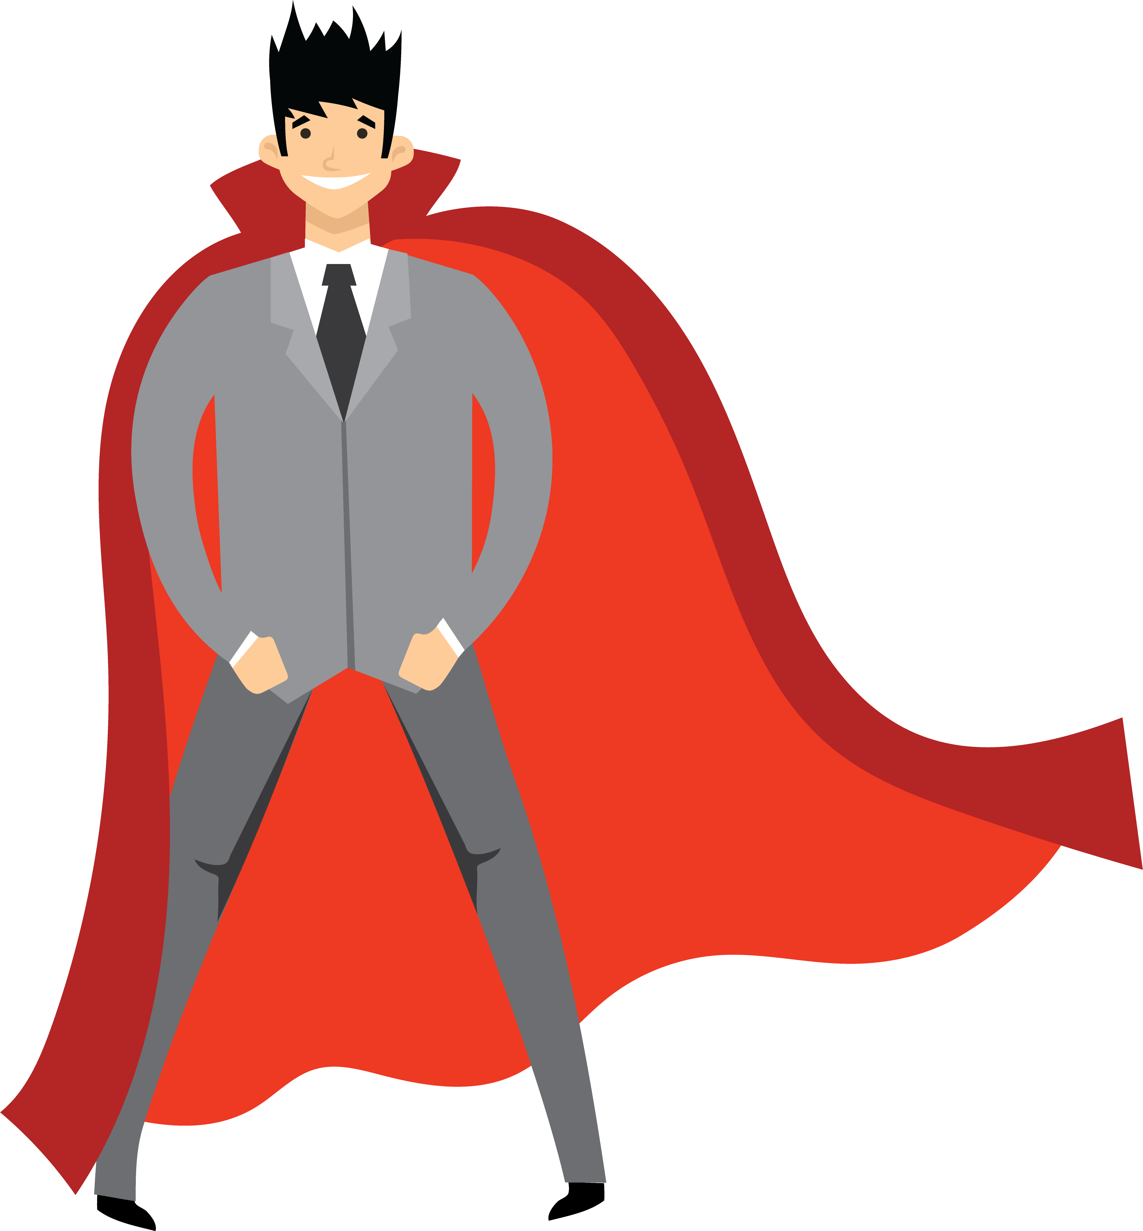
Re: damaging villain stereotypes
“…we are led to believe their disabilities are a result of them being evil. This framing links evil and disability despite the fact that disability isn’t the consequence of evil in reality. Disability just is.”

Slide 24
references

Slide 25
references
Images from DC and Marvel Comics
https://www.inverse.com/entertainment/loki-hero-or-villain-comic-book-history
Ms. Marvel sizzle reel
https://www.ranker.com/list/best-superhero-doppelgangers/ranker-comics

