Slide 1

W0rld-building
Real vs. imagined landscapes

Slide 2

objectives
of this lesson

Slide 3
objectives
Share origin stories created for our superhero characters since last week.
Imagine the world of your superhero story.
Consider examples from classic and comic book literature.
Draw a “split screen” picture of your room and your superhero hideout and prepare to write captions describing each setting.

Slide 4
Pass or play!
Share origin stories you created for your superhero character.
How did you get your powers?

Slide 5


Slide 6
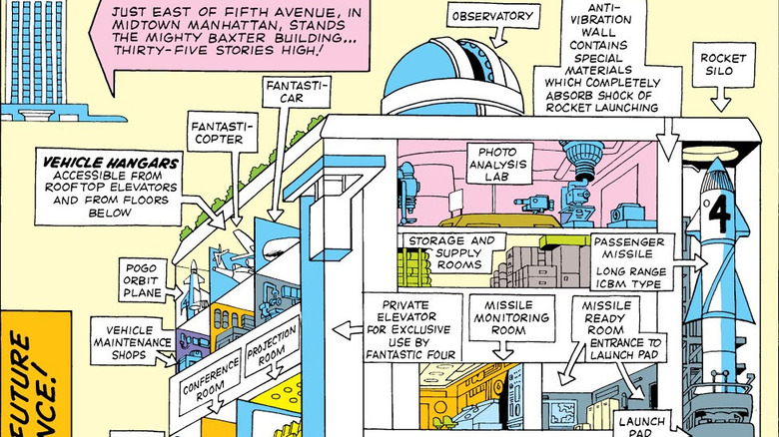

Slide 7
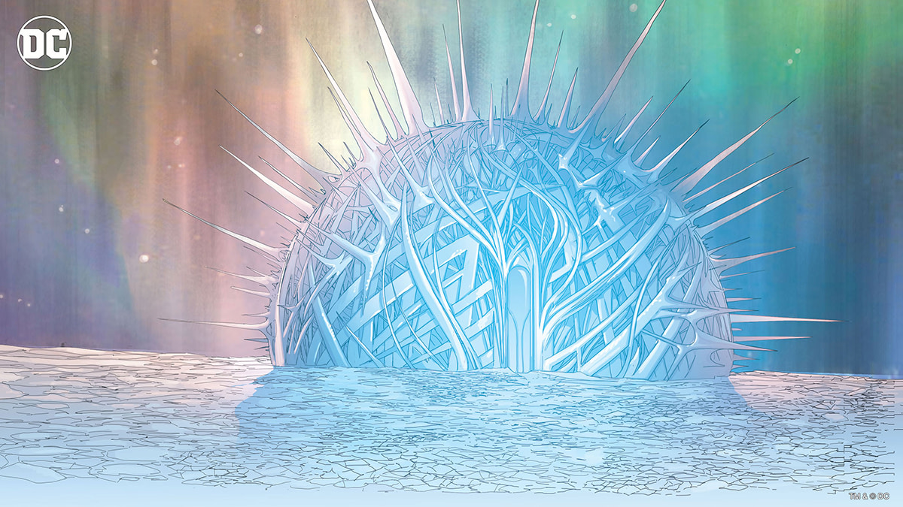
Superman’s Fortress of Solitude

Slide 8
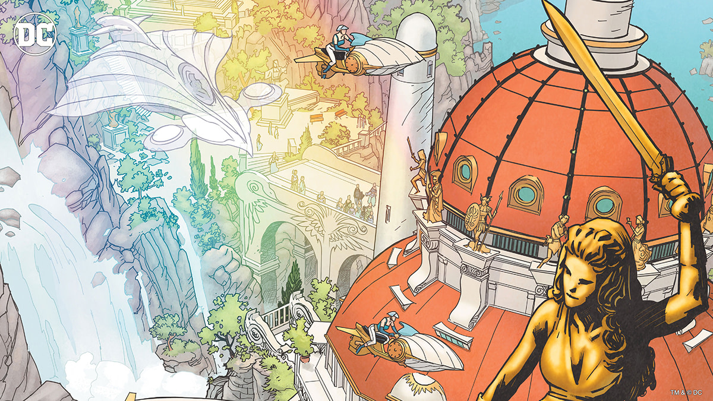
Wonder Woman’s Paradise Island or Themyscira

Slide 9
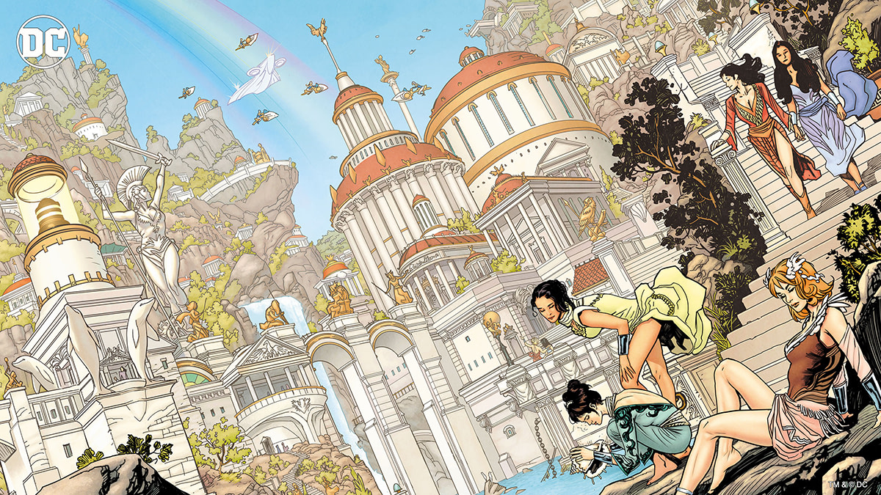
Wonder Woman’s Paradise Island or Themyscira

Slide 10
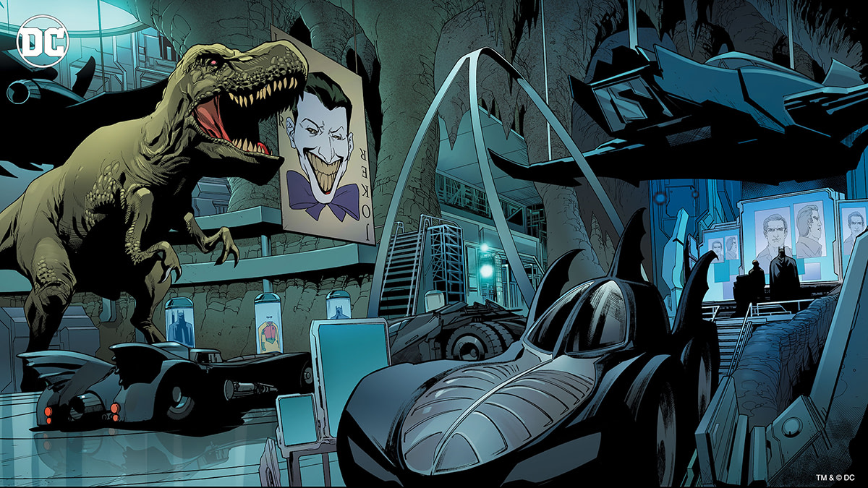
The Batcave

Slide 11
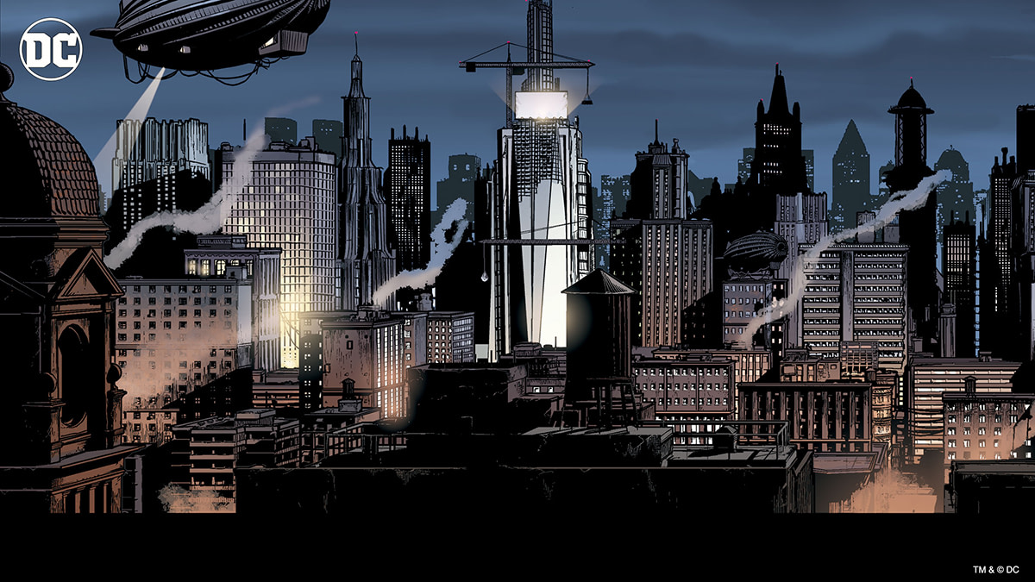
Batman’s Gotham

Slide 12
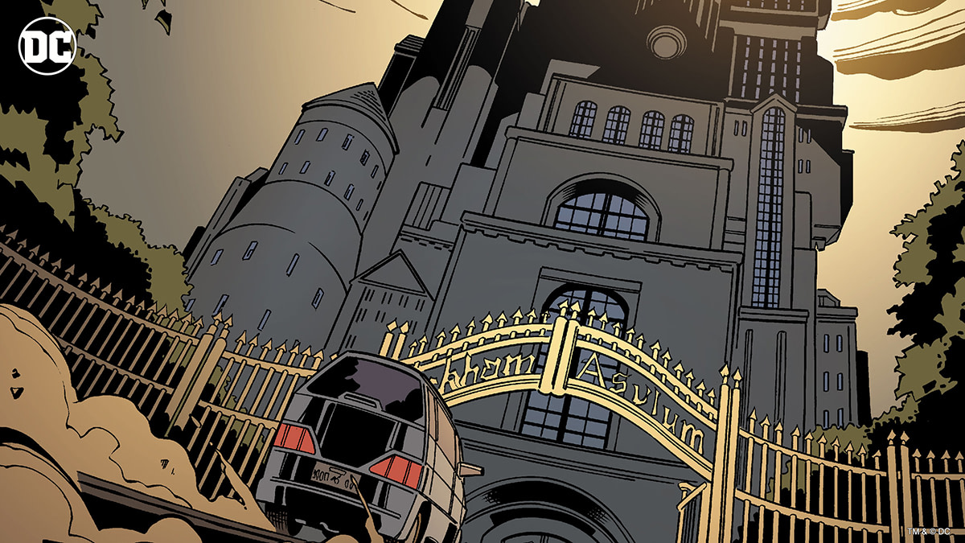
The Elizabeth Arkham Asylum for the Criminally Insane

Slide 13
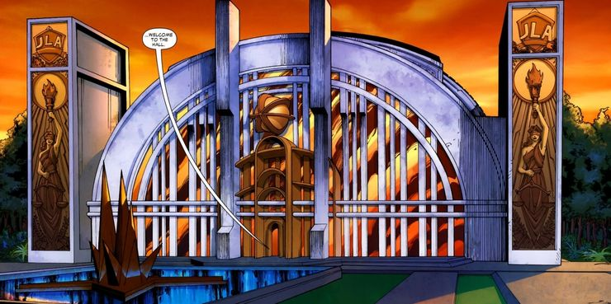
The Hall of Justice

Slide 14
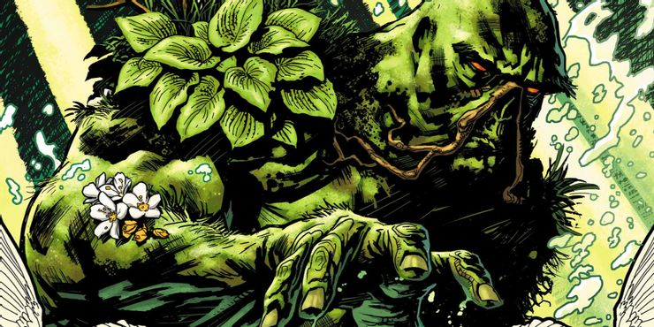
Swamp Thing, Louisiana

Slide 15
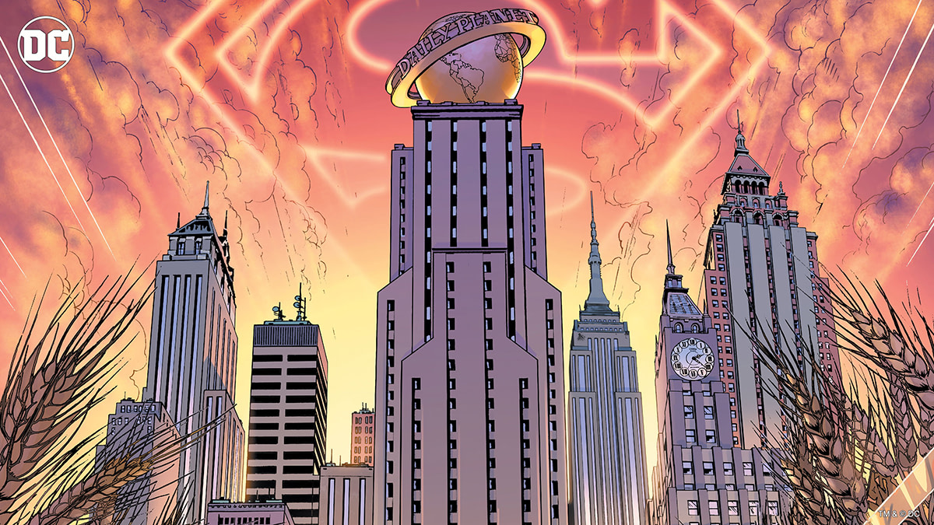
Daily Planet, Metropolis (Superman)

Slide 16
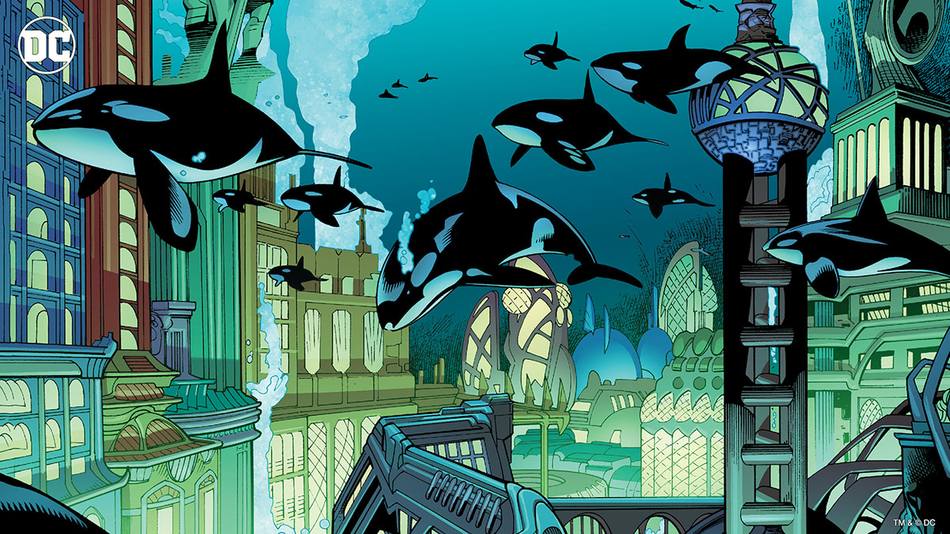
Aquaman’s Atlantis

Slide 17
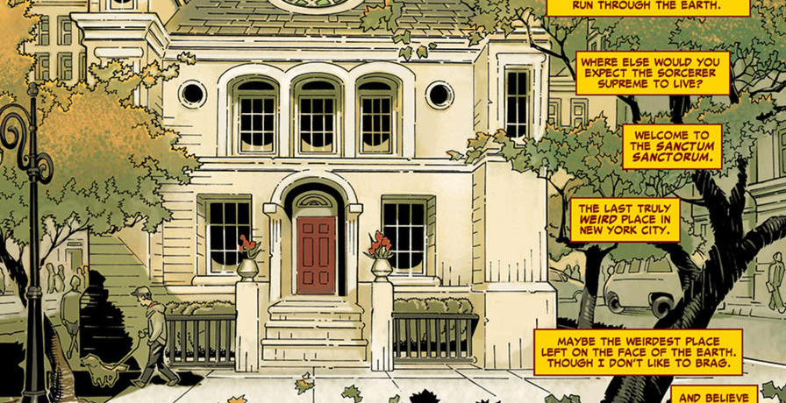
Doctor Strange’s Sanctum Sanctorum

Slide 18
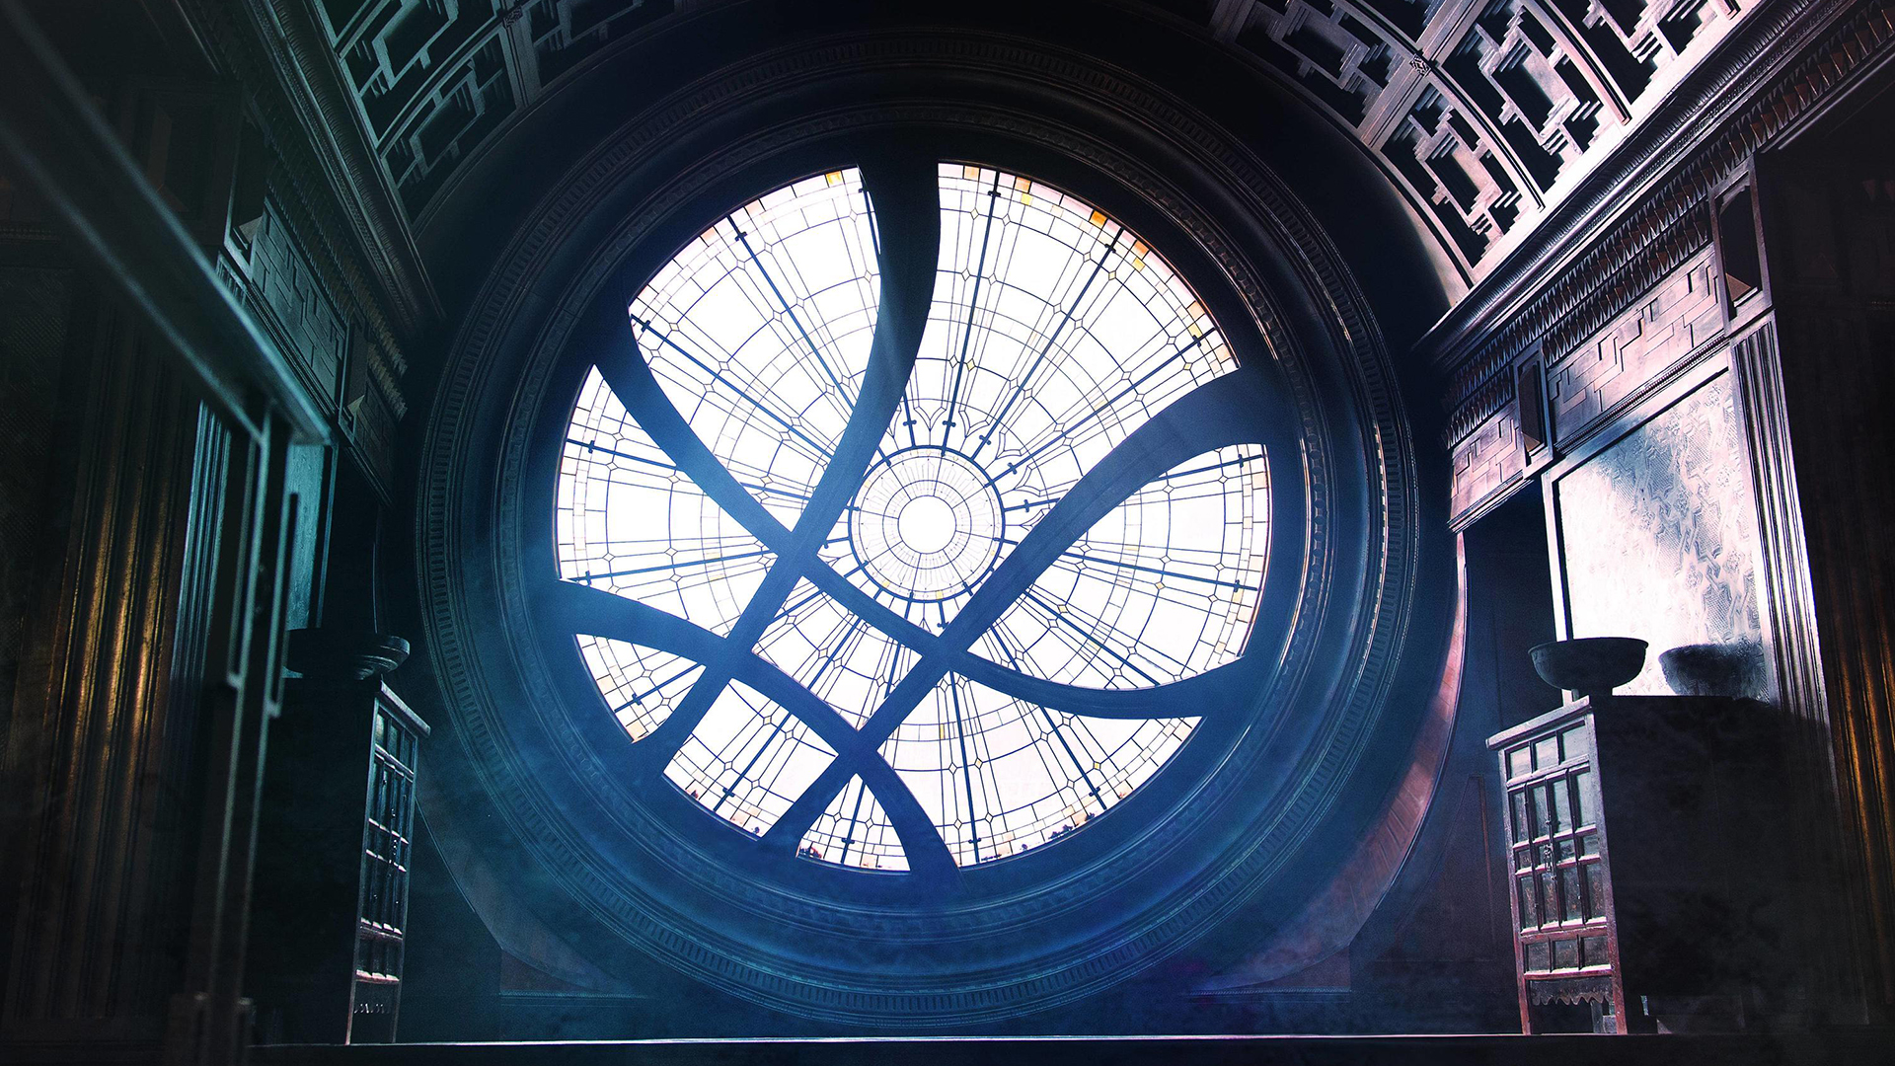
Doctor Strange’s Sanctum Sanctorum

Slide 19
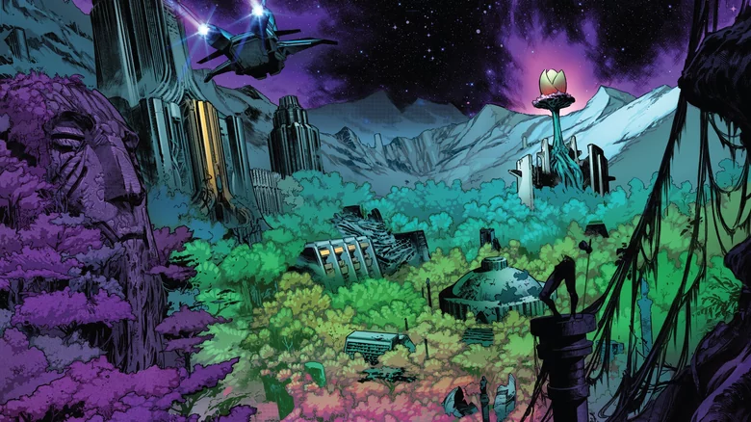
Blue Side of the Moon, Fantastic Four

Slide 20
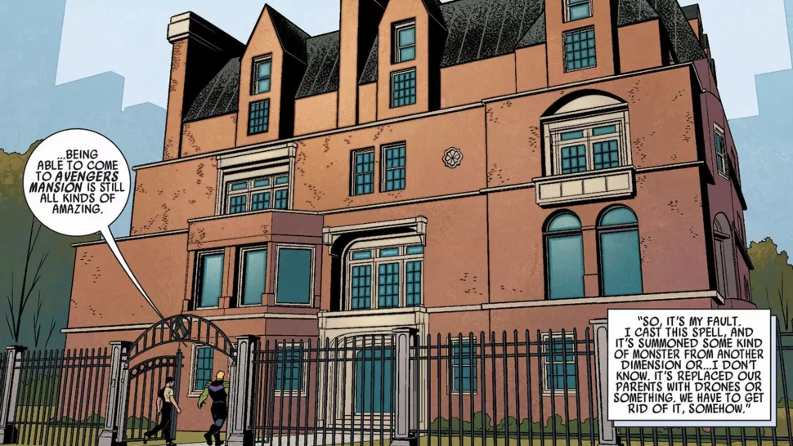
Avengers Mansion

Slide 21
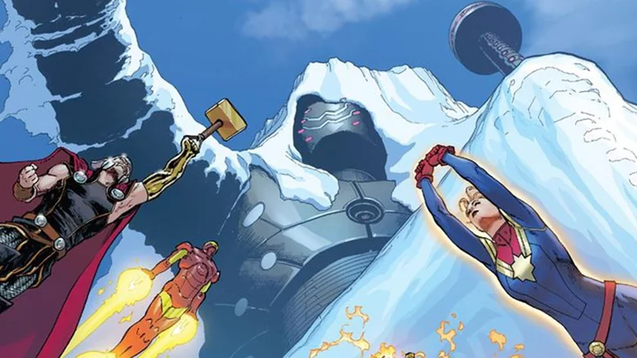
Avengers Mountain

Slide 22
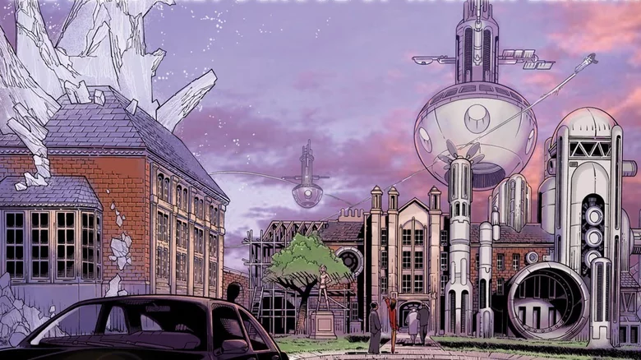
Xavier’s School for Gifted Youngsters

Slide 23
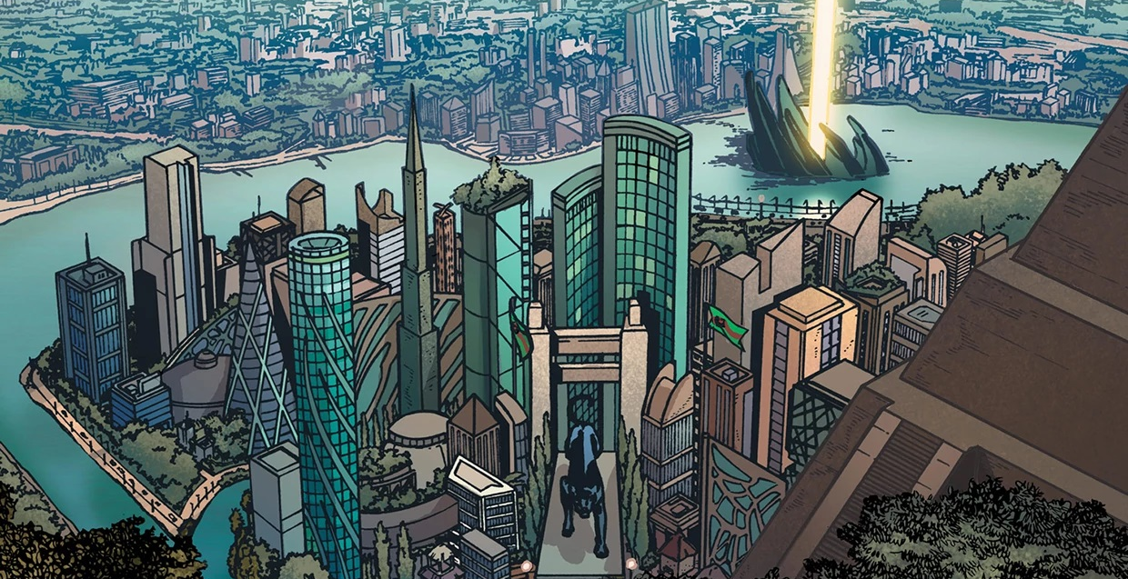
Black Panther’s Wakanda

Slide 24
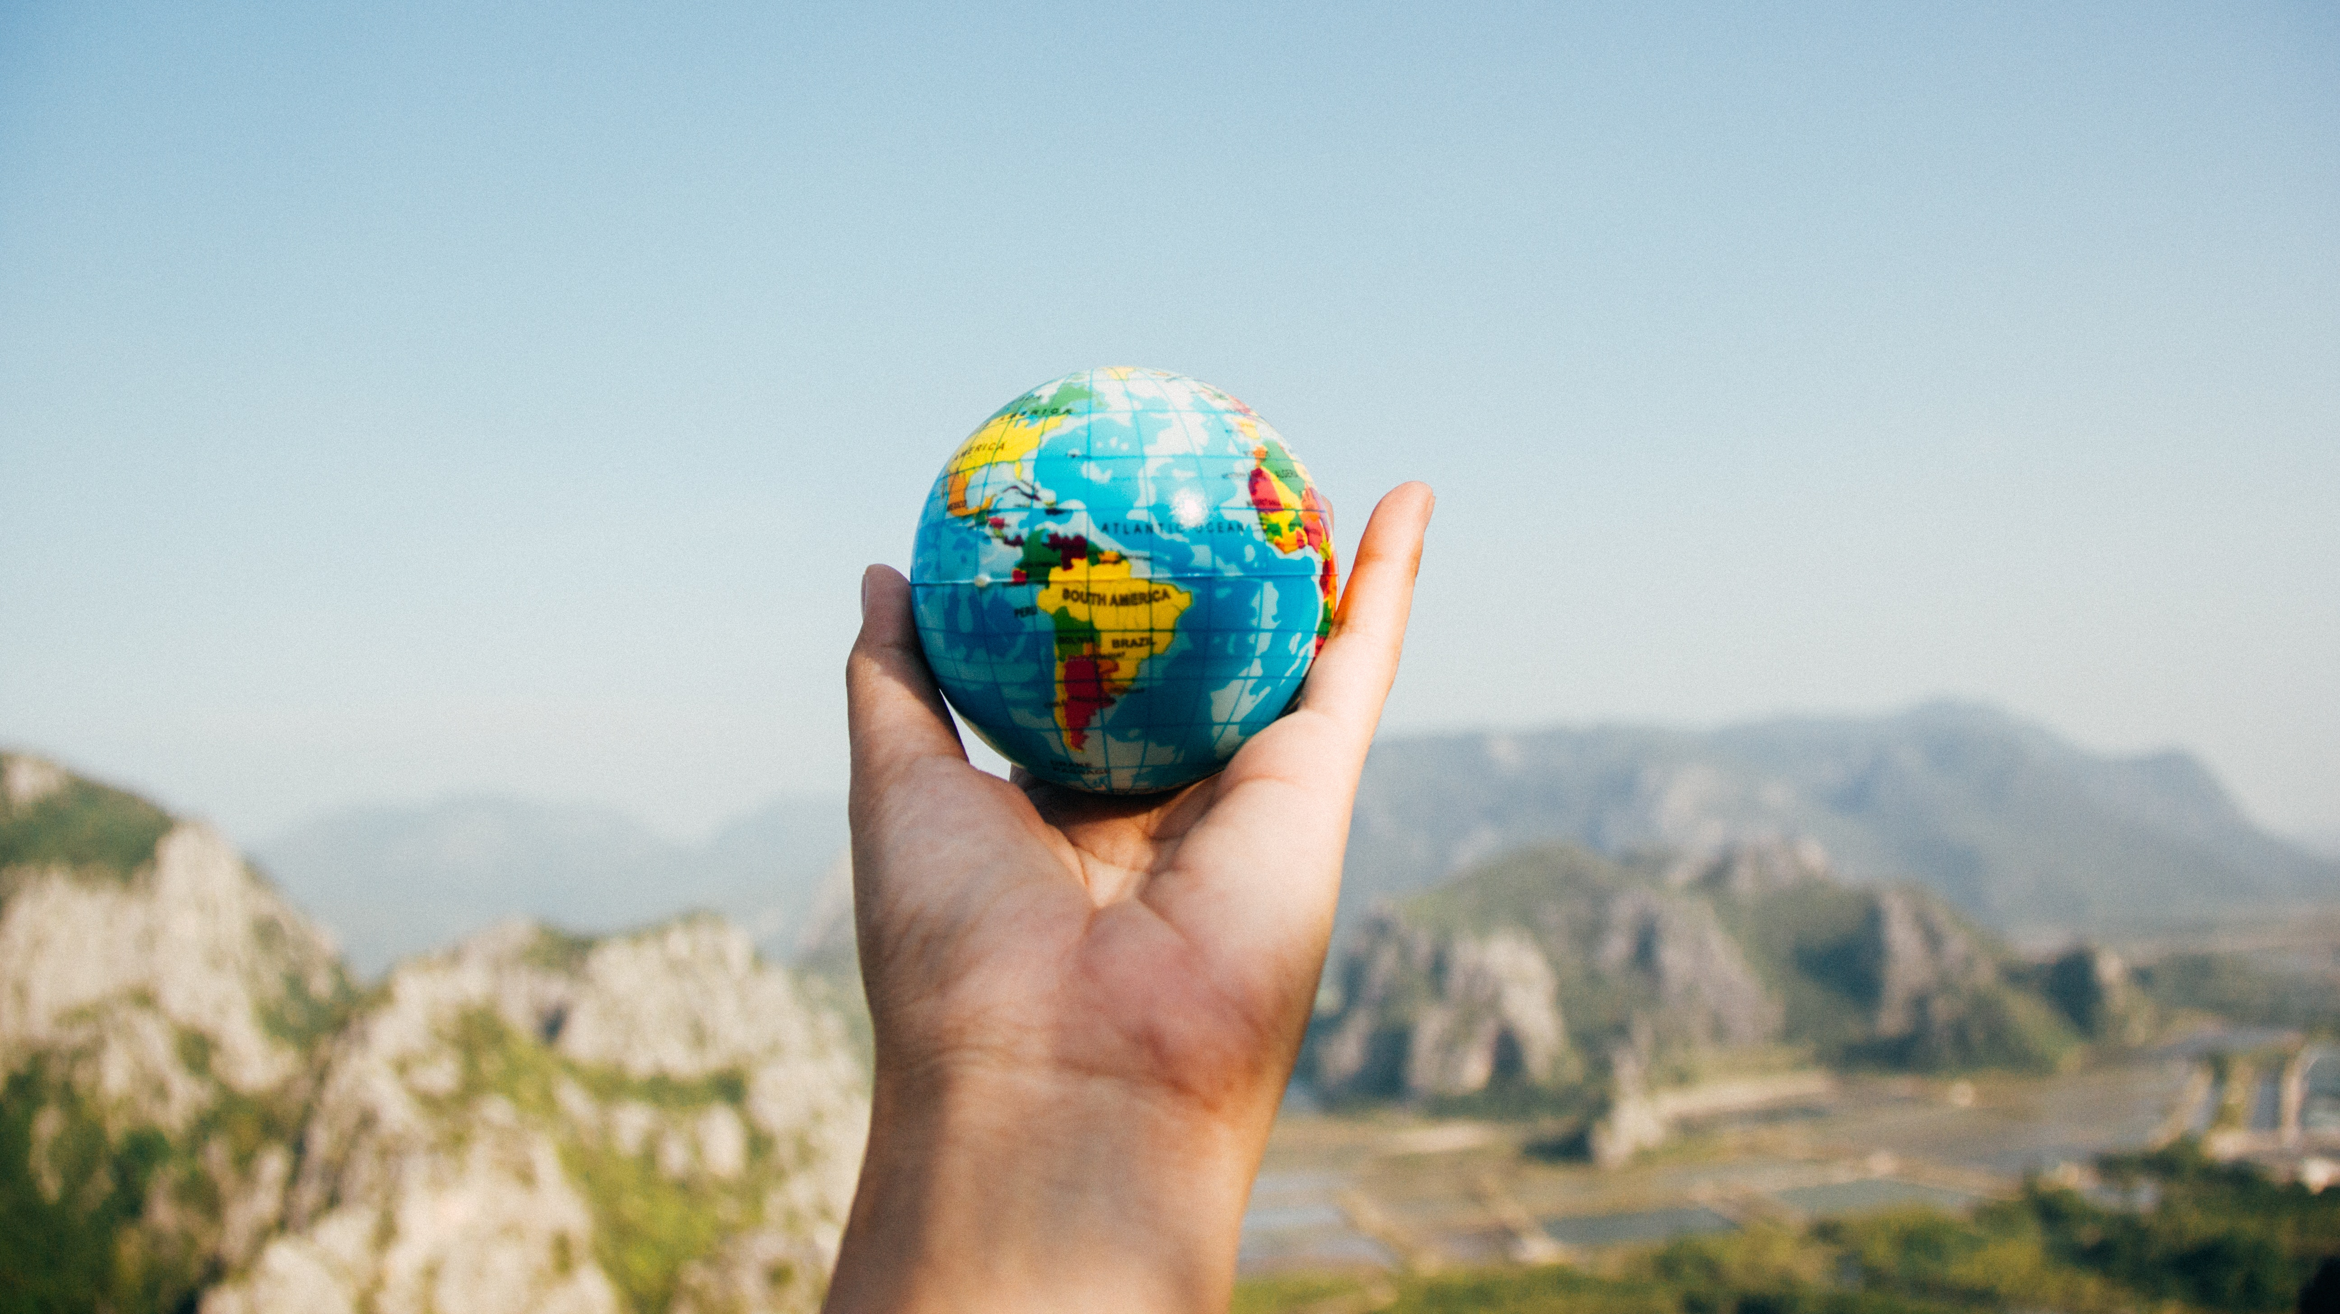
Exercise
imagining the world of your story

Slide 25
Imagine you are molding the story into a medium-sized ball. Set it before you and squint your eyes.
This is the “world of the story.” Ask these questions as you try to picture your story’s setting.
What is space like on this planet?
Are we inside or outside?
Is it man-made or natural?
Is space here confined or wide open?
Do you see a long passage with many “stations”?
Do you see a landscape of valleys and mountains? Sea and land?
Are we on an island? In a cave? In a desert or a jungle? On a country road?
Now ask about the time. How does time behave on this planet?
Does “time stand still”? Is it rushed or relaxed?
How is time marked on this planet? By clock? By the sun? By the sound of footsteps?
What kind of time are we in? Does it go in a straight line? In cycles? Does there seem to be no beginning or end? Is it one day? One lifetime?
Ask about the climate. Do we have storms? Eclipses of the sun and moon? Do we have extreme heat? Freezing cold? Is the environment on this planet lush and growing or, dry and deserted, airless and suffocating? What is the seasonal “feel” of this world? Autumnal? Wintry?
What is the mood on this planet? Jolly? Serious? Sad? Ironic? Terrified?
What is the tone of this planet? Gentle or rude? Brainy or emotional? Calm or threatening?
Is there music? Light, sound, color, shape? What shapes? Curves? Angles?
Adapted
From Elinor Fuchs
“Visit to a Small Planet:
Some Questions to Ask a Play”

Slide 26
vocabulary
The SETTING is where and when the story takes place.
Place – choose a location that adds feeling or risk to your story
Mood – How does the surrounding environment affect the characters?
Remember: Good storytelling triggers the senses (vision, hearing, taste, smell, feeling)

Slide 27
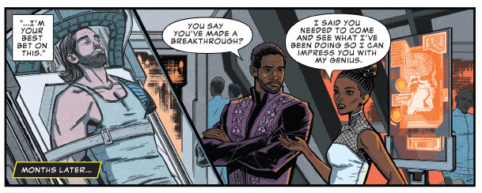
Inside the world …

Slide 28
instructions
Using a large sheet of paper from your ArtsLink sketchbook – divide in half either vertically or horizonatally
Label one half: “my room.”
Label the other half: “my superhero hideout.”
Draw the most important details of each setting.
Consider how you get into and out of your “secret lair.”
How do you keep it a secret?

Slide 29
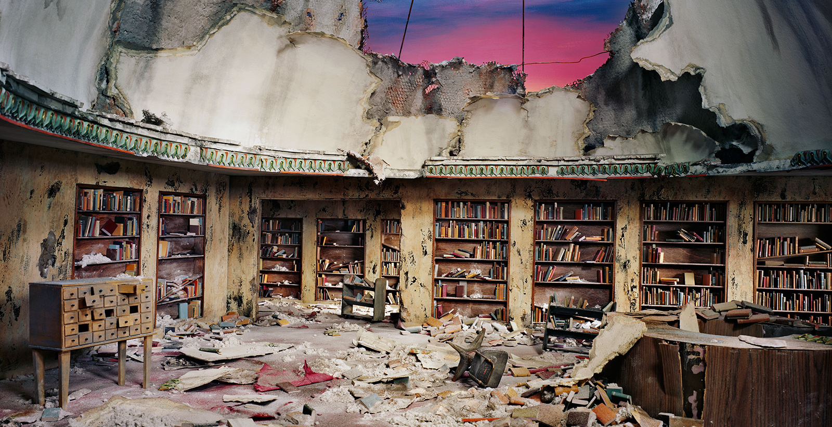
Abandoned library (Lori Nix) perfect hideout for The Unleasher

Slide 30
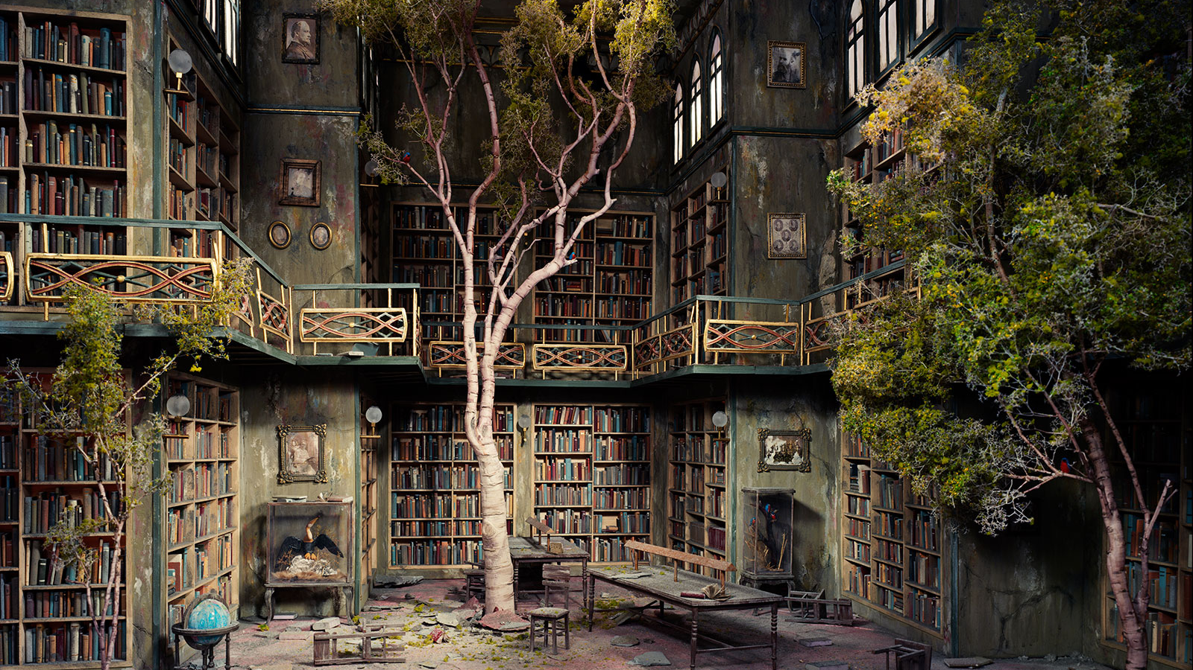

Slide 31

references

Slide 32
references
Images from DC and Marvel comics
(Zoom background) Photo by Nix + Gerber (Lori Nix)
Licensed superhero clip art

Slide 33
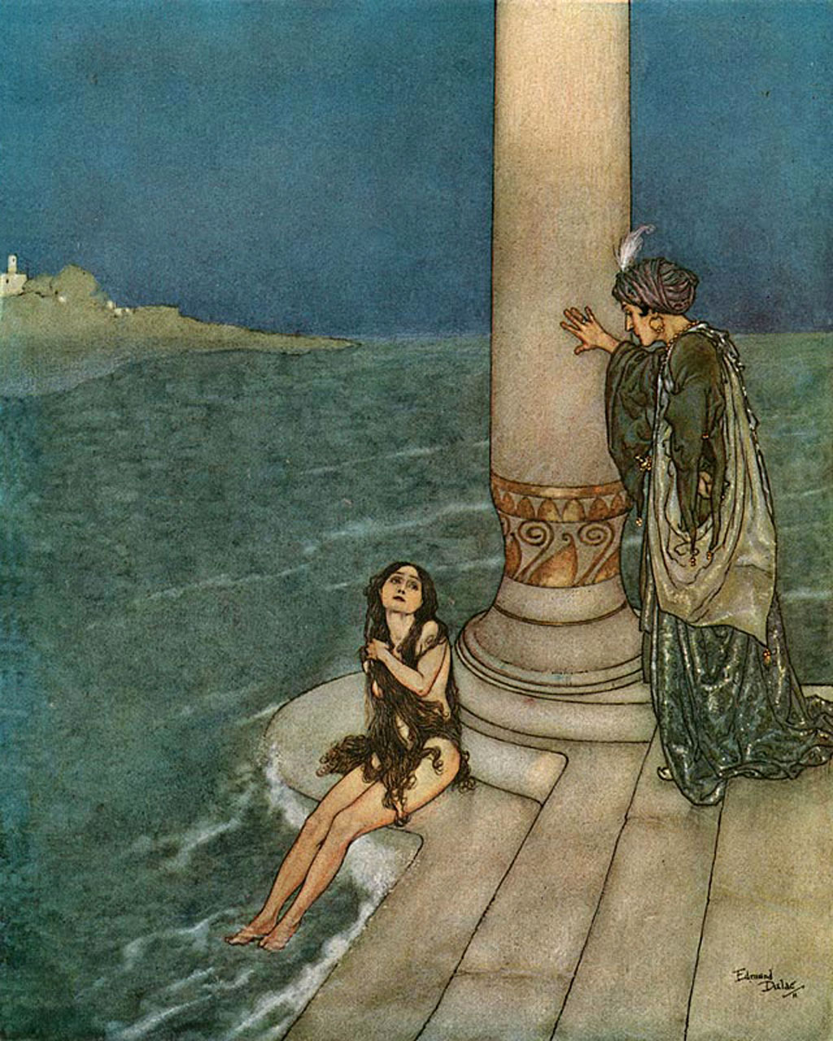
Far out in the ocean, where the water is as blue as the prettiest cornflower, and as clear as crystal, it is very, very deep; so deep, indeed, that no cable could fathom it: many church steeples, piled one upon another, would not reach from the ground beneath to the surface of the water above. There dwell the Sea King and his subjects. We must not imagine that there is nothing at the bottom of the sea but bare yellow sand. No, indeed; the most singular flowers and plants grow there; the leaves and stems of which are so pliant, that the slightest agitation of the water causes them to stir as if they had life. Fishes, both large and small, glide between the branches, as birds fly among the trees here upon land. In the deepest spot of all, stands the castle of the Sea King. Its walls are built of coral, and the long, gothic windows are of the clearest amber. The roof is formed of shells, that open and close as the water flows over them. Their appearance is very beautiful, for in each lies a glittering pearl, which would be fit for the diadem of a queen.
The Little Mermaid
Hans Christian Andersen, 1836

Slide 34
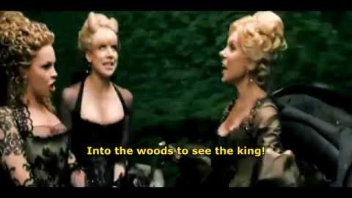
Into the Woods

