Slide 1
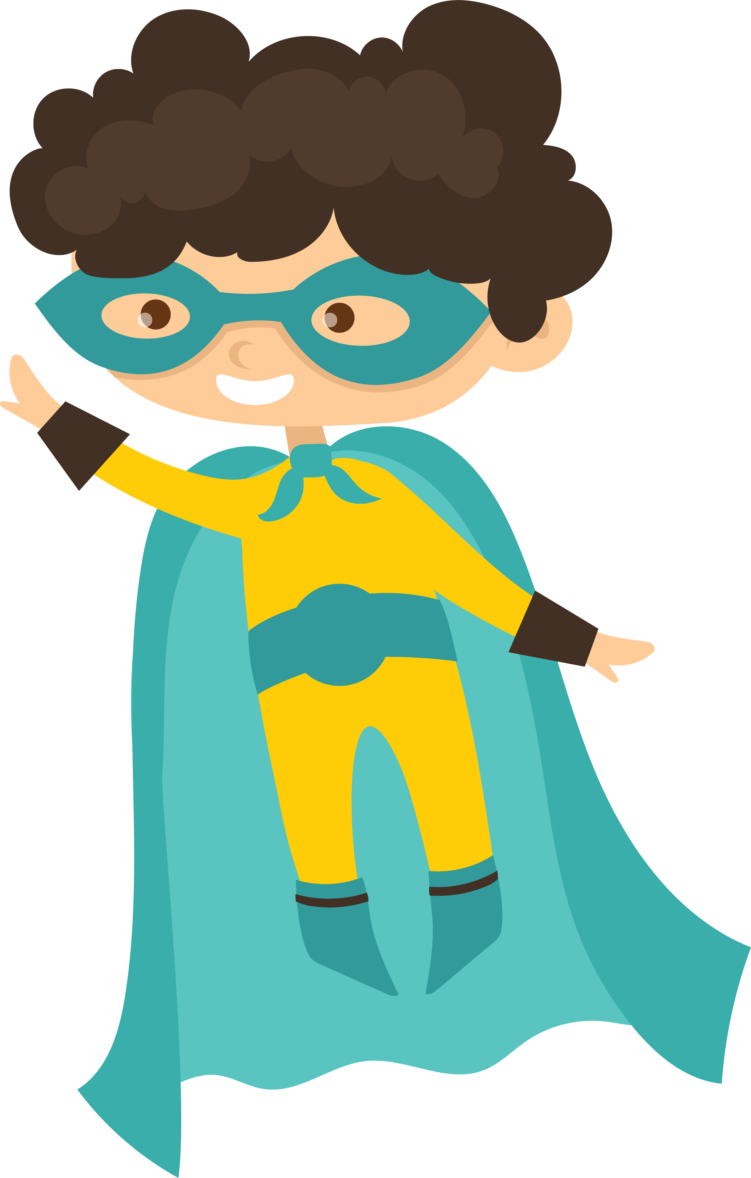
Conflict & Problems
Plotting “act two” of your story
aka THE MiDDLE

Slide 2
objectives
of this lesson

Slide 3
objectives
Students will share comic book pages
Recap act one (beginning) story set-up
View examples of conflict and problems in famous superhero stories
Brainstorm ideas for our characters’ stories

Slide 4
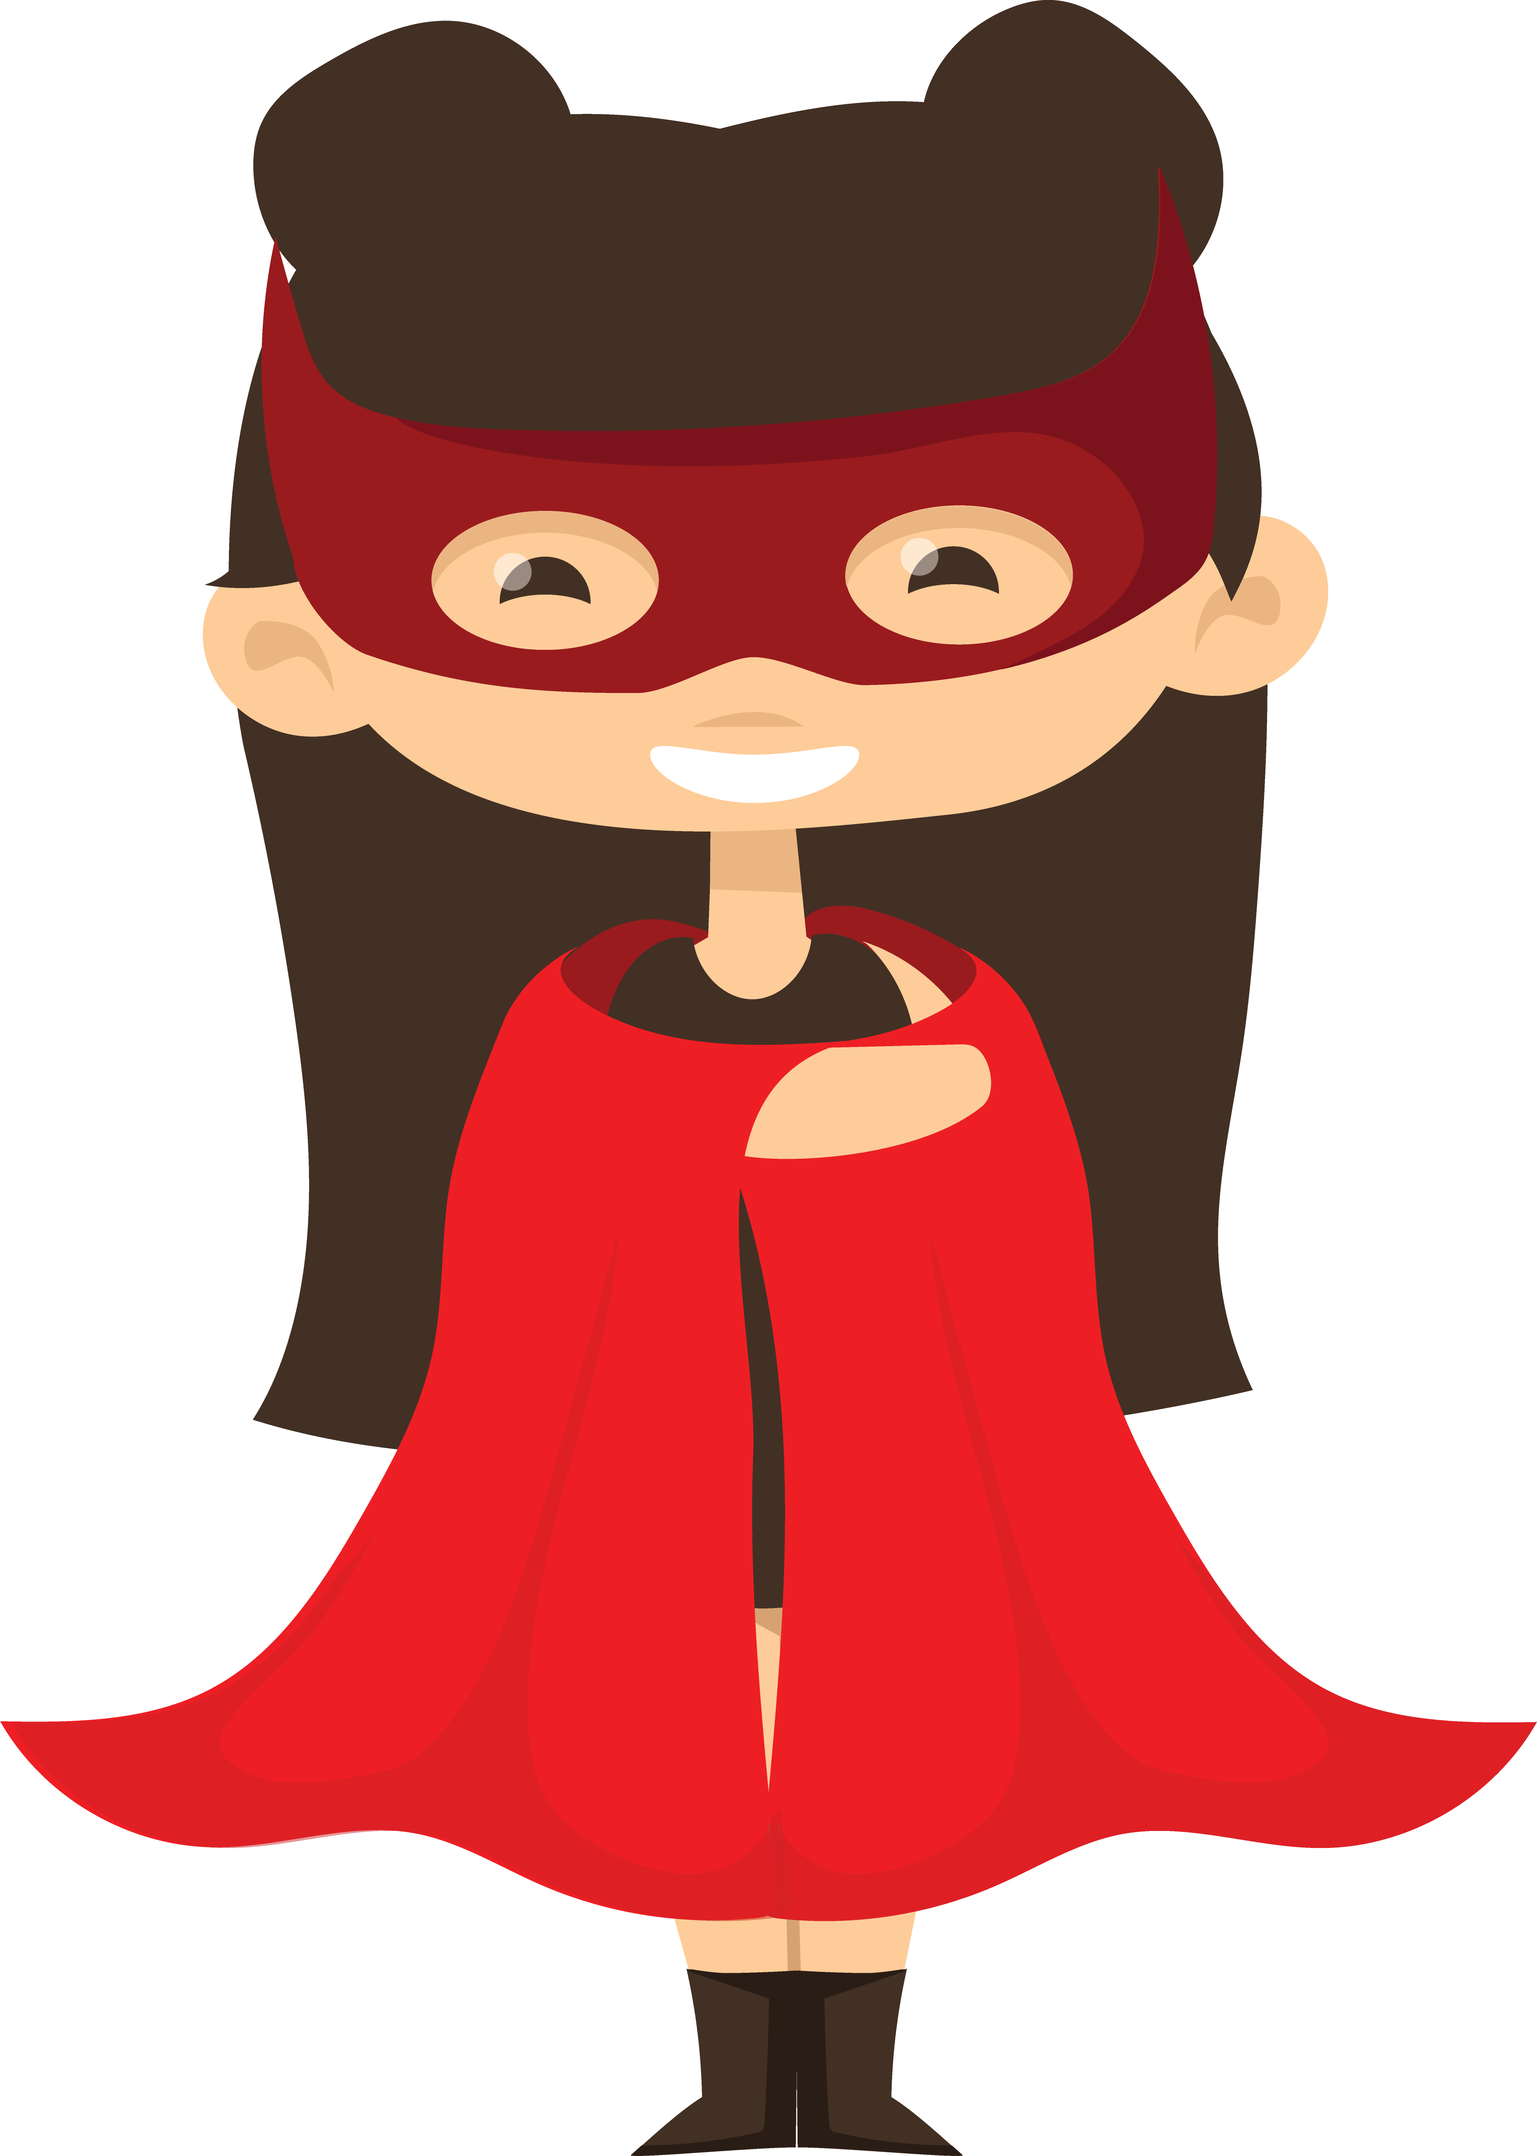
materials
Comic book pages created on templates since last class
ArtsLink notebooks
Pencil

Slide 5
Pass or play!
SHARE YOUR COMIC BOOK PAGES
AND STORY IN PROGRESS

Slide 6

Examples
It’s not easy being a super hero …

Slide 7
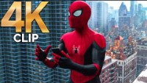
Secret identity revealed

Slide 8
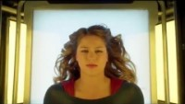
Loses powers

Slide 9
Common Superhero problems
The Reluctant Hero – didn’t ask for this job. (Shazam, Jessica Jones, The Thing of Fantastic Four.)
Discrimination: People don’t trust them – Superman is an alien. X-Men are mutants. Not allowed to make mistakes – held to higher standards.
Put people at risk – attract villains. Cause destruction.
Always getting hurt.
Have to lie to people they love about who they really are.
RESPONSIBILITY. Not allowed to take a day off.
People come to count on them and can’t defend themselves.
Trouble controlling powers; lose powers.
Villain probably killed one or more of your parents.
Surviving Trauma.
Guilt.

Slide 10
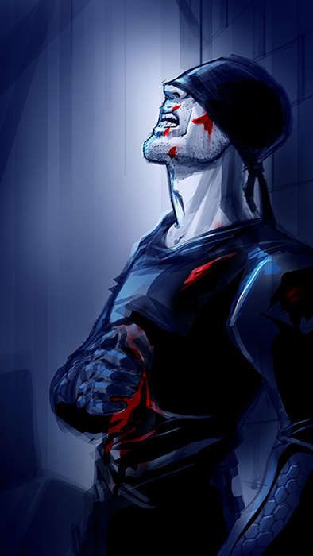
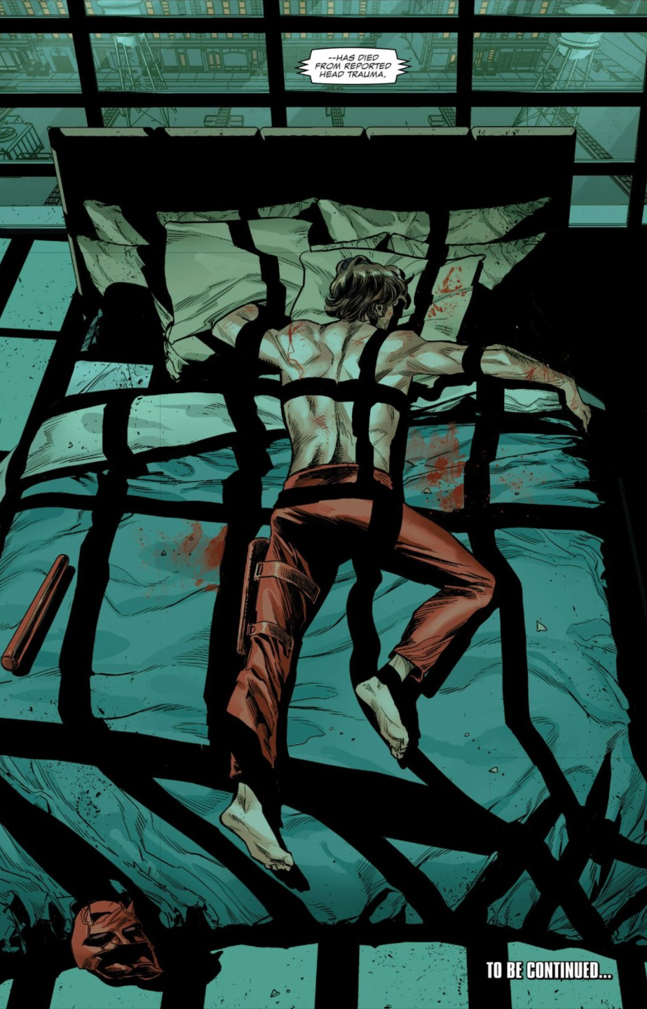

Slide 11
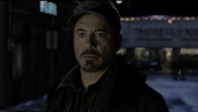
Trauma and anxiety

Slide 12
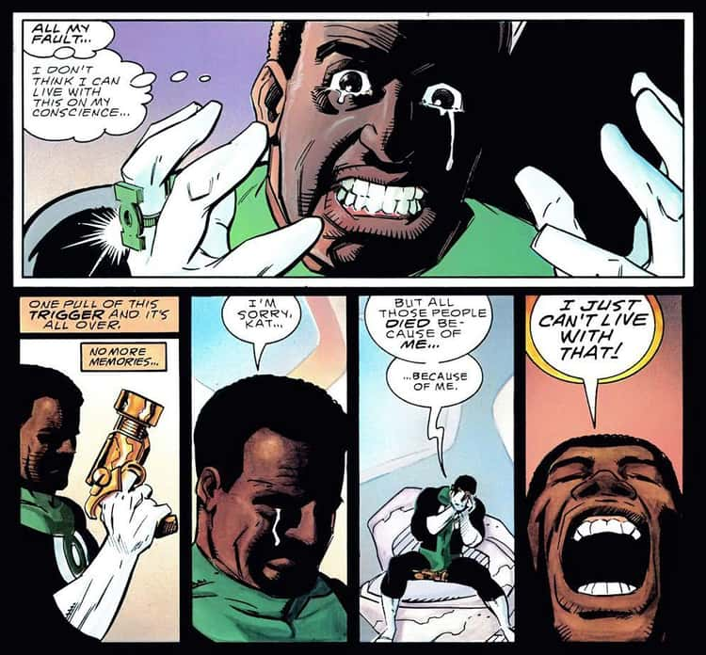

Slide 13
vocabulary
Conflict
Story beat
Act two
Rising action
Cause and effect
Fun and games
Climax

Slide 14
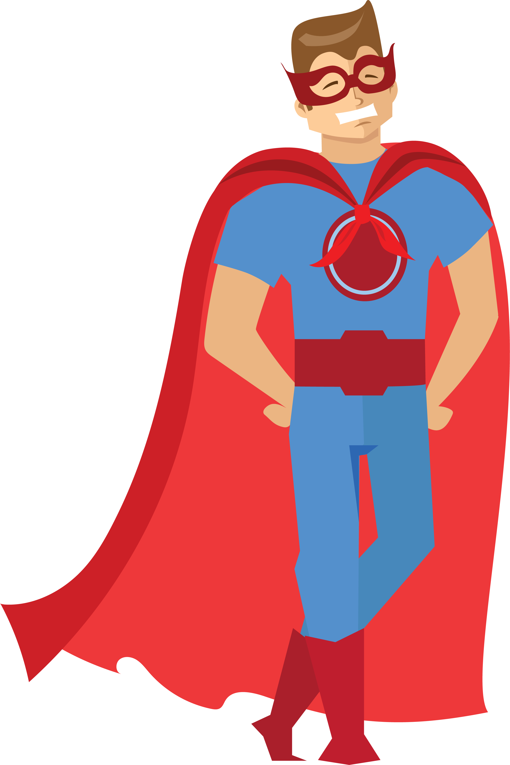
instructions
Choose one big problem
And one personal problem
Your superhero has to face.

Slide 15
instructions
What external (community) problem is your hero asked to fix?
What internal problem (self/flaw) makes this difficult?
What other obstacle(s) stand in the way? (villain, other responsibility, lack of tools or resources, etc.)
What does your hero fear?
Where can your hero turn for help? (allies and/or other resources)?
What change/transformation has to happen in order for your hero (and team) to solve the problem.

Slide 16
references

Slide 17
references
http://www.superheronation.com/2012/01/07/possible-problems-and-obstacles-for-superheroes-to-face-besides-supervillains/
Clips from Spiderman (Marvel), Supergirl (DC), and IronMan3 (Marvel)
Comic book pages from Green Lantern and Daredevil.

