Slide 1
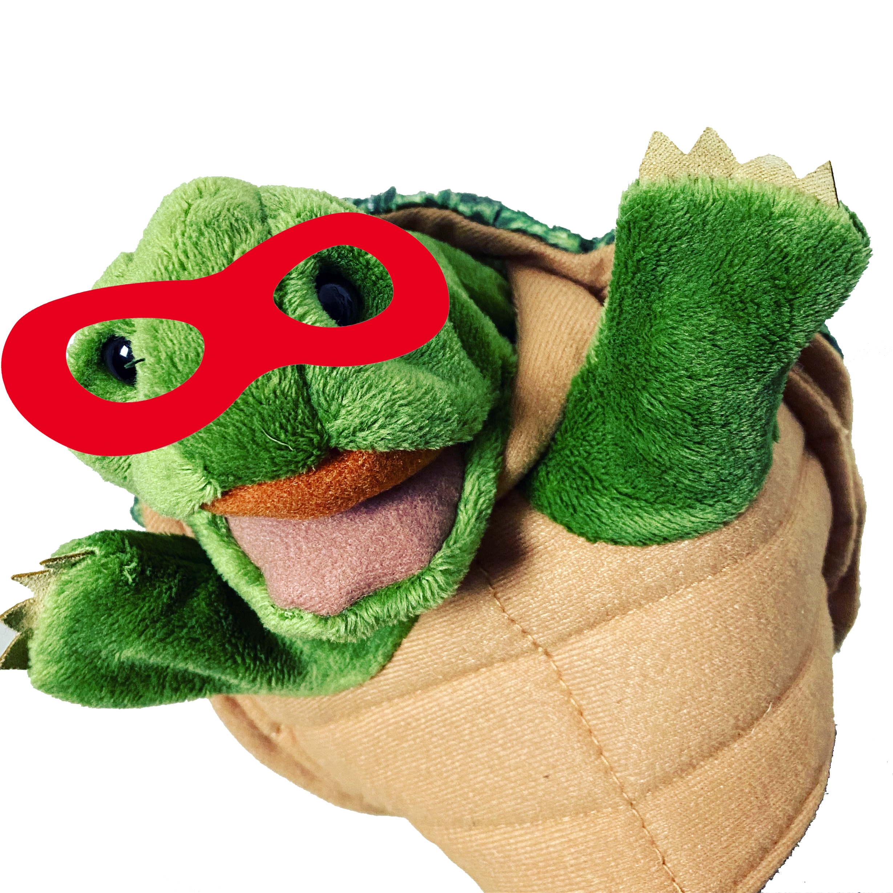
Origin story
Birth of your superhero

Slide 2
objectives
of this lesson

Slide 3

objectives
Share superhero characters in progress.
Review example origin stories.
Start writing sentences to tell the story of how we became superheroes.

Slide 4
Warm-up exercise

Slide 5
Five senses warm-up
RELAXATION-STIMULATION
Ask children to relax and explore their five senses by PRETENDING to:
TOUCH
• A hot stove
• Icicles
• Sharp tacks
• Velvet
TASTE
• A sour lemon
• Their favorite candy
• Spinach
HEAR…
• A gentle wind
• Underwater sounds
• A whistle
SEE
• A car coming far away and towards you
• A giant
• An ant
• A big black spider
SMELL…
• chocolate chip cookies
• A skunk
• Perfume
• Onions
https://kidactivities.net/drama-games-and-activities/

Slide 6

Pass or play!
Share your superhero character

Slide 7

materials
Superhero drawing from last week
What did you write about your superhero?
Pencil and paper.

Slide 8
examples
More Superhero origin stories

Slide 9
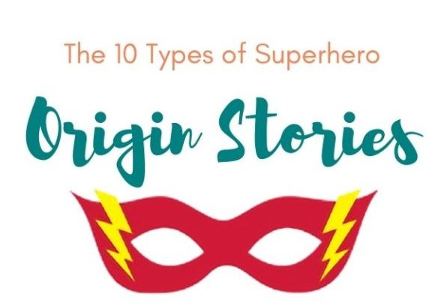
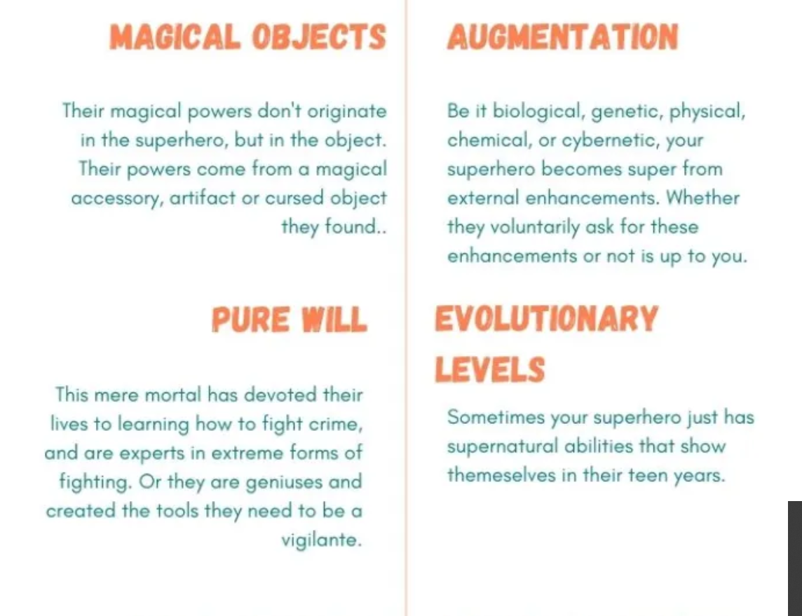

Slide 10
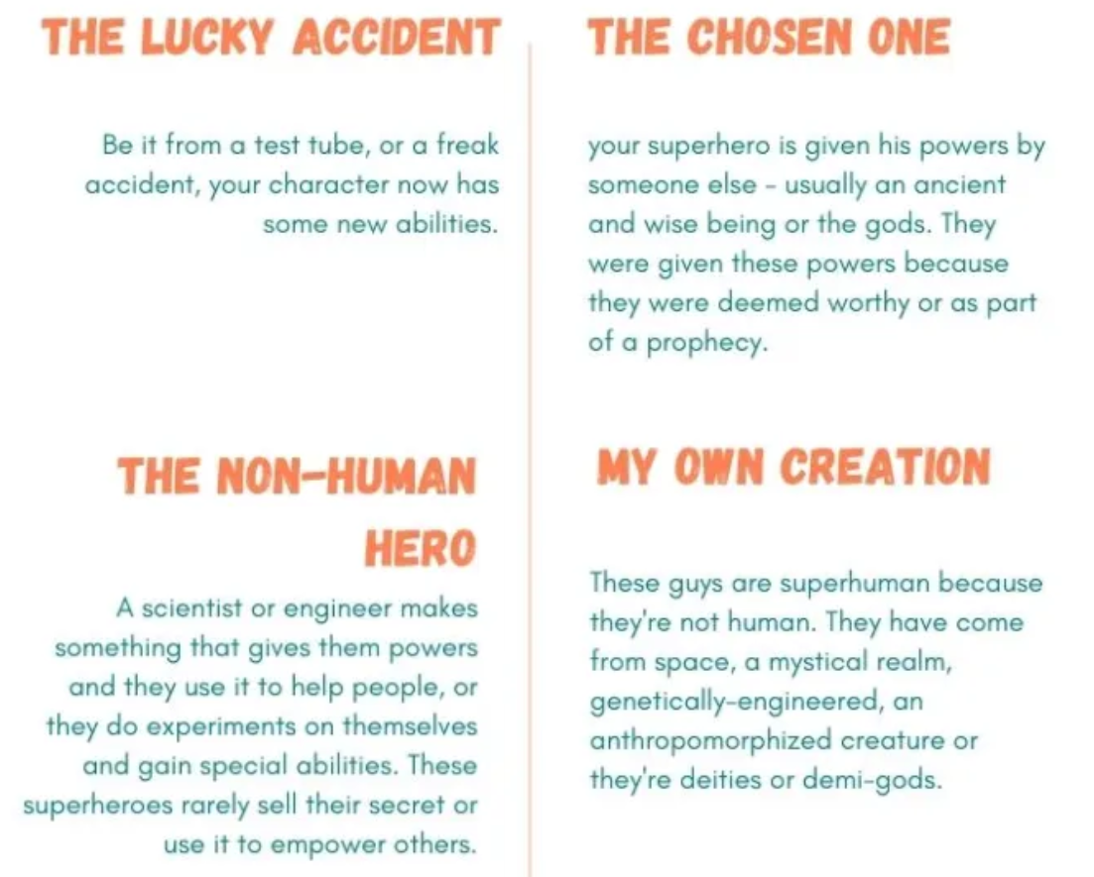

Slide 11
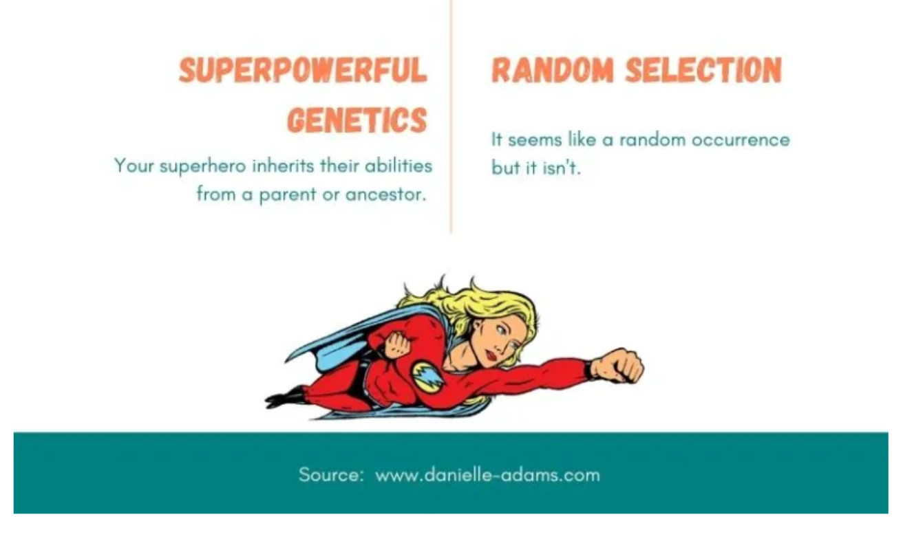

Slide 12
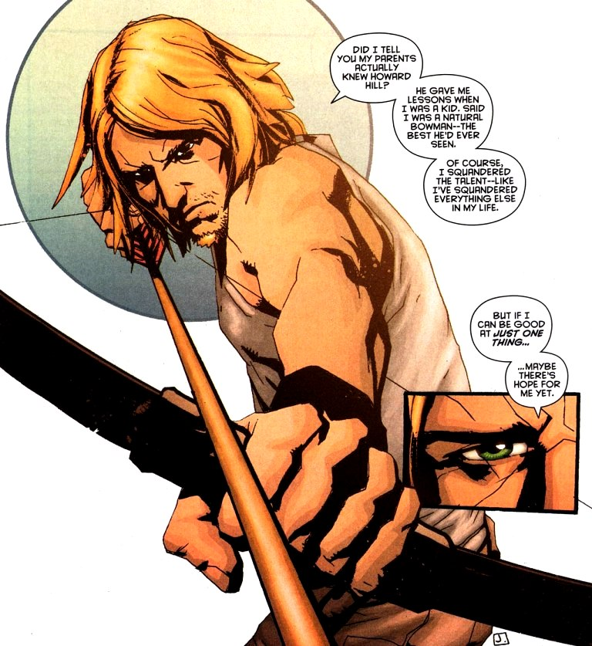
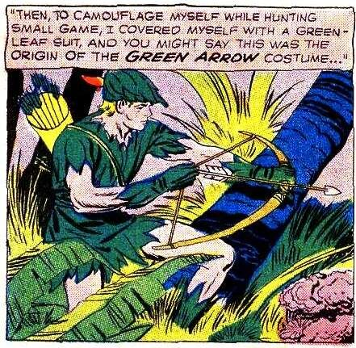
Green arrow
Inspired in part by Robin Hood, Oliver Queen was a rich young man who shipwrecked on a deserted island and had to learn to survive – his money was no good here.
When a passing ship was attacked by pirates, he rescued the passengers and realized he could use his powers of archery to help people in need.

Slide 13
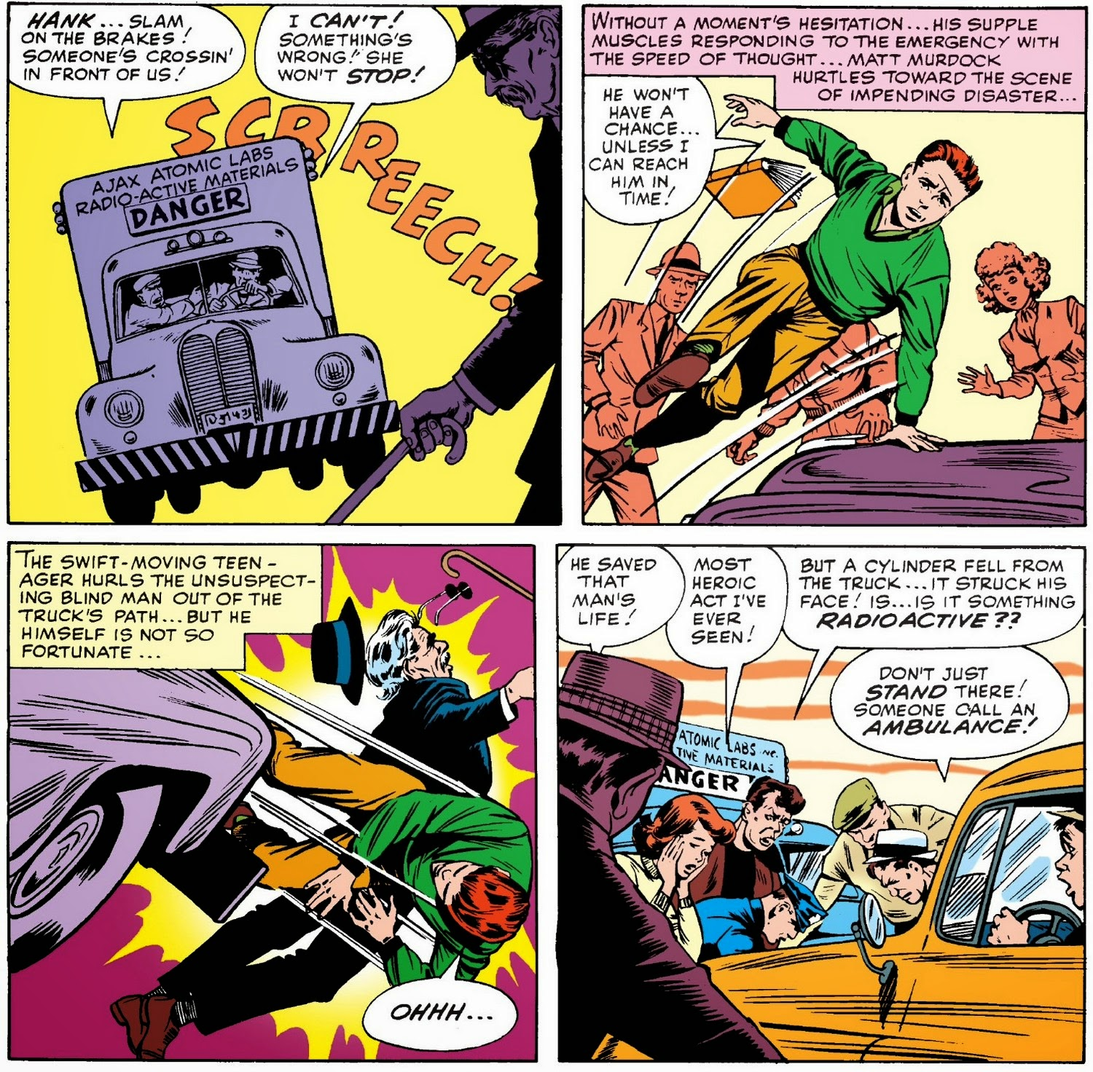
Daredevil

Slide 14
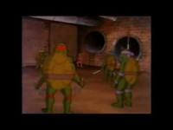
Teen age
Mutant
Ninja
turtles

Slide 15

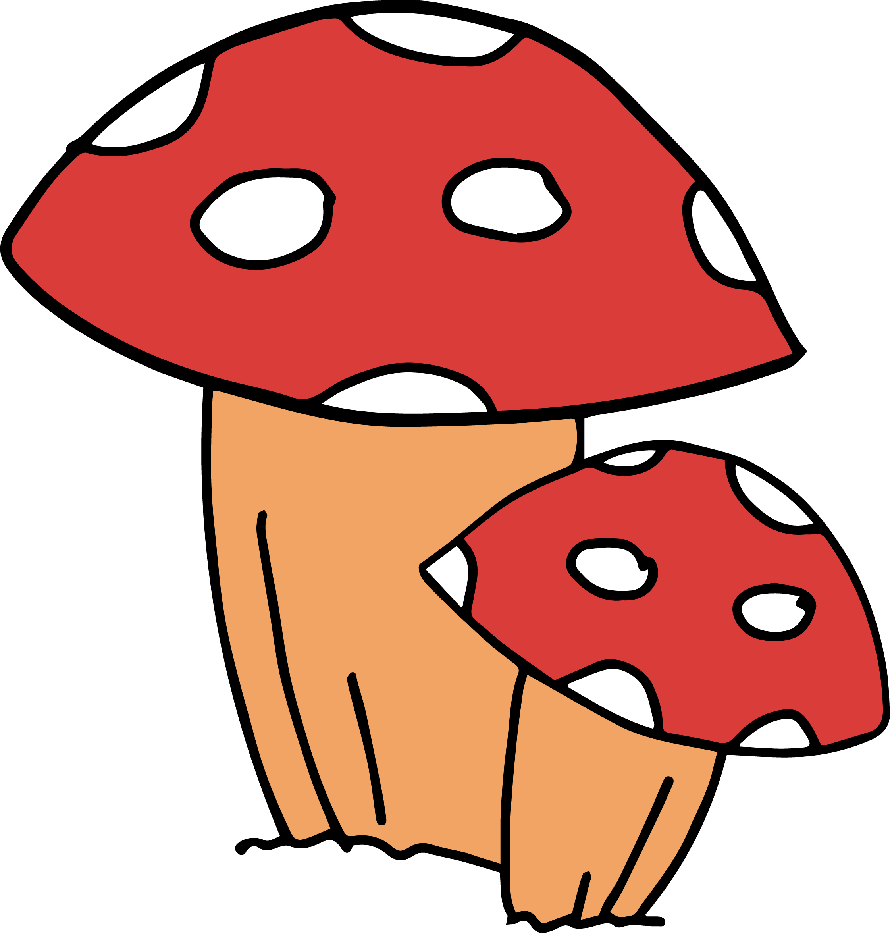
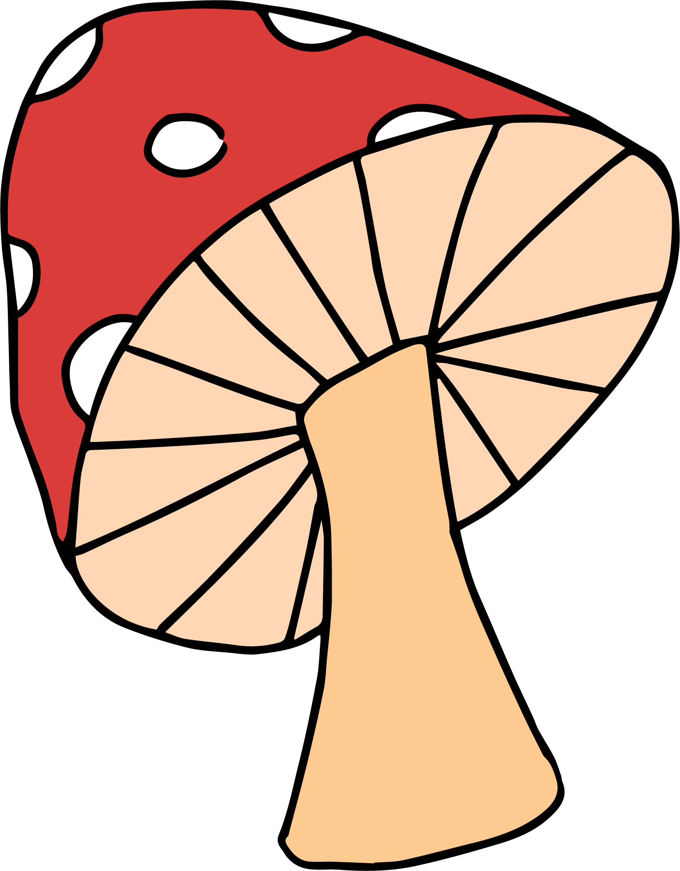
The unleasher
How did Miss Alicia get her powers?

Slide 16
Story template
My name is …
I am in ... Grade at … School.
I am … (character traits)
One day … (something weird happened)
I decided to … (heroic choice).

Slide 17
references

Slide 18
references
Teenage Mutant Ninja Turtles created in 1983 by American comic book authors Peter Laird and Kevin Eastman. Published by Mirage Studios.
Superhero and Superkids art licensed via Creative Market.
Images from Daredevil (Marvel) and Green Arrow (DC) comics.
Five senses exercise from kidactivities.net

