Slide 1
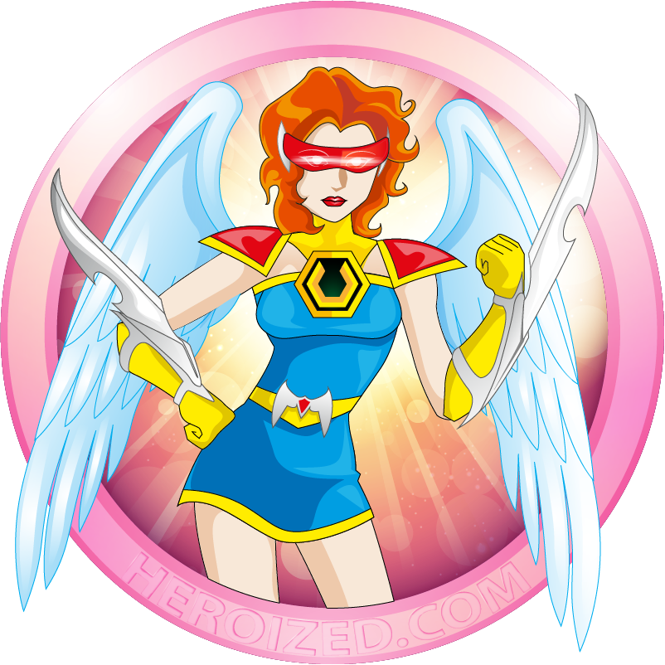
W2. character
Self vs. super-hero

Slide 2
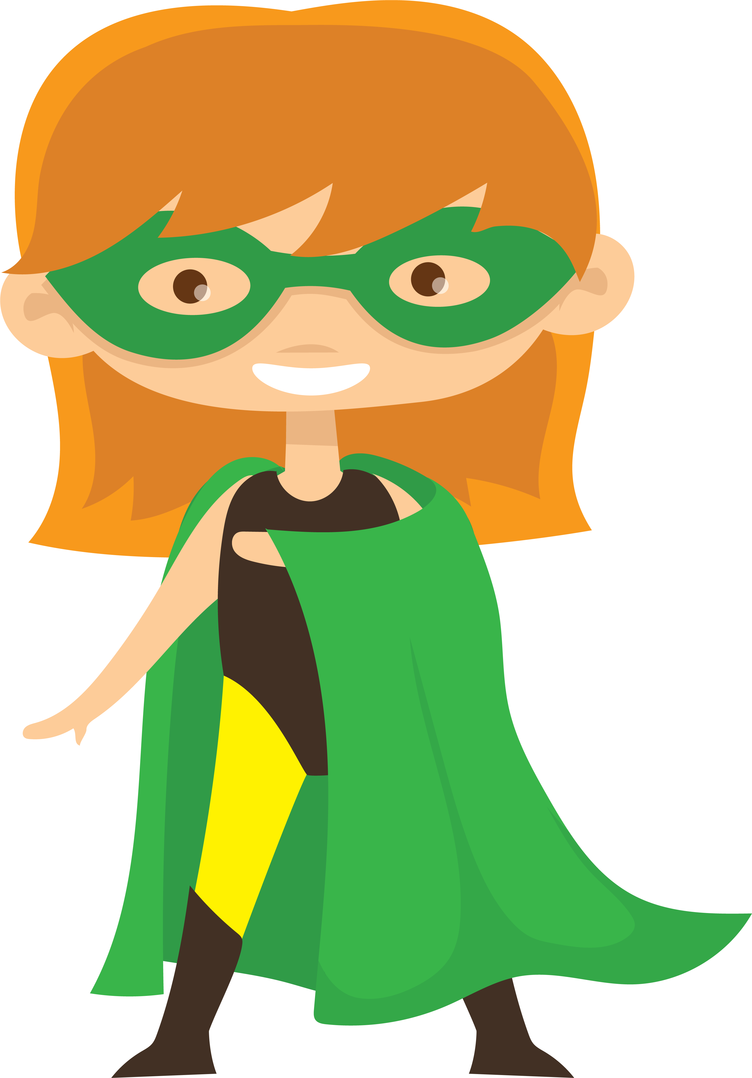
objectives
of this lesson

Slide 3
objectives
Understand self as character: share character traits chosen between classes.
Use traits to inspire a superhero persona (alter ego)
Which character traits might shape a story?
“You don't inspire people by revealing your super powers; you inspire people by helping them reveal their own super powers.”
- ALEXANDER DEN HEIJER, motivational speaker

Slide 4
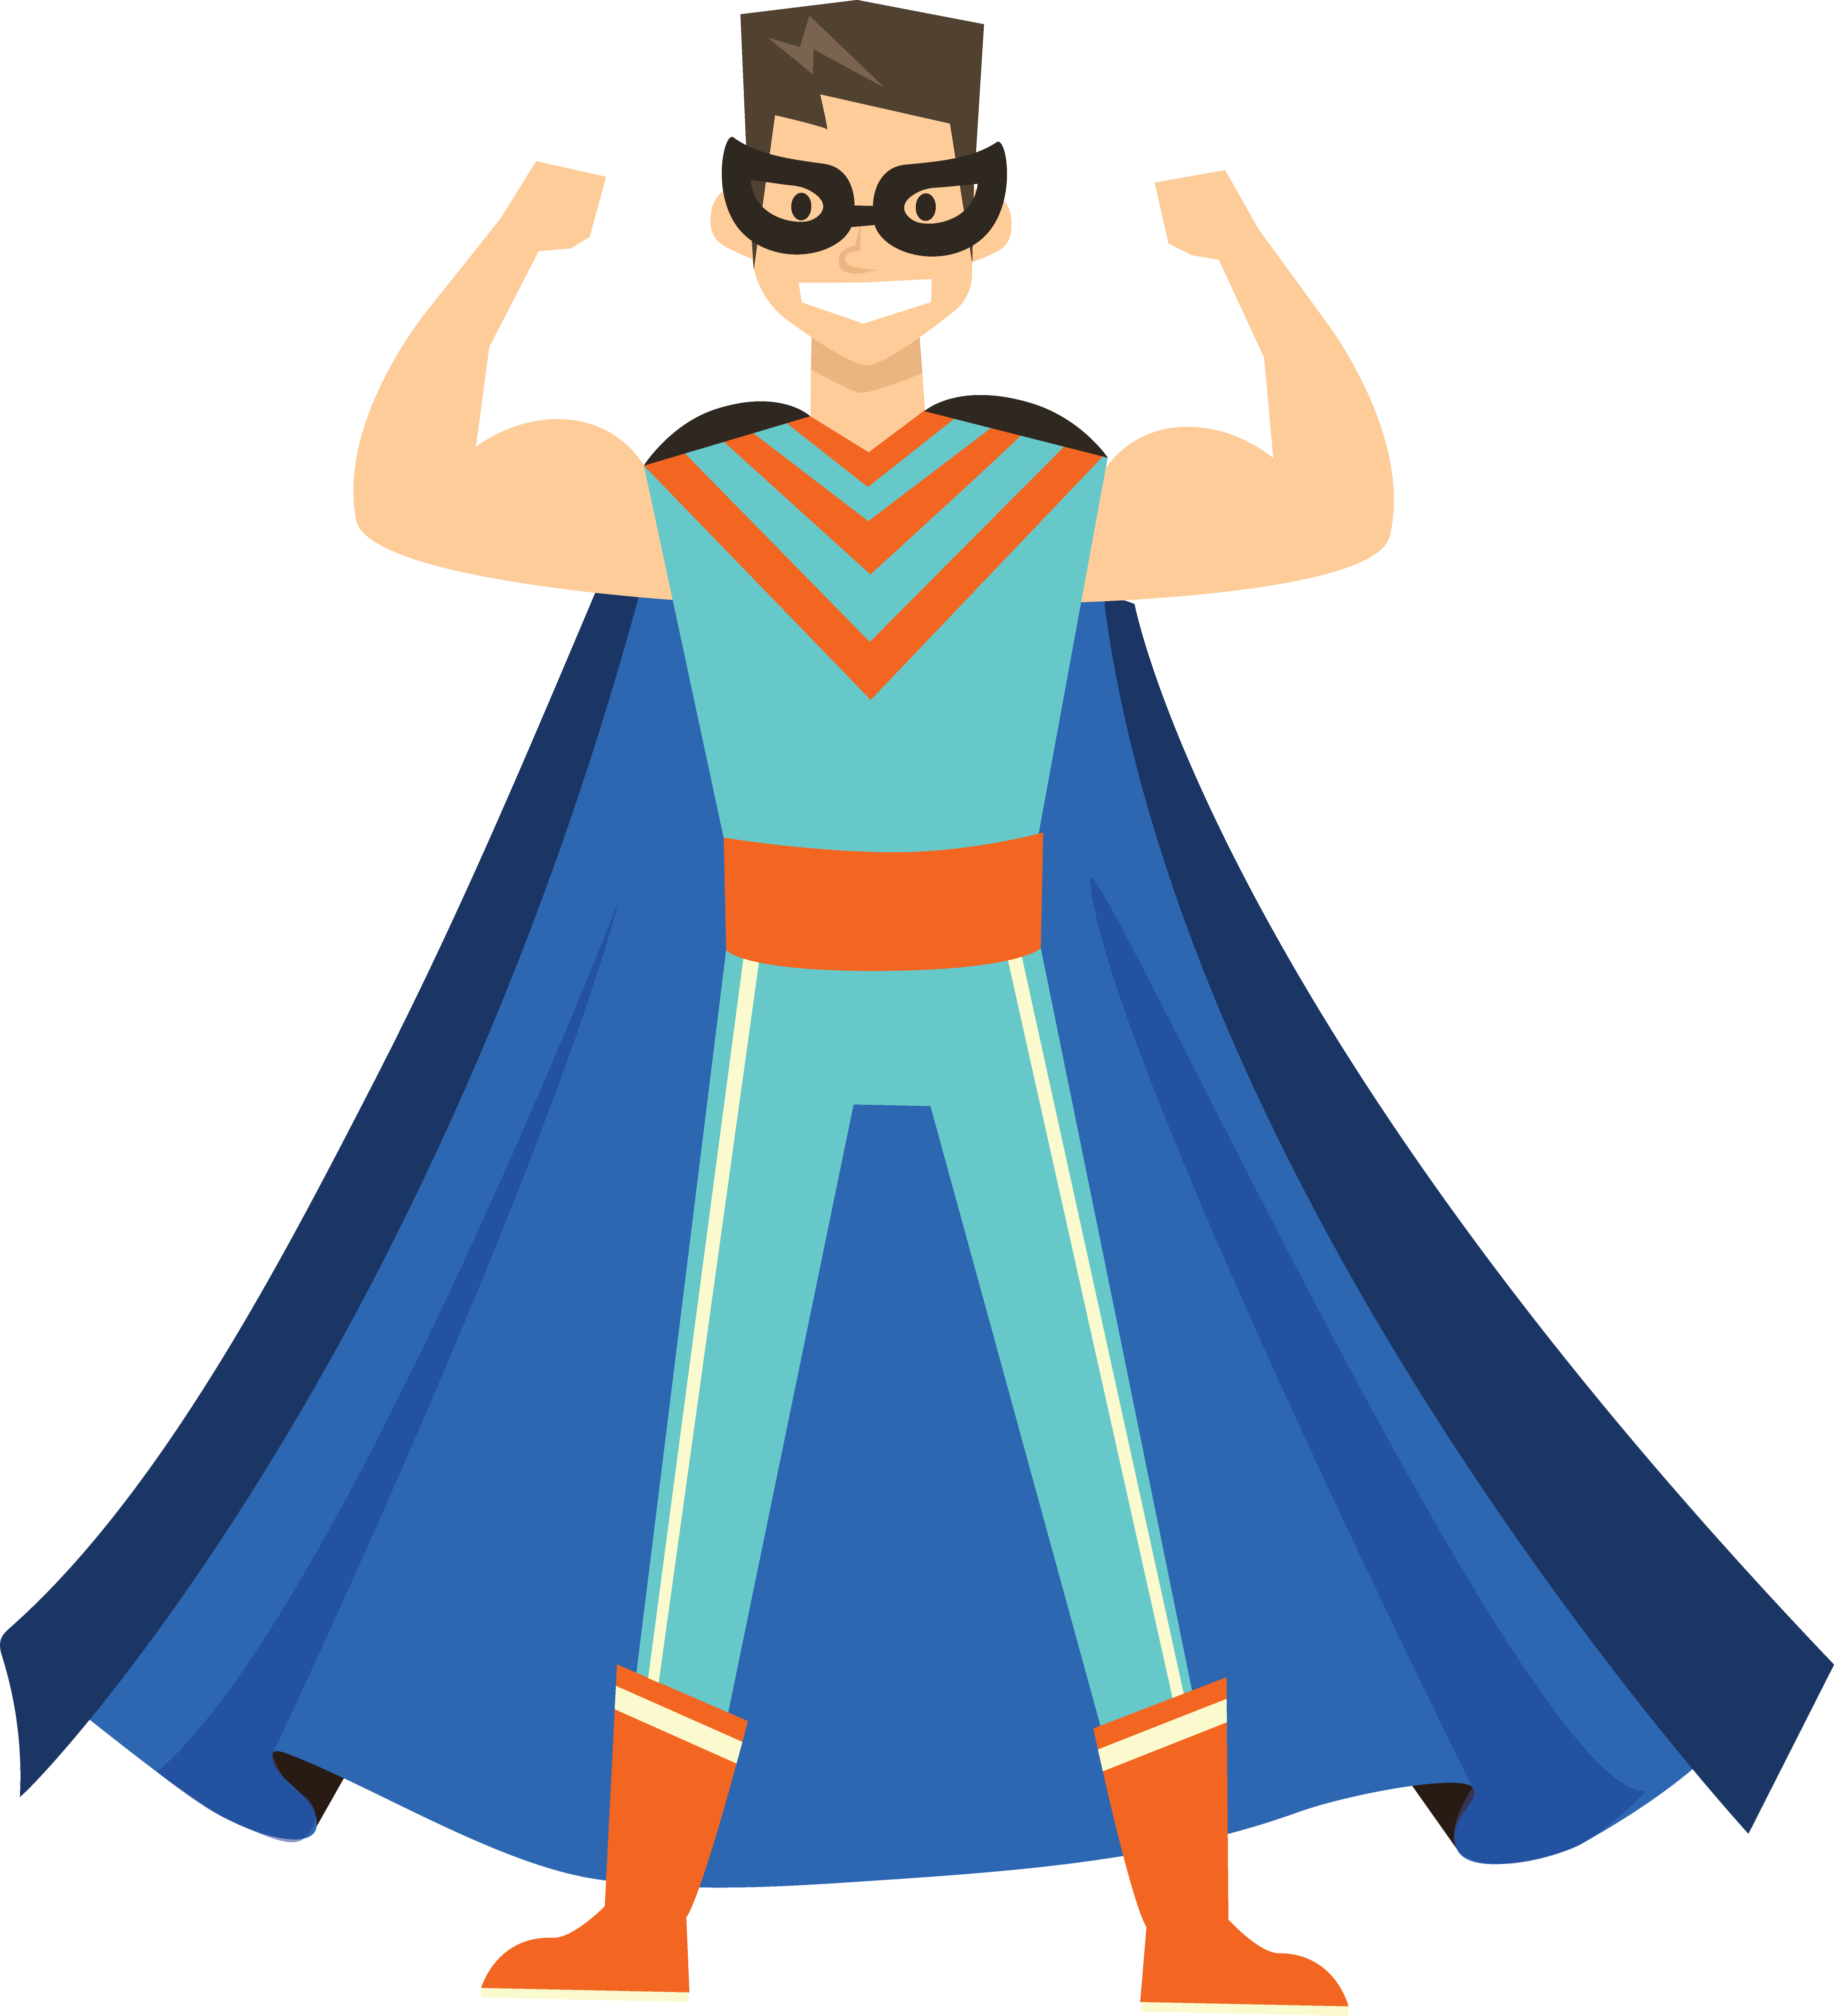
Warm-up
Self as gesture

Slide 5
Warm-up
A gesture is a simple movement that communicates an idea.
Choose a gesture that represents one of your character traits.
Perform the gesture while saying your name.
The rest of the class will observe and copy the gesture.
Take turns for about five minutes or until all students who want to share have had a turn.

Slide 6
Pass or play!
What character traits did you choose for yourself?

Slide 7
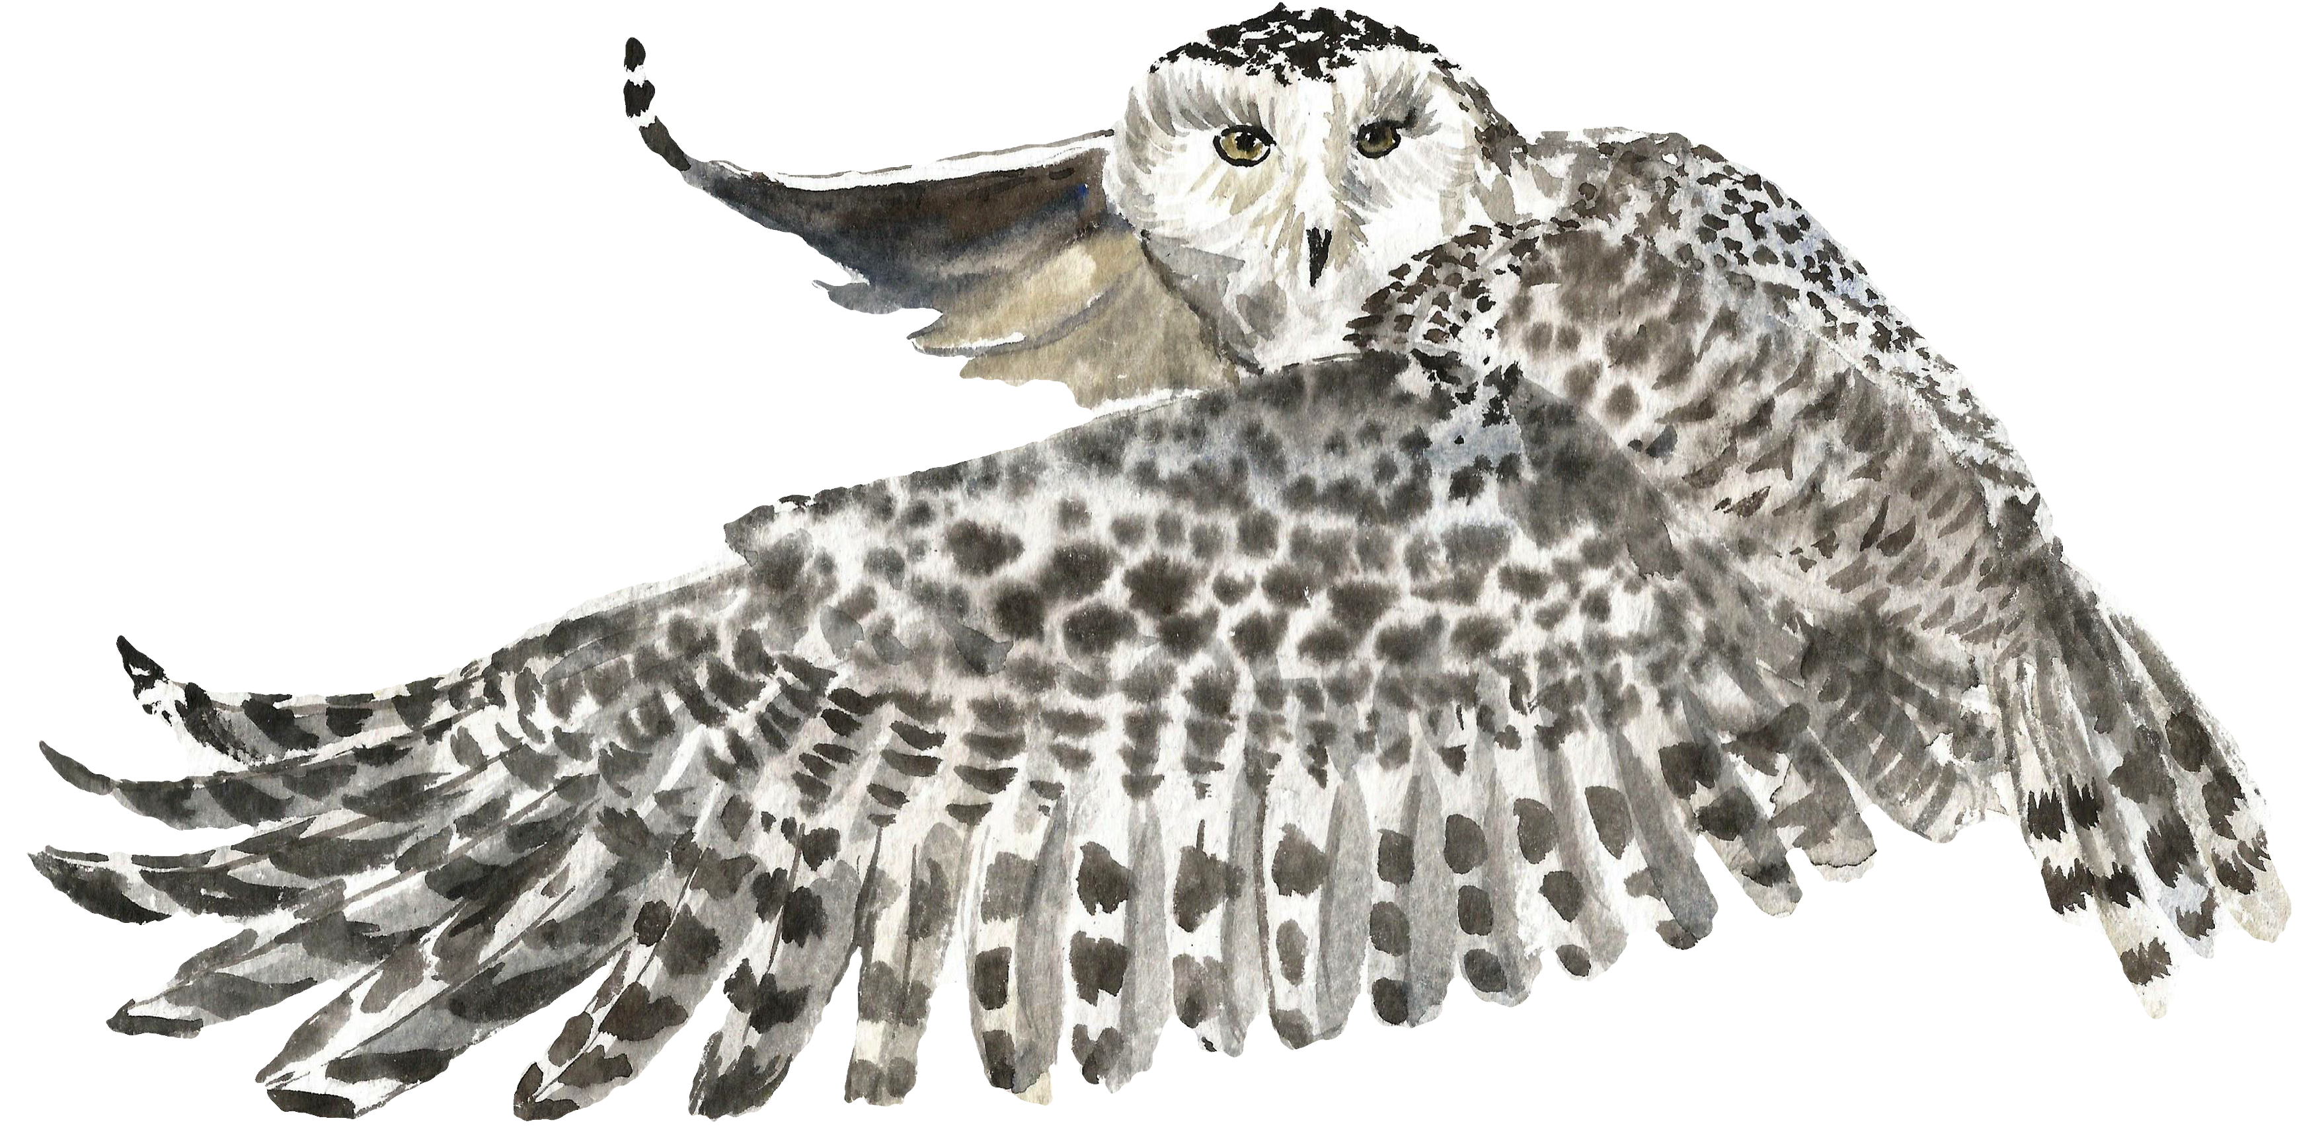
Miss Alicia is…
Curious,
Clumsy,
And
Creative.

Slide 8
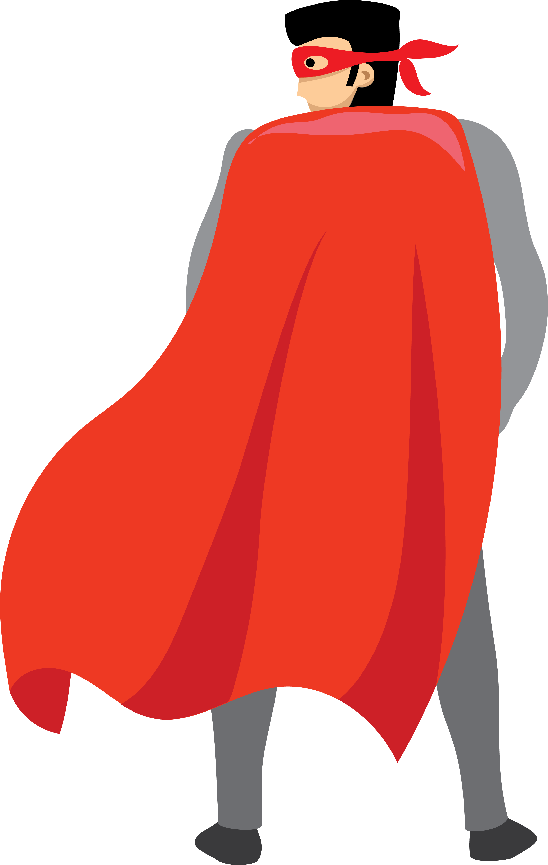
vocabulary
Character trait: words that describe character’s personality or qualities that make them who they are
Alter-ego: second personality
Hero
Character “flaw”
Origin story
Notes:
– how a character behaves tells us who they are
character flaws often determine what happens in a story
each story event leads to a degree of change in a character’s values
these changes allow character to reach the goal or realize a new goal

Slide 9
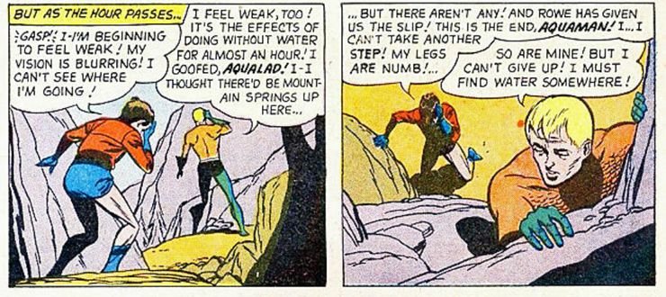
Character flaw or weakness: Aquaman can’t go long without water
https://www.cbr.com/dc-strange-superhero-weaknesses/

Slide 10
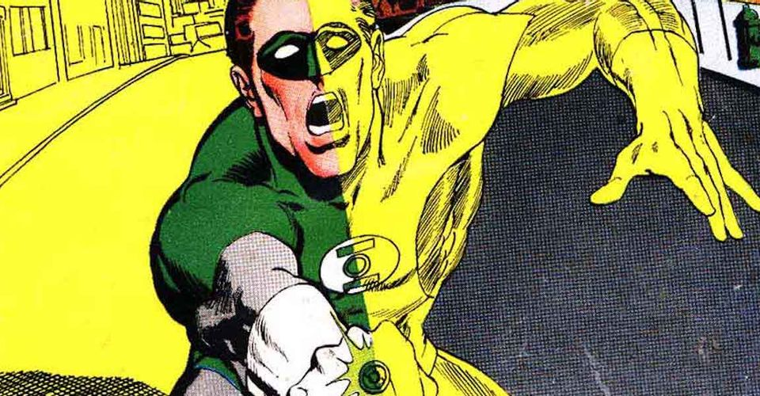
Green Lantern is weakened by the color yellow!
https://screenrant.com/worst-most-embarrassing-lame-wtf-superhero-weaknesses/

Slide 11
Origin story
Show who someone is and what makes them the way they are
Show us “not how to become super but how to be heroes, choosing altruism over the pursuit of wealth and power.”
“inspire us and provide models of coping with adversity, finding meaning in loss and trauma, discovering our strengths and using them for good purpose.”
Robin Rosenberg
Author of Superhero Origins

Slide 12
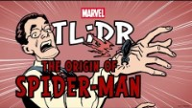

Slide 13
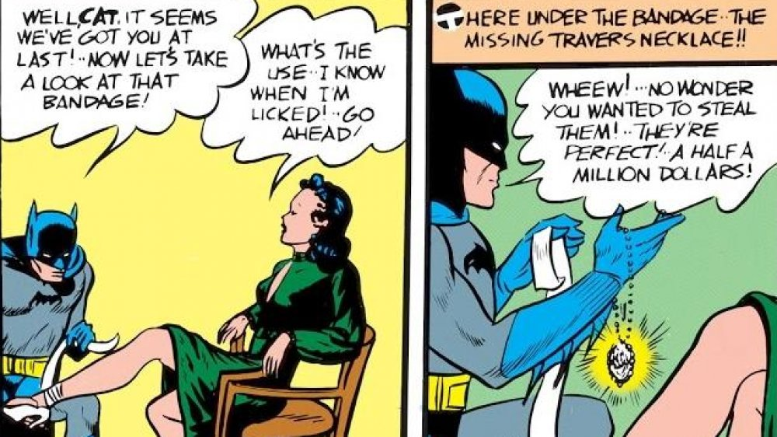
Catwoman makes her entrance in 1940s Batman #1. Though she goes by "the Cat," she actually disguises herself as an old woman in this first appearance in an effort to make off with a fabulous emerald necklace.
Looper.com

Slide 14
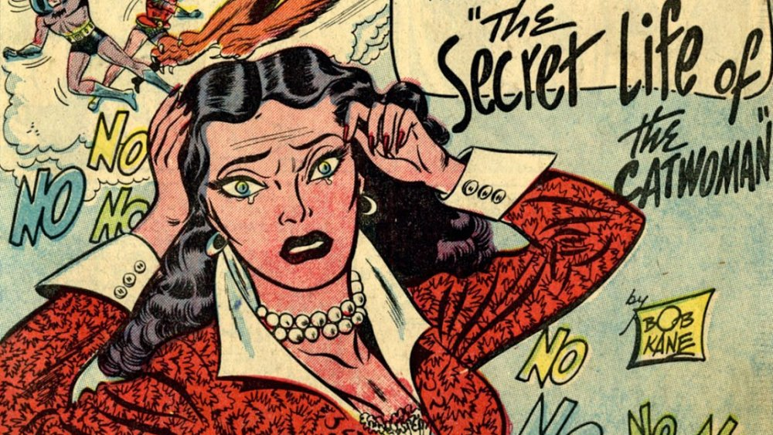
In Batman #62, Catwoman leaps in front of a crumbling building to save Batman's life. Disoriented by the blows of the falling bricks, she claims to be a stewardess.
... Once upon a time, Selina Kyle was a mild-mannered flight attendant. A terrible plane crash spared her life, but it left her in an amnesiac haze. All she had left of her old life were her memories of her father's pet store, and so she christened herself Catwoman, in tribute to the animals her dad taught her to love. The bricks' bonk to her head restored her memories and she becomes repentant.
Looper.com

Slide 15
instructions
Create two-column comparison

Slide 16
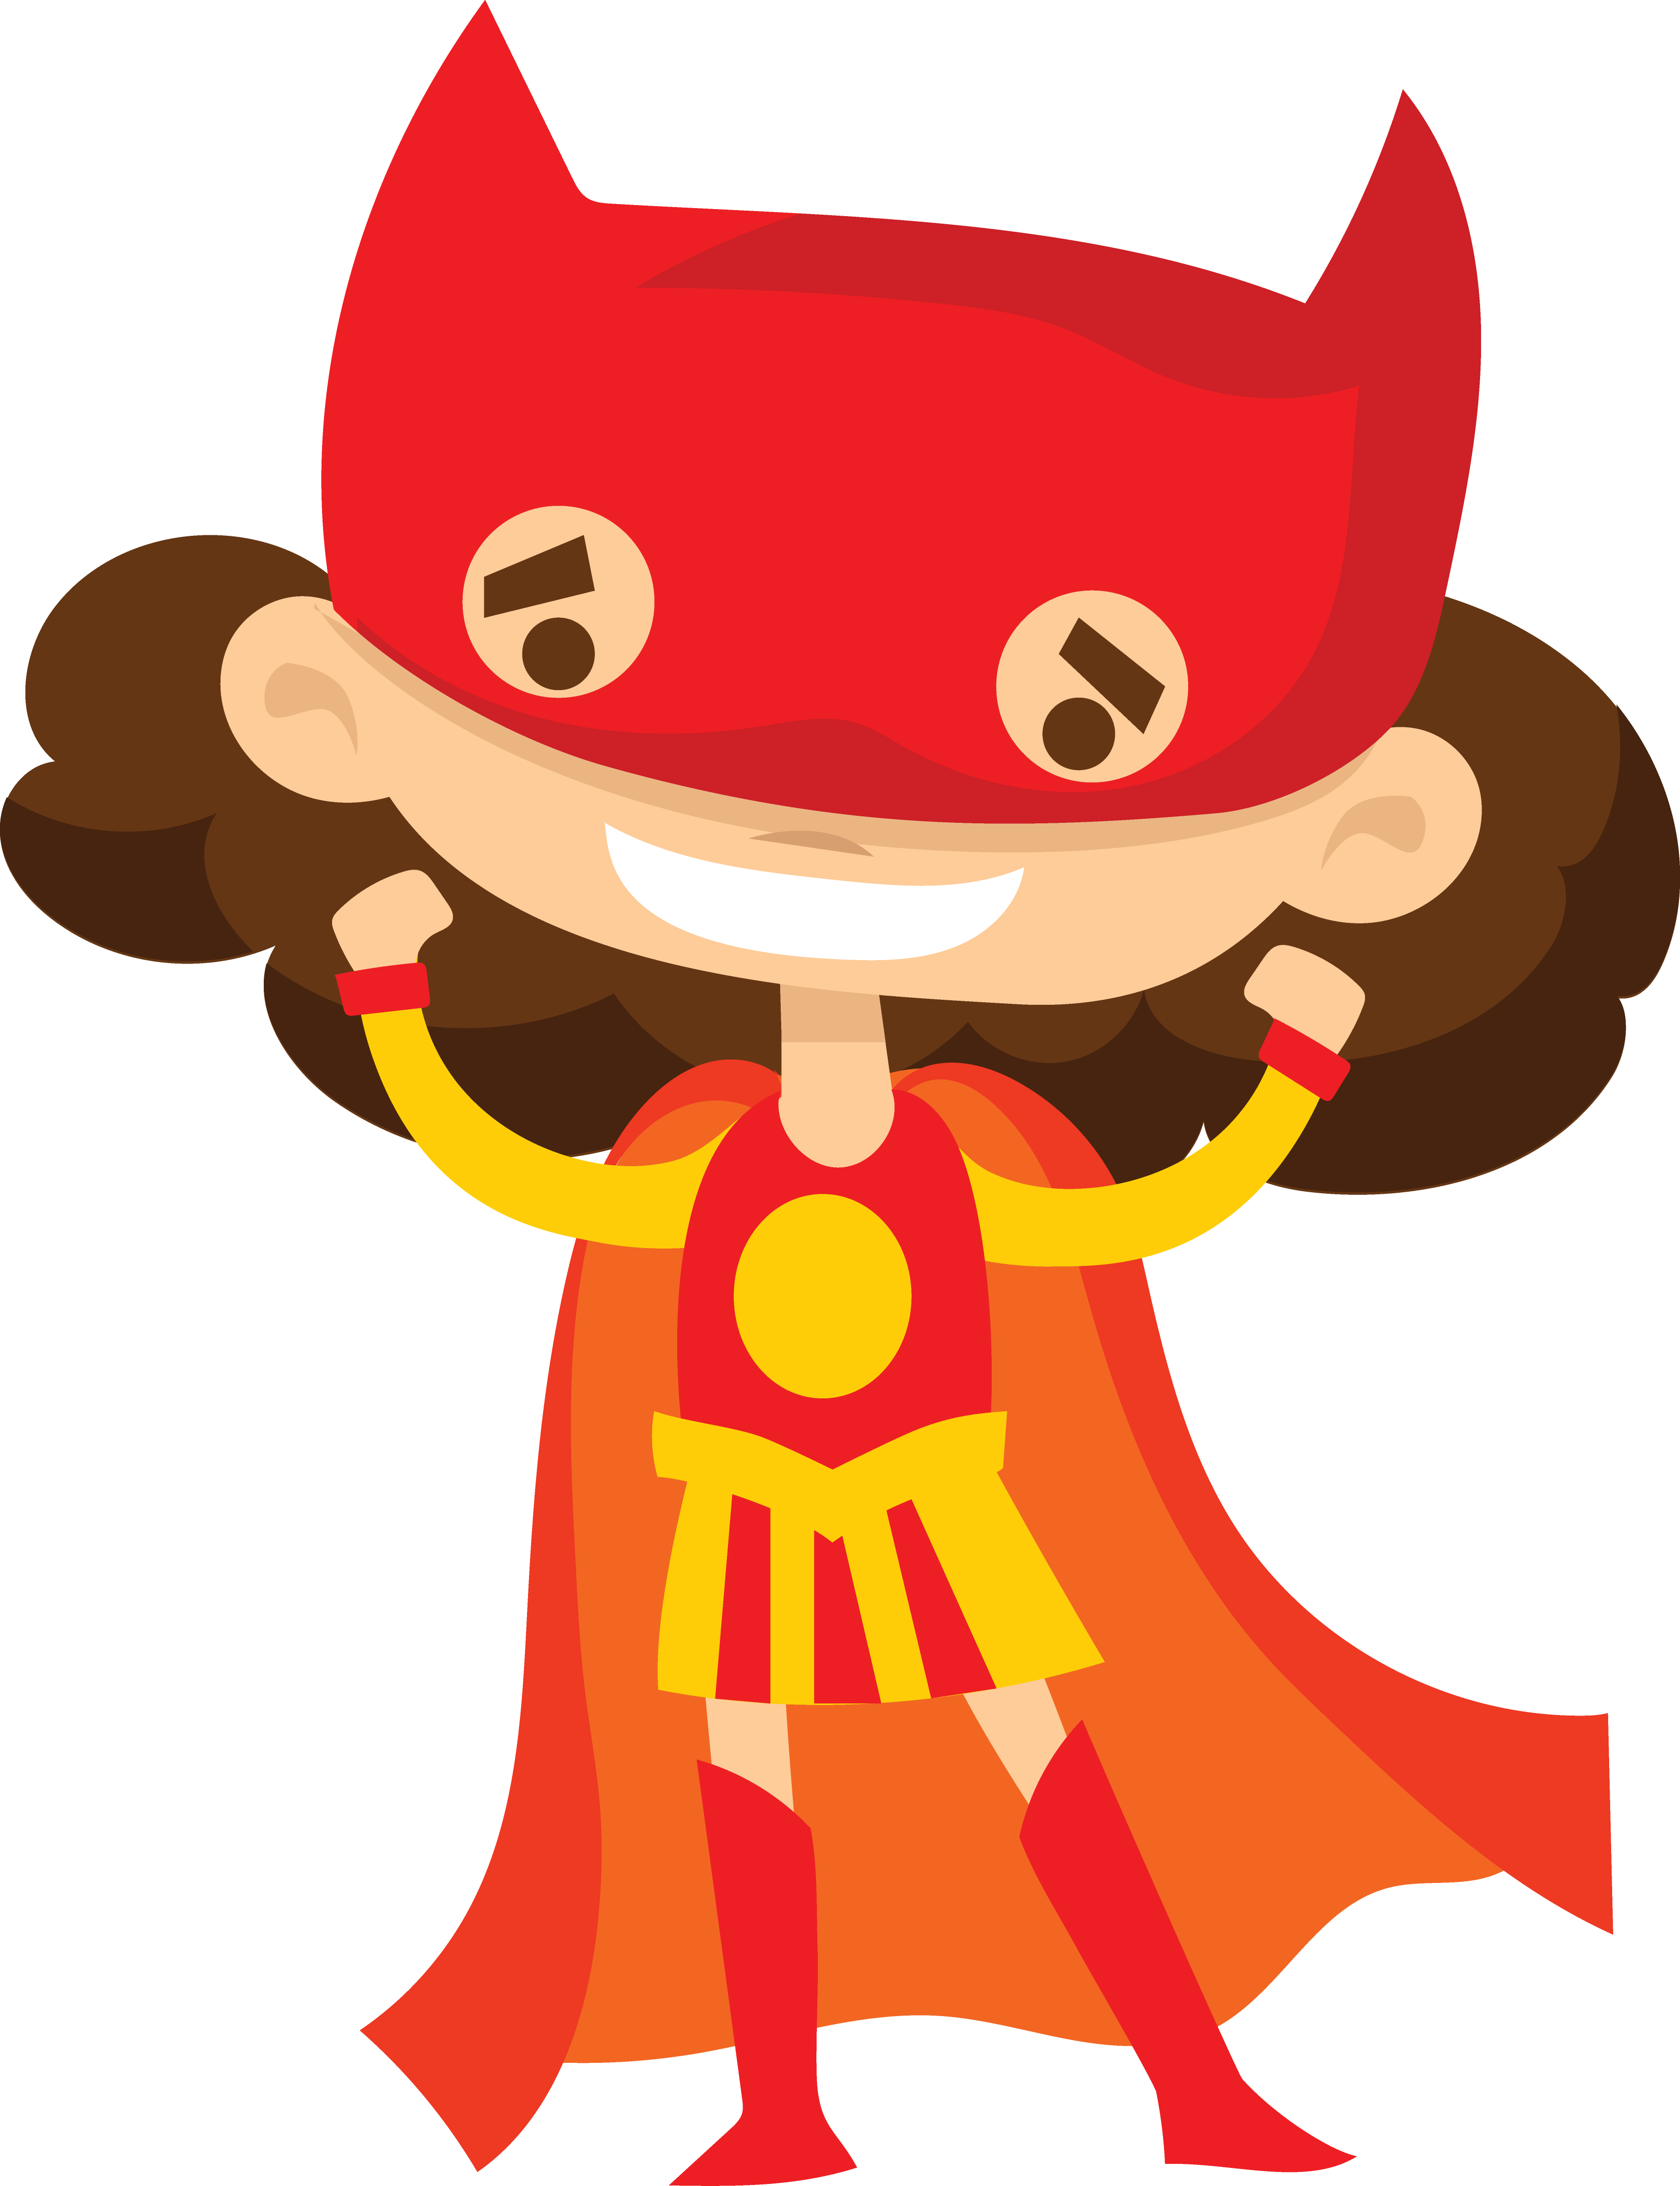
instructions
Turn your character trait(s) into a super-power
Name your super-hero.
What does their costume look like? (mask, cape, wings, armor, etc.)
Draw or describe their special features (tools, weapons, vehicle, etc.)

Slide 17
The Unleasher
Sounds like “Alicia”
Empowers other people to be confident and discover their superpowers (unleashes powers in others)
X-ray vision – can see the good inside people

Slide 18
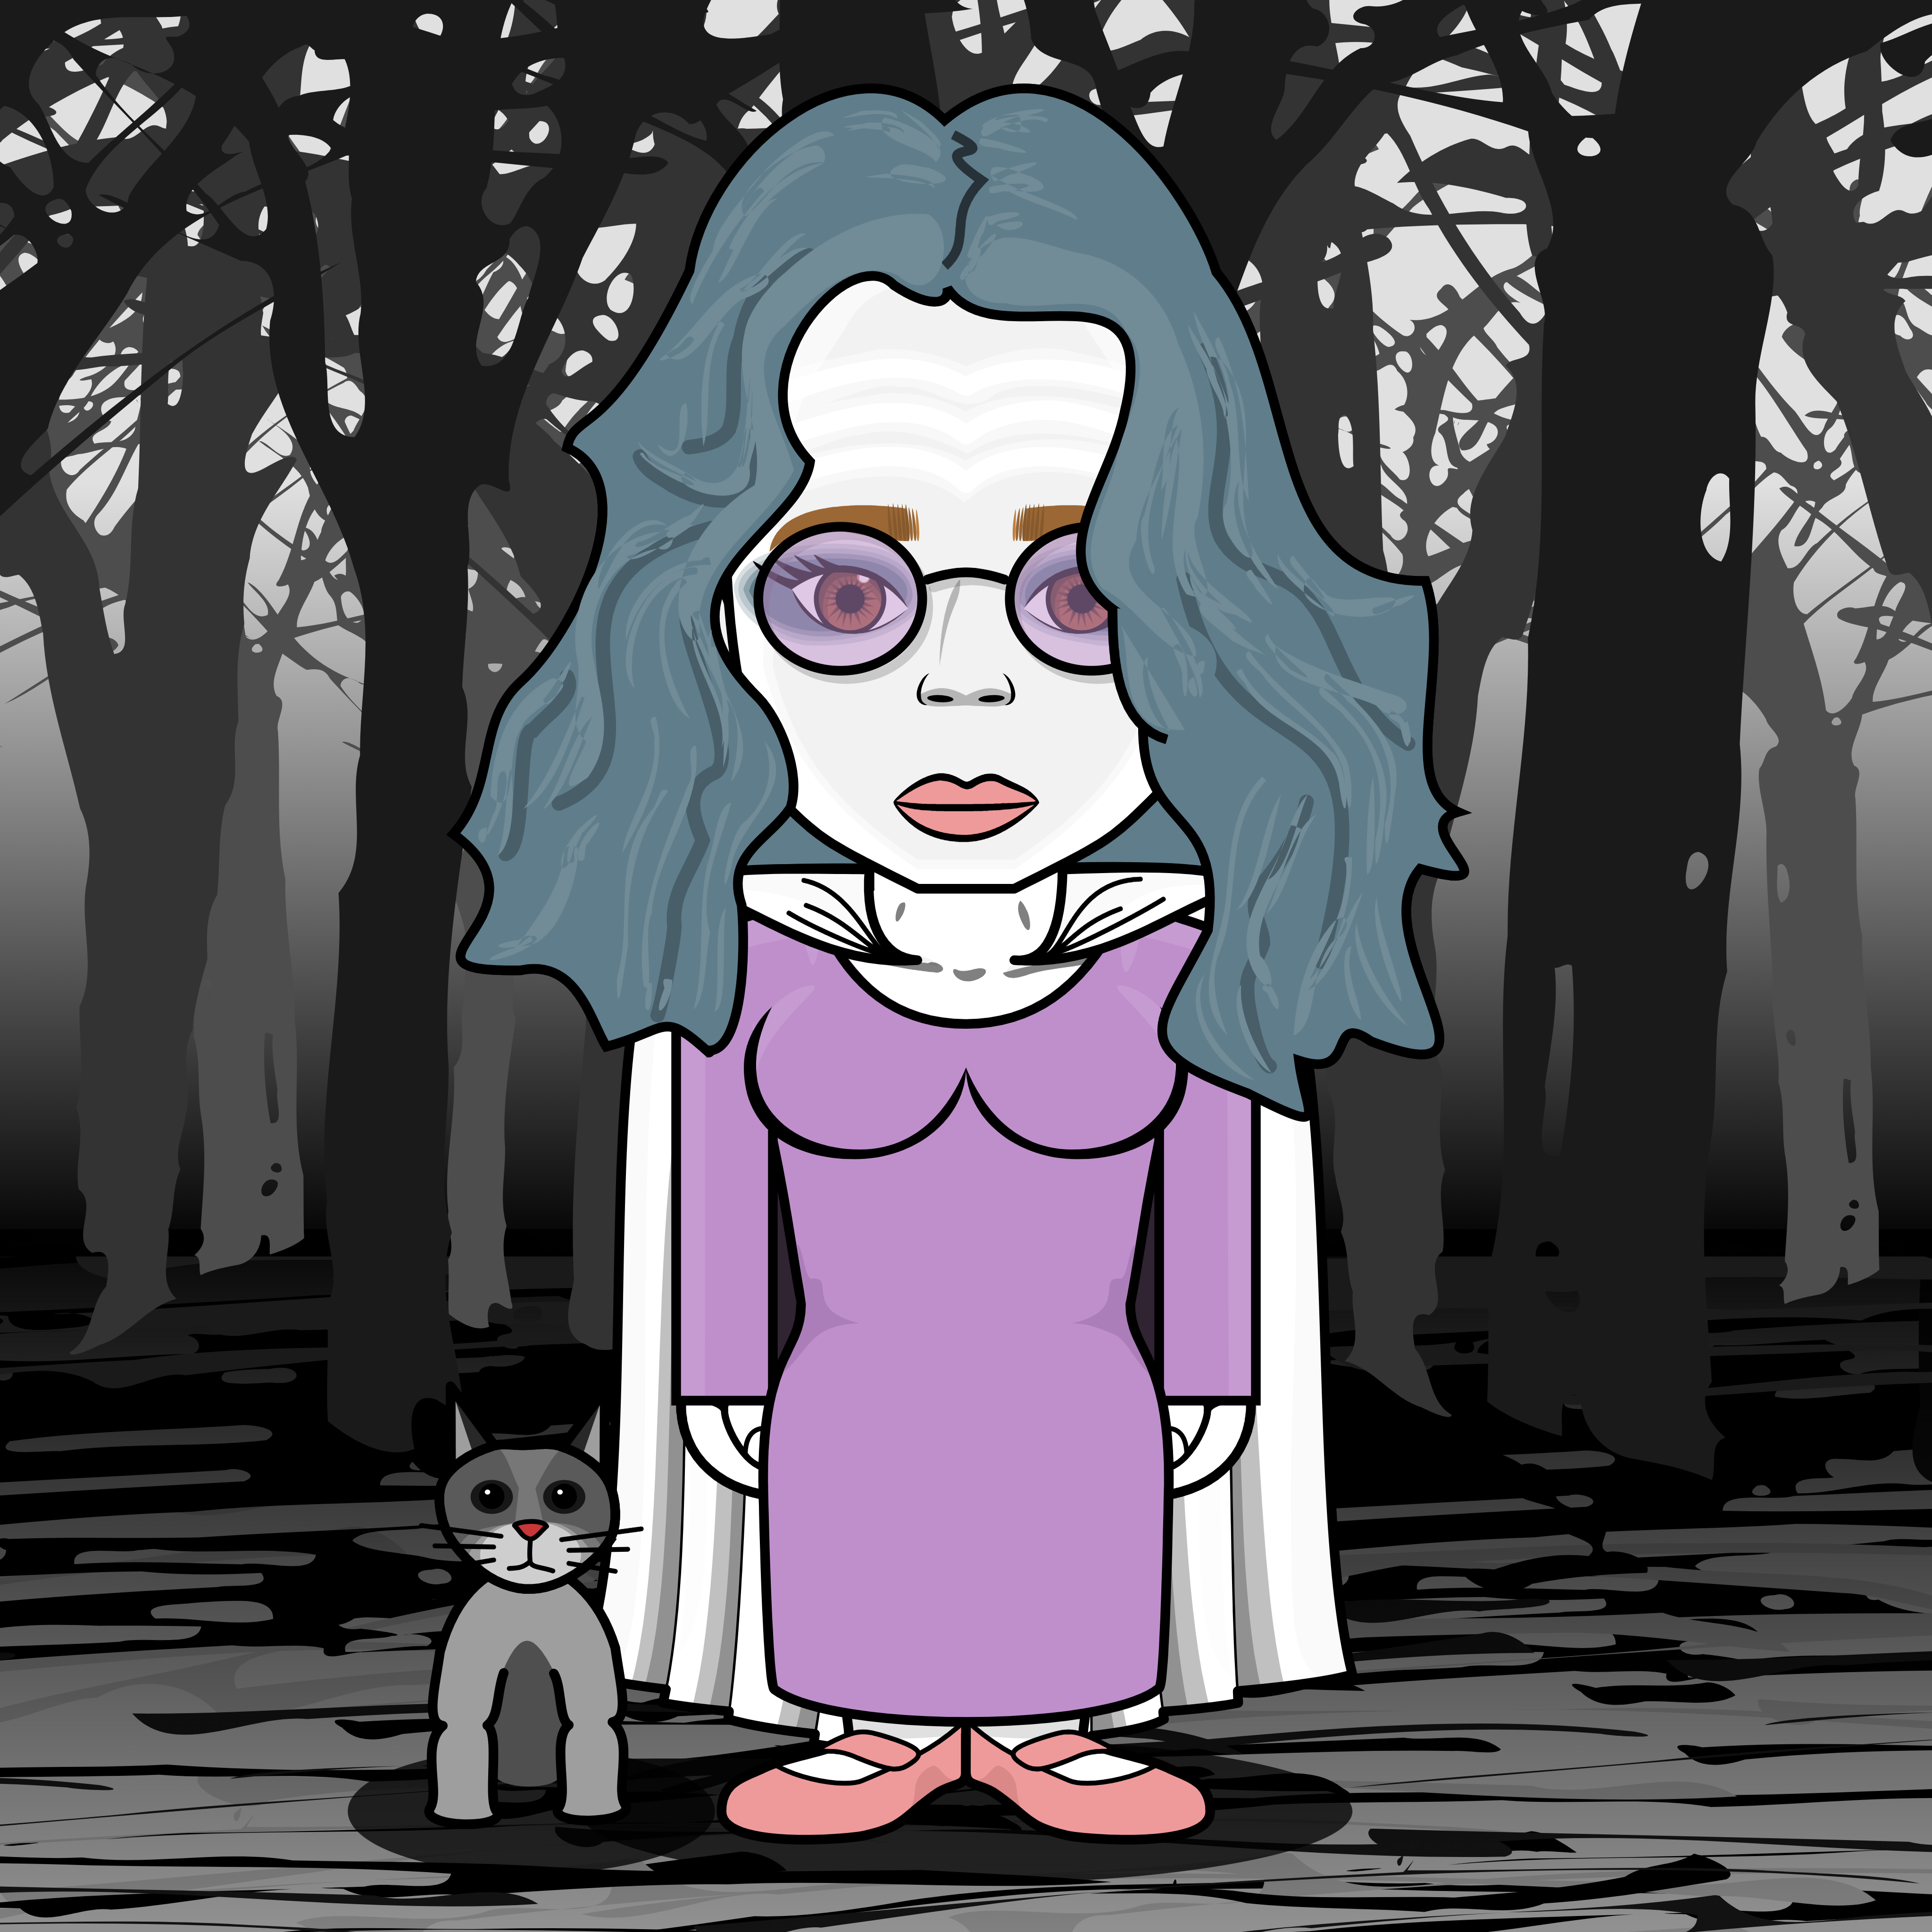
Baba (Grandmother) Spider
Knows all the words (speed reader)
Weaves words into stories that change the way people feel and think
Looks like a weak and harmless “old lady.”
Can make herself invisible

Slide 19
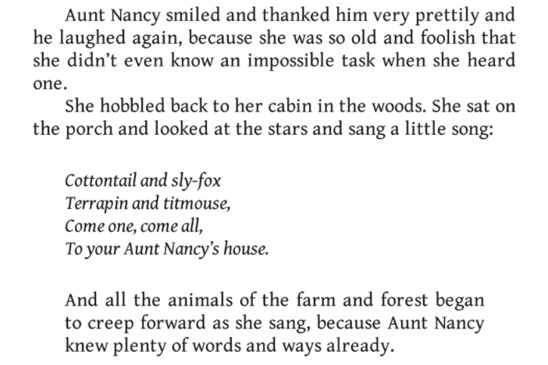
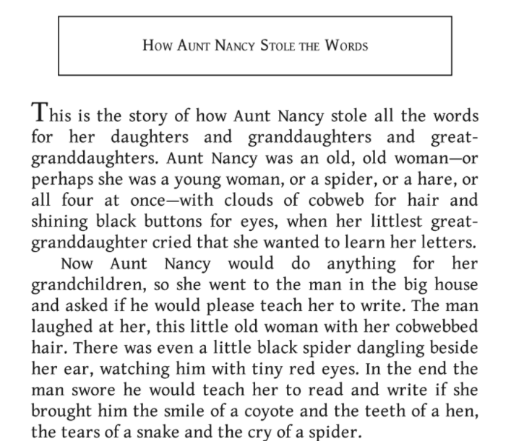
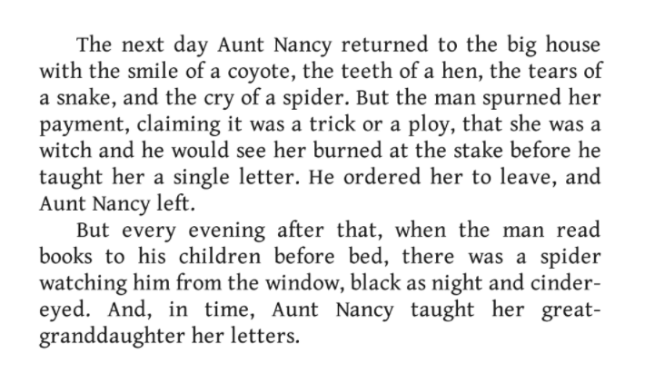

Slide 20
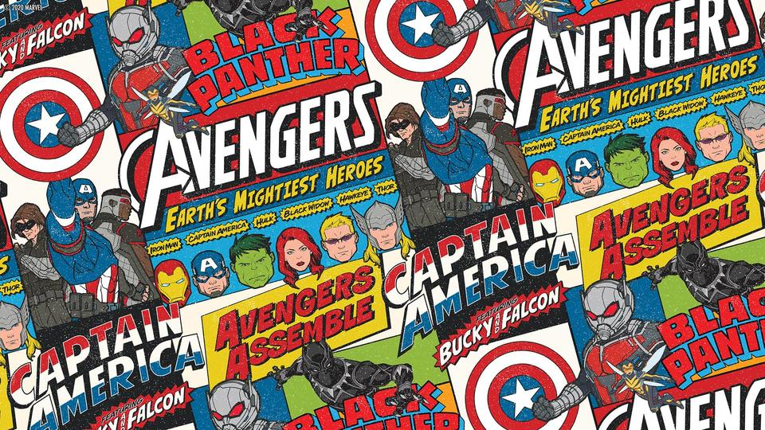

Slide 21
references

Slide 22
references
Origins of Spiderman (Marvel)
Batman comics, #1, #62
https://www.smithsonianmag.com/arts-culture/the-psychology-behind-superhero-origin-stories-4015776/
Licensed (commercial) superhero art by Virinaflora (via Creative Market).
Aunt Nancy story from The Once and Future Witches, Alix E. Harrow
HEROized – Create Your Own Superhero for Free
Superherotar - Create Your Own Free Superhero Avatars

