Slide 1

From page to Play
Adapting our stories

Slide 2
objectives
Warming up with Pass & Play, students will share the ENDings of their comic books in progress.
Our next lesson includes an exploration of stage design (set, prop, costume, sound & lights) before we begin adapting our own comic books into a scripted scenes.
Students & teacher will contribute ideas on what they want their play to look like. (e.g. puppets or readers theater, etc.)

Slide 3
Pass or play!
Share your comic book in progress
THE END…
How Do you tie up loose ends…

Slide 4
Double check
Did your character solve all the problems?
What is the feeling you want to leave your reader with?
Finishing touches:
Add detail to your pictures
Color your frames
Check your spelling
Is it clear what happens in your story?

Slide 5
Now what?
Do we want to split into groups and write several short plays?
Which characters do we include? Each student can only play one role.
Puppet show or play?
  Consider limitations of what we can make and rehearse
What are our favorite things about everyone’s stories?
What are the common themes we want to pursue?
  For example: power of nature vs. manmade technology
Notes:
Looked like there was no way Daredevil could defeat Kingpin. Was tempted to kill him in order to stop him even though he’s sworn not to kill (Catholicism).

Slide 6
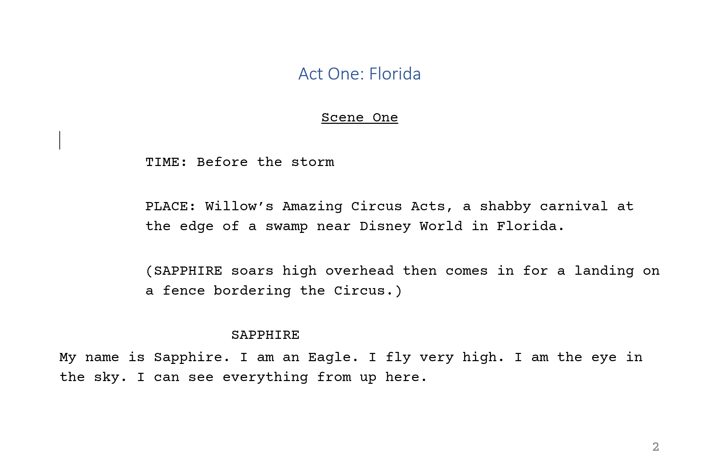






What does a script look like?
Act/Scene titles
Stage directions
character name
parenthetical
dialogue

Slide 7
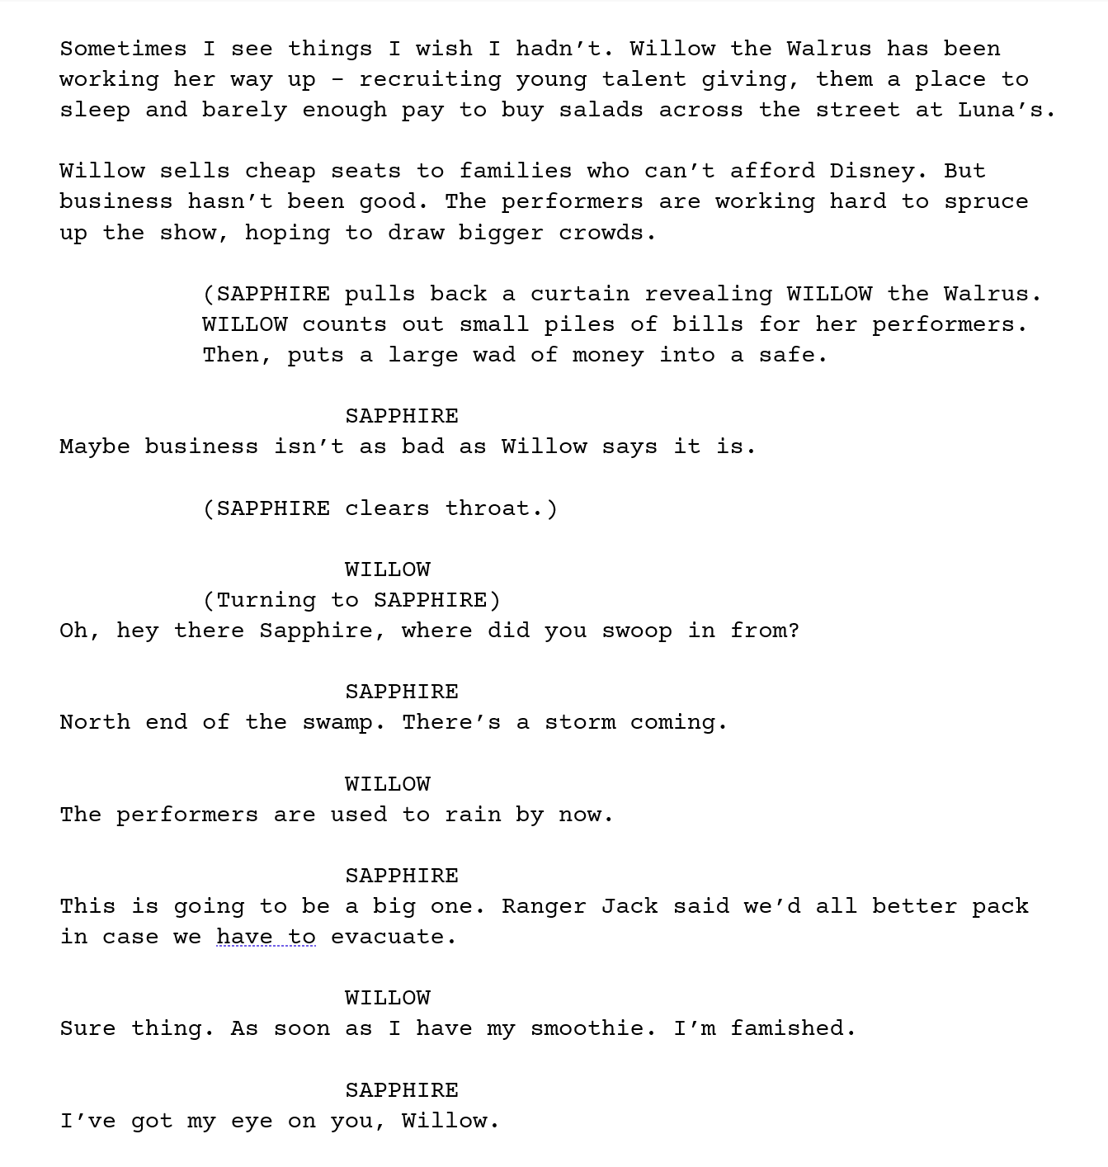



Act/Scene titles
Stage directions character name parenthetical dialogue

Slide 8


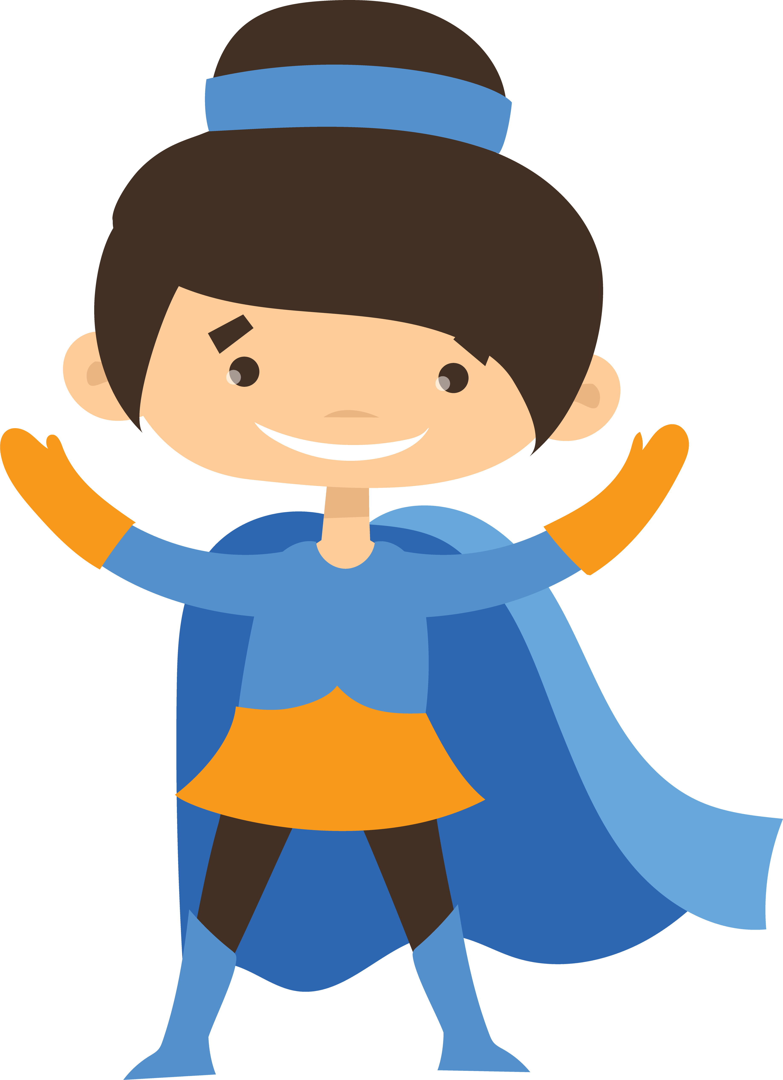

Character list
Each student will play/read ONE character in a group story.
We will need:
Superheroes
Villains
Narrator(s)
Optional:
Allies (friends & family) – can be sidekicks or pets
Other (mayor/president/police etc.)

Slide 9
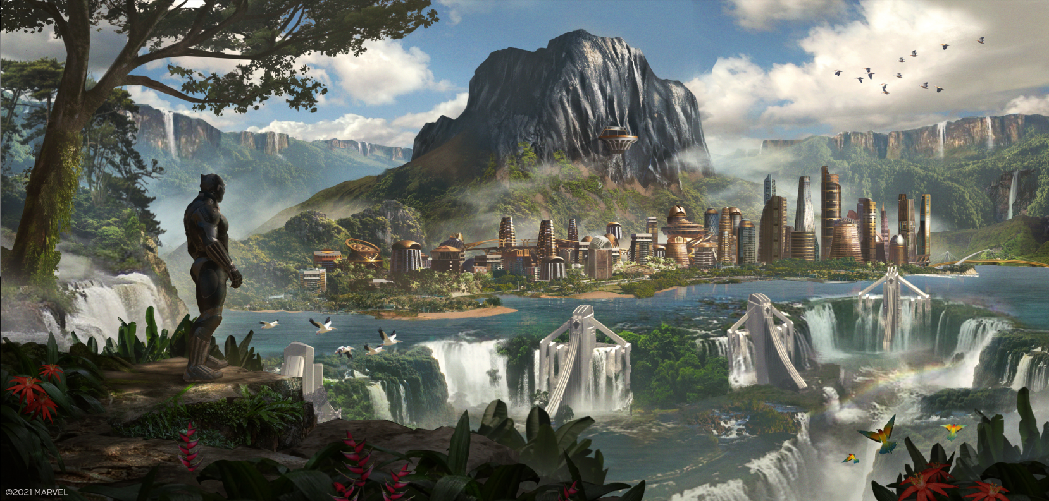
Designing the Story world
When and where does our story take place?
What are the rules of this world?
Who is ‘in charge’?
How are superheroes treated?

Slide 10
Group Story premise
What event brings our Superheroes together?
Where do they gather?
Who is “in charge”?
What threat do they need to fight?
How do they plan to win?
What actually happens?

Slide 11
story premise
Mrs. Bottley’s third grade class at Heights-Terrace (PM):
PLACE: Technology World’s official headquarters is in Los Angeles, California.
  At Technology World the brightest, most creative technology geeks search for hackers and crime. They are retired undercover superheroes who have taken a break from the craziness and chaotic life of saving the world, but still need a little dose of excitement once and awhile.
PLACE 2: Dark Cave, home of the villains, is located below Technology World.
  The villains are seeking revenge on the Tech Team for ruining all their projected crime attempts. They create a new video game that will camouflage their evil plan.
Meanwhile at Technology World, Nintendo Man (AKA-Luis) is playing a new video game – Cyber-Pong – when he gets hypnotized by the villains. His mind is taken over (by Super Hypnosis) and he is forced to follow the evil plans of the villains from Dark Cave. Under the villain's control, Luis will send an email to his co-workers at Technology World tricking them into a prize vacation getaway in Hawaii.
The superheroes believe that they have won this amazing prize but are about to be fooled.

Slide 12
3rd grade story premise sample
Mrs. Bottley’s third grade class at Heights-Terrace (PM):
HERO ACADEMY
Hero Academy is a high school in New York City for aspiring superheroes.
Backstory: The villains are seeking revenge from when they attended Hero Academy. The villains did not pass the training exams, but don’t know why. They want the graduation badges that the new class will receive.
The villains left the school for good but warned they would never be forgotten. They are looking for a second chance to rejoin the Academy and pass the certification exams.
Second location: An abandoned library is the hideout for the villains. The leader of the villains, Copycat, is going to pretend to be the new head administrator at Hero Academy. She will gain access to the building and allow the others to get in. Her badge gives secret access to the rooms in the Academy. The files of the superhero’s real identities and classified information are kept there. The villains find out that the scores were changed, and they did pass their exams. Now the real question is … who changed the scores?
Spoiler: The former principal changed the scores because the parents of those students trapped his father and turned him to stone. His stone statue is standing in front of Hero Academy.

Slide 13
Sample Second grade story premise
MIDDLE
Series of short scenes:
picking up garbage
raking leaves (landscaping)
painting a fence
planting flowers
Some hero(es) are frustrated they cannot use their powers.
They learn from the students how important it is to take care of the earth and make the neighborhood nice for everyone.
Maybe it’s a park that means a lot to the kids – to have a safe and clean and fun place to play outside together.
BEGINNING
The heroes are tasked with going out into the community to do an Earth Day “spring cleaning” project.
Some are resistant - they think such basic tasks are beneath them or they have villains to think about.
END
Everyone can be a hero. It’s not about having powers.

