Slide 1
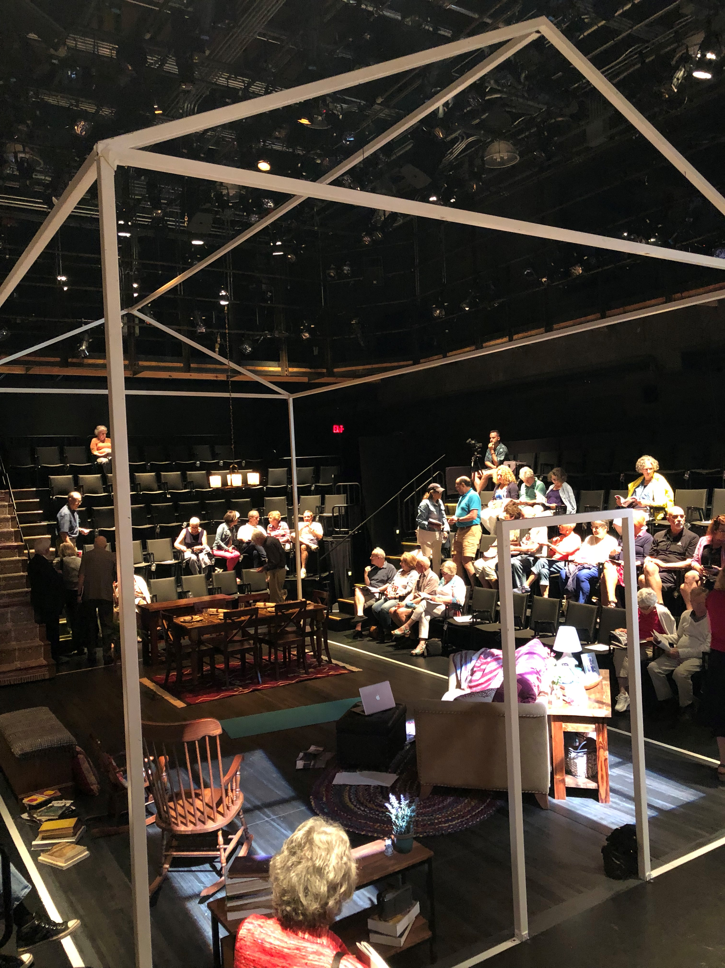
Production design
“staging” our stories

Slide 2
objectives
Explore stage design (set, prop, costume, sound & lights); and script reading/practice before we begin adapting our own comic books into scripted scenes.
Continue to develop character list teams.

Slide 3
Pass or play!
Did we make any new decisions about our collective stories?

Slide 4
Types of Design in the Theater
The elements of theatrical design help to tell the story. Theatre combines all the art form to create an experience that works on all the senses. All of the design elements use symbolism to provide information.
Set / Stage Design : the landscape / surroundings
Costume & Makeup : how the characters look
Lighting design : in order to see, also creates mood, etc.
Sound design : what we hear adds to emotion
Choreography : how the characters move

Slide 5
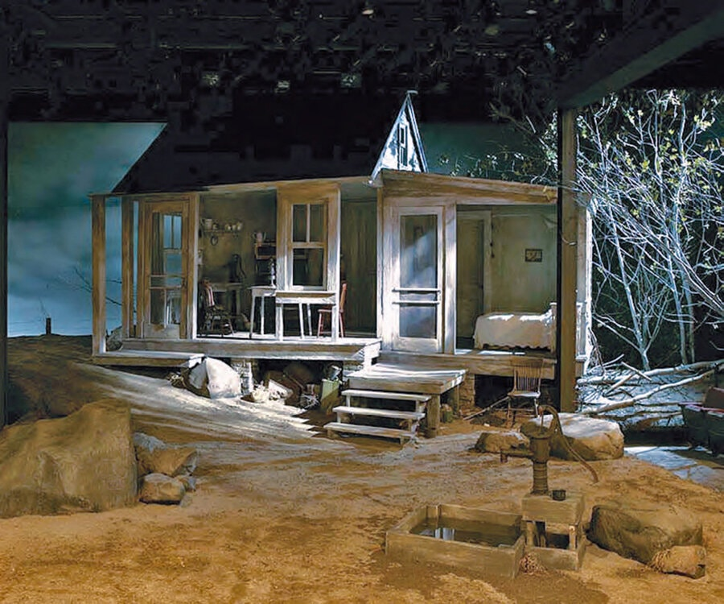
Designer: Ming Cho Lee.
Set for Eugene O’Neill A Moon for the Misbegotten at the Long Wharf Theater in New Haven, CT. (2005)

Slide 6
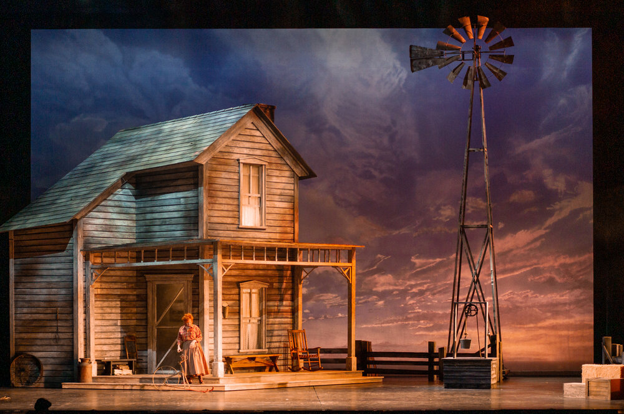
Designer:
Michael Schweikardt. Okhlahoma!
for Pittsburgh PLO

Slide 7
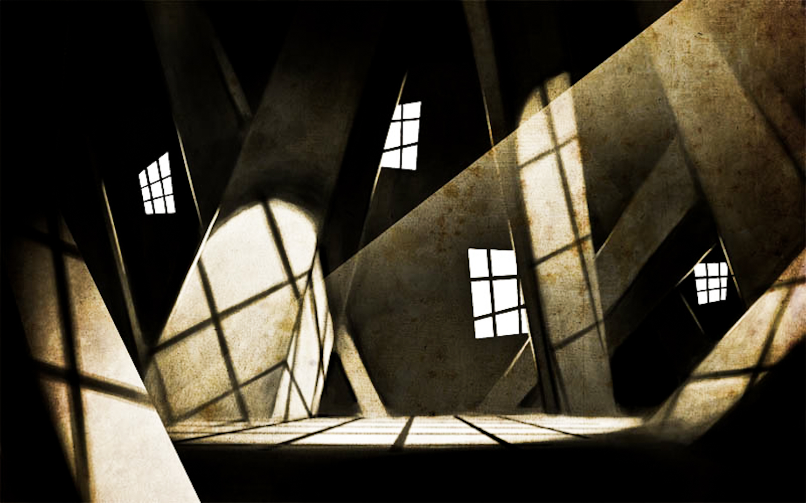
The Cabinet of Dr. Caligari

Slide 8
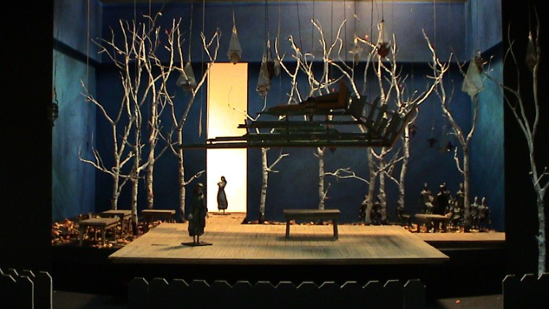
Fiddler on the Roof model for the Broadway revival Tom Pye.

Slide 9
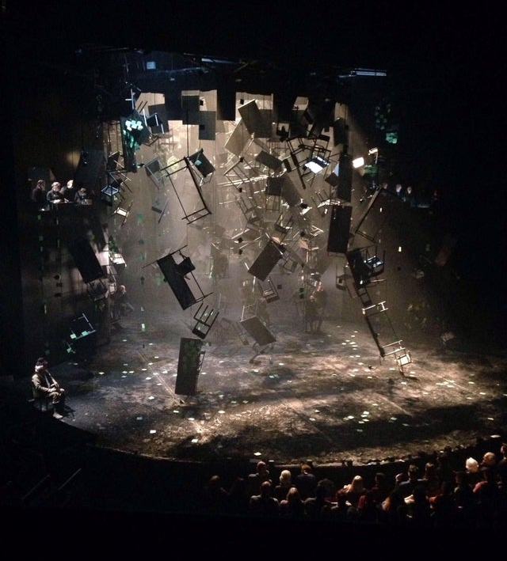
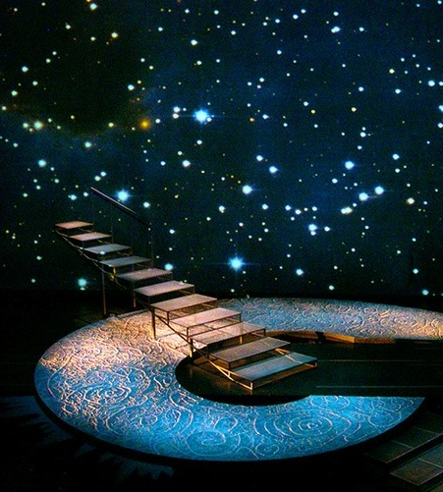
Shakespeare’s As You Like It
A Wrinkle in Time

Slide 10
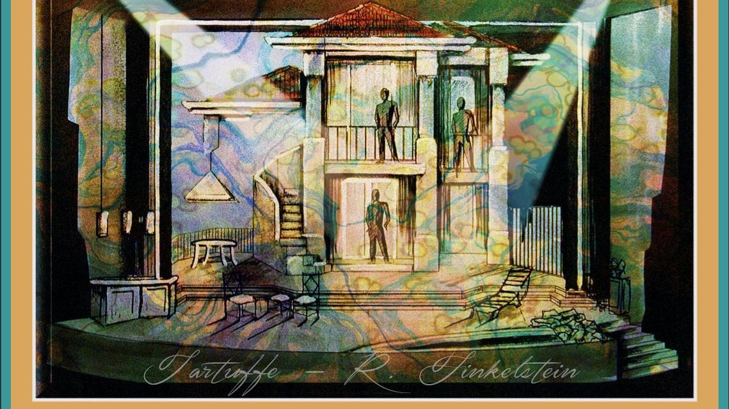

Slide 11
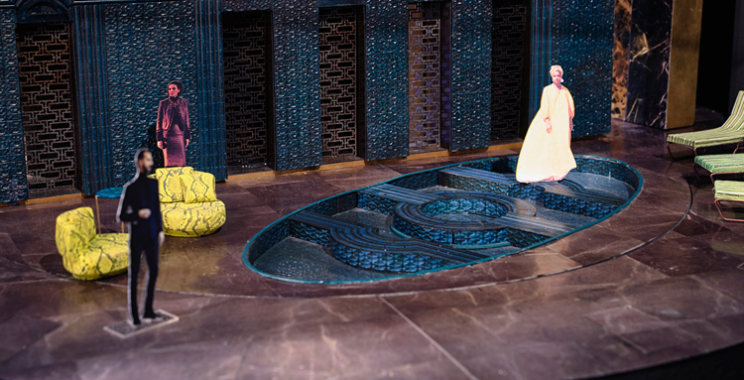
Designer. Hildegard-Bechtler. Model, Antony and Cleopatra. 2018. © James-Bellorini Photography

Slide 12
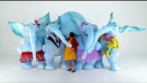
Costume Design: The Elephantom

Slide 13
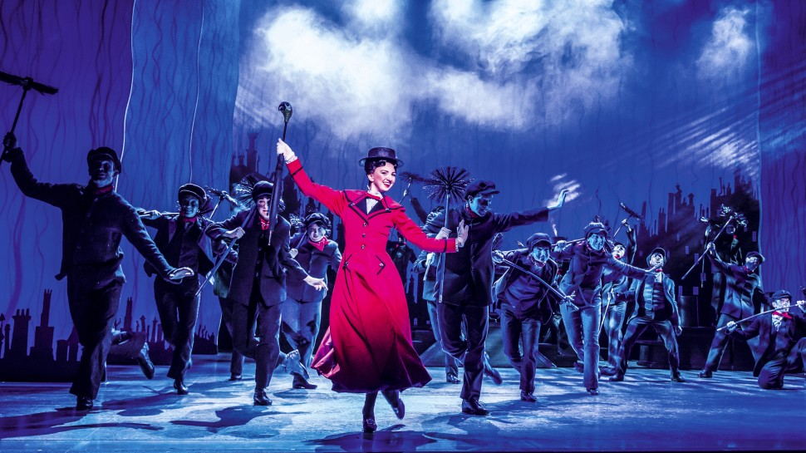
Zizi Strallen and the London revival cast. Photo by Johan Persson.

Slide 14
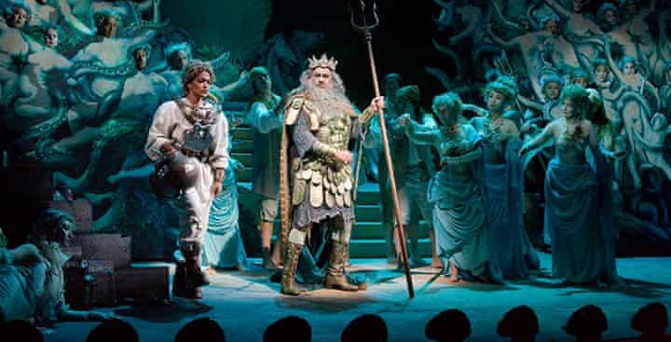
The Enchanted Island, Metropolitan Opera. Photo by Ken Howard.

Slide 15
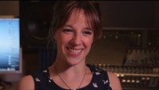
Sound design: The Elephantom

Slide 16
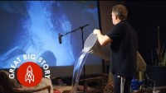
Sound design: What does a Foley artist do?

Slide 17
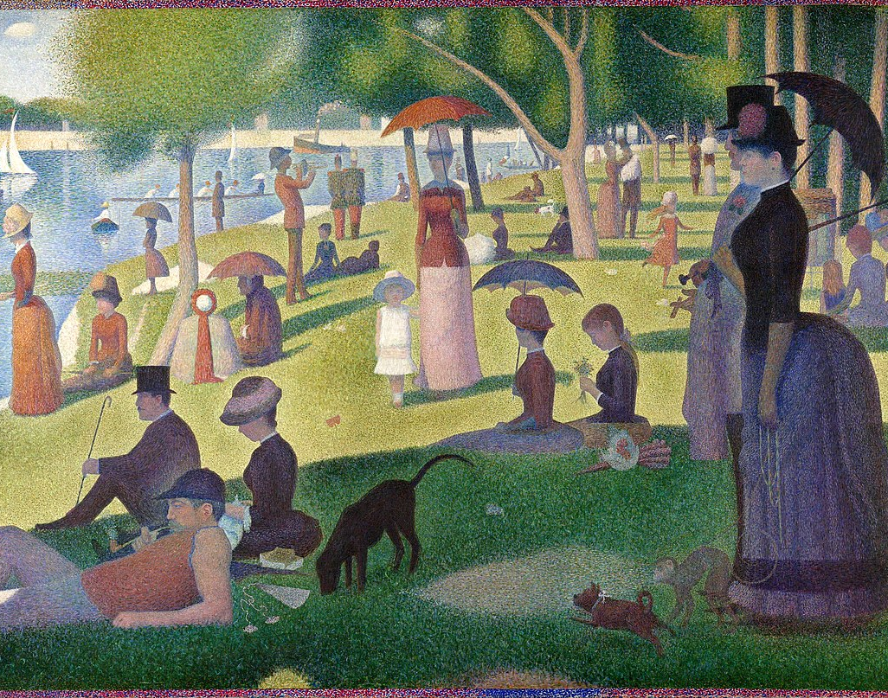
Sunday in the Park with George
The musical by Stephen Sondheim and James Lapine brings a famous painting in Georges Seurat to life.
The video montage on the next slide shows a London production featuring the work of creative director Timothy Bird and set and costume designer David Farley. Directed by Sam Buntrock, the show opened at London’s Chocolate Factory and later transferred to the West End and then to Broadway NYC (2008).
The set relies heavily on lighting, in particular projection, and animation by Knifedge.
A Sunday Afternoon on the Island of La Grande Jatte https://g.co/arts/WvJnyZqayh5doA947

Slide 18
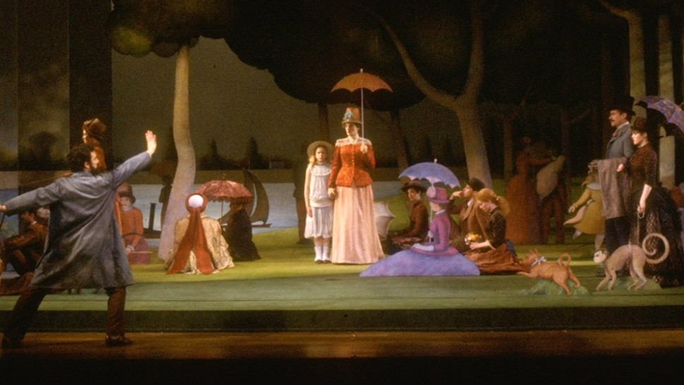
Original Broadway production of Sunday in the Park with George (1984)
Martha Swope/©Billy Rose Theatre Division,
NYPL for the Performing Arts.

Slide 19
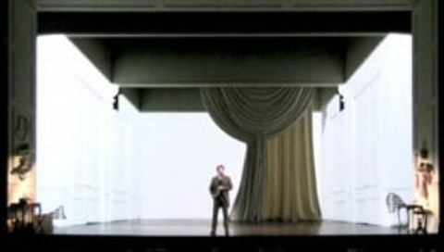

Slide 20

What will our plays look and sound like?

Slide 23
references

