Slide 1

Writing the play
From story premise to story beats

Slide 2
objectives
Reflections on last week’s lesson on production design.
From story premise to story beats.
Review script in progress.
We will write a scene outline
Each change in setting is a new scene. Time + Place.
Who is in the scene (at the top + entrances/exits)?
Action description (what happens in this scene?
Transitions
Dialogue will be filled in later after the structure is built.

Slide 3

Sound Design EXTRA: The Willhelm Scream

Slide 4
Script Review
Look at story in progress on the page.
Any changes? Updates? New ideas?

Slide 5
Writing scenes: things to consider
What needs to happen in this scene?
Who needs to be in the scene
Where could the scene take place?
What’s the most surprising thing that could happen?
Brainstorm three different ways the scene could begin?
Imagine the scene playing on the screen in your mind?
Adapted from JohnAugust.com

Slide 6
Dialogue tips
We don’t always tell the truth
We say things to get what we want.
We don’t talk in complete sentences – we struggle for words, use slang, we gesture and interrupt each other.

Slide 7
story premise
Mrs. Bottley’s third grade class at Heights-Terrace (PM):
PLACE: Technology World’s official headquarters is in Los Angeles, California.
At Technology World the brightest, most creative technology geeks search for hackers and crime. They are retired undercover superheroes who have taken a break from the craziness and chaotic life of saving the world, but still need a little dose of excitement once and awhile.
PLACE 2: Dark Cave, home of the villains, is located below Technology World.
The villains are seeking revenge on the Tech Team for ruining all their projected crime attempts. They create a new video game that will camouflage their evil plan.
Meanwhile at Technology World, Nintendo Man (AKA-Luis) is playing a new video game – Cyber-Pong – when he gets hypnotized by the villains. His mind is taken over (by Super Hypnosis) and he is forced to follow the evil plans of the villains from Dark Cave. Under the villain's control, Luis will send an email to his co-workers at Technology World tricking them into a prize vacation getaway in Hawaii.
The superheroes believe that they have won this amazing prize but are about to be fooled.

Slide 8
Second grade story premise
The heroes are tasked with going out into the community to do an Earth Day “spring cleaning” project.
Some are resistant - they think such basic tasks are beneath them or they have villains to think about.
Series of short scenes:
picking up garbage
raking leaves (landscaping)
painting a fence
planting flowers
Some hero(es) are frustrated they cannot use their powers.
They learn from the students how important it is to take care of the earth and make the neighborhood nice for everyone.
Maybe it’s a park that means a lot to the kids – to have a safe and clean and fun place to play outside together.
Everyone can be a hero. It’s not about having powers.

Slide 9


Slide 10
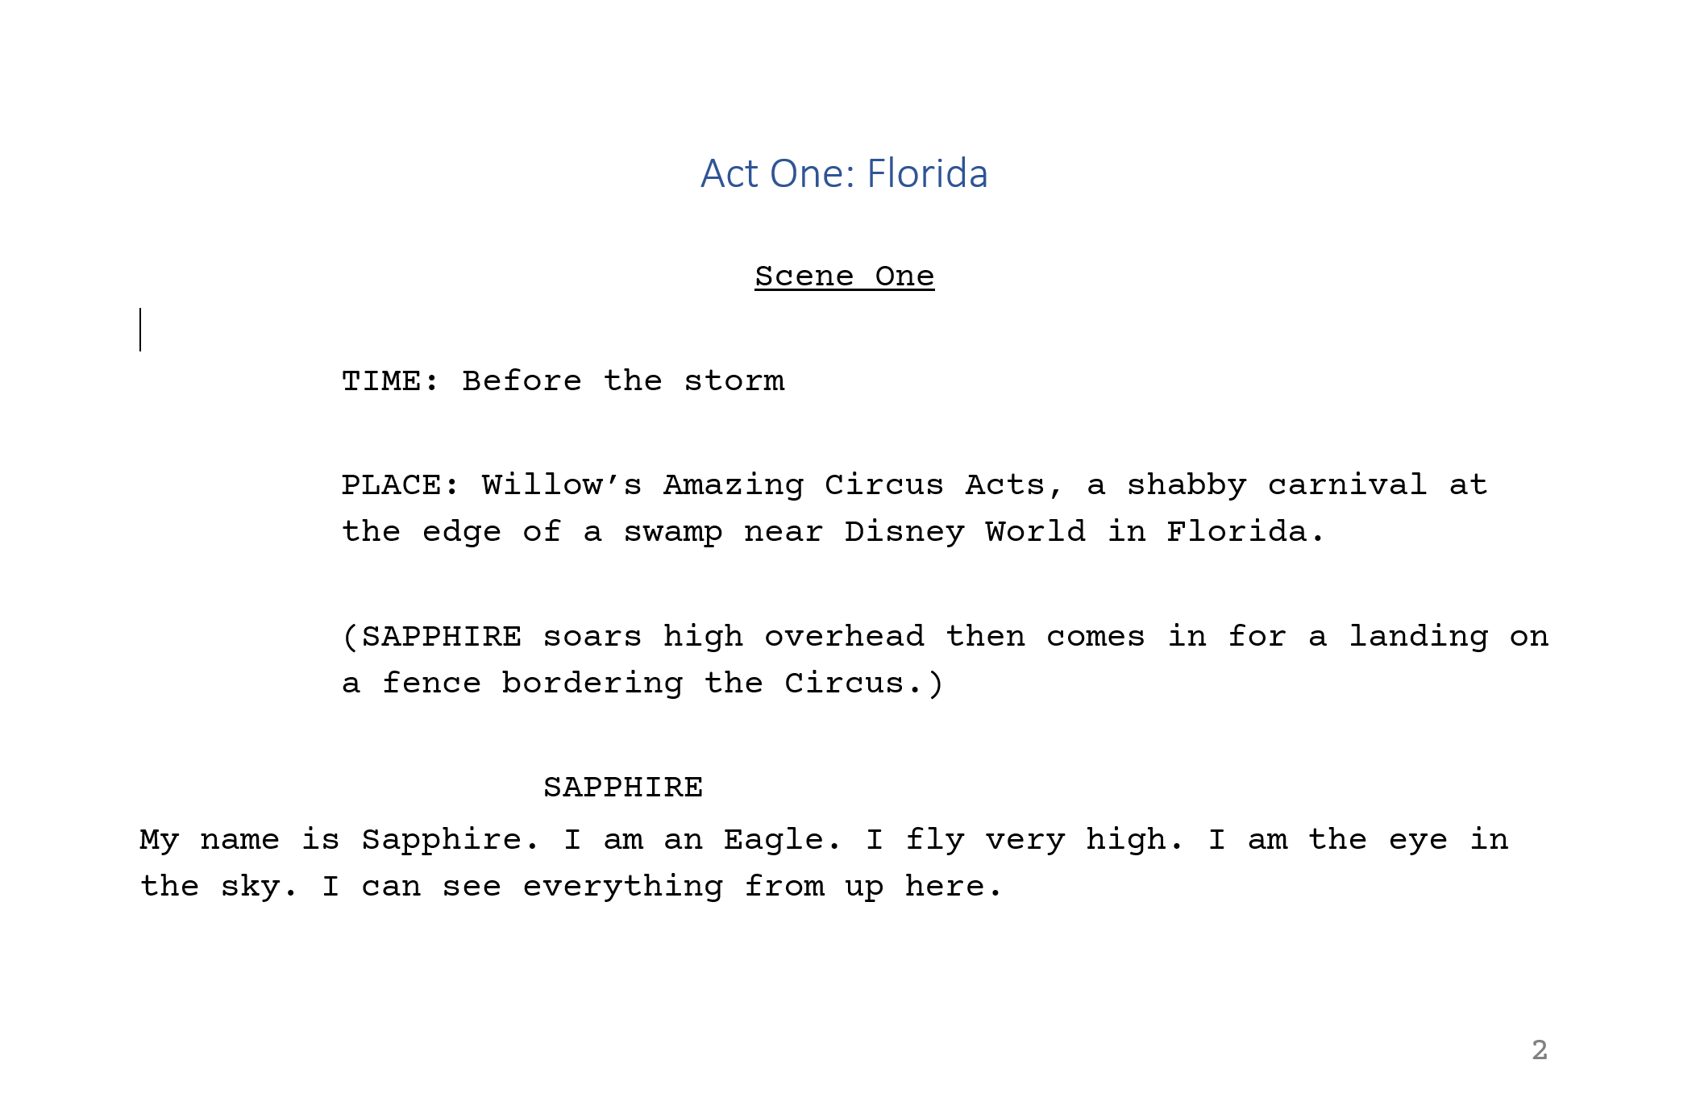
What does a script look like?

Slide 11
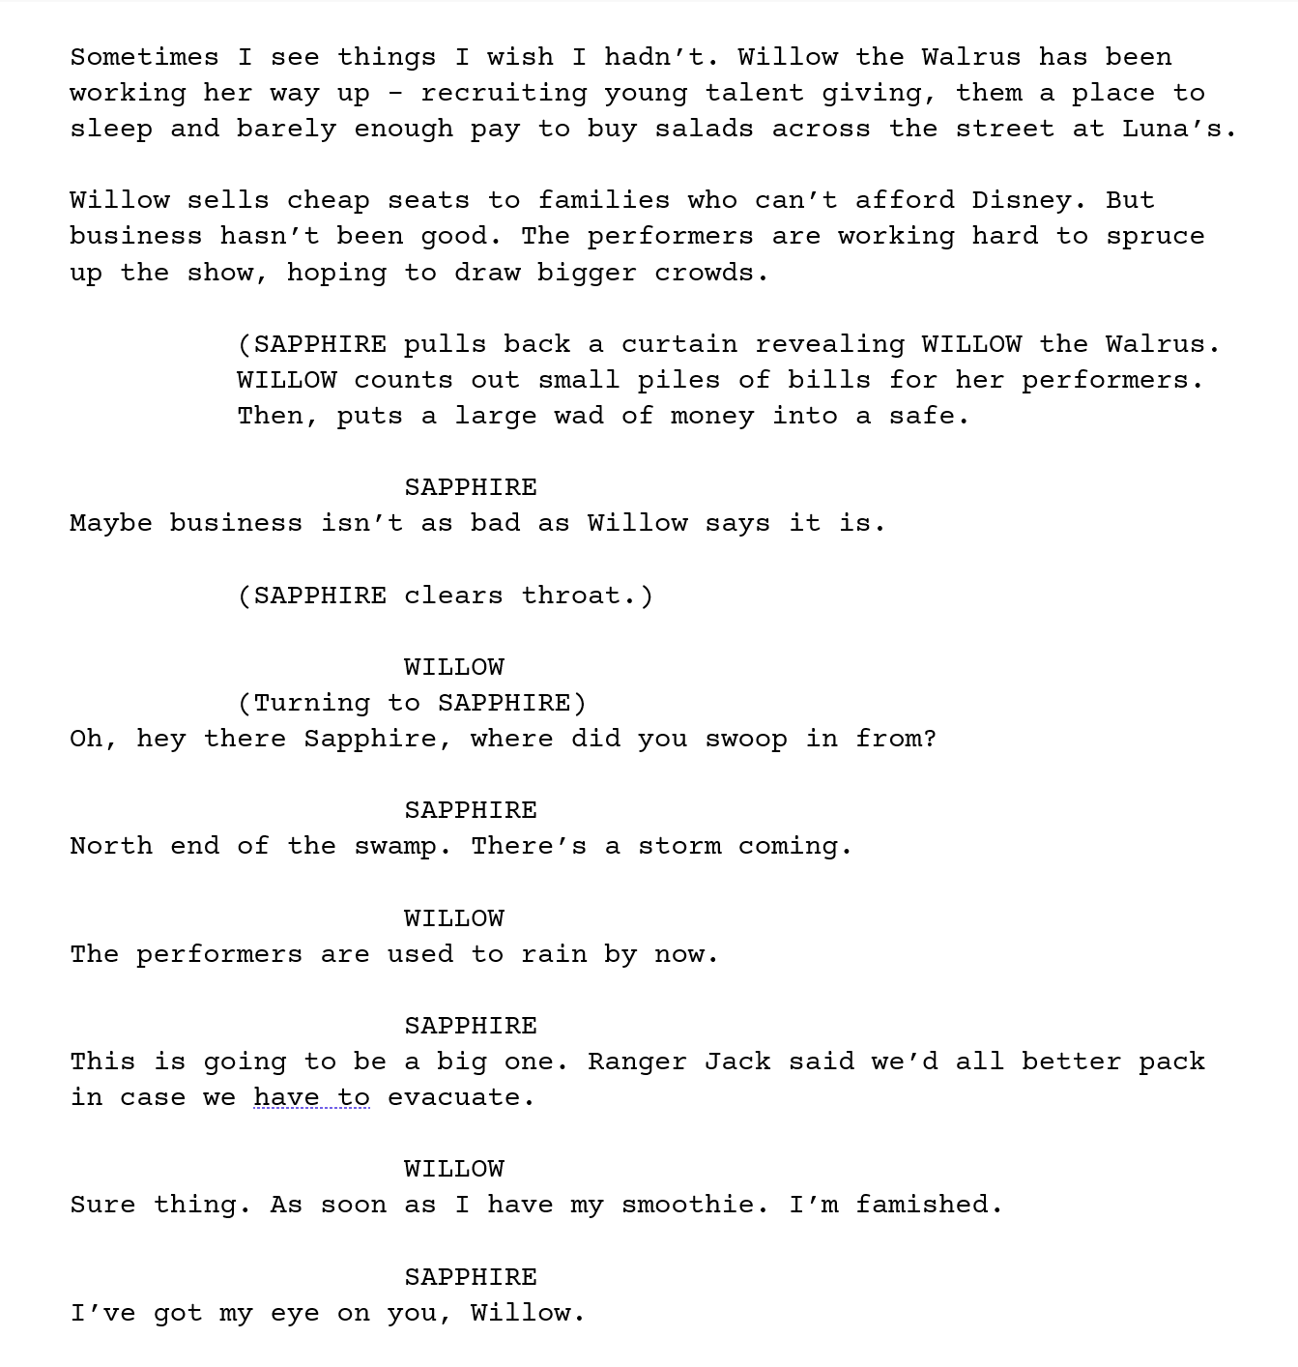
Act/Scene titles Stage directions character name parenthetical dialogue

