Slide 1
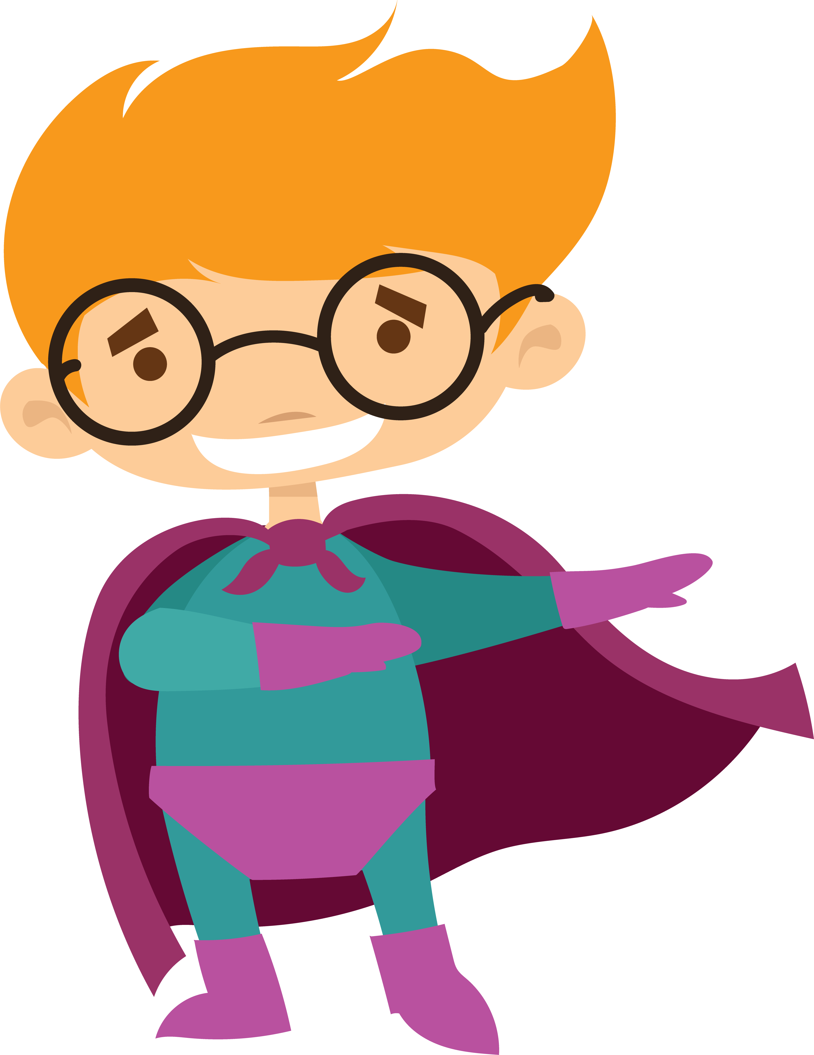
Twists & victories
Act 2 part two – how do superheroes win?

Slide 2
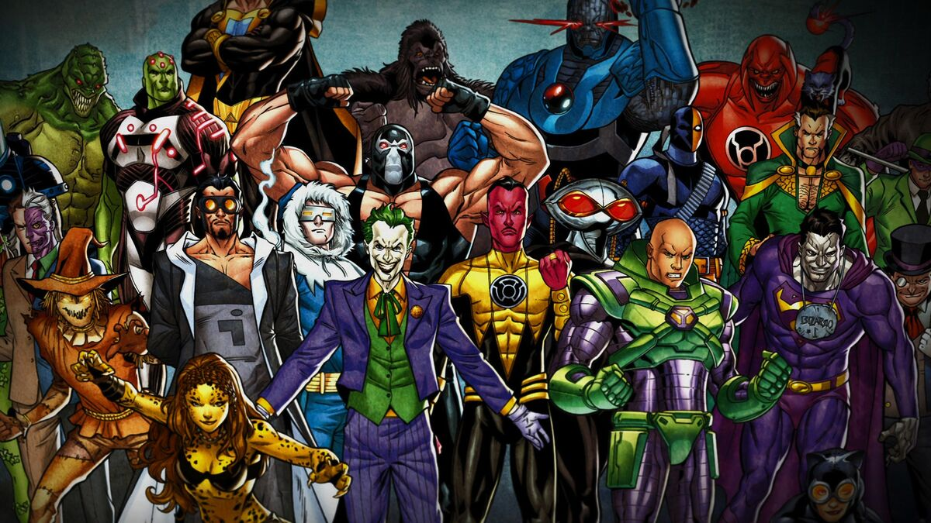
materials
Comic book pages illustrating your superheroes’ problems
  One BIG (villain) problem e.g. world destruction.
  One PERSONAL problem – internal, emotional, relationship, etc.

Slide 3
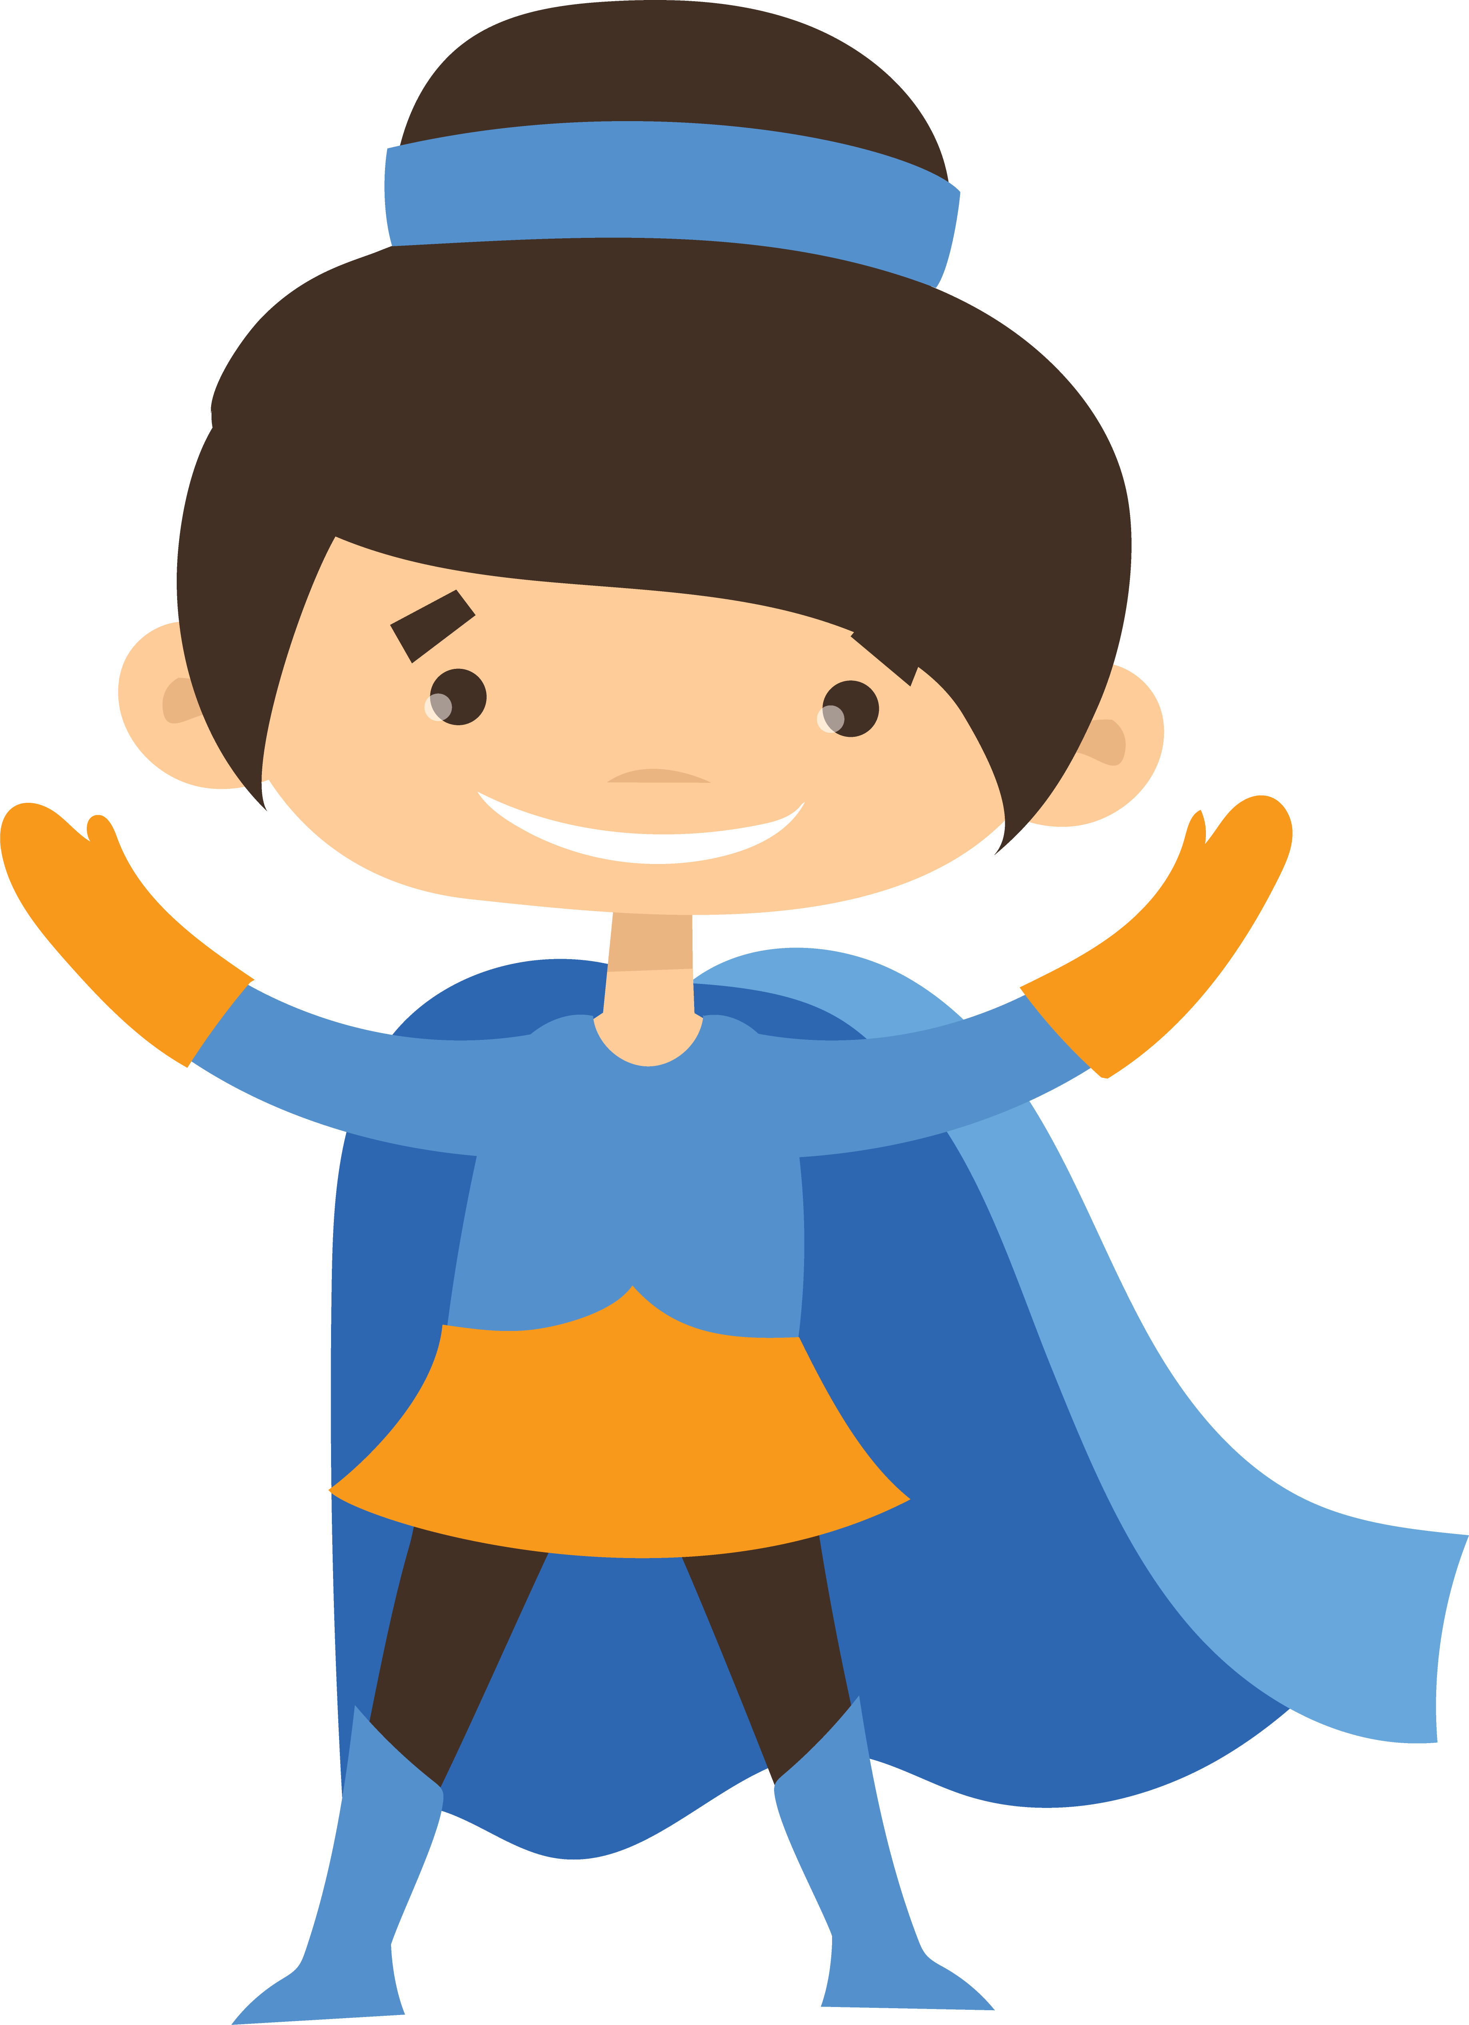
objectives
Let’s see your superhero problems! How are your pages progressing? (student share)
Examples of false defeats and other (midpoint) twists through to superhero victories from comic book and superhero movies
Brainstorm surprises and creative ways your heroes will win.

Slide 4
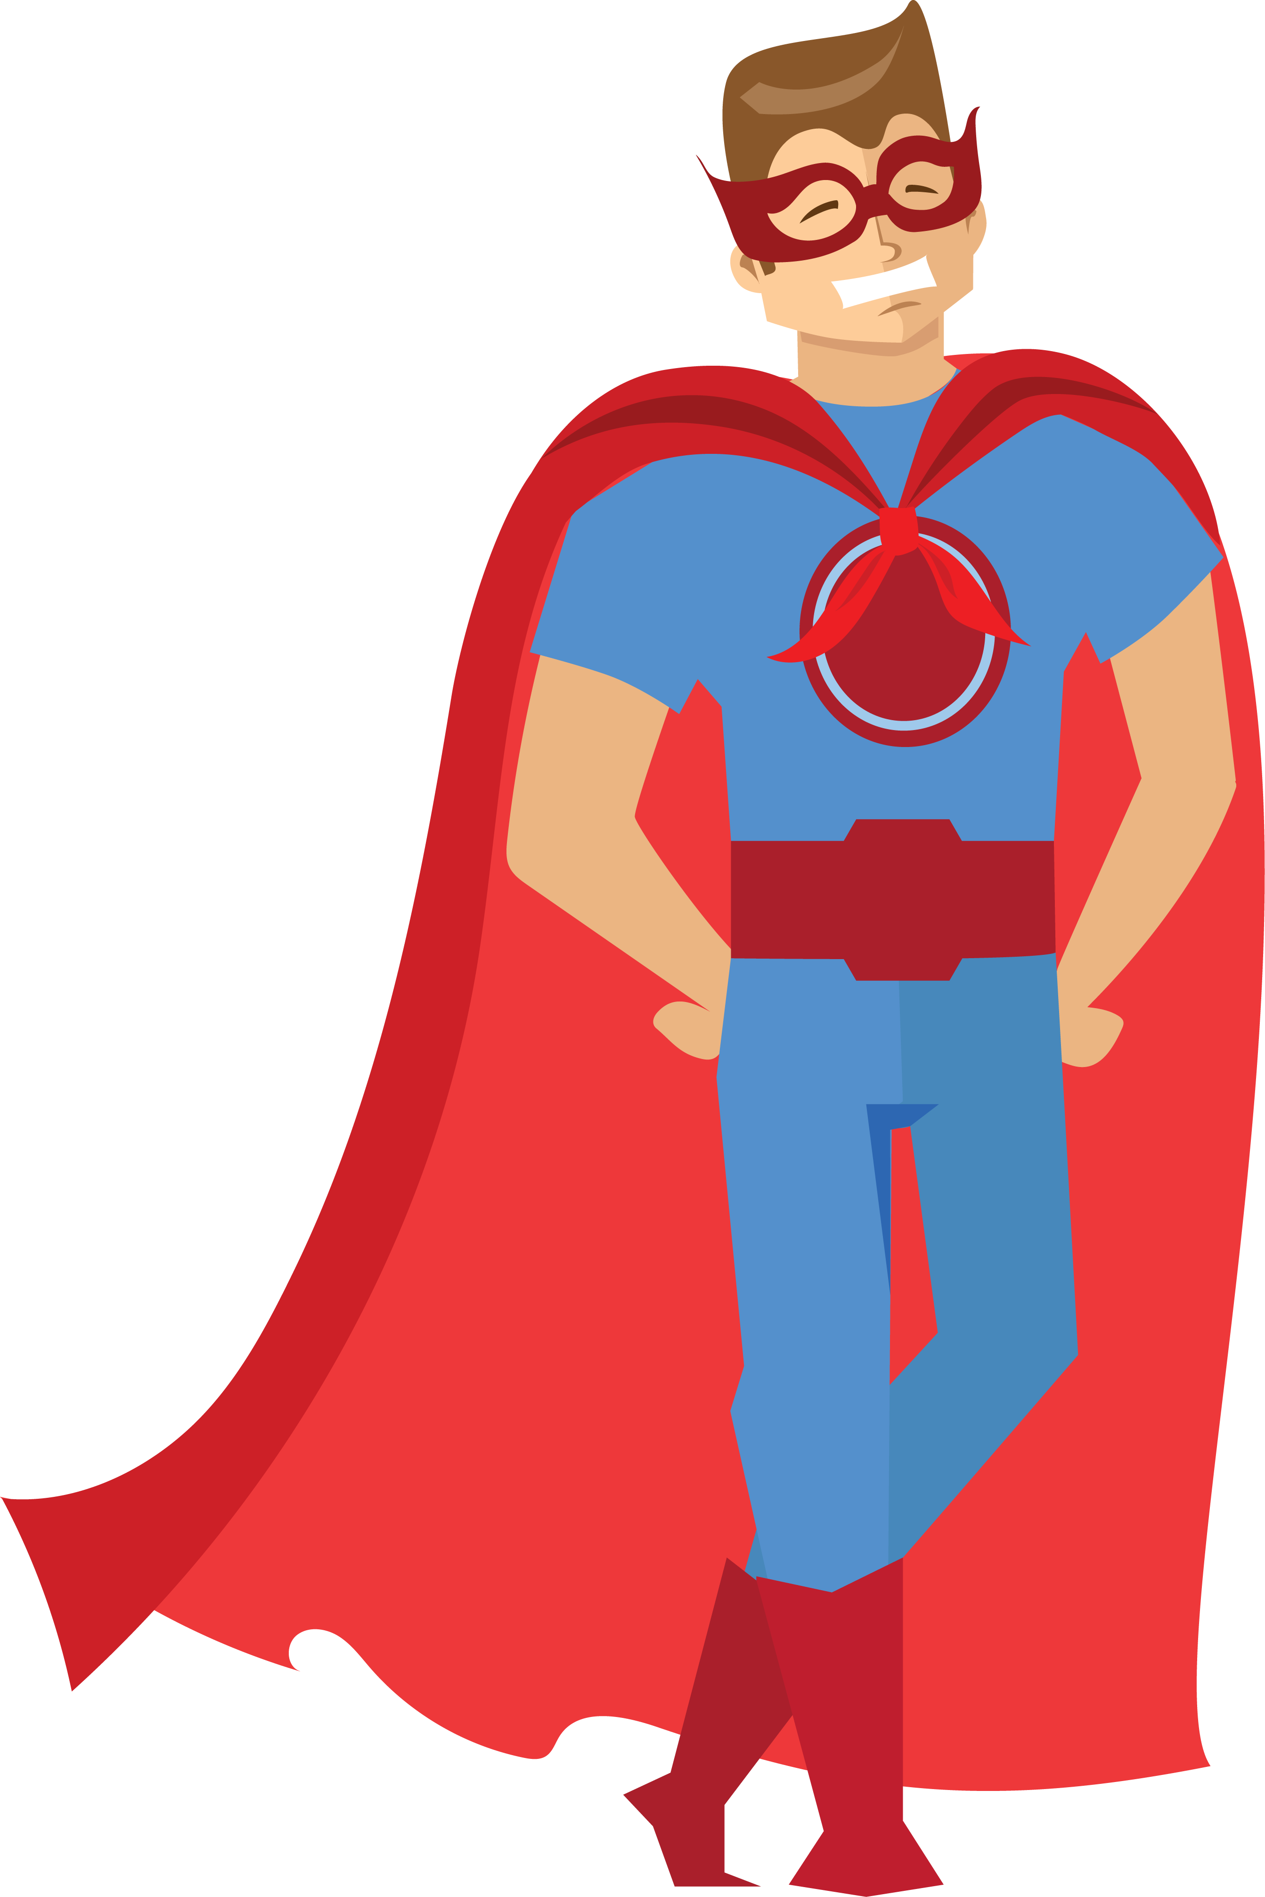
Pass or play!
Share your comic book pages;
stories in progress.

Slide 5

vocabulary
Midpoint
Plot twist (a dramatic reveal that alters some portion of the story for the audience)
False victory
False defeat
Dark Night / All is Lost
Climax

Slide 6
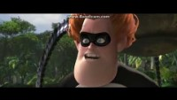
twist: The Incredibles
Notes:
First Pinch Point: Bob returns to the island for another job, only to be taken out by a bigger, badder OmniDroid. Syndrome reveals himself to Bob for the first time, and the full import of the conflict becomes known. Although Syndrome’s presence has been felt, via foreboding, ever since the First Plot Point, this is the first time he’s introduced as the antagonist. The movie did an amazing job of working him into the First Act, as a child, so that his presence here has real meaning and resonance. As a result, his late re-introduction into the plot works perfectly.

Slide 7
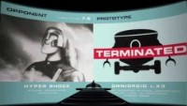
Midpoint: The Incredibles
Notes:
Midpoint: After escaping Syndrome, Bob hacks into his computer and learns of Syndrome’s plan to destroy the supers and launch his OmniDroid into the heart of Metroville. Simultaneously, the increasingly suspicious Helen activates a tracking beacon in Bob’s new supersuit—which alerts Syndrome to Bob’s presence. He is captured.
This is a nice double revelation here, since we get one for both Bob who figures out Syndrome’s plan and Helen who figures out what’s up with her husband. The timing couldn’t have been better, since Helen’s revelation impacts Bob’s plotline, pushing the whole thing forward into the second half of the story.

Slide 8
How do superheroEs win?
Beyond the fight …
Hint: The best action scenes are more about the emotional stakes than punches and power blasts.
e.g. Super-Man is a romantic comedy.

Slide 9
Hint: It’s the Hero part
It’s personal and it’s more than personal.
  They are fighting for something bigger than themselves at the same time they are fighting for someone they love. A purely selfish villain can’t compete.
They are more “human.” Love, kindness, empathy, etc.
  In X-Men: The Last Stand – Wolverine’s love for Jean Grey is what allows him to connect to (and destroy, for her own good) the Phoenix.
They have friends!
  Other heroes come to their aid because they admire the good and just fight.
They are smarter.
  Peter Parker, Tony Stark, Ant-Man, Doctor Strange, etc. win because they are genius (creative) scientists.

Slide 10
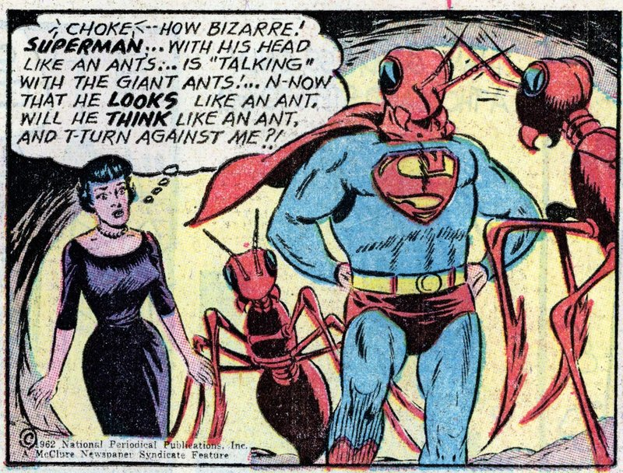
Creative thinking
In Action Comics #296, Superman disarms an army of giant ants from outer space, by fighting them but with communication!
He intentionally flies into a cloud of red kryptonite, transforming his head into a giant ant-head. Using his new antennae, Superman talks to the ants and discovers they aren’t a threat but came to warn humans about the dangers of nuclear war.

Slide 11
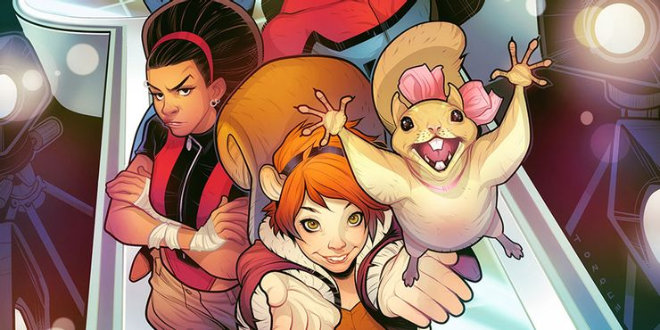
Surprising weapons!
The “Unbeatable” Squirrel Girl talks to squirrels and gets them to attack her enemies. It’s weird and no one sees it coming and it’s how she beats Doctor Doom (squirrels chew through wiring), M.O.D.O.K. (squirrels disable his chair and bite his nose) and Thanos!

Slide 12
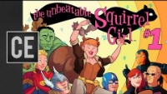

Slide 13
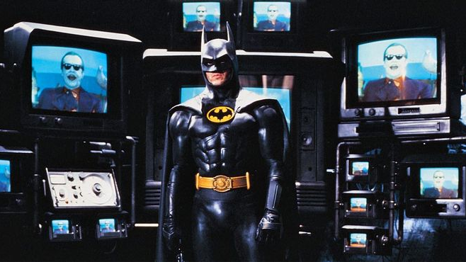

Slide 14
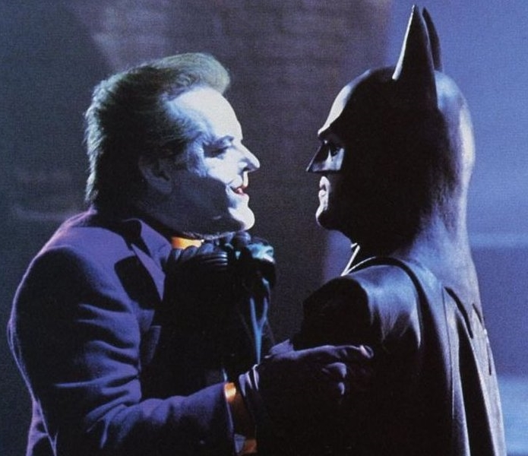
Letting villains destroy themselves
With the exception of supervillains, most criminals aren’t that smart. In the 1989 Batman movie, the Joker sends three of his goons after an injured Batman who’s making his way up a cathedral.
The first is defeated with a punch, but the second falls through a rotting floor trying to jump Batman who steps aside.
The third requires another violent battle, but …

Slide 15
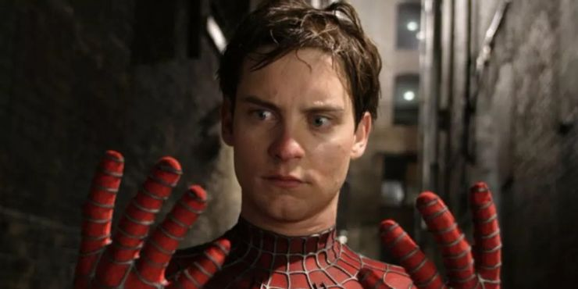
Playing tricks
In Marvel Adventures Spider-Man #57, Spidey draws on his weird creepiness to trick a crook into releasing a hostage. Realizing the crooks didn’t know about all of his spider-powers, Spider-Man threatens to summon thousands of spiders to attack his enemy. Terrified and grossed out, the crook immediately surrendered.

Slide 16
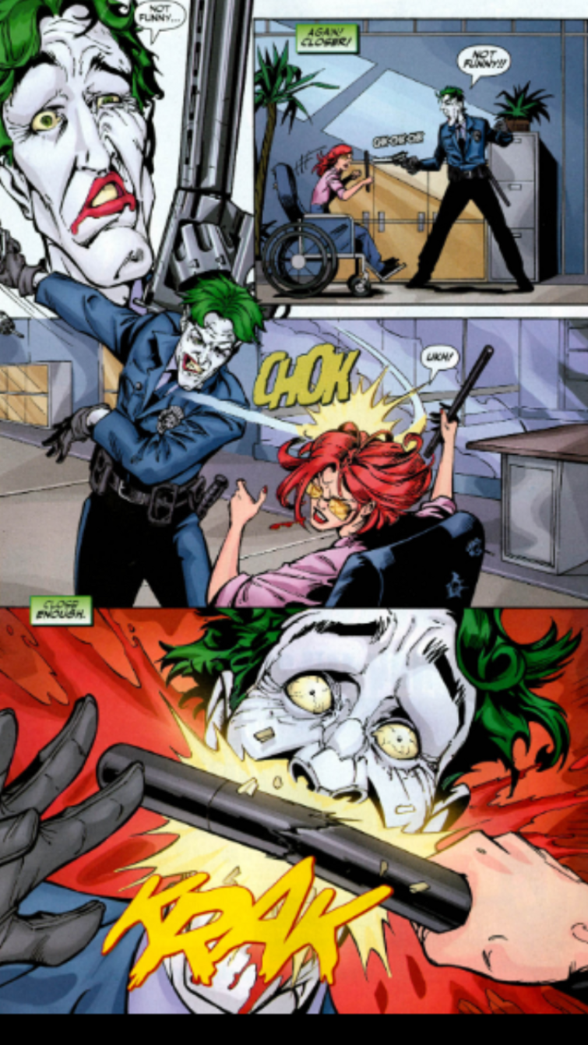
Hit ‘em in the ego
After Barbara Gordon aka Batgirl is shot by the Joker and paralyzed from the waist down, she returns in a wheelchair and smashes the Joker’s teeth in. Given the importance of his smile – this is a huge blow.

Slide 17
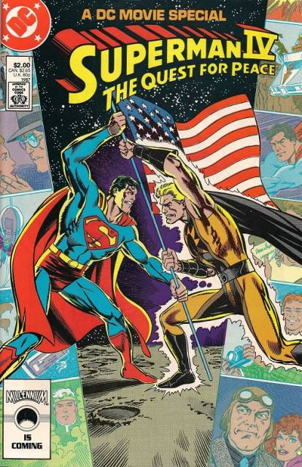
Equal match or are they?
Lex Luthor steals a strand of Superman’s hair from a museum from which he plans to fabricate a villain (who does his will) who has all the powers of Superman. How will Superman defeat an equal match?
Nuclear man’s powers are fueled by the sun and Superman is smart enough to figure that this fatal flaw – defeating him in the dark.

Slide 18
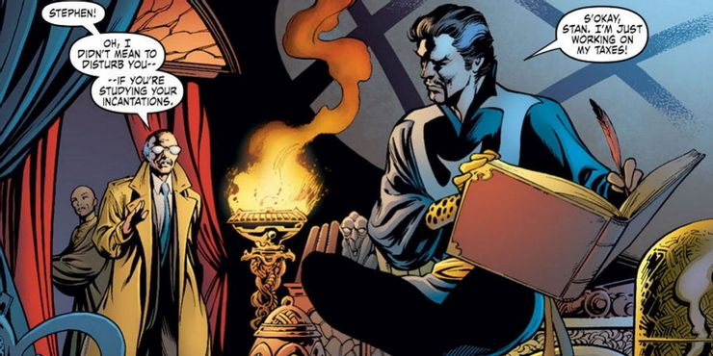

Slide 19
references
https://www.cbr.com/most-ridiculous-ways-superheroes-have-won-battles/
https://comicvine.gamespot.com/barbara-gordon/4005-5368/forums/what-issue-did-barbara-knock-out-jokers-teeth-1497218/
https://plotdevices.co/blogs/blog/the-incredibles

