Slide 1

Wrapping it up
The END of your story

Slide 2
objectives
Warming up with Pass & Play, students will share their comic books in progress. (act 2 – midpoint to climax)
Miss Alicia will share examples of THE END of stories.
Upcoming lessons include an exploration of stage design (set, prop, costume, sound & lights); and script reading/practice before we begin adapting our own comic books into scripted scenes.
Students & teacher will contribute ideas on what they want their play to look like. (e.g. puppets or readers theater, etc.)

Slide 3
Pass or play!
Share your comic book in progress
From midpoint to climax …
How does your superhero win …

Slide 4
How do stories end?
COMEDY
Party / feast
Fun with friends (jokes)
Awards, prizes (recognition)
Reunite with Family
Peace and happiness
Prosperity
Vacation
TRAGEDY
Funeral(s) – honor those who’ve made the ultimate sacrifice to save (the world)
Healing
Rest
Fix what’s broken
Hope for better future

Slide 5
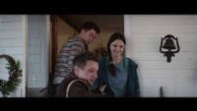
Hawkeye – home with the family in time for Christmas

Slide 6

vocabulary
Comedy
Tragedy
Foreshadowing
De-noue-ment (untying the knots)
Closure
Conclusion

Slide 7
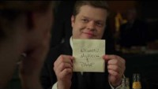
Daredevil series finale: Friends back together again. (He couldn’t have done it without them.) Now what? … tease what’s next?
Notes:
Looked like there was no way Daredevil could defeat Kingpin. Was tempted to kill him in order to stop him even though he’s sworn not to kill (Catholicism).

Slide 8
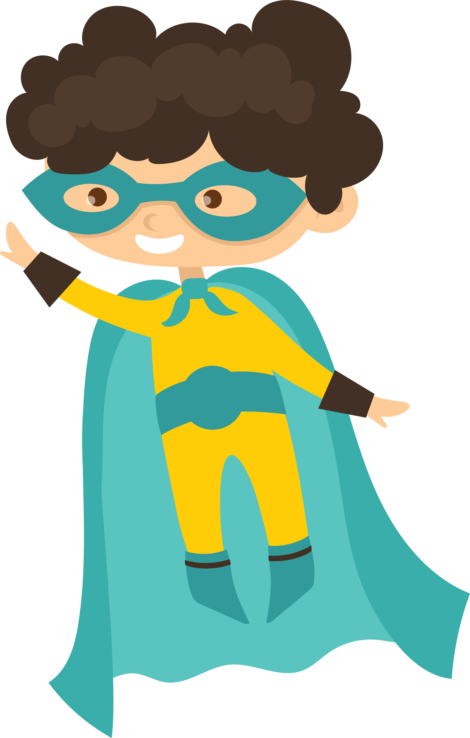
Outcome revealed
How is life going to be different now?
How has world changed?
How has hero changed?
Show impact of the conflict
Problems solved
Assess the costs – reconstruction
Character needs/wants met

Slide 9
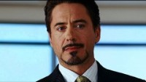
Iron Man – a final surprise

Slide 10
But Is it really over?
Set up for next episode = tease (solutions temporary?)
New villain emerges or villain is only wounded, & vows to return
A new problem is introduced – side effects of damage done during conflict
Dead brought back to life or next generation
Clean & fix equipment / weapons / property

Slide 11
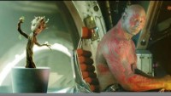
NOT REALLY DEAD! Rocket grows a new Groot from residual twig
Notes:
During the final battle aboard Ronan's ship, the Dark Astor, Groot saves the other Guardians from dying in the crash by forming a protective "shell" ultimately sacrificing himself. After the impact, pieces of Groot can be seen scattered all over the ground. Rocket takes a piece and plants it which later grows to be arguably the most anticipated character of the sequel, Baby Groot.
SOURCE: https://www.reddit.com/r/FanTheories/comments/4v73la/guardians_of_the_galaxy_there_is_more_than_one/

Slide 12
Amazing Spider-Man #248
Sometimes, a twist can be far more heart-warming than just a big shock and nowhere does that work more than in this classic issue. Most of it involves Spider-Man fighting Thunderball, but the true highlight is the back-up tale, “The Kid Who Collected Spider-Man.” A columnist for the Daily Bugle talks about a 10-year-old boy named Tim who’s the biggest Spider-Man fan alive, collecting news clippings, souvenirs and more. He’s overjoyed when Spidey shows up in his bedroom to show off his powers and talks of how happy he is to meet a fan. Things get more dramatic as Tim asks why Spider-Man does this and he shares how he once failed his uncle.
The big move comes when Tim asks who he really is. After a pause, Spidey unmasks to reveal himself as Peter Parker and Tim is happy to know this. He promises he’ll never tell a soul and Peter says he knows he won’t, giving Tim a hug before leaving. It’s baffling why Spidey would trust this kid with his greatest secret but the answer comes in the heart-breaking final panel. After a tearful Spidey swings away, we see a sign showing that Tim’s “home” is a hospice. Tim has leukemia and was given only a few weeks left to live. It’s a stunning turn but also a perfect one, capping off what many consider one of the greatest Spider-Man stories of all time.

Slide 13
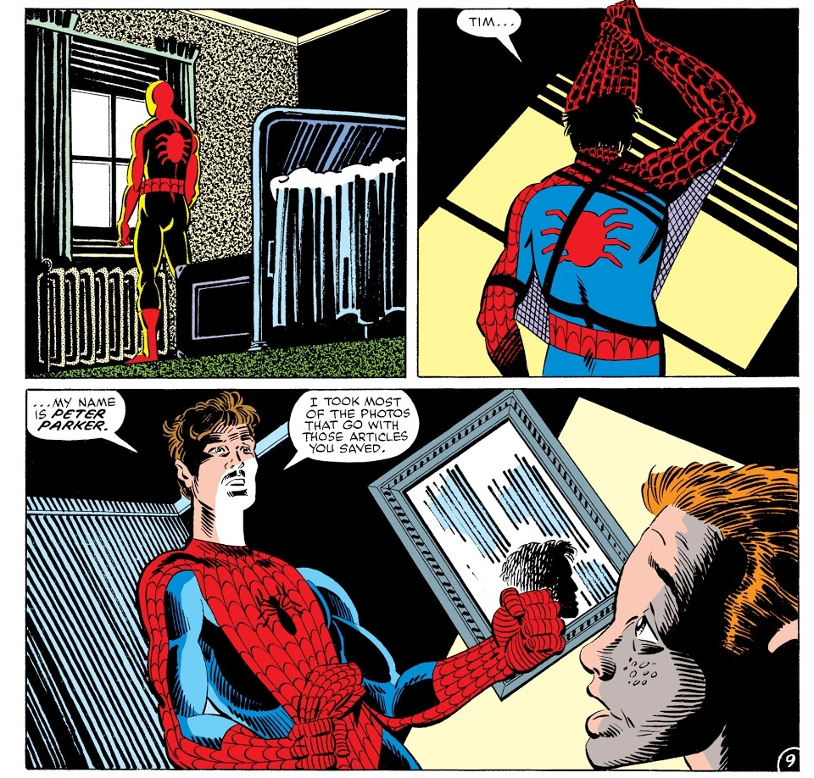

Slide 14
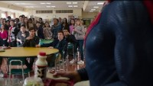
One final feelgood – give the audience what they want. Shazam goes to school.

Slide 15
