Slide 1

shaping your story
Plotting the sequence of events
Act One or the Beginning

Slide 2
objectives
Share new characters you created
Explore story beat examples from DC’s Stargirl and other comics.
Introduce comic book template pages
Review cause and effect in story action
Prepare to transfer your story to comic pages

Slide 3
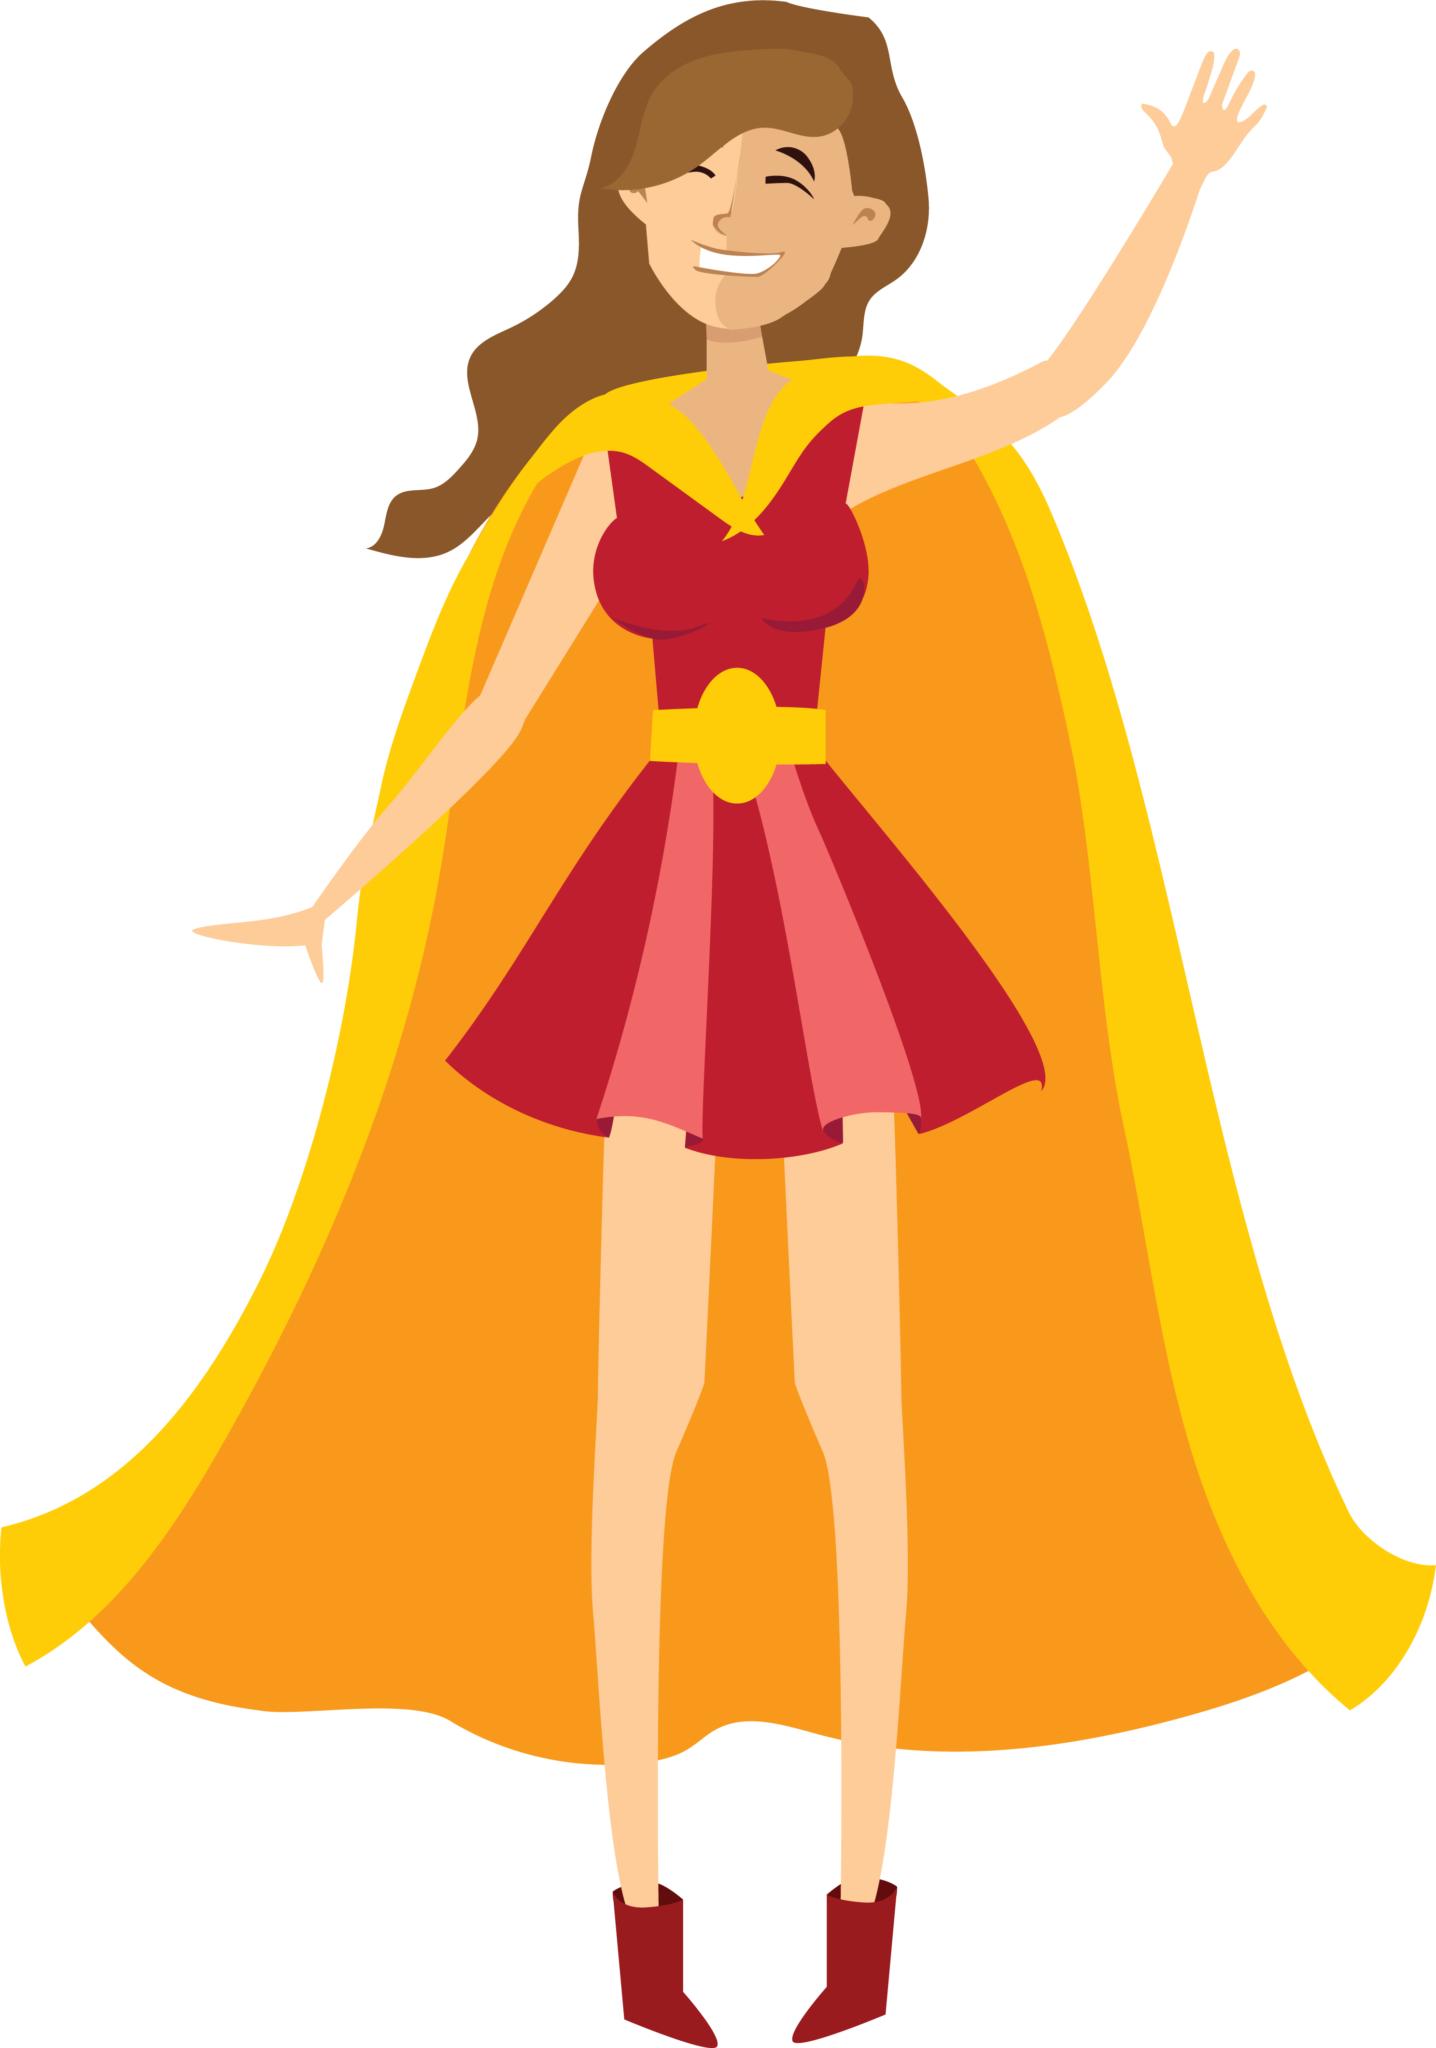
Pass or play!
Tell me about your sidekicks and villains

Slide 4
materials
Comic book page templates will be made available for your teachers to print

Slide 5
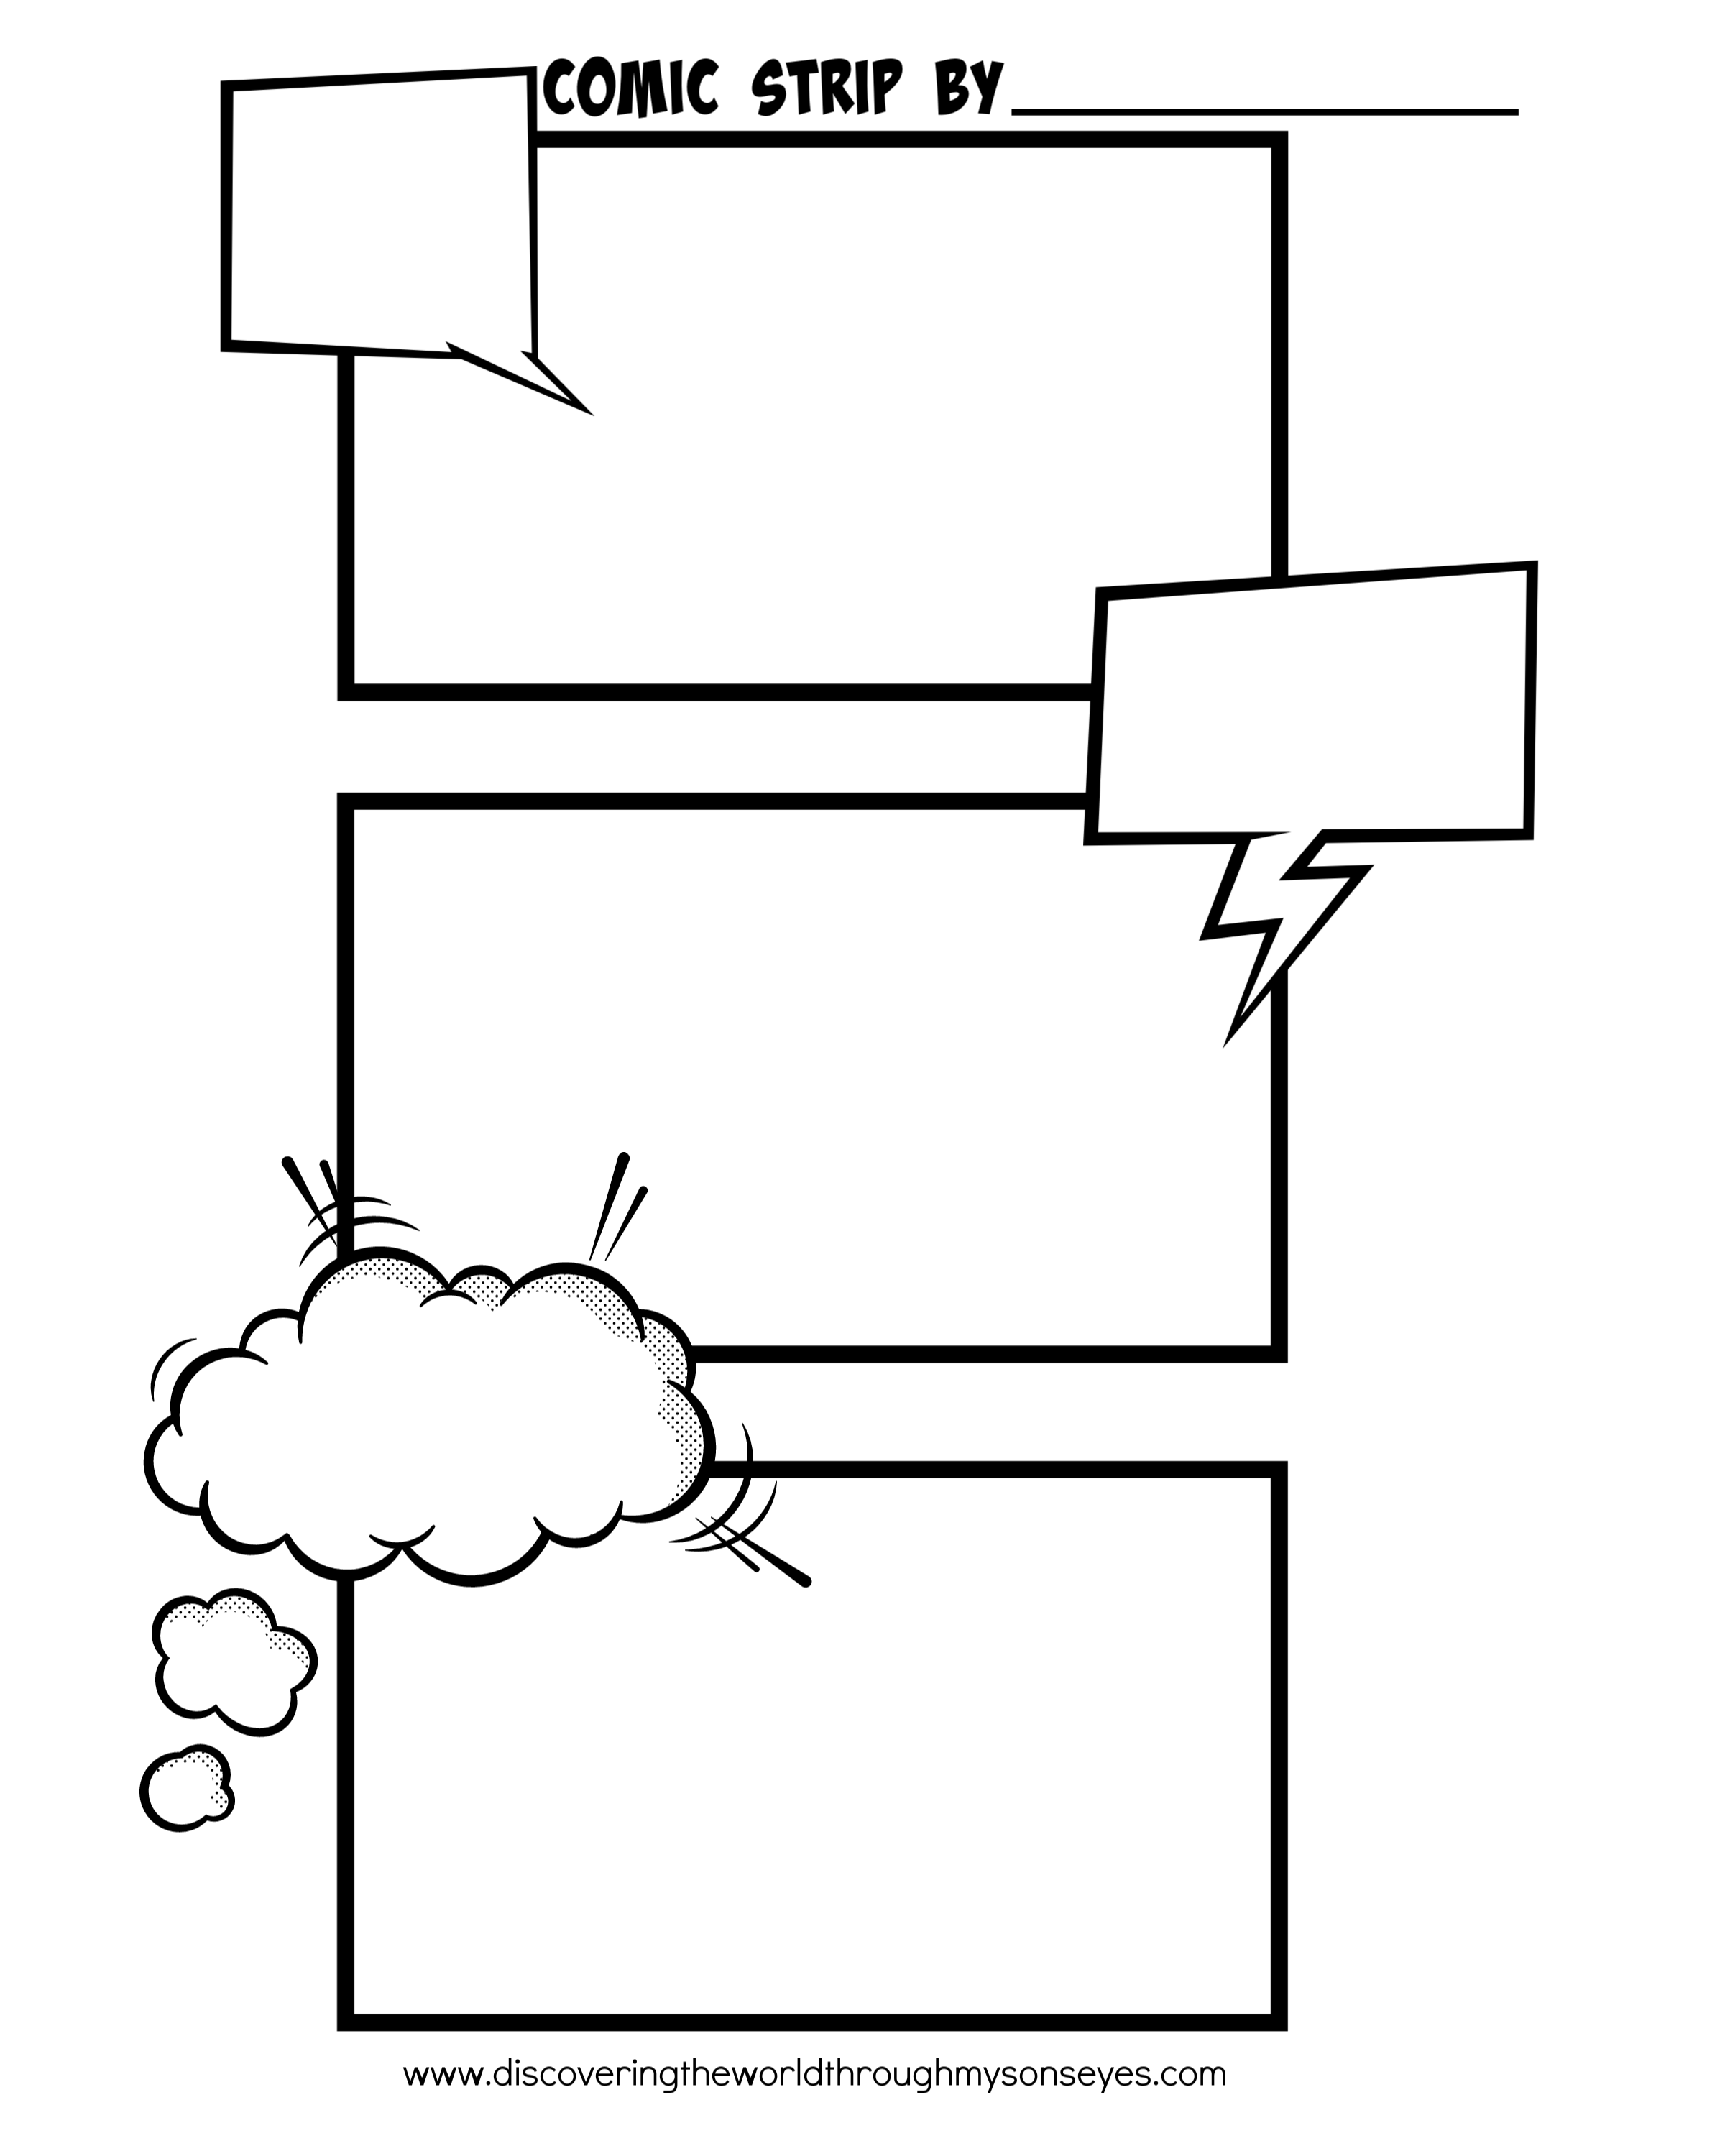
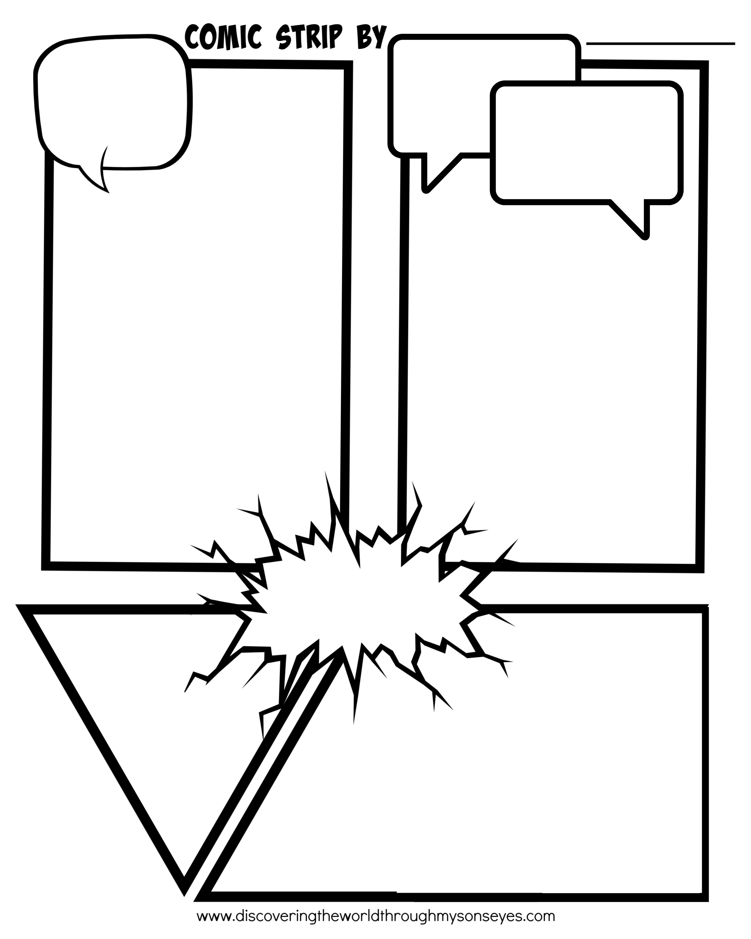

Slide 6

Stargirl realizes her sidekick is Starman’s sidekick, conveniently her new step-dad. A key inciting incident happens before the comic, when her mom re-marries. We don’t need to see this scene. Better to start with the move from CA to NE.

Slide 7
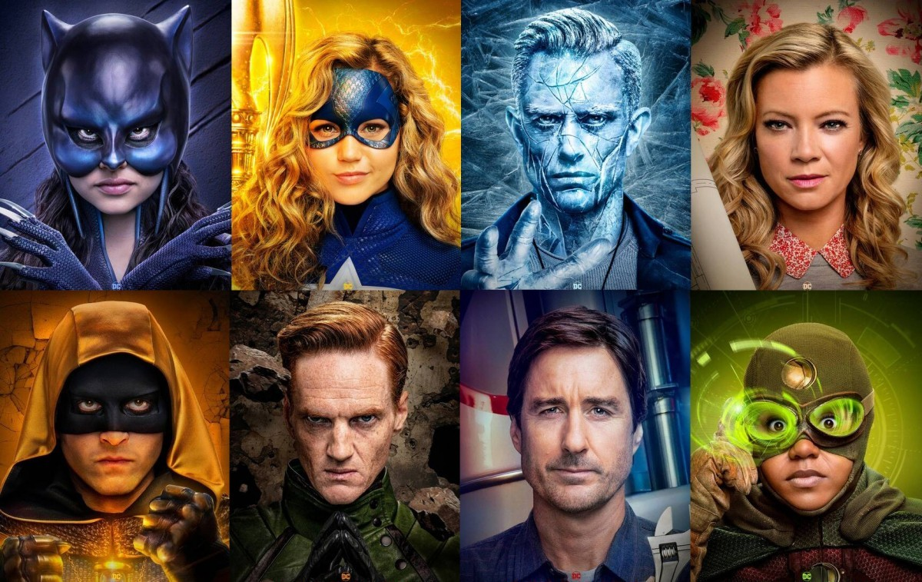
Villains and allies

Slide 8
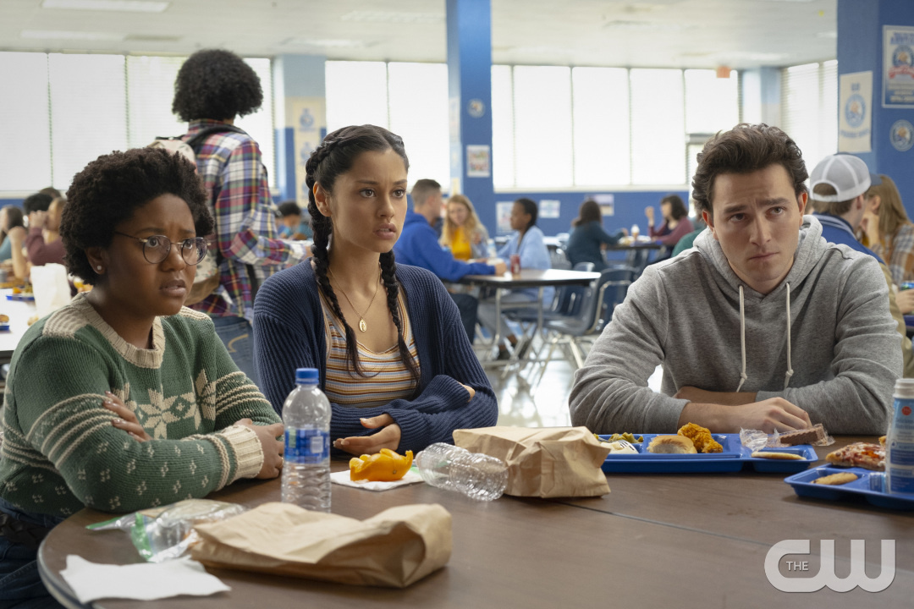
First day of school – singles table

Slide 9
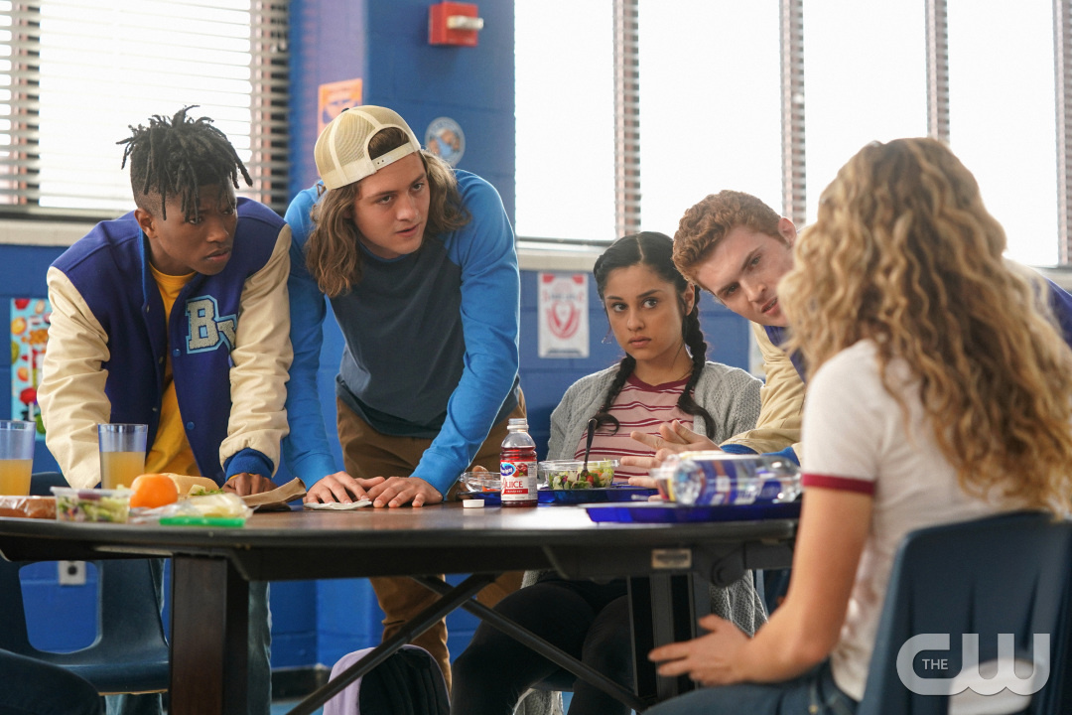

Slide 10
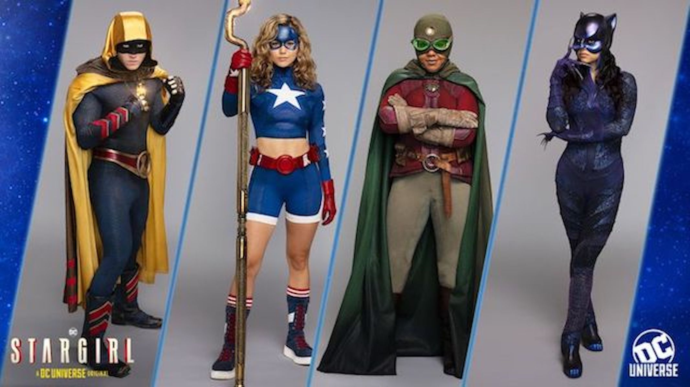
These same students later become her allies …

Slide 11
vocabulary
Act one or the beginning
Sequence of events
Plot
Action
Status quo
Inciting incident

Slide 12
Common events in act one (vocabulary)
Real life character’s normal world (status quo or stasis)
Superhero gets powers
Hero tests powers : small victory - looks like this is going to be fun
Villain attacks – superhero is forced to respond before they are ready
Superhero realizes family is in danger now
Superhero investigates – Who is villain? What does villain want?
Superhero can’t win alone; must recruit allies.
Allies hesitate or say no, then something happens that makes them change their mind.
Together they plan an attack. (End act one).

Slide 13
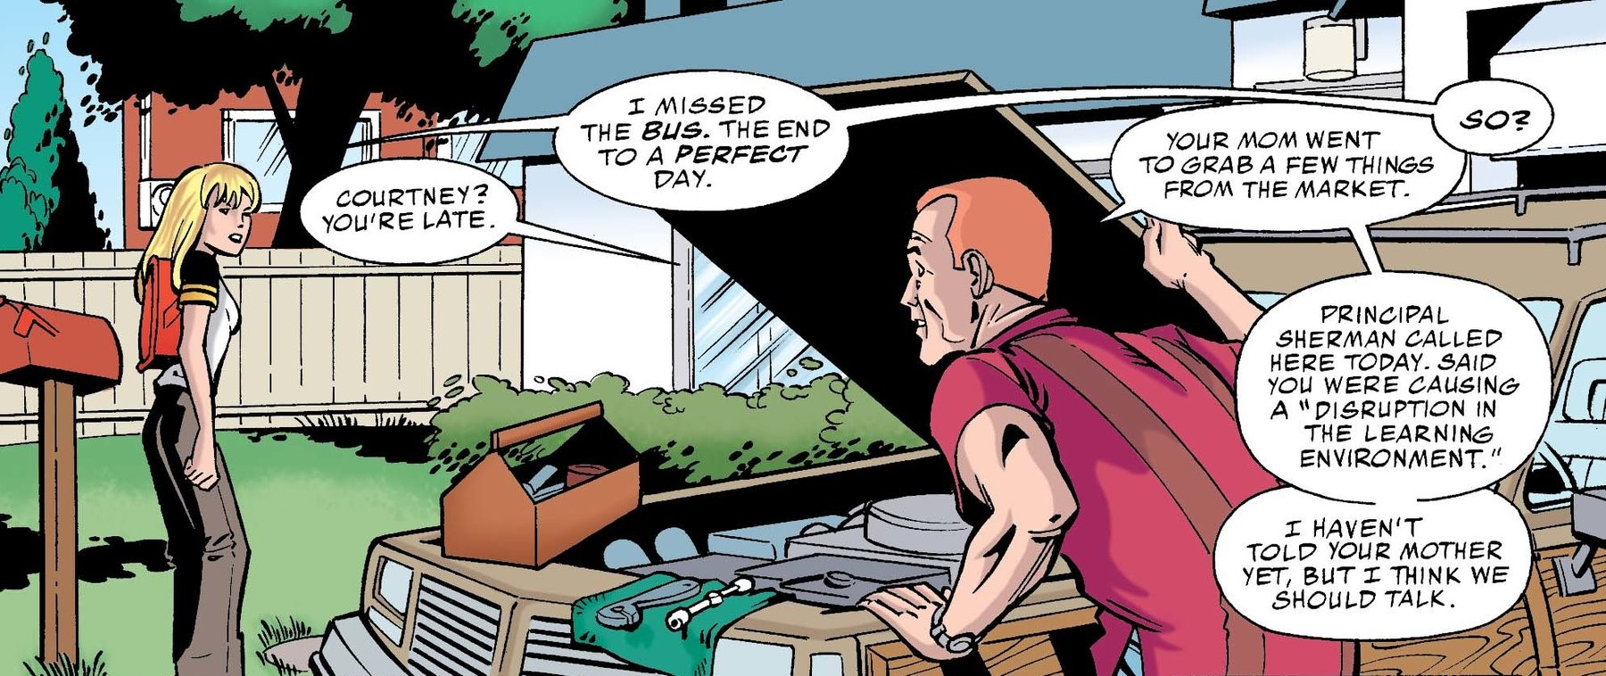

Slide 14
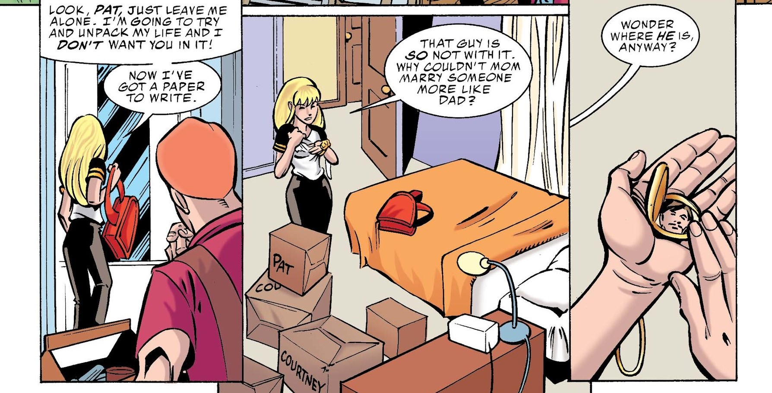

Slide 15
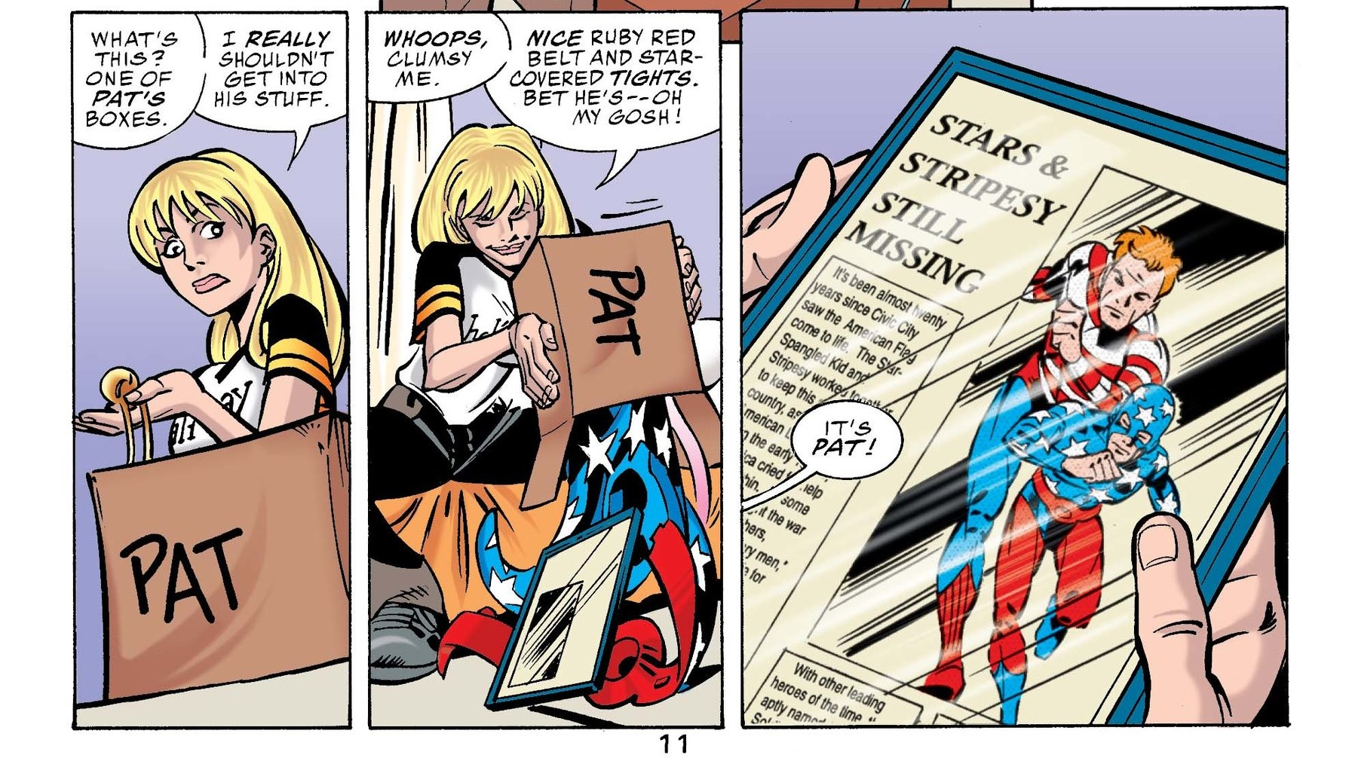

Slide 16
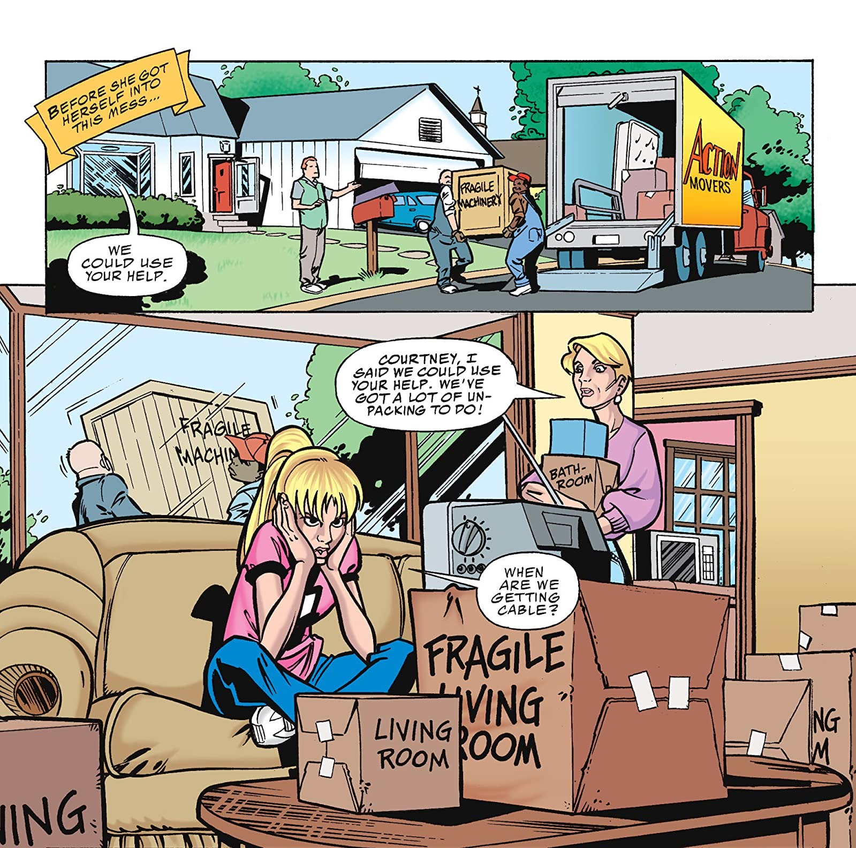

Slide 17
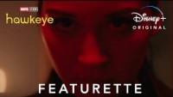
Origin story doesn’t always come at the beginning: Echo (Maya Lopez) is introduced in episode three of Hawkeye.

Slide 18
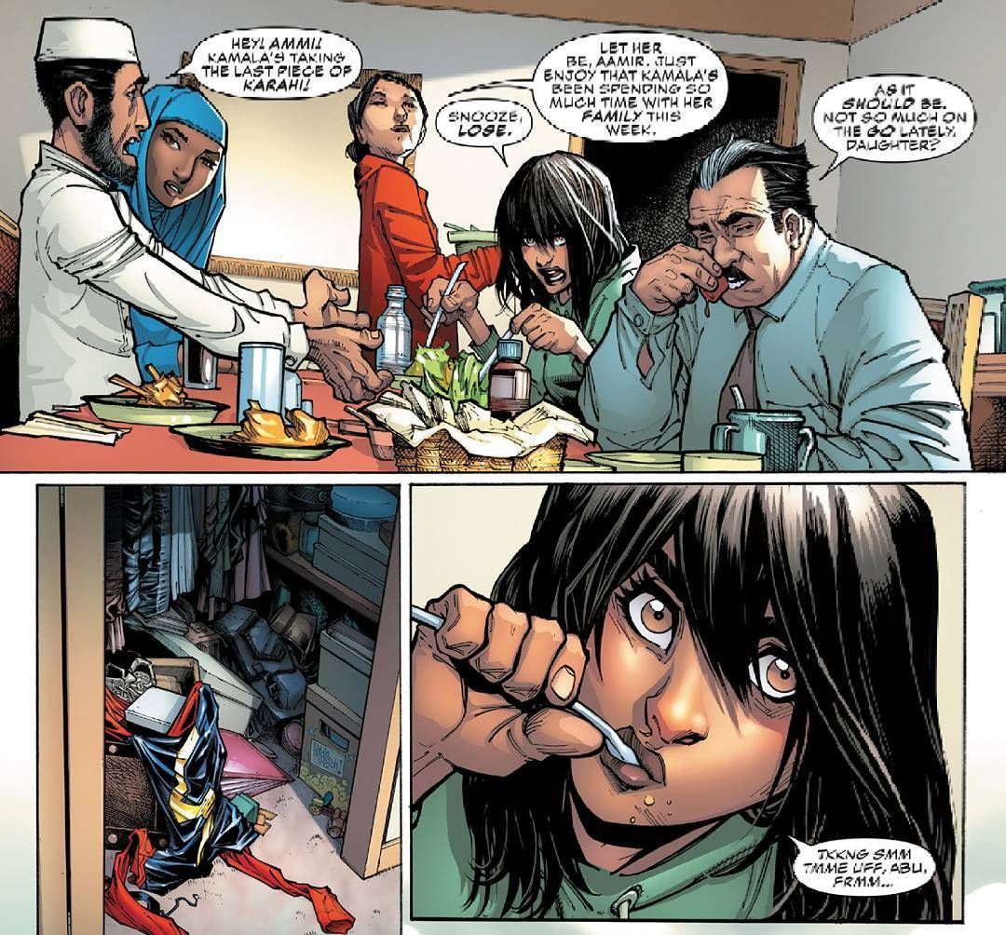
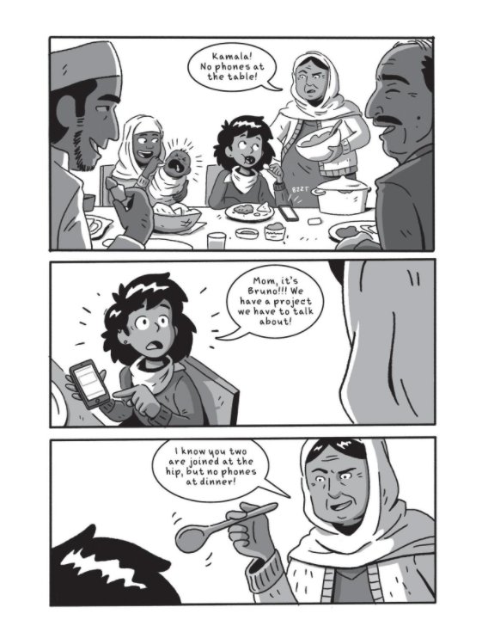

Slide 19
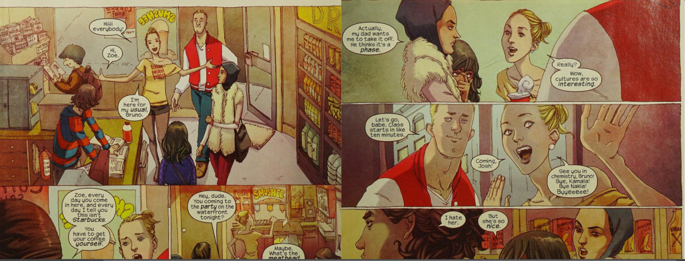

Slide 20
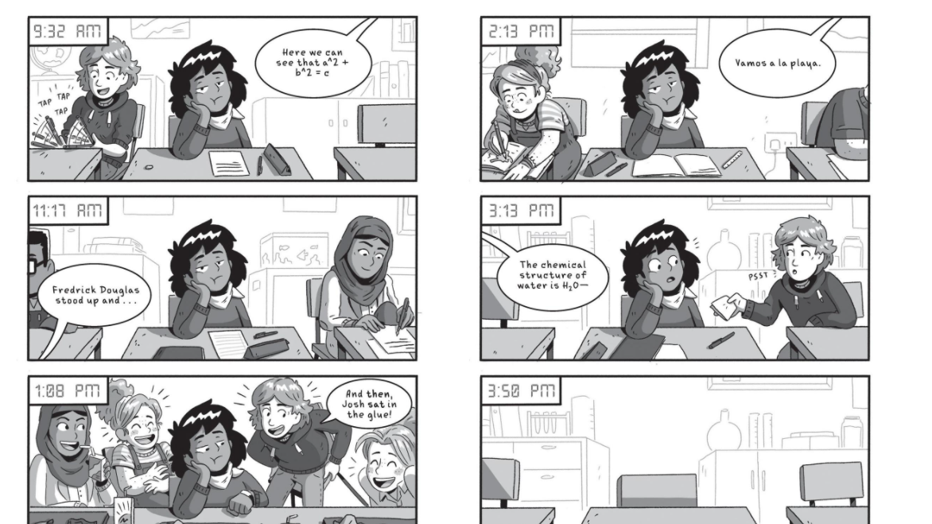

Slide 21
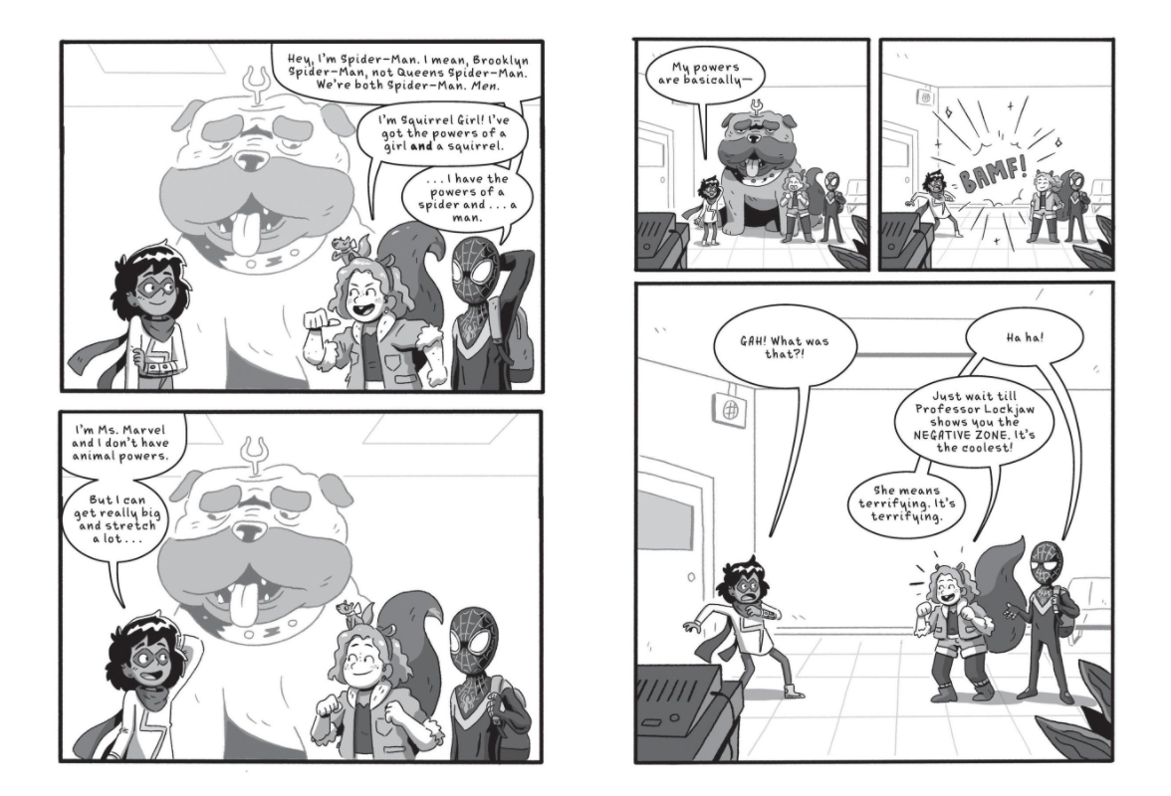

Slide 22
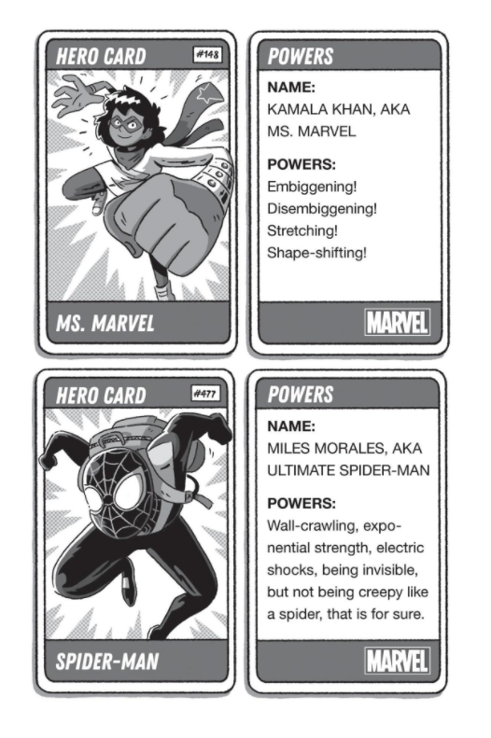
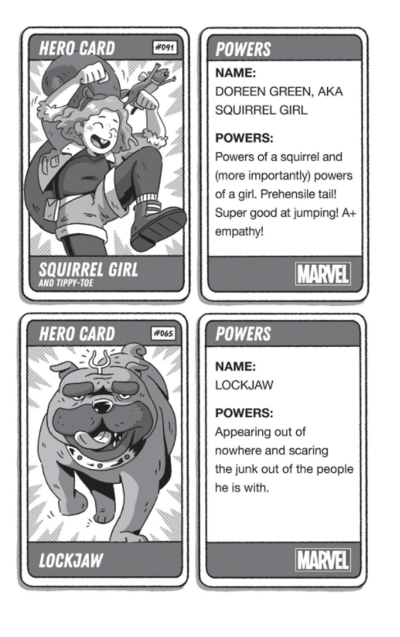

Slide 23
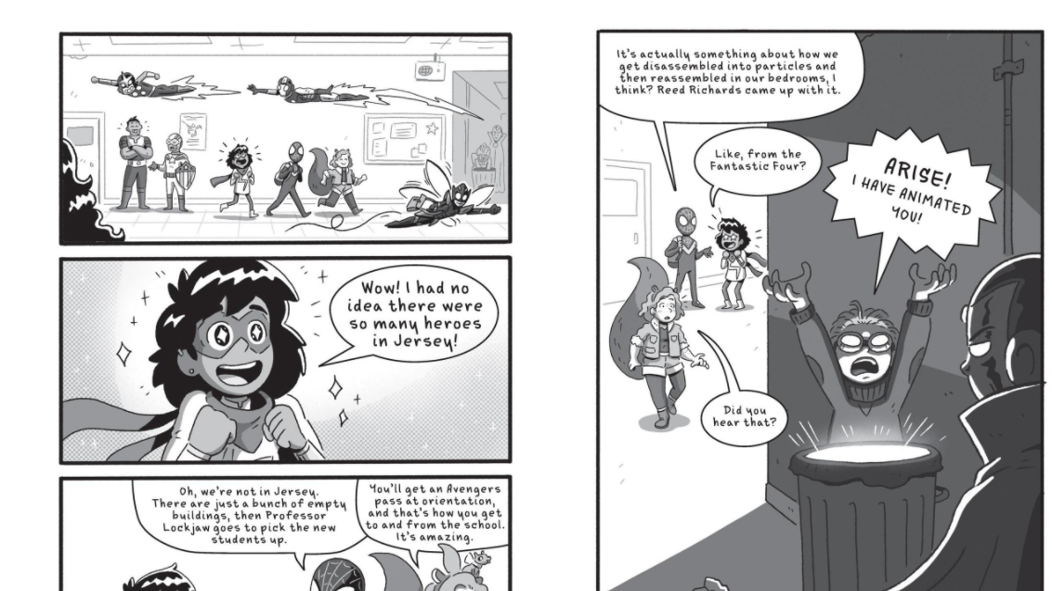

Slide 24
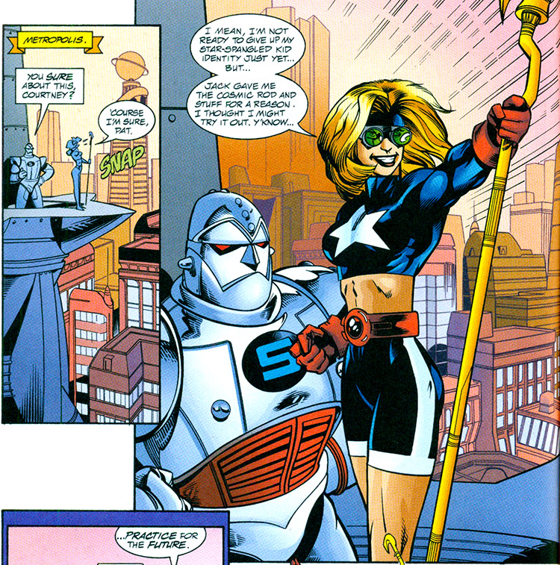
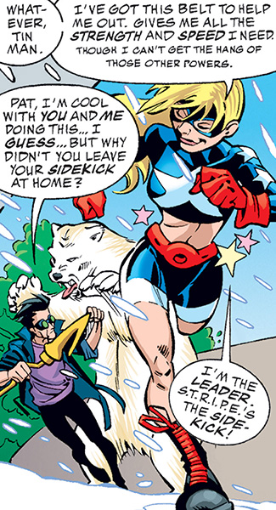
Hero tests new powers

Slide 25
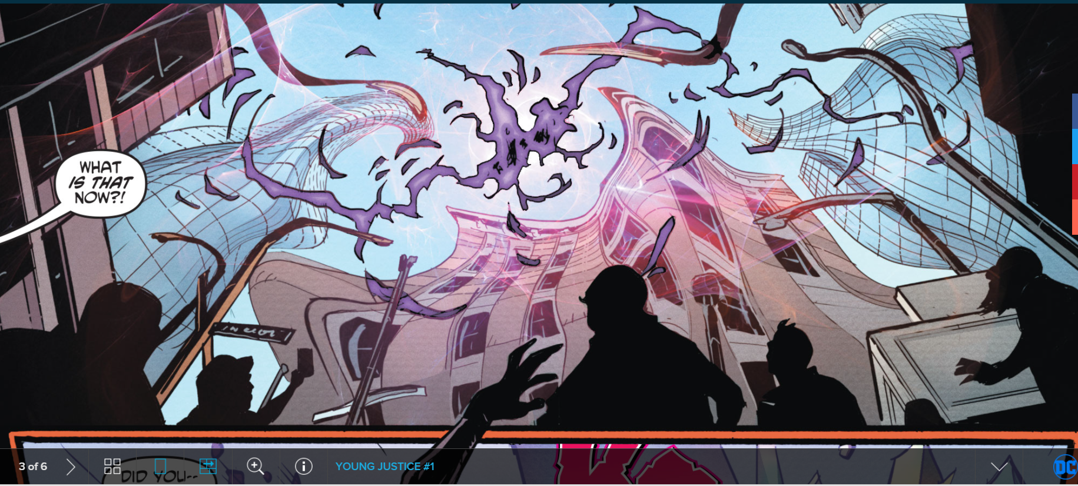
Real scary unknown villain appears

Slide 26
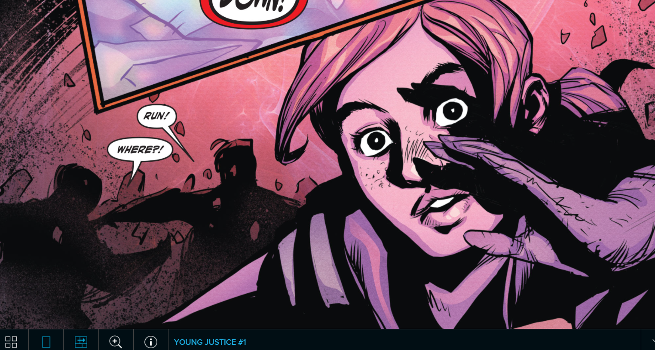

Slide 27
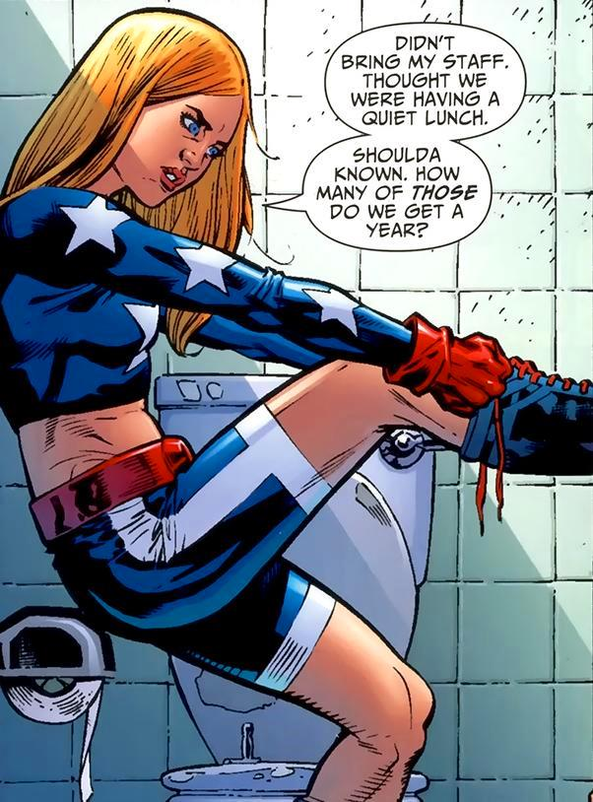
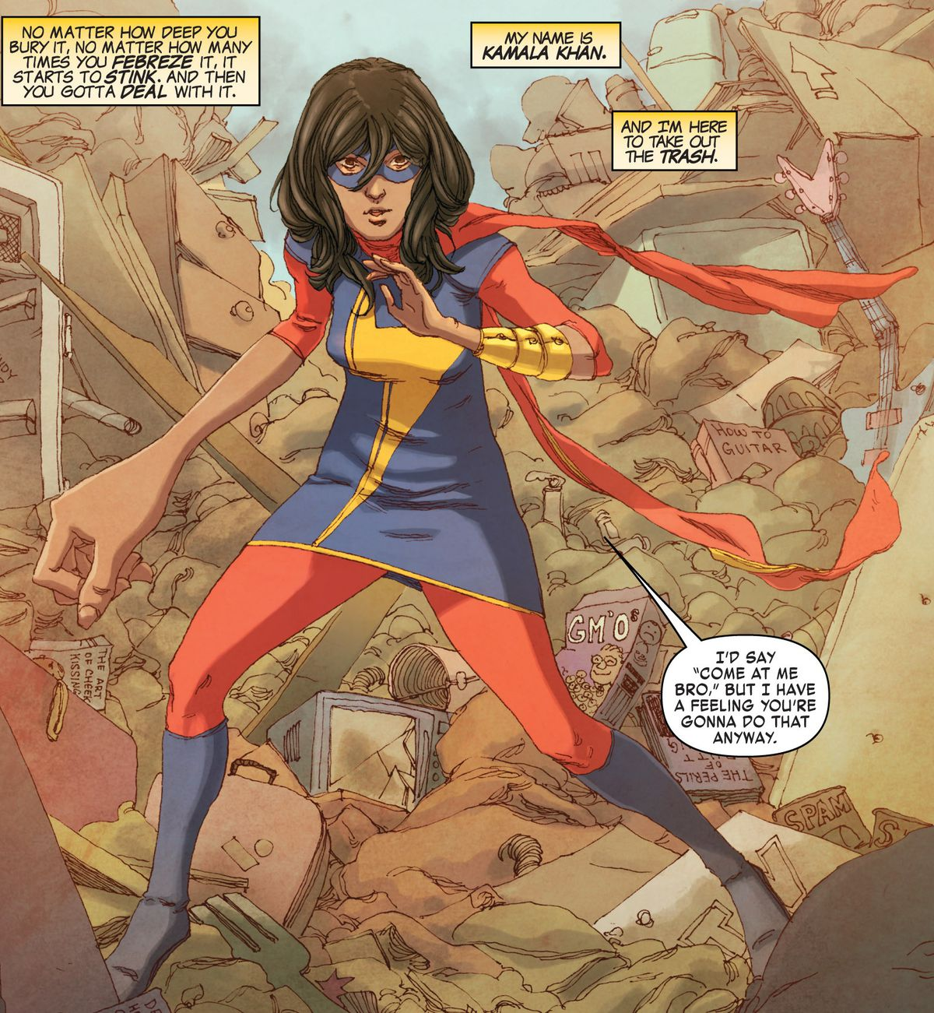
After practice, hero becomes more confident

Slide 28
references

Slide 29
references
Free comic strip printables
Images from Star Girl comics (DC) and Ms. Marvel comics (MARVEL.
Screenshots of “Young Justice”
Echo featurette from MARVE/Disney+ series Hawkeye

