Slide 1

WELCOME BACK, CLASS!
Project #5 - Intro
3/30/2022

Slide 2

WARM-UP EXERCISE: Draw 2 objects that you may find within a city...

Slide 3
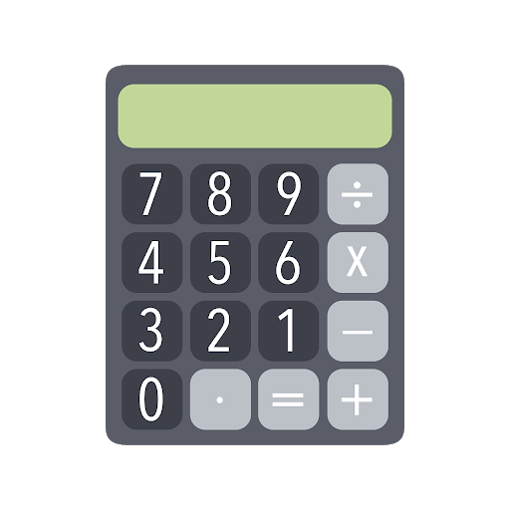

What are we going to be doing? Connecting art & math!

Slide 4
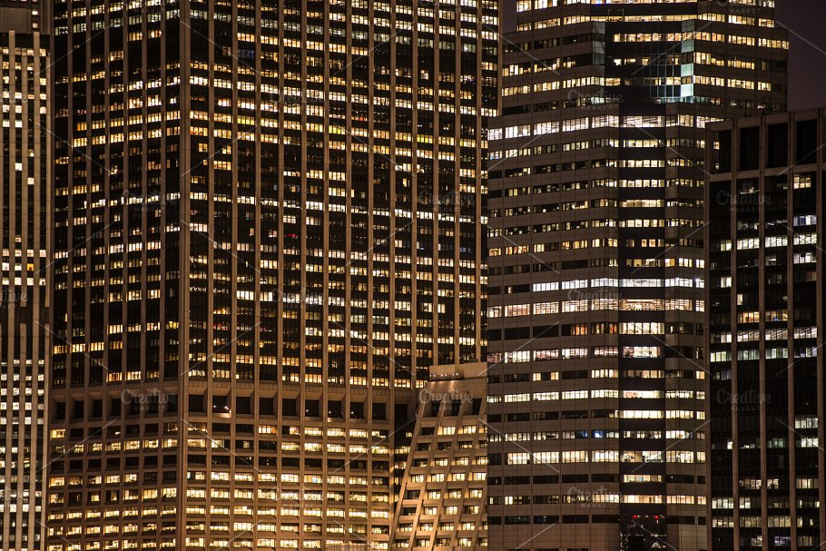
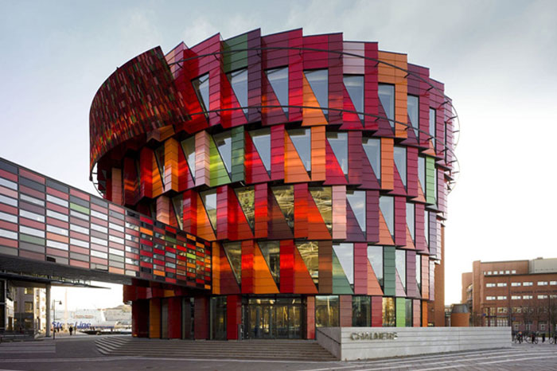
LESSON BACKGROUND: Art in Architecture!

Slide 5

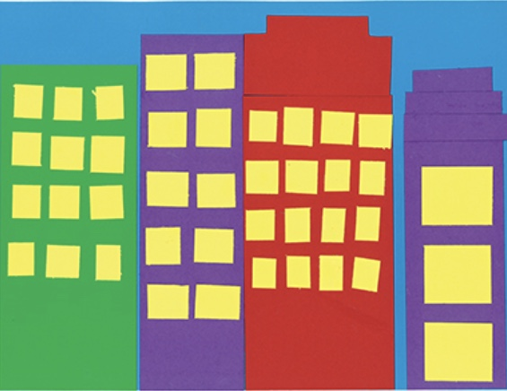
City of Perimeters & Shapes: Examples

Slide 6
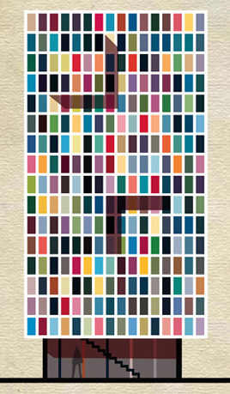
LESSON VOCAB: Art in Architecture, Part 1
Perimeter – The distance around the edge of a shape.
Area - The amount of space taken up by a 2D shape. Usually measured by square units.
Array - An arrangement of objects, pictures, or numbers in rows and columns is called an array. Arrays are useful representations of multiplication.
Geometry – Deals with shapes and figures. It explains how to build or draw shapes, measure them, and compare them.
City Blocks - The space for buildings within the street pattern of a city. They’re like the quilt squares of a city!
Building Stories - Any level part of a building with a floor that could be used by people

Slide 7
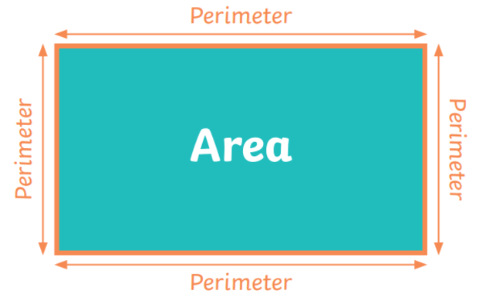
Perimeter & Area Example:

Slide 8
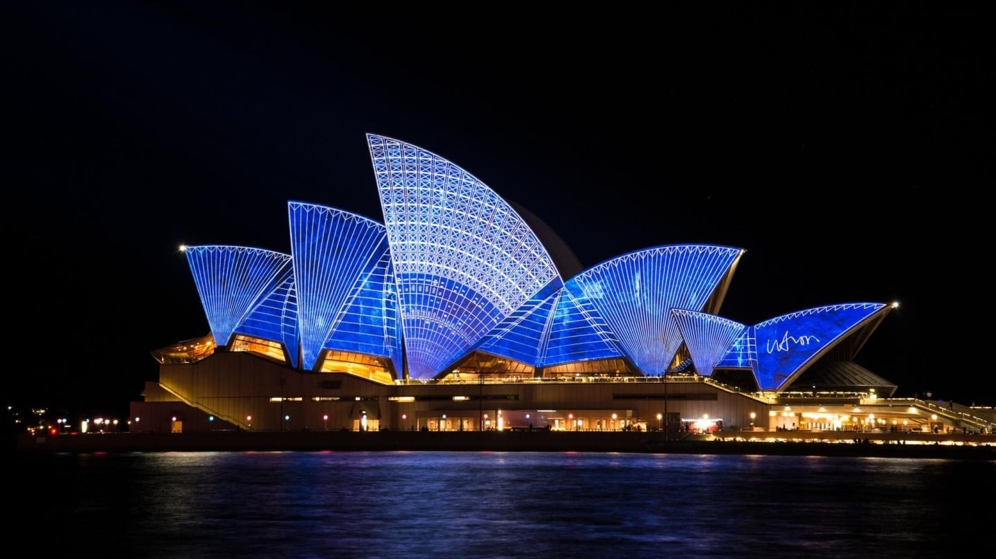
Architecture around the world

Slide 9
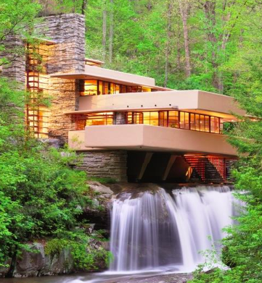
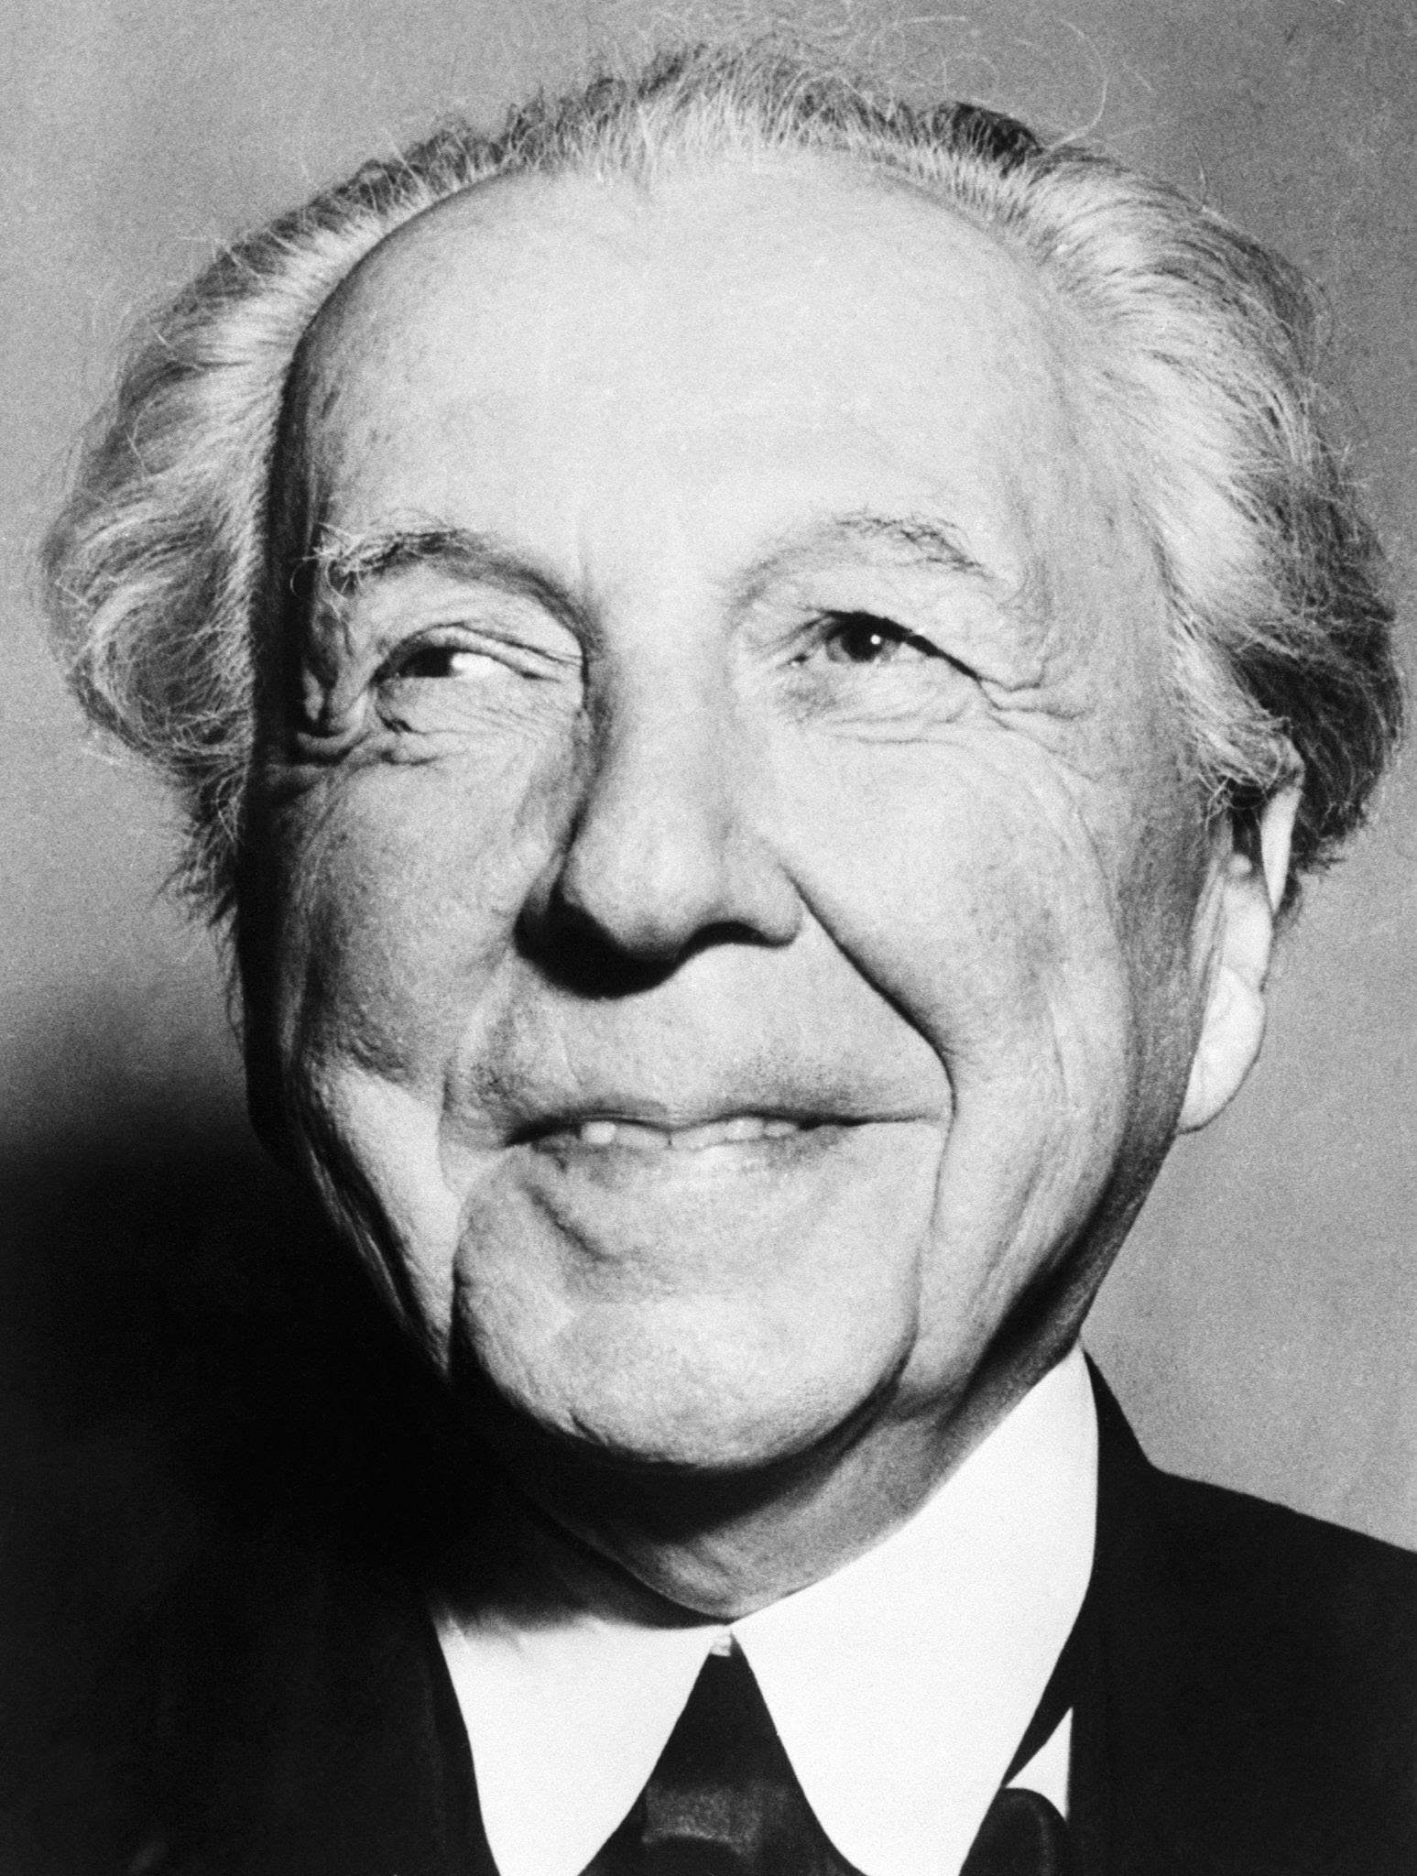
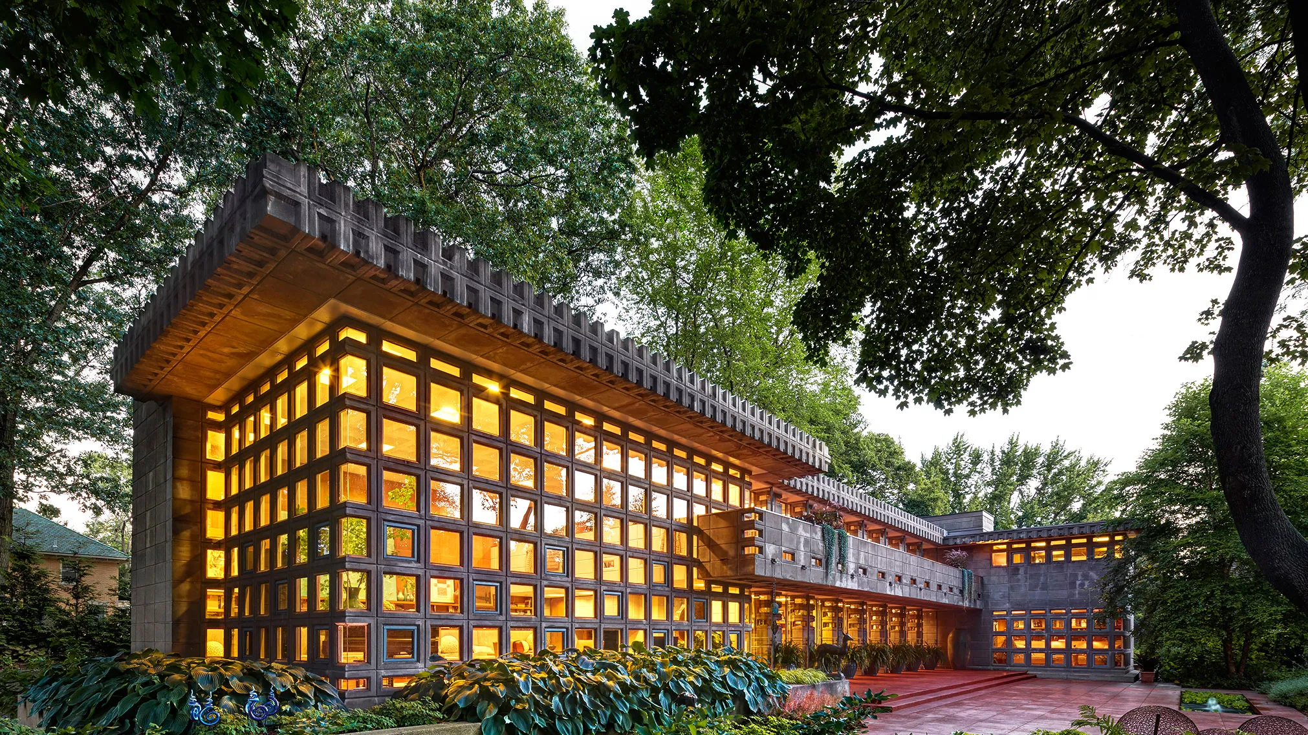
Architecture in art history: Frank Lloyd Wright (1867 - 1959)
https://www.youtube.com/watch?v=bC9ipWcYnQc

Slide 10
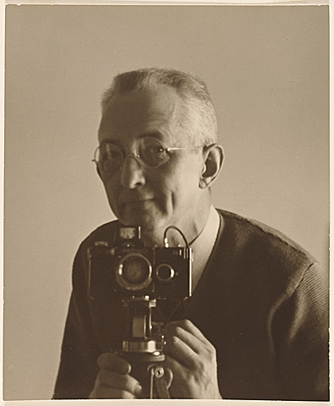
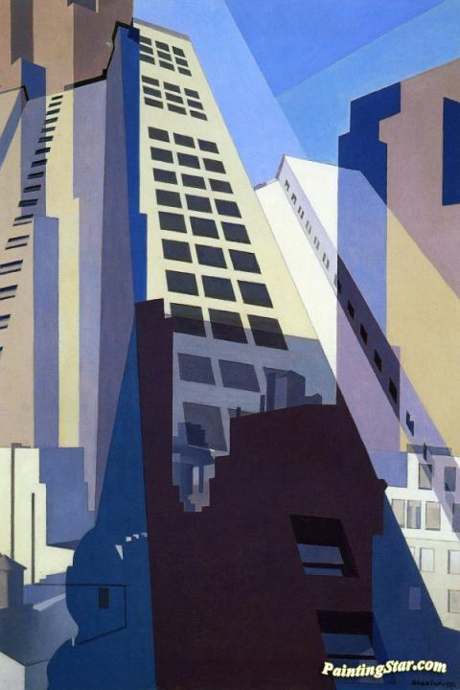
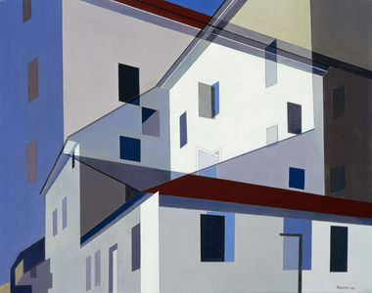
Architecture in art history: Charles Sheeler (1883 - 1965)

Slide 11
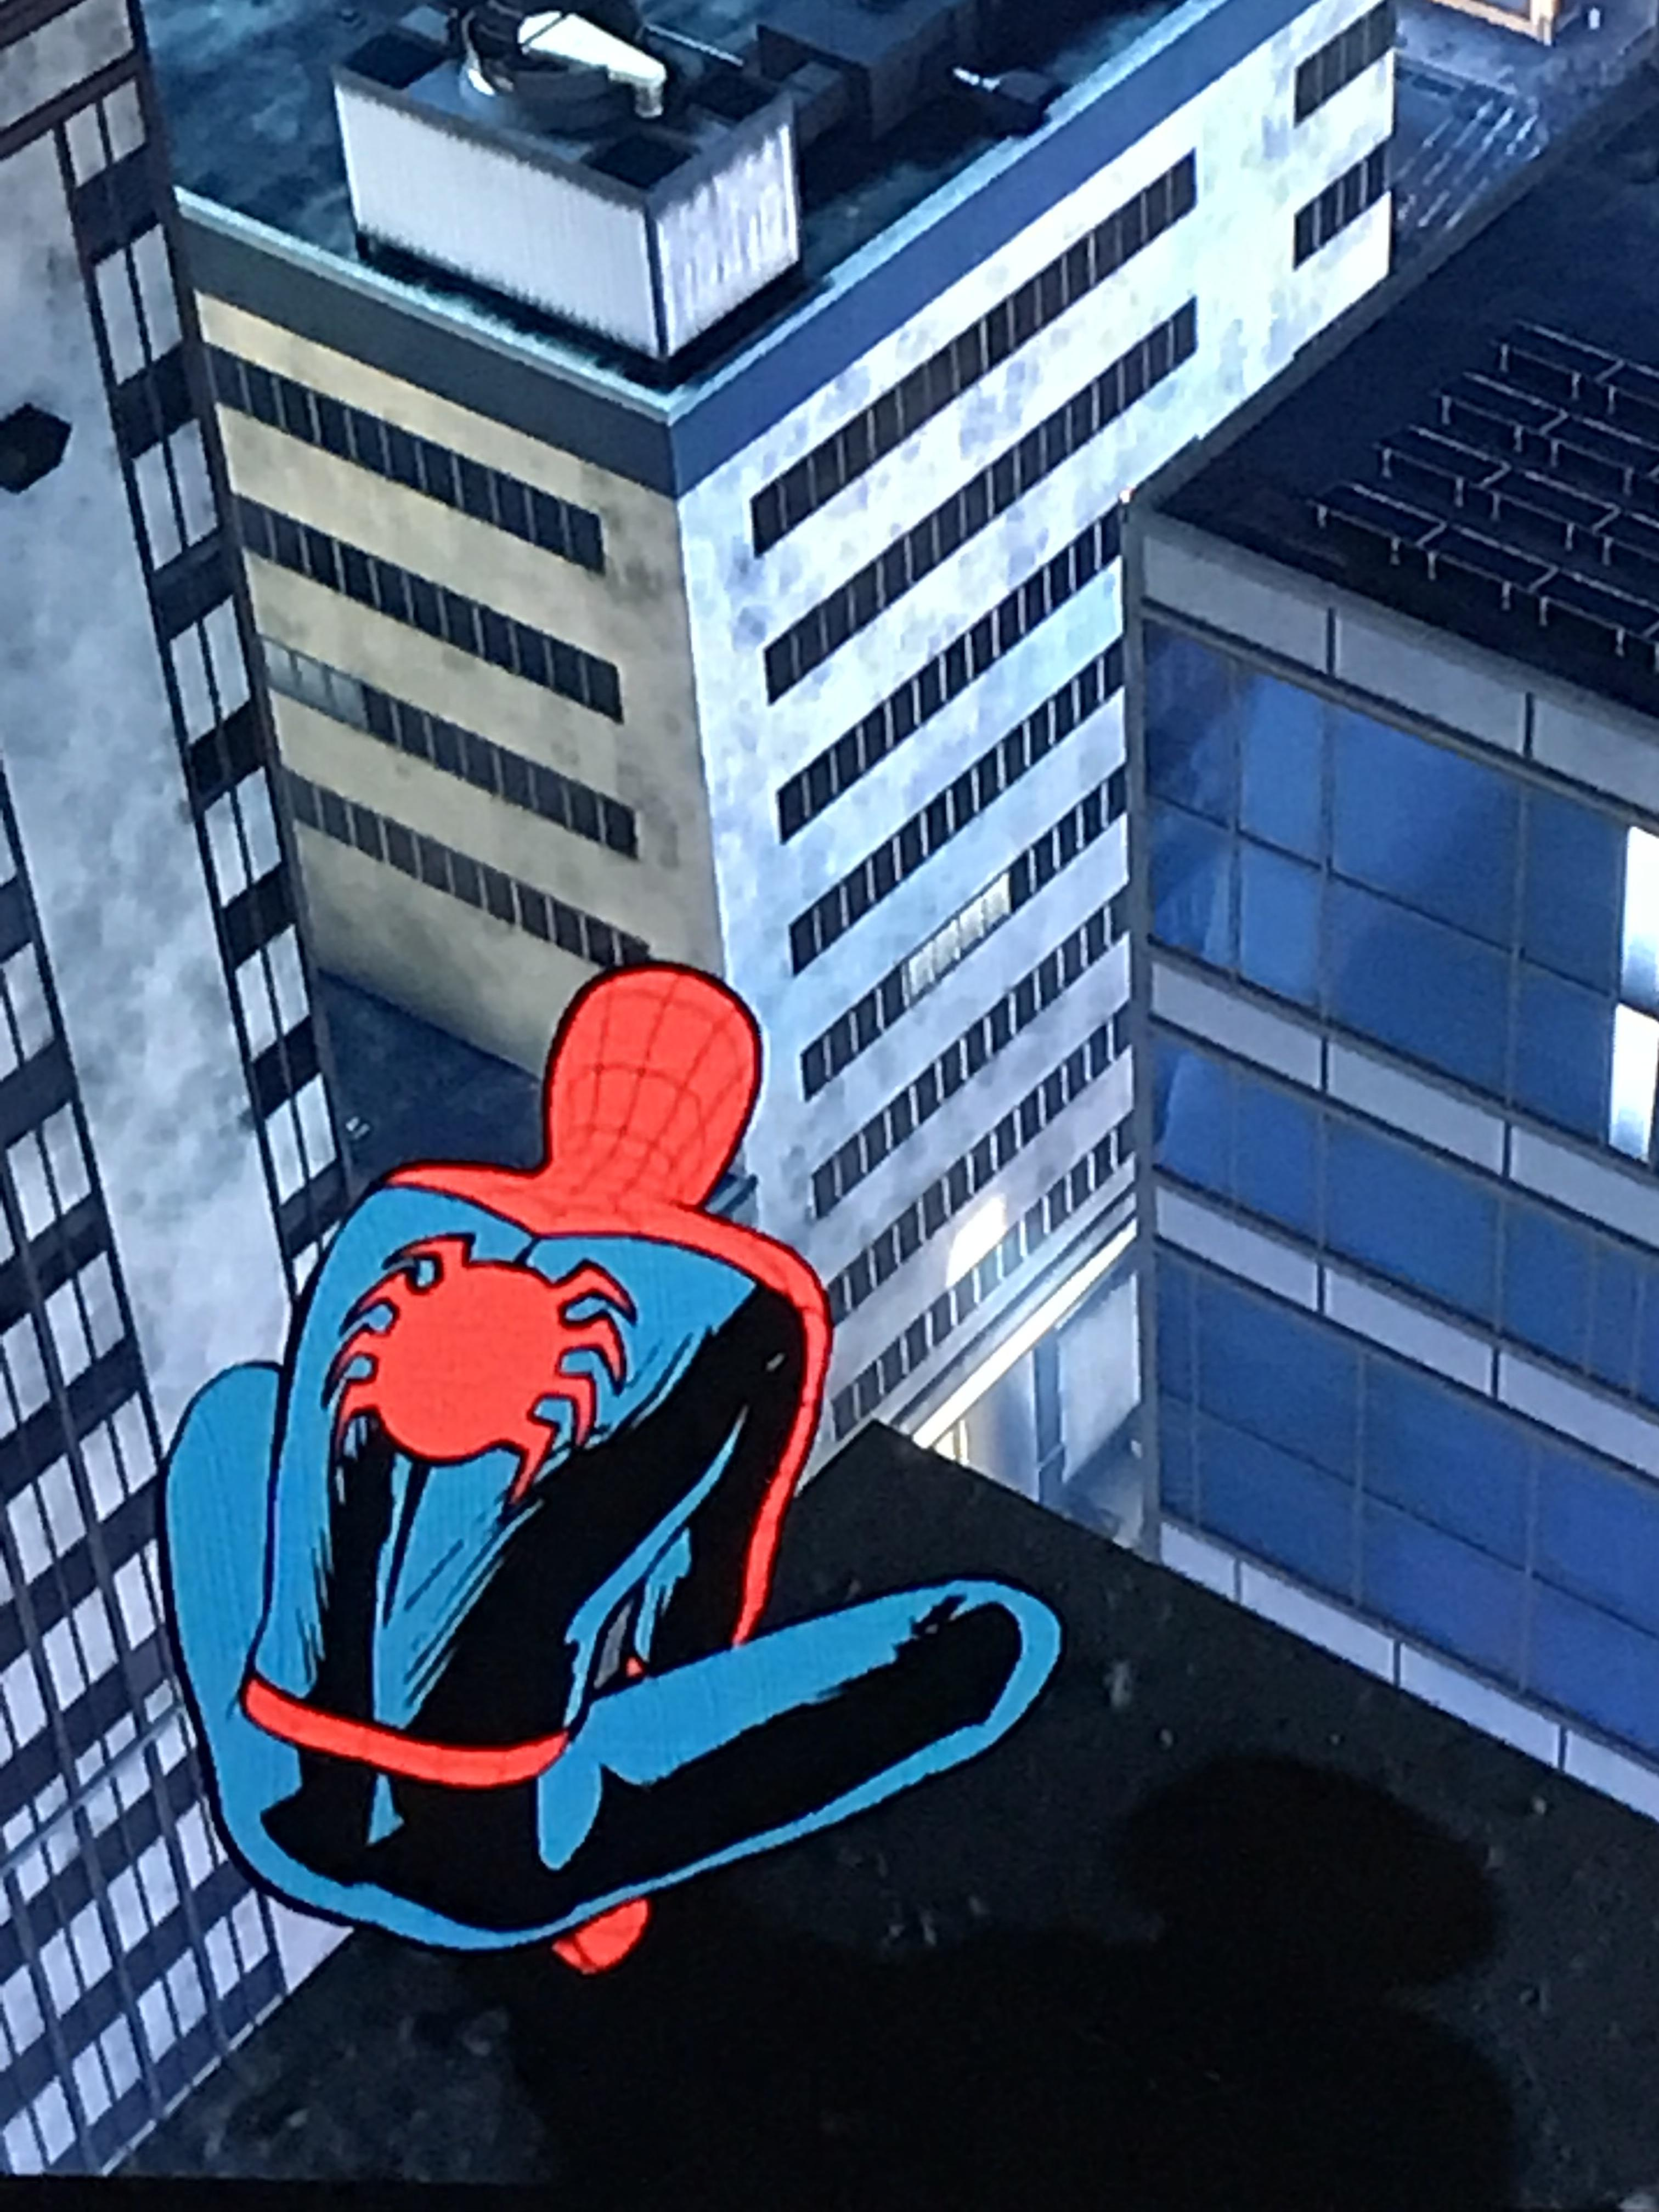
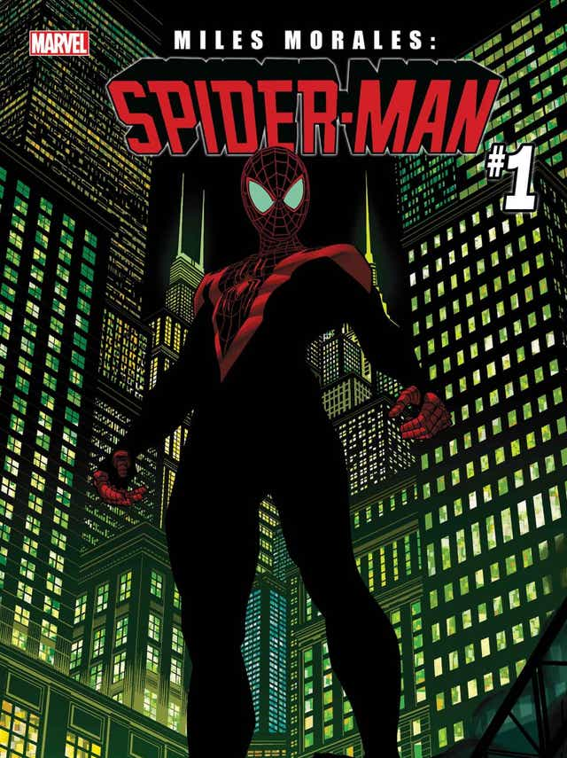

Architecture in popular culture: Spiderman
https://www.youtube.com/watch?v=Y0eFPON4BKQ

Slide 12

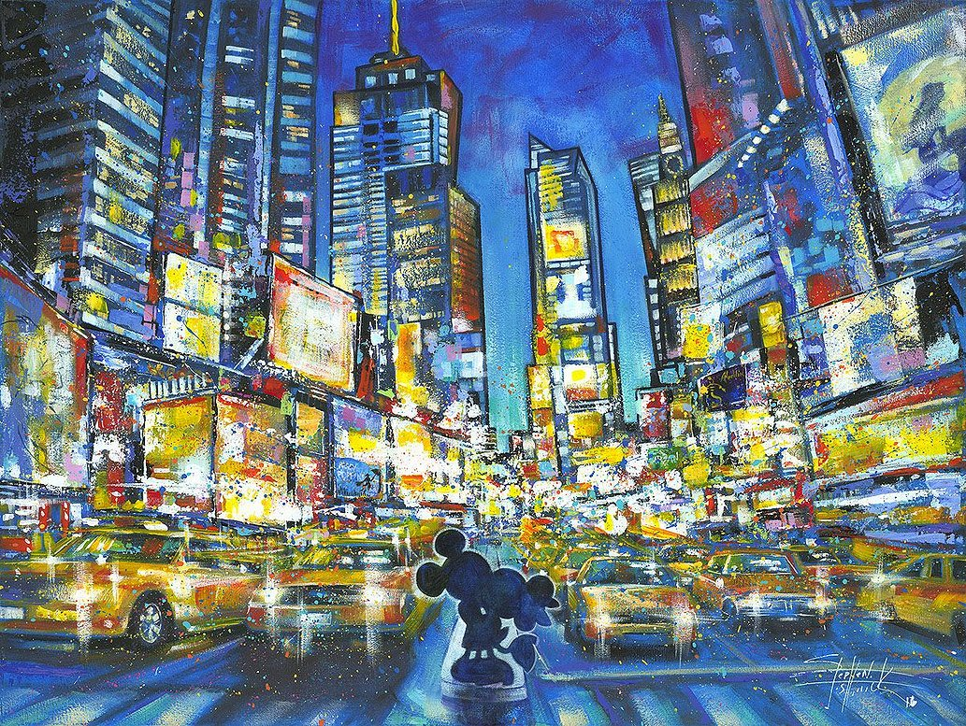
What can we imagine in a fictional city?

Slide 13


What can we imagine in a fictional city?

Slide 14
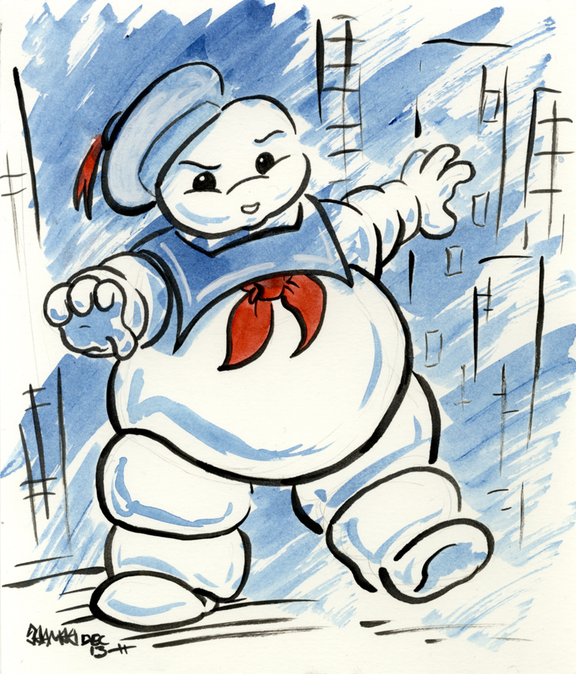
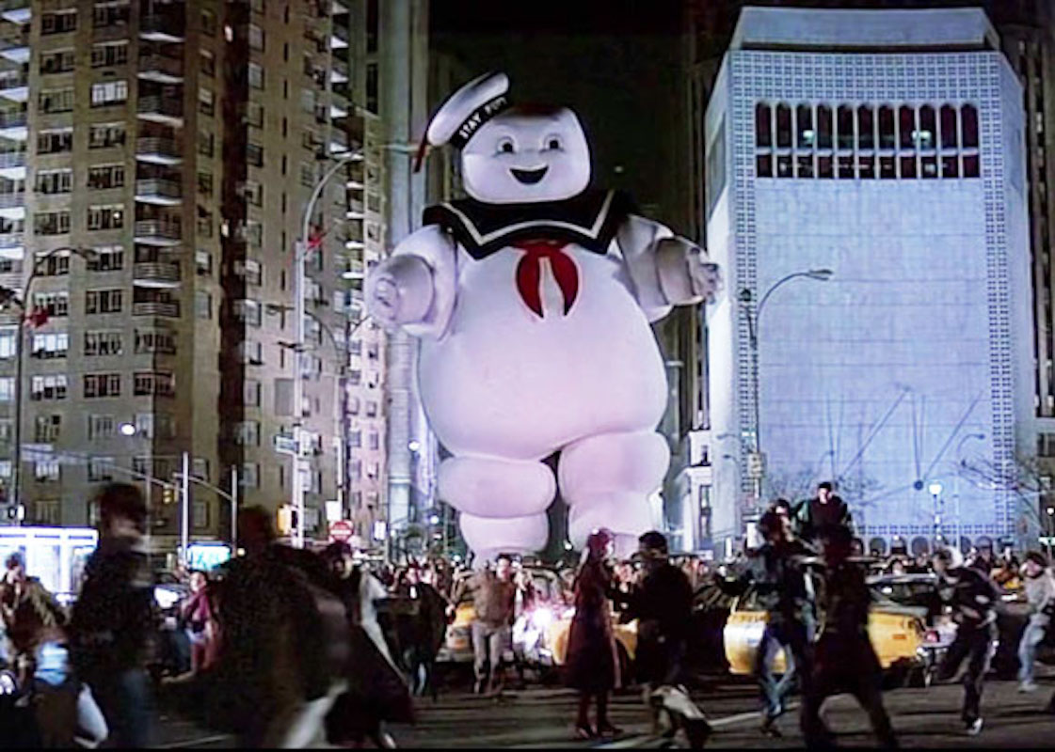
What can we imagine in a fictional city?

Slide 15
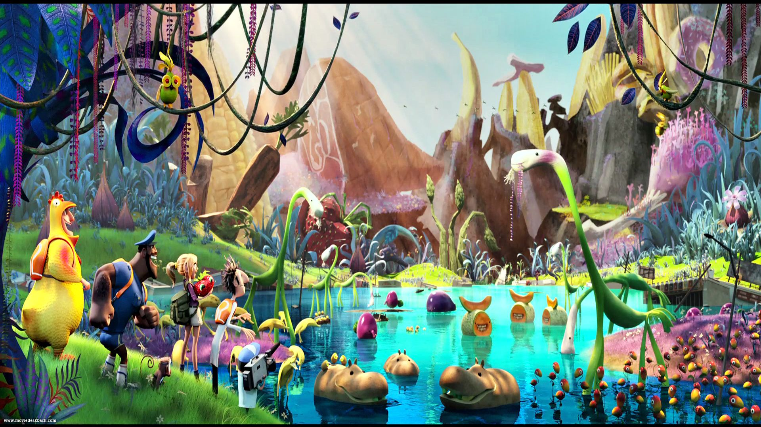
What can we imagine in a fictional city?
https://www.youtube.com/watch?v=xAkmG6uqBd4

Slide 16

CLOSURE
What did we accomplish with our project?
What did we learn about architecture in art?
How did we connect art & math today?

Slide 17

SEE YOU NEXT TIME!

