Slide 1

Welcome, Class!
Project #1 – Intro
Meeting #1
10/27/2021

Slide 2

My name is Olivia Oddo & I’m a teaching artist!
BA in Studio Art.
MFA in Painting.
Certificate in Art Therapy.
Enjoys painting, drawing, and printmaking.
Lives in Waynesburg, PA.
Has a dog named Reese and a chameleon named Huey.

Slide 3
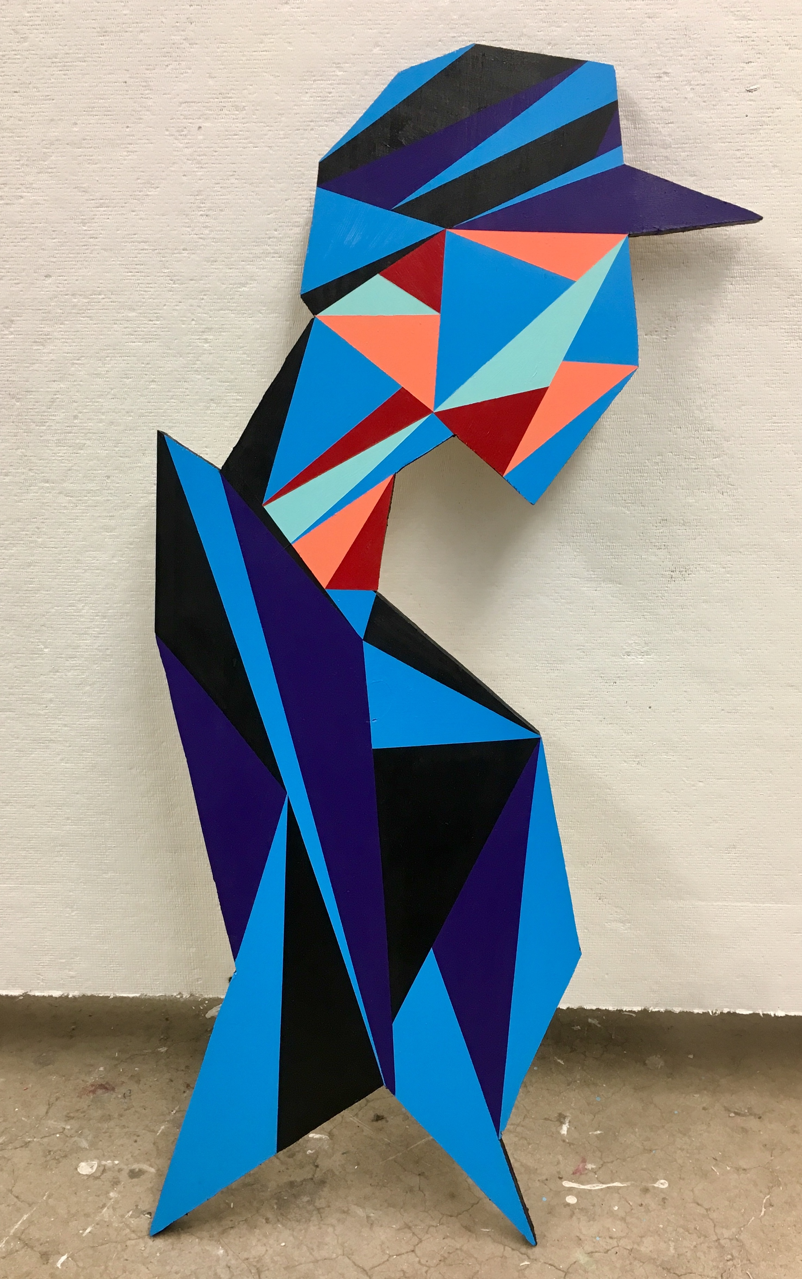
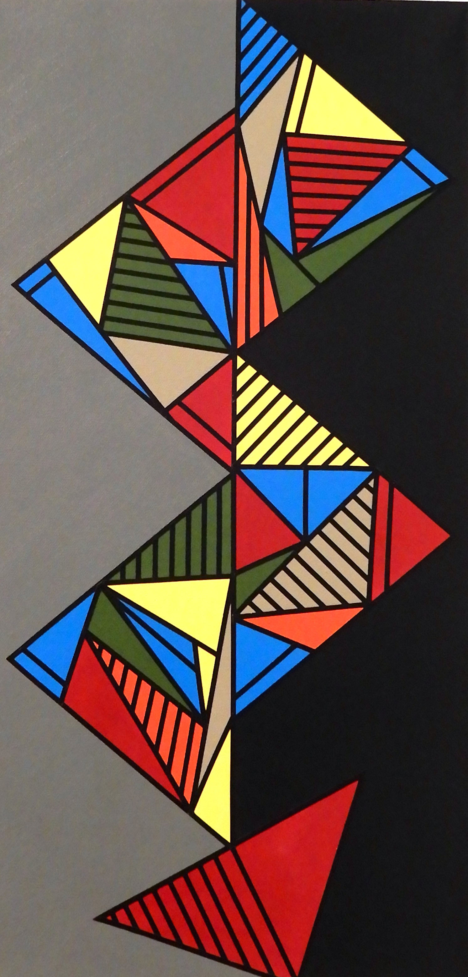
Examples of my work

Slide 4
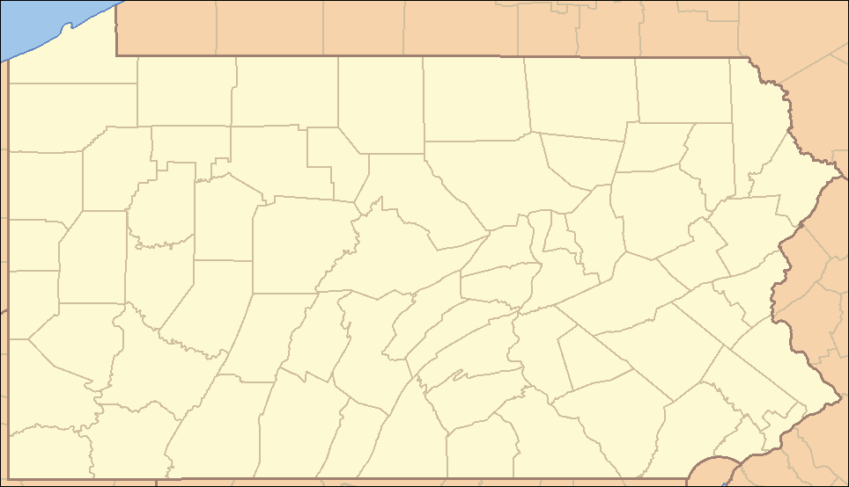
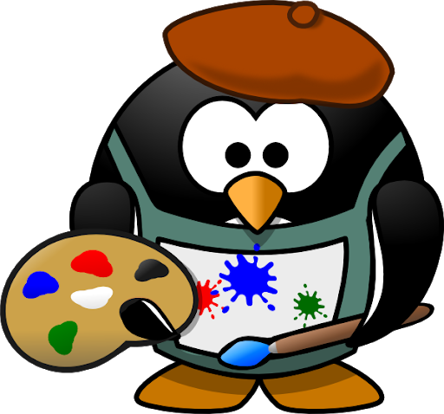

Slide 5


Materials: gather these items for today!

Slide 6

Warm-up exercise: Draw a quick doodle of something that relates to each emoji icon! ☺

Slide 7

Warm-up exercise: .... the hot emoji

Slide 8

Warm-up exercise: .... the cold emoji

Slide 9
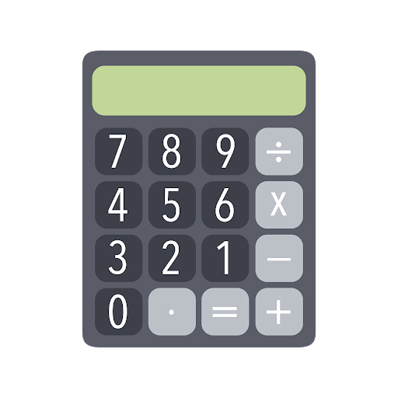

What are we going to be doing? Connecting Art & math!

Slide 10


What do you know about cubist art?

Slide 11



Lesson Background: cubist art
https://www.youtube.com/watch?v=j-v9DEOMYOQ

Slide 12
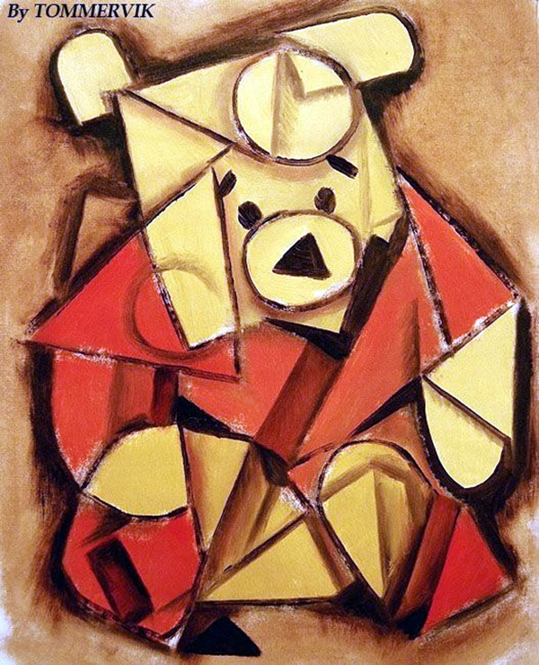
Lesson Vocabulary for cubist art
Difference – The remaining amount of an object after subtracting one from another.
Average – How many of an object are in a set.
Cubism – Art that includes shapes and lines to create a collaged picture.
Picture Plane – The drawing surface of a picture that goes up and down, left to right.

Slide 13
Lesson Vocabulary for Multiplication & Division
Product – The answer to a multiplication sentence.
Factor – The number being multiplied.
Commutative Property – The order if the factors in a multiplication sentence does not change the product.
Identity Property – Any number multiplies by one has a product of that number.

Slide 14

Cubist art in history: Piet Mondrian (1872-1944)
https://www.youtube.com/watch?v=iSCmWnIoRpI

Slide 15
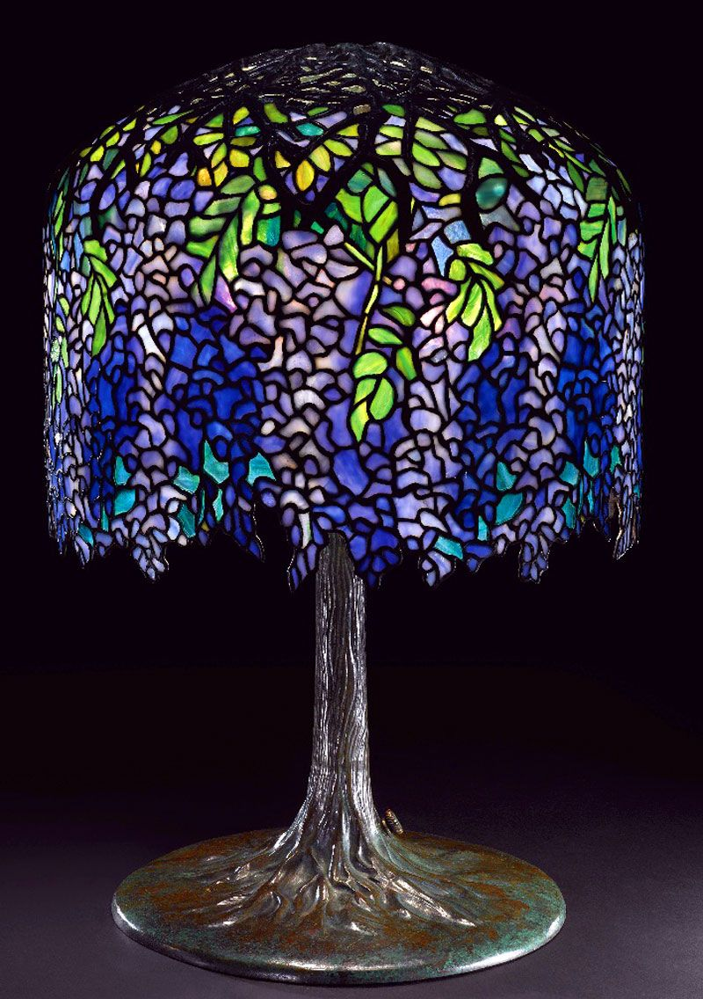
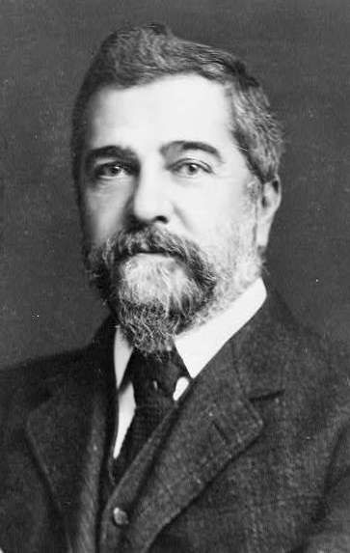
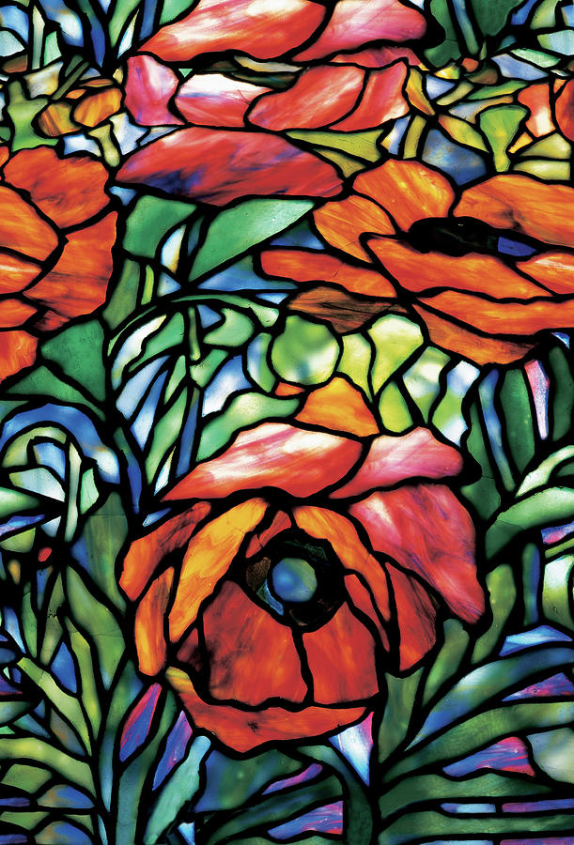
Cubist art in history: louis tiffany (1848-1933)

Slide 16

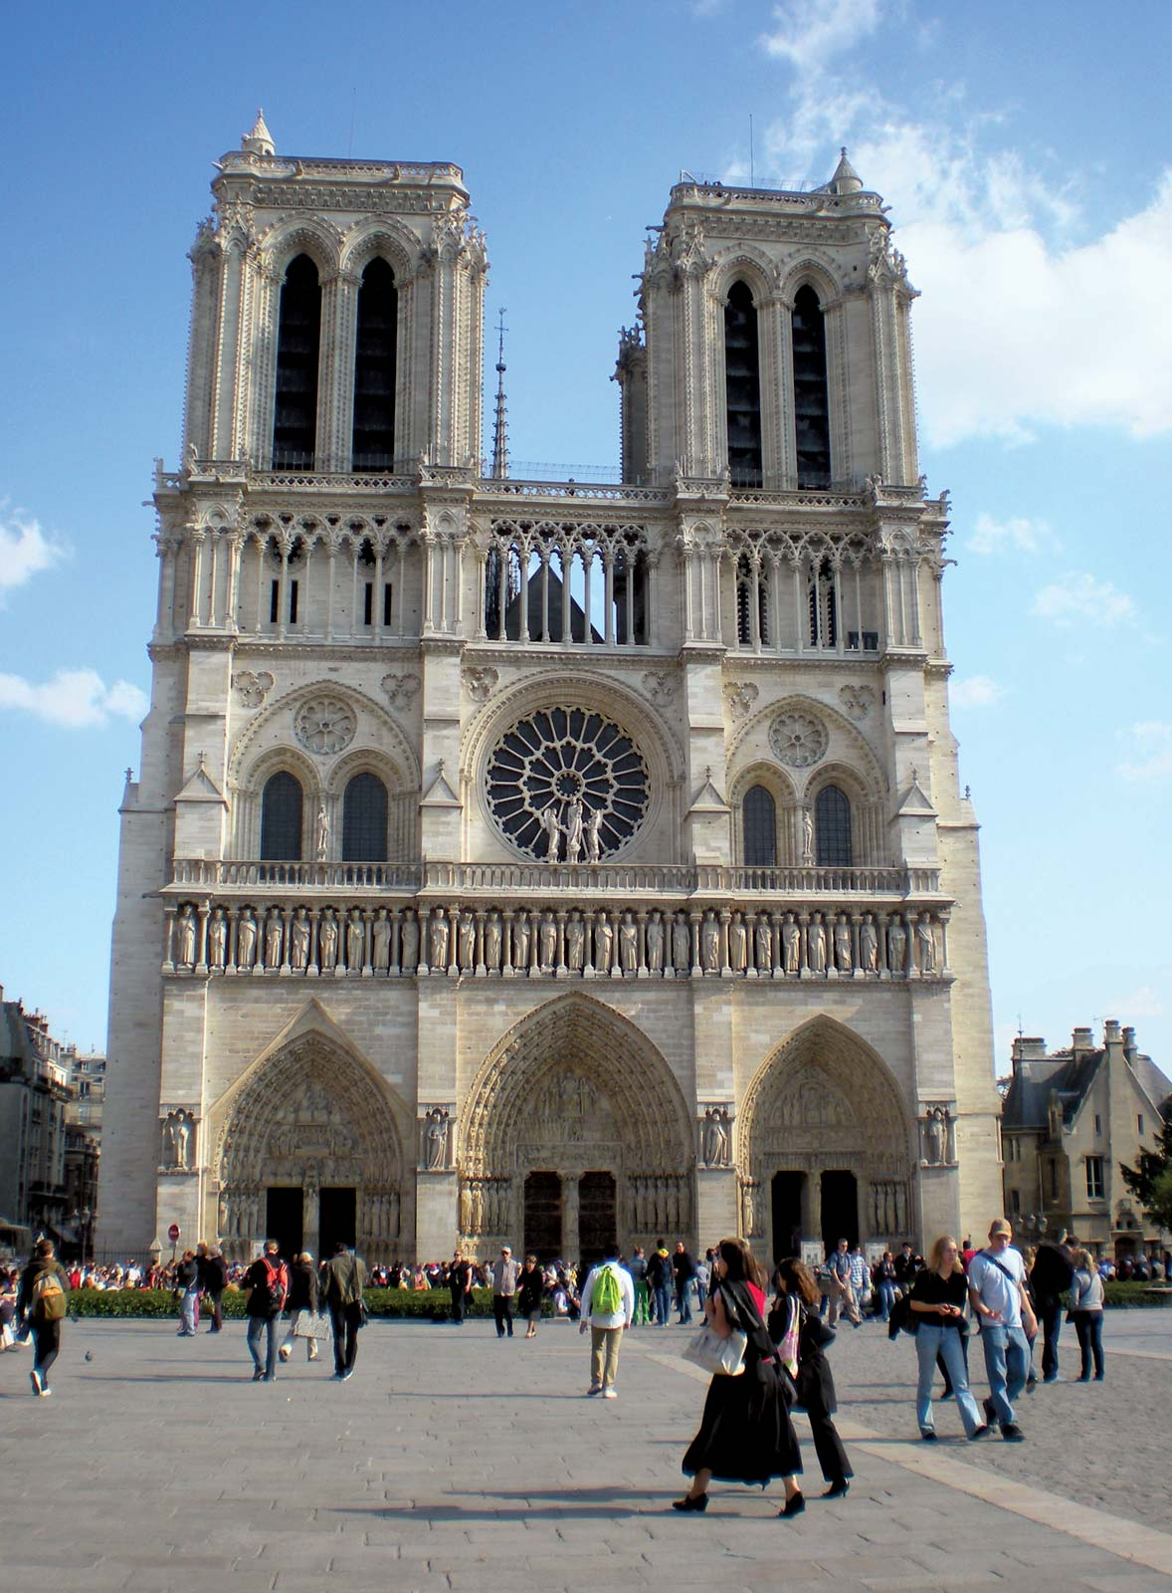
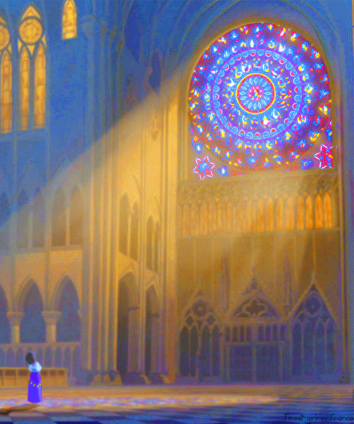
Cubist art around the world since 675 AD
https://www.youtube.com/watch?v=LK7S32JIaFU

Slide 17


Slide 18

closure
What did we accomplish with our project?
What did we learn about cubist art?
How did we connect art & math today?

Slide 19
Extension art activities
http://weavesilk.com
https://www.mathplayground.com/index_geometry.html
https://www.sheppardsoftware.com/mathgames/menus/geometry.htm
http://www.colorwithleo.com/artstudio.php?PHPSESSID=46aae1ddc70aa2b00571af541ea33790
https://lol.disney.com/games/coloring-pages

Slide 20

See you next time!

