Slide 1
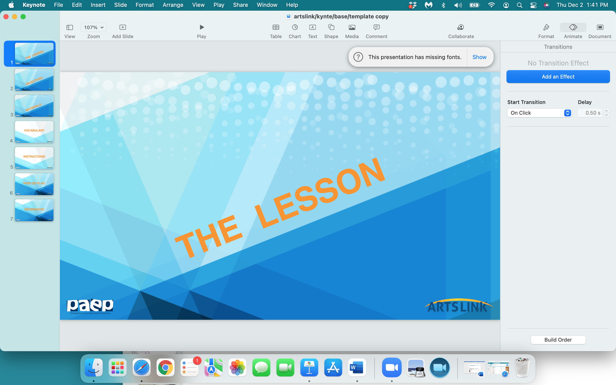

Slide 2
Duck
Truck
& Stuck

Slide 3
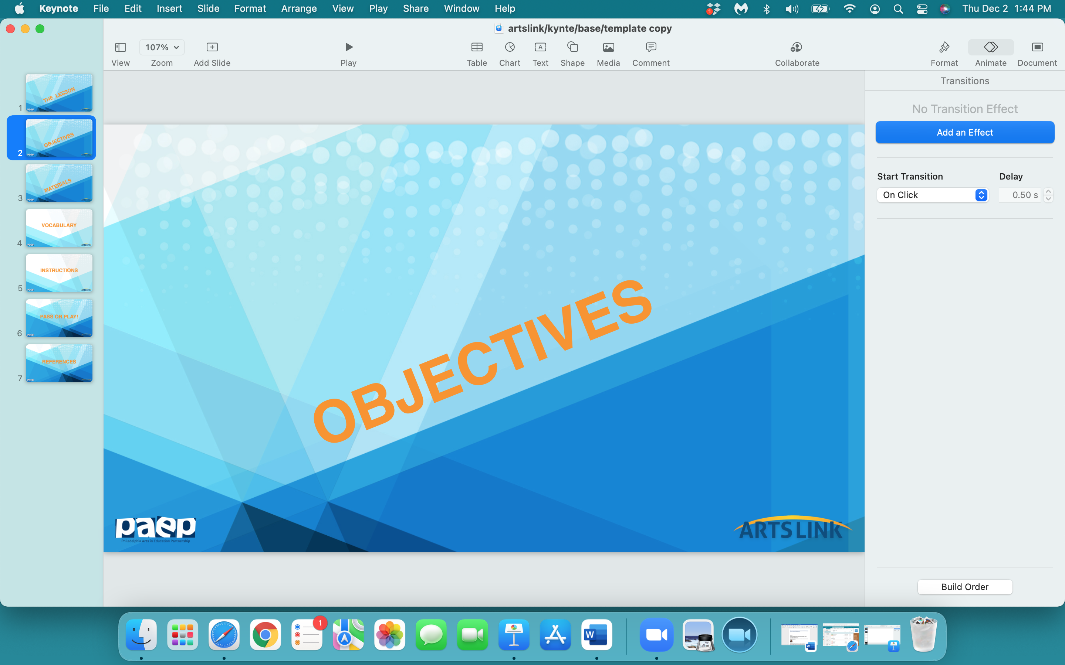

Slide 4
In the next hour, we will:
interpret a children’s book text to design and draw a special ‘fix - it - truck’
look at 4 different vehicles - a truck, a gas tanker, a submarine, a helicopter
design a truck that performs all of the 4 special ‘functions’ of the above vehicles

Slide 5
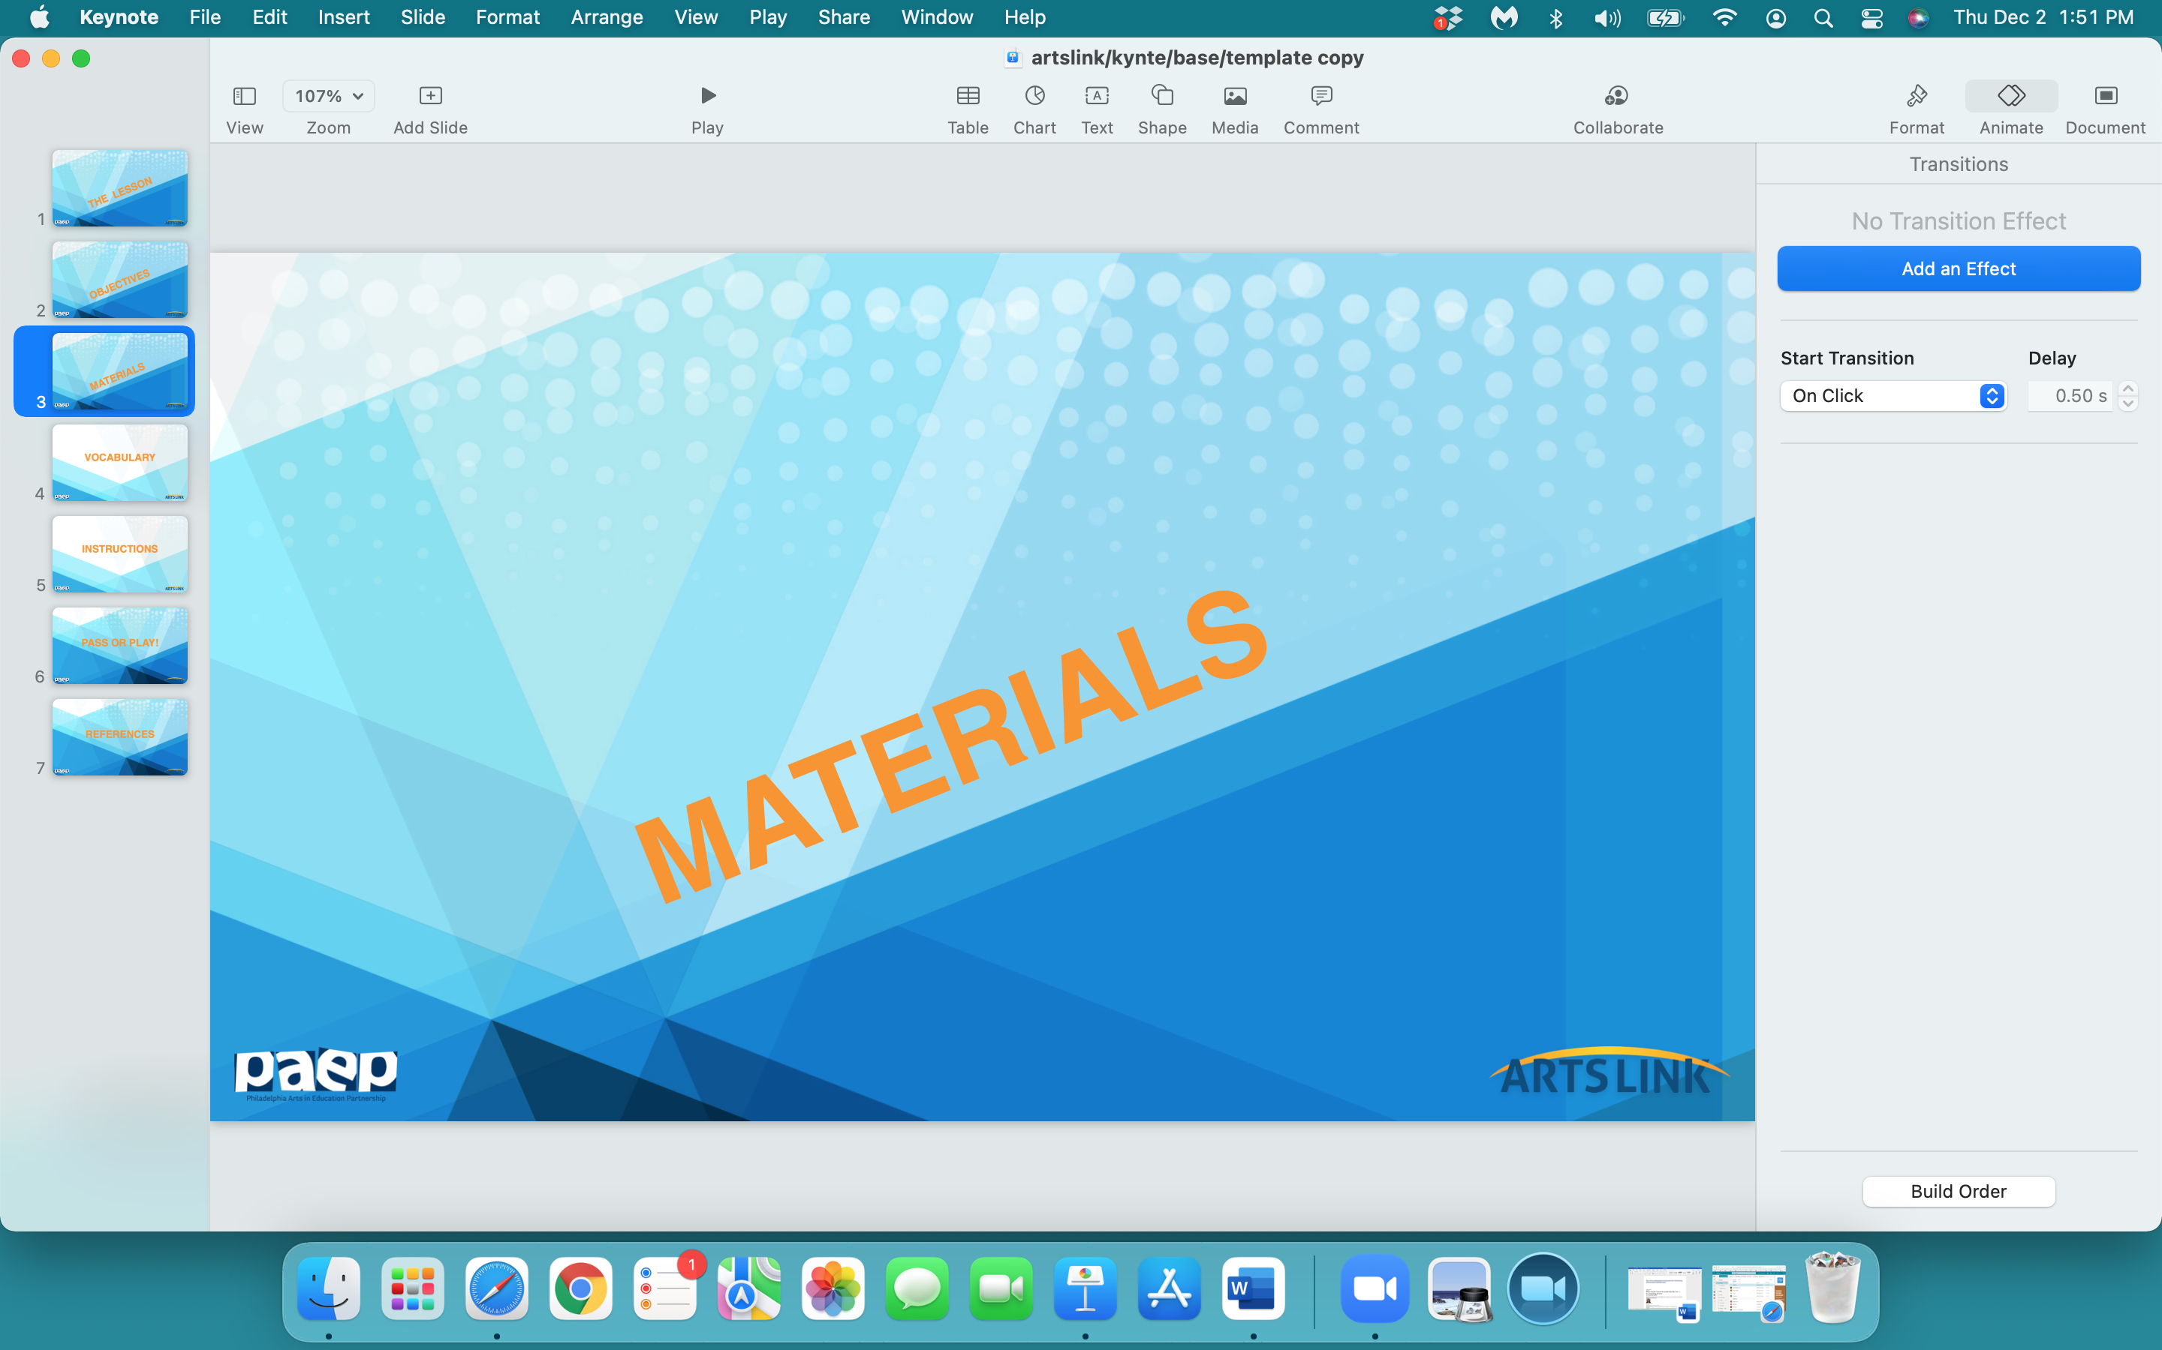

Slide 6
notebook
any white paper
pencil
eraser
scissors
fasteners
black marker
glue stick

Slide 7
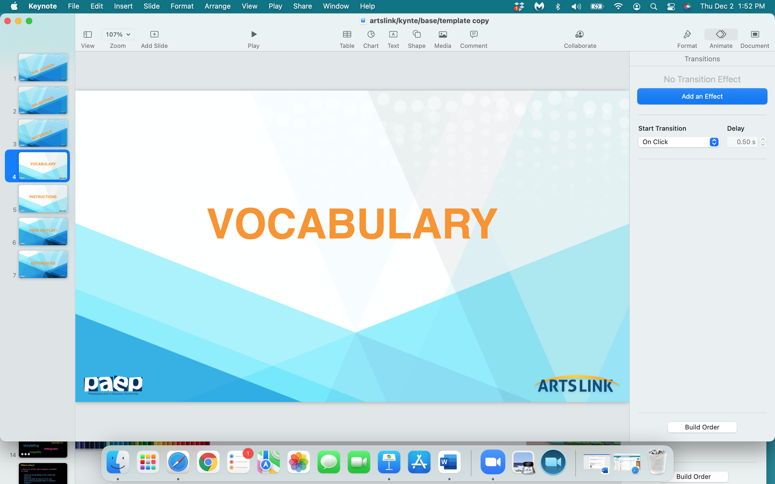

Slide 8
articulated: having two or more sections, connected by a flexible joint
transformation: a dramatic change in form
chapter book: a story book for readers around 7 – 10 years of age
function: purpose

Slide 9
duck
truck
stuck

Slide 10
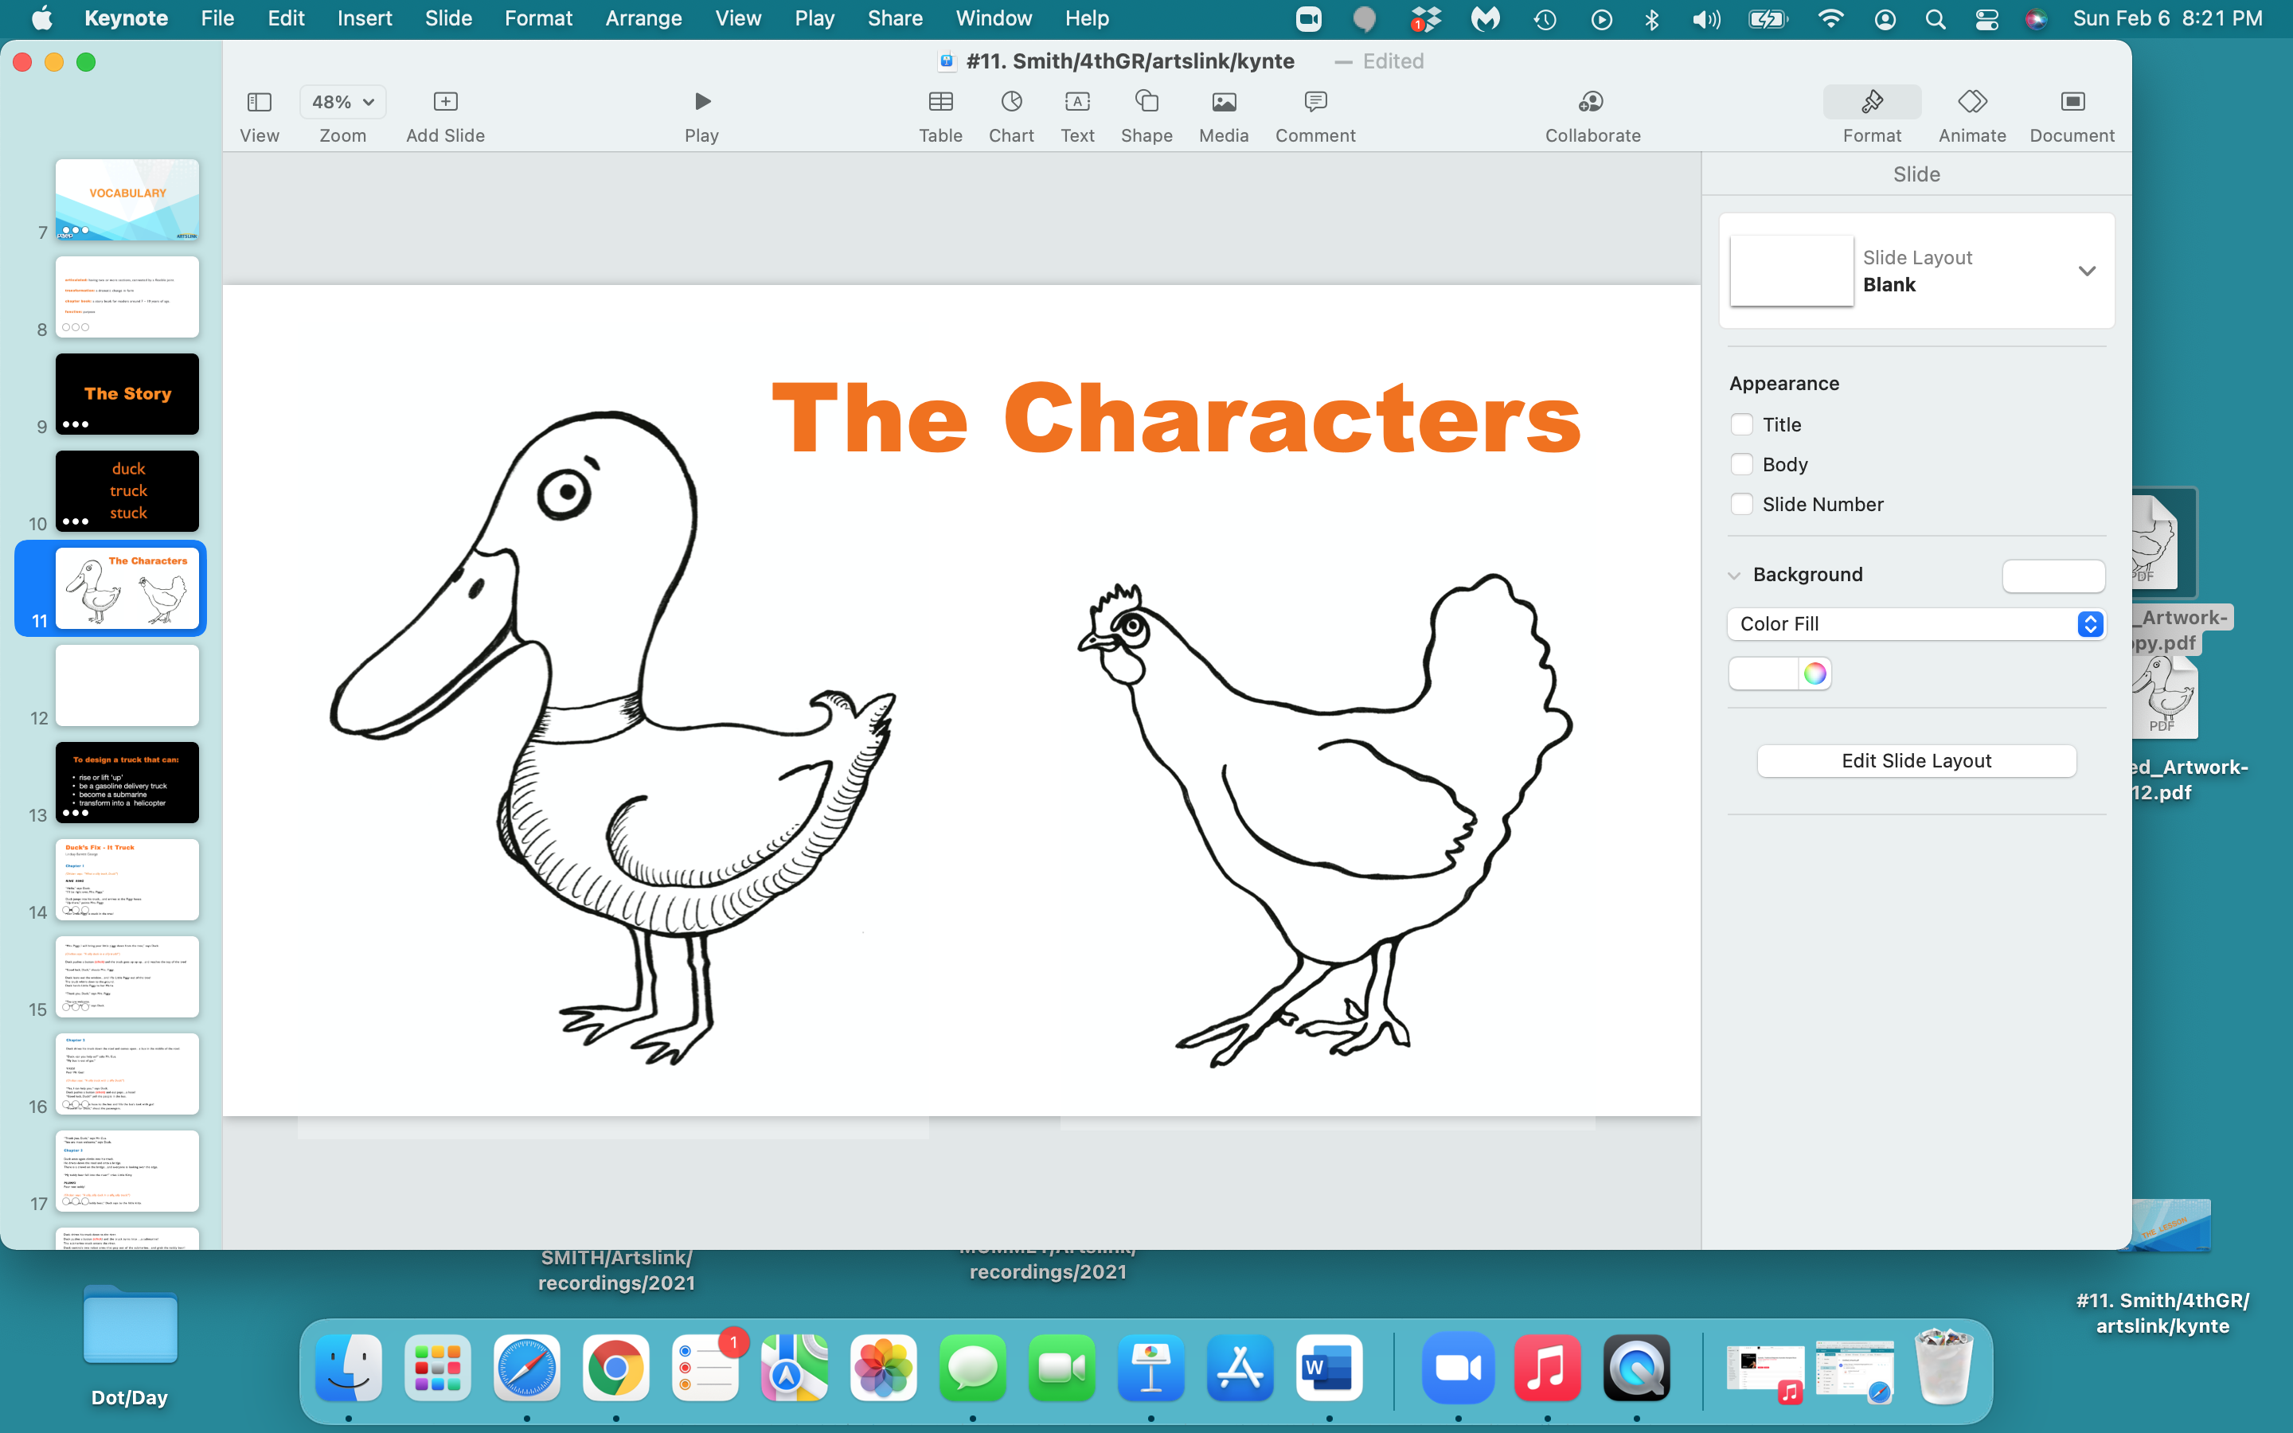

Slide 11
The Story

Slide 12
Duck’s Fix - It Truck
Lindsay Barrett George
Chapter 1
(Chicken says: “What a silly truck, Duck!”)
RING RING
“Hello,” says Duck.
“I’ll be right over, Mrs. Piggy.”
Duck jumps into his truck…and arrives at the Piggy house.
“Up there,” points Mrs. Piggy.
OINK!
Poor Little Piggy is stuck in the tree!

Slide 13
“Mrs. Piggy, I will bring your little piggy down from the tree,” says Duck.
(Chicken says: “A silly duck in a silly truck!”)
Duck pushes a button (click) and the truck goes up up up…and reaches the top of the tree!
“Good luck, Duck,” shouts Mrs. Piggy.
Duck leans out the window…and lifts Little Piggy out of the tree!
The truck whirrs down to the ground.
Duck hands Little Piggy to her Mama.
“Thank you, Duck,” says Mrs. Piggy.
“You are welcome.
Good-bye, Piggies,” says Duck.

Slide 14
Chapter 2
Duck drives his truck down the road and comes upon…a bus in the middle of the road.
“Duck, can you help us?” asks Mr. Gus.
“We are stuck.
My bus is out of gas.”
YIKES!
Poor Mr. Gus!
(Chicken says: “A silly truck with a silly Duck!”)
“Yes, I can help you,“ says Duck.
Duck pushes a button (click) and out pops…a hose!
“Good luck, Duck!” yell the people in the bus.
Duck connects the hose to the fuel tank and fills it with gas!
“Hoorah for Duck,” shout the passengers.

Slide 15
“Thank you, Duck,” says Mr. Gus.
“You are most welcome,” says Duck.
Chapter 3
Duck once again climbs into his truck.
He drives down the road and onto a bridge.
There is a crowd on the bridge…and everyone is looking over the edge.
“My teddy bear fell into the river” cries Little Kitty,
“and she’s stuck in the muck!”
PLUNK!
Poor wet teddy!
(Chicken says: “A silly, silly duck in a silly, silly truck!”)
“I will rescue your teddy bear,” Duck says to the little kitty.

Slide 16
Duck drives his truck down to the river.
Duck pushes a button (click) and the truck turns into …a submarine!
The submarine-truck enters the river.
Duck controls two robot arms that pop out of the submarine…and they grab the teddy bear!
“Thank you, Mr. Duck,” says Little Kitty.
“You are welcome, Little Kitty.
Goodbye, everyone,” says Duck.
Duck climbs into his truck and drives back to his house.
“It was a bad day to be a dizzy piggy and an out-of-gas bus and a wet teddy,” clucks Chicken.
“But it was a good day to be a duck in a truck,” says Duck (click)…“that flies!”
So long Chicken!

Slide 17
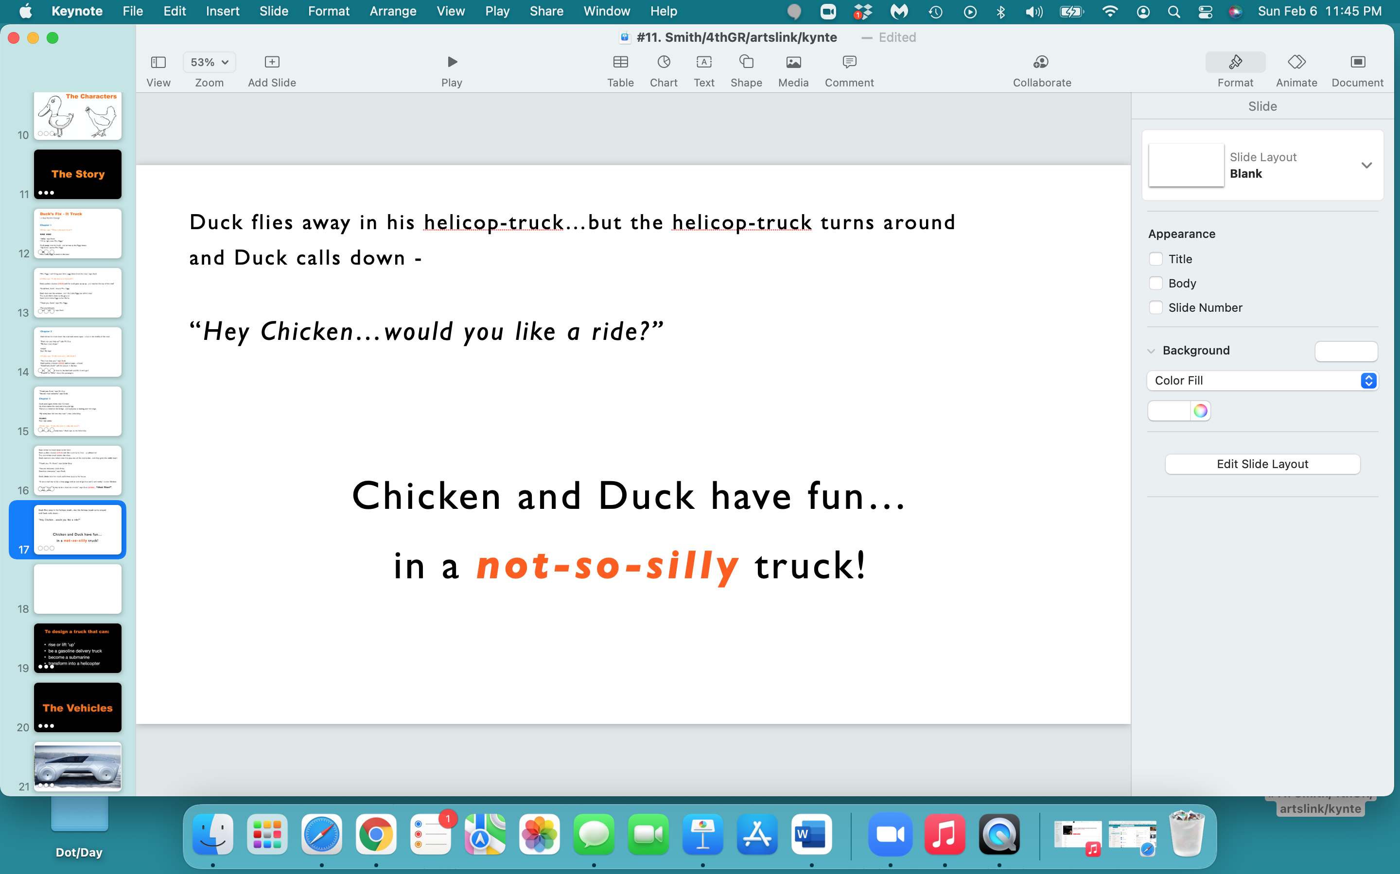

Slide 18
To design a truck that can:
rise or lift ‘up’
be a gasoline delivery truck
become a submarine
transform into a helicopter

Slide 19
The Vehicles

Slide 20
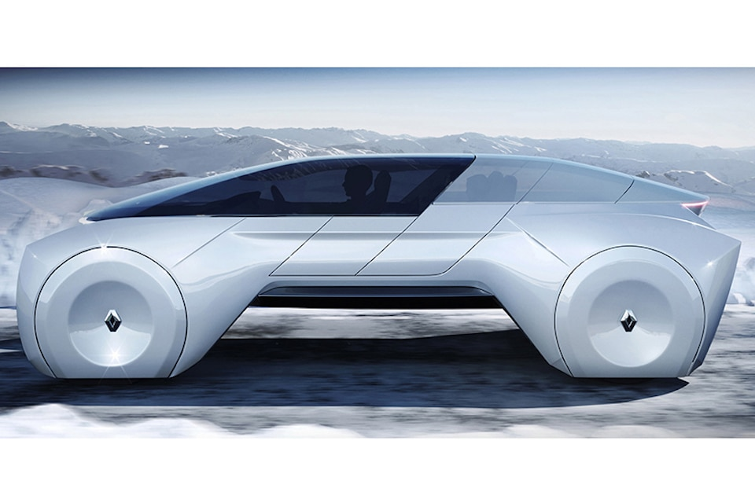
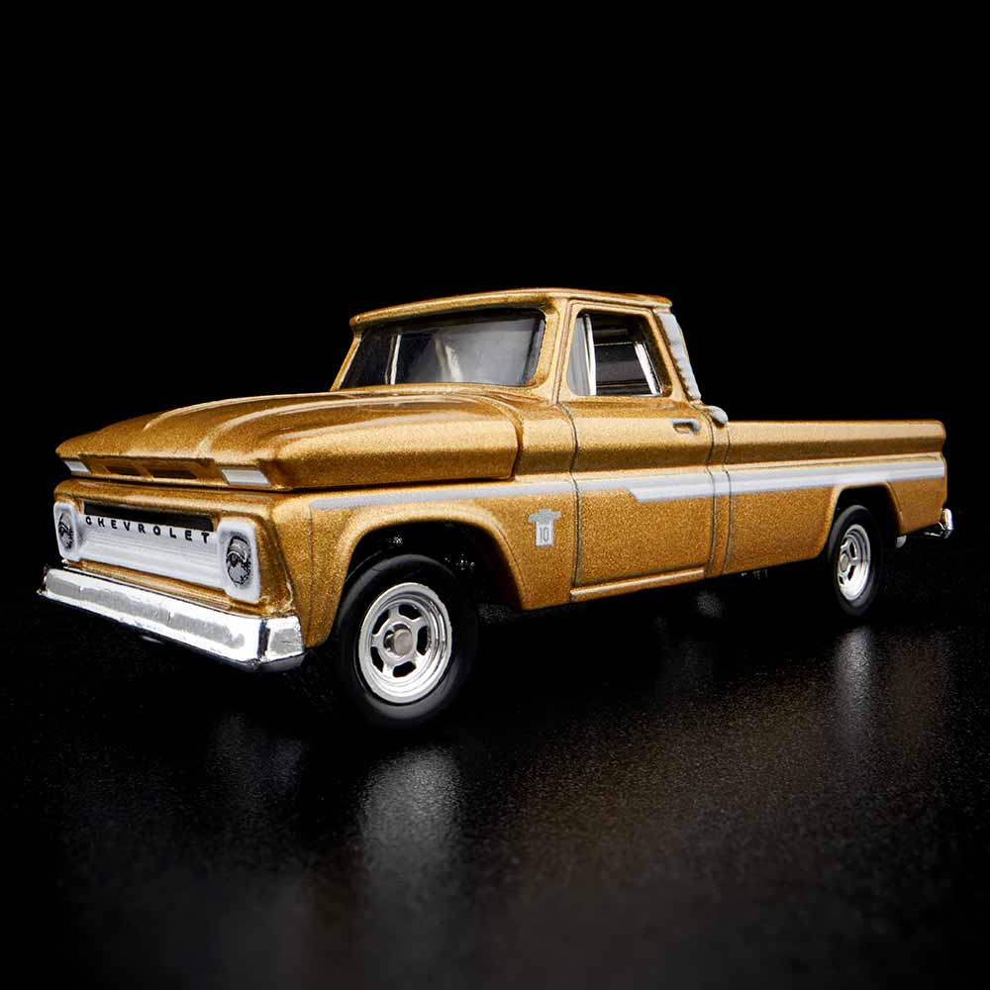
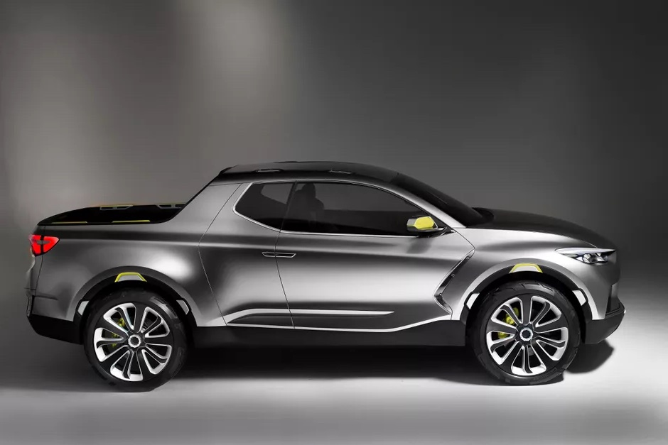
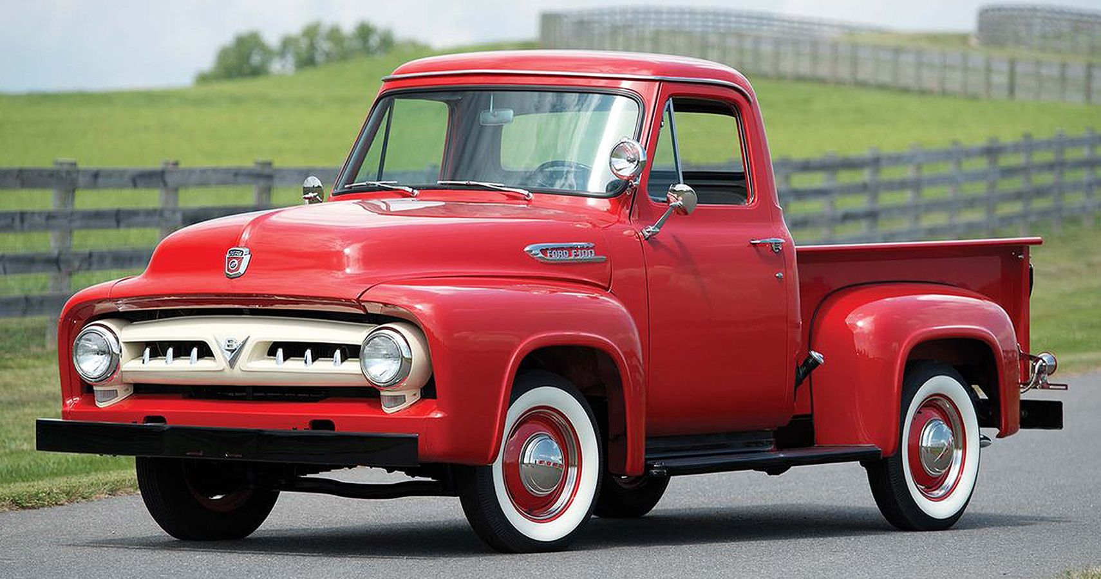

Slide 21
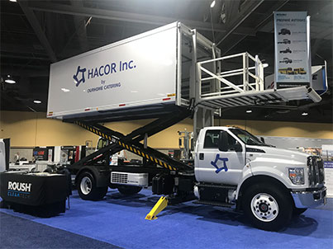
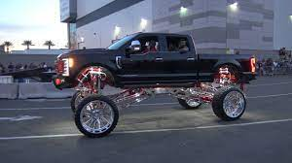

Slide 22
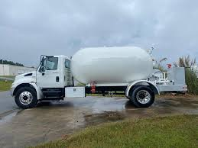
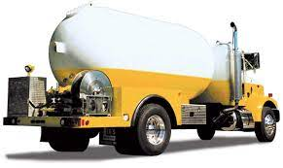
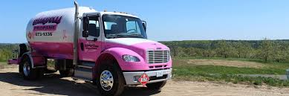

Slide 23
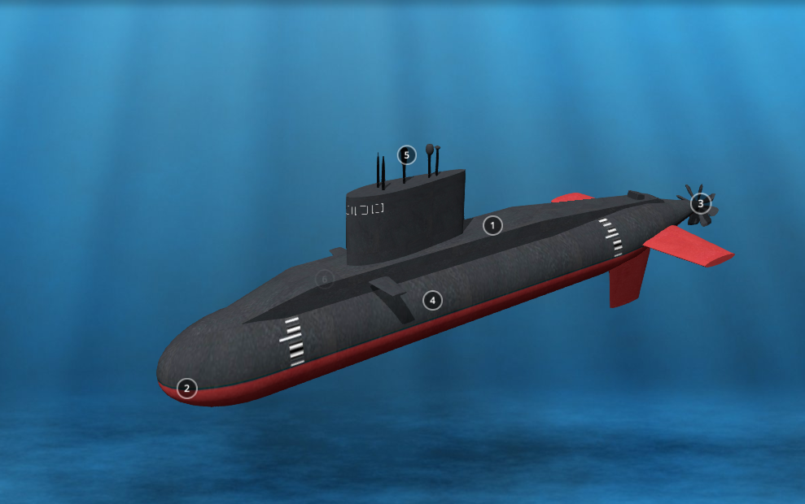
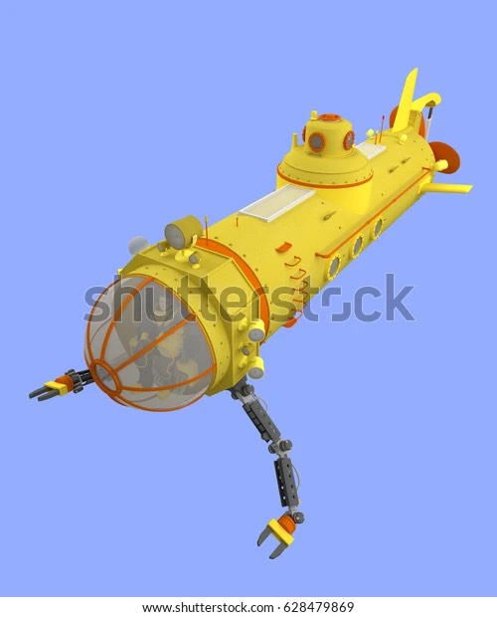

Slide 24
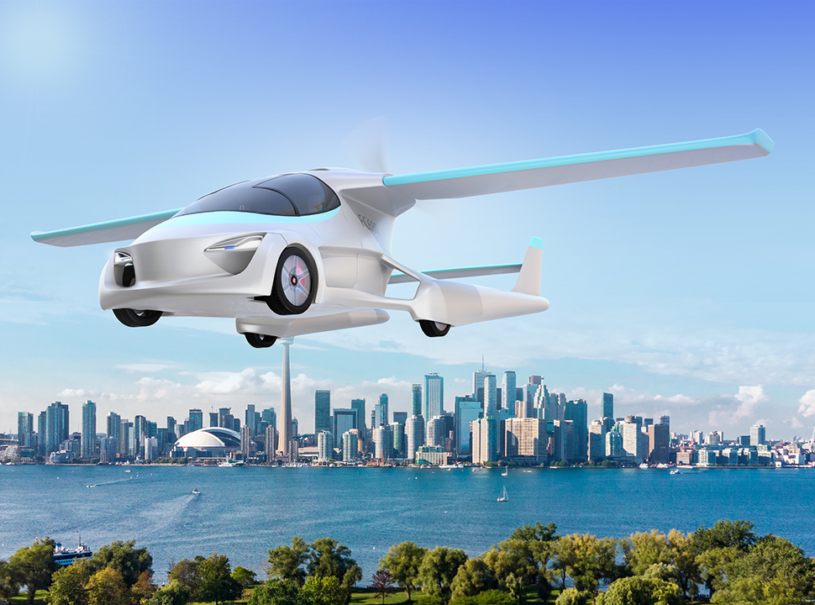
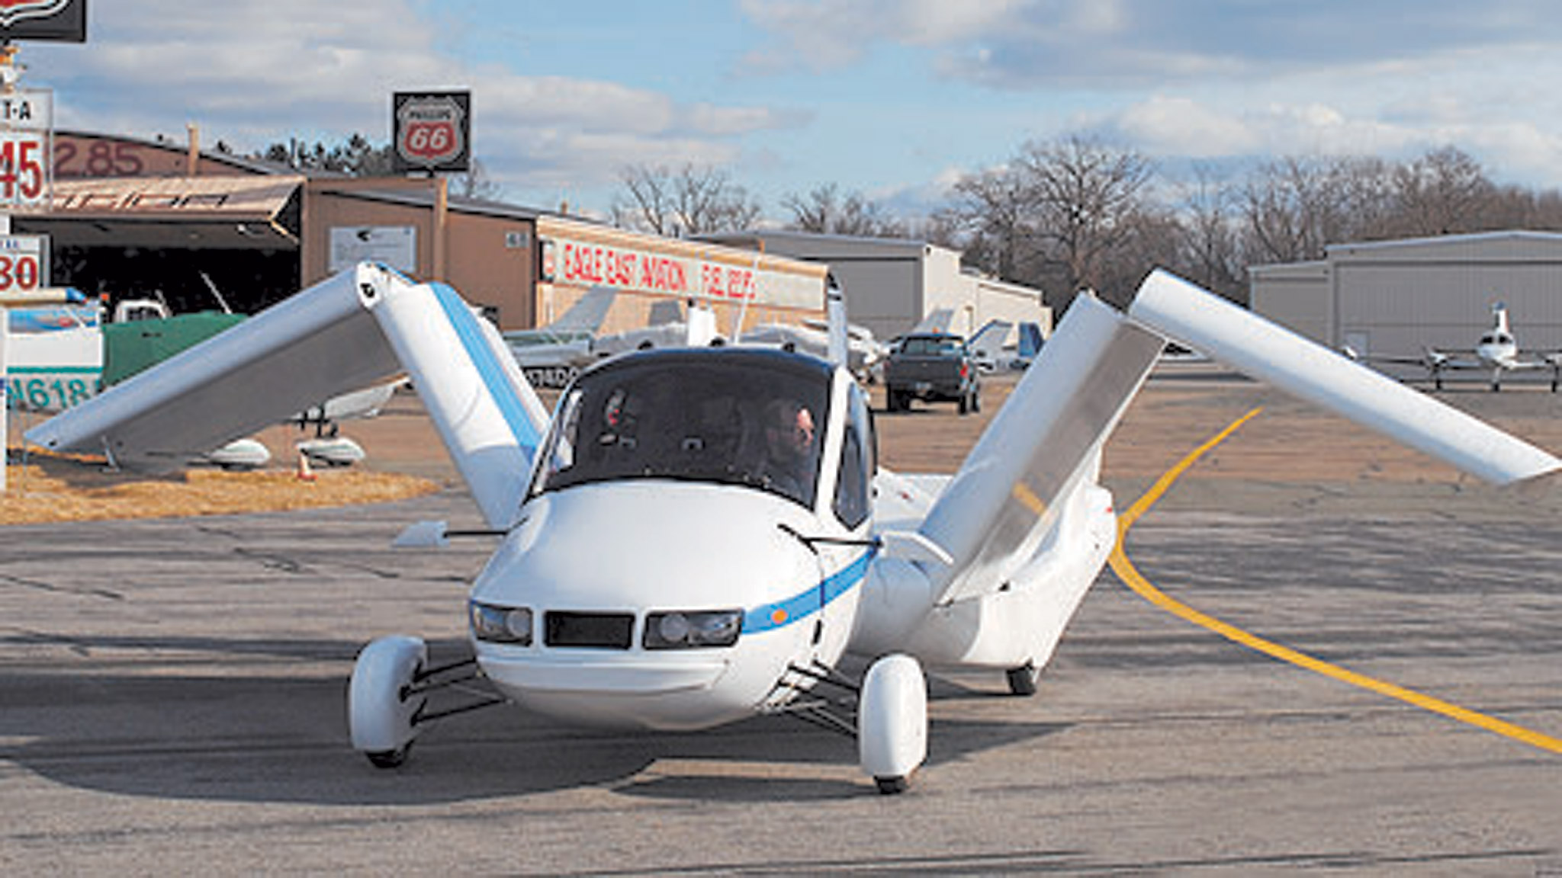
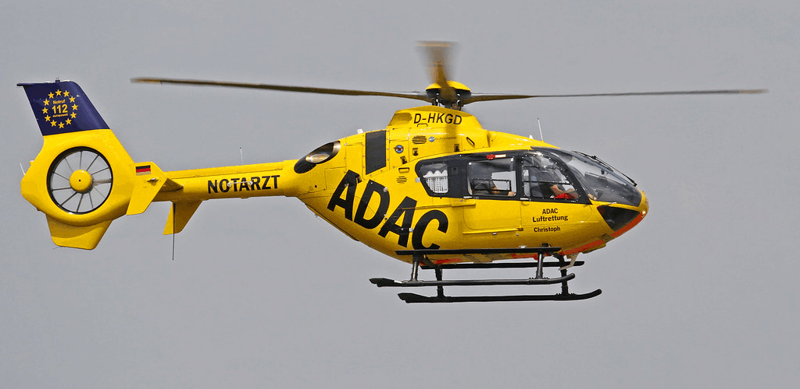
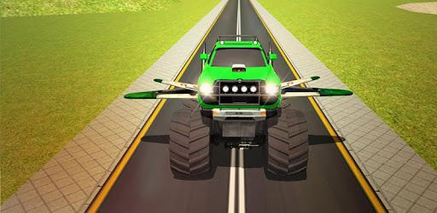

Slide 25
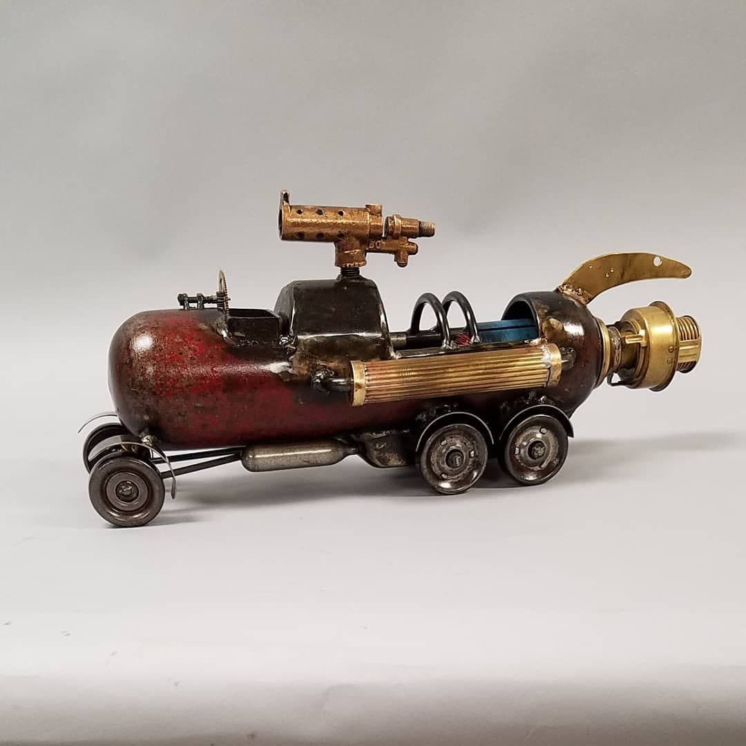
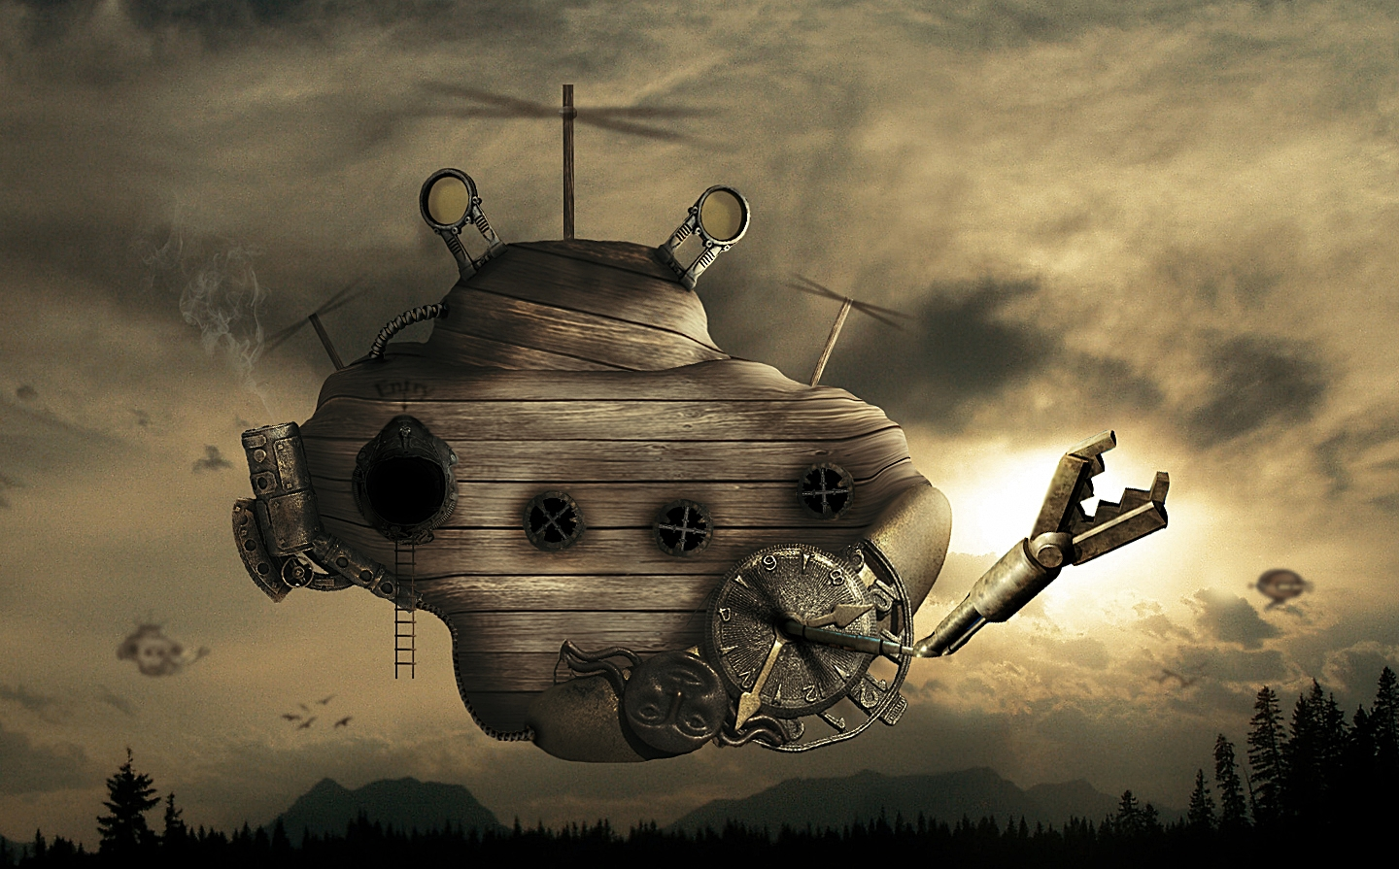
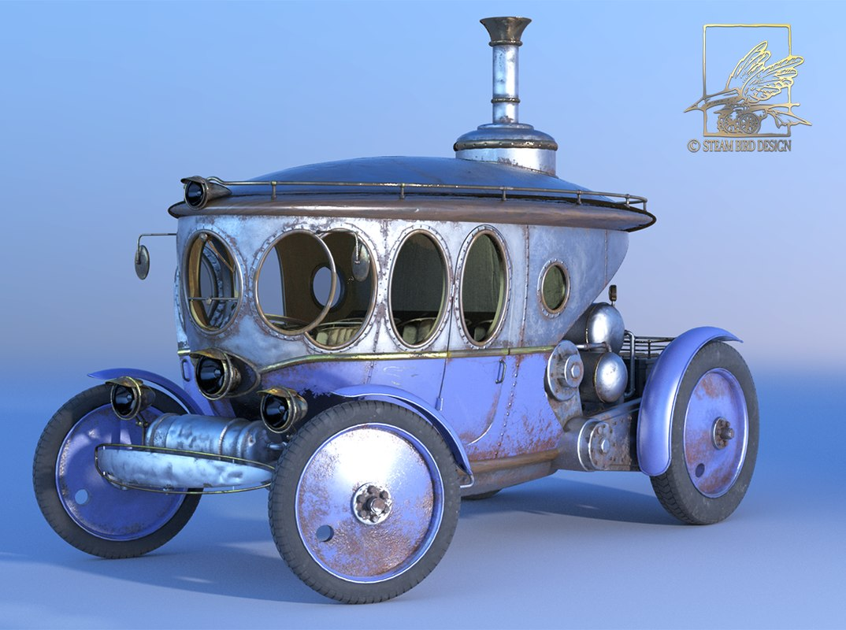
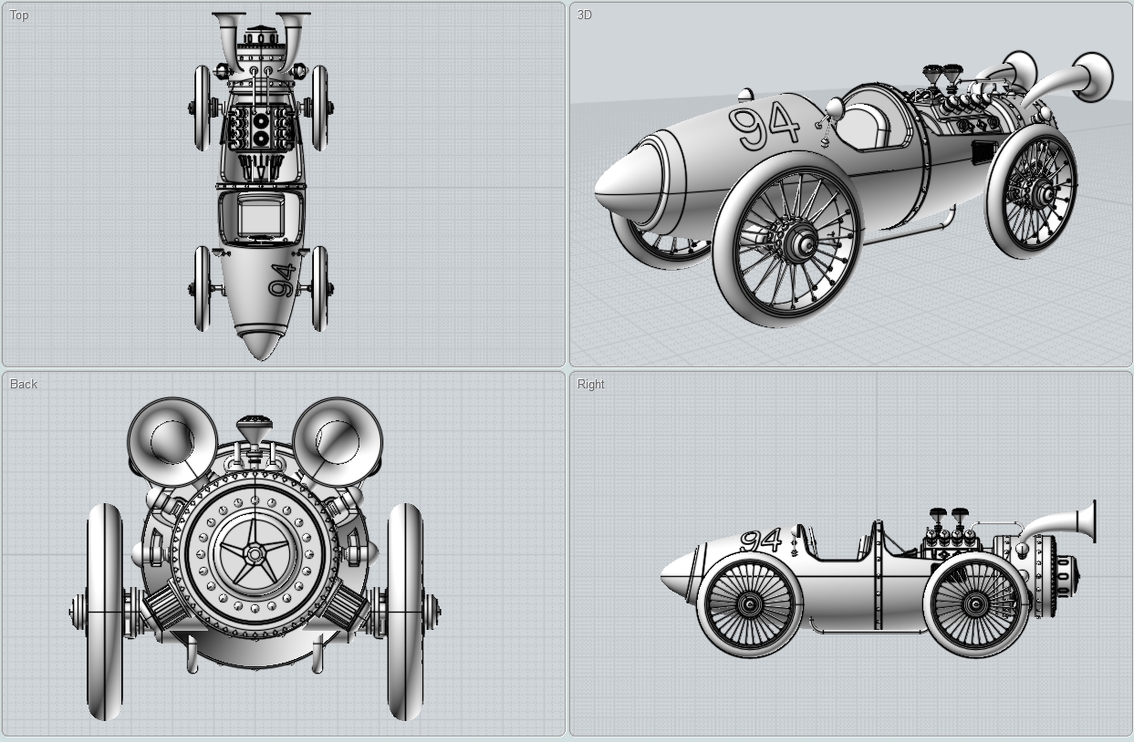
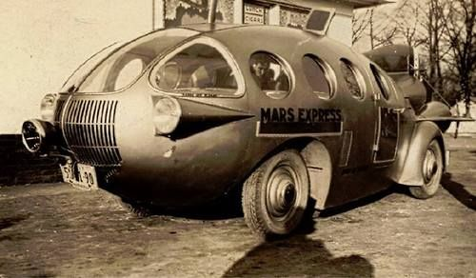
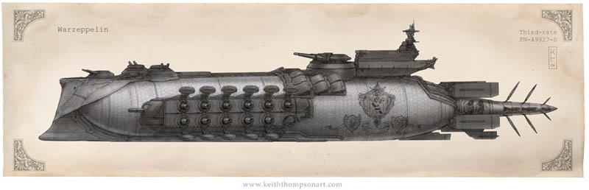

Slide 26
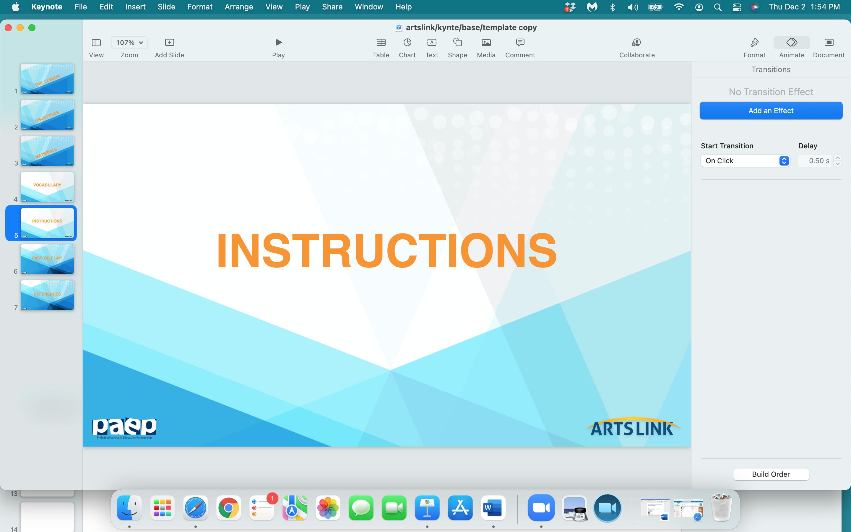

Slide 27
The Challenge:
Class divides into teams of 3.
Each team designs & draws a truck that can:
lift ‘up’
pump gas into another vehicle
transform into a submarine
transform into a helicopter

Slide 28
3. With the use of ‘fasteners’ and extra paper, draw and create
the parts of the truck that will transform it into a truck with 4 functions.
4. Demonstrate your truck’s transformation into a vehicle
with 4 different functions by moving the various truck ‘parts’
with fasteners.
5. Write an ‘Owner’s Manual’ on how to operate
your multi-purpose truck.

Slide 29
OK - time to design a FABULOUS truck!

Slide 30
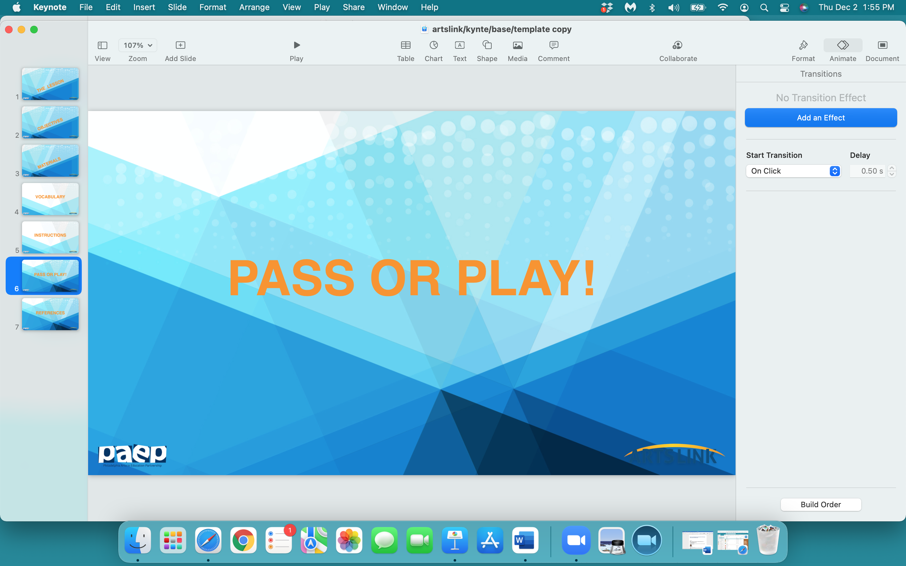

Slide 31
what one thing
did
you
learn
today…pass or play?

Slide 32
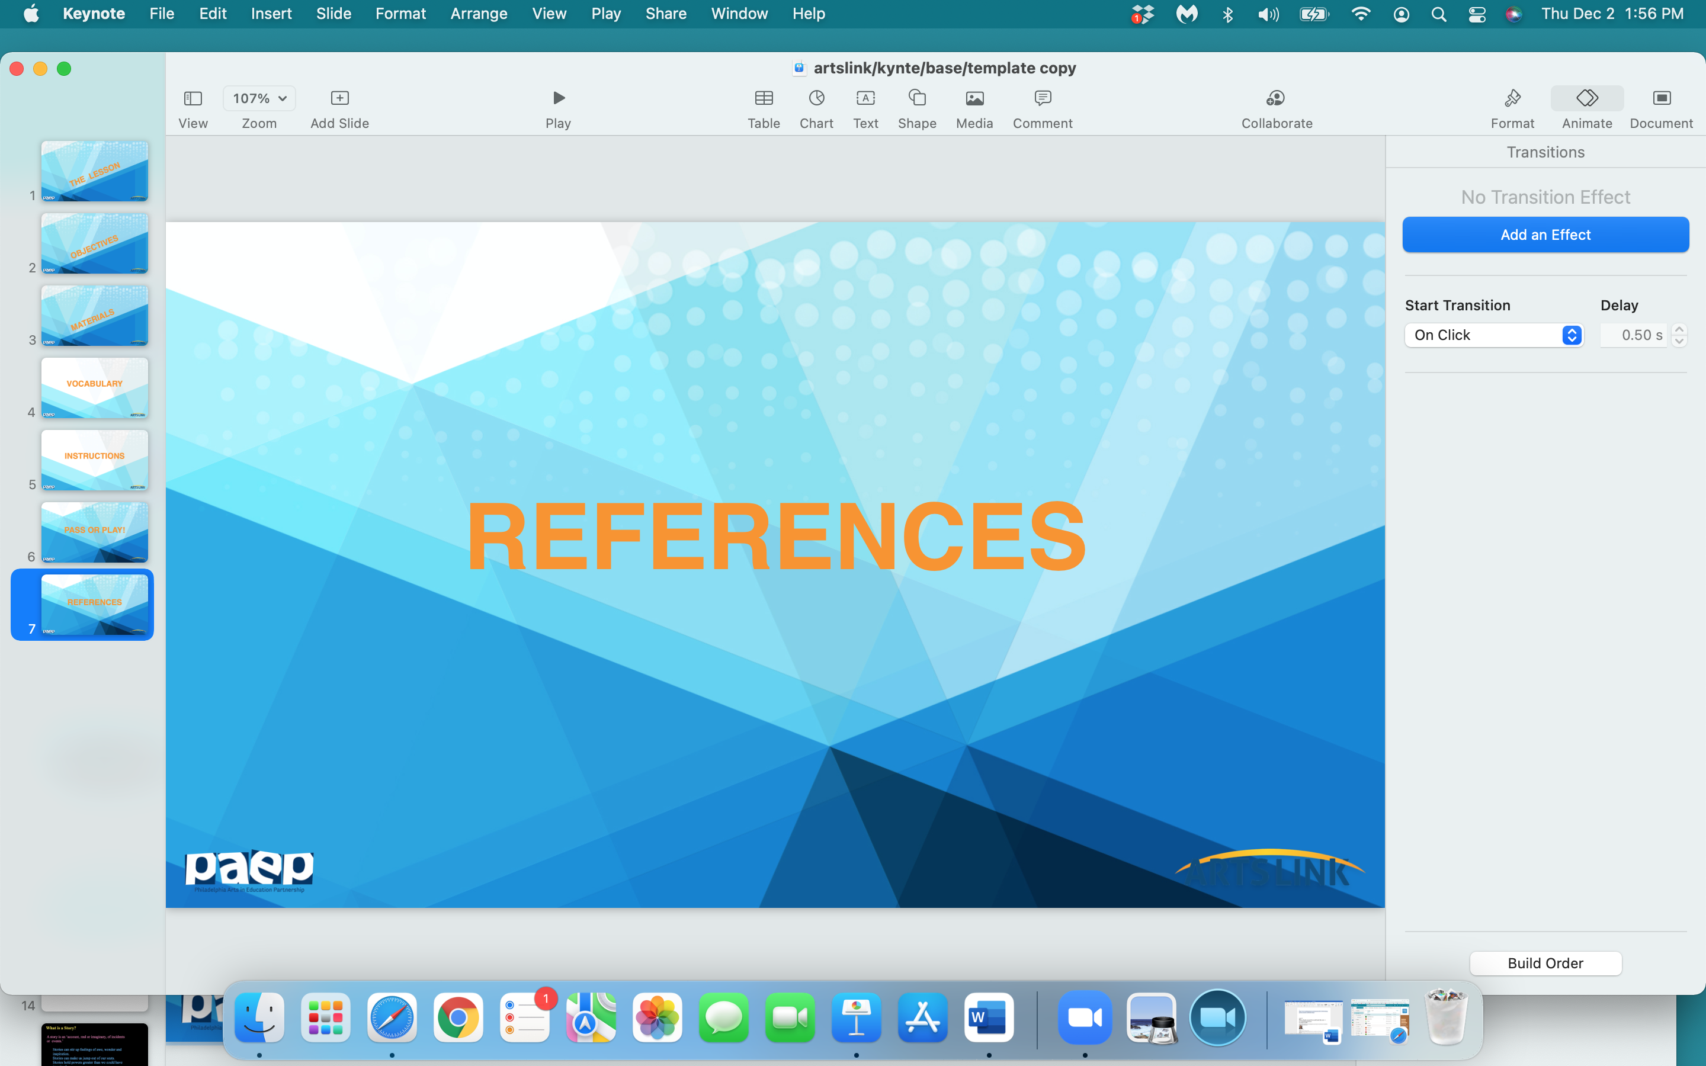

Slide 33
Heroman, Cate, ‘Making & Tinkering with STEM,’ National Association for the Education of Young Children, Washington, DC, 2017, pps. 111 – 113.
George, Lindsay Barrett, ‘Duck’s Fix - It Truck’, 2014, unpublished manuscript
https://en.wikipedia.org/wiki/Steampunk
https://www.explainthatstuff.com/submarines.html
All images of trucks, submarines, helicopters, steampunk vehicles, gas delivery vehicles found on ‘google search’.

