Slide 1
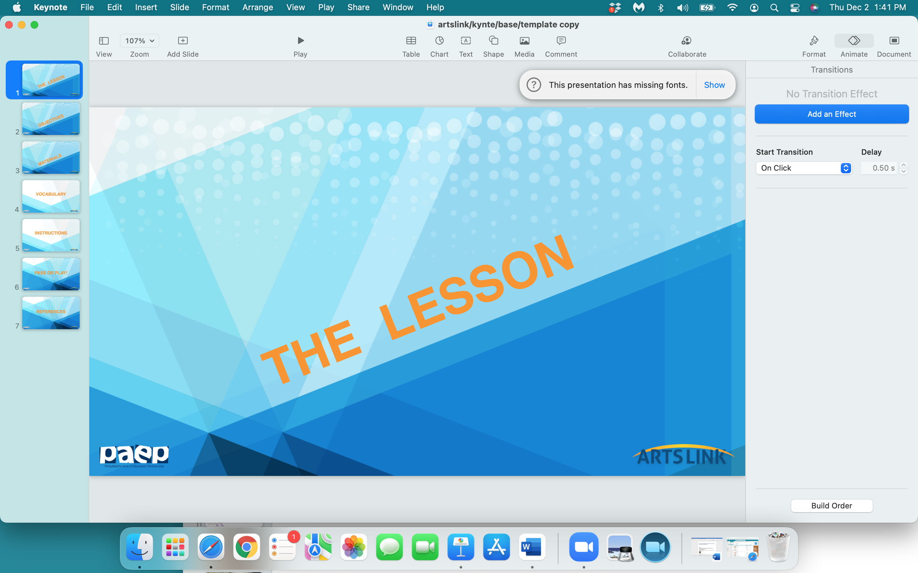

Slide 2
SHOW ME
YOUR
MONEY

Slide 3
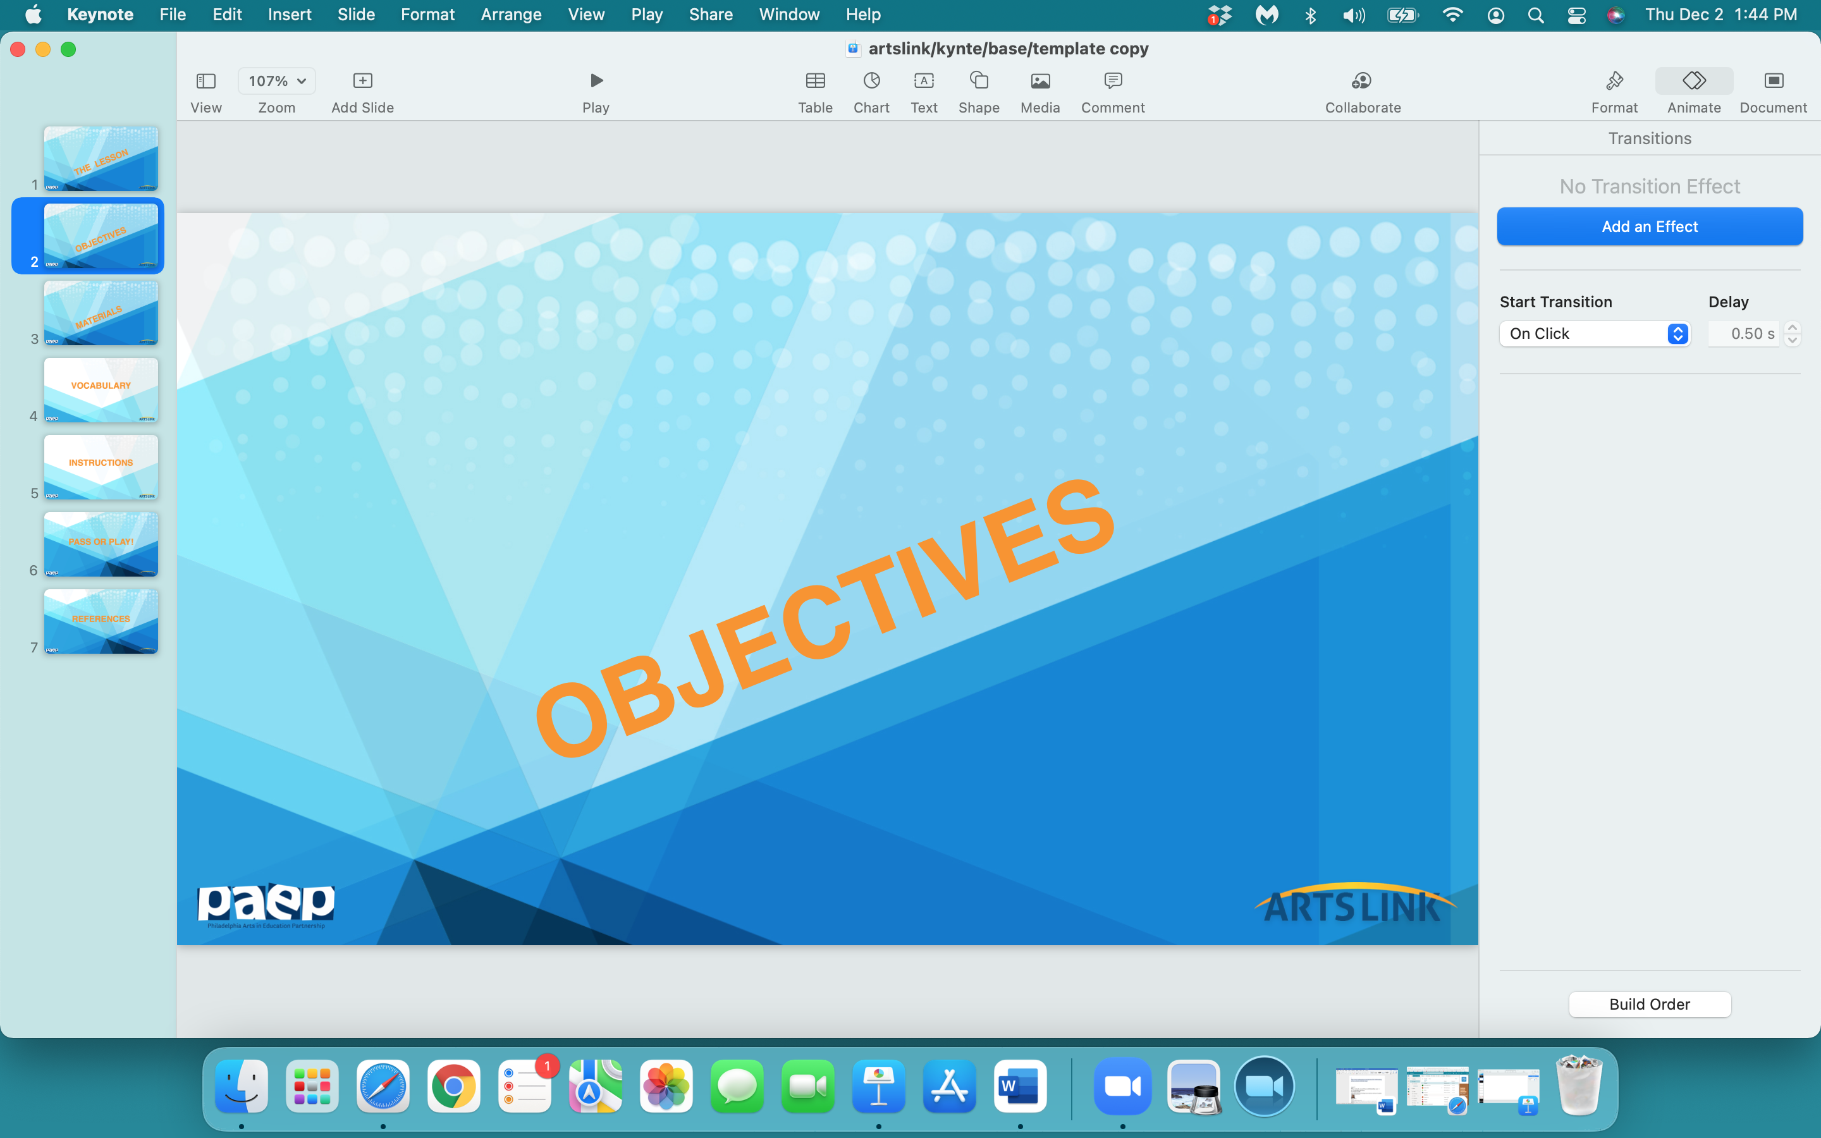

Slide 4
In the next hour, you will:
- define what money is & understand why we need money
- understand the symbols on US paper currency
- design your own paper money
- write about what you would buy with your money
- and why

Slide 5
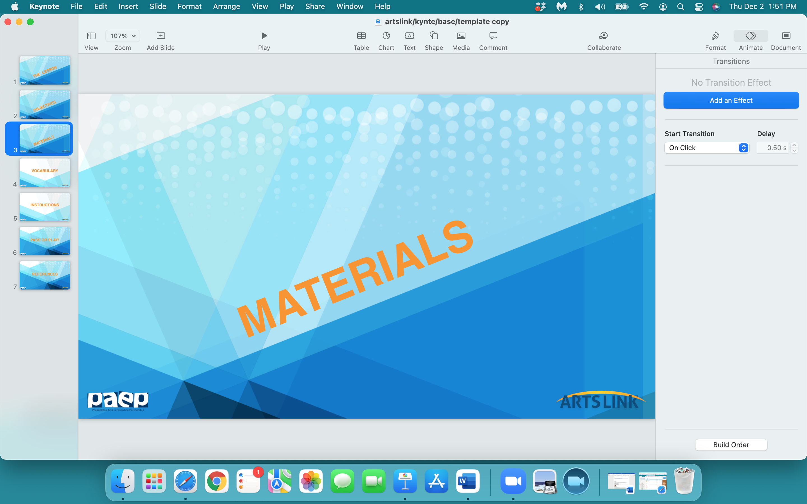

Slide 6
notebook
any white paper
pencil
eraser
scissors
colored pencils, markers
ruler

Slide 7
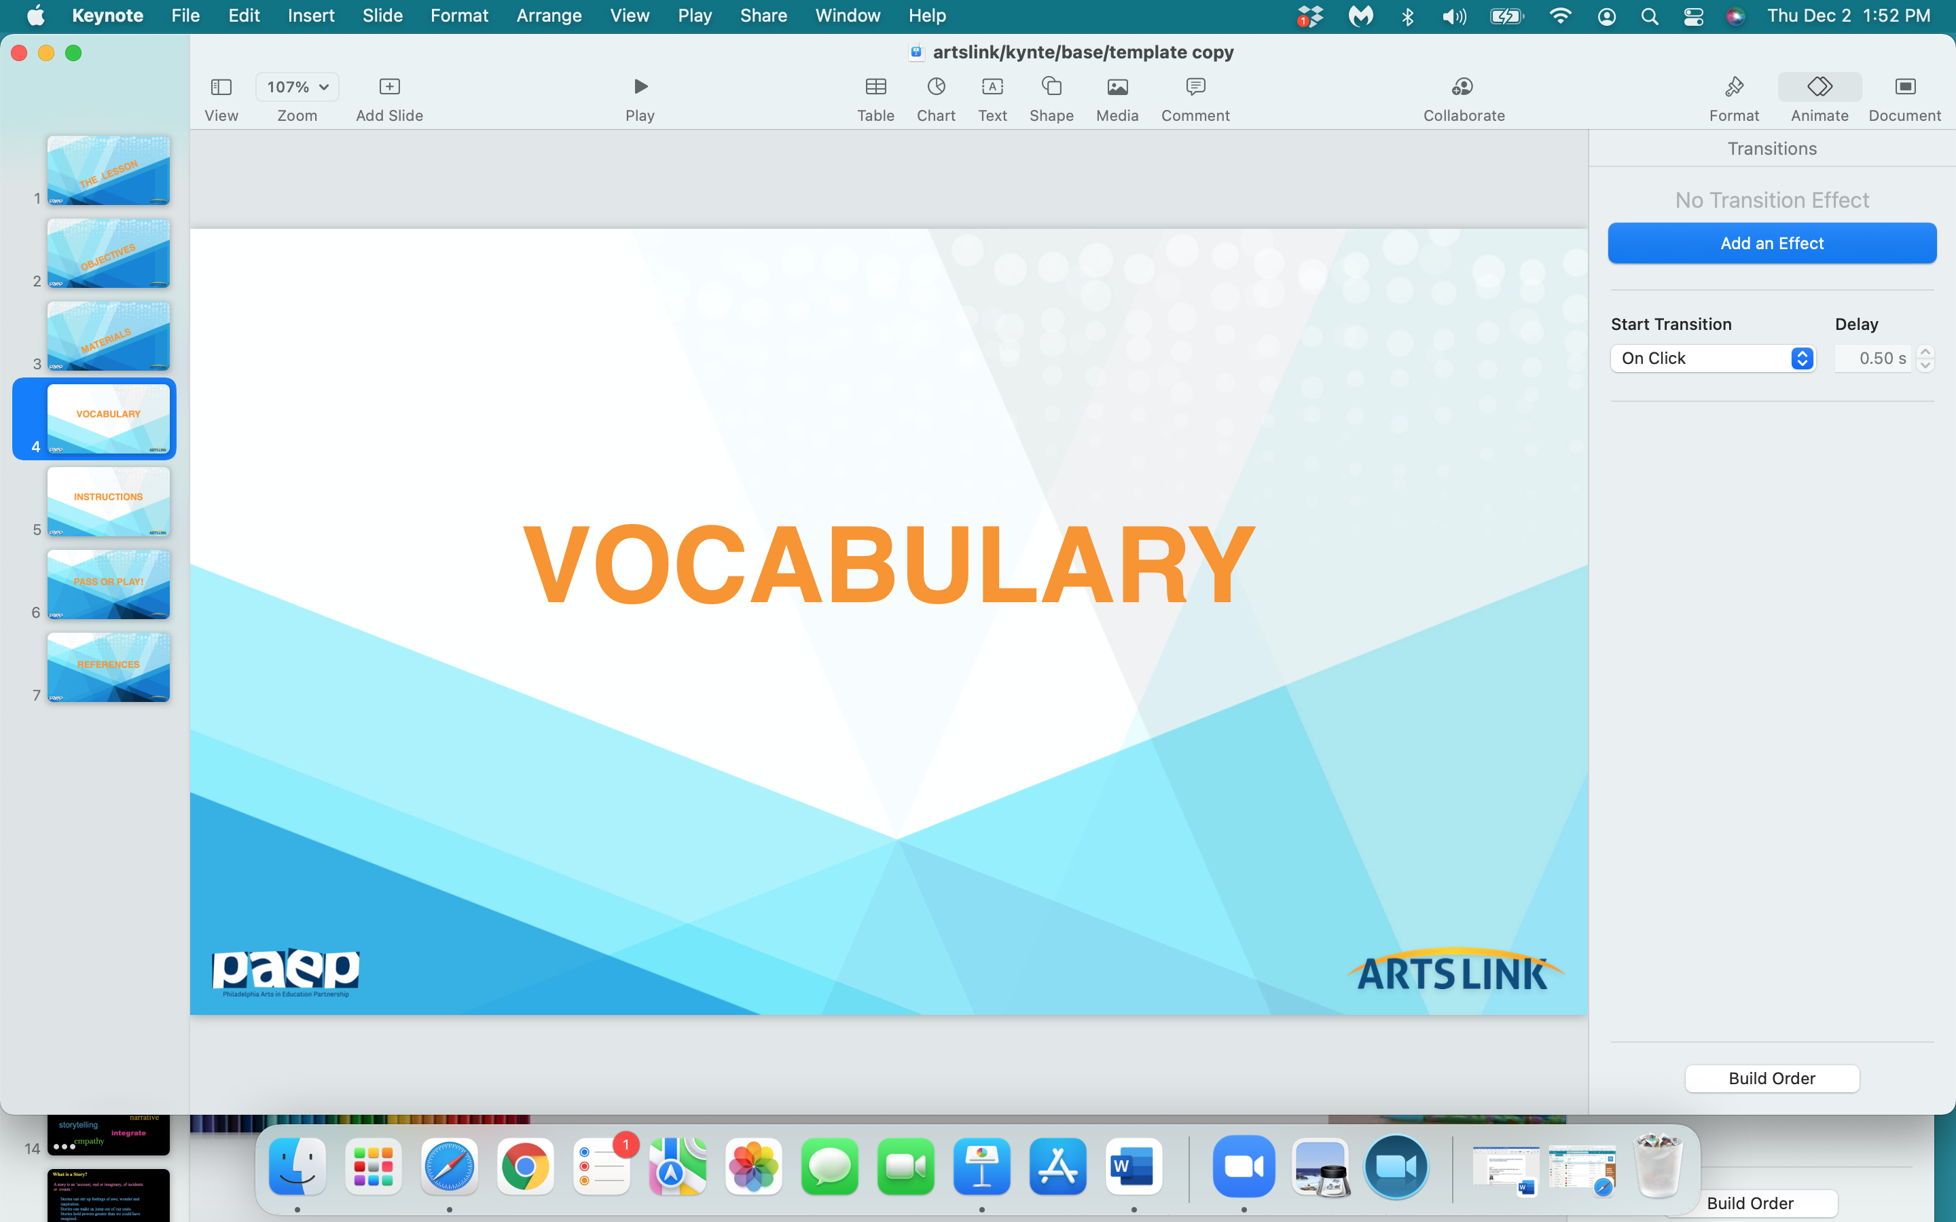

Slide 8
money
currency
barter
‘cowrie shell’
portable
denomination

Slide 9
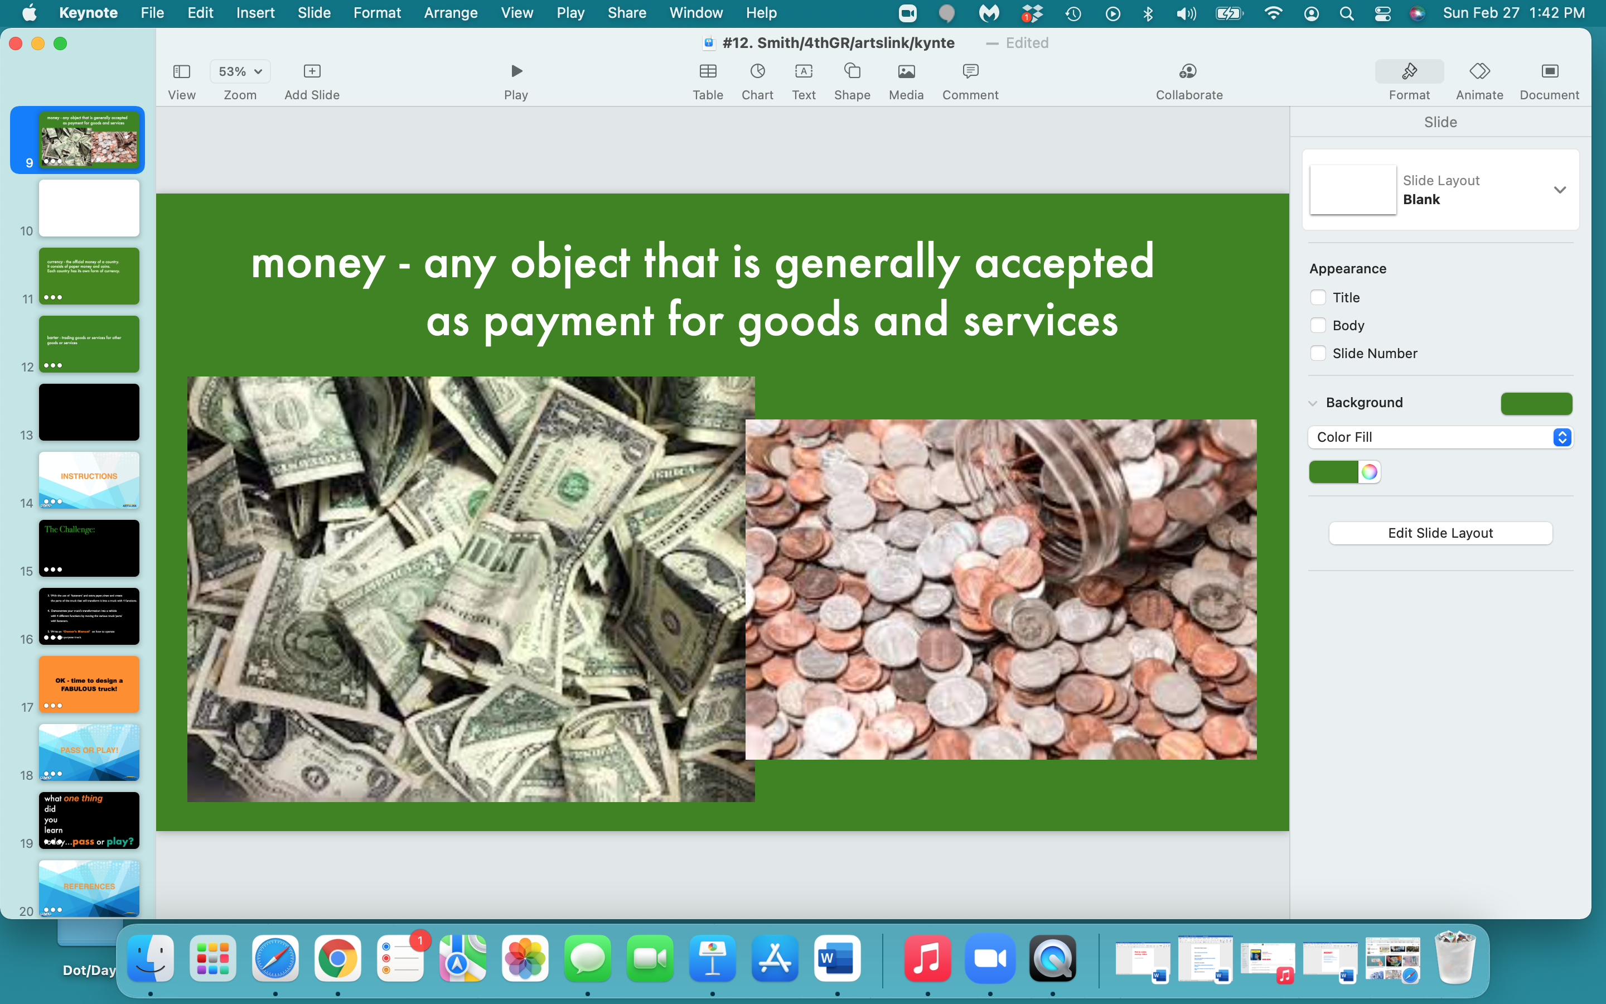

Slide 10
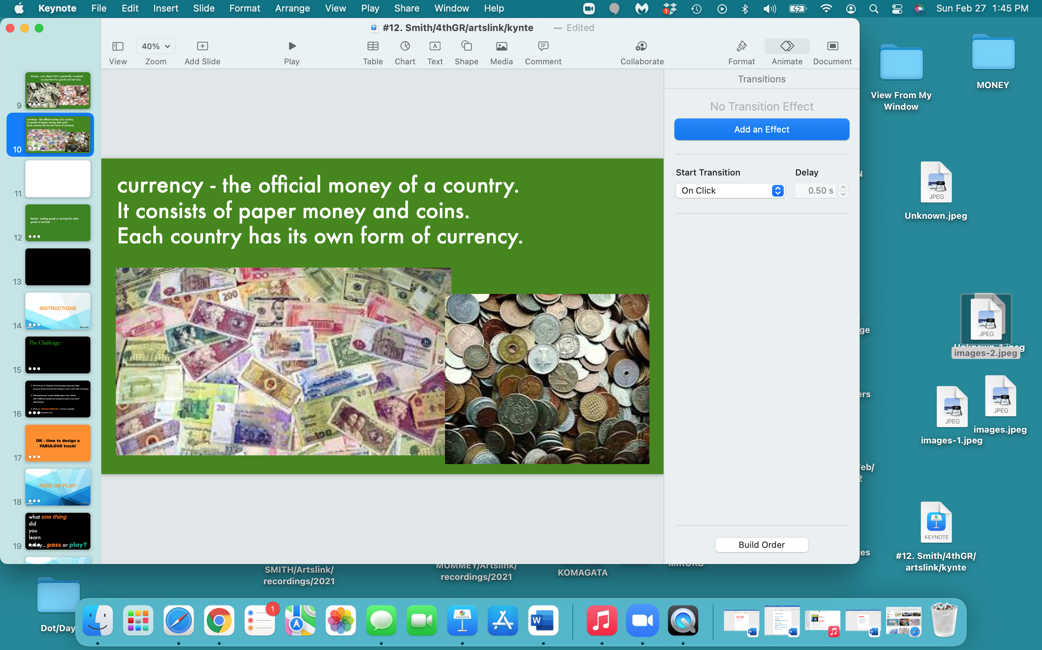

Slide 11
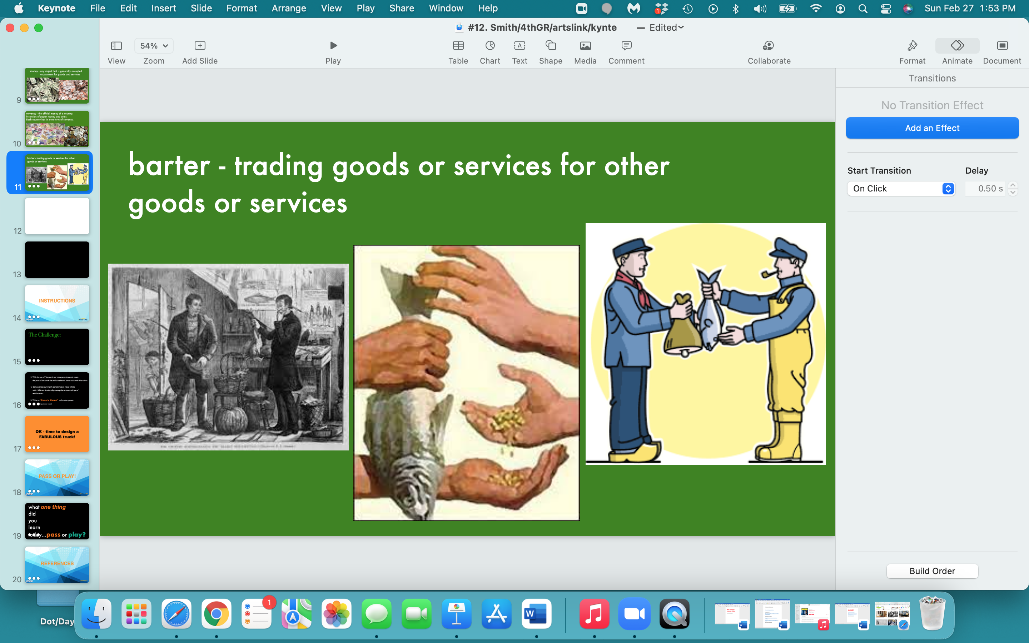

Slide 12
A Little History
on
MONEY

Slide 13
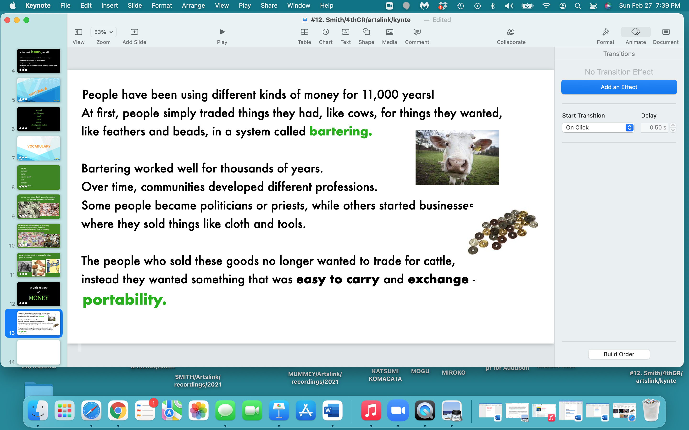

Slide 14
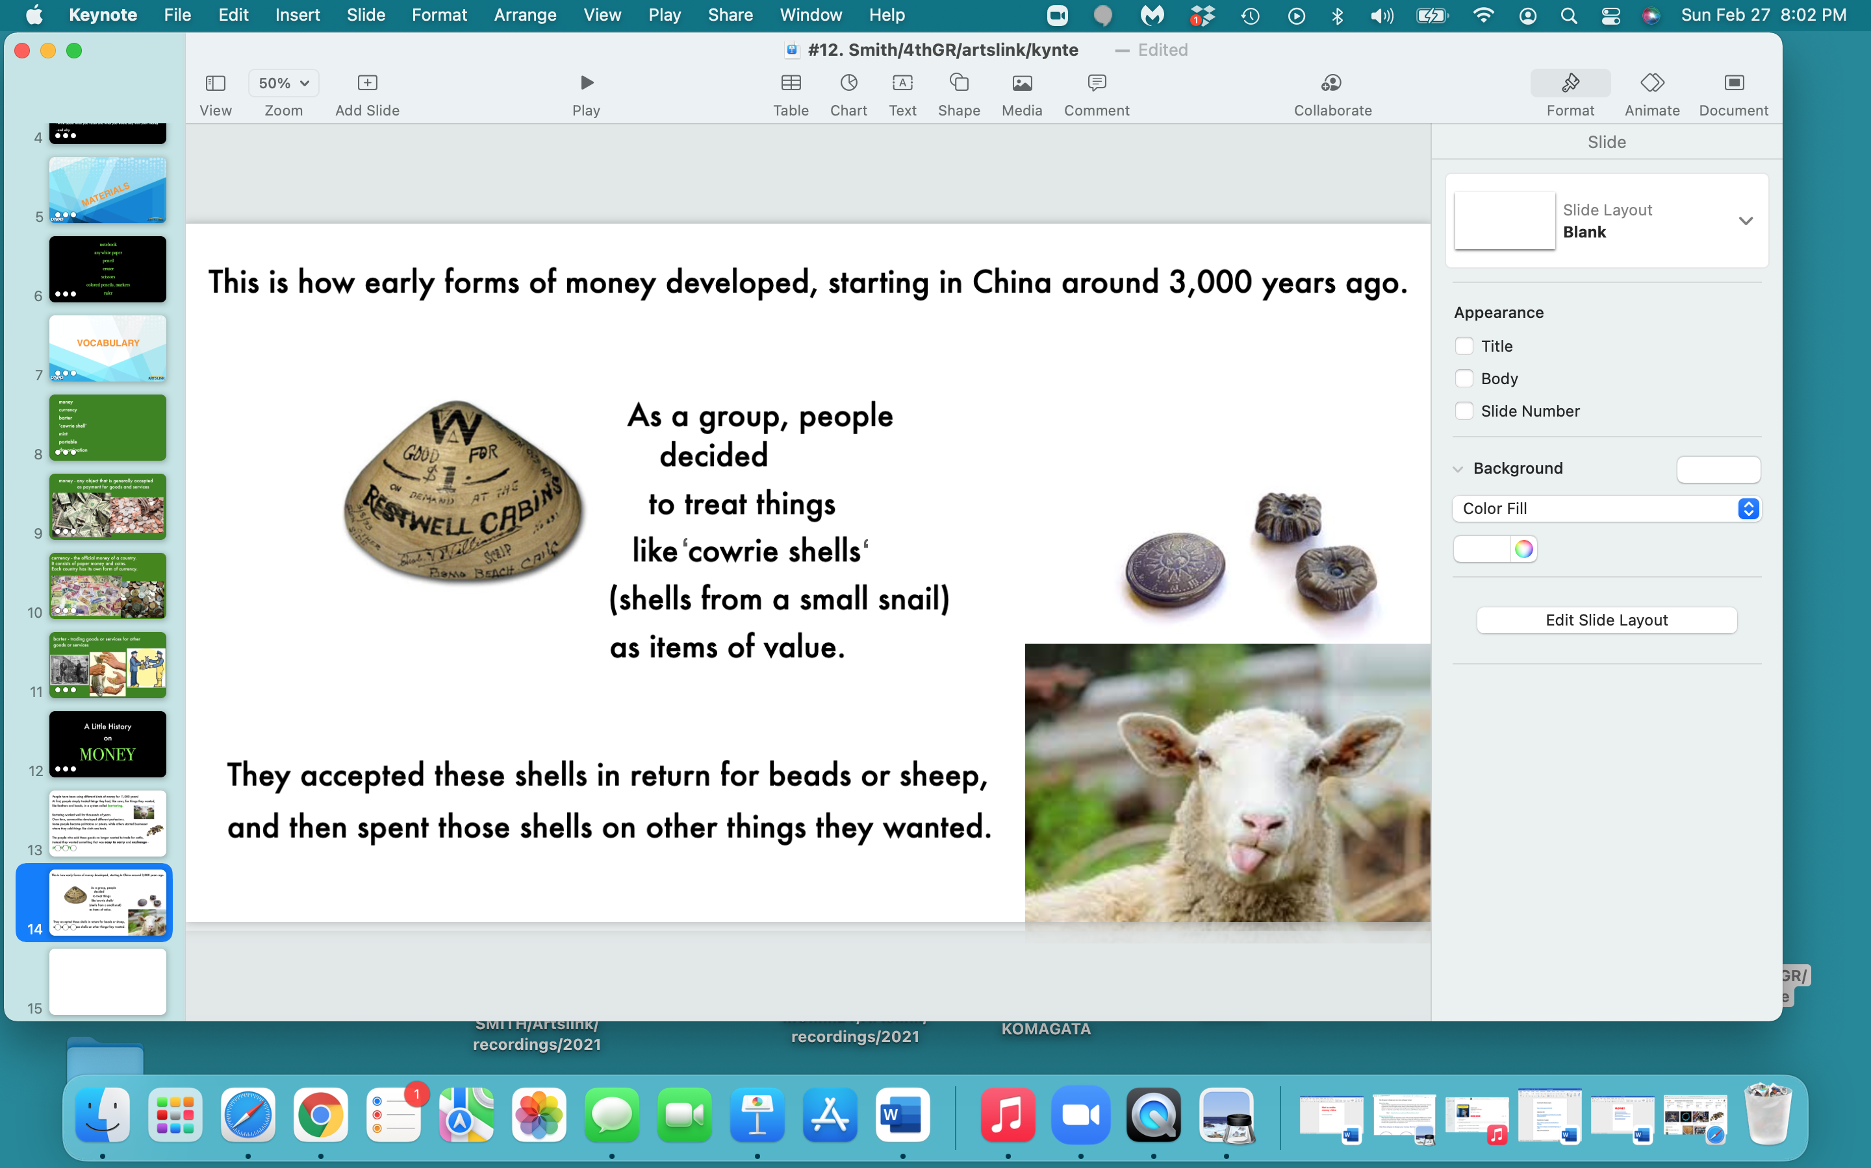

Slide 15
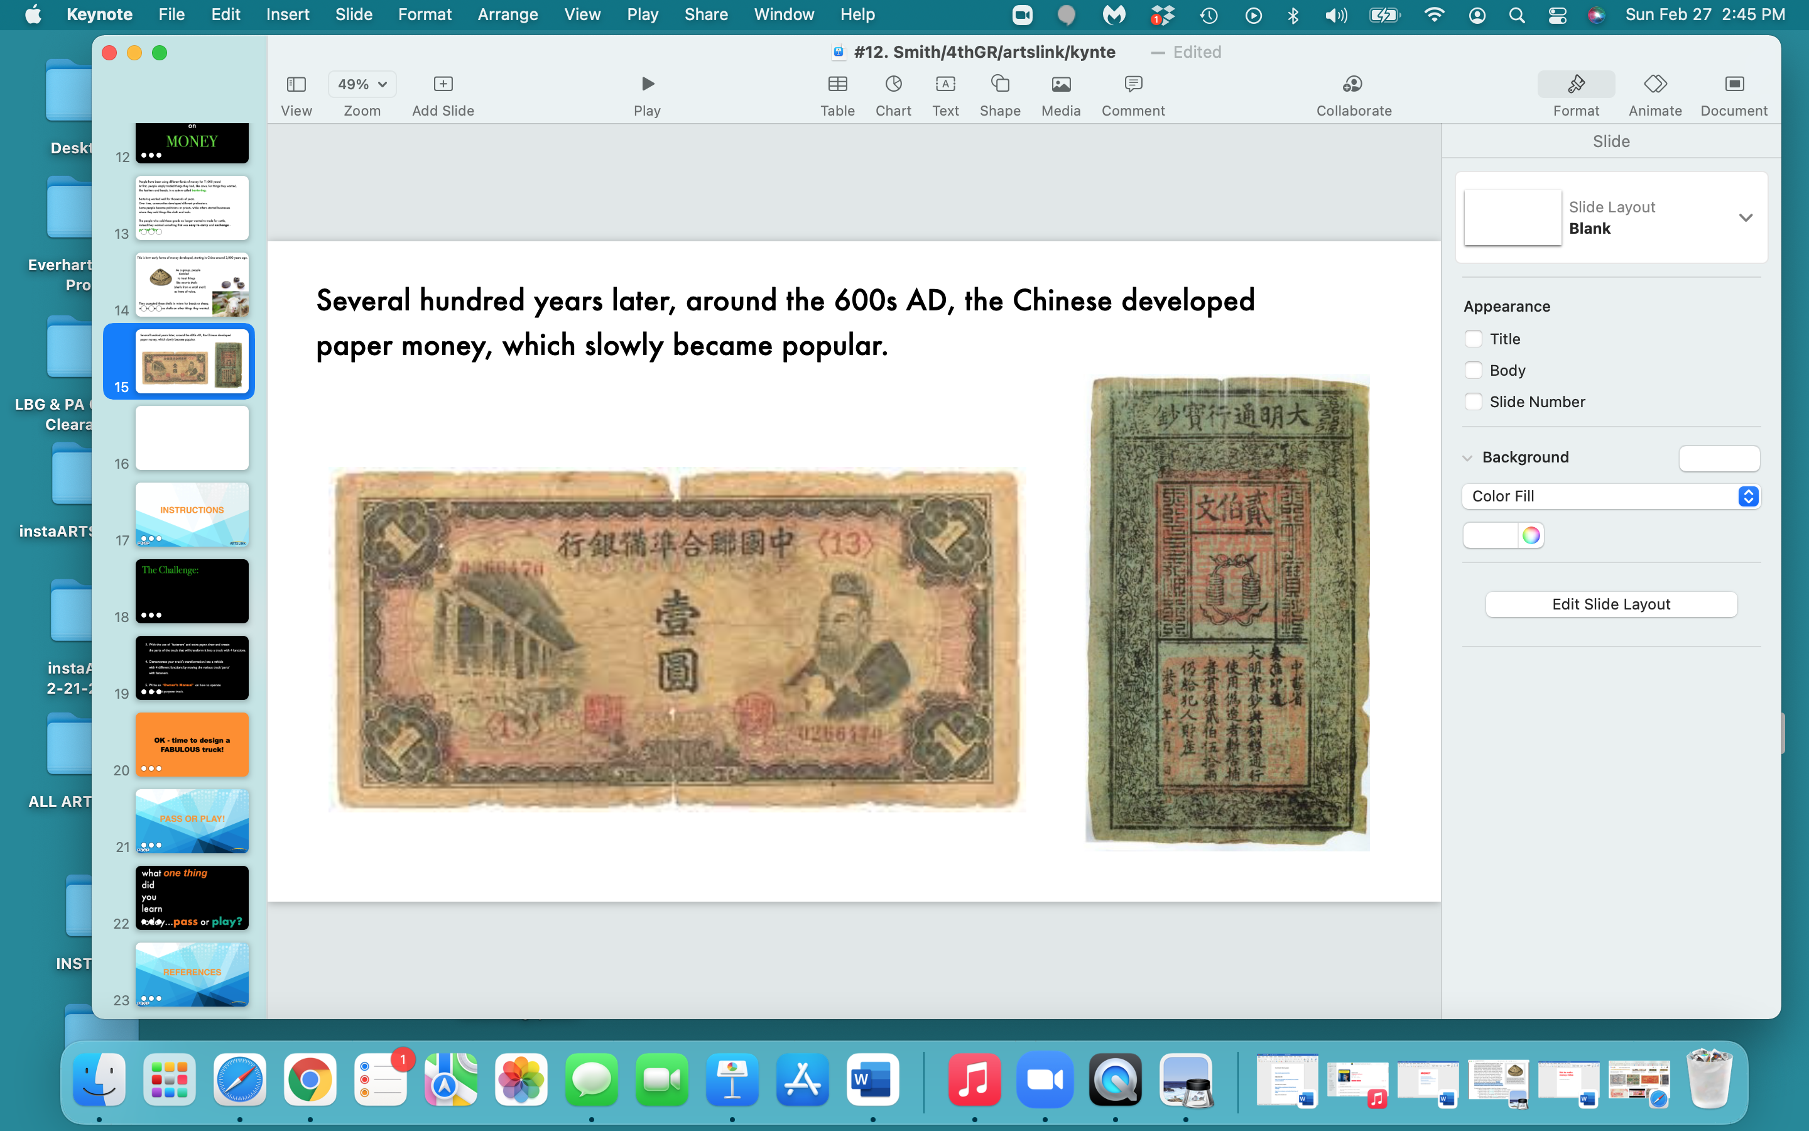

Slide 16
So - all money needs to be:
portable able to be easily carried around
durable it needs to be tough, so that it won’t break or tear
limited needs to be able to be limited in quantity, so that
you can control how much there is of it
divisible the money needs to be able to be divided - a dollar
is divisible into pennies

Slide 17
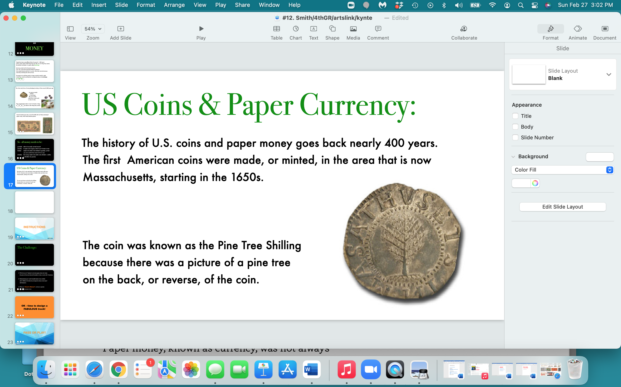

Slide 18
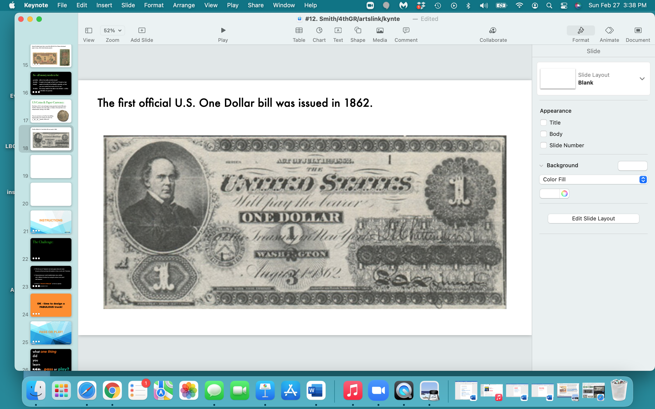

Slide 19
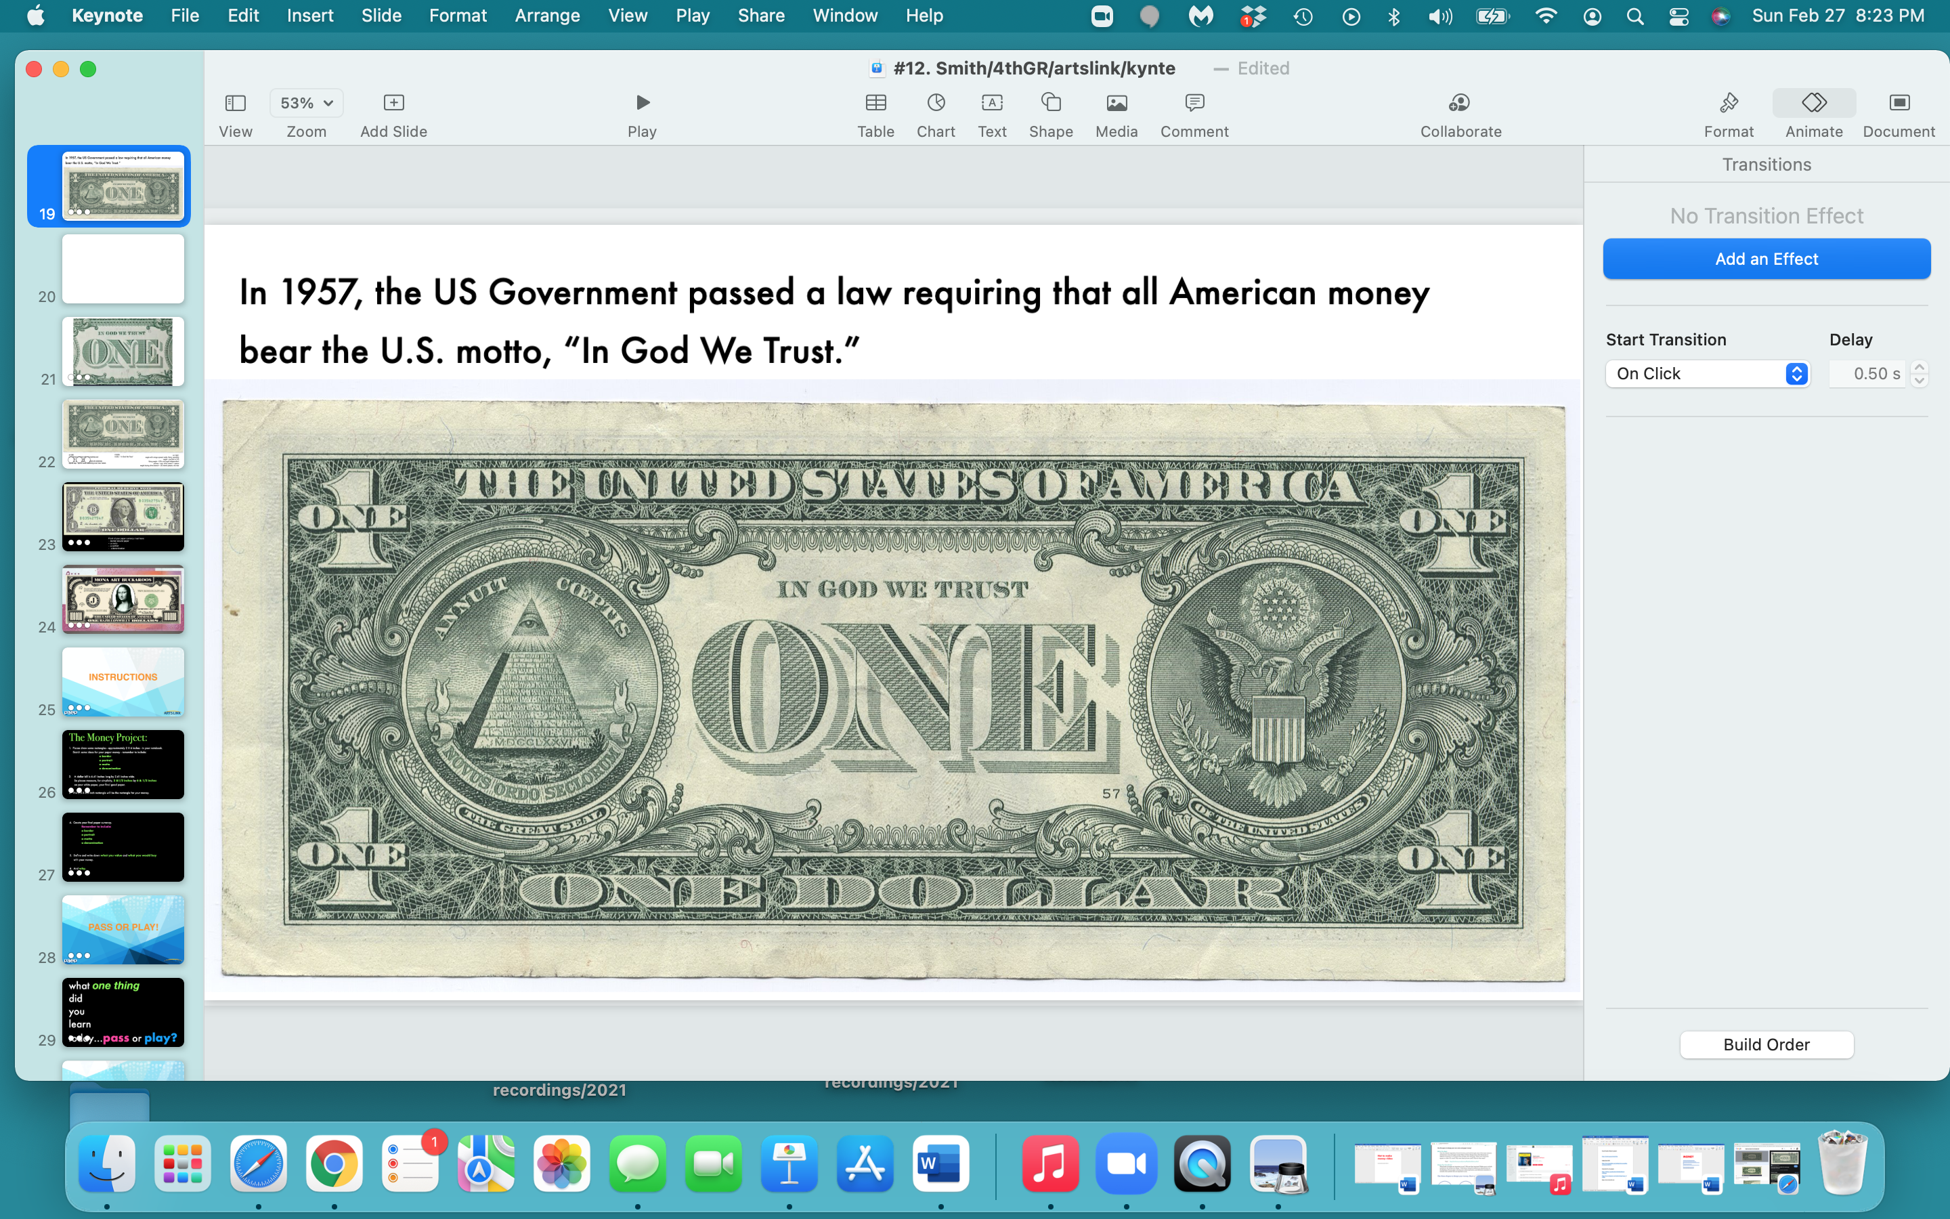

Slide 20
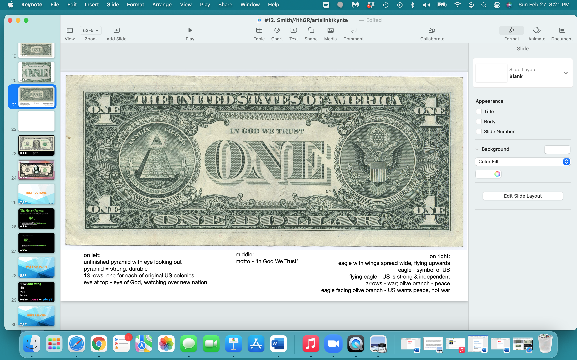

Slide 21
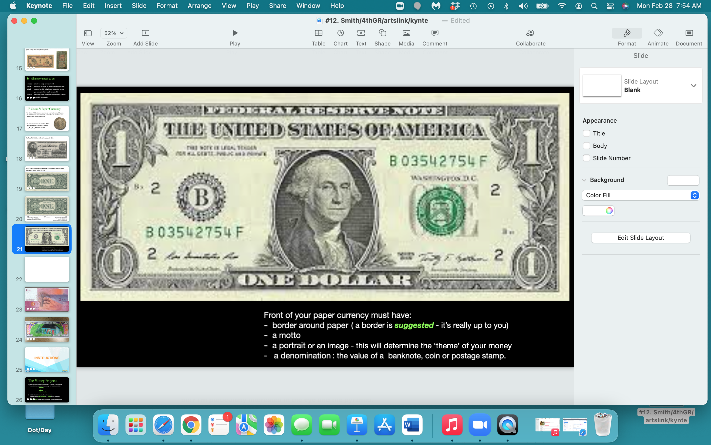

Slide 22
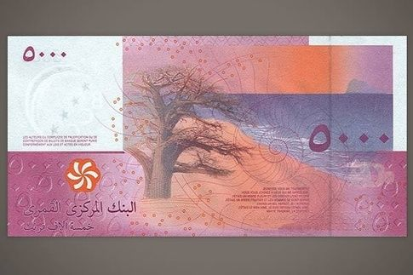
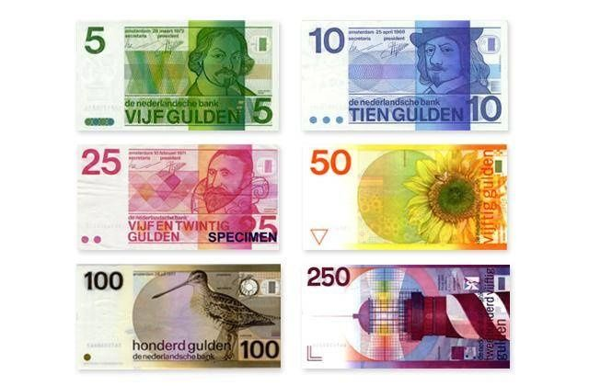
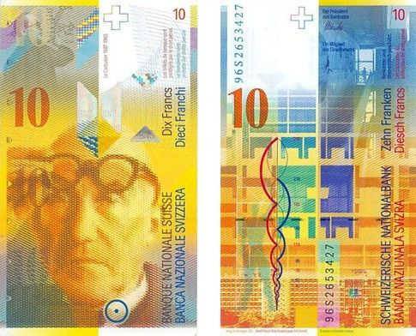
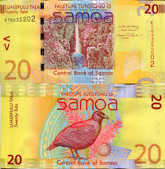
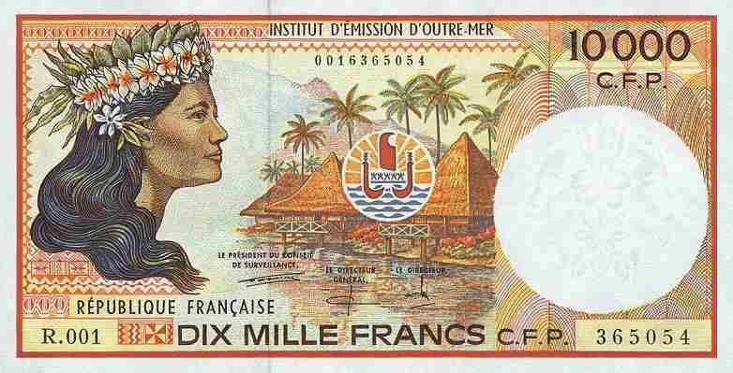
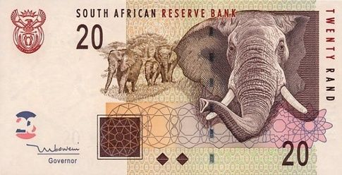
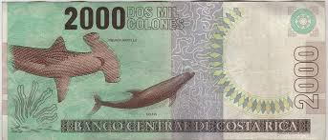

Slide 23
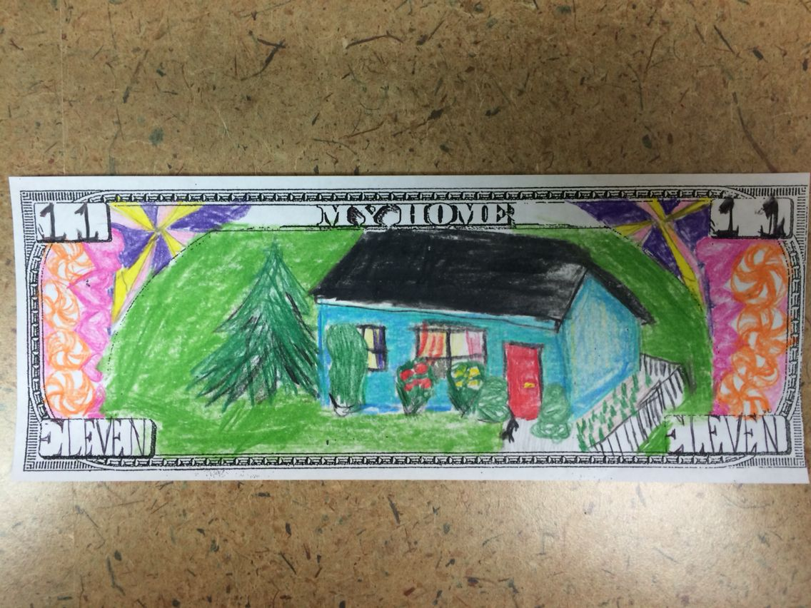
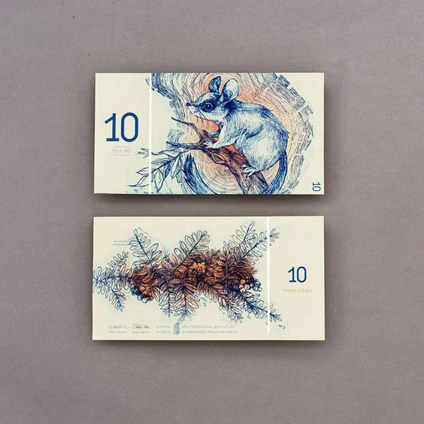
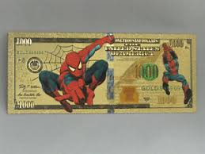
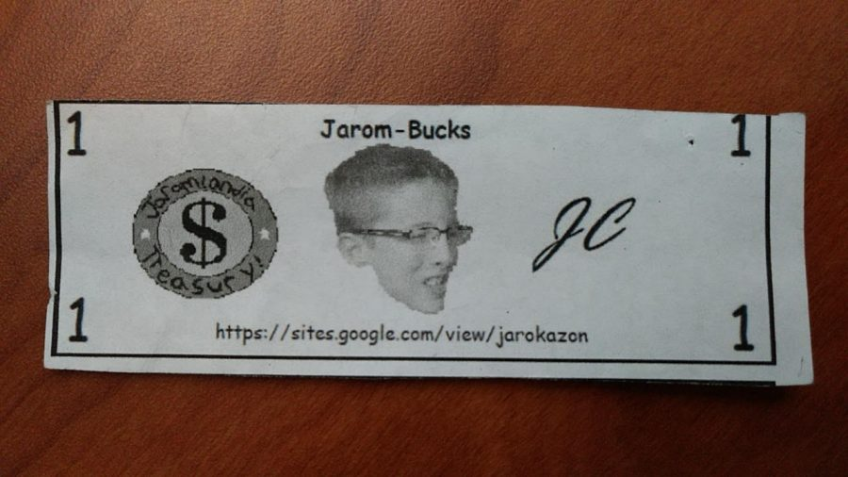
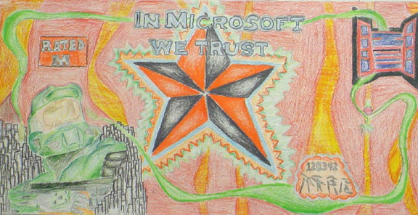
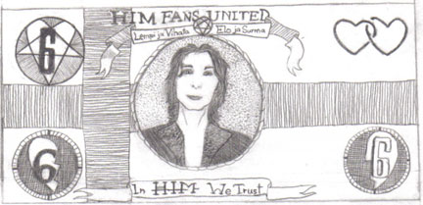
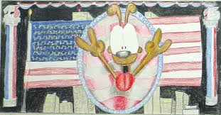
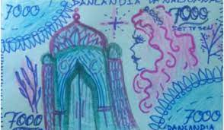

Slide 24
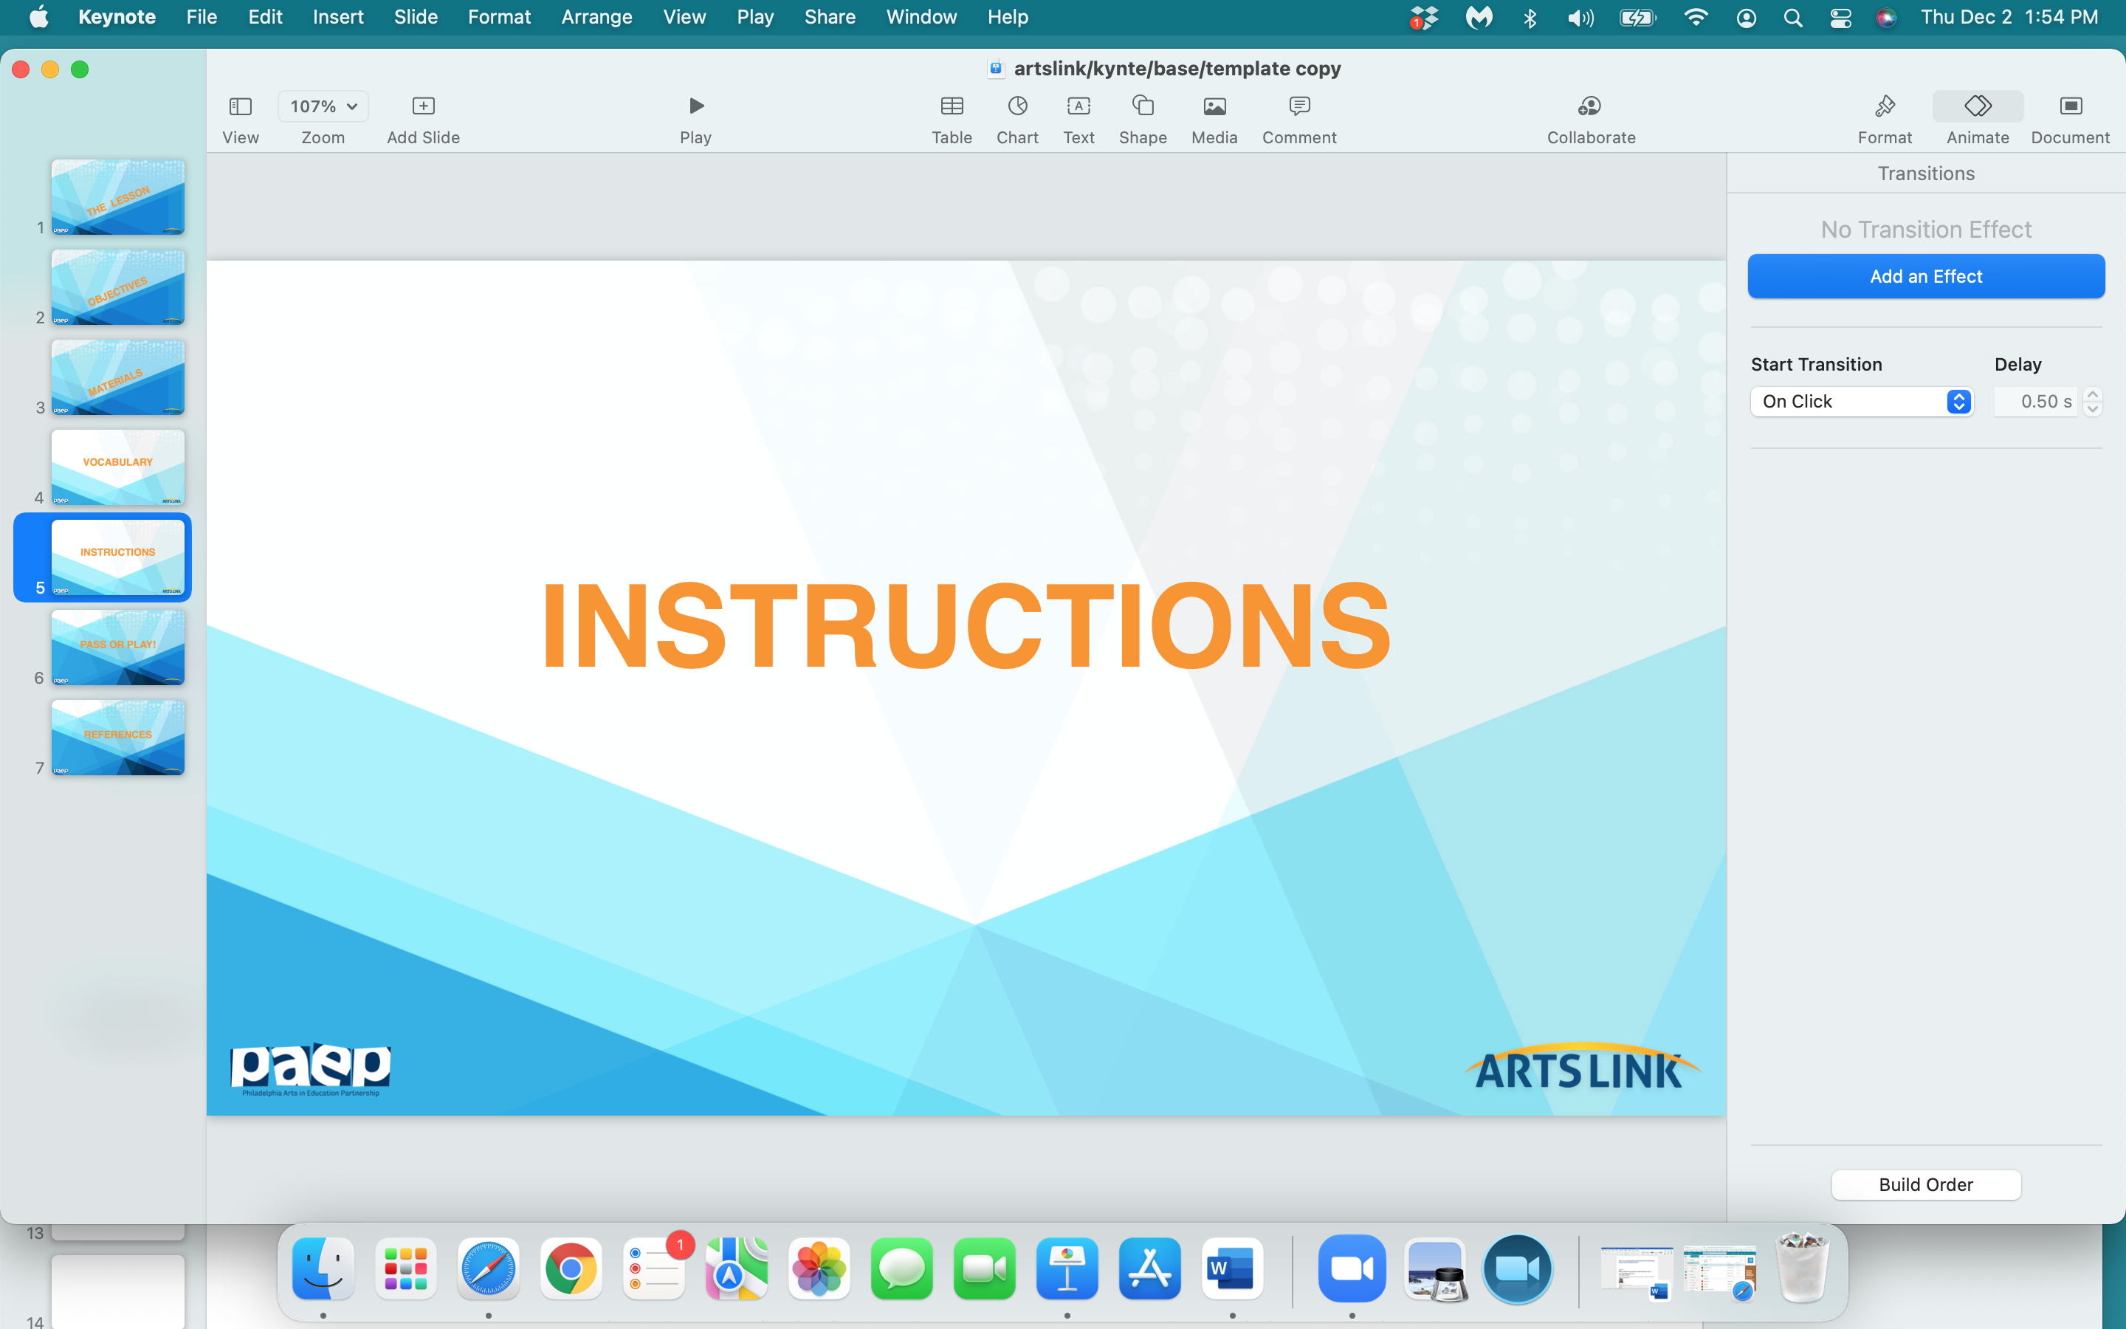

Slide 25
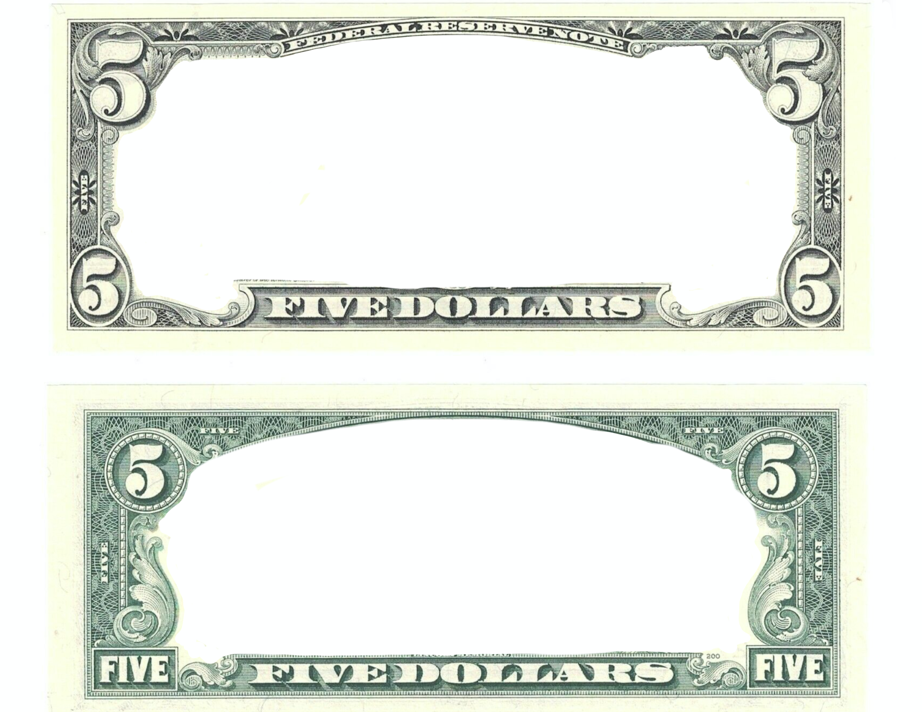
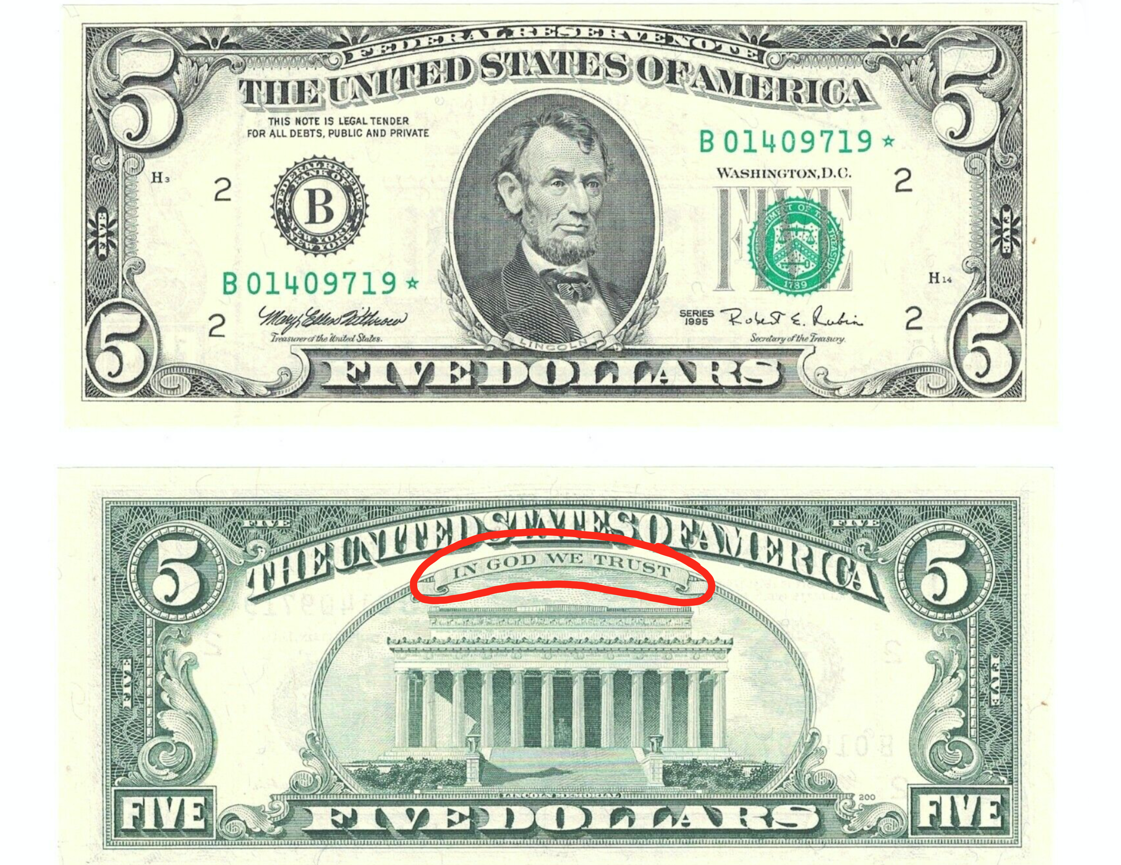
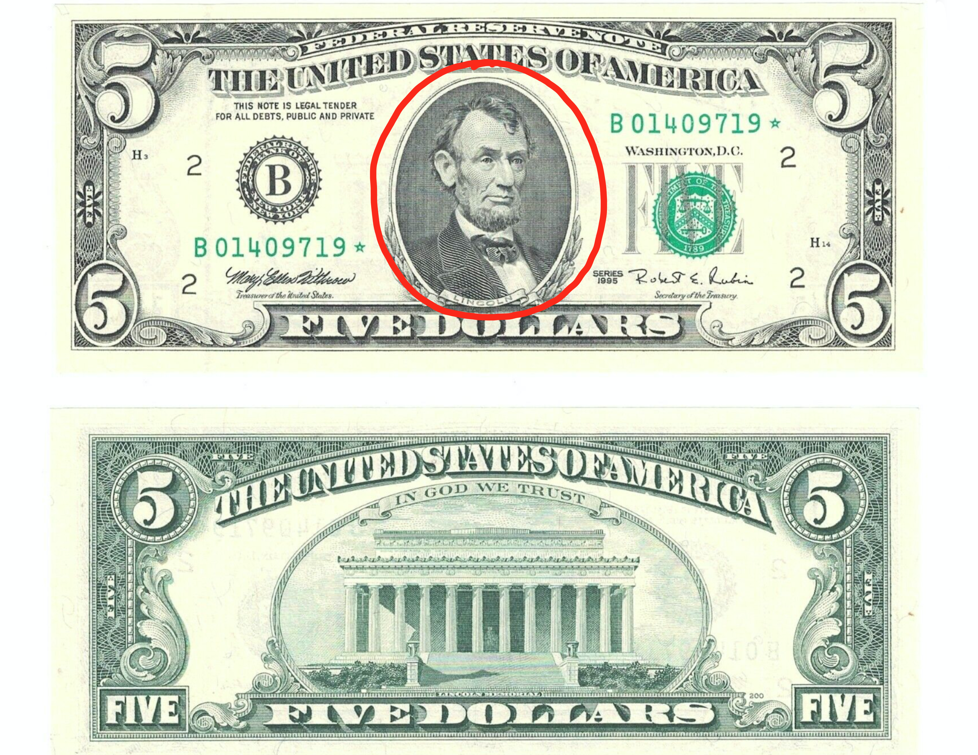
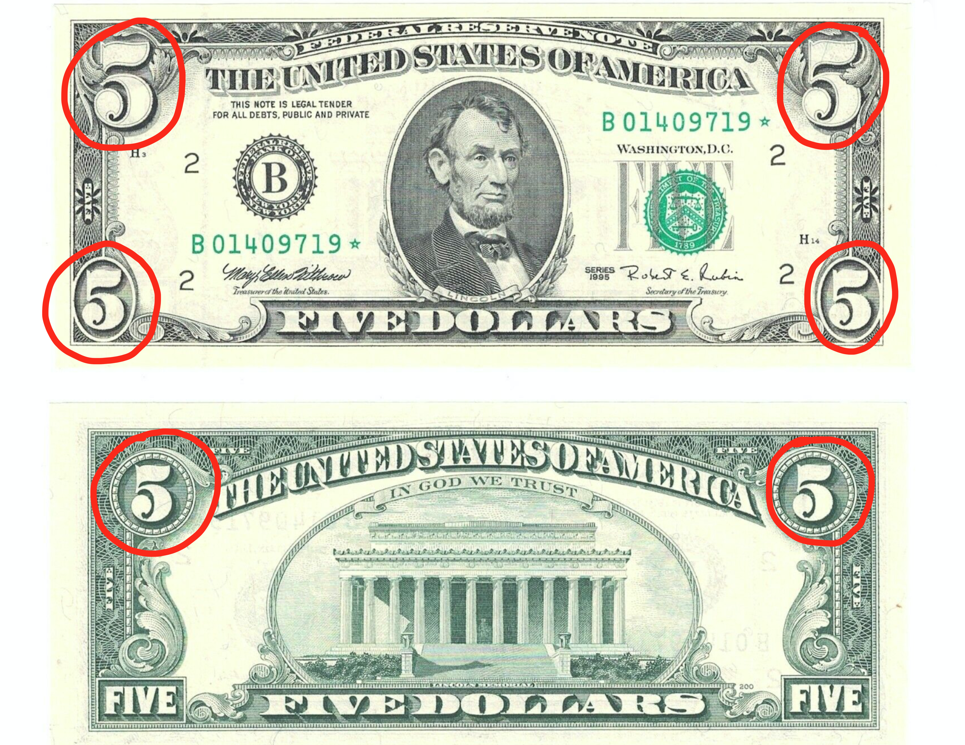

Slide 26
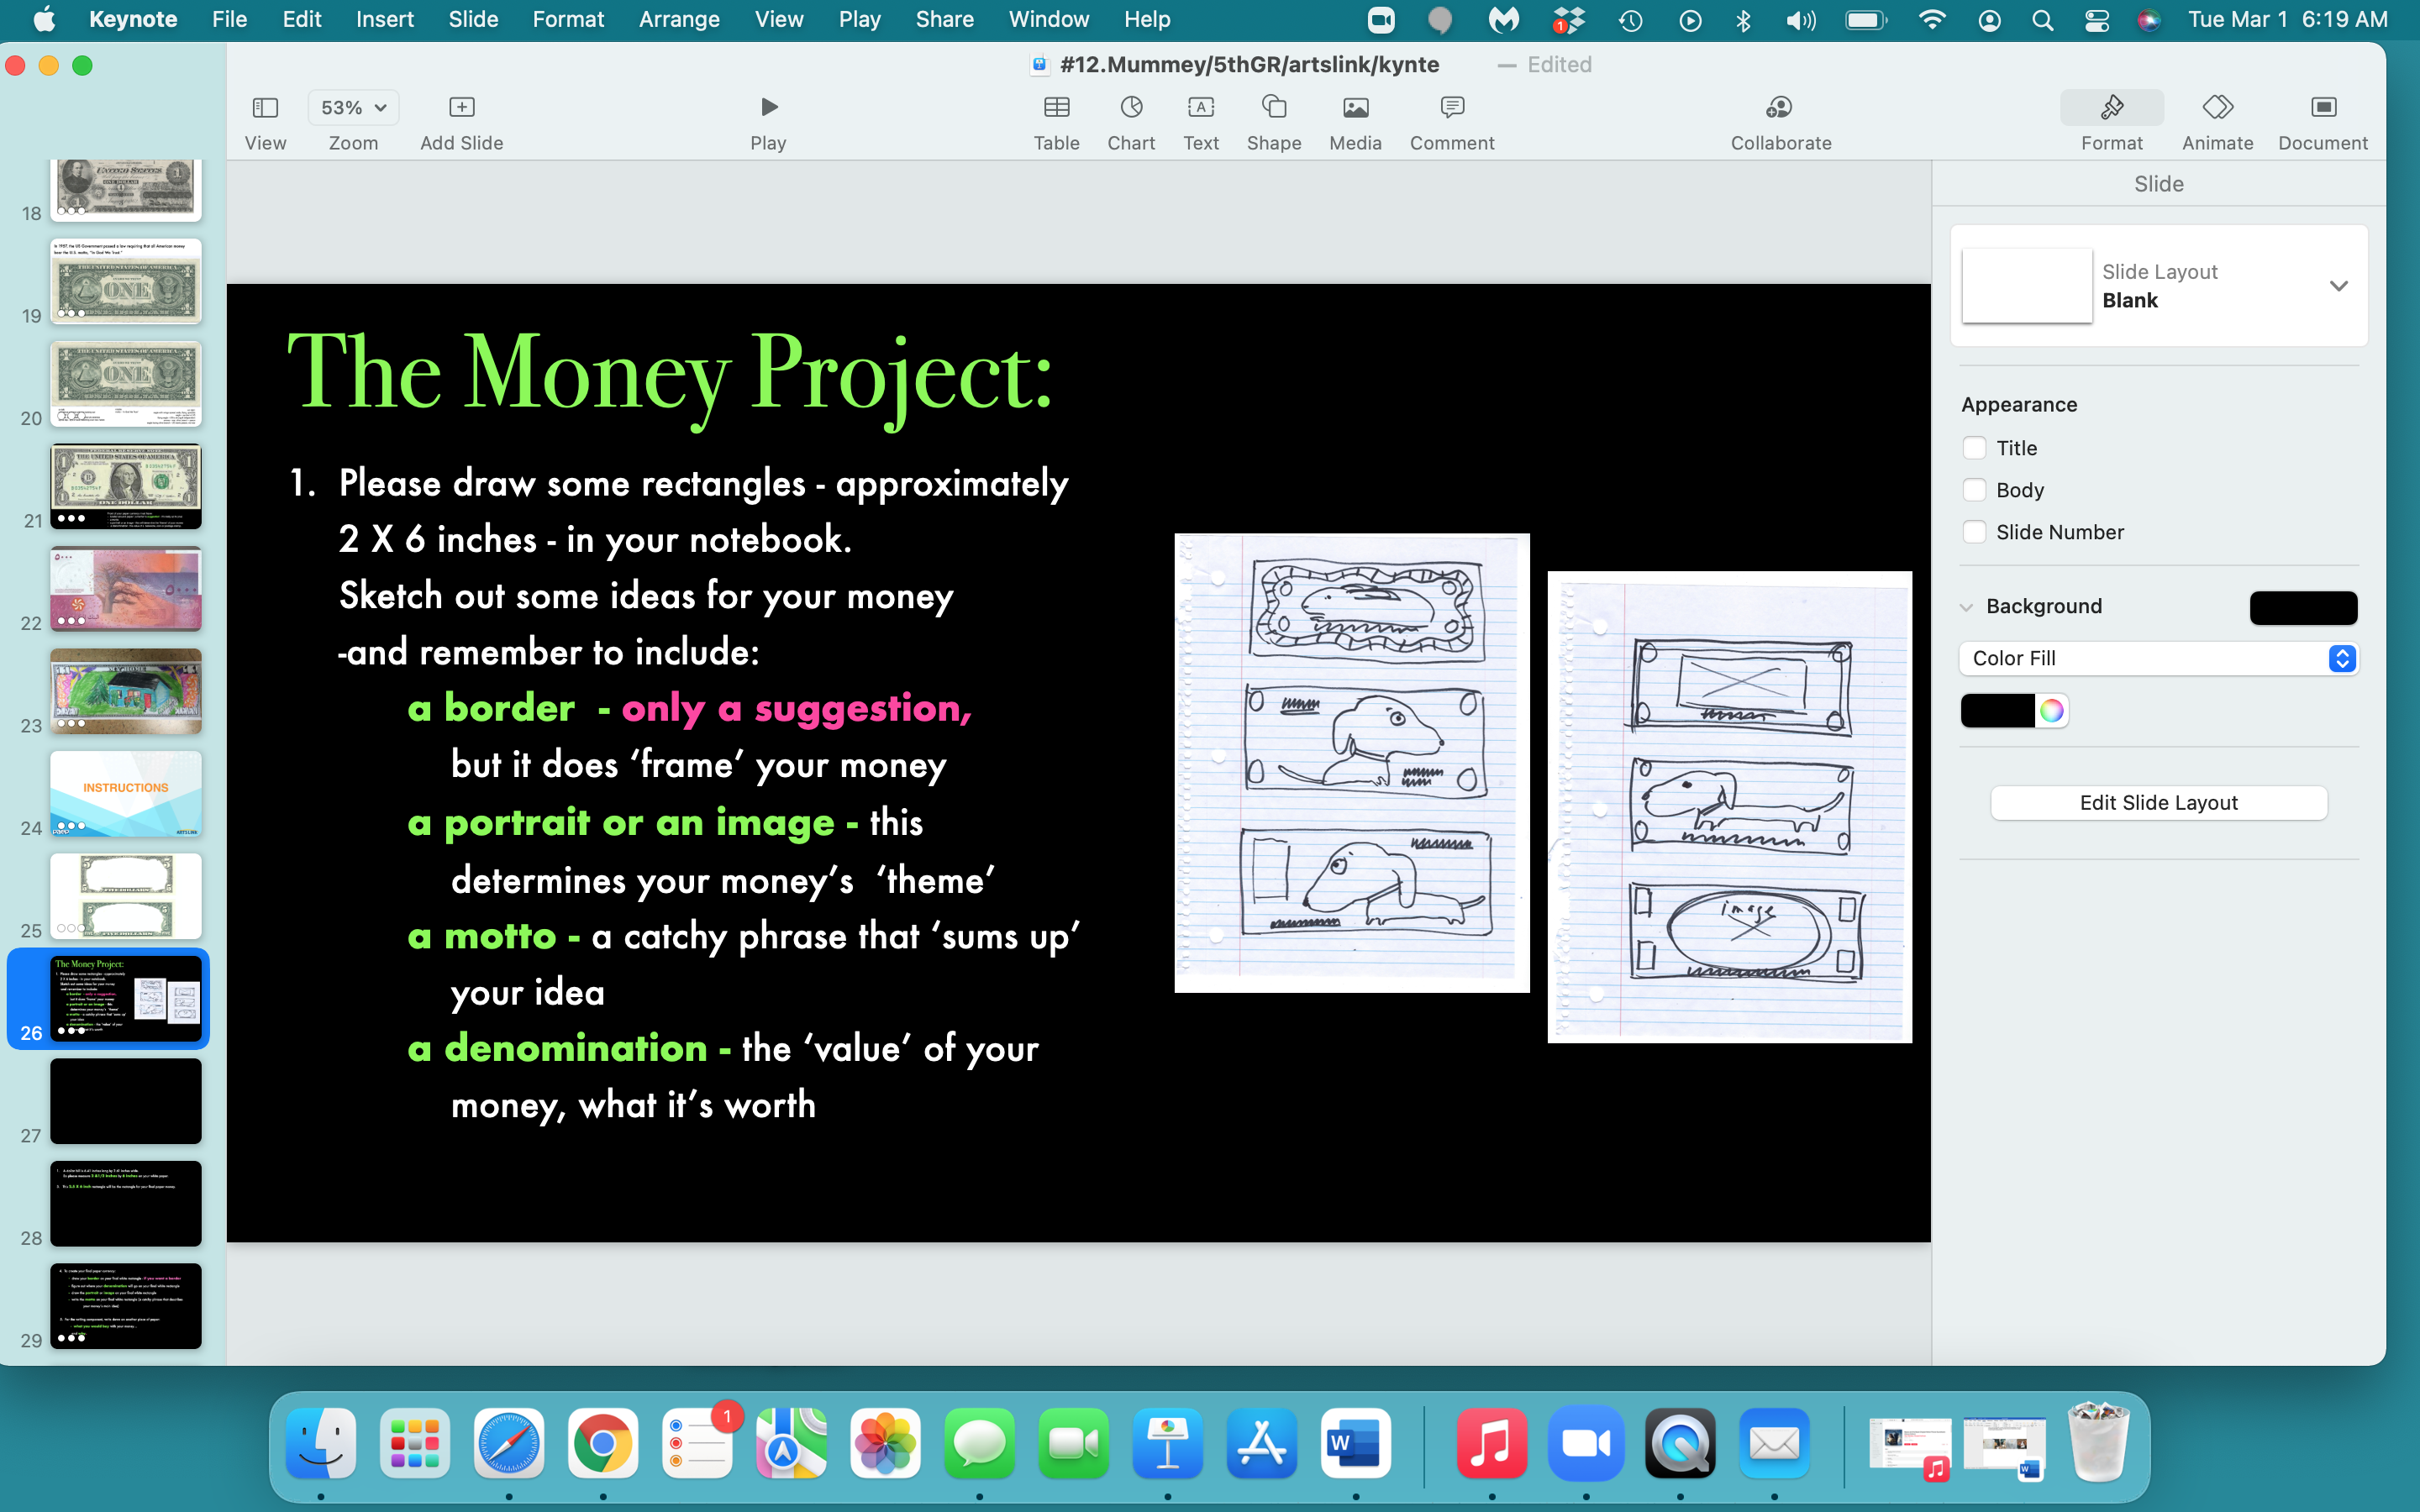

Slide 27
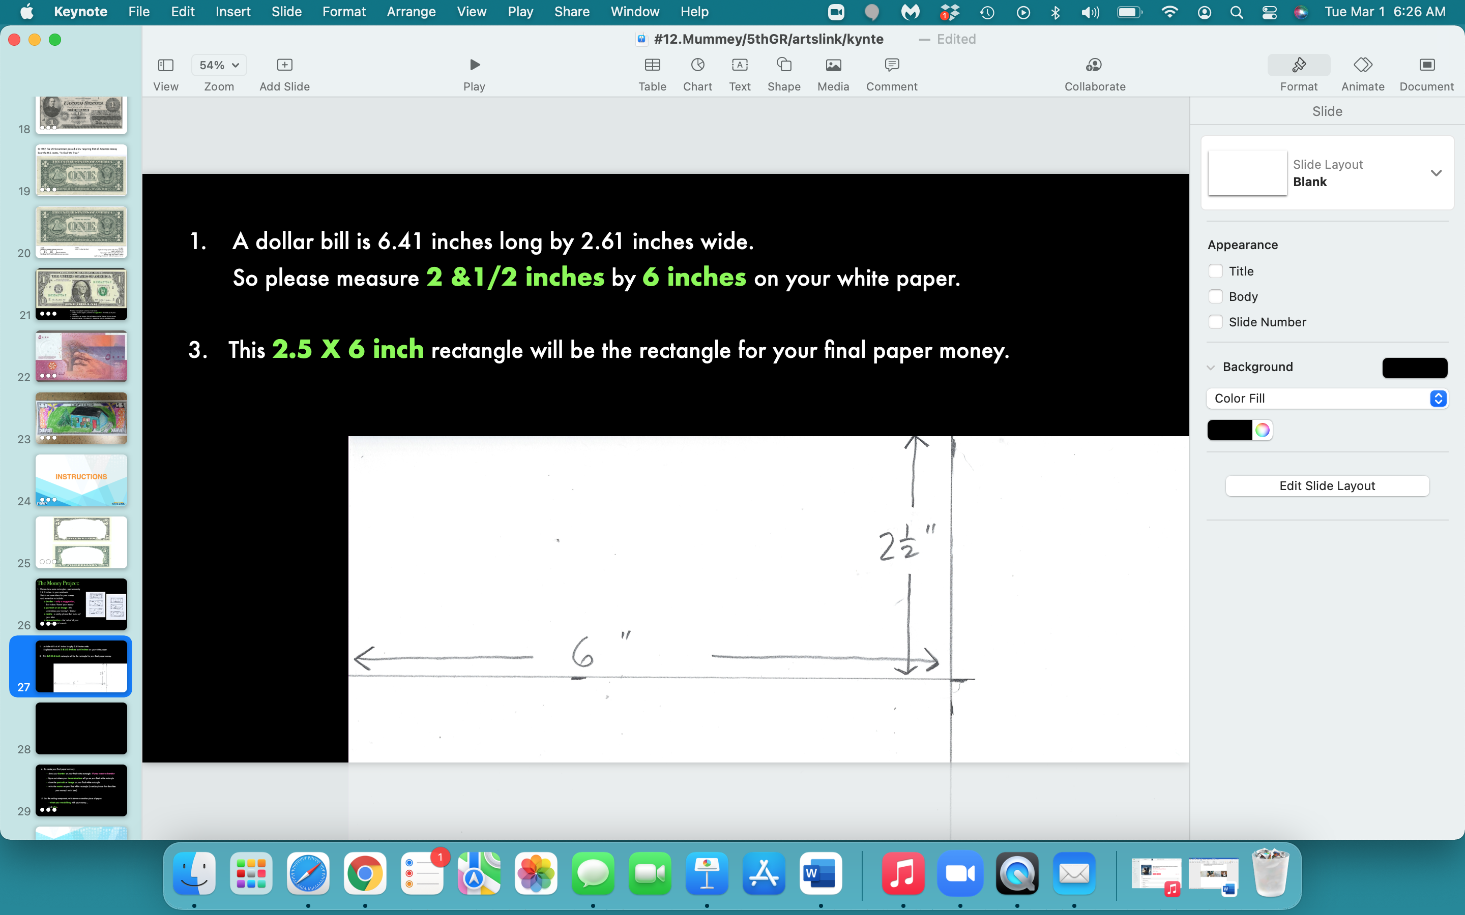

Slide 28
4. So - after you’ve created your money
with an image, a motto
and the denomination of your money
(remember - a border is optional)…
5. Write down on another piece of paper:
- what you would buy with your money…
and why.

Slide 29
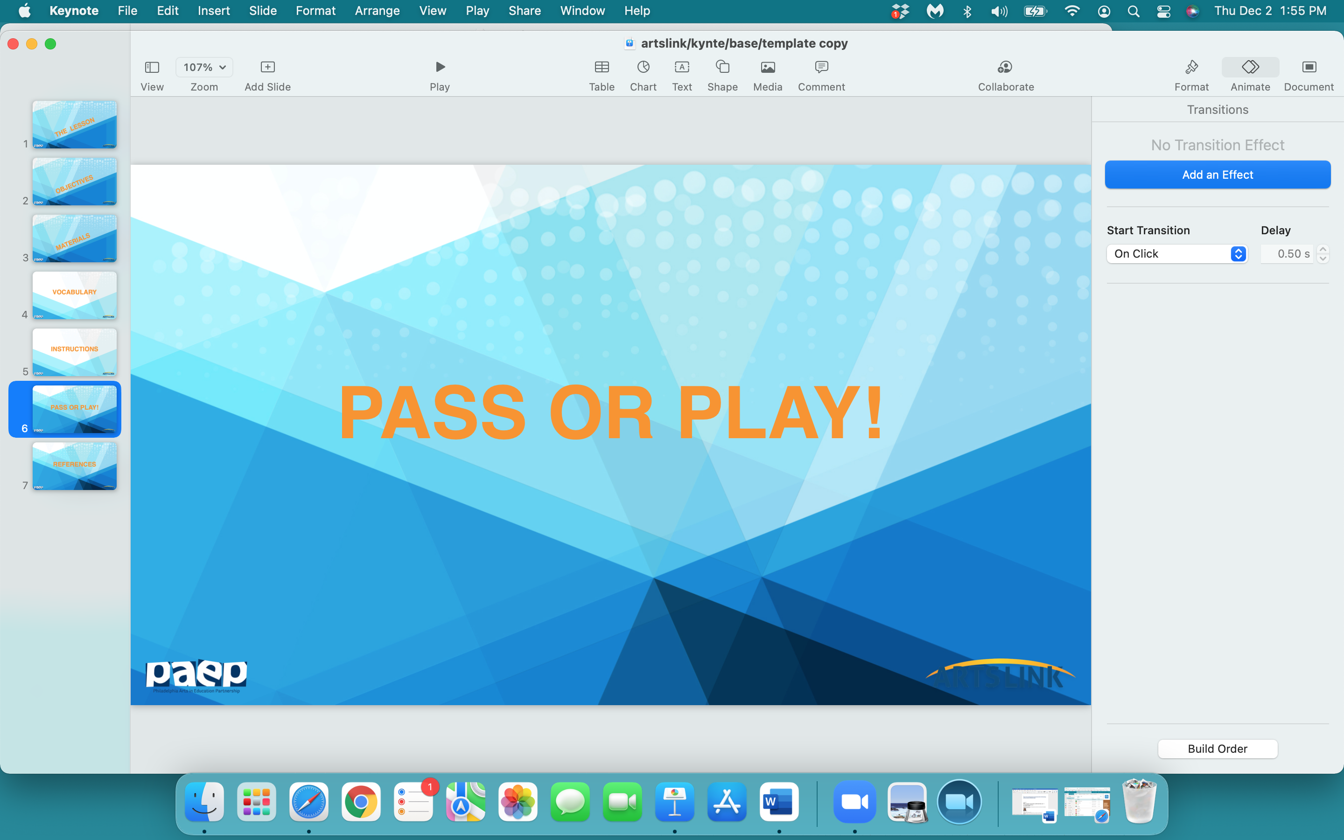

Slide 30
what one thing
did
you
learn
today…pass or play?

Slide 31
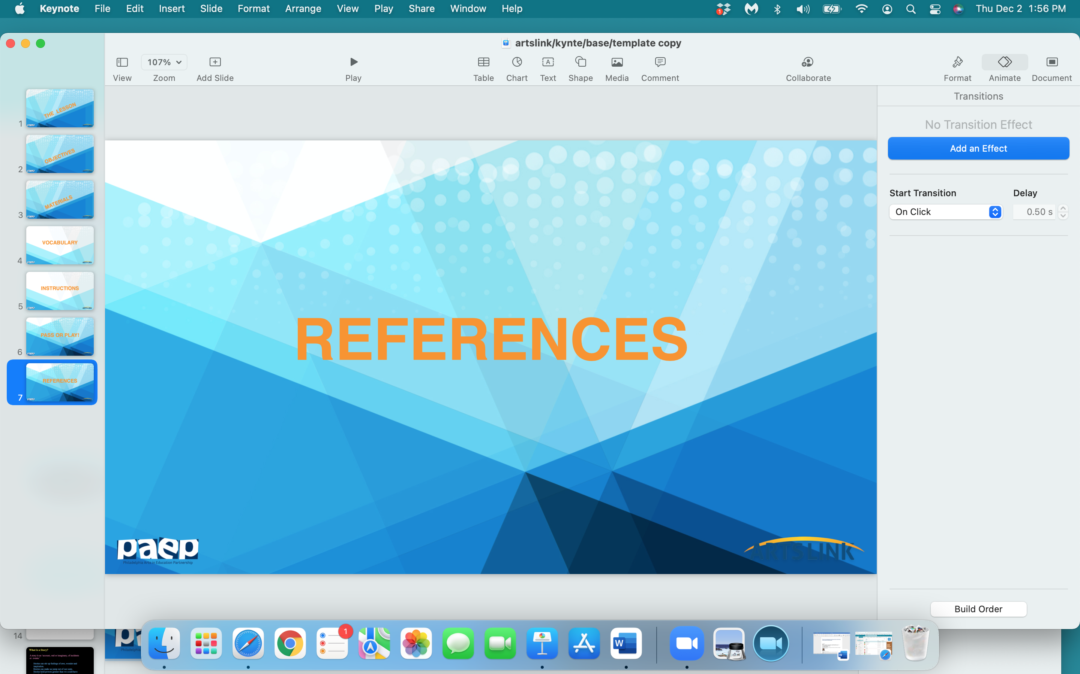

Slide 32
https://amhistory.si.edu/ourstory/pdf/money/money_design.pdf
https://www.education.com/activity/article/design-create-family-money/
https://constitutioncenter.org/learn/educational-resources/activities/design-your-own-dollar-bill
https://www.youtube.com/watch?v=-IBHbe-t-X4
https://99designs.com/blog/creative-inspiration/20-examples-worlds-best-currency-design/
https://www.vintag.es/2018/08/american-money-design.html
https://www.incredibleart.org/lessons/middle/alix-super.htm

