Slide 1
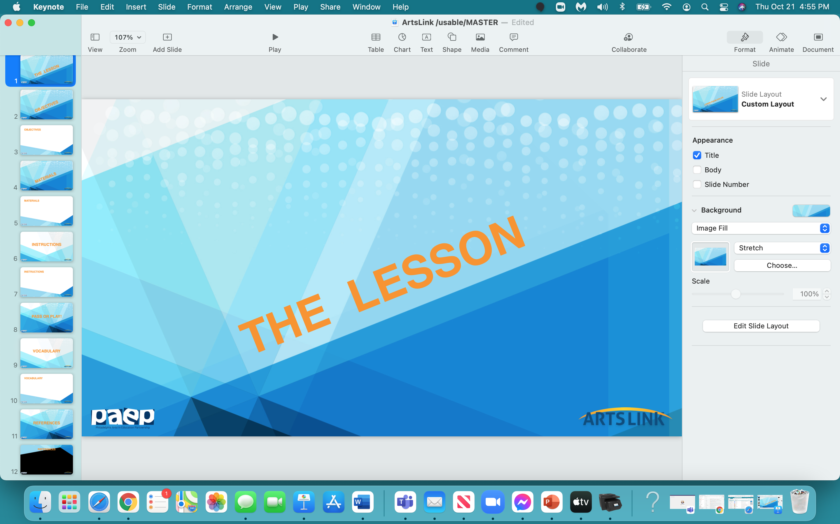

Slide 2
3 - D
Onomato
poeia

Slide 3


Slide 4
In the next hour, we will:
- understand what Pop Art is
- understand the work of Roy Lichtenstein and his art
- understand and use onomatopoeia in a 3-D Word Project

Slide 5


Slide 6
pad of construction paper
2 sheets of white drawing paper
scissors
black marker
glue stick
pencil
eraser
markers

Slide 7
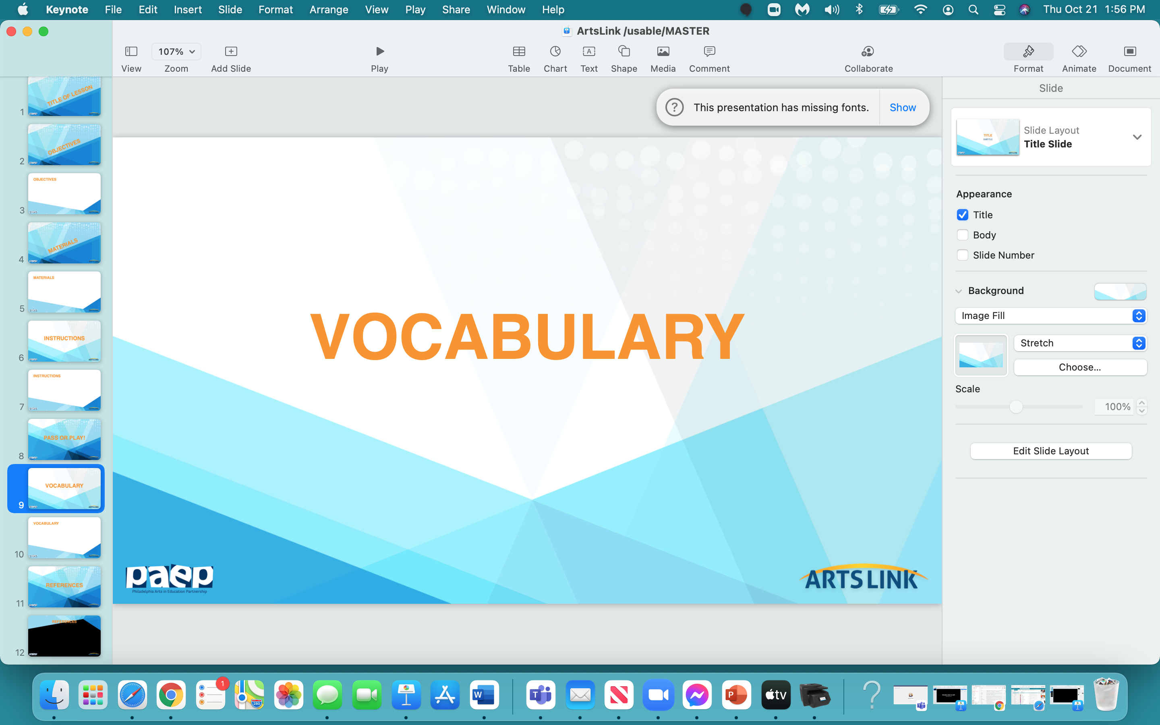

Slide 8
Pop Art
Roy Lichtenstein
onomatopoeia
Ben-Day dots

Slide 9
onomatopoeia: a word that imitates sounds
Can you think of an example of an onomatopoeia
word?
Why do we use onomatopoeia words?
These words create very powerful images,
or feelings -
to make you feel as if you’re in the story.
Onomatopoeia words help you ‘hear’ what’s going on
in the story…they make the story more ‘real’.

Slide 10
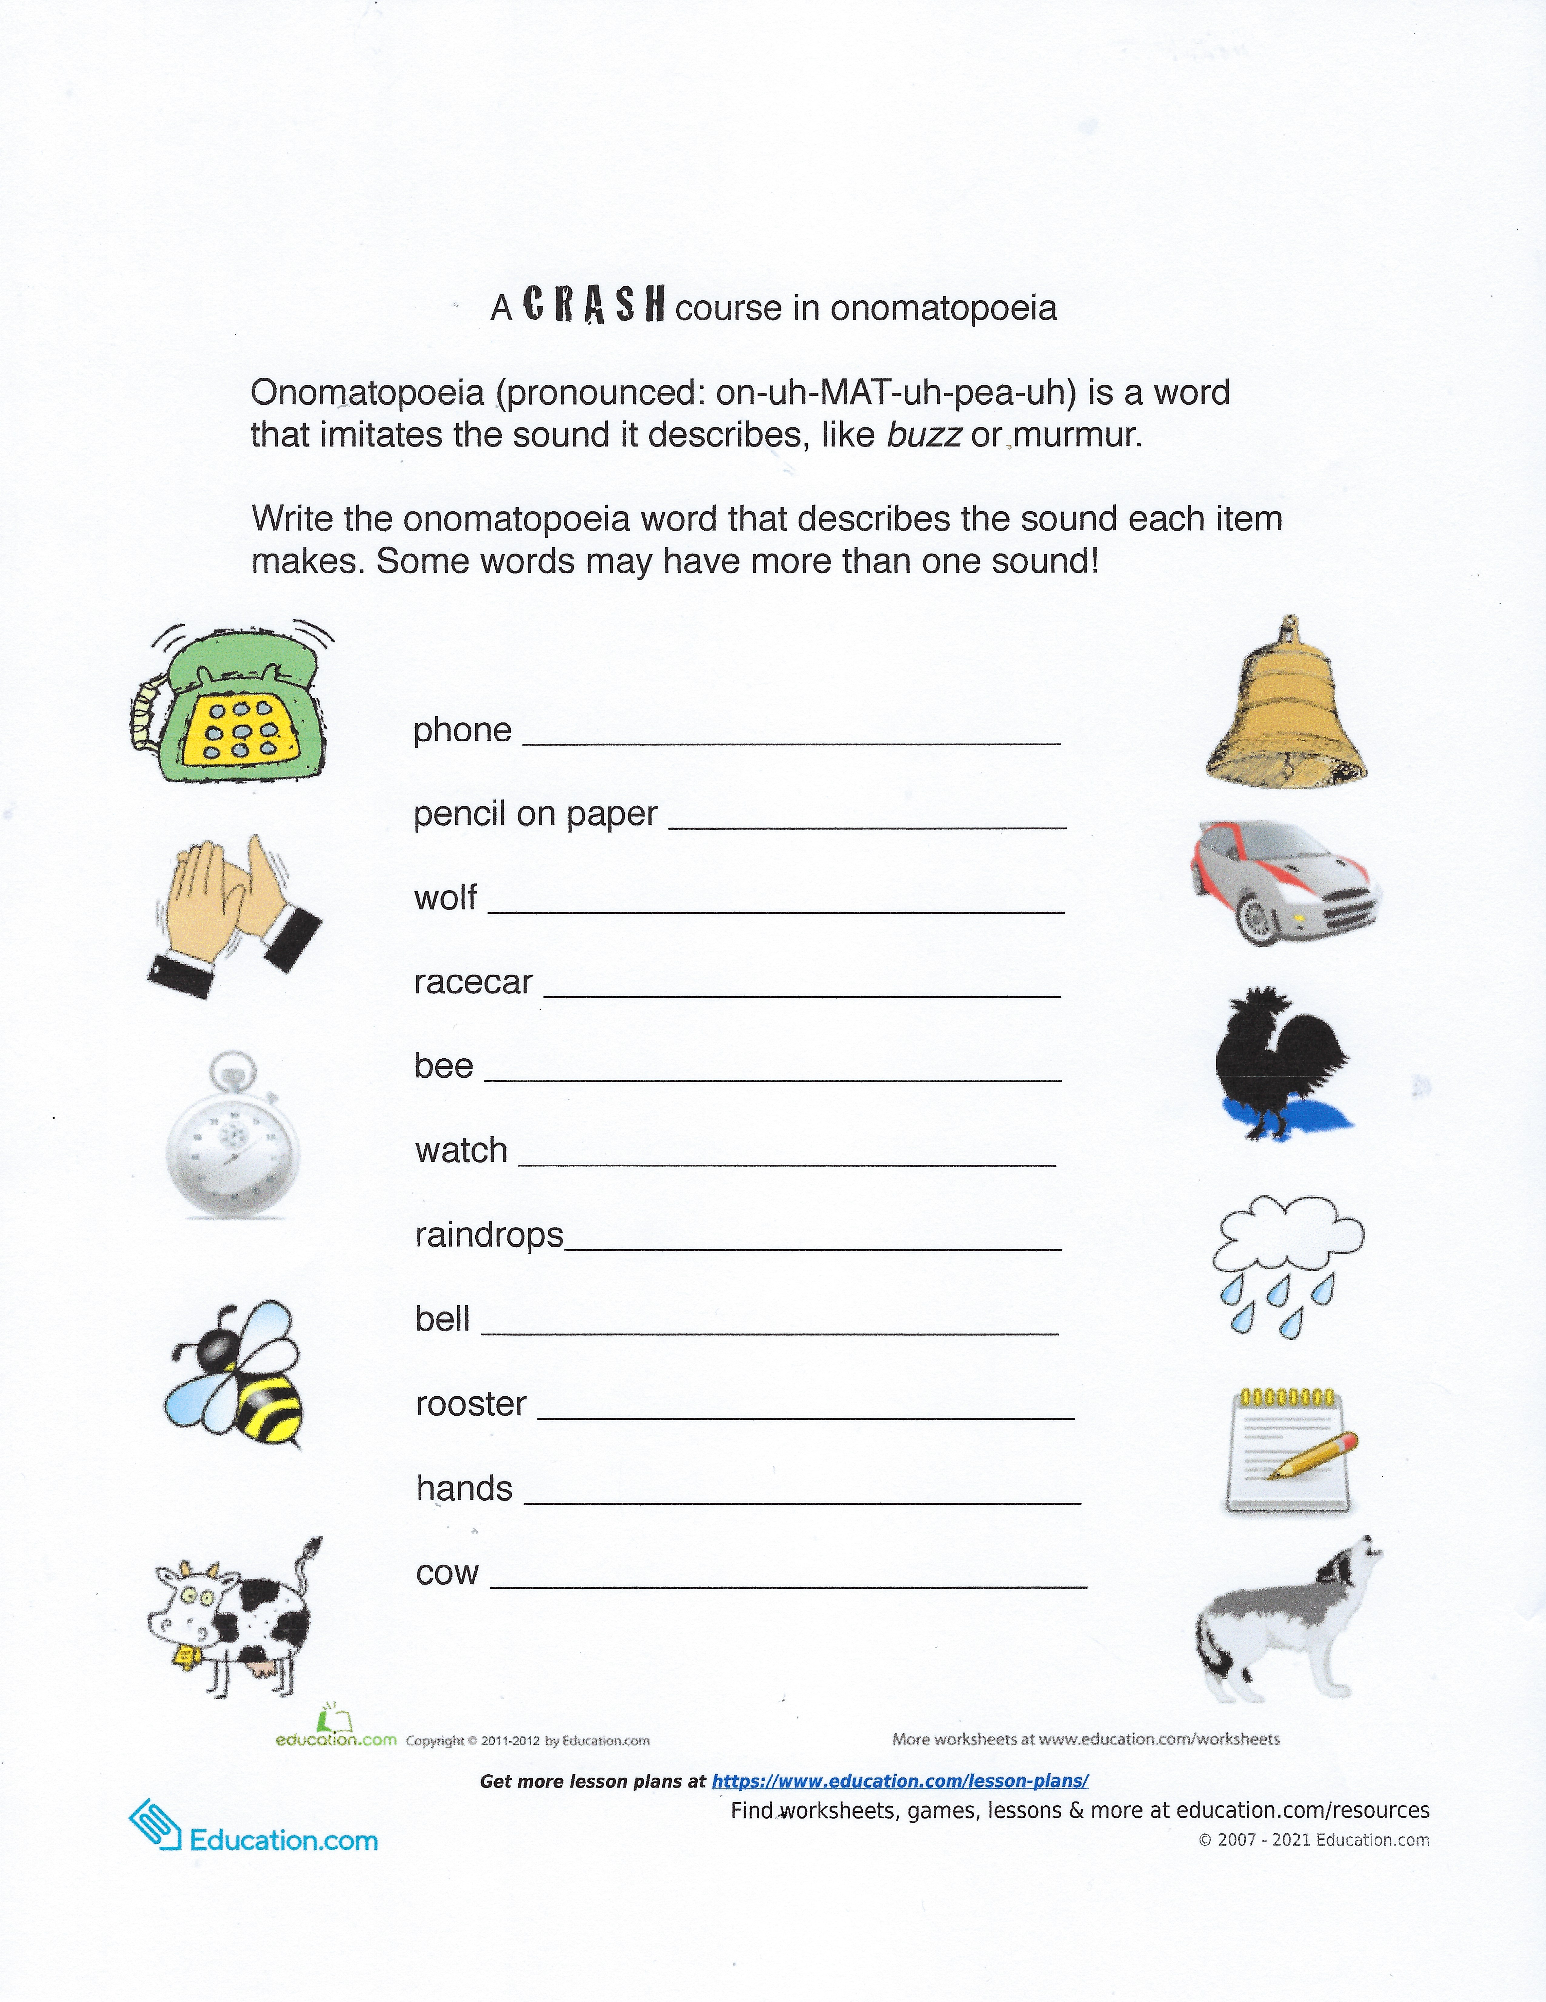
ring
scratch
howl
zoom, vroom
buzz
tick tock
pitter pitter, drip, drop
ding dong
cock a doodle doo
clap
moo

Slide 11
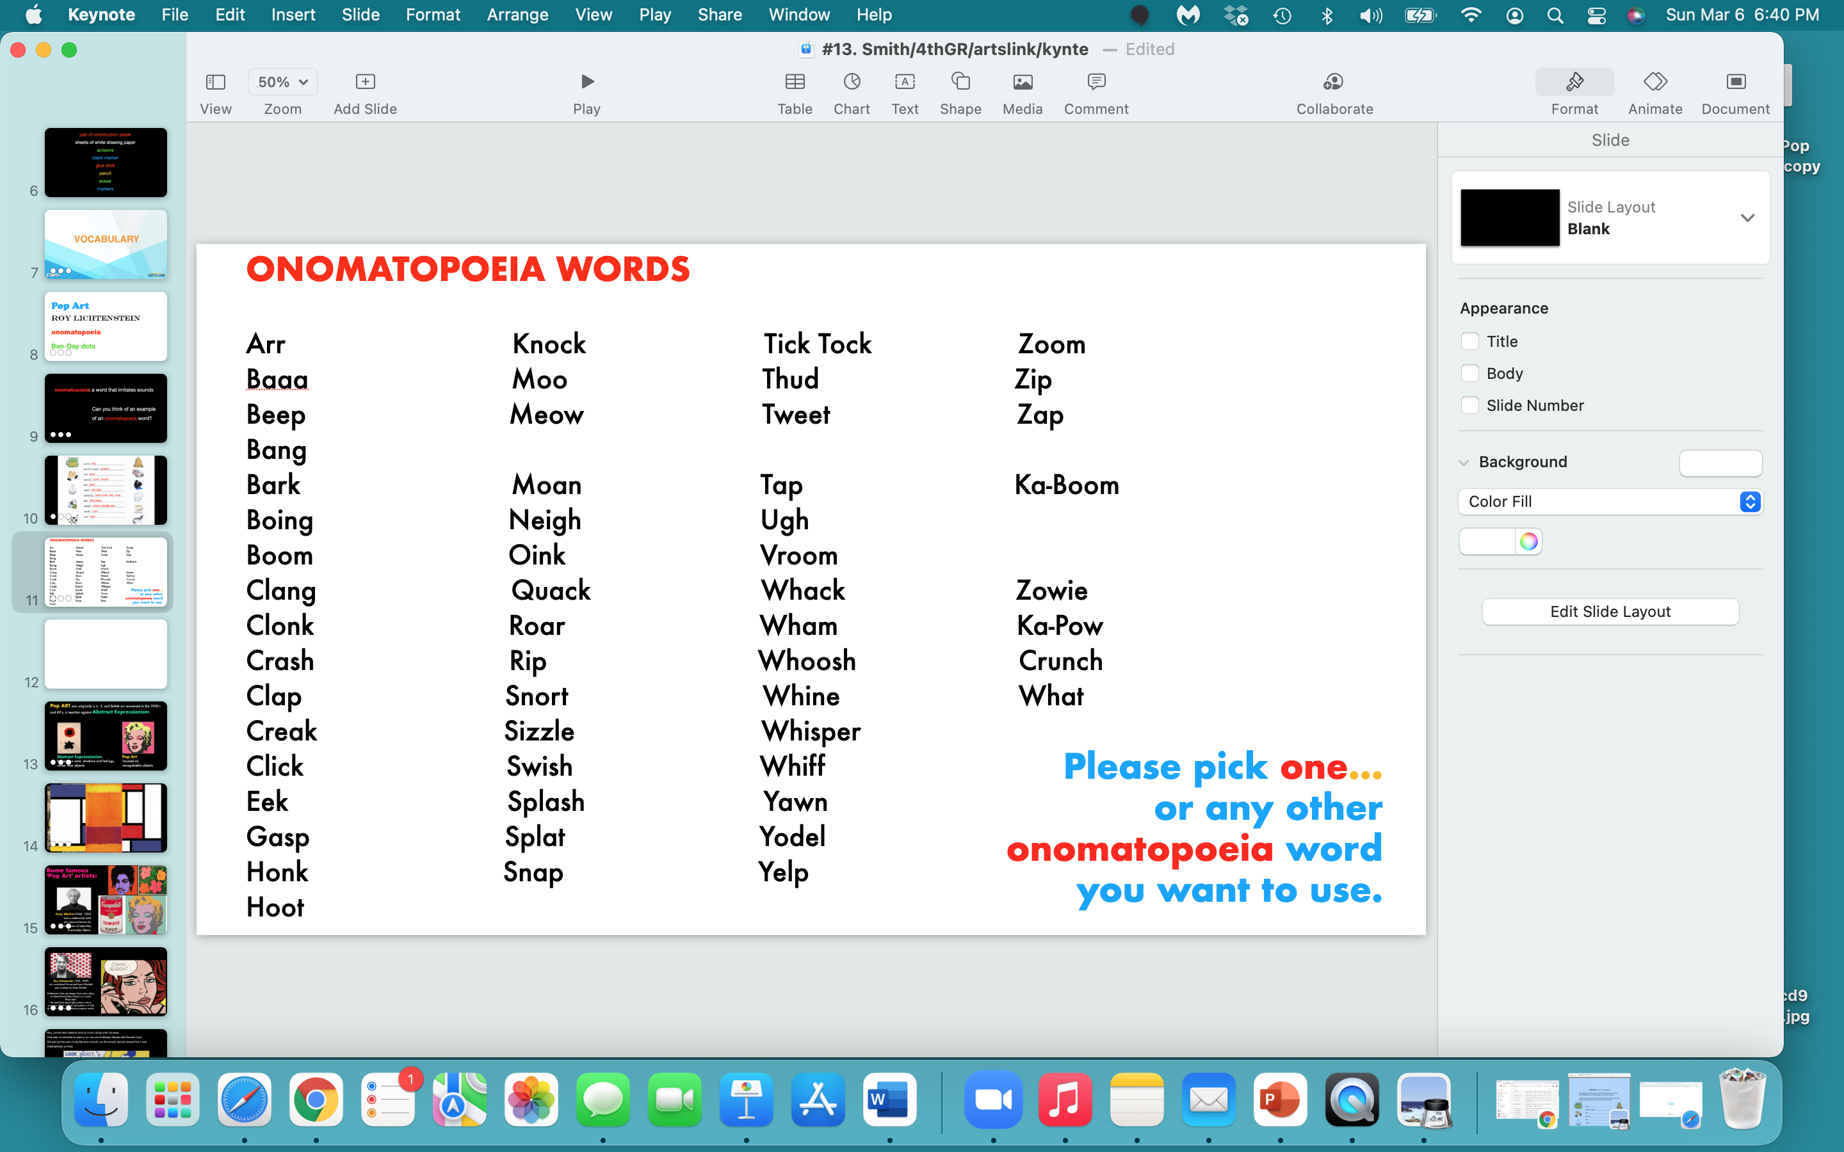

Slide 12
Write the word you picked -
in some form of bubble type,
or any type that you like
(make up your own type) -
on a piece of white drawing paper -
but make sure all the letters in your word
CONNECT.
Draw it BIG!

Slide 13
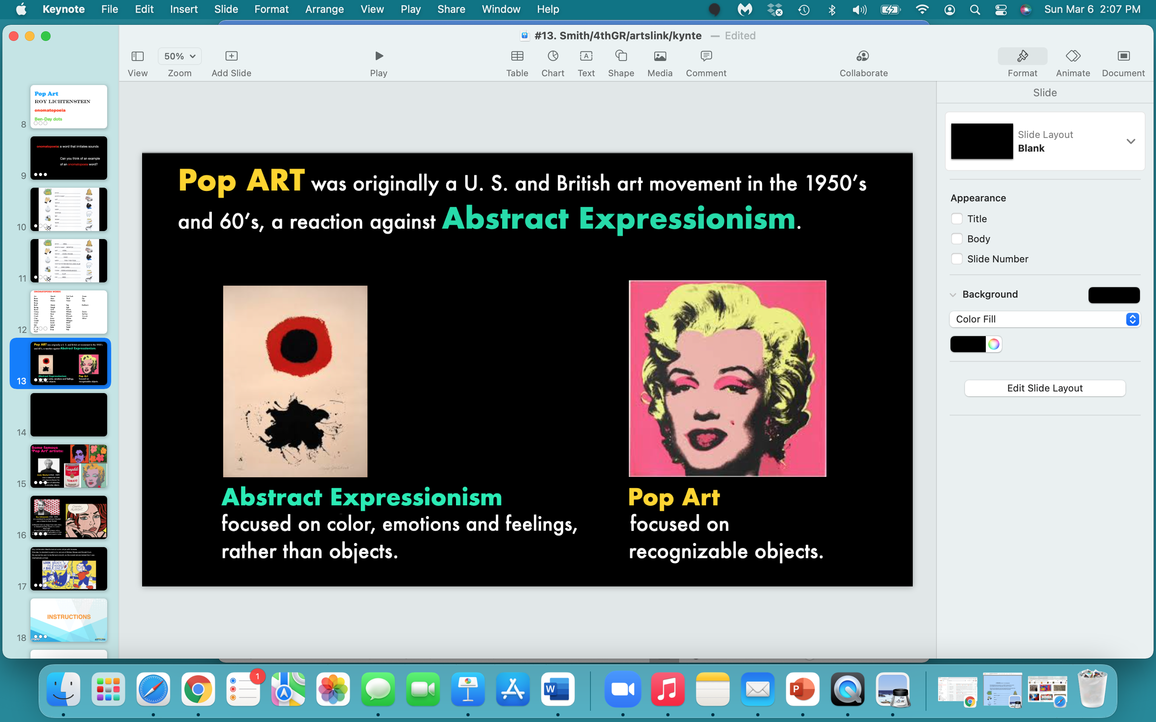

Slide 14
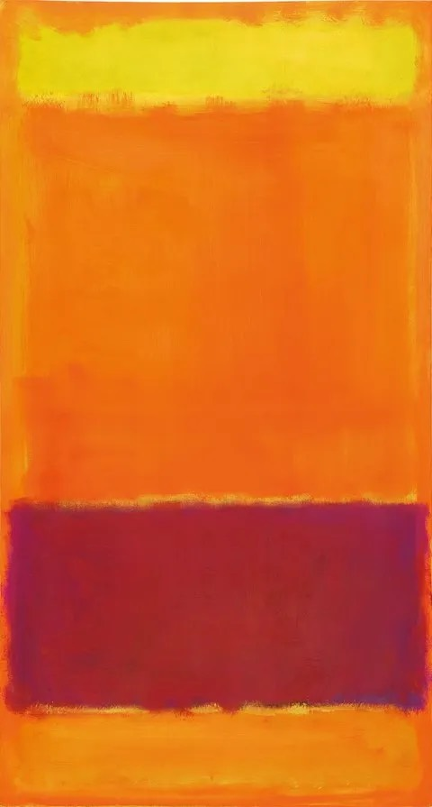
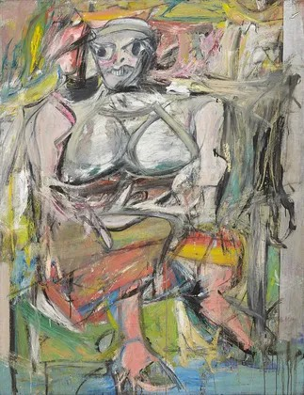

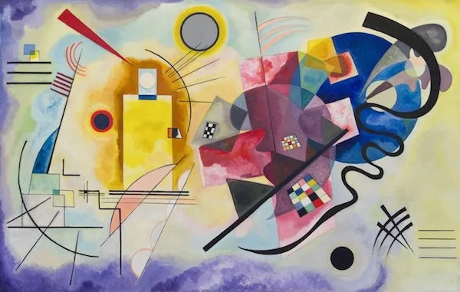
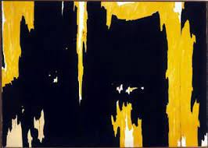
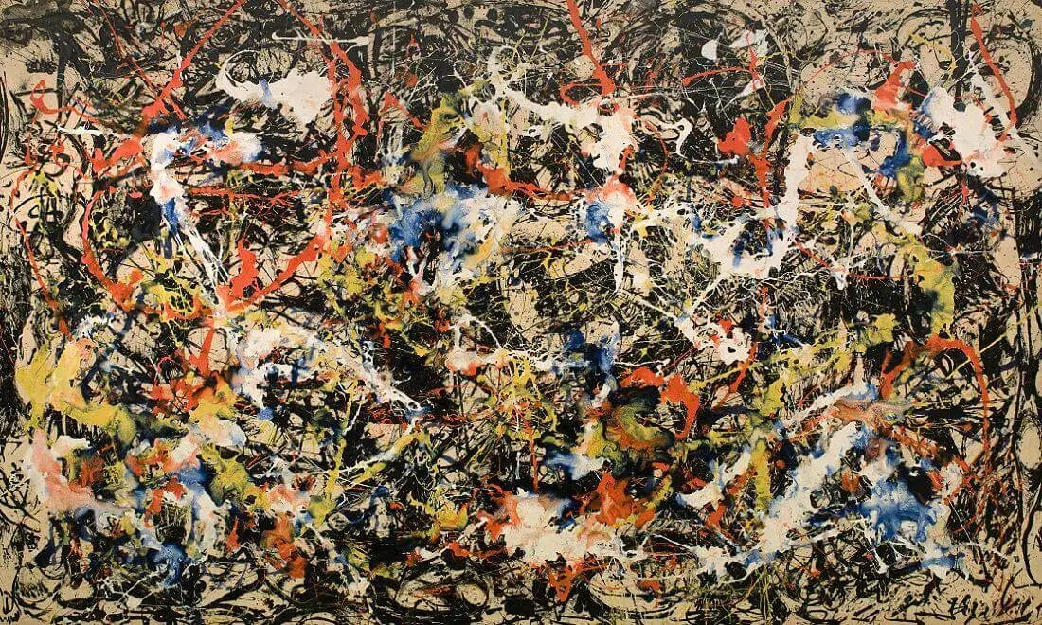

Slide 15
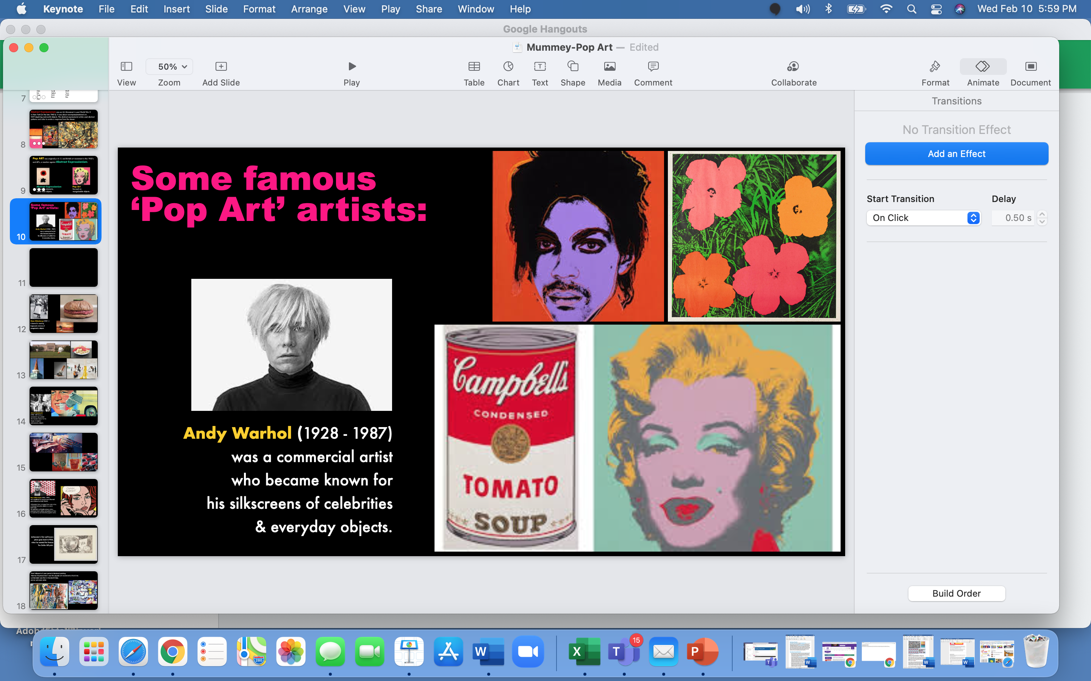

Slide 16
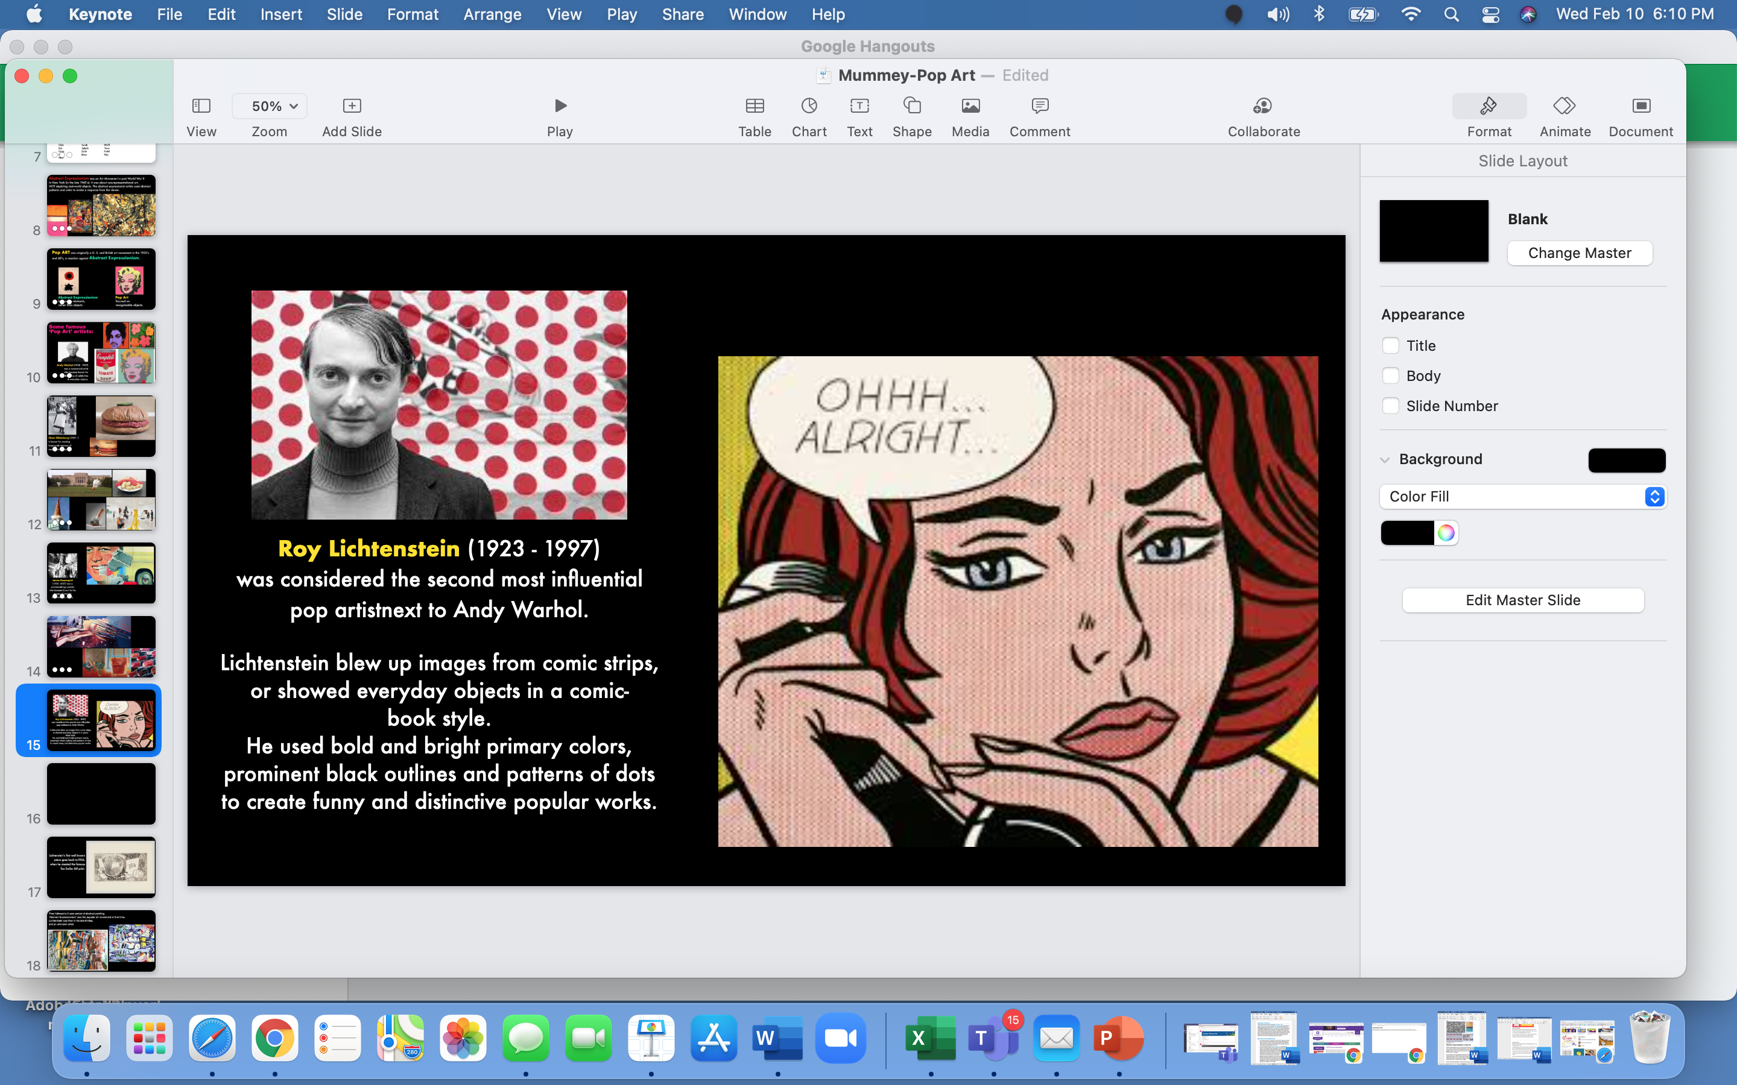

Slide 17
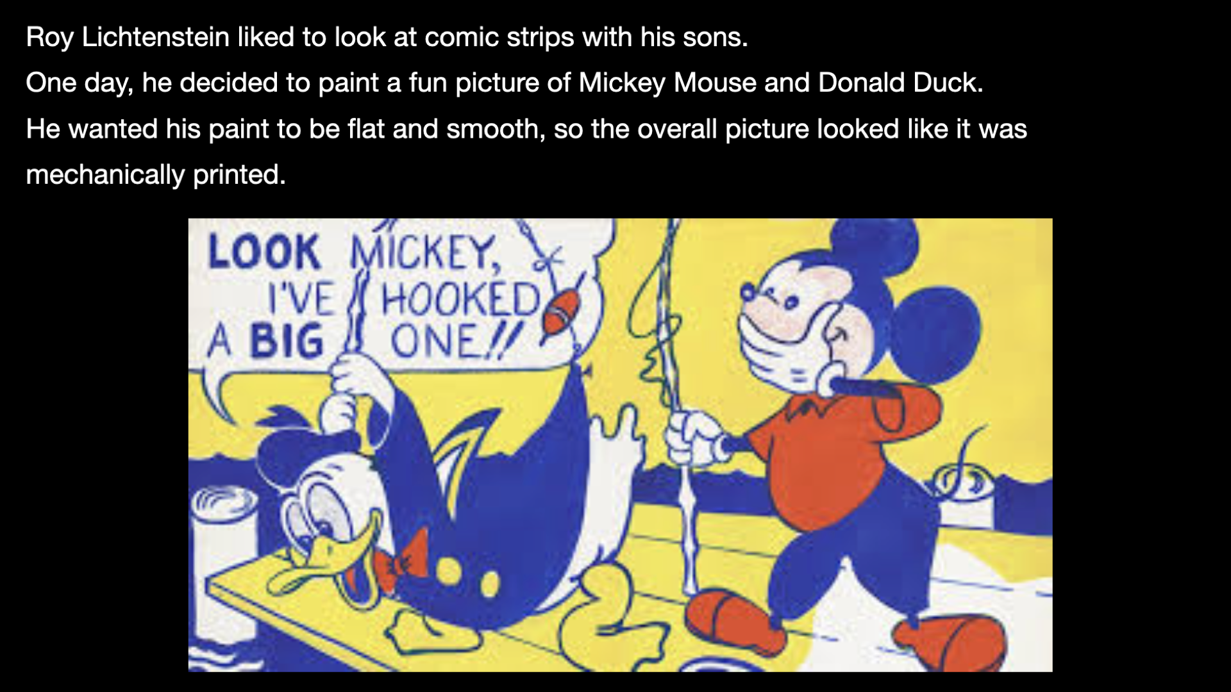

Slide 18
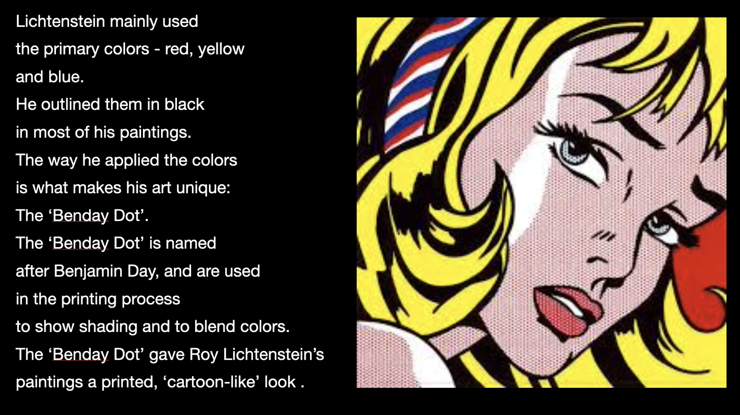

Slide 19
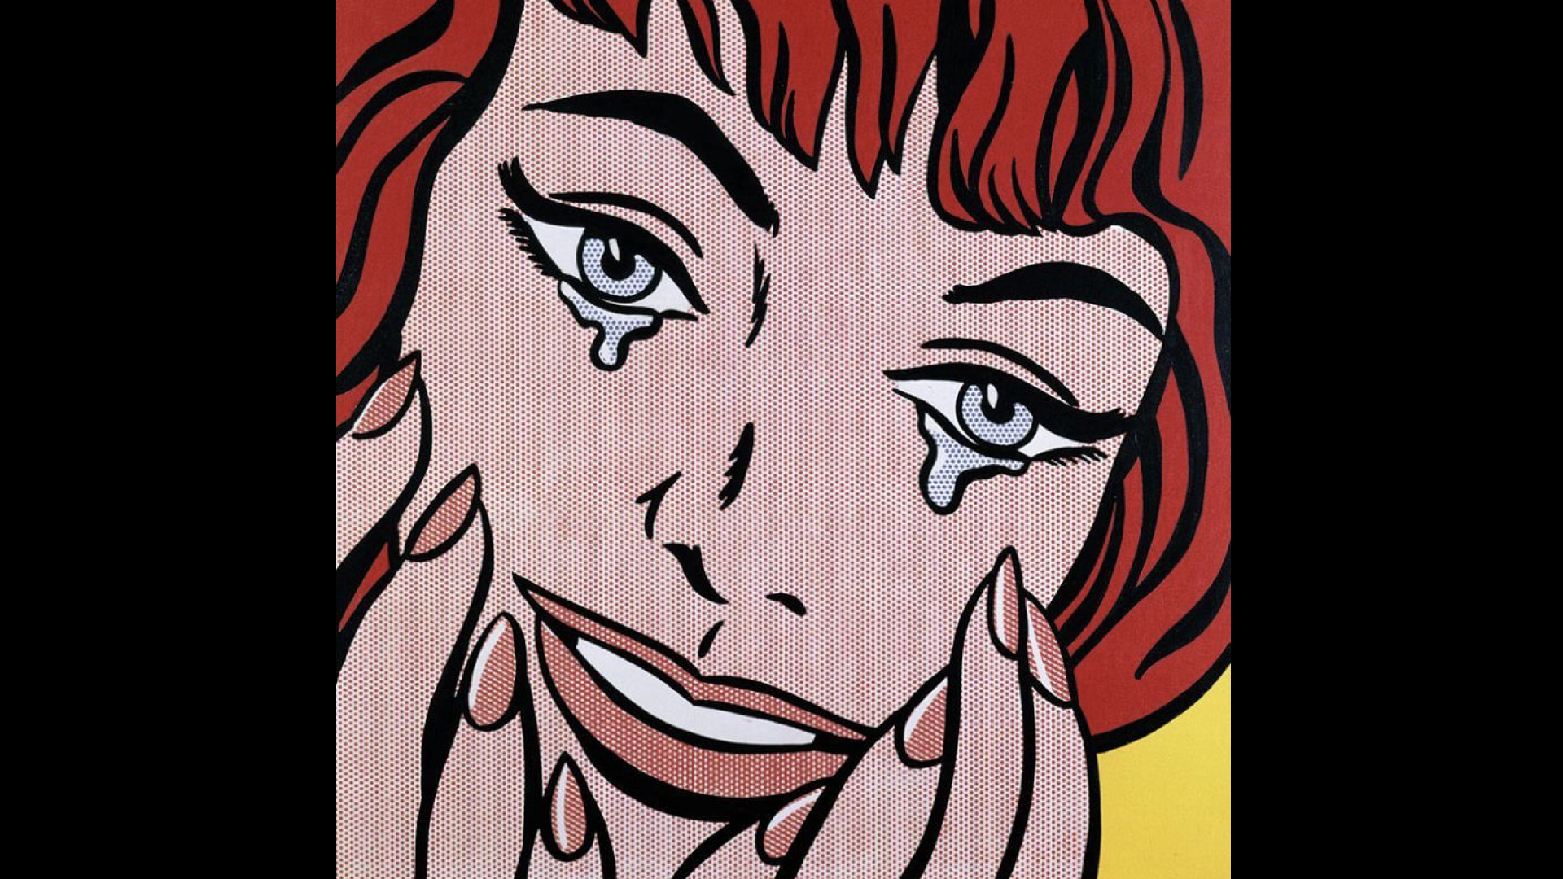

Slide 20
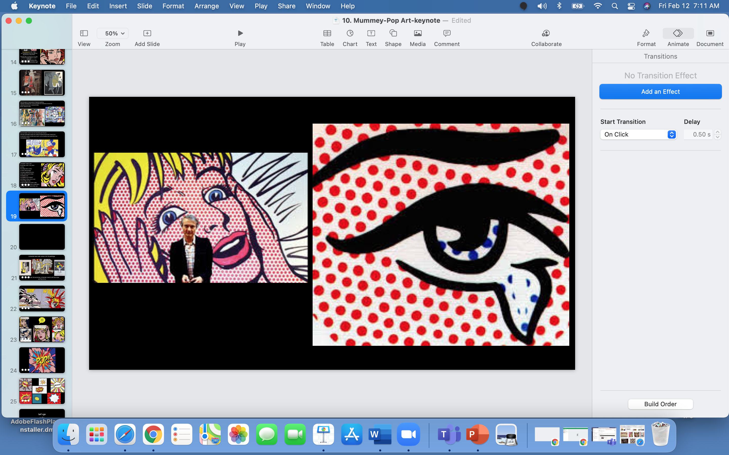

Slide 21
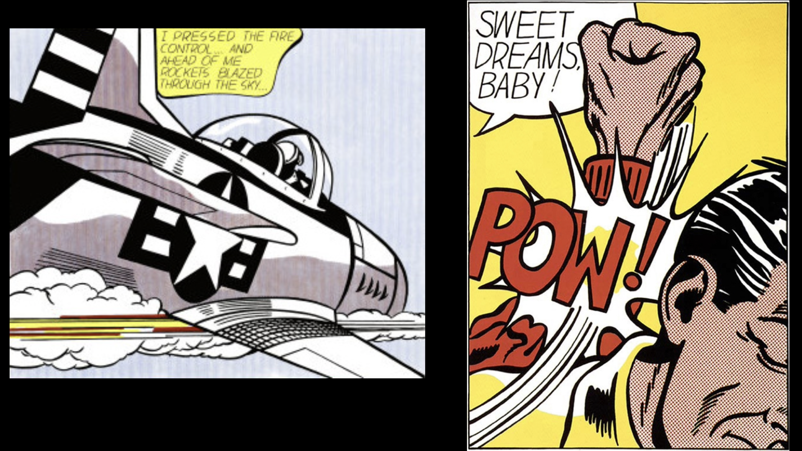

Slide 22
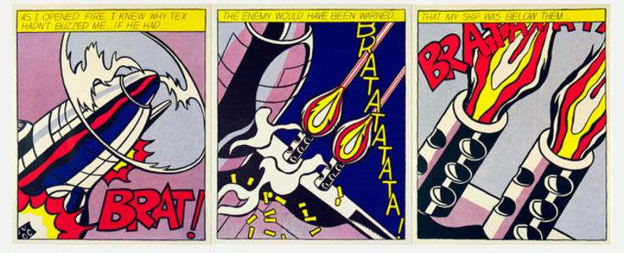

Slide 23
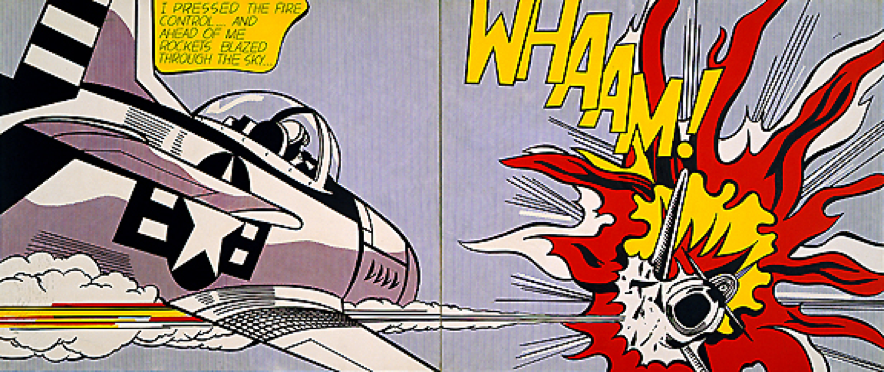
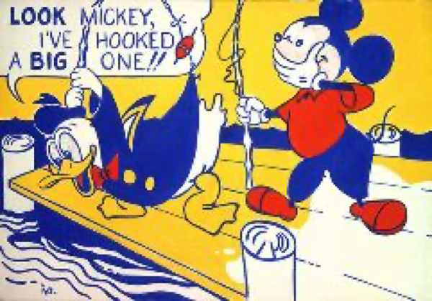

Slide 24
Examples
of Student
3-D Word Art -
using
an onomatopoeia word

Slide 25
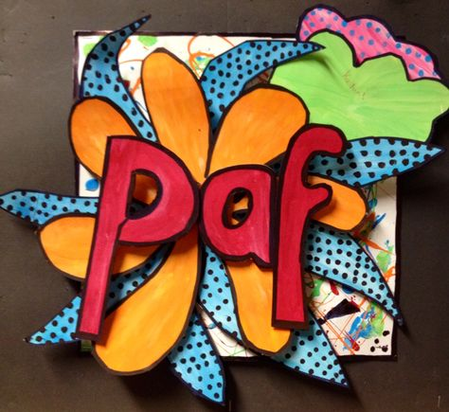
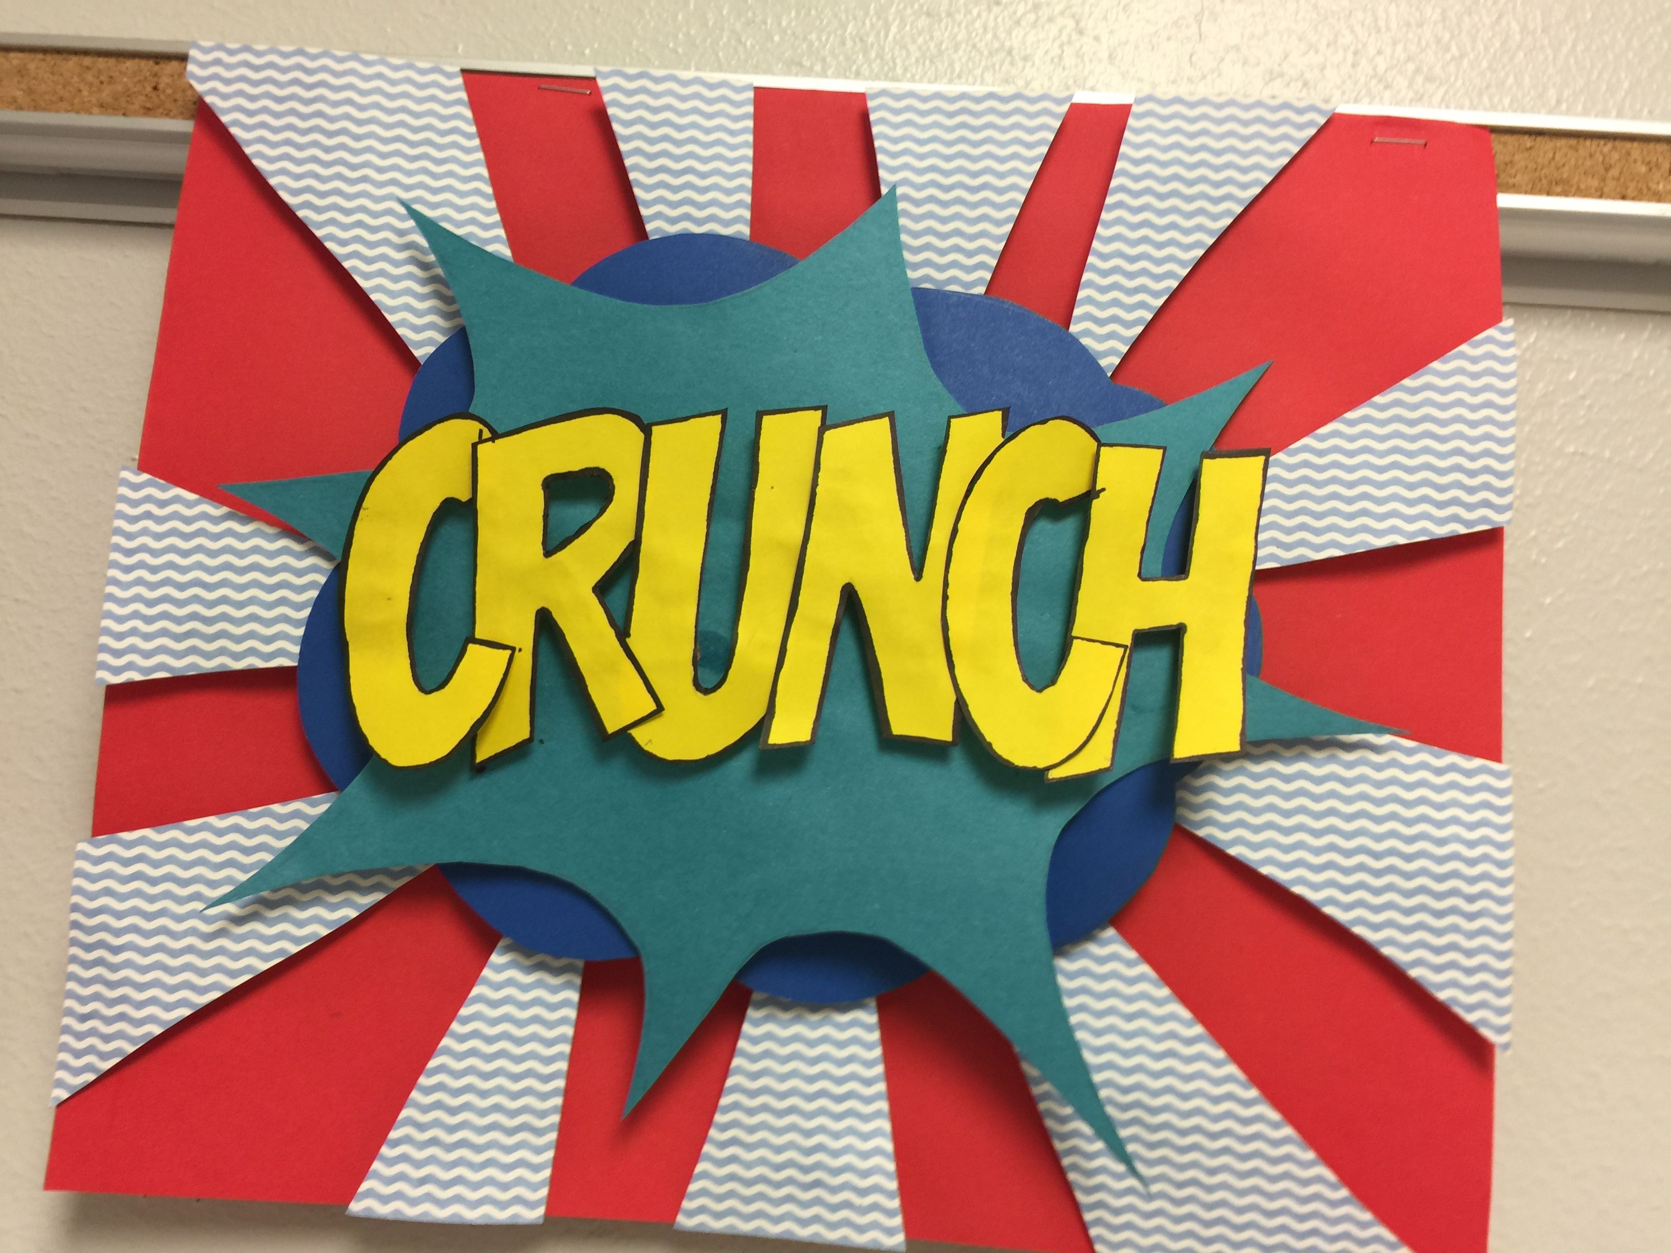
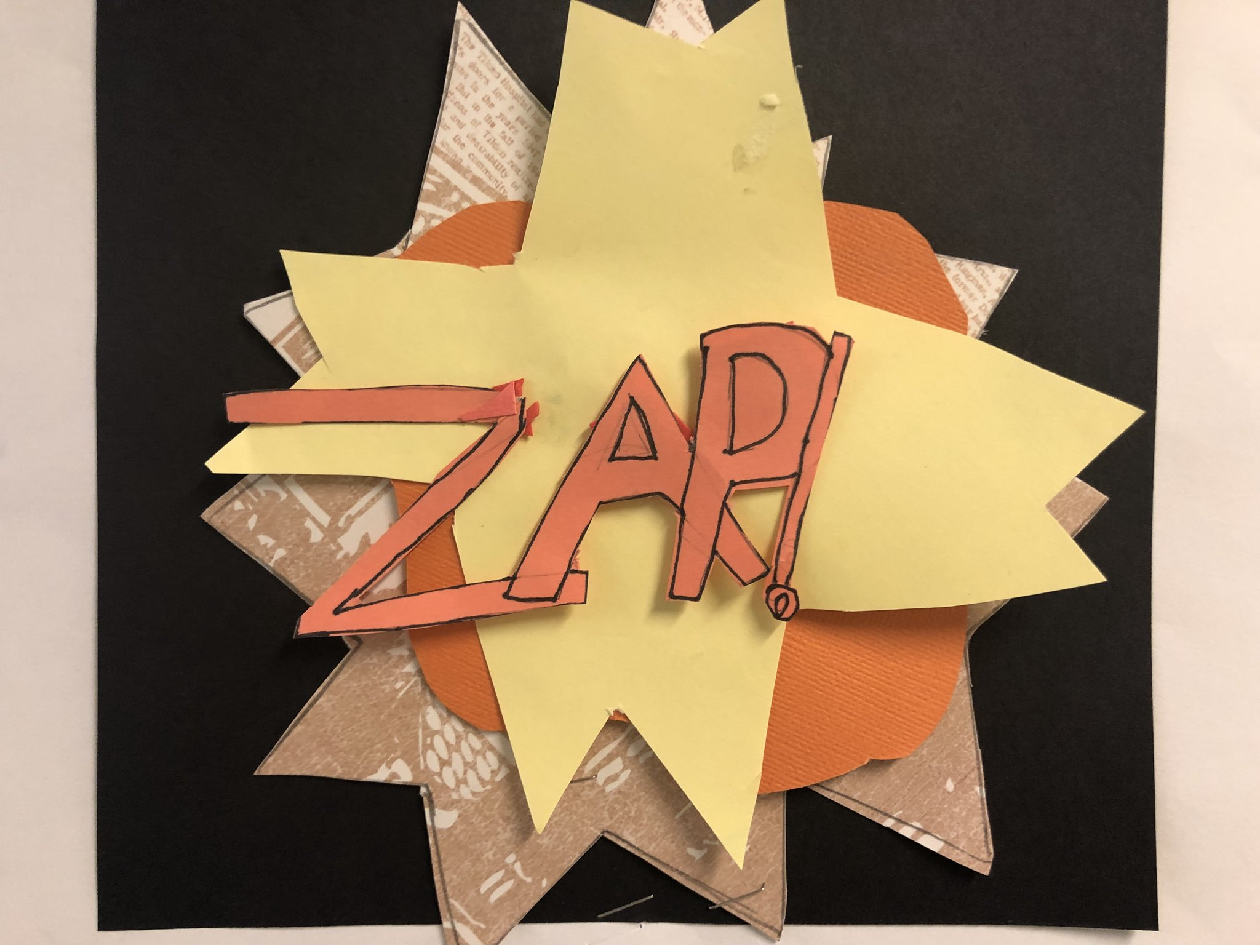
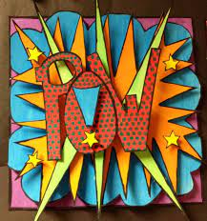
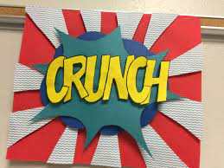

Slide 26
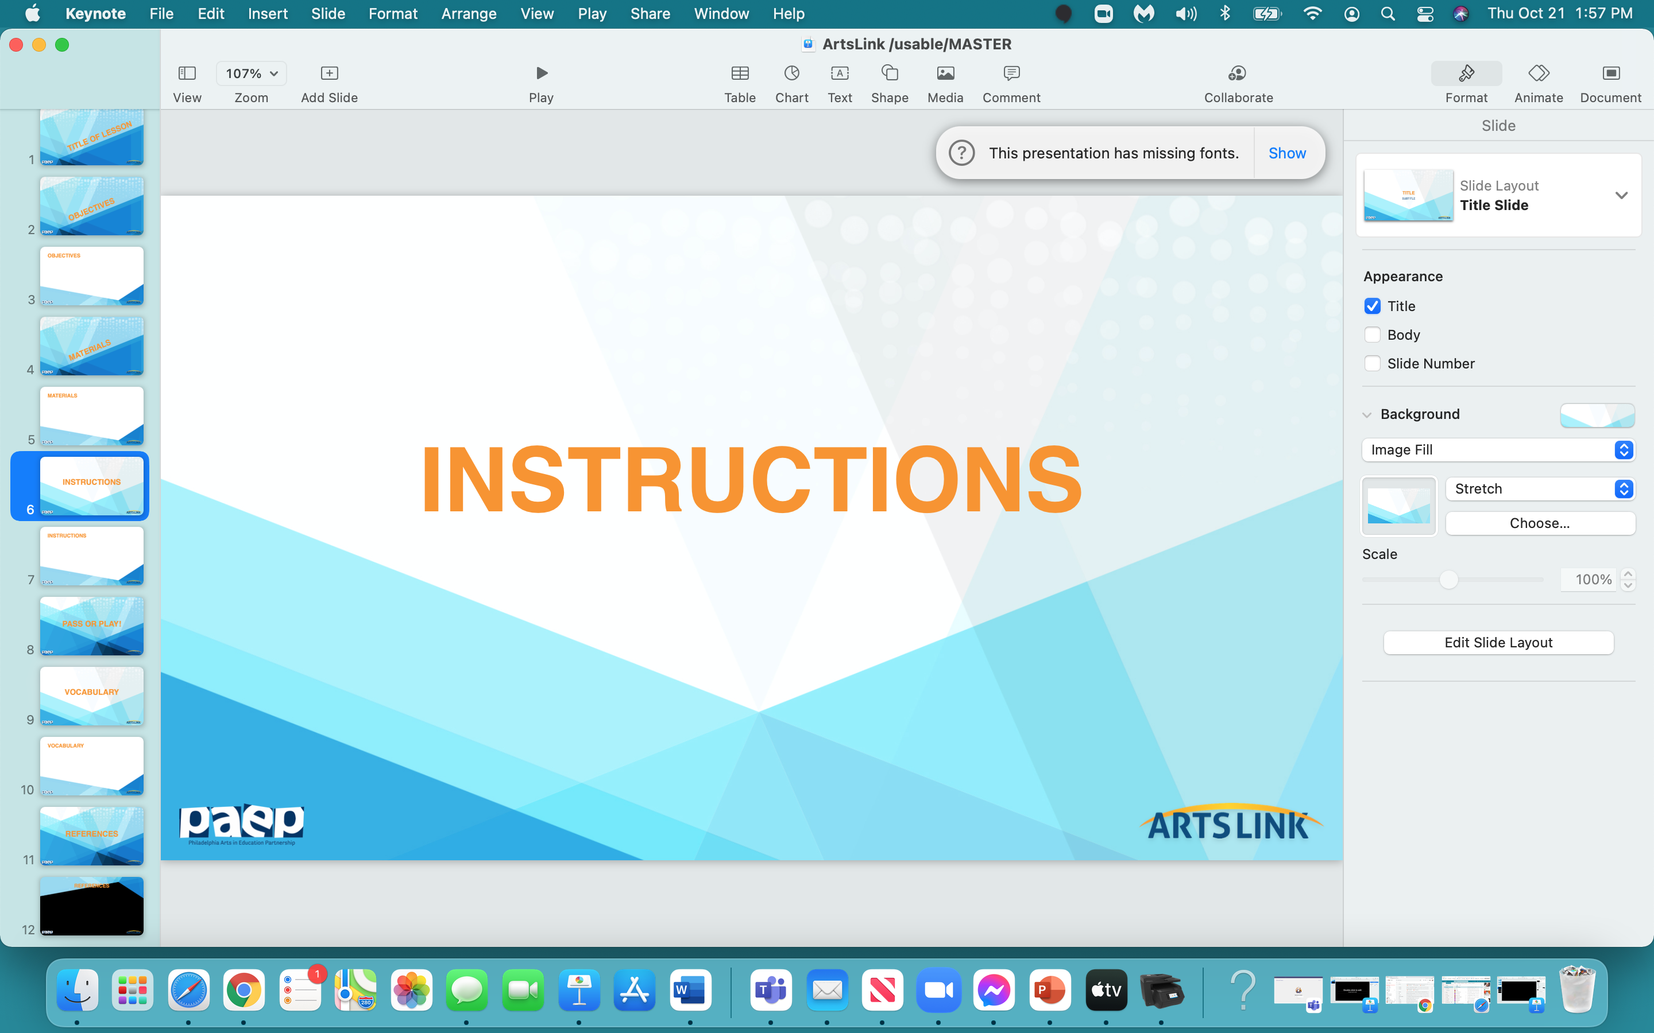

Slide 27
Let’s Think in 3-D
Your 3-D Word Collage will have 7 layers - to make it look ‘3-D’ - to make it ‘pop’ out from your ‘base’ paper.
Try and use around 3 or 4 colors for your word collage - Lichtenstein used mostly primary colors (red, yellow, blue - and always a thick black line around some images. He did use green and orange, but not often).
We need to make the ‘spacers’ that will raise each layer up from the previous layer.
Let’s make the ‘spacers’ now.

Slide 28
The Collage
1. Take a piece of construction paper and cut it into a square (it doesn’t need
to be exact - just approximate a square shape). This square paper is your ‘base’ paper.
2. Cut ‘strips’ of paper - around 8.
Attach these ‘strips’ to your ‘base’ paper - (the square paper is your ‘base paper’).
3. Draw a bubble (cloud) shape in a thick, black line, cut out & attach onto your collage…
(making sure it covers the ‘strips’ underneath).
4. Draw and cut out a ‘spiky’ shape - use ‘spacers’ and attach the ‘spiky’ shape onto your collage.
5. Draw and cut out some more very long , thin triangles…and attach onto your collage.

Slide 29
6. Draw and cut out a ‘star’ shape - outline in a thick back line and attach with ‘spacers’
onto your collage.
7. Use ‘spacers’ to attach your cut-out onomatopoeia word onto your collage…and
YOU ARE DONE!!!

Slide 30
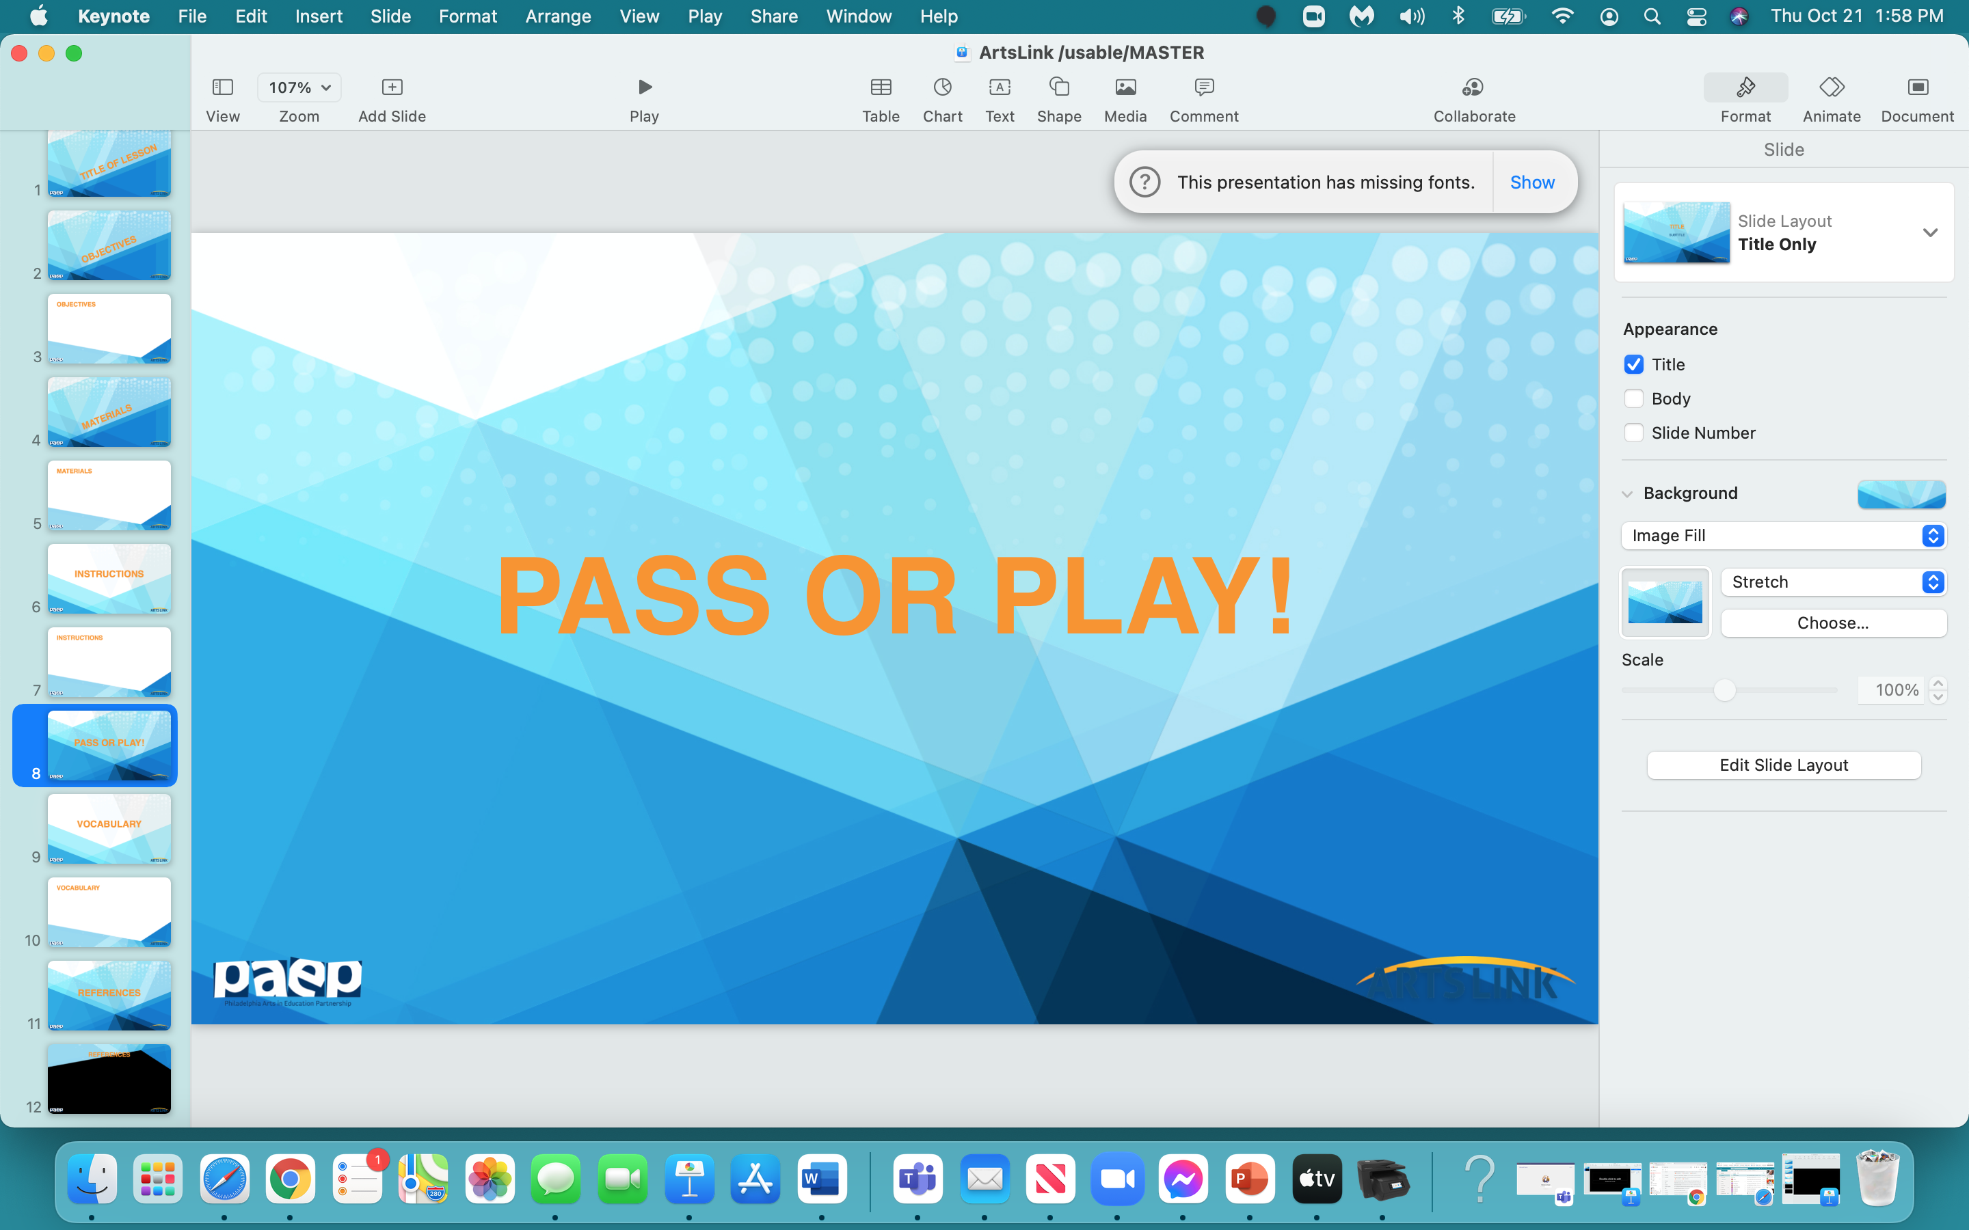

Slide 31
OK - who wants to volunteer
ONE THING
that they learned today
in this lesson,
in this project…
you can either PASS
or PLAY (SHARE)!

Slide 32
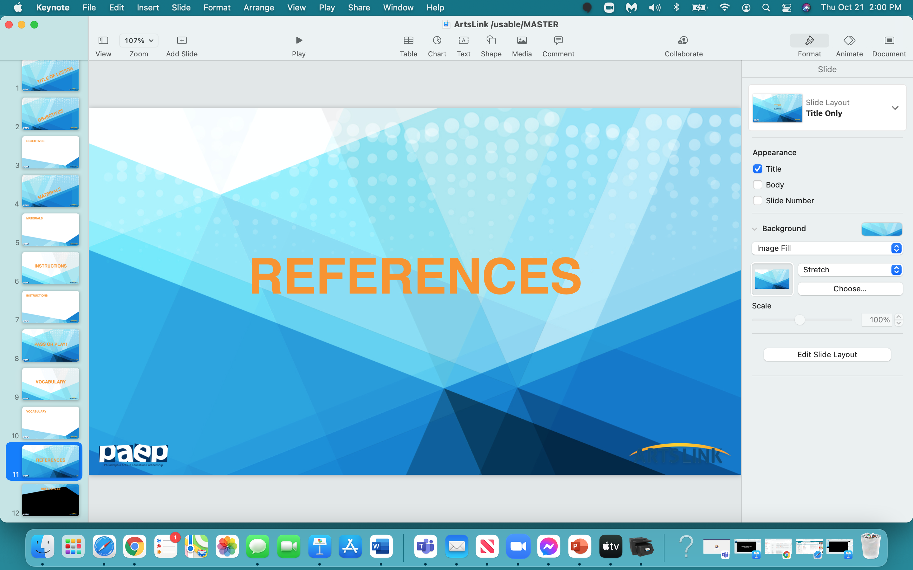

Slide 33
https://www.education.com/download/lesson-plan/onomatopoeia-bing-bam-boom/onomatopoeia-bing-bam-boom.pdf
https://www.education.com/download/lesson-plan/onomatopoeia/onomatopoeia.pdf
https://www.marcieatkins.com/wp-content/uploads/2013/06/Onomatopoeia-Lesson-Plan.pdf
https://www.youtube.com/watch?v=9KsEUqEQft0&t=27s
https://www.youtube.com/watch?v=kZV8eubKEYc
https://www.imagineforest.com/blog/how-to-create-a-comic-strip/
https://glittermeetsglue.com/onomatopoeia-pop-art-word-projects/

