Slide 1
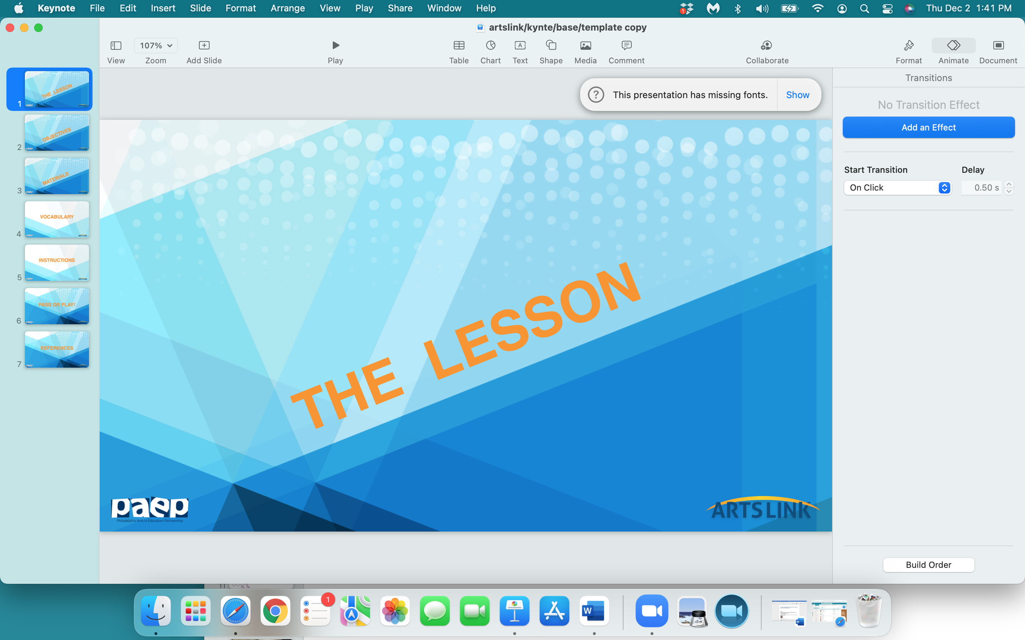

Slide 2
Comic
Strip
Stories

Slide 3
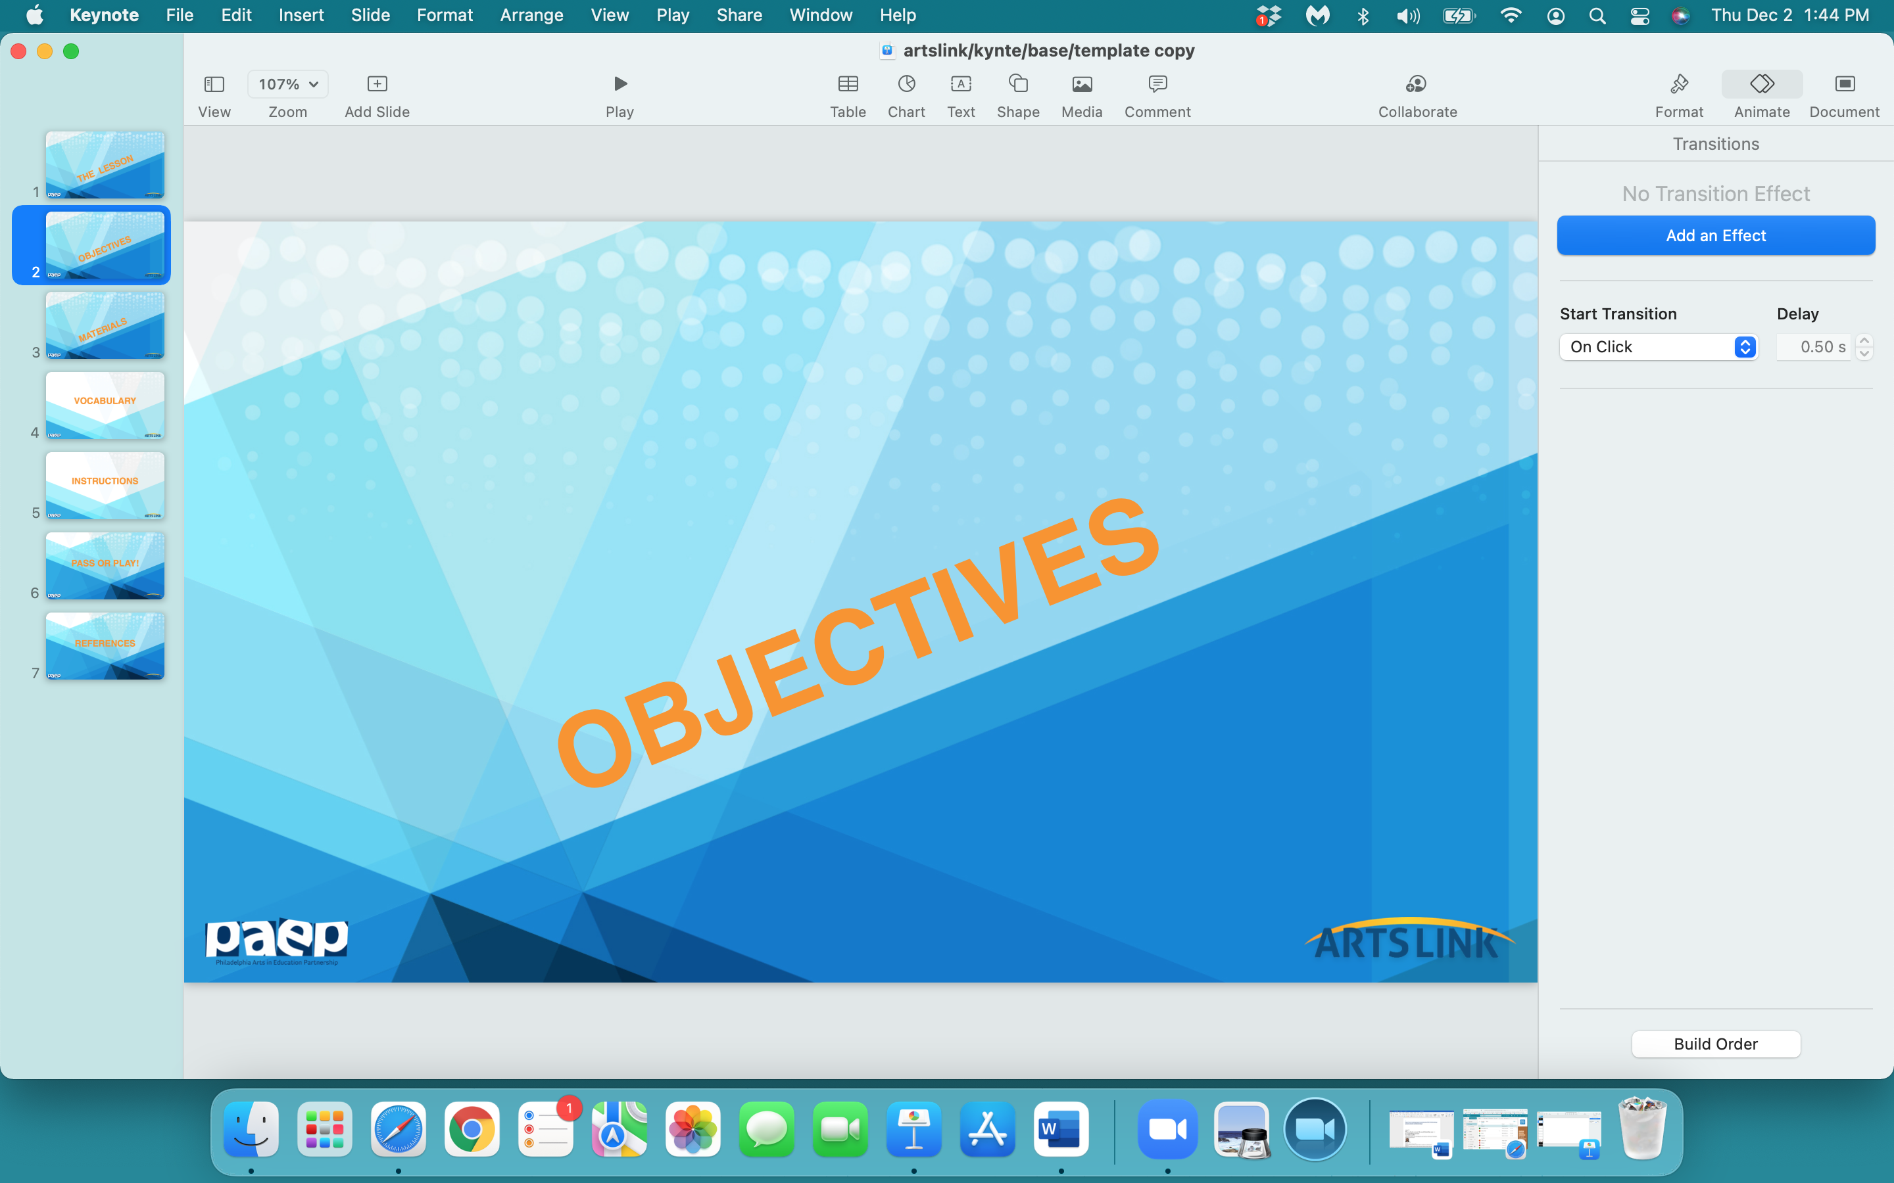

Slide 4
In the next hour, you will:
evaluate comic strips by looking at their words & pictures: how both work together to tell a story
learn comic strip ‘language’
create a ‘template’ for your 4 - panel comic strip
draw a story using only pictures in 4 panels, but include one onomatopoeia word

Slide 5
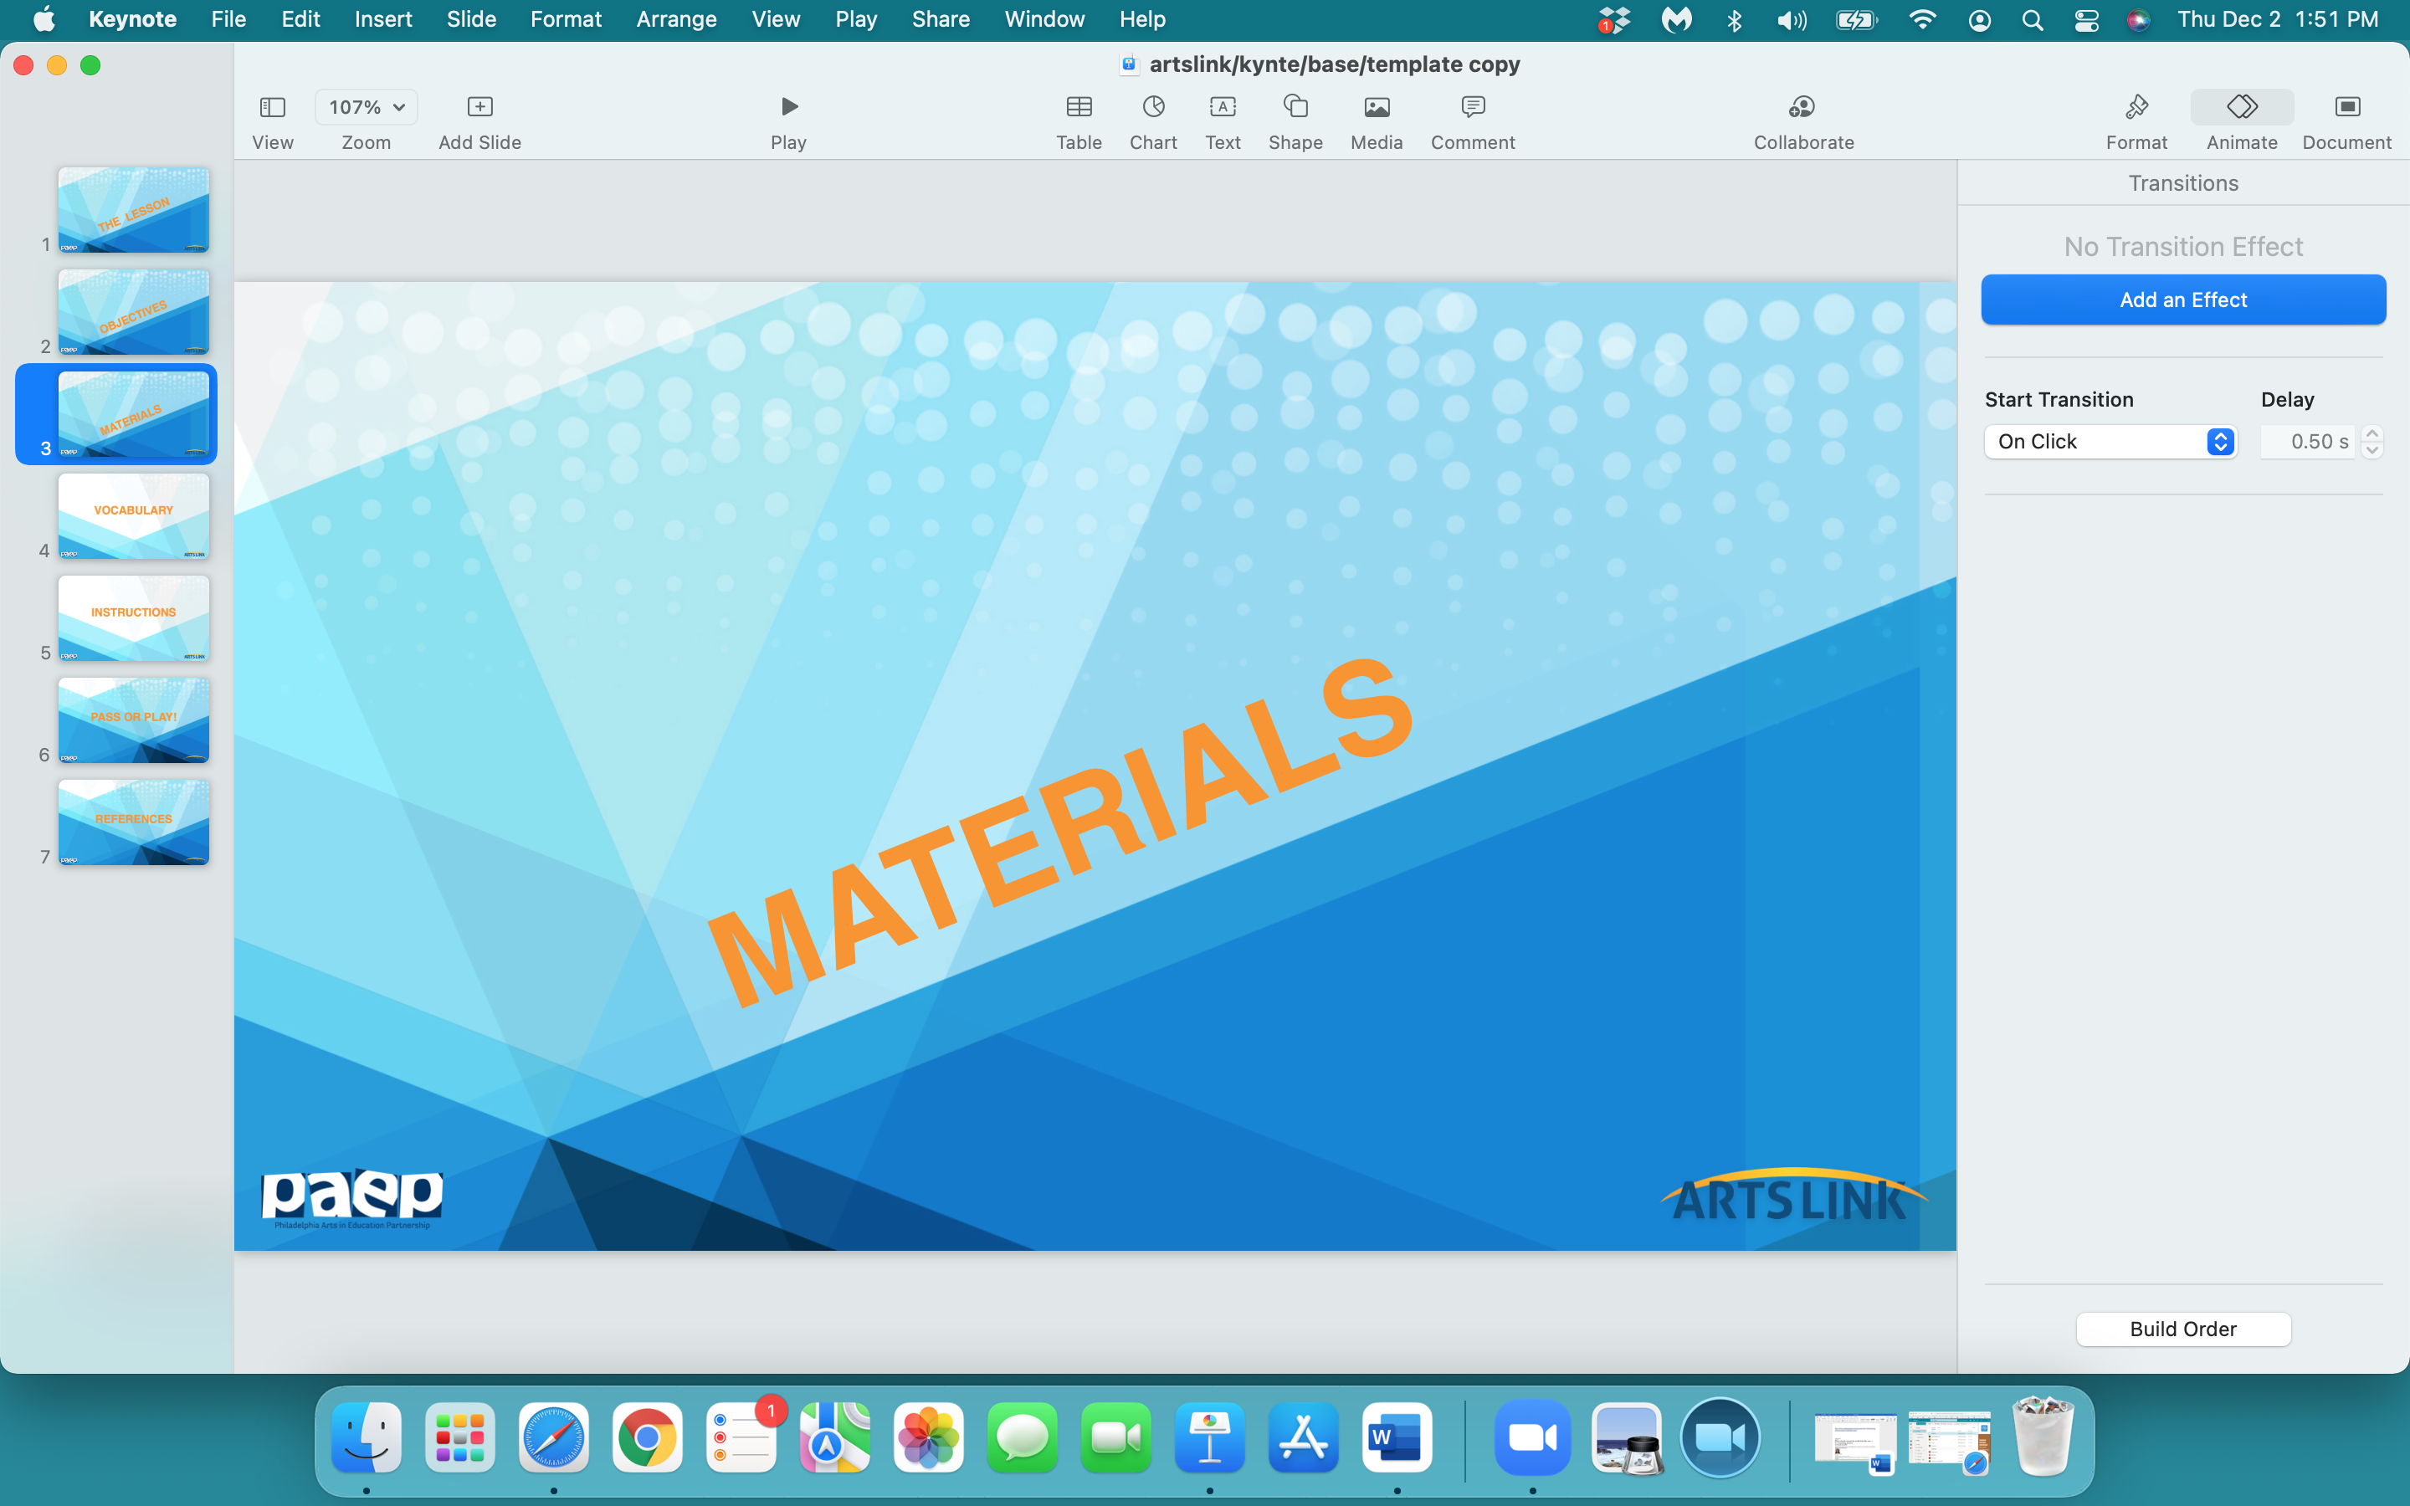

Slide 6
notebook/journal
one sheet from your sketchpad
pencil
eraser
color markers
black marker

Slide 7
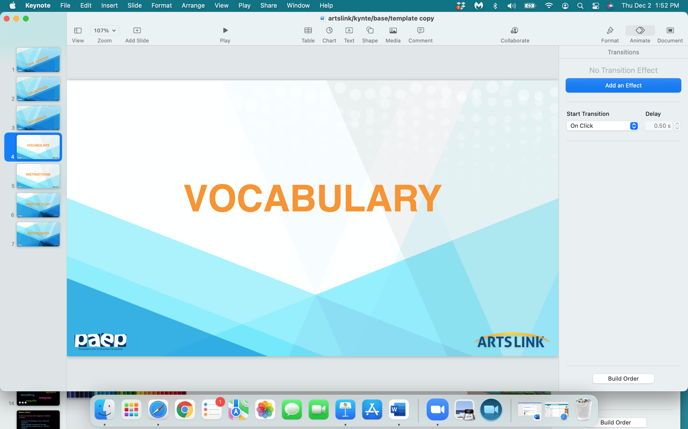

Slide 8
comic strip
sequence
storyboard
dialogue (optional)
speech bubble
template / panel

Slide 9
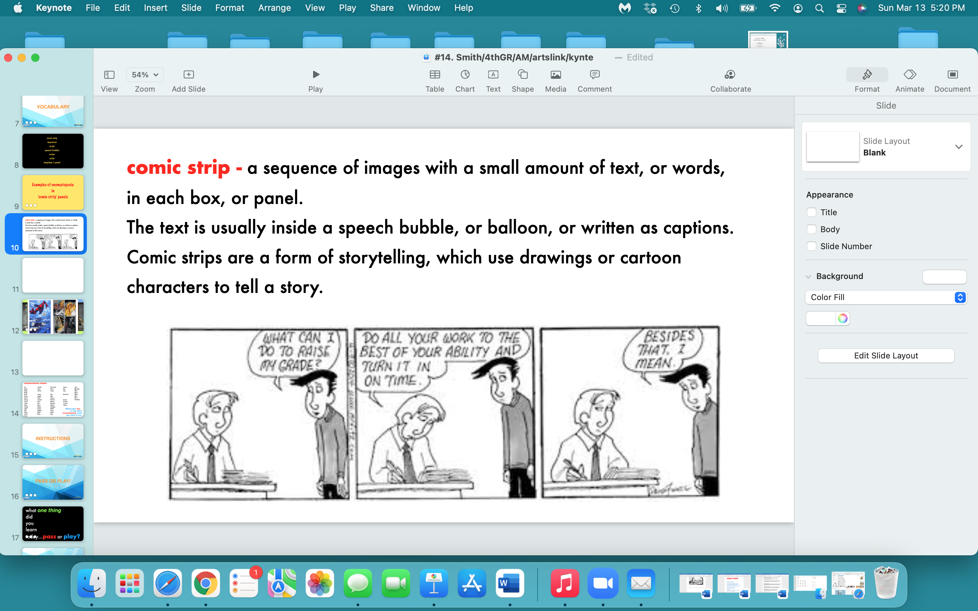

Slide 10
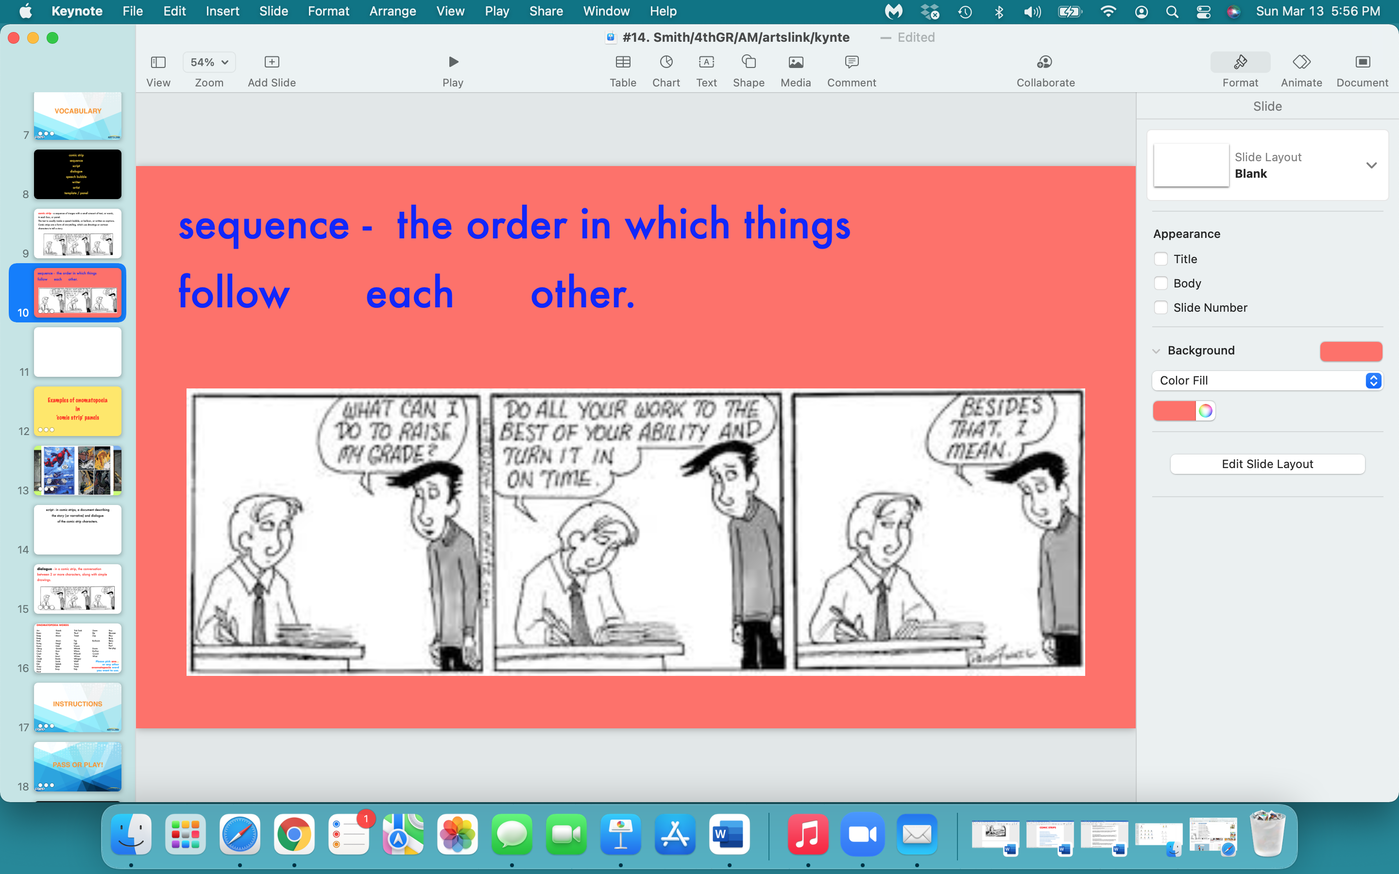

Slide 11
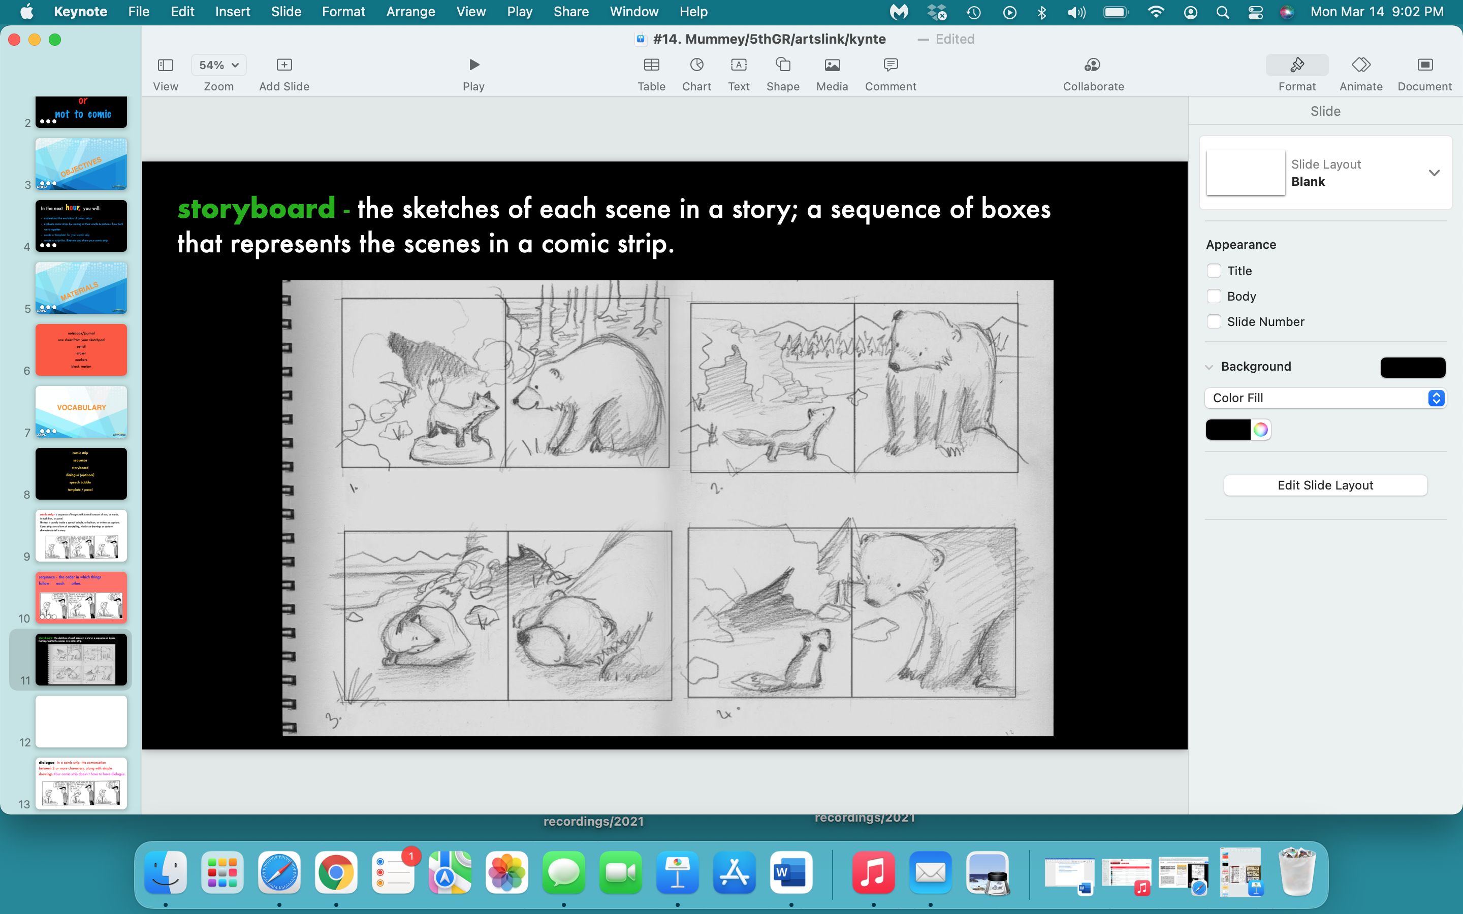

Slide 12
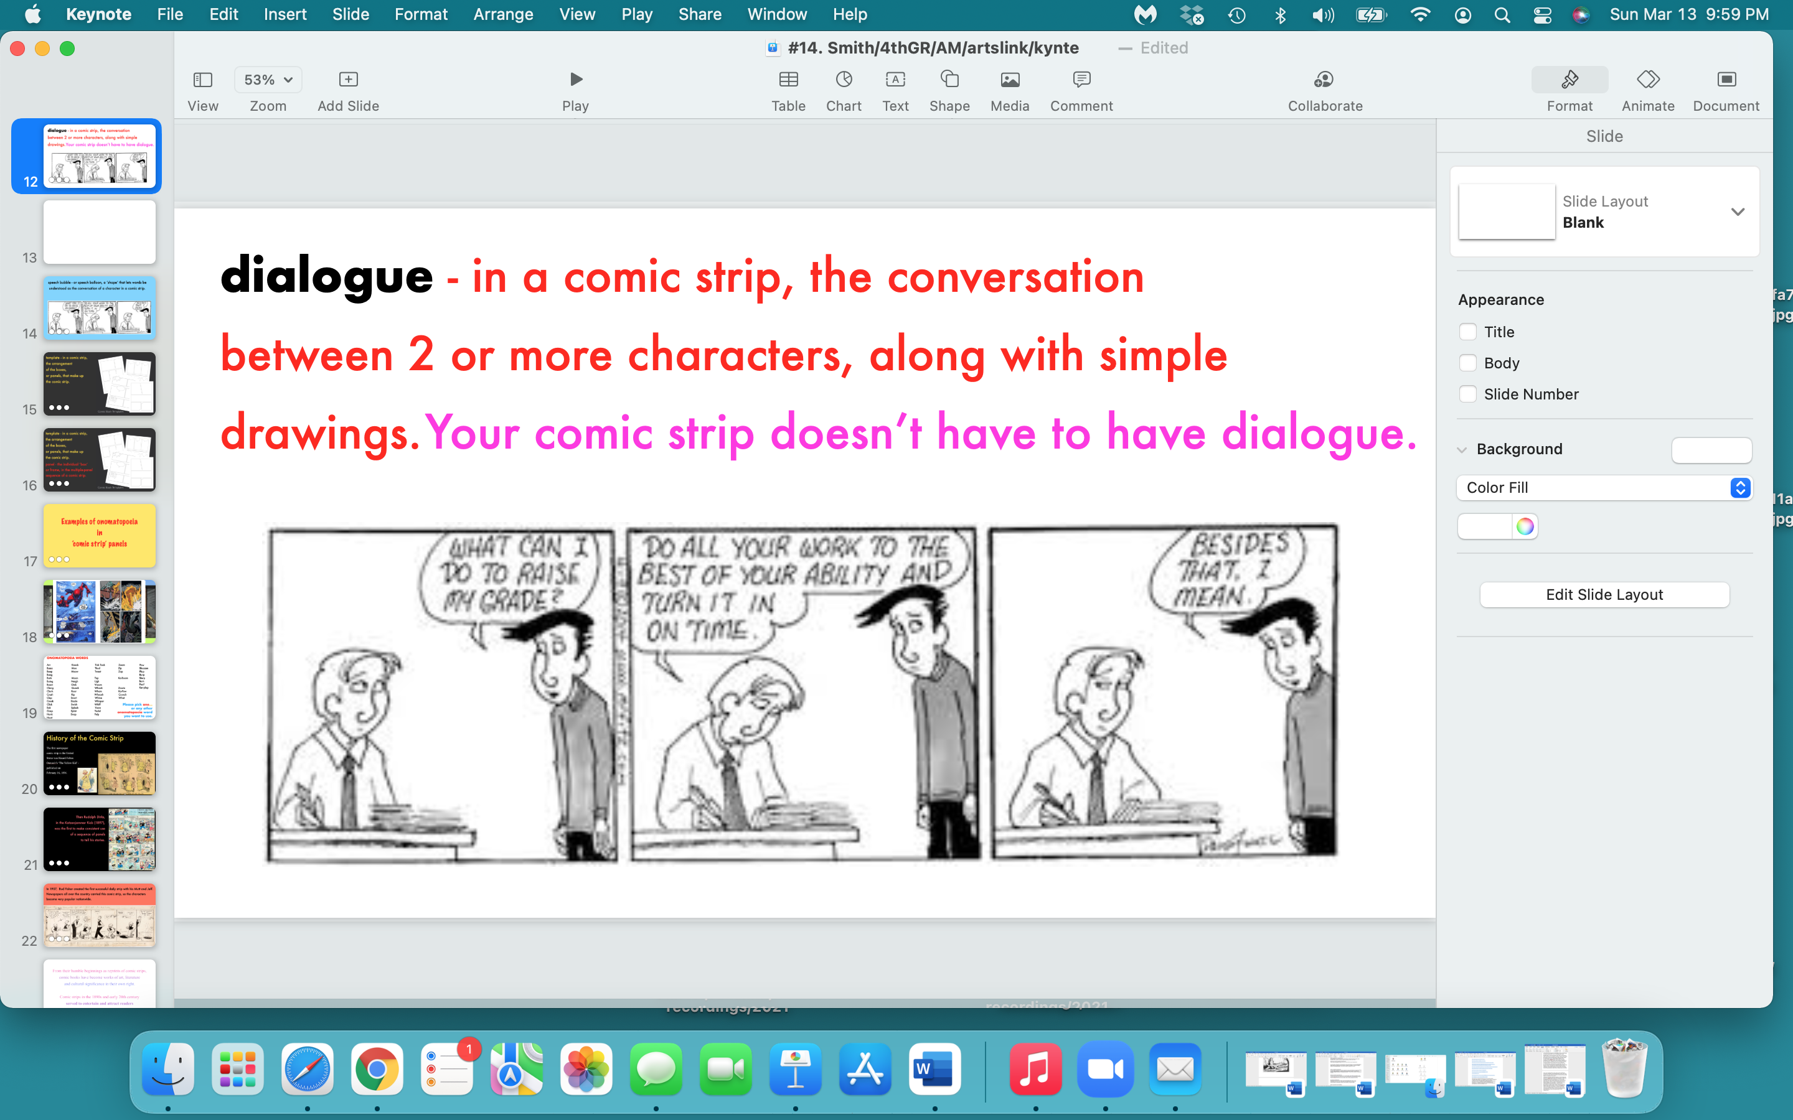

Slide 13
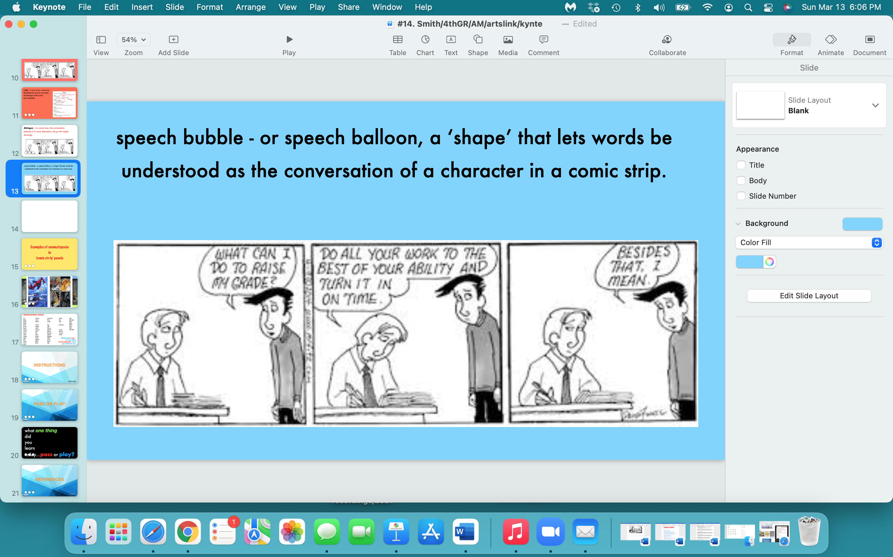

Slide 14
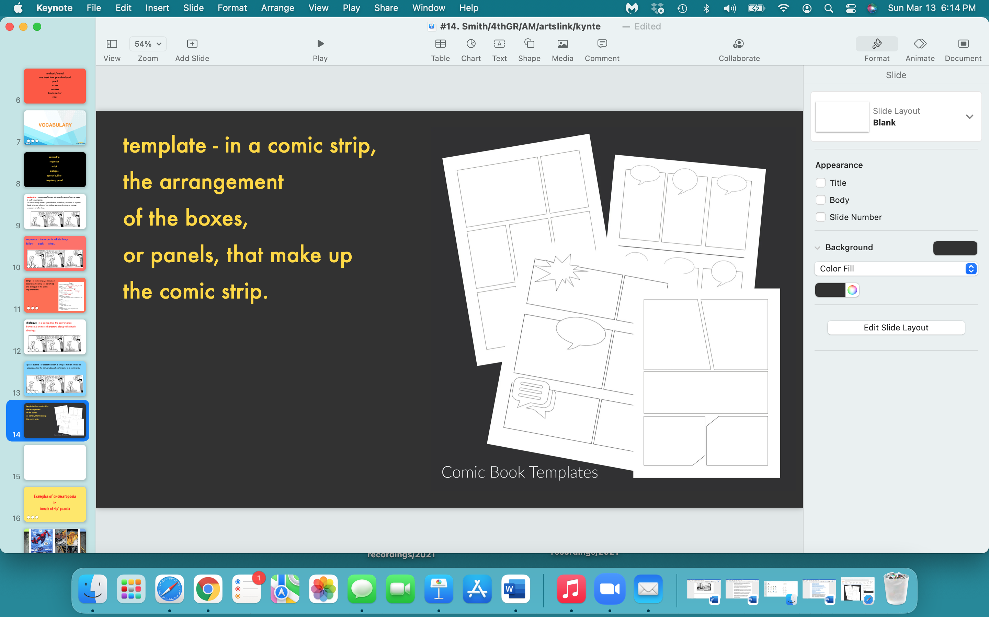

Slide 15
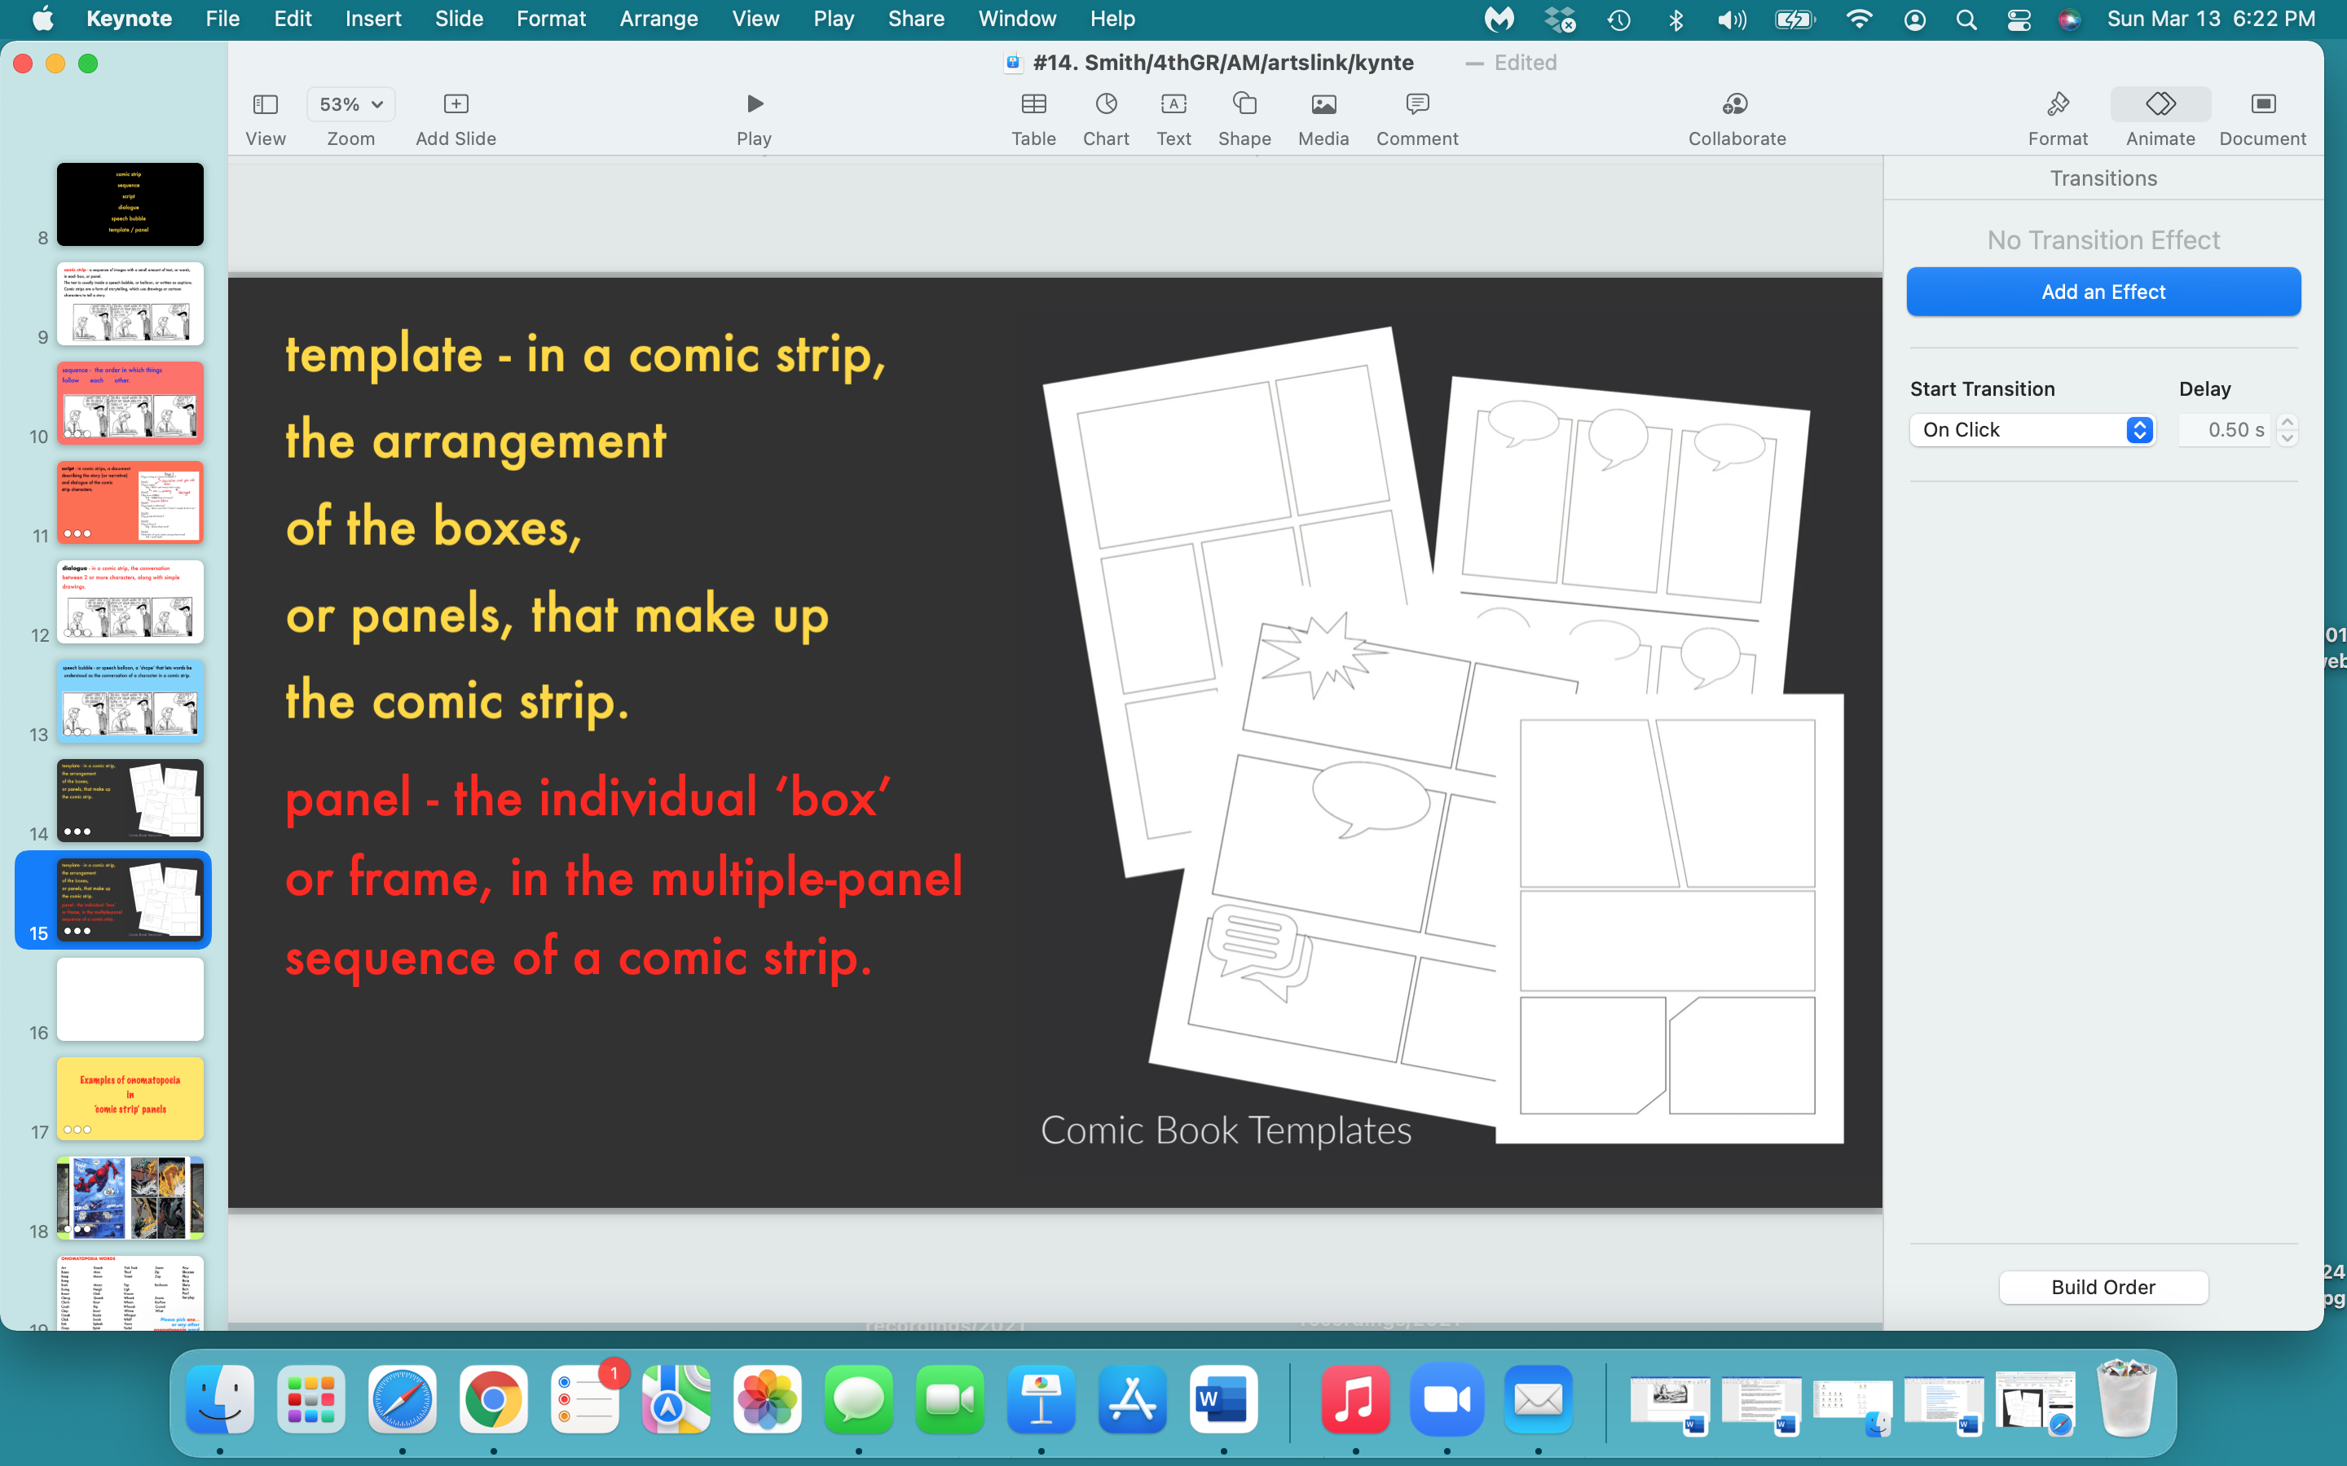

Slide 16
Examples of onomatopoeia
in
‘comic strip’ panels

Slide 17
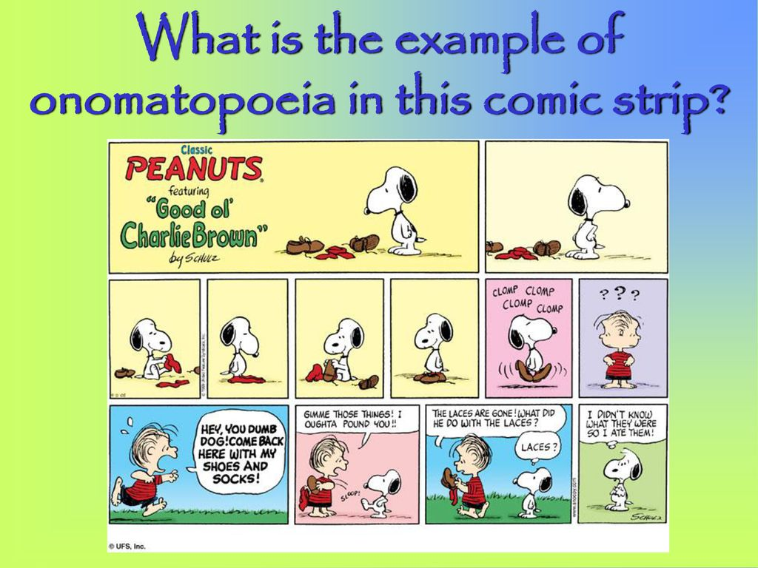
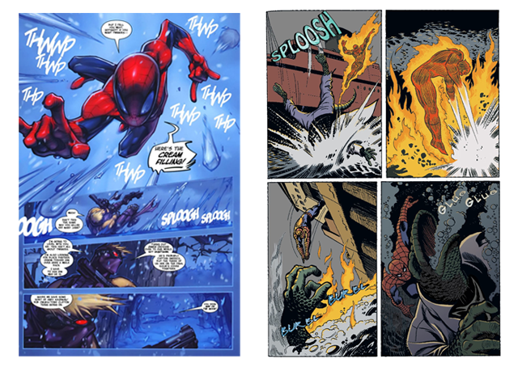
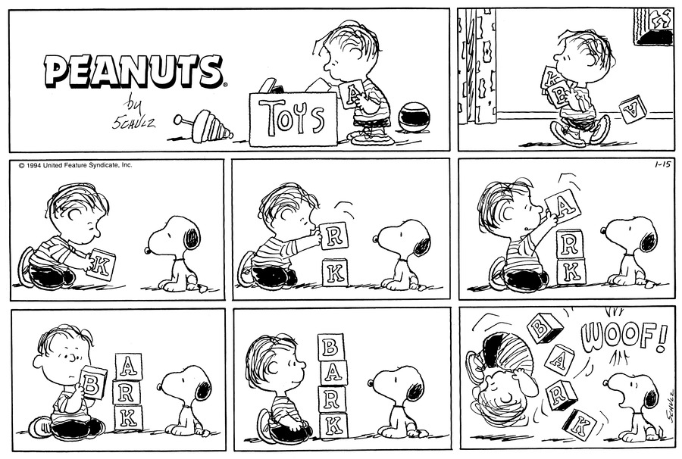
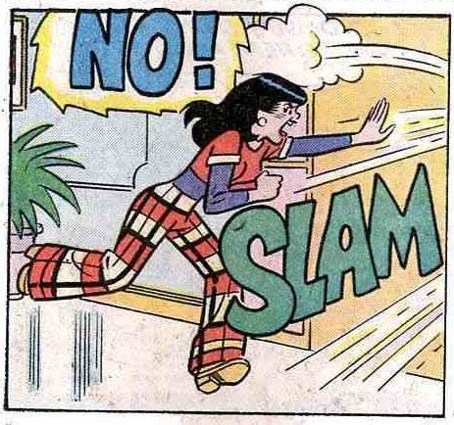
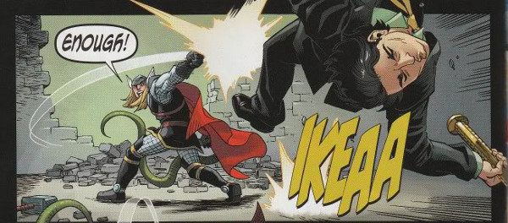



Slide 18
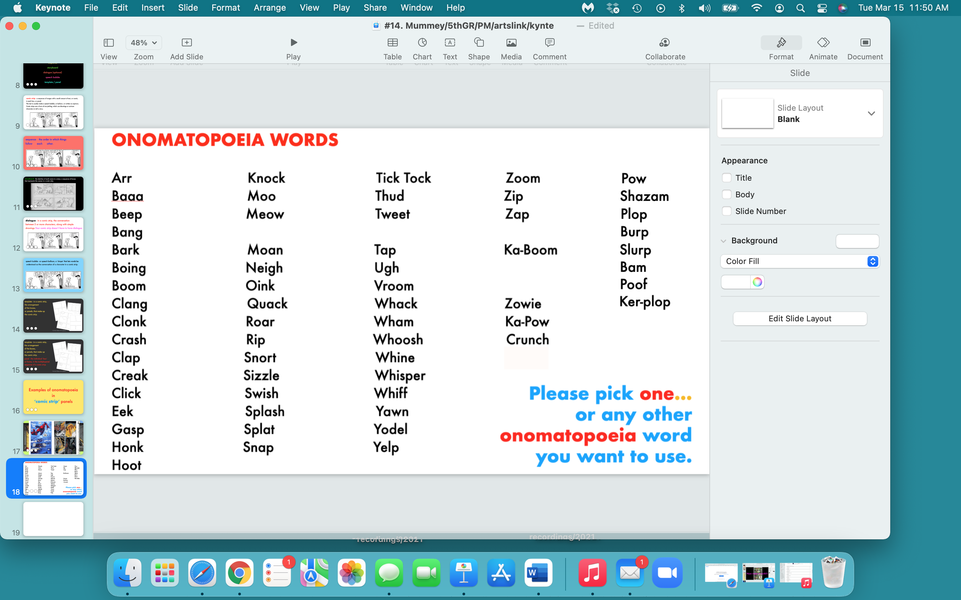

Slide 19
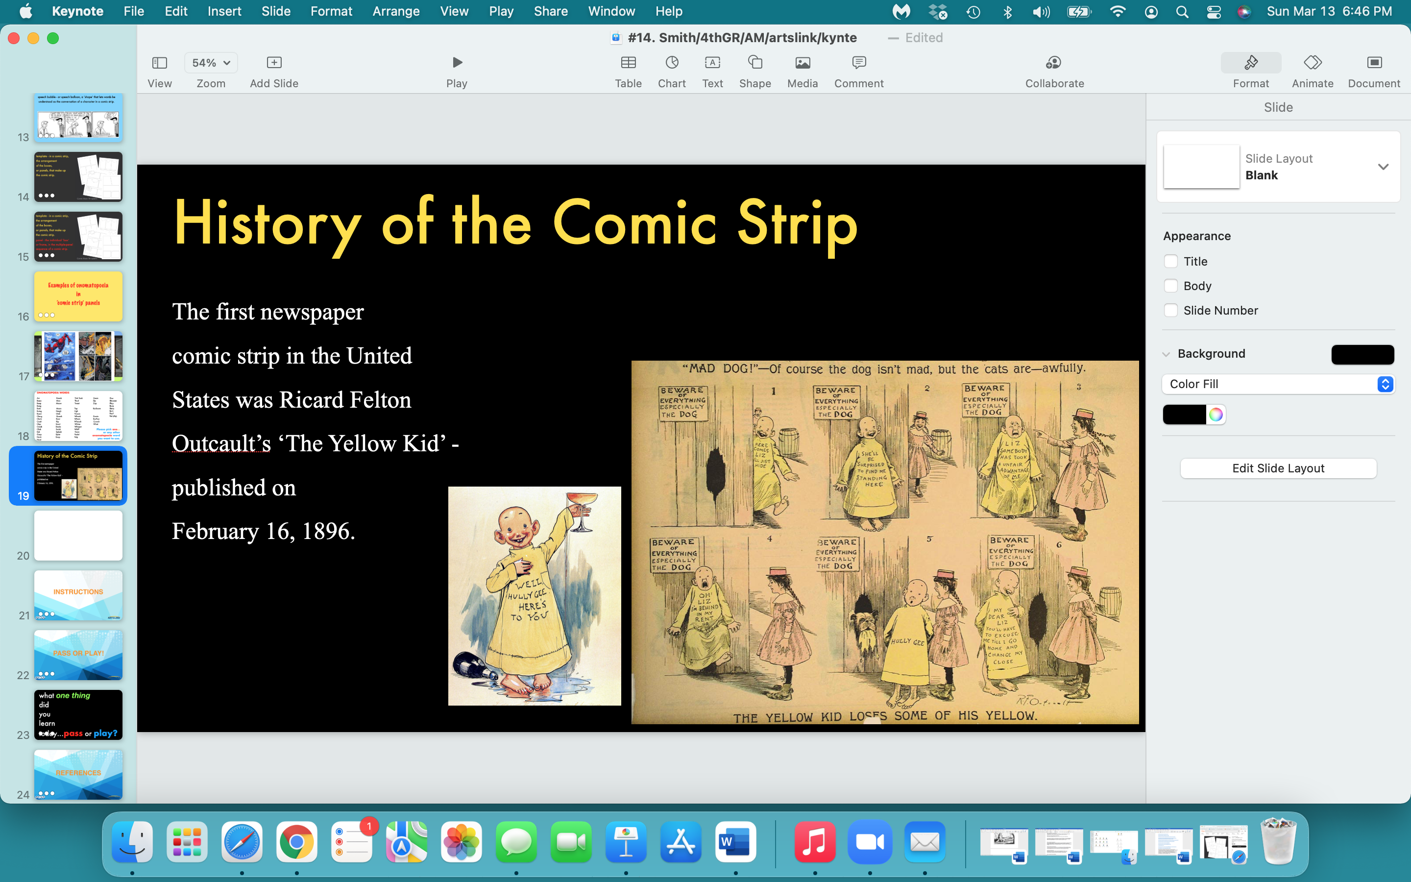

Slide 20
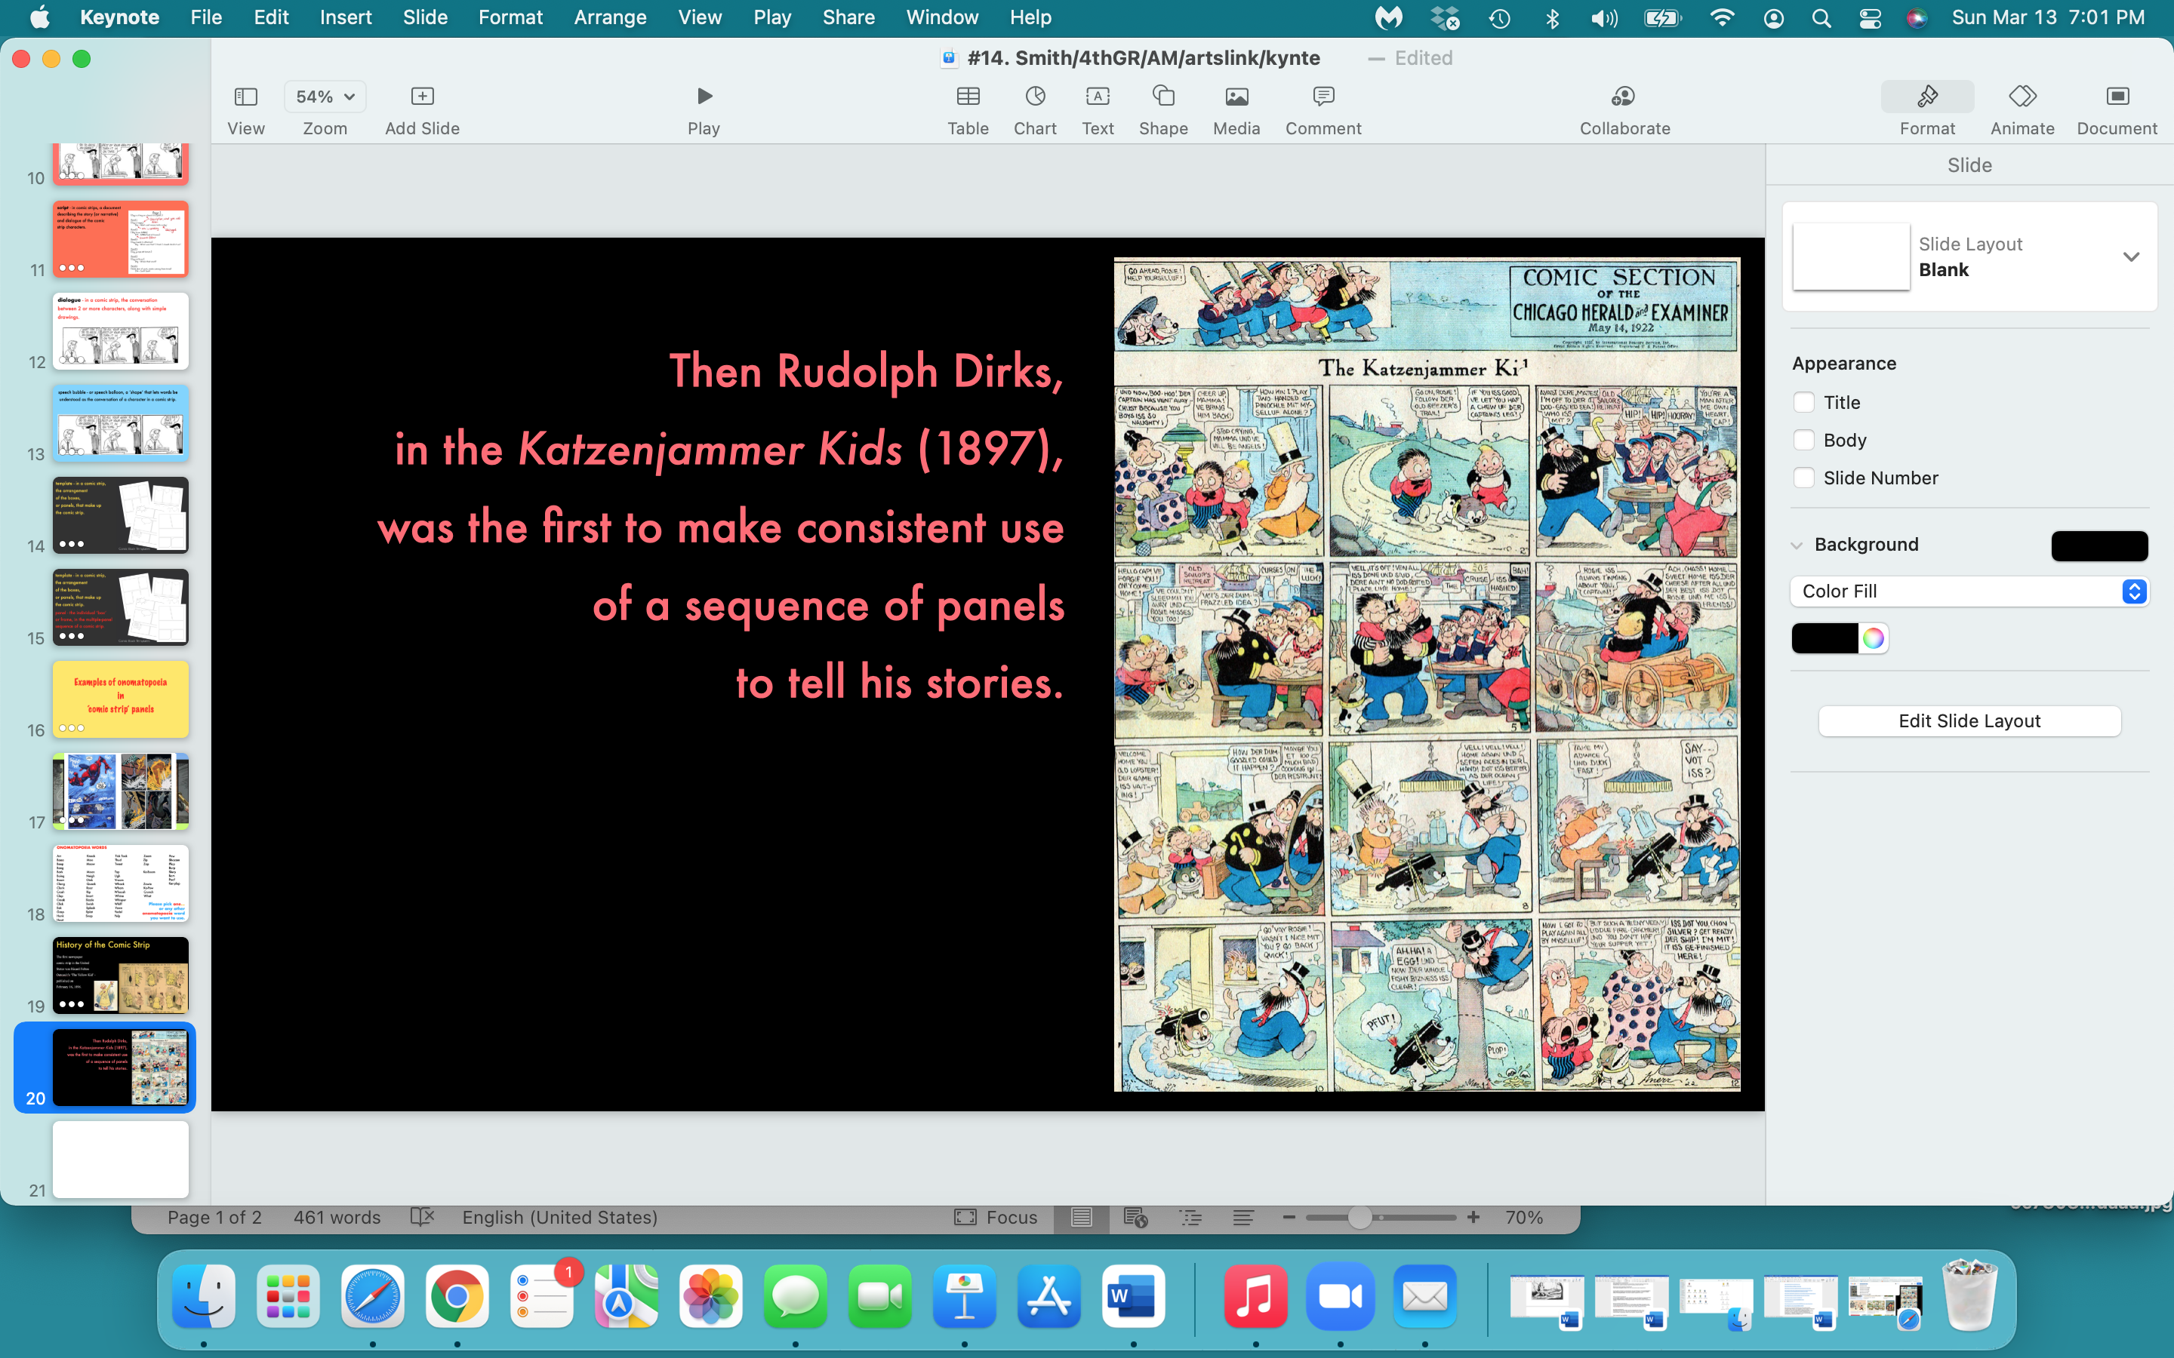

Slide 21
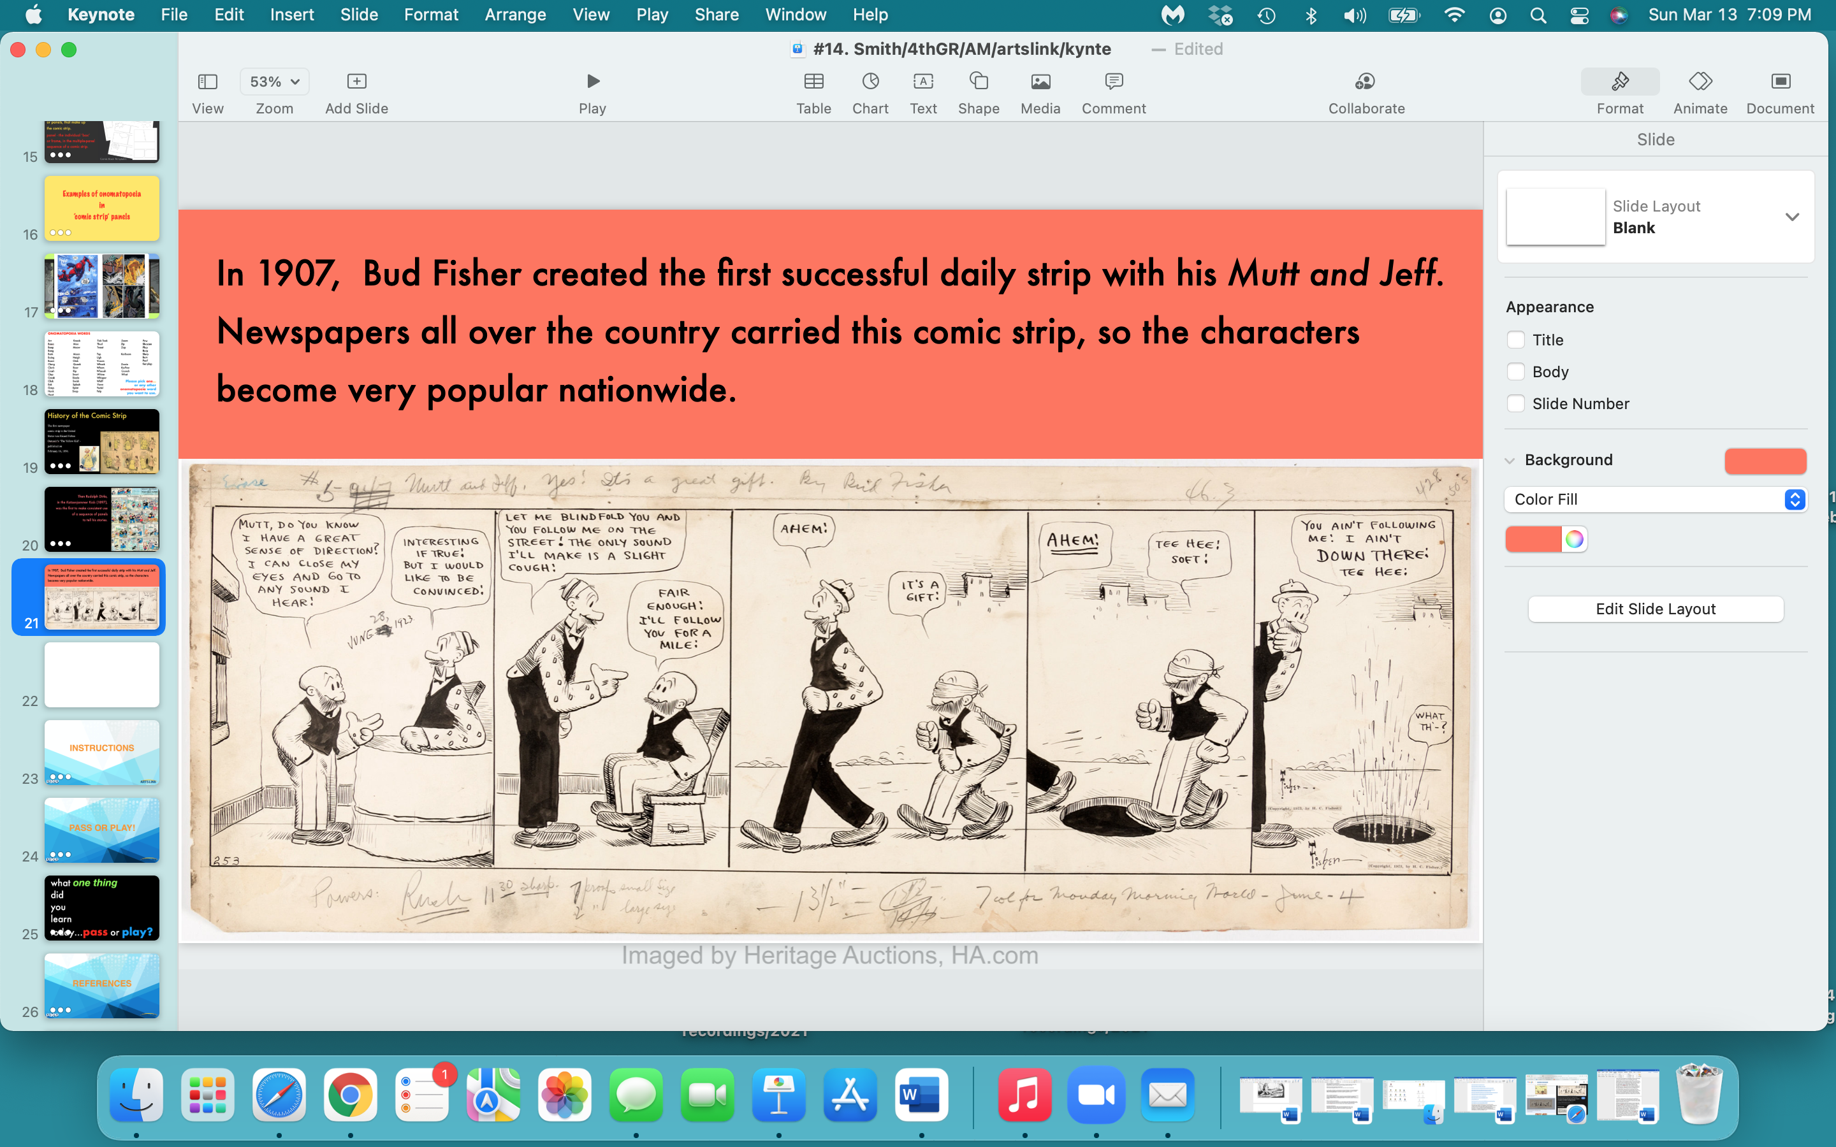

Slide 22
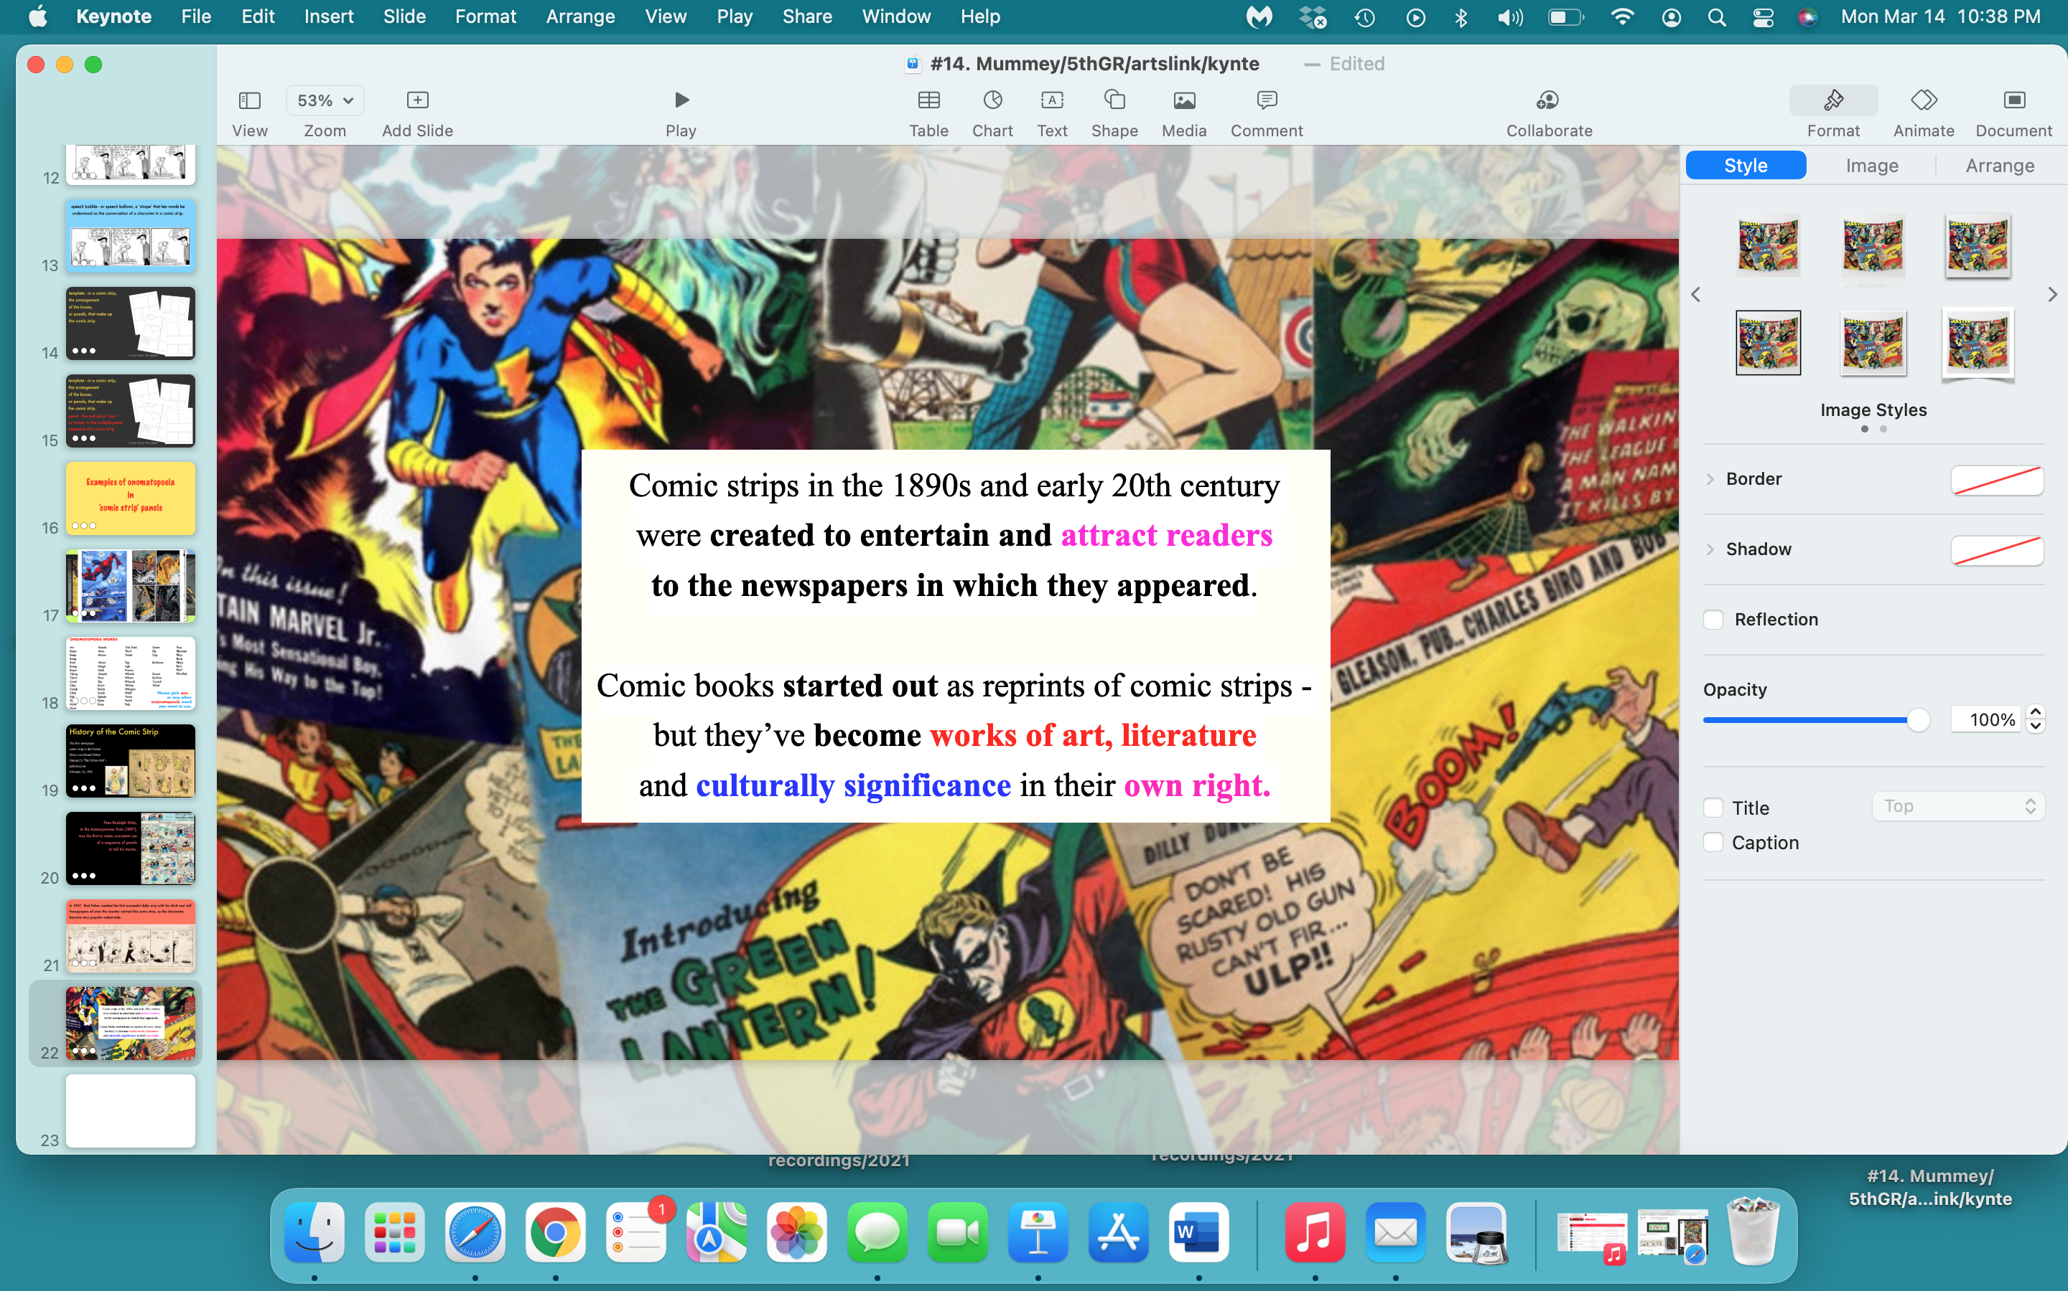

Slide 23
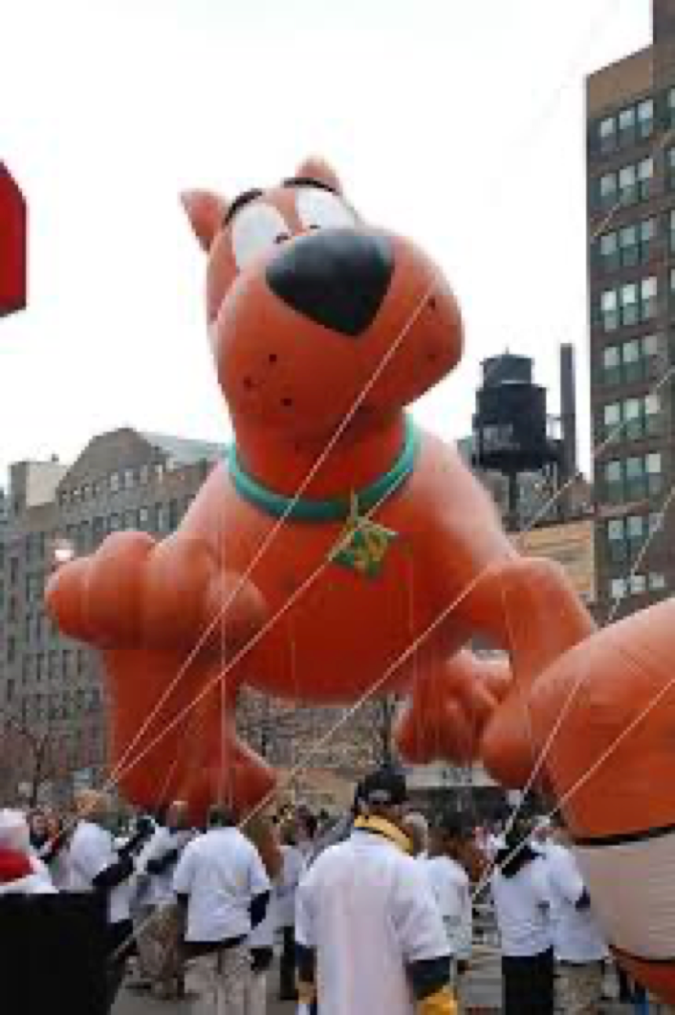

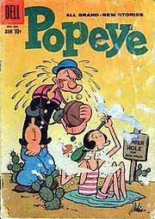
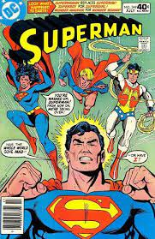
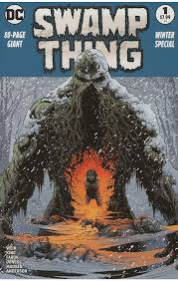
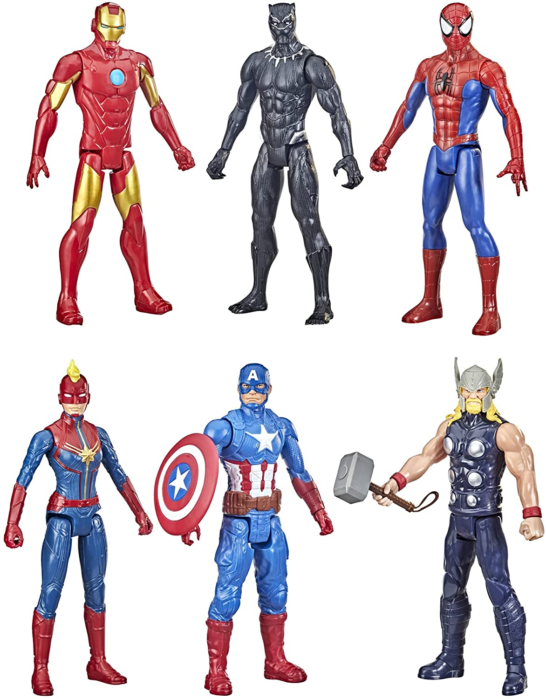
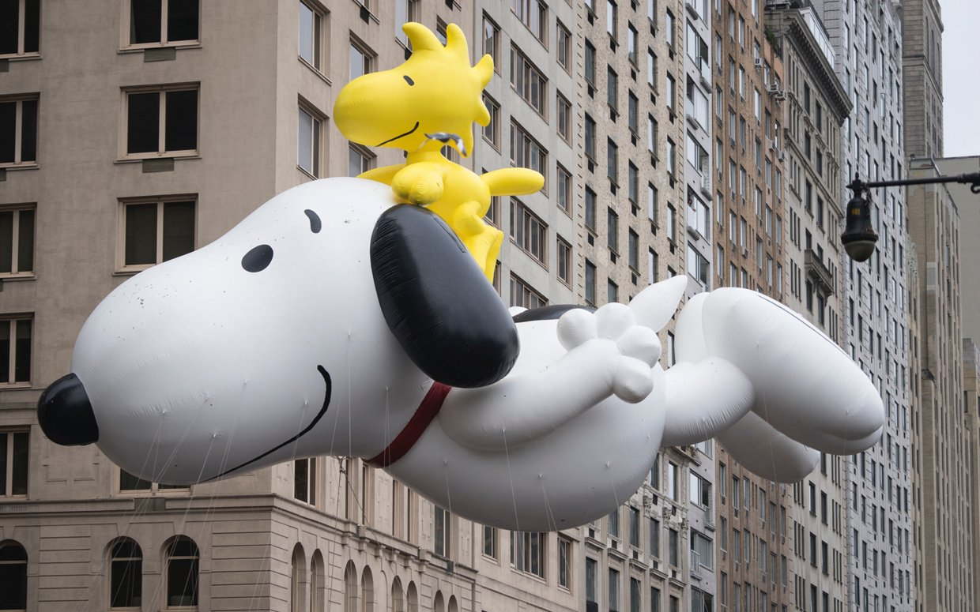
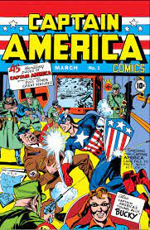
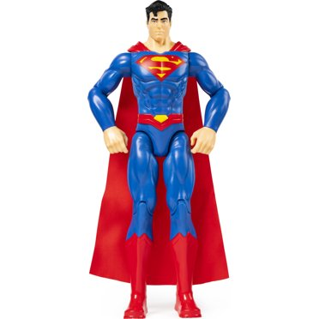

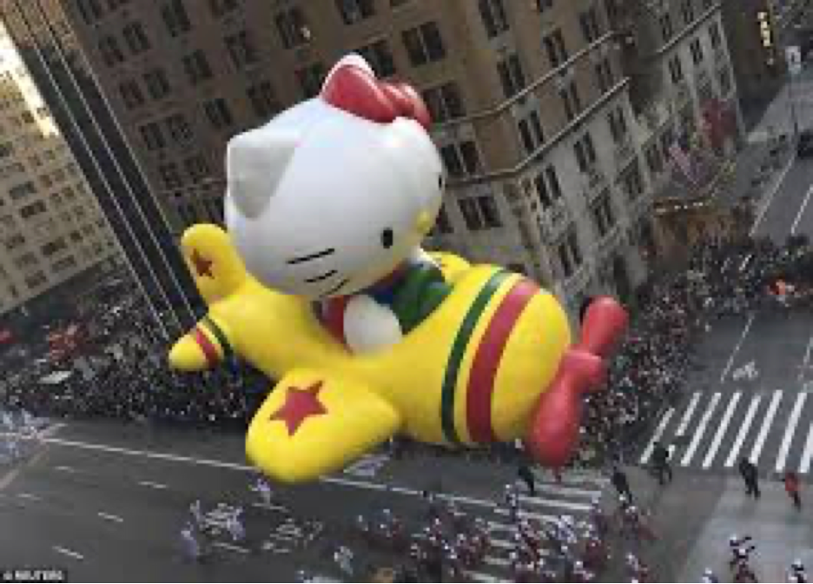
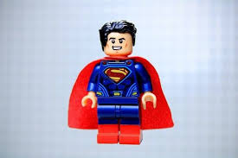
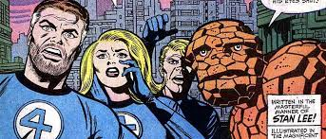

Slide 24
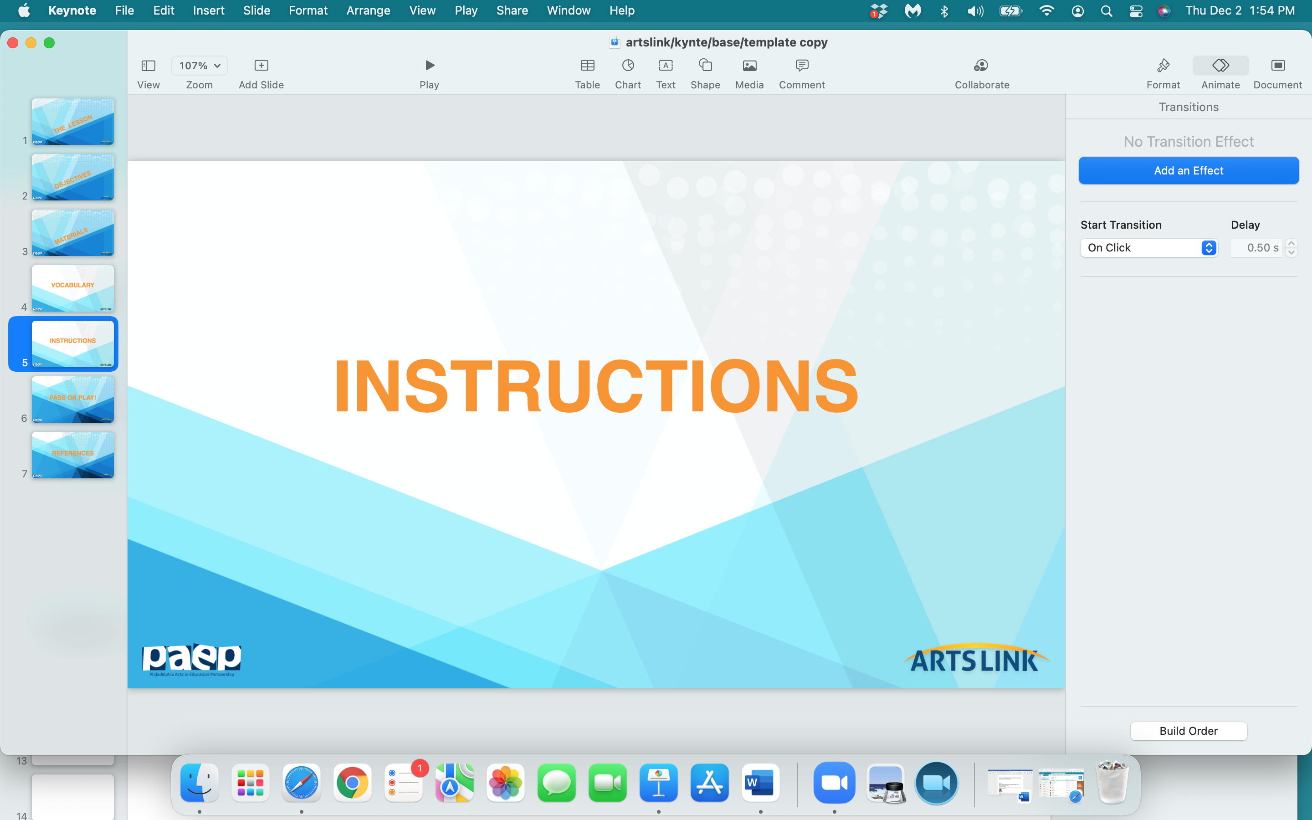

Slide 25
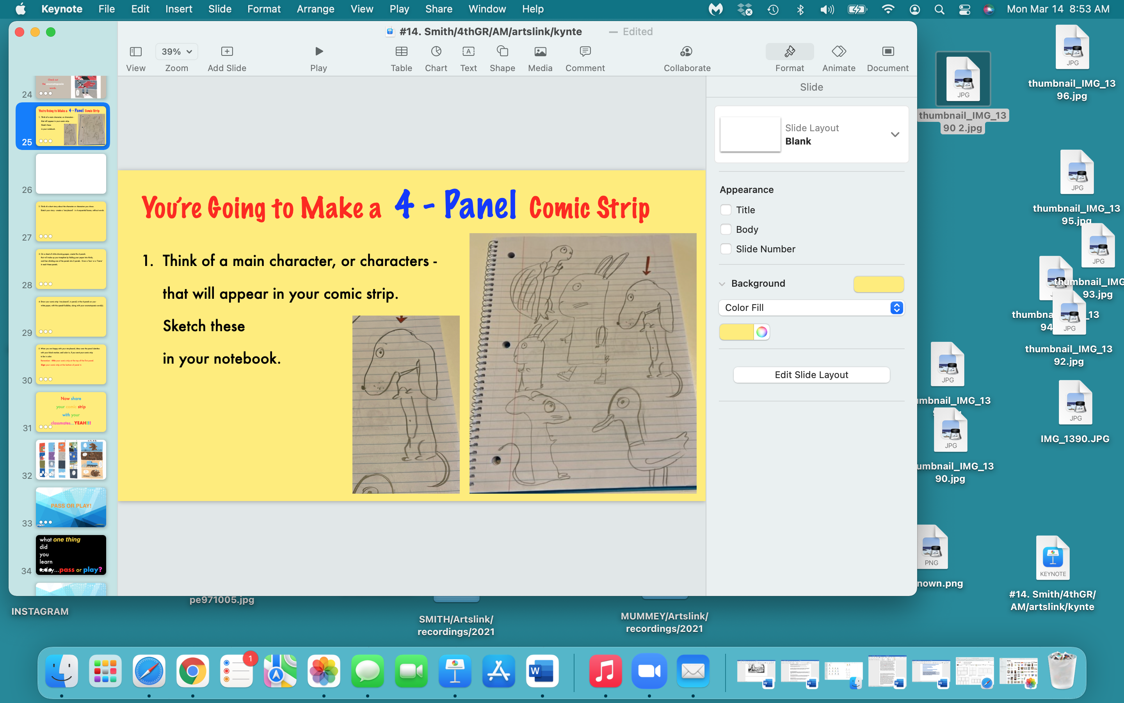

Slide 26
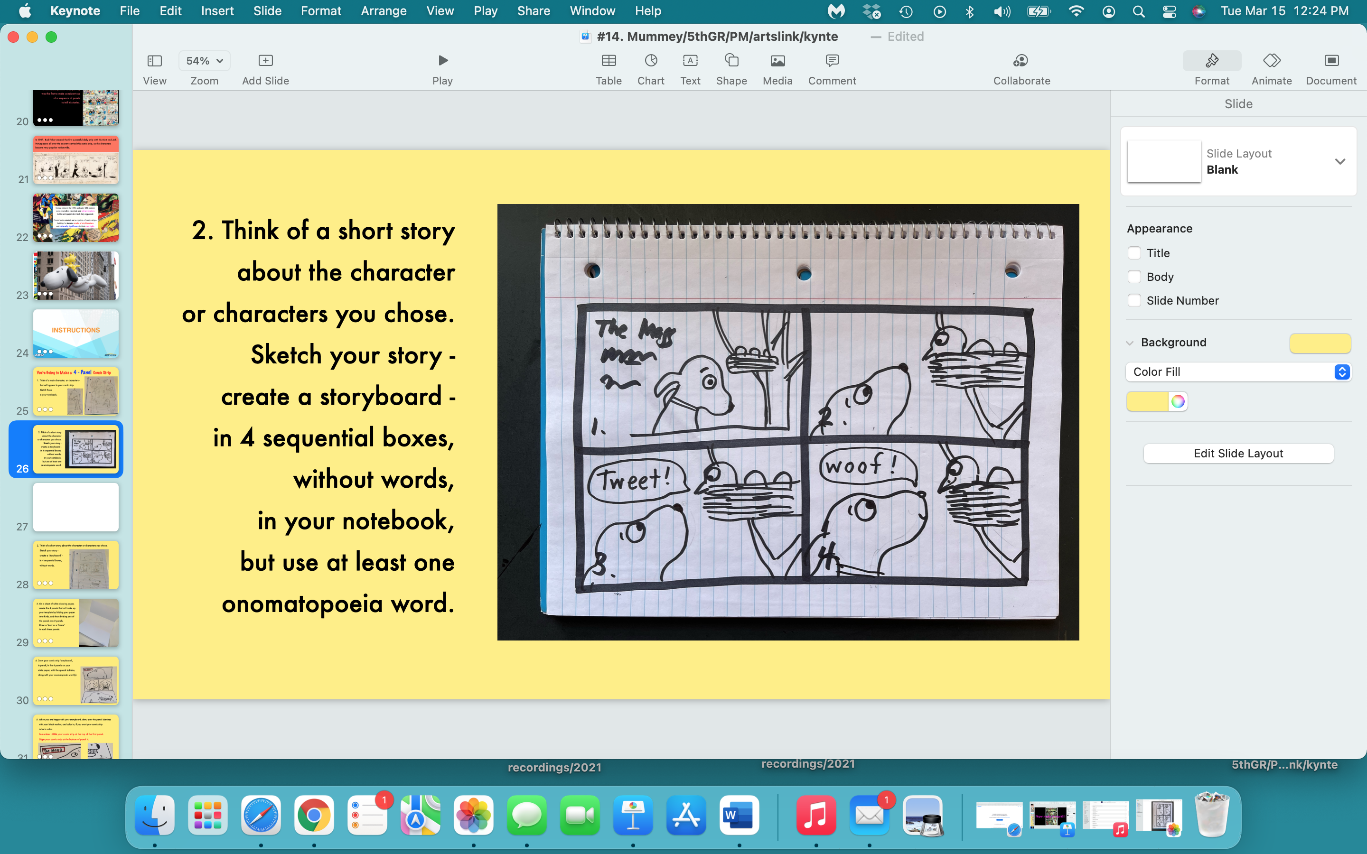

Slide 27
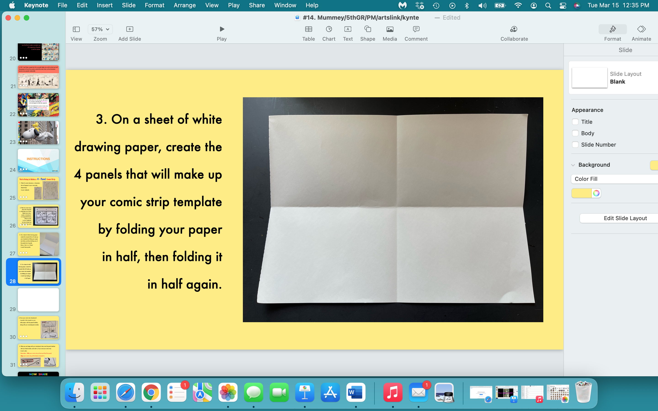

Slide 28
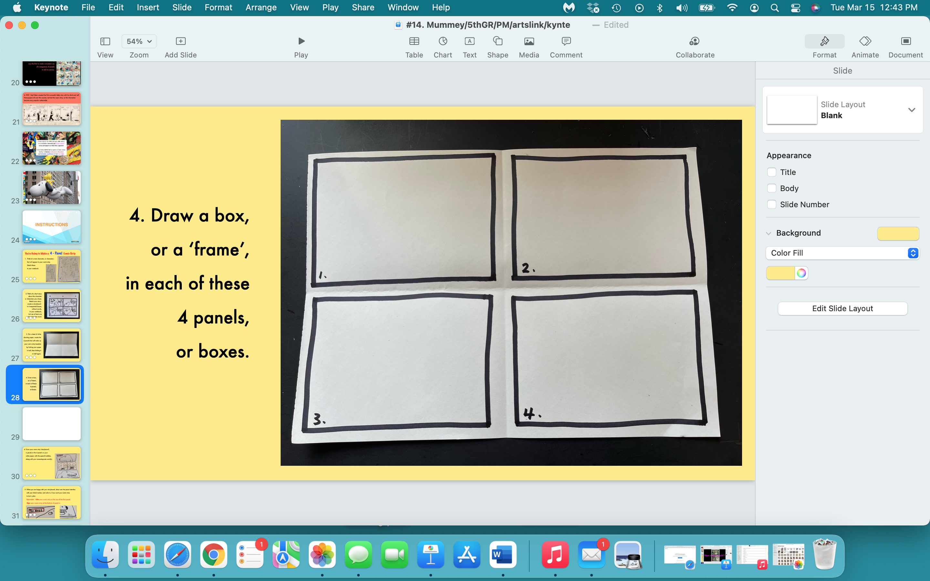

Slide 29
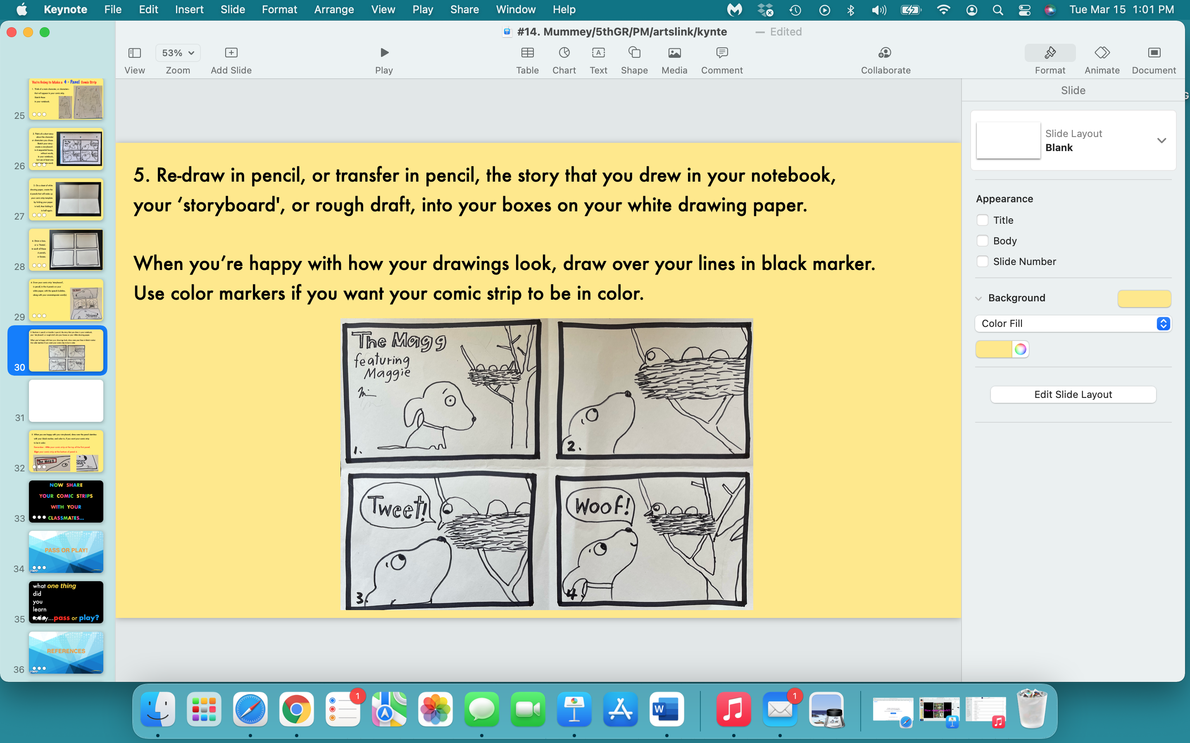

Slide 30
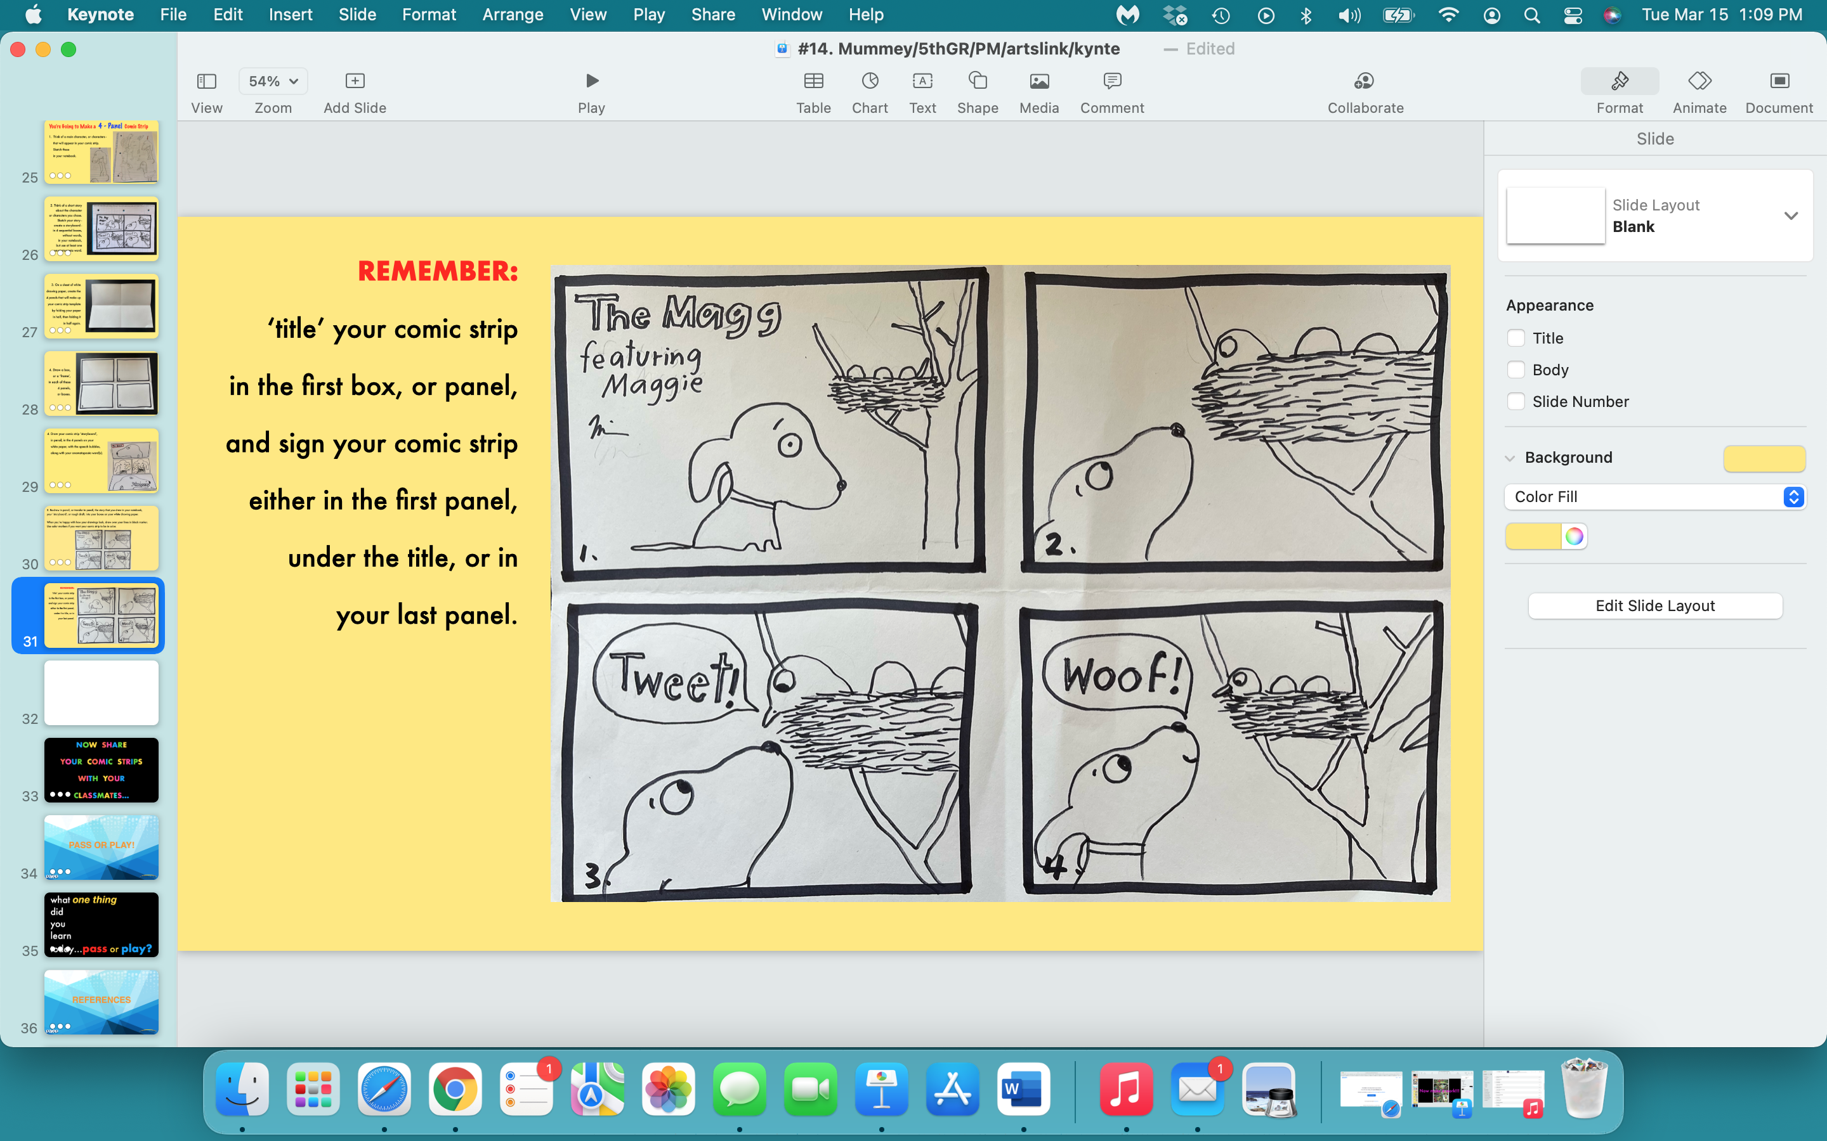

Slide 31
NOW SHARE
YOUR COMIC STRIPS
WITH YOUR
CLASSMATES…

Slide 32


Slide 33
what one thing
did
you
learn
today…pass or play?

Slide 34
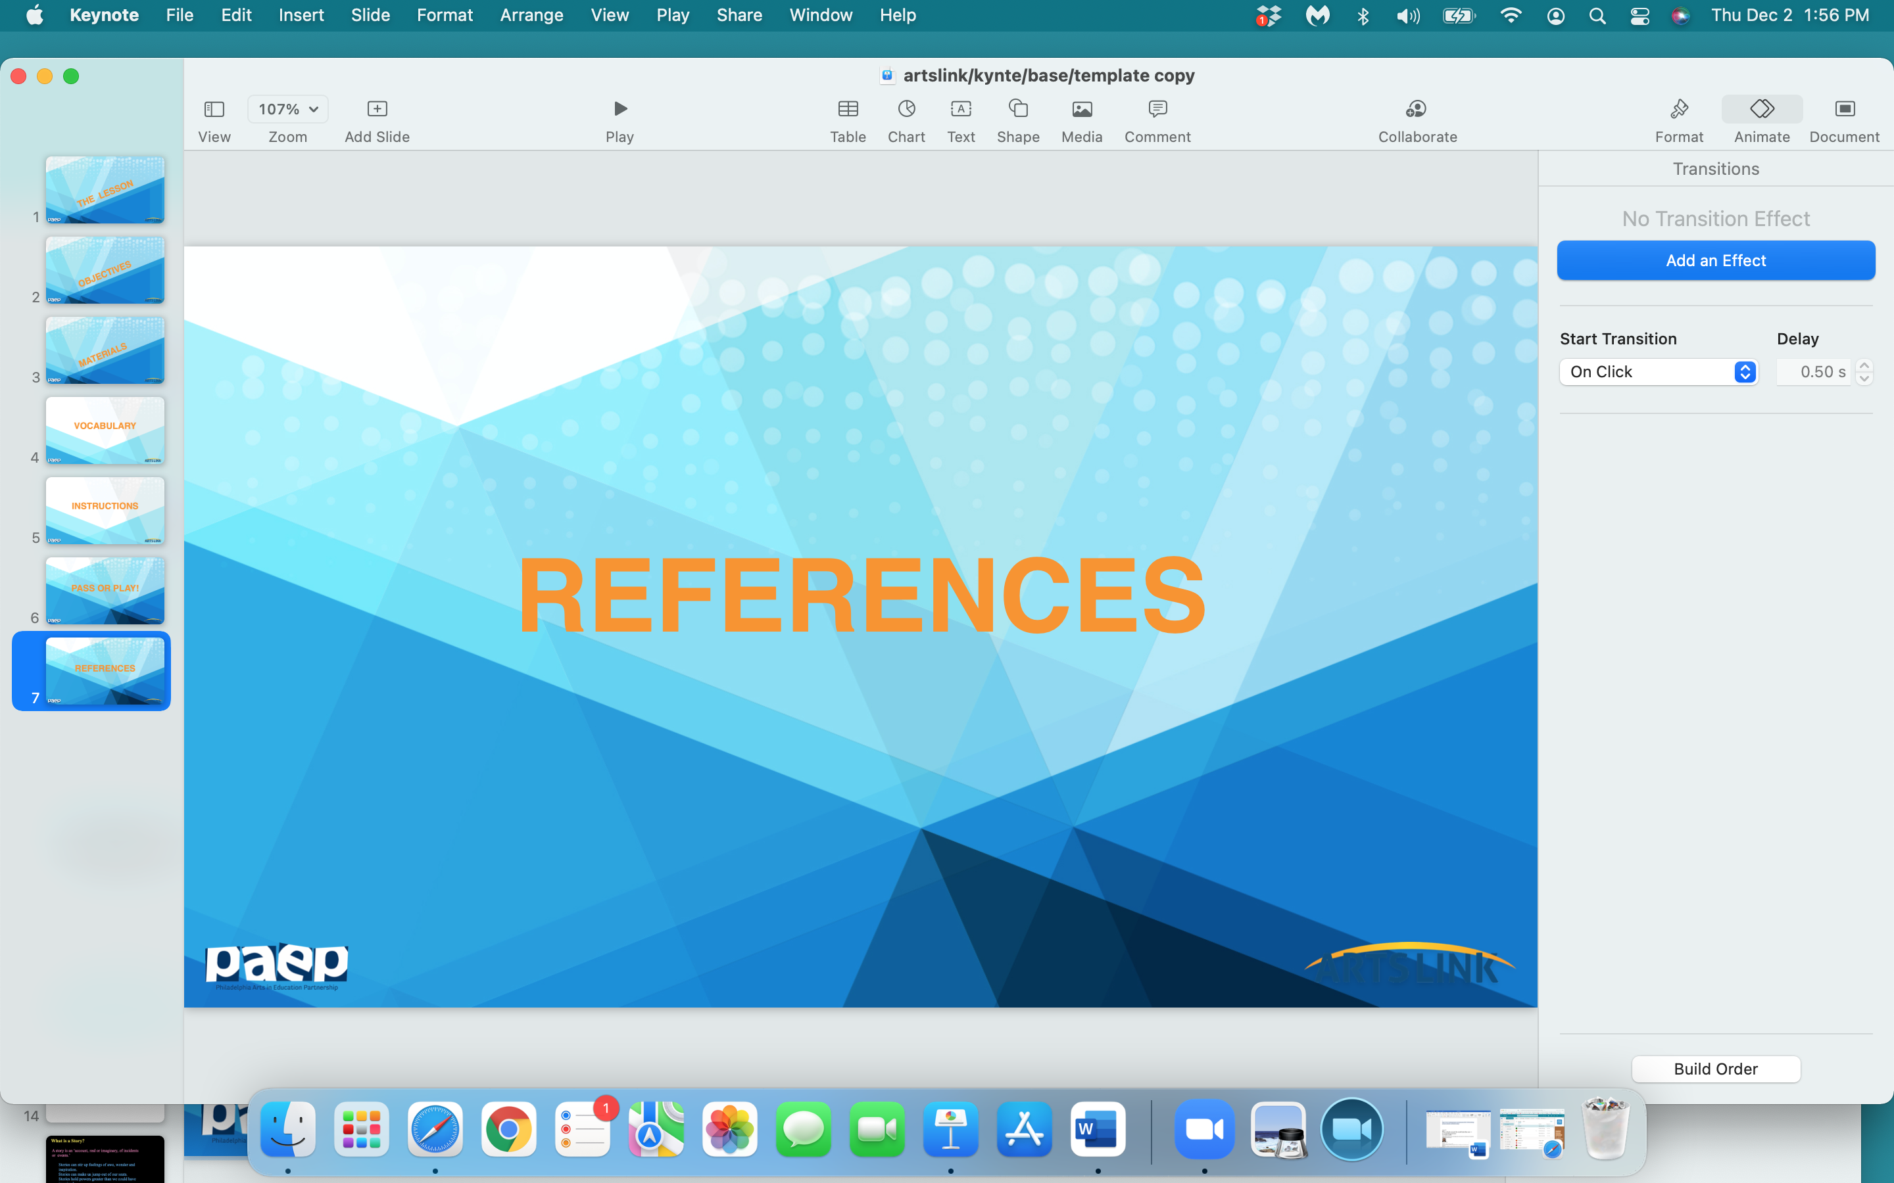

Slide 35
https://www.britannica.com/art/comic-strip
https://www.wikihow.com/Make-a-Comic-Strip
https://www.commonsense.org/education/lesson-plans/comic-strip-writing
https://www.kennedy-center.org/education/resources-for-educators/classroom-resources/lessons-and-activities/lessons/3-5/creating-comic-strips/
https://www.readwritethink.org/classroom-resources/lesson-plans/comic-book-show-tell
https://www.education.com/lesson-plan/bam-pow-comic-strip-writing/
https://www.youtube.com/watch?v=KiWdZt047Kc
https://www.pinterest.com/pin/261560690844710770/
www.MarekBennett.com
https://www.gocomics.com/comics/lists/1626949/peanuts-snoopy-happy-dance
https://libguides.asu.edu/c.php?g=613607&p=4263347

