Slide 1
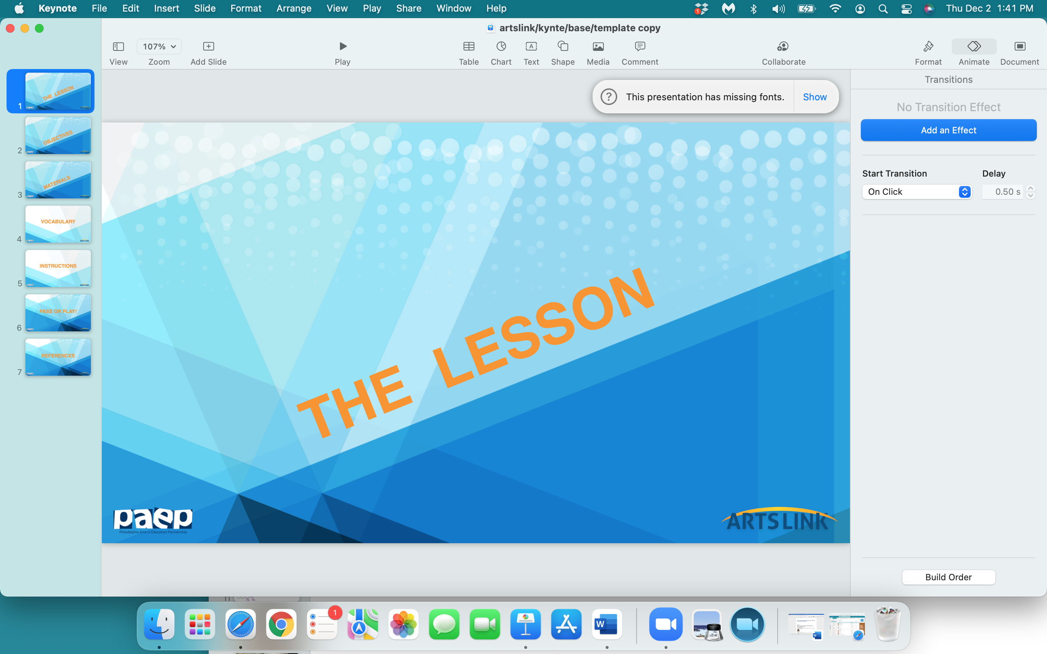

Slide 2
to comic
or
not to comic

Slide 3
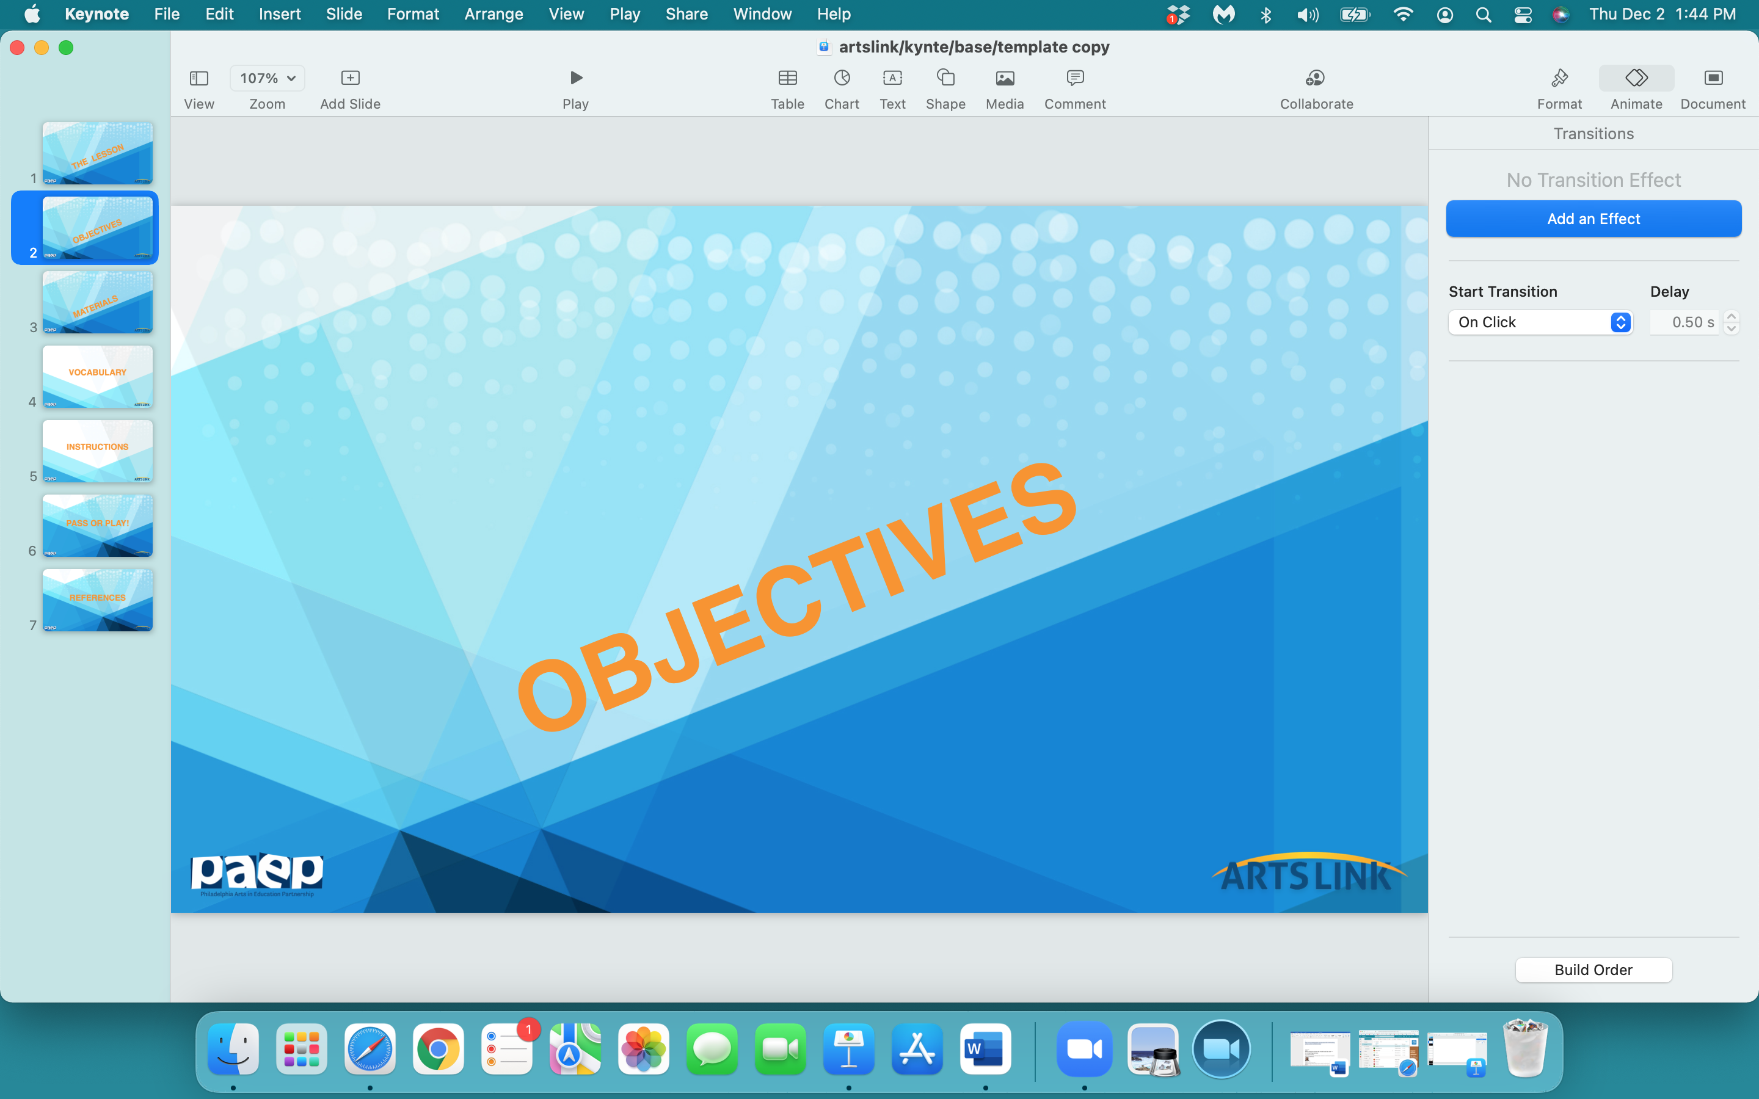

Slide 4
In the next hour, you will:
evaluate comic strips by looking at their words & pictures: how both work together
create a ‘template’ for your comic strip
create a storyboard for, illustrate and share your comic strip

Slide 5
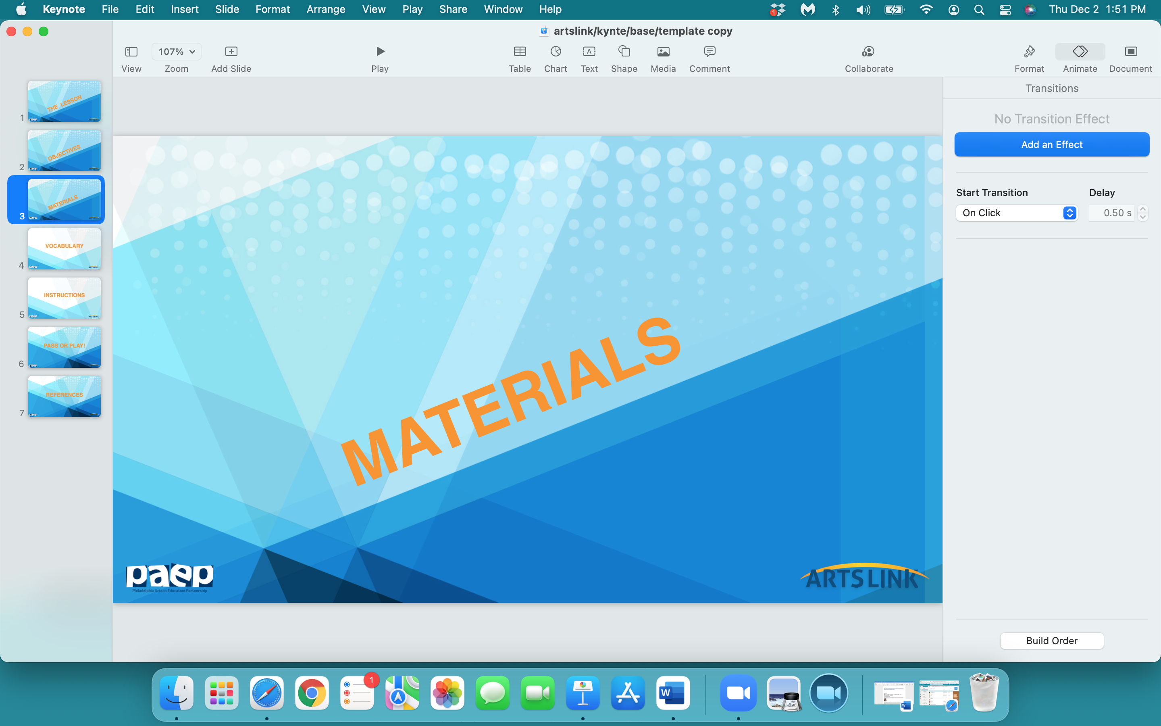

Slide 6
notebook/journal
one sheet from your sketchpad
pencil
eraser
markers
black marker
ruler

Slide 7
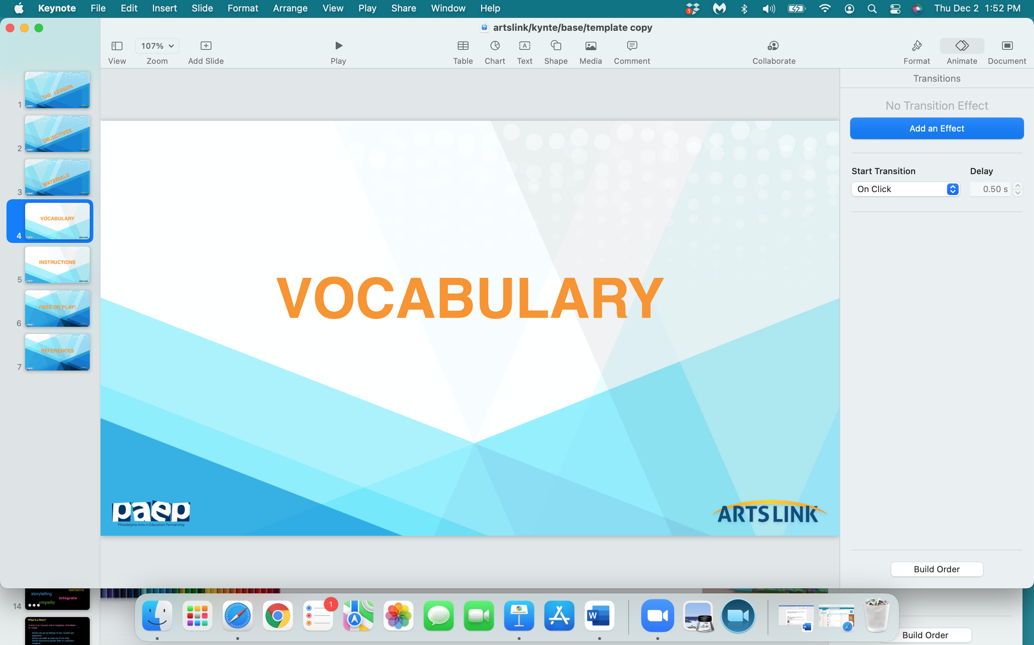

Slide 8
comic strip
sequence
storyboard
dialogue (optional)
speech bubble
template / panel

Slide 9
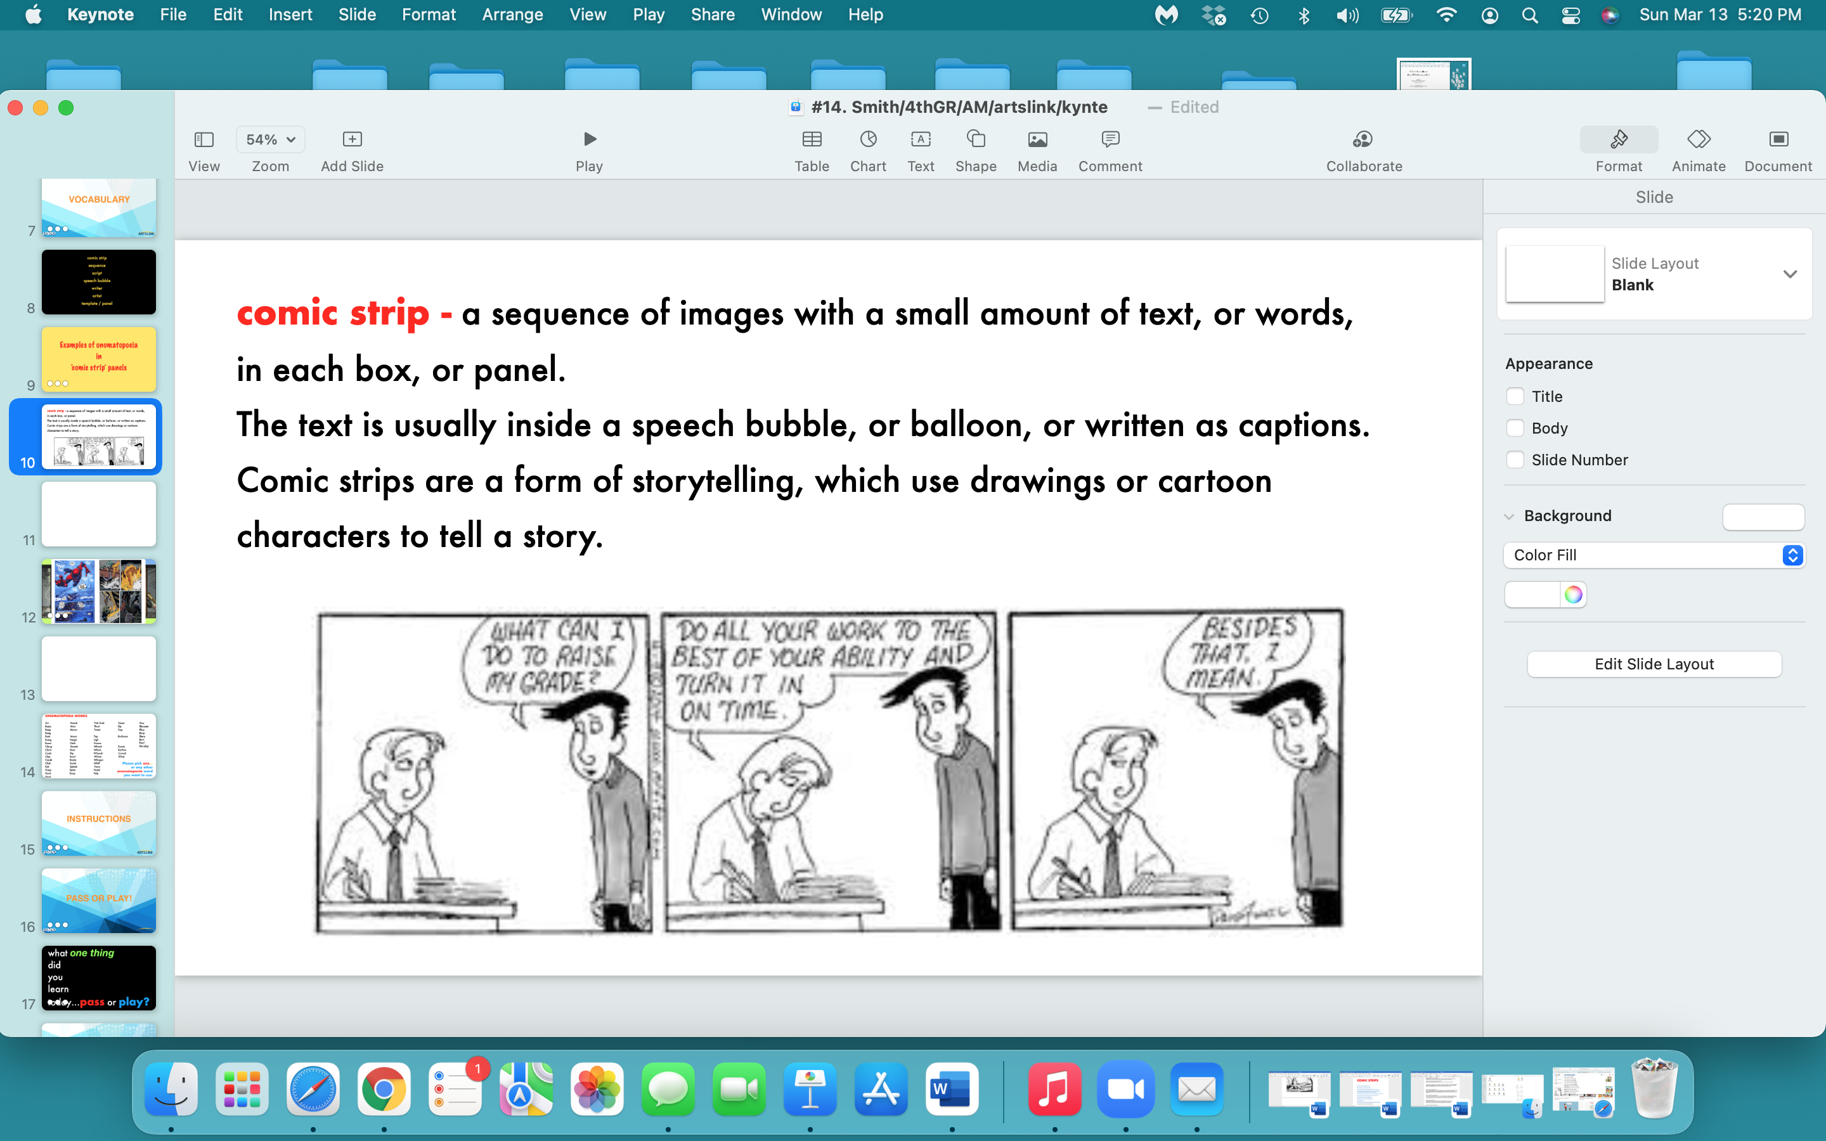

Slide 10
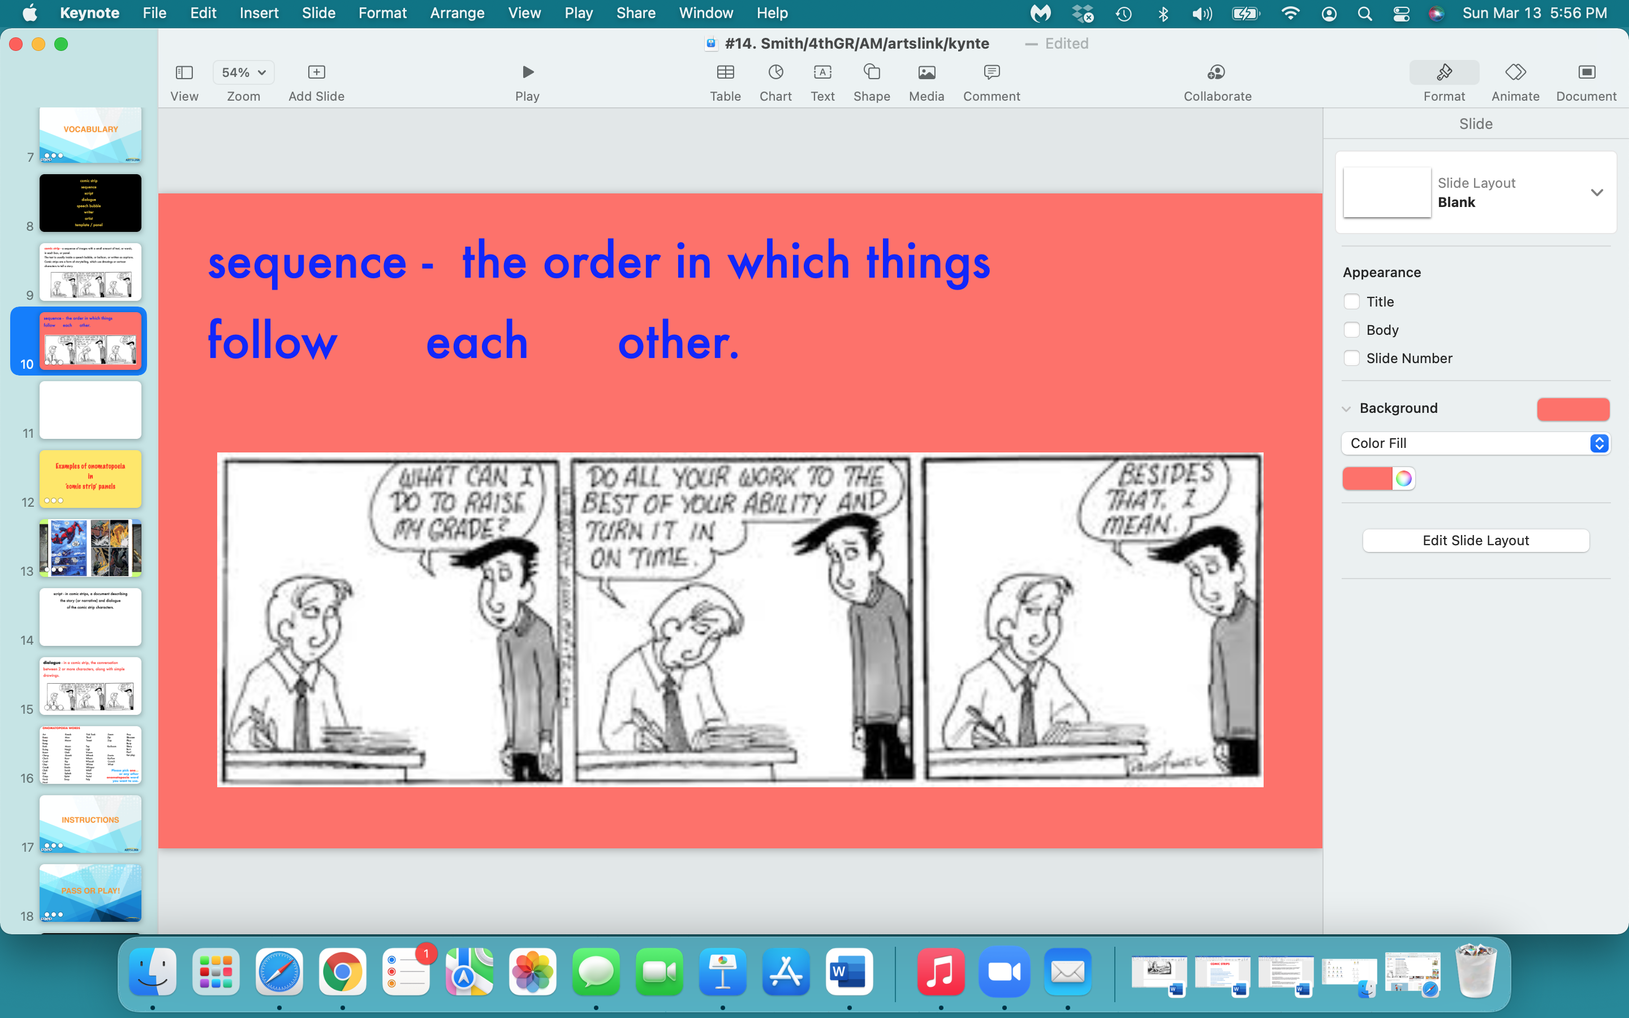

Slide 11
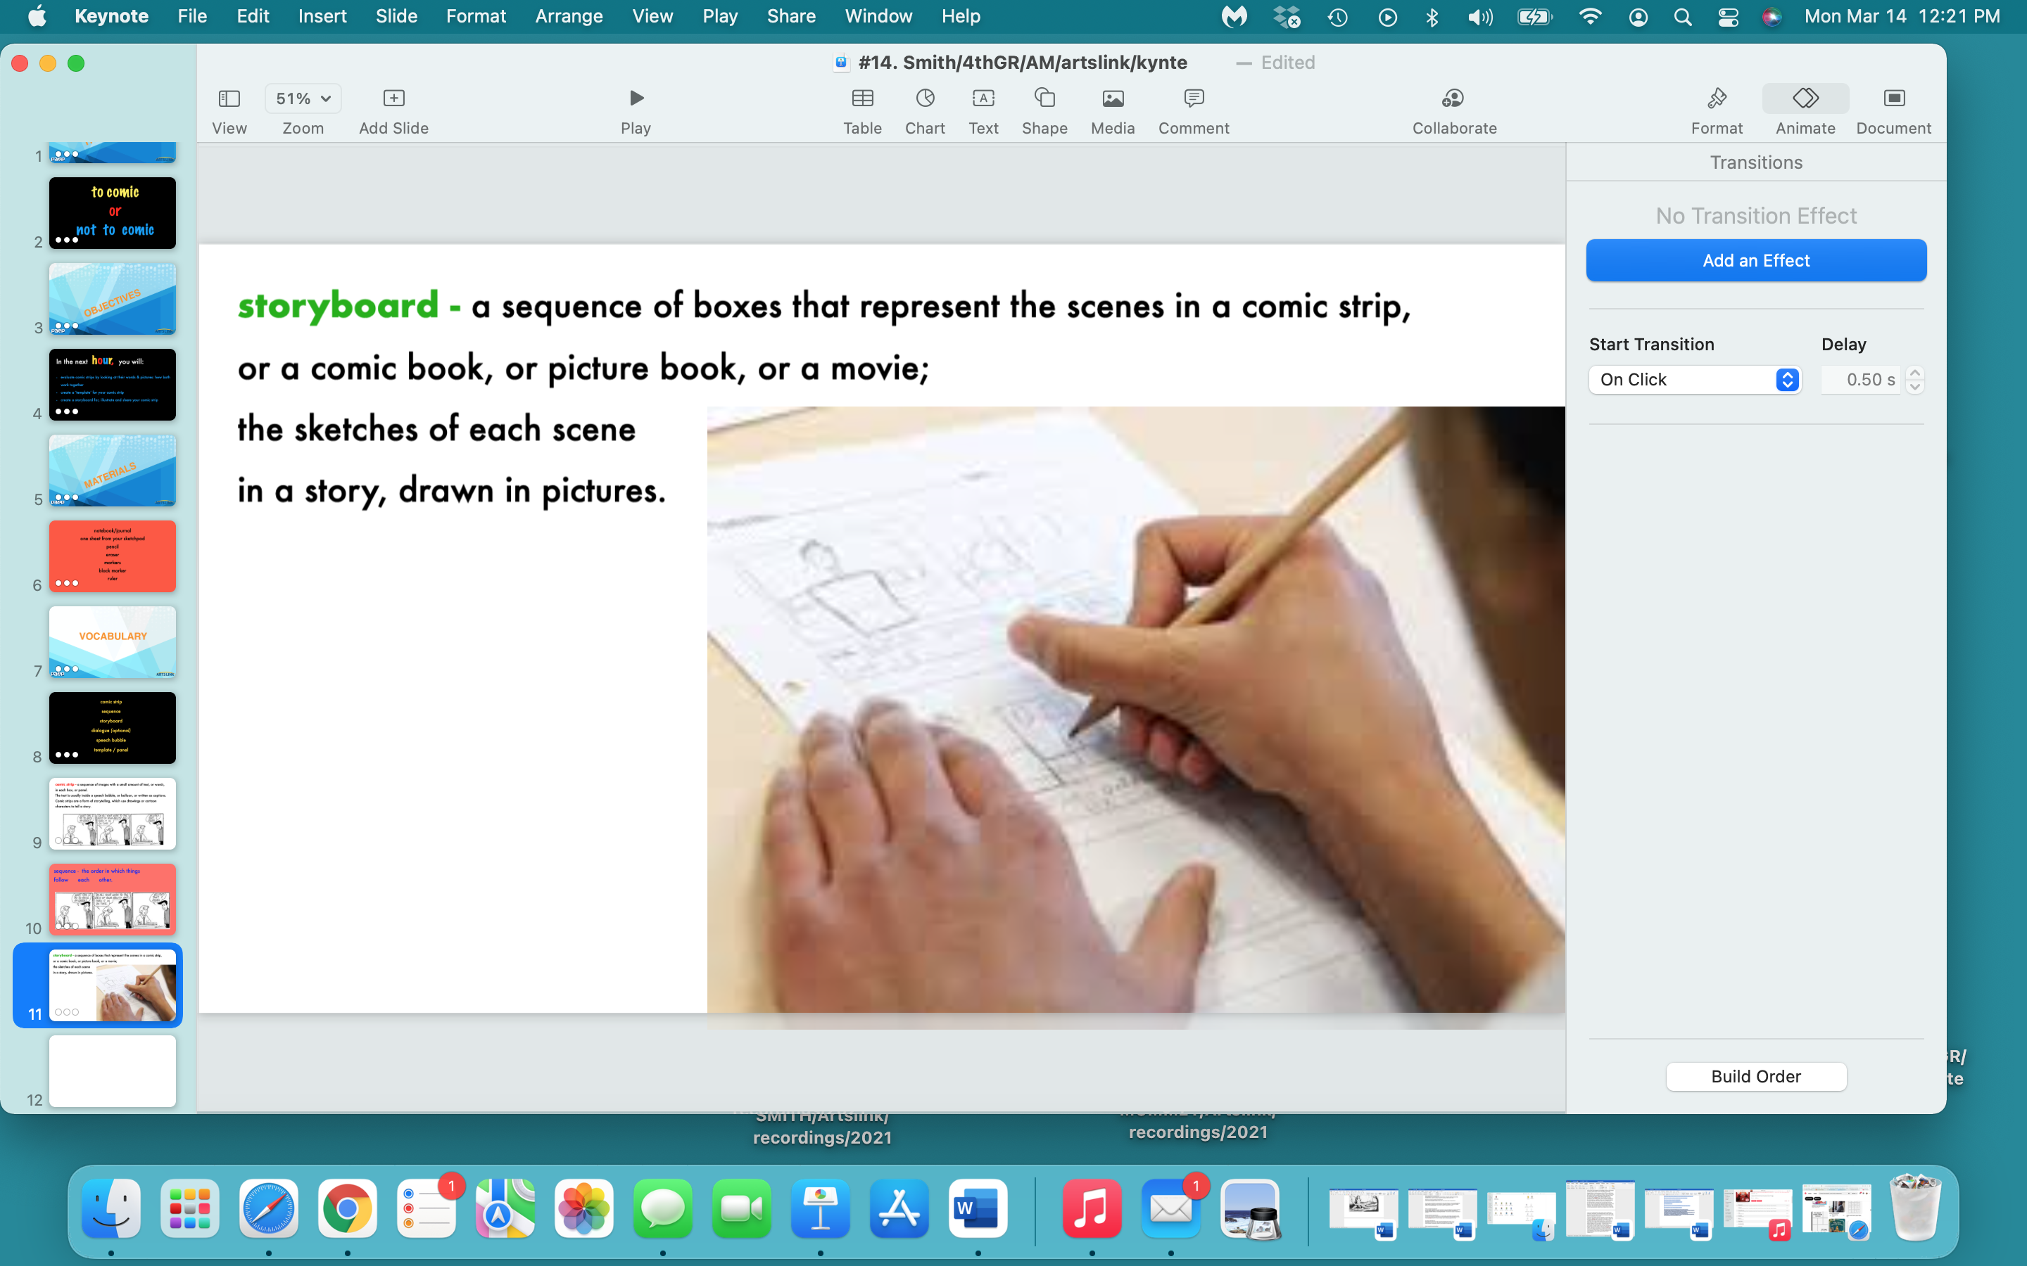

Slide 12
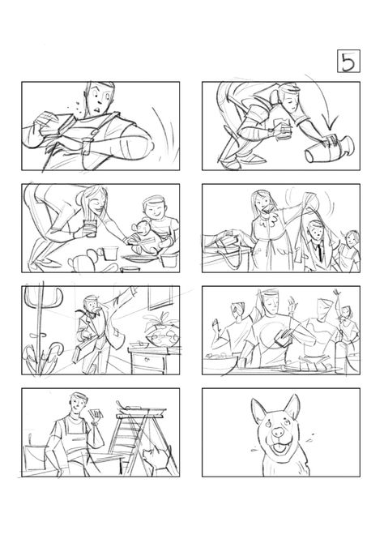
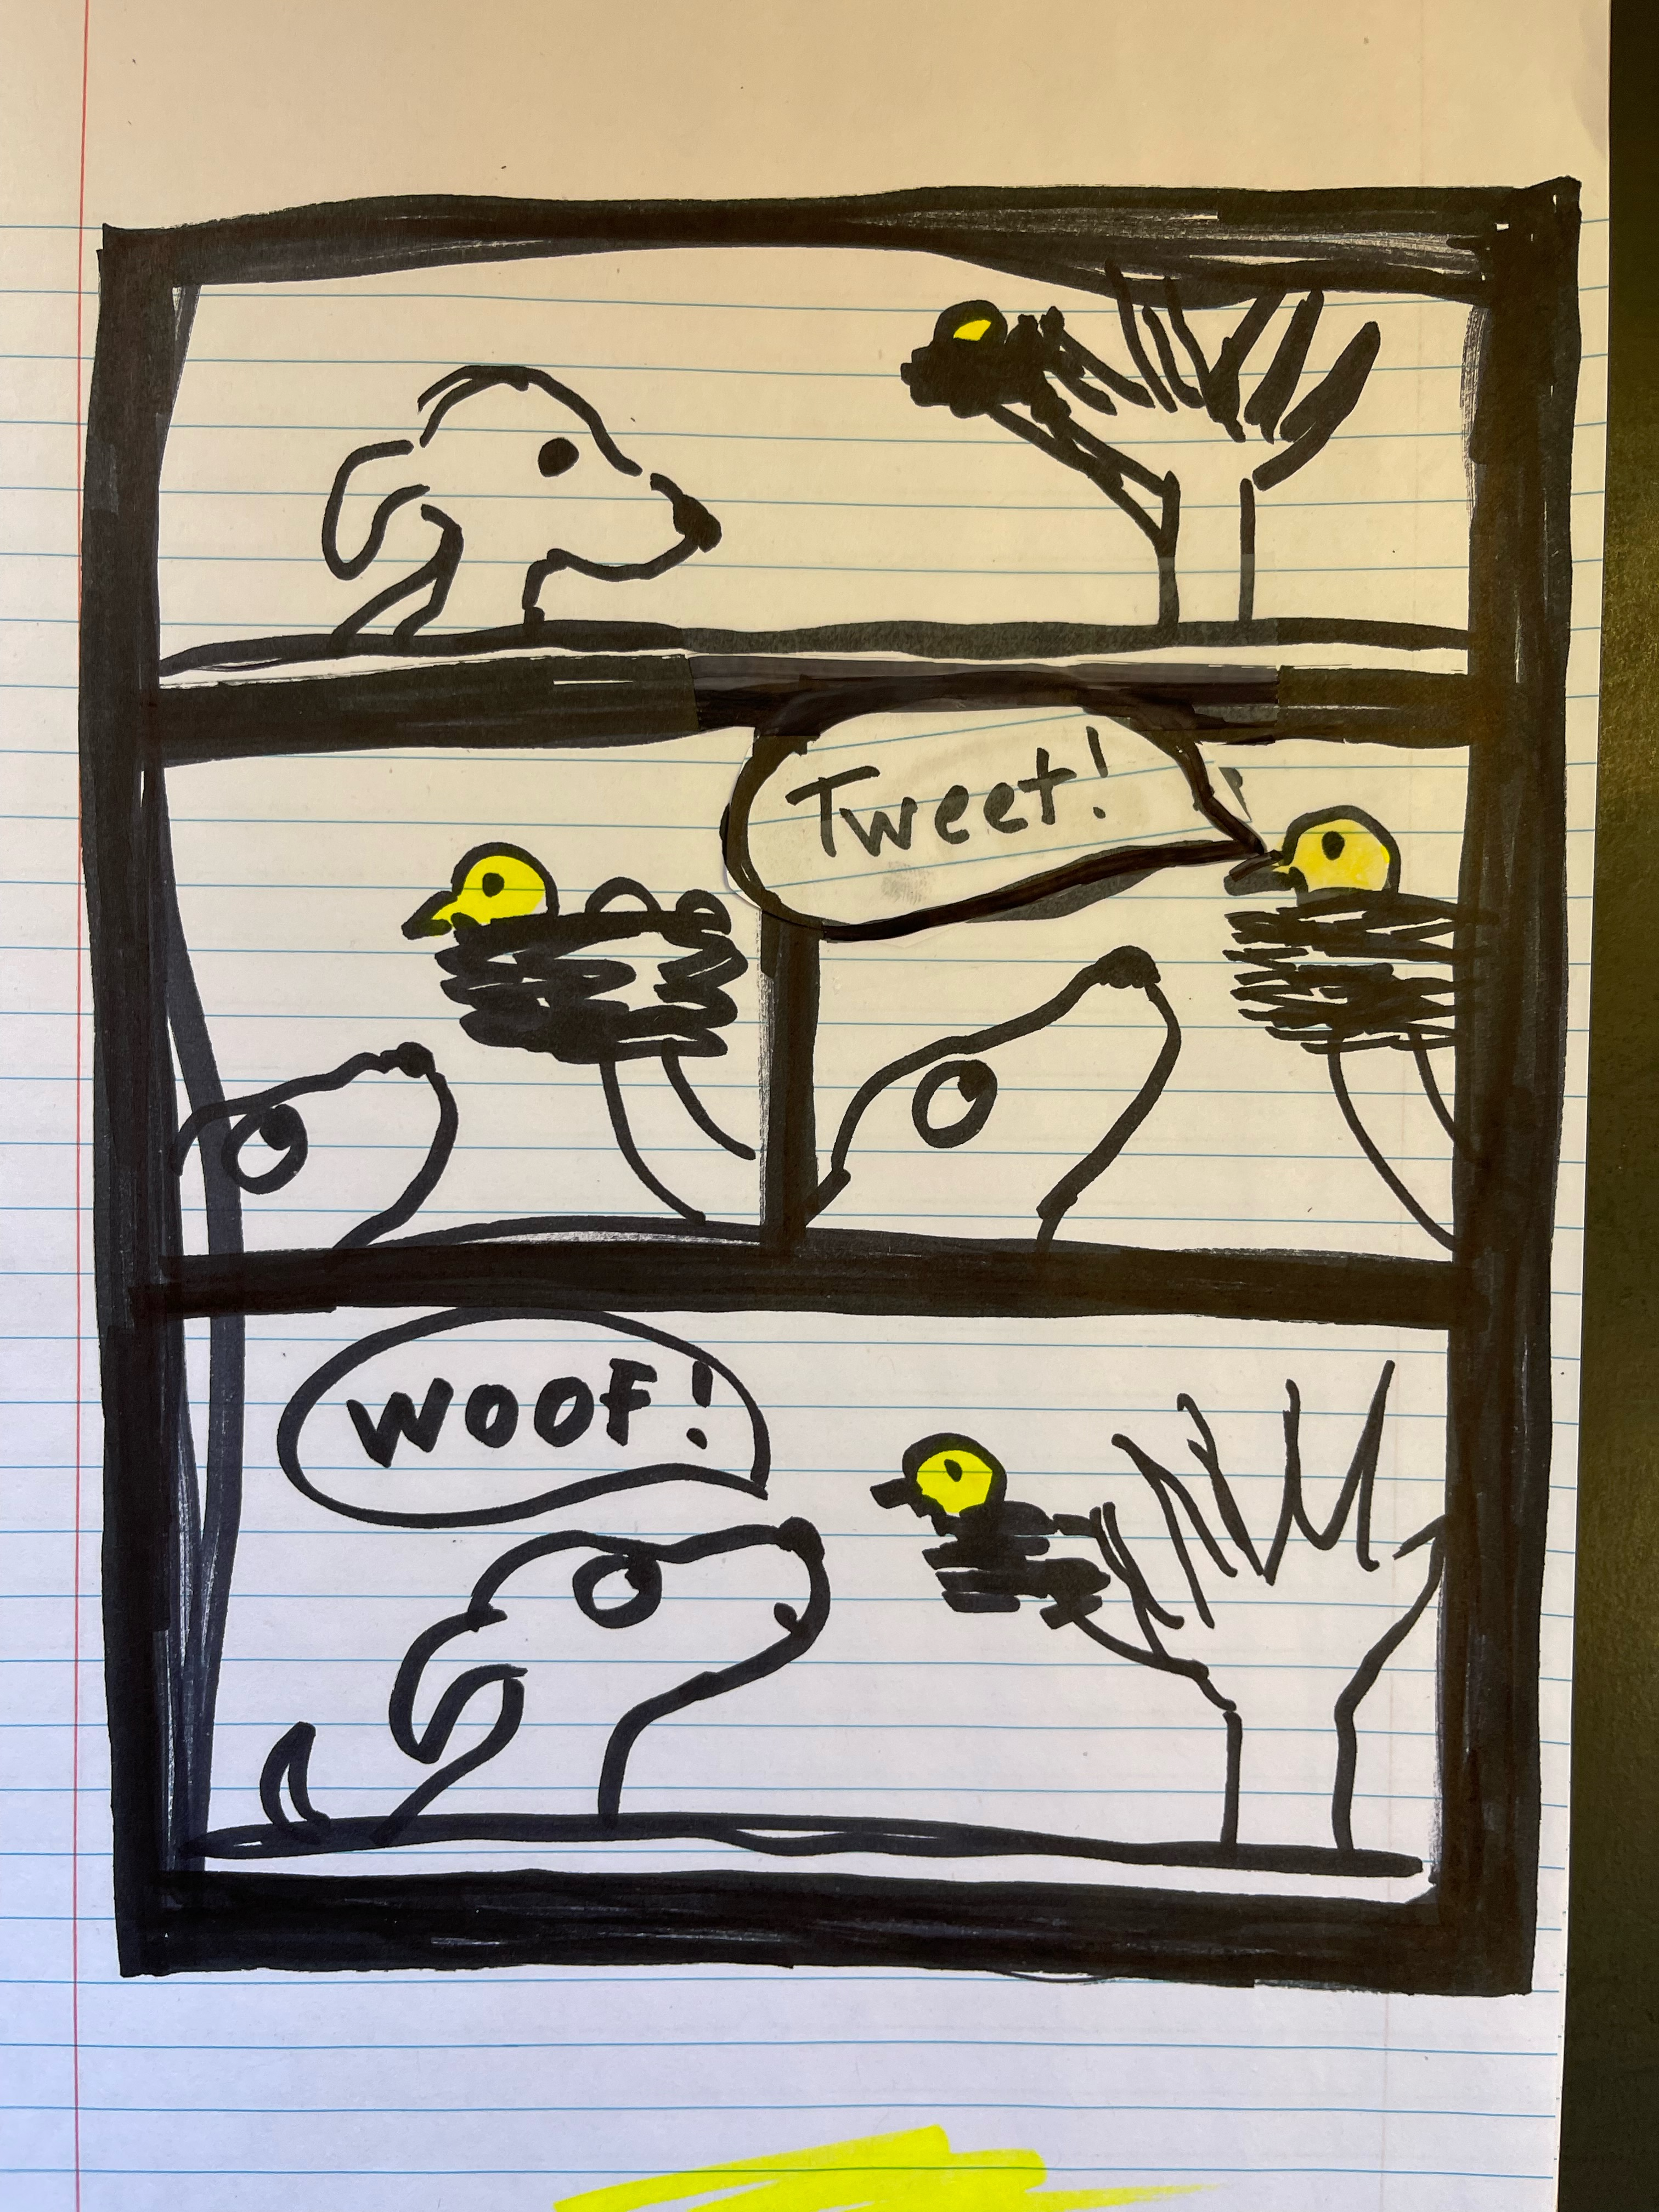
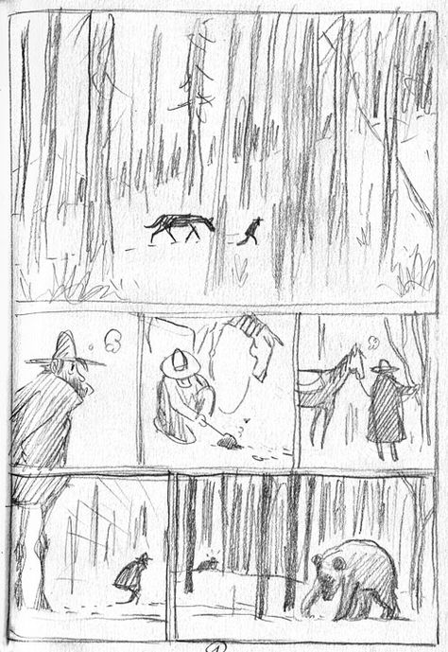
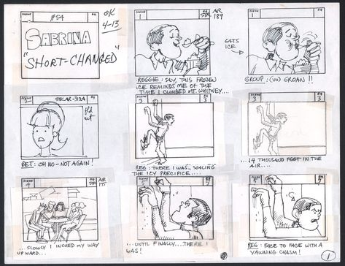
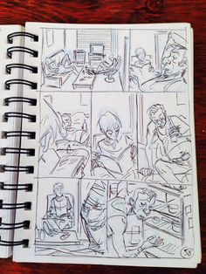
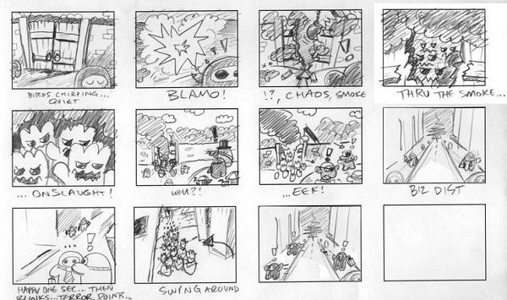

Slide 13
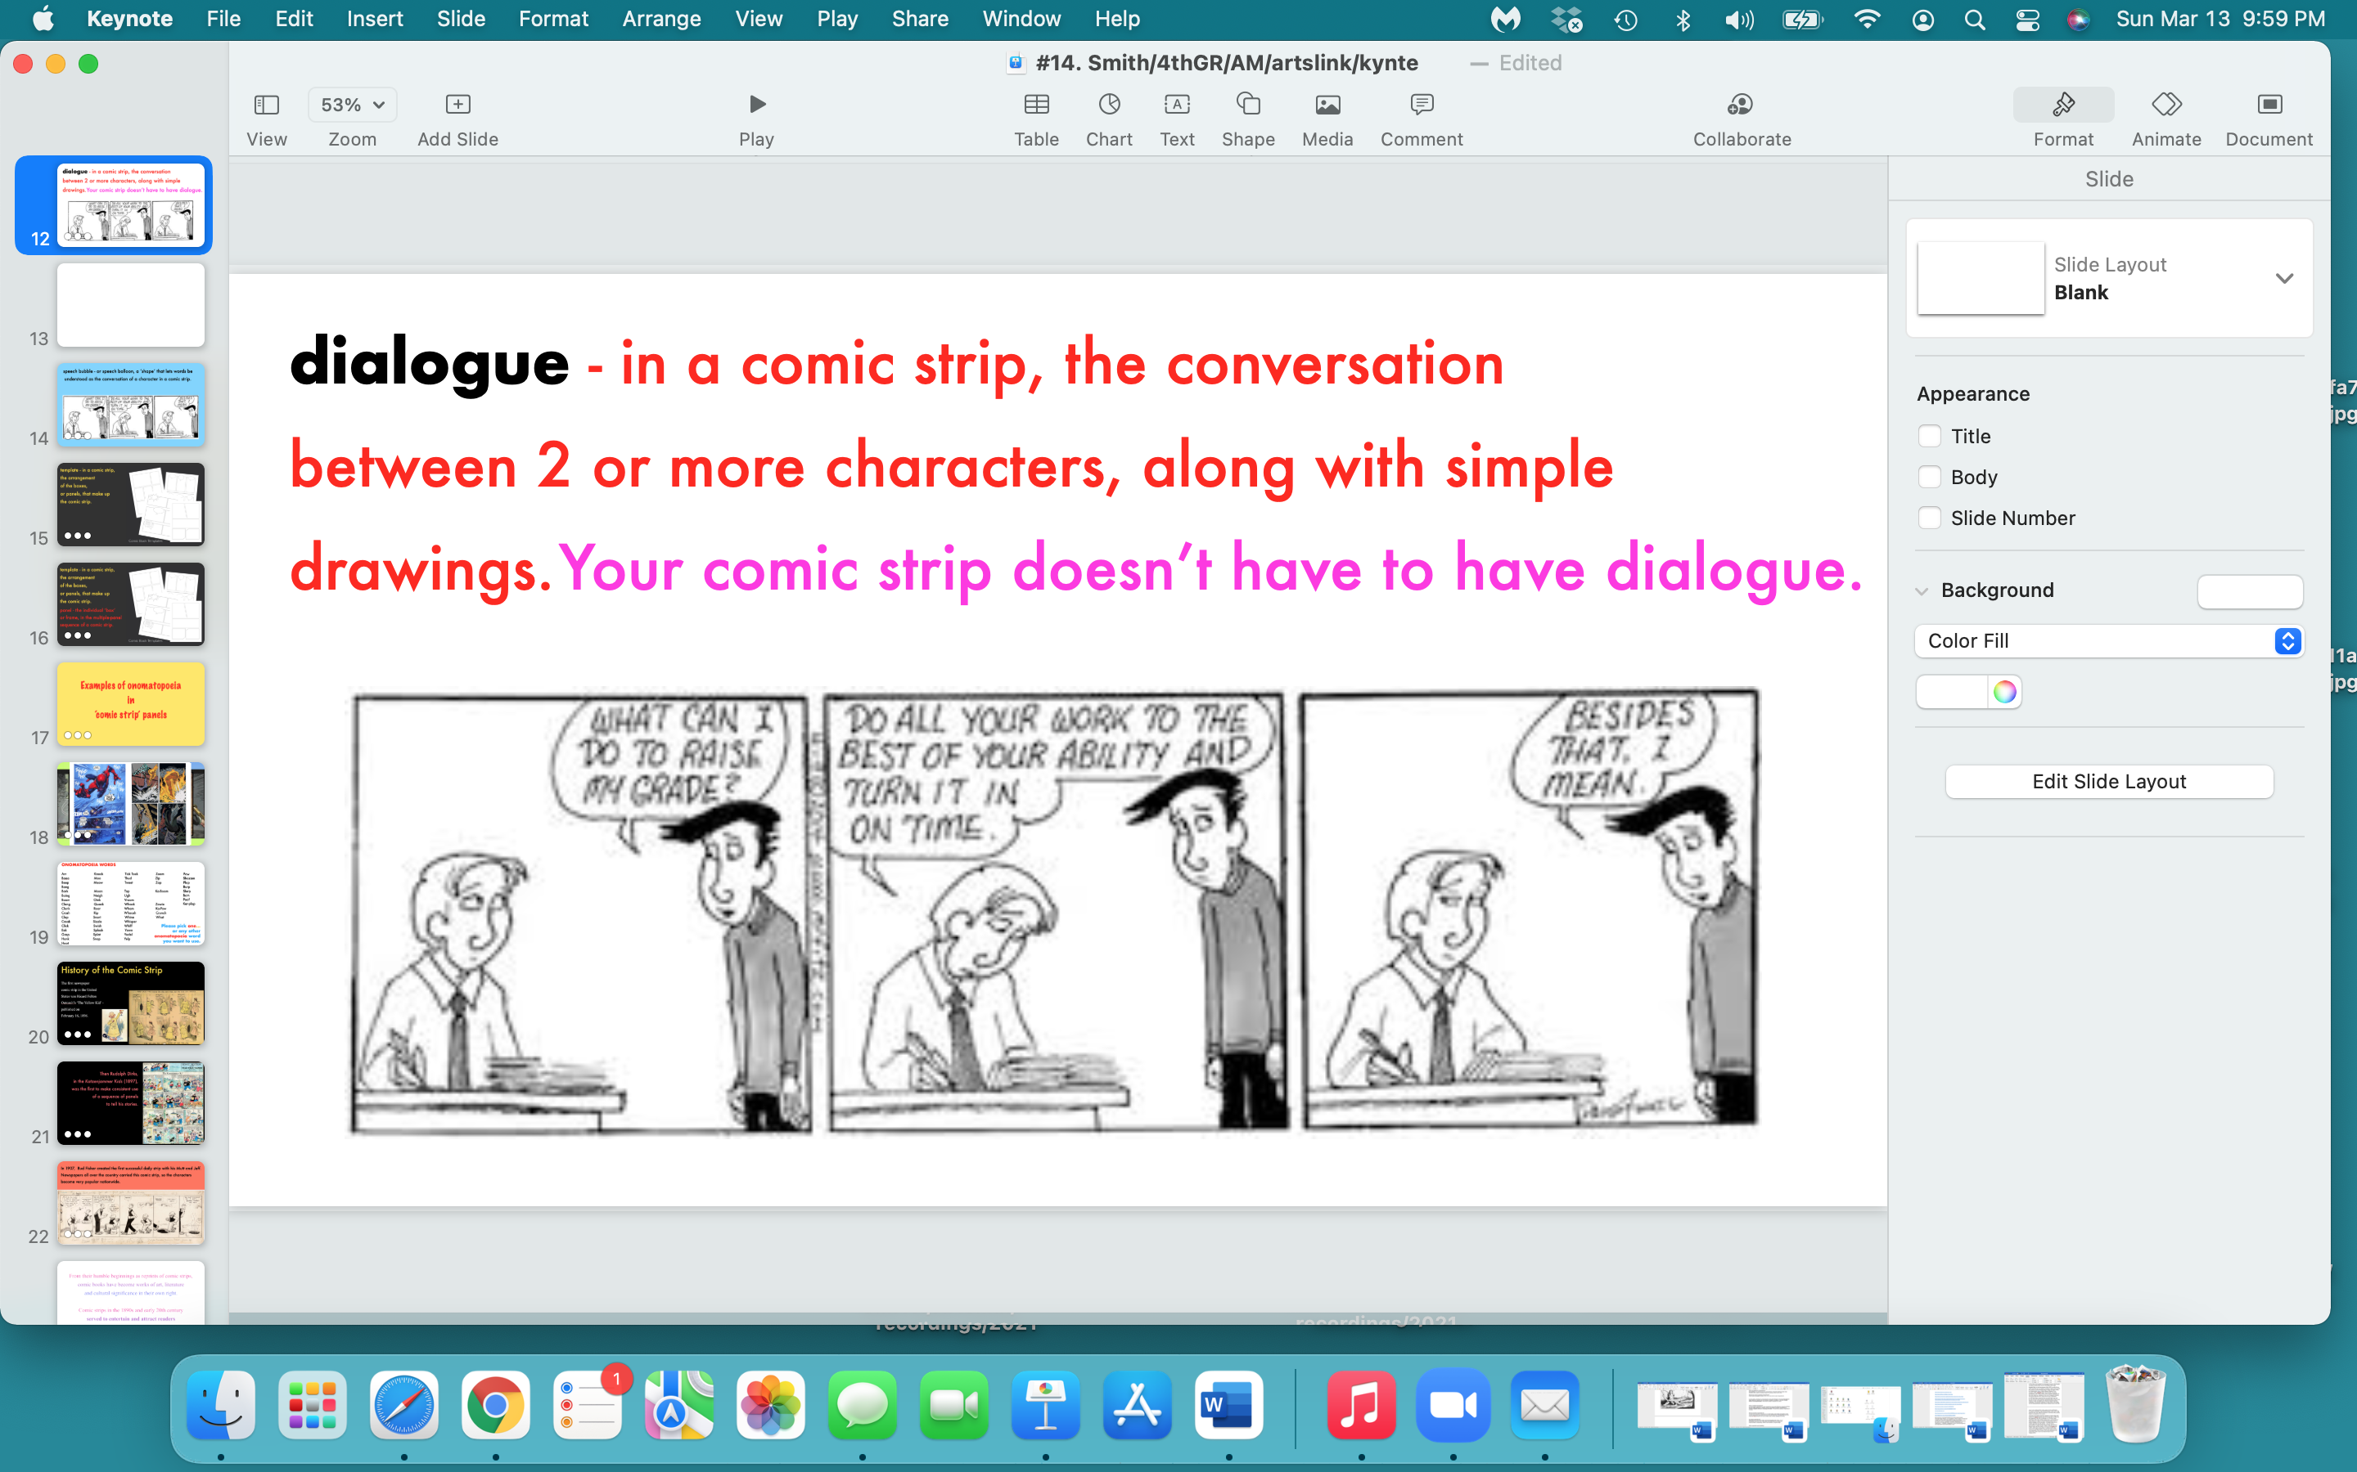

Slide 14
…but it does have to have at least
ONE ONOMATOPOEIA WORD
in a speech bubble.

Slide 15
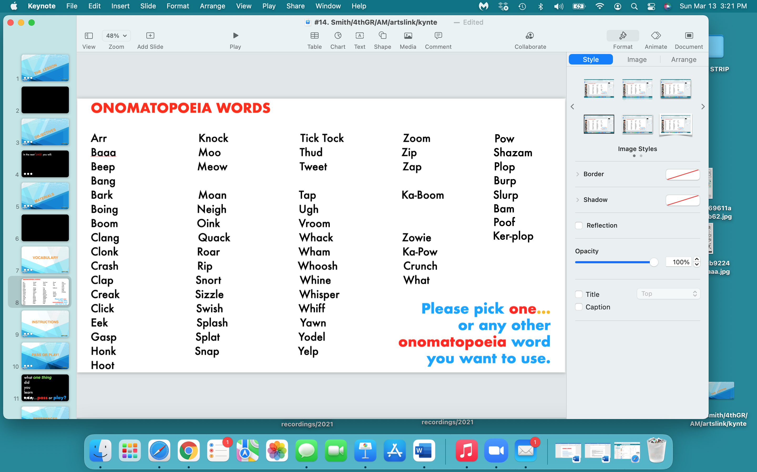

Slide 16
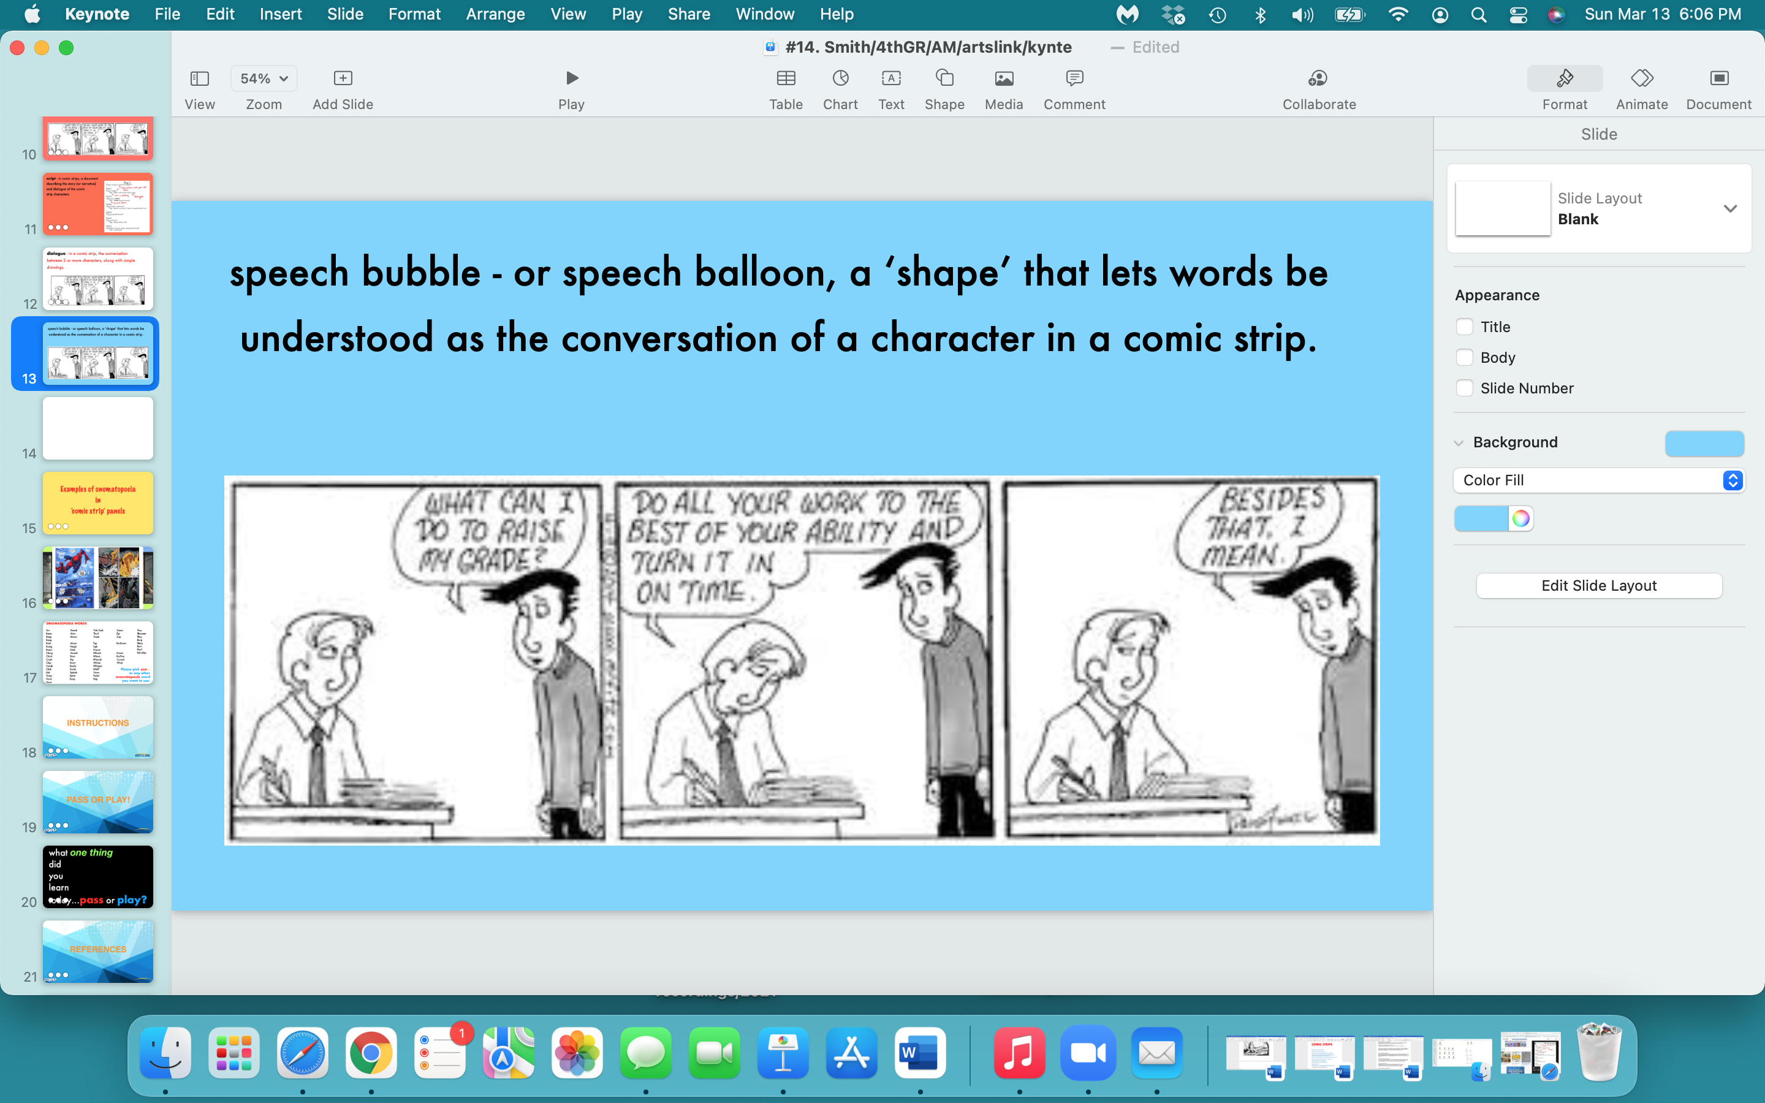

Slide 17
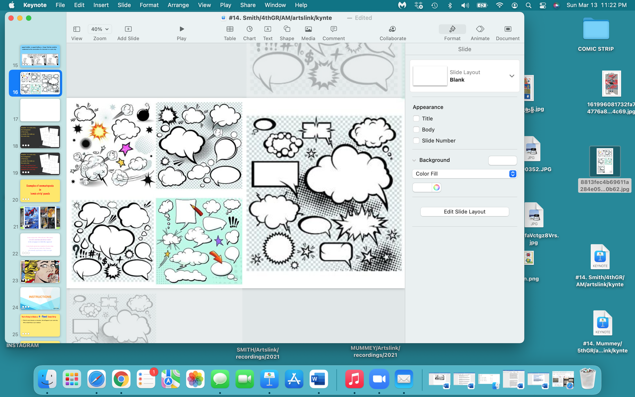

Slide 18
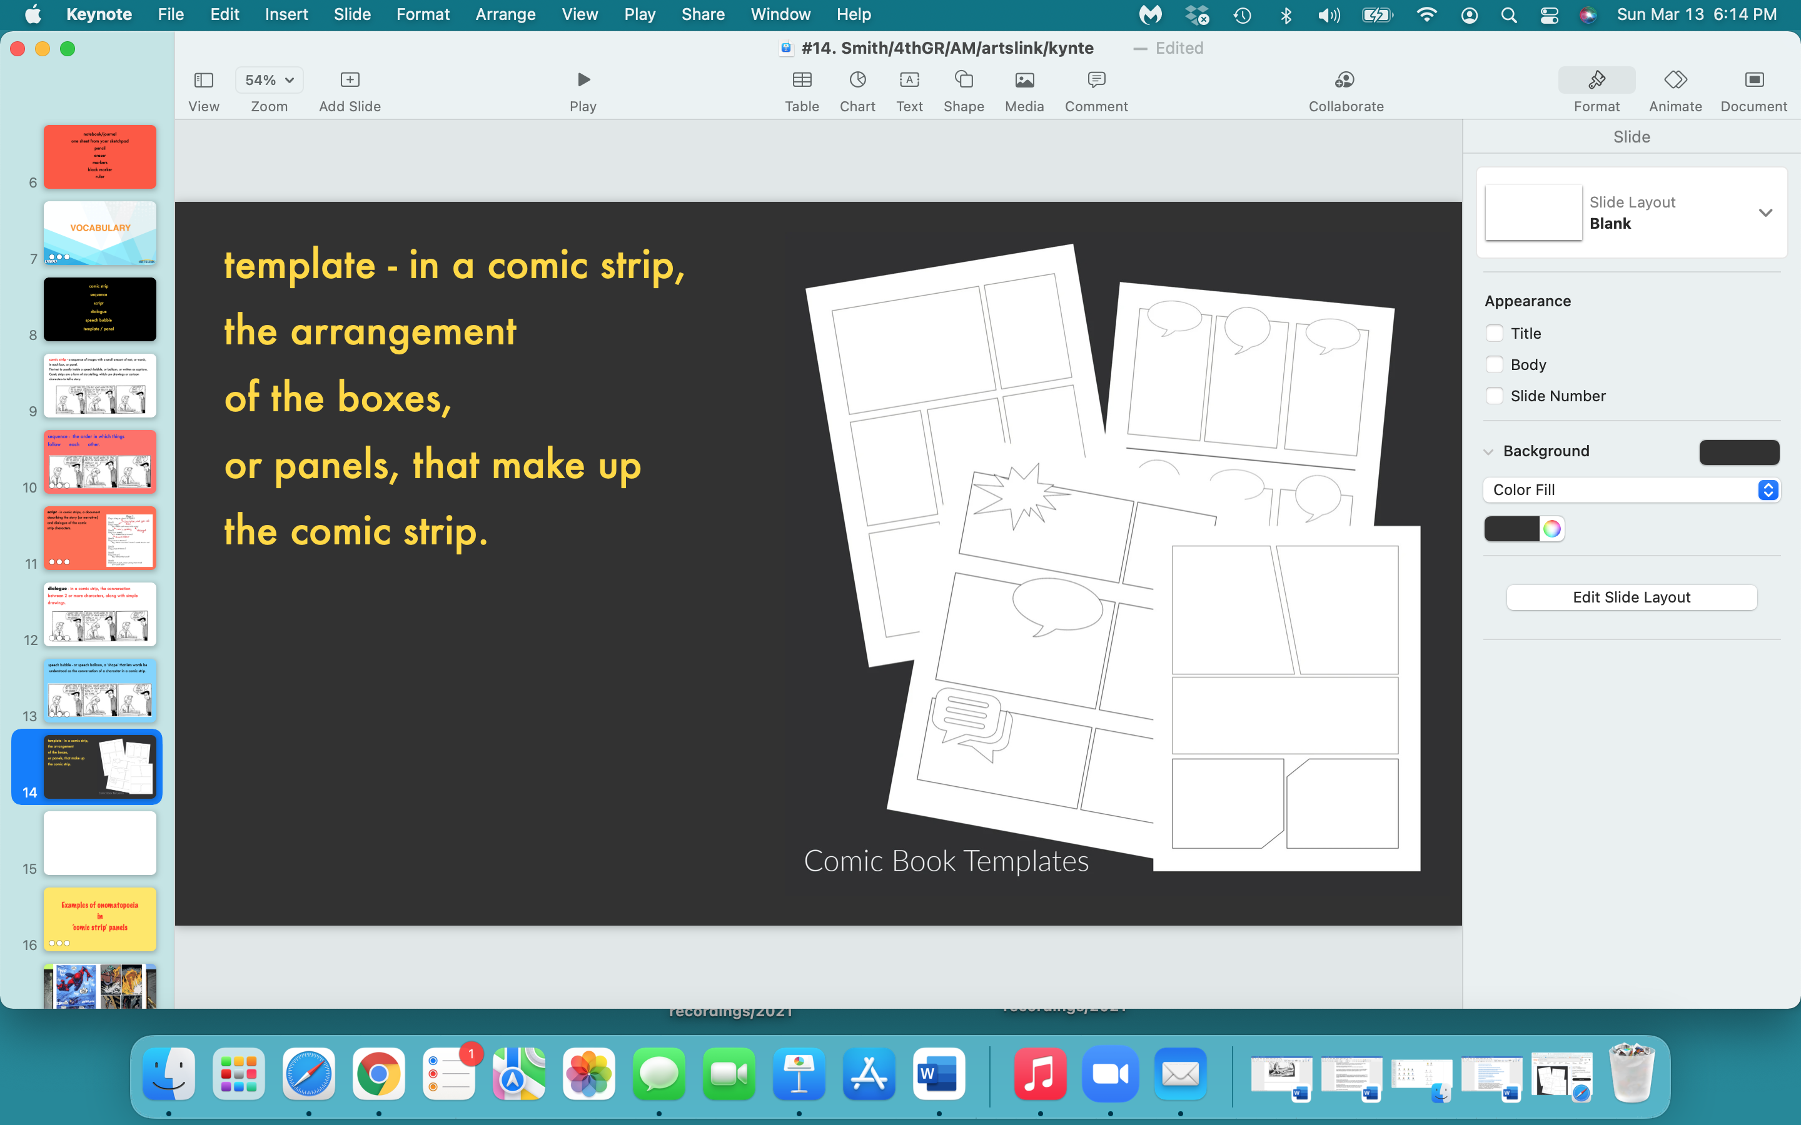

Slide 19
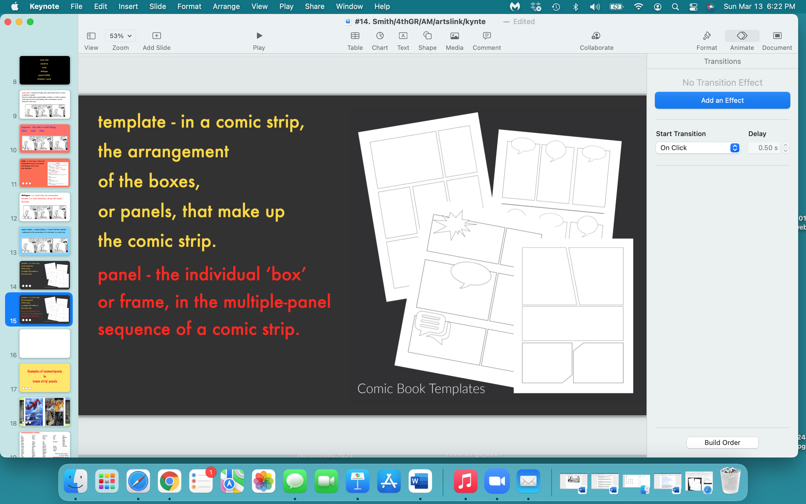

Slide 20
Examples of onomatopoeia
in
‘comic strip’ panels

Slide 21
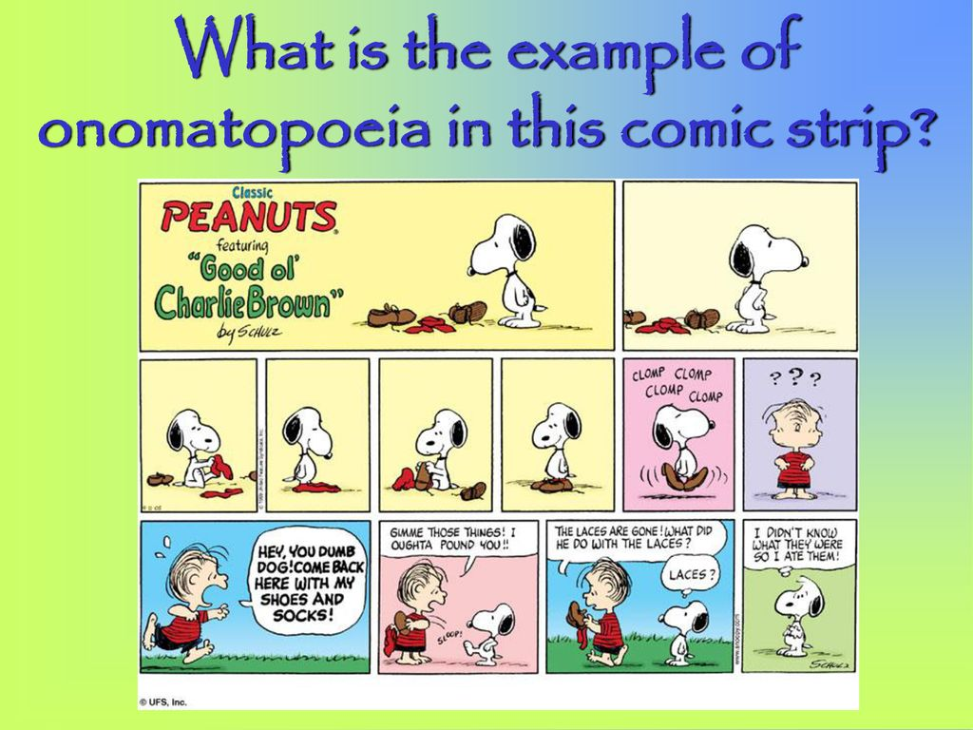
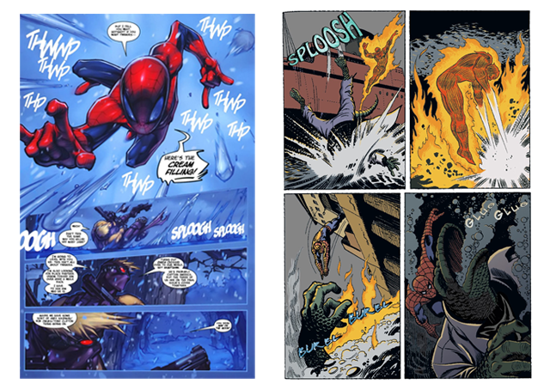
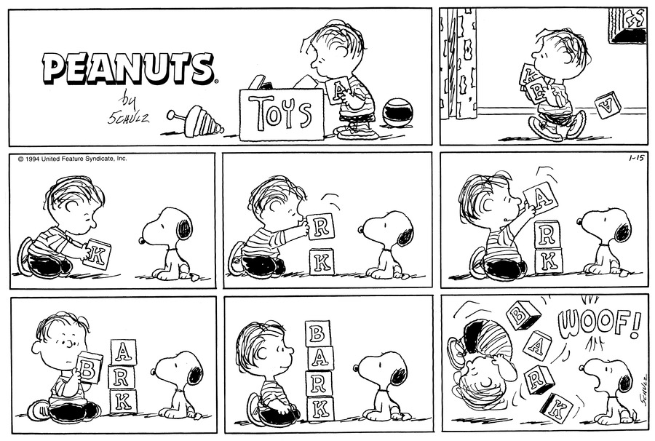
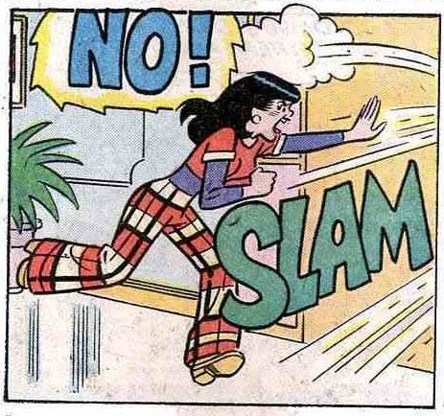
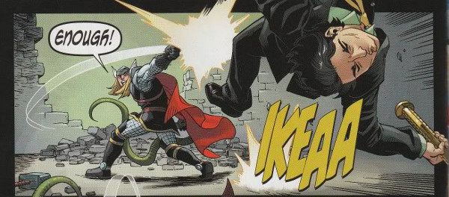



Slide 22
Comic strips in the 1890s and early 20th century
served to entertain and attract readers
to the newspapers in which they appeared.
Comic books started out as reprints of comic strips -
but have become works of art, literature
and culturally significance in their own right.

Slide 23

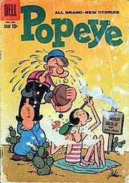
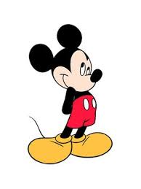
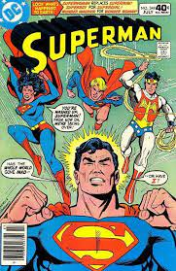
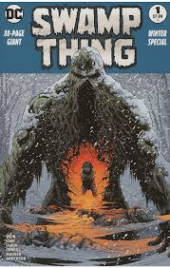
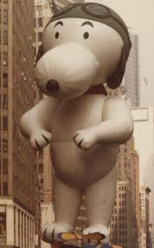
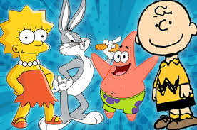
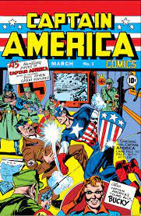
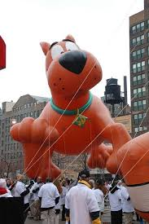

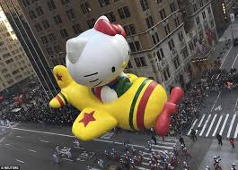

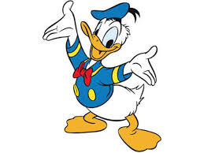
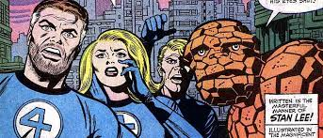
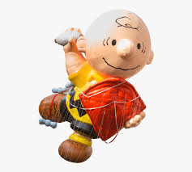

Slide 24
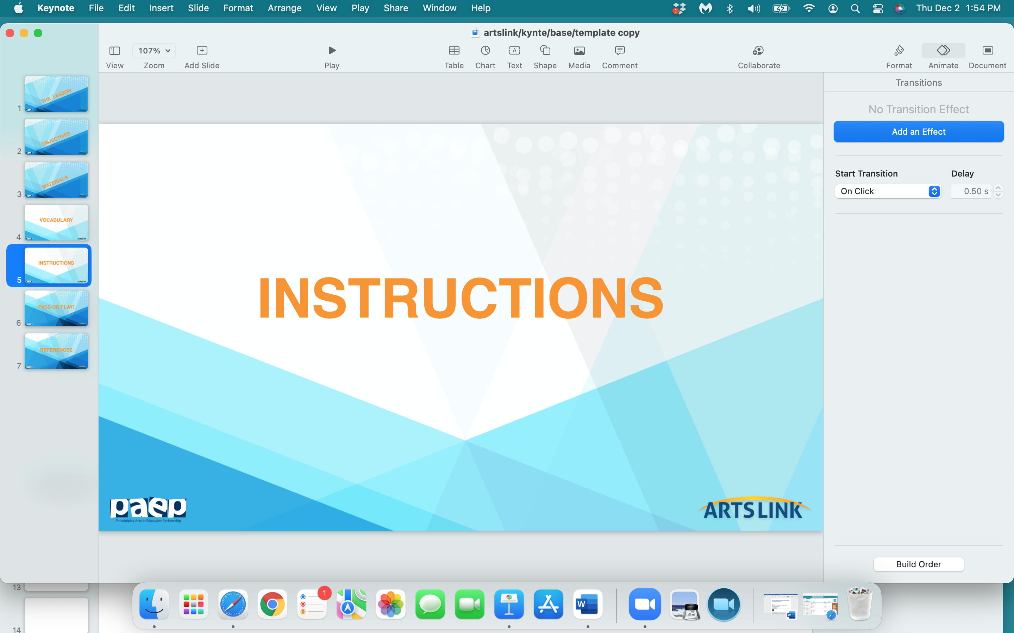

Slide 25
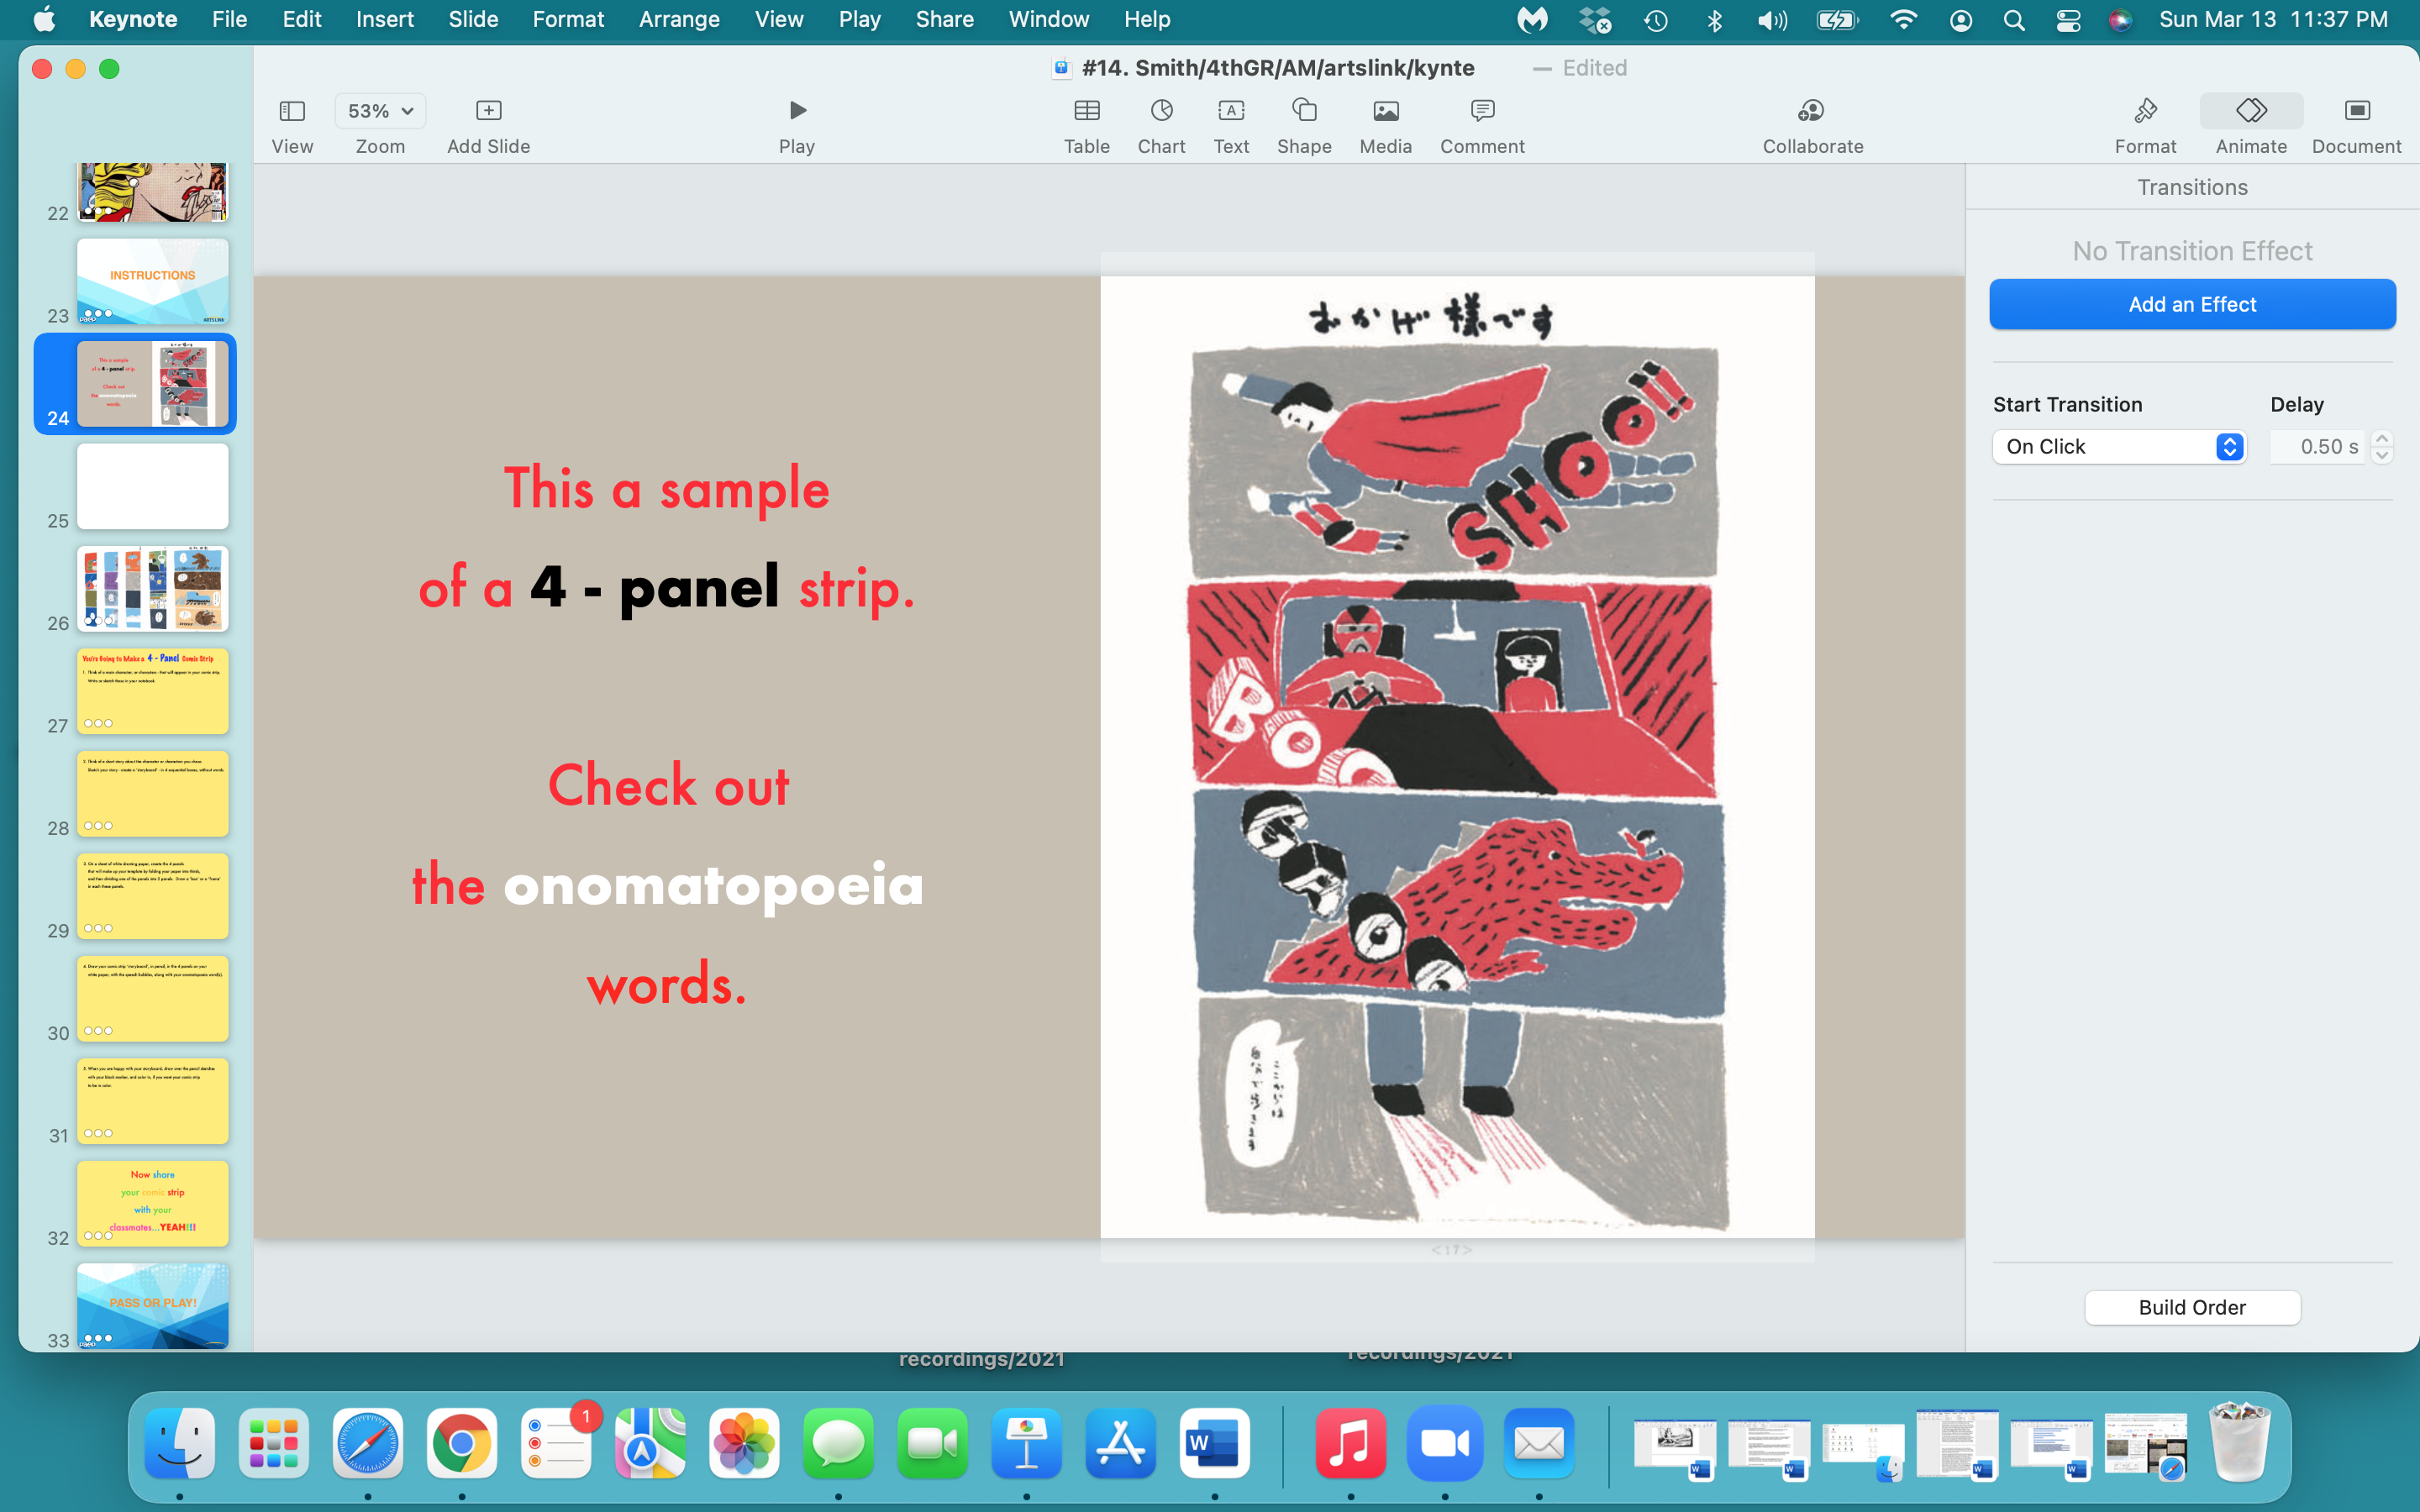

Slide 26
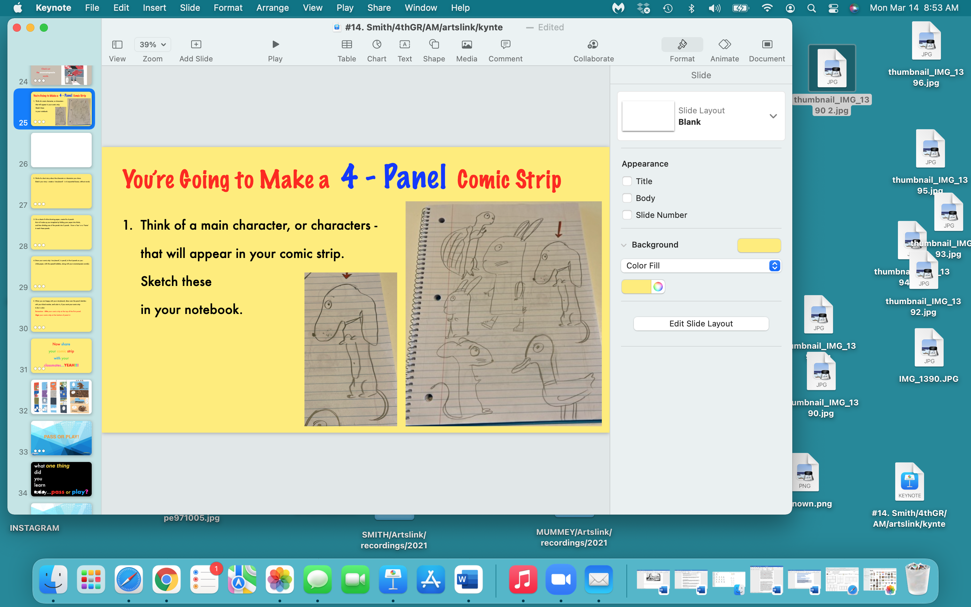

Slide 27
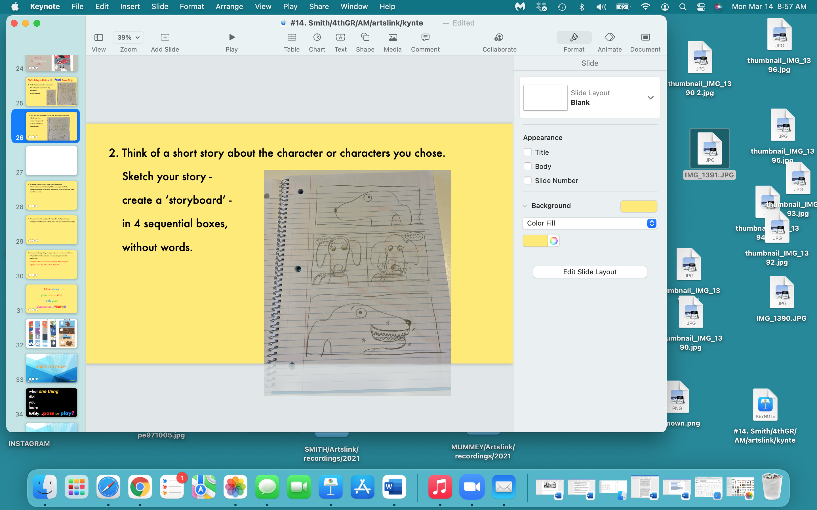

Slide 28
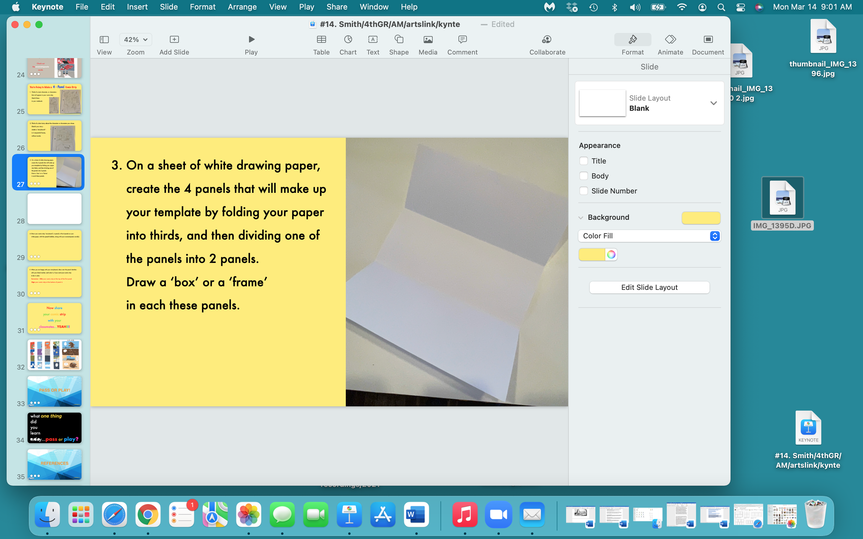

Slide 29
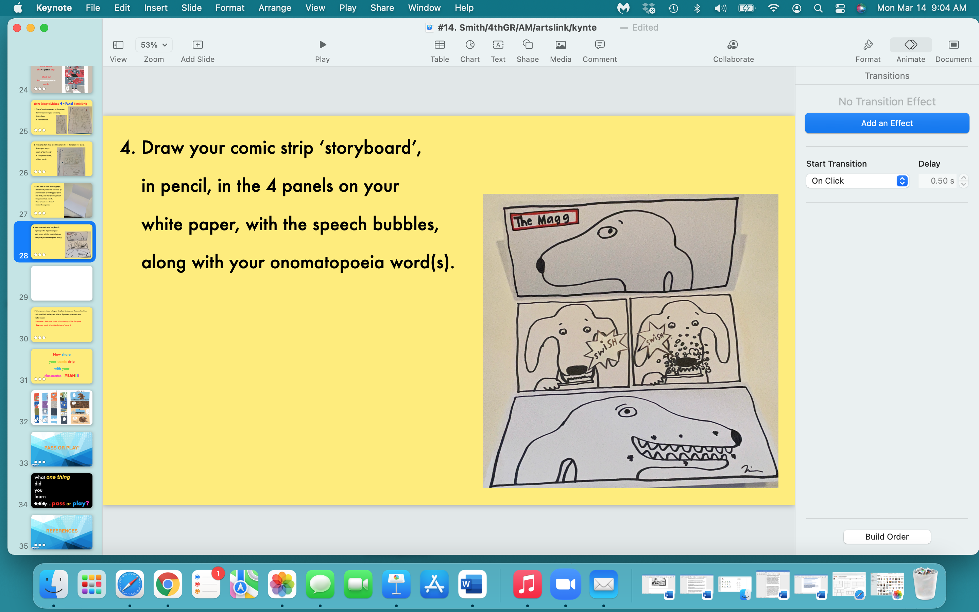

Slide 30
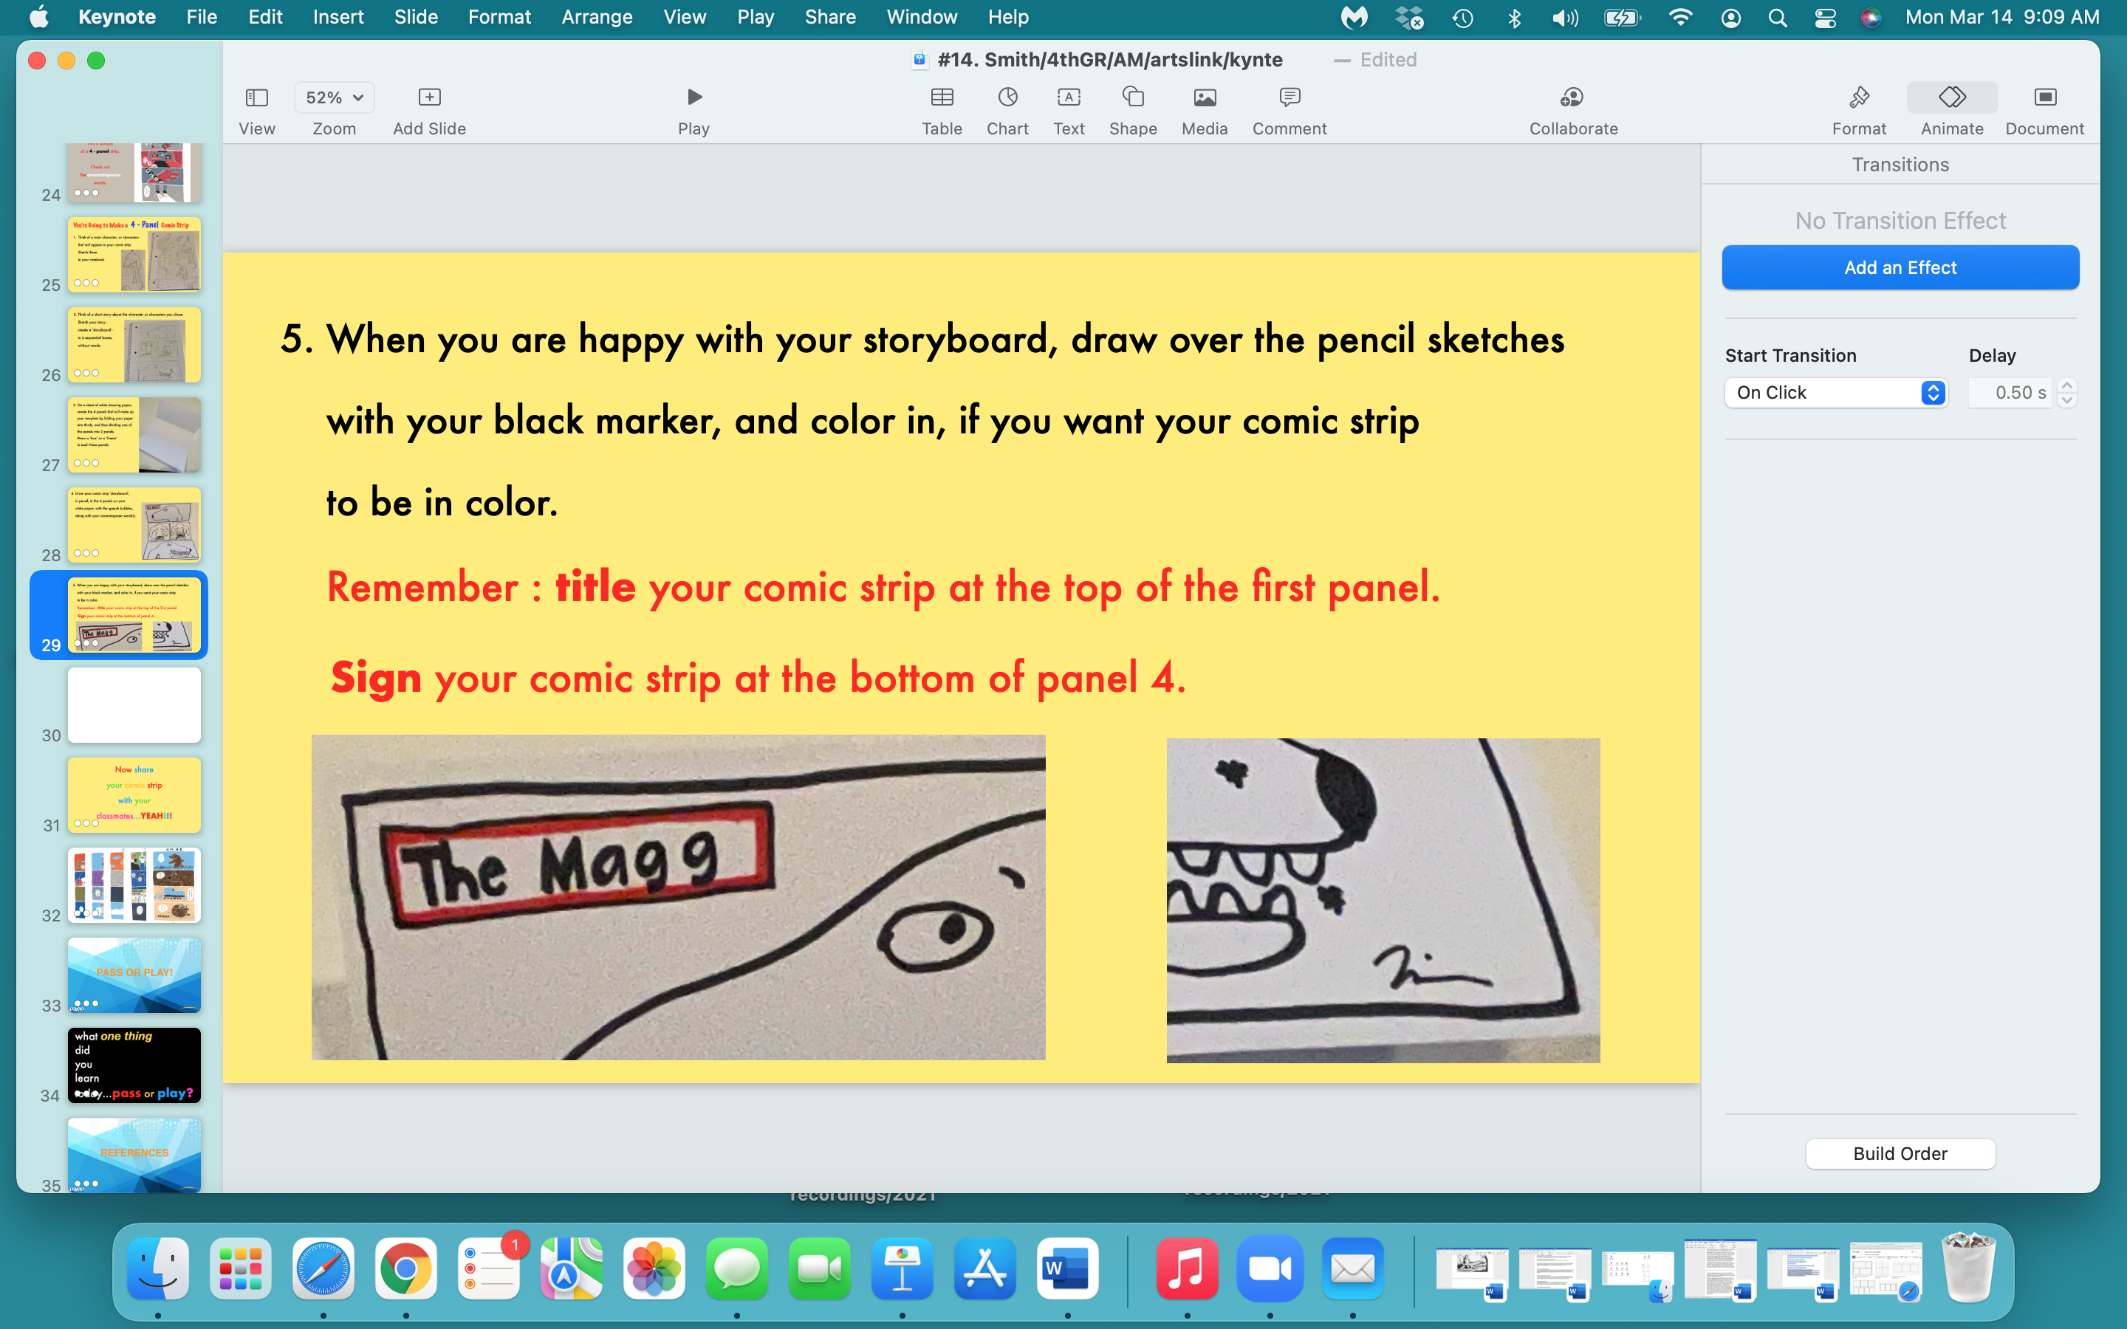

Slide 31
Now share
your comic strip
with your
classmates…YEAH!!!

Slide 32
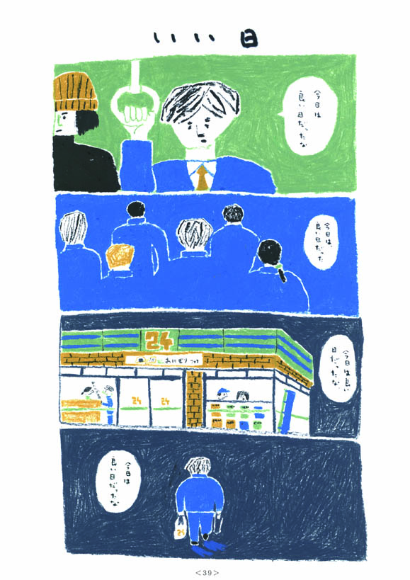
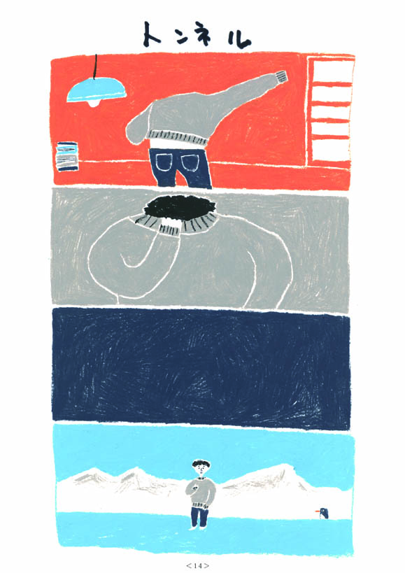
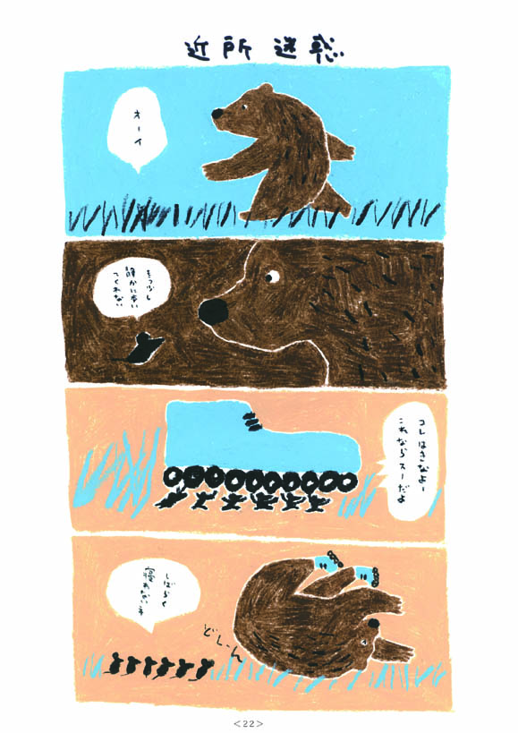
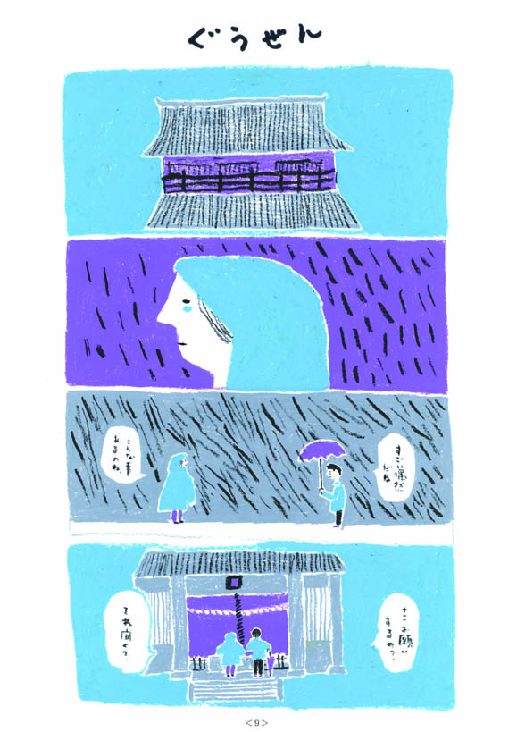
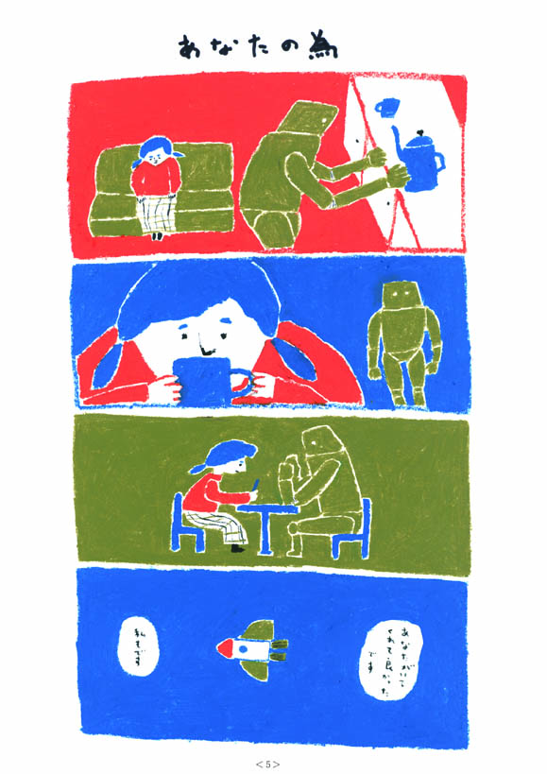

Slide 33
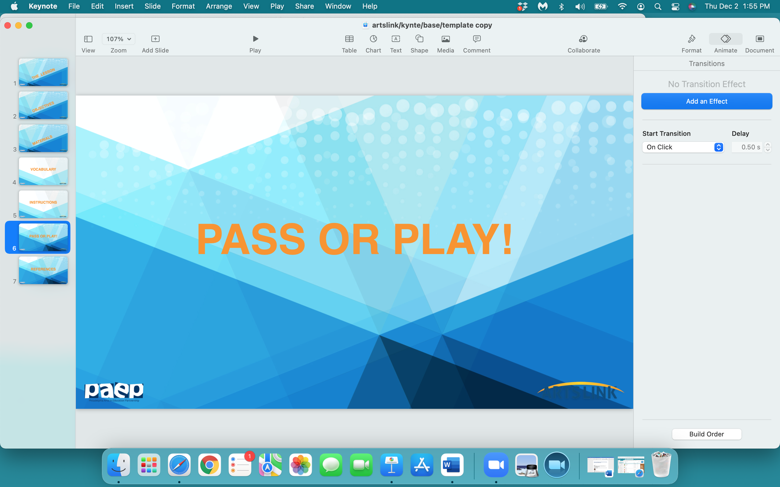

Slide 34
what one thing
did
you
learn
today…pass or play?

Slide 35
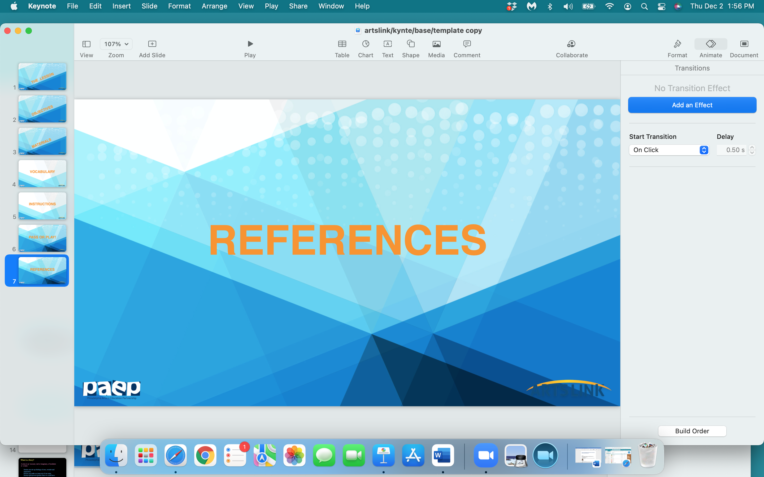

Slide 36
https://www.britannica.com/art/comic-strip
https://www.wikihow.com/Make-a-Comic-Strip
https://www.commonsense.org/education/lesson-plans/comic-strip-writing
https://www.kennedy-center.org/education/resources-for-educators/classroom-resources/lessons-and-activities/lessons/3-5/creating-comic-strips/
https://www.readwritethink.org/classroom-resources/lesson-plans/comic-book-show-tell
https://www.education.com/lesson-plan/bam-pow-comic-strip-writing/
https://www.youtube.com/watch?v=KiWdZt047Kc
https://www.pinterest.com/pin/261560690844710770/
www.MarekBennett.com
https://www.gocomics.com/comics/lists/1626949/peanuts-snoopy-happy-dance
https://libguides.asu.edu/c.php?g=613607&p=4263347

