Slide 1


Slide 2
Tell Me
A
Painting

Slide 3


Slide 4
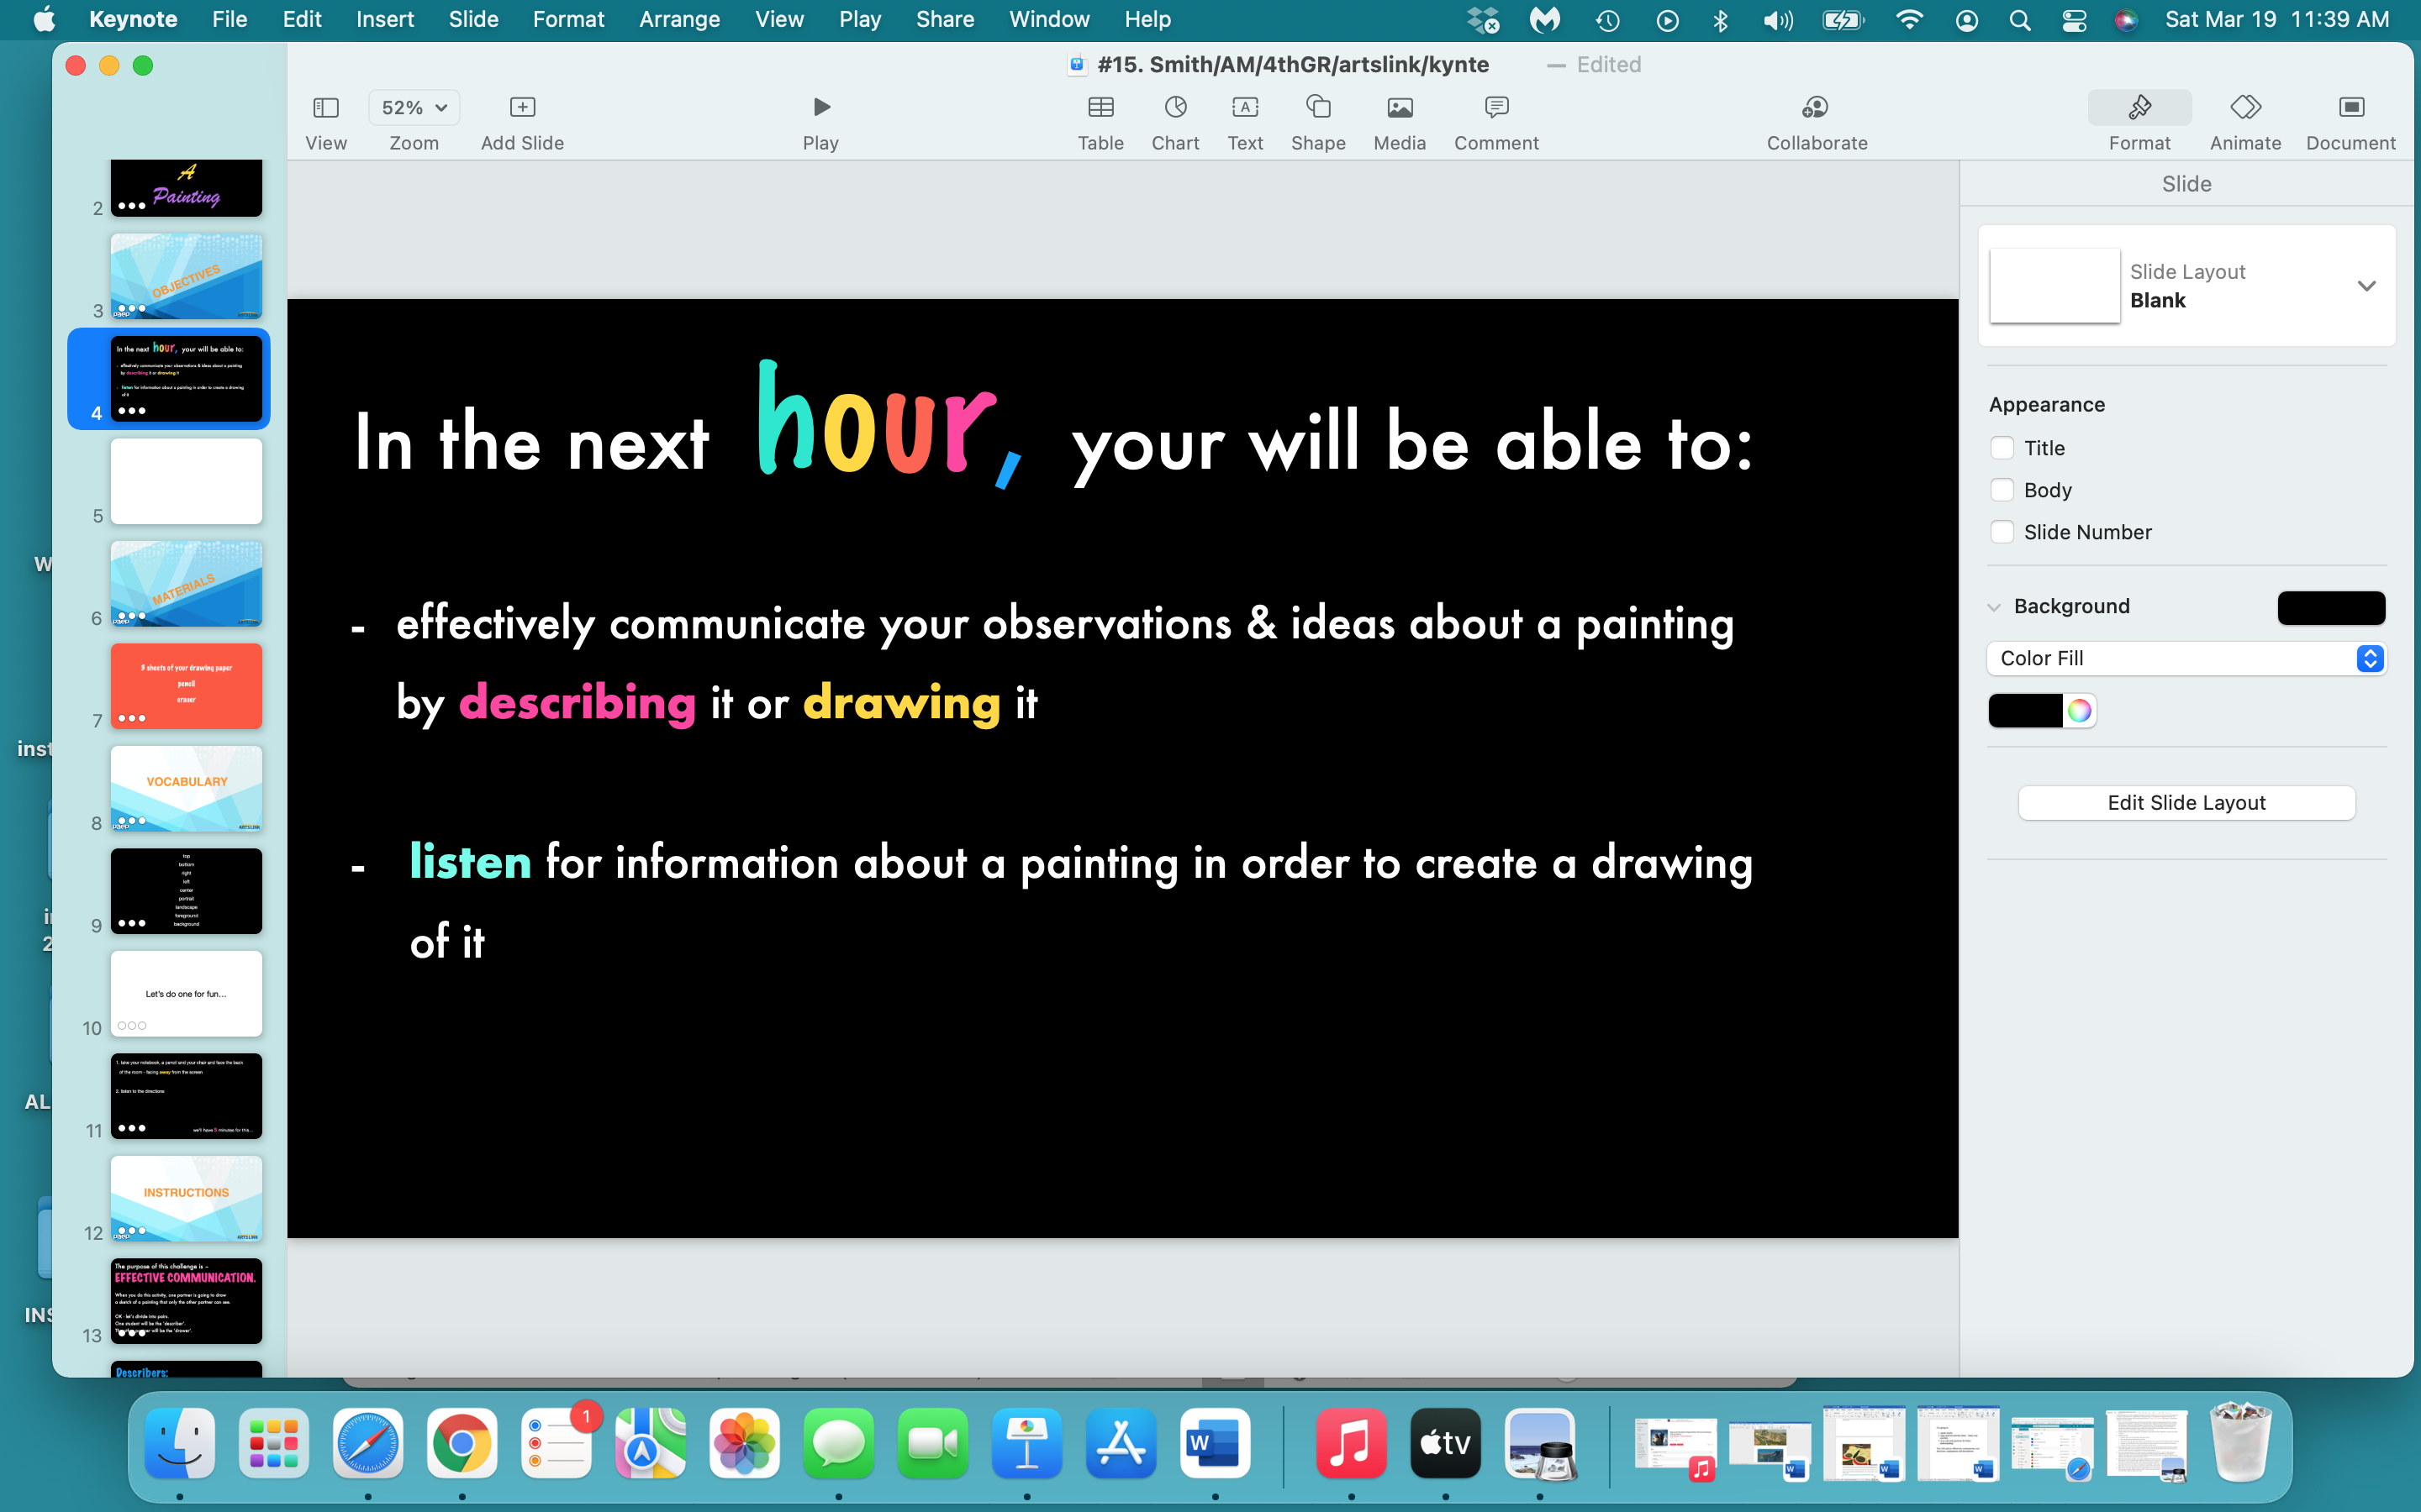

Slide 5


Slide 6
your journal / notebook
pencil
eraser

Slide 7
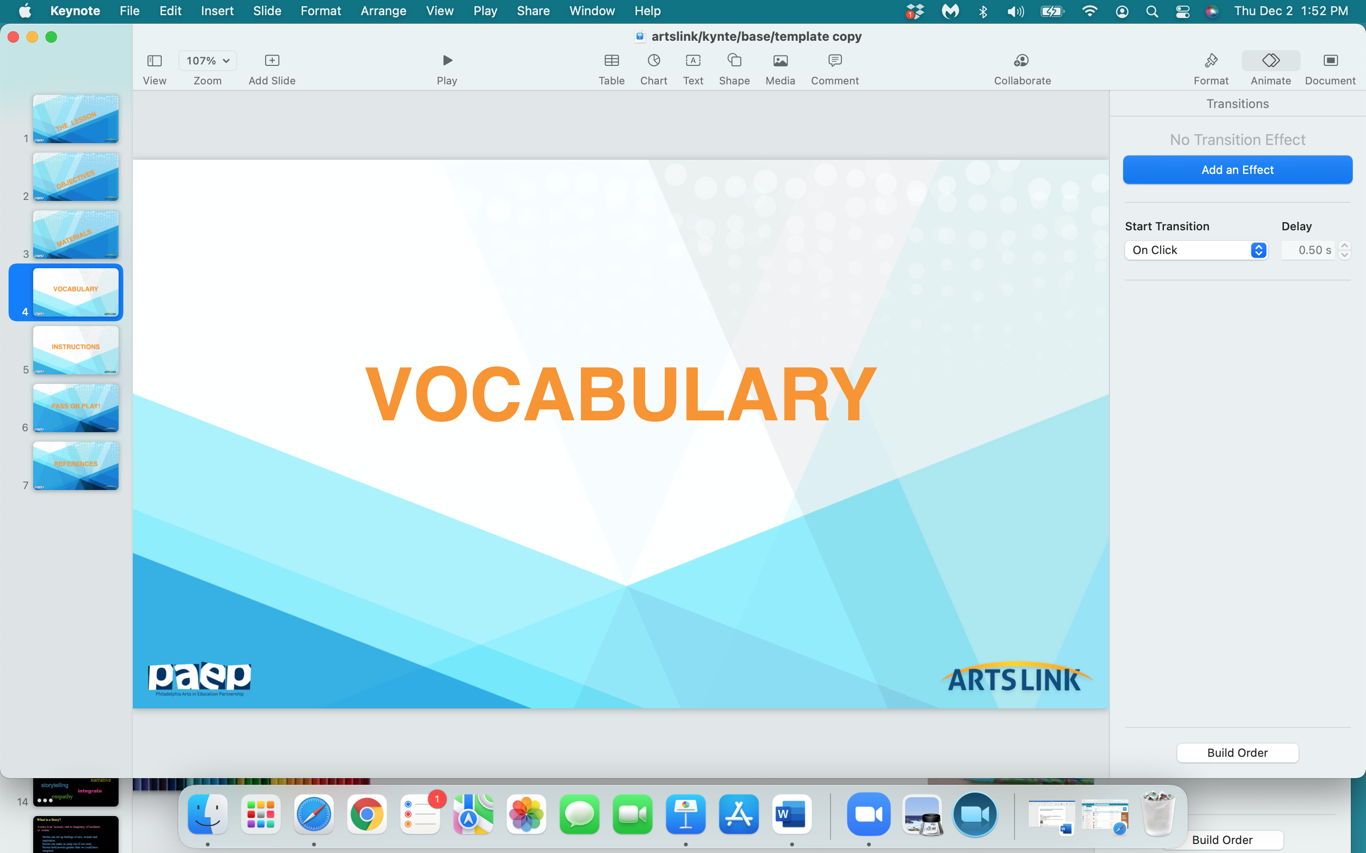

Slide 8
top
bottom
right
left
center
portrait
landscape
foreground
background

Slide 9
Let’s do one for fun…

Slide 10
take your notebook, a pencil and your chair and face the back of the room - facing away from the screen
listen to the directions
we’ll have 5 minutes for this…

Slide 11


Slide 12
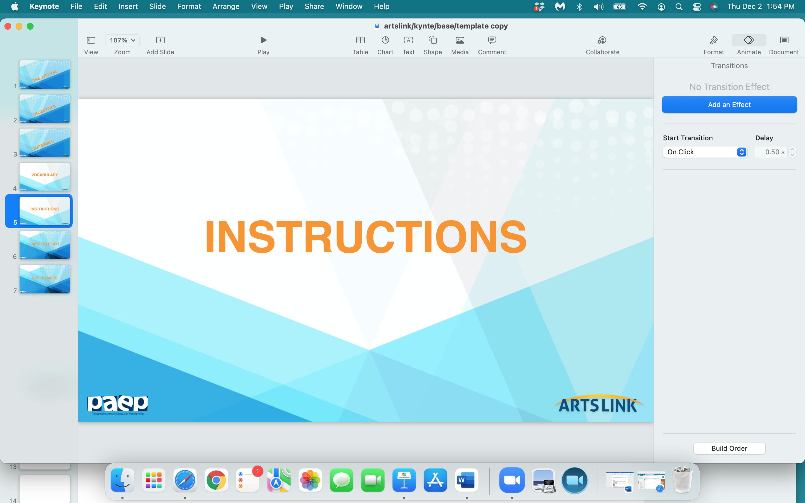

Slide 13
The purpose of this challenge is –
EFFECTIVE COMMUNICATION.
When you do this activity, one partner is going to draw a sketch of a painting that only the other partner can see.
OK - let’s divide into pairs.
One student will be the ‘describer’.
The other partner will be the ‘drawer’.

Slide 14
Describers:
Describers may only communicate using their words.
Describers may only ‘describe’ the painting – you are not allowed to turn around to look at your partners’ drawing.
Keep your voice at a low level so that the other drawers can hear their partner’s descriptions/directions.

Slide 15
Drawers:
Your only drawing tool is a pencil.
Drawers are not allowed to look at the paintings – but you may ask as many questions as you want.
Partners will have a chance to switch roles after the first round.

Slide 16
You’ll have 5 minutes for this activity.
After the 5 minutes are up, the ‘drawers’ should turn around and compare their sketch to the original painting.

Slide 17
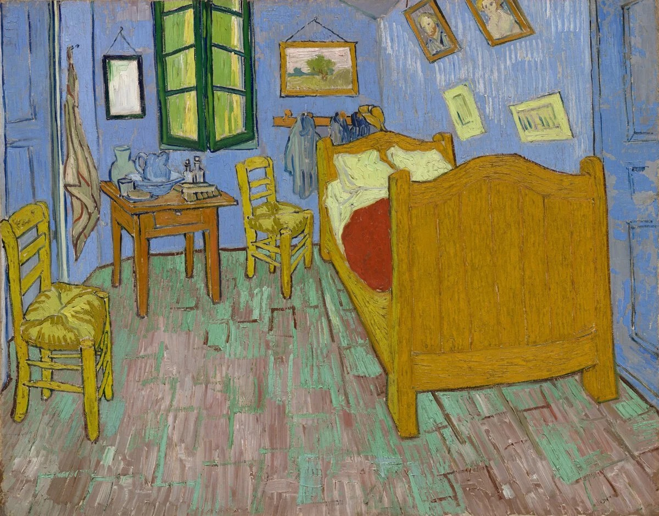

Slide 18
For the ‘describers’:
what worked well in the first round, and what could you do better in the next round?
For the ‘drawers’:
what worked well in the first round, and what could you do better in the next round?
Now – let’s switch roles and do this again…

Slide 19
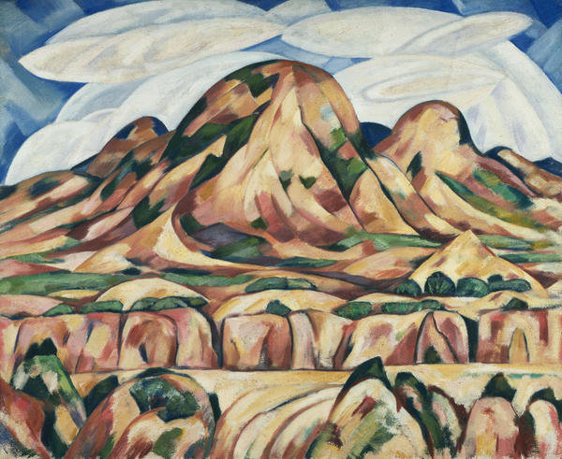

Slide 20
What was challenging
about this activity?

Slide 21


Slide 22


Slide 23


Slide 24


Slide 25
what one thing
did
you
learn
today…pass or play?

Slide 26
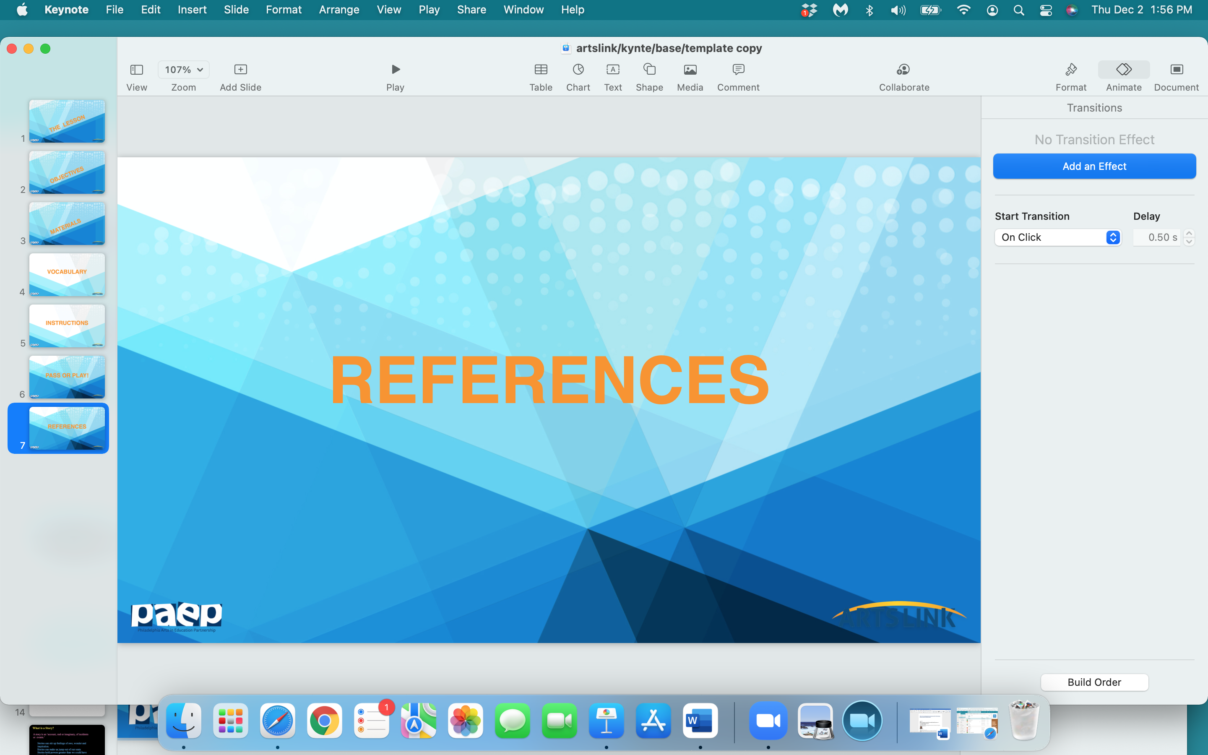

Slide 27
https://www.philamuseum.org/doc_downloads/education/lessonPlans/13076_EDU_Lesson-Plan_SEPT-2019_082019.pdf

