Slide 1
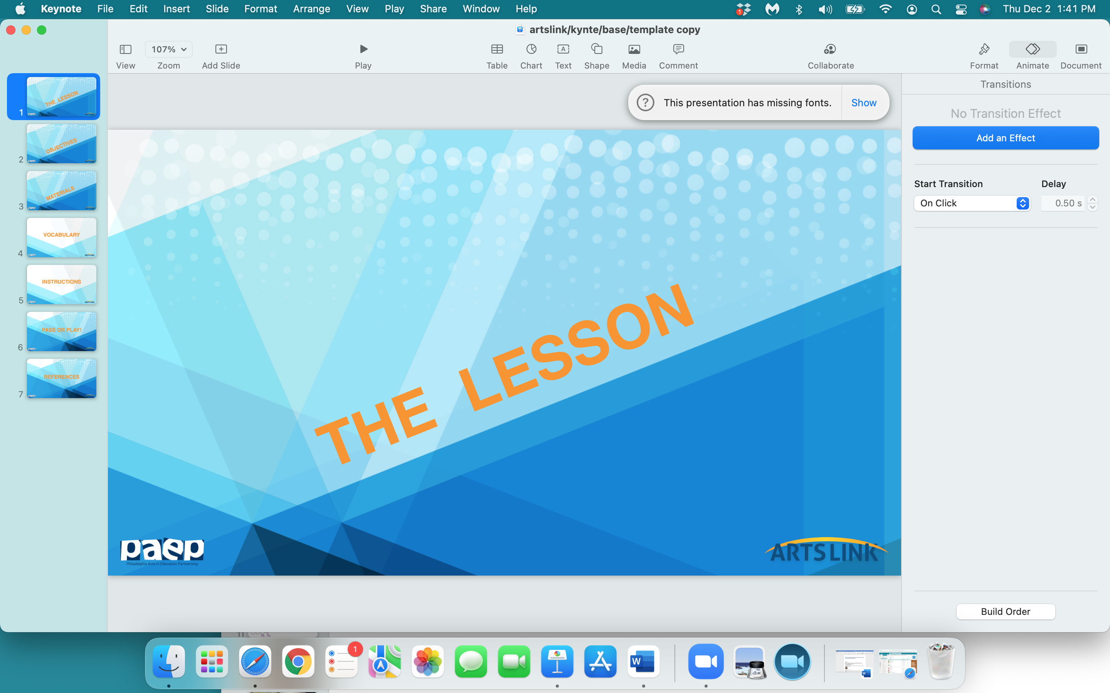

Slide 2
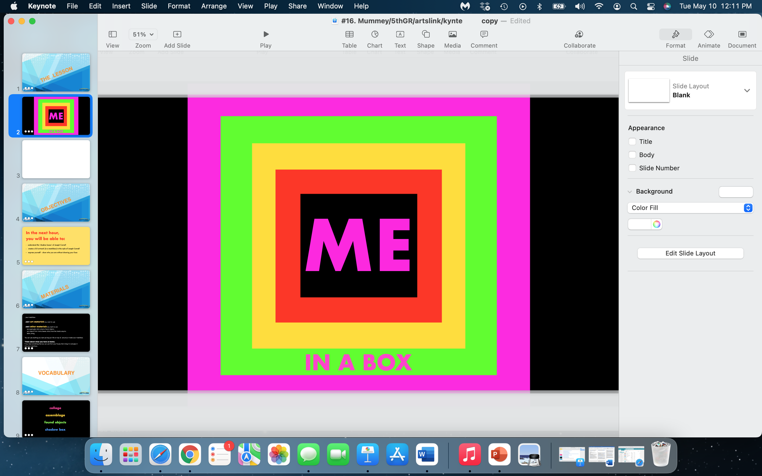

Slide 3
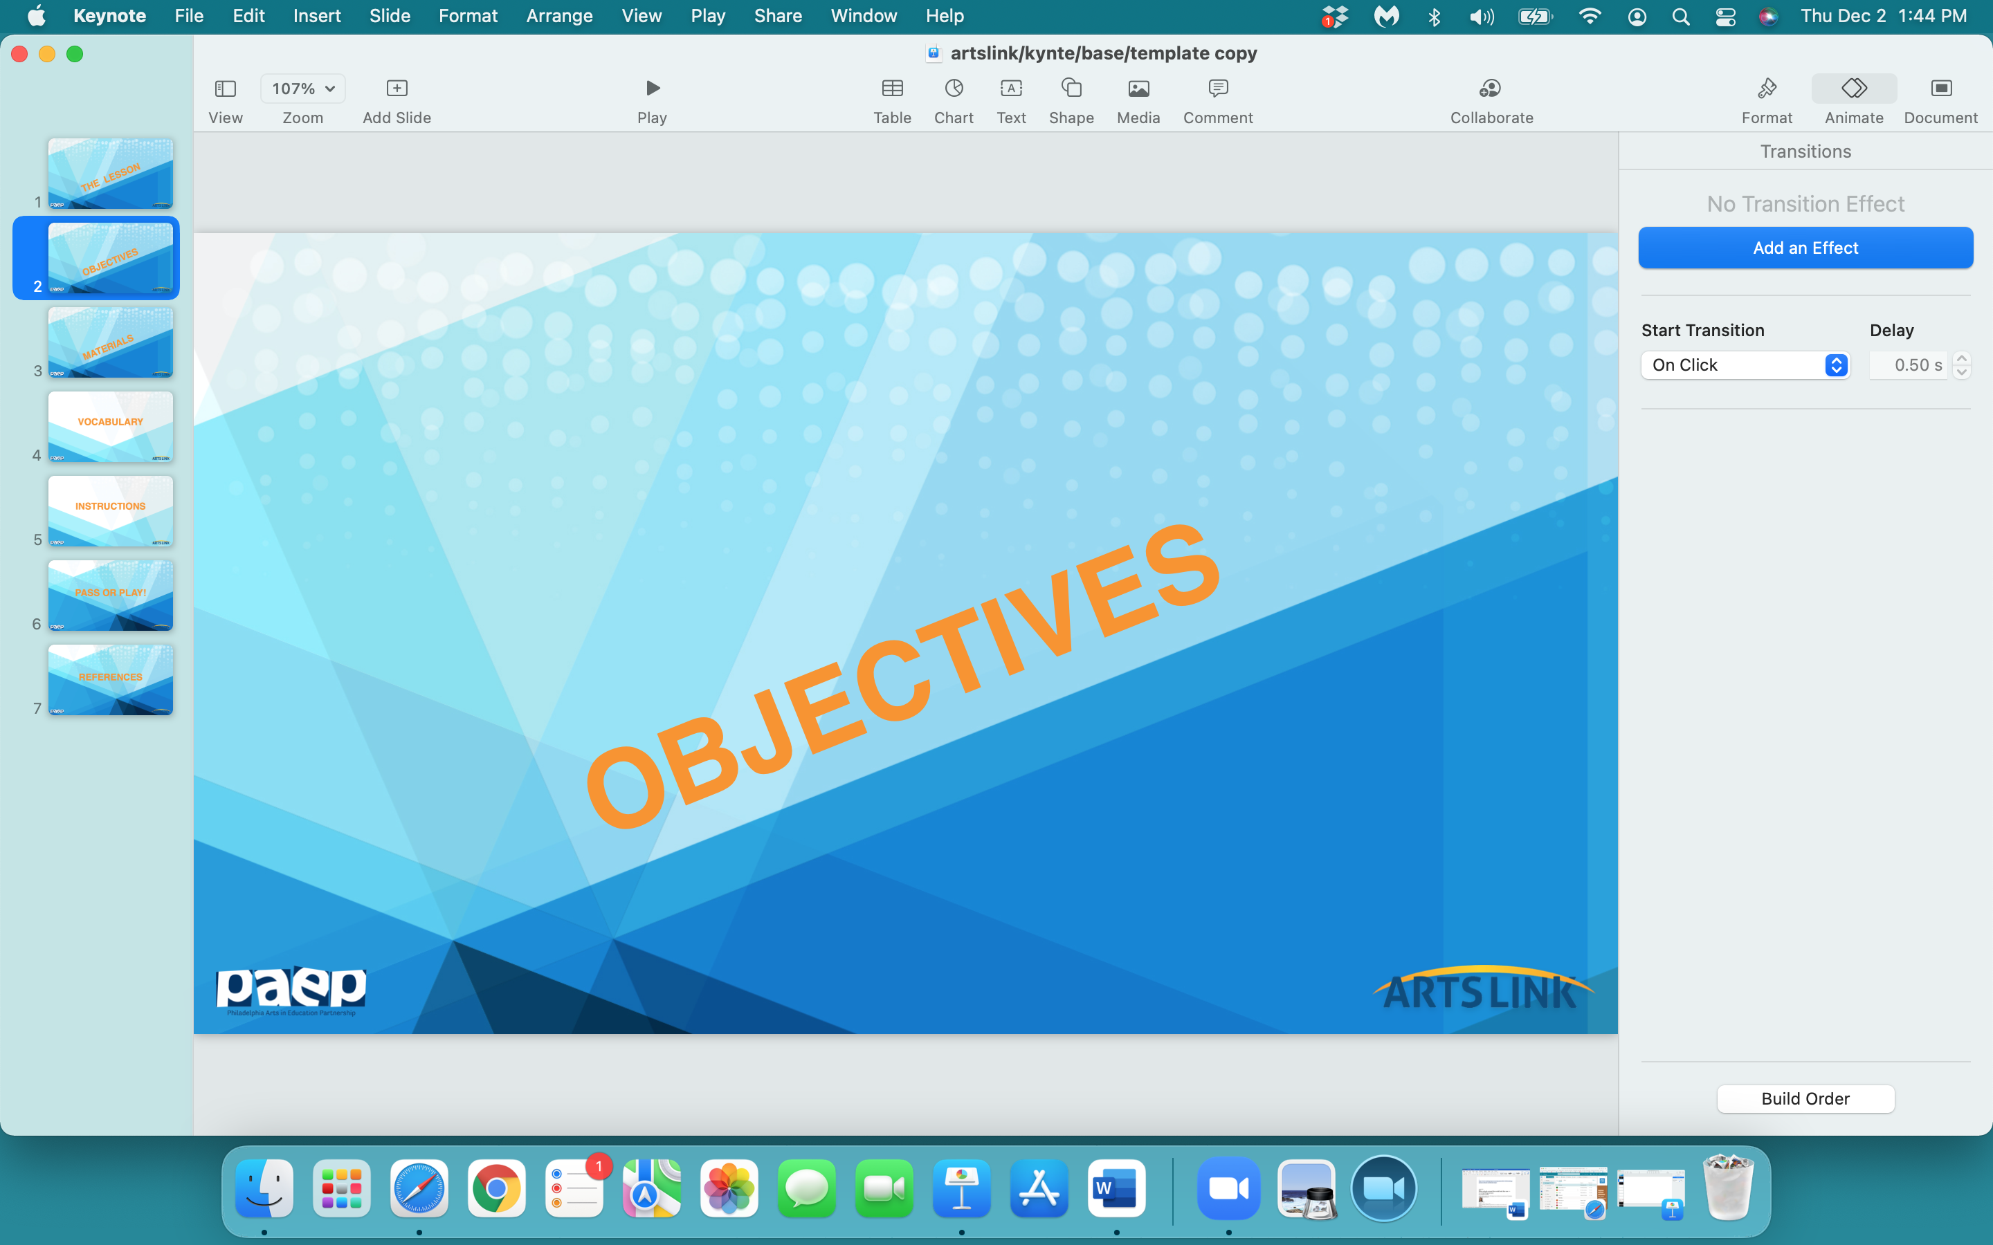

Slide 4
In the next hour,
you will be able to:
- understand the ‘shadow boxes’ of Joseph Cornell
create a 3-D artwork (in a matchbox)
express yourself - show who you are or what you like to think about

Slide 5
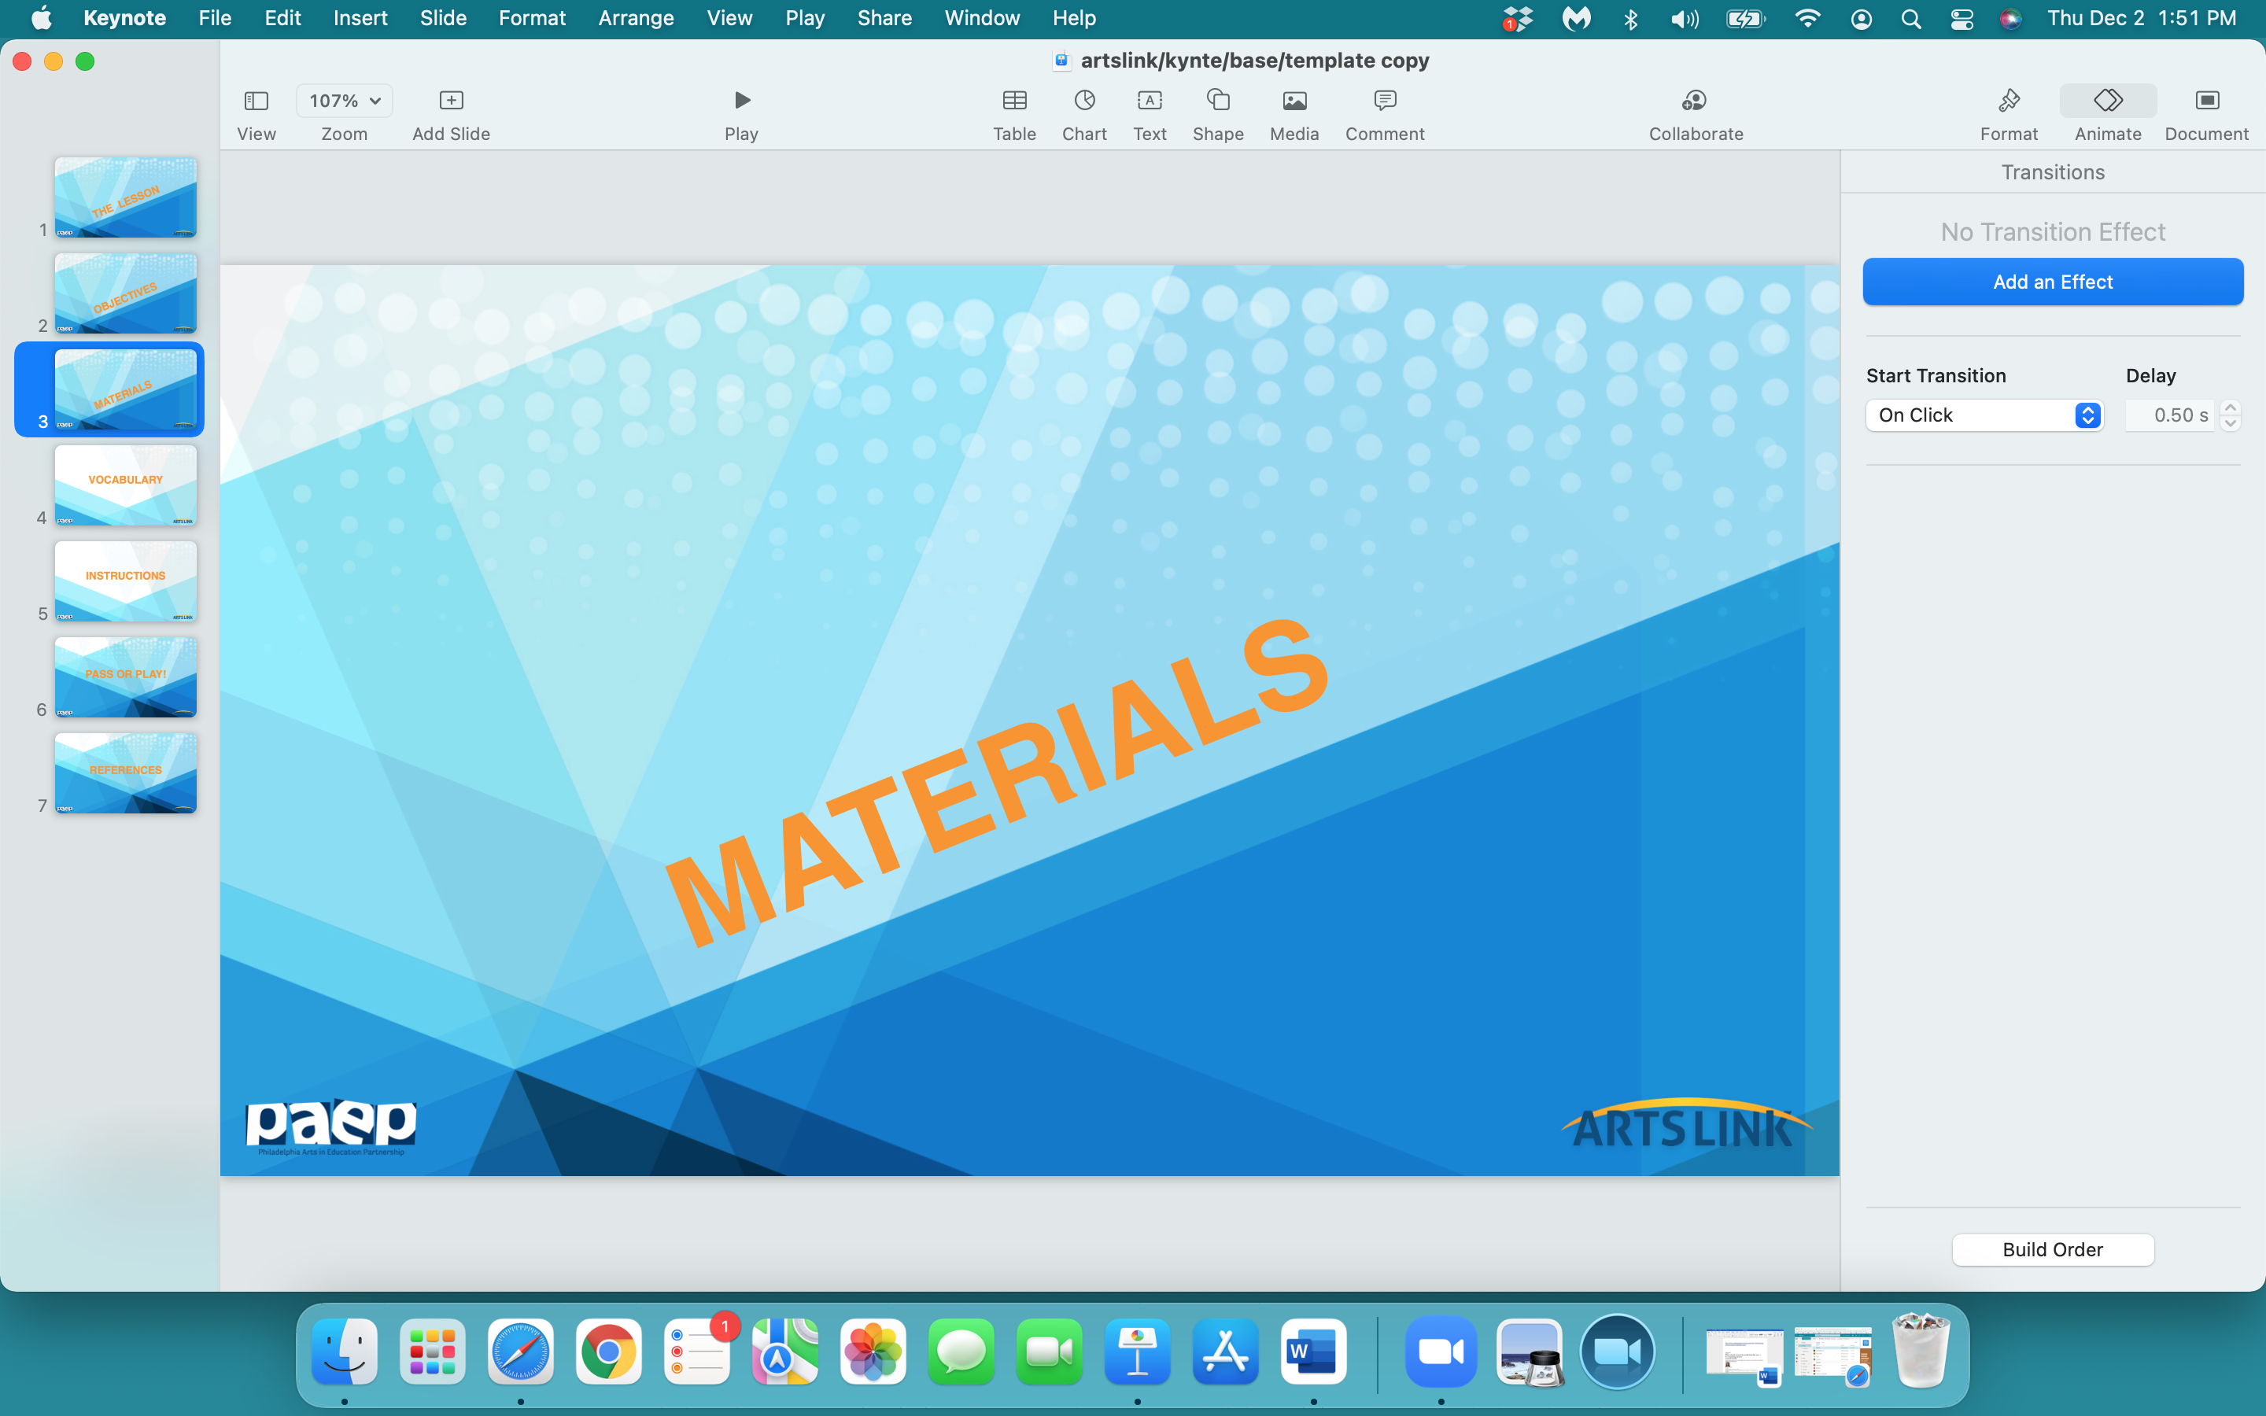

Slide 6
your matchbox
ANY art materials in your Art Box

Slide 7
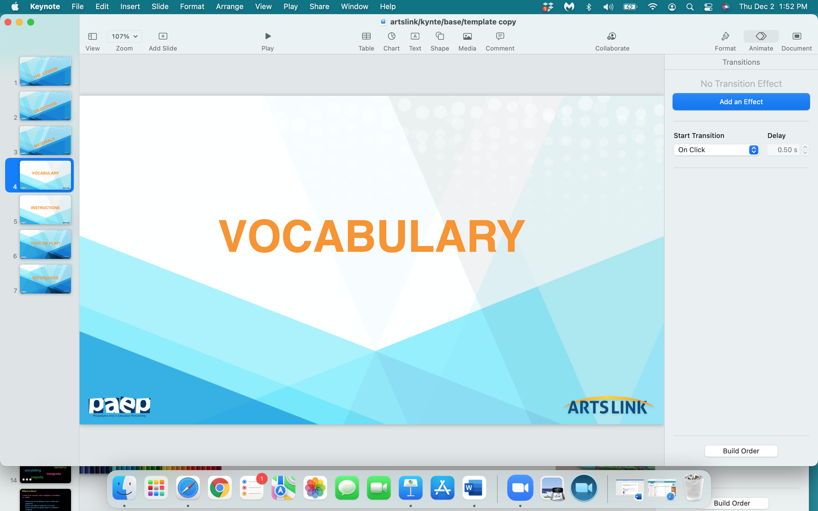

Slide 8
collage
shadow box
self portrait

Slide 9
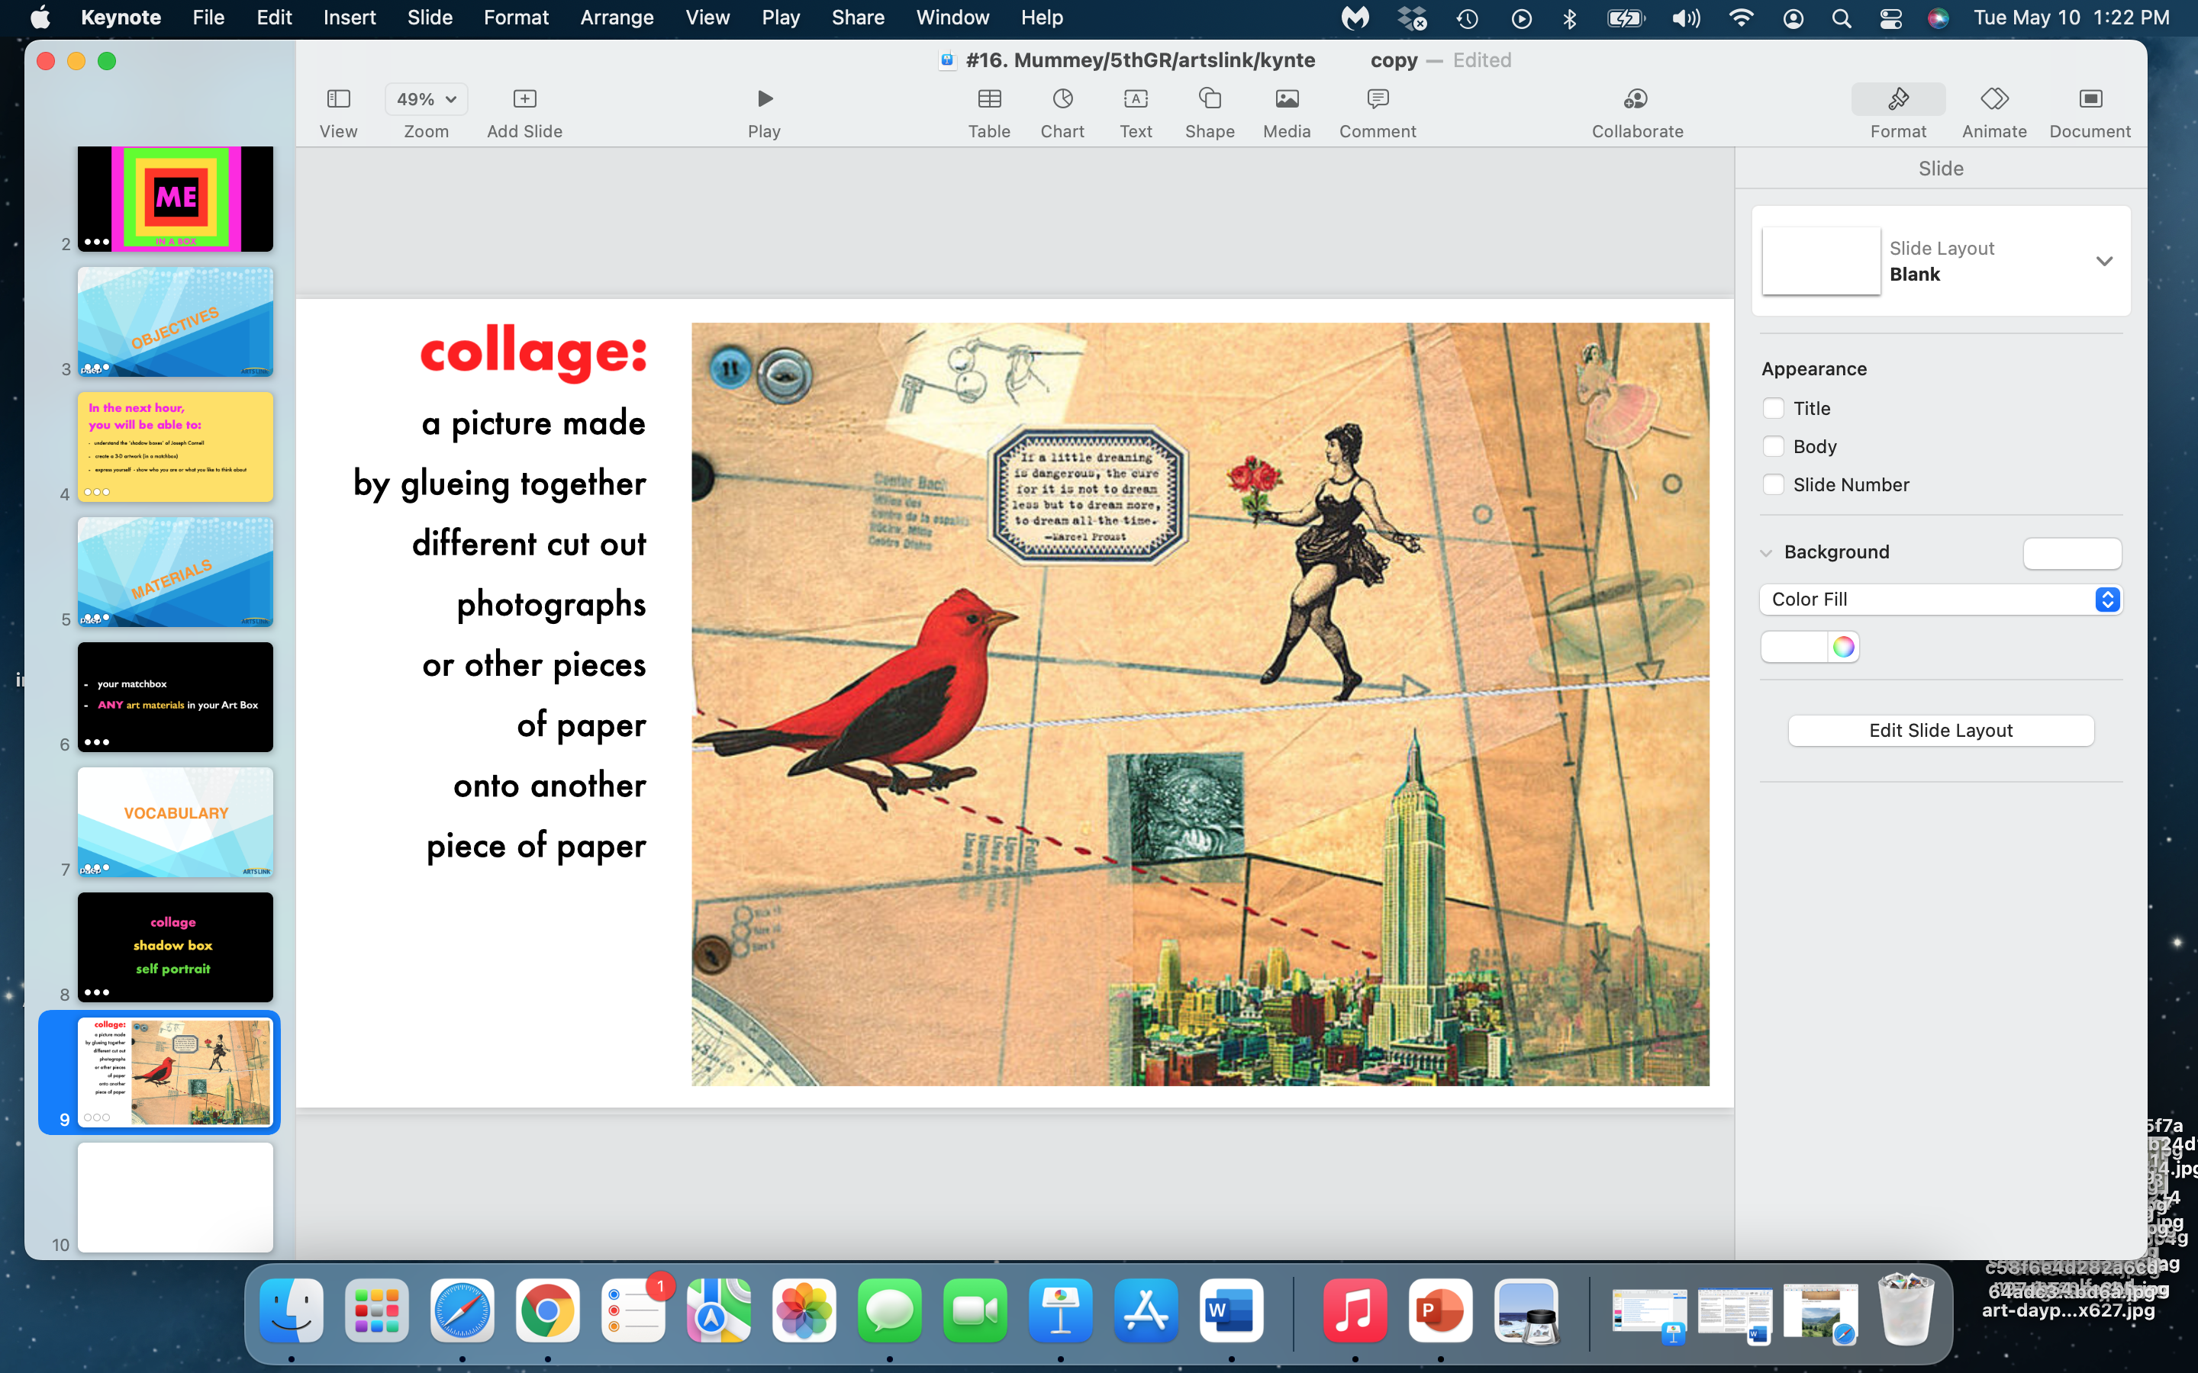

Slide 10
self portrait: a portrait of the artist by the artist

Slide 11
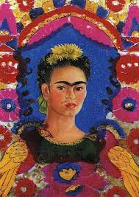
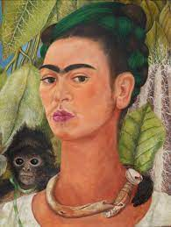
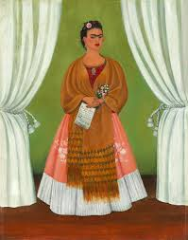
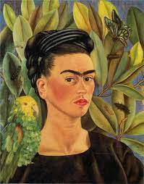
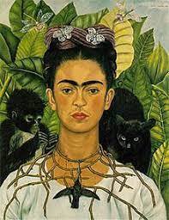
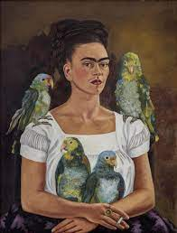
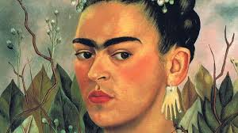
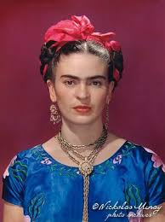
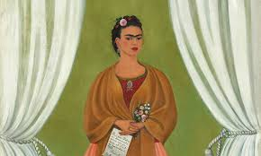
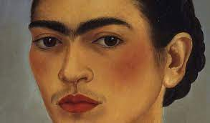

Slide 12
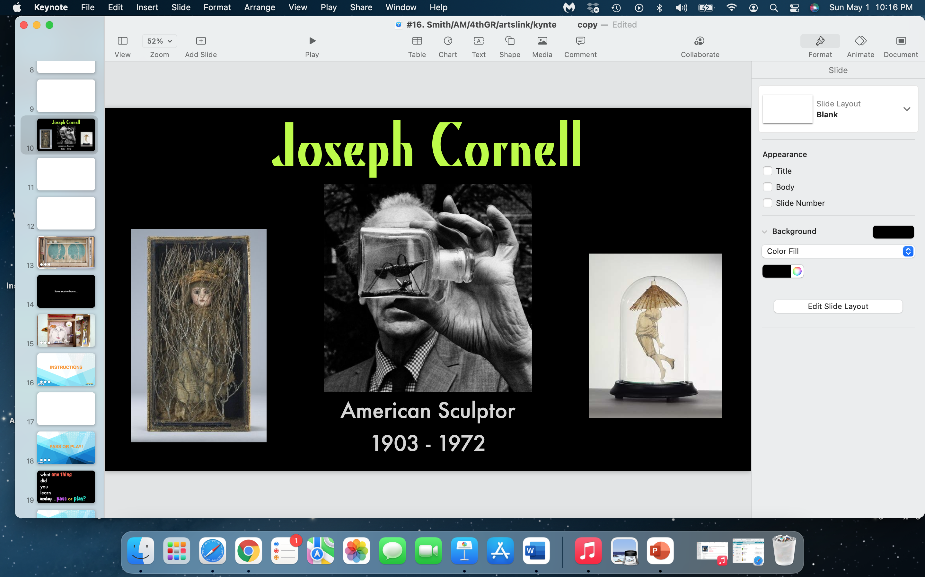

Slide 13
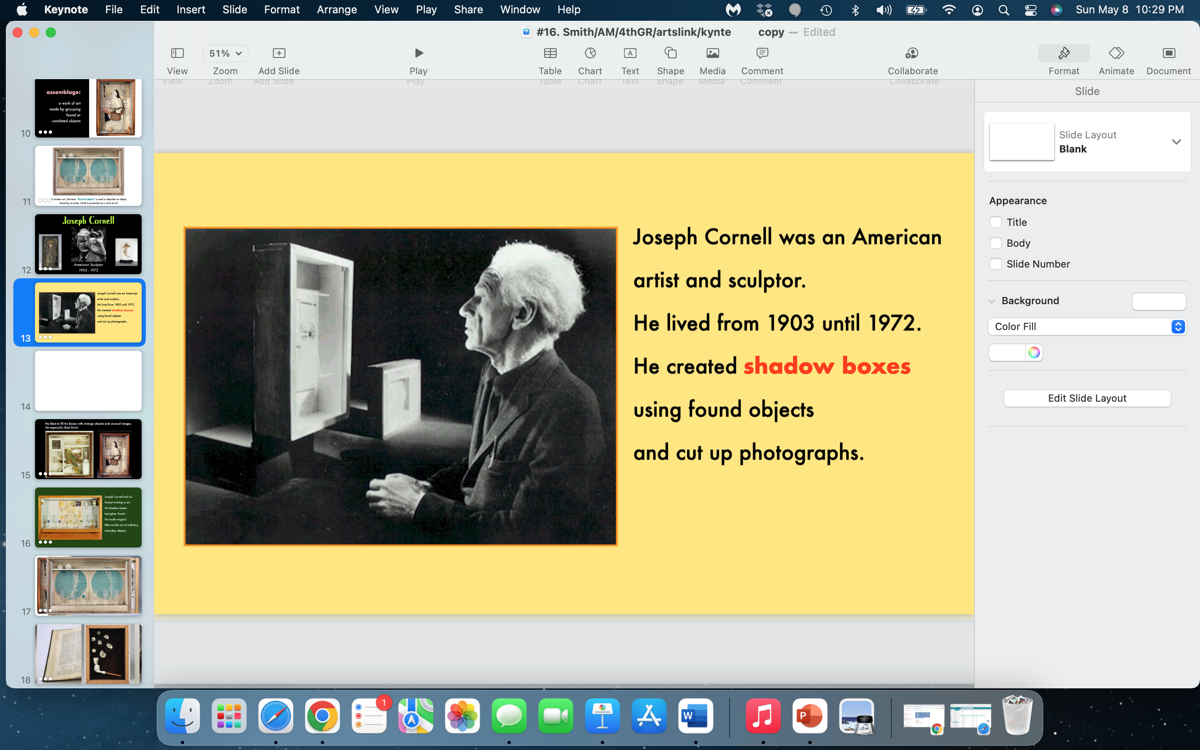

Slide 14
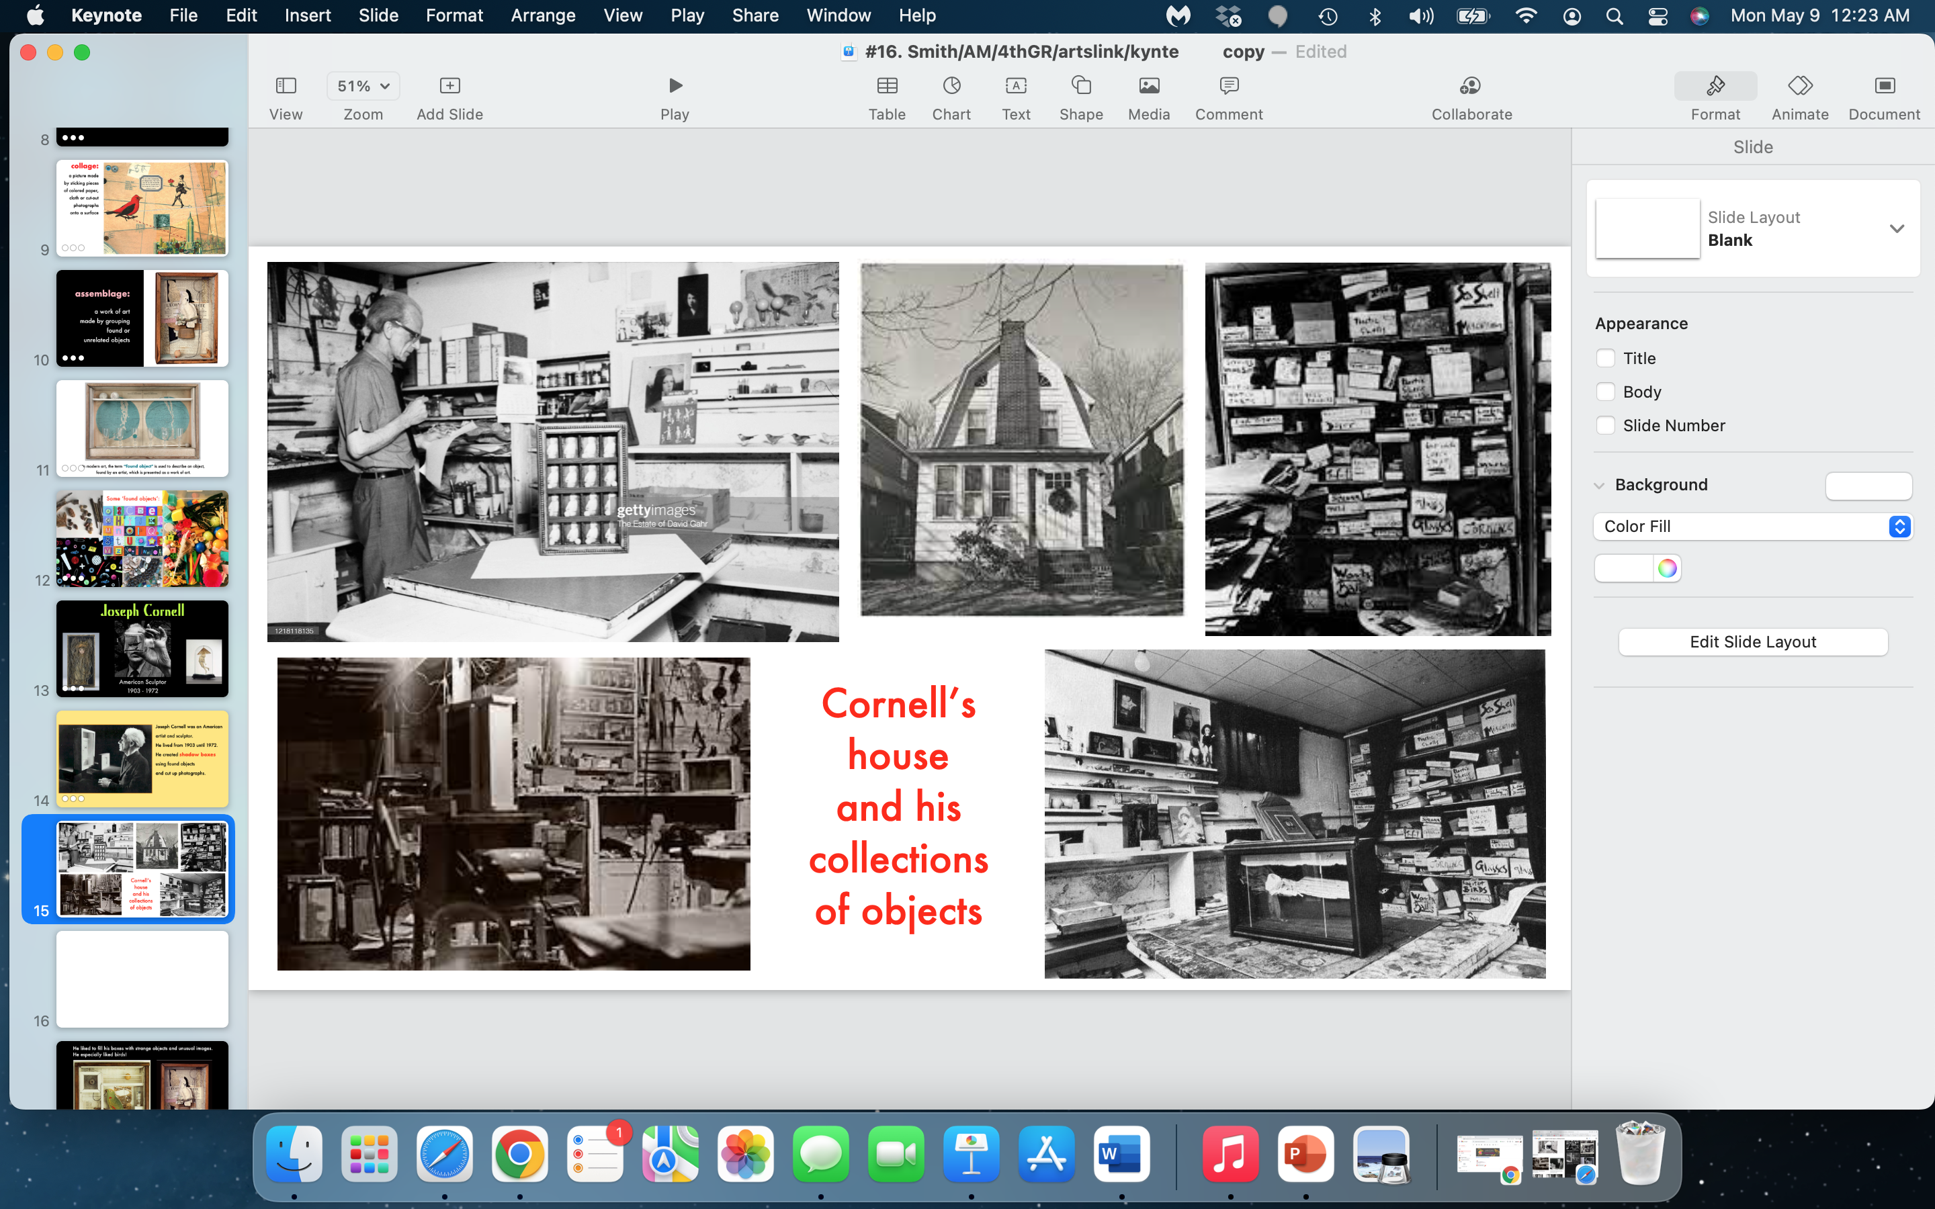

Slide 15
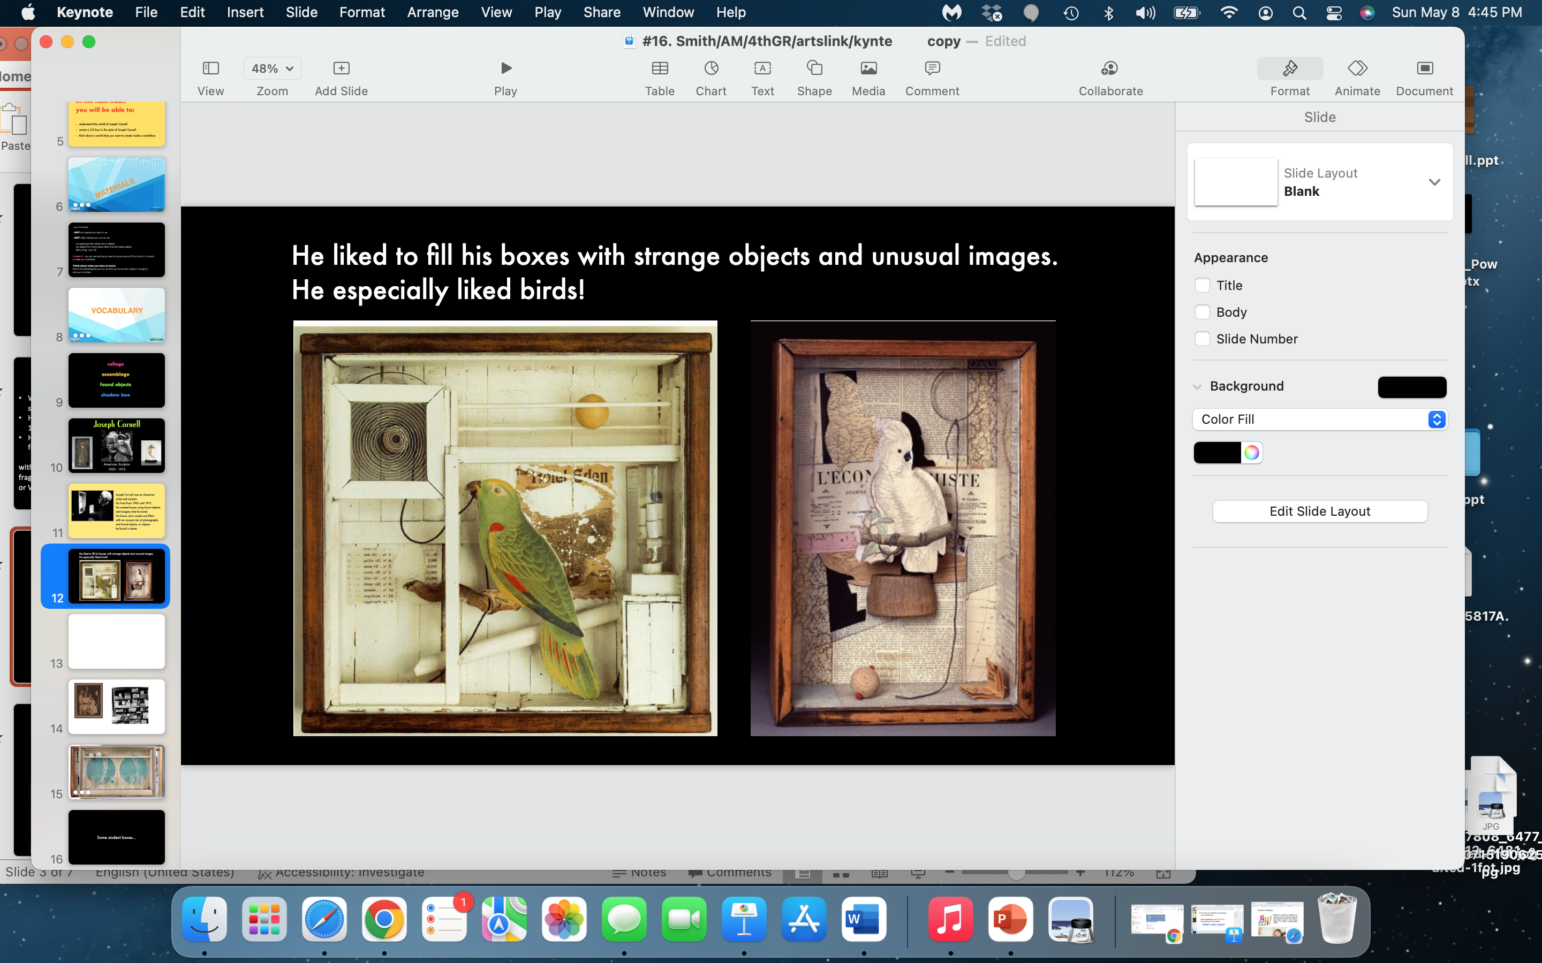

Slide 16
Some student self-portrait boxes…

Slide 17
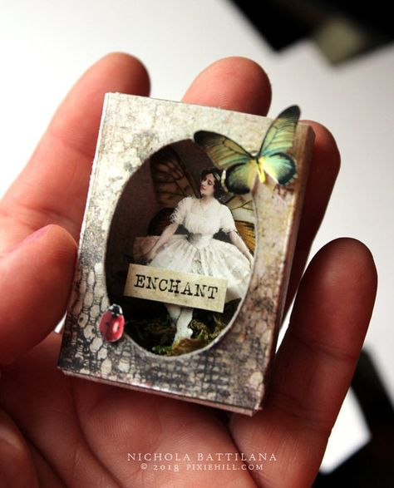
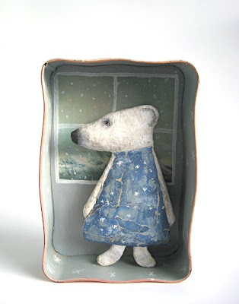
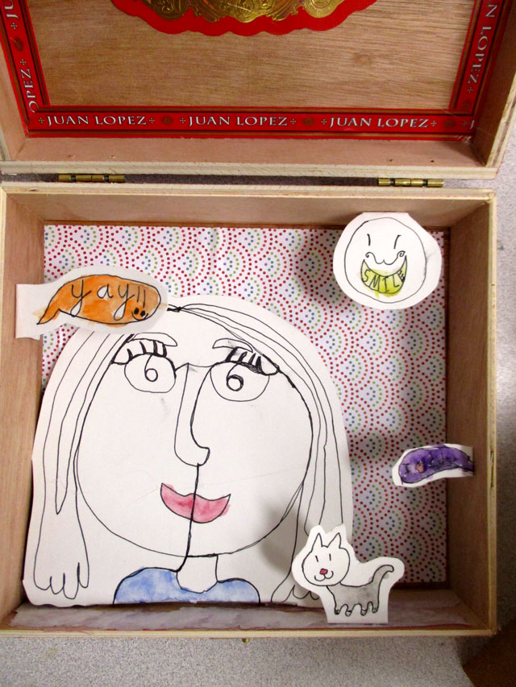
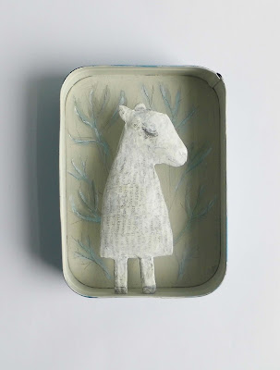
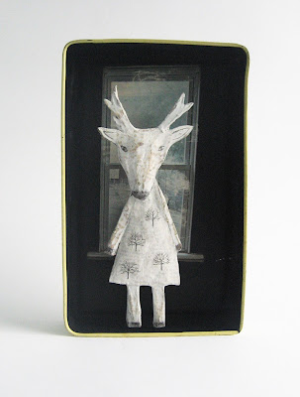
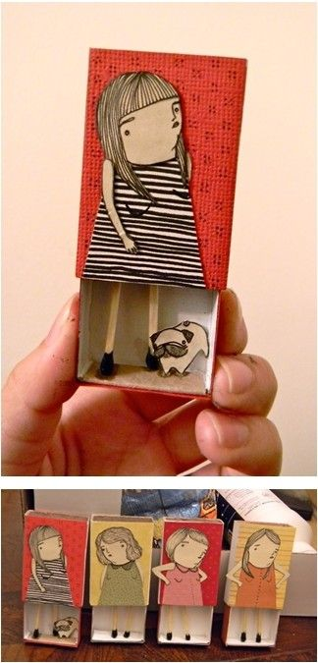
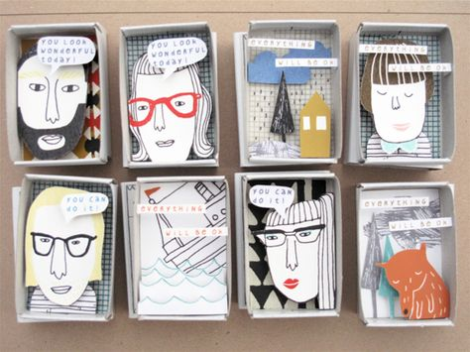
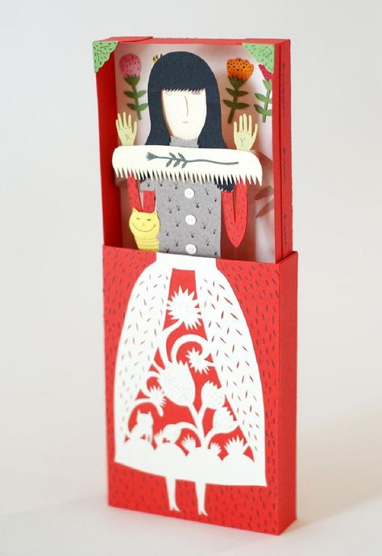
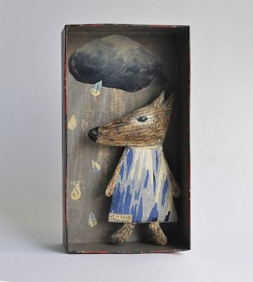
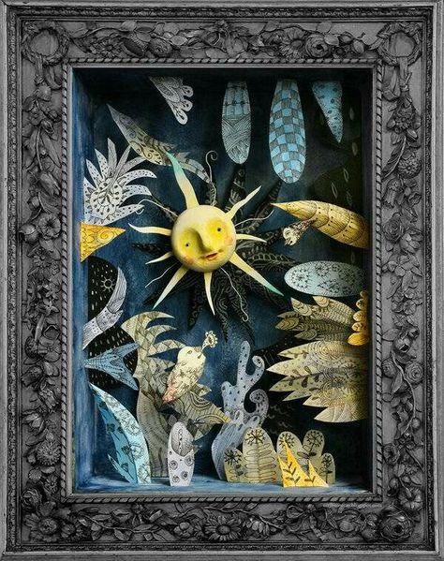
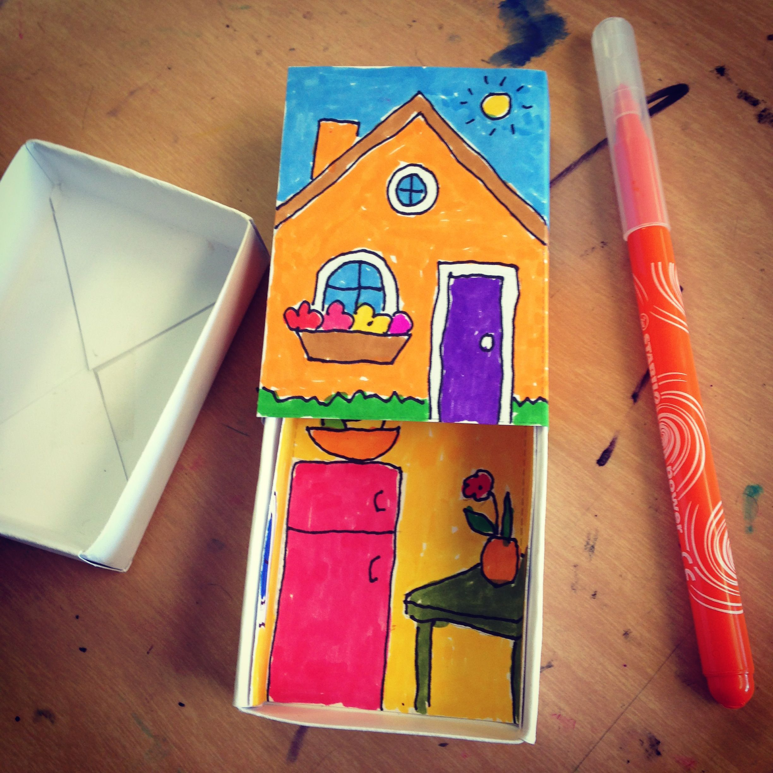
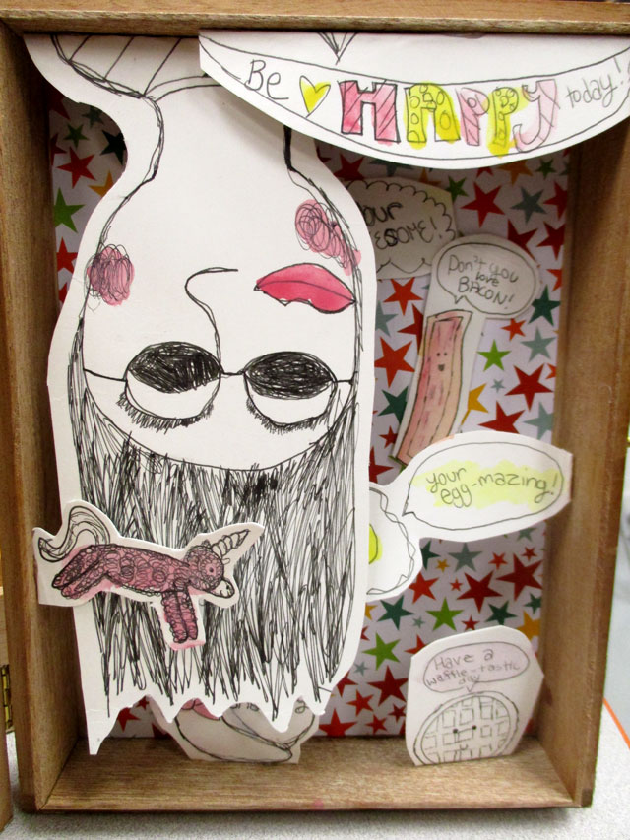
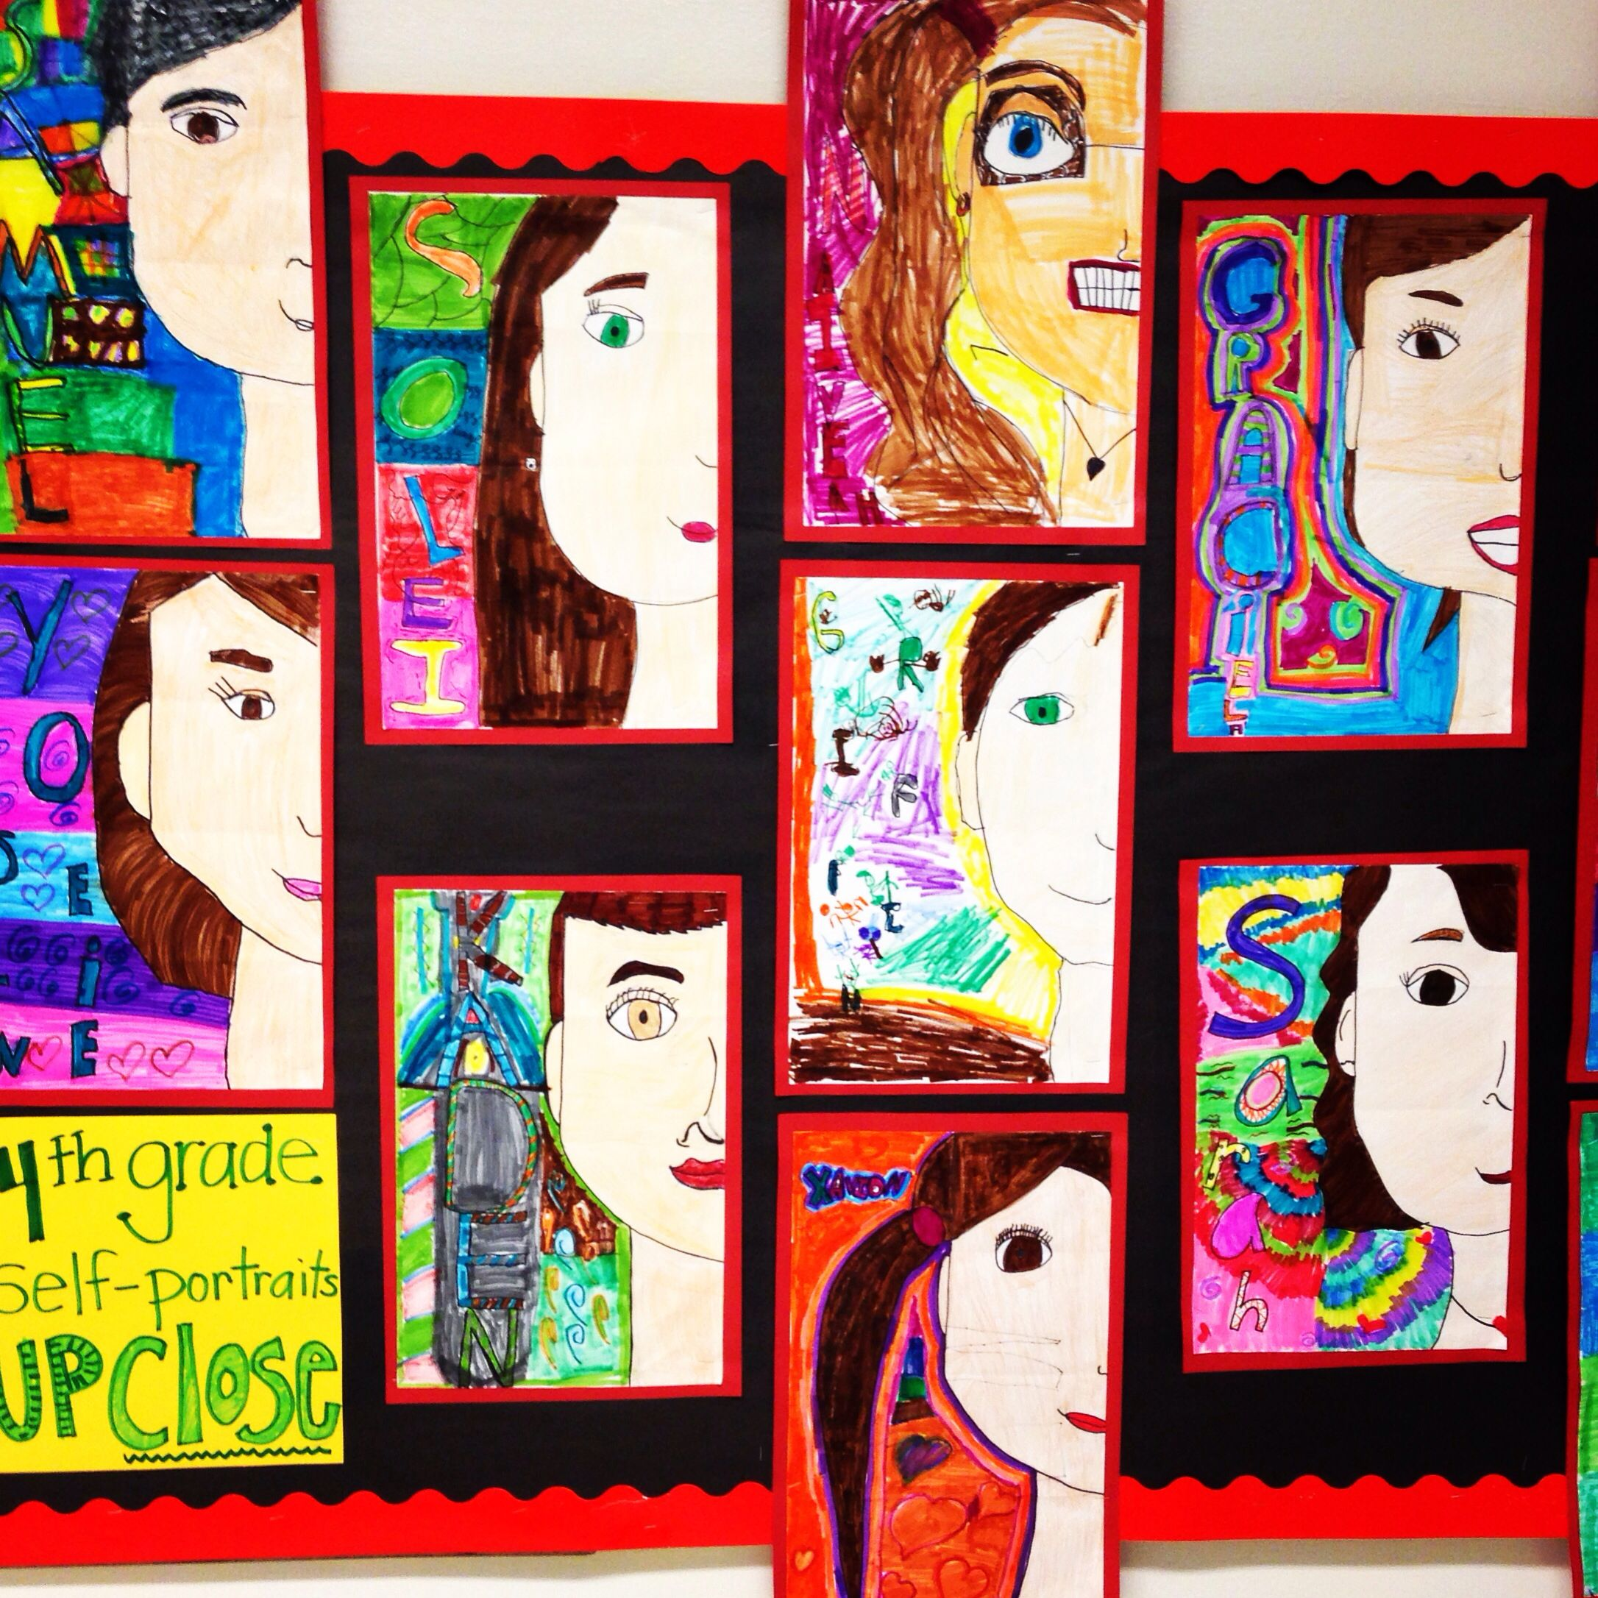
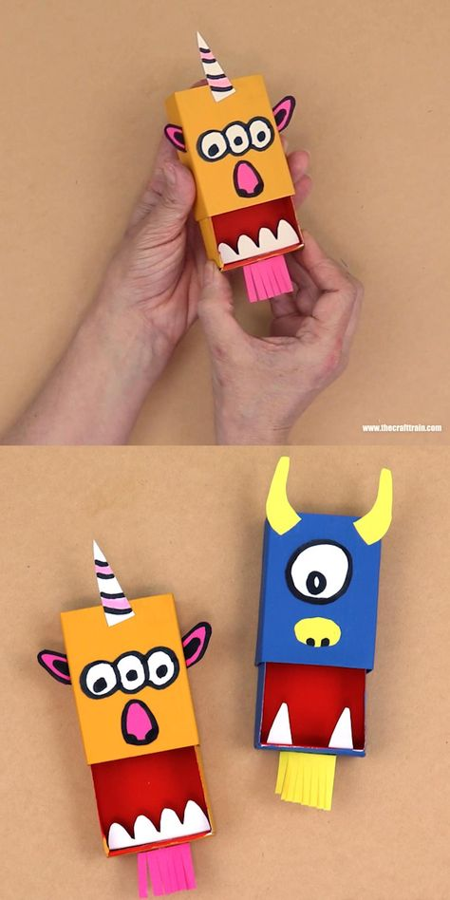
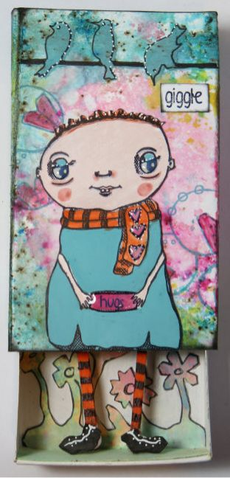
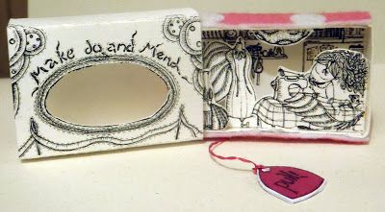

Slide 18
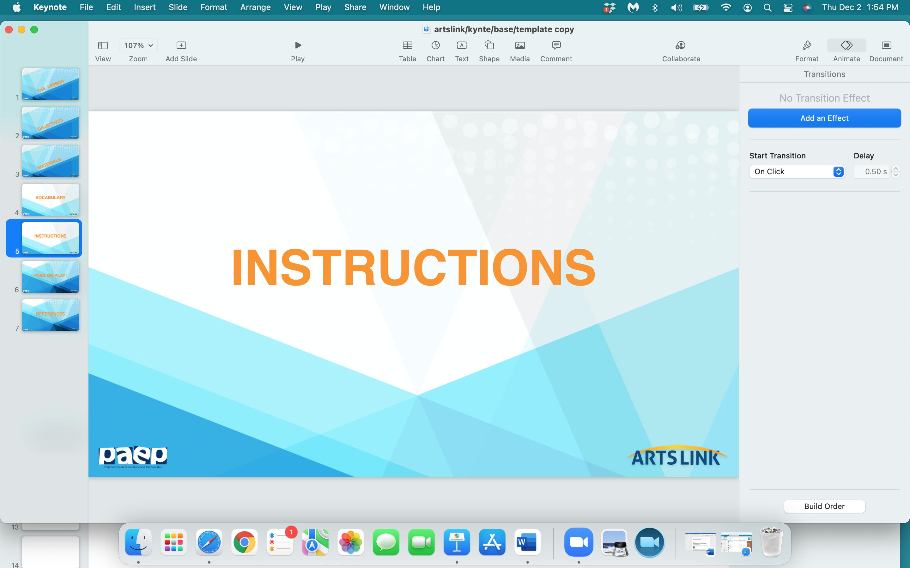

Slide 19
The Challenge:
You’re going create a self - portrait in your matchbox.
It will reflect you…what you look like, or what you like to think about, or what you like to dream about.
Draw something that is important to you.

Slide 20
You might choose to make a box where:
  - you draw your bedroom, maybe your house - real or imaginary
  - you draw something you really like (pets, objects, places)
  you draw a ‘dream world’ that you would like to visit
  you draw a happy memory
  you draw your friends or family

Slide 21
  For the inside of your matchbox:
  - draw on the back of the box first, then the sides.
  Then you can glue down images of other things you’ve drawn
  inside your box.

Slide 22
For the outside of your matchbox -
the cover of your box:
Do you want to cut a hole in your cover - to give a sneak peek of what’s inside?
Do you want to use words anywhere in, on or around your box?

Slide 23
So…
let’s create
your ‘self-portraits’…
and then let’s
share your boxes.

Slide 24
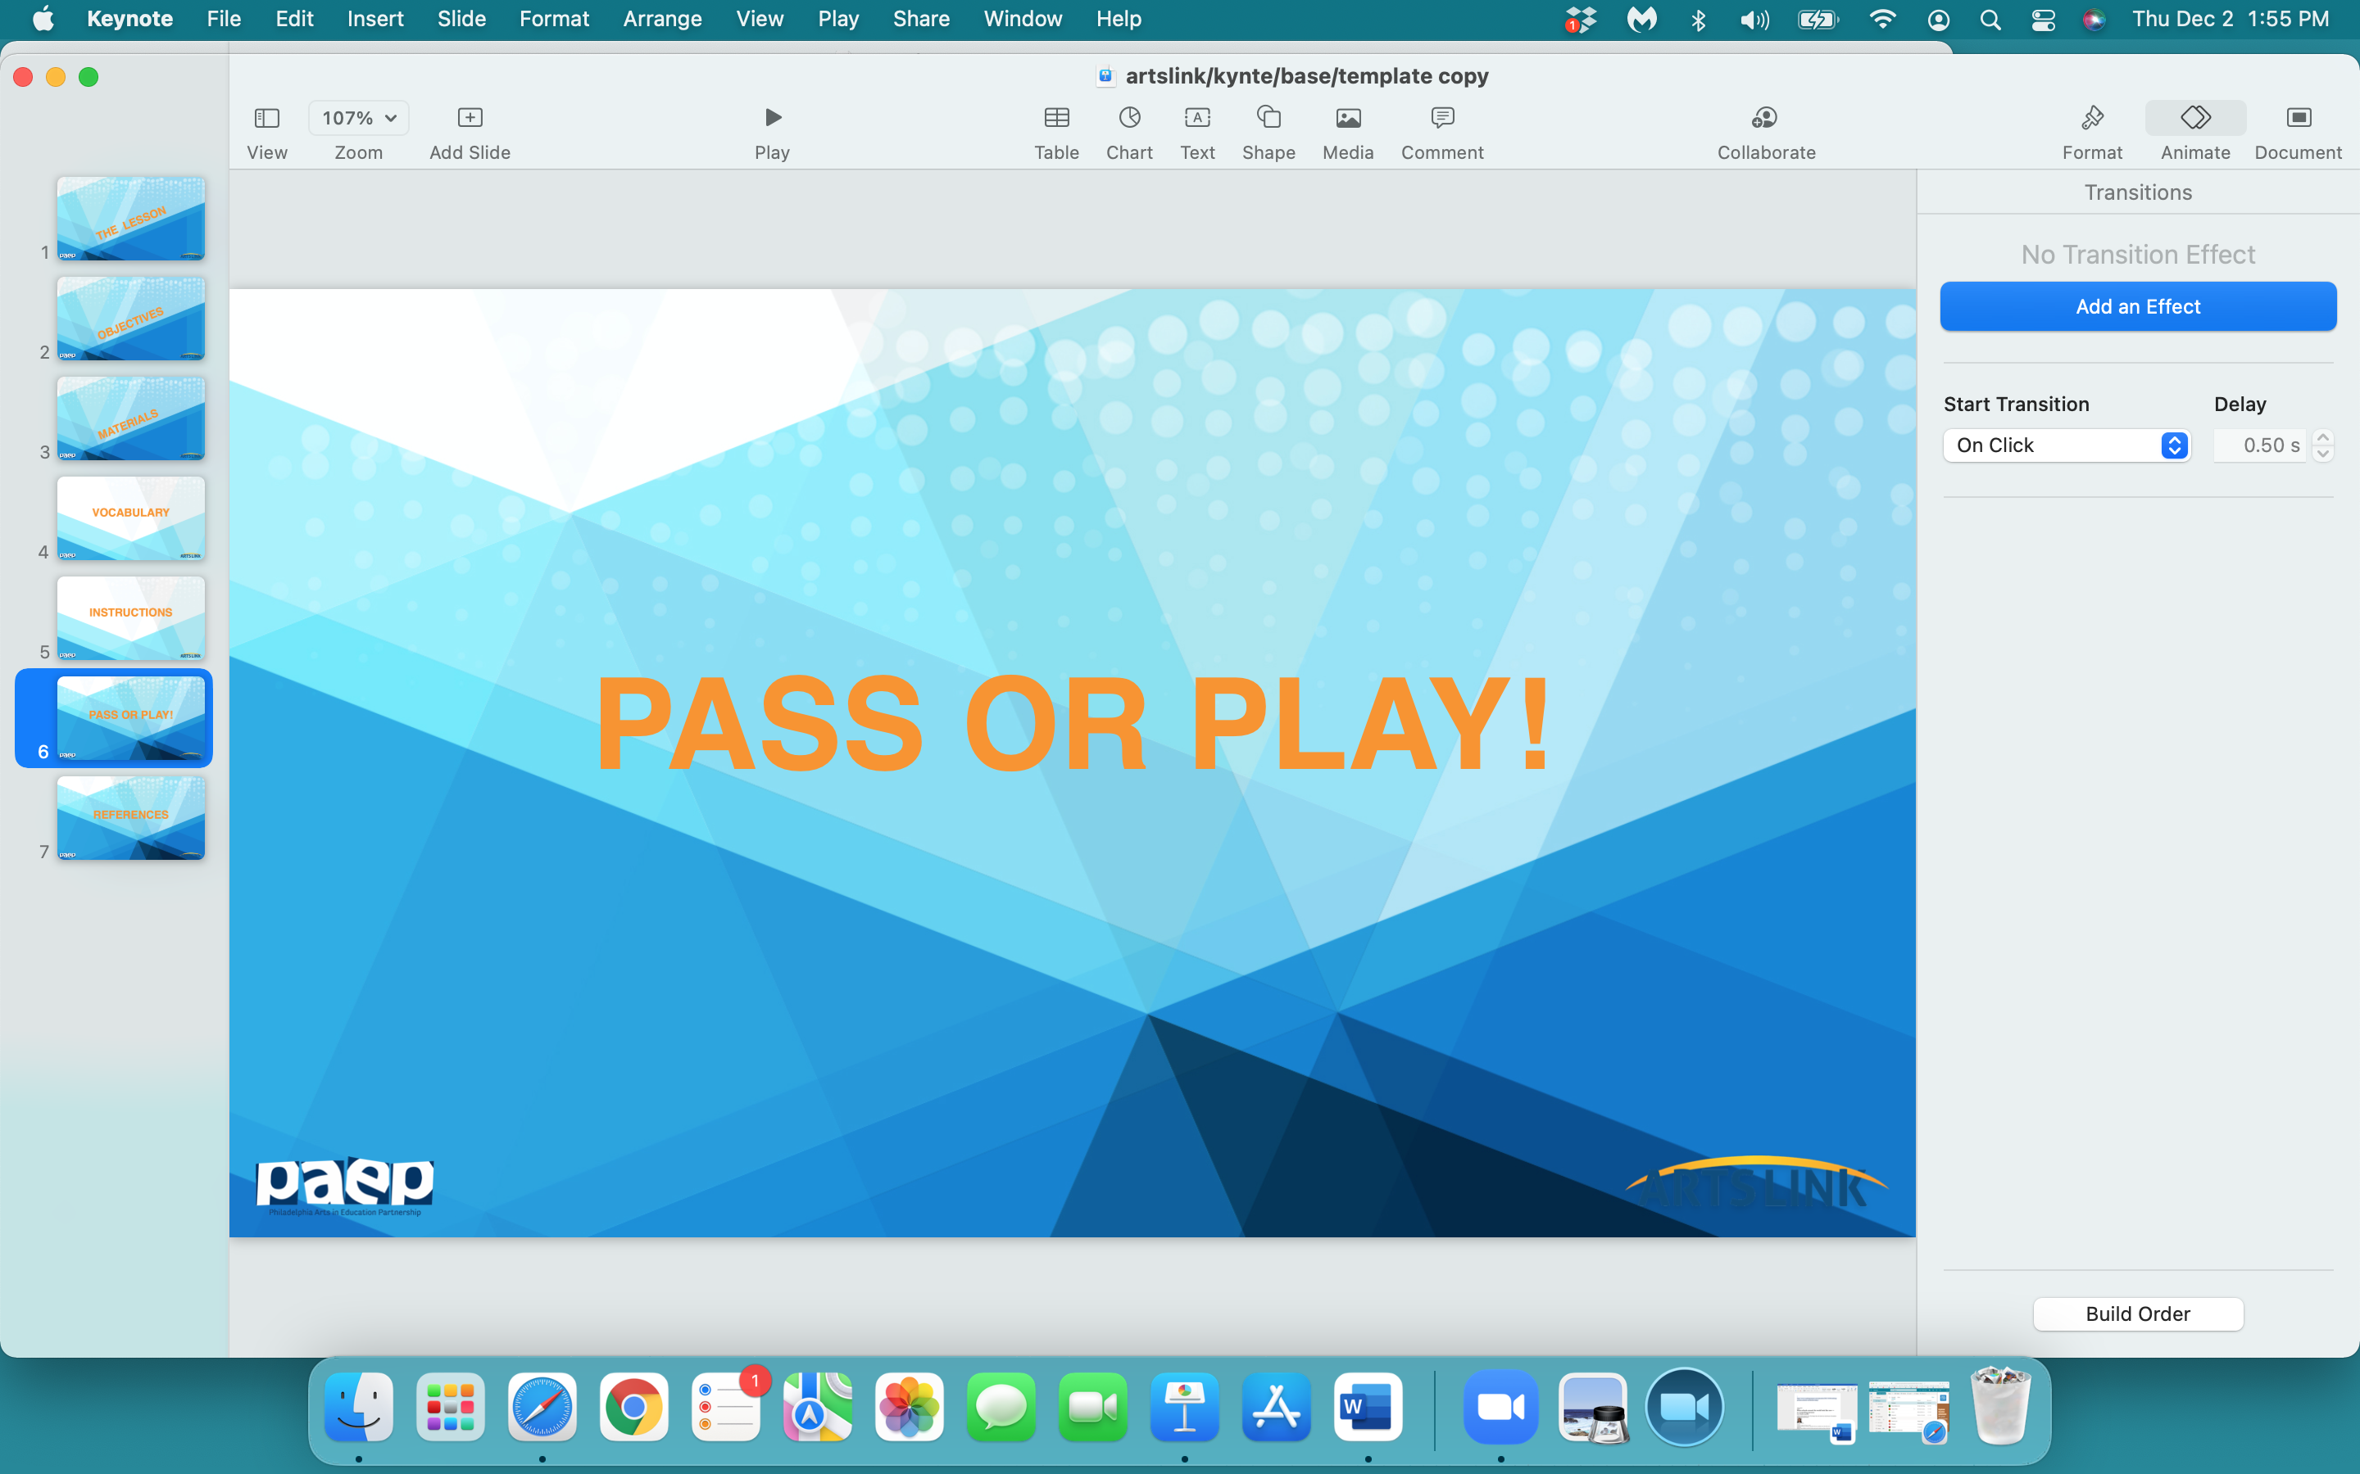

Slide 25
what one thing
did
you
learn
today…pass or play?

Slide 26
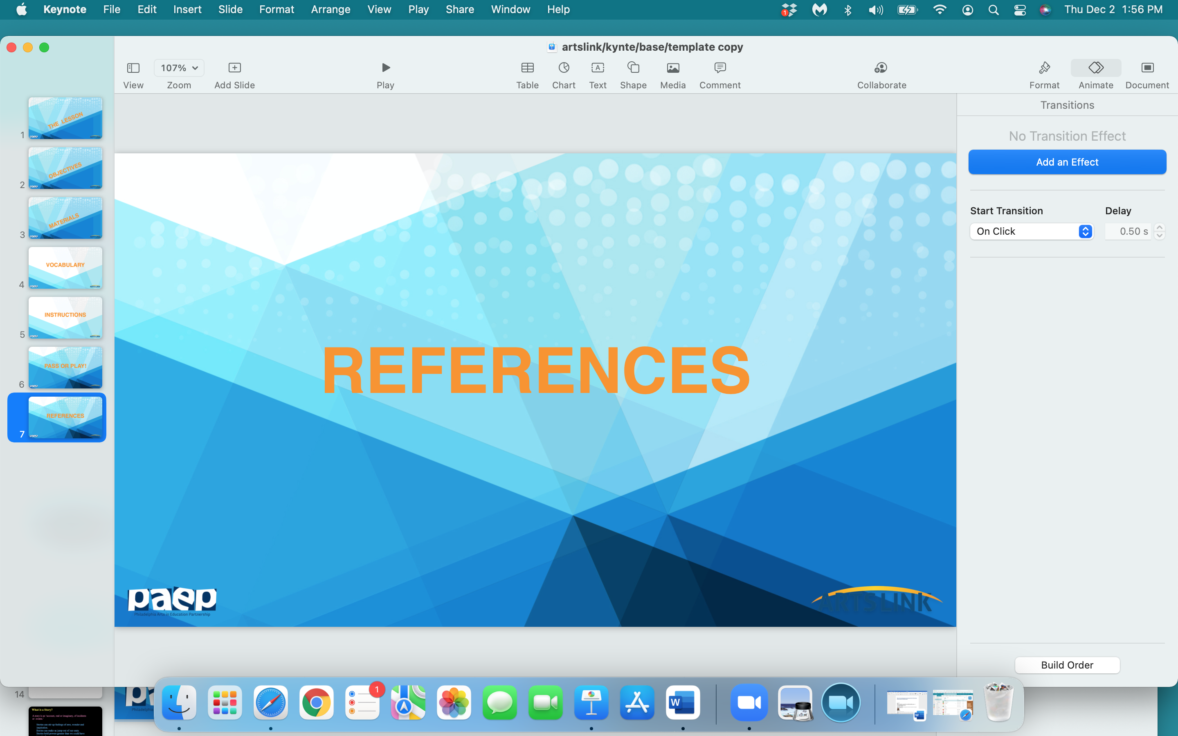

Slide 27
http://www.gabrielsartkids.com/uploads/4/5/5/6/4556661/joseph_cornell_lp.pdf
https://americanart.si.edu/artist/joseph-cornell-995
http://www.beaconlearningcenter.com/lessons/lesson.asp?ID=1423
https://noma.org/art-making-activity-create-a-shadowbox/
https://www.enchantedlearning.com/artists/cornell/activity.shtml
https://www.artic.edu/collection/resources/educator-resources/47-educator-resource-packet-untitled-hotel-de-la-duchesse-anne-by-joseph-cornell
https://learn.ncartmuseum.org/artists/joseph-cornell/
https://manoswelt.blogspot.com/2012/03/kunstschachteln-59-65-und-februar.html
https://fdocuments.us/document/joseph-cornell.html
https://www.thoughtco.com/joseph-cornell-4685957
https://jonathangriffin.org/2015/10/17/joseph-cornell/
https://www.accessart.org.uk/matchboxworlds/?print=print
https://docs.google.com/document/d/1AWT8W47CQm5LkjML7tBdogpiJ4KVwA4SG0WXIzqK_M8/edit#

