Slide 1
Who is the artist when someone comes up with an idea for a work of art, but other people make it?

Slide 2


Slide 3
What’s Your Line?

Slide 4


Slide 5
In the next hour, you will be able to:
understand what ‘conceptual art’ is
understand Sol LeWitt’s method of creating his ‘Wall Drawings’
contribute one ‘drawing instruction’ for a group ‘conceptual drawing’

Slide 6


Slide 7
1 sheet of paper from your drawing pad
notebook
pencil
ruler
markers
colored pencils

Slide 8
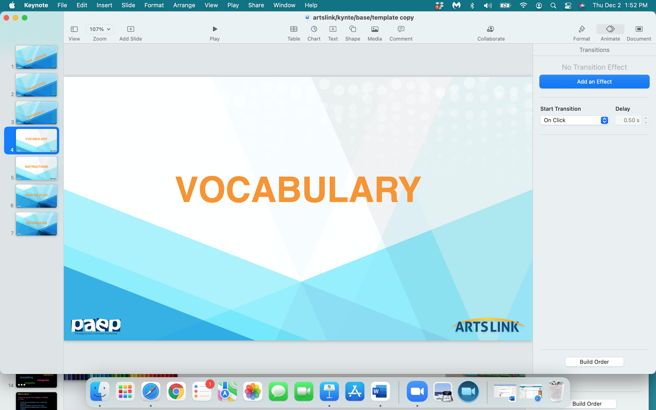

Slide 9
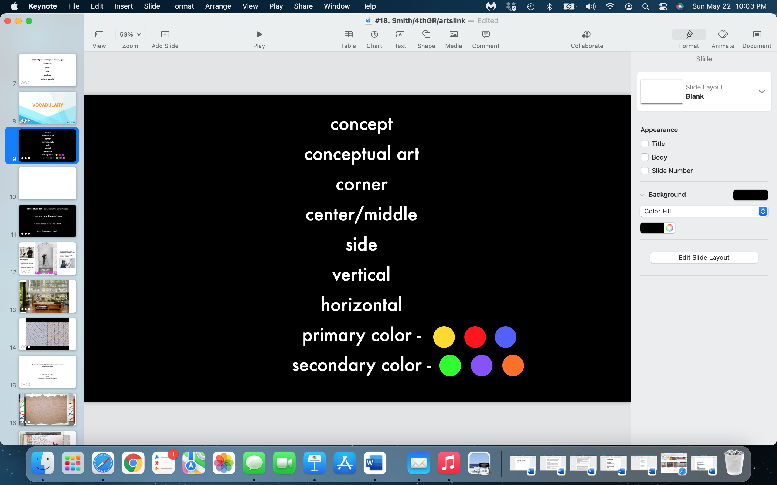

Slide 10
conceptual art : art where the artists’s idea
or concept - the idea - of the art
is considered more important
than the artwork itself.

Slide 11
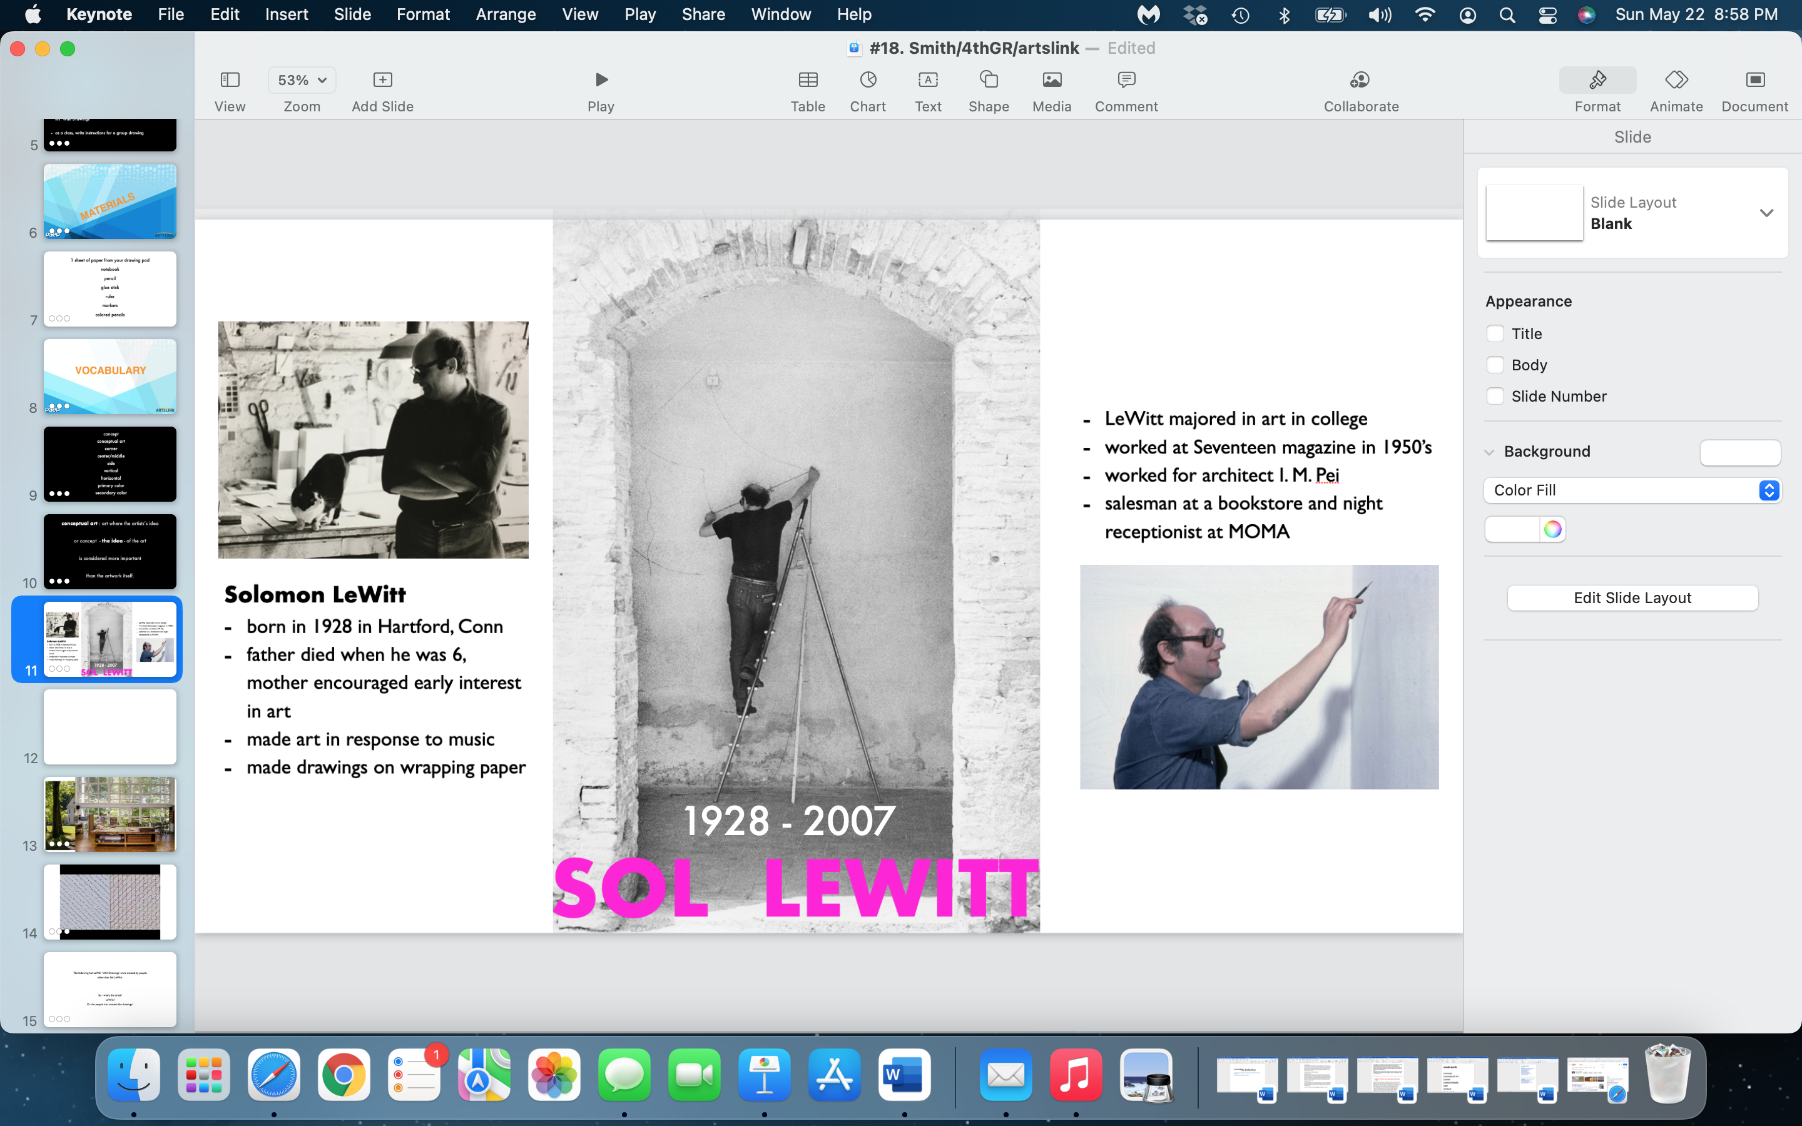

Slide 12



Slide 13
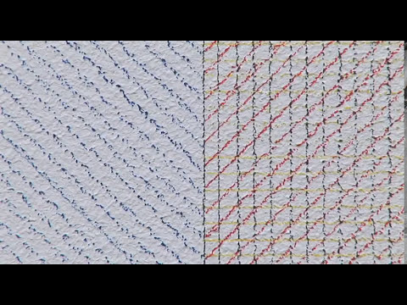

Slide 14
The following are some of Sol LeWitt’s ‘Wall Drawings’.
LeWitt wrote the instructions.
People created the drawings according to his instructions.
So - who’s the artist?
Sol LeWitt?
Or the people that created the drawings?

Slide 15
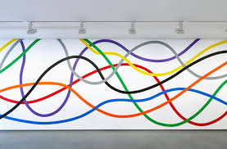
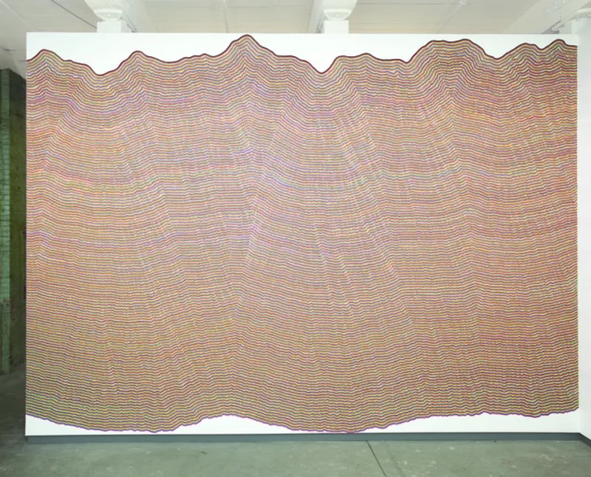
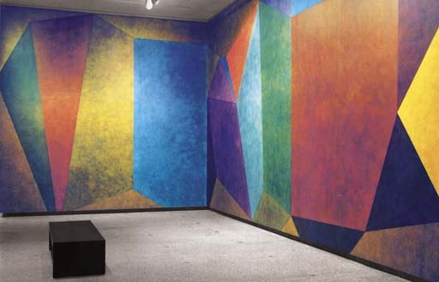
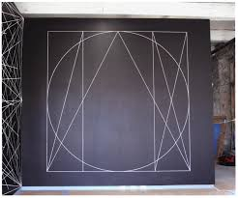

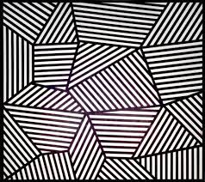

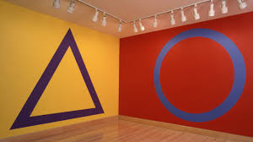
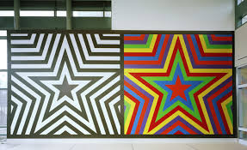


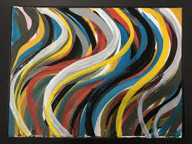
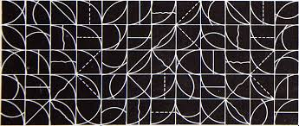
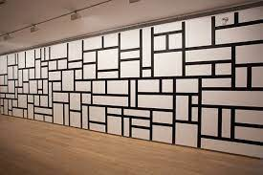
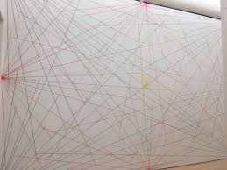


Slide 16
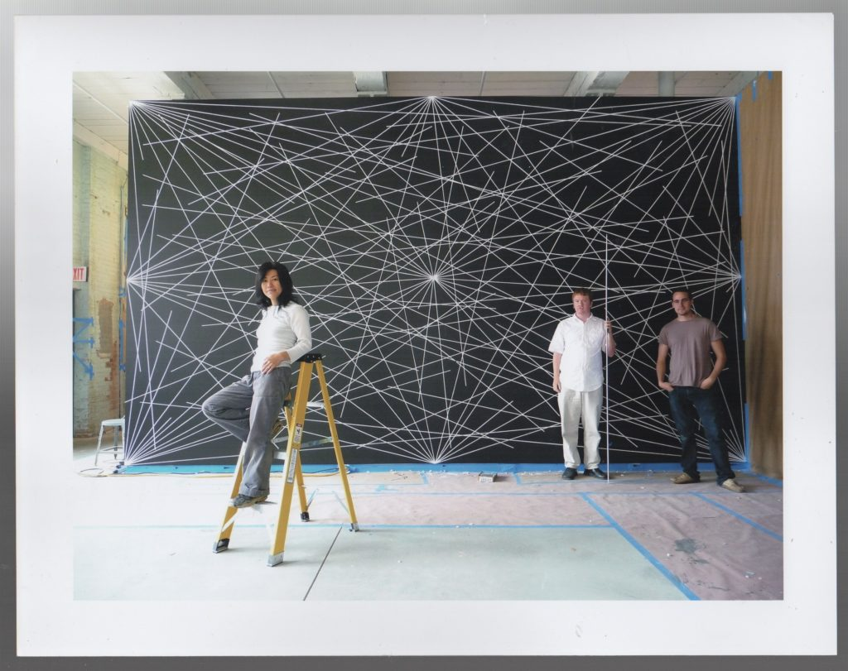
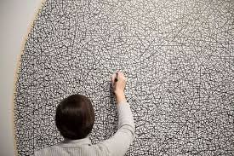
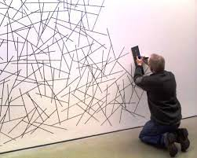
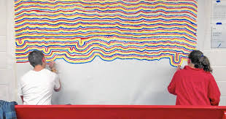

Slide 17
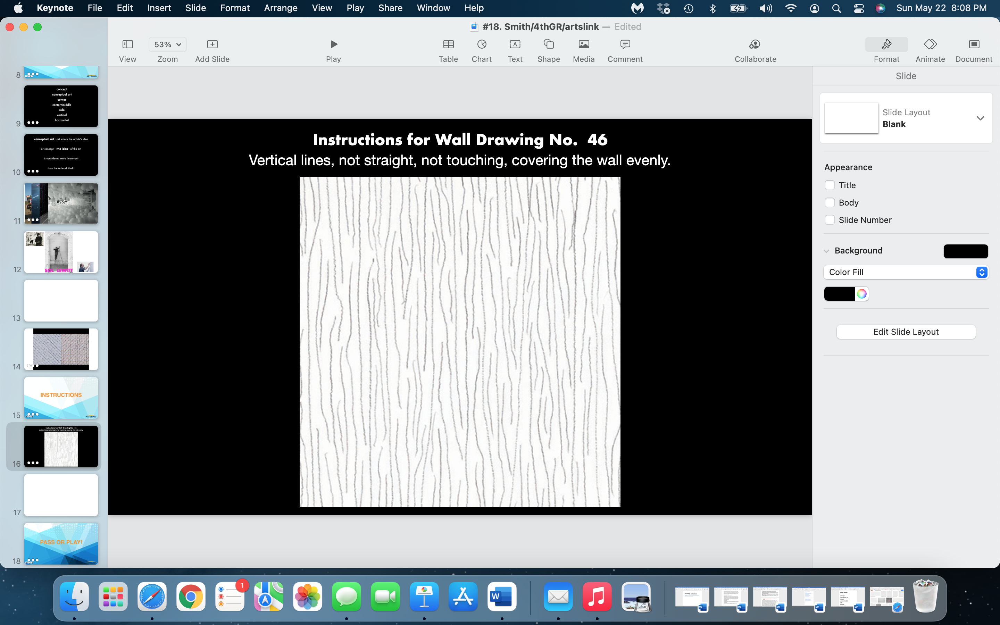

Slide 18


Slide 19
The Instructions:
Each student will come up with one ‘drawing instruction’.
The ‘drawing instruction’ should be limited to lines, circles and simple geometric shapes.
The student will choose the color used in their ‘drawing instruction’.
The ‘drawing instruction’ must be clear to the other students, so that the drawing can be easily made.
When the ‘drawing instruction’ has been given, each student will draw it on their own piece of paper.

Slide 20
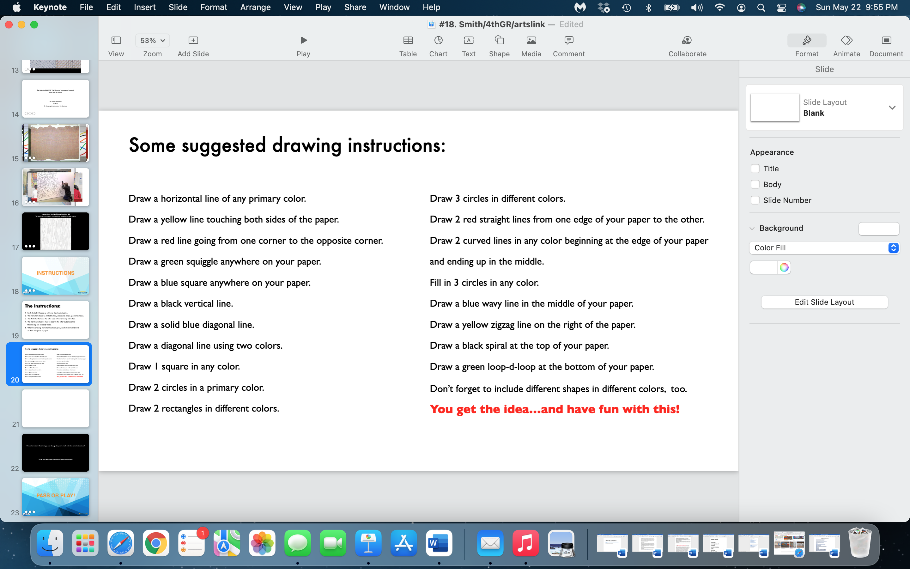

Slide 21
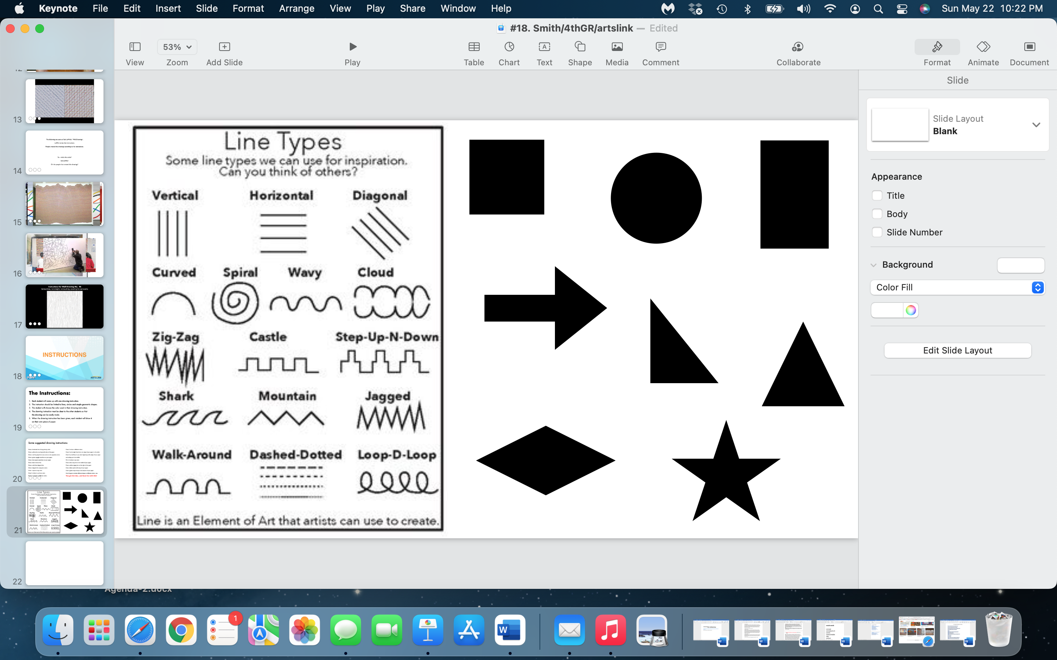

Slide 22
How different are all the students’ drawings, even though they were made with the same instructions?
What is it like to see the result of your instructions?

Slide 23


Slide 24
what one thing
did
you
learn
today…pass or play?

Slide 25


Slide 26
https://whitney.org/artists/776
https://publicdelivery.org/wp-content/uploads/2013/07/Sol-LeWitt-–-Wall-Drawing-16-September-1969.jpg
https://hyperallergic.com/391967/a-performance-of-sol-lewitts-drawing-instructions/
https://ray2401.wordpress.com/2017/08/21/sol-lewitts-art/
https://www.diaart.org/media/_file/brochures/lewitt6-10.pdf
https://publicdelivery.org/sol-lewitt-wall-drawings/
https://whitney.org/education/families/kids-art-challenge/sol-lewitt
https://tnartseducation.org/lesson-plans/sol-lewitt-fraction-lesson/
https://larryspeck.com/2014/07/thoughts-on-sol-lewitt-the-visionary-and-the-makers/
https://www.sfmoma.org/read/drawing-with-instructions/
https://www.guggenheim.org/teaching-materials/singular-forms-sometimes-repeated-art-from-1951-to-the-present/sol-lewitt-1928-2007
https://www.moma.org/momaorg/shared/pdfs/moma_learning/docs/MAI8_2.pdf
https://www.dickblick.com/lesson-plans/the-conceptual-art-game/
https://www.dickblick.com/lesson-plans/the-conceptual-art-game/
https://web.williams.edu/wcma/modules/lewitt/pdf/EducatorsGuide_ABCDsofSolLewitt.pdf
https://www.theartstory.org/blog/sol-lewitt-why-is-this-art/

