Slide 1
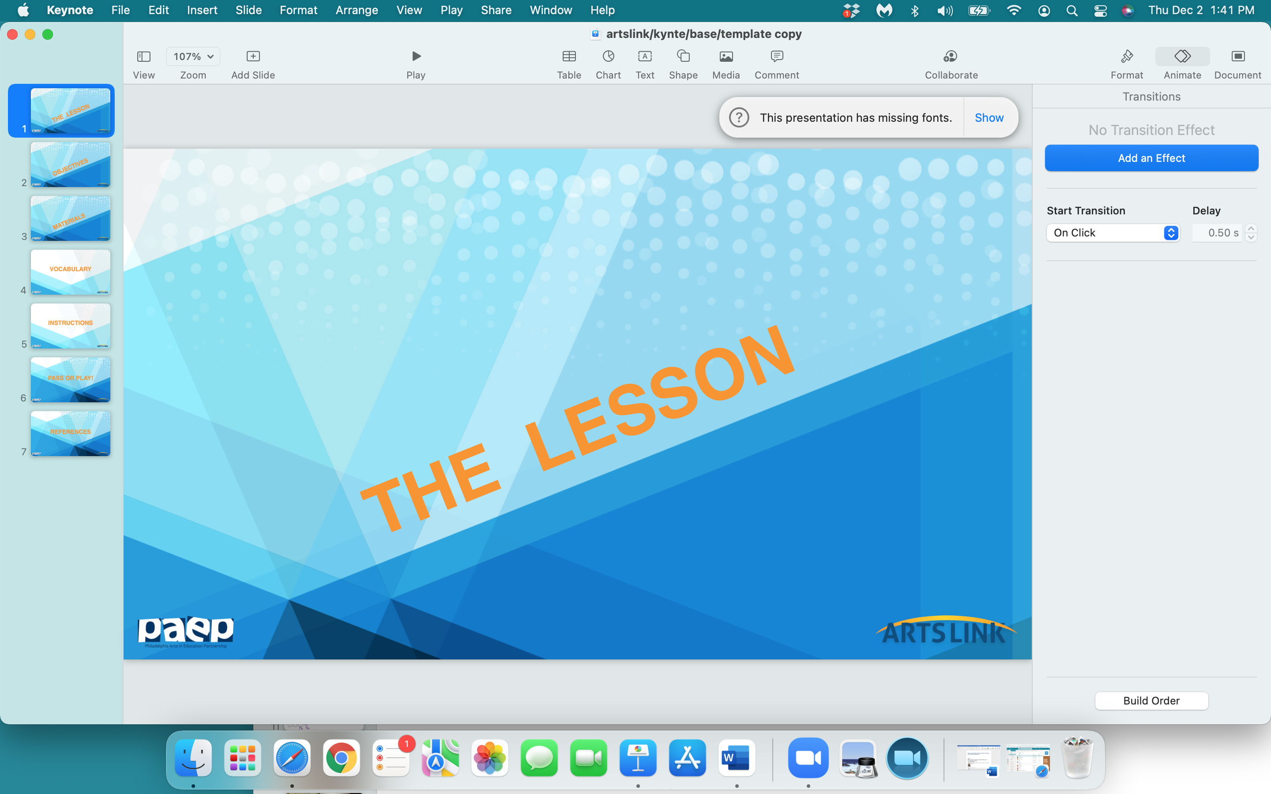

Slide 2
Drawing From Life

Slide 3


Slide 4
In the next hour, you will:
understand the role of ‘still lifes’ in our history of art
develop your observational skills by looking closely at objects in your classroom
create your own still-life from careful observation

Slide 5


Slide 6
1 sheet of paper from your drawing pad
pencil
markers
or
colored pencils
eraser

Slide 7
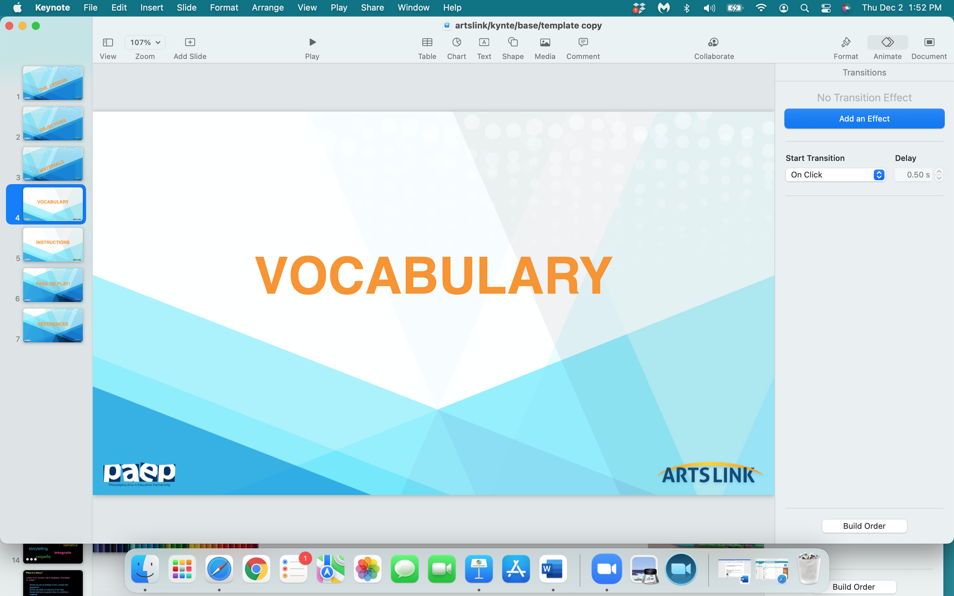

Slide 8
observation
observational drawing
still life
composition

Slide 9
observation: the process of looking at something very closely; directly looking at something

Slide 10
observational drawing: drawing what you see.
It's as simple and as complicated as that.
It can be a flower, a person, a still life, a landscape, whatever.
But it's drawing what you see in front of you
as realistically and as true to life as possible.

Slide 11
still life - a work of art that features an arrangement of objects -
like fruit and flowers, foods, fabric - anything not living or alive.
Still life drawings or paintings depict things that don’t move, or aren’t alive.
The term ‘still life’ was used to name a kind of art around the late 1500’s
into the 1600’s - in the Netherlands.
Still life artists arrange objects in a unique way - sometimes telling a story.

Slide 12
composition : the way subjects of an artwork are arranged in relation to one another.

Slide 13
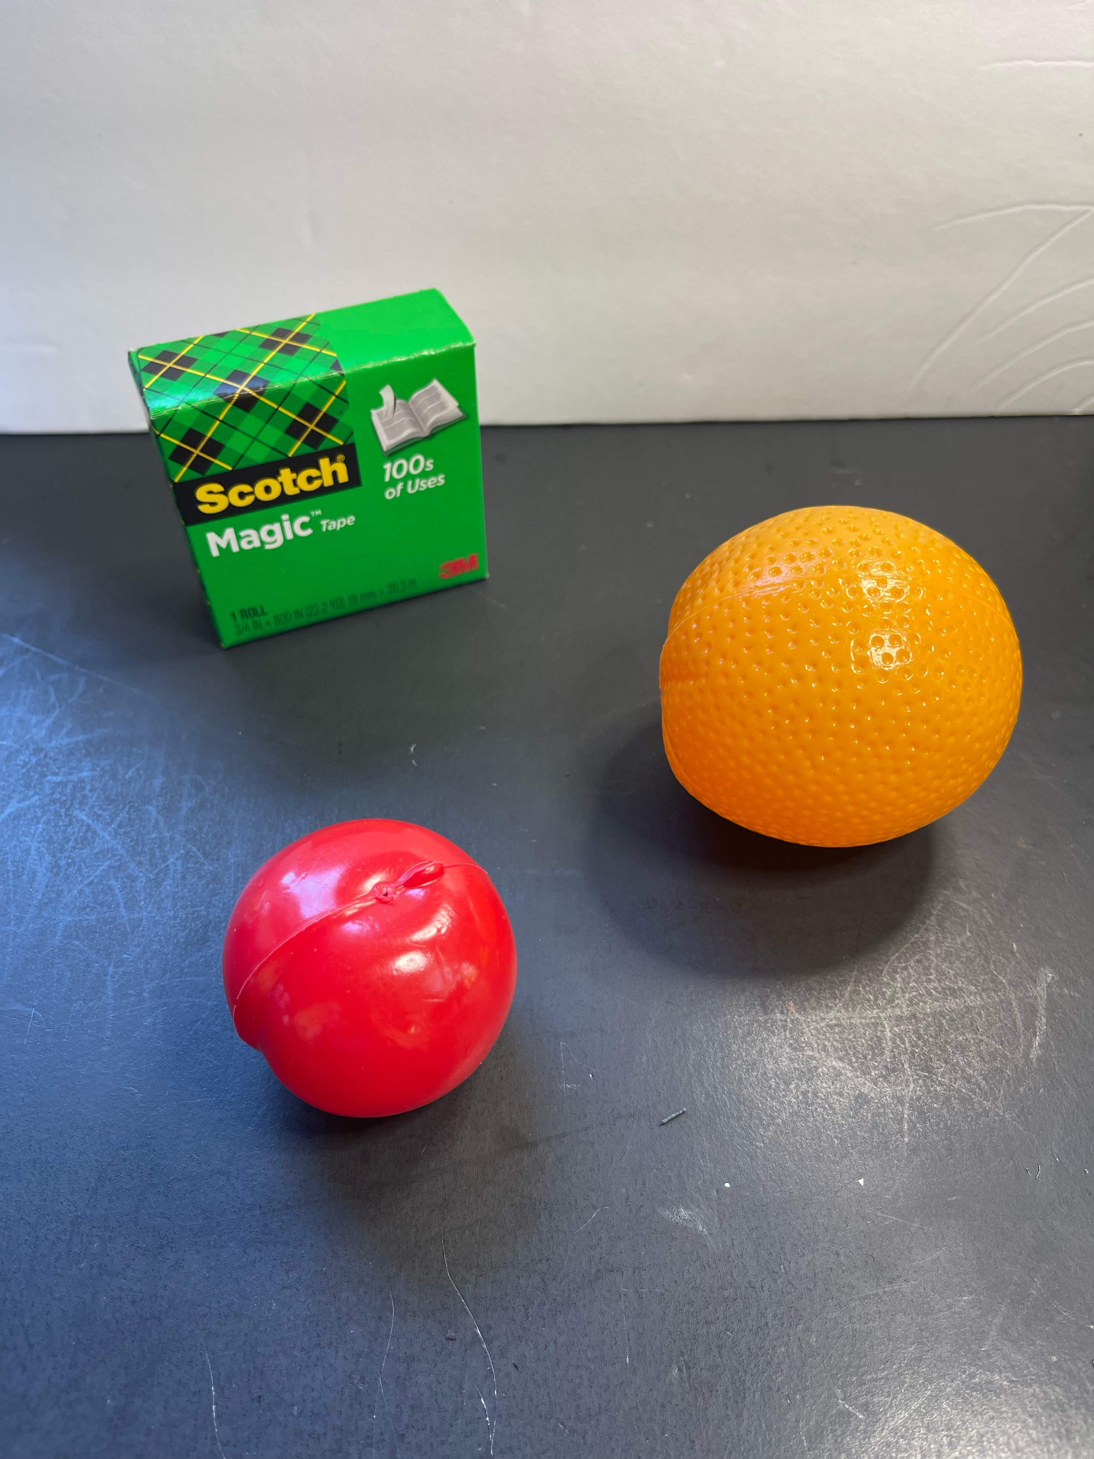
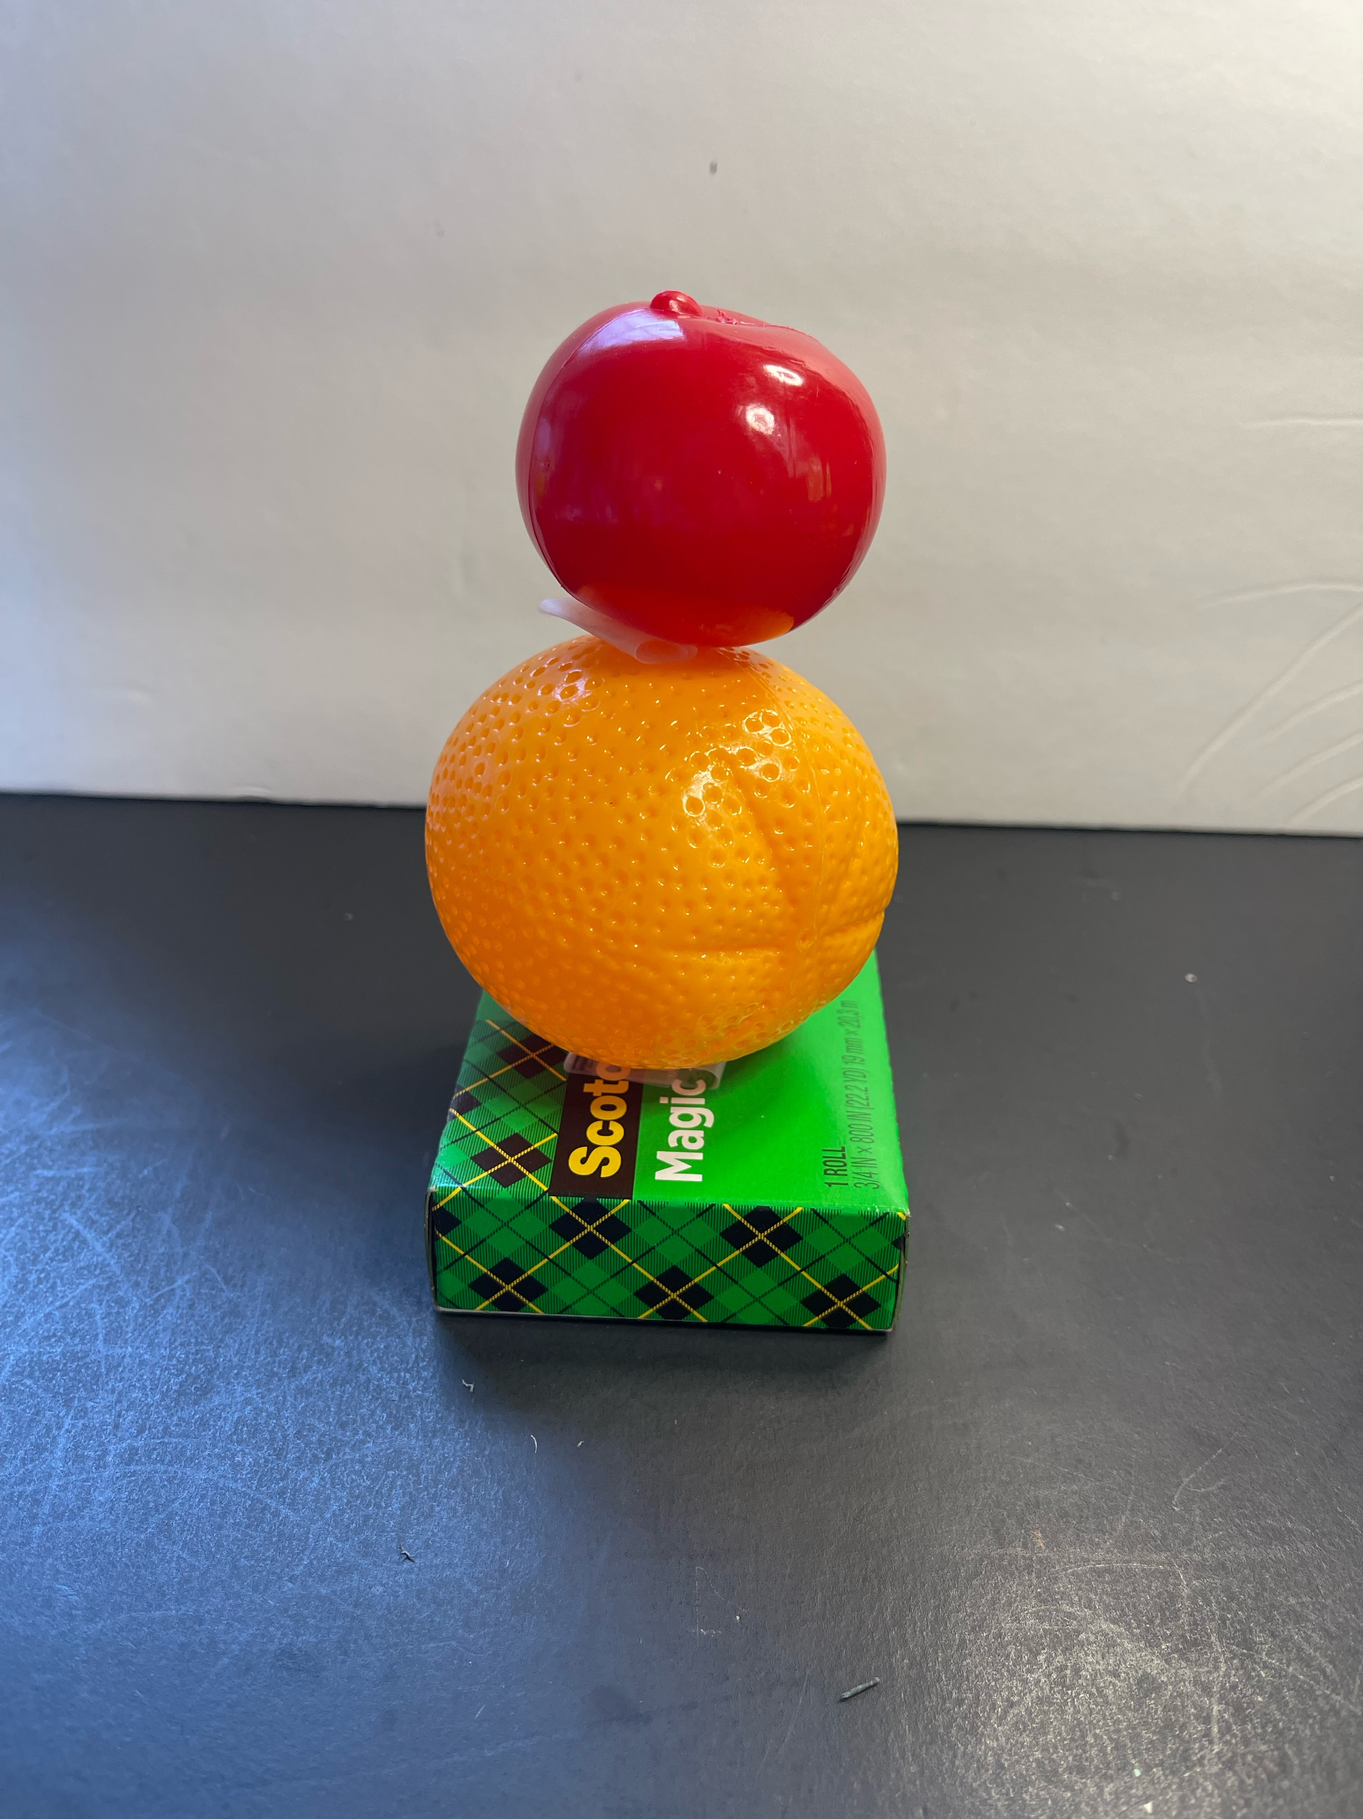
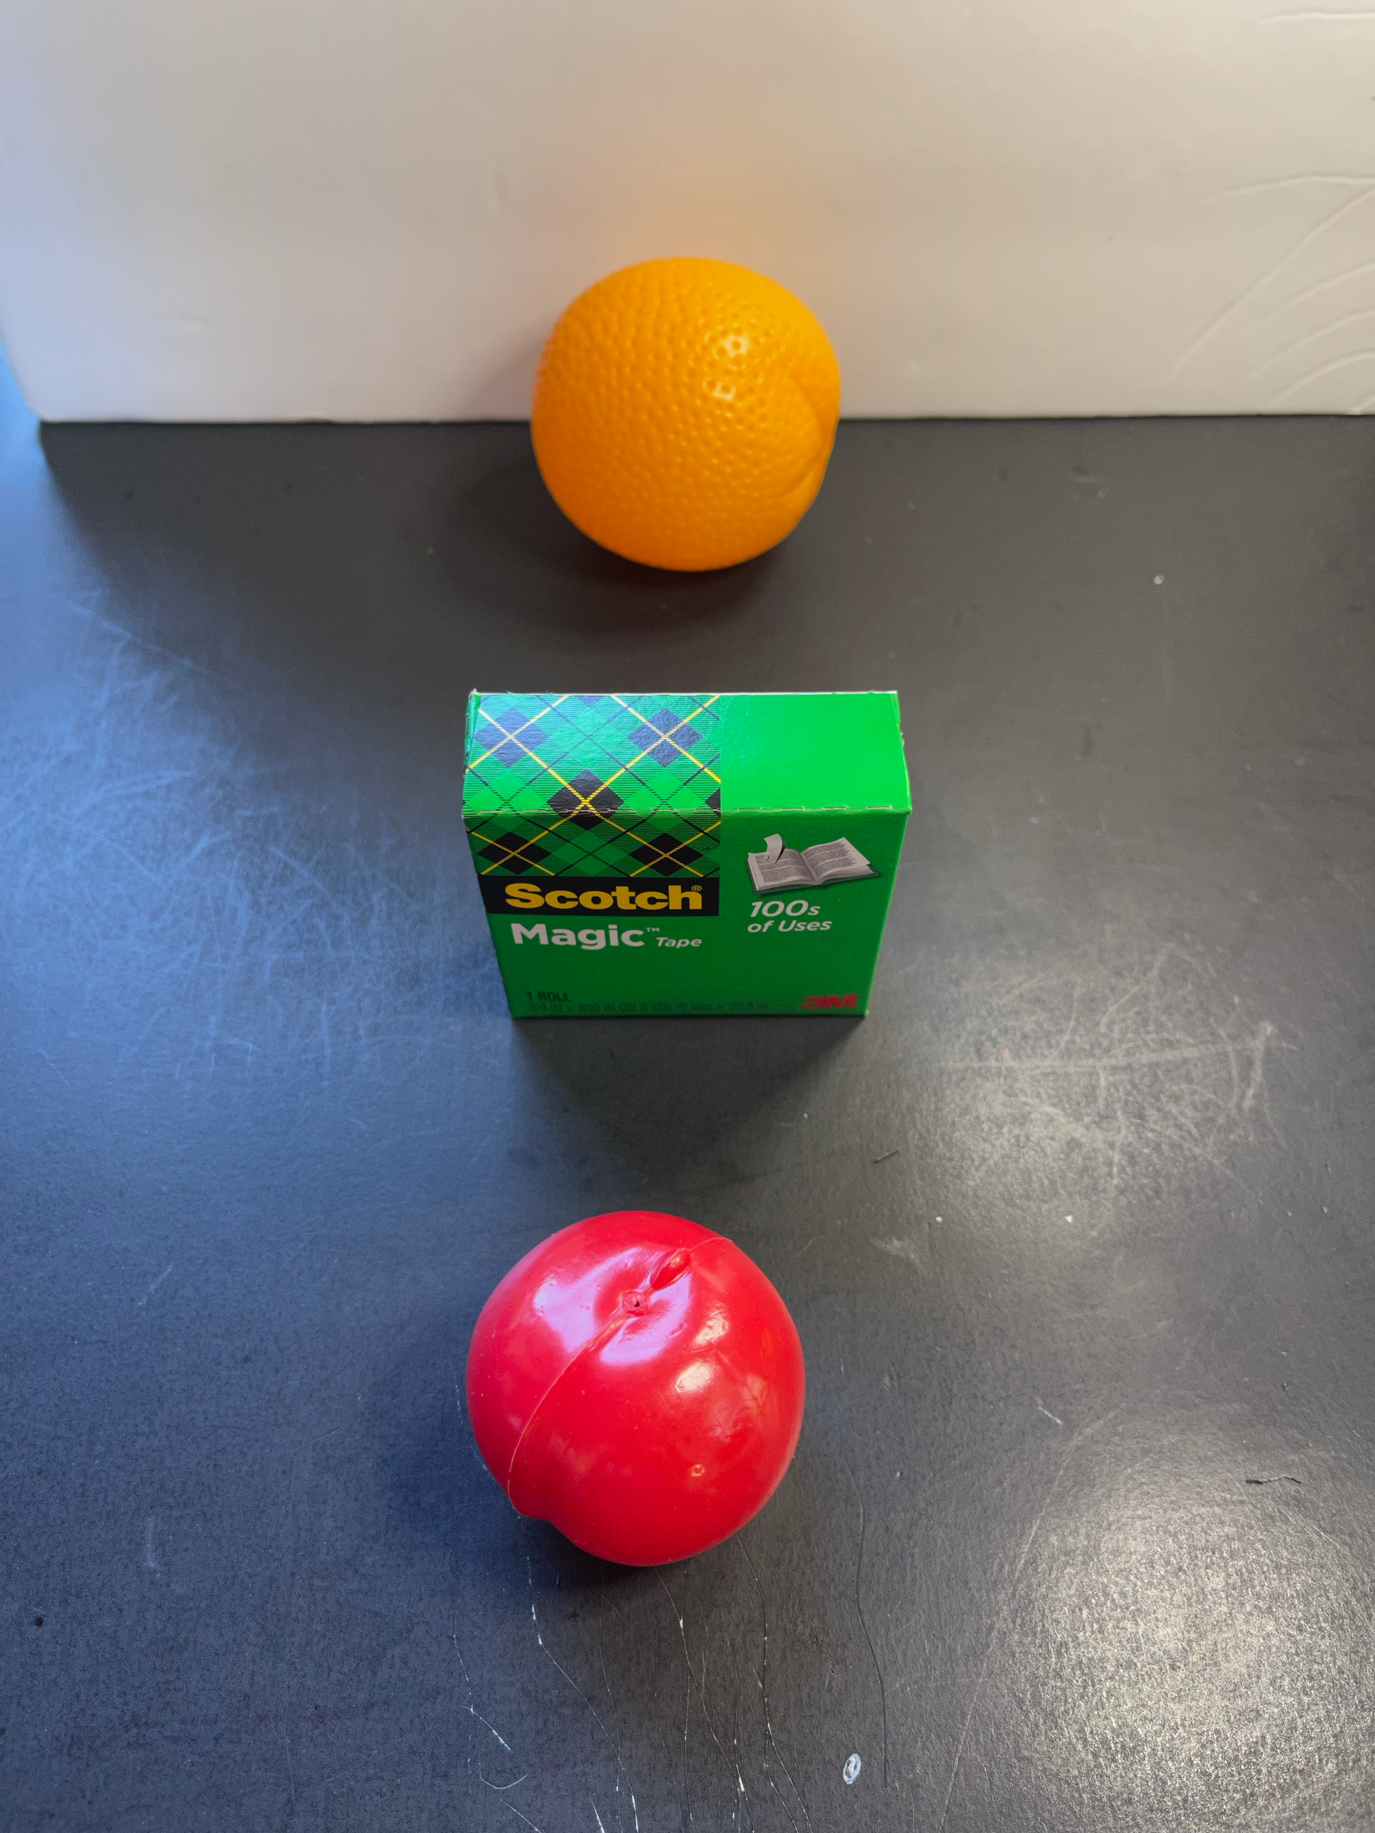

Slide 14
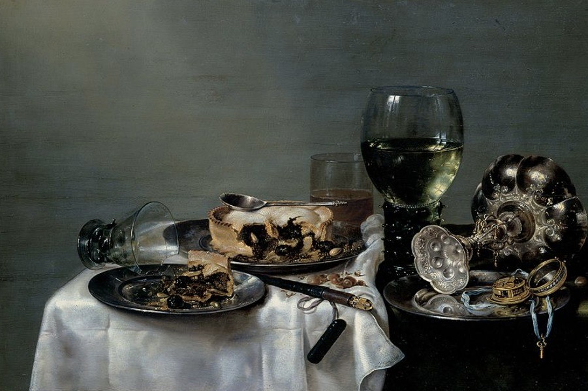
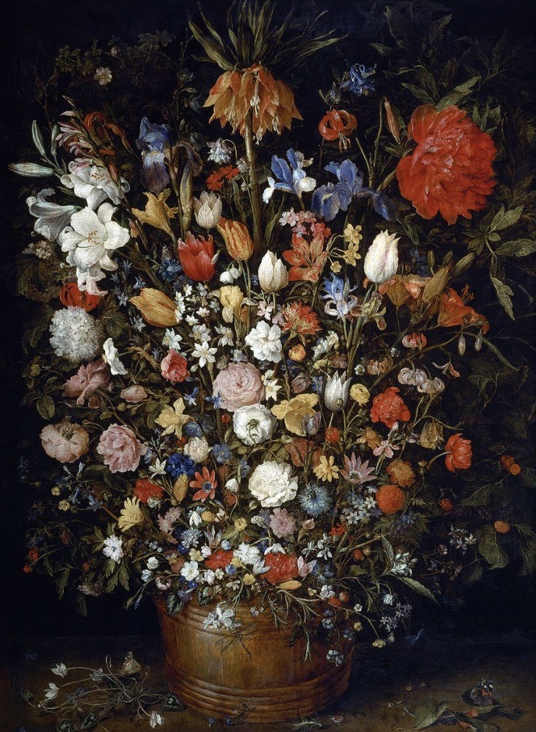
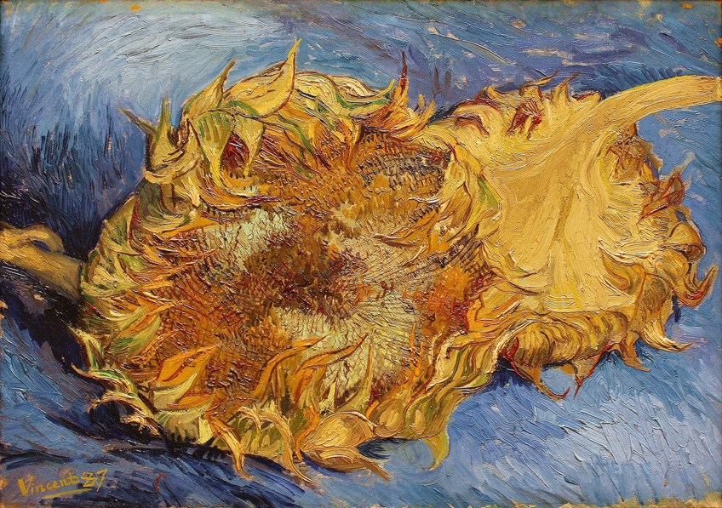
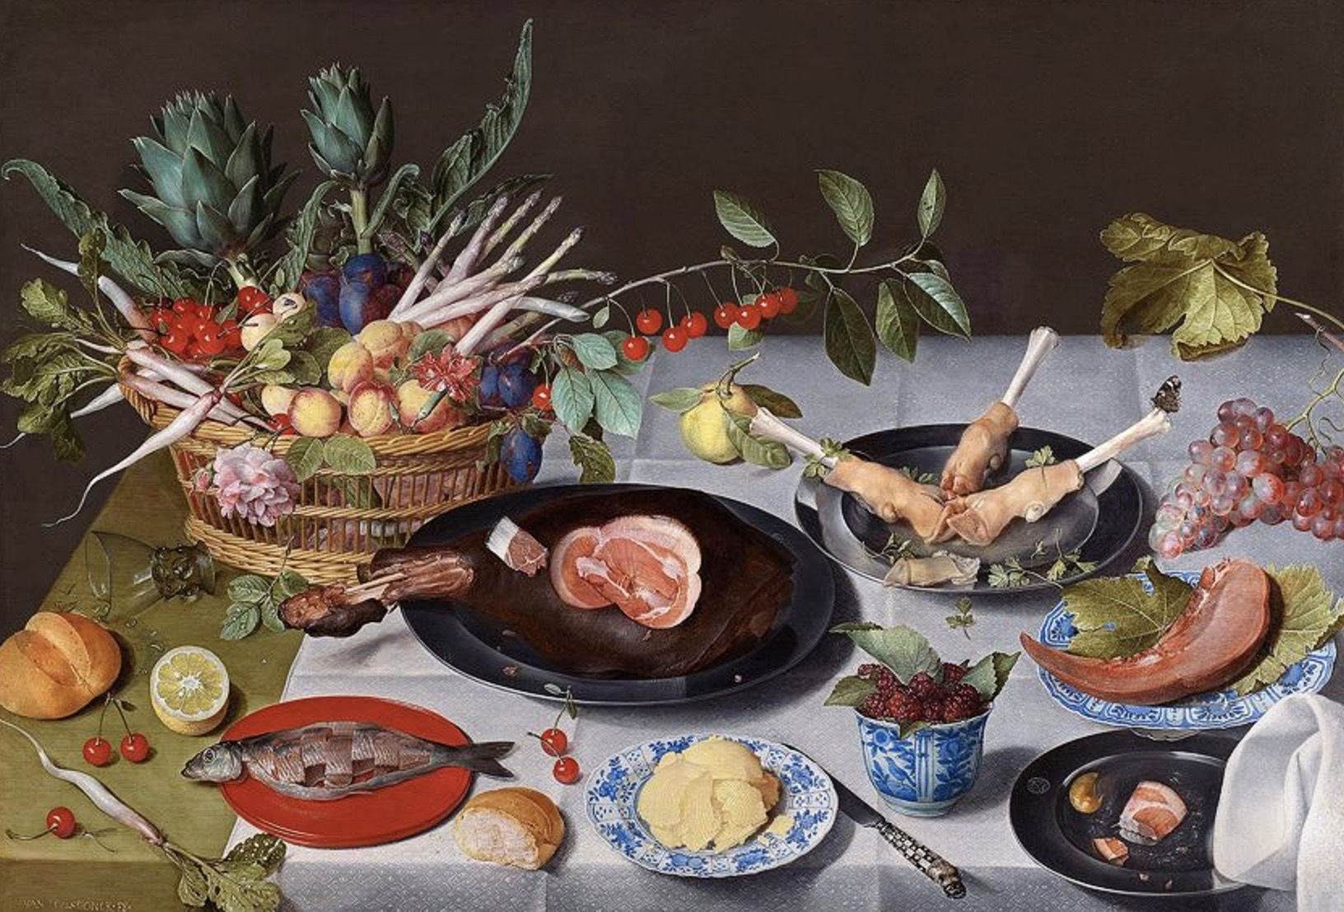
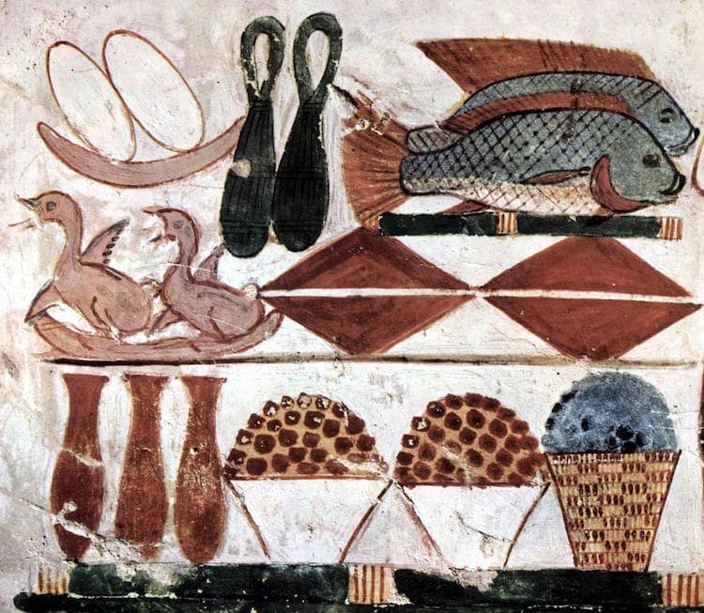

Slide 15
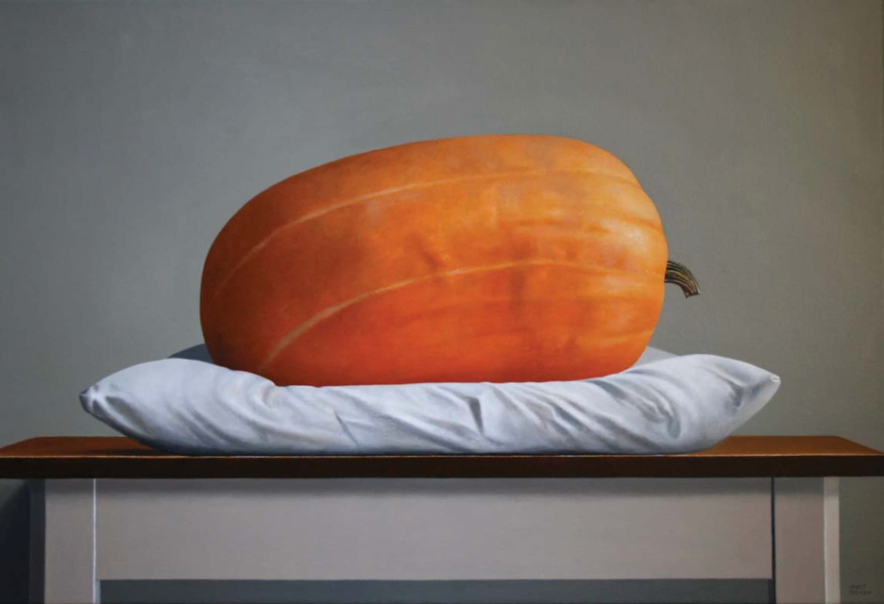
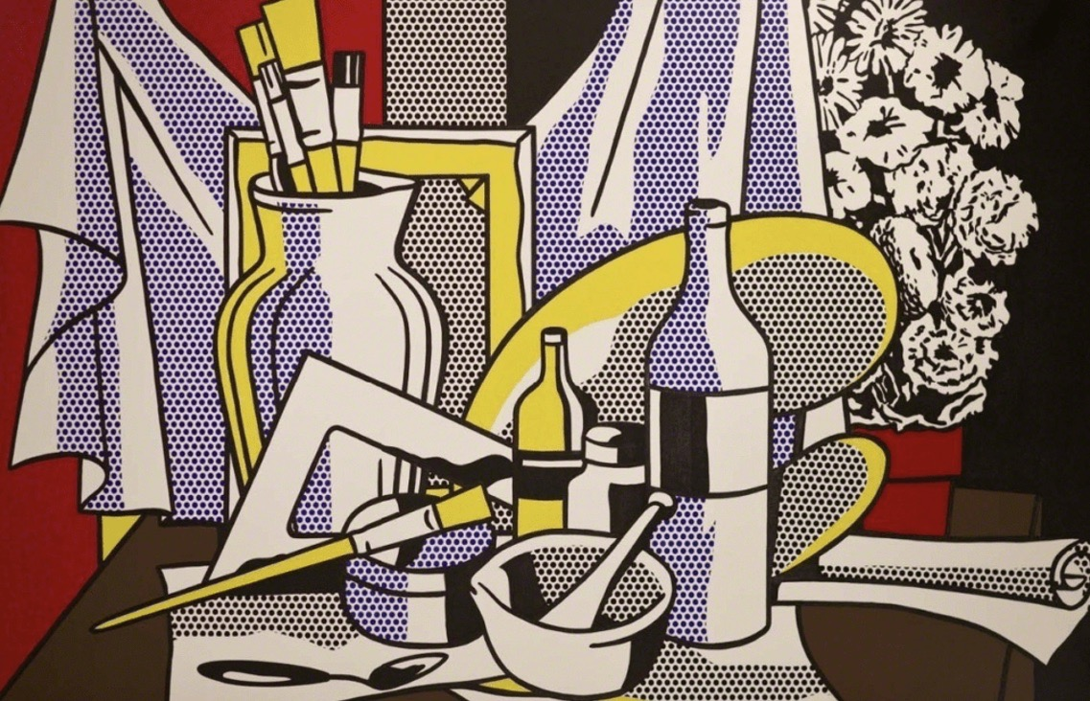
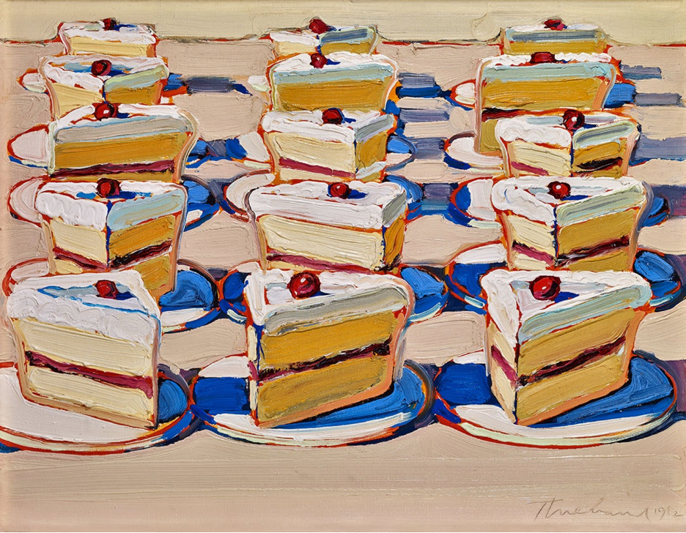
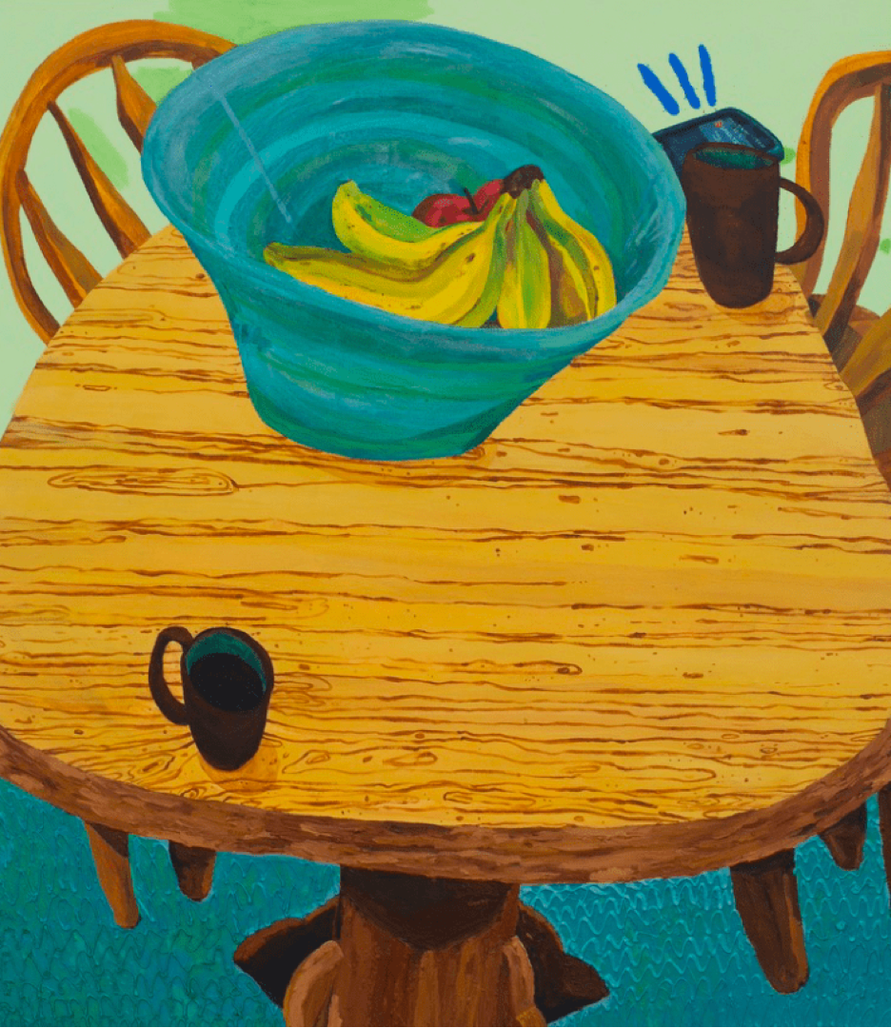
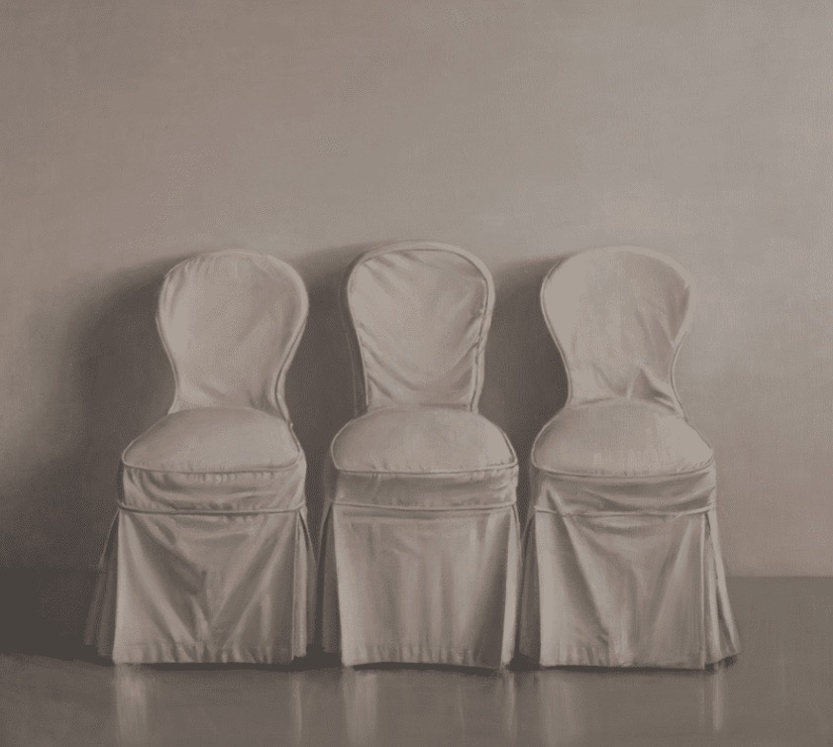
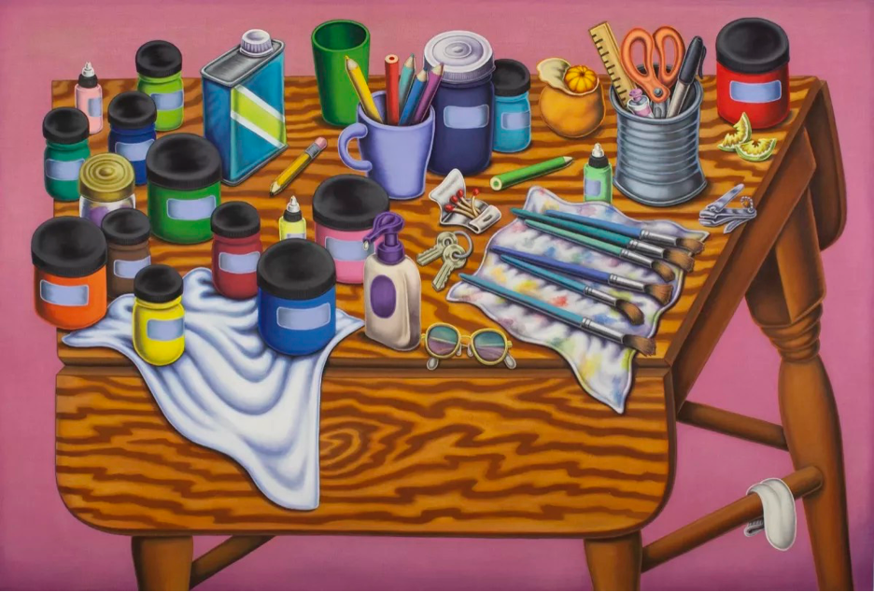

Slide 16
Still Lifes by Students

Slide 17
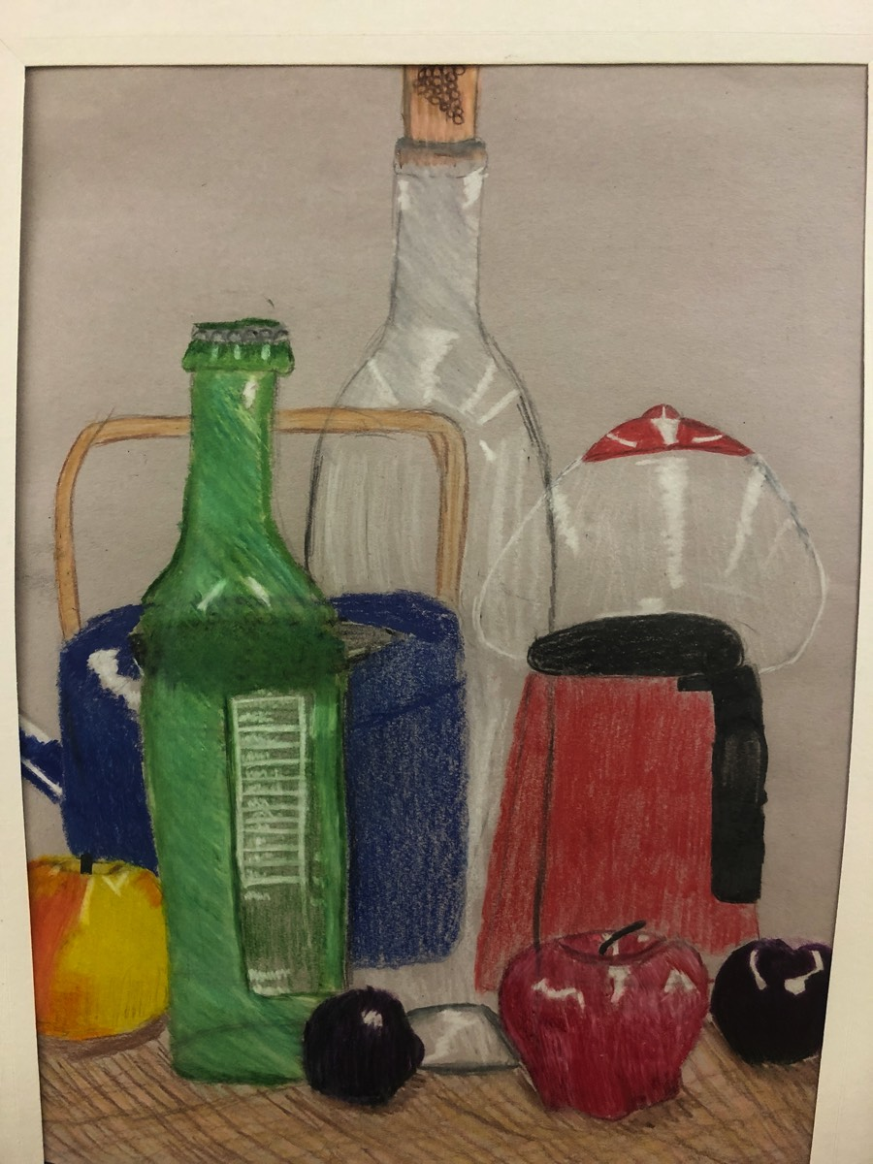
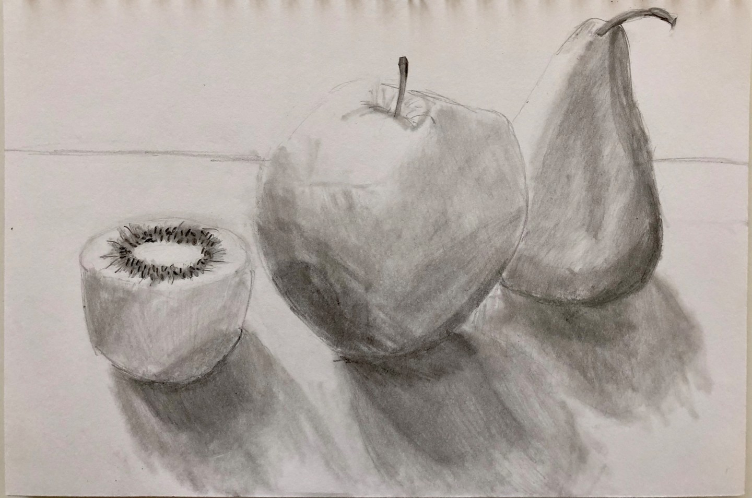
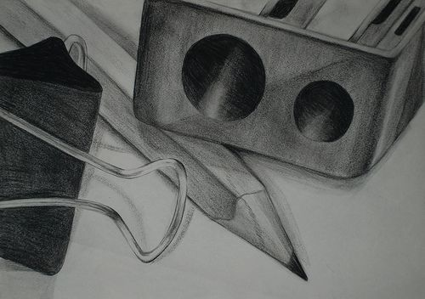

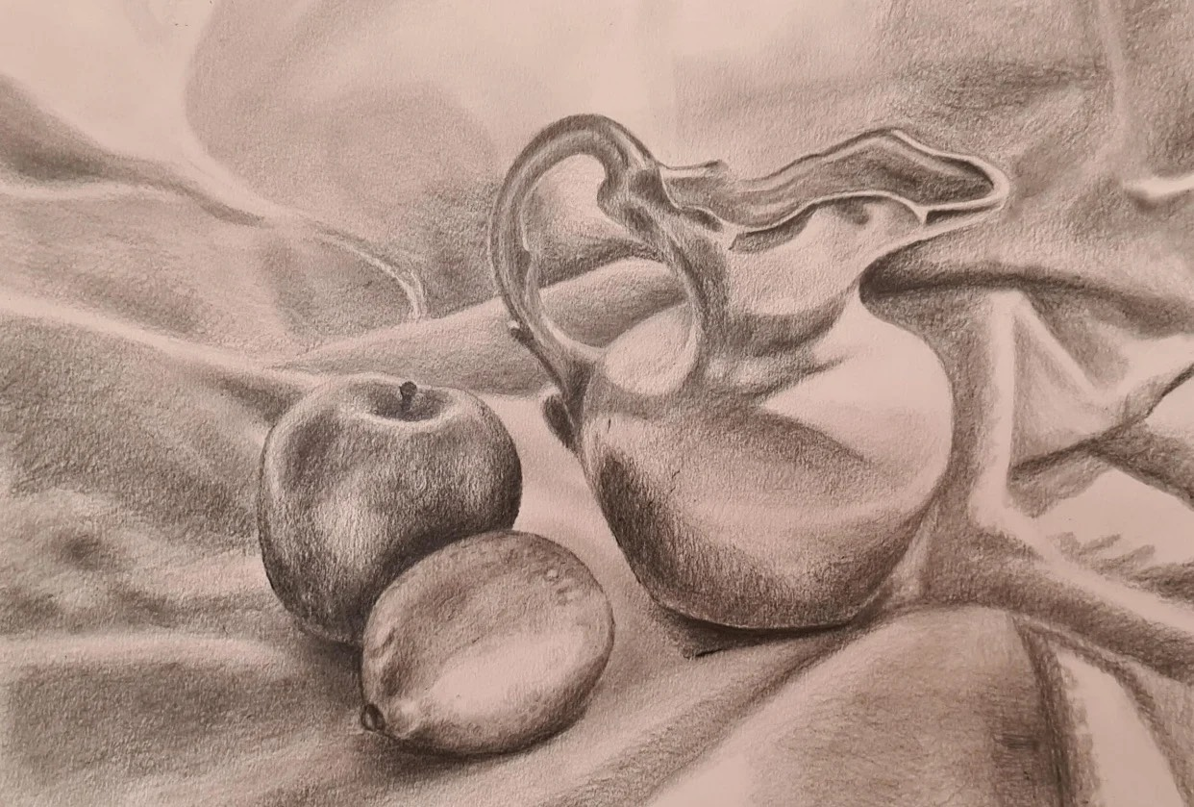
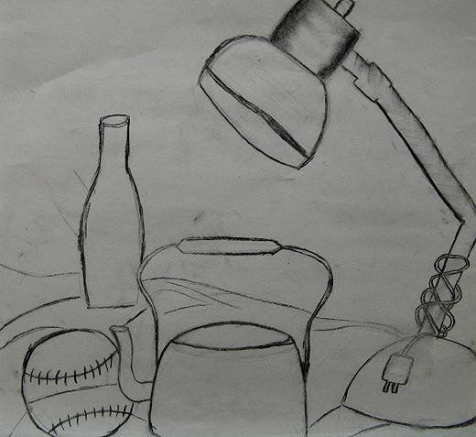
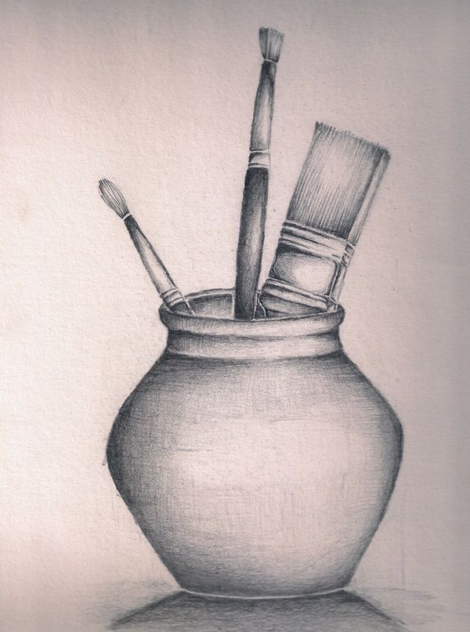
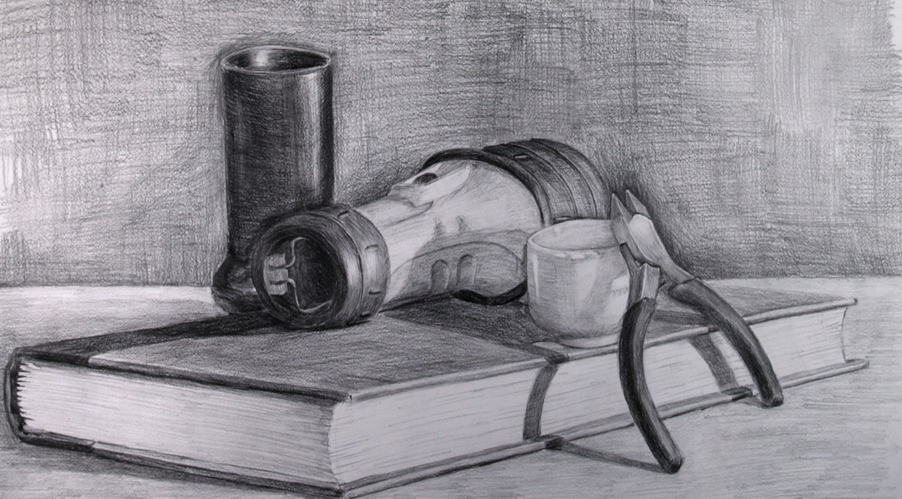
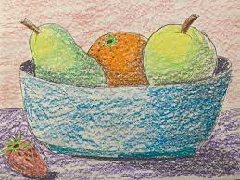
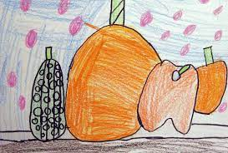
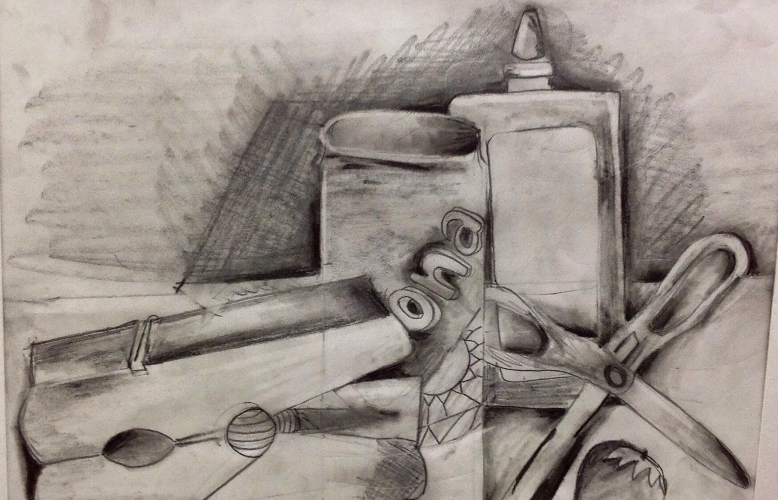

Slide 18
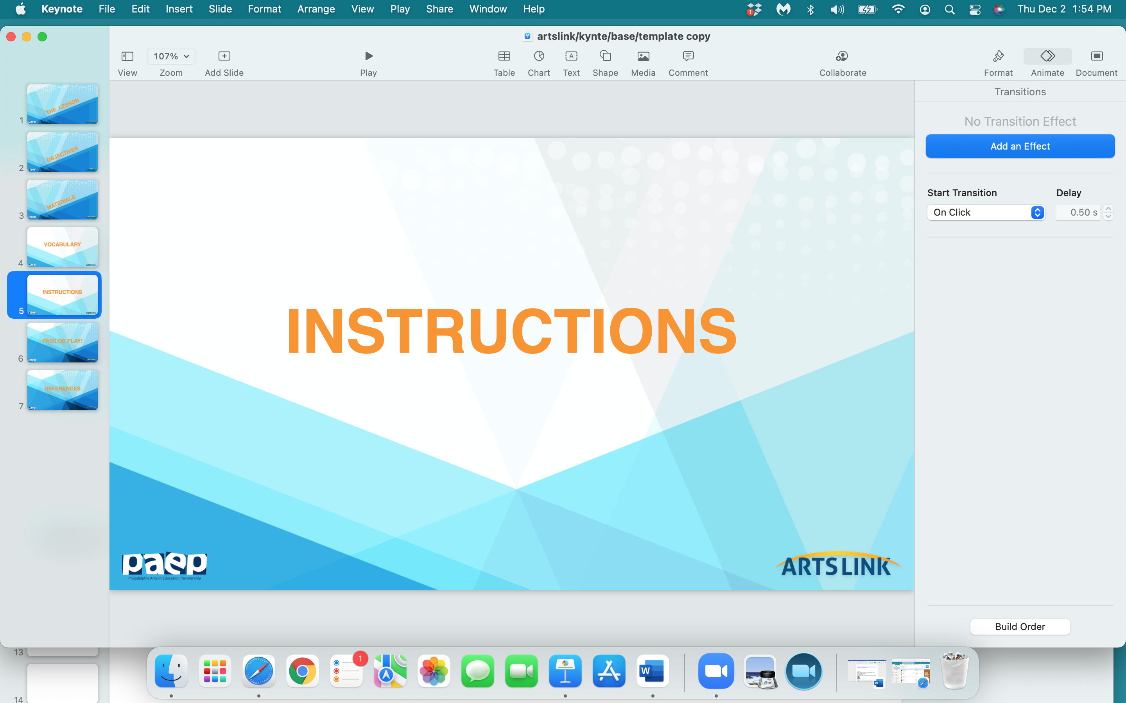

Slide 19
You’re going to create your own
‘still-life’ - by looking carefully
at objects that you find
in your classroom
and drawing them from life.

Slide 20
Every student - walk around the classroom and choose one object that you want to draw…or use the object you brought from home.

Slide 21
2. Bring the object back to your desk.
Every 4 students will form a ‘group’.
Arrange the 4 objects creatively
in the middle of the group of 4 desks.

Slide 22
3. Start sketching or ‘blocking in’ the objects you chose.
Make an interesting ‘composition’ with the 4 objects on your paper. Try and overlap the 4 objects - either in front of or in back of each other.

Slide 23
4. Start adding details to each object that you’re drawing.

Slide 24
5. If you want to add color to your drawing, I suggest
you try your colored pencils.
Start out by drawing very lightly with your colored
pencils, building up the ‘tone’, or color of your objects,
slowly.
But if you want to use your markers - go ahead.
Your drawing will be bold - and will make a statement!

Slide 25
6. And remember - give your drawing a title.
And sign your drawing.

Slide 26
Time to share!

Slide 27


Slide 28
what one thing
did
you
learn
today…pass or play?

Slide 29


Slide 30
https://www.google.com/search?q=drawings+throughout+history&source=lmns&bih=588&biw=1213&client=safari&hl=en&sa=X&ved=2ahUKEwi31dGyuIX4AhWDgHIEHZY3CiUQ_AUoAHoECAEQAA
https://www.indeed.com/career-advice/career-development/types-of-drawing
https://www.nhm.ac.uk/discover/news/2018/september/the-oldest-drawing-ever-found-is-a-stone-hashtag.html
https://www.britannica.com/art/drawing-art/History-of-drawing
https://learn.ncartmuseum.org/lesson-plans/drawing-from-observation/
https://www.youtube.com/watch?v=DuMwRO9vQuU
https://study.com/academy/lesson/still-life-lesson-plan-for-elementary-school.html
https://artincontext.org/still-life-painting/
https://theartofeducation.edu/2019/09/27/extra-teach-youngest-students-draw-life/#disqus_thread

