Slide 1


Slide 2
The
Artist Trading Card…
a really small version of you

Slide 3


Slide 4
In the next 60 minutes, you will:
experiment with a variety of line, shape, pattern, type, materials, collage - to create your own artist trading card - to trade and collect
think about what ‘defines’ or ‘represents you’ - in images, in pictures

Slide 5


Slide 6
notebook
paper - any kind - construction paper, cover stock, tag paper - a paper with some weight is preferable (you can always glue 2 pieces of paper together); or glue some paper on card stock
ruler
scissors
pencil
eraser
glue sticks - or any kind of glue
ANY MATERIAL of your choice - markers, colored pencils, rubber stamps, stickers, pastels, collage materials, gel sticks, crayons, fabric, sequins, beads - if you can glue it, you can use it!

Slide 7
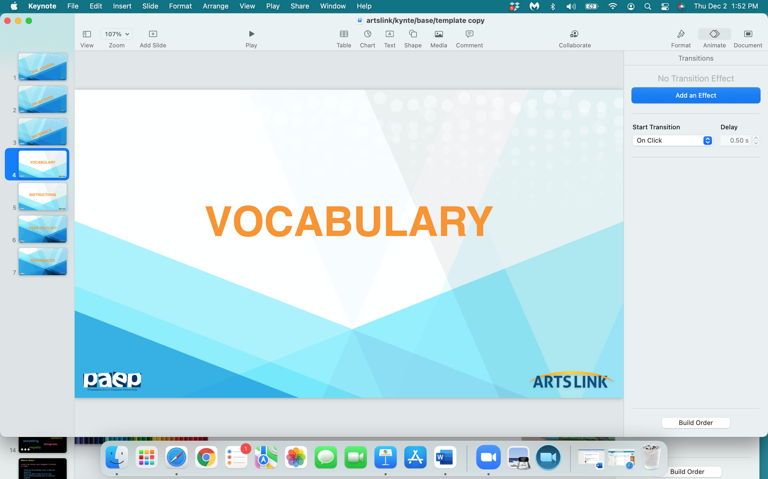

Slide 8
ATC
medium
reflection
creativity

Slide 9
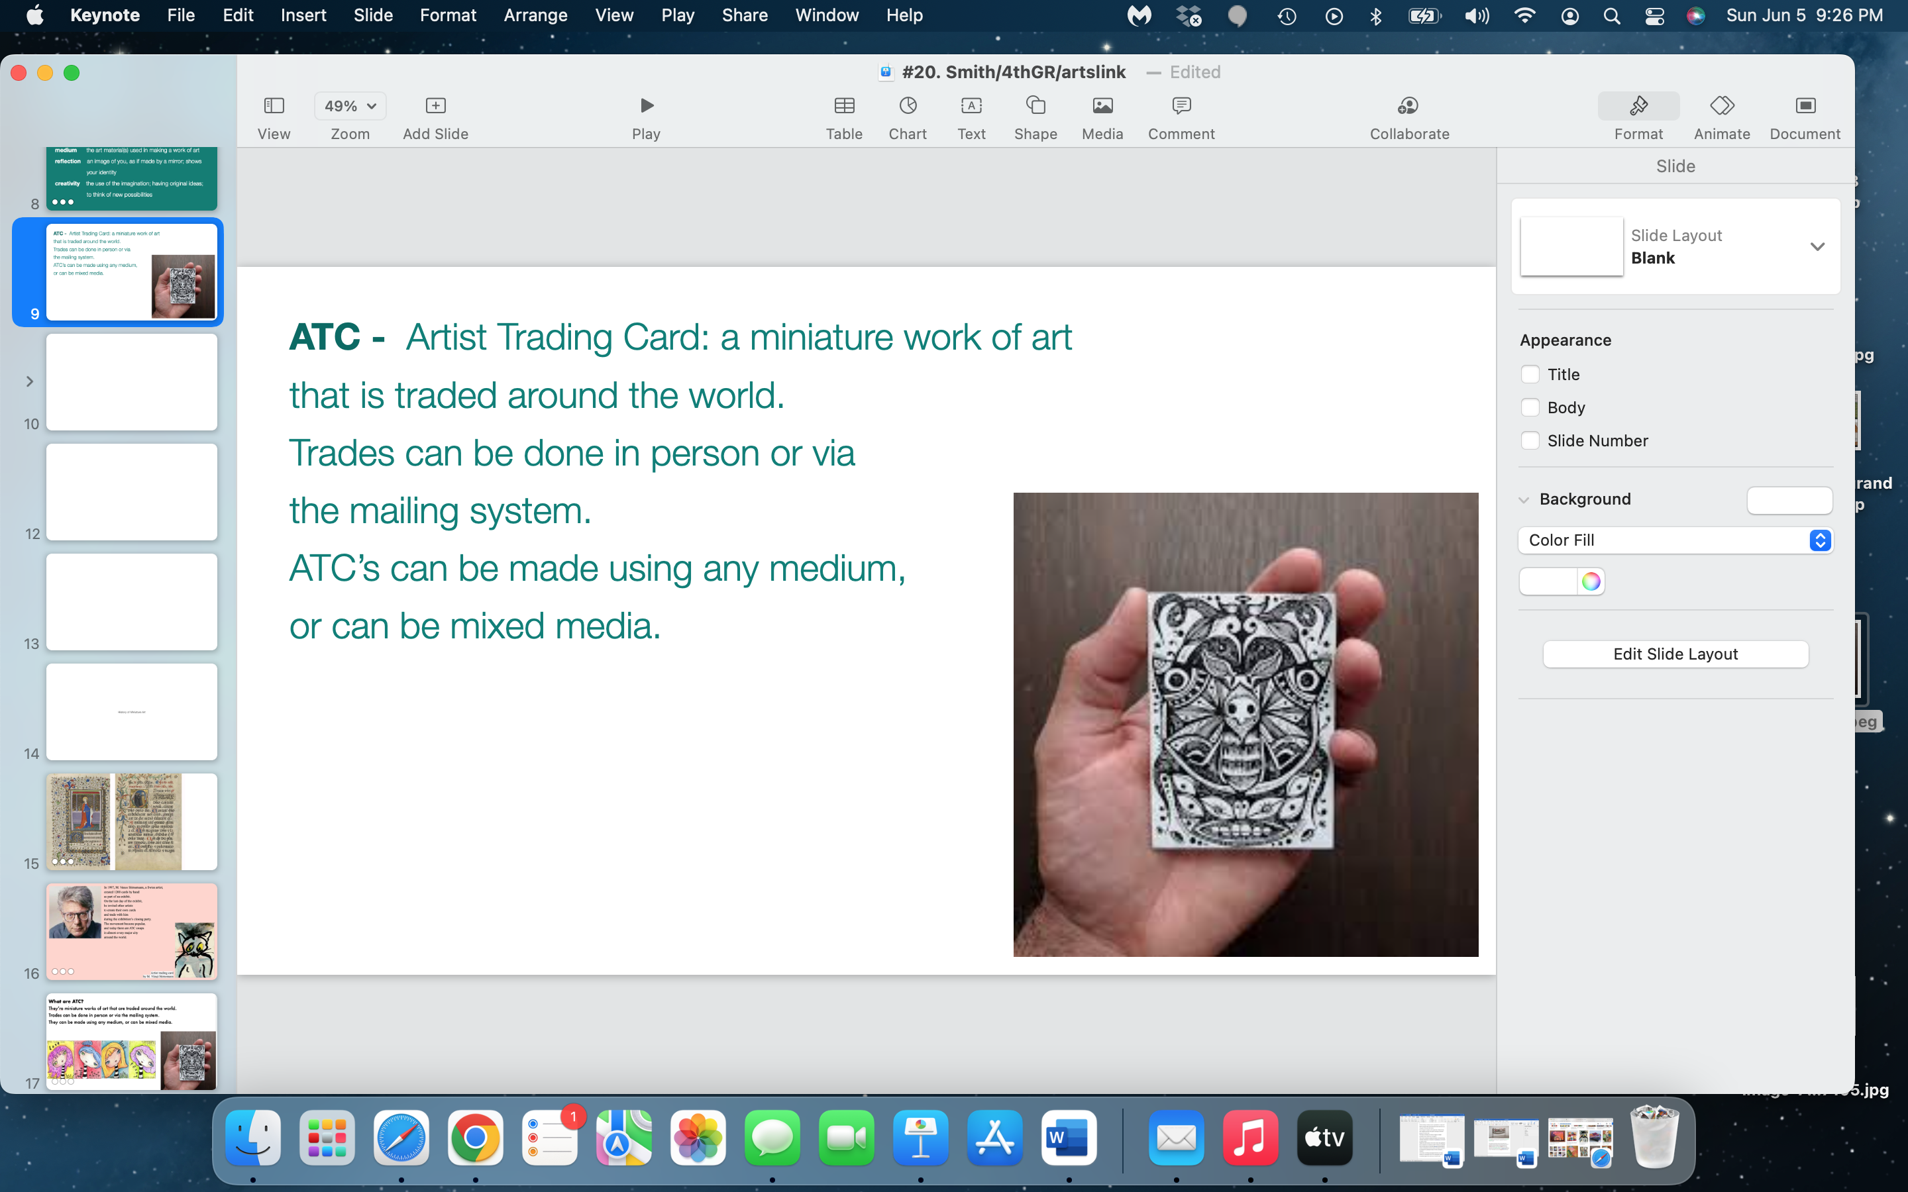

Slide 10
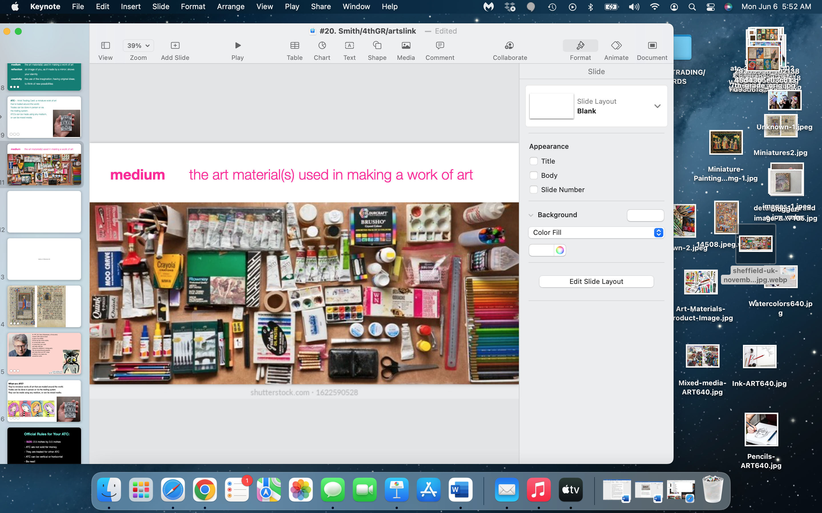

Slide 11
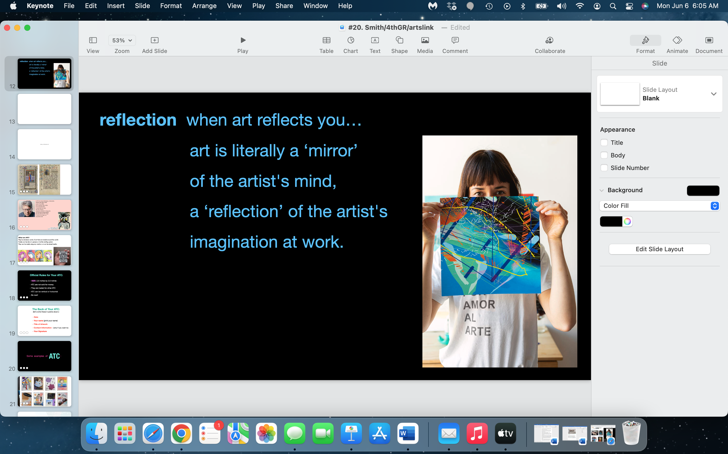

Slide 12
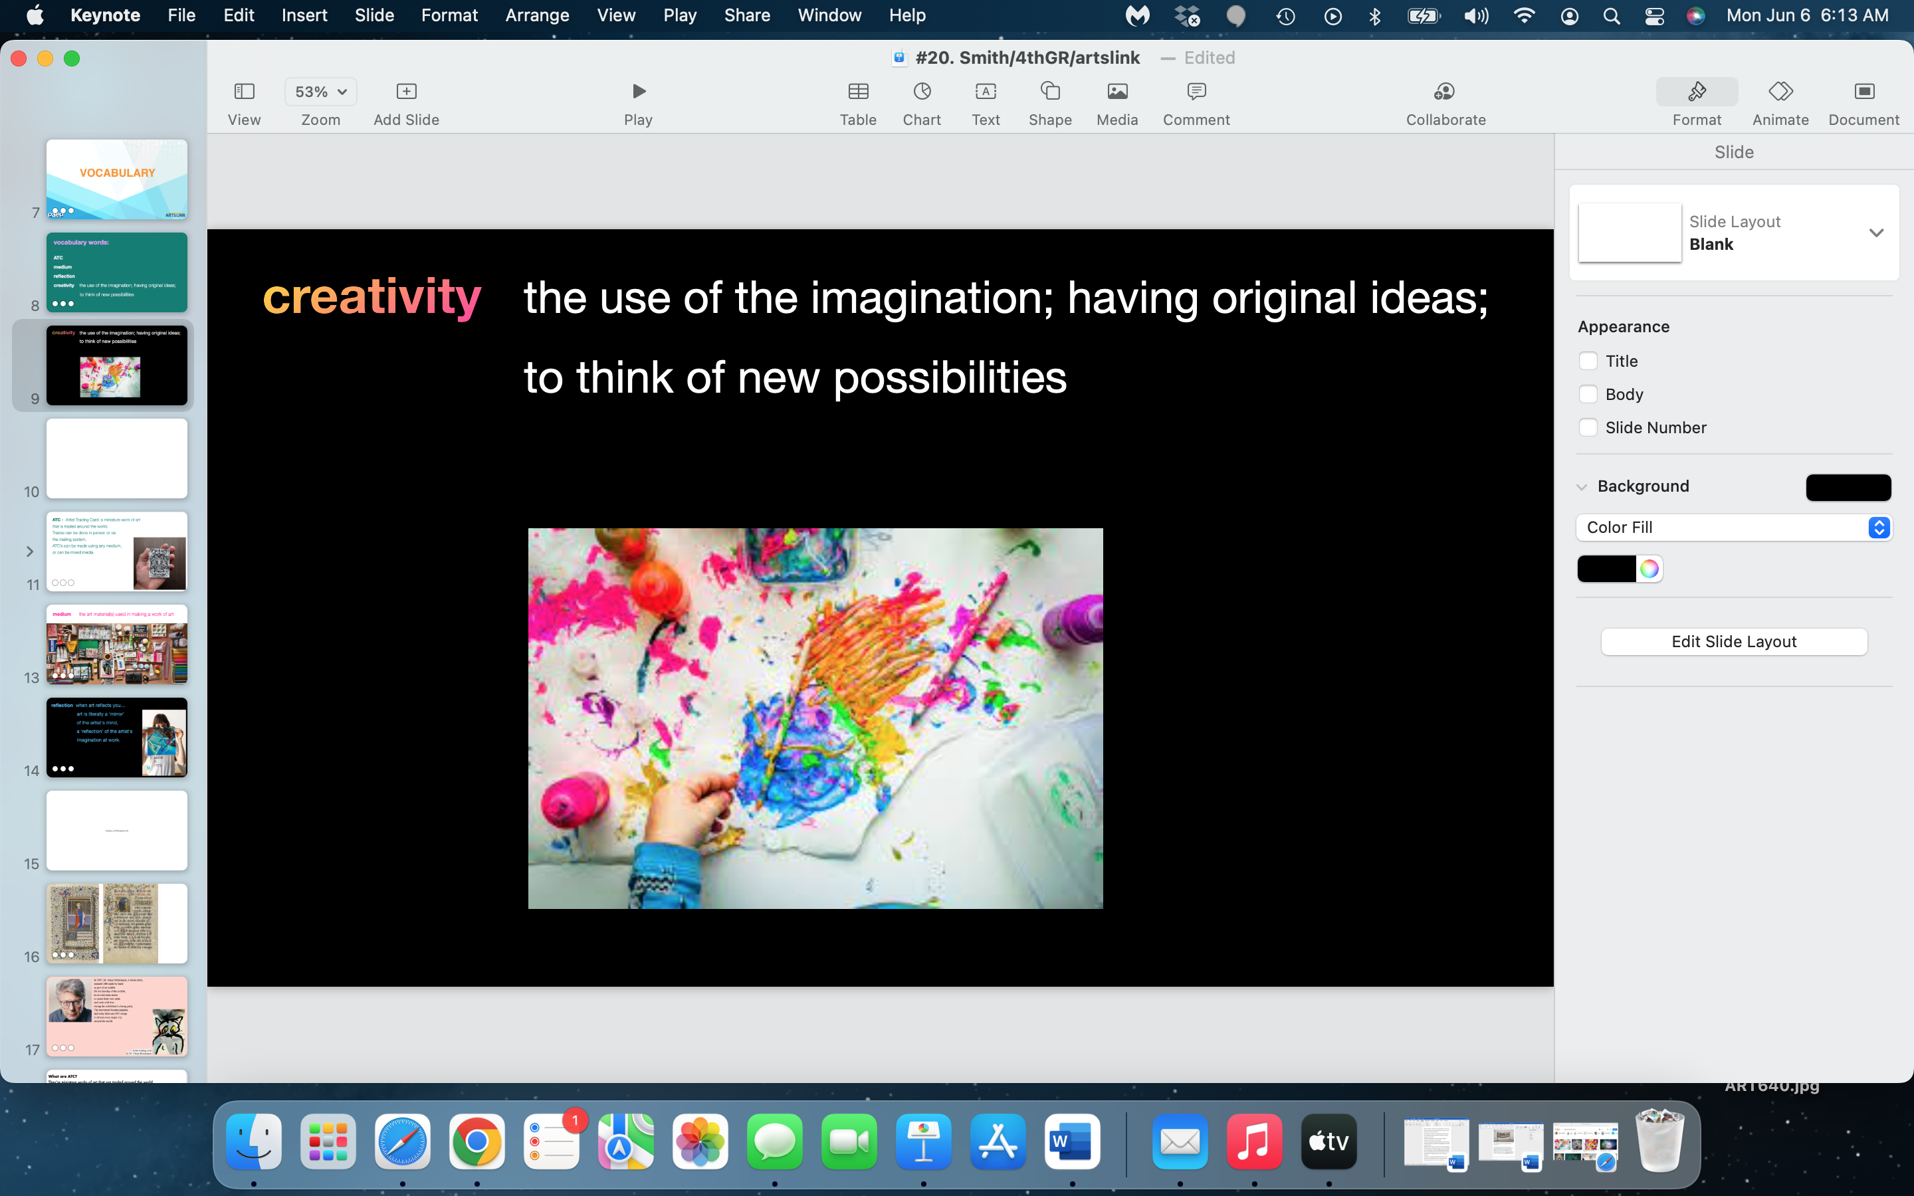

Slide 13
miniatures…in history

Slide 14
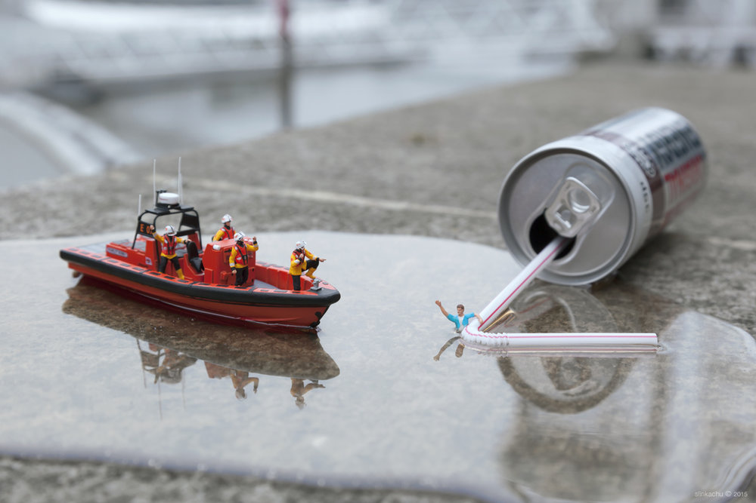
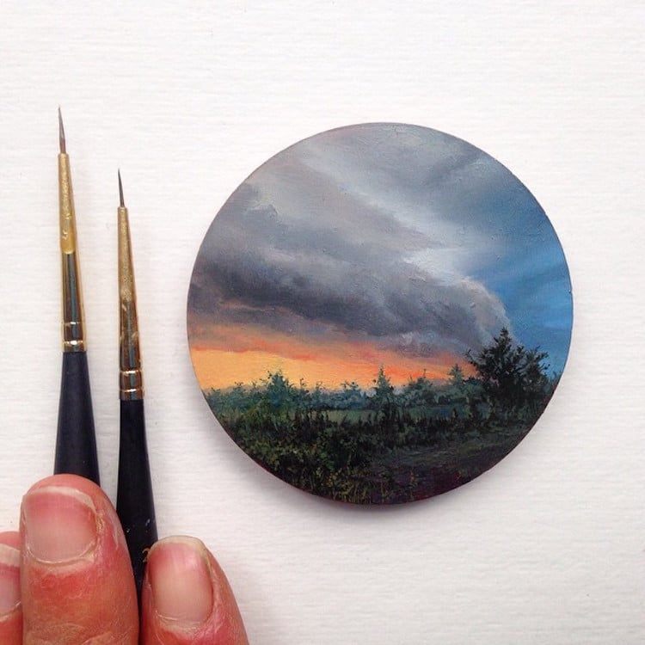
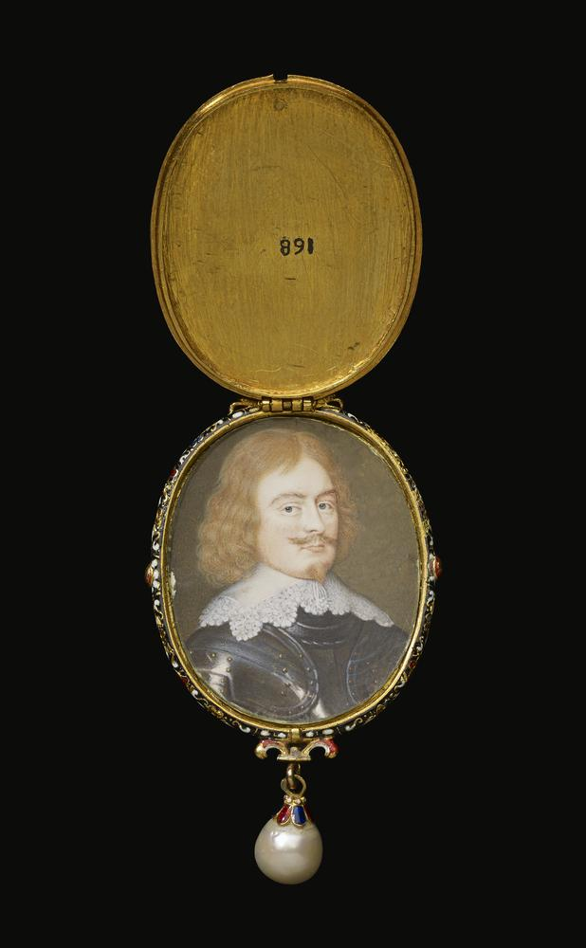
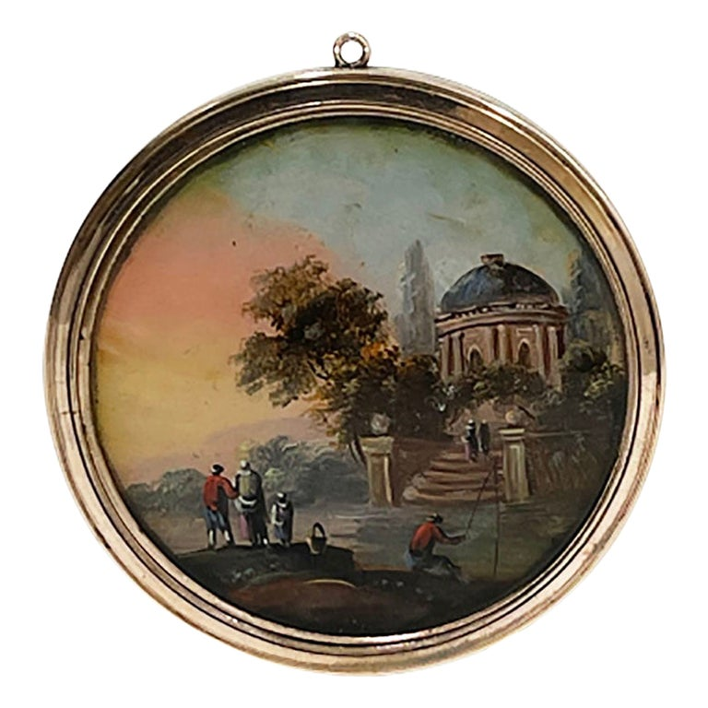
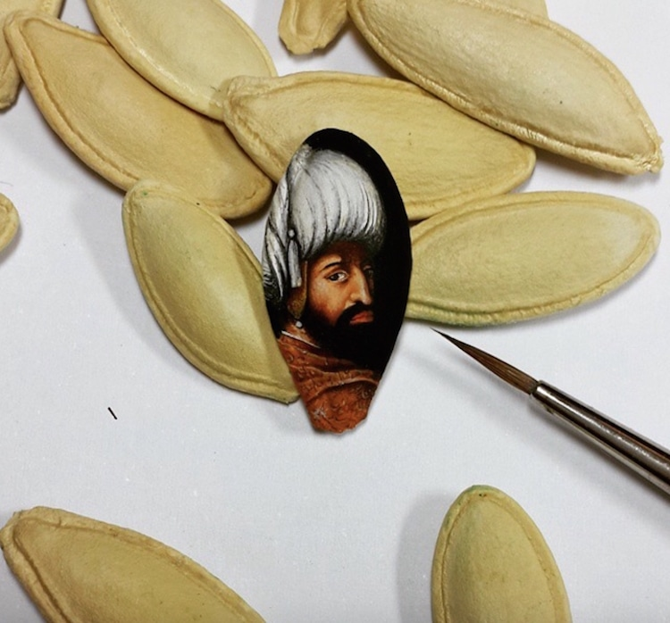
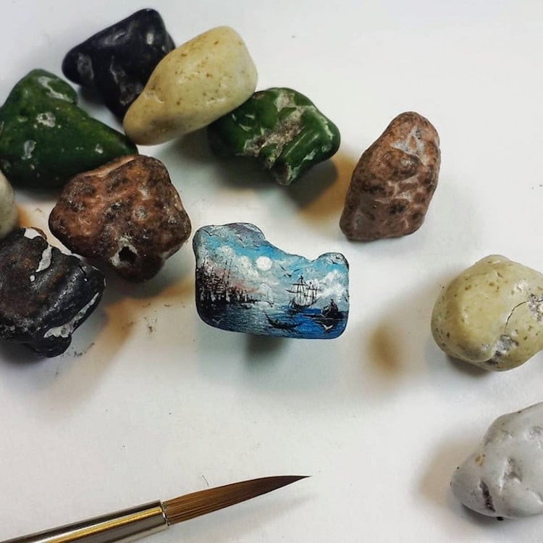
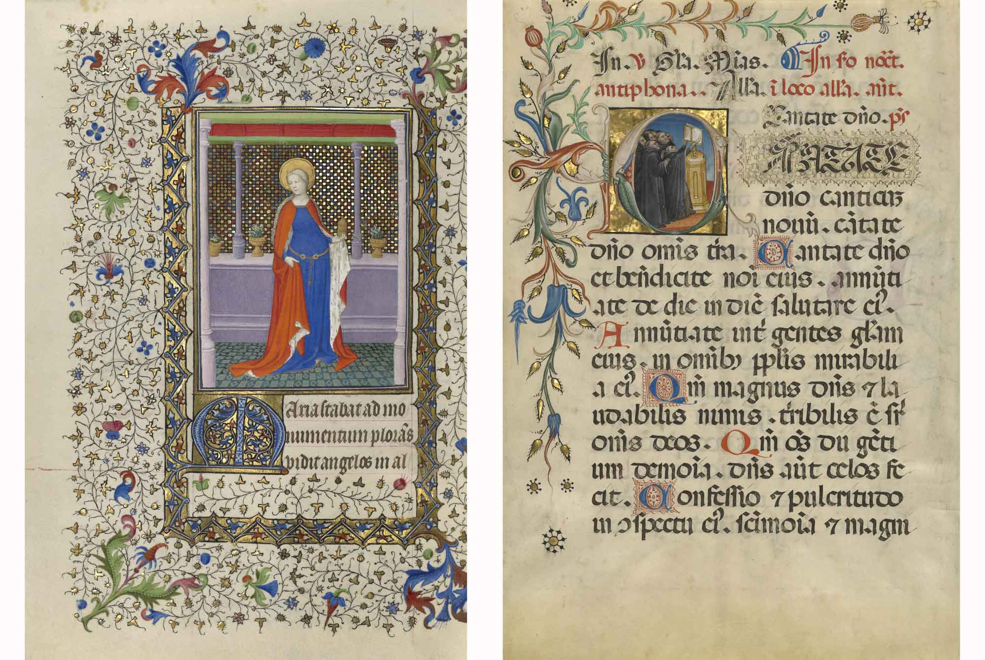
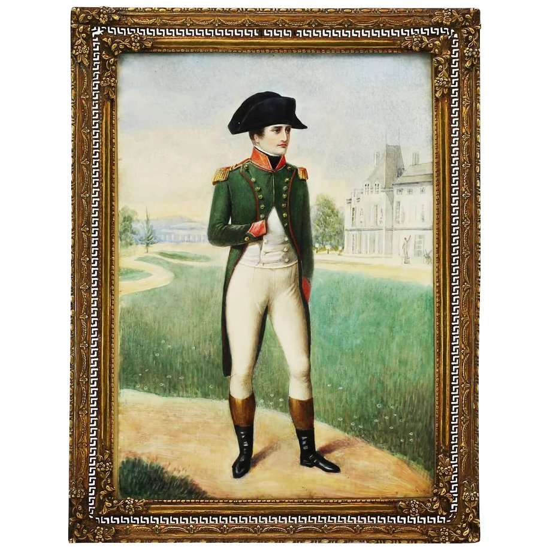
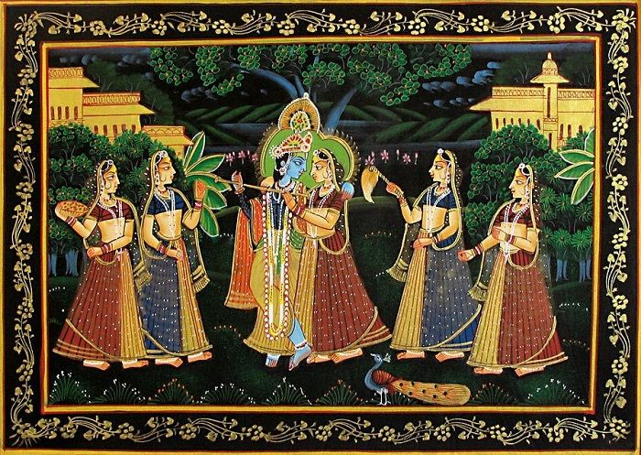

Slide 15
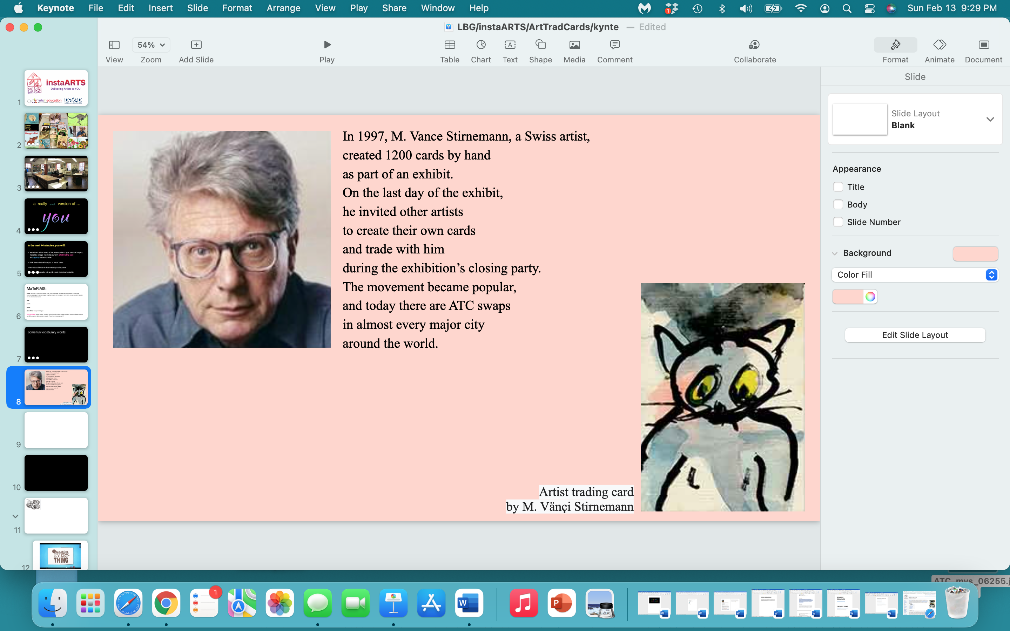

Slide 16
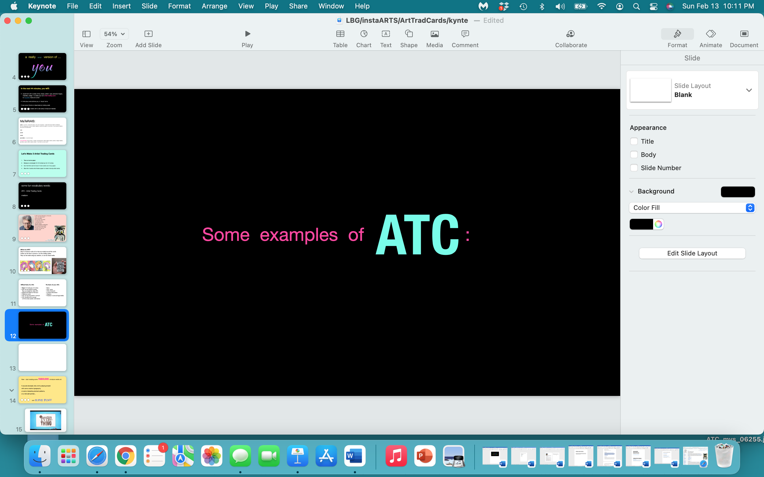

Slide 17
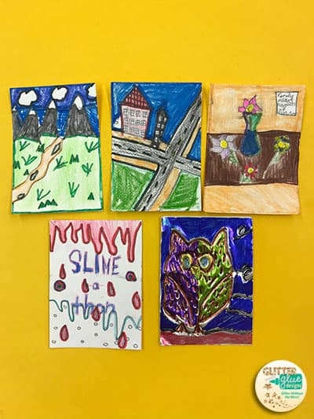
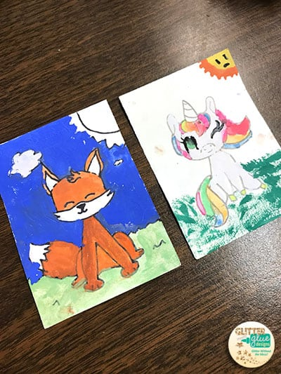
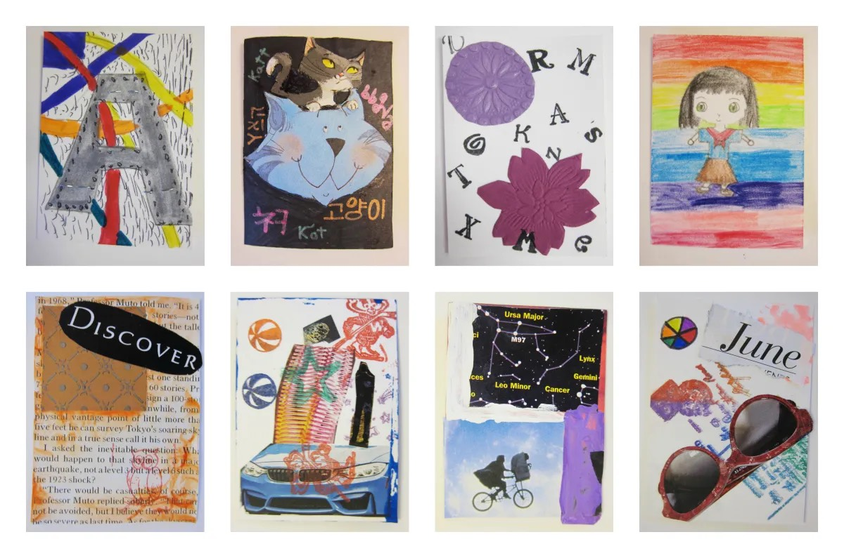
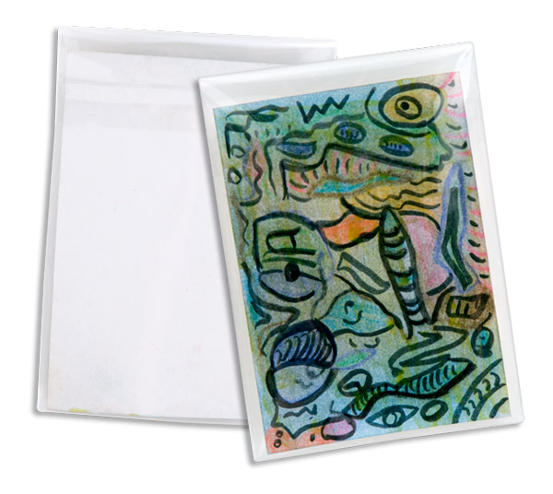
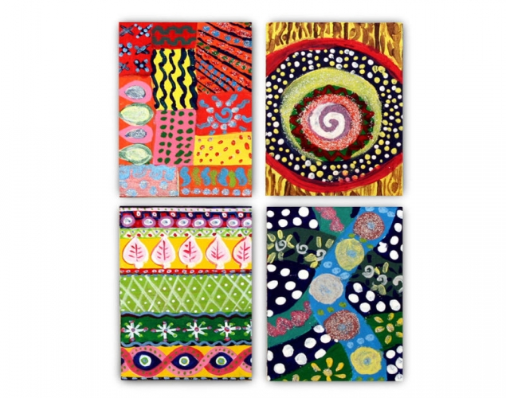
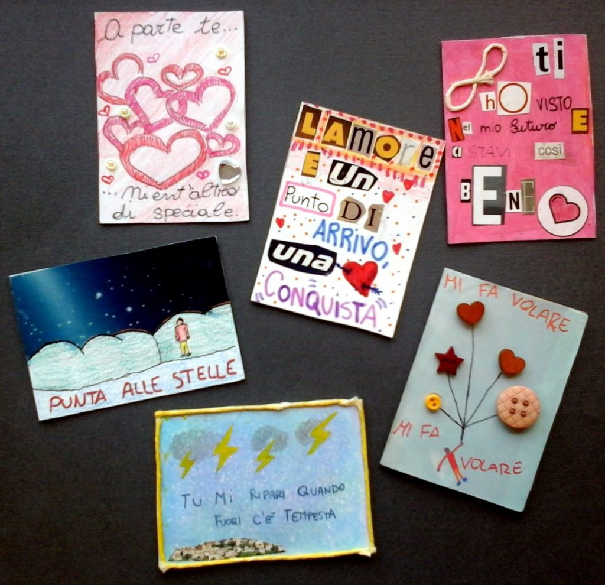
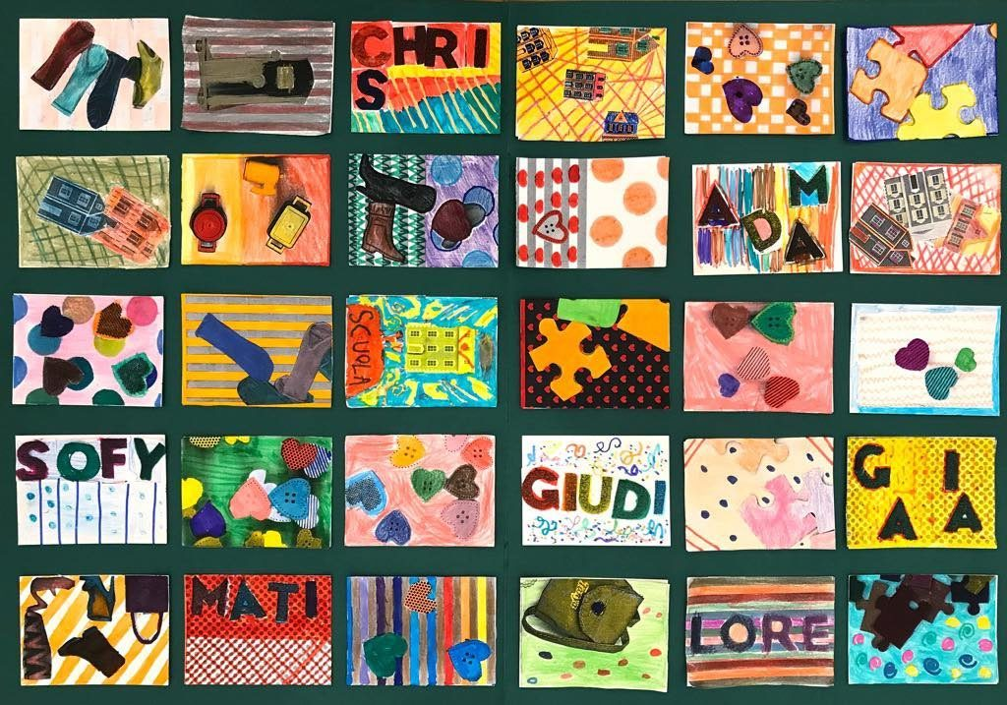
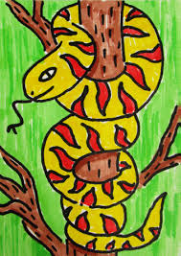
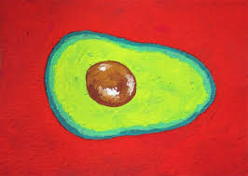
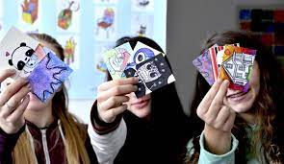

Slide 18


Slide 19
Start creating some FABULOUS miniature works art.
If you don’t know where to start, try playing around
with some creative typography,
or some interesting abstract patterns,
or a mini self-portrait…
and HAVE FUN!!!

Slide 20
BUT…
there are some rules:

Slide 21
Official Rules for Your ATC:
- SIZE: 2.5 inches by 3.5 inches
- ATC are not sold for money
- They are traded for other ATC
- ATC can be vertical or horizontal
- Be creative…and neat!

Slide 22
The Back of Your ATC: (let’s write these 5 points down in your notebook:)
- Date
- Your name (print your name)
- Title of Artwork
- Contact Info - (only if you want to)
- Your Signature

Slide 23
REMEMBER…
you can use any art material,
any medium,
anything you want -
to create your Artist Trading Card.

Slide 24
Your Artist Trading Card
is a reflection
of YOU…
only smaller!!!

Slide 25


Slide 26
what one thing
did
you
learn
today…pass or play?

Slide 27


Slide 28
https://www.strathmoreartist.com/cards-atc.html
https://artbyro.com/how-to-make-artist-trading-cards-atcs/
https://en.wikipedia.org/wiki/Artist_trading_cards
https://www.fabercastell.com/blogs/creativity-for-life/art-lesson-for-kids-artist-trading-cards
https://www.wikihow.com/Make-Artist-Trading-Cards
https://art.sugarlift.com/blogs/discover/81733894-a-brief-history-of-miniatures

