Slide 1


Slide 2
Author Improv:
Collaboration / Improvisation / Dramatization

Slide 3


Slide 4
In the next hour,
you will:
- improvise a dialogue with your partner
- dramatize what your main character ‘wants’
- perform or dramatize your improvised dialogue

Slide 5
This writing workshop
doesn’t teach kids
to write a story…
it teaches kids
to be the story.

Slide 6


Slide 7
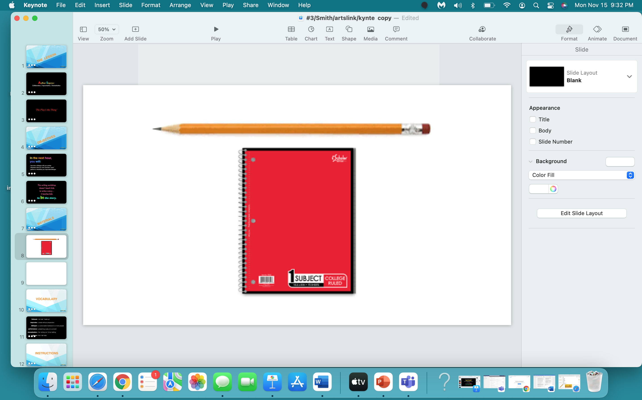

Slide 8


Slide 9
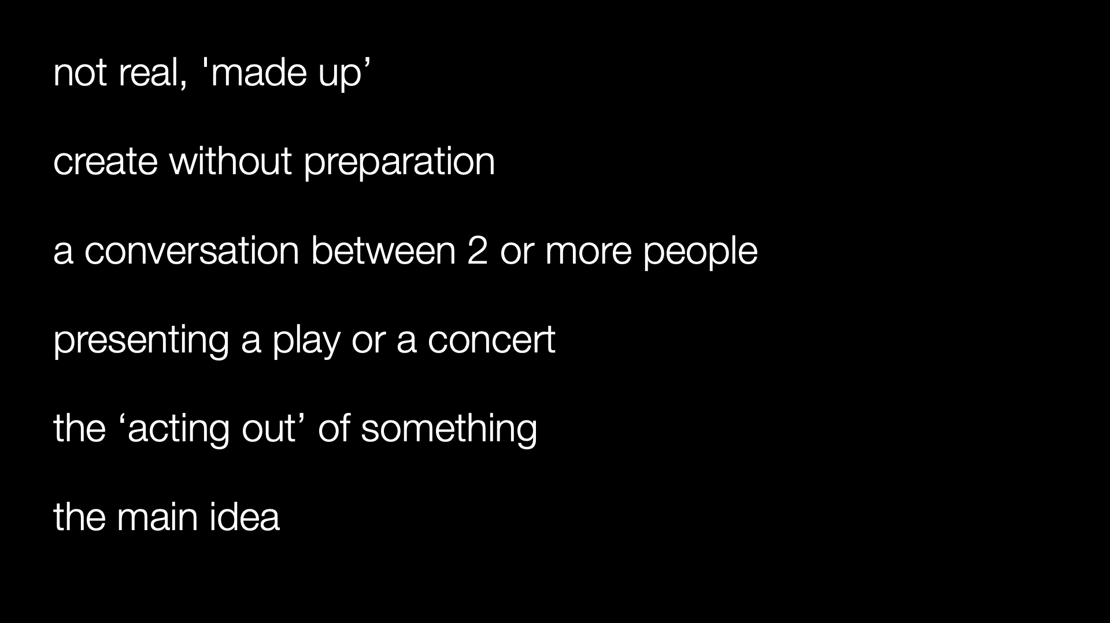
fictional :
improvise :
dialogue :
performance :
dramatization :
theme :

Slide 10


Slide 11
Every story of fiction has a main character.

Slide 12
Every story of fiction is about
the main character.

Slide 13
Every story of fiction is about
what the main character
wants.

Slide 14
The ‘Step by Step’:
1. Students divide into teams of 2.
2. Each team is given a ‘prompt’.
3. Each team presents their improvisation, their dramatization -
to the class.
4. Class is asked - was the goal achieved?

Slide 15
THE PROMPTS:
A child brings a dog into her house who “followed her home”.
The child tries to convince her parent to let her keep the dog.
One friend tries to convince another friend that she has seen a UFO.
The friend doesn’t believe her.
A child tries to convince a parent to stay home from work and let her stay home from school.
A teacher tells a student that she is going to fail science class.
The student tries to convince the teacher that she will improve, and asks her not to put
an ‘F’ on the report card which comes out next week

Slide 16
One friend tries to convince another that he has seen something unbelievable
(a UFO, a zombie invasion, an elephant walking down the street).
Two siblings, one popular and one shy, try to convince one another to go/not go to a party
Two people are at an amusement park.
One wants to ride the newest roller coaster in the park,
and the other one is terrified to do so. He/she tries to convince the other
not to ride without letting on that he/she is scared.
Babysitter tries to get a child to go to bed.
The child will not fall asleep, because he/she is afraid of a monster in the closet.
A parent and son/daughter are shopping for school clothes.
The parent does not think her child’s attire choices are appropriate for his/her age.

Slide 17
TEACHERS: At the end of each improv, you could ask the class:
    Who got what they wanted?
    Were they successful?
    This is your main character.
You want your students to:
    - have fun
- build confidence
- stretch their imagination
- and grow as a class

Slide 18


Slide 19
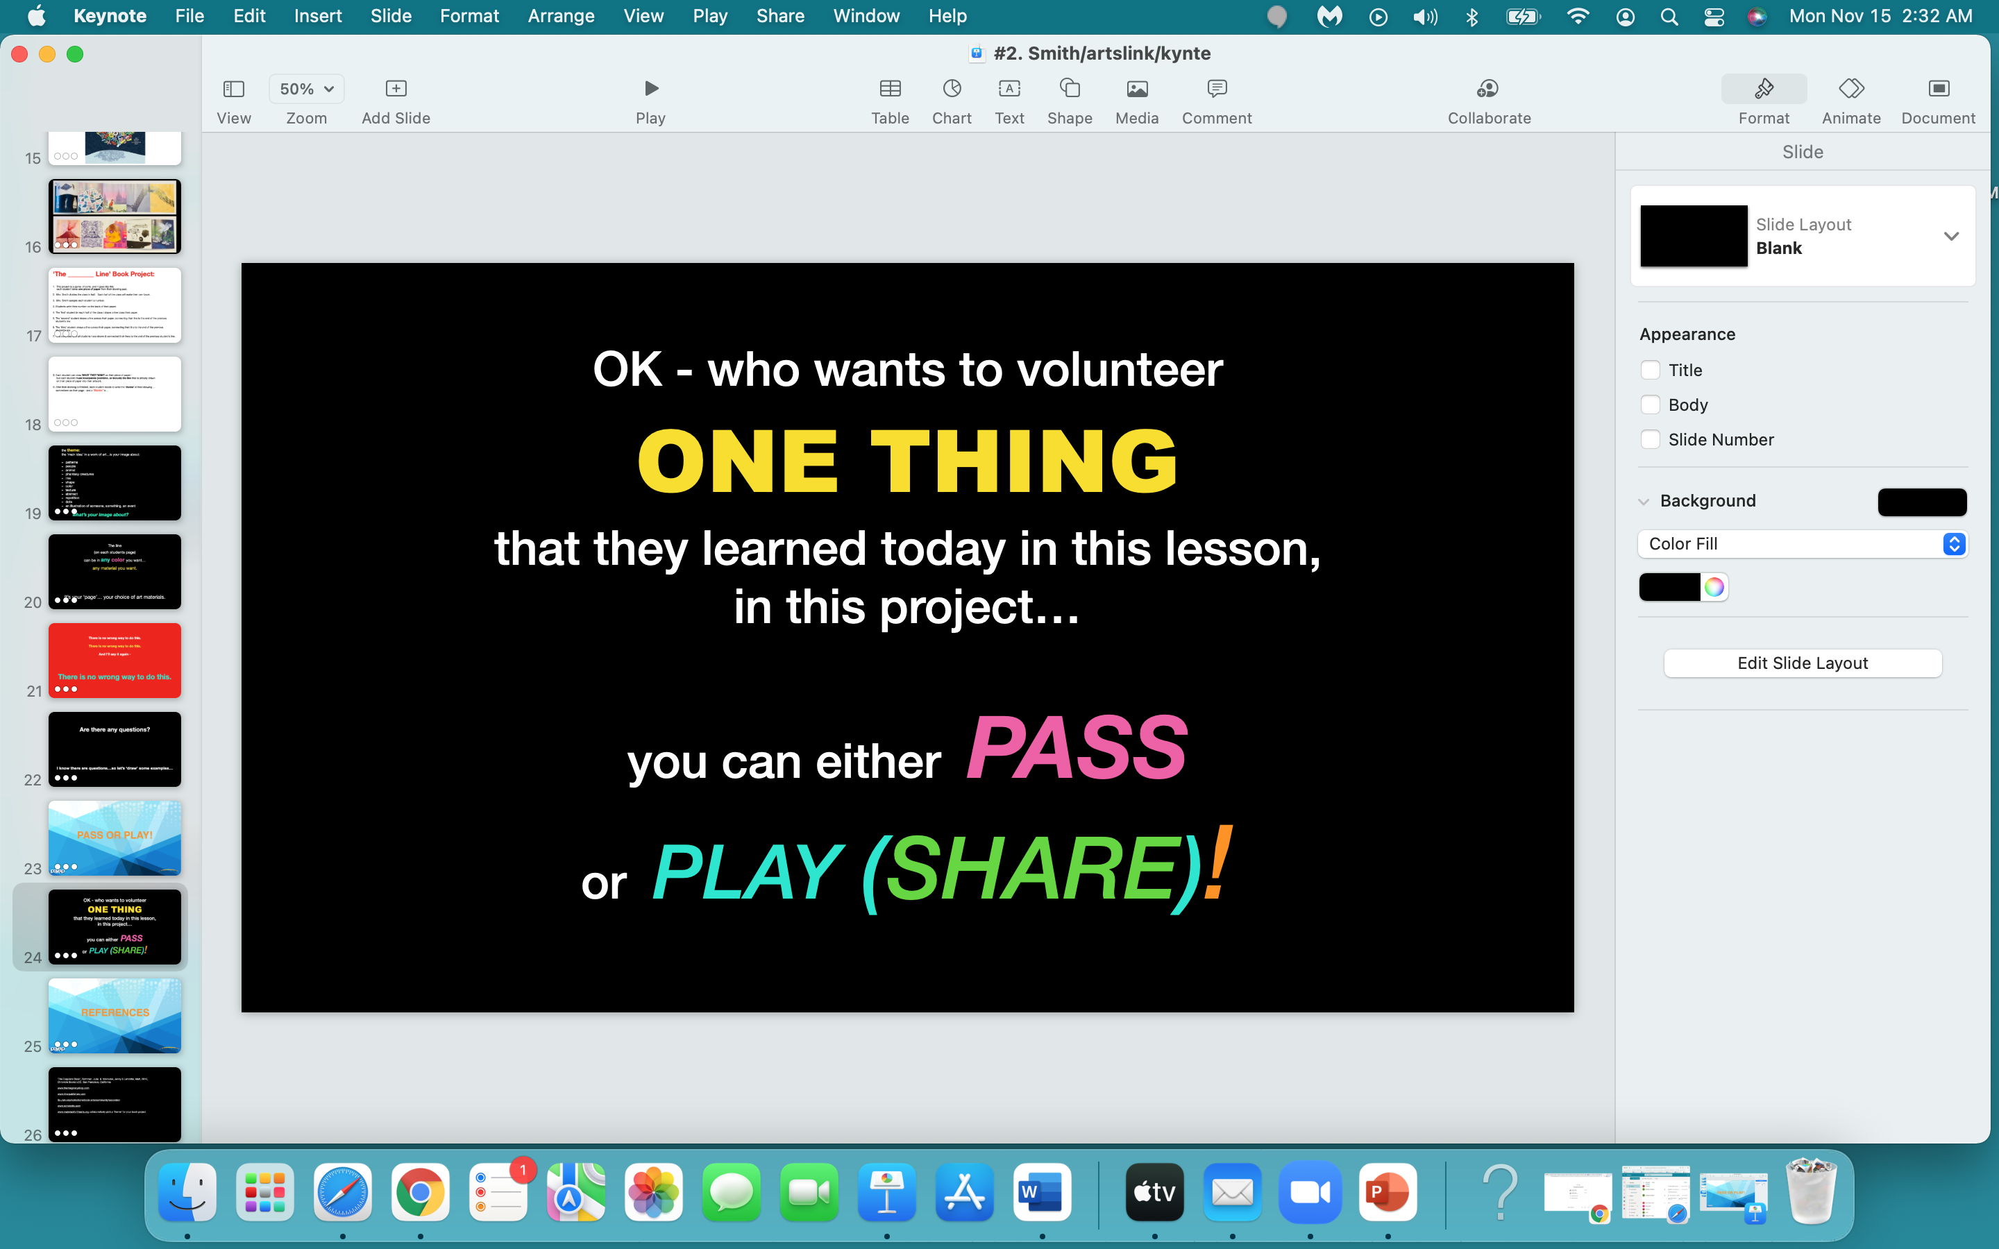

Slide 20


Slide 21
Wood, C. (2015). Yardsticks, children in the classroom, ages 4 - 14 (3rd ed.) . Turner falls, MA: Center for Responsive Schools, Inc. (pp. 107 - 129).
George, Lindsay Barrett, ‘Author Improv’, KSLA Annual Conference, 2017.
https://www.creativedrama.com

