Slide 1
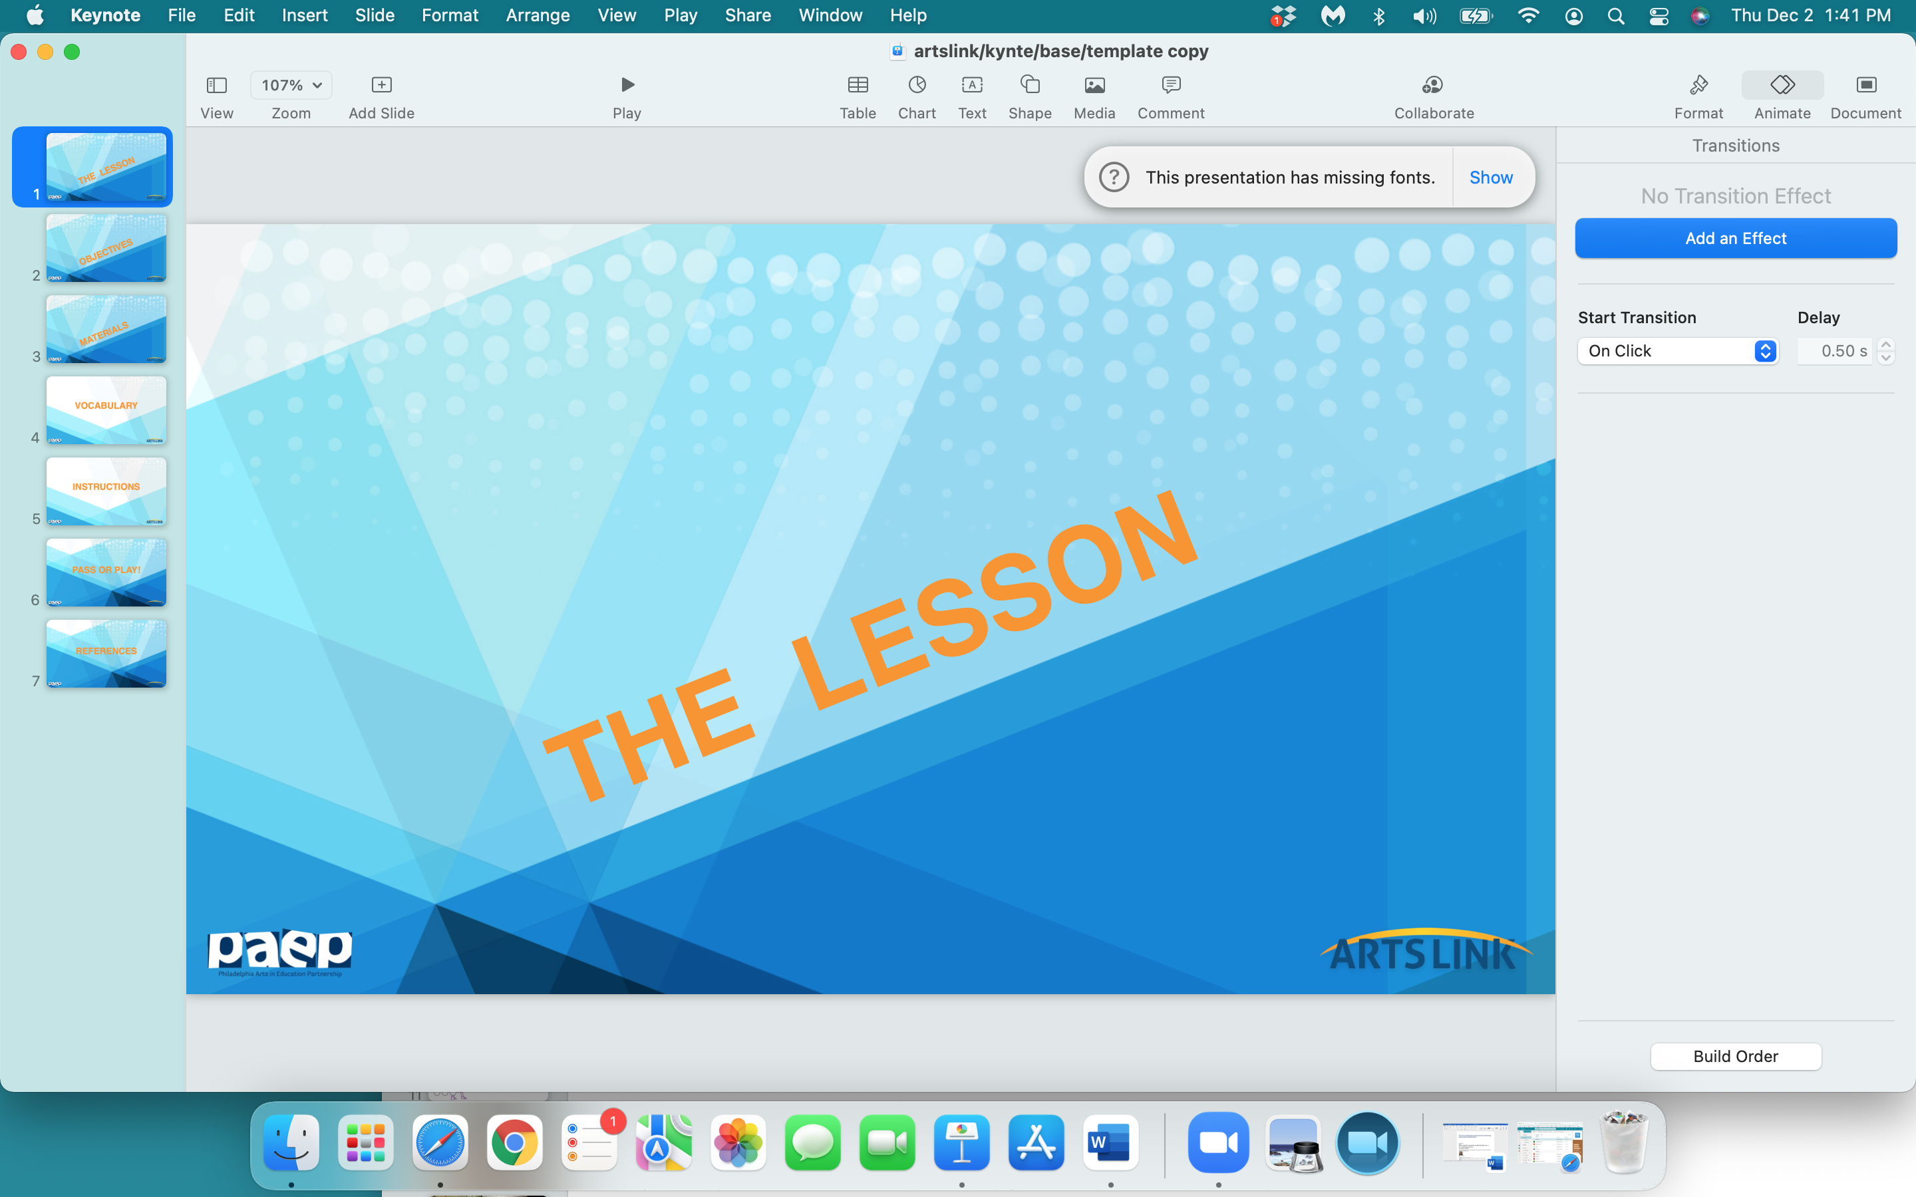

Slide 2
The Origins
of
‘A Merry Christmas
and a
Happy New Year’

Slide 3


Slide 4
In the next 60 minutes, you will:
be totally creative - experiment with colors, shapes, decorations
collaborate as a ‘class community’
create something that has been a tradition for over 178 years (a card)
promote kindness by writing and designing a Christmas card for someone special
display either the completed Christmas card, or paper tree, or paper ballerina in your classroom for other students to view and enjoy

Slide 5
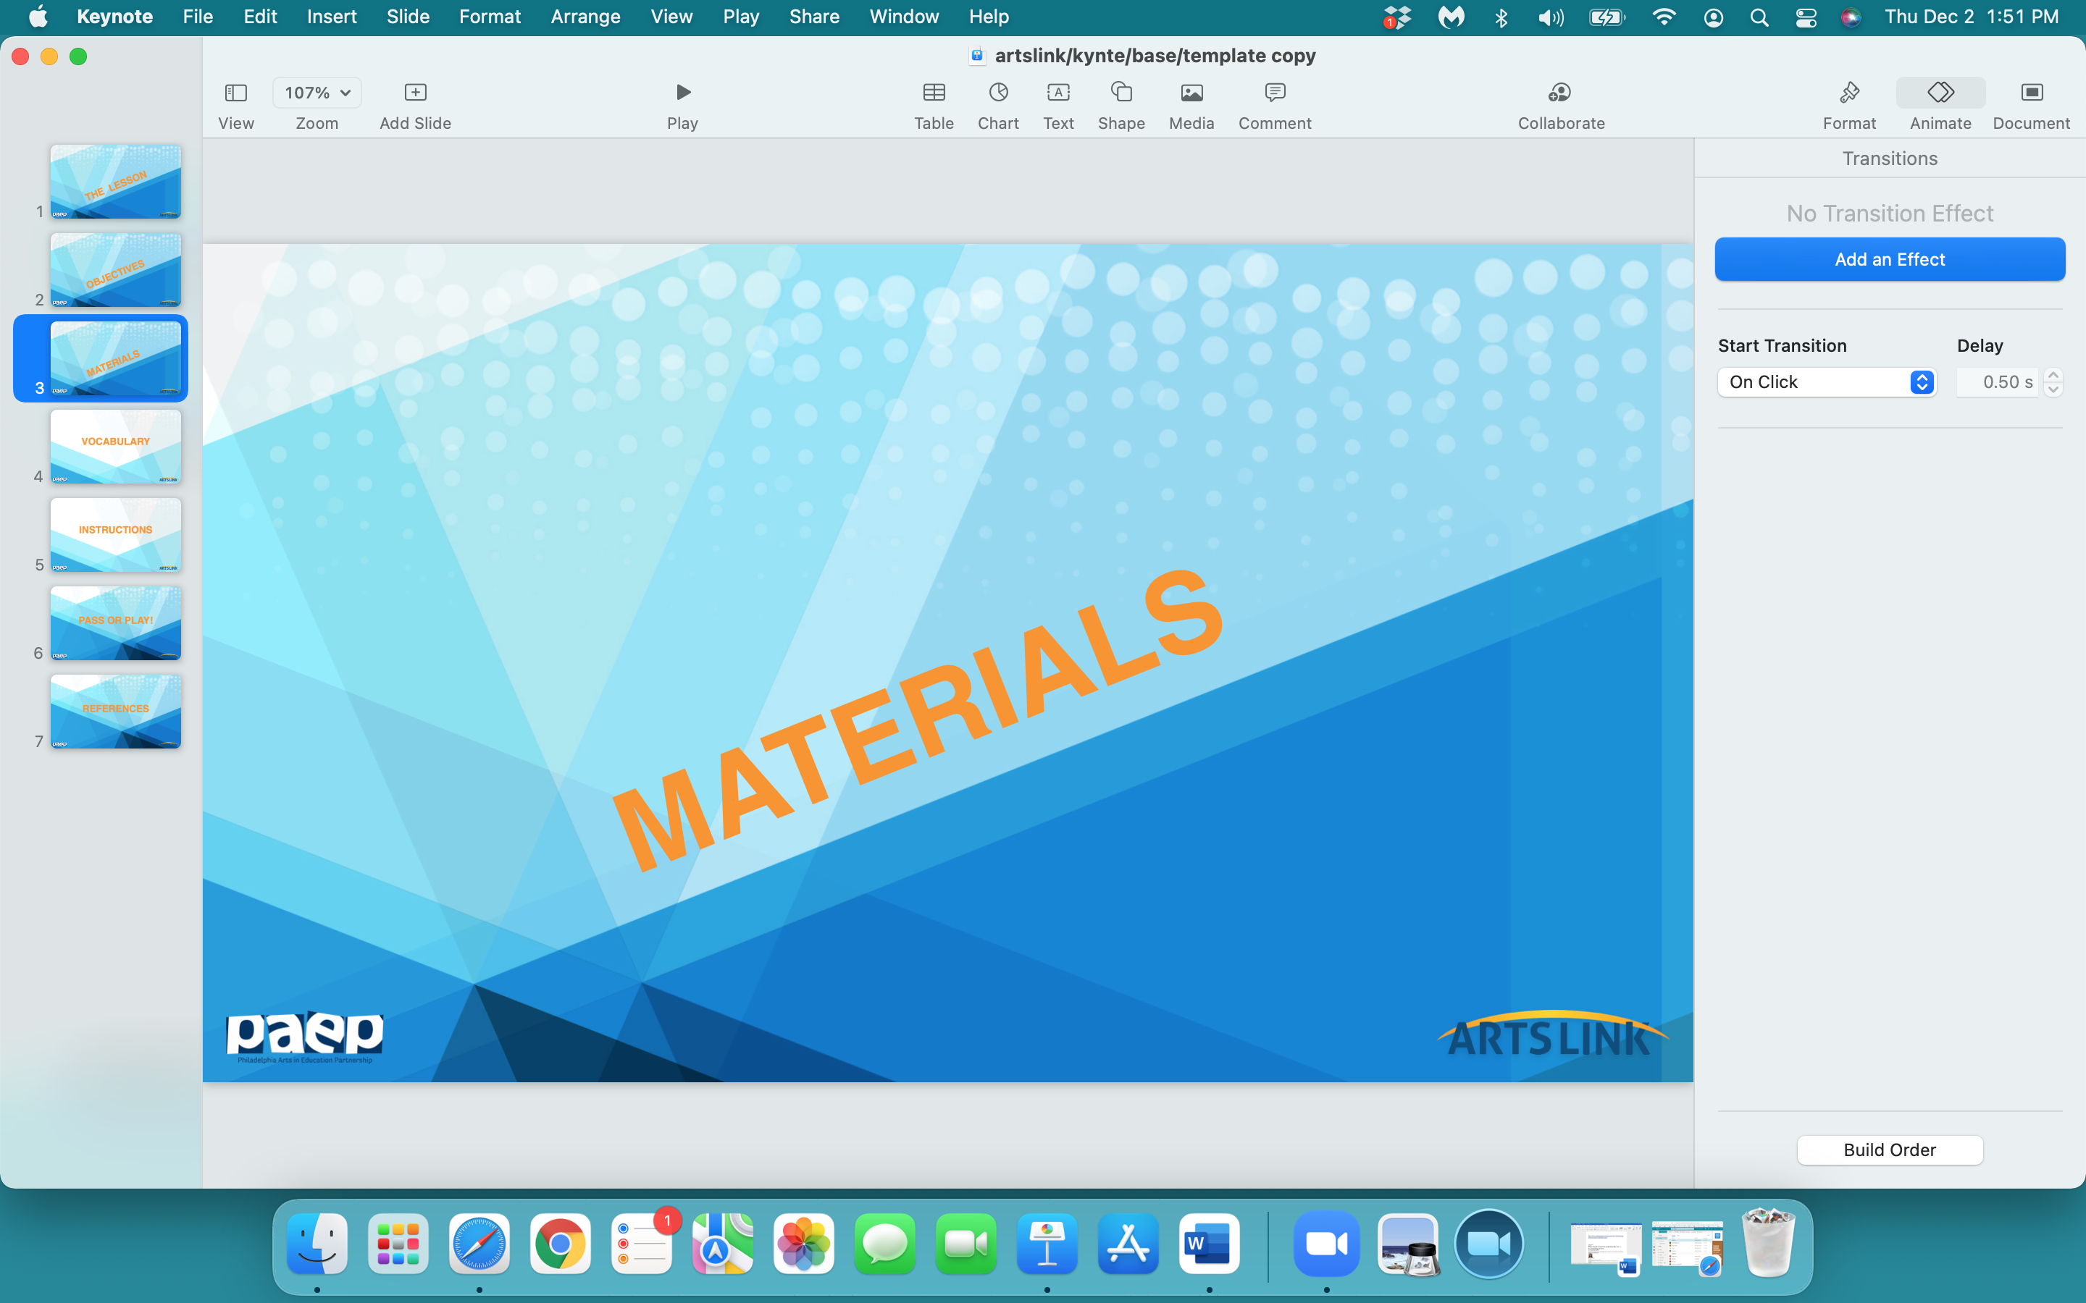

Slide 6
several sheets of paper from your drawing pad or sketch pad
construction papers
pencil
scissors
markers
colored pencils
glue sticks

Slide 7
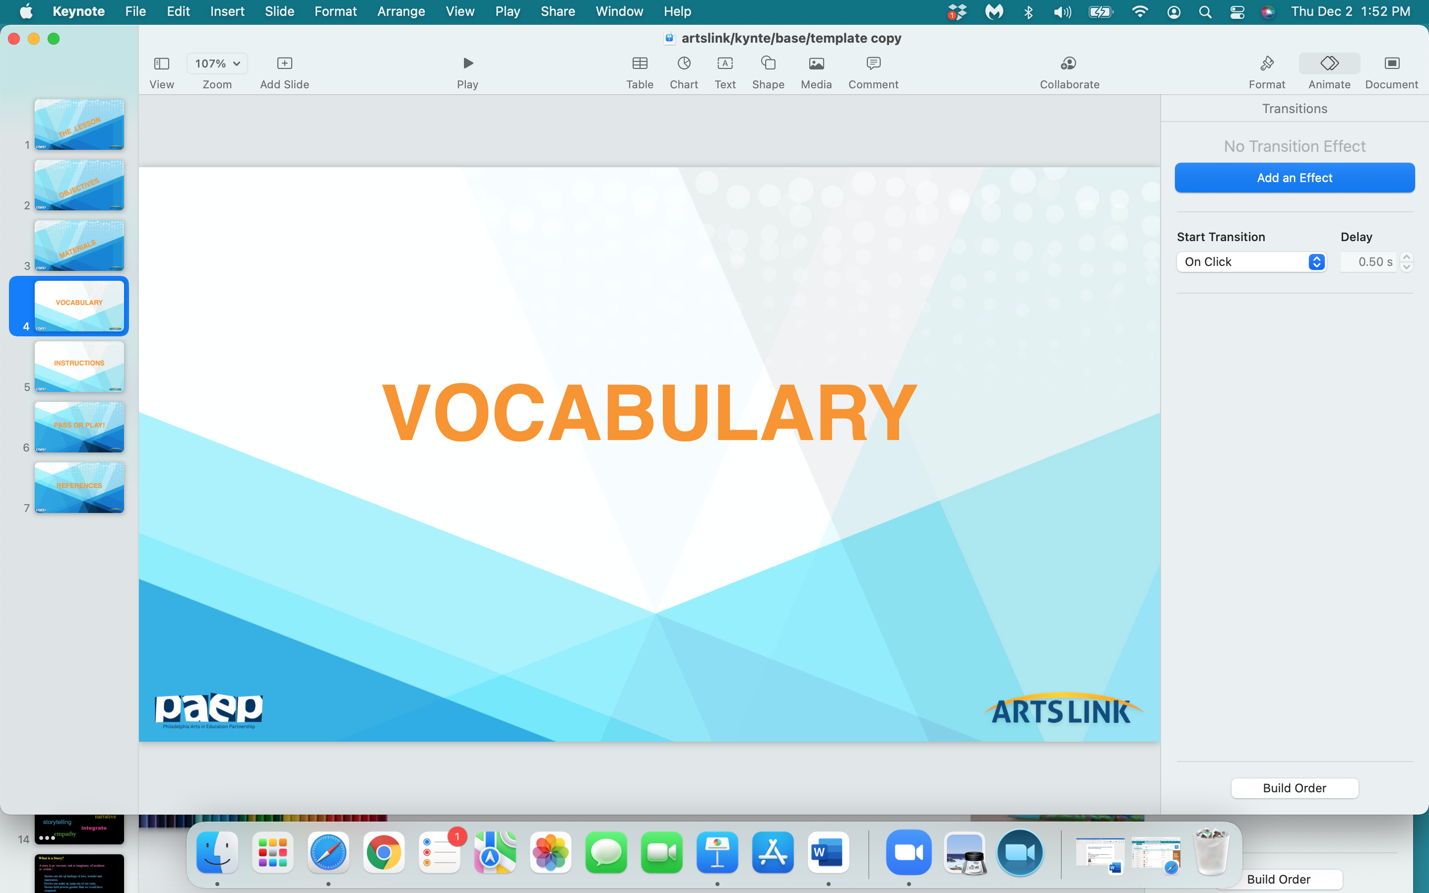

Slide 8
origin
tradition
creativity
inscription

Slide 9
origin - the point or place where something begins

Slide 10
origin
tradition - the handing down of customs and beliefs from generation to generation
creativity

Slide 11
origin
tradition
creativity - the use of imagination
or original ideas
inscription

Slide 12
origin
tradition
creativity
inscription - something written in the front of a book or on a photograph

Slide 13
The History of the Christmas Card
In 1843, Henry Cole didn’t have time for the English tradition of of writing notes to friends and family over the holidays.
So he asked his friend, the artist John Calcott Horsley, to design a card. Cole had about a thousand of the cards printed and hand-colored.
It caused a sensation in Victorian society because it showed a child drinking wine.

Slide 14
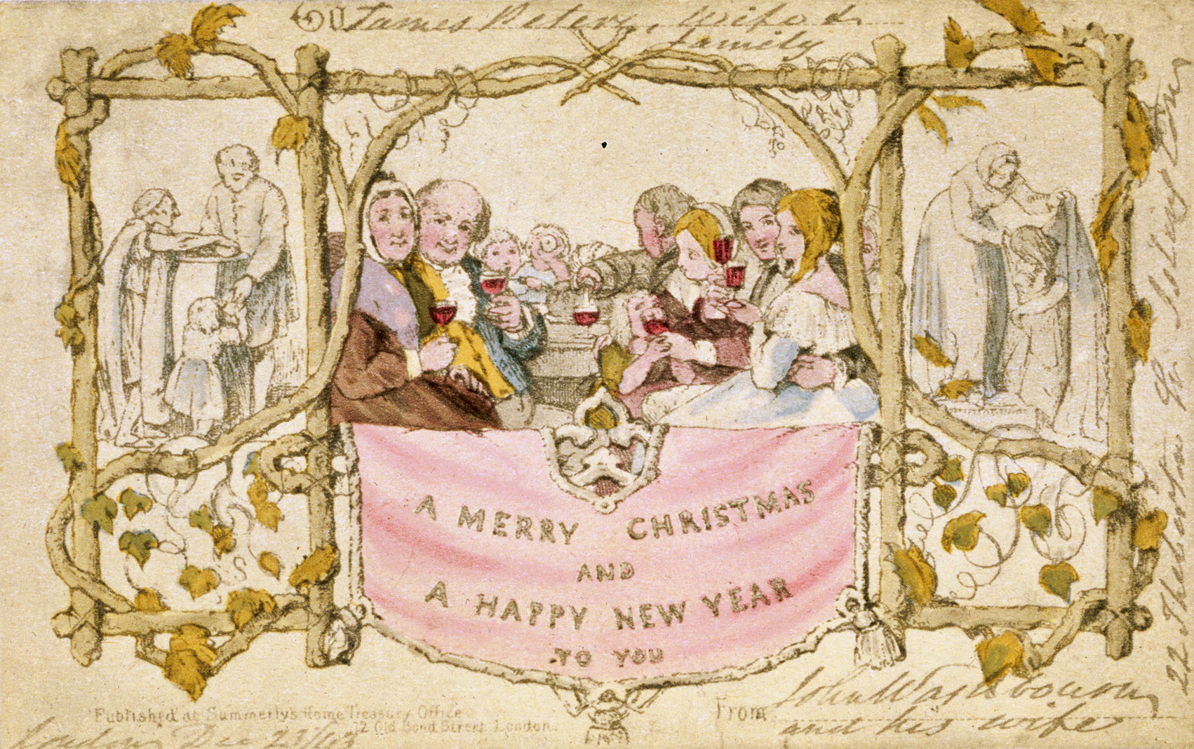

Slide 15
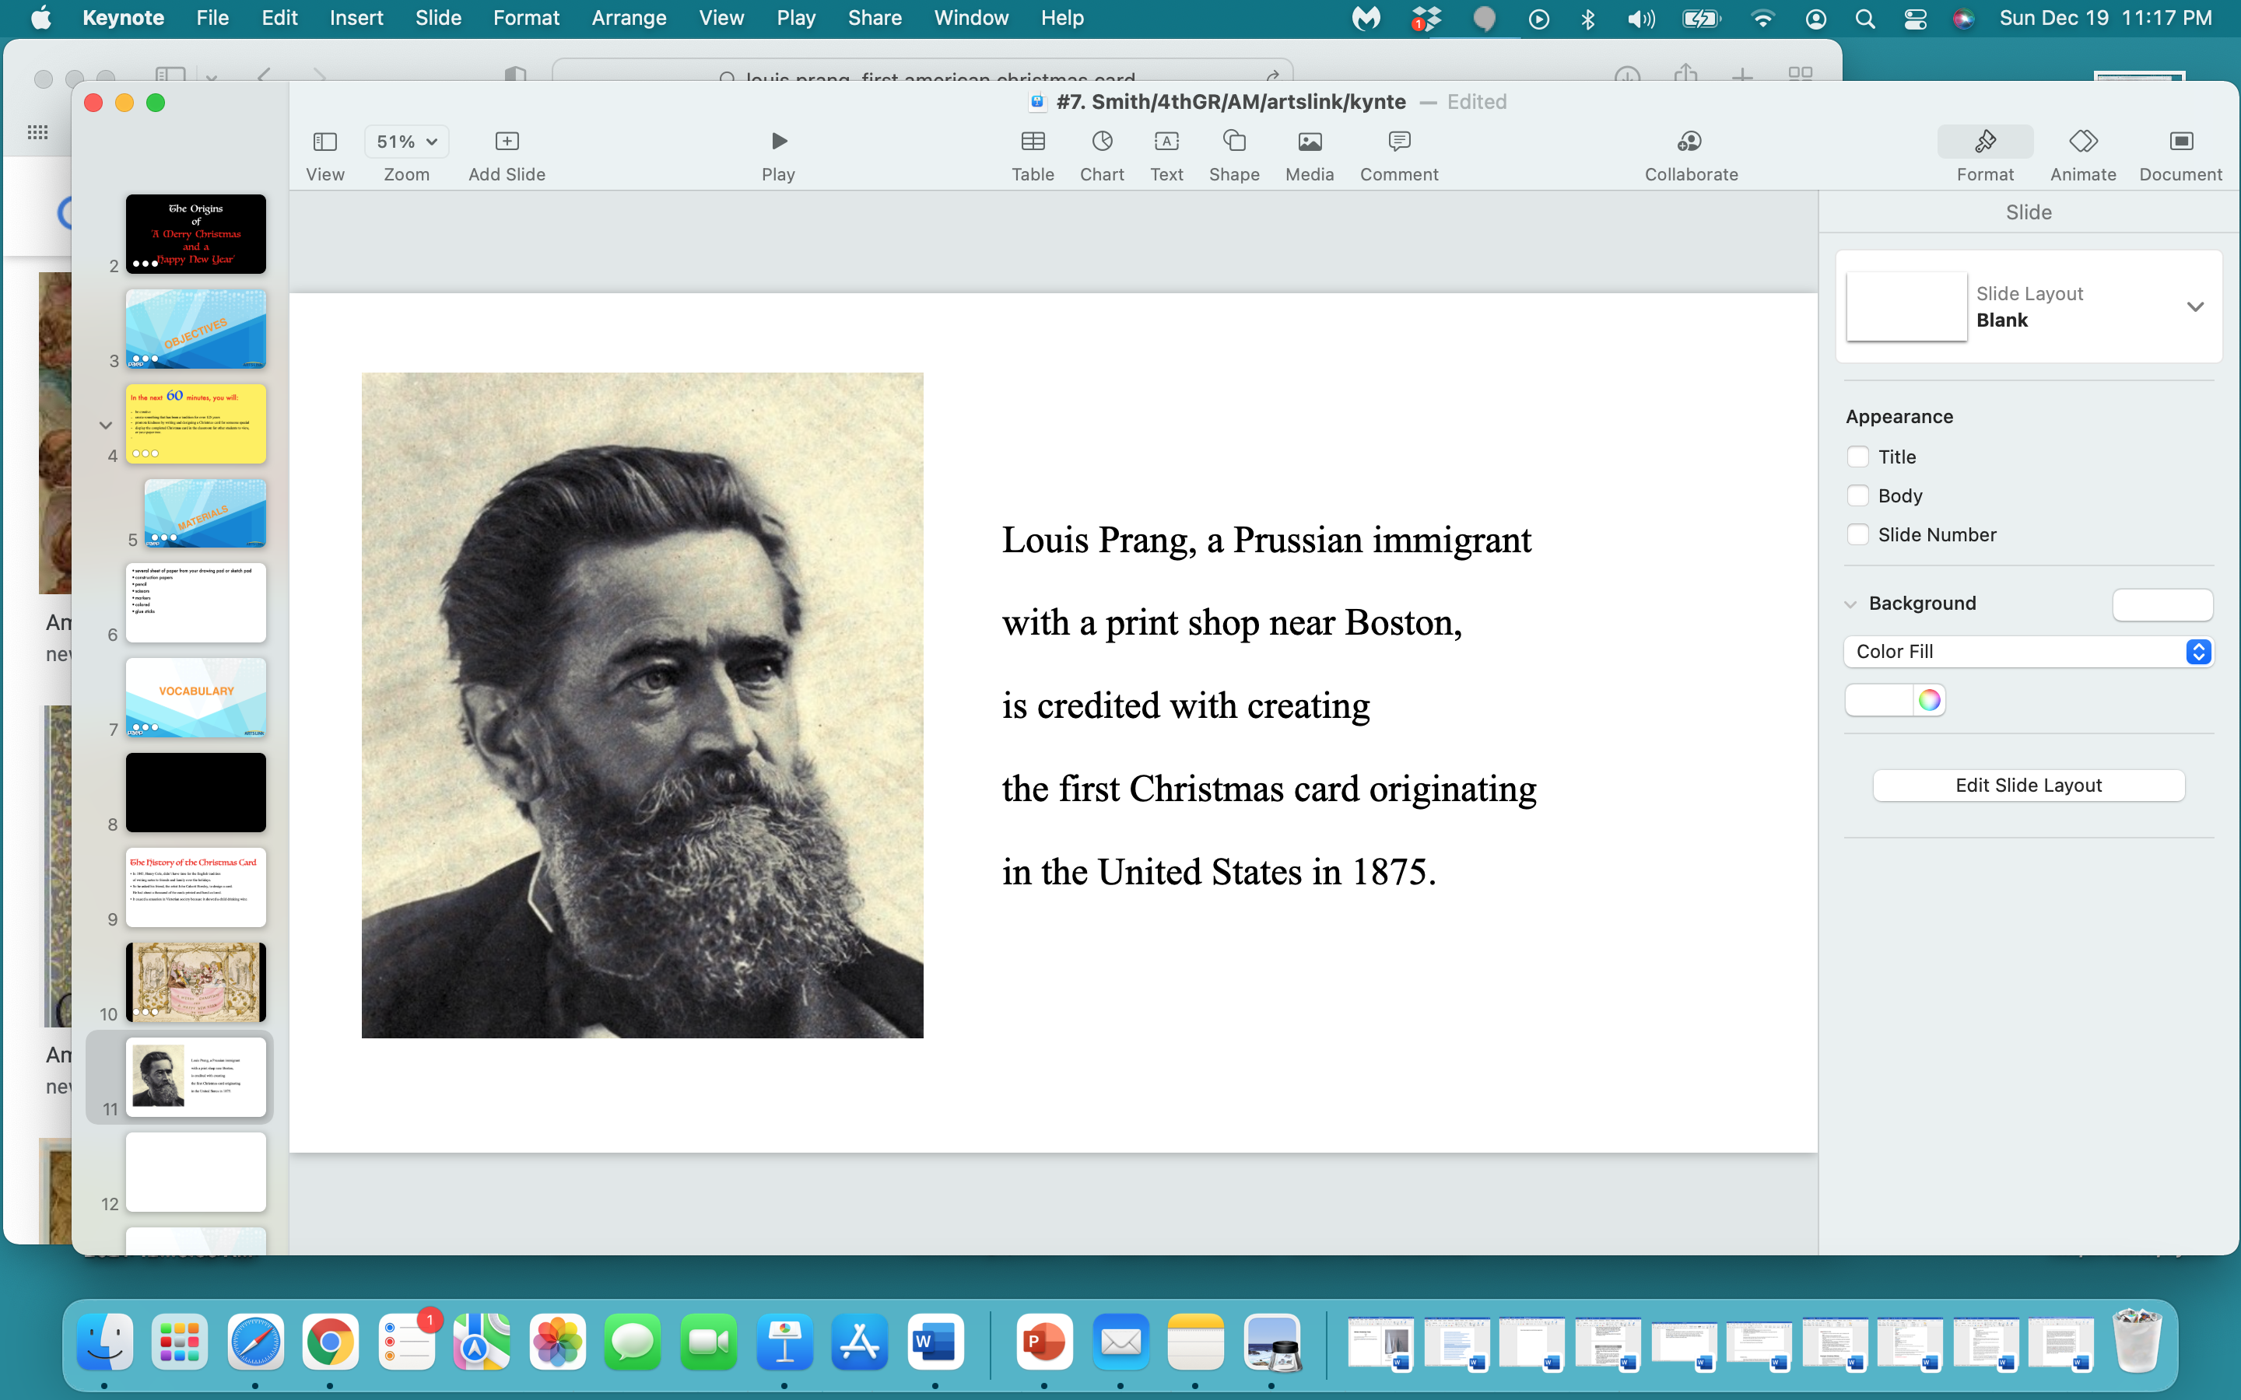

Slide 16
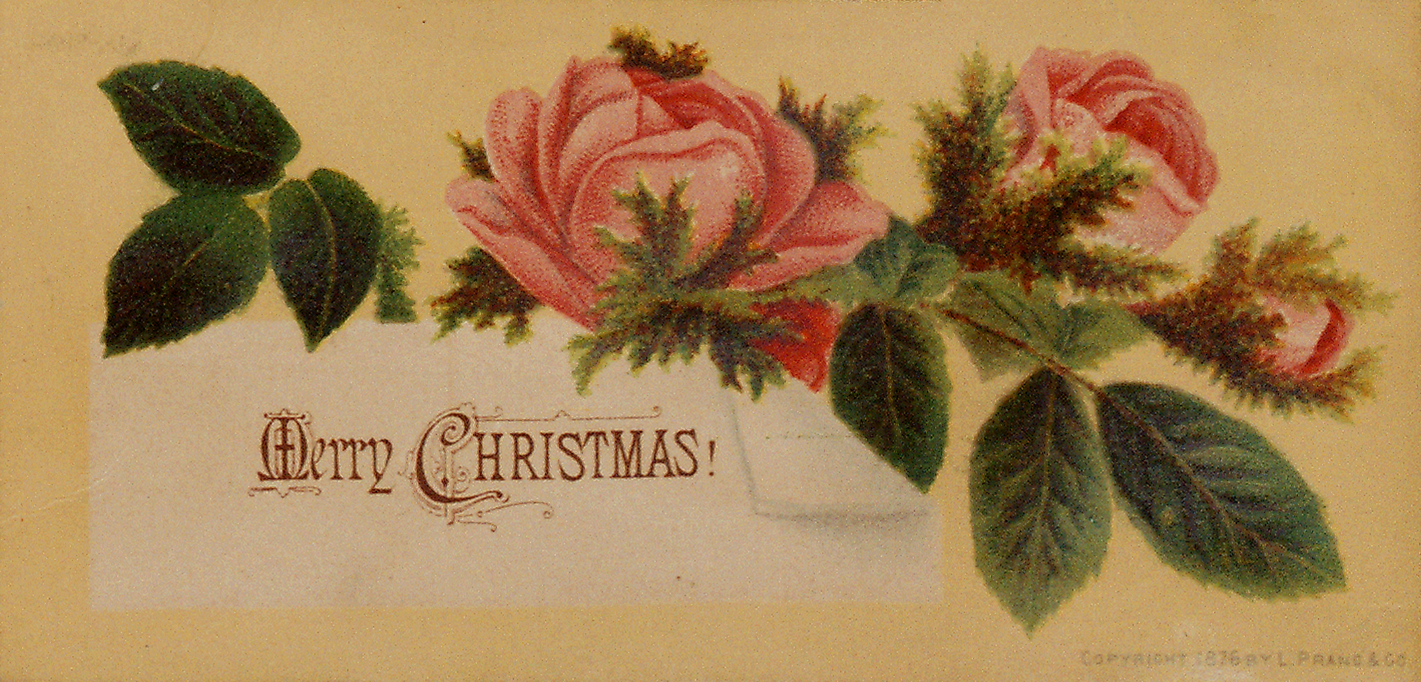

Slide 17
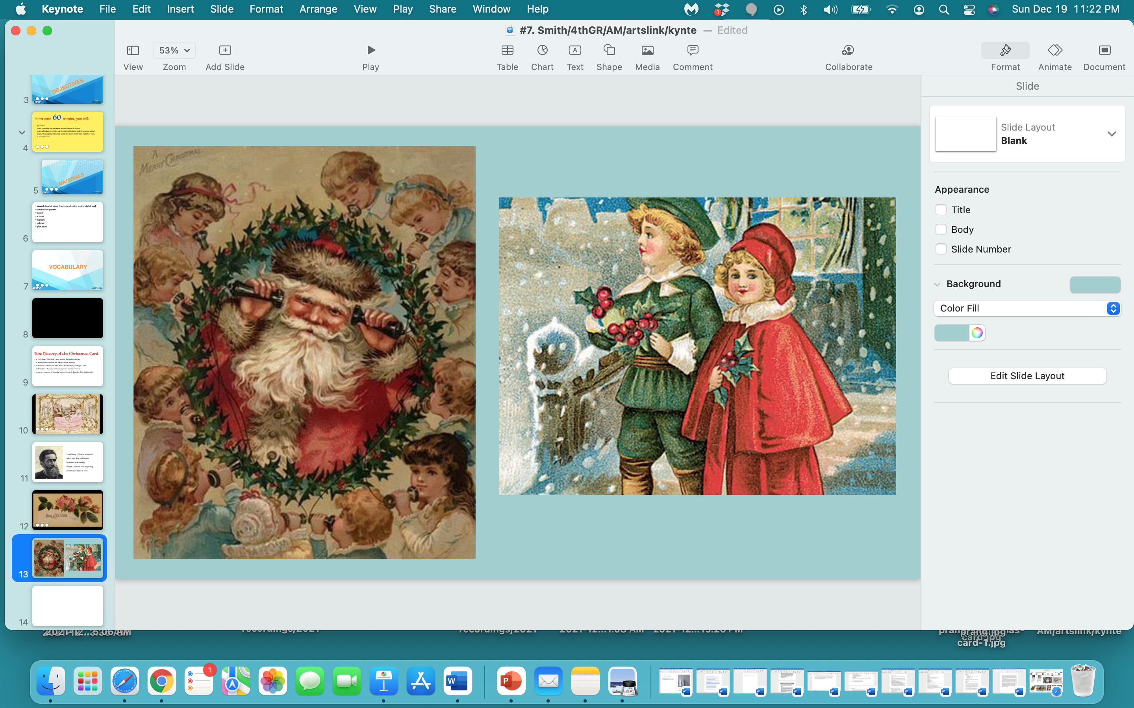

Slide 18
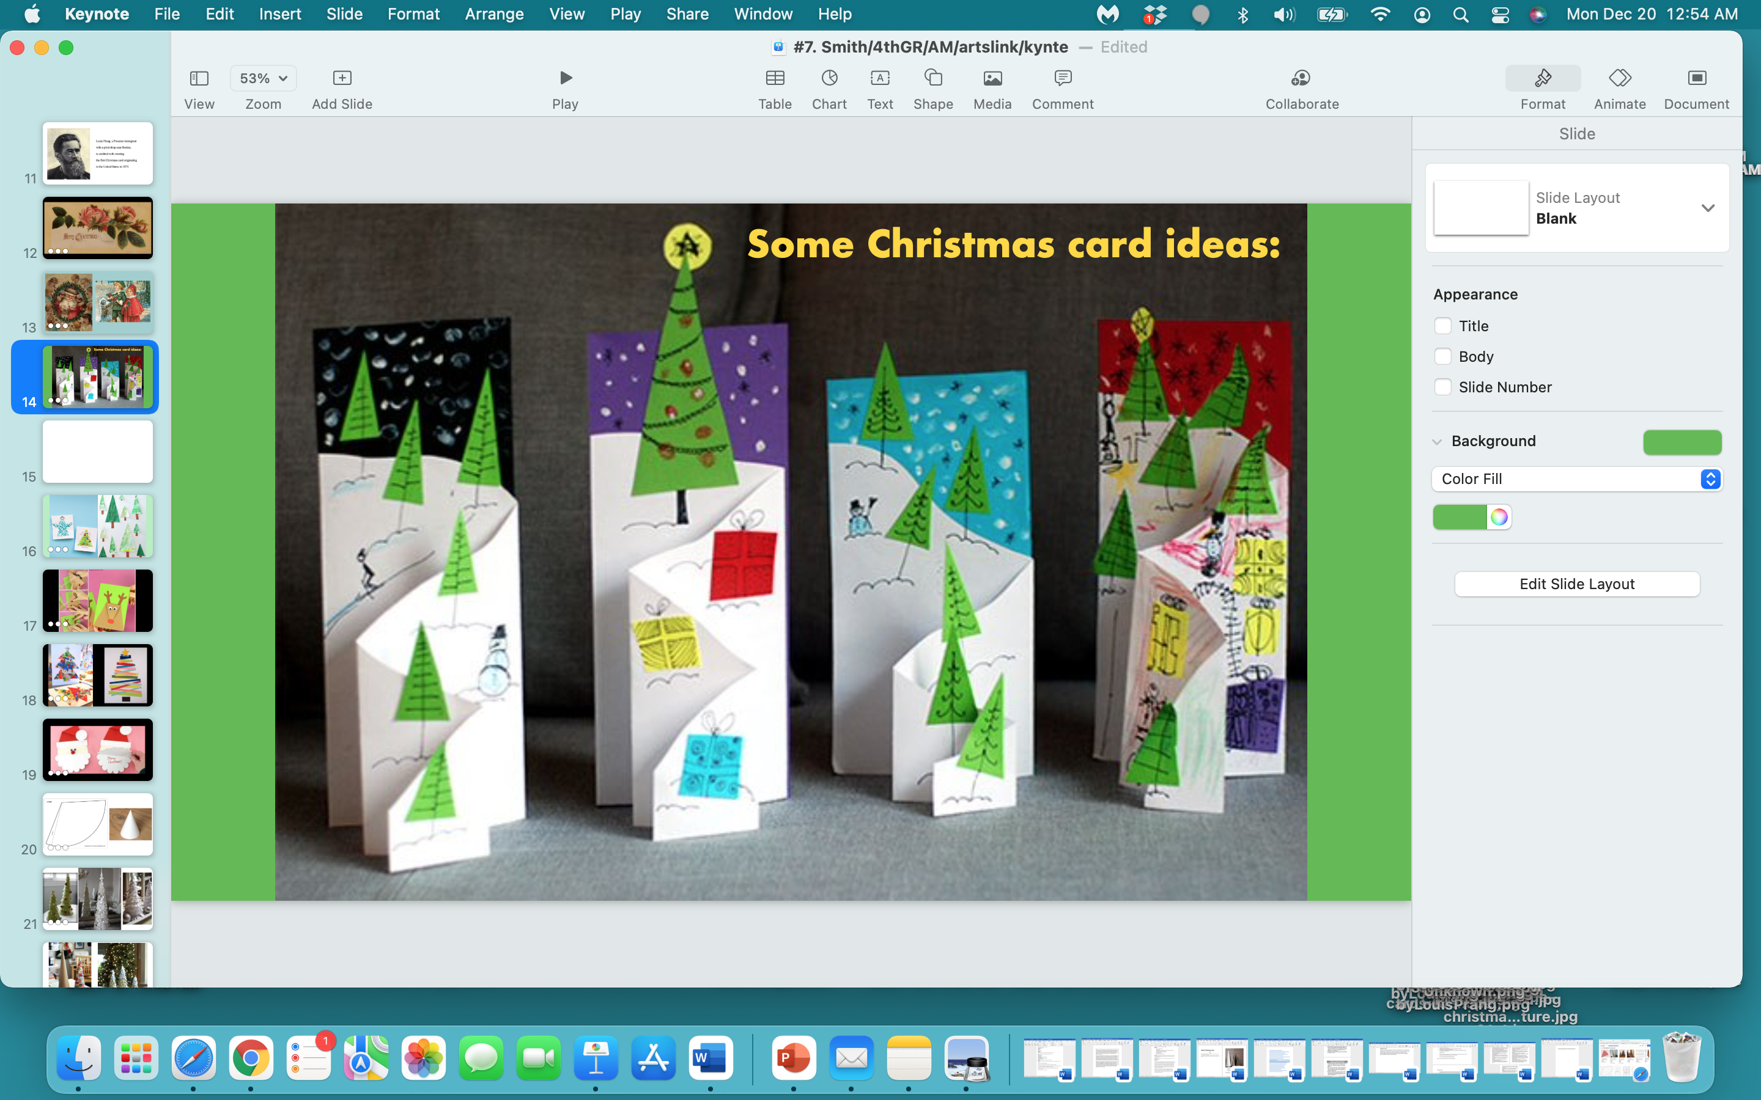

Slide 19
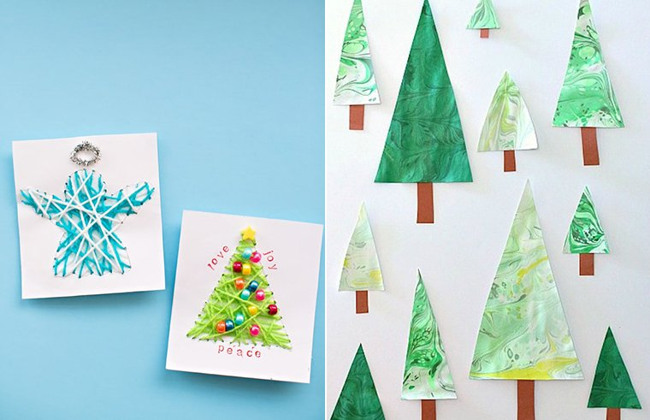

Slide 20
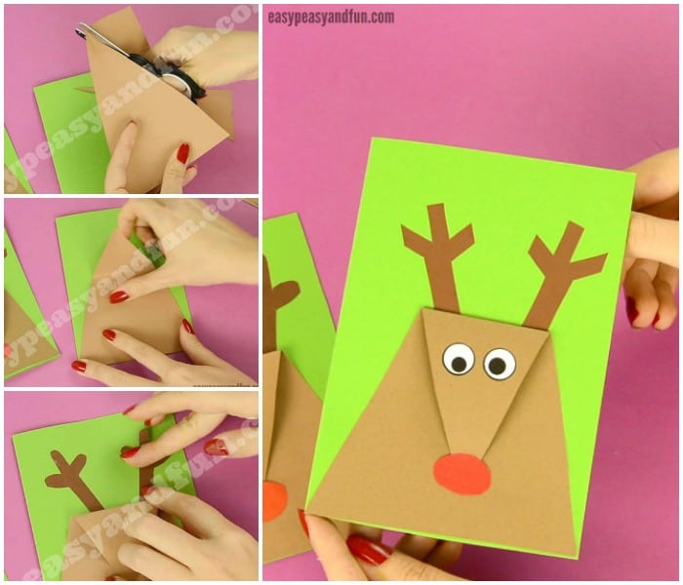

Slide 21
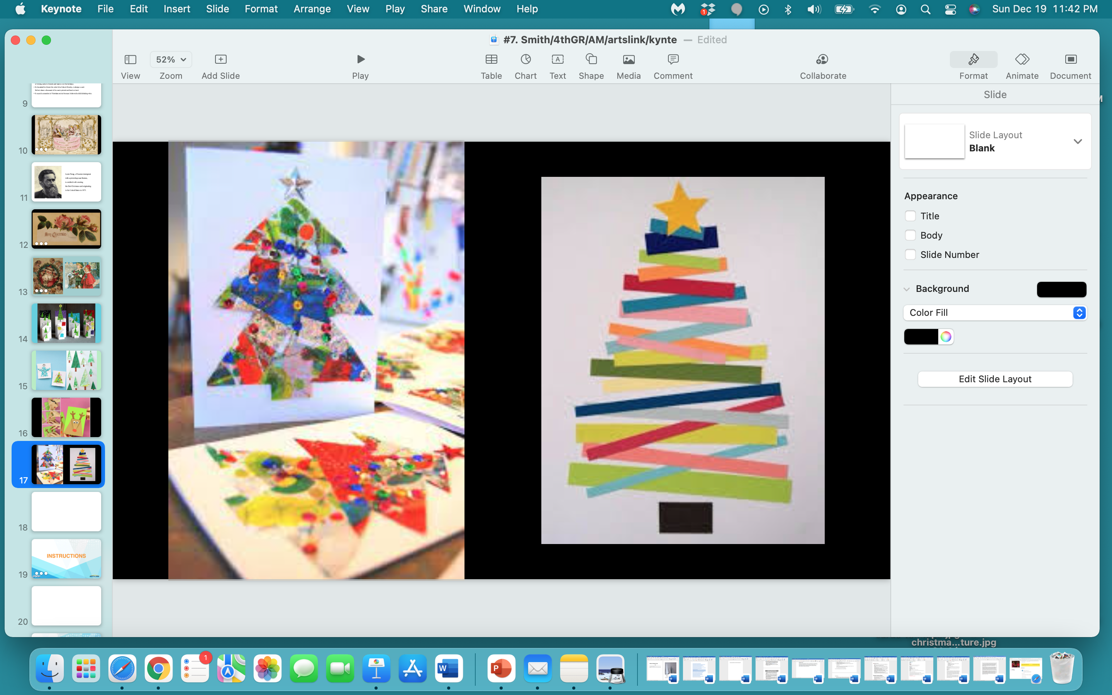

Slide 22
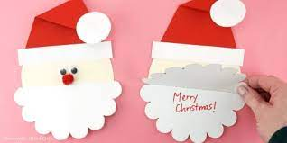

Slide 23
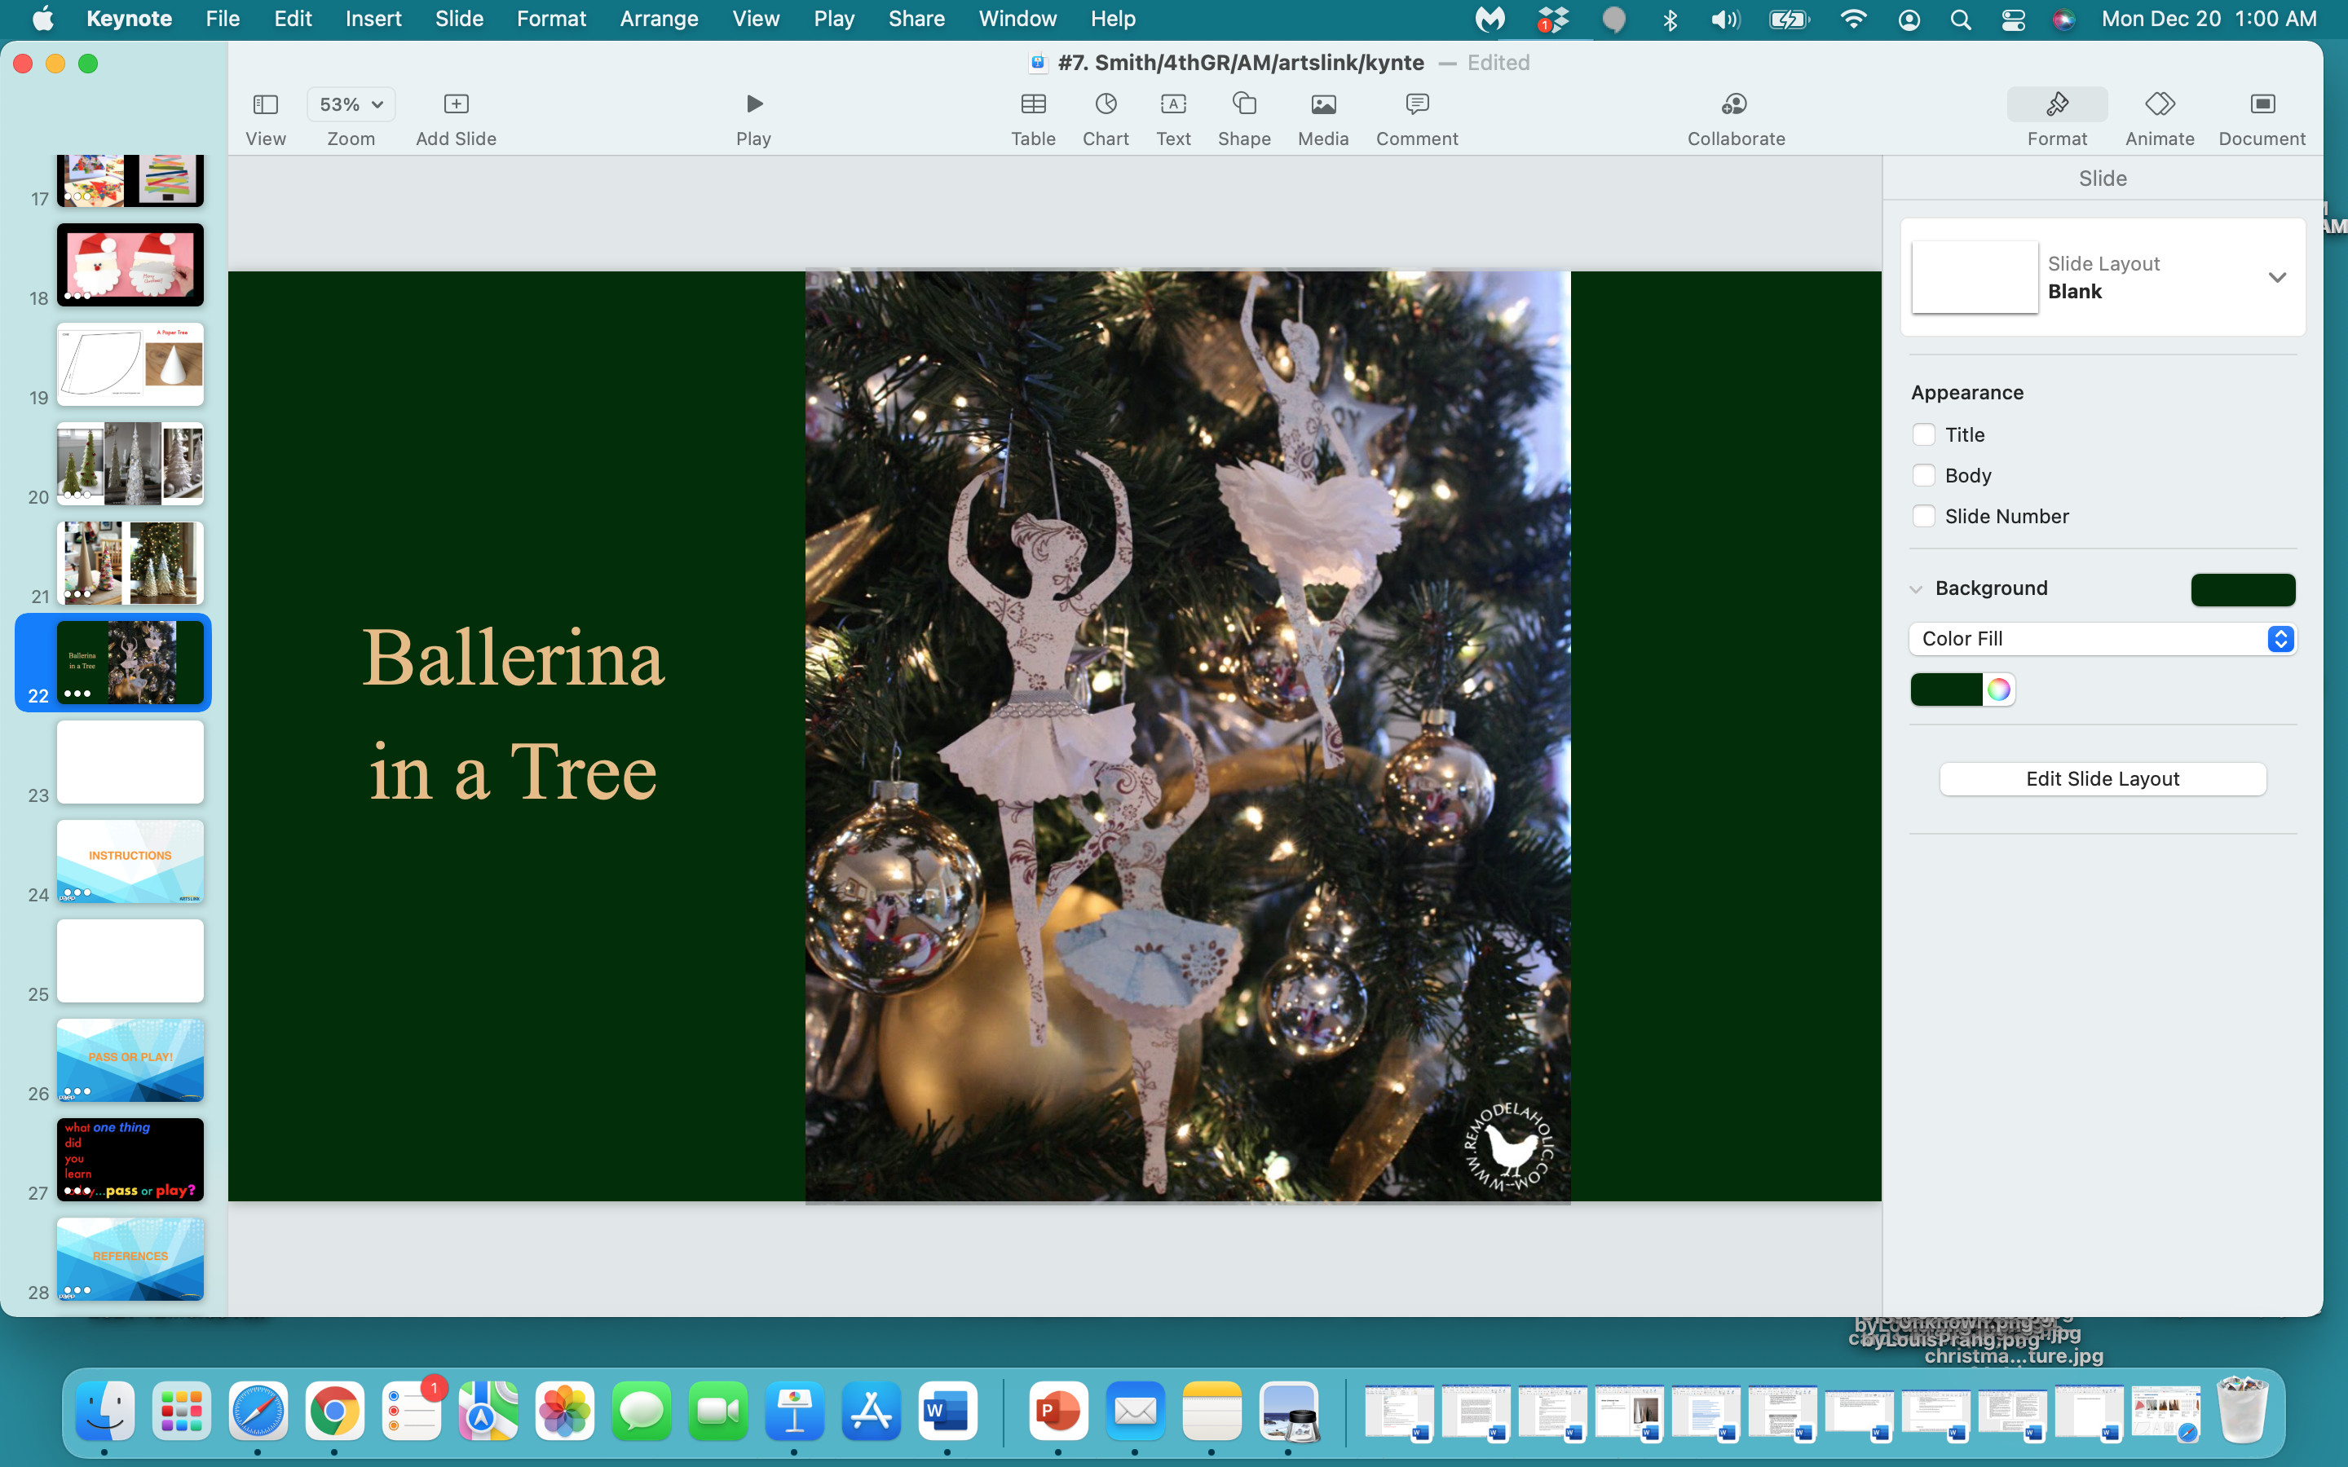

Slide 24
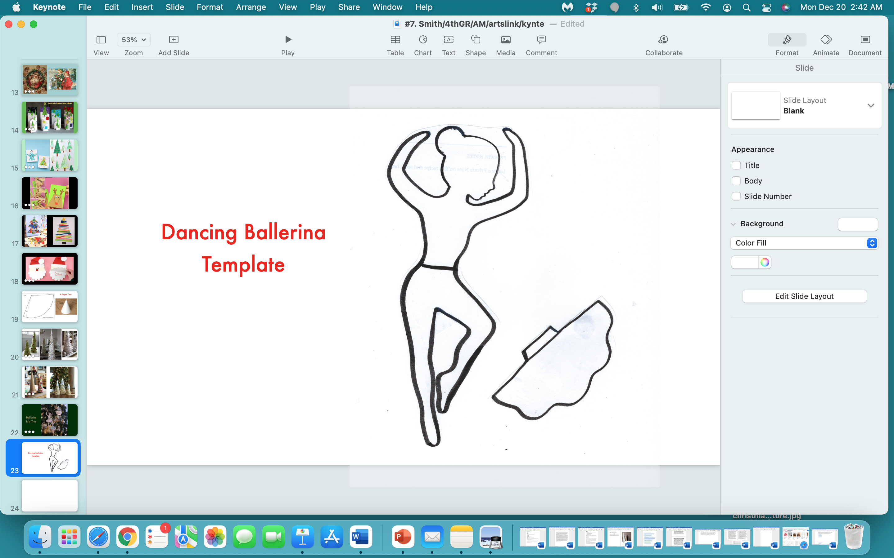

Slide 25
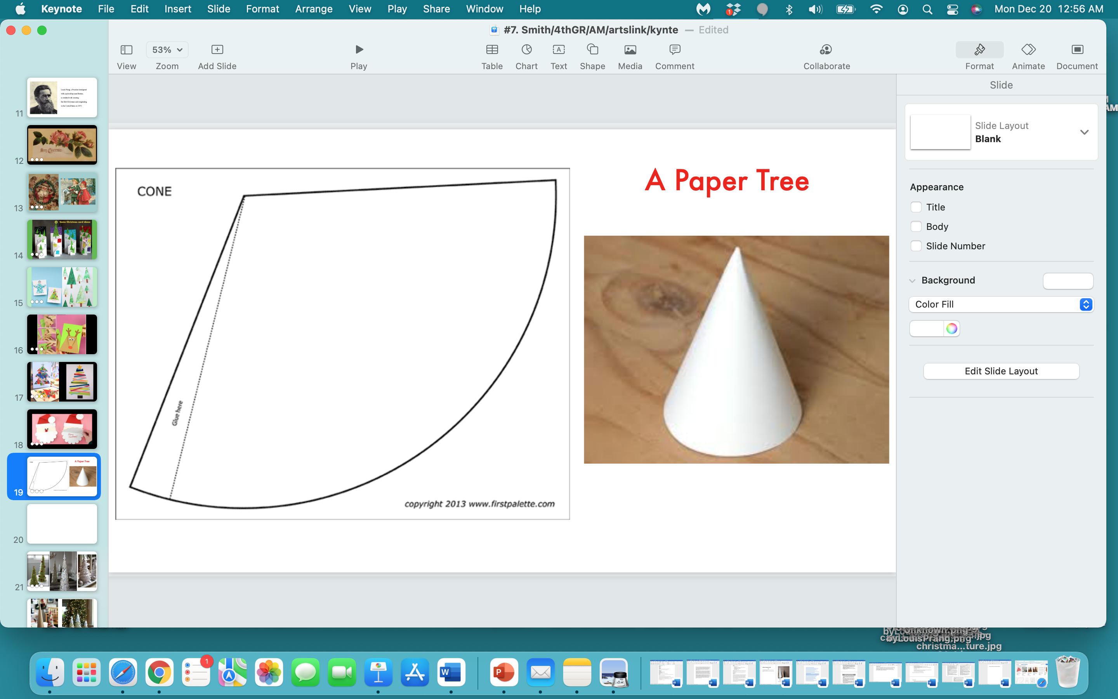

Slide 26
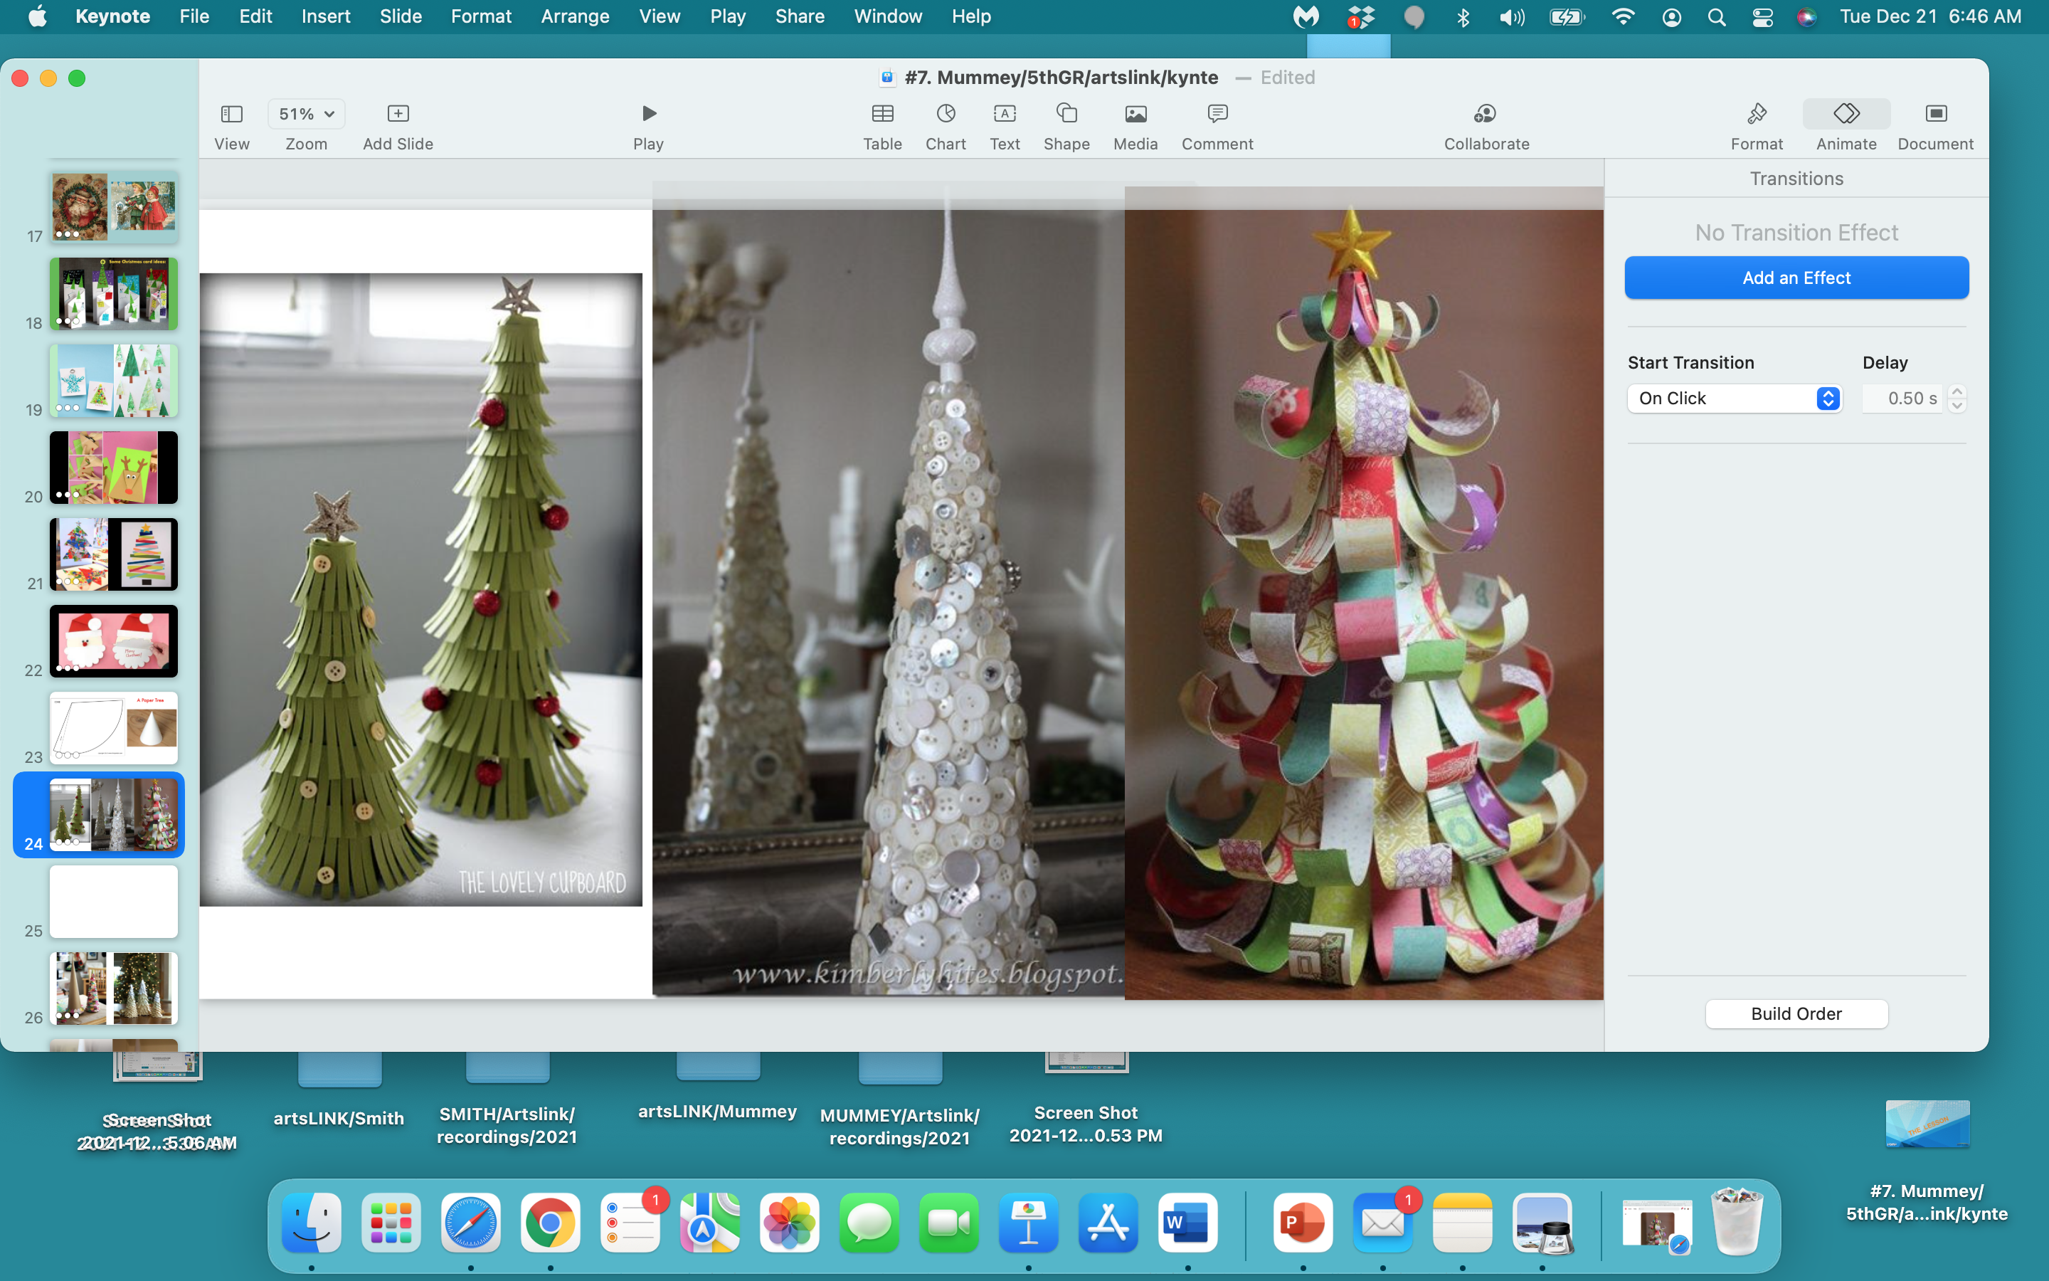

Slide 27
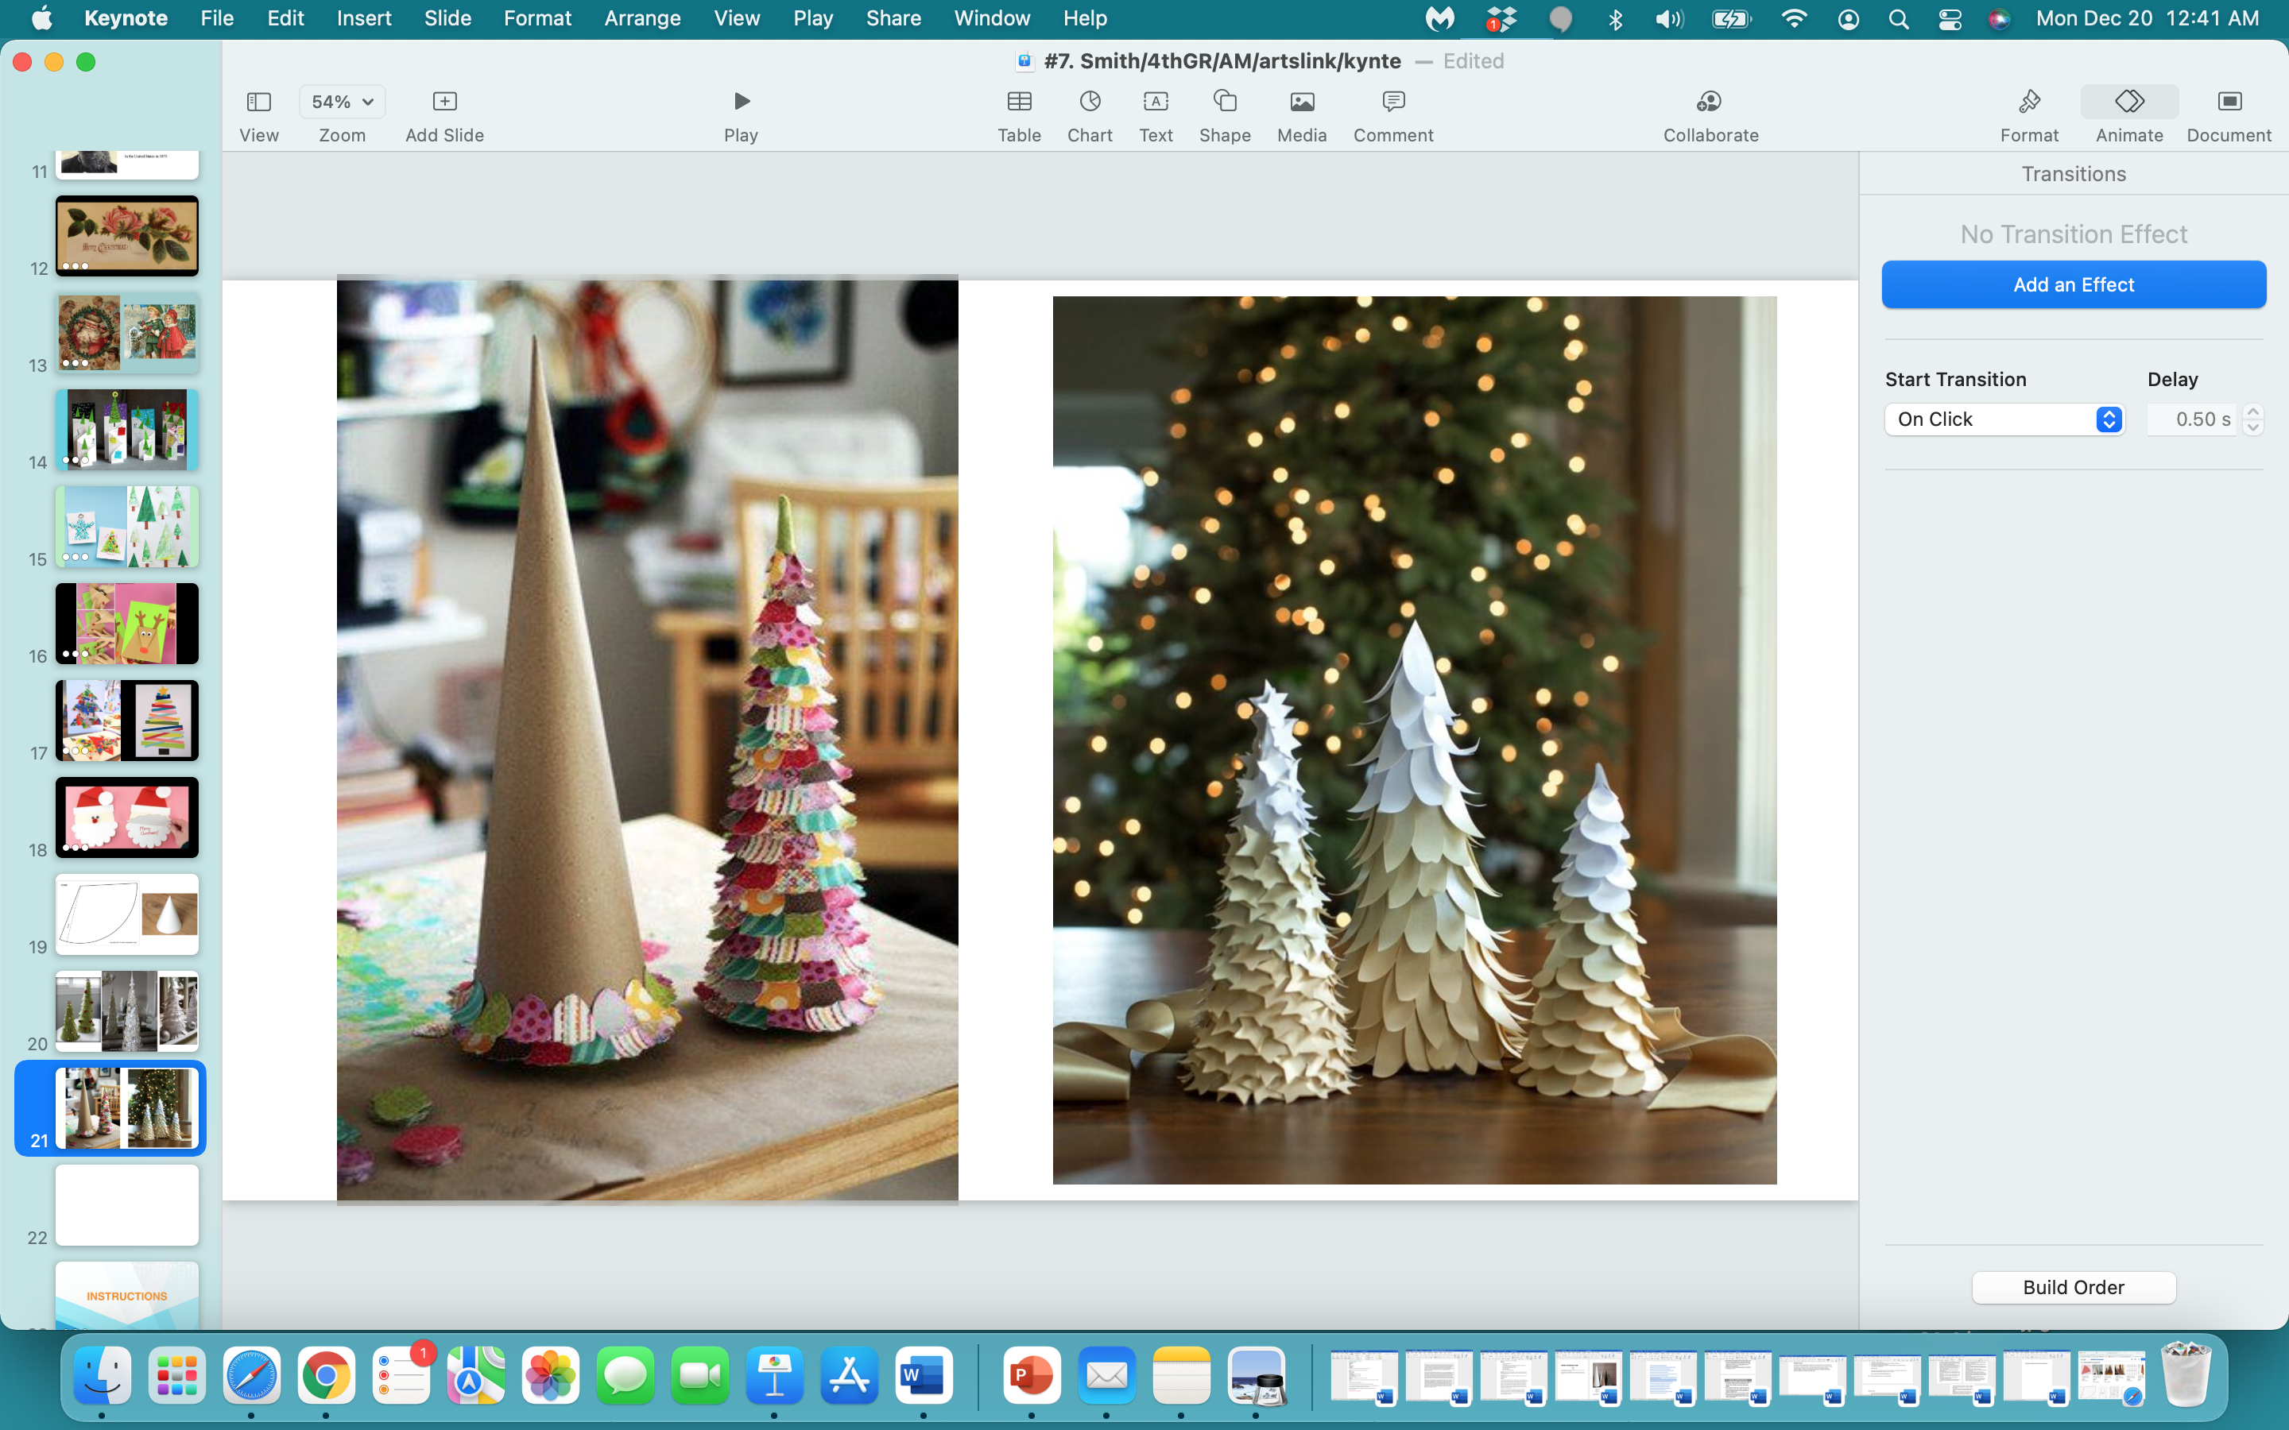

Slide 28
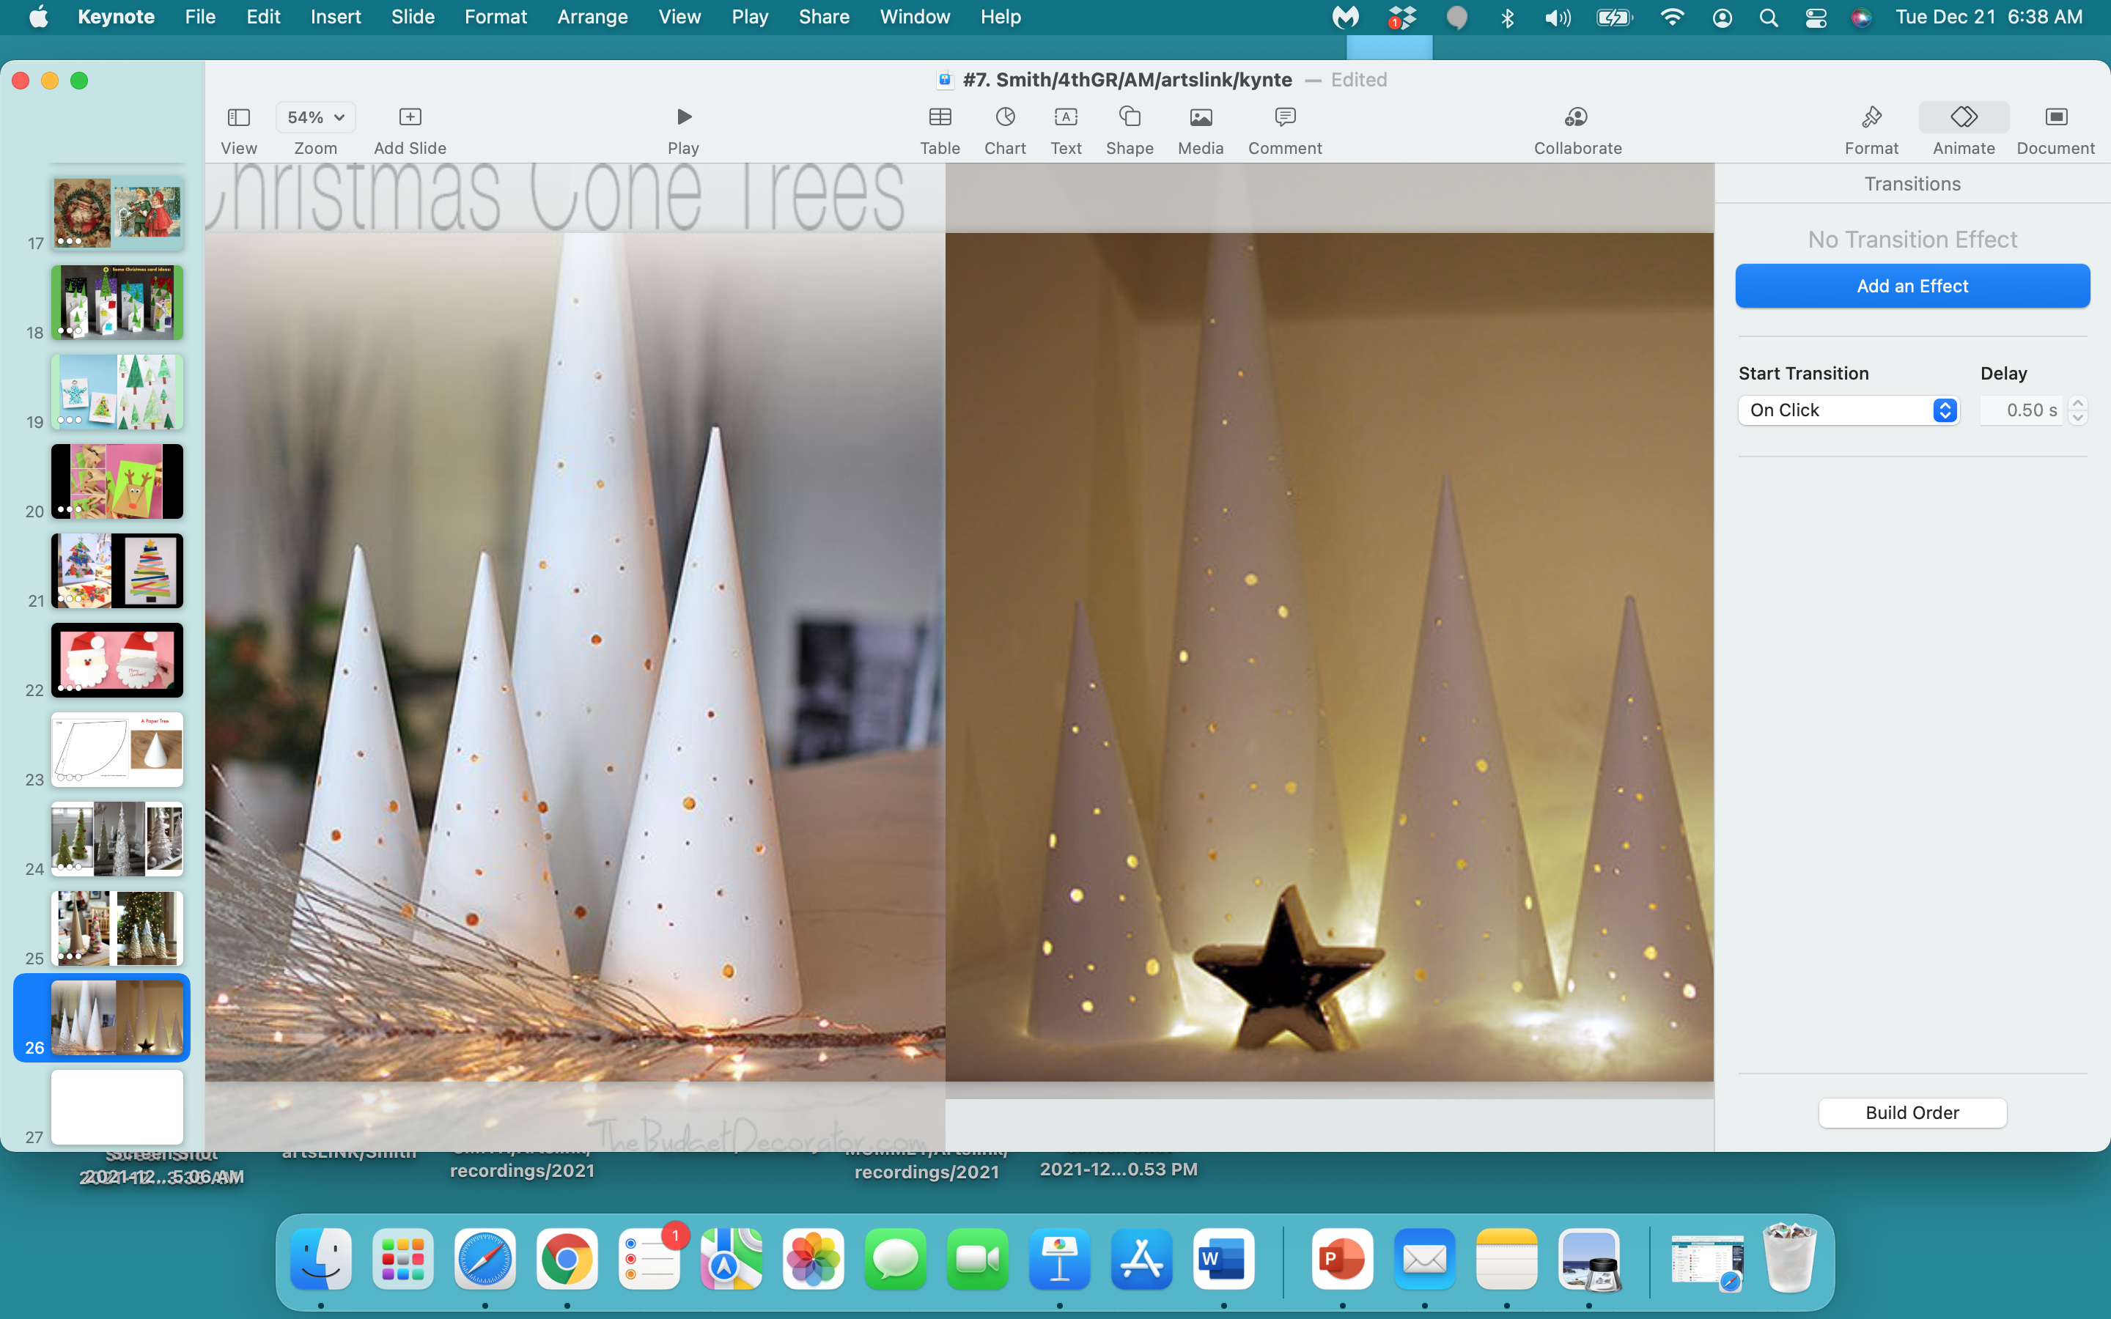

Slide 29
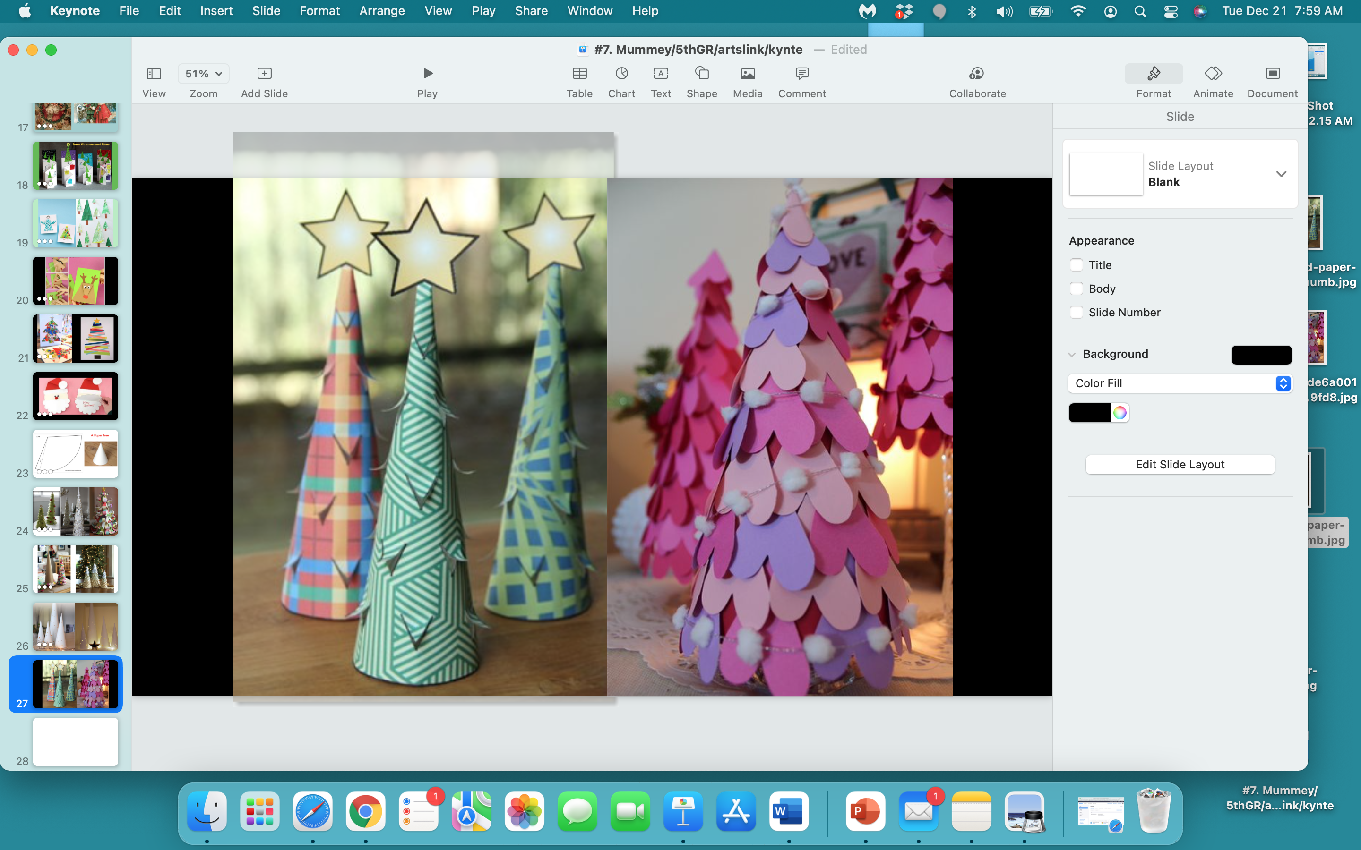

Slide 30
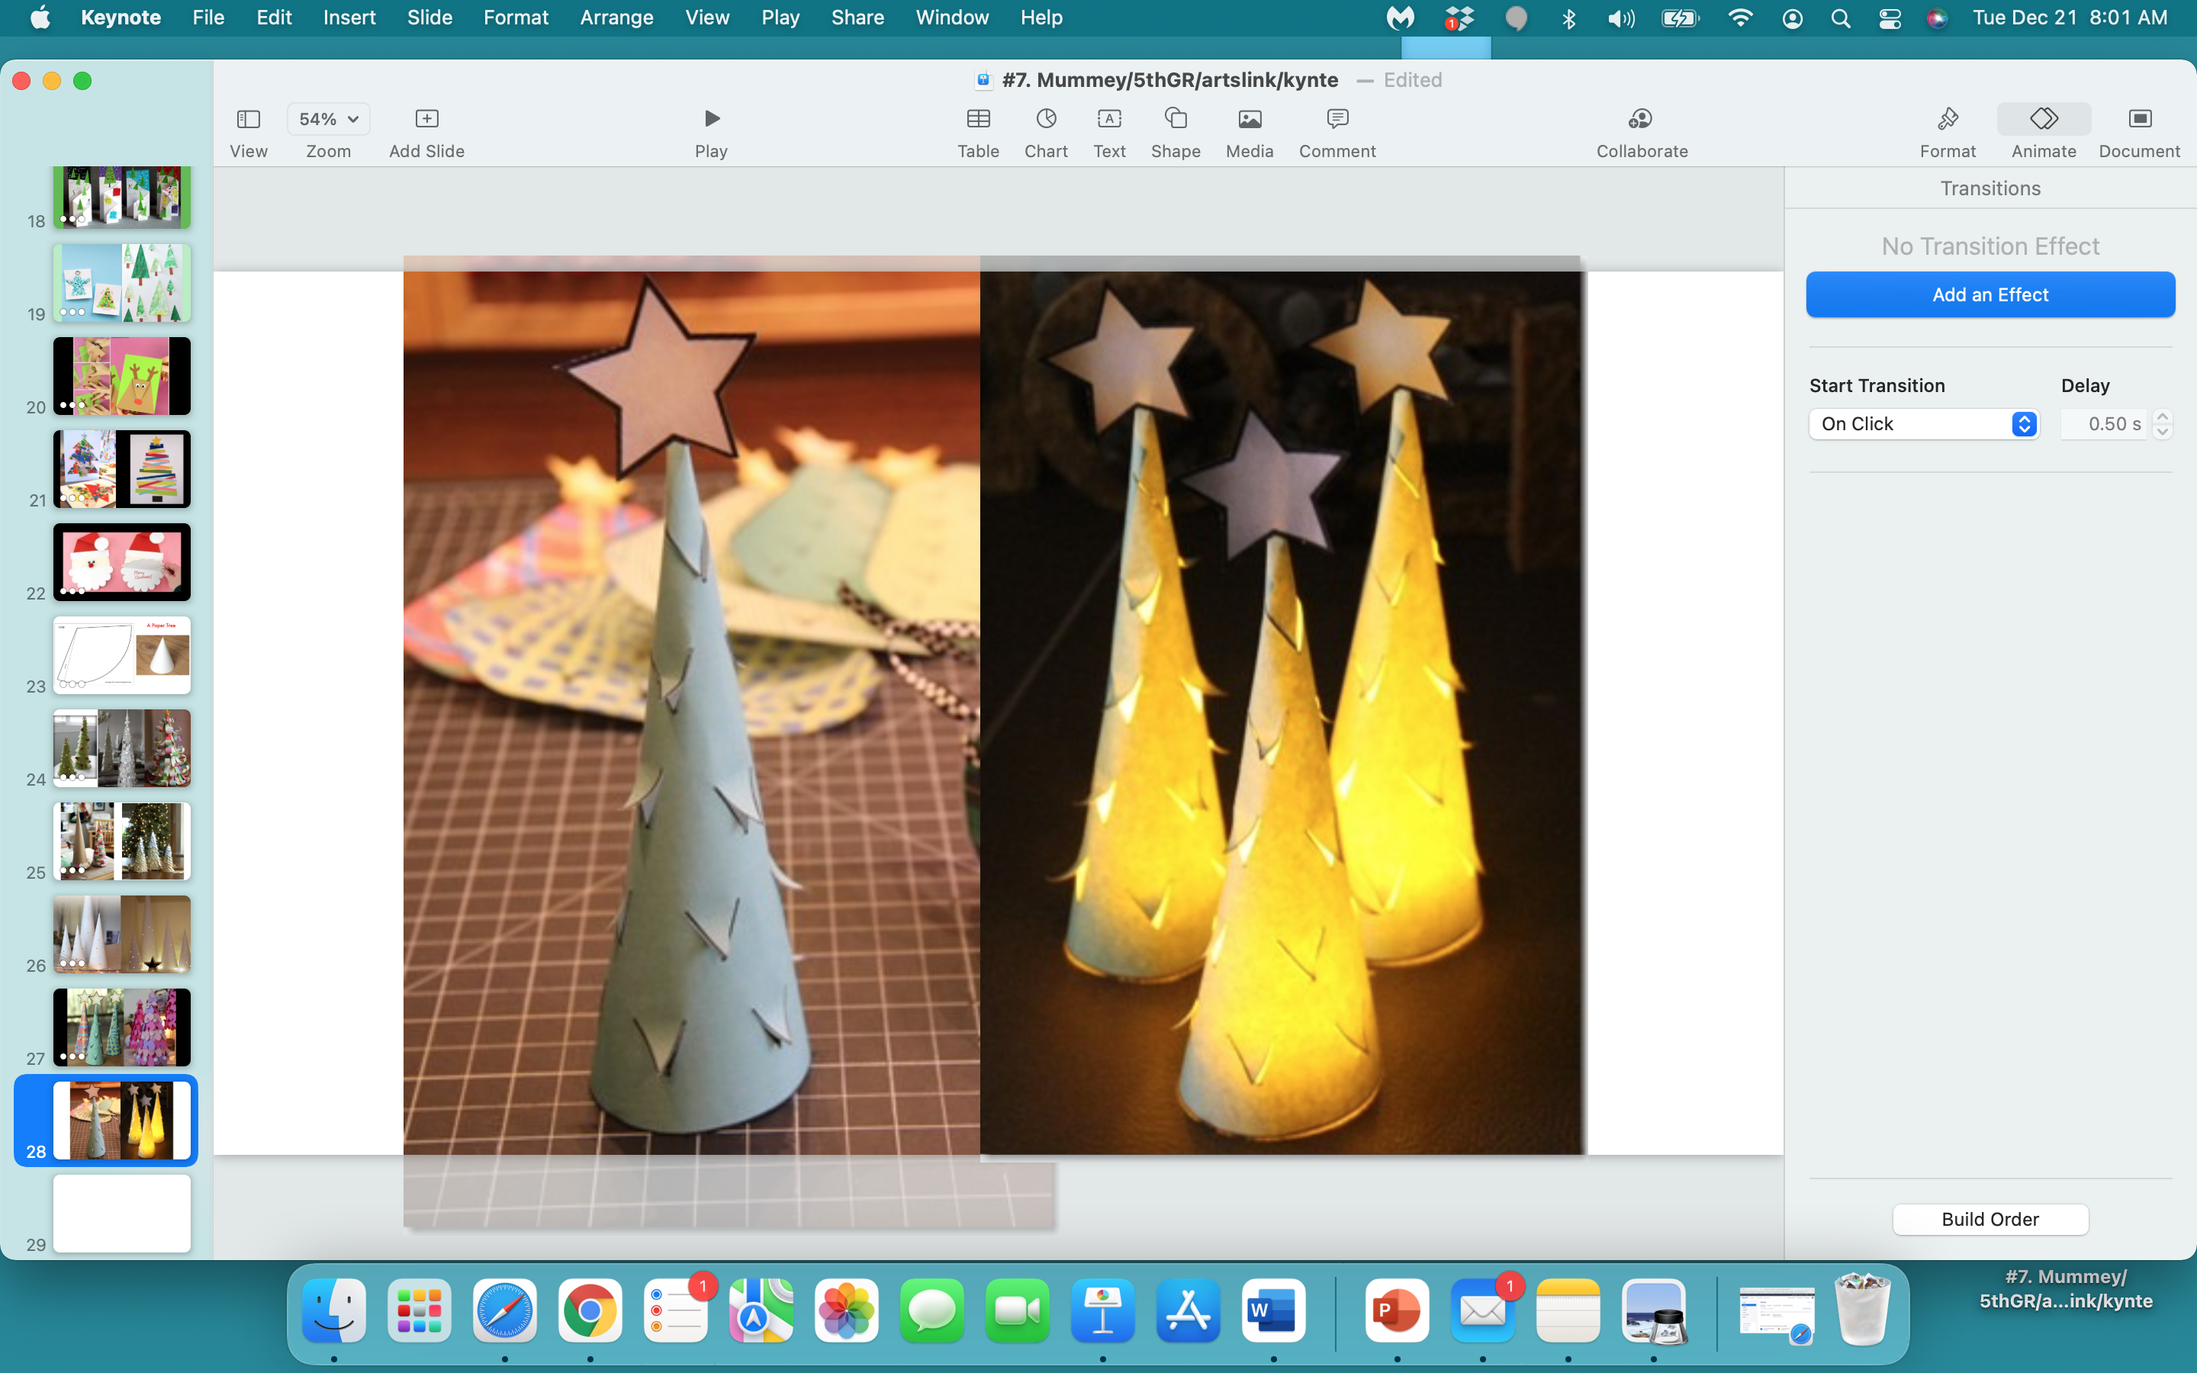

Slide 31


Slide 32
Pick One project to start with…
either a Christmas Card,
a Dancing Ballerina ornament for the tree,
or a paper cone Christmas Tree.
I’ll demo each project.

Slide 33


Slide 34
what one thing
did
you
learn
today…pass or play?

Slide 35
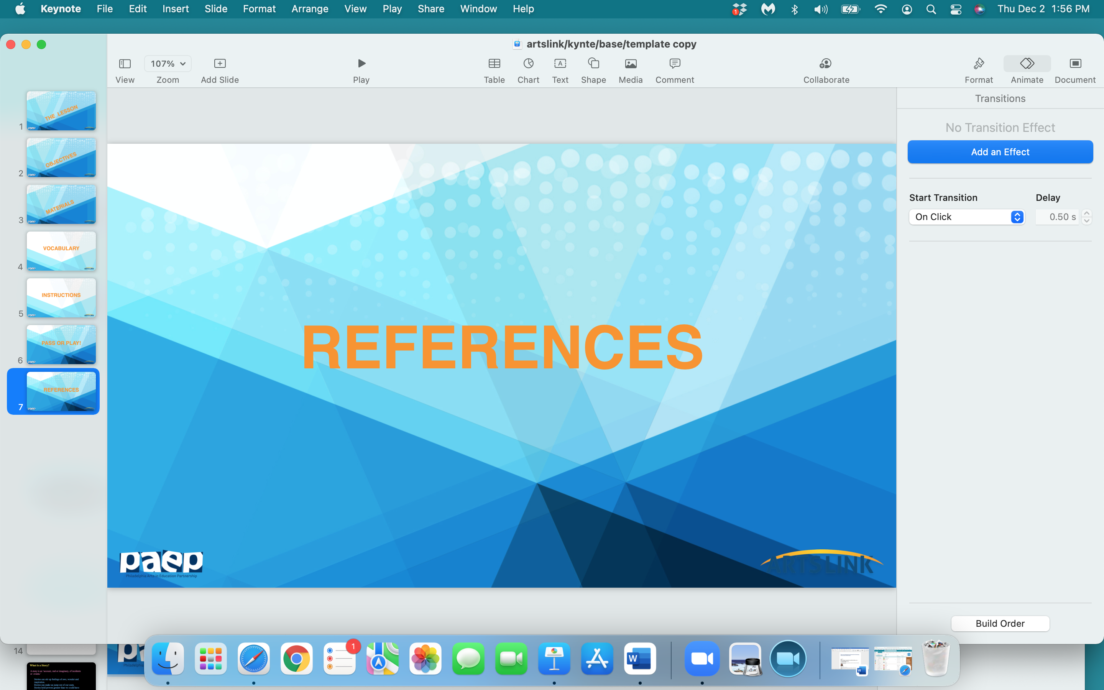

Slide 36
http://www.localschooldirectory.com/lesson-plans/id/303
https://www.pathstoliteracy.org/strategies/teaching-many-skills-through-christmas-cards
https://www.teachstarter.com/us/blog/5-crafty-christmas-card-ideas-2/
https://myartcards.com/wp-content/uploads/MyArtCardsClassroomLessonPlan.pdf
https://teachingmadepractical.com/christmas-writing-prompts/
https://holidappy.com/holidays/Christmas-Card-Messages-What-to-Write-in-a-Christmas-Card
https://teachingmadepractical.com/christmas-literacy-activities/
http://priyam-simplejoys.blogspot.com/2013/12/paper-christmas-tree.html
https://www.redtedart.com/printable-expandable-christmas-cards/
https://www.thejoysharing.com/2018/11/christmas-cards-for-kids.html
https://www.whychristmas.com/customs/cards.shtml
https://www.smithsonianmag.com/history/history-christmas-card-180957487/

