Slide 1
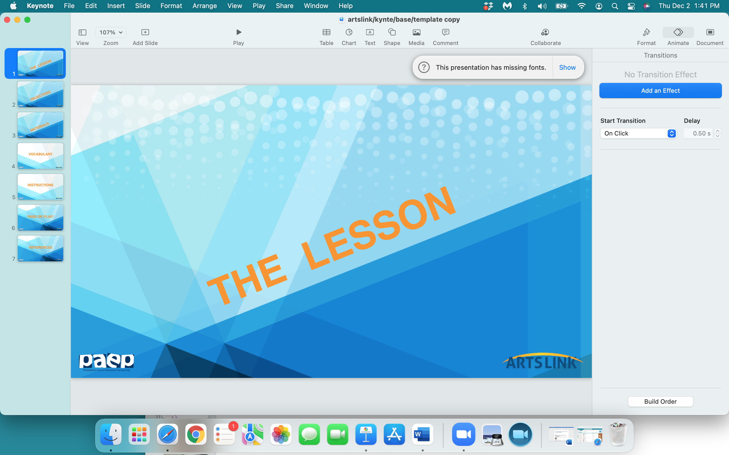

Slide 2
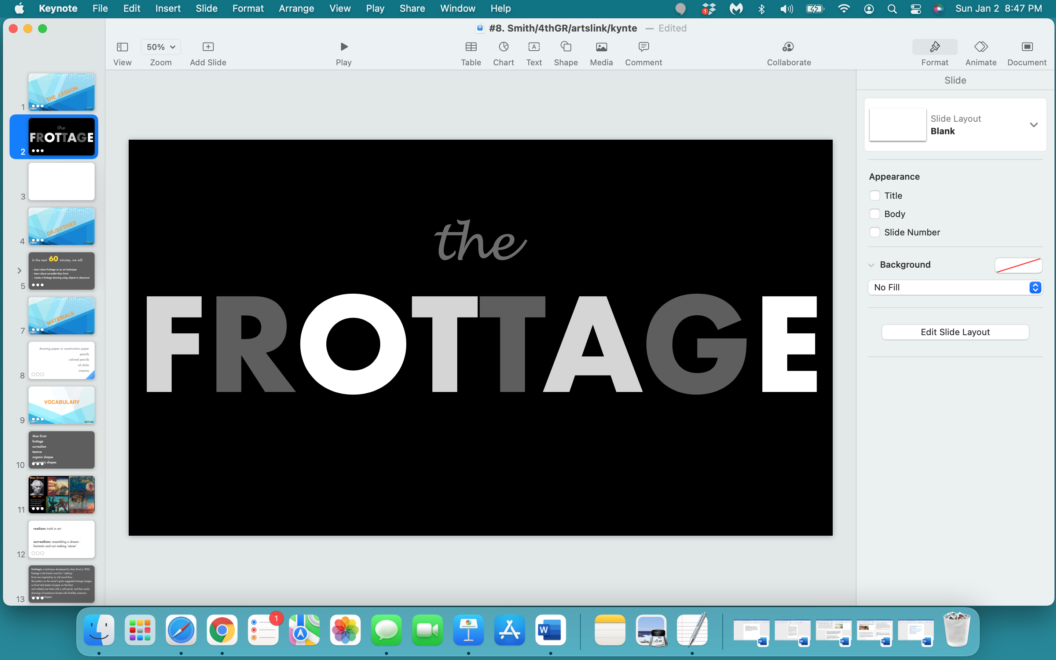

Slide 3
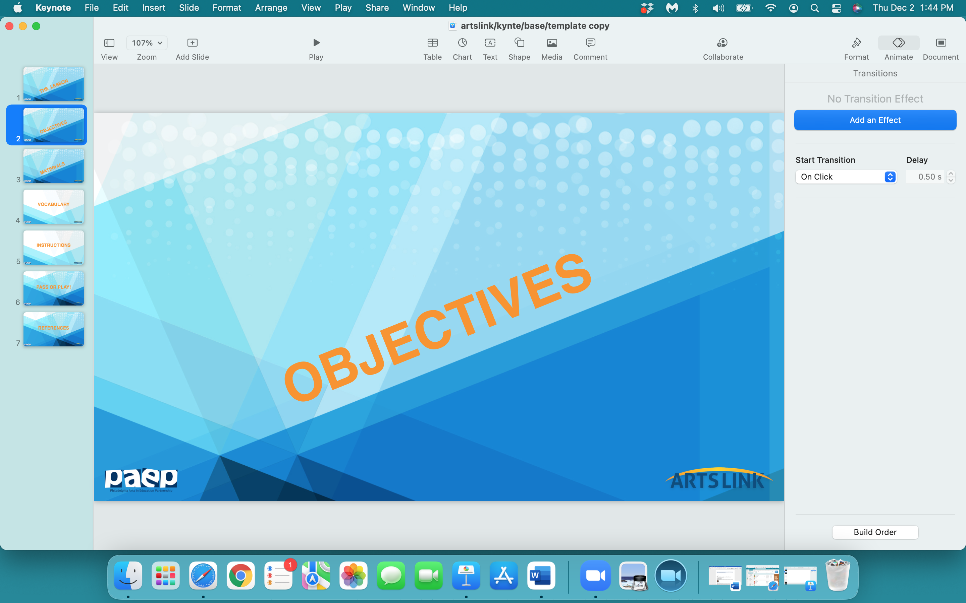

Slide 4
In the next 60 minutes, we will:
- be introduced to the concept of texture and hunt for textures in the classroom
learn about surrealist Max Ernst and his experimental ‘frottage’ technique
create a ‘frottage’ drawing by taking rubbings of objects in classroom and using them to create a new image

Slide 5
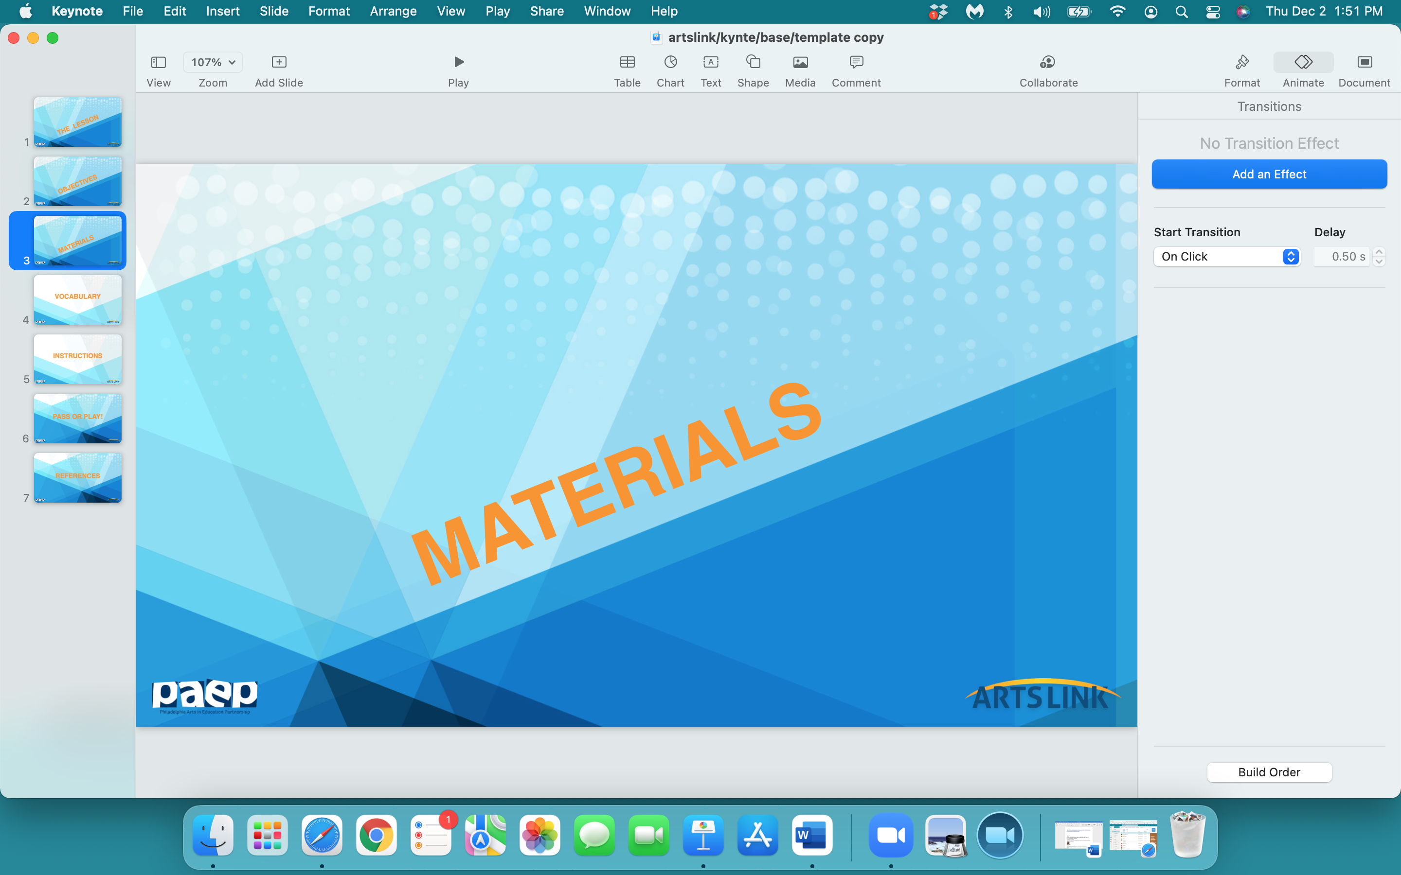

Slide 6
drawing papers or construction papers
colored pencils
crayons
scissors
glue stick

Slide 7
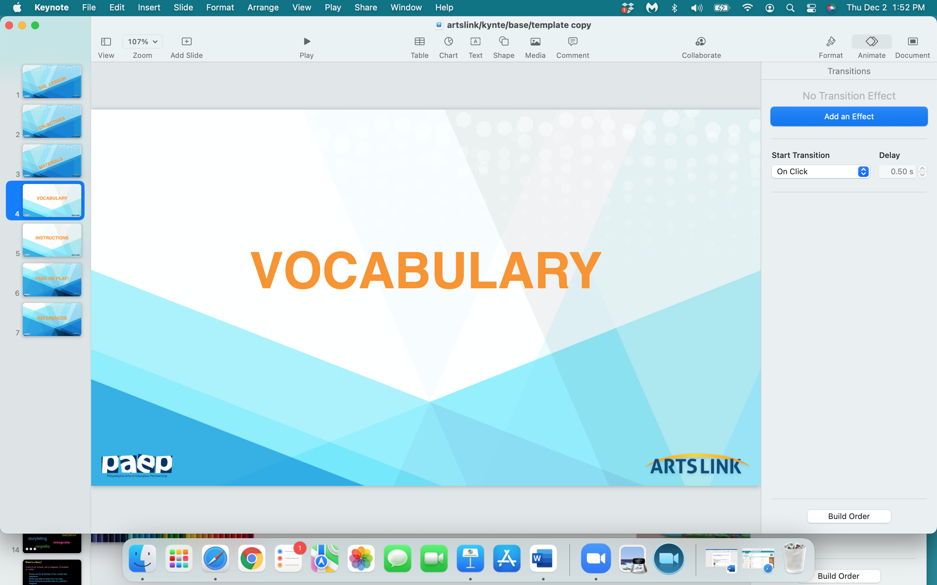

Slide 8
Max Ernst
‘frottage’
surrealism
‘unconscious mind’
texture
organic shapes
geometric shapes
collage

Slide 9
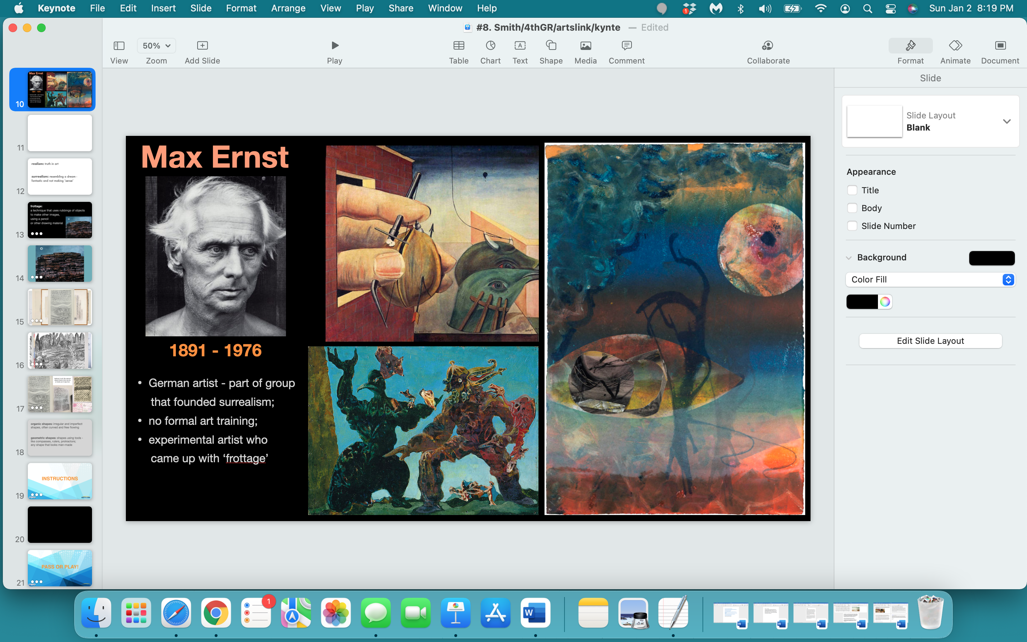

Slide 10
realism: truth in art; art depicting reality
surrealism: resembling a dream - fantastic and not making ‘sense’

Slide 11
frottage: creating a textured rubbing; a technique developed by Max Ernst in 1925;
‘frottage’ is the french word for ‘rubbing’.
Ernst was inspired by an old wood floor - the pattern on the wood’s grain suggested strange images, so Ernst laid sheets of paper on the floor
and rubbed over them with a soft pencil, and then made drawings
of mysterious forests with bird-like creatures - (using his ‘frottages’).
Ernst allowed his unconscious mind to guide the creation
of his images.

Slide 12
Some of Max Ernst’s
Frottage Images

Slide 13
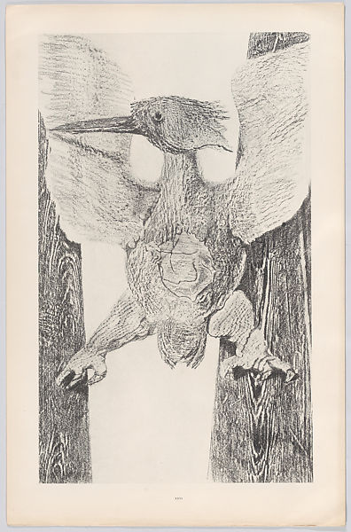

Slide 14
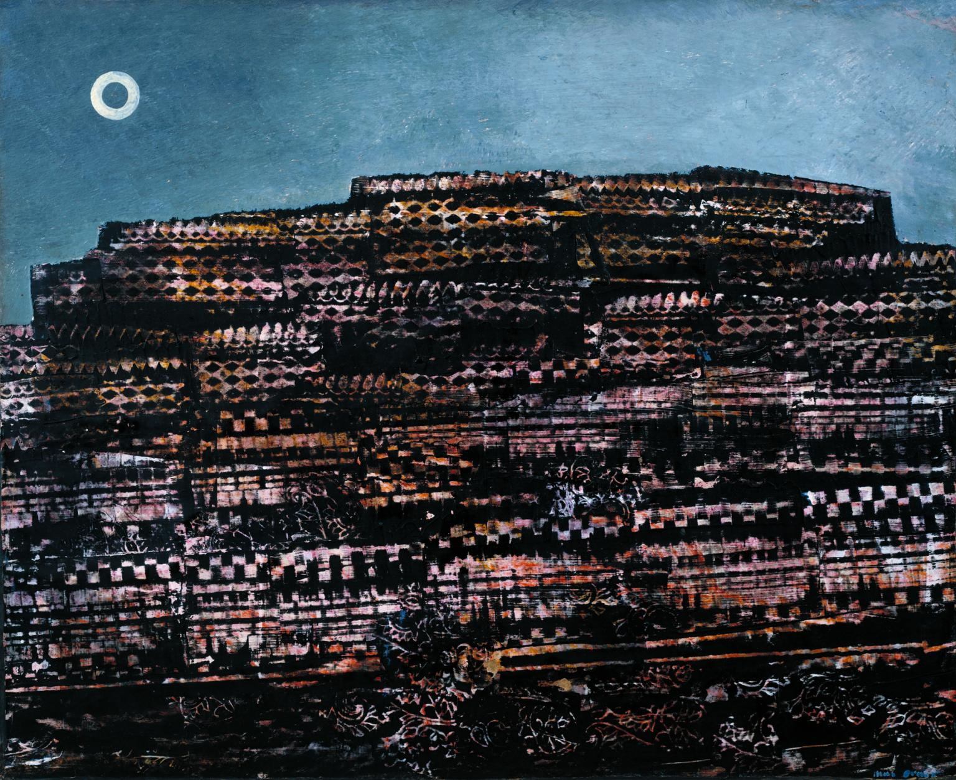

Slide 16
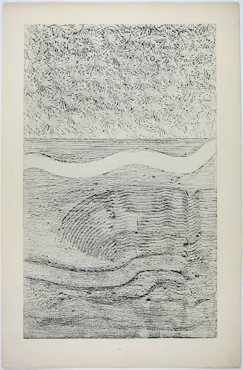
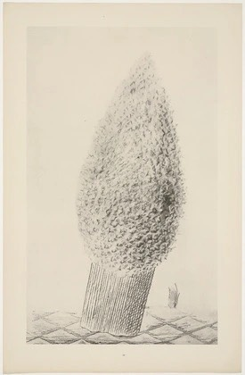
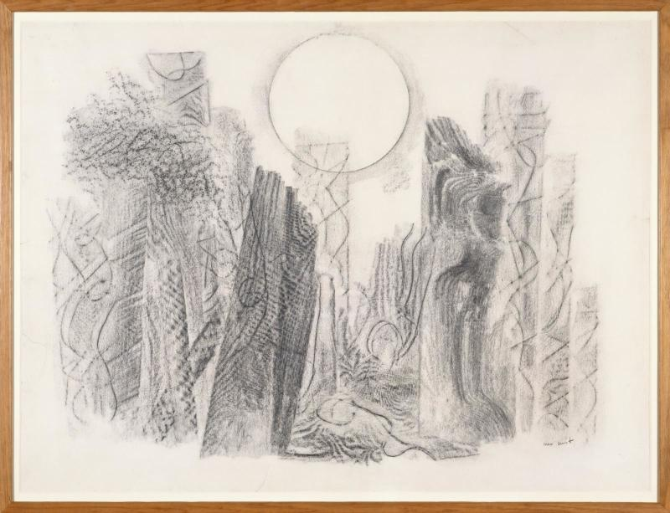
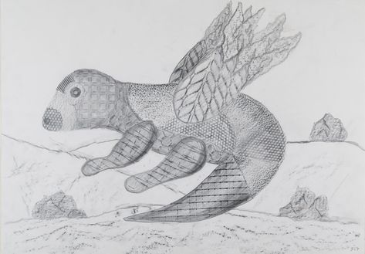
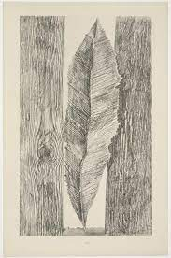
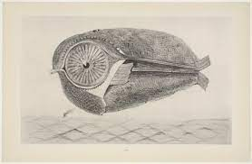

Slide 17
Some Examples of
Student Frottage
Imagery

Slide 18
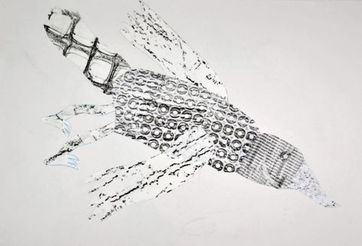
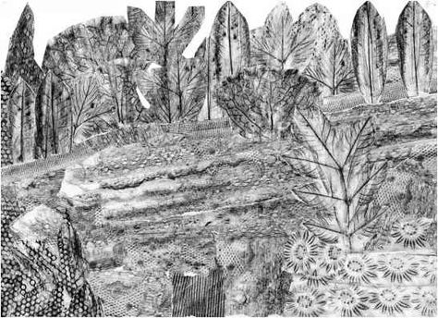
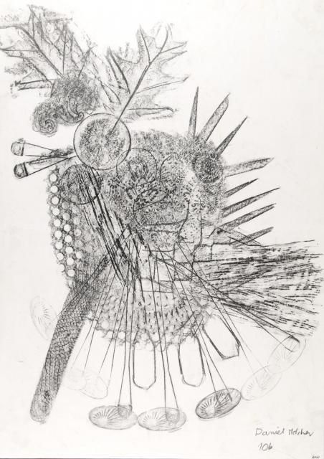
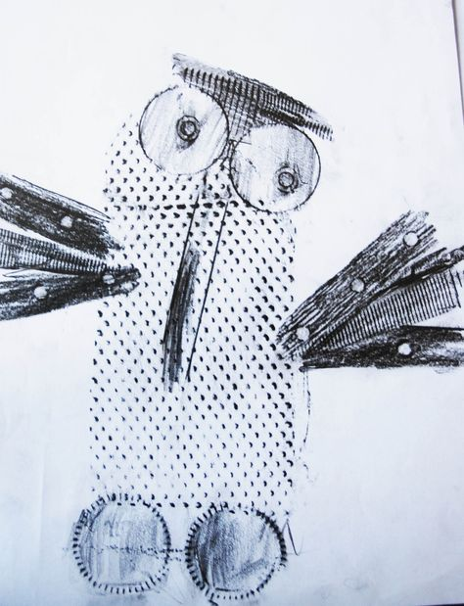
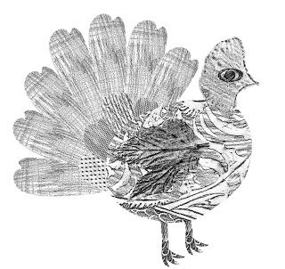
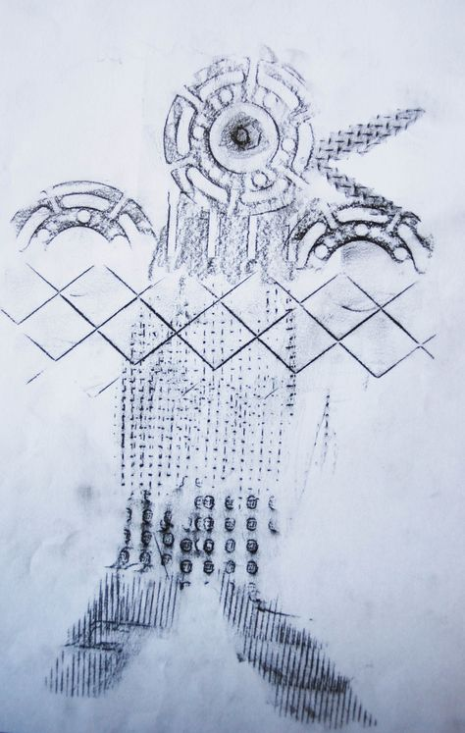
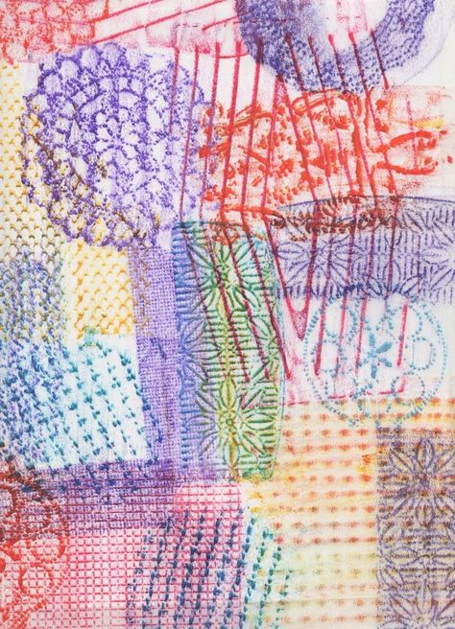
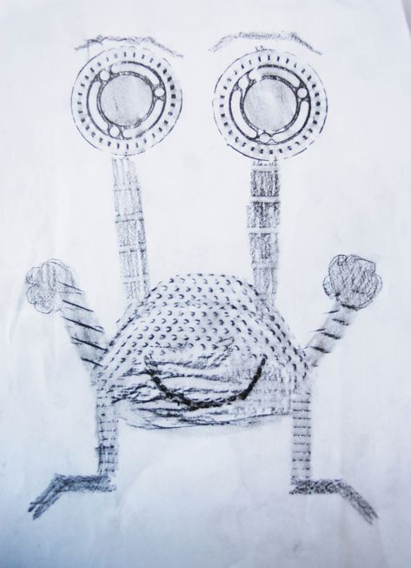
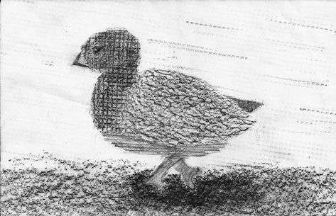

Slide 19
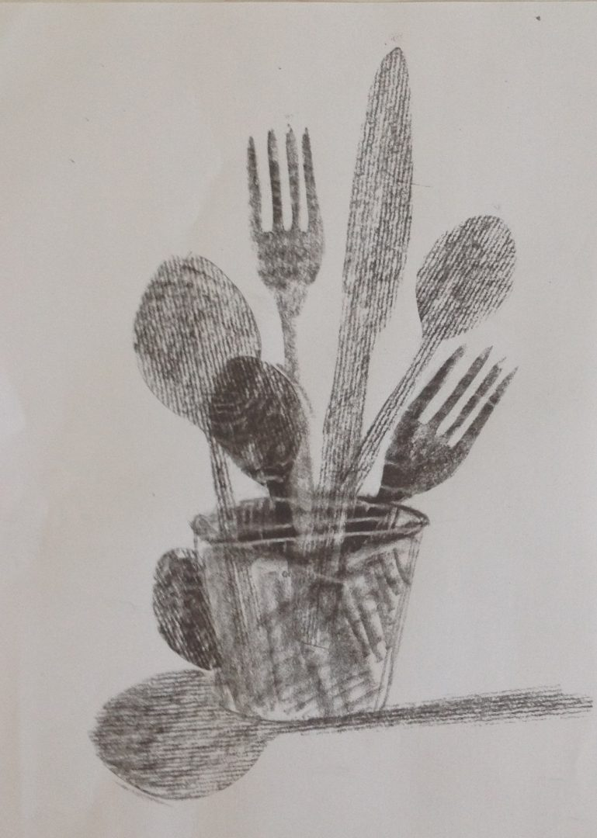
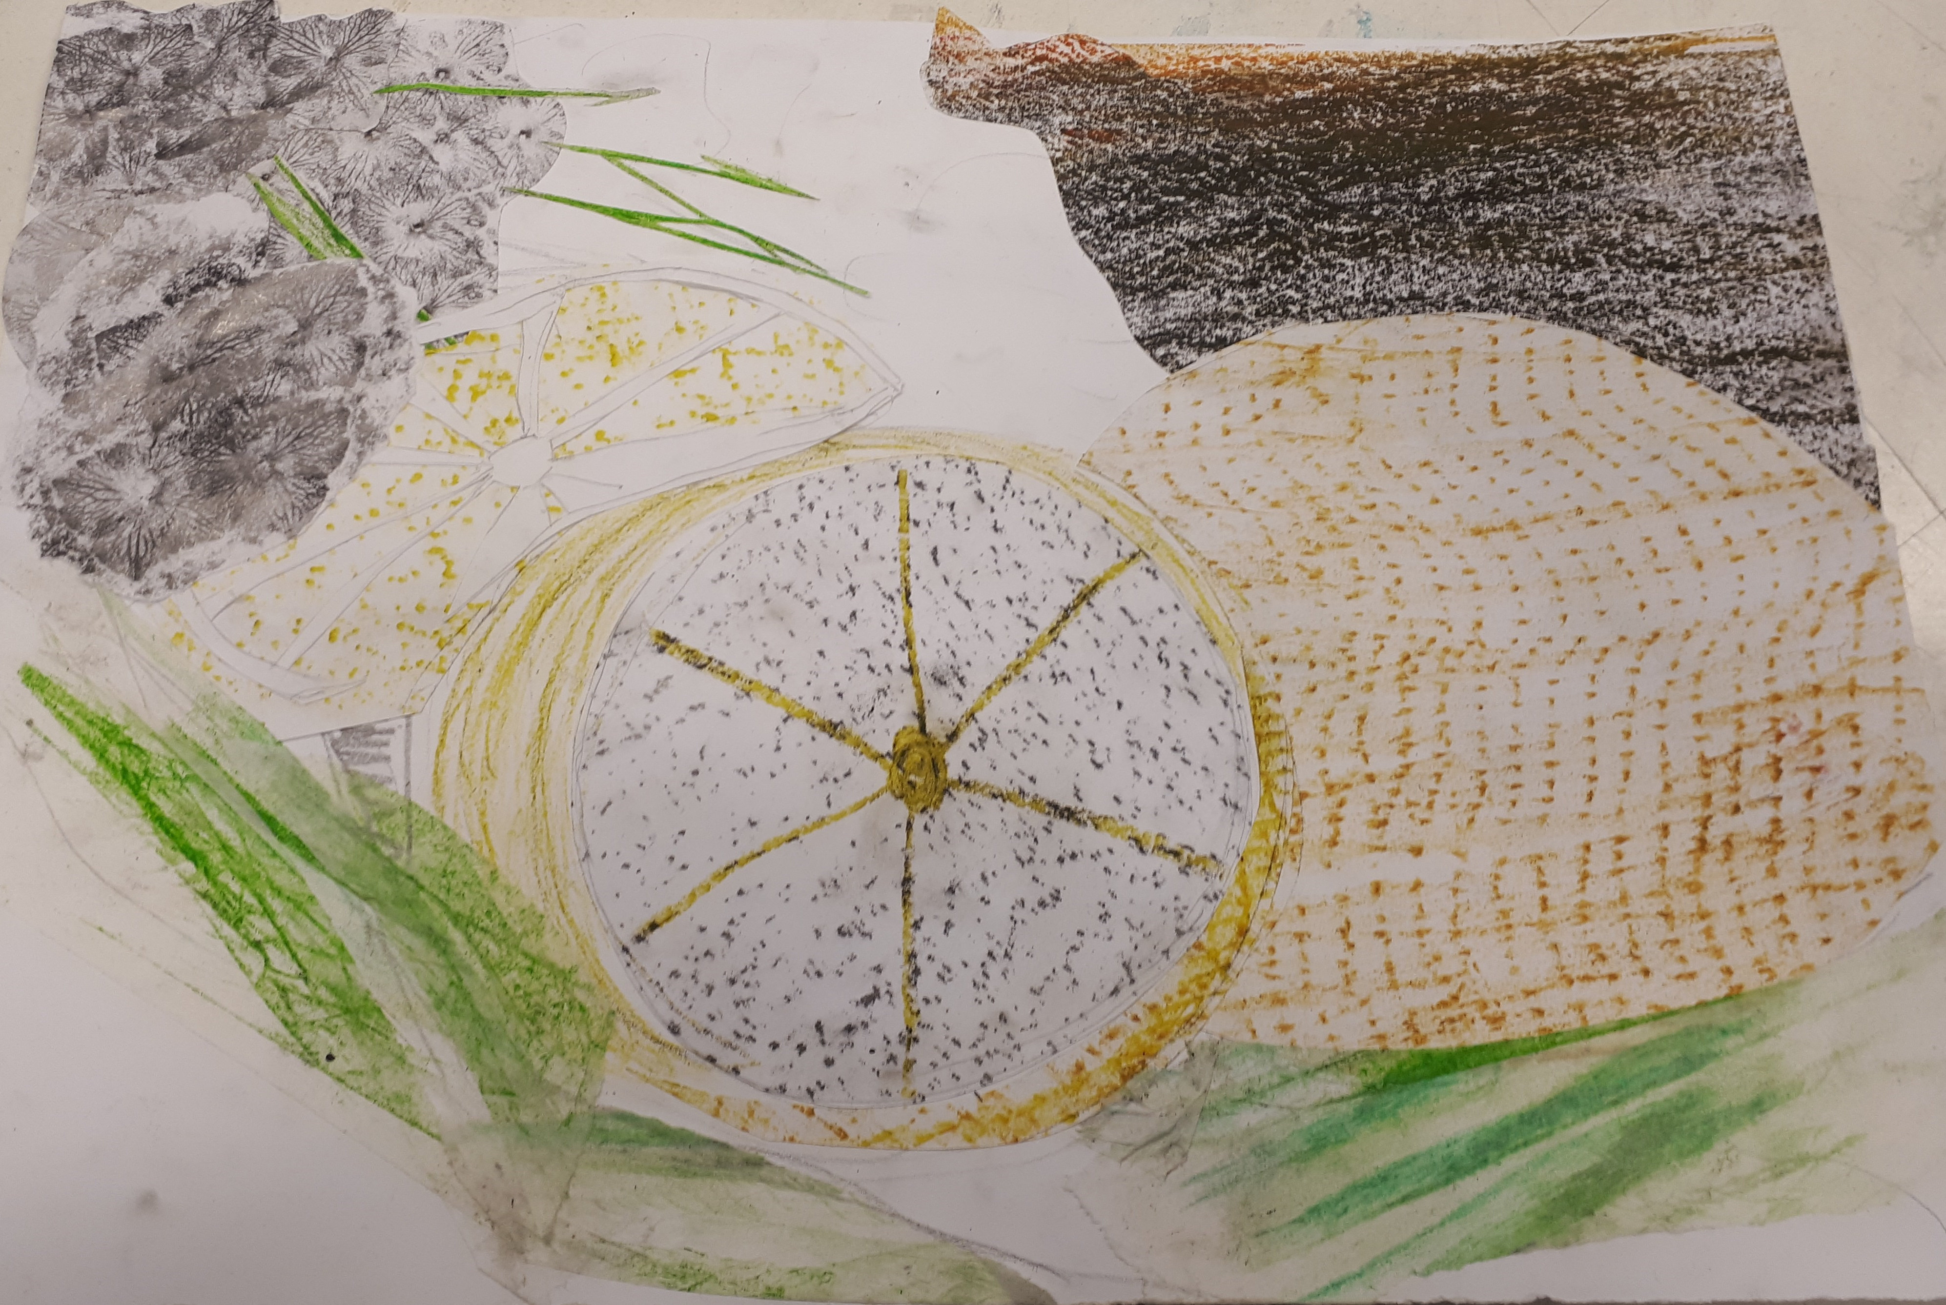
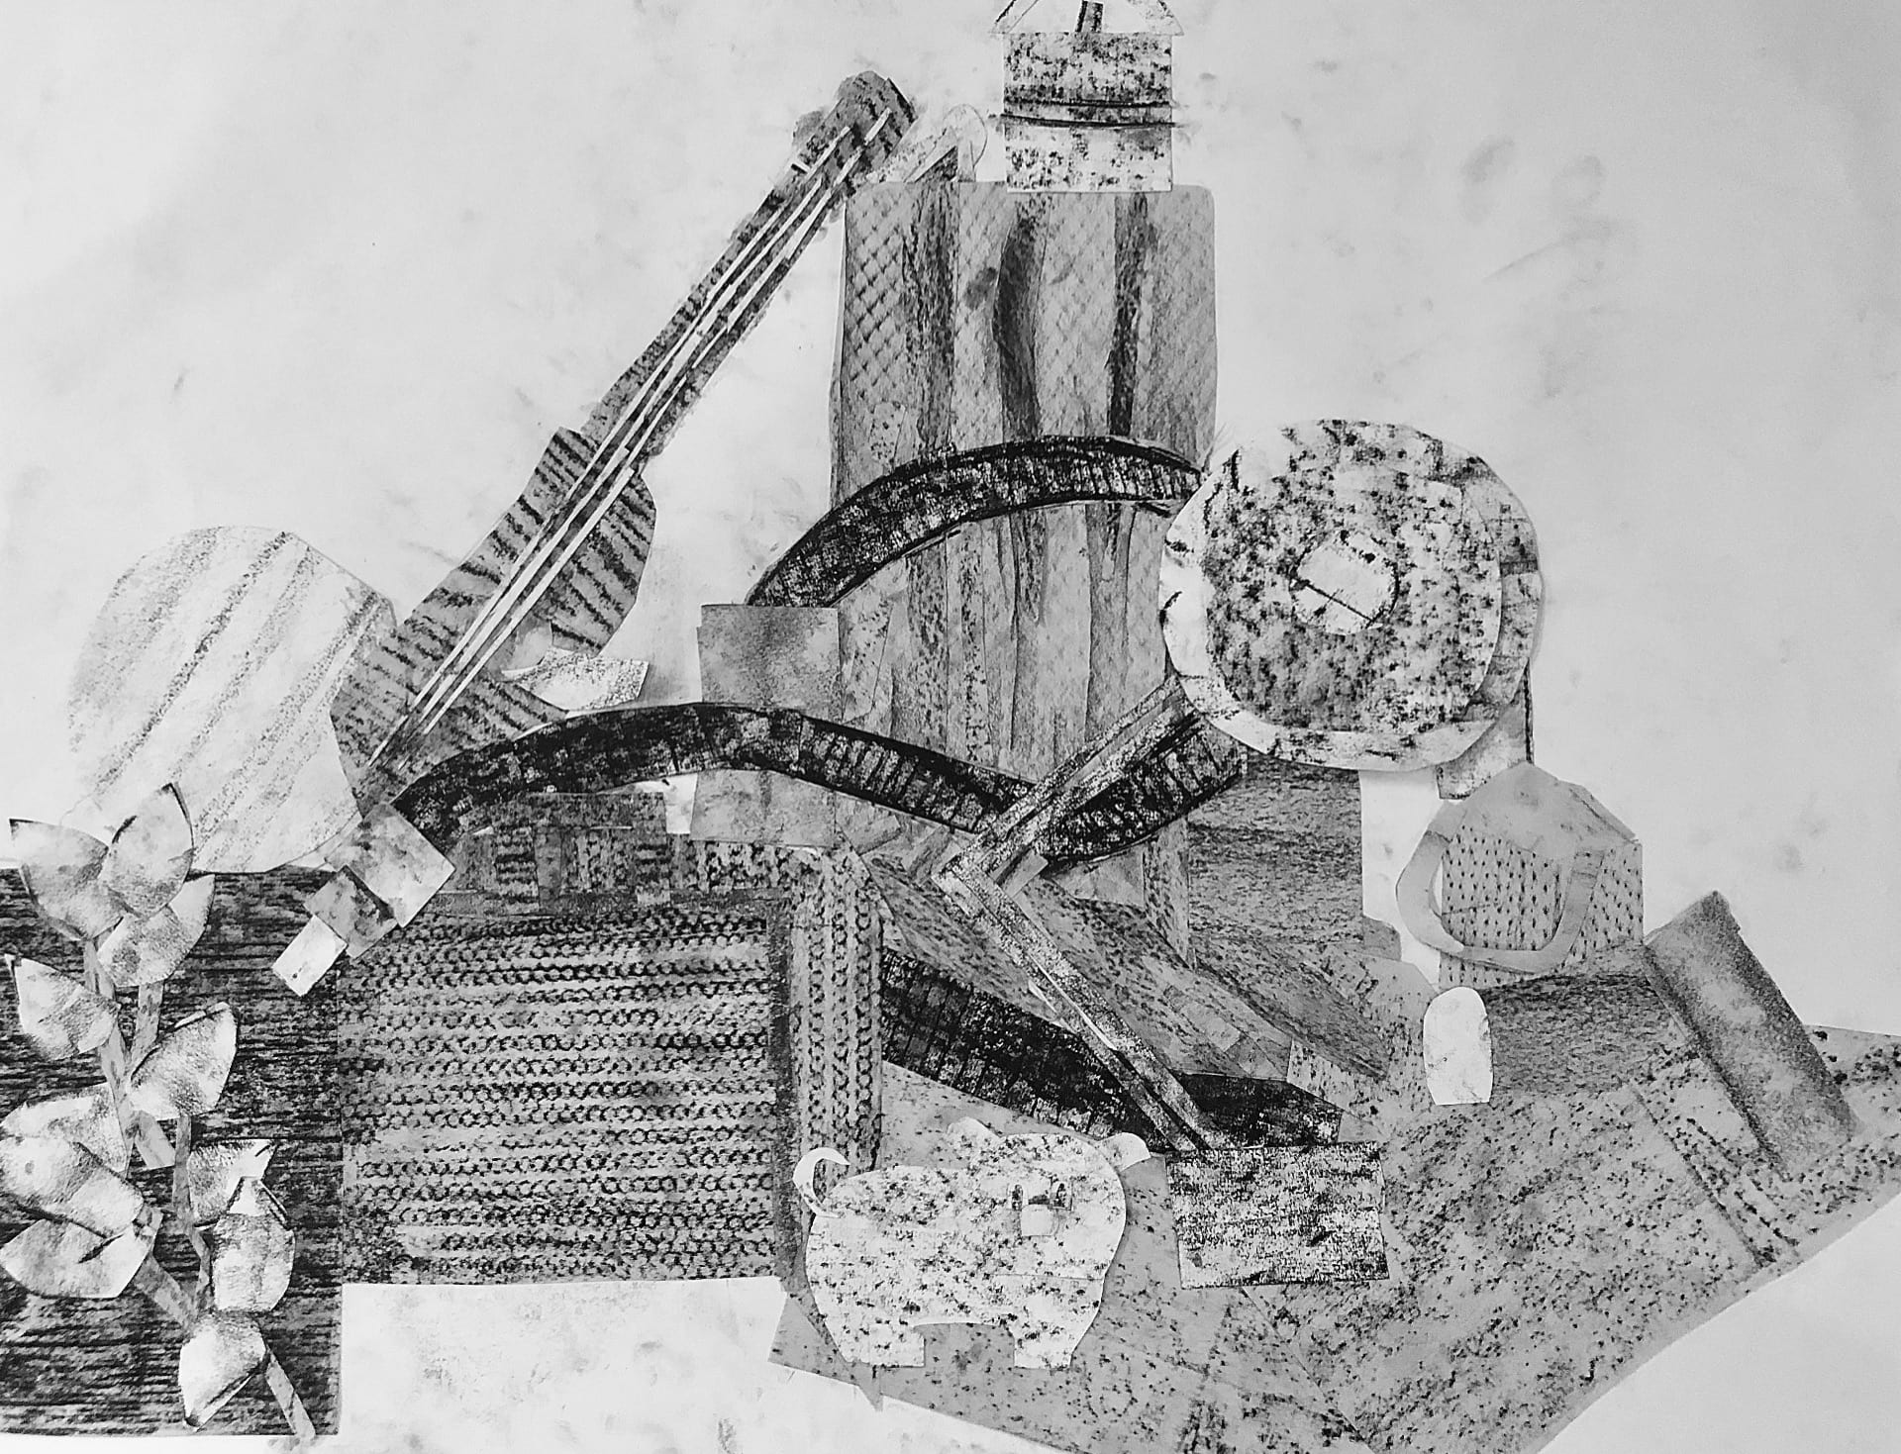

Slide 20
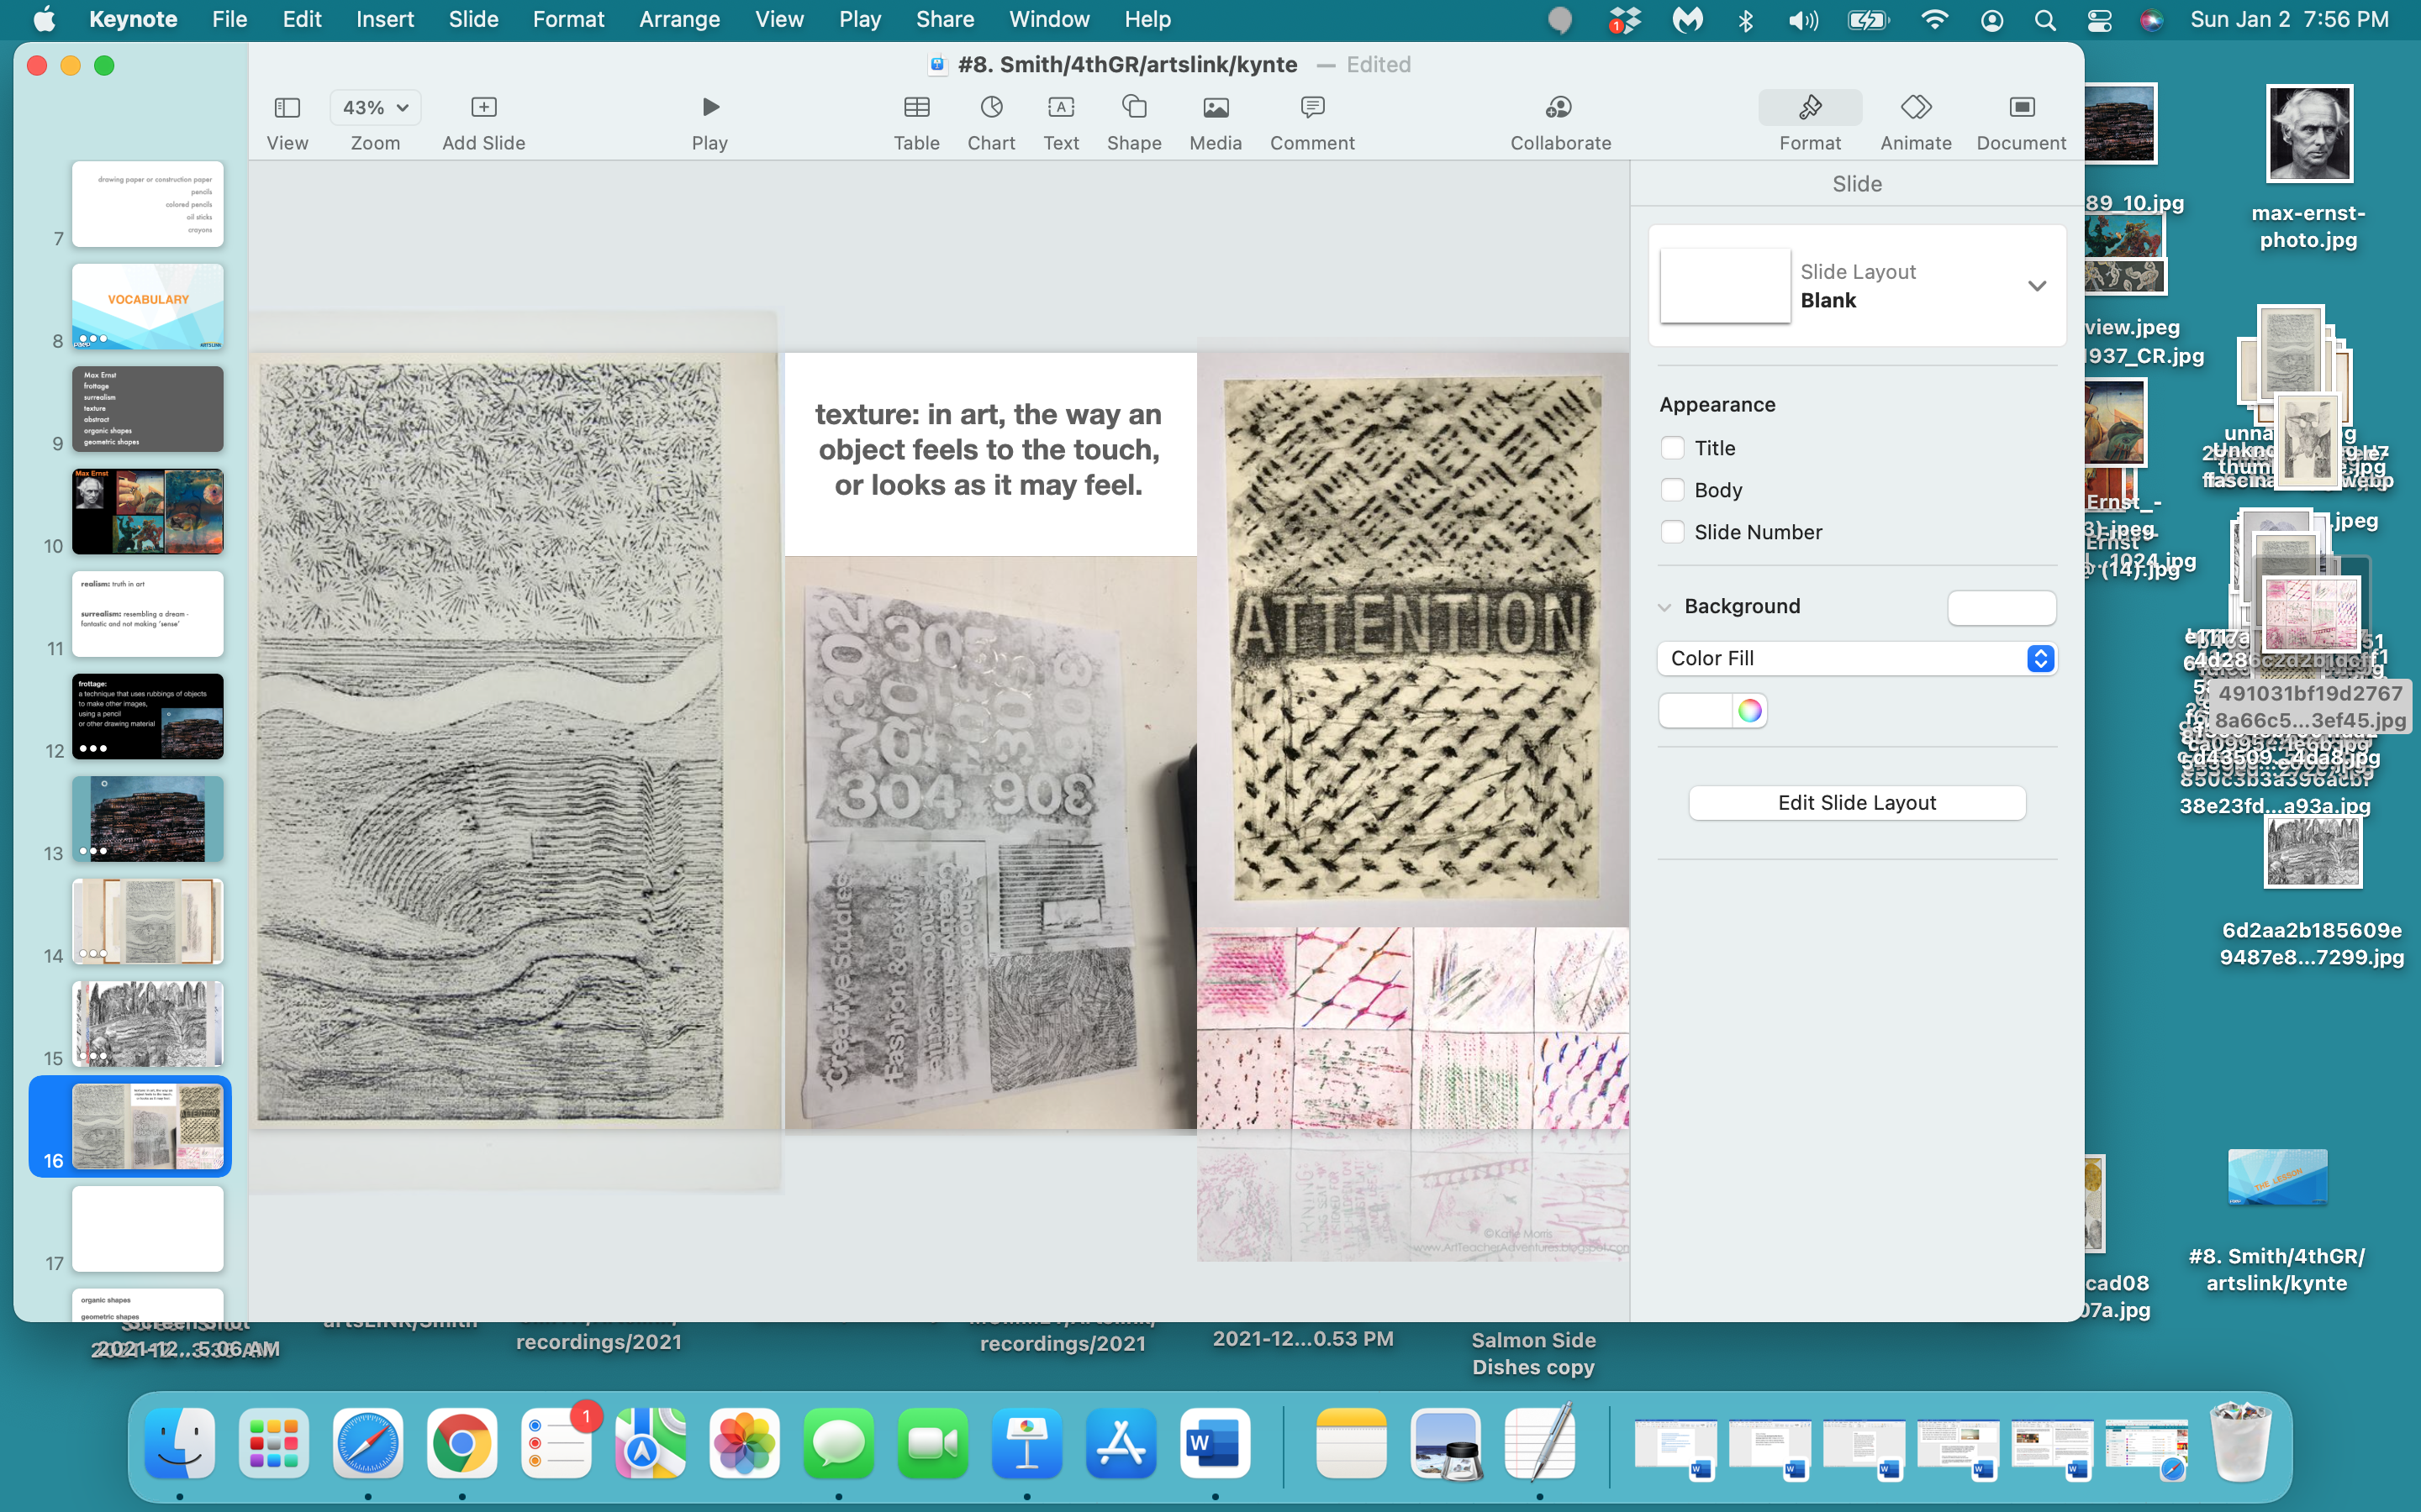

Slide 21
organic shapes: irregular and imperfect
shapes, often curved and free flowing
geometric shapes: shapes using tools -
like compasses, rulers, protractors;
any shape that looks ‘man-made’

Slide 22
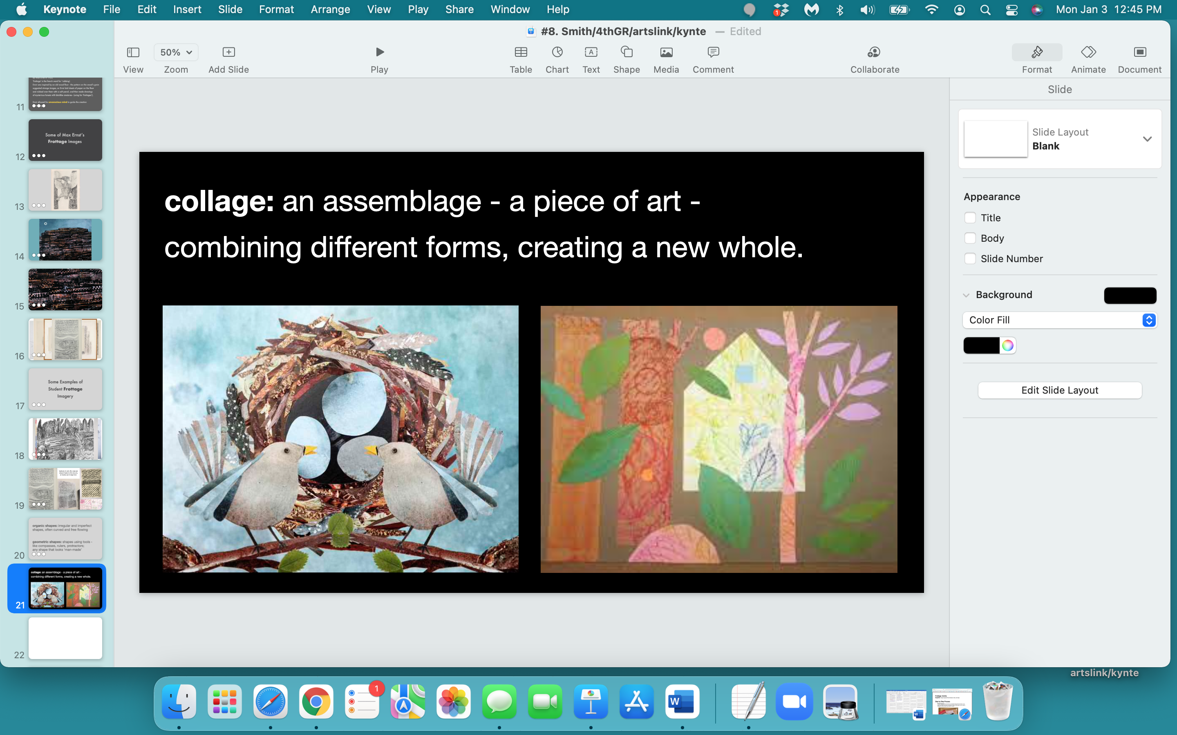

Slide 23
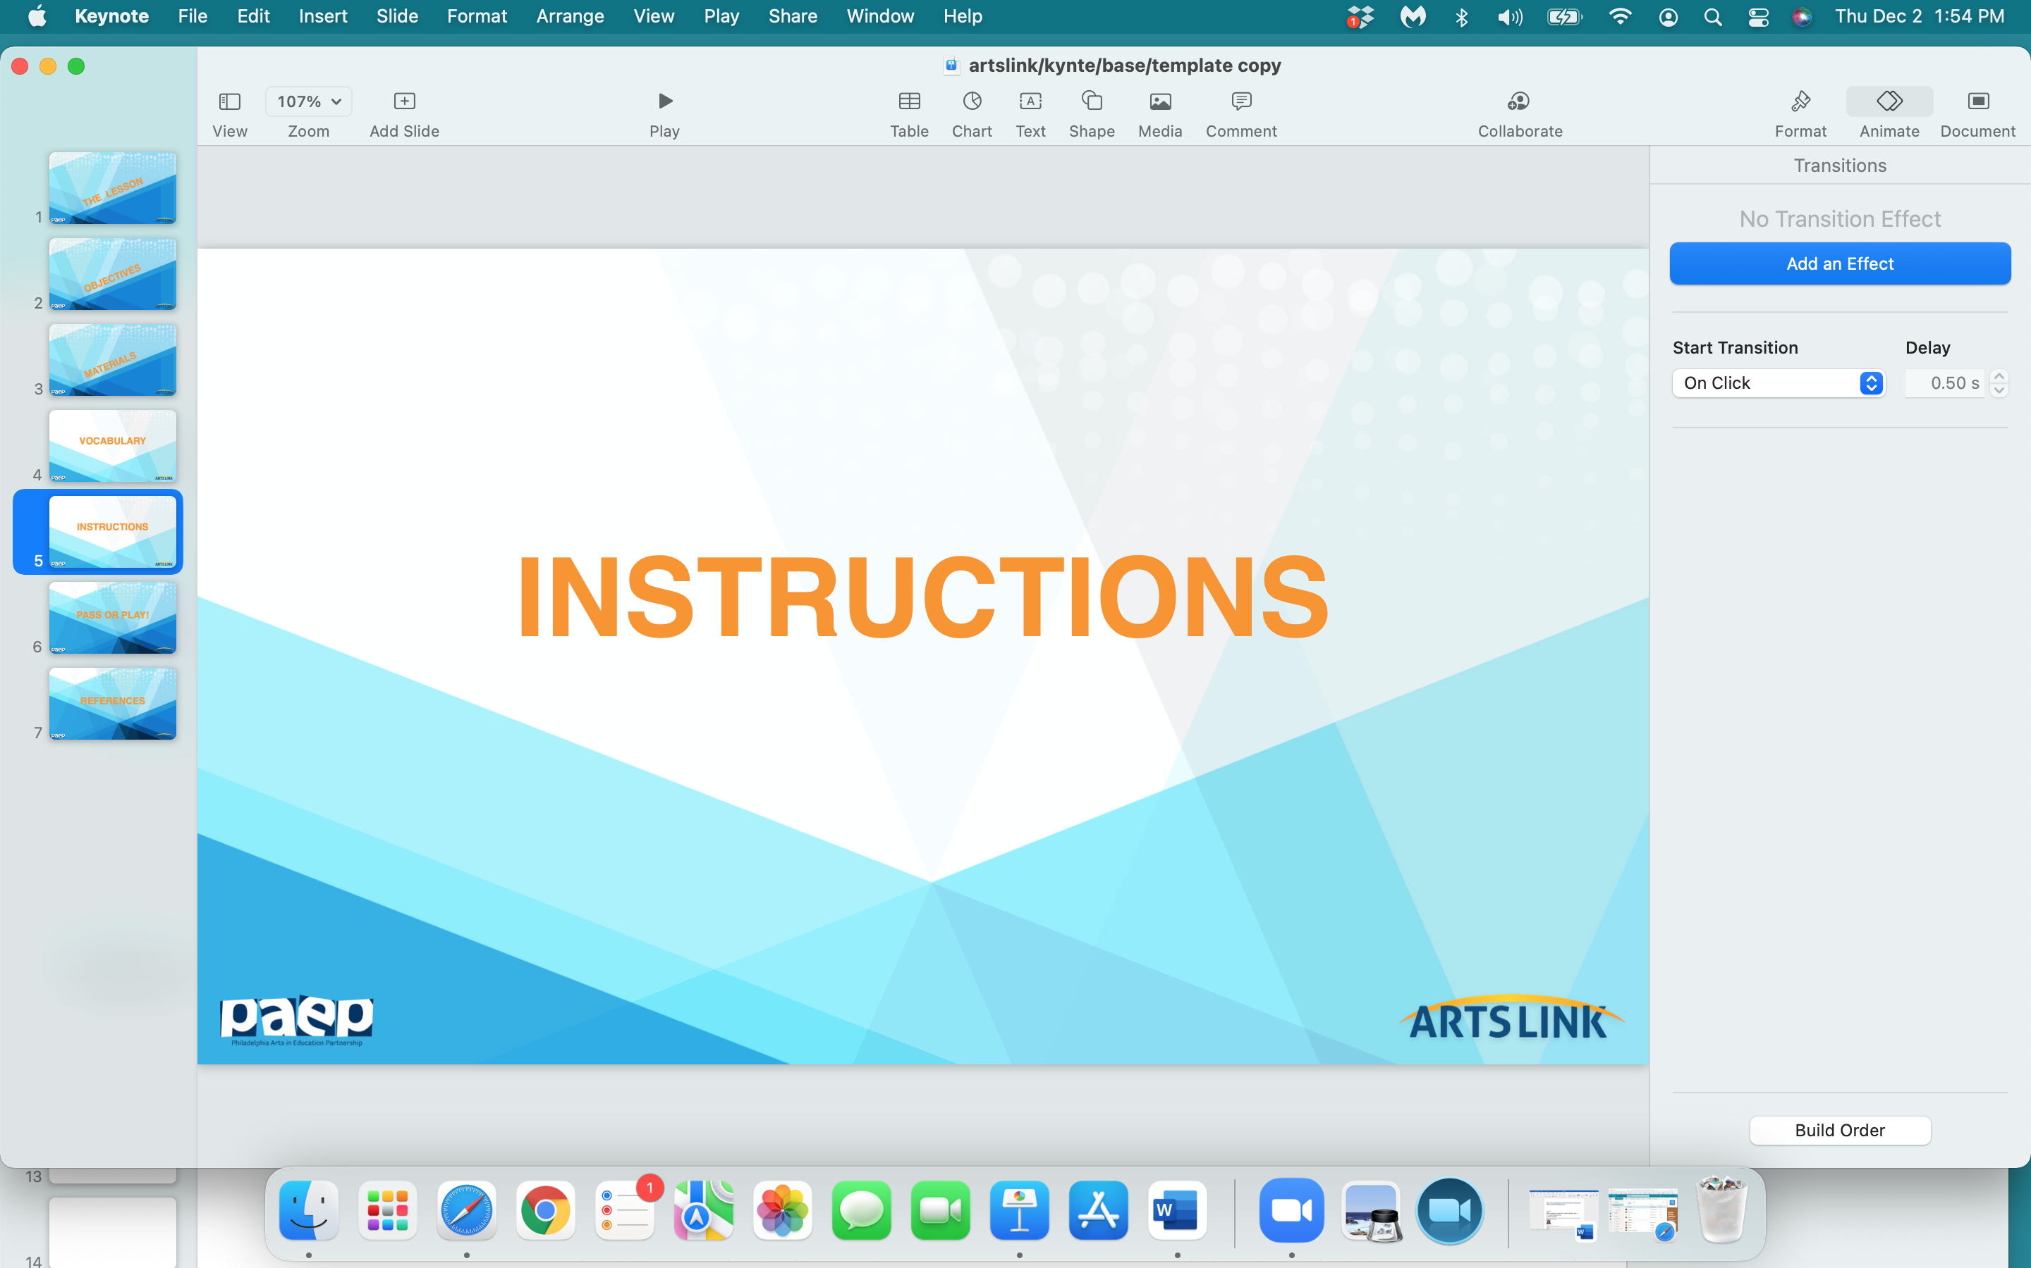

Slide 24
Create a Fantastical Animal, Landscape or
Anything You Want with Your ‘Frottages’
Find objects around you that have interesting textures: wood floors, tile floors, fabrics, books, top of desk, pencils, rulers, the wall - you get the point - anything with a ‘texture’ or interesting shape.
Put a piece of paper over the textured object you want to use. Using the side of a crayon or the tip of your pencil, create a ‘frottage’- a rubbing over the object under the paper - making a textured impression.

Slide 25
3. After you’ve taken several rubbings, or ‘frottages’, look at
your impressions - or rubbings - then think of a ‘theme’ for your new image,
and start to create this new image by cutting up your ‘frottages’ -
and create a fantastic animal, or unreal landscape, or any image you want.
THERE IS NO WRONG WAY TO DO THIS.
BONUS! BONUS! BONUS!
Share you artworks with the rest of the class…
and ask your classmates to guess what surfaces you used
to make your rubbings - or ‘frottages’.

Slide 26
And when you share your artwork
with the class…
please describe your artwork -
describe what you created -
in one sentence.

Slide 27
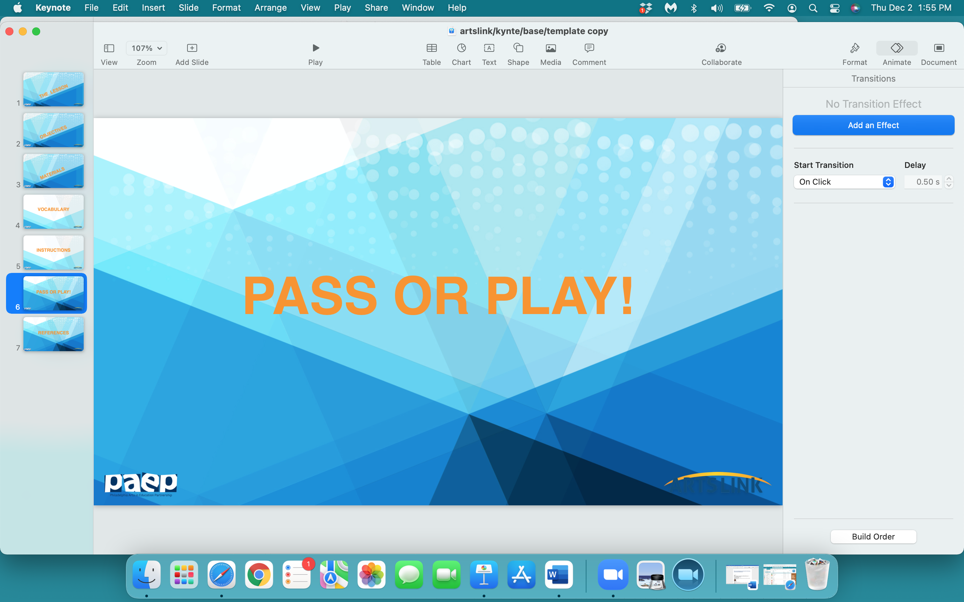

Slide 28
what one thing
did
you
learn
today…pass or play?

Slide 29
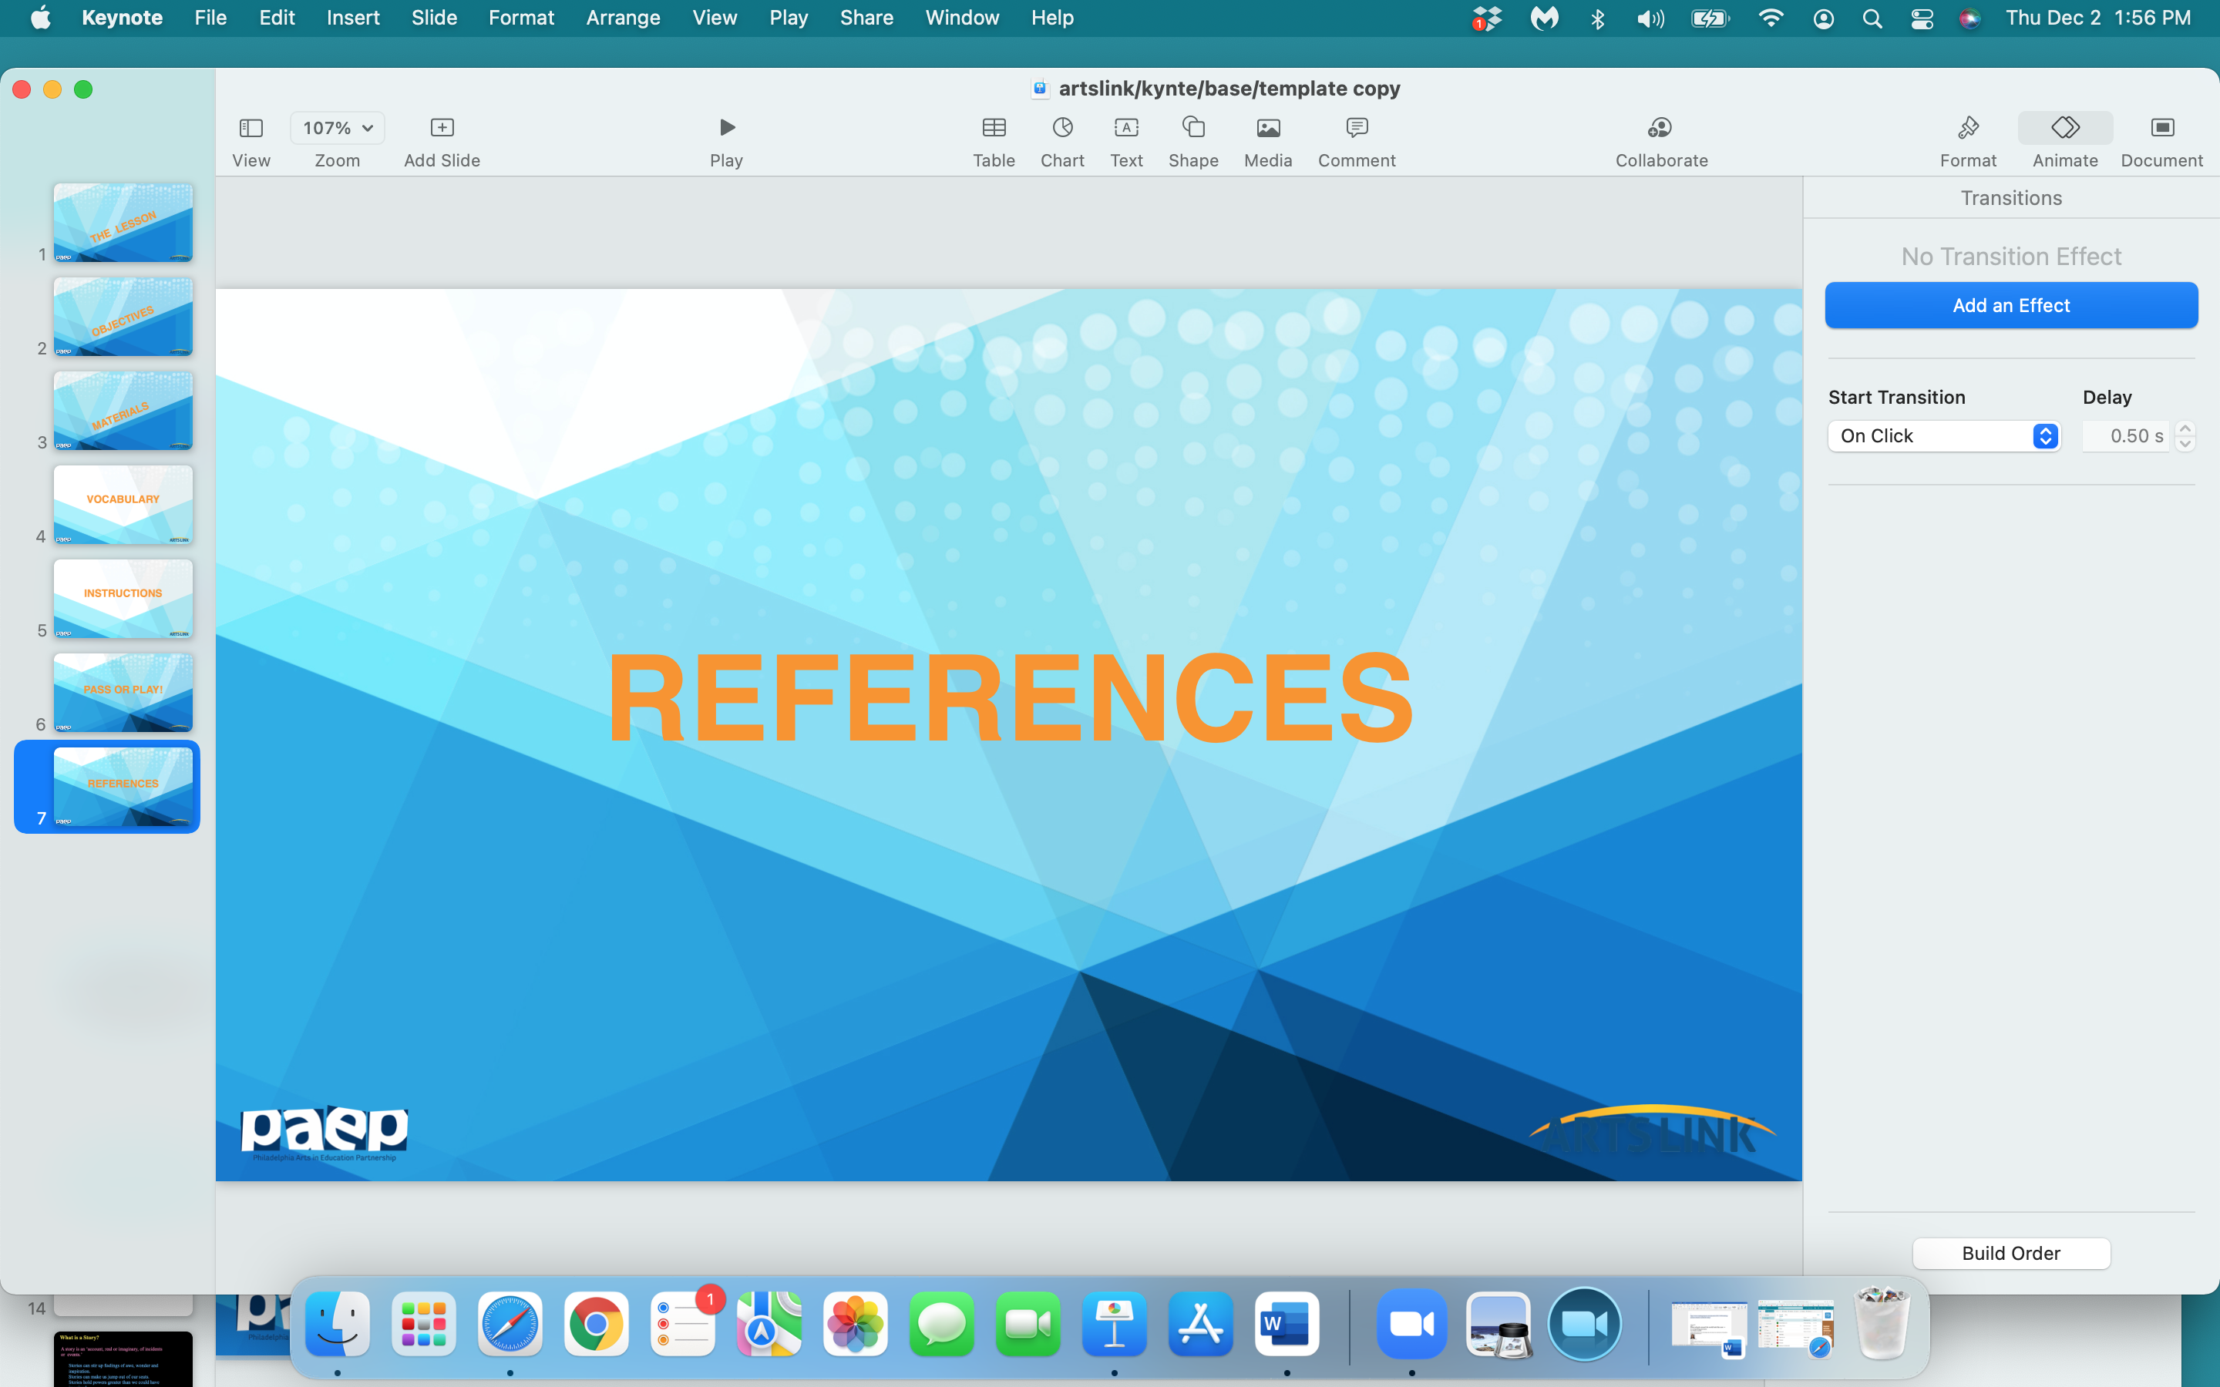

Slide 30
https://www.joshuanava.biz/techniques-2/frottage.html
https://www.moma.org/collection/works/portfolios/10056?=undefined&page=&direction=
https://www.tate.org.uk/art/art-terms/f/frottage
http://artsattrinity.weebly.com/frottage.html
http://bechtler.org/public/files/learn/Max_Ernst_Leaf_Rubbings_Compact_Lesson_.pdf
https://cpb-us-w2.wpmucdn.com/sites.stedwards.edu/dist/1/170/files/2012/12/Potts_Texture-and-Frottage-2jxzce2.pdf
https://www.teach-nology.com/teachers/lesson_plans/arts/Frottage912.html
https://www.tate.org.uk/art/art-terms/s/surrealism
https://www.moma.org/calendar/exhibitions/390
https://www.tate.org.uk/art/art-terms/f/frottage

