Slide 1


Slide 2
LOUISE BOURGEOIS
SECOND GRADE
Leigh Pawling March 2022

Slide 3
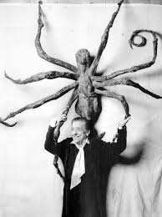
LOUISE
BOURGEOIS
1911-2010

Slide 4
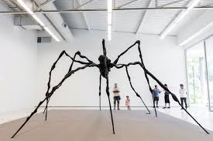
Bourgeois once explained that she chose the spider as a subject
because its traits reminded her of her mother.

Slide 5
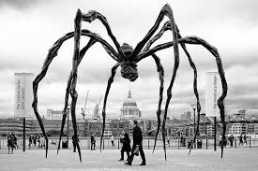
She was deliberate,
clever
, patient,
soothing
, reasonable,
dainty
, subtle,
indispensable,
neat,
and
as useful as a spider,” the artist said.
Art that is accessible to the public is called PUBLIC ART

Slide 6
Vocabulary word
Sculpture :
Branch of visual art that operates in three dimension. Originally carving and modelling , in stone, metal, ceramics, wood and other materials

Slide 7
Pass or play!
Where have you seen a sculpture?

Slide 8
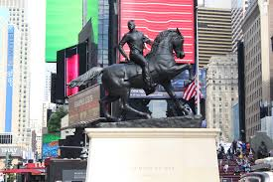

PASS OR PLAY!
HAVE YOU EVER SEEN A SCULPTURE? WHERE??

Slide 9
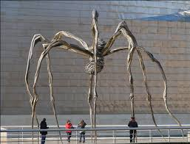
ART THAT IS ACCESSIBLE TO THE PUBLIC IS CALLED:
PUBLIC ART

Slide 10
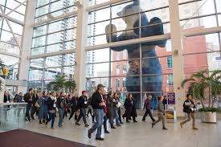
Vocabulary word
Scale :
The overall physical size of objects in an artwork.
We relate SCALE to the size of the human body

Slide 11
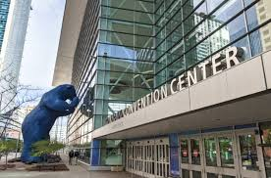
This is in Denver Colorado! This is an example of three dimensional art because you can see all of it’s sides!
Created by Lawrence Agent

Slide 12
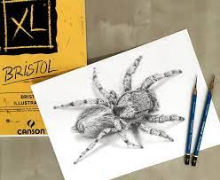
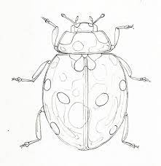
Did you ever draw something that is really BIG, small? Or something really SMALL, big?

Slide 13
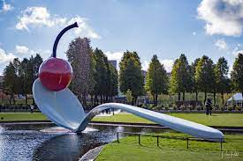
‘Spoon Bridge and Cherry’ by Claus Oldenburg

Slide 14
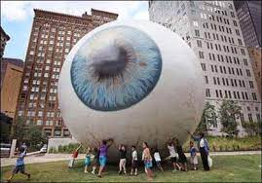
This piece is called “EYE” by Tony Tasset and is in Dallas Texas

Slide 15
THIS SHOWS ‘SCALE’ COMPARING THE PEOPLE TO THE SPIDER SHOWS HOW BIG THE SPIDER SCULPTURE IS!

Slide 16
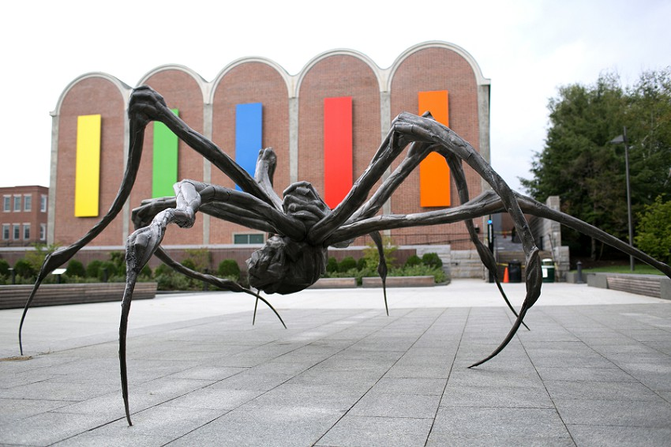
Look! A different kind of spider - public art sculpture by Louise Bourgeois!

Slide 17

Vocabulary word:
SYMMETRY
which means :
Same
On
Both
Sides !
LIKE YOUR FACE!

Slide 18
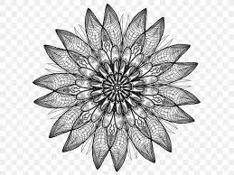
This is another example of symmetry! See! It’s the same on both sides!

Slide 19
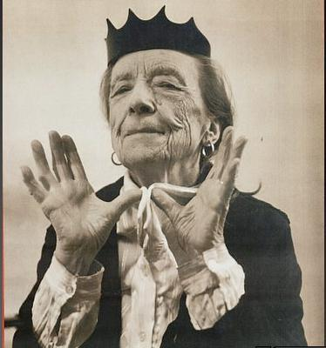
Wouldn’t you just LOVE to meet this woman?????
Art is a guaranty of sanity

Slide 20
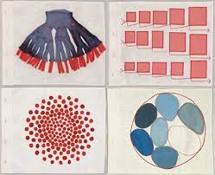
Some of Louise’s drawings

Slide 21
materials
For this lesson

Slide 22
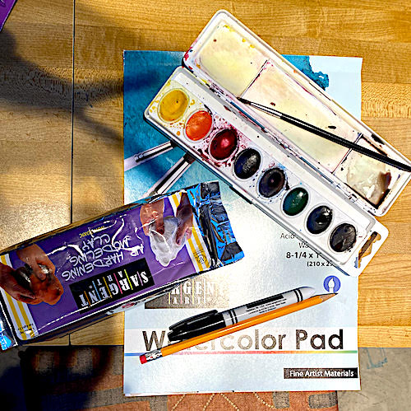
Supplies you will need :
Supplies needed:
Watercolor set and brush
Watercolor pad
Pencil
Magic marker/ black
Self hardening clay
Plastic bag to keep project in
Between classes

Slide 23
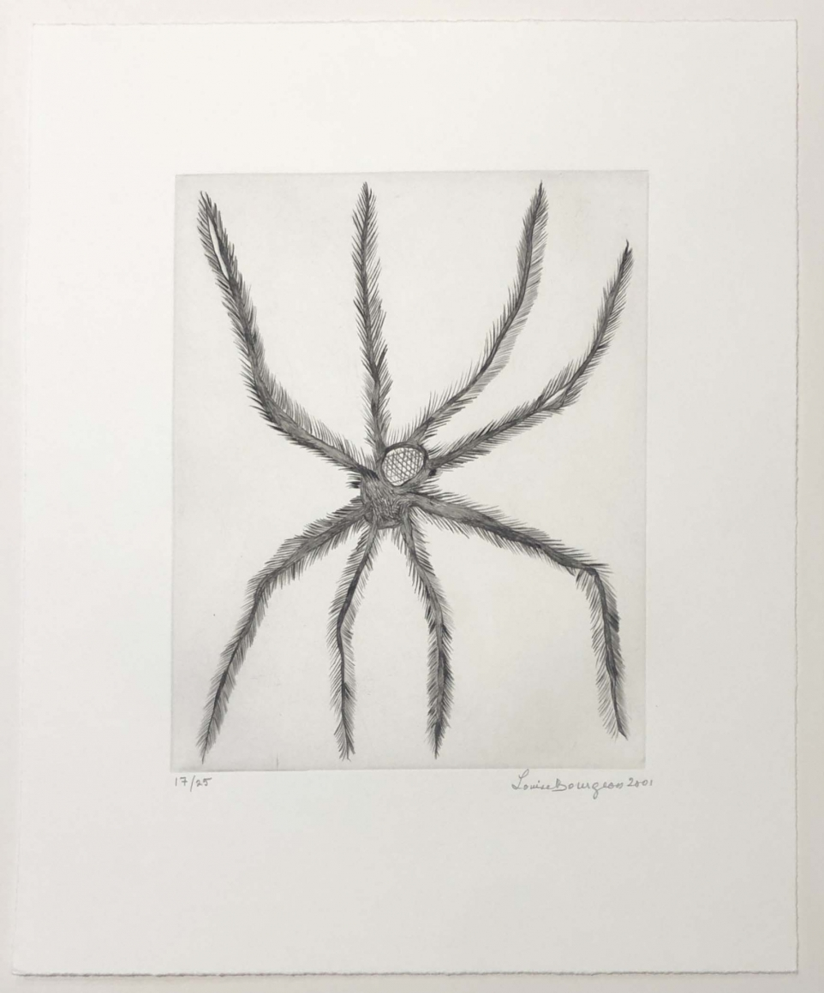
Louise did a ‘study’ of the spider before doing her big sculpture! This is an example of two dimension

Slide 24
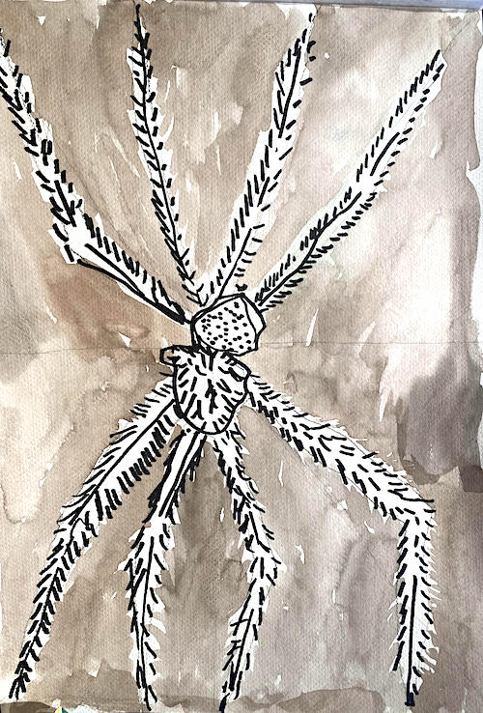
Our study for our sculpture in watercolor, magic marker and pencil!

Slide 25
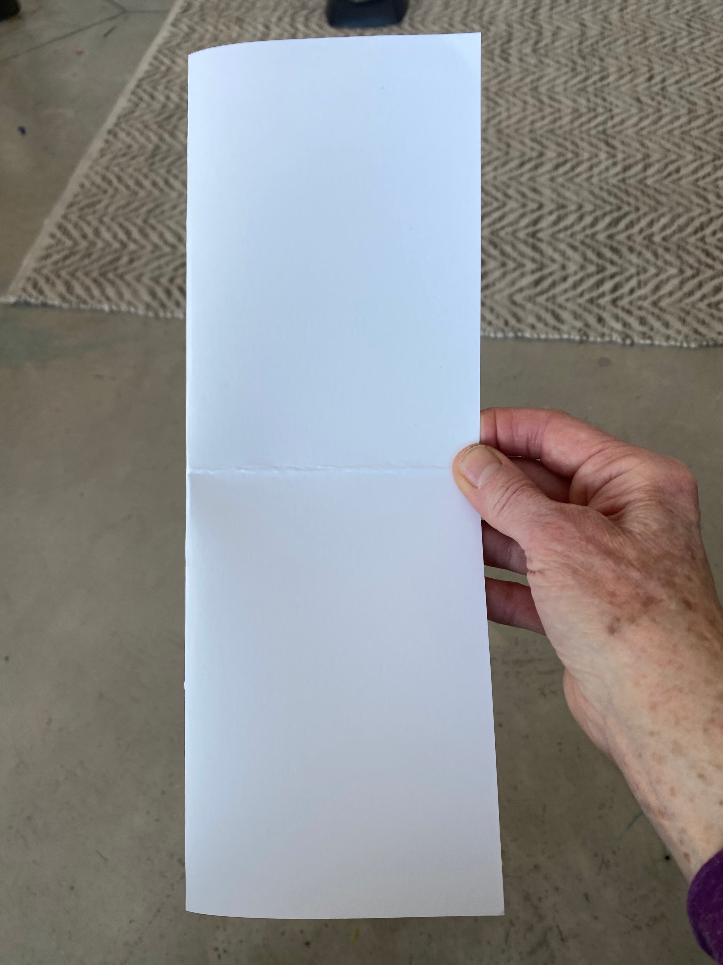
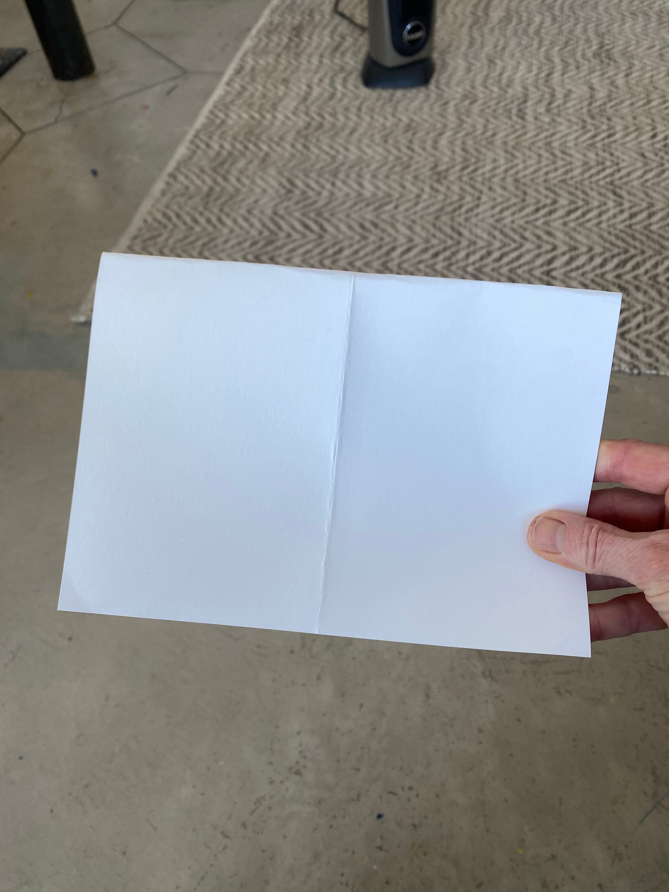
Fold paper in half horizontally and then in half vertically!

Slide 26
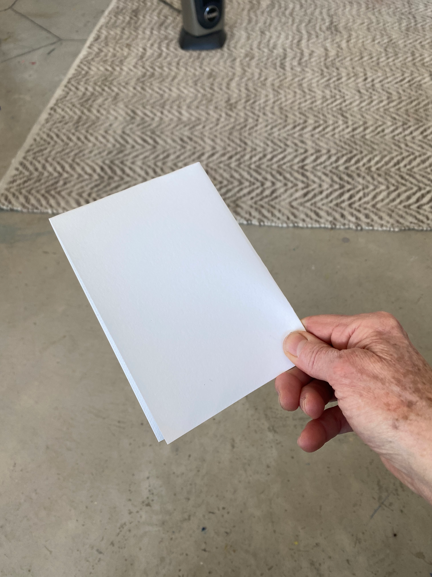

Slide 27
This makes four equal quarters

Slide 28
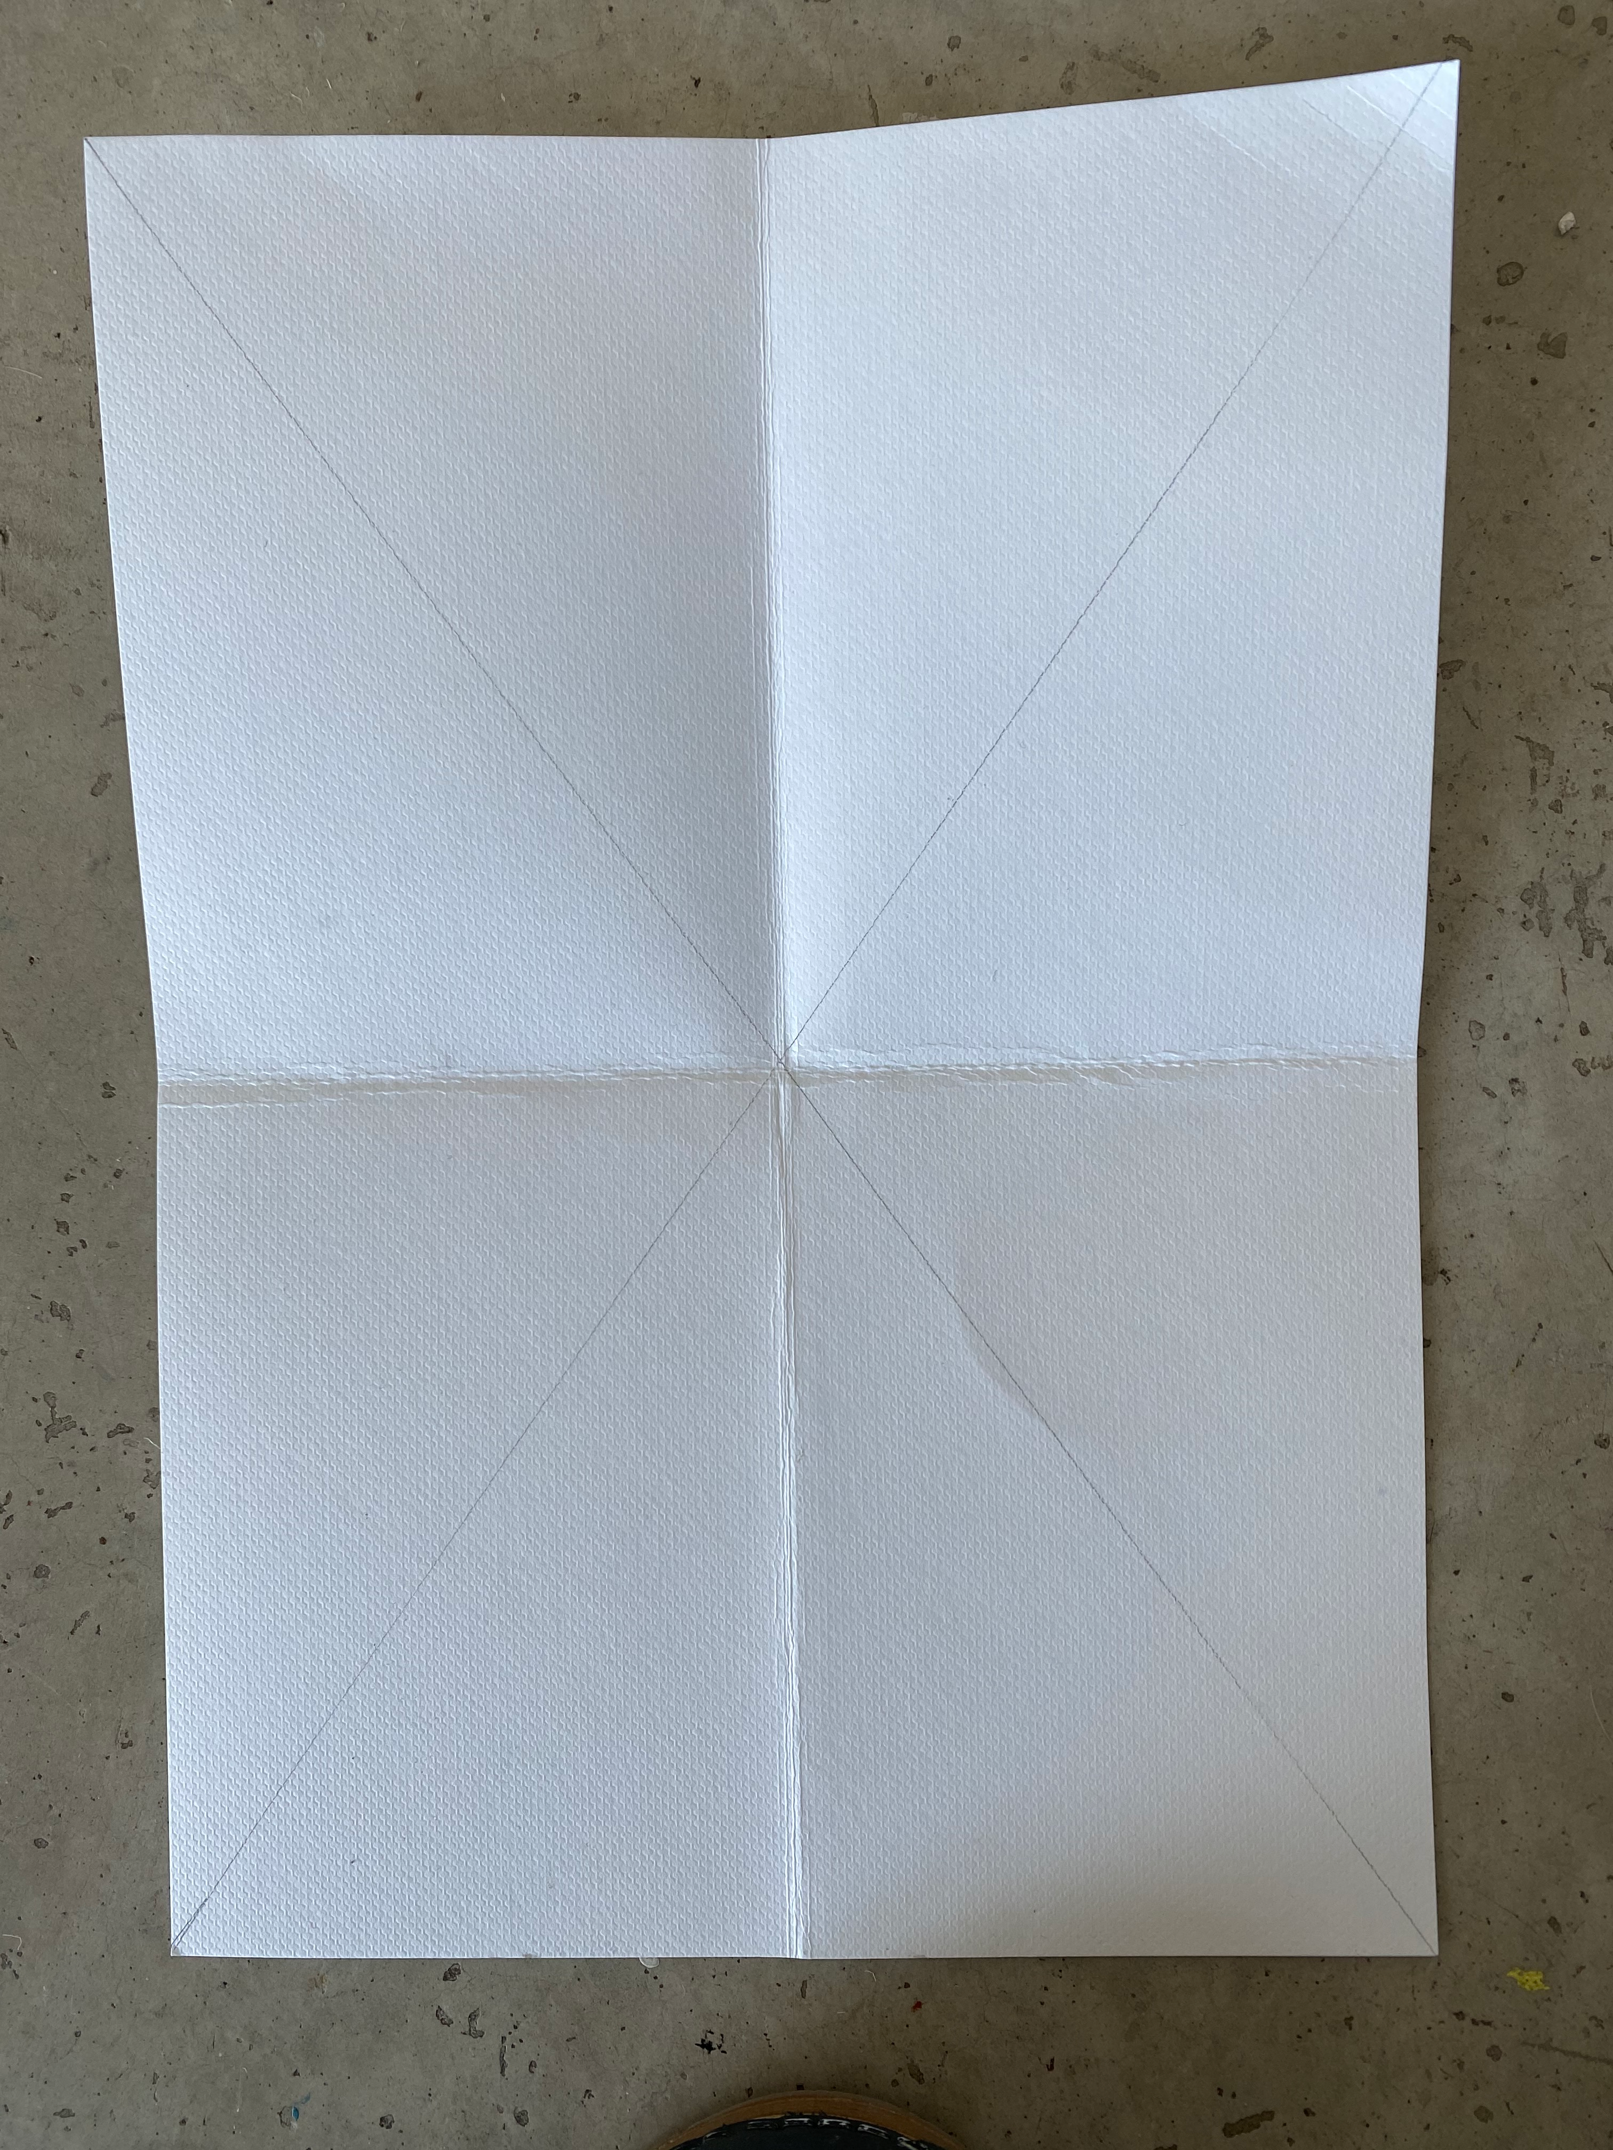
Now, make diagonal lines with a straight edge or ruler

Slide 29
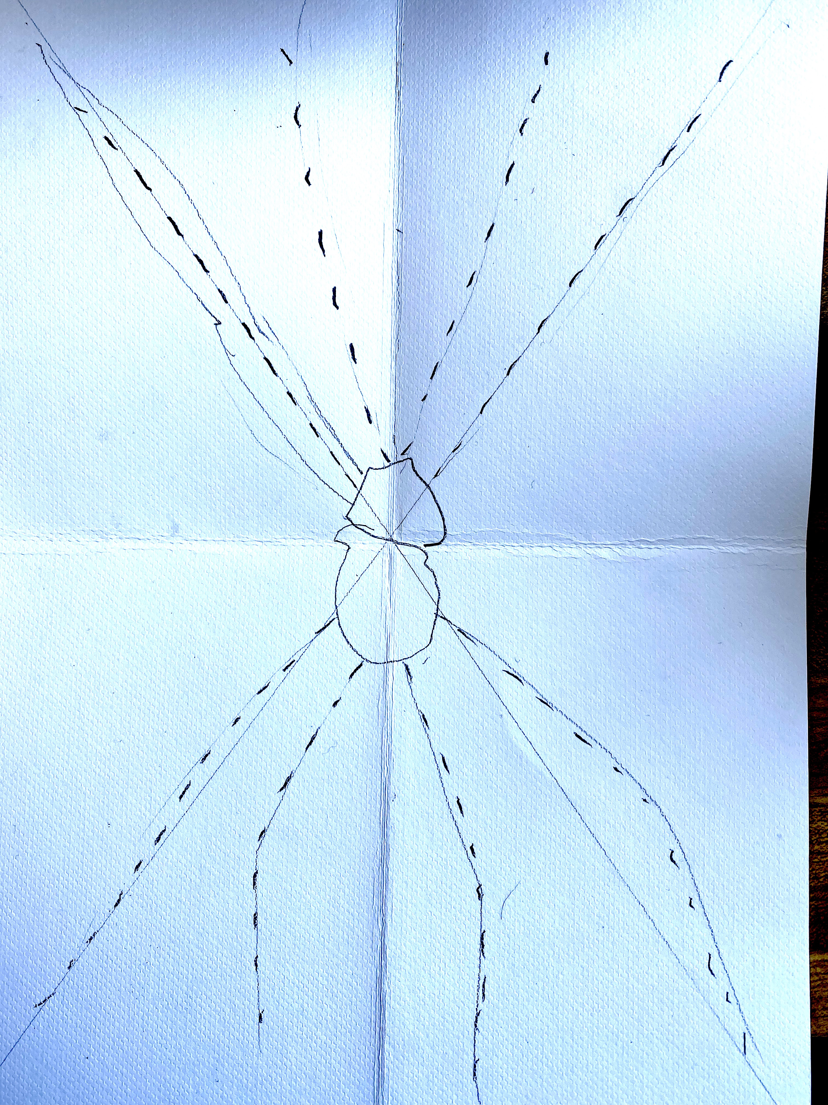
Now…. We construct our spider! It’s going to have… eight legs! And our paper is ready! YAY

Slide 30
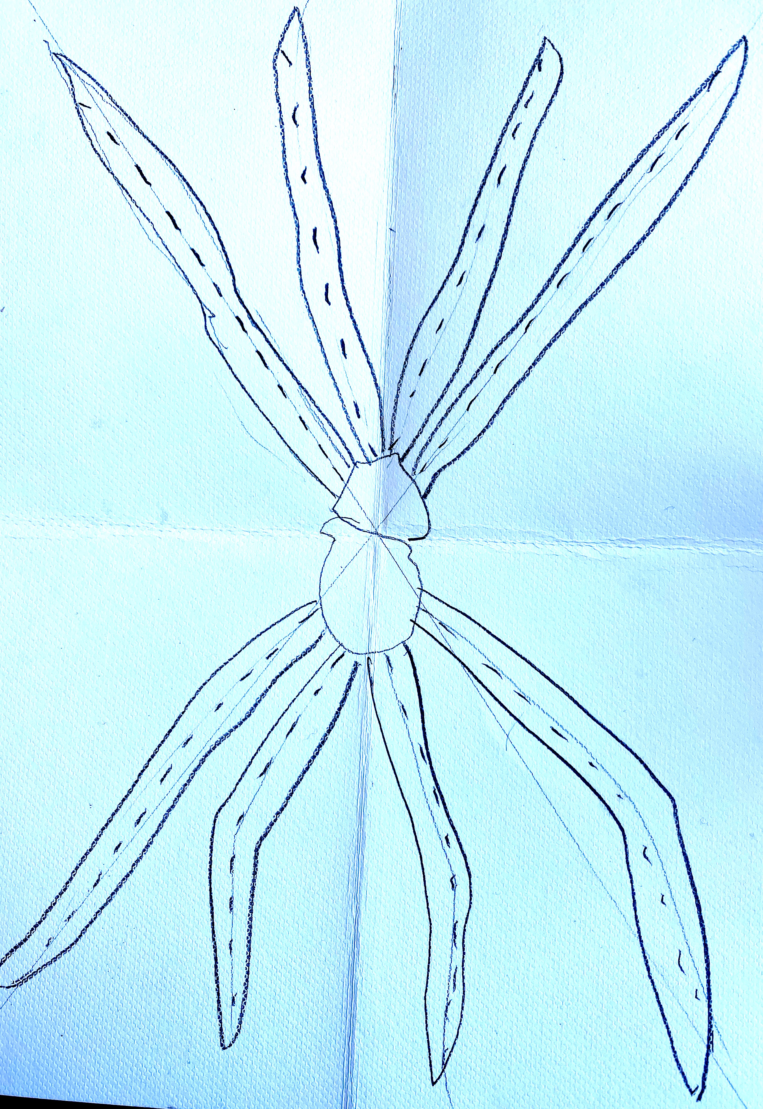
We now create eight legs using mid line as guide to chunk up those legs!

Slide 31
Now we make those legs hairy and scary!

Slide 32
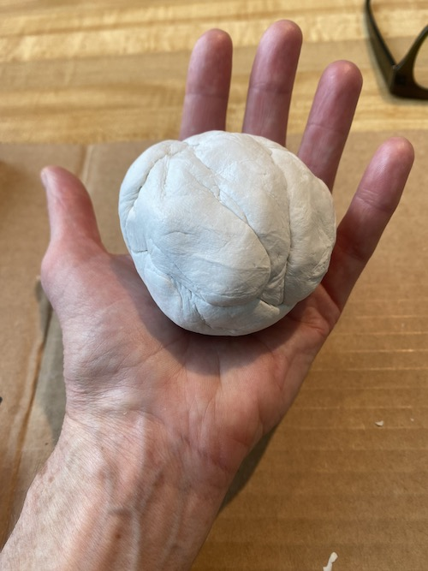
Start with half the amount of clay from your pack. Make sure you put rest of clay in plastic bag
Or it will dry out.

Slide 33
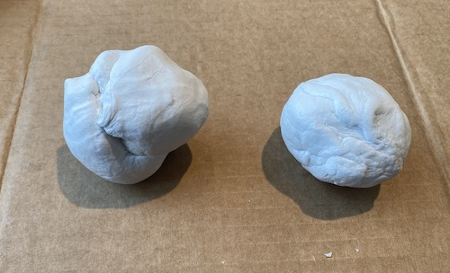
Divide that clay into two pieces - in two dimension these
Are circles- in three dimension they are called spheres

Slide 34
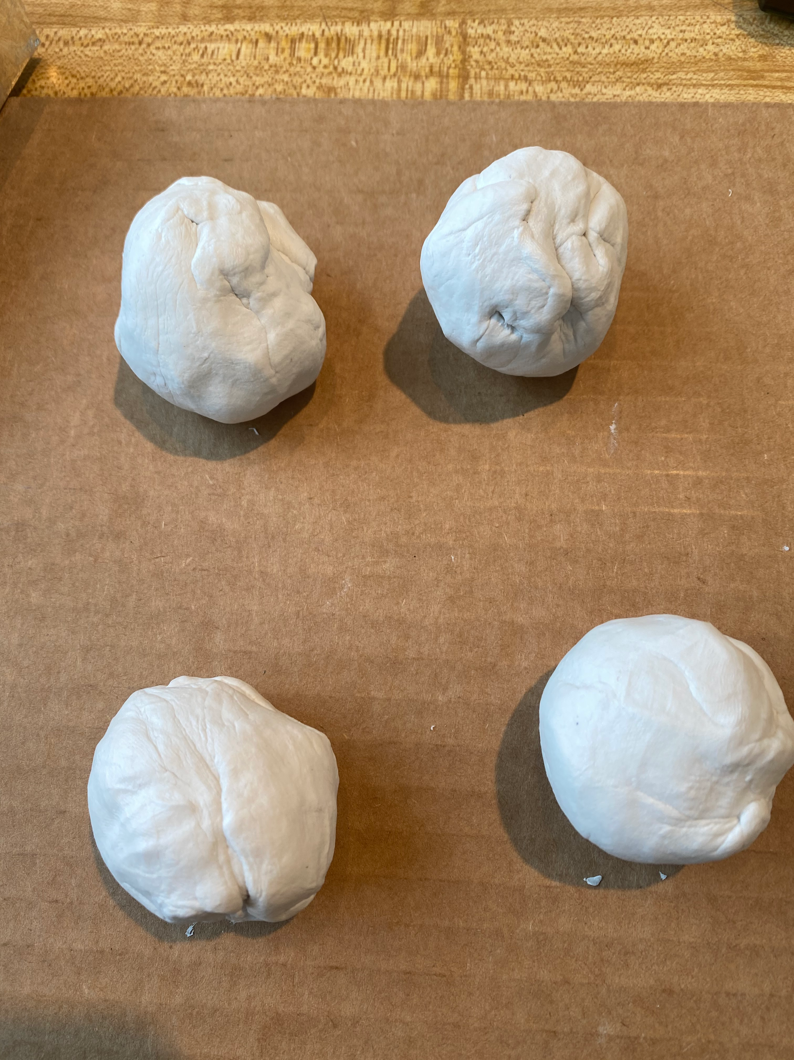
Divide those two balls into half to make four balls

Slide 35
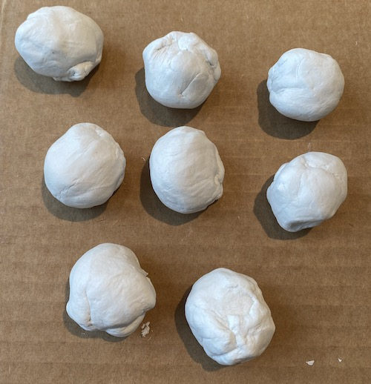
Divide those four balls into half to make eight balls / spheres

Slide 36
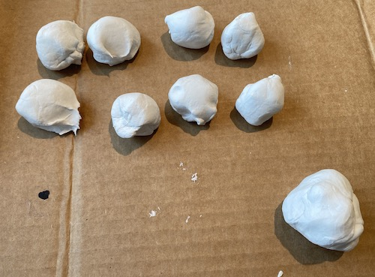
Now, take a quarter of each ball off to create on bigger sphere. That big sphere is divided into two pieces
To make the head and body of the spider!

Slide 37
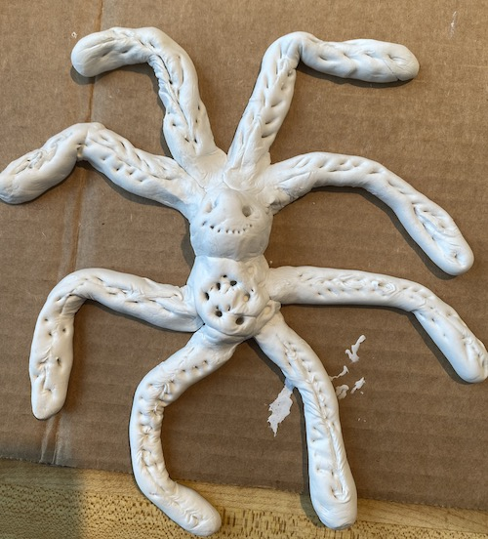
The balls are rolled out into cylinders to create the legs. The two balls are joined to create the head and body
The legs are carefully put on the body.
And viola! There is you Louise Bourgeois inspired spider!

Slide 38
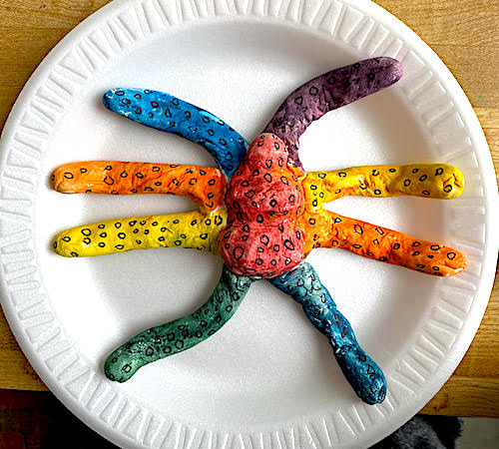
This is what our finished spider will look like! We roll the balls of clay into balls and cylinders put it all
Together and then paint with our watercolors and markers! FUN!!!!!

Slide 39
vocabulary
Public art
Sculpture
Scale
Subtle
Symmetry
vertical
Horizontal
Half
Quarter
Cylinder
Sphere
percent

Slide 40
instructions
For our spider ‘study’, we will fold the paper in half and half again to create quarters. In each quarter we will draw two vertical lines which we then double to create the legs. Making 8 legs. The center is an oval and circle to create the head. We will use our brown and black watercolors to ‘cut around the legs’ so that are white. Going over with black marker we’ll add the hair for texture.
  For the self Hardening clay - we take 1/2 the amount of clay in the package for this project.
  Start with making it into a ball.
  Divide that ball in half.
  Divide those two balls in half making four.
  Then divide each of those in half making eight balls.
  Take 10% off each of the eight balls
  Make the eights balls into cylinders
  Using the 10% taken off each ball make three balls like a snowman to make the head.
  Carefully adhere the legs to the back of the ‘head’
  Allow to dry
  Use magic markers to add color or watercolor.
  Voila - ze spider : )

Slide 41
objectives
To introduce public art and sculpture
To introduce Louise Bourgeois public art and sculpture
To show the importance of a study 2D before doing clay 3D
To reiterate whole, halves, quarters, sphere and cylinder
To create a sculpture slider based on L.B.
To finish the spider as the student wishes in order to foster individuality and creativity.

Slide 42

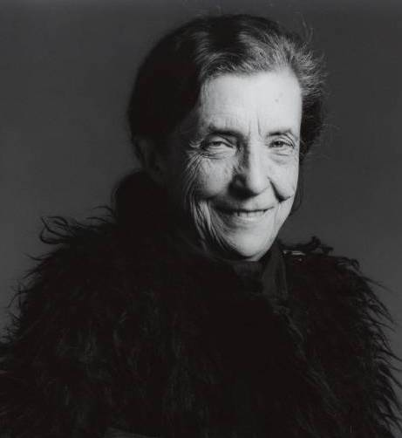
Good job kids!!! Proud of each and every one of YOU!

Slide 43
Extension project:
Get some poster paint and paint your spider / add dots and dashes. Draw the
Web on a piece of paper and put her on it.

Slide 44
references
Louise Bourgeois

Slide 45
References
Slide 3 crystalbridges.org
Slide 4 theartnewspaper.com
Slide 5 iconcon.com
Slide 8 untapped cities.com commons.wikimedia.org
Slide 9 abc.net.au
Slide 10 thefield.asla.org
Slide 11 travellemmening.com
Slide 13 photosbyraui.com
Slide 14 pinterest.com
Slide 15 icon-icon.com
Slide 16 oddthingsiveseen.com
Slide 17 faupng.com
Slide 18 wikiart.org
Slide 19 wikiart.org
Slide 2o moma.org

Slide 46
References
Slide 19 medium.com
Slide 21 antiqueandthearts.com
Slide 23 slate.com
Slide 26 Rachel Winterberg The helpful art teacher
Slide 27 winged canvas.com
Slide 38 alamy.com

