Slide 1

Welcome back, class!
Project #3 Finished – Mini Project
Meeting #9
02/10/22 & 02/11/22

Slide 2
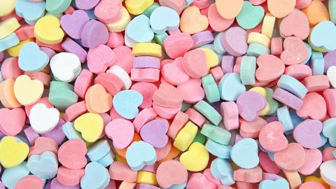
What special day is coming up next week?

Slide 3
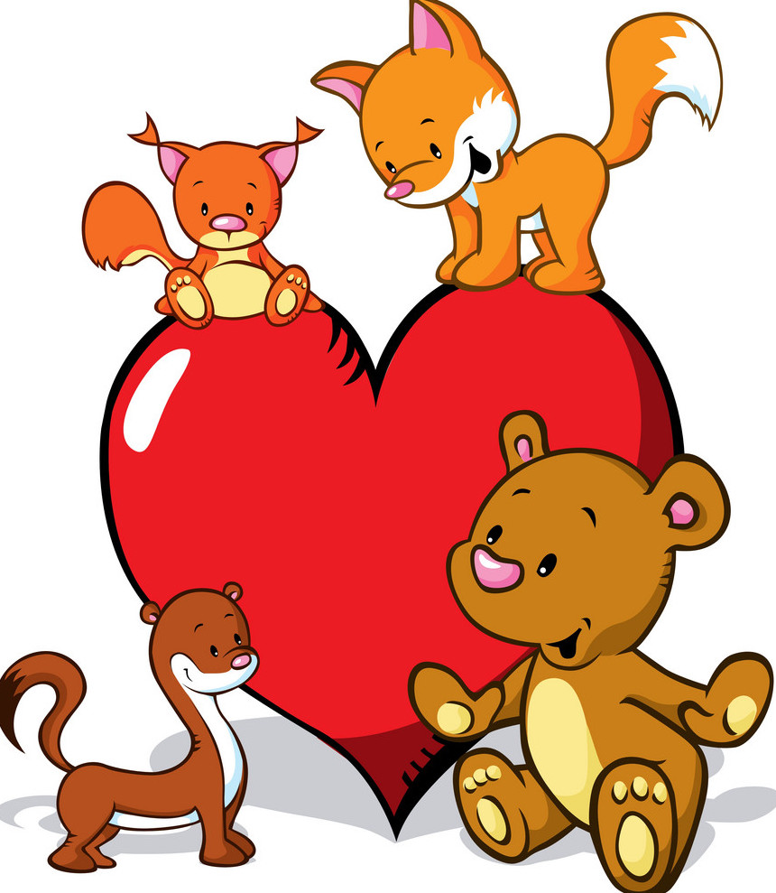
”Hearty” Creature Mini Project ☺

Slide 4
Instructions ☺
Your creature or animal should primarily include hearts!
Your creature can be any combo of color(s).
You can divide up the heart shapes to create wings, eyes, noses, ears, etc.!
Have fun creating!

Slide 5
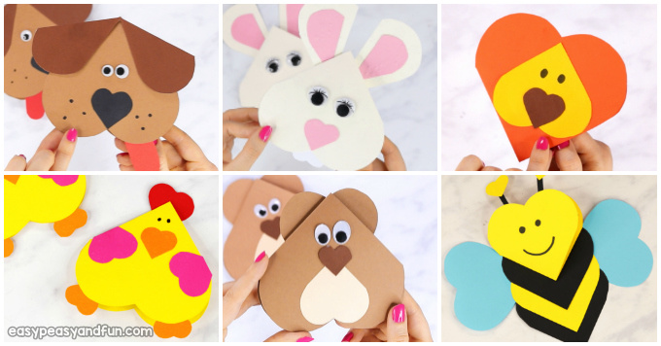
Examples ☺

Slide 6
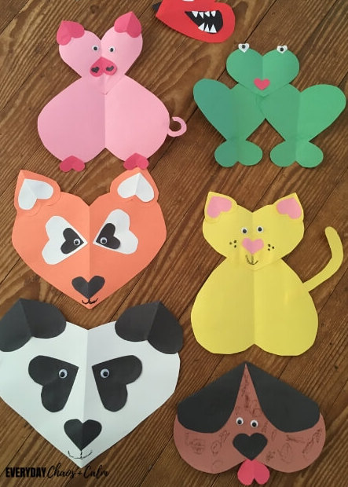
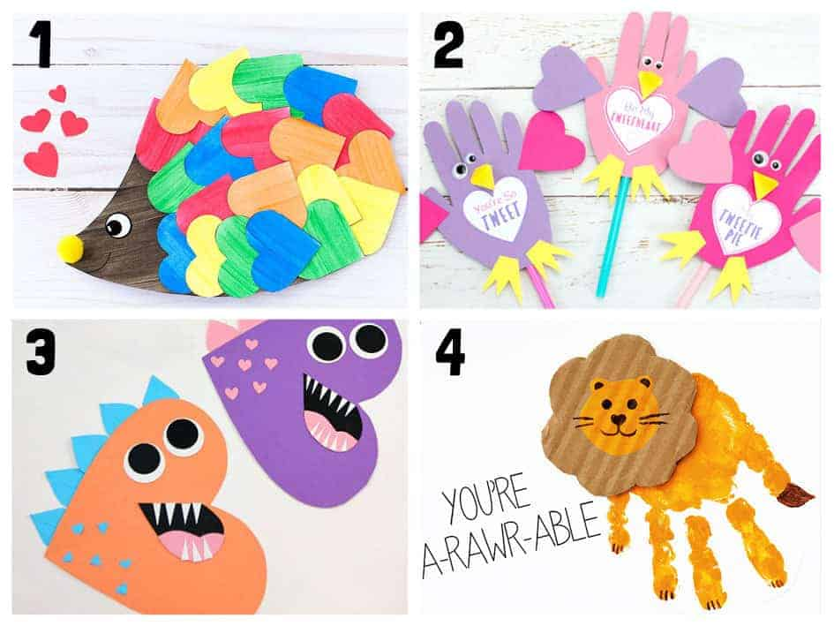
Examples ☺

Slide 7
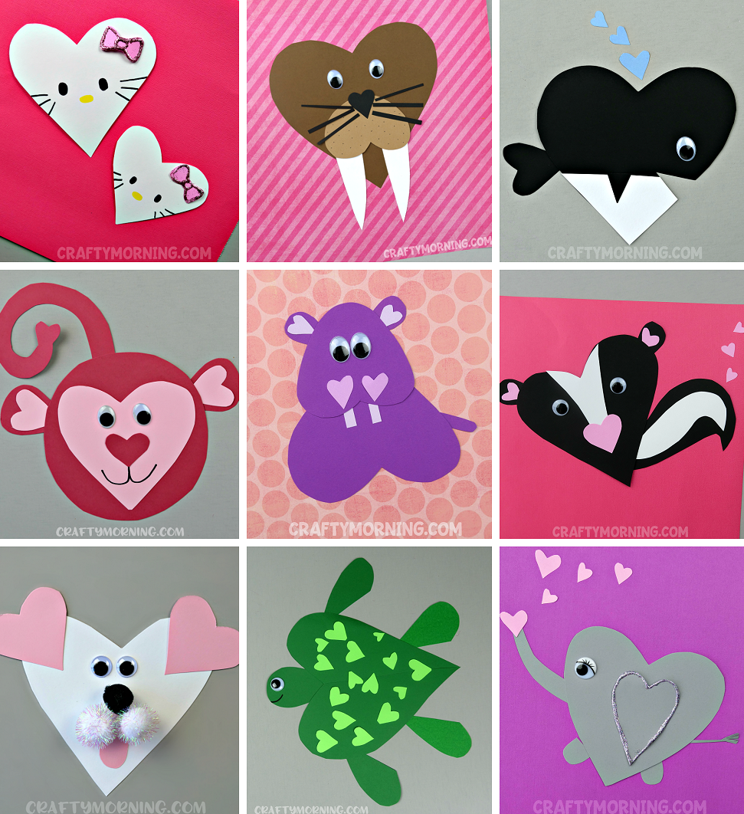

Examples ☺

Slide 8
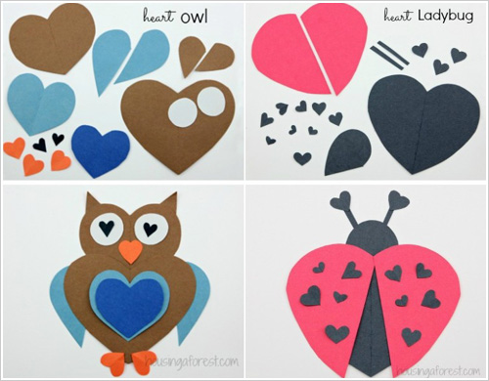
Example broken down ☺

