Slide 1

Welcome, class!
Project #1 – Intro
Meeting #1
10/28/2021

Slide 2

My name is Olivia Oddo & I’m a teaching artist!
BA in Studio Art.
MFA in Painting.
Certificate in Art Therapy.
Enjoys painting, drawing, and printmaking.
Lives in Waynesburg, PA.
Has a dog named Reese and a chameleon named Huey.

Slide 3
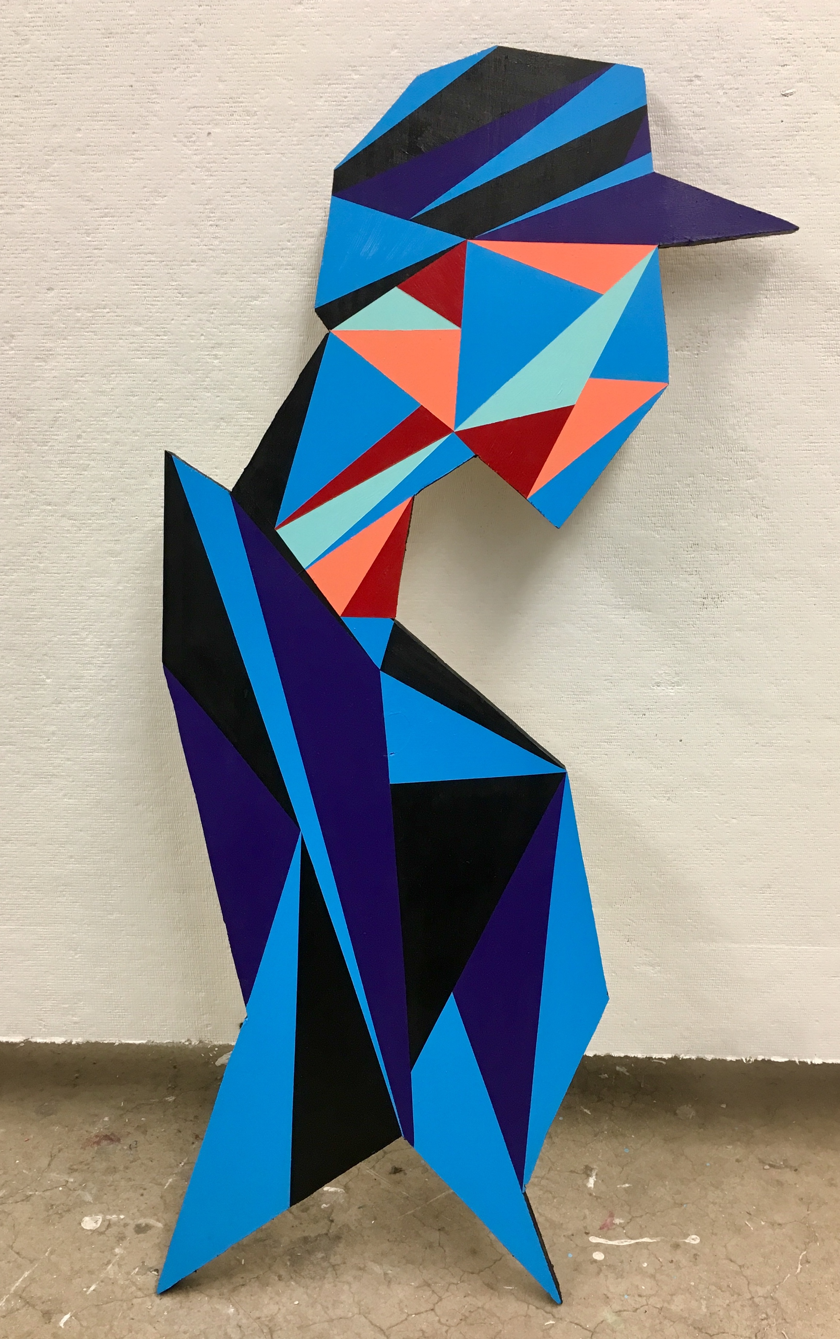
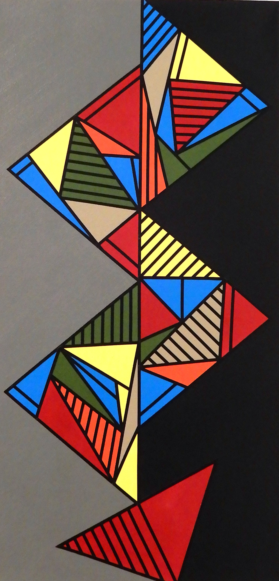
Examples of my work

Slide 4
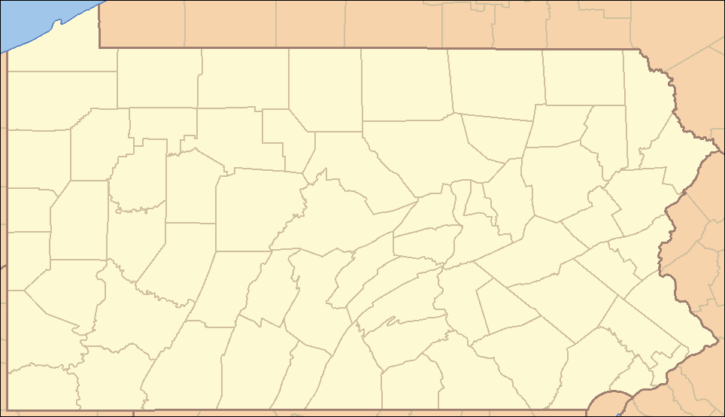


Slide 5


Materials: gather these items for today!

Slide 6

Warm-up exercise: Draw a quick doodle of something that relates to each emoji icon! ☺

Slide 7

Warm-up exercise: .... the Leaf emoji

Slide 8

Warm-up exercise: .... the candy emoji

Slide 9
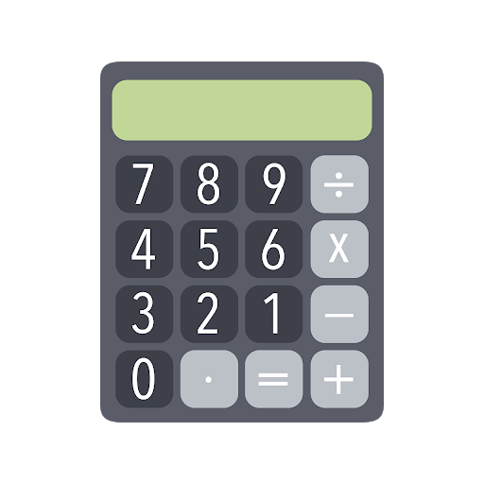

What are we going to be doing? Connecting Art & math!

Slide 10

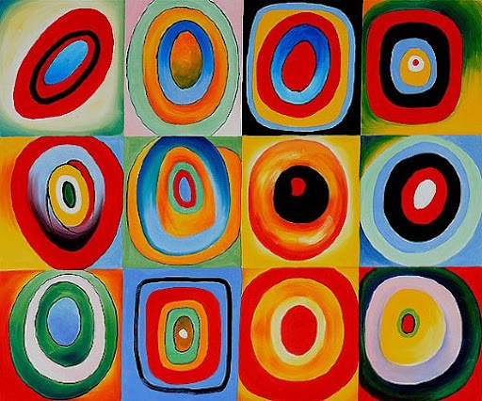
What do you know about place value in art?

Slide 11
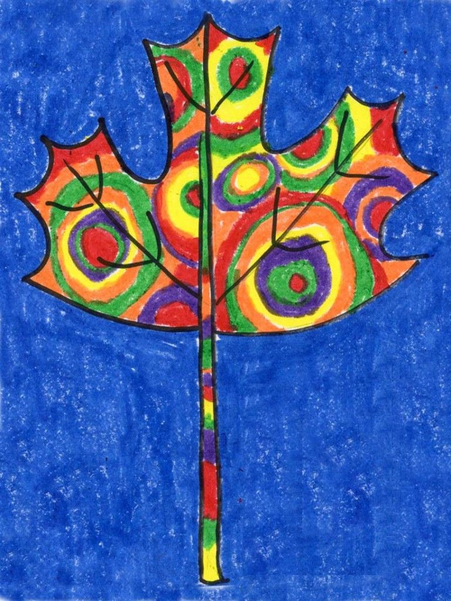
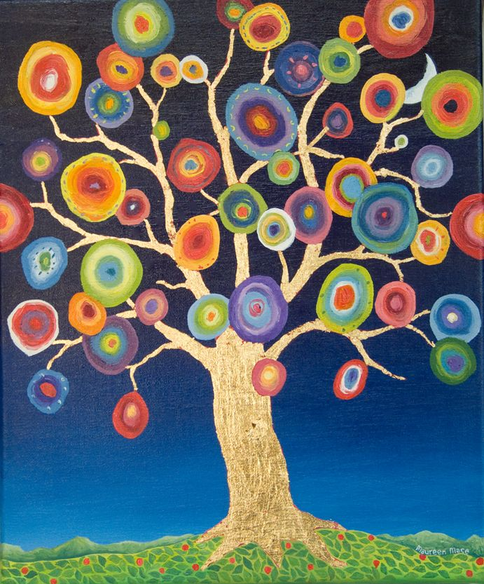
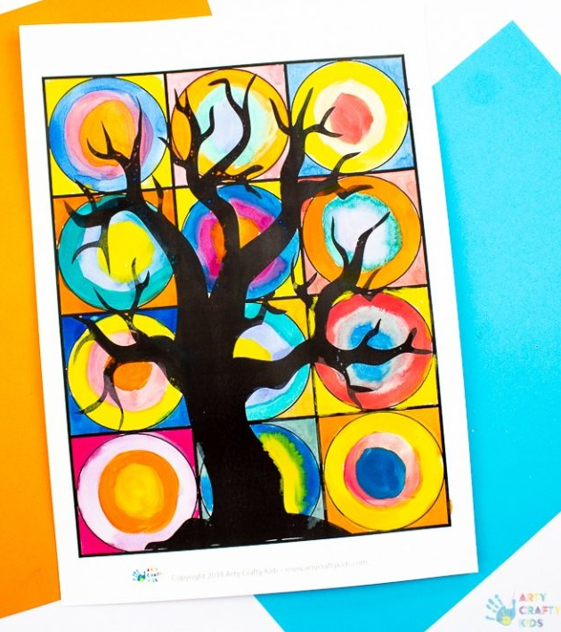
Lesson Background: Place value in art
https://www.youtube.com/watch?v=UsPbHcJW3WM

Slide 12
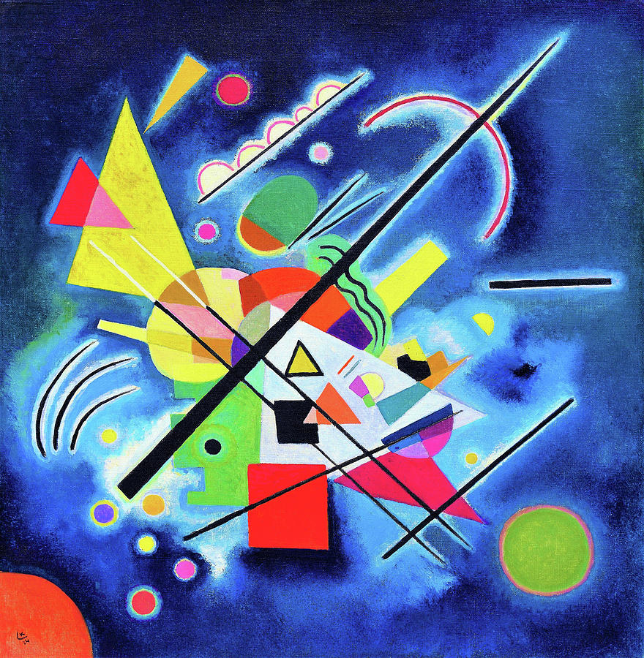
Lesson Vocab for place value in art
Orphism – The combo of form, light, and color to express harmony within a figure.
Average – How many of an object are in a set. Such as shapes.
Silhouette – An image or design in a single color. Such as a shadow.
Picture Plane – The drawing surface of a picture that goes up and down, left to right.

Slide 13
Lesson Vocab for place value in math
Place Value chart – A chart that shows the value of the digits in a number.
Place – The position of a digit in a number.
Standard Form – The usual or common way to write a number using digits.
Expanded Form – A way of writing a number as the sum of the value of its digits.

Slide 14
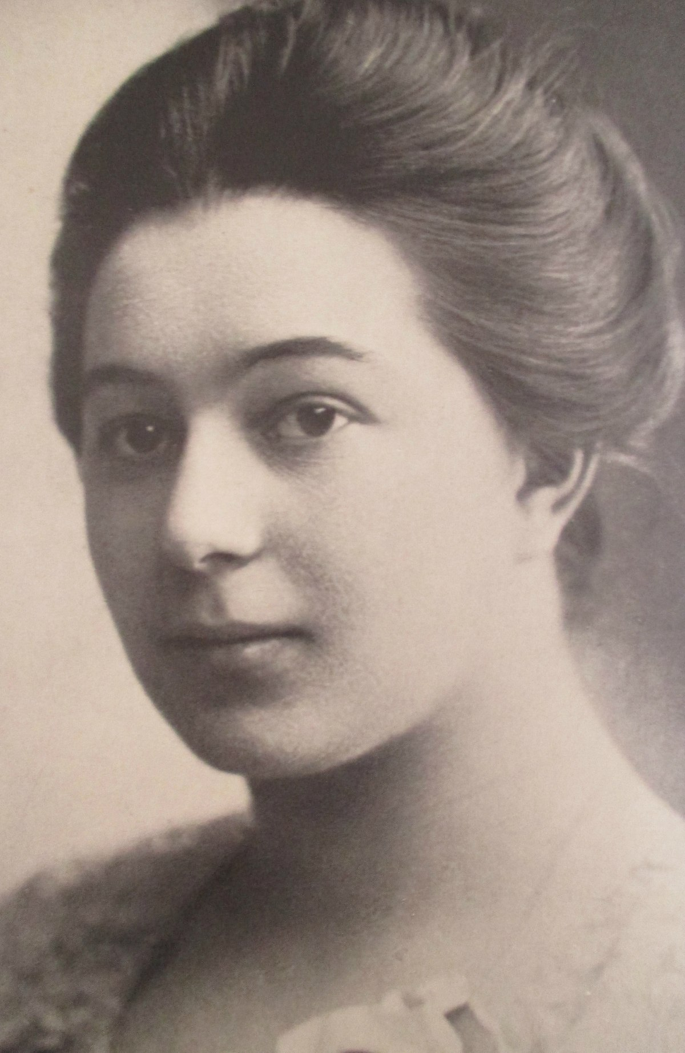
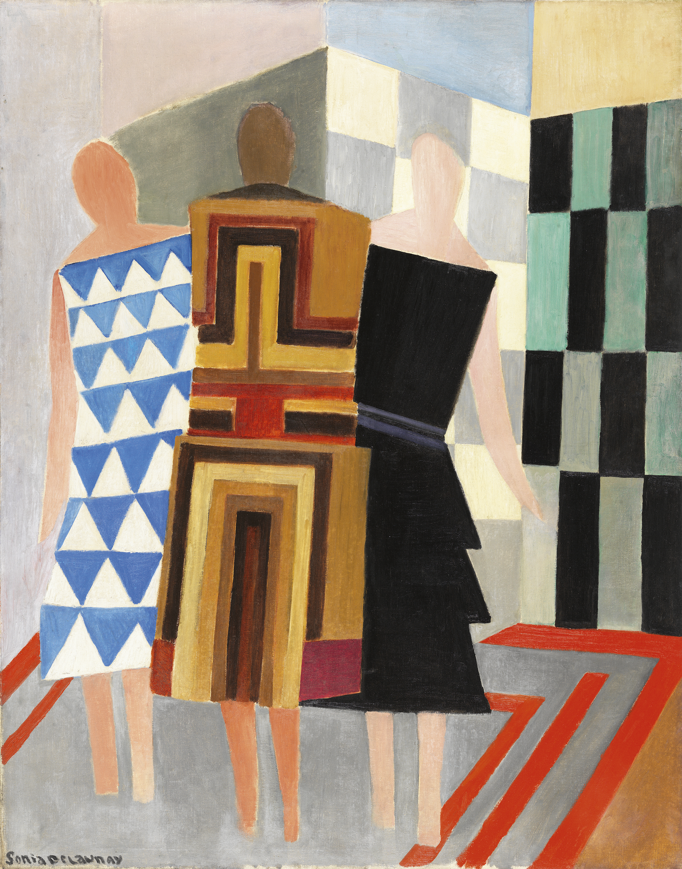
Place value art in history: Sonia Delaunay (1885-1979)

Slide 15
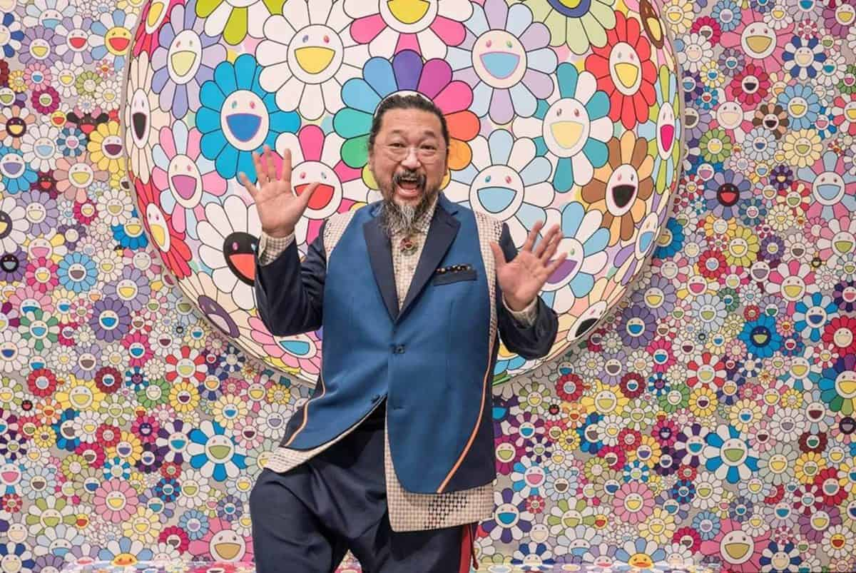


Place value art in history: Takashi murakami (1962-present)
https://www.youtube.com/watch?v=DZef5jUueyI

Slide 16



Place value art in movies: the minions
https://www.youtube.com/watch?v=OcPRNIycl7U

Slide 17


Slide 18

closure
What did we accomplish with our project?
What did we learn about place value in art?
How did we connect art & math today?

Slide 19
Extension art activities
http://weavesilk.com
https://www.mathplayground.com/index_geometry.html
https://www.sheppardsoftware.com/mathgames/menus/geometry.htm
http://www.colorwithleo.com/artstudio.php?PHPSESSID=46aae1ddc70aa2b00571af541ea33790

Slide 20

See you next time!

