Slide 1
WELCOME BACK, CLASS!
Project #4 Intro – Meetings 10 & 9 – 2/17/22 & 2/25/22

Slide 2


Please gather these materials: Markerboard, eraser, & marker. ☺

Slide 3

Warm-Up Exercise: If the wind blew you away to a distant place, where would you like to go? Draw a quick doodle! ☺

Slide 4
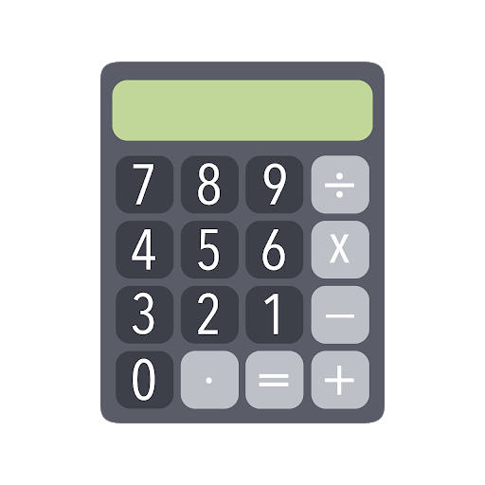

What are we going to be doing? Connecting art & math!

Slide 5

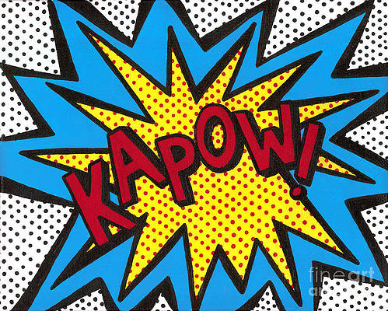
What do you know about dots & decimals?

Slide 6
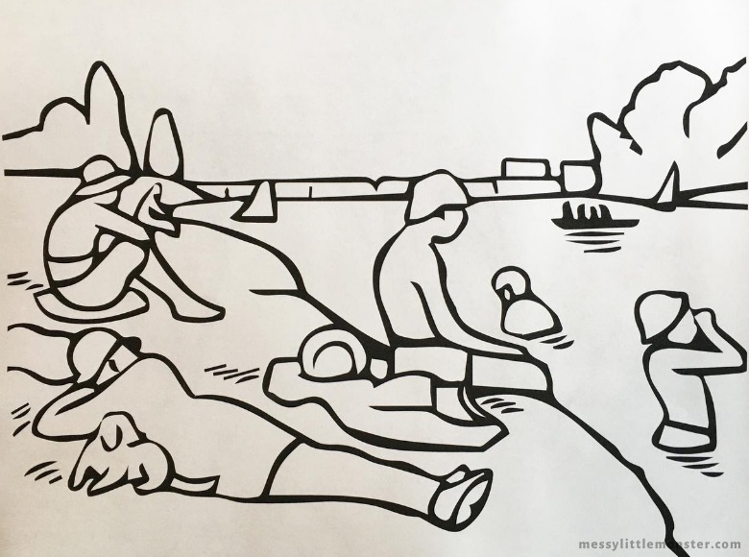
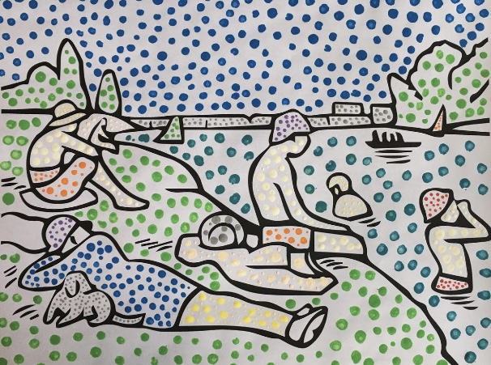
Project Example

Slide 7
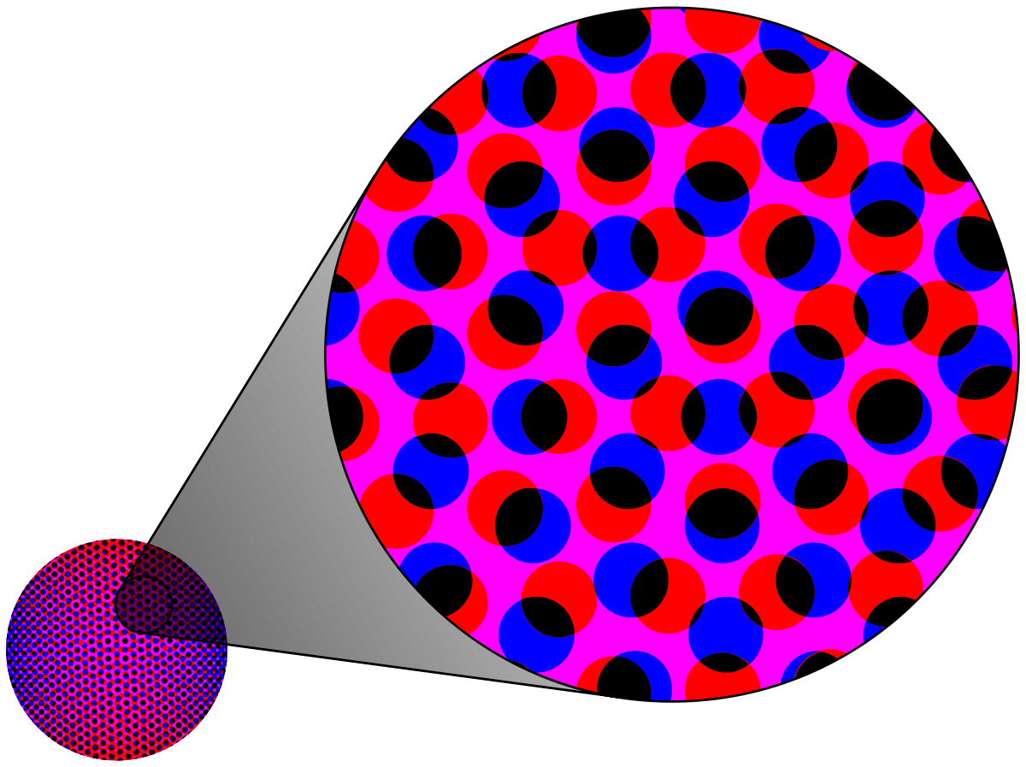
Dots & Decimals in Math Vocab
Decimal – A number that has a digit in the tenths place, hundredths place, and beyond.
Decimal Point – A period separating the ones and the tenths in a decimal number. Such as 0.8 or $3.77.
Equivalent Decimal – Decimals that have the same value.
Digit - A symbol used to write numbers. The ten digits are 0,1, 2, 3, 4, 5, 6, 7, 8, and 9.

Slide 8
Dots & Decimals in Art Vocab
Pointillism – Art that’s made up of small dots and visually blend together from a distance to make a picture.
Repetition – The recurrence of a shape, line, pattern or other element.
Space – The blank area around an object.
Ben-Day Dots – Multiple transparent shades of a dot stacked on top of each other to create depth.

Slide 9
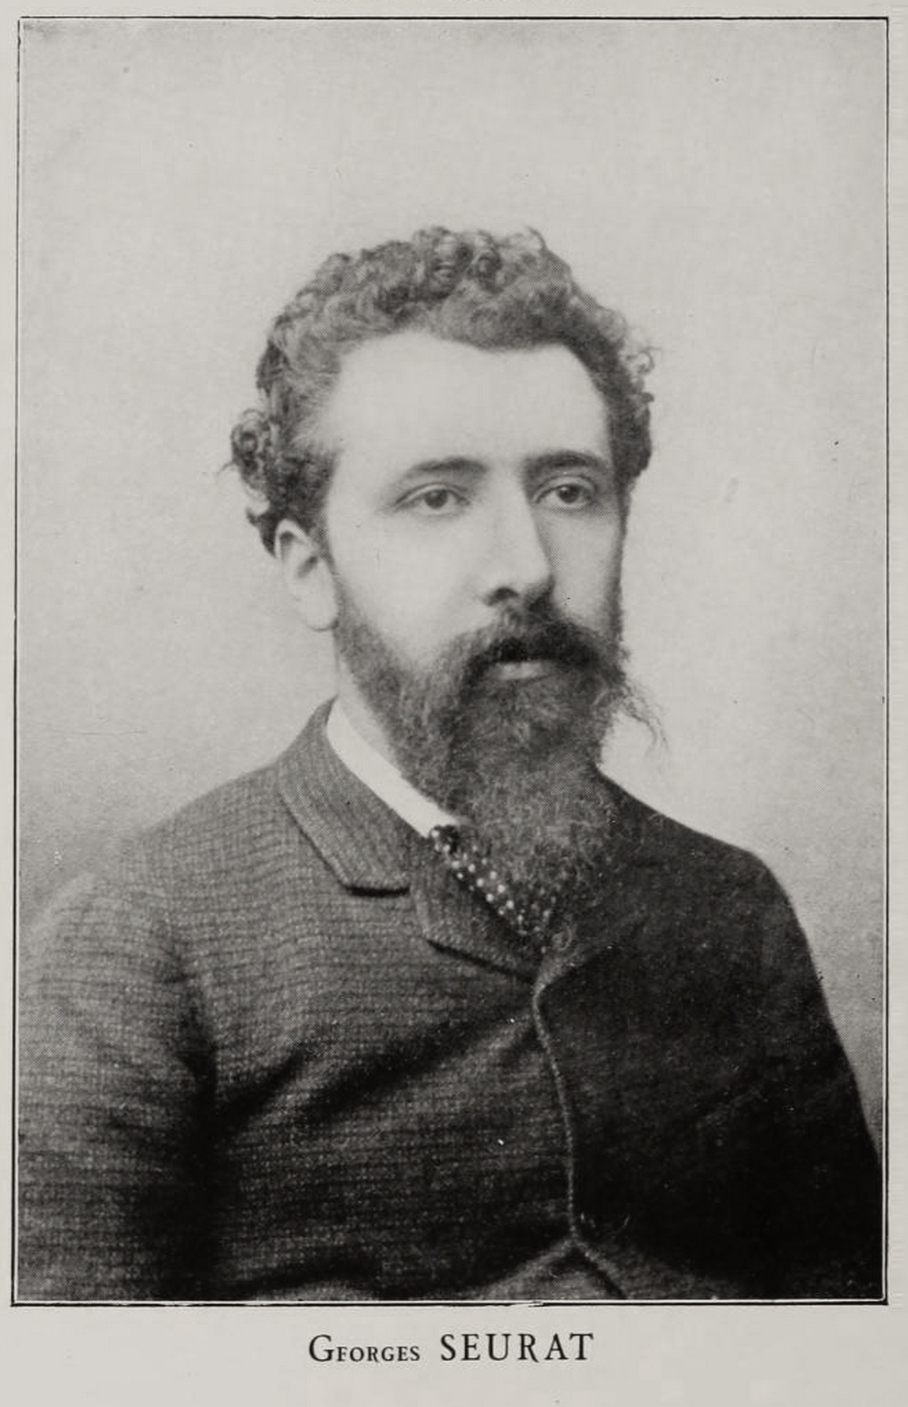
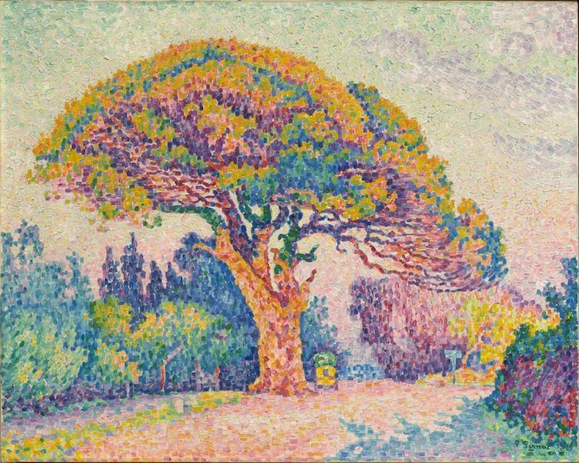
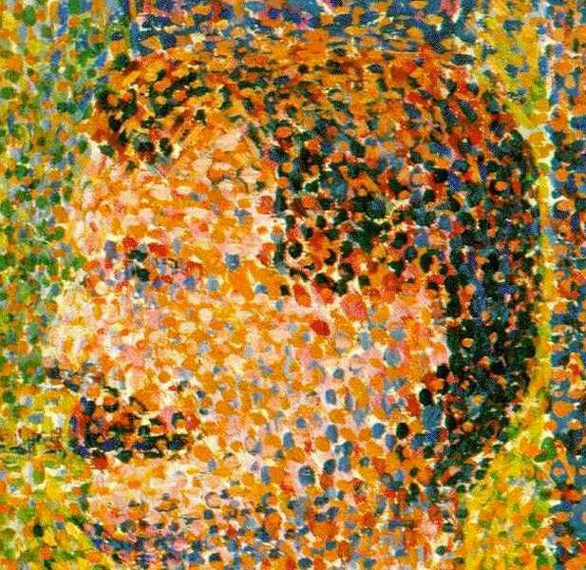
Dots in Art History – Georges Seurat (1859-1891)

Slide 10
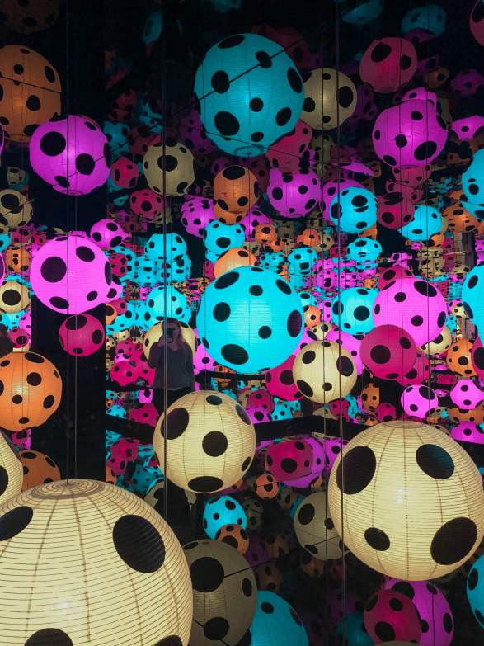
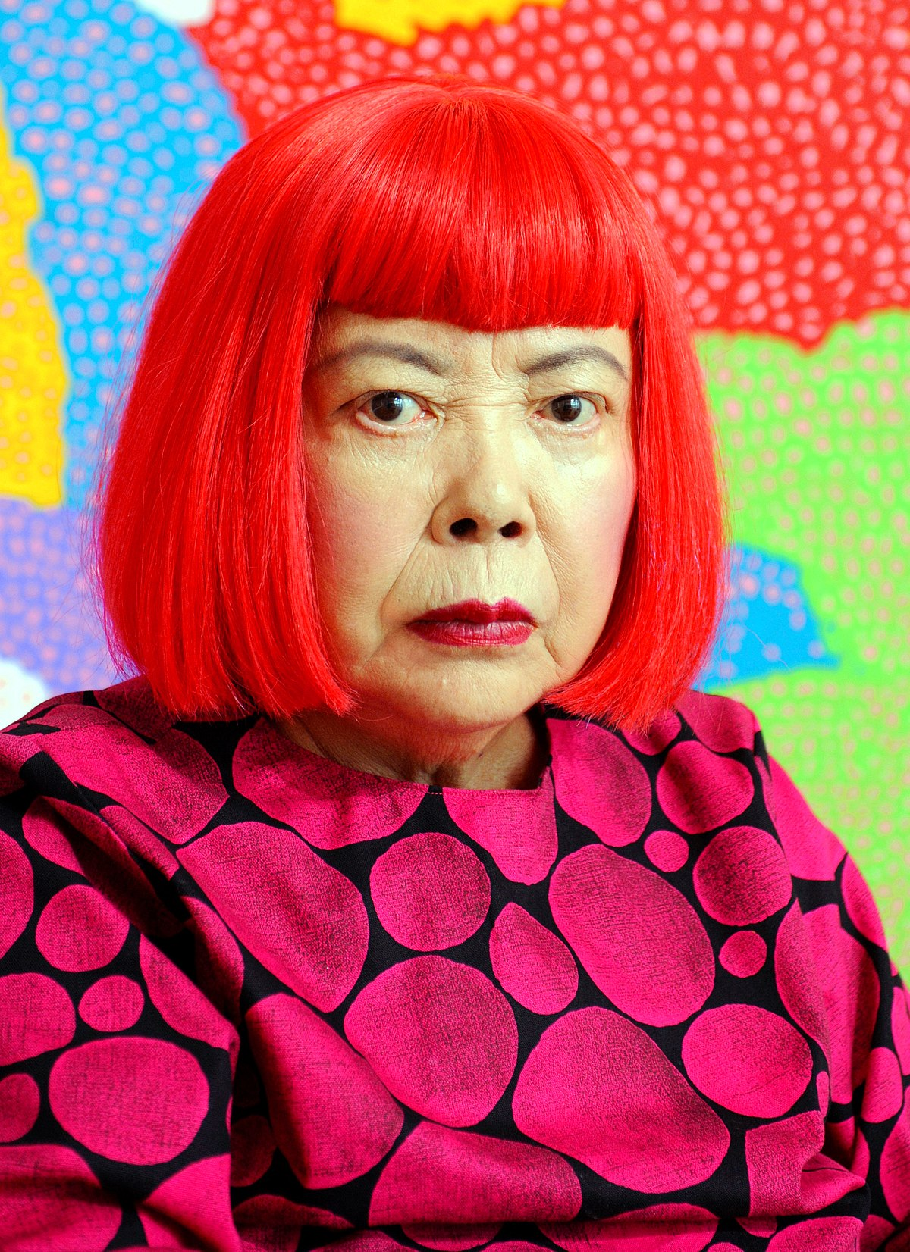
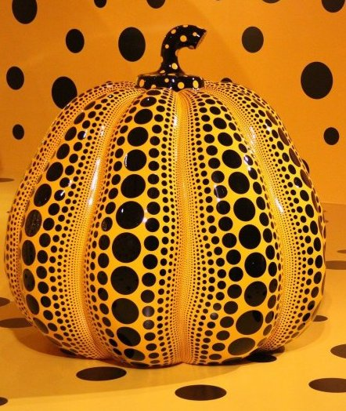
Dots in Art History – Yayoi Kusama (present)
https://www.youtube.com/watch?v=5lXpp7ADar4
https://www.youtube.com/watch?v=-xNzr-fJHQw

Slide 11
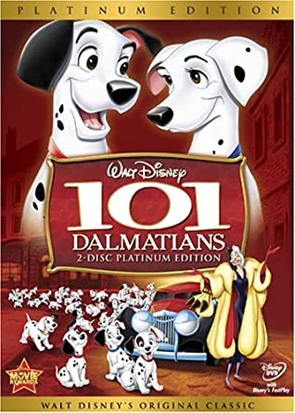

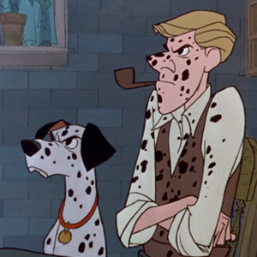
Dots in Animation – Disney’s 101 Dalmatians (1961), & 102 (2000)
https://www.youtube.com/watch?v=bKt75JkX_Vo
https://www.youtube.com/watch?v=j_Up2PRKhoM

Slide 12
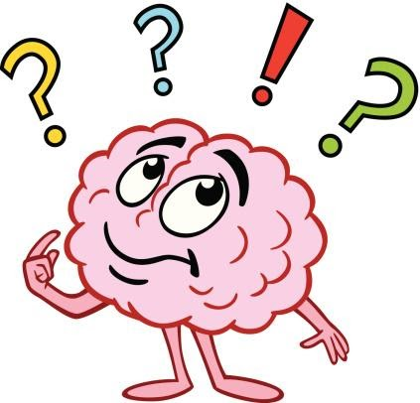
Closure
What did we accomplish with our project?
What did we learn about dots and decimals?
How did we connect art & math today?

Slide 13
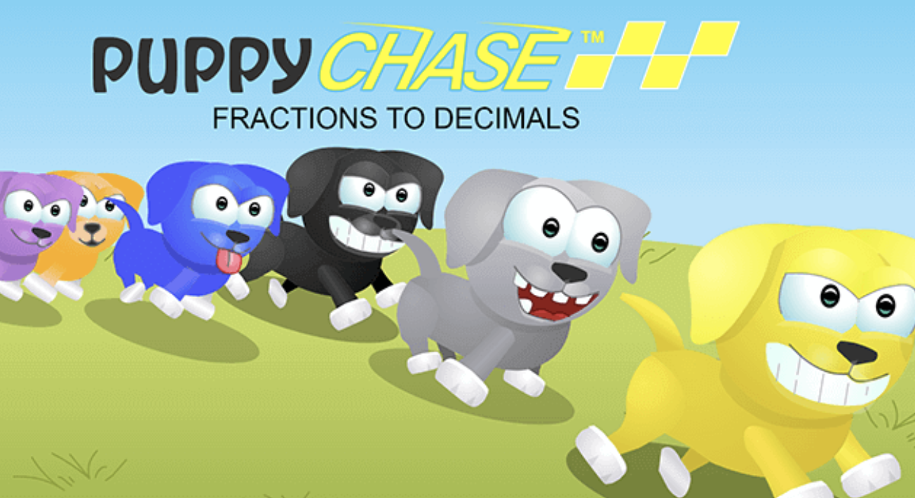
Extension art and math activities
https://mrnussbaum.com/math/decimals
https://www.splashlearn.com/math/fractions-and-decimals-games
https://www.mathplayground.com/grade_5_games.html

Slide 14


See you next time!

