Slide 1

Welcome, class!
Project #2 – Intro
Meeting #4
12/02/2021 & 12/03/21

Slide 2


Gather these materials: Markerboard, eraser, and marker ☺

Slide 3



Warm-up exercise: if you could make a snowman out of anything, what would it be? (food, toys, etc)

Slide 4
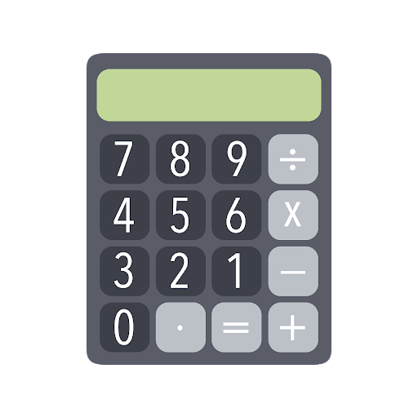

What are we going to be doing? Connecting Art & math!

Slide 5


What do you know about division in art?

Slide 6


Positive and Negative space – what do you see?

Slide 7
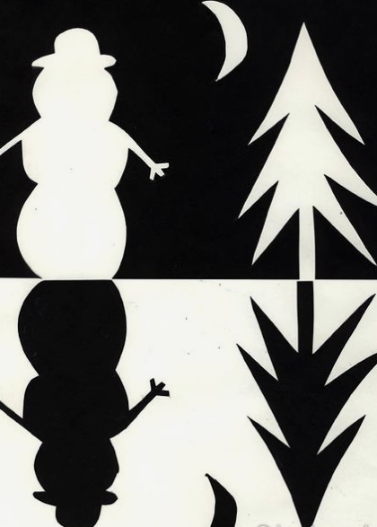
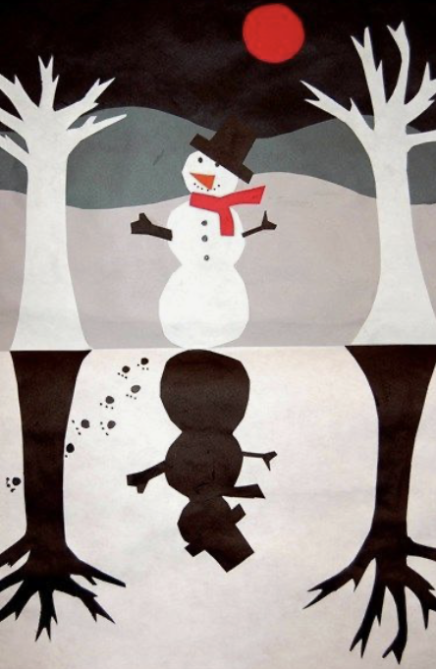
Some project examples: positive and negative space

Slide 8

Lesson vocab for division in math:
Dividend – A number that is being divided.
Divisor – The number that divides the dividend.
Remainder – The number that is left after one whole number is divided by another.
Divide – An operation on two numbers in which the first number is split into the same number of equal groups as the second number.
Variable – A letter or symbol used to represent an unknown quantity.

Slide 9
Lesson vocab for division in art:
Positive Space – The space that is filled with something (shapes, colors, designs, etc.)
Negative Space – The empty space or area surrounding the object.
Composition – The arrangement of elements in a work of art.
Contour – The outline of the object or objects.

Slide 10
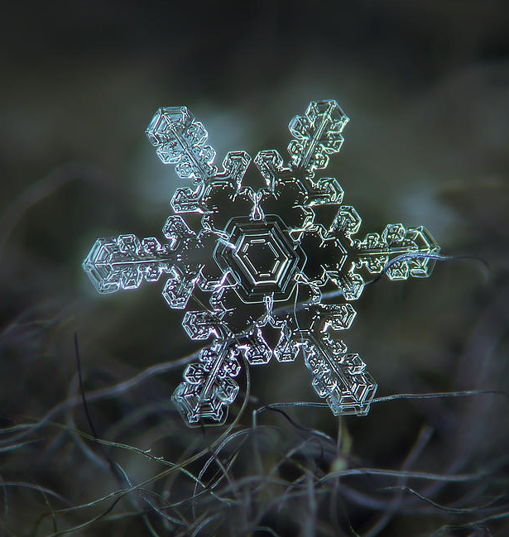

Division art in history: alexey kljatov (present)
https://www.youtube.com/watch?v=bDPczGUovzE

Slide 11
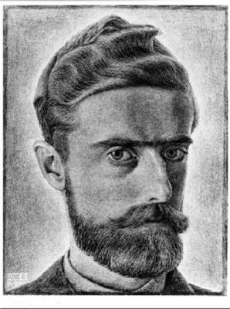
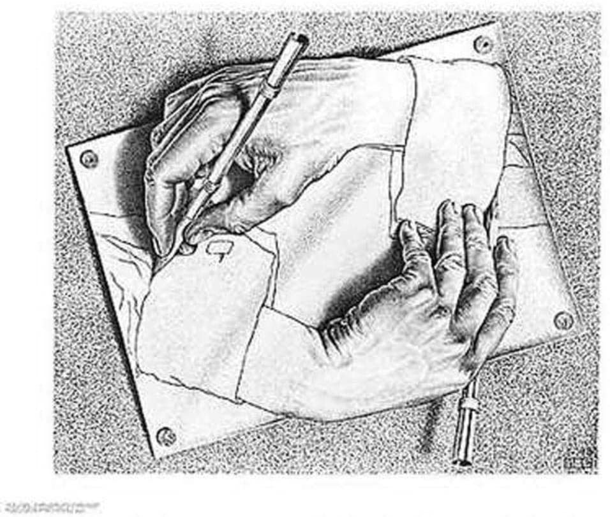
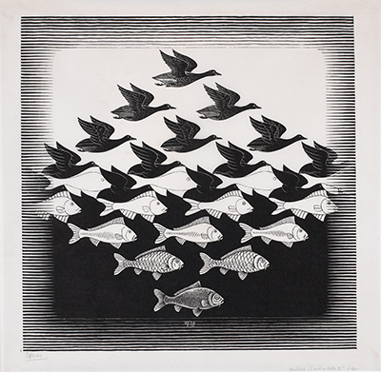
Lesson vocab for division in art: M.C. Escher (1898– 1972)
https://www.youtube.com/watch?v=2KfSdOhgMvk

Slide 12
Division art in cartoons: Shadow puppets
https://www.youtube.com/watch?v=G9DgUxP_2Hw

Slide 13

closure
What did we accomplish with our project?
What did we learn about division in art?
How did we connect art & math today?

Slide 14
Extension art activities
http://weavesilk.com
https://www.mathplayground.com/index_geometry.html
https://www.sheppardsoftware.com/mathgames/menus/geometry.htm
http://www.colorwithleo.com/artstudio.php?PHPSESSID=46aae1ddc70aa2b00571af541ea33790

Slide 15

See you next time!

