Slide 1

Welcome back, class!
Project #4 Intro
2/23/22

Slide 2



Warm-up exercise ☺
If you had the power to change what fell out of the sky when it rained, what objects, creatures, or food would you pick?

Slide 3
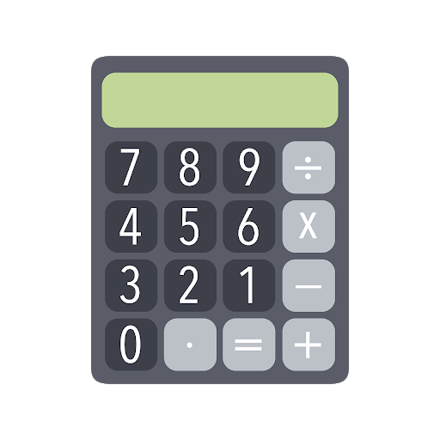

Connecting art & math ☺

Slide 4
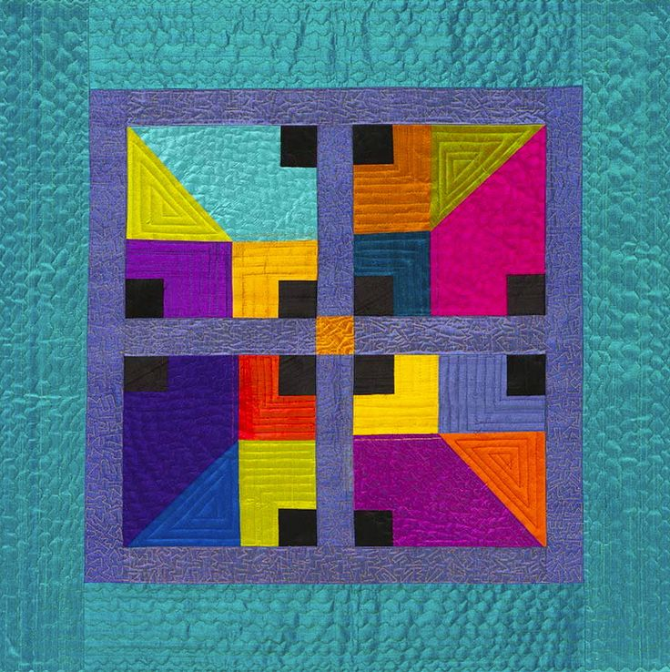
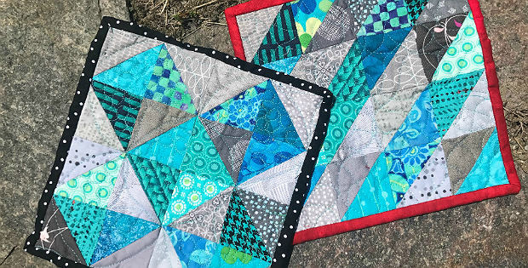
Lesson background – Patchwork art ☺

Slide 5
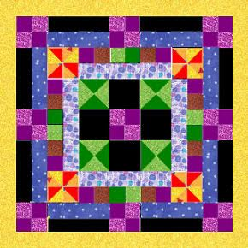
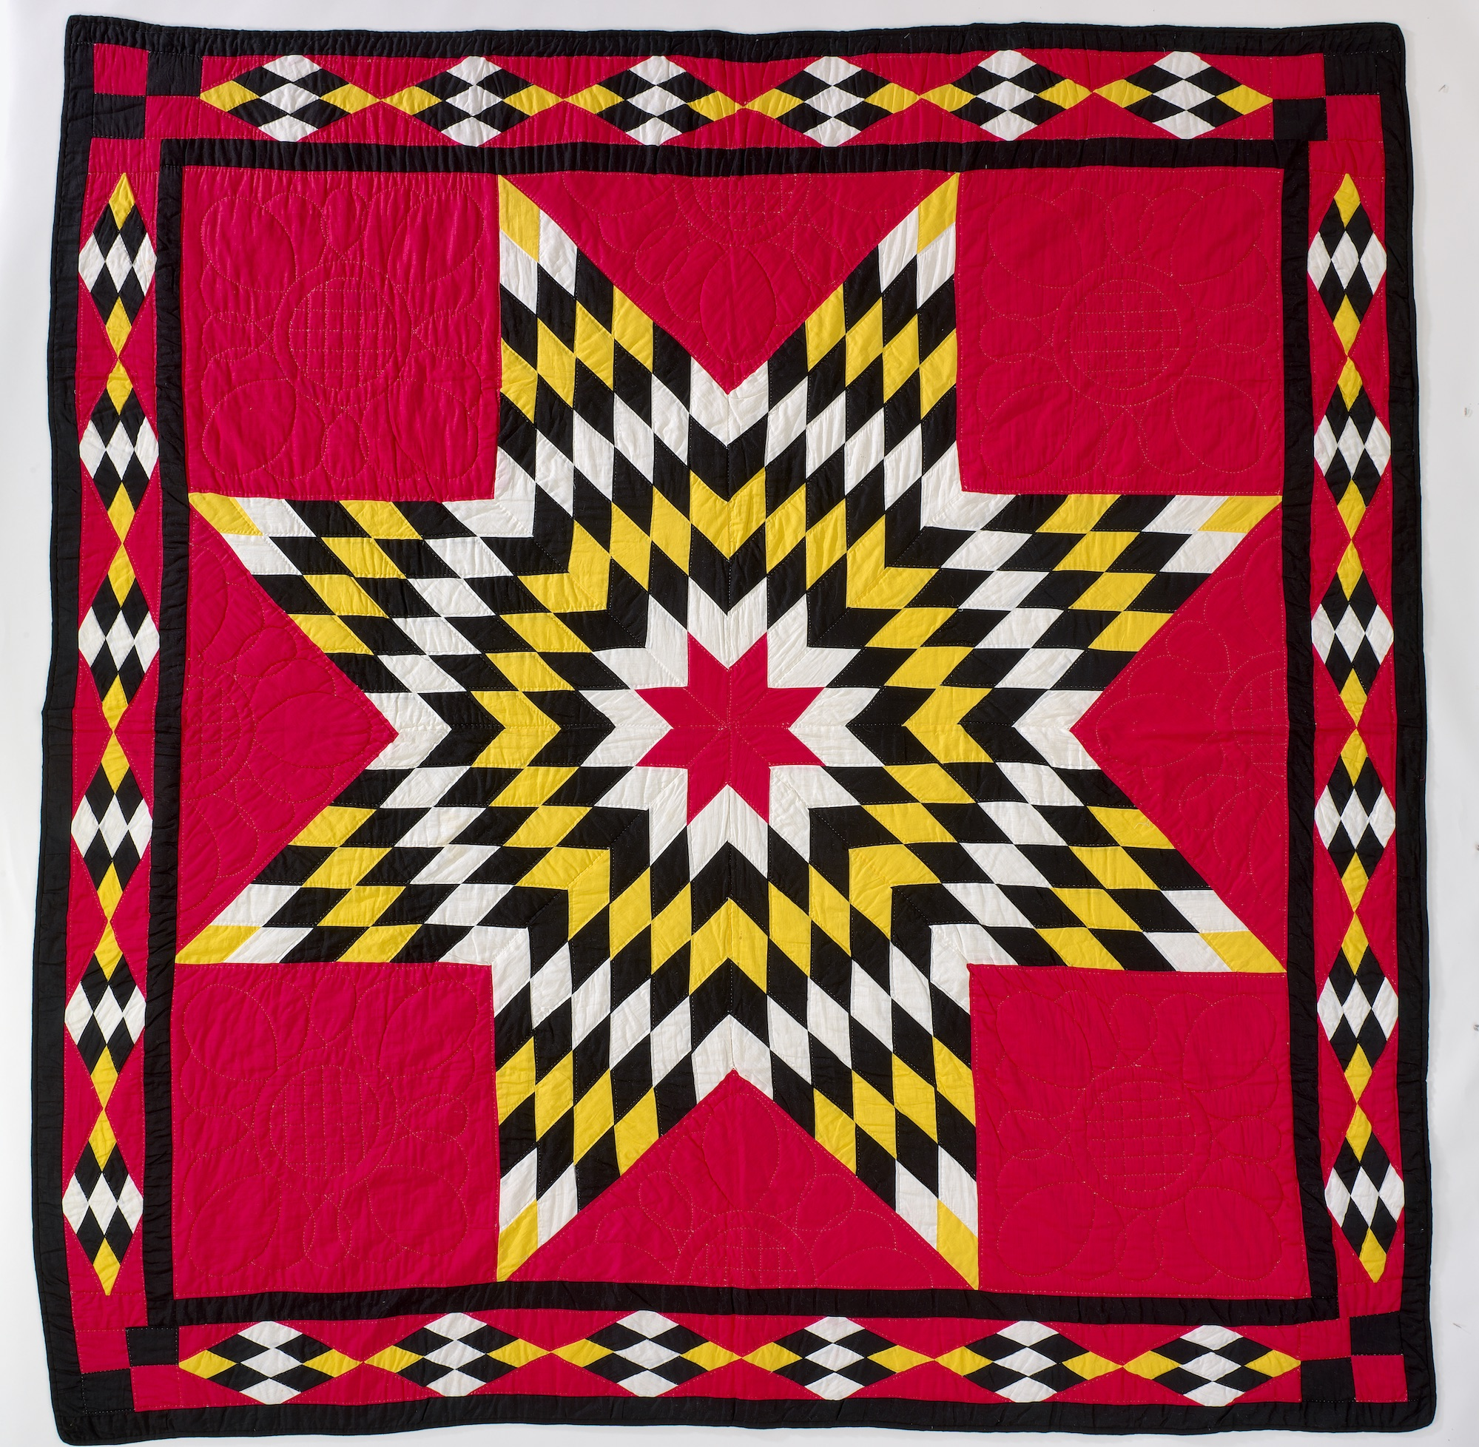
Project example – ”fraction Fabric”

Slide 6
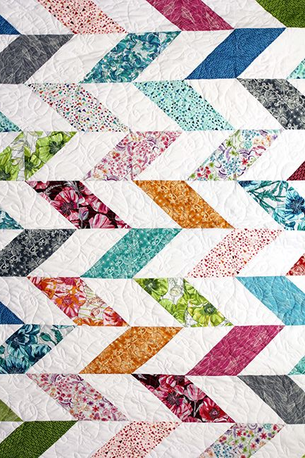
Lesson vocab ☺
Proper Fractions: When the numerator is less than the denominator.
Improper Fractions: When the numerator is greater than or equal to the denominator.
Equivalent Fractions: Fractions that represent the same number.
Mixed Fractions: Whole number and a fraction.
Part: A piece of an entire whole fraction or object.
Patchwork: Stitching various fabric pieces together to create a big piece of fabric.
Templates: Made of either plastic or metal, these help patchwork artists draw certain shapes before cutting the fabric.
Sleeve: A strap that’s added to the back of the quilt to help hang it on a wall.
Quilter’s Rule: A clear numbered ruler to help create gridlines and measurements while still being able to see the fabric beneath.
Quilt Sandwich: The 3 layers that make up a quilt – the top, batting, and backing.

Slide 7
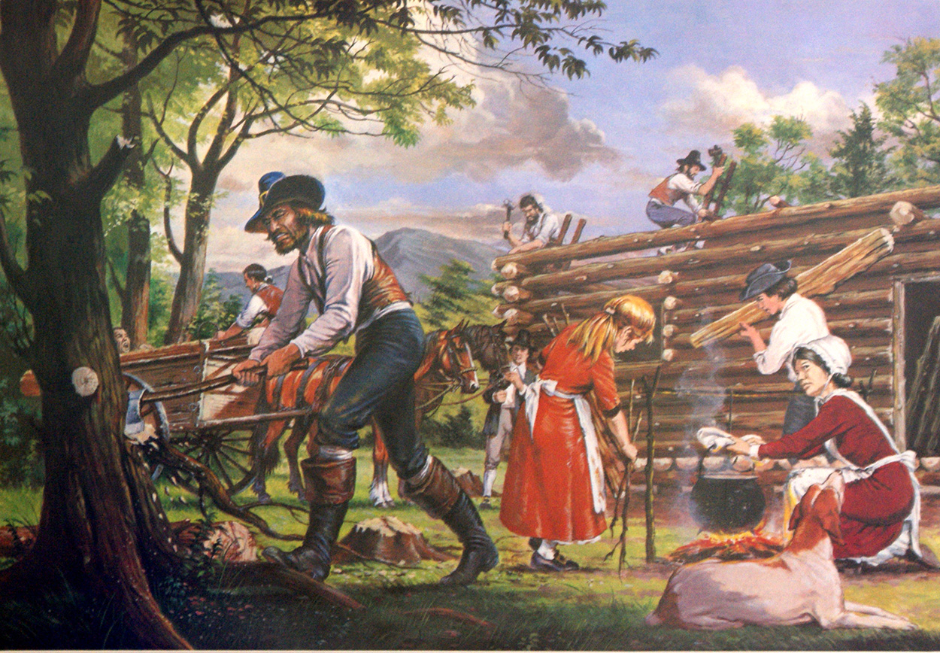
Who brought patchwork to America?
- The Dutch and English settlers between 1650-1850, but the oldest tapestries can be traced back to ancient Egypt!
- Patchwork can be seen in flags, uniforms, art, clothing, blankets (that represent special life moments and other designs), and even in maps!

Slide 8
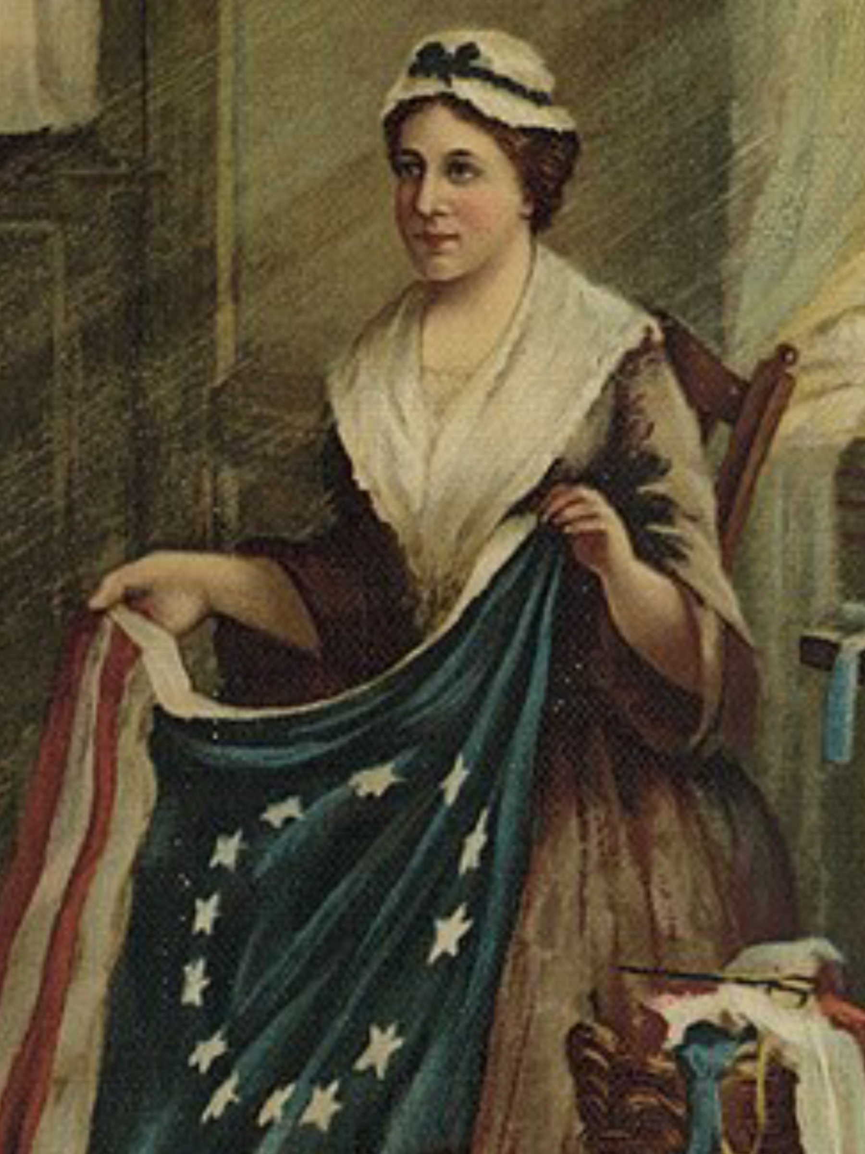
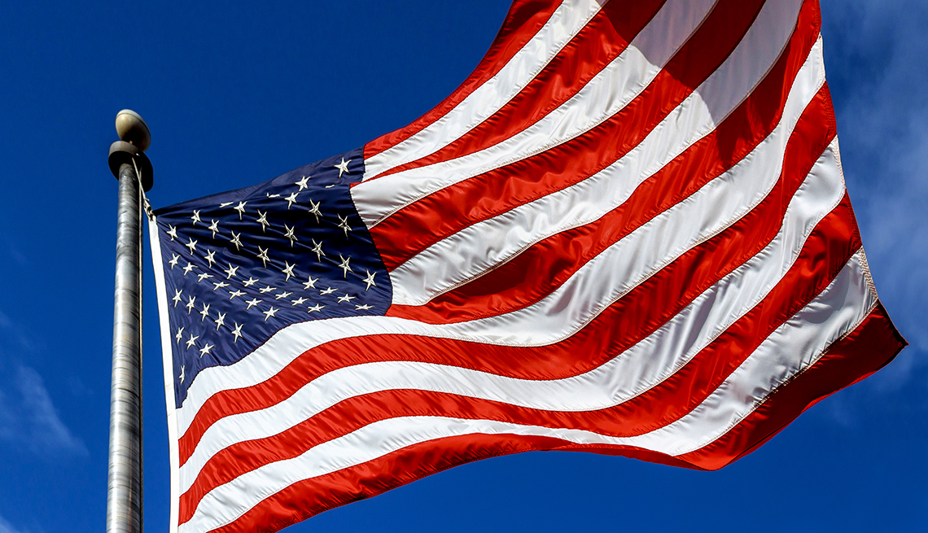
Patchwork art around the world –
USA, Betsy ross, & the moon

Slide 9
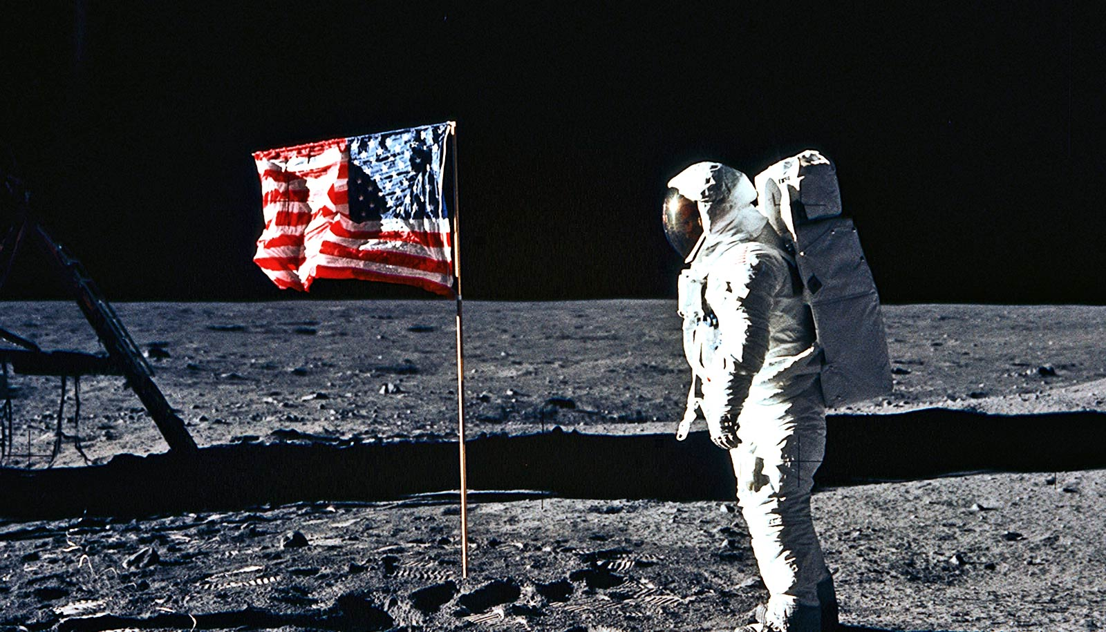

Slide 10
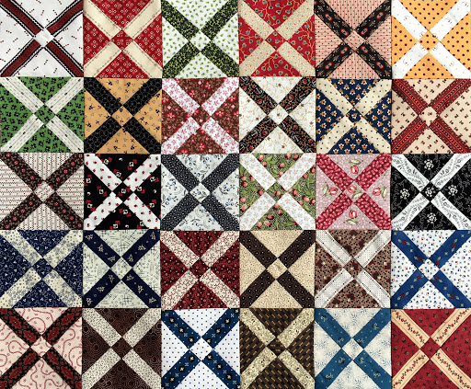
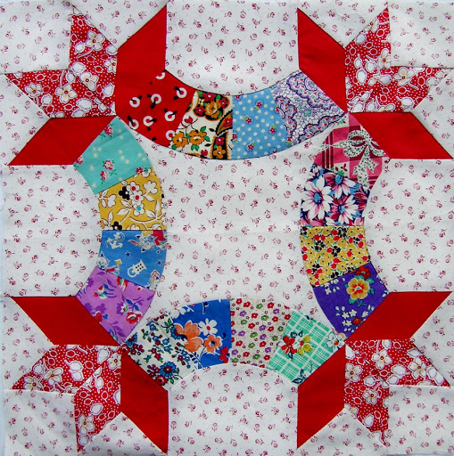
Patchwork art around the world –
Italian friendship quilt

Slide 11
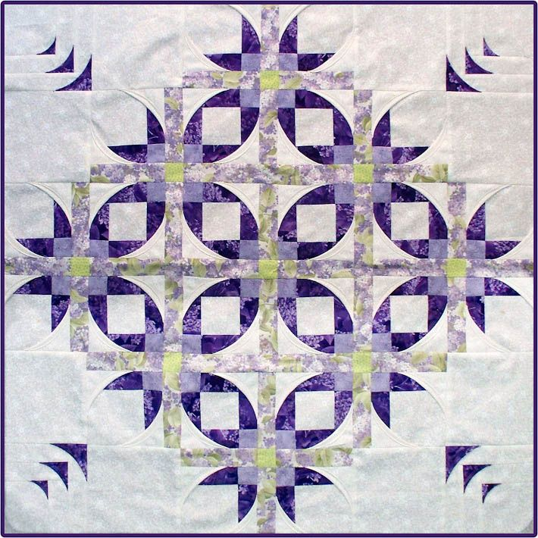
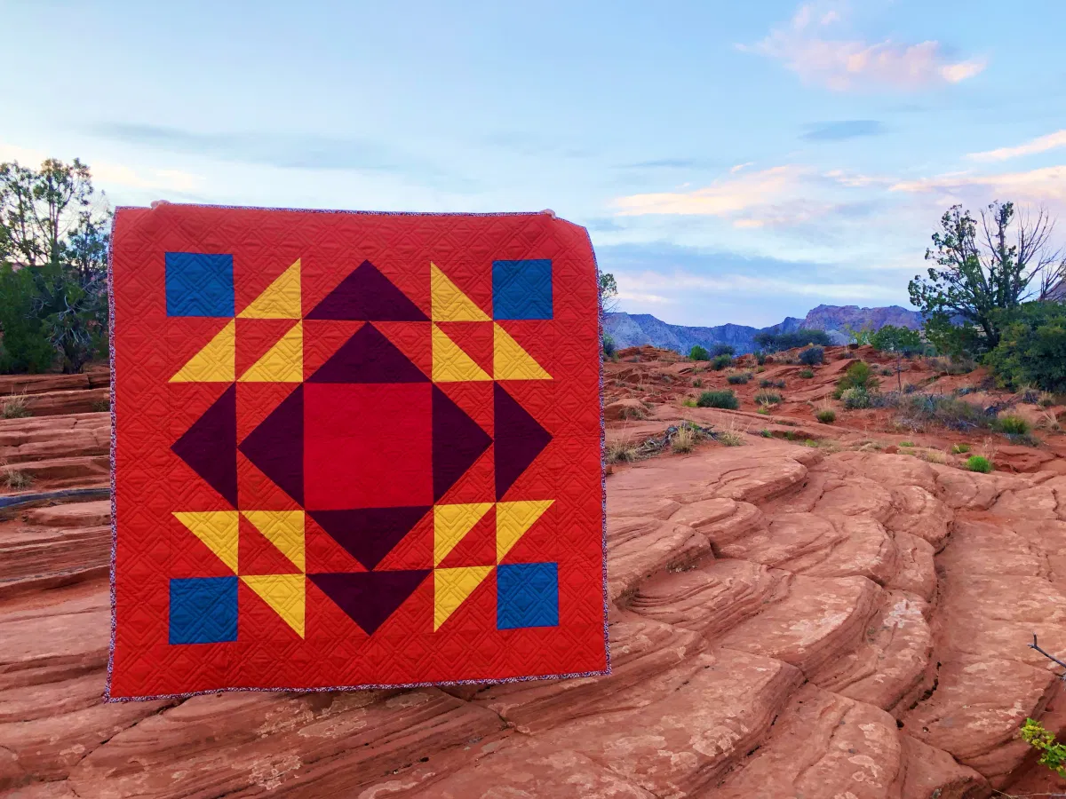
Patchwork art around the world –
Mexican star dance quilts

Slide 12
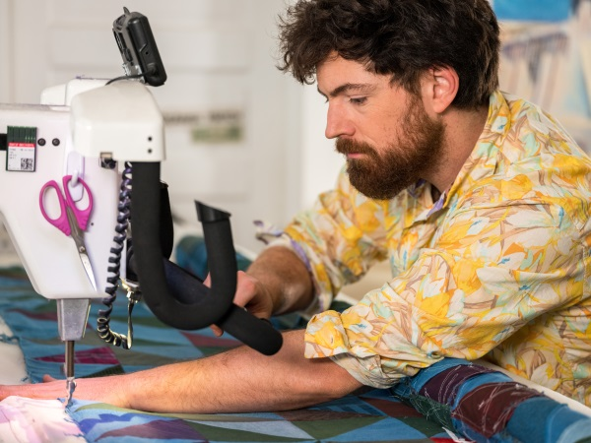

Artist – Luke Haynes (fabric & mixed media)

Slide 13
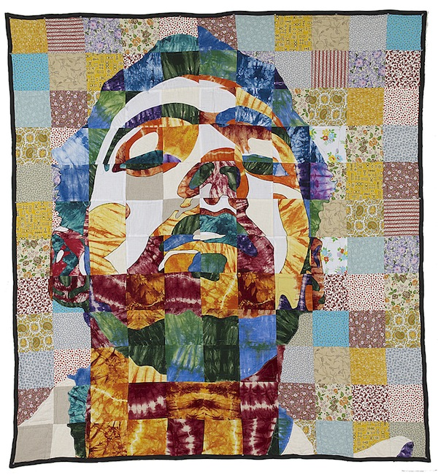
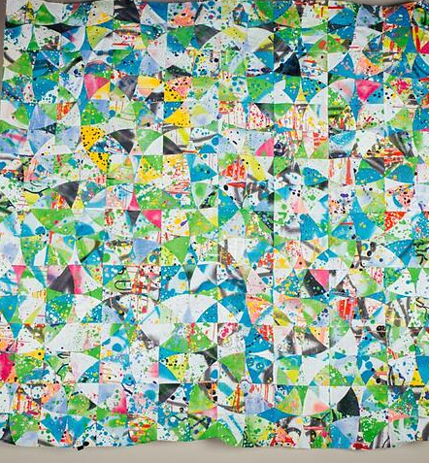

Slide 14
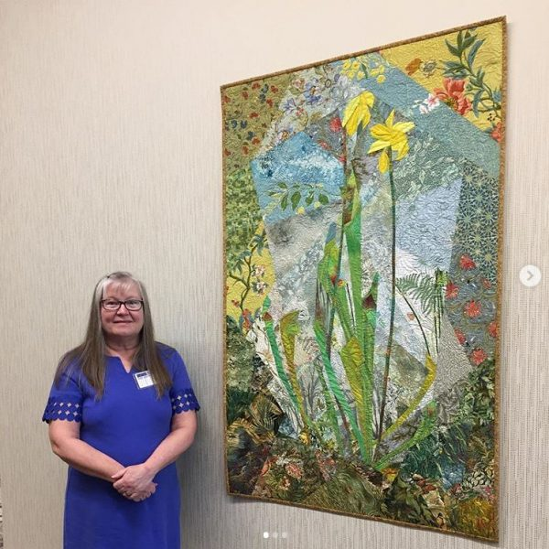
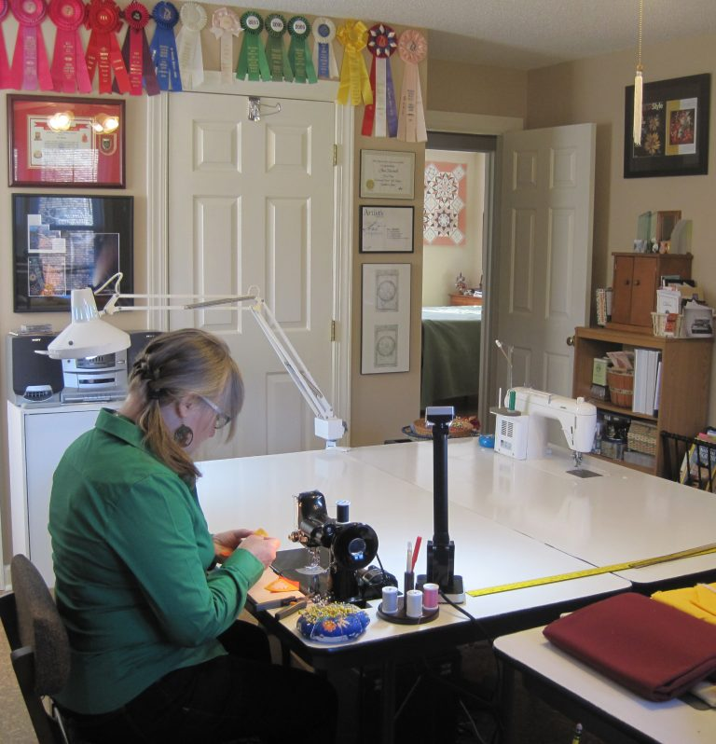
artist – ann harwell (fabric & Jewels)

Slide 15
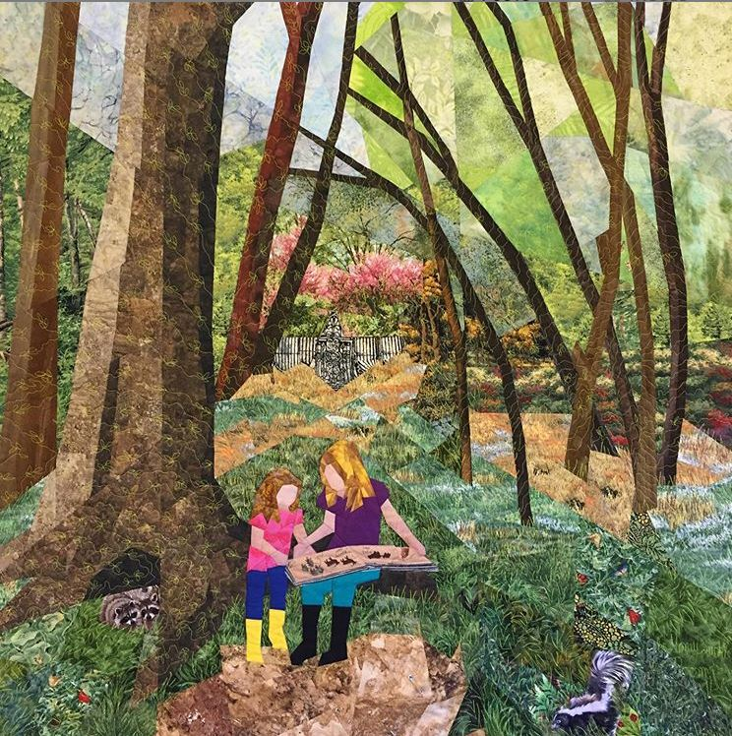
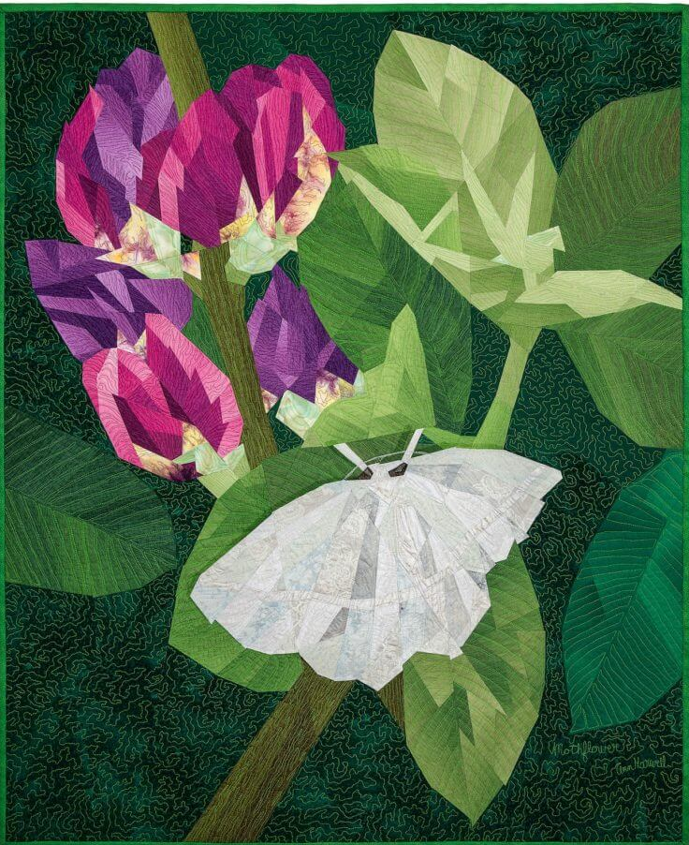

Slide 16
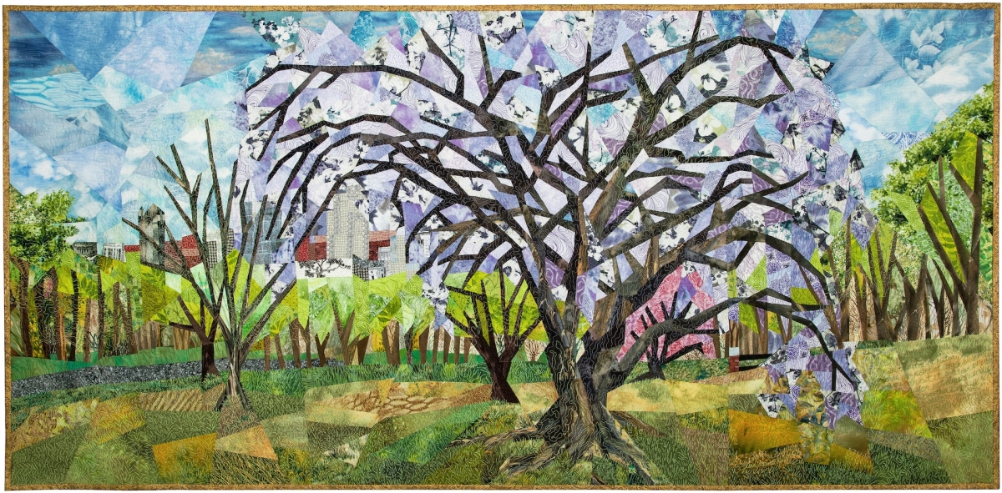

Slide 17
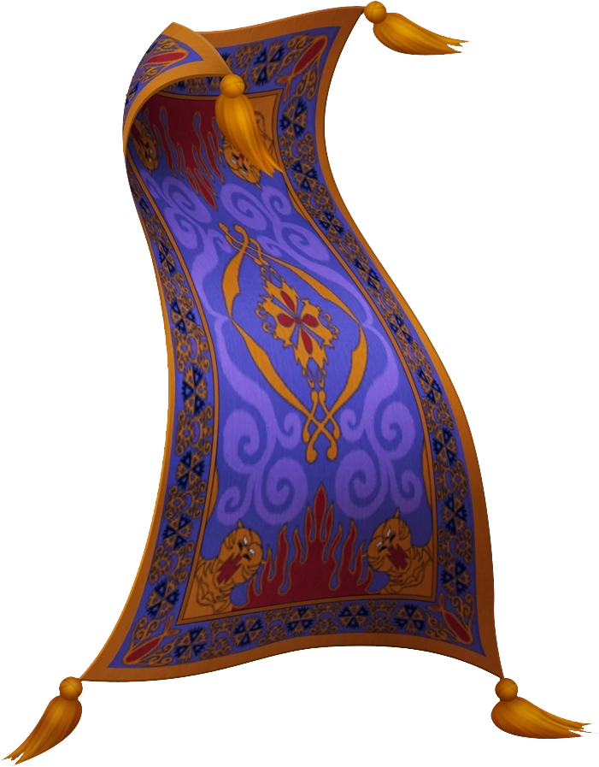

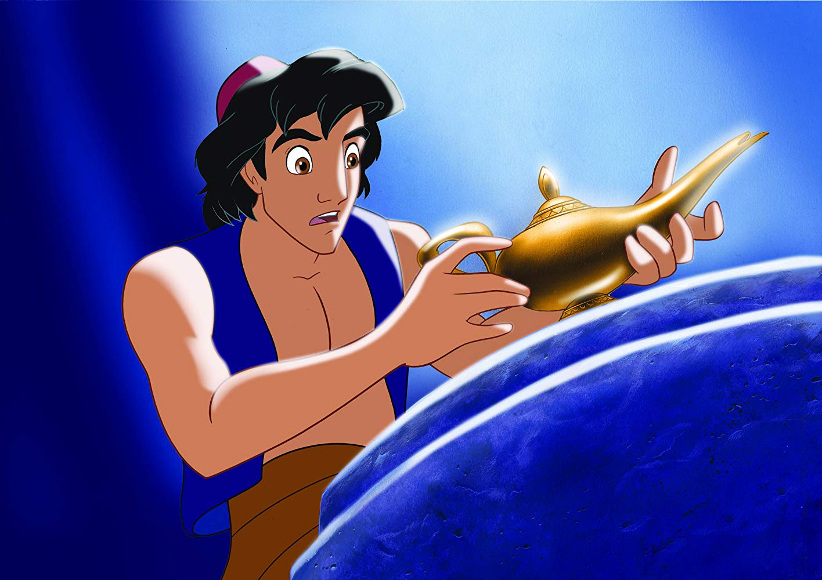
Pop culture – “Aladdin” (1992)
https://www.youtube.com/watch?v=BCgcQXOXYfk

Slide 18

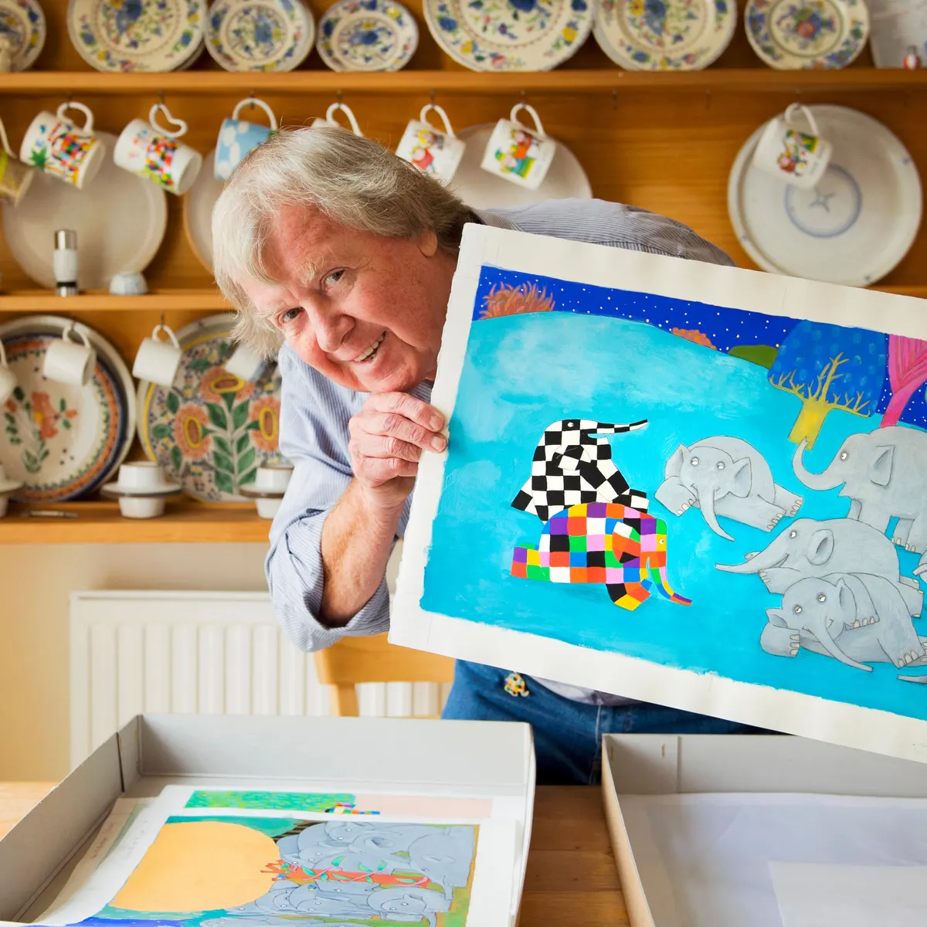
Pop culture – “elmer the patchwork elephant” by David McKee (2007)

Slide 19
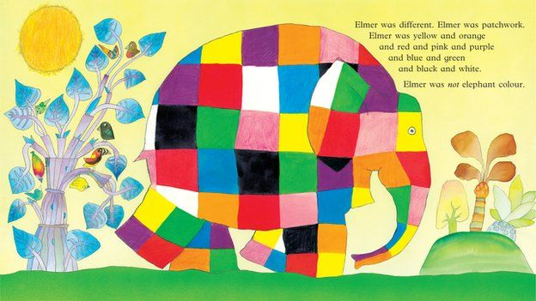
https://www.youtube.com/watch?v=M6nuNSOV_9c

Slide 20
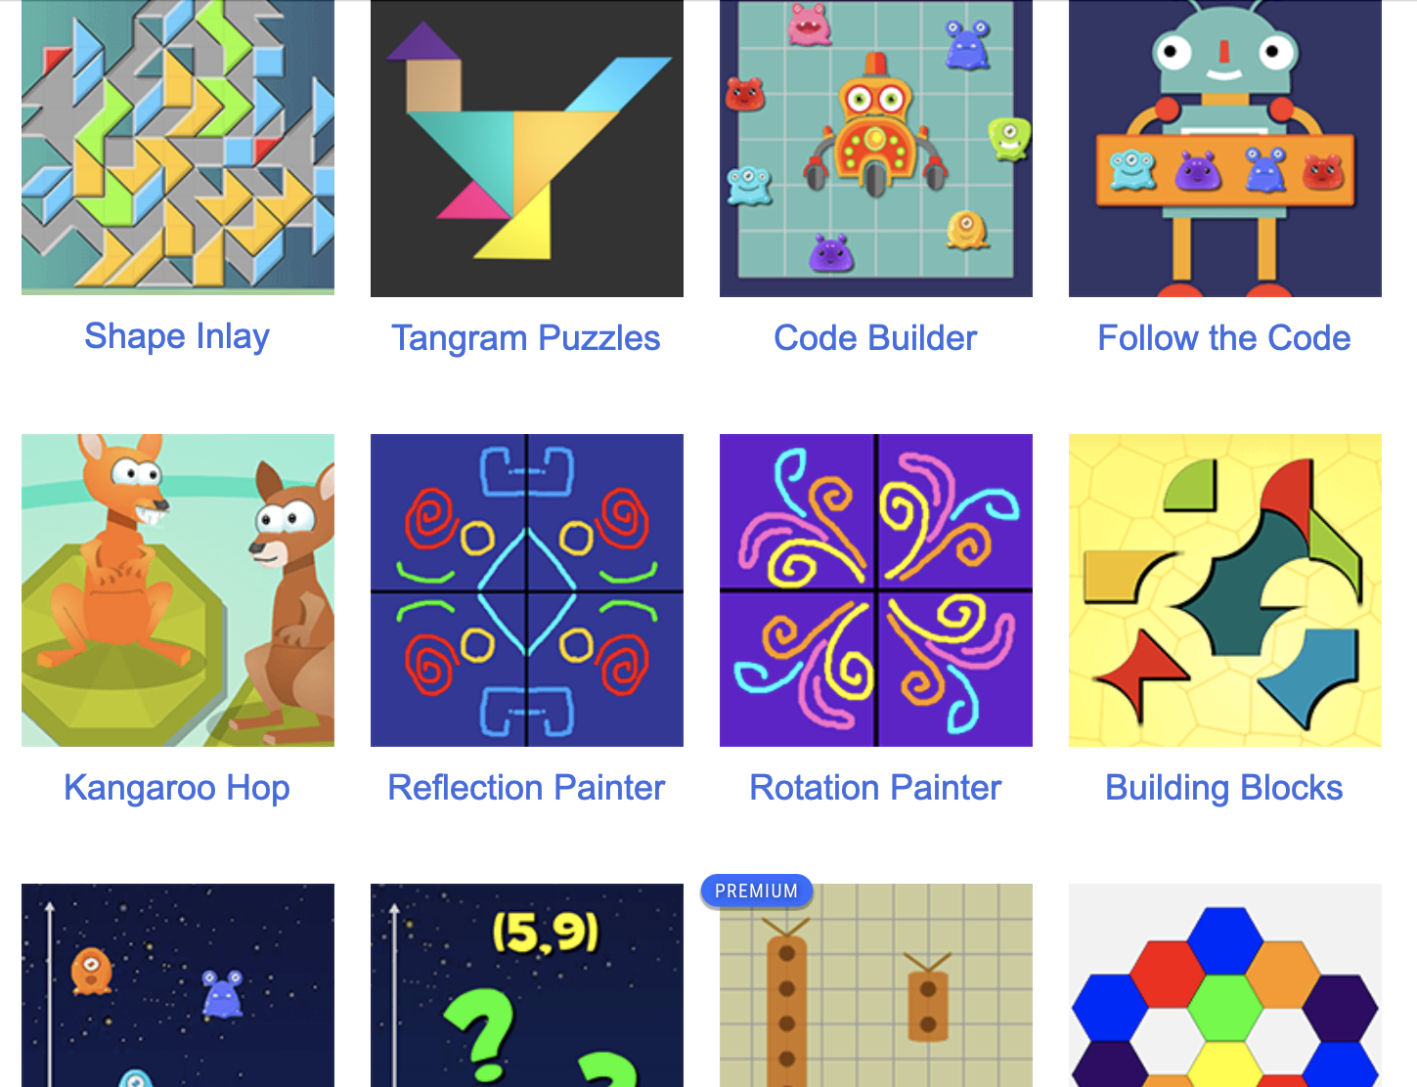
Extension activity ☺
https://www.mathplayground.com/index_geometry.html

Slide 21

Closure ☺
- What did we accomplish with our project?
- What did we learn about patchwork art and fractions?
- How did we connect art and math today?

Slide 22

See you all next time! ☺

