Slide 1

Welcome, class!
Project #2 – Intro
Meeting #5
12/08/2021

Slide 2


Gather these materials: Markerboard, eraser, and marker ☺

Slide 3



Warm-up exercise: if you could make a snowman out of anything, what would it be? (food, toys, etc)

Slide 4
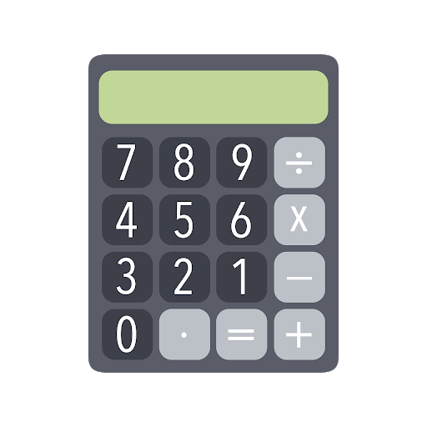

What are we going to be doing? Connecting Art & math!

Slide 5


What do you know about division & Multiplication in art?

Slide 6


Positive and Negative space – what do you see?

Slide 7
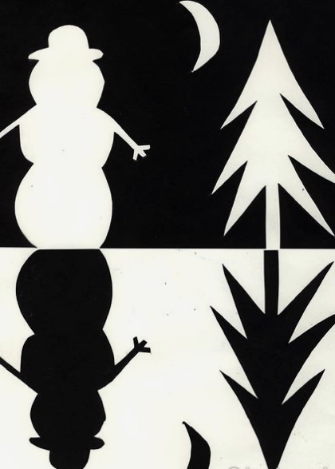
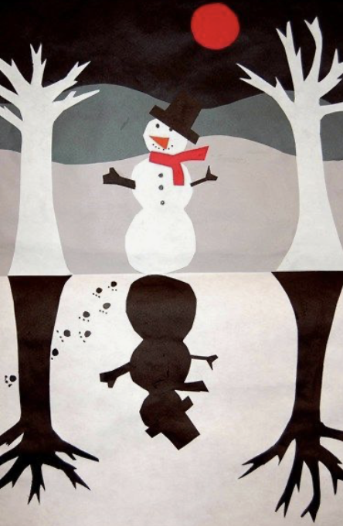
Some project examples: positive and negative space

Slide 8

Lesson vocab for division & Multiplication in math:
Dividend – A number that is being divided (the bigger number).
Divisor – The smaller number.
Divide – An operation on two numbers in which the first number is split into the same number of equal groups as the second number.
Product – The answer to a multiplication sentence.
Factor – The number being multiplied.
Multiple – The product of that number and any whole number.

Slide 9
Lesson vocab for art:
Positive Space – The space that is filled with something (shapes, colors, designs, etc.)
Negative Space – The empty space or area surrounding the object.
Composition – The arrangement of elements in a work of art.
Contour – The outline of the object or objects.

Slide 10
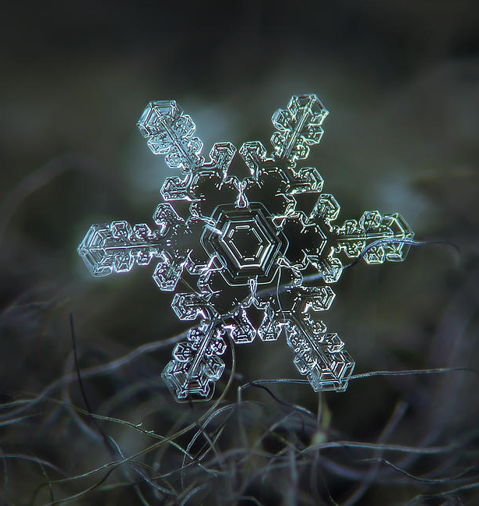

Div. & Mult. art in history: alexey kljatov (present)
https://www.youtube.com/watch?v=bDPczGUovzE

Slide 11
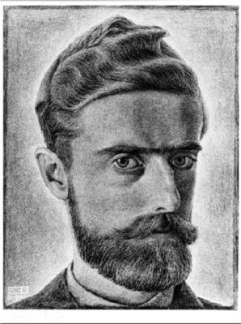
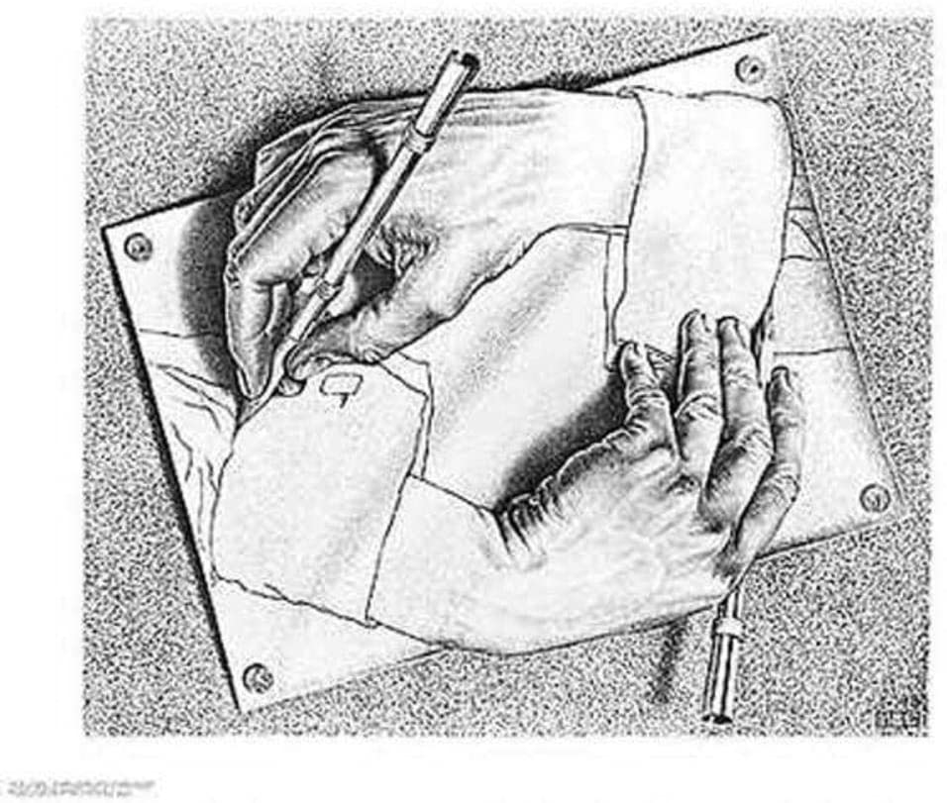
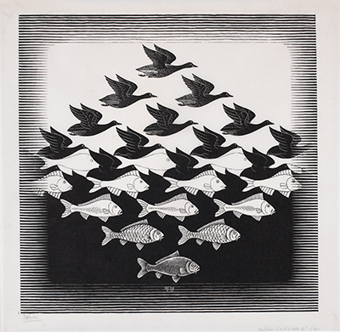
Lesson vocab for div. & Mult. in art: M.C. Escher (1898– 1972)
https://www.youtube.com/watch?v=2KfSdOhgMvk

Slide 12
Division & multiplication art in cartoons: Shadow puppets
https://www.youtube.com/watch?v=G9DgUxP_2Hw

Slide 13

closure
What did we accomplish with our project?
What did we learn about division and multiplication in art?
How did we connect art & math today?

Slide 14
Extension art activities
http://weavesilk.com
https://www.mathplayground.com/index_geometry.html
https://www.sheppardsoftware.com/mathgames/menus/geometry.htm
http://www.colorwithleo.com/artstudio.php?PHPSESSID=46aae1ddc70aa2b00571af541ea33790

Slide 15

See you next time!

