Slide 1
Rousseau
Second Grade

Slide 2
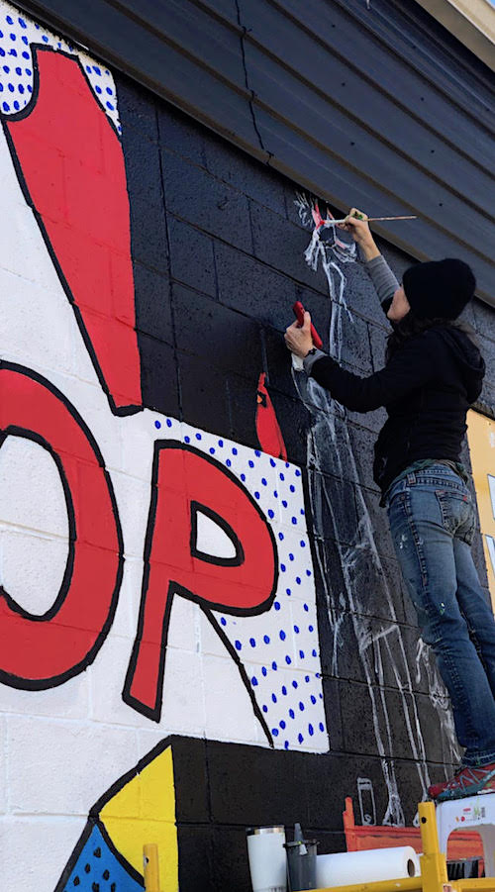

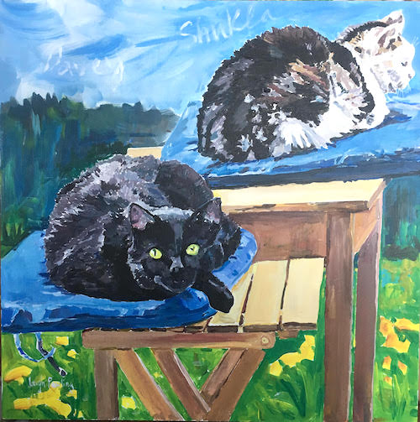

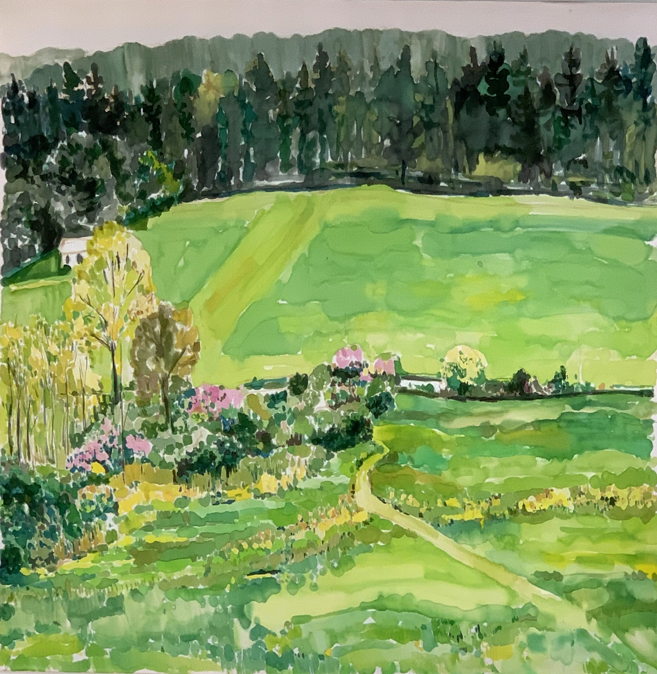
When I was your age, I wanted to be an artist!

Slide 3

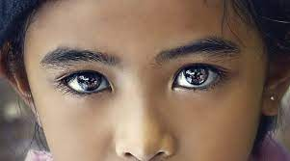

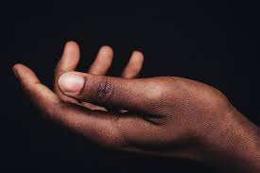
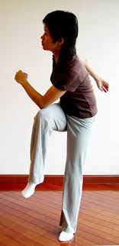
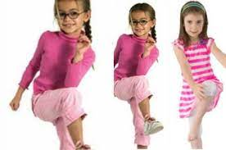
Let’s warm up our creative juices!
Warm up our eyes
hands and body!
L

Slide 4
objectives
of this lesson

Slide 5
objectives
Introduction to the ruler
Attempt to use the ruler
Learn quarters, halves and whole
Use hand motor skills with cutting
Introduce museums

Slide 6
instructions

Slide 7
Pass or play!
Have you ever been to a museum
??? Which ones?

Slide 8

Pass or Play!
Have you ever been to a museum ?

Slide 9
vocabulary

Slide 10
vocabulary
Museum
Quarters
Half
Whole
Inch
Botanical garden
Texture

Slide 11
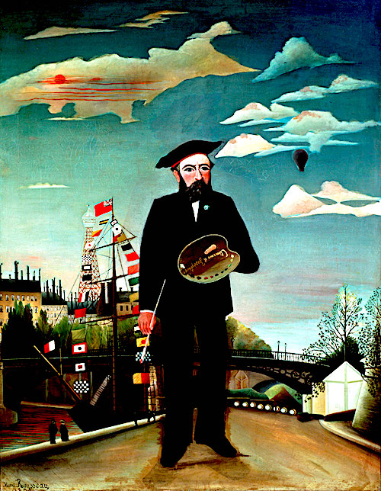
HENRI ROUSSEAU 1844-1910

Slide 12

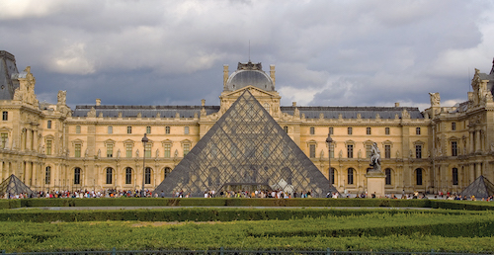
Rousseau went to the LOUVRE a famous museum
in Paris, France to copy masterpieces

Slide 13
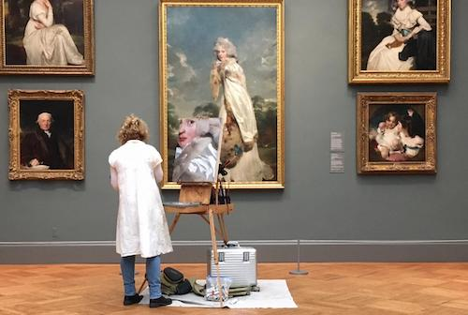
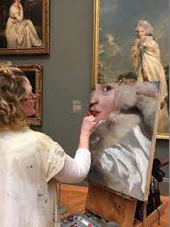
j
Artists copy famous master painters paintings to gain knowledge!
This student is copying a famous painting in a museum!

Slide 14
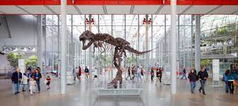

Slide 15

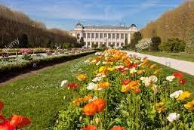
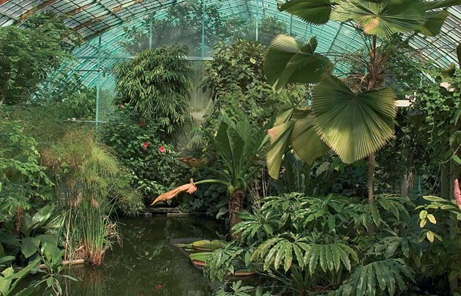
Botanical gardens in Paris where Rousseau would draw tropical plants

Slide 16

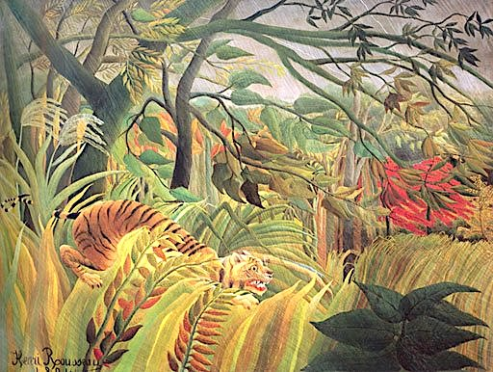
He invented this painting from museums,
The botanical gardens and children’s books!

Slide 17


Rousseau would look at animals from children’s books to learn how to paint them!

Slide 18

pass or play!
What kind of books do you read that have animals illustrated in them?

Slide 19
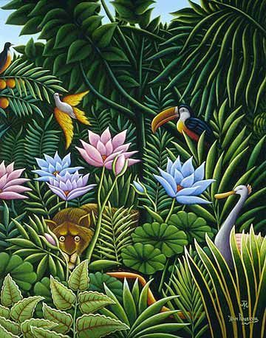
Museums, children’s books and botanical garden were used as inspiration to create this painting!

Slide 20
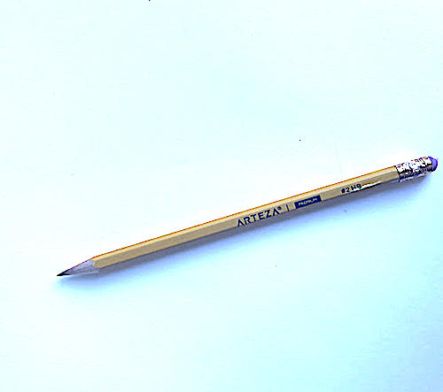
For today, the only supplies you’ll need are a pencil and paper !

Slide 21
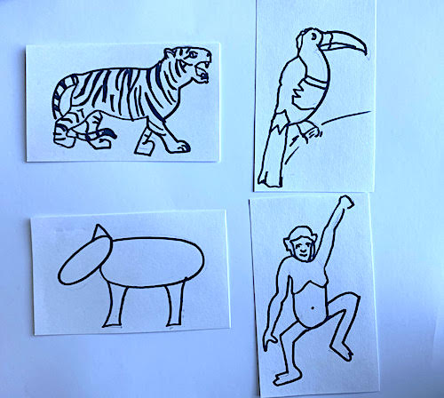
We’re going to make a Rousseau like jungle scene!
FIRST!
We’re going to draw a toucan, a lion, a zebra and a monkey! Step by step : )

Slide 22
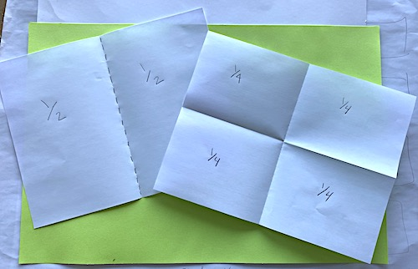
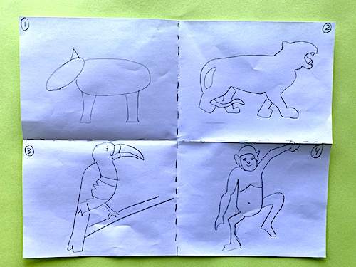
Now we do… I DO….YOU DO!
take a piece of paper, fold it in half and then again to make quarters!
watch and follow me in my studio
Watch me in my studio!

Slide 23
materials
For this lesson

Slide 24
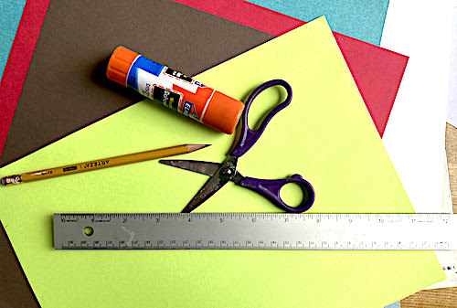
Now it’s your turn! Here are the supplies you’ll need: ruler
Pencil, construction paper, scissor and glue stick!

Slide 25
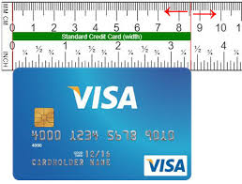
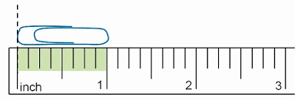
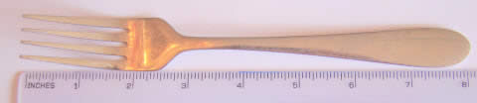
A paper clip is ONE INCH, a credit card is a little more than THREE INCHES and a for is EIGHT INCHES!

Slide 26
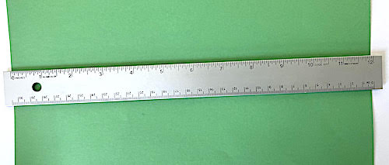
Let’s practice measuring our paper! The end of the ruler starts at zero - we are working in INCHES

Slide 27
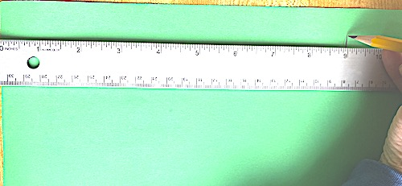
Let’s make the paper
9” x 9” what shape is that?

Slide 28
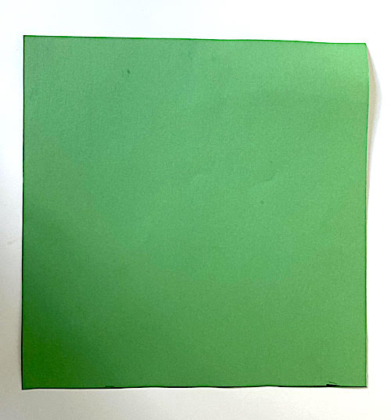
Now you have a 9”x 9” square piece of paper!

Slide 29
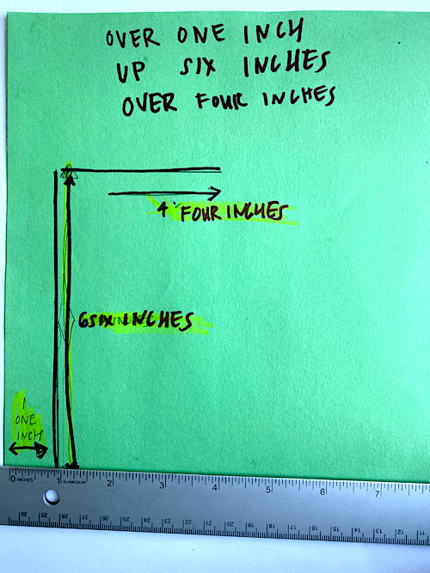
We are making the trunk - you can place the tree trunk anywhere you want on your square!

Slide 30
Next, we are going to crumble colored
construction paper to make the bark of the tree. You
Can use any color you want!
It goes in the half “T” shape
You just made with your ruler!

Slide 32
references
Henri rousseau

Slide 33
references
Slide 3 braingym.com, sg.theasianparent.com, steemit.com, unsplash.com
Slide 9 winmoreacademy.com
Slide 10 winmoreacademy.com
Slide 13 commons.wikimedia.ort
Slide 16 henrirousseau.org
Slide 14 britannica.com
Slide 17 mommynearest.com
Slide 15 artsy,net
Slide 18 alamy.com
Slide 20 A children’s Book about Tigers by Catherine Wilder
Slide 20 Snow Leopard Ghost of the Mountain Justin Anderson
Slide 21 dyslexia help.umich.edu
Slide 22 mymodernmet.com
Slide 23 winmoreacademy.com
Slide 25 pinterest.com

